Slide 1
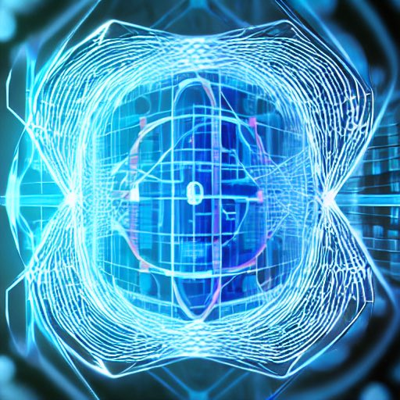
Overview of quantum error correction
stability.ai image, @quantshah

Slide 2
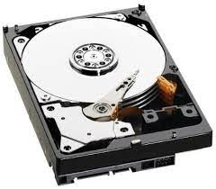
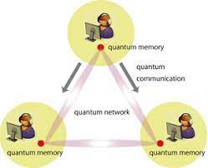
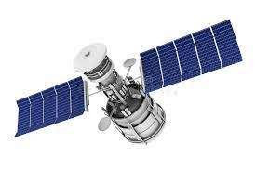
GOAL OF ERROR CORRECTION
To preserve messages sent through a noisy transmission channel by encoding the messages in an error-correcting code
More precisely: to make sure the rate of corruption of encoded (i.e., logical) information is lower than that of the same information sent without the extra encoding step.
message
$$ρ→$$
$$ℰncoder$$
$$𝒩oise$$
$$𝒟ecoder$$
$$→𝒟𝒩ℰ\left(ρ\right)≈𝒟ℰ(ρ)$$
space- or time-like
Fault tolerance: to successfully apply (reversible) operations $𝒢$ on the message within a noisy environment:
$$𝒟𝒢𝒩ℰ\left(ρ\right)=𝒟\tilde{𝒩}𝒢ℰ(ρ)$$
$$𝒟𝒢𝒩ℰ\left(ρ\right)≈𝒟𝒢ℰ(ρ)$$
$$(\tilde{𝒩}=𝒢𝒩𝒢^{−1})$$

Slide 3
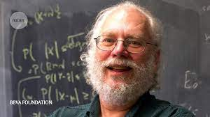
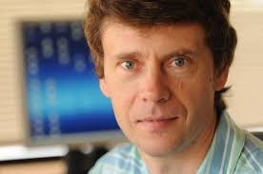
QEC: ORIGINS & GROWTH
Peter Shor:
Quantum error-correcting codes (1995)
Fault-tolerant syndrome measurement (1996)
Fault-tolerant universal quantum gates (1996)
Using QEC to prove security of QKD (2000)
Alexei Yu. Kitaev:
Topological quantum codes (1996-2003)
Physically protected quantum computing (1997)
Computing with nonabelian anyons (1997)
CSS-to-homology dictionary (1998)
Magic state distillation (1999-2004)
Majorana modes in quantum wires (2000)
Other pioneers:
Stabilizer codes (Gottesman + Calderbank, Rains, Shor, Sloane)
FT error correction (Shor, Steane, Knill)
QEC conditions (Knill, Laflamme)
Concatenated threshold theorem (Aharonov, Ben-Or)
Some material from: J. Preskill, QEC 2017 talk

Slide 4
INTRO TO QEC
(questions encouraged)
Notes:
Interacted with researchers in all four of these areas

Slide 5
BASICS OF ERROR CORRECTION: REPETITION CODE
Code: subspace of a quantum system that allows protection against some noise channel.
Consider the repetition code, protecting against bit-flip noise ($X=σ_{x}$ acting on one qubit).
Codewords:
Quantum information is encoded into the codespace via coefficients $c_{0,1}$. A logical state is:
Bit flips map code space to an error space. E.g., flipping the 2nd qubit via $I⊗X⊗I=IXI$:
error words
Since the two spaces can be distinguished without collapsing the logical information within them, bit flips are detectable. This is true for any error taking information out of codespace.
Q.E.D.

Slide 6
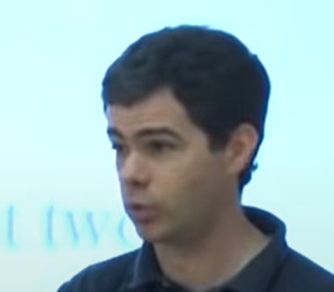
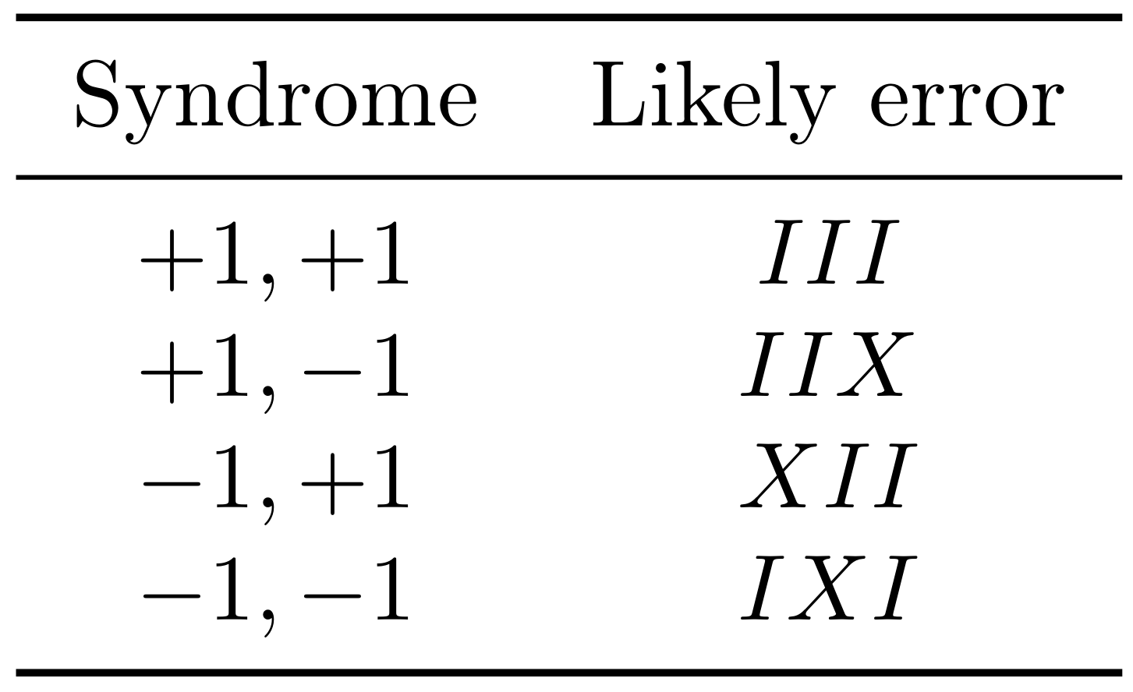
ONE ROUND OF QEC
Measure the syndrome, not the data!
$$U$$
$$|ψ⟩$$
Lookup table
$+1$ for $\left|00⋆\right\rangle ,|11⋆⟩$
$$\left|+1\right\rangle$$
$−1$ for $\left|01⋆\right\rangle ,|10⋆⟩$
$+1$ for $\left|⋆00\right\rangle ,\left|⋆11\right\rangle$
$$\left|+1\right\rangle$$
$−1$ for $\left|⋆01\right\rangle ,\left|⋆10\right\rangle$
To resolve code and error spaces (error diagnosis), measure eigenvalues of commuting set of observables (check operators; here, $ZZI$ and $IZZ$ with $Z=σ_{z}$) and apply recovery $U$ conditional on parity-check eigenvalue (error syndrome). This is one round of correction:
Diagnose: measure error syndromes using ancillary qubits.
Decode: given a syndrome, determine which recovery $U$ to apply.
Correction rounds generalize straightforwardly to other types of errors and other codes.

Slide 7
MY FIRST QUANTUM CODE
Repetition code fails vs. phase errors:
Four-qubit code detects both bit and phase errors:
Single bit flips are detectable due to spacing between computational basis states participating in superpositions of each codeword:
1st qubit bit flip
2nd qubit bit flip
Each error takes one out of codespace → detectable.
Both errors map to same error space (degeneracy). Are they both correctable?
Both errors are not correctable because they induce a different operation on the codewords.
Flipping qubit one is equivalent to first undergoing a logical bit-flip $X_{L}$ and then flipping qubit two: .

Slide 8
MY FIRST QUANTUM CODE
Four-qubit code detects both bit and phase errors:
Single phase flips are detectable due to each codeword itself being in superposition:
1st or 2nd qubit phase flip
3rd or 4th qubit bit flip
All four phase flips take one out of codespace → detectable.
1st & 2nd qubit phase flips map to same error space, induce different effect than 3rd & 4th qubit phase flips → not correctable.
Similar behavior happens to bit-phase flips $Y=σ_{y}$.
All single-qubit Pauli errors are detectable, but not correctable.

Slide 9
ERROR SPACE STRUCTURE
Noise is continuous, but measured errors are discrete!
Check operator measurement collapses system onto codespace or an error space.
Paulis are a basis for single-qubit operators
→ General errors are detectable!
$$\left|0_{L}\right\rangle ,\left|1_{L}\right\rangle$$
$$\left|0_{X}\right\rangle ,\left|1_{X}\right\rangle$$
Example: Z-axis rotation:
$$\left|0_{Z}\right\rangle ,\left|1_{Z}\right\rangle$$
The result superposition of error space collapses to one error space upon a round of EC:
$$\left|0_{Y}\right\rangle ,\left|1_{Y}\right\rangle$$

Slide 10
GENERAL QEC CONDITIONS
Errors $E_{j}$ are detectable iff they act trivially on the codewords:
Environment does not distinguish codewords
Environment cannot connect distinct codewords:
Error-detection conditions
Example: constant need not be zero:
Errors $E_{j,k}$ mapping to
…different error spaces are correctable if they are detectable.
…same error space are correctable if detectable + undo each other.
Error-correction conditions
Example: single-qubit bit flips are not correctable for four-qubit code b/c they cannot undo each other:

Slide 11
SIMPLE CODES → IMPORTANT CODES
Notes:
Interacted with researchers in all four of these areas

Slide 12
FOUR-QUBIT CODE → CONCATENATED CODE
Another basis for the codespace yields a pattern:
$m_{2}=2$ copies
$m_{1}=2$ qubits
The four-qubit code can be viewed as a bit-phase concatenated code:
$m_{1}$ bit-flip repetition code
change to phase basis
$m_{2}$ phase-flip repetition code
Concatenating larger codes ($m_{1}=m_{2}=3$) yields Shor nine-qubit code, the first to correct single-qubit errors:
For general $m_{1},m_{2}$, one obtains quantum parity / generalized Shor codes.
https://errorcorrectionzoo.org/c/quantum_parity

Slide 13
FOUR-QUBIT CODE → STABILIZER CODE
Recall four-qubit code:
Recall observation of operator for which the codespace is a +1-eigenvalue eigen-subspace:
Operators $IIZZ$ and $XXXX$ satisfy this as well. The three mutually commuting operators generate the code’s stabilizer group $S_{four−qubit}$:
Example: Four-qubit code is an $[\left[4,1,2\right]]$ code.
$$[\left[n,k,d\right]]$$
Distance
# logical qubits
# physical qubits
Advantages of stabilizer codes (over other codes):
Efficient presentation in terms of stabilizer generators.
Syndromes obtained for free: group generators are check operators.
General idea: works for bosons, fermions, modular qudits, Galios qudits, molecules.
https://errorcorrectionzoo.org/c/stabilizer

Slide 14
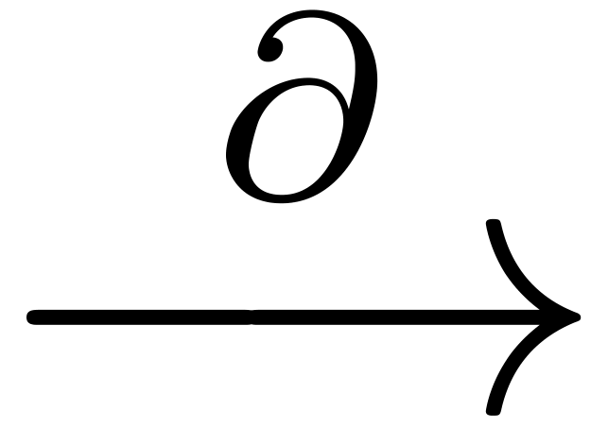
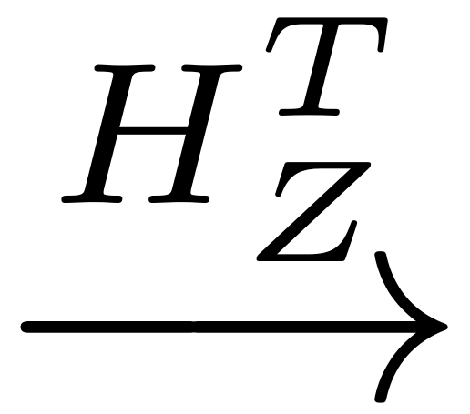
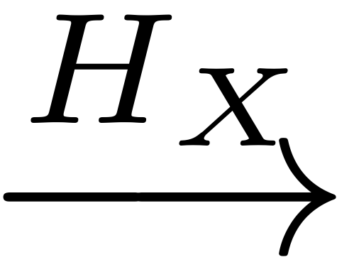
FOUR-QUBIT CODE → CSS CODE
Re-write stabilizer generators of four-qubit code as binary matrices:
Stabilizer commutation requirement equivalent to following CSS condition on matrices:
We just need a particular pair of matrices:
Borrow from classical codes → CSS codes
Embed into chain complex → CSS-to-homology dictionary
Calderbank-Shor-Steane: https://errorcorrectionzoo.org/c/css
Kitaev 1998
$∂^{2}=0$ “boundaries don’t have boundaries”
$X$-check space
physical qubit space
$Z$-check space
$$H_{X}H_{Z}^{T}=0$$
CSS condition

Slide 15
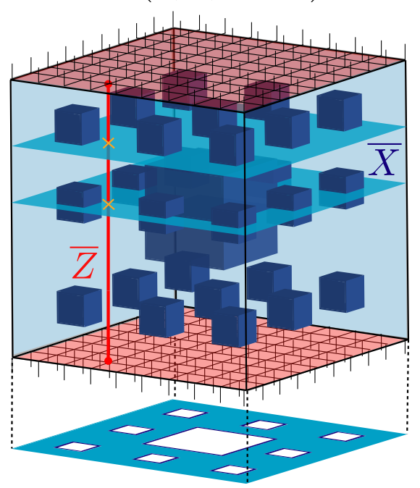
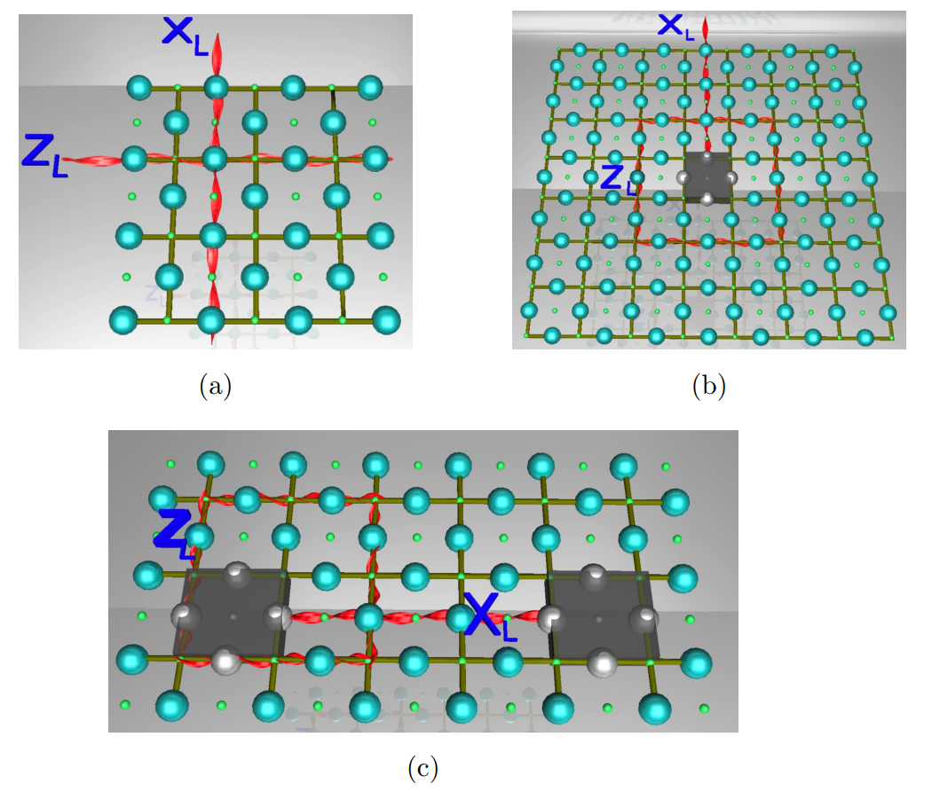
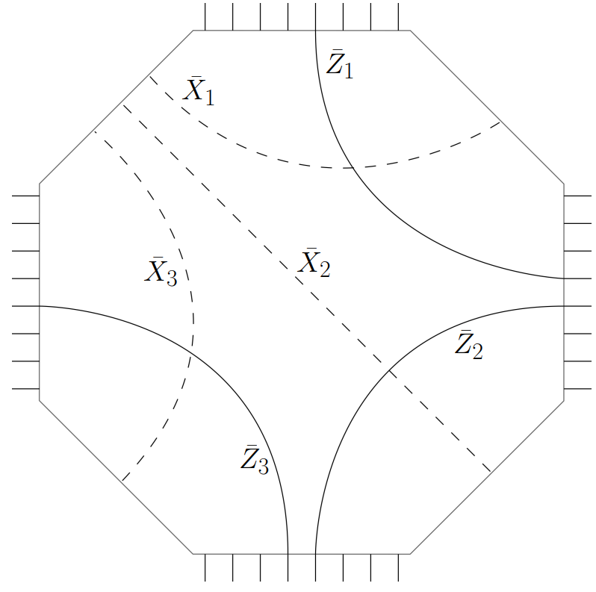
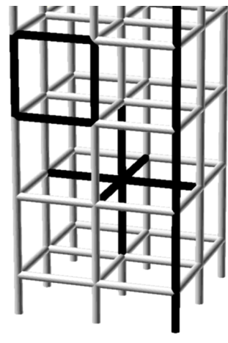
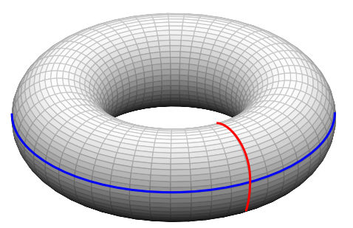
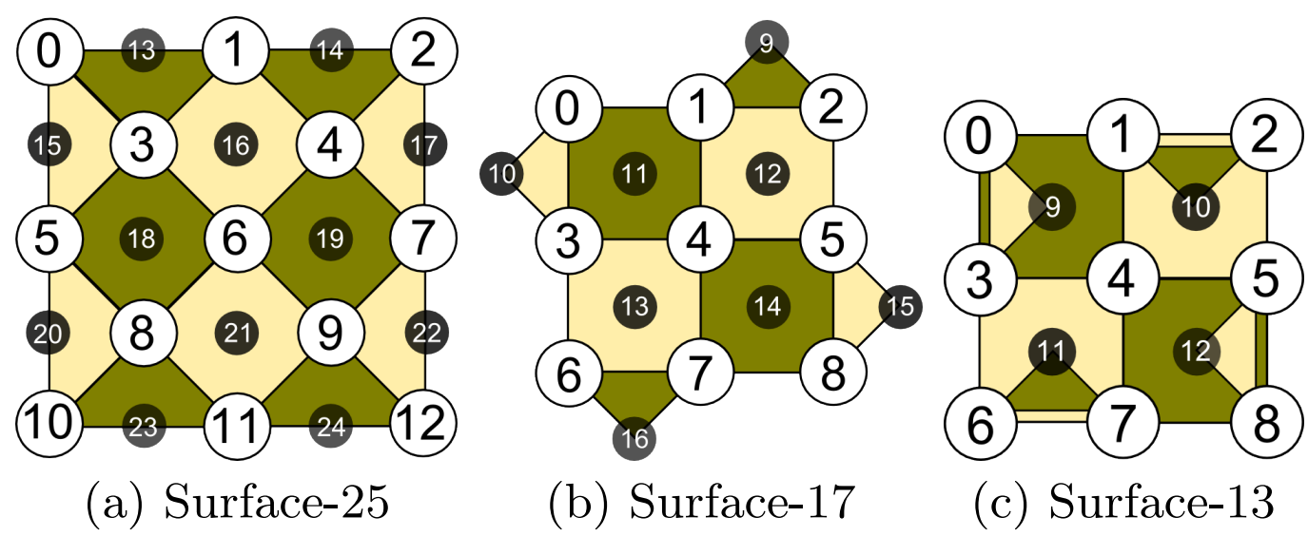
FOUR-QUBIT CODE → SURFACE CODE
Arrange the four qubits ( ) into a square and observe geometrical pattern formed by stabilizer generators:
$$ZZII$$
$$XXXX$$
$$IIZZ$$
Geometries with holes arXiv:1111.4022
Hyperbolic geometries arXiv:1506.04029
Fractal geometries arXiv:2201.03568
Springboard to other geometries; connection to topological phases.
Nontrivial boundaries
toric code
quant-ph/9707021
Exotic manifolds >=4D
arXiv:math/0002124, arXiv:1310.5555
3D version
arXiv:1406.4227
Rotated surface codes: arXiv:1404.3747

Slide 16
FOUR-QUBIT CODE → BINOMIAL CODE
Add up individual binary labels of each basis state for each codeword:
This yields the binomial code, a subspace of the Fock space of a single boson / qumode / mode / harmonic oscillator / $l^{2}(ℝ)$.
This is a bosonic code…

Slide 17
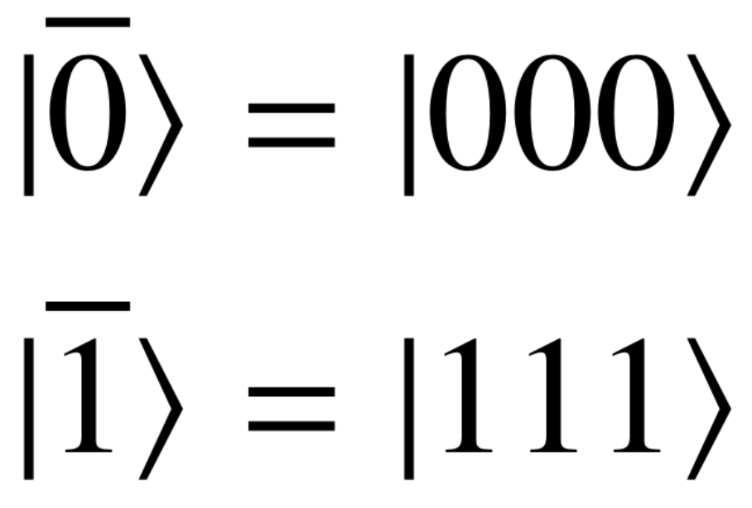
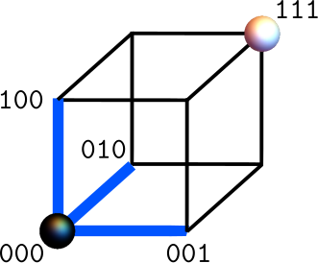
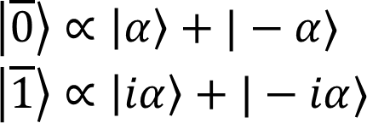
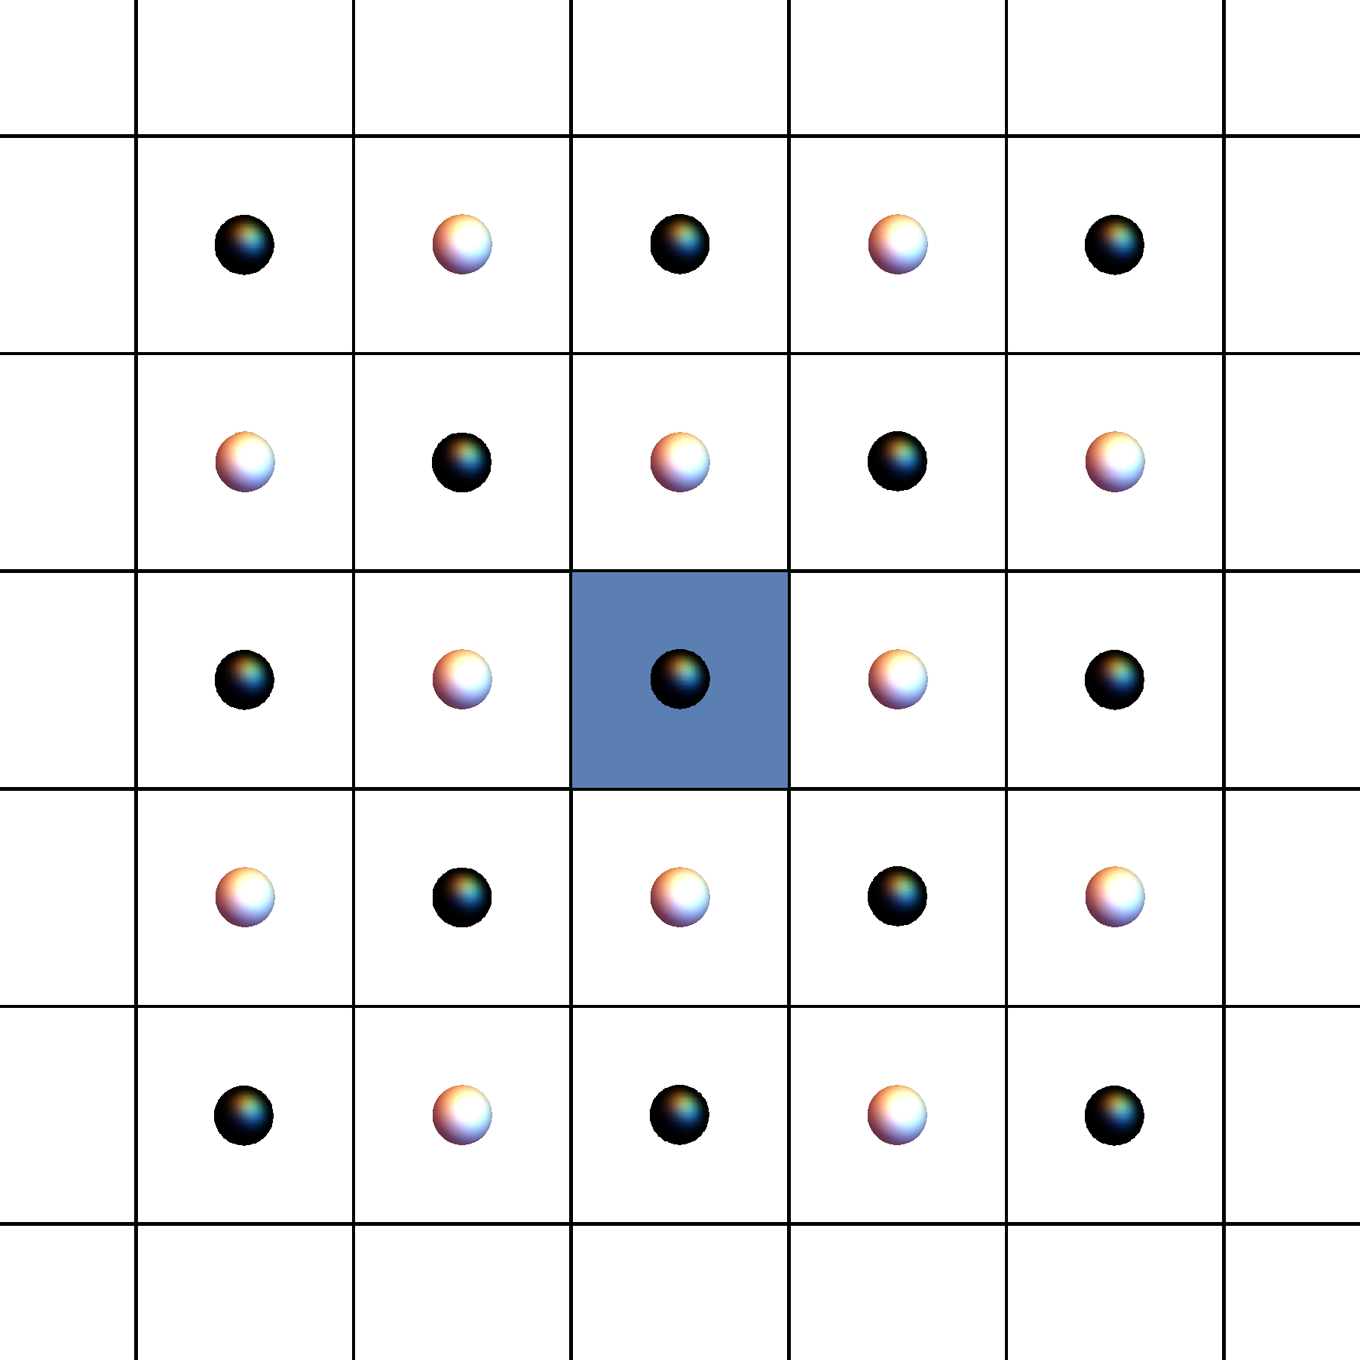
GEOMETRIC PERSPECTIVE → BOSONIC CODES
$$p$$
rotation error
bit flip
Two-legged cat code:
CV analogue of rep. code vs rotational errors.
Deep connections to 1D/2D classical Ising models.
Practical dissipative stabilization scheme.
Bias-preserving gates.
Repetition codes --- geometric view:
Voronoi cell (of $|\overline{0}⟩$) --- set of states closer to logical $|\overline{0}⟩$ than to logical $|\overline{1}⟩$
Single flips keep each state inside its Voronoi cell
$$x$$
arXiv:2205.09767
$$α$$
arXiv:1312.2017
arXiv:1905.00450
shift error
$$p$$
$$p$$
GKP codes:
Protect against small simultaneous shifts in both position and momentum.
Syndromes are modular position and momentum quadratures.
Four-legged cat code:
Protects against rotational errors and one photon loss event $\hat{a}$ (radial contraction).
arXiv:1312.2017
arXiv:quant-ph/0008040
$$x$$
$$x$$
$$α$$
Oscillator phase space

Slide 18
USE CASES OF $∞$ DIMENSIONS
GKP states are powerful non-Gaussian resources
GKP QEC + Gaussian states = universal computation (no magic-state distill.) arXiv:1903.00012
Protecting against small shifts in a logical mode (no-go thm in DV) arXiv:1903.12615
Continuous-parameter families of transversal gates (Eastin-Knill no-go thm in DV).
arXiv:1902.07714 and many others
Hamiltonian-based bias-preserving gates (no-go thm in DV).
arXiv:1905.00450 (cat code CNOT gate)
Q-simulation; commuting-projector models for chiral topological phases (no-go thm in DV).
arXiv:1902.06756, 1906.08270, 2107.02817 (e.g., bosonic fractional quantum Hall on the lattice)
Hardware efficiency: small CV codes $≥$ small DV codes; cat codes $>$ 1D Ising repetition code
arXiv:2205.09767 (cat codes + 2D classical Ising model)
Single-mode codes do not have thresholds, but concatenation can improve qubit thresholds.
arXiv:2107.13589 and refs. therein
Notes:
Interacted with researchers in all four of these areas

Slide 19
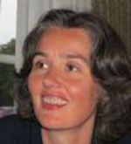
BREAK EVEN & THRESHOLD THEOREM
The primary goal of error correction is to yield a probability of corruption of the encoded information ($p_{logical}$) that is smaller than a reference probability of unencoded information corruption ($p_{physical}$).
[The threshold is] everything and nothing.
A more ambitious goal in the quantum setting is made possible by the notion of an error-correcting threshold ($p_{threshold}$), below which it should be possible to construct error-correcting protocols with arbitrarily large gain by scaling up the physical degrees of freedom
Existing threshold theorems require infinite families of tensor-product codes (e.g., $[\left[n_{i},k_{i},d_{i}\right]]$ for $i≥1$) as well as the thermodynamic limit. Few-qubit/mode codes won’t cut it.

Slide 20
RECENT (AND NOT-SO-RECENT) HIGHLIGHTS
Notes:
Interacted with researchers in all four of these areas

Slide 21
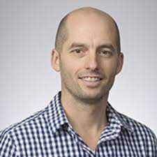
HARDNESS OF DECODING
We picked most likely error (maximum-likelihood or ML decoding), based on the assumption that low-weight Paulis are more likely than high-weight Paulis.
General stabilizer recovery consists of three parts:
$$U=T⋅L⋅S$$
ML decoding: Which $L$ do we pick?
Stabilizer group equivalence
Residual logical operations
Map back to codespace
ML decoding generally NP-complete.
Can be efficient: e.g., surface code or some bosonic codes.
arXiv:1009.1319; Kuo, Lu IEEE 2012
Surface: arXiv:1405.4883
Bosonic: arXiv:2209.04573
Degenerate ML decoding solves for most likely error class → #P-complete.
arXiv:1310.3235
stat-mech mapping relates maximization to partition function of classical model.
arXiv:quant-ph/0110143
Notes:
Interacted with researchers in all four of these areas

Slide 22
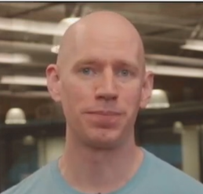
STABILIZER EXPERIMENTS
Parameters | Name | Platforms
[[n,1]] | Repetition | NMR (Waterloo), SC circuits (Google, IBM), silicon (RIKEN, Delft), NV centers (Wratchup, Kosaka, Hanson groups), ions (Blatt group)
[[4,1,2]] variants | Four-qubit | Photonic (Rarity group), ions (IonQ), SC circuits (IBM, Google, Delft, Wallraff, Monz groups)
[[5,1,3]] | Five-qubit perfect | NMR (Waterloo), SC circuits (Pan group), ions (Quantinuum), NV centers (Delft)
[[7,1,3]] | Steane | Ions (Blatt, Monz groups, Quantinuum), Rydberg arrays (Lukin group)
[[9,1,3]] | Shor | Ions (Linke group, IonQ), photonics (Pan group)
[[9,1,3]] | Bacon-Shor subsystem | Ions (IonQ)
[[m^2,m,3]], m=2,3 | Heavy-Hexagon subsystem | SC circuits (IBM)
[[m^2,m,3]], m<=7 | Quantum Parity / Shor | Ions (Linke group)
[[9,1,3]] | Surface-17 | SC circuits (Wallraff, Pan groups)
n=19 planar, 24 toric | Kitaev surface | Rydberg arrays (Lukin group)
n=9,25, d=3,5 planar | XZZX surface | SC circuits (Google)
Is our system good enough that adding these extra qubits actually improves logical performance?
For references, see:
https://errorcorrectionzoo.org/list/realizations
Notes:
Rudolph: the number of modes really depends on which error correcting code we use. If it was standard surface code (which for photonics is ok, but we have other codes which are very different since we arent constrained in spacetime) you can imagine its something like a factor of 100 modes per final physical qubit.
note: physical qubit! then a logical qubit +logical gate is something like 30^3 physical qubits by that metric

Slide 23
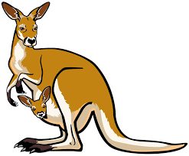
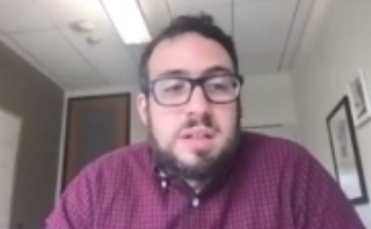
BOSONIC EXPERIMENTS
COMMERCIAL PROPOSALS
Material from: Steve Girvin, 2021 March Meeting
modes | Name | Platforms
4 | Niset-Andersen-Cerf | Photonics (Anderson group)
9 | Lloyd-Slotine analog | Photonics (Furusawa group)
1 | Binomial | Microwave cavities (Devoret, Sun groups)
1 | Two-legged cat | Microwave cavities (Devoret, Leghtas, Wang groups, Alice & Bob)
1 | Four-legged cat | Microwave cavities (Schoelkopf group; break-even QEC)
1 | GKP | Trapped ions (Home group), Microwave cavities (Devoret group)
Evaluate ideas quickly and don’t get attached.
microwave
Multi-mode binomial (unpublished)
Chuang Leung Yamamoto 1996
$χ^{2}$-codes (Niu Chuang Shapiro 2017)
Multi-mode binomial (unpublished)
Chuang Leung Yamamoto 1996
$χ^{2}$-codes (Niu Chuang Shapiro 2017)
arXiv:2012.04108, 2103.06994
https://youtu.be/fN5-UO2fy0c
phononic
Cat/GKP + rep-n/surface
arXiv:1907.11729
arXiv:2204.09128
microwave
Cat + repetition
arXiv:2010.02905
https://youtu.be/vzc53S3ACWw
optical
GKP + cluster states
FBQC arXiv:2101.09310,
Interleaving arXiv:2103.08612,
https://youtu.be/E_dD1XUTaq4
For references, see:
https://errorcorrectionzoo.org/list/realizations
optical
Dual-rail + fusion-based QC
Notes:
Rudolph: the number of modes really depends on which error correcting code we use. If it was standard surface code (which for photonics is ok, but we have other codes which are very different since we arent constrained in spacetime) you can imagine its something like a factor of 100 modes per final physical qubit.
note: physical qubit! then a logical qubit +logical gate is something like 30^3 physical qubits by that metric

Slide 24
PAST QEC CONFERENCES
 | QEC 2017 |  | QEC 2019
Topological codes | 9 | Yoder, Jones, Litinski, Browne, Terhal, Kubica, Beverland, B. Brown, Krishna | 6 | Litinski, Takita, Chubb, Tuckett, B. Brown, Kubica
General fault tolerance | 8 | Flammia, Gottesman, Bravyi, Haah, Fowler, Campbell, Poulin, Chao | 3 | Beverland, N. Brown, Babbush
Experiments & platforms | 8 | Taminlau (NV centers), Martinis (SC circuits), Paik (SC circuits), Schoelkopf (SC circuits), Linke (ions), Marinelli (ions), Gutierrez (ions), Flühmann (ions) | 3 | Home (ions), Cai (silicon), Boter (silicon)
QLDPC | 0 |  | 9 | Panteleev, Fawzi, Krishna, Breuckmann, Vuillot, Debroy, Crosson, Pryadko, Groues
Bosonic/CV coding | 1 | Niu | 5 | Puri, Albert, Heinze, Noh, Pantaleoni
Holography & QEC | 4 | Harlow, Yoshida, Pastawski, Swingle | 1 | Cubbitt
General coding | 2 | Kastoryano, Nezami | 1 | Nezami
Circuits/algorithms | 0 |  | 3 | Koenig, Kim, Benjamin
QEC for sensing | 1 | Cappellaro | 1 | Jiang
AQC | 1 | Lidar | 1 | Marvian
Quantum control | 0 |  | 1 | Biercuk
Overview | 1 | Preskill | 0
Some material from: J. Preskill, QEC 2017 talk

Slide 25
PAST QEC CONFERENCES
 | QEC 2017 |  | QEC 2019
Topological codes | 9 | Yoder, Jones, Litinski, Browne, Terhal, Kubica, Beverland, B. Brown, Krishna | 6 | Litinski, Takita, Chubb, Tuckett, B. Brown, Kubica
General fault tolerance | 8 | Flammia, Gottesman, Bravyi, Haah, Fowler, Campbell, Poulin, Chao | 3 | Beverland, N. Brown, Babbush
Experiments & platforms | 8 | Taminlau (NV centers), Martinis (SC circuits), Paik (SC circuits), Schoelkopf (SC circuits), Linke (ions), Marinelli (ions), Gutierrez (ions), Flühmann (ions) | 3 | Home (ions), Cai (silicon), Boter (silicon)
QLDPC | 0 |  | 9 | Panteleev, Fawzi, Krishna, Breuckmann, Vuillot, Debroy, Crosson, Pryadko, Groues
Bosonic/CV coding | 1 | Niu | 5 | Puri, Albert, Heinze, Noh, Pantaleoni
Holography & QEC | 4 | Harlow, Yoshida, Pastawski, Swingle | 1 | Cubbitt
General coding | 2 | Kastoryano, Nezami | 1 | Nezami
Circuits/algorithms | 0 |  | 3 | Koenig, Kim, Benjamin
QEC for sensing | 1 | Cappellaro | 1 | Jiang
AQC | 1 | Lidar | 1 | Marvian
Quantum control | 0 |  | 1 | Biercuk
Overview | 1 | Preskill | 0
Some material from: J. Preskill, QEC 2017 talk

Slide 26
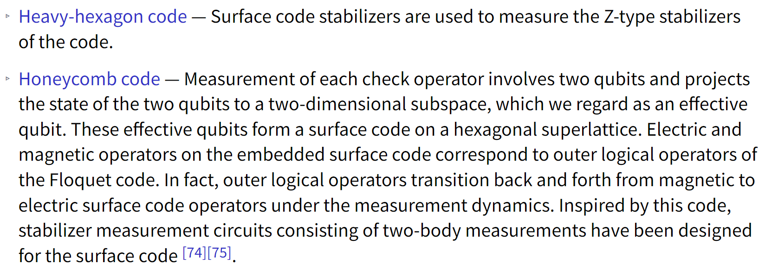
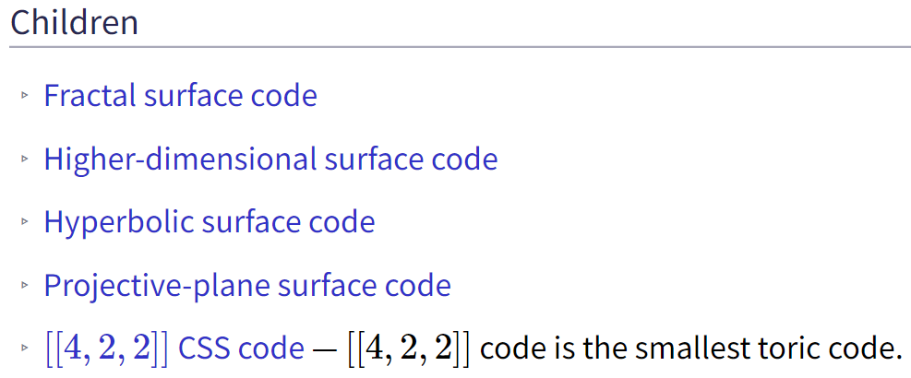
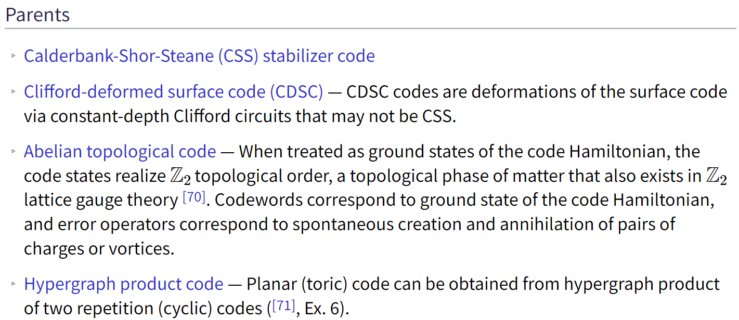
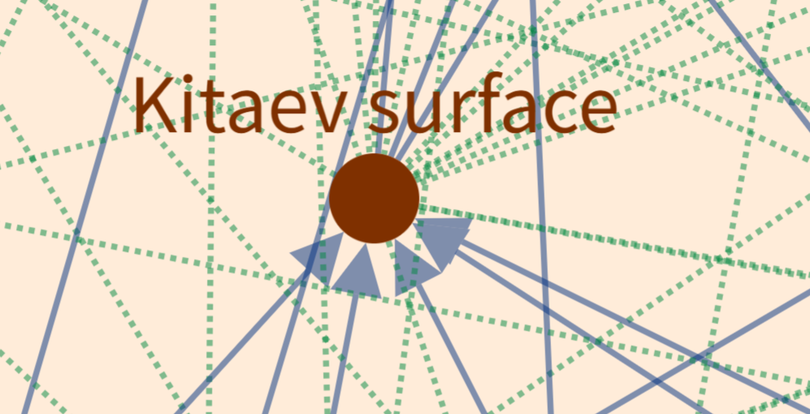
SURFACE CODE: NEW FRIENDS
Key papers:
Kitaev 1998-2003: definitions
Bravyi, Kitaev 1998: boundaries
Dennis et al 2002: decoding, topological threshold, stat-mech mapping
Bombin 2010: twist-defect encoding
Fowler et al 2012: defect encoding, resource est.
Horsman et al 2012: lattice surgery
NEW
XY, XZZX, etc
For references, see:
https://errorcorrectionzoo.org/c/surface

Slide 27
QLDPC EXPLOSION
https://errorcorrectionzoo.org/c/good_qldpc
https://errorcorrectionzoo.org/c/qldpc
QLDPC code: stabilizer code such that the number of qubits participating in each stabilizer generator and the number of stabilizer generators that each qubit participates in are both independent of $n$.
Geometric locality not required (!) → this is “locality” in the CS sense.
Asymptotically good QLDPC: a family $[\left[n_{i},k_{i},d_{i}\right]]$ for $i≥1$ for which the rate $k_{i}/n_{i}$ and relative distance $d_{i}/n_{i}$ remain constant as $i→∞$.
arXiv:2206.07750
arXiv:2111.03654
arXiv:2202.13641
Geometric locality has to be dropped ☹. Codes on lattices in any dimension:
Cannot be good QLDPC codes
Admit limited set of transversal gates
arXiv:quant-ph/0304161, arXiv:0810.1983, arXiv:2106.00765, arXiv:2109.10982
Bravyi-Koenig arXiv:1206.1609
Notes:
Interacted with researchers in all four of these areas

Slide 28
OTHER NOTABLE CODES
Holographic codes: encoding circuit is a tensor network in a hyperbolic geometry.
https://errorcorrectionzoo.org/list/holographic
QEC for sensing: separating noise from signal of interest within a codespace.
https://errorcorrectionzoo.org/c/metrological
https://errorcorrectionzoo.org/c/metopt
Subsystem codes: use only some of the $k$ logical qubits for storage, set the rest to be malleable gauge qubits.
https://errorcorrectionzoo.org/list/subsystem
Floquet codes: logical qubits are generated through a particular sequence of check-operator measurements.
https://errorcorrectionzoo.org/c/floquet
Generalized homological product codes: chain-complex math taken to the extreme in the race to good QLDPC.
https://errorcorrectionzoo.org/c/generalized_homological_product
Magic-state distillation codes: particular properties useful for magic-state factories.
https://errorcorrectionzoo.org/list/quantum_magic
Notes:
Interacted with researchers in all four of these areas

Slide 29
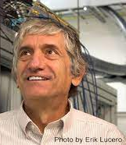
OBSERVATIONS & OPPORTUNITIES
Errors don’t all go to hell [as we scale up].
Beginning to scale up and see favorable scaling
exponential decrease with repetition codes
nonzero decrease with quantum codes
Noise remains local
Daunting systems engineering / control issues require industrial efforts.
Companies not upfront about much money/people-power has been invested.
Once a roadblock is overcome, others can easily replicate (I am told…).
Graduate career may no longer be enough to single-handedly make progress.
[Fancy papers] are nice, but what is going to keep everyone employed is making the qubits better.
Characterizing physical noise in materials.
Low-lying fruit can only last us so long before we hit operational ceiling.
Threshold and associated scaling from experimentally observed data.
For quantum memory or, more ambitiously, logical gates.
Interpolating between QLDPC and geometrically local codes.
Tailoring QEC and fault-tolerant protocols to experiments.
Notes:
Characterizing physical noise in materials remains unsexy, but crucial endeavor for progress.
Scaling up further looks to be an indu$trial endeavor. Companies not revealing how much resources have been put in.
Fault-tolerant gates actively investigated, including in experiment.
Break-even QEC achieved, close to going beyond.
New QLDPC results yield sunny but impossibly far away horizon.

Slide 30
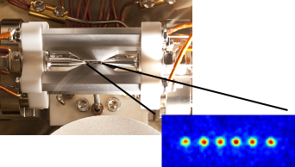
BOSONIC NOISE
The big four physical settings and their dominant noise type:
Kraus form
Attenuation
related via amplification
Photon loss
Dephasing
AGWN
Dephasing
Optical fibers
& cavities
Motion of trapped ions
Microwave cavities + superconducting circuits
Nano-acoustic resonators
O. Painter, M. Mirhosseini, A. Faraon, M. Spiropulu, R. Schoelkopf, M. Devoret, J. Home, J. Teufel groups, many others
Notes:
Interacted with researchers in all four of these areas

