Slide 1
Weaving Social Accountability into Cryptographic Systems
Introduction
Gabriel Kaptchuk
11 March, 2022
Charles River Area Crypto Day
Based on joint work with Matthew Green (JHU), Gijs Van Laer (JHU), and Ran Canetti (BU)

Slide 2
In Theory there is no difference between Theory and Practice, while in Practice, there is
- Unclear Origins (Active Internet Argument)
Introduction

Slide 3
Cryptographic Systems In Theory
Honest Party
Ideal Functionality
Adversary
Honest Party
Introduction
Honest Party

Slide 4

Cryptographic Systems In Practice
User with Complicated Life
CEO
Share Holders
Politics/Money
Cryptographic Protocol
User Device
System Admin
Introduction
Intermediary Organization
Data Collector

Slide 5
The Limitations of Provable Security
Legitimate Social Process
Compromised Social Process
Cryptographic Component
Introduction
Boundary of Formal Security Analysis/Auditability
Wouldn’t it be better to analyze this?

Slide 6
A Simple (and obvious?) Example
MPC
(For Satellite Collision)
Satellite
Position
Satellite
Position
Introduction
Beautiful Malicious Secuirty Proof
Satellite
Telemetry
Satellite
Telemetry

Slide 7



What Could We Ask For?
Hope Policies Work
Accountability Measures
Abuse Impossible
eg. Semi-honest Security
eg. Covert Security
eg. Malicious Security
Introduction

Slide 8
Outline For Today
Abuse Resistant Law Enforcement Access Systems
Apple’s CSAM Scanning Protocol
Introduction
Conclusions and Opportunities for Future Work

Slide 9
Law Enforcement Access Systems

Slide 10







X

Slide 11
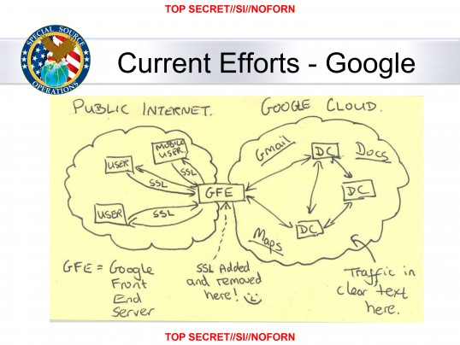
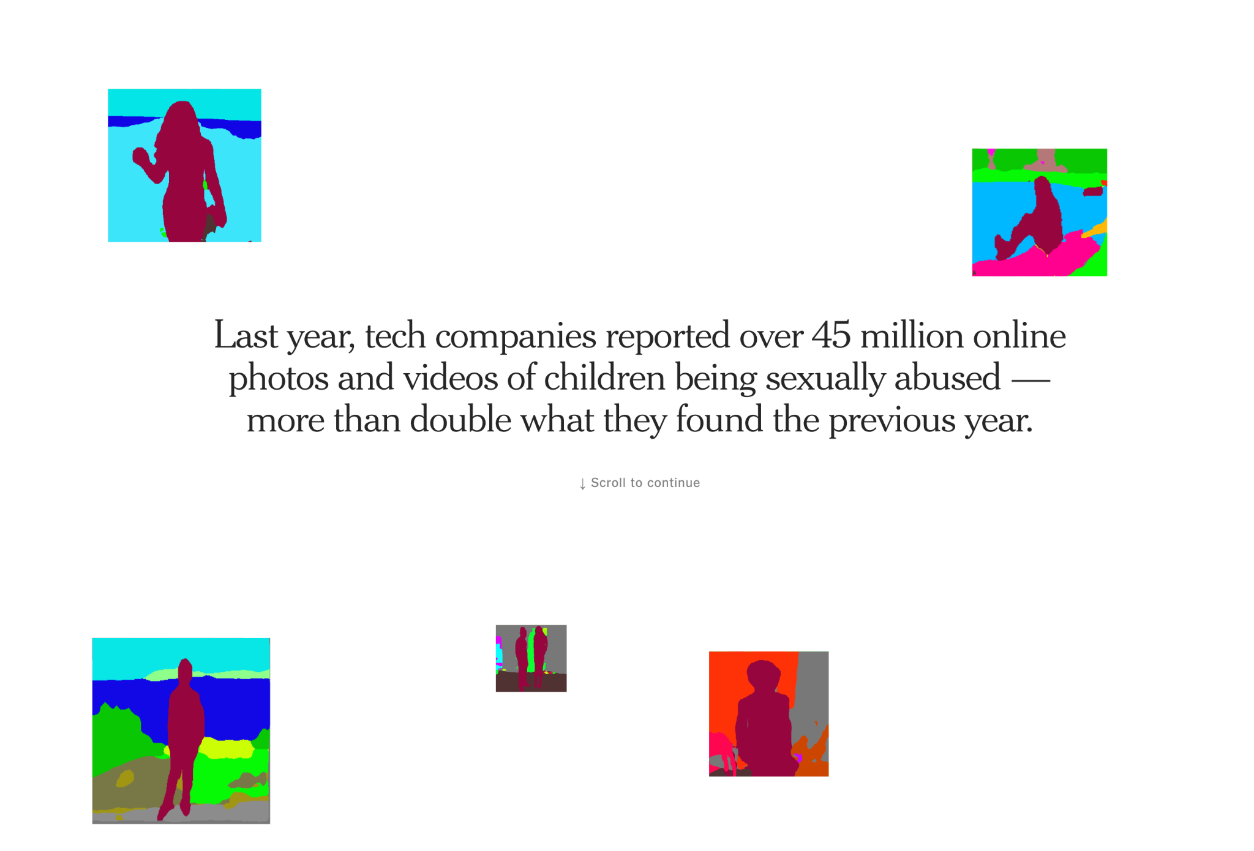
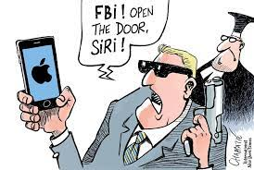
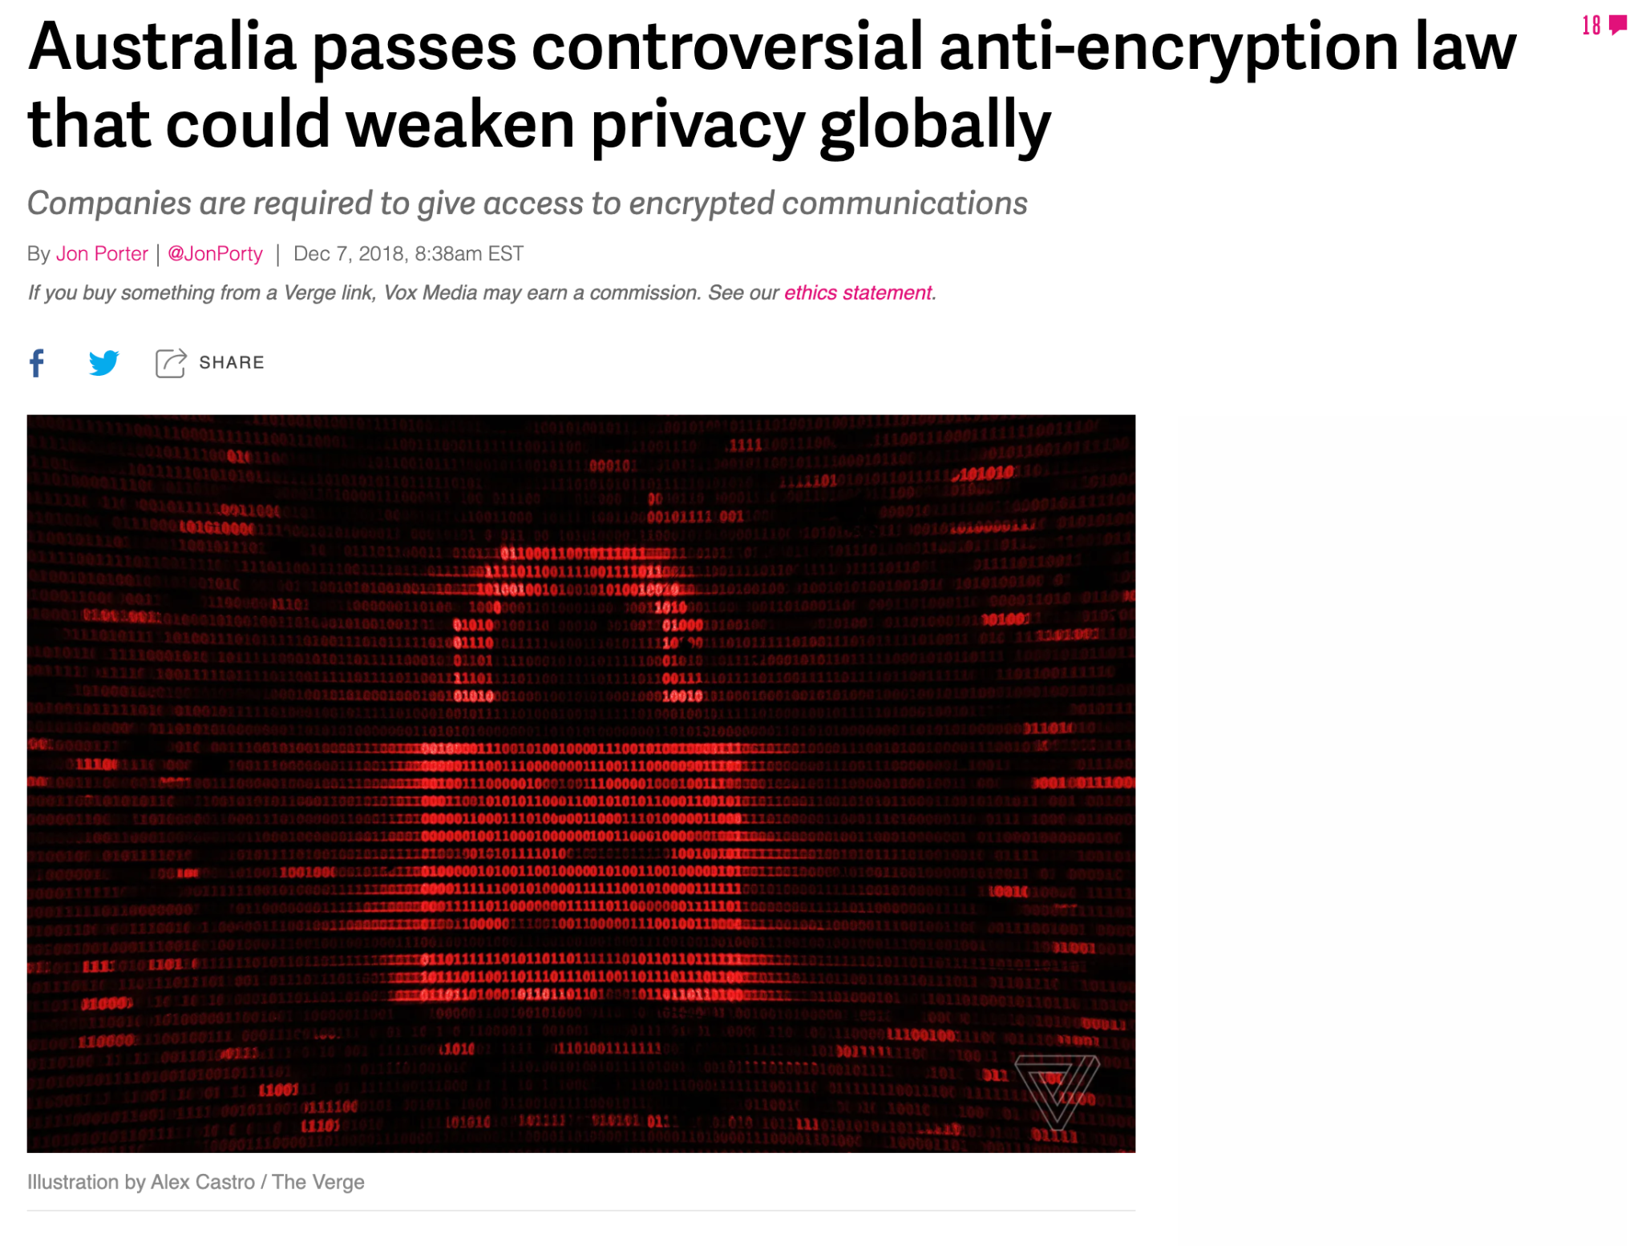
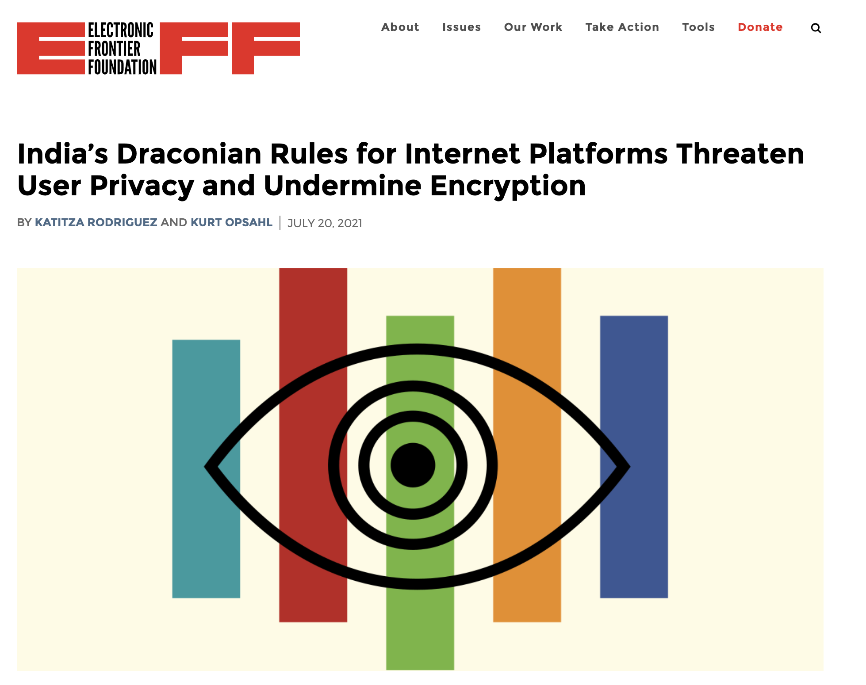
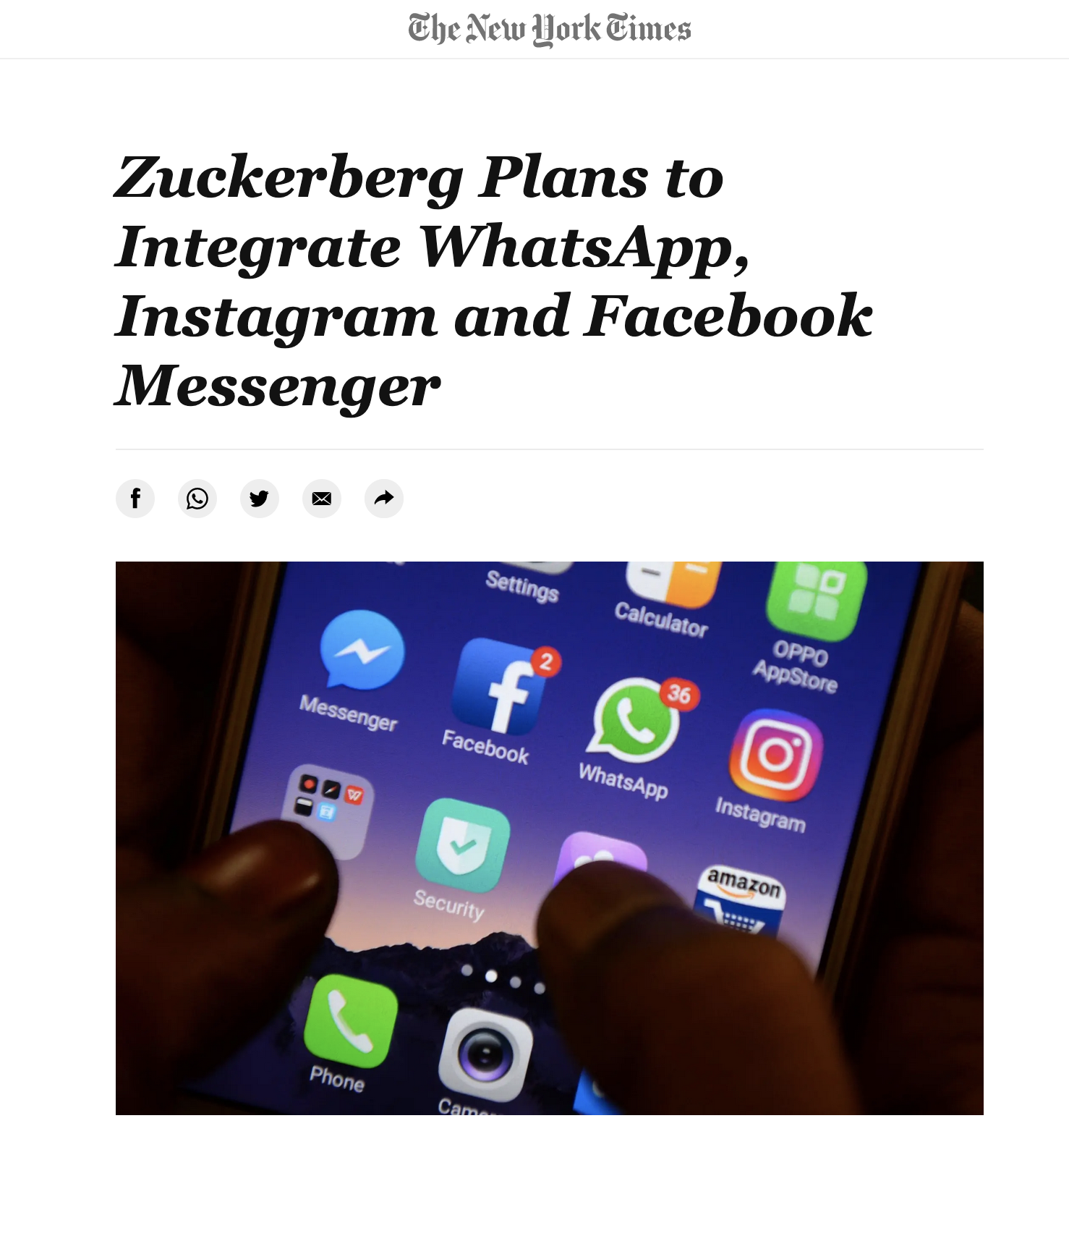
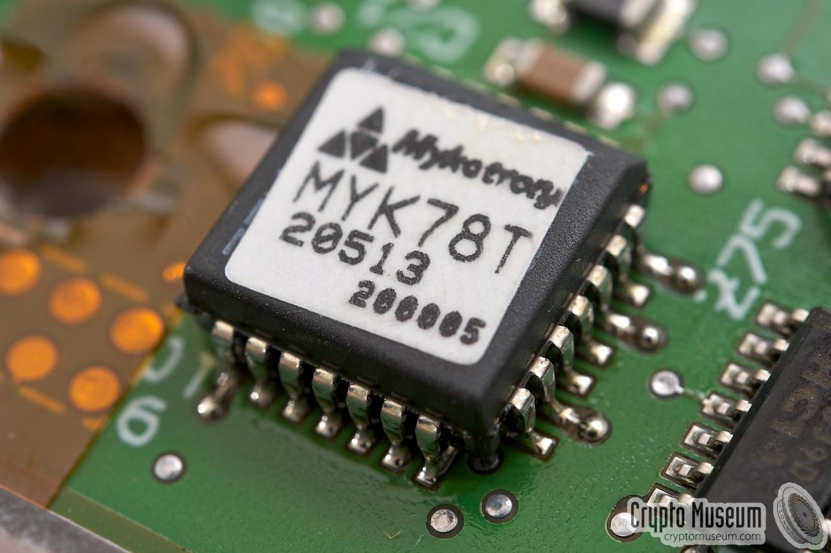
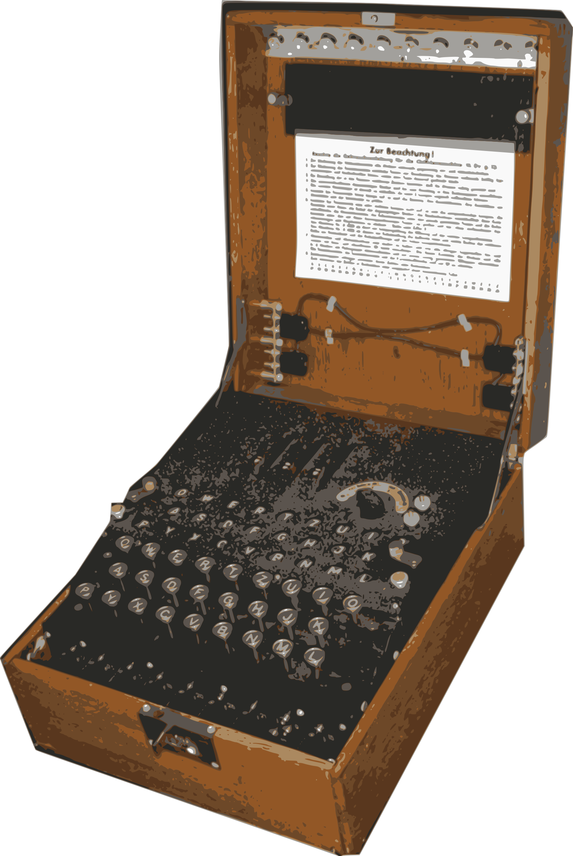
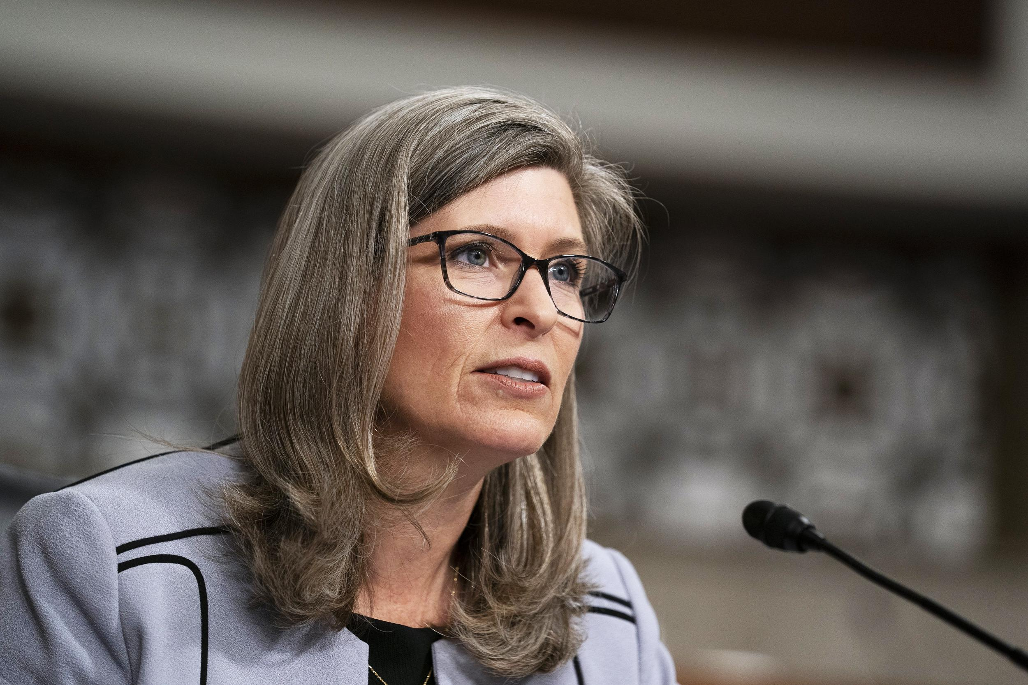
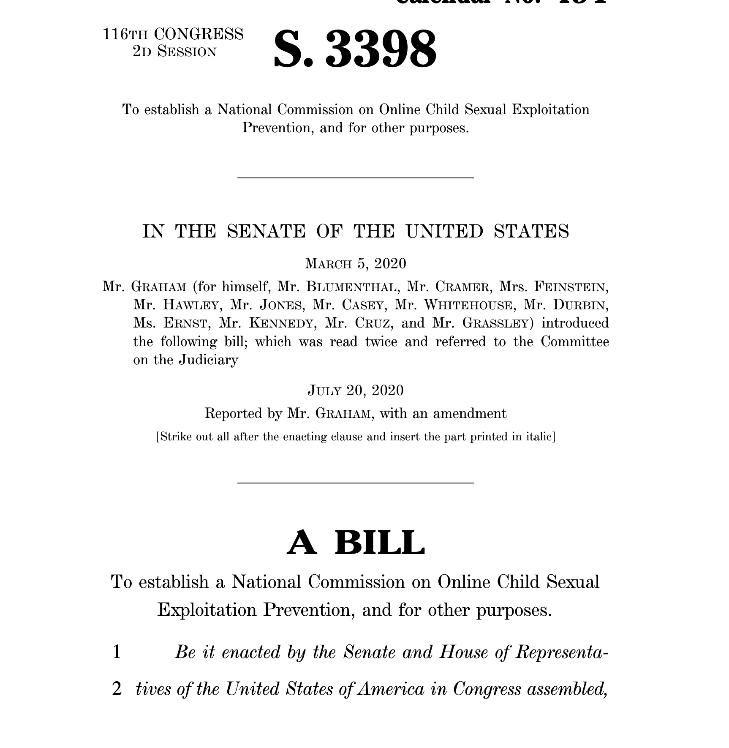
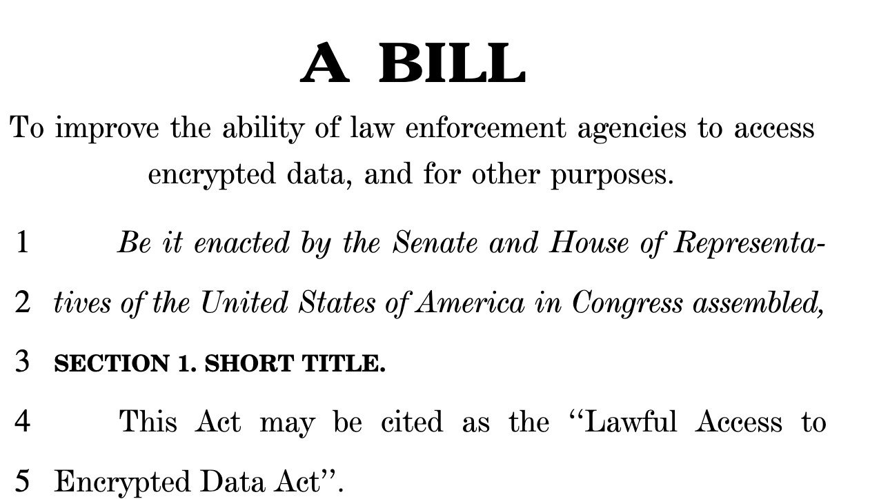
A (Very) Abridged Timeline of the Encryption Debate
Cryptography’s Military Origins
Snowden Revelations
Terrorism to CSAM
Increased Legislative
Pressure on Encryption
FBI vs Apple
First Crypto Wars
"I think you'd rather find the solution than have Congress do it for you."
    -- Senator Ernst (R, Iowa). Senate Hearing Dec 2019
Notes:
India - Intermediary Guidelines and Digital Media Ethics Code (“2021 Rules”)
Australia - Assistance and Access Bill 2018
Who’s arguemtn is being heard in congress? RWC talk
Danger. Need more clarity from cryptographic community if we want to have a say

Slide 12
A Critical Look at Key Escrow
Warrant Signing, Audited Key Reconstruction
Key Compromise
Cryptographic Component
(Decryption Mechanism)
Boundary of Formal Security Analysis

Slide 13
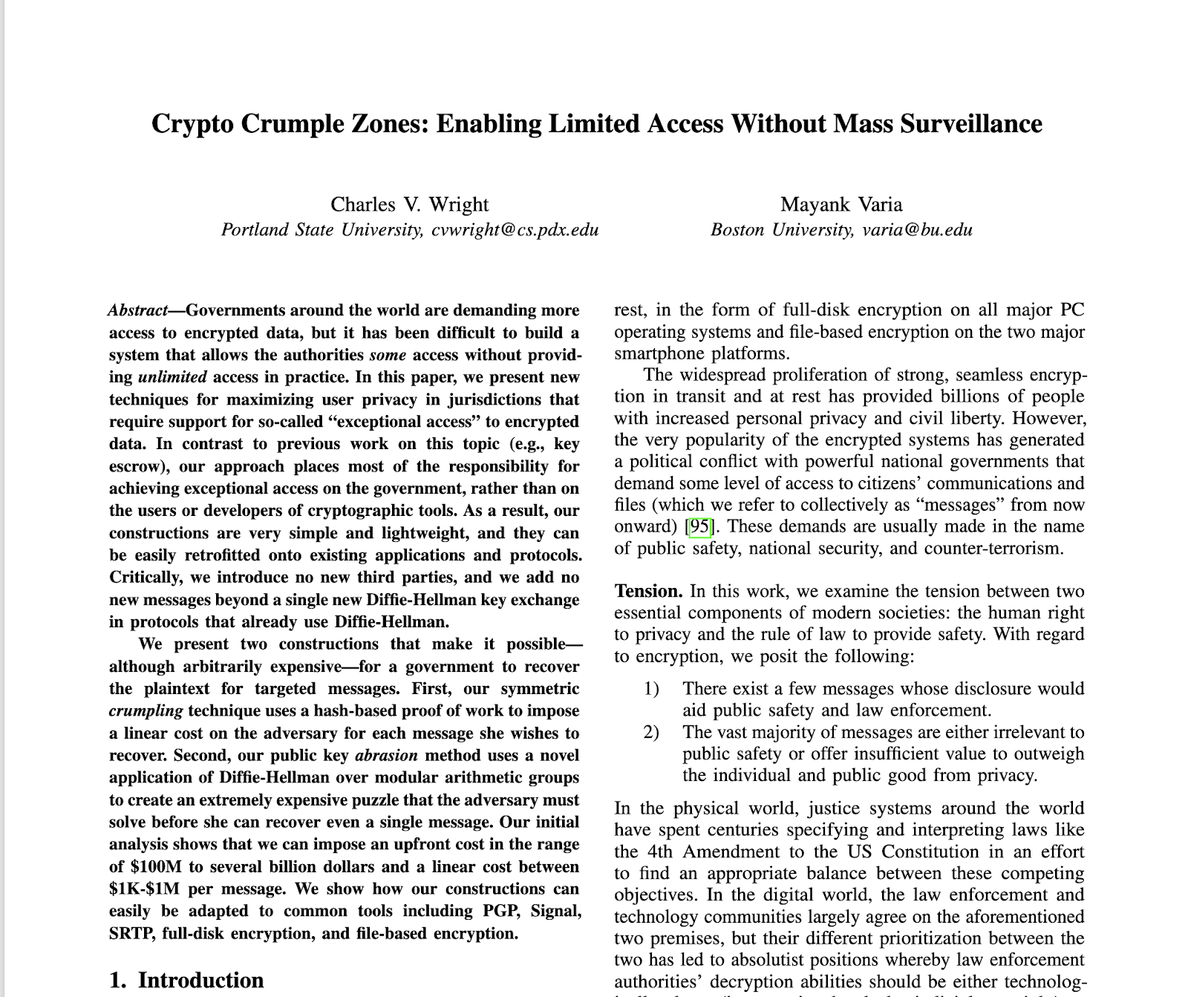
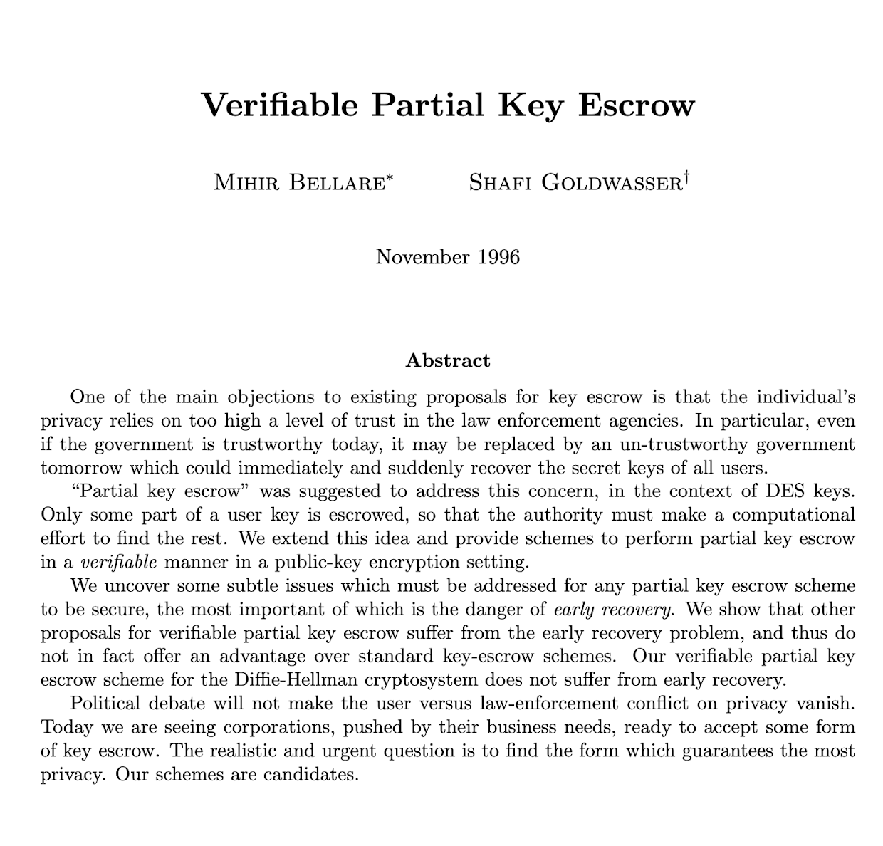
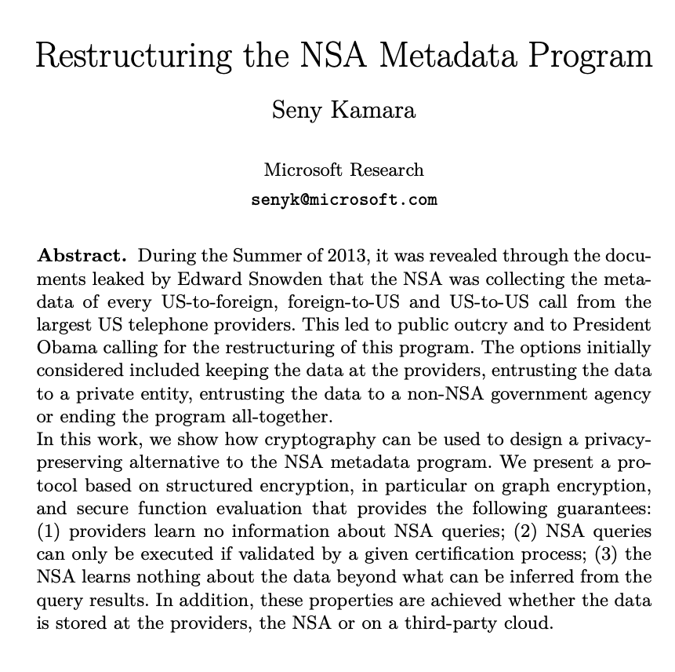
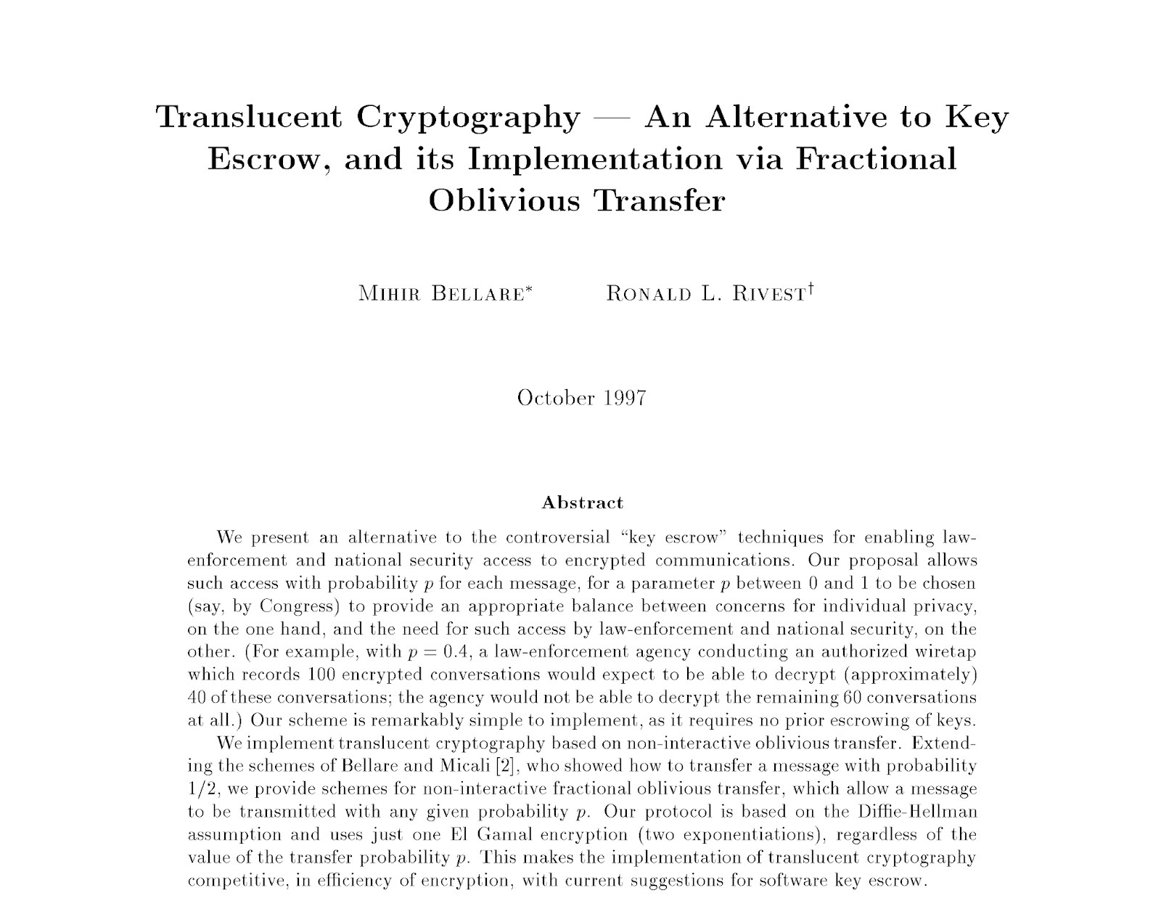

Slide 14
Abuse Resistant Law Enforcement Access Systems
Put forward a new simulation-based, socially explicit definition:
Abuse Resistant Law Enforcement Access Systems
Split into two flavors:
(1) Prospective ARLEAS (2) Retrospective ARLEAS
Constructions:
(1) Prospective ARLEAS from NI-MPC, SS-NIZKs, and Public Ledgers
(2) Retrospective ARLEAS from EWE, SS-NIZKs, and Public Ledgers
Policy Implications:
Retrospective ARLEAS implies implausible cryptography

Slide 15



ARLEAS Properties
Messages Secure without Warrant
Global Warrant Policies
eg. Warrants Must List Individuals
eg. No Location-based Warrants
Transparency and
Abuse Detectability
Cryptographic Enforcement
eg. Number of activated Warrants
eg. Differentially Private statistics
ie. Backdoor use (computationally) implies
policy adherence

Slide 16


ARLEAS Parties
Serves as a publicly verifiable transparency information delivery channel
No escrow secrets
Publicly accessible
Append only
Authenticate postings offline
Public Ledger
Judge
Law Enforcement
User

Slide 17



ARLEAS Paradigm
Generic System Parameter
C₁ || C₂ || π

Slide 18


Based on
Real-World
Cryptography
Prospective ARLEAS
(purple)
Retrospective ARLEAS
(orange)
Moment of Warrant Activation

Slide 19
Prospective ARLEAS Sketch
Transparency Information
Proof of Correctness
First round of NI-MPC for
“Reveal message if it is covered by warrant”
C₁ “Normal” E2E Ciphertext
C₂ Second Round of NI-MPC

Slide 20


(Efficient) Identity-Based Prospective ARLEAS
Lossy Key
Injective Key
Public keys for all users
(or more efficient parameters)
Proof of correct key generation
with respect to signed warrants

Slide 21

(Efficient) Identity-Based Prospective ARLEAS
Lossy Key
Injective Key

Slide 22
Retrospective ARLEAS Sketch
Transparency Information
Proof of Correctness
Warrant Signed By Judge
Proof of Publication for Trans. Info.
C₁ “Normal” E2E Ciphertext
C₂ Extractable Witness Encryption

Slide 23
ARLEAS Policy Implications
(Inherently)
Based on
Real-World
Cryptography
Implausible Crypto [GGHW14]
23
Prospective ARLEAS
(purple)
Retrospective ARLEAS
(orange)
Moment of Warrant Activation

Slide 24
Theorem (Informal):
If there exists a Retrospective ARLEAS scheme, then there exists an Extractable Witness Encryption scheme for a (non-trivial) language defined over (1) the ledger verification function (2) the transparency function, and (3) the global warrant policy.

Slide 25
ARLEAS Policy Implications
25
Transparency and
Abuse Detectability
Global Warrant Policies

Slide 26
Apple’s CSAM Scanning Proposal

Slide 27
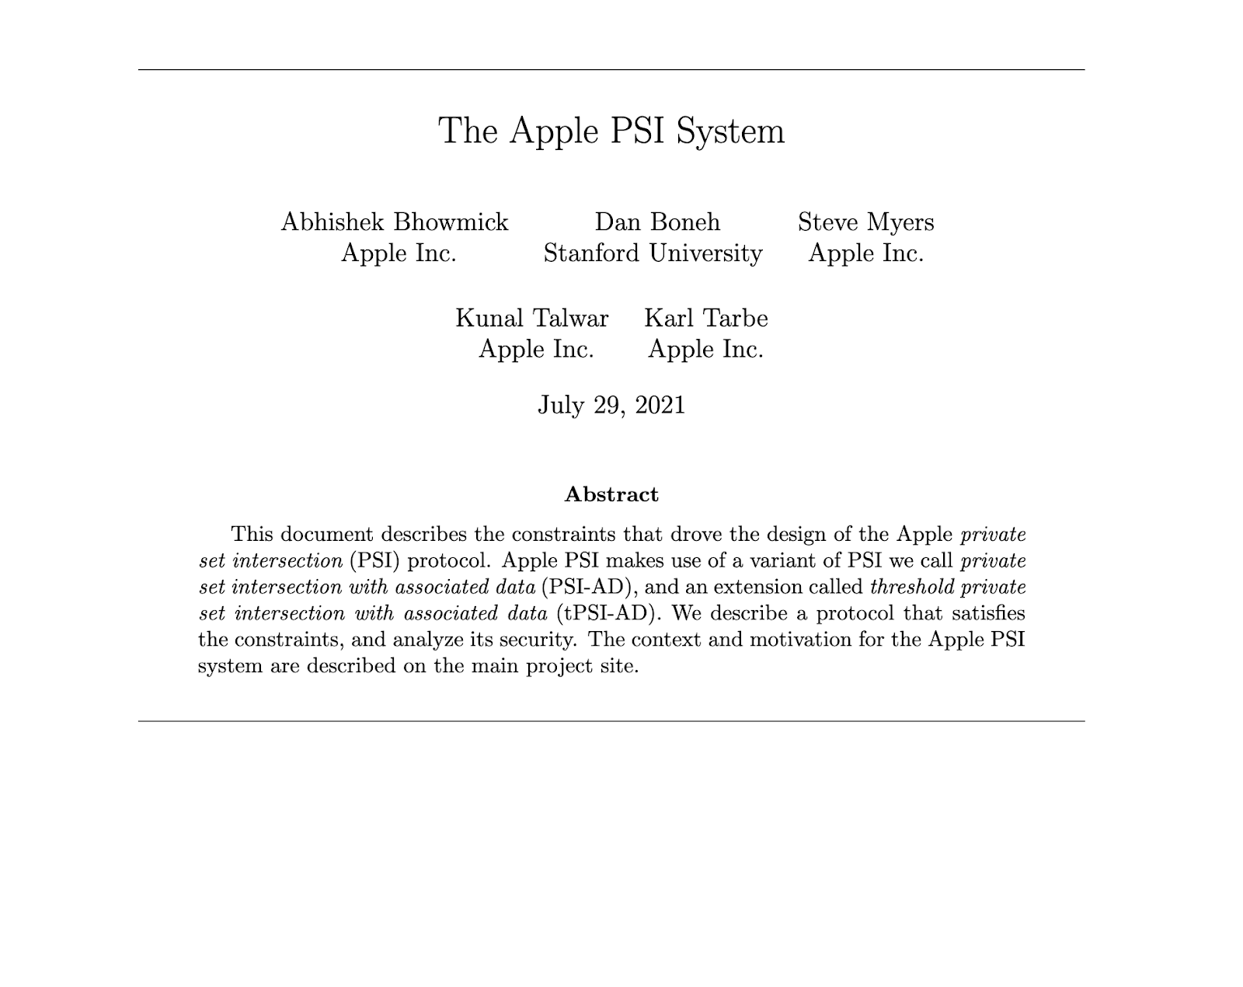

Slide 28
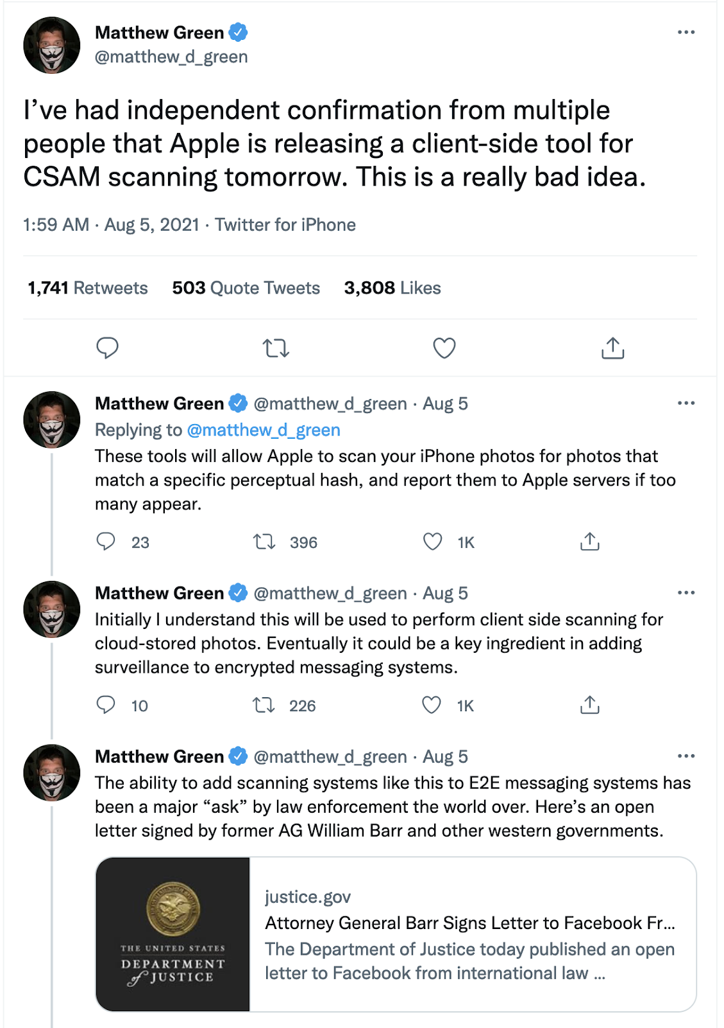
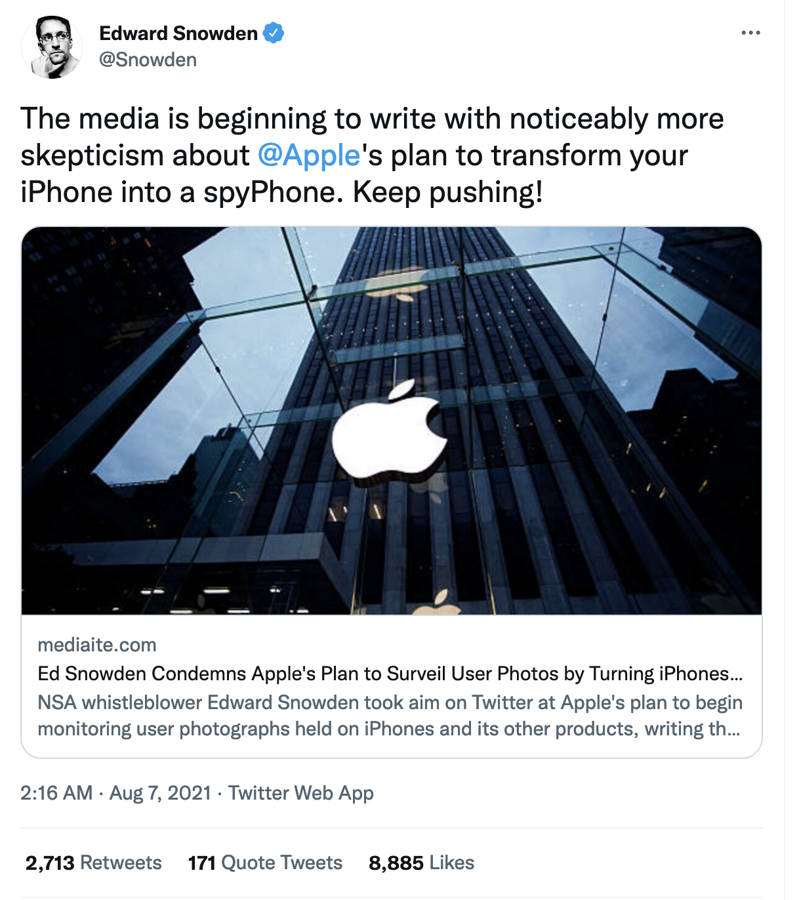
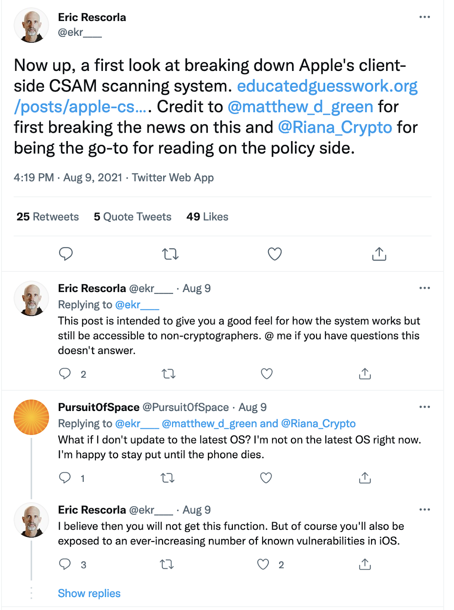
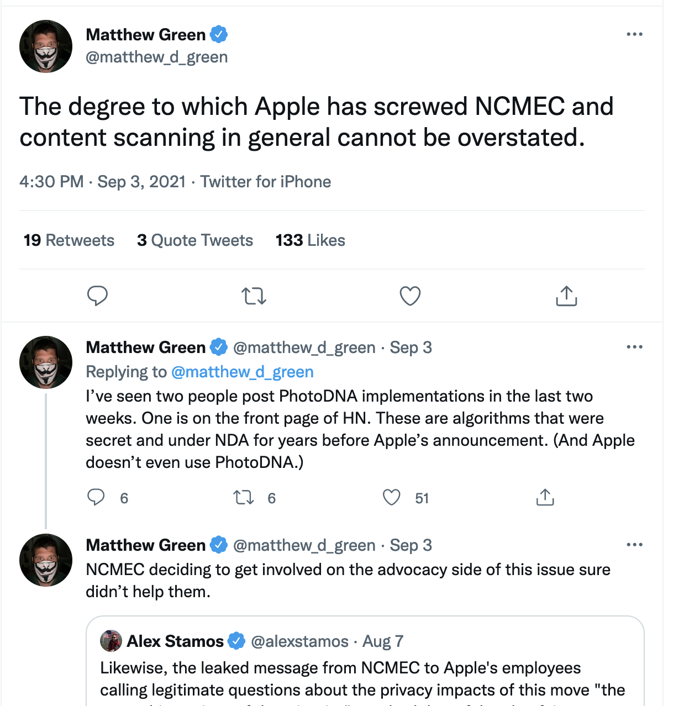
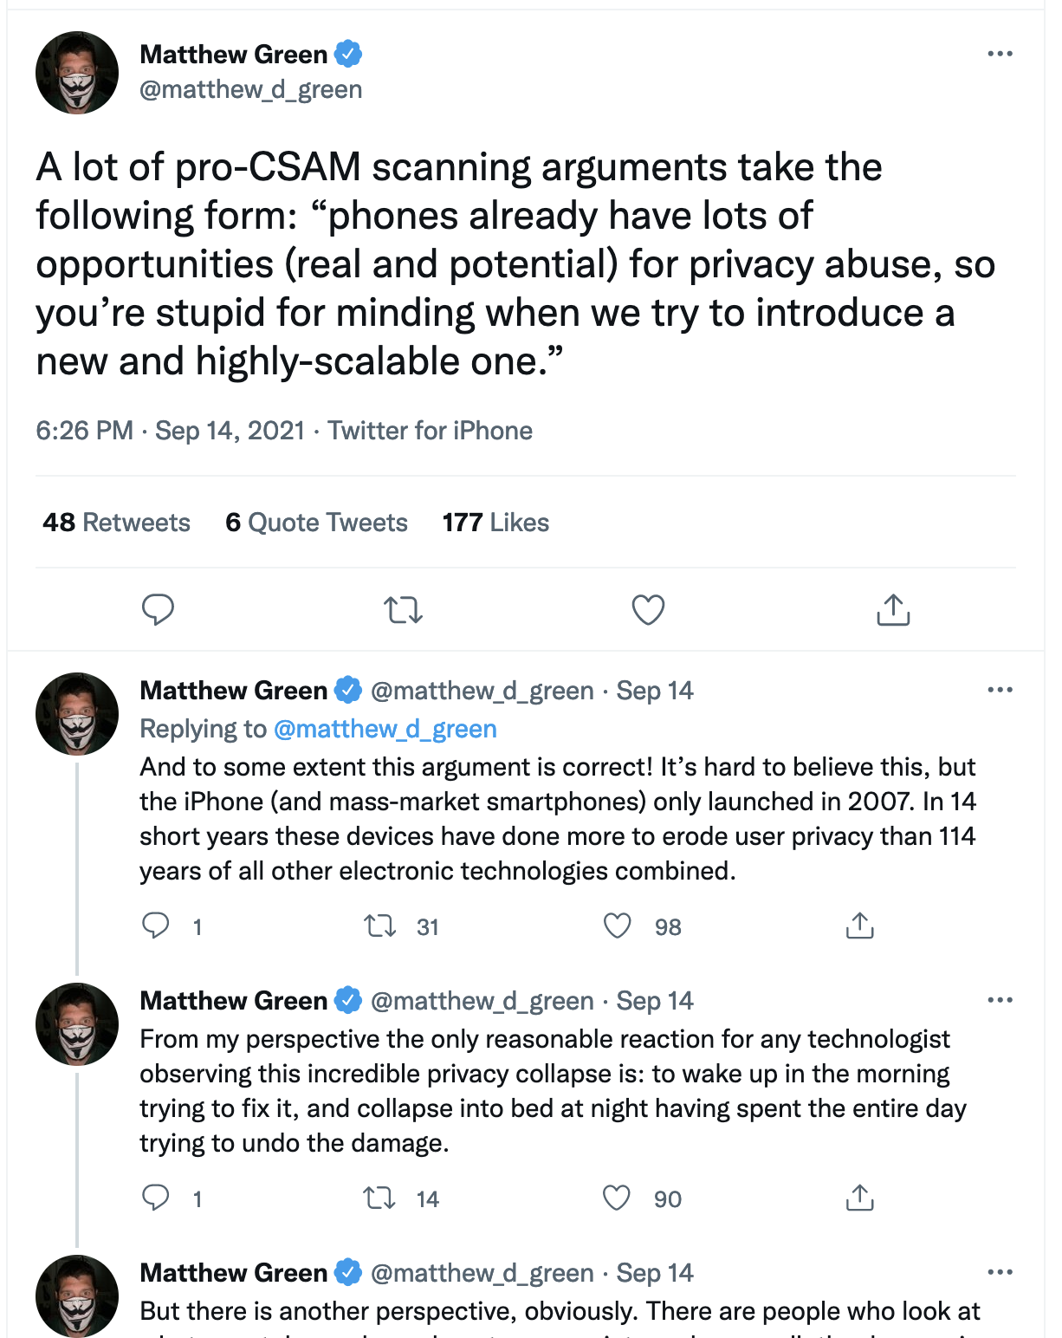
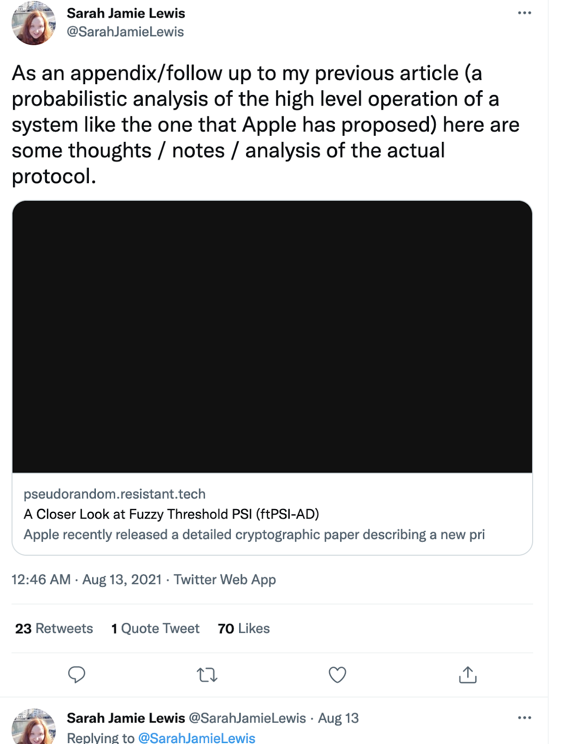
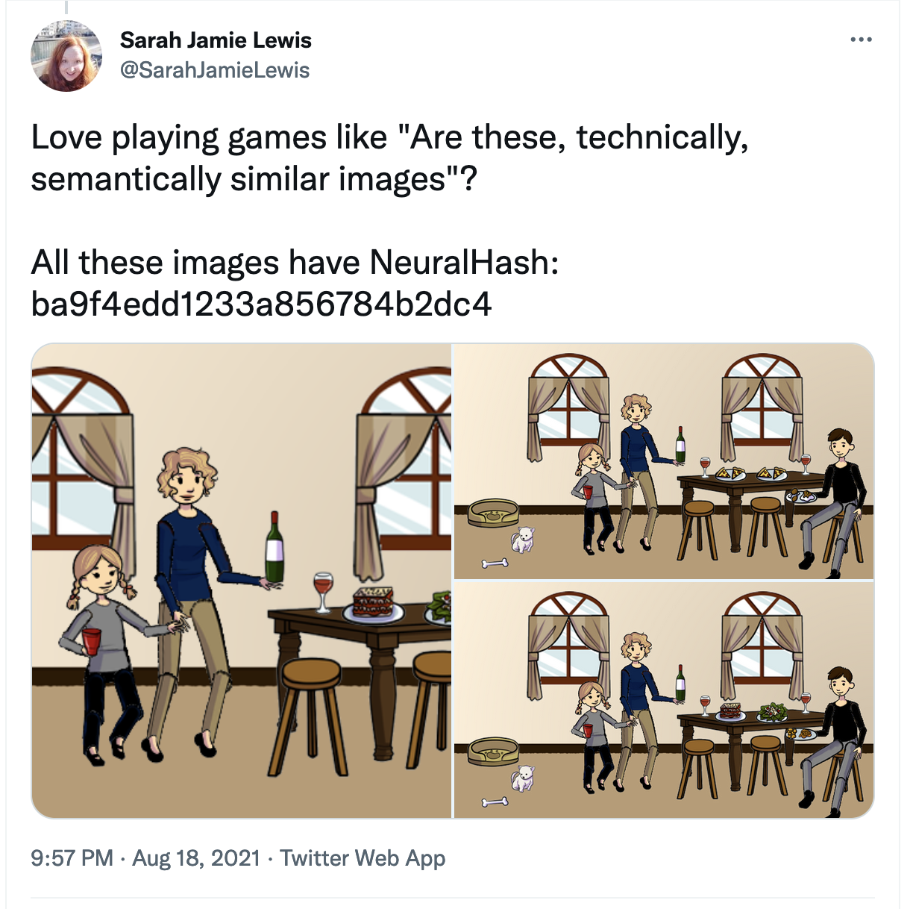
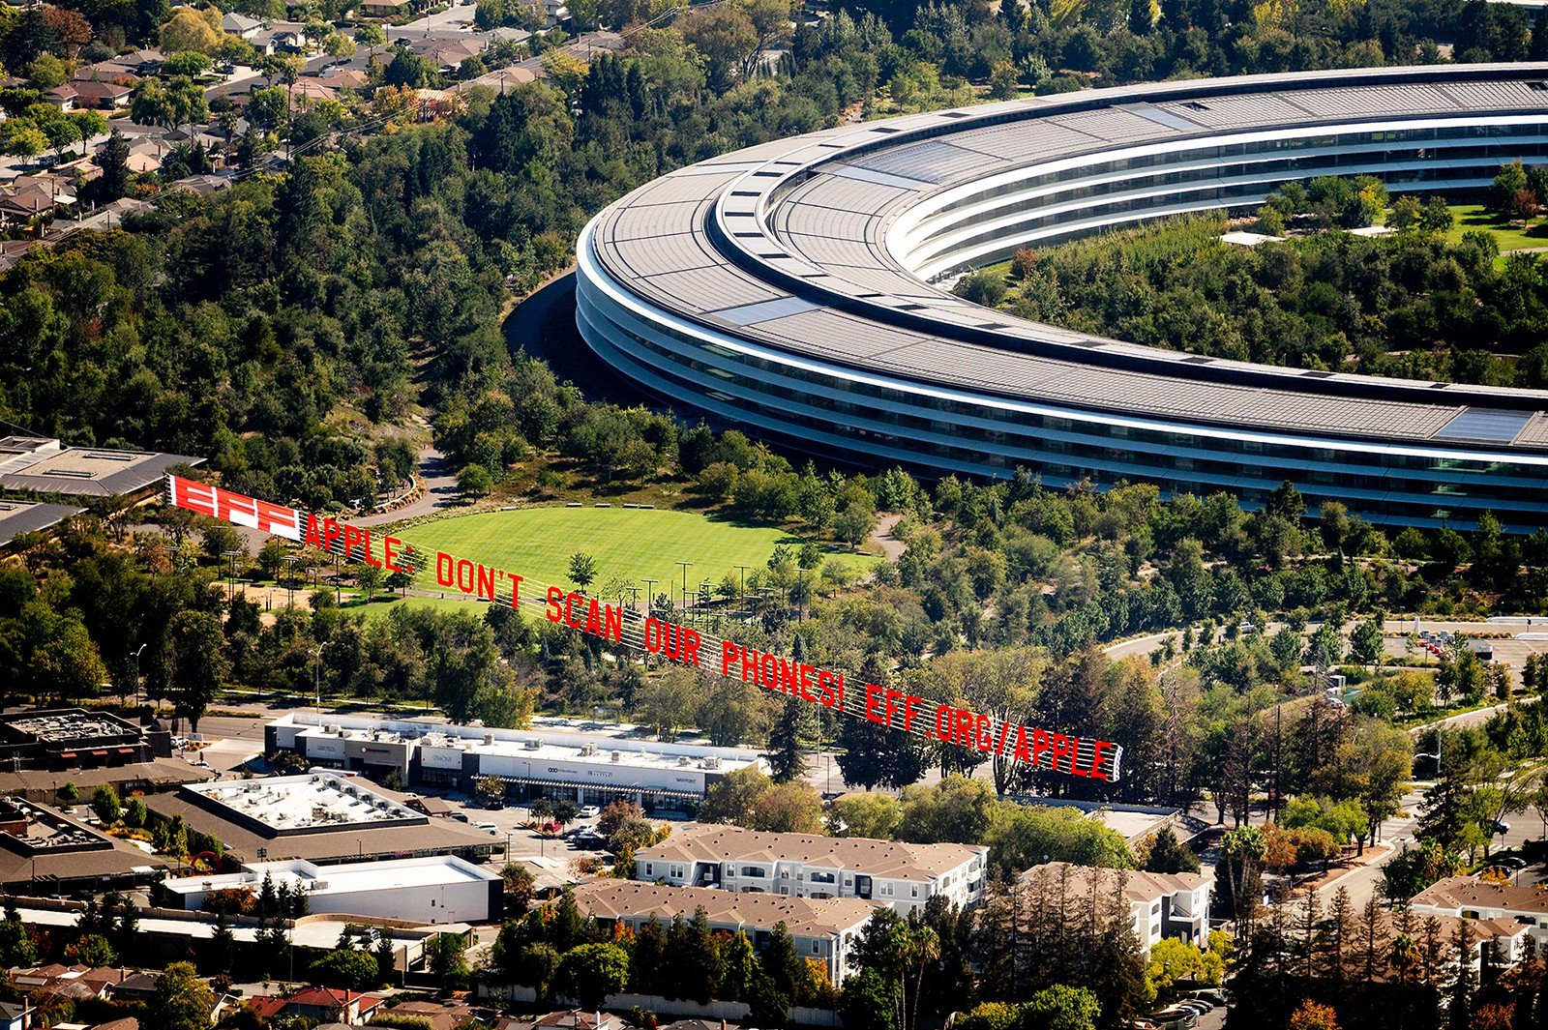
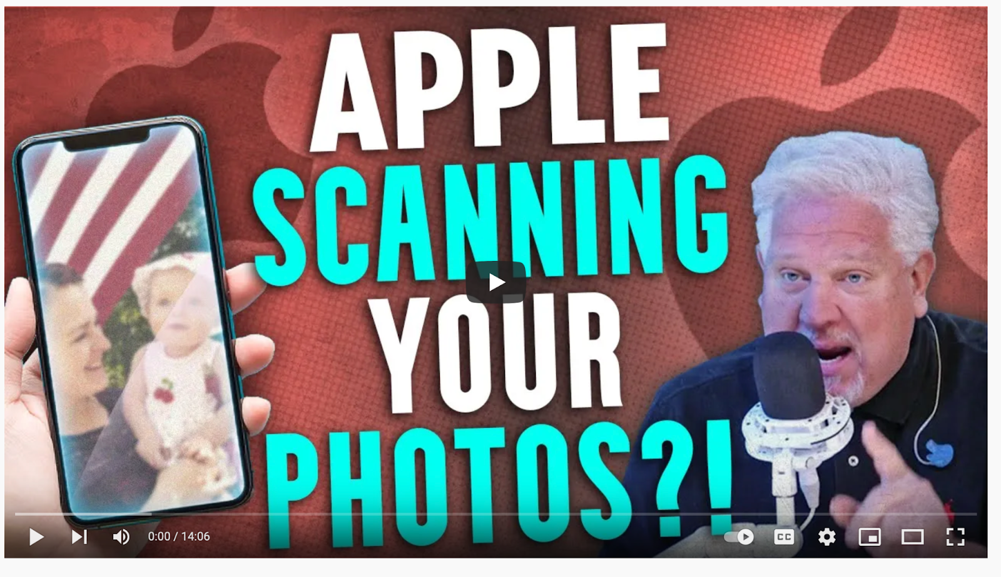
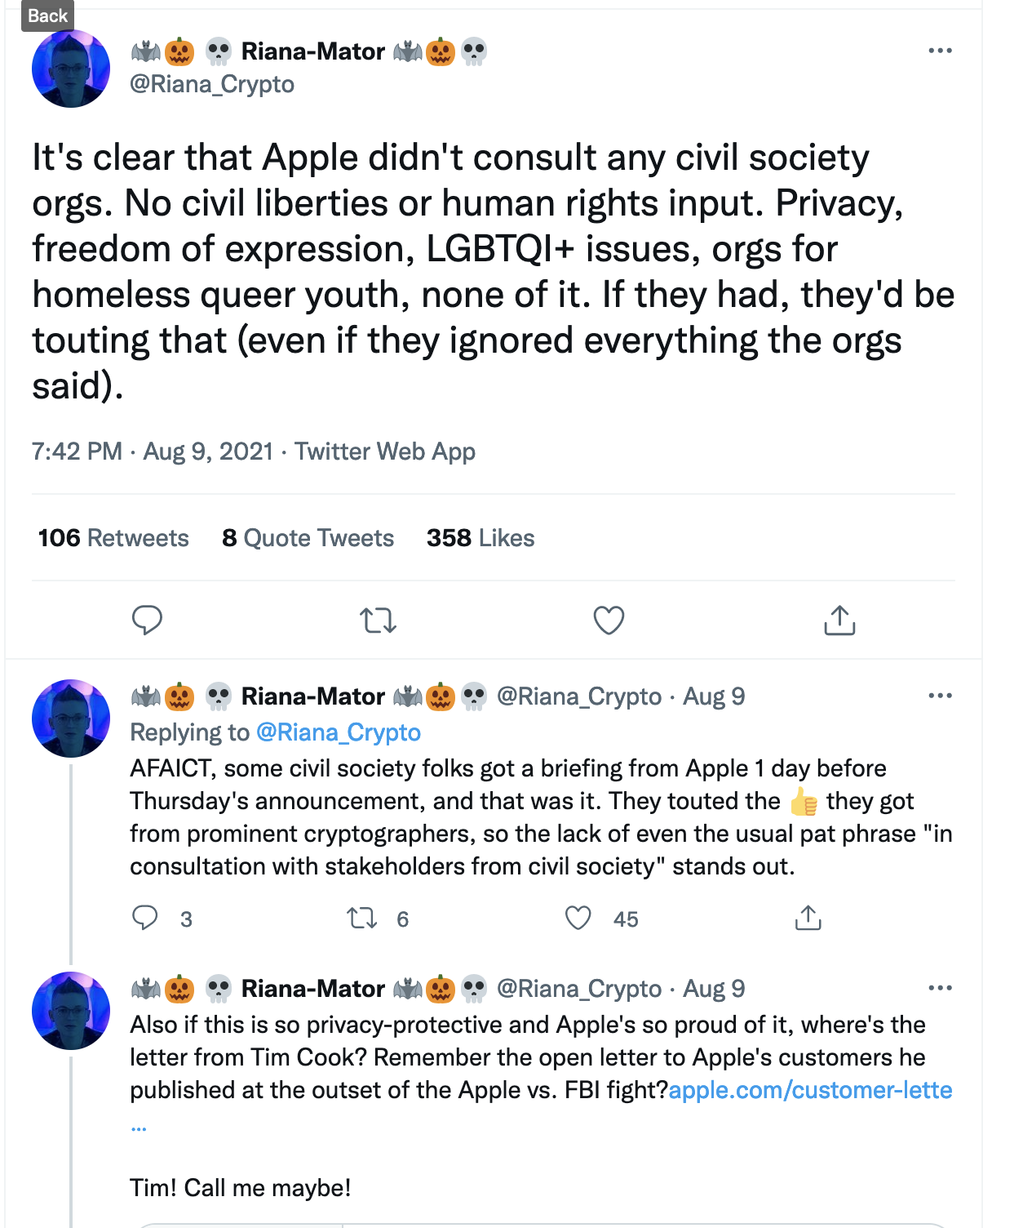
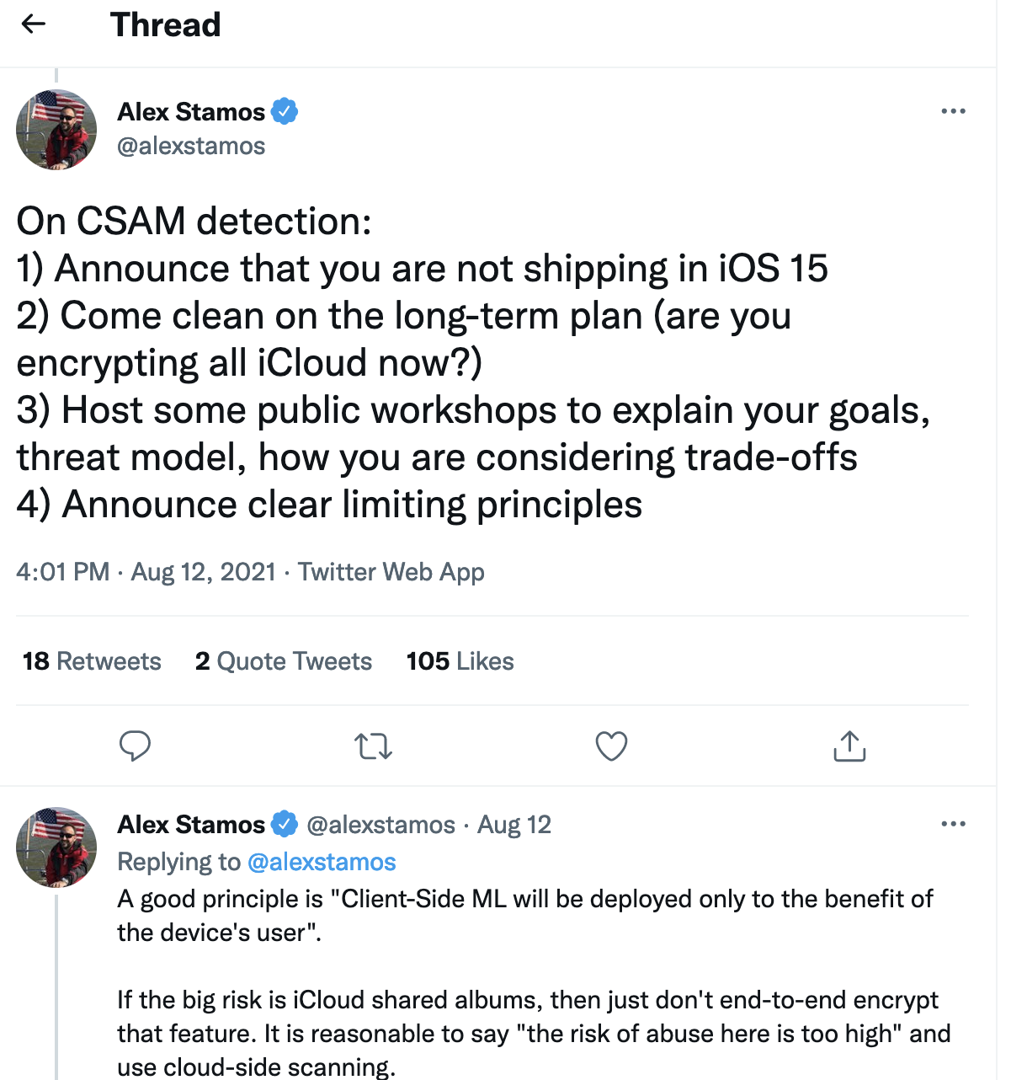
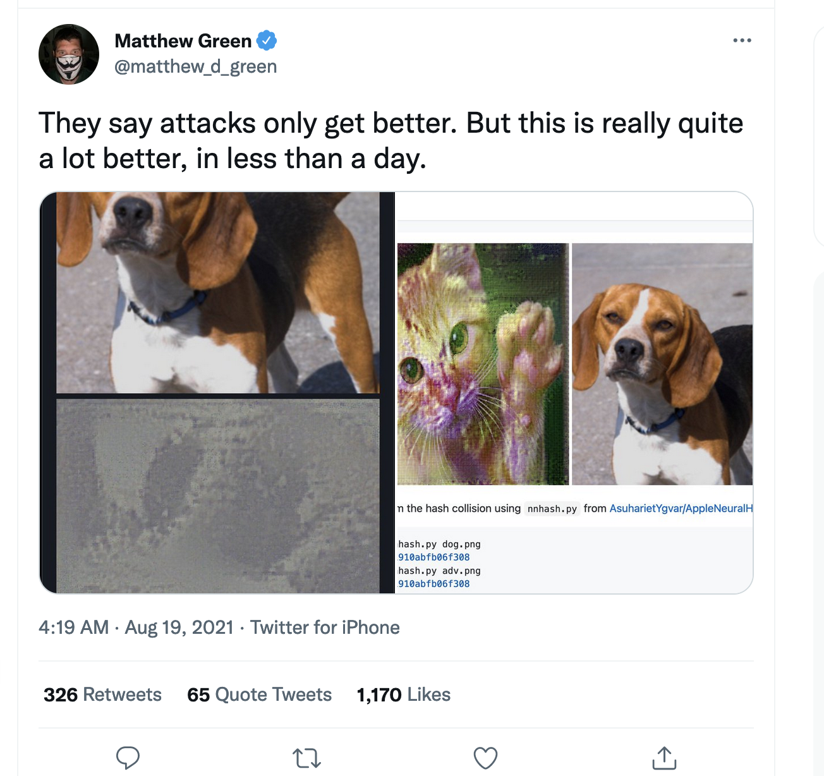
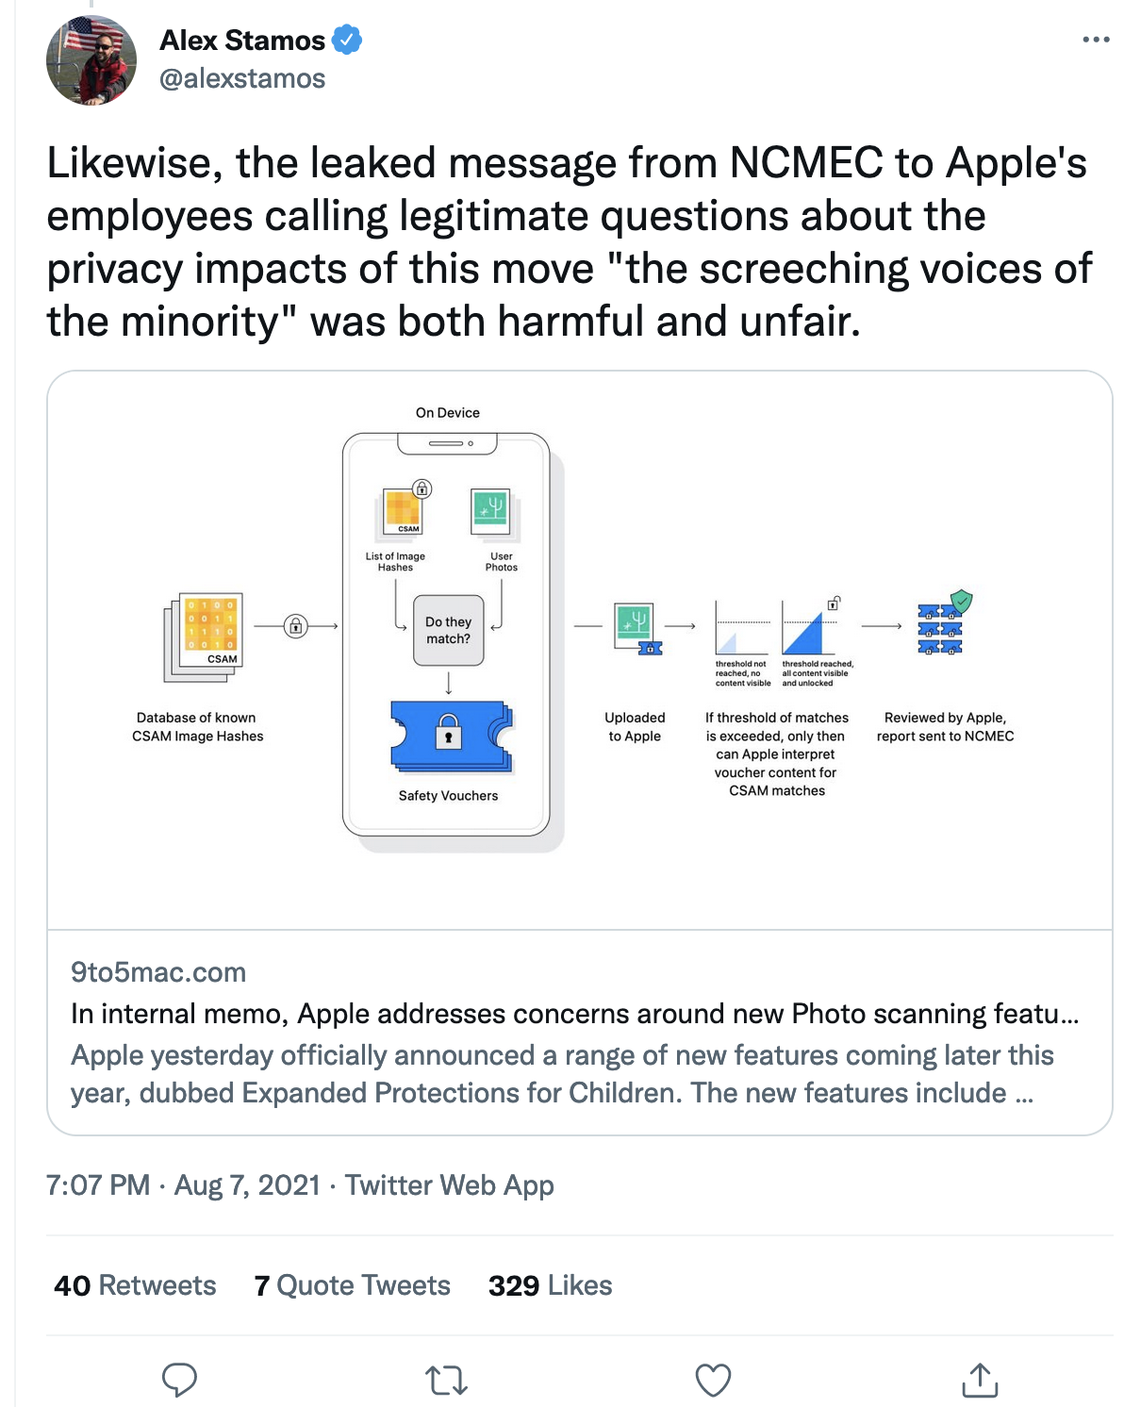
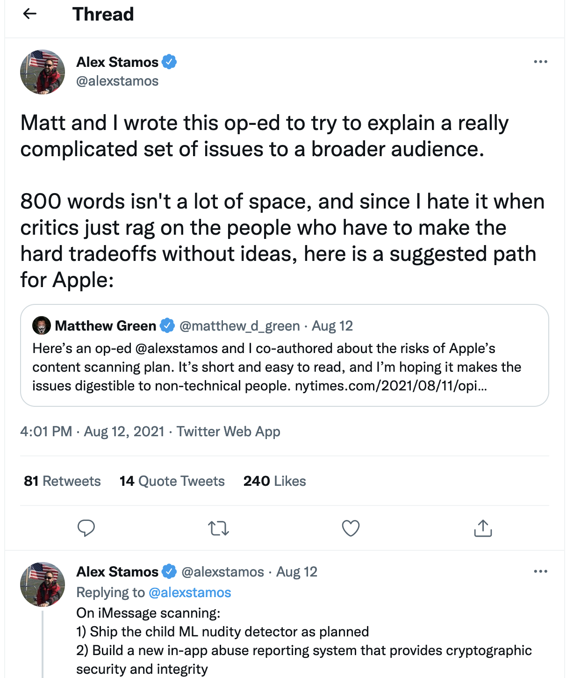

Slide 29



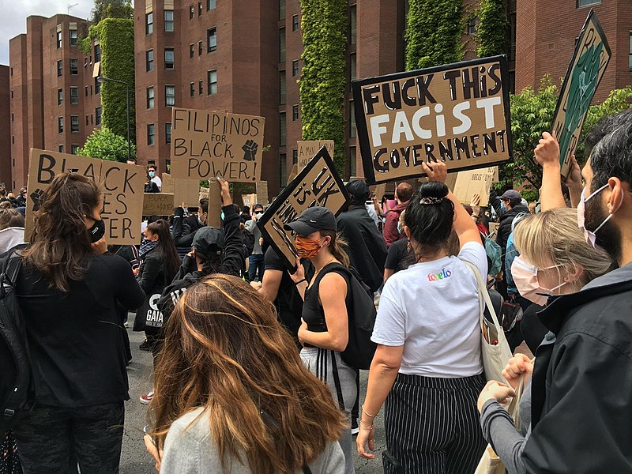

“Target” Images (hashed)
Encrypted Images
Plaintext Images
“Target”
Image Hashes
National Center for Missing
and Exploited Children
(Fuzzy) (Threshold) (Low Round) (Iterative)
Private Set Intersection
Locally Computed
Image Hashes
Formal Security Analysis

Slide 30
Apple’s CSAM Scanning Proposal
Law Enforcement Access
Easy to Abuse the System
Easy to Abuse the System
Difficult to Detect Catastrophic Failure
Difficult to Detect Catastrophic Failure
Security Analysis Hides Society
Security Analysis Hides Society
Value of Proof Unclear
Value of Proof Unclear

Slide 31
National Center for Missing and Exploited Children
Judge
Apple
Law Enforcement

Slide 32
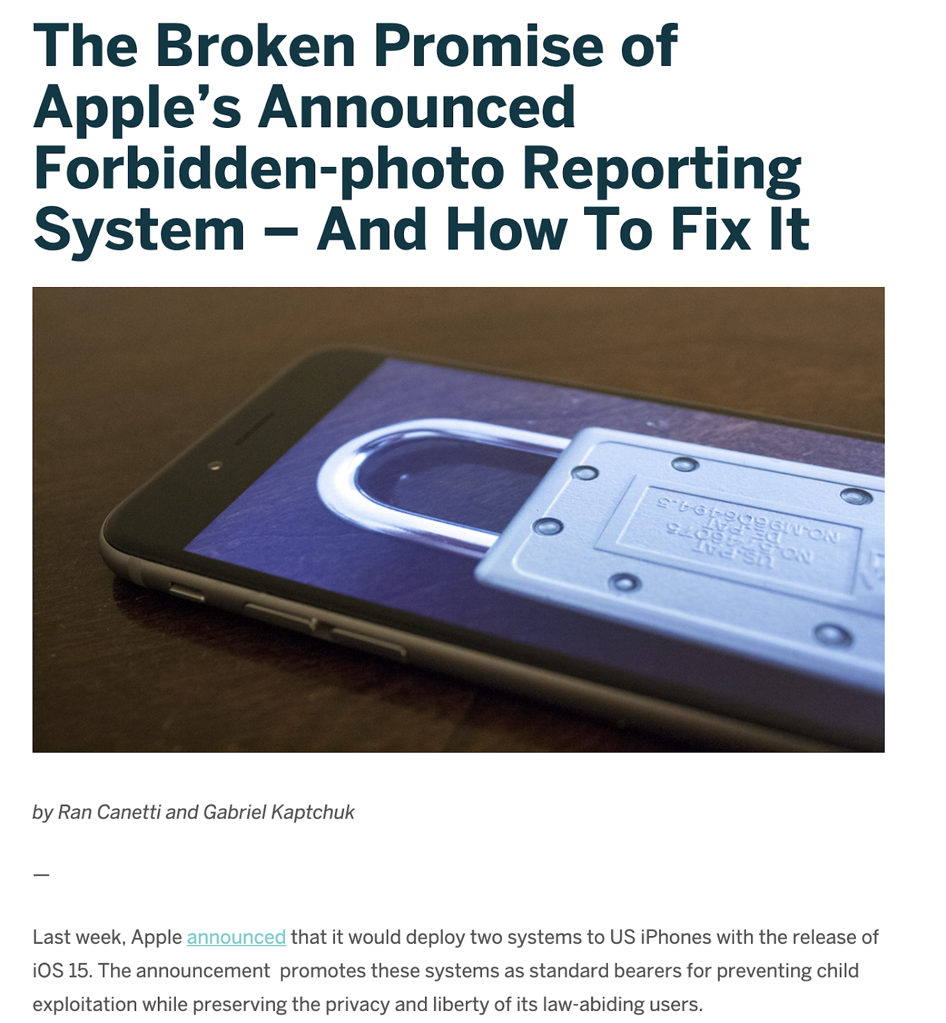

Slide 33
Law Enforcement
Physical World
Prove images come from cases
Images
Apple’s Inputs
Match
NCMEC’s
Images
NCMEC
Hashes
Apple
Private Set Intersection
(with some superpowers)
Client-Side Processing
Prove hashes correspond to images
Prove images contain “correct” content
Boundary of Formal Security Analysis

Slide 34
Apple’s Inputs Match NCMEC’s
NCMEC
Hashes
Apple
Com(Hashes)
Normal Protocol +
NIZK of consistency
with Com
Private Set Intersection
(with some superpowers)

Slide 35
Prove images contain “correct” content
Law Enforcement
Images
NCMEC
Hashes
Apple
Normal Protocol +
NIZK of consistency
with Com(Hash)
Com(Images)
Com(Hashes)
NIZK that images
satisfy a predicate
NIZK of consistency
with Com(Image)
Private Set Intersection
(with some superpowers)

Slide 36
Prove images come from cases (hand wavey)
Cryptographic
Chain of Custody
Law Enforcement
Images
Physical World
Images
NCMEC
Hashes
Apple
Normal Protocol +
NIZK of consistency
with Com(Hash)
Com(Images)
Com(Hashes)
NIZK that images
satisfy a predicate
NIZK of consistency
with Com(Image)
Private Set Intersection
(with some superpowers)

Slide 37
Opportunities for Future Work

Slide 38
Is Accountability Enough?

Slide 39
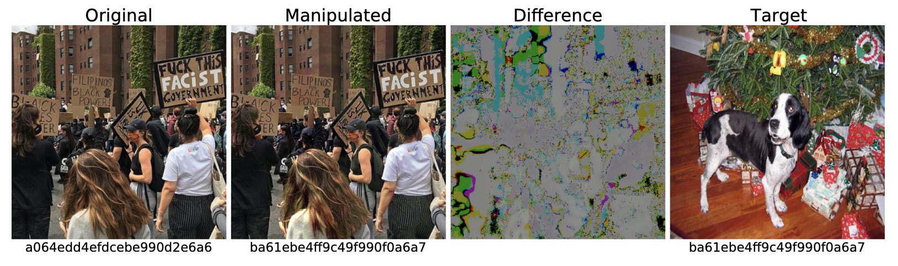
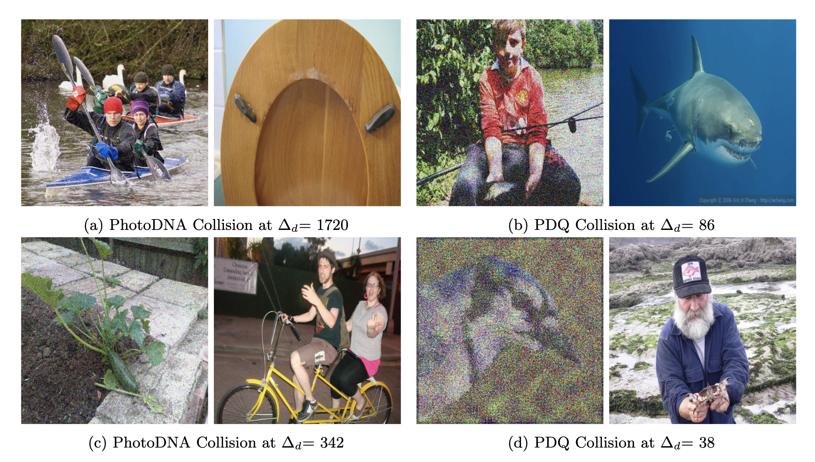
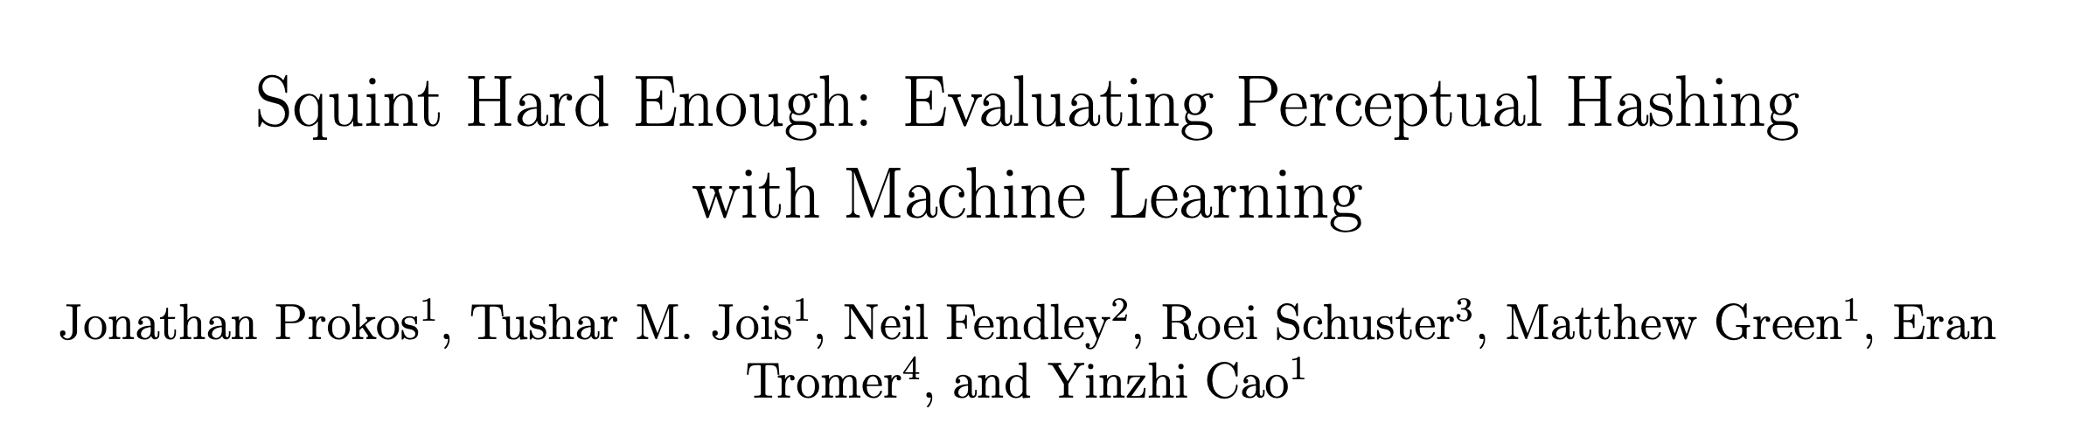
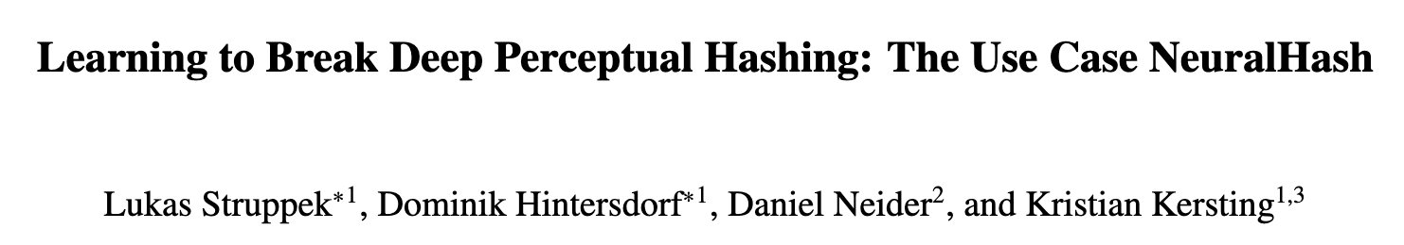
Build Better Practice for Theory

Slide 40
Efficient Instantiations for Specific Parameters
Theorem (Informal):
If there exists a Retrospective ARLEAS scheme, then there exists an Extractable Witness Encryption scheme for a (non-trivial) language defined over (1) the ledger verification function (2) the transparency function, and (3) the global warrant policy.

Slide 41
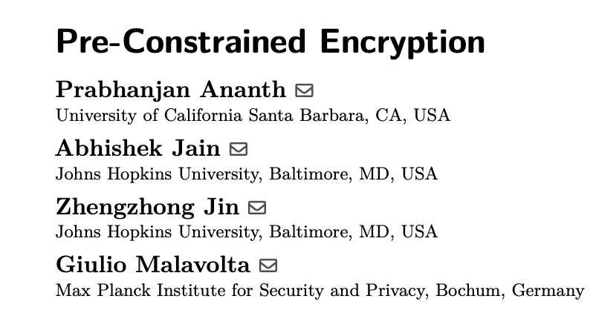
Build Agile Theory
Master Key Parameters
Pre-Constrained Parameters

