Slide 1
Chapter 3
Deliberation with Refinement Methods
Dana S. Nau
University of Maryland

Slide 2


Planning and Acting
Actor
Planning
Tasks
Planning: prediction + search
  Search over predicted states, possible
  organizations of tasks and actions
  Uses descriptive models (e.g., PDDL)
    predict what the actions will do
    don’t include instructions for performing it
Acting: performing
  Dynamic, unpredictable, partially observable environment
    Adapt to context, react to events
  Uses operational models
    instructions telling how to perform the tasks
    usually hierarchical
Queries
Plans
Acting
State
Commands
Events
Execution Platform
Actuation
Sensing
Planning
Acting

Slide 3
Outline
Actor
Planning
Tasks
Queries
Plans
Motivation
Representation
Acting (Rae)
Planning for Rae
Acting with Planning (RAE+UPOM)
Learning
Evaluation, Application
Acting
State
Commands
Events
Execution Platform
Actuation
Sensing
Planning
Acting

Slide 4
Example
Consider an actor that controls two robots
Environment is partially observable
  Each robot can only see what’s at the current location
Objects
  Robots = {r1, r2}
  Containers = {c1, c2}
  Locations = {loc0, loc1, loc2, loc3, loc4}
Rigid relations (properties that won’t change)
  adjacent(loc0,loc1), adjacent(loc1,loc0), adjacent(loc1,loc2), adjacent(loc2,loc1), adjacent(loc2,loc3), adjacent(loc3,loc2), adjacent(loc3,loc4), adjacent(loc4,loc3)
c2
loc4
loc3
r2
c1
r1
loc2
loc1
loc0
State variables (fluents)
    where r ∈ Robots, c ∈ Containers, l ∈ Locations
  loc(r) ∈ Locations
  cargo(r) ∈ Containers ⋃ {empty}
  pos(c) ∈ Locations ⋃ Robots ⋃ {unknown}
  view(l) ∈ {T, F}
    Whether a robot has looked at location l
    If view(l) = T then pos(c) = l for every container c at l

Slide 5
Example (continued)
c2
loc4
loc3
r2
c1
Actor
Planning
r1
Tasks
loc2
loc1
loc0
Queries
Plans
Acting
Commands to the execution platform:
  take(r,o,l): r takes object o at location l
  put(r,o,l): r puts o at location l
  perceive(r,l): robot r perceives what objects are at l
  move-to(r,l): robot r moves to location l
State
Commands
Events
Execution Platform
Actuation
Sensing

Slide 6
Tasks and Methods
Task: an activity for the actor to perform
  taskname(arg₁, …, arg_{k})
For each task, one or more refinement methods
  Operational models telling how to perform the task
c2
loc4
loc3
r2
c1
r1
loc2
method-name(arg₁, …, arg_{k})
task: task-identifier
pre: test
body: a program
loc1
loc0
m-fetch1(r,c)
task: fetch(r,c)
pre: pos(c) = unknown
body:
if ∃l (view(l) = F) then
  move-to(r,l)
  perceive(r,l)
  if pos(c) = l then
  take(r,c,l)
  else fetch(r,c)
  else fail
m-fetch2(r,c)
task: fetch(r,c)
pre: pos(c) ≠ unknown
body:
if loc(r) = pos(c) then
take(r,c,pos(c))
else do
move-to(r,pos(c))
take(r,c,pos(c))
assignment statements
control constructs:
  if-then-else, while, … .
tasks
  can extend this to include events, goals
commands to the execution platform
command
task

Slide 7
Outline
Actor
Planning
Tasks
Queries
Plans
Motivation
Representation
Acting (Rae)
Planning for Rae
Acting with Planning (RAE+UPOM)
Learning
Evaluation, Application
Acting
State
Commands
Events
Execution Platform
Actuation
Sensing
Planning
Acting

Slide 8
RAE (Refinement Acting Engine)
Tasks
Actor
Hierarchical
Operational
Models
Acting Engine
(RAE)
Performs multiple tasks in parallel
  Purely reactive, no lookahead
For each task or event τ, a refinement stack
  execution stack
Agenda = {all current refinement stacks}
Refinement stack for a task τ
⬄ current path in RAE’s search tree for τ
    refinement tree
State
Commands
Events
Execution Platform
Actuation
Sensing
procedure RAE:
  loop:
    for every new external task or event τ do
      choose a method instance m for τ
      create a refinement stack for τ, m
      add the stack to Agenda
    for each stack σ in Agenda
    call Progress(σ)
    if σ is finished then remove it
,
,
τ₁
τ₂
τ₃

Slide 9
Example (reminder)
c2
State variables (fluents)
    where r ∈ Robots, c ∈ Containers, l ∈ Locations
  loc(r) ∈ Locations
  cargo(r) ∈ Containers ⋃ {nil}
  pos(c) ∈ Locations ⋃ Robots ⋃ {unknown}
  view(l) ∈ {T, F}
    Whether a robot has looked at location l
    If view(l) = T then pos(c) = l for every container c at l
Commands to the execution platform:
  take(r,o,l): r takes object o at location l
  put(r,o,l): r puts o at location l
  perceive(r,l): robot r perceives what objects are at l
  move-to(r,l): robot r moves to location l
loc4
loc3
r2
c1
r1
loc2
loc1
loc0
Objects
  Robots = {r1, r2}
  Containers = {c1, c2}
  Locations = {loc1, loc2, loc3, loc4}
Rigid relations (properties that won’t change)
  adjacent(loc0,loc1), adjacent(loc1,loc0), adjacent(loc1,loc2), adjacent(loc2,loc1), adjacent(loc2,loc3), adjacent(loc3,loc2), adjacent(loc3,loc4), adjacent(loc4,loc3)

Slide 10
Example
m-fetch1(r,c)
task: fetch(r,c)
pre: pos(c) = unknown
body:
if ∃l (view(l) = F) then
  move-to(r,l)
  perceive(r,l)
  if pos(c) = l then
  take(r,c,l)
  else fetch(r,c)
  else fail
Refinement tree
τ
procedure RAE:
  loop:
    for every new external task or event τ do
      choose a method instance m for τ
      create a refinement stack for τ, m
      add the stack to Agenda
    for each stack σ in Agenda
    call Progress(σ)
    if σ is finished then remove it
m-fetch2(r,c)
task: fetch(r,c)
pre: pos(c) ≠ unknown
body:
if loc(r) = pos(c) then
take(r,c,pos(c))
else do
move-to(r,pos(c))
take(r,c,pos(c))
Container locations unknown
Partially observable
  Robot only sees current location
c2
loc4
loc3
r2
c1
r1
loc2
loc1
loc0

Slide 11
Example
r = r₀, c = c2
m-fetch1(r,c)
task: fetch(r,c)
pre: pos(c) = unknown
body:
if ∃l (view(l) = F) then
  move-to(r,l)
  perceive(r,l)
  if pos(c) = l then
  take(r,c,l)
  else fetch(r,c)
  else fail
Refinement tree
Candidates
= {m-fetch1(r1,c2),
m-fetch1(r2,c2)}
τ
procedure RAE:
  loop:
    for every new external task or event τ do
      choose a method instance m for τ
      create a refinement stack for τ, m
      add the stack to Agenda
    for each stack σ in Agenda
    call Progress(σ)
    if σ is finished then remove it
m-fetch2(r,c)
task: fetch(r,c)
pre: pos(c) ≠ unknown
body:
if loc(r) = pos(c) then
take(r,c,pos(c))
else do
move-to(r,pos(c))
take(r,c,pos(c))
Container locations unknown
Partially observable
  Robot only sees current location
c2
loc4
loc3
r2
c1
r1
loc2
loc1
loc0

Slide 12
Example
r = r1, c = c2
m-fetch1(r,c)
task: fetch(r,c)
pre: pos(c) = unknown
body:
if ∃l (view(l) = F) then
  move-to(r,l)
  perceive(r,l)
  if pos(c) = l then
  take(r,c,l)
  else fetch(r,c)
  else fail
Refinement tree
Candidates
= {m-fetch(r1,c2),
m-fetch(r2,c2)}
τ
r₀ = r1
m
procedure RAE:
  loop:
    for every new external task or event τ do
      choose a method instance m for τ
      create a refinement stack for τ, m
      add the stack to Agenda
    for each stack σ in Agenda
    call Progress(σ)
    if σ is finished then remove it
m-fetch2(r,c)
task: fetch(r,c)
pre: pos(c) ≠ unknown
body:
if loc(r) = pos(c) then
take(r,c,pos(c))
else do
move-to(r,pos(c))
take(r,c,pos(c))
Container locations unknown
Partially observable
  Robot only sees current location
c2
loc4
loc3
r2
c1
r1
loc2
loc1
loc0

Slide 13
Example
r = r1, c = c2
m-fetch1(r,c)
task: fetch(r,c)
pre: pos(c) = unknown
body:
if ∃l (view(l) = F) then
  move-to(r,l)
  perceive(r,l)
  if pos(c) = l then
  take(r,c,l)
  else fetch(r,c)
  else fail
Refinement tree
Candidates
= {m-fetch(r1,c2),
m-fetch(r2,c2)}
τ
r₀ = r1
σ
m
procedure RAE:
  loop:
    for every new external task or event τ do
      choose a method instance m for τ
      create a refinement stack for τ, m
      add the stack to Agenda
    for each stack σ in Agenda
    call Progress(σ)
    if σ is finished then remove it
m-fetch2(r,c)
task: fetch(r,c)
pre: pos(c) ≠ unknown
body:
if loc(r) = pos(c) then
take(r,c,pos(c))
else do
move-to(r,pos(c))
take(r,c,pos(c))
Container locations unknown
Partially observable
  Robot only sees current location
c2
loc4
loc3
r2
c1
r1
loc2
loc1
loc0

Slide 14
Example
r = r1, c = c2
m-fetch1(r,c)
task: fetch(r,c)
pre: pos(c) = unknown
body:
if ∃l (view(l) = F) then
  move-to(r,l)
  perceive(r,l)
  if pos(c) = l then
  take(r,c,l)
  else fetch(r,c)
  else fail
Refinement tree
Candidates
= {m-fetch(r1,c2),
m-fetch(r2,c2)}
τ
r₀ = r1
σ
m
m-fetch2(r,c)
task: fetch(r,c)
pre: pos(c) ≠ unknown
body:
if loc(r) = pos(c) then
take(r,c,pos(c))
else do
move-to(r,pos(c))
take(r,c,pos(c))
Container locations unknown
Partially observable
  Robot only sees current location
c2
loc4
loc3
r2
c1
r1
loc2
loc1
loc0

Slide 15
Example
r = r1, c = c2
m-fetch1(r,c)
task: fetch(r,c)
pre: pos(c) = unknown
body:
if ∃l (view(l) = F) then
  move-to(r,l)
  perceive(r,l)
  if pos(c) = l then
  take(r,c,l)
  else fetch(r,c)
  else fail
Refinement tree
τ
l = loc1
r₀ = r1
m
τ′
m-fetch2(r,c)
task: fetch(r,c)
pre: pos(c) ≠ unknown
body:
if loc(r) = pos(c) then
take(r,c,pos(c))
else do
move-to(r,pos(c))
take(r,c,pos(c))
Container locations unknown
Partially observable
  Robot only sees current location
c2
loc4
loc3
r2
c1
r1
loc2
loc1
loc0

Slide 16
Example
r = r1, c = c2
m-fetch1(r,c)
task: fetch(r,c)
pre: pos(c) = unknown
body:
if ∃l (view(l) = F) then
  move-to(r,l)
  perceive(r,l)
  if pos(c) = l then
  take(r,c,l)
  else fetch(r,c)
  else fail
Refinement tree
τ
l = loc1
r₀ = r1
m
τ′
m-fetch2(r,c)
task: fetch(r,c)
pre: pos(c) ≠ unknown
body:
if loc(r) = pos(c) then
take(r,c,pos(c))
else do
move-to(r,pos(c))
take(r,c,pos(c))
Container locations unknown
Partially observable
  Robot only sees current location
c2
loc4
loc3
r2
c1
r1
loc2
loc1
loc0

Slide 17
Example
r = r1, c = c2
m-fetch1(r,c)
task: fetch(r,c)
pre: pos(c) = unknown
body:
if ∃l (view(l) = F) then
  move-to(r,l)
  perceive(r,l)
  if pos(c) = l then
  take(r,c,l)
  else fetch(r,c)
  else fail
Refinement tree
τ
l = loc1
r₀ = r1
m
σ
τ′
procedure RAE:
  loop:
    for every new external task or event τ do
      choose a method instance m for τ
      create a refinement stack for τ, m
      add the stack to Agenda
    for each stack σ in Agenda
    call Progress(σ)
    if σ is finished then remove it
m-fetch2(r,c)
task: fetch(r,c)
pre: pos(c) ≠ unknown
body:
if loc(r) = pos(c) then
take(r,c,pos(c))
else do
move-to(r,pos(c))
take(r,c,pos(c))

Slide 18
Example
r = r1, c = c2
m-fetch1(r,c)
task: fetch(r,c)
pre: pos(c) = unknown
body:
if ∃l (view(l) = F) then
  move-to(r,l)
  perceive(r,l)
  if pos(c) = l then
  take(r,c,l)
  else fetch(r,c)
  else fail
Refinement tree
τ
l = loc1
r₀ = r1
← running …
m
m-fetch2(r,c)
task: fetch(r,c)
pre: pos(c) ≠ unknown
body:
if loc(r) = pos(c) then
take(r,c,pos(c))
else do
move-to(r,pos(c))
take(r,c,pos(c))
c2
loc4
loc3
r2
c1
r1
loc2
loc1
loc0

Slide 19
Example
r = r1, c = c2
m-fetch1(r,c)
task: fetch(r,c)
pre: pos(c) = unknown
body:
if ∃l (view(l) = F) then
  move-to(r,l)
  perceive(r,l)
  if pos(c) = l then
  take(r,c,l)
  else fetch(r,c)
  else fail
Refinement tree
τ
l = loc1
r₀ = r1
← succeeded
m
m-fetch2(r,c)
task: fetch(r,c)
pre: pos(c) ≠ unknown
body:
if loc(r) = pos(c) then
take(r,c,pos(c))
else do
move-to(r,pos(c))
take(r,c,pos(c))
c2
loc4
loc3
r2
c1
r1
loc2
loc1
loc0

Slide 20
Example
r = r1, c = c2
m-fetch1(r,c)
task: fetch(r,c)
pre: pos(c) = unknown
body:
if ∃l (view(l) = F) then
  move-to(r,l)
  perceive(r,l)
  if pos(c) = l then
  take(r,c,l)
  else fetch(r,c)
  else fail
Refinement tree
τ
l = loc1
r₀ = r1
m
τ′
m-fetch2(r,c)
task: fetch(r,c)
pre: pos(c) ≠ unknown
body:
if loc(r) = pos(c) then
take(r,c,pos(c))
else do
move-to(r,pos(c))
take(r,c,pos(c))
c2
loc4
loc3
r2
c1
r1
loc2
loc1
loc0

Slide 21
Example
r = r1, c = c2
m-fetch1(r,c)
task: fetch(r,c)
pre: pos(c) = unknown
body:
if ∃l (view(l) = F) then
  move-to(r,l)
  perceive(r,l)
  if pos(c) = l then
  take(r,c,l)
  else fetch(r,c)
  else fail
Refinement tree
τ
l = loc1
r₀ = r1
m
← failed
τ′
sensor failure
m-fetch2(r,c)
task: fetch(r,c)
pre: pos(c) ≠ unknown
body:
if loc(r) = pos(c) then
take(r,c,pos(c))
else do
move-to(r,pos(c))
take(r,c,pos(c))
c2
loc4
loc3
r2
c1
r1
loc2
loc1
loc0

Slide 22
Example
r = r2, c = c2
m-fetch1(r,c)
task: fetch(r,c)
pre: pos(c) = unknown
body:
if ∃l (view(l) = F) then
  move-to(r,l)
  perceive(r,l)
  if pos(c) = l then
  take(r,c,l)
  else fetch(r,c)
  else fail
Refinement tree
Candidates
= {m-fetch(r1,c2),
m-fetch(r2,c2)}
τ
retry
r₀ = r2
m-fetch1(r2,c2)
sensor failure
m-fetch2(r,c)
task: fetch(r,c)
pre: pos(c) ≠ unknown
body:
if loc(r) = pos(c) then
take(r,c,pos(c))
else do
move-to(r,pos(c))
take(r,c,pos(c))
c2
loc4
loc3
r2
c1
r1
loc2
loc1
loc0

Slide 23
Example
r = r2, c = c2
m-fetch1(r,c)
task: fetch(r,c)
pre: pos(c) = unknown
body:
if ∃l (view(l) = F) then
  move-to(r,l)
  perceive(r,l)
  if pos(c) = l then
  take(r,c,l)
  else fetch(r,c)
  else fail
Refinement tree
Candidates
= {m-fetch(r1,c2),
m-fetch(r2,c2)}
τ
retry
r₀ = r2
m-fetch1(r2,c2)
sensor failure
m-fetch2(r,c)
task: fetch(r,c)
pre: pos(c) ≠ unknown
body:
if loc(r) = pos(c) then
take(r,c,pos(c))
else do
move-to(r,pos(c))
take(r,c,pos(c))
Poll: Is this the same as a backtracking search?
c2
loc4
loc3
r2
c1
r1
loc2
loc1
loc0

Slide 24
Extensions to RAE
Methods for events
  e.g., an emergency
Methods for goals
  special kind of task: achieve(goal)
  sets up a monitor to see if the goal has been achieved
Concurrent subtasks

Slide 25
Outline
Motivation
Representation
Acting (Rae)
Planning for Rae
Acting with Planning (RAE+UPOM)
Learning
Evaluation, Application
Actor
Planner
Tasks
Hierarchical
Operational
Models
Queries
Plans
Acting Engine (RAE)
State
Commands
Events
Execution Platform
Actuation
Sensing

Slide 26
Planning for Rae?
procedure RAE:
  loop:
    for every new external task or event τ do
      choose a method instance m for τ
      create a refinement stack for τ, m
      add the stack to Agenda
    for each stack σ in Agenda
    call Progress(σ)
    if σ is finished then remove it
retry τ using an
untried candidate
Four places where Rae and Progress choose a method instance for a task
Bad choice may lead to
  more costly solution
  failure - need to recover, sometimes unrecoverable
Solution:
  call a planner, choose the method instance it suggests
choose a candidate m′
push (τ′,m′, …) onto σ
retry τ using an
untried candidate

Slide 27
Planning and Acting Integration
Planner’s action models are abstractions
  The planned actions are tasks for the actor to refine
Consistency problem:
  How to get action models that
  describe what the actor will do?
One possible solution:
  Actor and planner both use the same representation
    Must be operational; descriptive models too abstract
    Need planning algorithms that can use operational models
Actor
Descriptive models
What the
actions do
Planning
Consistent?
Queries
Plans
Operational models
How to
perform tasks
Acting (RAE)

Slide 28
Planning and Acting Integration
Planner’s action models are abstractions
  The planned actions are tasks for the actor to refine
Consistency problem:
  How to get action models that
  describe what the actor will do?
One possible solution:
  Actor and planner both use the same representation
    Must be operational; descriptive models too abstract
    Need planning algorithms that can use operational models
Actor
Descriptive models
What the
actions do
Planning
Consistent?
Queries
Plans
Operational models
How to
perform tasks
Acting (RAE)
Idea 1:
  Planner uses Rae’s tasks and refinement methods
  For each of Rae’s commans, have a classical action model
  DFS or GBFS search among alternatives to see which works best

Slide 29
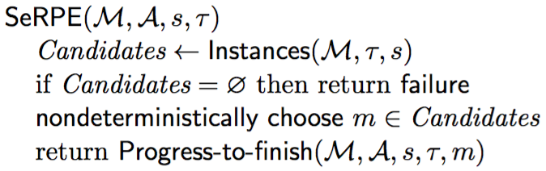
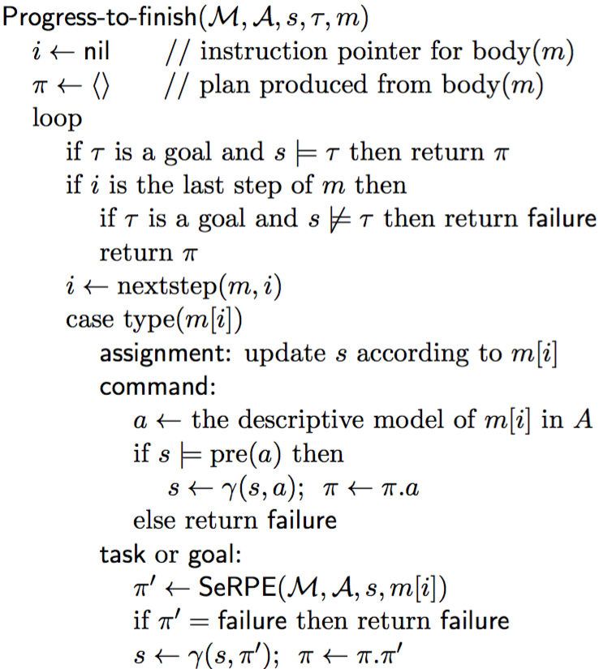
SeRPE (Sequential Refinement Planning Engine)
M = {methods}
A = {action models}
s = initial state
τ = task or goal
Like Rae with just one external task
  Progress it all the way to the end,
  like Progress with a loop around it
  Plan rather than act
    For each command, apply a classical action model
But SeRPE there are problems …

Slide 30
Problems with SeRPE
m-foo(k)
task: foo(k)
pre: …
body:
for i ← 1 to k:
  bar(i)
  baz(i)
Problem 1: difficult to implement
Each time a method invokes a subtask, SeRPE makes a nondeterministic choice
To implement deterministically
  Each path in the search space is an execution trace of the body of a method
  Need to backtrack over code execution
Need to write a compiler that can do backtracking
  Is it worth the effort?
Example:
Suppose that
  Each task has two applicable methods
  When i=2, the 1st method for baz(2) fails
Backtracking:
  Try 2nd method for baz(2)
  If it fails, try 2nd method for bar(2)
  If it fails, backtrack to i = 1
    Try 2nd method for baz(1)
    If it fails, try 2nd method for bar(1)
  If it fails, backtrack to task foo(k) …

Slide 31
Problems with SeRPE
Problem 2: limitations of classical action models
  e.g., the fetch example
We don’t know in advance what perceive’s effects will be
  If we did, perceive wouldn’t actually be needed
  take(r,o,l)
  // robot r takes object o at location l
  pre: cargo(r) = nil, loc(r) = l, loc(o) = l
  eff: cargo(r) ← o, loc(o) ← r
  put(r,o,l)
  // r puts o at location l
  pre: loc(r) = l, loc(o) = r
  eff: cargo(r) ← nil, loc(o) ← l
  perceive(r,l):
  // robot r sees what objects are at l
  pre: loc(r) = l
  eff: ?
c2
loc4
loc3
r2
c1
r1
loc2
loc1
loc0

Slide 32
Planning for Rae
Progress(σ):
procedure RAE:
  loop:
    for every new external task or event τ do
      choose a method instance m for τ
      create a refinement stack for τ, m
      add the stack to Agenda
    for each stack σ in Agenda
    call Progress(σ)
    if σ is finished then remove it
retry τ using an
untried candidate
Idea 2: simulation with multithreading or multiprocessing
  Run Rae in simulated environment
    Simulate the commands (see next page)
  To choose among method instances, try all of them in parallel
Planner returns the method instance m having the highest
expected utility (≈ least expected cost)
Poll: is this a reasonable approach?
choose a candidate m′
push (τ′, m′, …) onto σ
retry τ using an untried candidate

Slide 33
Simulating commands
Simplest case:
  probabilistic action template
    a(x₁, …, x_{k})
    pre: …
    (p₁) effects₁: e₁₁, e₁₂, …
    …
    (p_{m}) effects_{m}: e_{m1}, e_{m2}, …
  Choose effects_{i} at random with probability p_{i}
  and use it to update the current state
More general:
  Arbitrary computation, e.g.,
  physics-based simulation
  Run the code to get simulated effects
subtree below m_{k}

Slide 34
Planning for Rae
Progress(σ):
procedure RAE:
  loop:
    for every new external task or event τ do
      choose a method instance m for τ
      create a refinement stack for τ, m
      add the stack to Agenda
    for each stack σ in Agenda
    call Progress(σ)
    if σ is finished then remove it
retry τ using an
untried candidate
Idea 3: simulation with Monte Carlo rollouts
  Multiple runs
    Random choices and outcomes in each run
  Maintain statistics to estimate each choice’s expected utility
  Return the method instance m that has the highest estimated utility
Patra, Mason, Kumar, Traverso, Ghallab, and Nau. Integrating Acting, Planning, and Learning in Hierarchical Operational Models. ICAPS, 2020. Best student paper honorable mention award. https://doi.org/10.1609/aaai.v33i01.33017691
choose a candidate m′
push (τ′, m′, …) onto σ
retry τ using an untried candidate

Slide 35
Planner
Simulate-Progress(σ):
Plan-with-UPOM (task τ):
  Candidates ← {method instances relevant for τ}
  for i ← 1 to n
  call UPOM(τ)
  update estimates of methods’ expected utility
  return the m ∈ Candidates that has
  the highest estimated utility
simulation
status
UPOM(τ):
  choose a method instance m for τ
  create refinement stack σ for τ and m
  loop while Simulate-Progress(σ) ≠ failure
  if σ is completed then return (m, utility)
  return failure
start simulation of τ′
Each call to UPOM does a Monte Carlo rollout
  Simulated execution of RAE on τ

Slide 36
Monte-Carlo rollouts
Plan-with-UPOM (task τ):
  Candidates ← {method instances relevant for τ}
  for i ← 1 to n
  call UPOM(τ)
  update estimates of methods’ expected utility
  return the m ∈ Candidates that has
  the highest estimated utility
UPOM(τ):
  choose a method instance m for τ
  create refinement stack σ for τ and m
  loop while Simulate-Progress(σ) ≠ failure
  if σ is completed then return (m, utility)
  return failure
subtree below m_{k}
Each call to UPOM does a Monte Carlo rollout
  Simulated execution of RAE on τ

Slide 37

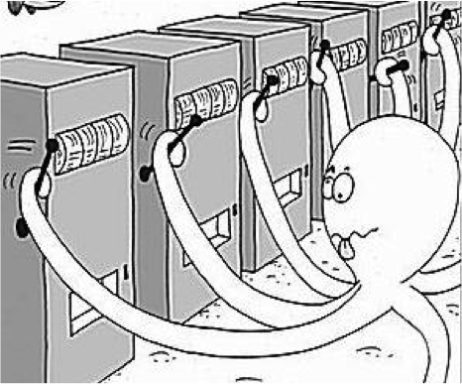
Digression: Monte Carlo rollouts
Multi-arm bandit problem
  Statistical model of sequential experiments
  Name derived from one-armed bandit (slot machine)
Multiple actions a₁, a₂, …, a_{n}
  Each a_{i} provides a reward from an unknown probability distribution p_{i}
  Assume each p_{i} is stationary
    Same every time, regardless of history
  Objective: maximize expected utility of a sequence of actions
Exploitation vs exploration dilemma:
  Exploitation: choose an action that has given
  you high rewards in the past
  Exploration: choose an action that’s less familiar,
  in hopes that it might produce a higher reward

Slide 38
UCB (Upper Confidence Bound) Algorithm
Assume all rewards are between 0 and 1
  If they aren’t, normalize them
For each action a, let
  r(a) = average reward you’ve gotten from a
  n(a) = number of times you’ve tried a
  n_{t} = ∑_{a} n(a) _______________
  Q(a) = r(a) + √ 2(ln n_{t})/n(a)
UCB:
  if there are any untried actions:
  ã ← any untried action
  else:
  ã ← argmax_{a} Q(a)
  perform ã
  update r(ã), n(ã), n_{t} , Q(ã)
Theorem (given some assumptions):
  As the number of calls to UCB → ∞,
  UCB’s choice at each call → optimal choice

Slide 39
UCT Algorithm
MDP: state space in which each action has probabilistic outcomes
  We’ll discuss this in Chapter 6
UCT algorithm: Monte Carlo rollouts on an MDP
At each state s,
  Use UCB to choose an action at random
    Balances exploration vs exploitation at s
  Action’s outcome ⇒ next state s
How to use UCT:
  Call it many times, return action
  with highest expected utility
Theorem:
  As number of calls to UCT → ∞,
  choice converges to optimal

Slide 40
Convergence
UCT algorithm:
  Monte Carlo rollouts on MDPs
  Call it many times, choice converges to optimal
UPOM search tree more complicated
  tasks, method instances, commands, code execution
If no exogenous events,
  Can map it to UCT search of a complicated MDP
  Proof of convergence to optimal

Slide 41
Outline
Motivation
Representation
Acting (Rae)
Planning for Rae
Acting with Planning (RAE+UPOM)
Learning
Evaluation, Application
Actor
Planner (UPOM)
Tasks
Hierarchical
Operational
Models
Queries
Plans
Acting Engine (RAE)
State
Commands
Events
Execution Platform
Actuation
Sensing

Slide 42
RAE + UPOM
Progress(σ):
procedure RAE:
  loop:
    for every new external task or event τ do
      choose a method instance m for τ
      create a refinement stack for τ, m
      add the stack to Agenda
    for each stack σ in Agenda
    call Progress(σ)
    if σ is finished then remove it
retry τ using an
untried candidate
Whenever RAE needs to choose a method instance
  call Plan-with-UPOM, use the method instance it returns
Open-source Python implementation: https://bitbucket.org/sunandita/RAE/
choose a candidate m′
push (τ′, m′, …) onto σ
retry τ using an untried candidate

Slide 43
Can we use UPOM with Run-Lookahead?
Suppose we try to use Run-Lookahead with a
modified version of UPOM (call it UPOM′)
  Instead of returning method instance m₁, return
  the actions in the last Monte Carlo rollout
    π = ⟨a₁, a₂, a₃, a₄, a₅⟩
    corresponding commands: c₁, c₂, c₃, c₄, c₅
Problem
  Run-lookahead calls UPOM′, gets π,
  executes c₁, then calls UPOM′ again
  This time, UPOM′ needs to plan for t₁
  in state s₁ rather than s₀
  There might not be an applicable method
If we want to use Run-Lookahead, we need to
ensure that methods can work in unexpected states

Slide 44
Can we use UPOM with Run-Lazy-Lookahead?
Run-Lazy-Lookahead calls UPOM′,
UPOM′ returns π = ⟨a₁, a₂, a₃, a₄, a₅⟩
Run-Lazy-Lookahead executes c₁, c₂, c₃, c₄, c₅,
won’t call UPOM′ again unless
something unexpected happens, e.g.,
    command c₂ has an execution failure
    c₂ produces a state in which c₃ is inapplicable
    or an exogenous event makes c₃ inapplicable
  Method m₂ fails; we need to replan task t₂
Need to modify Run-Lazy-Lookahead so that
when a failure occurs, it knows which task to replan
  Need to modify the methods to work in unexpected states

Slide 45
Comparison
Rae + UPOM has tighter coupling between planning and acting
  works better than Run-Lazy-Lookahead + UPOM′
Example
  Case 1: Run-Lazy-Lookahead calls UPOM′ for t₁ in state s₀
    UPOM′ returns π = ⟨a₁, a₂, a₃, a₄, a₅⟩
    corresponding commands: c₁, c₂, c₃, c₄, c₅
    Run-Lazy-Lookahead executes c₁, gets state s₁′ (not s₁)
      Suppose this makes action a₂ redundant
    Run-Lazy-Lookahead doesn’t have a way to
    detect this; continues with the rest of π
  Case 2: Rae calls UPOM for t₁ in state s₀
    UPOM returns m₁, Rae executes c₁, gets state s₁′
    Rae calls UPOM for t₂ in state s₁′
      UPOM might return a better method instance
      Or maybe UPOM returns m₂, but m₂’s body
      includes an if-test to omit a₂ if it’s redundant

Slide 46
Outline
Motivation
Representation
Acting (Rae)
Planning for Rae
Acting with Planning (RAE+UPOM)
Learning
Evaluation, Application
Actor
Planner
(UPOM)
Learning
Tasks
Hierarchical
Operational
Models
Acting Engine (RAE)
State
Commands
Events
Execution Platform
Actuation
Sensing

Slide 47
Motivation
Plan-with-UPOM is called by RAE, runs online
  Time constraints might not allow complete search
Case 1: no time to search at all
  need a choice function
Case 2: enough time to do partial search
  Receding horizon
    Cut off search at depth d_{max}
    or when we run out of time
    At leaf nodes, use heuristic function
    to estimated expected utility
Learning algorithms:
  Learnπ: learns a choice function
  LearnH: learns a heuristic function

Slide 48
Integration with Learning
Gather training data from acting-and-planning traces of RAE and Plan-with-UPOM
Train classifiers (multi-layered perceptrons)
Learnπ
  Learns function for choosing a method
  Given current task and context (state
  and other information), choose m from
  the set of available refinement methods
  Useful if there isn’t enough time to use UPOM
Actor:
Planning
(UPOM)
Learnπ
Task, context
m
Acting Engine (RAE)

Slide 49
Integration with Learning
Gather training data from acting-and-planning traces of RAE and Plan-with-UPOM
Train classifiers (multi-layered perceptrons)
LearnH
  Learns a heuristic function to guide UPOM’s search
  UPOM can use it to estimate expected utility at leaf nodes
  Useful if there isn’t enough time to search all the way to the end
Actor:
m, task,
context
Planning
(UPOM)
LearnH
Learnπ
h(m)
Task, context
m
Acting Engine (RAE)

Slide 50
Outline
Motivation
Representation
Acting (Rae)
Planning for Rae
Acting with Planning (RAE+UPOM)
Learning
Evaluation, Application
Actor
Planning
(UPOM)
Learning
Tasks
Hierarchical
Operational
Models
Acting Engine (RAE)
State
Commands
Events
Execution Platform
Actuation
Sensing

Slide 51
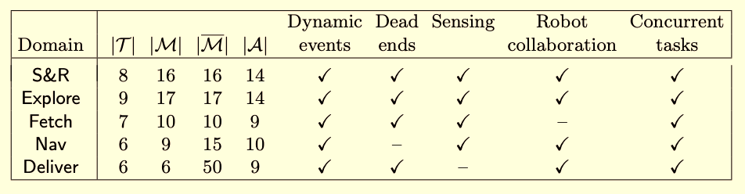
Experimental Evaluation
Five different domains, different combinations of characteristics
Evaluation criteria: efficiency (reciprocal of cost), successes vs failures
Result: Planning and learning help
  RAE operates better with UPOM or learning than without
  RAE’s performance improves with more planning

Slide 52
Prototype Application
Software-defined networks
  Decoupled control and data layers
  Prone to high-volume, fast-paced online attacks
  Need automated attack recovery
Prototype solution using RAE+UPOM
  Expert writes recovery procedures as refinement methods
Experimental results
  Improved efficiency, retry ratio, success ratio,
  resilience compared to human expert
Billions of Data Points
Millions of Alerts
High-volume, fast-paced
Cyber Events
. . .
Cyber Warriors
S. Patra, A. Velasquez, M. Kang, and D. Nau. Using online planning and acting to recover from cyberattacks on software-defined networks. In Proc. Innovative Applications of AI Conference (IAAI), Feb. 2021. https://www.cs.umd.edu/~nau/papers/patra2021using.pdf
Complex
Systems to Defend

Slide 53
Summary
3.1 Operational models
  ξ versus s, tasks, events,
  Commands to the execution platform
  Extensions to state-variable representation
  Refinement method
    name, task/event, preconditions, body
  Example: fetch a container
3.2 Refinement Acting Engine (RAE)
  Purely reactive: select a method and apply it
  Rae: input stream, Candidates, Instances, Agenda, refinement stacks
  Progress:
    command status, nextstep, type of step
  Retry: Candidates \ tried
    comparison to backtracking
  Refinement trees
3.3 Refinement planning
  plan by simulating Rae on a single external task/event/goal
  SeRPE uses classical action models
  UPOM simulates the actor’s commands, does Monte Carlo rollouts
3.4 Acting and planning
  Rae + UPOM
  Comparison: Run-Lazy-Lookahead + UPOM′
  A little about learning, experimental evaluation, prototype application
Open-source Python implementation of Rae and UPOM:
  https://bitbucket.org/sunandita/RAE/

