Slide 1
Chapter 6
Deliberation with Probabilistic
Domain Models
Dana S. Nau
University of Maryland

Slide 2
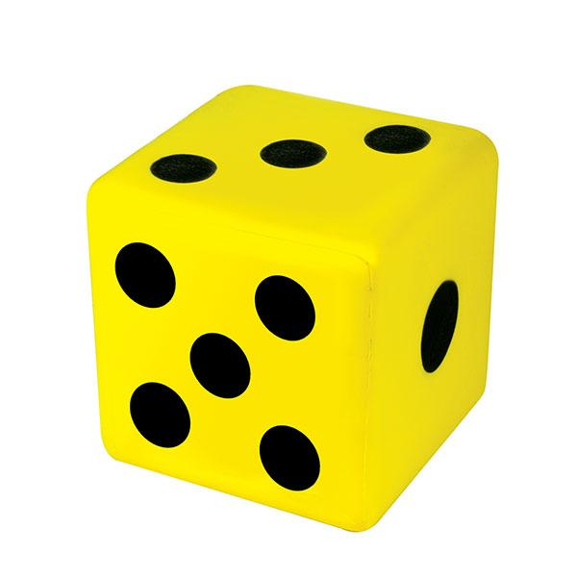
Motivation
Situations where actions have multiple possible outcomes and each outcome has a probability
Several possible action representations
  Bayes nets, probabilistic actions, …
Book doesn’t commit to any representation
  Mainly concentrates on the underlying semantics
roll-die(d)
  pre: holding(d) = true
  eff:
  1/6: top(d) ← 1
  1/6: top(d) ← 2
  1/6: top(d) ← 3
  1/6: top(d) ← 4
  1/6: top(d) ← 5
  1/6: top(d) ← 6

Slide 3
Probabilistic planning domain
Definitions
Σ = (S, A, γ, Pr, cost)
S = {states}
A = {actions}
γ : S × A → 2^{S}
Pr(s′ | s, a) = probability of going to state s′ if
we’re in s and apply a
  Pr(s′ | s, a) ≠ 0 iff s′ ∈ γ(s,a)
cost: S ×A → R_{≥0}
  cost(s,a) = cost of action a in state s
  may omit, default is cost(s,a) = 1
Applicable(s) = {a | γ(s,a) ≠ ∅}
←
Example
Start at d1, want to get to d4
Some roads are one-way,
some are two-way
Unreliable steering
when the road forks
  may take the
  wrong fork
Simplified state and action names:
  write {loc(r1)=d2} as d2
  write move(r1,d2,d3) as m23
γ(d1,m12) = {d2}
  Pr(d2 | d1,m12) = 1
m21, m34, m41, m43, m45, m52, m54:
  like m12
→ 0.2
d5
d2
→
→ 0.8
↔
↔
d3
↔
Start:
s₀= d1
r1
→ 0.5
d4
Goal:
S_{g}= {d4}
→
→
→ 0.5
←
d1
γ(d1,m14) = {d1,d4}
  Pr(d4 | d1,m14) = 0.5
  Pr(d1 | d1,m14) = 0.5
γ(d2,m23) = {d3,d5}
  Pr(d3 | d2,m23) = 0.8
  Pr(d5 | d2,m23) = 0.2
No m11, no m25

Slide 4
Probabilistic planning domain
m52
Definitions
Σ = (S, A, γ, Pr, cost)
S = {states}
A = {actions}
γ : S × A → 2^{S}
Pr(s′ | s, a) = probability of going to state s′ if
we’re in s and apply a
  Pr(s′ | s, a) ≠ 0 iff s′ ∈ γ(s,a)
cost: S ×A → R_{≥0}
  cost(s,a) = cost of action a in state s
  may omit, default is cost(s,a) = 1
Applicable(s) = {a | γ(s,a) ≠ ∅}
d5
Example
γ(d1,m12) = {d2}
  Pr(d2 | d1,m12) = 1
m21, m34, m41, m43,
m45, m52, m54:
  like m12
γ(d1,m14) = {d1,d4}
  Pr(d4 | d1,m14) = 0.5
  Pr(d1 | d1,m14) = 0.5
γ(d2,m23) = {d3,d5}
  Pr(d3 | d2,m23) = 0.8
  Pr(d5 | d2,m23) = 0.2
there’s no m25
0.2
d2
m23
0.8
d3
m12
m21
m54
m43
m34
m41
m45
Start:
s₀= d1
d1
d4
Goal:
S_{g}= {d4}
m14
0.5
0.5
Poll: Can a plan (sequence of actions) be a solution for this problem?
  yes
  no

Slide 5
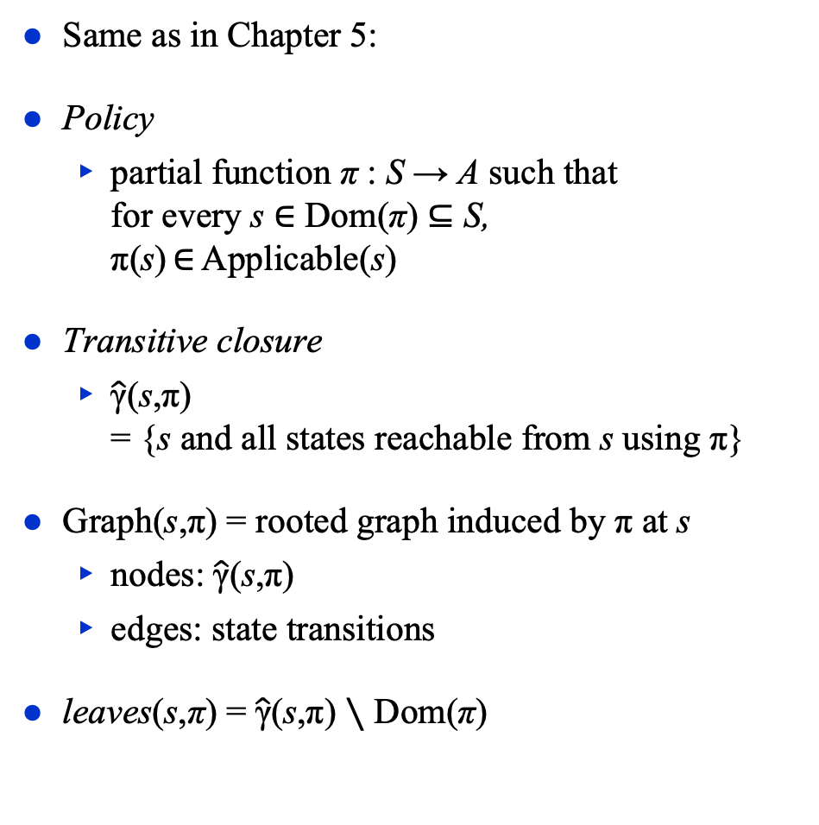
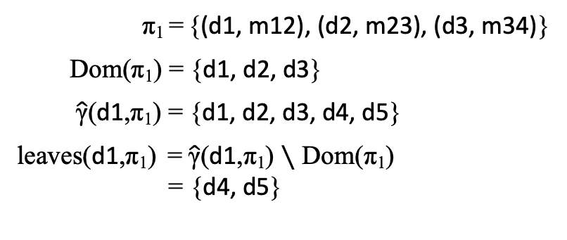
Policies, Problems
m52
Same as in Chapter 5:
Policy
  partial function π : S → A such that
  for every s ∈ Dom(π) ⊆ S,
  π(s) ∈ Applicable(s)
Transitive closure
  $\hat{\text{γ}}$(s,π)
  = {s and all states reachable from s using π}
Graph(s,π) = rooted graph induced by π at s
  nodes: $\hat{\text{γ}}$(s,π)
  edges: state transitions
leaves(s,π) = $\hat{\text{γ}}$(s,π) ∖ Dom(π)
d5
0.2
d2
m23
0.8
d3
m12
m21
m54
m43
m34
m41
m45
Start:
s₀= d1
d1
d4
m14
0.5
0.5
Goal: S_{g}= {d4}
π₁ = {(d1, m12), (d2, m23), (d3, m34)}
Dom(π₁) = {d1, d2, d3}
$\hat{\text{γ}}$(d1,π₁) = {d1, d2, d3, d4, d5}
leaves(d1,π₁) = $\hat{\text{γ}}$(d1,π₁) ∖ Dom(π₁)
= {d4, d5}

Slide 6
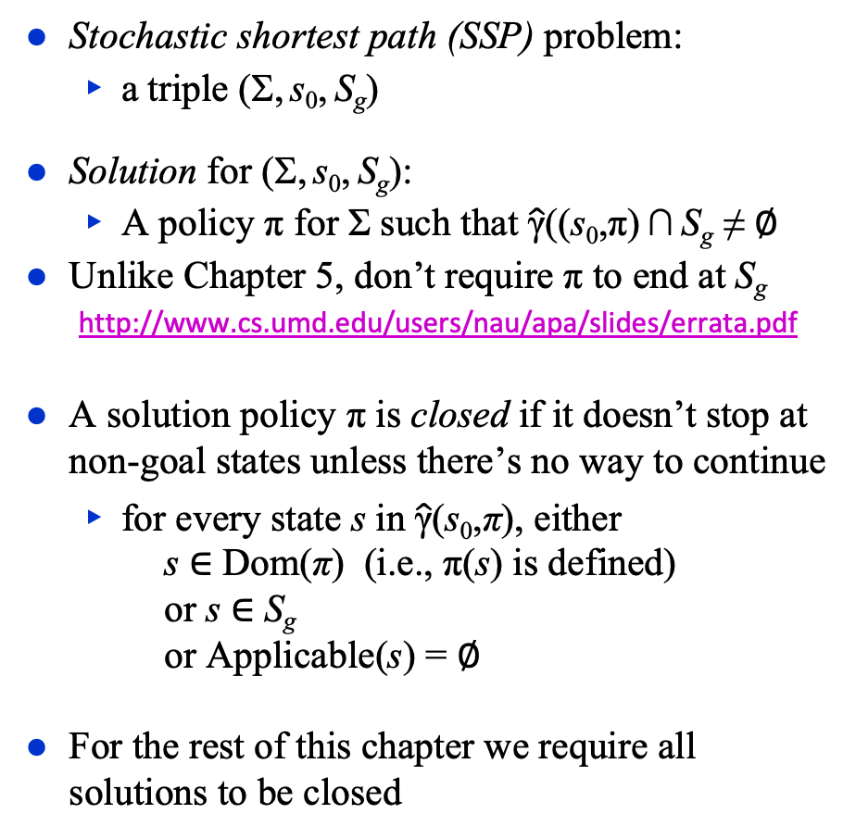
Solutions
m52
d6
d5
d7
Stochastic shortest path (SSP) problem:
  a triple (Σ, s₀, S_{g})
Solution for (Σ, s₀, S_{g}):
  A policy π for Σ such that $\hat{\text{γ}}$((s₀,π) ∩ S_{g} ≠ ∅
Unlike Chapter 5, don’t require π to end at S_{g}
  http://www.cs.umd.edu/users/nau/apa/slides/errata.pdf
A solution policy π is closed if it doesn’t stop at
non-goal states unless there’s no way to continue
  for every state s in $\hat{\text{γ}}$(s₀,π), either
  s ∈ Dom(π) (i.e., π(s) is defined)
  or s ∈ S_{g}
  or Applicable(s) = ∅
For the rest of this chapter we require all solutions to be closed
0.2
d2
m23
0.8
d3
m12
m21
m54
m43
m34
m41
m45
Start:
s₀= d1
d1
d4
m14
0.5
0.5
Goal: S_{g}= {d4}
π₁ = {(d1,m12), (d2,m23), (d3,m34)}
π₂ = {(d1,m12), (d2,m23), (d3,m34), (d5,m54)}
π₃ = {(d1,m12), (d2,m23), (d3,m34), (d5,m56)}
π₄ = {(d1,m12), (d2,m23), (d3,m34), (d5,m57), (d7,m75)}

Slide 7
Histories
m52
d6
d5
d7
History: sequence of states σ = ⟨s₀, s₁, s₂, …⟩
  May be finite or infinite
⟨d1, d2, d3, d4⟩
⟨d1, d2, d1, d2, …⟩
Let H(s,π) = set of all possible histories if
we start at s and follow π
  Stop if we reach a state s′ such that
  s′ ∉ Dom(π) or s′ ∈ S_{g}
If σ ∈ H(s, π) then
  Pr (σ | s, π) = ∏ Pr (s_{i+1} | s_{i}, π(s_{i}))
  s_{i} ,s_{i+1}∈σ
  Product of the probabilities of the state transitions
∑_{σ∈H(s,π)} Pr (σ | s, π) = 1
0.2
d2
m23
0.8
d3
m12
m21
m54
m43
m34
m41
m45
Start:
s₀= d1
d1
d4
m14
0.5
0.5
Goal: S_{g}= {d4}
π₃ = {(d1,m12), (d2,m23), (d3,m34), (d5,m56)}
H(s₀, π₃) = {σ₁, σ₂}, where:
  σ₁ = ⟨d1,d2,d3,d4⟩
  σ₂ = ⟨d1,d2,d5,d6⟩
Pr(σ₁ | s₀, π₃) = 1×0.8×1 = 0.8
Pr(σ₂ | s₀, π₃) = 1×0.2×1 = 0.2

Slide 8
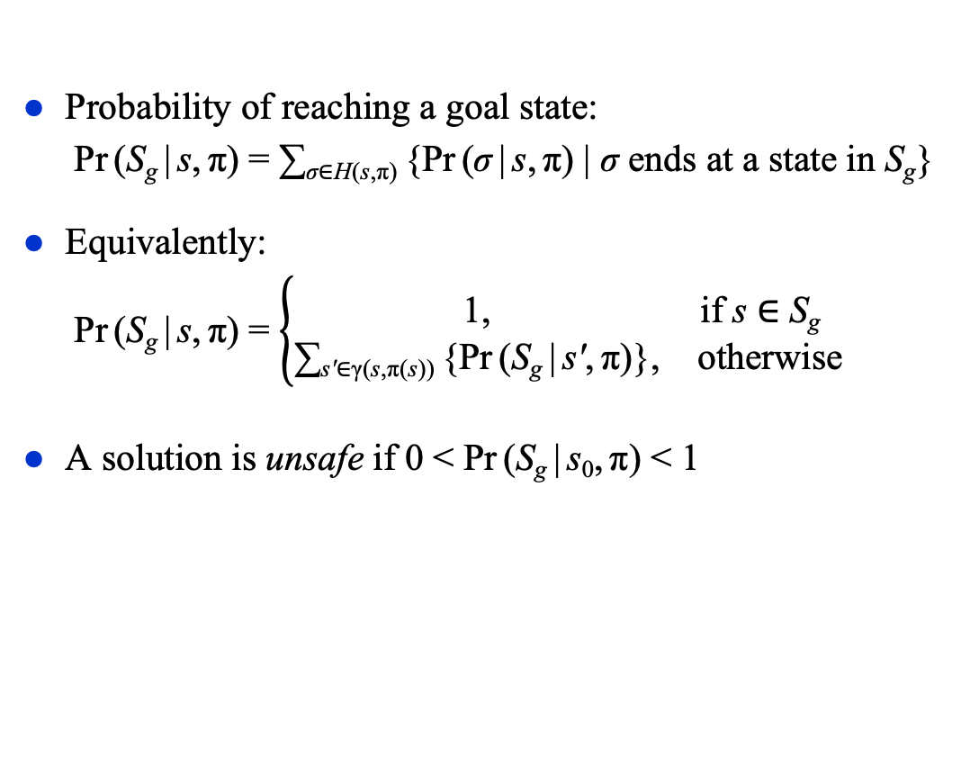
Unsafe Solutions
m52
d6
d5
d7
Probability of reaching a goal state:
  Pr (S_{g} | s, π) = ∑_{σ∈H(s,π)} {Pr (σ | s, π) | σ ends at a state in S_{g}}
Equivalently:
  Pr (S_{g} | s, π) = $\left\{\begin{matrix}\text{1}\text{,} & \text{if} \text{s}\text{ ∈ }\text{S}\text{g} \\ \text{∑}\text{s}\text{′}\text{∈}\text{γ}\text{(}\text{s}\text{,}\text{π}\text{(}\text{s}\text{))} \text{\{}\text{Pr} \text{(}\text{S}\text{g} \text{|} \text{s}\text{′}\text{,} \text{π}\text{)\},} & \text{otherwise}\end{matrix}\right.$
A solution is unsafe if 0 < Pr (S_{g} | s₀, π) < 1
0.2
d2
m23
0.8
d3
m12
m21
m54
m43
m34
m41
m45
Start:
s₀= d1
d1
d4
m14
0.5
0.5
Goal: S_{g}= {d4}
π₃ = {(d1,m12), (d2,m23), (d3,m34), (d5,m56)}
Two possible histories:
  σ₁ = ⟨d1,d2,d3,d4⟩ ends at a goal state; Pr(σ₁ | s₀, π₃) = 1×0.8×1 = 0.8
  σ₂ = ⟨d1,d2,d5,d6⟩ doesn’t; Pr(σ₂ | s₀, π₃) = 1×0.2×1 = 0.2
Pr(S_{g} | s₀, π₃) = Pr(σ₁ | s₀, π₃) = 0.8

Slide 9
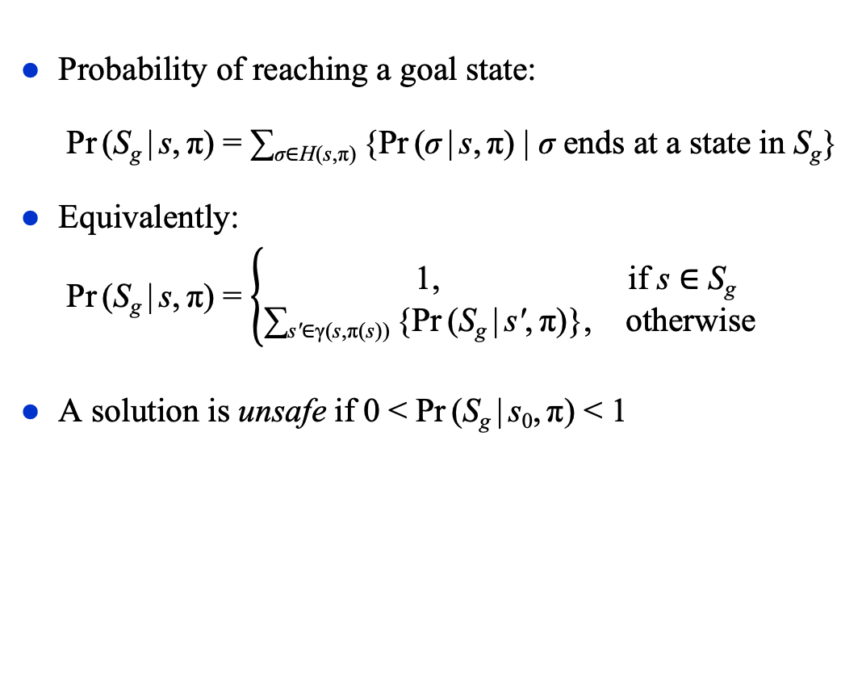
Unsafe Solutions
m52
d6
d5
d7
Probability of reaching a goal state:
  Pr (S_{g} | s, π) = ∑_{σ∈H(s,π)} {Pr (σ | s, π) | σ ends at a state in S_{g}}
Equivalently:
  Pr (S_{g} | s, π) = $\left\{\begin{matrix}\text{1}\text{,} & \text{if} \text{s}\text{ ∈ }\text{S}\text{g} \\ \text{∑}\text{s}\text{′}\text{∈}\text{γ}\text{(}\text{s}\text{,}\text{π}\text{(}\text{s}\text{))} \text{\{}\text{Pr} \text{(}\text{S}\text{g} \text{|} \text{s}\text{′}\text{,} \text{π}\text{)\},} & \text{otherwise}\end{matrix}\right.$
A solution is unsafe if 0 < Pr (S_{g} | s₀, π) < 1
0.2
d2
m23
0.8
d3
m12
m21
m54
m43
m34
m41
m45
Start:
s₀= d1
d1
d4
m14
0.5
0.5
Goal: S_{g}= {d4}
π₄ = {(d1,m12), (d2,m23), (d3,m34), (d5,m57), (d7,m75)}
Two possible histories
  σ₁ = ⟨d1,d2,d3,d4⟩ ends at a goal state; Pr (σ₁ | s₀, π₄) = 1×.8×1 = 0.8
  σ₃ = ⟨d1,d2,d5,d7,d5,d7,…⟩ doesn’t; Pr (σ₃ | s₀, π₄) = 1×.2×1×1×1×… = 0.2
  Pr(S_{g} | s₀, π₄) = Pr(σ₁ | s₀, π₄) = 0.8

Slide 10
Safe Solutions
m52
d5
A solution is safe if Pr (S_{g} | s₀, π) = 1
An acyclic safe solution:
  π₂ = {(d1, m12), (d2, m23), (d3, m34),
  (d5, m54)}
H(s₀, π₂) contains two histories:
  σ₁ = ⟨d1, d2, d3, d4⟩ Pr (σ₁ | s₀, π₂) = 1×.8×1 = .8
  σ₄ = ⟨d1, d2, d5, d4⟩ Pr (σ₄ | s₀, π₂) = 1×.2×1 = .2
Pr (S_{g} | s₀, π₂) = .8 + .2 = 1
0.2
d2
m23
0.8
d3
m12
m21
m54
m43
m34
m41
m45
Start:
s₀= d1
d1
d4
m14
0.5
0.5
Goal: S_{g}= {d4}

Slide 11
Safe Solutions
m52
d5
A solution is safe if Pr (S_{g} | s₀, π) = 1
A cyclic safe solution:
  π₅ = {(d1, m14}
H(s₀, π₅) contains infinitely many histories:
  σ₅ = ⟨d1, d4 ⟩ Pr (σ₅ | s₀, π₅) = ½
  σ₆ = ⟨d1, d1, d4⟩ Pr (σ₆ | s₀, π₅) = (½)² = ¼
  σ₇ = ⟨d1, d1, d1, d4⟩ Pr (σ₇ | s₀, π₅) = (½)³ = ¹/₈
    • • •
  σ∞ = ⟨d1, d1, d1, d1, d1, …⟩
Pr (S_{g} | s₀, π₅) = ½ + ¼ + ¹/₈ + … = 1
0.2
d2
m23
0.8
d3
m12
m21
m54
m43
m34
m41
m45
Start:
s₀= d1
d1
d4
Goal:
S_{g}= {d4}
m14
0.5
0.5
Poll: what is Pr (σ∞ | s₀, π₅)?
1
0
a number between 0 and 1
undefined

Slide 12
Safe Solutions
m52
d5
A solution is safe if Pr (S_{g} | s₀, π) = 1
Another cyclic safe solution:
  π₆ = {(d1, m54), (d4, m41)}
We stop when we reach a goal, so
(d4, m41) doesn’t matter
  Same histories and probabilities as for π₅
0.2
d2
m23
0.8
d3
m12
m21
m54
m43
m34
m41
m45
Start:
s₀= d1
d1
d4
Goal:
S_{g}= {d4}
m14
0.5
0.5

Slide 13
Unsafe States
m56
d6
s is safe if ∃π such that Pr (S_{g} | s, π) = 1
  e.g., d3 is safe
  same as saying (Σ, d3, S_{g}) has a safe solution
s is unsafe if ∀ closed policy π defined at s,
0 < Pr (S_{g} | s, π) < 1
  e.g., d5 is unsafe
  same as saying (Σ, d5, S_{g}) has an unsafe solution but no safe solution
s is a dead end if ∀π Pr(S_{g} | s, π) = 0
d5
d7
0.2
d2
m23
0.8
d3
0.5
0.5
d7
m12
m21
m43
m34
m41
m54
Start:
s₀= d1
d1
d4
Goal:
S_{g}= {d4}
m14
0.5
0.5
d6 is an explicit dead end
  No applicable actions
d7 and d8 are implicit dead ends
  Applicable actions, but no way to reach S_{g}

Slide 14
Safe SSPs
m52
d5
An SSP is safe if every state in the SSP is safe
  Same as a safely explorable SSP in Chapter 5
In what follows, only consider safe SSPs
0.2
d2
m23
0.8
d3
m12
m21
m54
m43
m34
m41
m45
Start:
s₀= d1
d1
d4
Goal:
S_{g}= {d4}
m14
0.5
0.5
Poll: Is the above SSP safe?
yes
no

Slide 15
Expected Cost
cost(s,a) = cost of using a in s
Example:
  each “horizontal” action costs 1
  each “vertical” action costs 100
Let σ = ⟨s₀, s₁, s₂, …⟩ ∈ H(s₀,π)
  i.e., starting at s₀, π can produce history σ
Then cost(σ | s₀, π) = ∑ _{i} cost(s_{i},π(s_{i}))
Let π be a safe solution
At each state s ∈ Dom(π), expected cost of following π to goal:
  Weighted sum of history costs:
    V^{π}(s) = ∑_{σ ∈ H(s,π)} Pr(σ | s, π) cost(σ | s, π)
  Recursive equation
    V^{π}(s) = 0, if s ∈ S_{g}
    cost(s,π(s)) + ∑_{s′∈γ(s,π(s))} Pr(s′ | s, π(s)) V^{π}(s′), otherwise
d5
c = 1
0.2
d2
0.8
d3
c = 100
c = 100
Start:
s₀= d1
d1
c = 1
d4
Goal:
S_{g}= {d4}
0.5
0.5
Poll: Are the two equations equivalent?
A. yes
B. no
My version
From the book

Slide 16
Example
d5
c = 1
0.2
π₃ = {(d1, m12), (d2, m23), (d3, m34), (d5, m54)}
Weighted sum of history costs:
  σ₁ = ⟨d1, d2, d3, d4⟩
    Pr (σ₁ | s₀, π₃) = 0.8
    cost(σ₁ | s₀, π₃) = 100 + 1 + 100 = 201
  σ₂ = ⟨d1, d2, d5, d4⟩
    Pr (σ₂ | s₀, π₃) = 0.2
    cost(σ₂ | s₀, π₃) = 100 + 1 + 100 = 201
V ^{π3}(d1) = .8(201) + .2(201) = 201
d2
0.8
d3
c = 100
c = 100
Start:
s₀= d1
d1
c = 1
d4
Goal:
S_{g}= {d4}
0.5
0.5
Recursive equation ⇒ 4 equations, 4 unknowns
  V ^{π3}(d1) = 100 + V ^{π3}(d2)
  V ^{π3}(d2) = 1 + .8(V ^{π3}(d3)) + .2(V ^{π3}(d5))
  V ^{π3}(d3) = 100 + V ^{π3}(d4)
  V ^{π3}(d5) = 100 + V ^{π3}(d4)
  V ^{π3}(d4) = 0
So V ^{π3}(d1) = 100 + 1 + .8(100) + .2(100) = 201

Slide 17
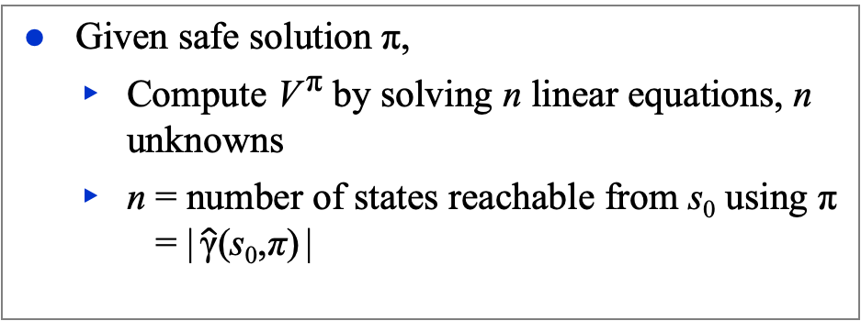
Example
d5
π₇ = {(d1, m14), (d2, m23), (d3, m34), (d5, m54)}
Weighted sum of history costs:
  σ₅ = ⟨d1, d4 ⟩
    Pr (σ₅ | π₇) = ½, cost (σ₅ | π₇) = 1
  σ₆ = ⟨d1, d1, d4⟩
    Pr (σ₆ | π₇) = (½)², cost (σ₆ | π₇) = 2
  σ₇ = ⟨d1, d1, d1, d4⟩
    Pr (σ₇ | π₇) = (½)³, cost (σ₇ | π₇) = 3
    • • •
V ^{π7}(d1) = (½)1 + (½)² 2 + (½)³ 3 + … = 2
Recursive equation:
  V ^{π7}(d1) = 1 + ½(0) + ½(V ^{π7}(d1))
  ½V ^{π7}(d1) = 1
  V ^{π7}(d1) = 2
c = 1
0.2
d2
0.8
d3
c = 100
c = 100
Start:
s₀= d1
d1
c = 1
d4
Goal:
S_{g}= {d4}
0.5
0.5
Given safe solution π,
  Compute V ^{π} by solving n linear equations, n unknowns
  n = number of states reachable from s₀ using π
  = | $\hat{\text{γ}}$(s₀,π) |

Slide 18
Planning as Optimization
d5
c = 1
0.2
Let π and π′ be safe solutions
  π dominates π′ if V^{π}(s) ≤ V^{π′}(s)
  at every state s where they’re both defined
    i.e., every state s ∈ Dom(π) ∩ Dom(π′)
On the previous two slides
  π₃ = {(d1,m12), (d2,m23), (d3,m34), (d5,m54)}
  π₇ = {(d1, m14), (d2, m23), (d3, m34), (d5, m54)}
  d1 is the only state where they differ
    V ^{π3}(d1) = 201; V ^{π7}(d1) = 2
  π₇ dominates π₃
On slide 11, π₅ = {(d1,m14)}
  d1 is the only state where they’re both defined
    V ^{π3}(d1) = 201; V ^{π5}(d1) = 2
  π₅ dominates π₃
d2
0.8
d3
c = 100
c = 100
Start:
s₀= d1
d1
c = 1
d4
Goal:
S_{g}= {d4}
0.5
0.5
π is optimal if π dominates every safe solution
If π and π′ are both optimal, then V^{π}(s) = V^{π′}(s) at every state where they’re both defined
  e.g., π₅ and π₇

Slide 19
Planning as Optimization
d5
Let V*(s) = expected cost of an optimal safe solution
Example:
  At state d1, applicable actions m12 and m14
  Suppose we know V*(d2), V*(d4), V*(d6)
Then
  cost(d1,m12) = 10 + V*(d2)
  cost(d1,m14) = 20 + 0.5 V*(d6) + 0.5 V*(d4)
  V*(d1) = min(cost(d1,m12), cost(d1,m14))
In general,
  V*(s) = 0, if s is a goal
  min_{a∈Applicable(s)}{cost(s,a) + ∑_{s′∈γ(s,a)} Pr(s′ | s,a) V*(s′), otherwise
Optimality principle (Bellman’s theorem)
c = 15
0.2
d2
0.8
d3
c = 10
d6
c = 100
0.5
c = 1
Start:
s₀= d1
c = 20
d1
0.5
d4
Goal:
S_{g}= {d4}

Slide 20
Cost to Go
d5
Let (Σ, s₀, S_{g}) be a safe SSP
  i.e., S_{g} is reachable from every state
  same as safely explorable in Chapter 5
Let π be a safe solution that’s defined at all non-goal states
  i.e., Dom(π) = S ∖ S_{g}
Compute V^{π} as |S| equations, |S| unknowns
Let s∈S, a∈Applicable(s)
  Cost-to-go:
    expected cost at s if we first use a,
    then use π afterward
  Q^{π}(s,a) = cost(s,a) + ∑_{s′∈γ(s,a′)} Pr (s′ | s,a′) V^{π}(s′)
c = 1
0.2
d2
0.8
d3
c = 100
c = 100
Start:
s₀= d1
d1
c = 1
d4
Goal:
S_{g}= {d4}
0.5
0.5
For every s ∈ S ∖ S_{g}
  let π′(s) ∈ argmin_{a′∈Applicable(s)} Q^{π}(s,a′)
Poll: Does π′ dominate π?
A. always
B. sometimes
C. never

Slide 21
Example
d5
d5
c = 1
0.2
c = 1
0.2
d2
d2
0.8
d3
0.8
d3
Q^{π}(d1,m12) = 100 + 101 = 201
Q^{π}(d1,m14) = 1 + ½(201) + ½(0) = 101.5
  ⇒ argmin_{a} Q^{π}(d1,a) = m14
Q^{π}(d2,m23) = 1 + (0.8(100) + 0.2(100))
= 101
Q^{π}(d2,m21) = 100 + 201 = 301
  ⇒ argmin_{a} Q^{π}(d2,a) = m23
Q^{π}(d3,m34) = 100 + 0 = 100
Q^{π}(d3,m32) = 1 + 101 = 102
  ⇒ argmin_{a} Q^{π}(d3,a) = m34
Q^{π}(d5,m54) = 100 + 0 = 100
Q^{π}(d5,m52) = 1+101 = 102
  ⇒ argmin_{a} Q^{π}(d5,a) = m54
new action m32
c = 100
c = 100
c = 100
c = 100
d1
c = 1
d4
d1
c = 1
d4
Start:
s₀= d1
0.5
0.5
Goal:
S_{g}= {d4}
Start:
s₀= d1
0.5
0.5
Goal:
S_{g}= {d4}
π = {(d1, m12), (d2, m23),
(d3, m34), (d5, m54)}
π′ = {(d1,m14), (d2,m23),
(d3,m34), (d5,m54)}
V^{π′}(d4) = 0
V^{π′}(d3) = 100 + V^{π′}(d4) = 100
V^{π′}(d5) = 100 + V^{π′}(d4) = 100
V^{π′}(d2) = 1 + (0.8 V^{π′}(d3) + 0.2 V^{π′}(d5))
= 101
V^{π′}(d1) = 1 + ½V^{π′}(d1) + ½V^{π′}(d4)
⇒ V^{π′}(d1) = 2
V^{π}(d4) = 0
V^{π}(d3) = 100 + V^{π}(d4) = 100
V^{π}(d5) = 100 + V^{π}(d4) = 100
V^{π}(d2) = 1 + (0.8 V^{π}(d3) + 0.2 V^{π}(d5))
= 101
V^{π}(d1) = 100 + V^{π}(d2) = 201

Slide 22
Policy Iteration
PI(Σ,s₀,S_{g},π₀)
π ← π₀
loop
compute {V^{π}(s) | s ∈ S}
for every s ∈ S ∖ S_{g} do
π′(s) ← argmin_{a∈Applicable(s)} Q^{π}(s,a)
if π′ = π then
return π
π ← π′
|S| equations, |S| unknowns
E(cost of using a then π)
Converges in a finite number of iterations
Example:
  iteration 1 iteration 2
  ⇒ ⇒
d5
d5
d5
c = 1
0.2
c = 1
0.2
c = 1
0.2
d2
d2
d2
0.8
d3
0.8
d3
0.8
d3
c = 100
c = 100
c = 100
c = 100
c = 100
c = 100
Start:
s₀= d1
Start:
s₀= d1
Start:
s₀= d1
d1
c = 1
d4
d1
c = 1
d1
c = 1
Goal:
S_{g}= {d4}
d4
Goal:
S_{g}= {d4}
d4
Goal:
S_{g}= {d4}
0.5
0.5
0.5
0.5
0.5
0.5

Slide 23
Value Iteration
V₀: a heuristic function
    e.g., adapt an h heuristic from Chapter 2
  V₀(s) ≈ optimal expected cost of getting from s to S_{g}
  Require V₀(s) = 0 for every s ∈ S_{g}
η > 0: for testing approximate convergence
V (global variable): an array
  V(s) ≈ optimal expected cost of getting from s to S_{g}
  Initially V(s) = V₀(s) ∀s
  Improve the estimates as we go along
π (global variable): policy computed from V
Difference from the book:
  In the book, VI computes r as a separate step,
  not in Bellman-Update
VI(Σ, s₀, S_{g},V₀, η)
  global V ← V₀
  global π ← ∅
  loop
    r ← max{Bellman-Update(s) | s ∈ S ∖ S_{g}}
    if r ≤ η then return π
Bellman-Update(s)
  global V, π
  v_{old} ← V(s)
  for every a ∈ Applicable(s) do
    Q(s,a) ← cost(s,a) + ∑_{s′∈S} Pr (s′|s,a) V(s′)
  V(s) ← min_{a∈Applicable(s)} Q(s,a)
  π(s) ← argmin_{a∈Applicable(s)} Q(s,a)
  return |V(s) – v_{old}|

Slide 24
Iteration 1
VI(Σ, s₀, S_{g},V₀, η)
  global V ← V₀
  global π ← ∅
  loop
    r ← max{Bellman-Update(s) | s ∈ S ∖ S_{g}}
    if r ≤ η then return π
Bellman-Update(s)
  global V, π
  v_{old} ← V(s)
  for every a ∈ Applicable(s) do
    Q(s,a) ← cost(s,a) + ∑_{s′∈S} Pr (s′|s,a) V(s′)
  V(s) ← min_{a∈Applicable(s)} Q(s,a)
  π(s) ← argmin_{a∈Applicable(s)} Q(s,a)
  return |V(s) – v_{old}|
initial values
V(d1) = 0
V(d2) = 0
V(d3) = 0
V(d5) = 0
  Q(d1,m12) = 100 + 0 = 100
  Q(d1,m14) = 1 + ½(0) + ½(0) = 1
  V(d1) = 1; π(d1) = m14; 1 – 0 = 1
  Q(d2,m21) = 100 + 1 = 101
  Q(d2,m23) = 1 + .8(0) + .2(0) = 1
  V(d2) = 1; π(d2) = m23; 1 – 0 = 1
  Q(d3,m32) = 1 + 1 = 2
  Q(d3,m34) = 100 + 0 = 100
  V(d3) = 2; π(d3) = m32; 2 – 0 = 2
  Q(d5,m52) = 1 + 1 = 2
  Q(d5,m54) = 100 + 0 = 100
  V(d5) = 2; π(d5) = m52; 2 – 0 = 2
  r = max(1, 1, 2, 2) = 2
η = 0.2
0.2
d5
c = 1
d2
d3
0.8
c = 100
c = 100
d1
c = 1
d4
0.5
0.5
Start:
s₀= d1
Goal:
S_{g}= {d4}

Slide 25
Iteration 2
VI(Σ, s₀, S_{g},V₀, η)
  global V ← V₀
  global π ← ∅
  loop
    r ← max{Bellman-Update(s) | s ∈ S ∖ S_{g}}
    if r ≤ η then return π
Bellman-Update(s)
  global V, π
  v_{old} ← V(s)
  for every a ∈ Applicable(s) do
    Q(s,a) ← cost(s,a) + ∑_{s′∈S} Pr (s′|s,a) V(s′)
  V(s) ← min_{a∈Applicable(s)} Q(s,a)
  π(s) ← argmin_{a∈Applicable(s)} Q(s,a)
  return |V(s) – v_{old}|
from iteration 1
V(d1) = 1
V(d2) = 1
V(d3) = 2
V(d5) = 2
π(d1) = m14
π(d2) = m23
π(d2) = m32
π(d5) = m52
  Q(d1,m12) = 100 + 1 = 101
  Q(d1,m14) = 1 + ½(1) + ½(0) = 1½
  V(d1) = 1½; π(d1) = m14; 1½ – 1 = ½
  Q(d2,m21) = 100 + 1½ = 101½
  Q(d2,m23) = 1 + .8(2) + .2(2) = 3
  V(d2) = 3; π(d2) = m23; 3 – 1 = 2
  Q(d3,m32) = 1 + 3 = 4
  Q(d3,m34) = 100 + 0 = 100
  V(d3) = 4; π(d3) = m32; 4 – 2 = 2
  Q(d5,m52) = 1 + 3 = 4
  Q(d5,m54) = 100 + 0 = 100
  V(d5) = 4; π(d5) = m52; 4 – 2 = 2
  r = max(½, 2, 2, 2) = 2
η = 0.2
0.2
d5
c = 1
d2
d3
0.8
c = 100
c = 100
d1
c = 1
d4
0.5
0.5
Start:
s₀= d1
Goal:
S_{g}= {d4}

Slide 26
Iteration 3
VI(Σ, s₀, S_{g},V₀, η)
  global V ← V₀
  global π ← ∅
  loop
    r ← max{Bellman-Update(s) | s ∈ S ∖ S_{g}}
    if r ≤ η then return π
Bellman-Update(s)
  global V, π
  v_{old} ← V(s)
  for every a ∈ Applicable(s) do
    Q(s,a) ← cost(s,a) + ∑_{s′∈S} Pr (s′|s,a) V(s′)
  V(s) ← min_{a∈Applicable(s)} Q(s,a)
  π(s) ← argmin_{a∈Applicable(s)} Q(s,a)
  return |V(s) – v_{old}|
from iteration 2
V(d1) = 1½
V(d2) = 3
V(d3) = 4
V(d5) = 4
π(d1) = m14
π(d2) = m23
π(d2) = m32
π(d5) = m52
  Q(d1,m12) = 100 + 3 = 103
  Q(d1,m14) = 1 + ½(1½) + ½(0) = 1³/₄
  V(d1) = 1³/₄; π(d1) = m14; 1³/₄ – 1½ = ¼
  Q(d2,m21) = 100 + 1³/₄ = 101³/₄
  Q(d2,m23) = 1 + .8(4) + .2(4) = 5
  V(d2) = 5; π(d2) = m23; 5 – 3 = 2
  Q(d3,m32) = 1 + 5 = 6
  Q(d3,m34) = 100 + 0 = 100
  V(d3) = 6; π(d3) = m32; 6 – 4 = 2
  Q(d5,m52) = 1 + 5 = 6
  Q(d5,m54) = 100 + 0 = 100
  V(d5) = 6; π(d5) = m52; 6 – 4 = 2
  r = max(¼ ,2, 2, 2) = 2
η = 0.2
0.2
d5
c = 1
d2
d3
0.8
c = 100
c = 100
d1
c = 1
d4
0.5
0.5
Start:
s₀= d1
Goal:
S_{g}= {d4}

Slide 27
Iteration 4
VI(Σ, s₀, S_{g},V₀, η)
  global V ← V₀
  global π ← ∅
  loop
    r ← max{Bellman-Update(s) | s ∈ S ∖ S_{g}}
    if r ≤ η then return π
Bellman-Update(s)
  global V, π
  v_{old} ← V(s)
  for every a ∈ Applicable(s) do
    Q(s,a) ← cost(s,a) + ∑_{s′∈S} Pr (s′|s,a) V(s′)
  V(s) ← min_{a∈Applicable(s)} Q(s,a)
  π(s) ← argmin_{a∈Applicable(s)} Q(s,a)
  return |V(s) – v_{old}|
from iteration 3
V(d1) = 1³/₄
V(d2) = 5
V(d3) = 6
V(d5) = 6
π(d1) = m14
π(d2) = m23
π(d2) = m32
π(d5) = m52
  Q(d1,m12) = 100 + 5 = 105
  Q(d1,m14) = 1 + ½(1³/₄) + ½(0) = 1⁷/₈
  V(d1) = 1⁷/₈; π(d1) = m14; 1⁷/₈ – 1³/₄ = ¹/₈
  Q(d2,m21) = 100 + 1⁷/₈ = 101⁷/₈
  Q(d2,m23) = 1 + .8(6) + .2(6) = 7
  V(d2) = 7; π(d2) = m23; 7 – 5 = 2
  Q(d3,m32) = 1 + 7 = 8
  Q(d3,m34) = 100 + 0 = 100
  V(d3) = 8; π(d3) = m32; 8 – 6 = 2
  Q(d5,m52) = 1 + 7 = 8
  Q(d5,m54) = 100 + 0 = 100
  V(d5) = 8; π(d5) = m52; 8 – 6 = 2
  r = max(¹/₈ , 2, 2, 2) = 2
η = 0.2
0.2
d5
c = 1
d2
d3
0.8
c = 100
c = 100
  Poll: How many iterations until termination?
  A. i ≤ 10 D. 40 < i ≤ 80
  B. 10 < i ≤ 20 E. 80 < i ≤ 160
  C. 20 < i ≤ 40 F. 160 < i
d1
c = 1
d4
0.5
0.5
Start:
s₀= d1
Goal:
S_{g}= {d4}

Slide 28
Iteration 1, with a better V₀
VI(Σ, s₀, S_{g},V₀, η)
  global V ← V₀
  global π ← ∅
  loop
    r ← max{Bellman-Update(s) | s ∈ S ∖ S_{g}}
    if r ≤ η then return π
Bellman-Update(s)
  global V, π
  v_{old} ← V(s)
  for every a ∈ Applicable(s) do
    Q(s,a) ← cost(s,a) + ∑_{s′∈S} Pr (s′|s,a) V(s′)
  V(s) ← min_{a∈Applicable(s)} Q(s,a)
  π(s) ← argmin_{a∈Applicable(s)} Q(s,a)
  return |V(s) – v_{old}|
initial values
V(d1) = 2
V(d2) = 101
V(d3) = 100
V(d5) = 100
  Q(d1,m12) = 100 + 101 = 201
  Q(d1,m14) = 1 + ½(0) + ½(2) = 2
  V(d1) = 2; π(d1) = m14; 2 – 2 = 0
  Q(d2,m21) = 100 + 2 = 102
  Q(d2,m23) = 1 + .8(100) + .2(100) = 101
  V(d2) = 101; π(d2) = m23; 101 – 101 = 0
  Q(d3,m32) = 1 + 101 = 102
  Q(d3,m34) = 100 + 0 = 100
  V(d3) = 100; π(d3) = m34; 100 – 100 = 0
  Q(d5,m52) = 1 + 101 = 102
  Q(d5,m54) = 100 + 0 = 100
  V(d5) = 100; π(d5) = m54; 100 – 100 = 0
  r = max( 0, 0, 0, 0) = 0 < η
  VI returns π
η = 0.2
0.2
d5
c = 1
d2
d3
0.8
c = 100
c = 100
d1
c = 1
d4
0.5
0.5
Start:
s₀= d1
Goal:
S_{g}= {d4}

Slide 29
Discussion
In each iteration of Policy Iteration
  Compute V^{π} for current π
    |S| linear equations, |S| unknowns
  Use V^{π} to choose new π
    argmin Q value at each state
More work per iteration than value iteration
  Needs to solve simultaneous equations
Usually converges in a smaller number of iterations
In each iteration of Value Iteration
  Compute new V: min Q value at each state
  New V is a revised set of heuristic estimates
    Doesn’t depend on any π
  Can let π = argmin Q value at each state
    But V isn’t V^{π} for π or any other policy
  Less work per iteration: doesn’t need to solve a set of equations
  Usually takes more iterations to converge
At each iteration, both algorithms need to examine the entire state space
  Number of iterations polynomial in |S|, but |S| may be quite large
Next: use search techniques to avoid searching the entire space

Slide 30
Digression: A* Search
All actions are deterministic
Each node 𝜈_{i} is a pair (π_{i}, s_{i})
f(𝜈_{i}) = cost of following π_{i} from s₀ to s_{i} + h(s_{i})
A* expands the frontier node
that has the smallest f value
f(𝜈₂′) = cost(π₂′)+h(s₂′) f(𝜈₃′) = cost(π₃′)+h(s₃′)
    s₂′ ––––––––––––––––→ s₃′
    a₃′
    a₂′
    a₁ a₂ a₃
s₀ —––––––––––––––→ s₁ —–––––––––––––→ s₂ —–––––––––––––→ s₃
f(𝜈₀) = h(s₀) f(𝜈₁) = cost(π₁)+h(s₁) f(𝜈₂) = cost(π₂)+h(s₂) f(𝜈₃) = cost(π₃)+h(s₃)
current “best path”
Expanded
Frontier
A* creates an acyclic plan
In deterministic planning domains, equivalent to an acyclic policy
  Above, ⟨a₁, a₂, a₃⟩ is equivalent to {(s₀,a₁), (s₁,a₂), (s₂,a₃)}
We can rewrite A* to create an acyclic policy …

Slide 31
Equivalent Approach Using Policies
Global policy π = {(s₀,a₁), (s₁,a₂), (s₂,a₃), (s₃,a₄), (s₃′,a₄′)}
V(s_{i}) = cost(following π from s_{i} to a frontier node) + h(the frontier node)
  h(s_{i}), if s_{i} is a frontier node
  ⁼ c(a_{i}) + V(s_{i+1}), otherwise
Expands the same nodes as A*, in the same order
V(s₂′) = c(a₃′)+V(s₃′) V(s₃′) = h(s₃′)
    s₂′ –––––––––––––––––––→ s₃′
    π(s₂′) = a₃′
    a₂′
    π(s₀) = a₁ π(s₁) = a₂ π(s₂) = a₃
s₀ —–––––––––––––→ s₁ —––––––––––––––→ s₂ —––––––––––––→ s₃
V(s₀) = c(a₁)+V(s₁) V(s₁) = c(a₂)+V(s₂) V(s₂) = c(a₃)+V(s₃) V(s₃) = h(s₃)
current “best path”
Expand s₃
For i = 3,2,1,0, update V(s_{i}) and π(s_{i})
  Updating:
    V(s) = min _{a∈Applicable(s)} c(a) + V(γ(s,a))
    π(s) = argmin _{a∈Applicable(s)} c(a) + V(γ(s,a))
  E.g., if c(a₂′)+V(s₂′) < c(a₂)+V(s₂) then π(s₁) ← a₂′
Expanded
Frontier
Poll: If V(s) doesn’t change, do we need to update its parent(s)?
A. yes
B. no

Slide 32
AO* (Basic Idea)
An SSP can be represented as an AND/OR graph
  OR nodes: choose an action
  AND nodes: action’s outcomes
AO*: generalization of A* for acyclic SSPs
leaves(s₀,π) = {s₇, s₈, s₁₁, s₁₂}
  Expand one of them, e.g., s₁₁
Going bottom-up, update V and π values
for s₁₁ and its ancestors
  V(s) = min _{a∈Applicable(s)} c(a) + ∑ _{s′∈γ(s,a)} P(s′ |s,a) V(s′)
  π(s) = argmin _{a∈Applicable(s)} c(a) + ∑ _{s′∈γ(s,a)} P(s′ |s,a) V(s′)
e.g.,
  V(s₂) = min(c(a₅)+V(s₉)+V(s₁₀), c(a₆)+V(s₁₁)+V(s₁₂))
Poll: If V(s) doesn’t change, do we need to update its parent(s)?
A. yes
B. no
Poll: Will this work correctly if the acyclic AND/OR graph isn’t a tree?
A. yes
B. no

Slide 33
AO* (Basic Idea)
An SSP can be represented as an AND/OR graph
  OR nodes: choose an action
  AND nodes: action’s outcomes
AO*: generalization of A* for acyclic SSPs
leaves(s₀,π) = {s₇, s₈, s₁₁, s₁₂}
  Expand one of them, e.g., s₁₁
Going bottom-up, update V and π values
for s₁₁ and its ancestors
  V(s) = min _{a∈Applicable(s)} c(a) + ∑ _{s′∈γ(s,a)} V(s′)
  π(s) = argmin _{a∈Applicable(s)} c(a) + ∑ _{s′∈γ(s,a)} V(s′)
e.g.,
  V(s₂) = min(c(a₅)+V(s₉)+V(s₁₀), c(a₆)+V(s₁₁)+V(s₁₂))
Poll: If we change V(s) and s has more than one parent, do we need to update all of them?
A. yes
B. no
C. sometimes

Slide 34
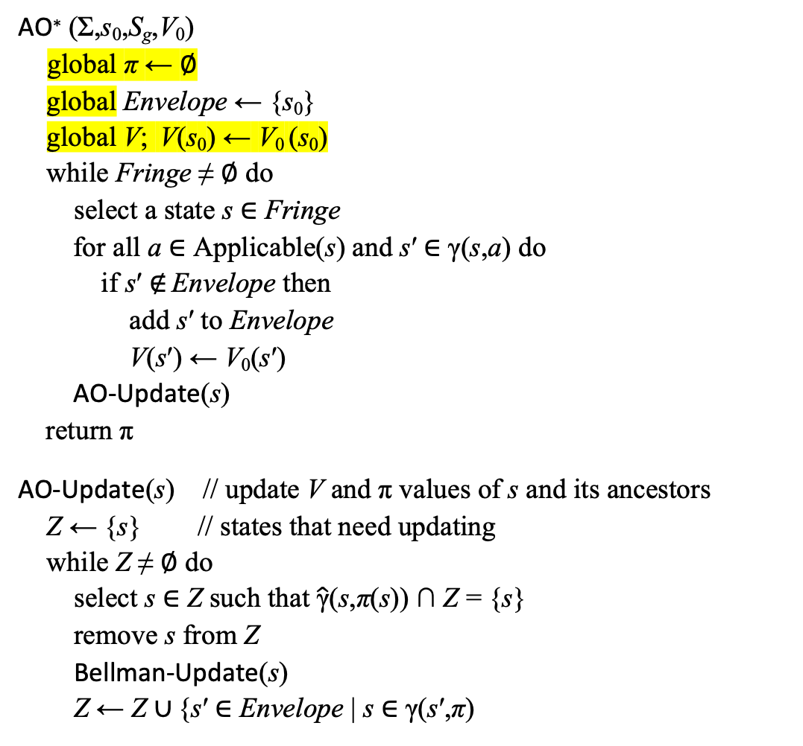
AO*
acyclic
AO∗ (Σ,s₀,S_{g},V₀)
  global π ← ∅
  global Envelope ← {s₀}
  global V; V(s₀) ← V₀ (s₀)
  while Fringe ≠ ∅ do
  select a state s ∈ Fringe
    for all a ∈ Applicable(s) and s′ ∈ γ(s,a) do
      if s′ ∉ Envelope then
      add s′ to Envelope
      V(s′) ← V₀(s′)
    AO-Update(s)
    return π
AO-Update(s) // update V and π values of s and its ancestors
  Z ← {s} // states that need updating
  while Z ≠ ∅ do
    select s ∈ Z such that $\hat{\text{γ}}$(s,π(s)) ∩ Z = {s}
    remove s from Z
      Bellman-Update(s)
      Z ← Z ∪ {s′ ∈ Envelope | s ∈ γ(s′,π)
Bellman-Update(s)
  global V, π
  v_{old} ← V(s)
  for every a ∈ Applicable(s) do
    Q(s,a) ← cost(s,a) + ∑_{s′∈S} Pr (s′|s,a) V(s′)
  V(s) ← min_{a∈Applicable(s)} Q(s,a)
  π(s) ← argmin_{a∈Applicable(s)} Q(s,a)
  return |V(s) – v_{old}|
like Expanded ∪ Frontier in A*
Fringe = Envelope ∖ (Dom(π) ∪ S_{g})
like non-goal Frontier states in A*
Fringe changes when
Bellman-Update changes π
expand
s
not needed
this time
a “lowest”
state in Z
add s’s
parents

Slide 35
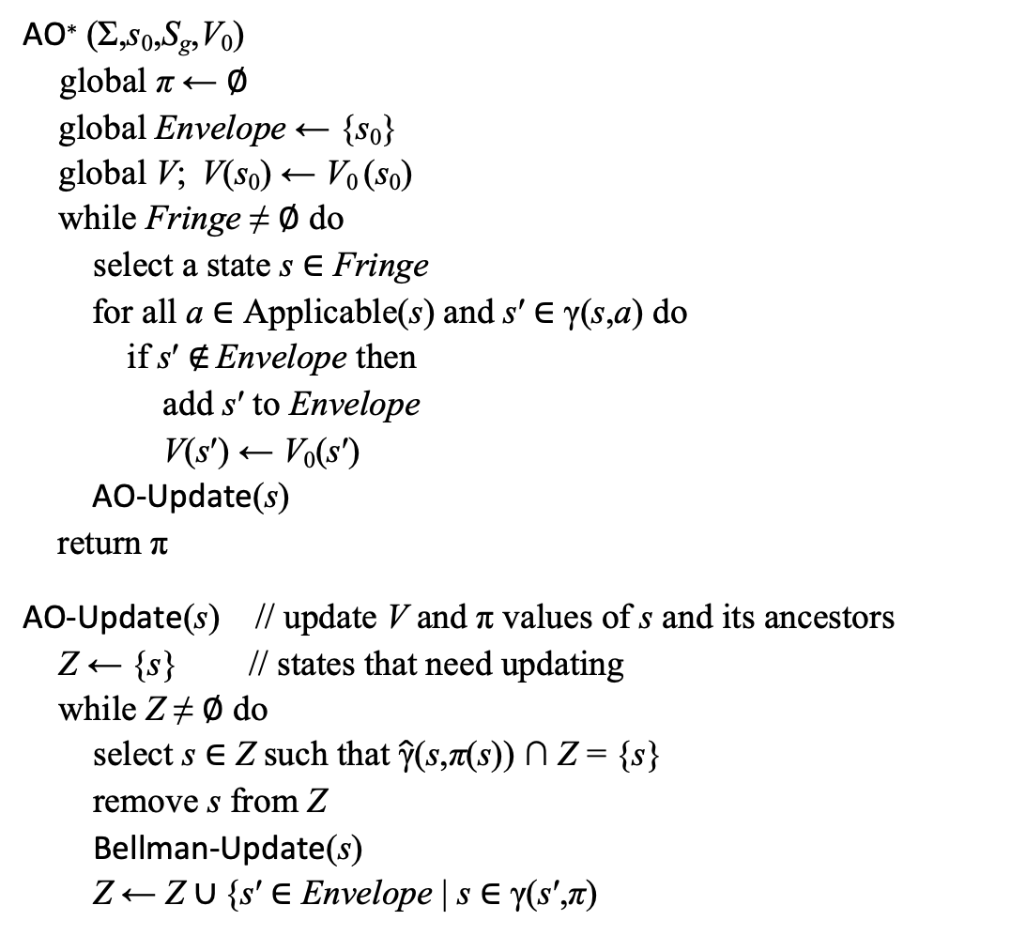
AO*
AO∗ (Σ,s₀,S_{g},V₀)
  global π ← ∅
  global Envelope ← {s₀}
  global V; V(s₀) ← V₀ (s₀)
  while Fringe ≠ ∅ do
  select a state s ∈ Fringe
    for all a ∈ Applicable(s) and s′ ∈ γ(s,a) do
      if s′ ∉ Envelope then
      add s′ to Envelope
      V(s′) ← V₀(s′)
    AO-Update(s)
    return π
AO-Update(s) // update V and π values of s and its ancestors
  Z ← {s} // states that need updating
  while Z ≠ ∅ do
    select s ∈ Z such that $\hat{\text{γ}}$(s,π(s)) ∩ Z = {s}
    remove s from Z
      Bellman-Update(s)
      Z ← Z ∪ {s′ ∈ Envelope | s ∈ γ(s′,π)
Bellman-Update(s)
  global V, π
  v_{old} ← V(s)
  for every a ∈ Applicable(s) do
    Q(s,a) ← cost(s,a) + ∑_{s′∈S} Pr (s′|s,a) V(s′)
  V(s) ← min_{a∈Applicable(s)} Q(s,a)
  π(s) ← argmin_{a∈Applicable(s)} Q(s,a)
  return |V(s) – v_{old}|
V(d2) = 0
d5
0.2
d2
d3
c = 15
0.8
V(d6) = 0
c = 100
c = 10
c = 1
V(d1) = 10
π(d1) = m12
d6
0.5
c = 20
d1
0.5
d4
V(d4) = 0
Start:
s₀= d1
Suppose V₀(s) = 0 for all s
Goal:
S_{g}= {d4}

Slide 36
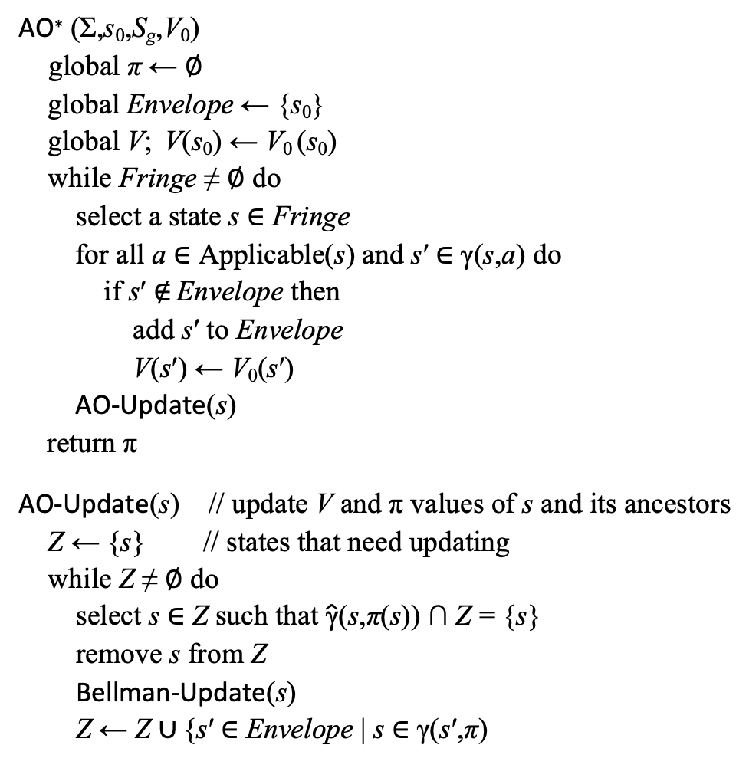
AO*
AO∗ (Σ,s₀,S_{g},V₀)
  global π ← ∅
  global Envelope ← {s₀}
  global V; V(s₀) ← V₀ (s₀)
  while Fringe ≠ ∅ do
  select a state s ∈ Fringe
    for all a ∈ Applicable(s) and s′ ∈ γ(s,a) do
      if s′ ∉ Envelope then
      add s′ to Envelope
      V(s′) ← V₀(s′)
    AO-Update(s)
    return π
AO-Update(s) // update V and π values of s and its ancestors
  Z ← {s} // states that need updating
  while Z ≠ ∅ do
    select s ∈ Z such that $\hat{\text{γ}}$(s,π(s)) ∩ Z = {s}
    remove s from Z
      Bellman-Update(s)
      Z ← Z ∪ {s′ ∈ Envelope | s ∈ γ(s′,π)
Bellman-Update(s)
  global V, π
  v_{old} ← V(s)
  for every a ∈ Applicable(s) do
    Q(s,a) ← cost(s,a) + ∑_{s′∈S} Pr (s′|s,a) V(s′)
  V(s) ← min_{a∈Applicable(s)} Q(s,a)
  π(s) ← argmin_{a∈Applicable(s)} Q(s,a)
  return |V(s) – v_{old}|
V(d5) = 0
V(d2) = 15
π(d2) = m23
d5
0.2
d2
d3
c = 15
0.8
V(d3) = 0
V(d6) = 0
c = 100
c = 10
c = 1
V(d1) = 25
π(d1) = m12
d6
0.5
c = 20
d1
0.5
d4
V(d4) = 0
Start:
s₀= d1
Suppose V₀(s) = 0 for all s
Goal:
S_{g}= {d4}

Slide 37
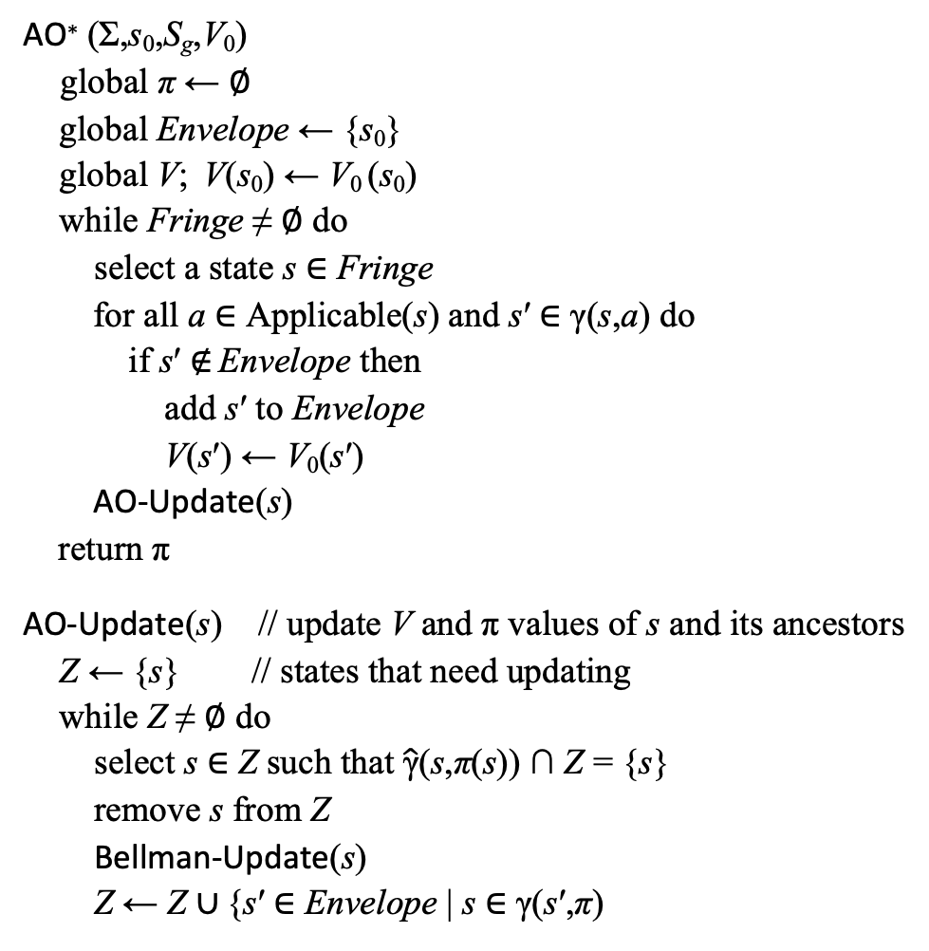
AO*
AO∗ (Σ,s₀,S_{g},V₀)
  global π ← ∅
  global Envelope ← {s₀}
  global V; V(s₀) ← V₀ (s₀)
  while Fringe ≠ ∅ do
  select a state s ∈ Fringe
    for all a ∈ Applicable(s) and s′ ∈ γ(s,a) do
      if s′ ∉ Envelope then
      add s′ to Envelope
      V(s′) ← V₀(s′)
    AO-Update(s)
    return π
AO-Update(s) // update V and π values of s and its ancestors
  Z ← {s} // states that need updating
  while Z ≠ ∅ do
    select s ∈ Z such that $\hat{\text{γ}}$(s,π(s)) ∩ Z = {s}
    remove s from Z
      Bellman-Update(s)
      Z ← Z ∪ {s′ ∈ Envelope | s ∈ γ(s′,π)
Bellman-Update(s)
  global V, π
  v_{old} ← V(s)
  for every a ∈ Applicable(s) do
    Q(s,a) ← cost(s,a) + ∑_{s′∈S} Pr (s′|s,a) V(s′)
  V(s) ← min_{a∈Applicable(s)} Q(s,a)
  π(s) ← argmin_{a∈Applicable(s)} Q(s,a)
  return |V(s) – v_{old}|
V(d5) = 0
V(d2) = 15
π(d2) = m23
d5
0.2
d2
d3
c = 15
0.8
V(d3) = 0
V(d6) = 0
c = 100
c = 10
c = 1
V(d1) = 20
π(d1) = m14
d6
0.5
c = 20
d1
0.5
d4
V(d4) = 0
Start:
s₀= d1
Suppose V₀(s) = 0 for all s
Goal:
S_{g}= {d4}

Slide 38
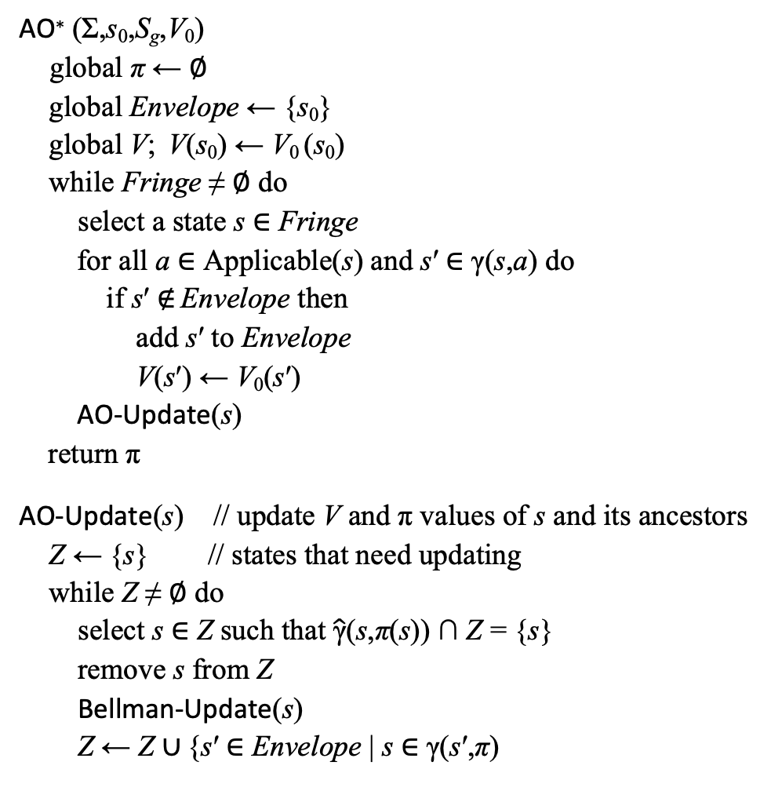
AO*
AO∗ (Σ,s₀,S_{g},V₀)
  global π ← ∅
  global Envelope ← {s₀}
  global V; V(s₀) ← V₀ (s₀)
  while Fringe ≠ ∅ do
  select a state s ∈ Fringe
    for all a ∈ Applicable(s) and s′ ∈ γ(s,a) do
      if s′ ∉ Envelope then
      add s′ to Envelope
      V(s′) ← V₀(s′)
    AO-Update(s)
    return π
AO-Update(s) // update V and π values of s and its ancestors
  Z ← {s} // states that need updating
  while Z ≠ ∅ do
    select s ∈ Z such that $\hat{\text{γ}}$(s,π(s)) ∩ Z = {s}
    remove s from Z
      Bellman-Update(s)
      Z ← Z ∪ {s′ ∈ Envelope | s ∈ γ(s′,π)
Bellman-Update(s)
  global V, π
  v_{old} ← V(s)
  for every a ∈ Applicable(s) do
    Q(s,a) ← cost(s,a) + ∑_{s′∈S} Pr (s′|s,a) V(s′)
  V(s) ← min_{a∈Applicable(s)} Q(s,a)
  π(s) ← argmin_{a∈Applicable(s)} Q(s,a)
  return |V(s) – v_{old}|
V(d5) = 0
V(d2) = 15
π(d2) = m23
d5
0.2
d2
d3
c = 15
0.8
V(d3) = 0
V(d6) = 1
π(d6) = m54
c = 100
c = 10
c = 1
V(d1) = 20.5
π(d1) = m14
d6
0.5
c = 20
d1
0.5
d4
V(d4) = 0
Start:
s₀= d1
Suppose V₀(s) = 0 for all s
Goal:
S_{g}= {d4}

Slide 39
What to do about dead ends?
AO∗ (Σ,s₀,S_{g},V₀)
  global π ← ∅
  global Envelope ← {s₀}
  global V; V(s₀) ← V₀ (s₀)
  while Fringe ≠ ∅ do
  select a state s ∈ Fringe
    for all a ∈ Applicable(s) and s′ ∈ γ(s,a) do
      if s′ ∉ Envelope then
      add s′ to Envelope
      V(s′) ← V₀(s′)
    AO-Update(s)
    return π
AO-Update(s) // update V and π values of s and its ancestors
  Z ← {s} // states that need updating
  while Z ≠ ∅ do
    select s ∈ Z such that $\hat{\text{γ}}$(s,π(s)) ∩ Z = {s}
    remove s from Z
      Bellman-Update(s)
      Z ← Z ∪ {s′ ∈ Envelope | s ∈ γ(s′,π)
Bellman-Update(s)
  global V, π
  v_{old} ← V(s)
  for every a ∈ Applicable(s) do
    Q(s,a) ← cost(s,a) + ∑_{s′∈S} Pr (s′|s,a) V(s′)
  V(s) ← min_{a∈Applicable(s)} Q(s,a)
  π(s) ← argmin_{a∈Applicable(s)} Q(s,a)
  return |V(s) – v_{old}|
d5
0.2
d2
d3
c = 15
0.8
c = 100
c = 80
d6
0.5
c = 10
d1
0.5
d4
Goal:
S_{g}= {d4}
Start:
s₀= d1
If action a in state s goes to a dead end, Guided-Find-Safe-Solution (Chap. 5) makes a inapplicable in s. AO* can be modified to do this.

Slide 40
Heuristics through Determinization
d5
What to use for V₀(s)?
One possibility: use a heuristic function for the determinized domain Σ_{d}
For each action a of Σ
  If a has k possible outcomes, then
    Σ_{d} contains k deterministic actions a₁, …, a_{k}
    one for each of a’s outcome
Let h be a classical heuristic function for Σ_{d}
If h is admissible for Σ_{d} then also admissible for Σ
Why:
  Let π be any optimal solution for Σ
  Let p be any acyclic execution of π
    p is a plan in Σ_{d}
    h(s₀) ≤ cost(p) ≤ cost(π)
m23
0.2
d2
d3
c = 15
0.8
m54
m12
m34
c = 100
c = 10
d6
m64
0.5
c = 1
m14
d1
0.5
c = 20
d4
d5
m23₂
d2
d3
m23₁
c = 15
m54
m12
m34
c = 100
c = 10
d6
m64
m14₂
c = 1
c = 20
d1
d4
m14₁

Slide 41
Heuristics through Determinization
d5
What to use for V₀(s)?
Another possibility: call a classical planner on the determinized problem (Σ_{d},s,g)
    Get plan p = ⟨a₁, a₂, …, a_{n}⟩
    Return V₀(s) = cost(p)
Theorem. If the classical planner always returns optimal plans, then V₀ is admissible
Outline of proof:
  Let π* be an optimal solution for (Σ,s,g)
  Then V*(s) = E(cost(π*))
  = weighted avg. of all executions of π
  Let p* be the least costly execution of π
    p* is a solution for (Σ_{d},s,g), so the classical planner returns a plan p of ≤ cost
    Thus V₀(s) = cost(p) ≤ cost(p*) ≤ E(cost(π))
m23
0.2
d2
d3
c = 15
0.8
m54
m12
m34
c = 100
c = 10
d6
m64
0.5
c = 1
m14
d1
0.5
c = 20
d4
d5
m23₂
d2
d3
m23₁
c = 15
m54
m12
m34
c = 100
c = 10
d6
m64
m14₂
c = 1
c = 20
d1
d4
m14₁

Slide 42
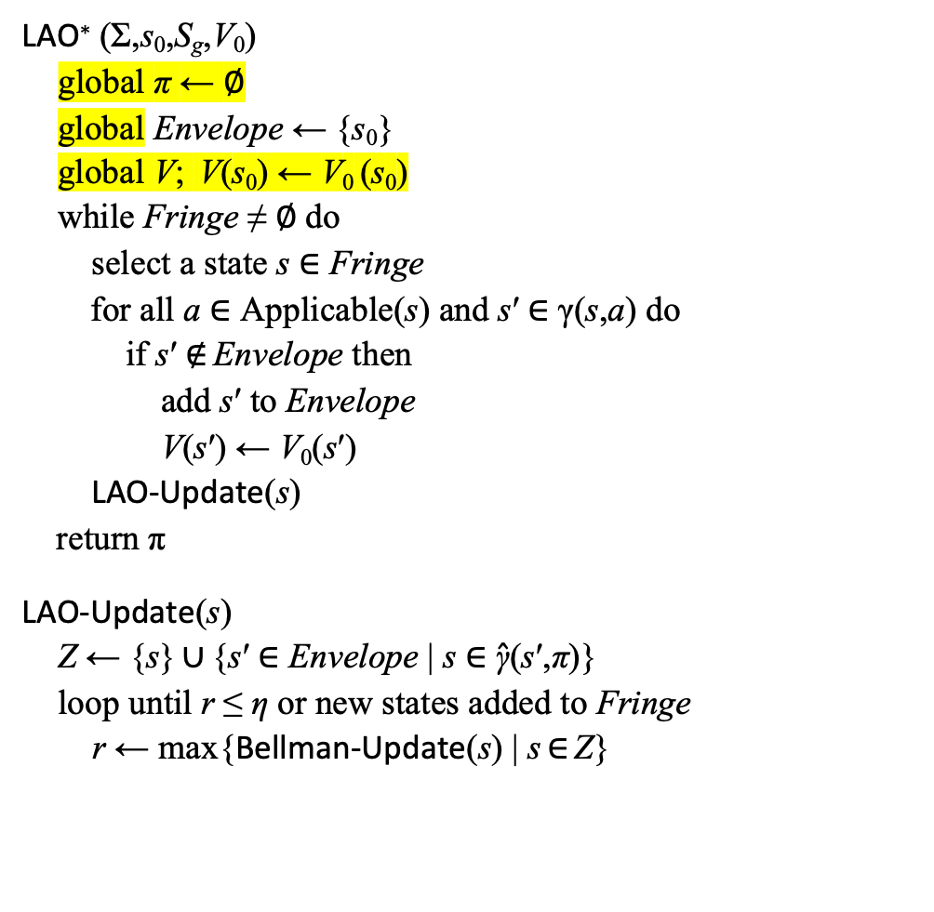
LAO*
may be cyclic
Bellman-Update(s)
  global V, π
  v_{old} ← V(s)
  for every a ∈ Applicable(s) do
    Q(s,a) ← cost(s,a) + ∑_{s′∈S} Pr (s′|s,a) V(s′)
  V(s) ← min_{a∈Applicable(s)} Q(s,a)
  π(s) ← argmin_{a∈Applicable(s)} Q(s,a)
  return |V(s) – v_{old}|
LAO∗ (Σ,s₀,S_{g},V₀)
  global π ← ∅
  global Envelope ← {s₀}
  global V; V(s₀) ← V₀ (s₀)
  while Fringe ≠ ∅ do
  select a state s ∈ Fringe
    for all a ∈ Applicable(s) and s′ ∈ γ(s,a) do
      if s′ ∉ Envelope then
      add s′ to Envelope
      V(s′) ← V₀(s′)
    LAO-Update(s)
    return π
LAO-Update(s)
  Z ← {s} ∪ {s′ ∈ Envelope | s ∈ $\hat{\text{γ}}$(s′,π)}
    loop until r ≤ η or new states added to Fringe
      r ← max{Bellman-Update(s) | s ∈ Z}
Same as AO*
except here
0.2
d5
c = 1
d2
d3
0.8
All π-ancestors of s in Envelope
c = 100
c = 100
d1
c = 1
d4
Start:
s₀= d1
0.5
0.5
Goal:
S_{g}= {d4}
Value iteration, restricted to Z
Example: V₀(s) = 0 for all s

Slide 43
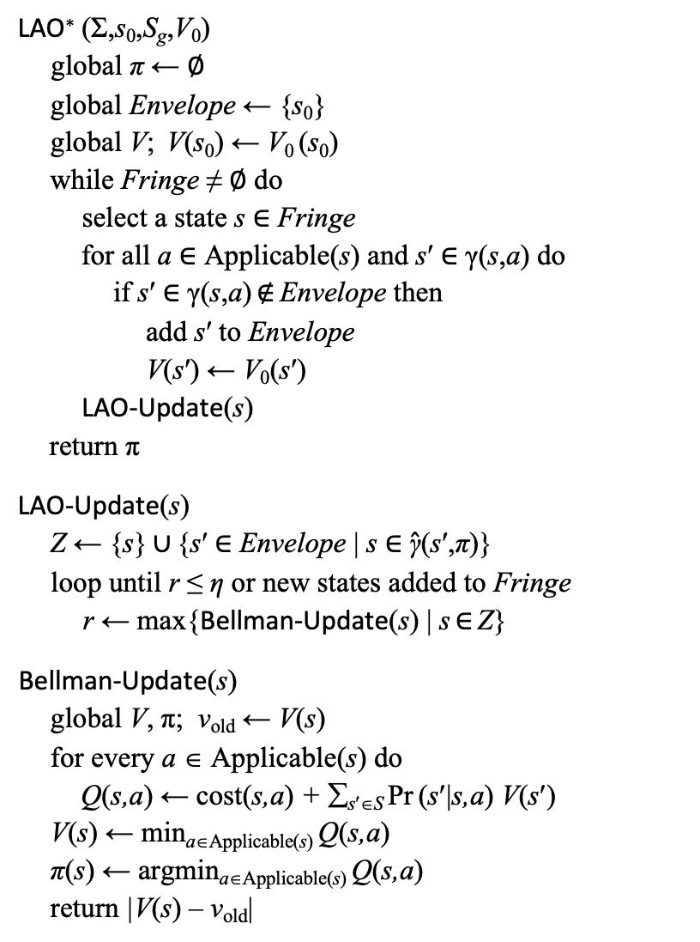
Example 1
LAO∗ (Σ,s₀,S_{g},V₀)
  global π ← ∅
  global Envelope ← {s₀}
  global V; V(s₀) ← V₀ (s₀)
  while Fringe ≠ ∅ do
  select a state s ∈ Fringe
    for all a ∈ Applicable(s) and s′ ∈ γ(s,a) do
      if s′ ∈ γ(s,a) ∉ Envelope then
      add s′ to Envelope
      V(s′) ← V₀(s′)
    LAO-Update(s)
    return π
LAO-Update(s)
  Z ← {s} ∪ {s′ ∈ Envelope | s ∈ $\hat{\text{γ}}$(s′,π)}
    loop until r ≤ η or new states added to Fringe
      r ← max{Bellman-Update(s) | s ∈ Z}
Bellman-Update(s)
  global V, π; v_{old} ← V(s)
  for every a ∈ Applicable(s) do
    Q(s,a) ← cost(s,a) + ∑_{s′∈S} Pr (s′|s,a) V(s′)
  V(s) ← min_{a∈Applicable(s)} Q(s,a)
  π(s) ← argmin_{a∈Applicable(s)} Q(s,a)
  return |V(s) – v_{old}|
η = 0.2
V₀(s) = 0 for all s
Envelope = {d1}
π = ∅
LAO* iteration 1:
  select s = d1
  Applicable(d1) = {m12, m14}
  add d2 to Envelope; V(d2) ← 0
  add d4 to Envelope; V(d4) ← 0
  Call LAO-Update(d1)
  π is empty, so Z = {d1}
  LAO-Update iteration 1:
    Call Bellman-update(d1):
    Q(d1,m12) = 100 + 0 = 100
    Q(d1,m14) = 1 + (½(0) + ½(0)) = 1
    V(d1) = 1; π(d1) = m14
    r = V(d1) – 0 = 1
  Keep iterating until r ≤ 0.2
    V(d1) = 1.875; r = 0.0625
LAO* iteration 2:
  Fringe = ∅, so return π = {(d1,m14)}
0.2
d5
c = 1
d2
d3
0.8
c = 100
c = 100
Start:
s₀= d1
d1
c = 1
d4
0.5
0.5
Goal:
S_{g}={d4}
Iteration 1
V(d2) = 0
0.2
d5
c = 1
d2
d3
0.8
c = 100
c = 100
V(d1) = 1.875
Start:
s₀= d1
d1
c = 1
d4
Goal:
S_{g}={d4}
0.5
0.5
V(d4) = 0

Slide 44
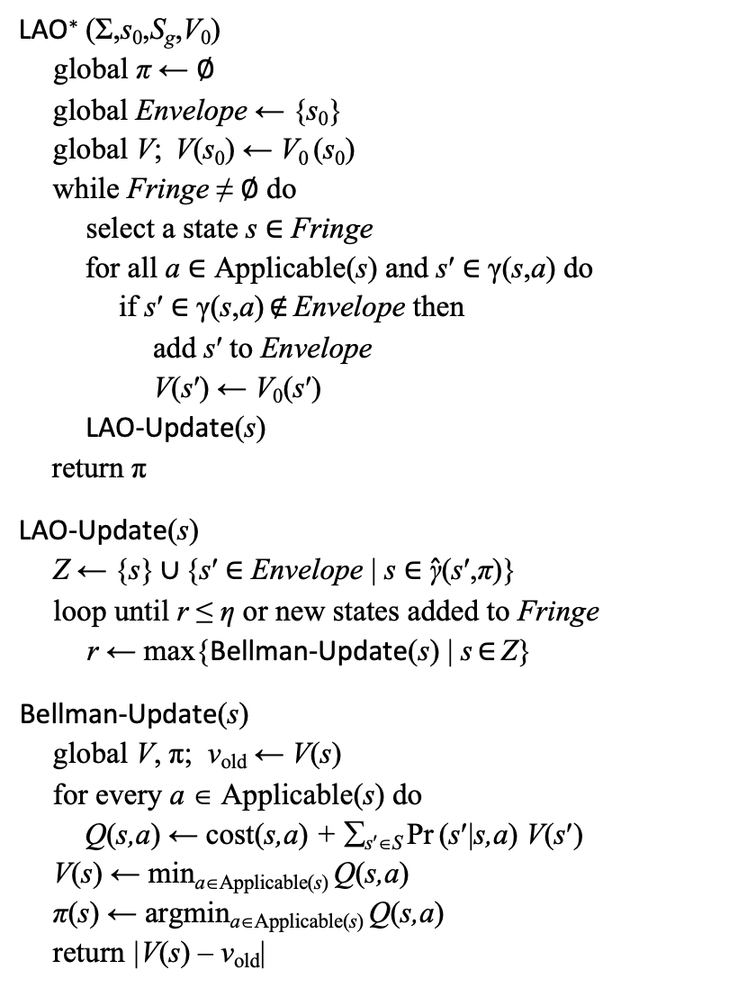
Example 2
LAO∗ (Σ,s₀,S_{g},V₀)
  global π ← ∅
  global Envelope ← {s₀}
  global V; V(s₀) ← V₀ (s₀)
  while Fringe ≠ ∅ do
  select a state s ∈ Fringe
    for all a ∈ Applicable(s) and s′ ∈ γ(s,a) do
      if s′ ∈ γ(s,a) ∉ Envelope then
      add s′ to Envelope
      V(s′) ← V₀(s′)
    LAO-Update(s)
    return π
LAO-Update(s)
  Z ← {s} ∪ {s′ ∈ Envelope | s ∈ $\hat{\text{γ}}$(s′,π)}
    loop until r ≤ η or new states added to Fringe
      r ← max{Bellman-Update(s) | s ∈ Z}
Bellman-Update(s)
  global V, π; v_{old} ← V(s)
  for every a ∈ Applicable(s) do
    Q(s,a) ← cost(s,a) + ∑_{s′∈S} Pr (s′|s,a) V(s′)
  V(s) ← min_{a∈Applicable(s)} Q(s,a)
  π(s) ← argmin_{a∈Applicable(s)} Q(s,a)
  return |V(s) – v_{old}|
η=0.2; V₀(s) = 0 for all s
Envelope = {d1}; π = ∅
LAO* iteration 1:
  select s = d1; Applicable(d1) = {m12, m14}
  V(d2) ← 0; add d2 to Envelope
  V(d4) ← 0; add d4 to Envelope
  Call LAO-Update(d1)
  π is empty, so Z = {d1}
  LAO-Update iteration 1:
    Call Bellman-update(d1):
    Q(d1,m12) = 100 + 0 = 100
    Q(d1,m14) = 80 + (½(0) + ½(0)) = 80
    V(d1) = 80; π(d1) = m14
    r = V(d1) – 0 = 80
  LAO-Update iteration 2:
    Call Bellman-update(d1):
    Q(d1,m12) = 100 + 0 = 100
    Q(d1,m14) = 80 + (½(80) + ½(0)) = 120
    V(d1) = 100; π(d1) = m12
    r = V(d1) – 80 = 20
    new state d2 in Fringe, so return
  LAO-Update returns
After more iterations, LAO* eventually returns
  π = {(d1,m12),(d2,m23),(d3,m34),(d5,m54)}
0.2
d5
c = 1
d2
d3
0.8
c = 100
c = 1
Start:
s₀= d1
d1
c = 80
d4
0.5
0.5
Goal:
S_{g}={d4}
Iteration 1
V(d2) = 0
0.2
d5
c = 1
d2
d3
0.8
c = 100
c = 1
V(d1) = 80
Start:
s₀= d1
d1
c = 80
d4
Goal:
S_{g}={d4}
0.5
0.5
V(d4) = 0

Slide 45
Skipping Ahead
Skipping ILAO*, HDP, LDFS_{a} , LRTDP, SLATE
  I’ll come back to these if there’s time

Slide 46
Planning and Acting
0.2
d5
c = 1
d2
d3
0.8
Run-Lookahead(Σ,s₀,S_{g})
  s ← s₀
  while s ∉ S_{g} and Applicable(s) ≠ ∅ do
    a ←Lookahead(s,θ)
    perform action a
    s ← observe resulting state
c = 100
c = 100
d1
c = 1
d4
0.5
0.5
Start:
s₀= d1
Goal:
S_{g}= {d4}
Like Run-Lookahead from Chapter 2
Differences:
  Explicit starting state s₀
    Not necessary, could observe s₀ instead
  Doesn’t abstract s (to simplify the presentation)
  Lookahead returns an action instead of a plan
What to use for Lookahead?
  AO*, LAO*, …
    Modify to search part of the space
  Classical planner on determinized domain
    next page
  Stochastic sampling algorithms

Slide 47
Planning and Acting
From Chapter 5
FS-Replan(Σ, s, S_{g})
π_{d} ← ∅
while s ∉ S_{g} and Applicable(s) ≠ ∅ do
if π_{d}(s) is undefined then do
π_{d} ← Plan2policy(Forward-search (Σ_{d}, s, S_{g}))
if π_{d} = failure then return failure
perform action π_{d}(s)
s ← observe resulting state
d5
m23
0.2
d2
d3
c = 1
0.8
m54
From Chapter 2
m12
m34
c=20
c = 10
c= 10
d6
m64
0.95
c = 300
Determinized domain
m14
c = 500
d1
0.05
d4
Generalization of a well-known planner called FF-Replan
Like Run-Lazy-lookahead from Chapter 2
  Lookahead = classical planner on determinized domain
Example:
  Forward-search returns ⟨m12, m23₁, m34⟩
  Plan2policy returns π_{d} = ⟨(d1,m12), (d2,m23), (d3,m34)⟩
  If m23 goes to d5, then call Forward-search again
d5
m23₂
d2
c = 1
m23₁
d3
m54
m12
m34
c=20
c = 10
c= 10
d6
m64
m14₂
c = 300
c = 500
d1
d4
m14₁

Slide 48
Planning and Acting
From Chapter 5
FS-Replan(Σ, s, S_{g})
π_{d} ← ∅
while s ∉ S_{g} and Applicable(s) ≠ ∅ do
if π_{d}(s) is undefined then do
π_{d} ← Plan2policy(Forward-search (Σ_{d}, s, S_{g}))
if π_{d} = failure then return failure
perform action π_{d}(s)
s ← observe resulting state
d5
m23
0.2
d2
d3
c = 1
0.8
m54
From Chapter 2
m12
m34
c=20
c = 10
c= 10
d6
m64
0.95
c = 300
Determinized domain
m14
c = 500
d1
0.05
d4
Problem: classical planner may choose a plan that depends on low-probability outcome
Example: Forward-search returns ⟨m14₁⟩
  m14 very likely to go to d6 ⇒ large cost
RFF algorithm (see book) attempts to alleviate this
d5
m23₂
d2
c = 1
m23₁
d3
m54
m12
m34
c=20
c = 10
c= 10
d6
m64
m14₂
c = 300
c = 5
d1
d4
m14₁

Slide 49
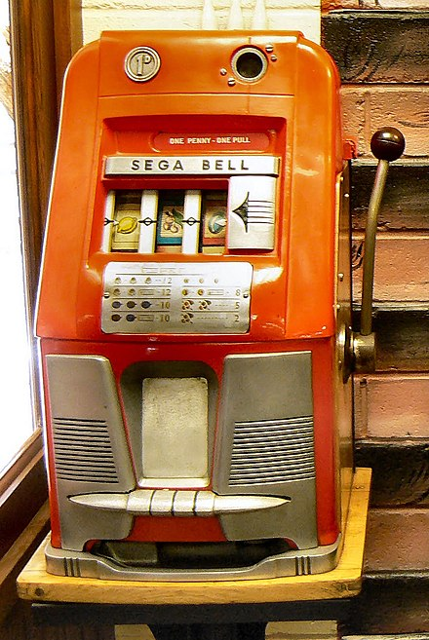
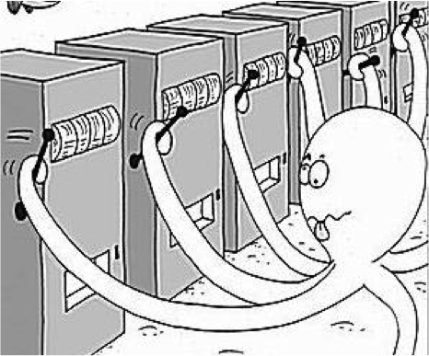
Digression: Monte Carlo rollouts
Multi-arm bandit problem
  Statistical model of sequential experiments
  Name derived from one-armed bandit (slot machine)
Multiple actions a₁, a₂, …, a_{n}
  Each a_{i} provides a reward from an unknown probability distribution p_{i}
  Assume each p_{i} is stationary
    Same every time, regardless of history
  Objective: maximize expected utility of a sequence of actions
Exploitation vs exploration dilemma:
  Exploitation: choose an action that has given
  you high rewards in the past
  Exploration: choose an action that’s less familiar,
  in hopes that it might produce a higher reward

Slide 50
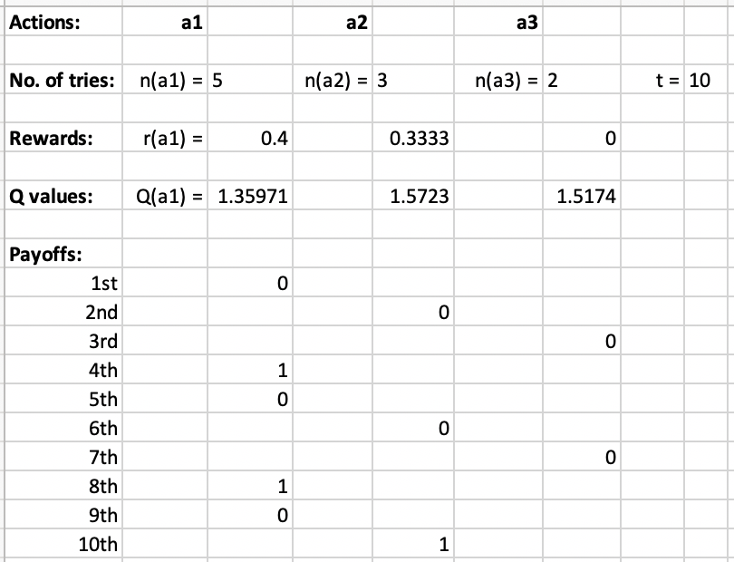
UCB (Upper Confidence Bound) Algorithm
Assume all rewards are between 0 and 1
  If they aren’t, normalize them
For each action a, let
  r(a) = average reward you’ve gotten from a
  n(a) = number of times you’ve tried a
  n_{t} = ∑_{a} n(a) _______________
  Q(a) = r(a) + √ 2(ln n_{t})/n(a)
UCB:
  if there are any untried actions:
  ã ← any untried action
  else:
  ã ← argmax_{a} Q(a)
  perform ã
  update r(ã), n(ã), n_{t} , Q(ã)
Theorem (given some assumptions):
  As the number of calls to UCB → ∞,
  UCB’s choice at each call → optimal choice

Slide 51
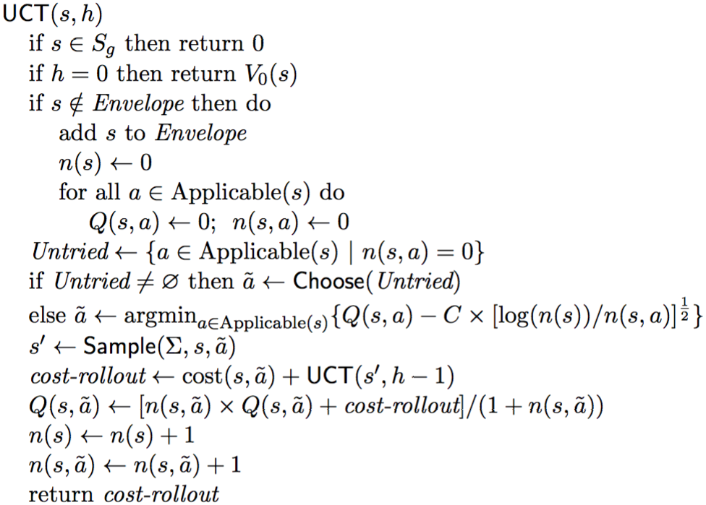
UCT Algorithm
UCT(s,h): recursive UCB computation on an SSP
  Adapted for minimization rather than maximization
Monte Carlo rollout:
  At s, choose action ã using UCB computation
    Perform ã, get state s′
    Do the same thing recursively at s′
    Continue until reaching a goal, dead end, or depth h
  At each state visited, keep statistics on choices, utilities
max search depth
like n_{t} on previous slide
like Q(a), n(a) on previous slide
ln, I think
_
√2 on previous slide
choose s′ with probability Pr(s′ | s,ã)

Slide 52
Using UCT Offline
  for i – 1 to n
    call UCT(s₀,∞)
  ∀s, π(s) ← argmin{Q(s,a) | a∈Applicable(s)}
As n → ∞, π converges to optimal
  Problem: finding optimal π may take many iterations

Slide 53
Using UCT Online
Works better for online planning
  π(s₀) approaches optimal must faster than the rest of π
Lookahead procedure for Run-Lookahead:
  call UCT(s,h) multiple times at current state s
  e.g., until
    allotted time runs out, or
    max{last change in Q(s,a) | a∈Applicable(s)} ≤ η
  return argmax{Q(s,a) | a∈Applicable(s)}

Slide 54
Using UCT Online
Lookahead procedure for Run-Lazy-Lookahead:
  loop:
    call UCT many times at current state
    At state s visited, π(s) ← action with highest expected utility
Problem: the farther you follow π, the less likely that π(s) is optimal
  Near the bottom of the tree, π(s) might be ≈ random choice
Possible workaround
  Modify Run-Lazy-Lookahead to call UCT more frequently

Slide 55
Using UCT with a Simulator
Suppose you don’t know the probabilities and costs
  But you have a fast, accurate simulator for the environment
Lookahead procedure (see previous slides)
  Run UCT multiple times in the simulated environment
  Learn state-transition probabilities, expected utilities
simulate a; observe s′

Slide 56
Using UCT for Exploration
Suppose you don’t know the probabilities and costs
Suppose you can restart your actor as many times as you want
  Caveat: usually not very feasible in real environments
Can modify UCT to be an acting procedure,
use it to explore the environment
perform a; observe s′

Slide 57
UCT in Two-Player Games
Generate Monte Carlo rollouts using a modified version of UCT
Main differences:
  Instead of choosing actions that minimize accumulated cost,
  choose actions that maximize payoff at the end of the game
  UCT for player 1 recursively calls UCT for player 2
    Choose opponent’s action
  UCT for player 2 recursively
  calls UCT for player 1
First competent computer programs for go
  ≈ 2008–2012
Monte Carlo rollout techniques similar
to UCT were used to train AlphaGo

Slide 58
Summary
SSPs
solutions, closed solutions, histories
unsafe solutions, acyclic safe solutions, cyclic safe solutions
expected cost, planning as optimization
policy iteration
value iteration (asynchronous version)
  Bellman-update
AO*, LAO*
Planning and Acting
  Run-Lookahead
  FS-Replan
UCB, UCT

