Slide 1
Section 2.7.8 Planning with Control Rules
Dana S. Nau
University of Maryland

Slide 2
Motivation
clear(a)=F, clear(b)=T, clear(c)=T, clear(d)=F, clear(e)=T, holding=nil, loc(a)=table, loc(b)=table, loc(c)=a, loc(d)=table, loc(e)=d
Sometimes we can write highly efficient planning algorithms for a specific domain
Use special properties of the domain
Example: the “blocks world”
e
c
d
a
b
pickup(x)
pre: loc(x)=table, clear(x)=T, holding=nil
eff: loc(x)=crane, clear(x)=F, holding=x
putdown(x)
pre: holding=x
eff: holding=nil, loc(x)=table, clear(x)=T
stack(x,y)
pre: holding=x, clear(y)=T
eff: holding=nil, clear(y)=F, loc(x)=y, clear(x)=T
unstack(x,y)
pre: loc(x)=y, clear(x)=T, holding=nil
eff: loc(x)=crane, clear(x)=F, holding=x, clear(y)=T
clear(a)=F, clear(b)=F, clear(c)=T, clear(d)=F, clear(e)=T, holding=b, loc(a)=table, loc(b)=crane, loc(c)=a, loc(d)=table, loc(e)=d
b
e
c
d
a

Slide 3
The Blocks World
clear(a)=F, clear(b)=T, clear(c)=T, clear(d)=F, clear(e)=T, holding=nil, loc(a)=table, loc(b)=table, loc(c)=a, loc(d)=table, loc(e)=d
For block-stacking problems with n blocks, easy to get a solution of length O(n)
Move all blocks to the table, then build up stacks from the bottom
With more domain knowledge, can do even better
e
c
d
a
b
pickup(x)
pre: loc(x)=table, clear(x)=T, holding=nil
eff: loc(x)=crane, clear(x)=F, holding=x
putdown(x)
pre: holding=x
eff: holding=nil, loc(x)=table, clear(x)=T
stack(x,y)
pre: holding=x, clear(y)=T
eff: holding=nil, clear(y)=F, loc(x)=y, clear(x)=T
unstack(x,y)
pre: loc(x)=y, clear(x)=T, holding=nil
eff: loc(x)=crane, clear(x)=F, holding=x, clear(y)=T
clear(a)=F, clear(b)=F, clear(c)=T, clear(d)=F, clear(e)=T, holding=b, loc(a)=table, loc(b)=crane, loc(c)=a, loc(d)=table, loc(e)=d
b
e
c
d
a

Slide 4
Block-Stacking Algorithm
loop
if ∃ a clear block c that needs moving
& we can move c to a position d where c won’t need to be moved
then move c to d
else if ∃ a clear block c that needs to be moved
then move c to any clear pallet
else if the goal is satisfied
then return success
else return failure
repeat
c needs to be moved if
s contains loc(c)=d and g contains loc(c)=e, where e≠d
s contains loc(c)=d and g contains loc(b)=d, where b≠c
s contains loc(c)=d and d needs moving
d
a
s₀:
b
d
e
c
g:
a
b
c
e
⟨unstack(e,a), putdown(e), unstack(d,c), stack(d,e), unstack(c,b), putdown(c), pickup(b), stack(b,c), pickup(a), stack(a,b)⟩

Slide 5
Properties of the Algorithm
Sound, complete, guaranteed to terminate on all block-stacking problems
Runs in time O(n³)
Can be modified (Slaney & Thiébaux) to run in time O(n)
Often finds optimal (shortest) solutions
But sometimes only near-optimal
For block-stacking problems, plan-length is NP-complete
Some ways to implement it:
As a domain-specific algorithm
Using refinement methods (RAE and SeRPE, Chapter 3)
Using HTN planning (SHOP, PyHop, Section 2.7.7)
Using control rules

Slide 6
Planning with Control Rules
Basic idea: given a state s and an action a, do domain-specific tests on γ(s,a) to find cases where we won’t want use a
a doesn’t lead to a solution
a is dominated (there’s a better solution along some other path)
a doesn’t lead to a solution that’s acceptable according to domain-specific criteria
In such cases, prune s
Write logical formulas giving conditions that states must satisfy
Prune states that don’t satisfy the formulas

Slide 7
Quick Review of First Order Logic
First Order Logic (FOL) syntax:
atomic formulas (or atoms)
predicate symbol with arguments, e.g., clear(c)
logical connectives (∨, ∧, ¬, ⇒, ⇔), quantifiers (∀, ∃), punctuation
e.g., (loc(r1)=d1 ∧ ∀c clear(c)) ⇒ ¬∃c loc(c)=r1
FOL with equality
‘=’ is a binary predicate symbol, e.g., loc(r1)=d1
First Order Theory T
“Logical” axioms, inference rules – encode logical reasoning in general
Additional “nonlogical” axioms – talk about a particular domain
Theorems: produced by applying the axioms and rules of inference
Model: a set of objects, functions, relations that the symbols refer to
For our purposes, a model is a state of the world s
In order for s to be a model, all theorems of T must be true in s
s ⊨ loc(r1)=d1 “s satisfies loc(r1)=d1” or “s entails loc(r1)=d1”
r1 is at d1 in the state s

Slide 8
Linear Temporal Logic
Modal logic: FOL plus modal operators
to express concepts that would be difficult to express within FOL
Linear Temporal Logic (LTL):
Purpose: to express a limited notion of time
Infinite sequence ⟨0, 1, 2, …⟩ of time instants
Infinite sequence M = ⟨s₀, s₁, …⟩ of states of the world
Modal operators to refer to states in M:
X f “next f ” - f is true in the next state, e.g., X loc(a)=b
F f “future f ” - f either is true now or in some future state
G f “globally f ” - f is true now and in all future states
f₁ U f₂ “f₁ until f₂” - f₂ is true now or in a future state, and f₁ is true until then
Propositional constant symbols true and false

Slide 9
Linear Temporal Logic (continued)
Quantifiers cause problems with computability
Suppose f(x) is true for infinitely many values of x
Problem evaluating truth of ∀x f(x) and ∃x f(x)
Bounded quantifiers
Let g(x) be such that {x | g(x) is true} is finite and easily computed
∀[x: g(x)] f(x)
means ∀x (g(x) ⇒ f(x))
expands into f(x₁) ∧ f(x₂) ∧ … ∧ f(x_{n})
∃[x: g(x)] f(x)
means ∃x (g(x) ∧ f(x))
expands into f(x₁) ∨ f(x₂) ∨ … ∨ f(x_{n})

Slide 10
State-Variable Notation in LTL Formulas
We can use state-variable assignments directly as atoms
clear(c)=T ∧ X loc(a)=c
Simplify the notation
Earlier we defined clear(x) to be Boolean, i.e., Range(clear(x)) = {T,F}
Can replace it with a logical proposition
Instead of writing clear(x)=T, write clear(x)
Instead of writing clear(x)=F, write ¬clear(x)
clear(c) ∧ X loc(a)=c

Slide 11
Examples
Suppose M = ⟨s₀, s₁, …⟩
All of the following are equivalent:
All mean a is on b in state s₂
(M,s₀) ⊨ XX loc(a)=b
M ⊨ XX loc(a)=b omit the state, it defaults to s₀
(M,s₂) ⊨ loc(a)=b
s₂ ⊨ loc(a)=b
M ⊨ G holding ≠ c
in every state in M, we aren’t holding c
M ⊨ G (clear(b) ⇒ (clear(b) U loc(a)=b))
whenever we enter a state in which b is clear, b remains clear until a is on b

Slide 12
Models for Planning with LTL
A model is a pair M = (M, s_{i})
M = ⟨s₀, s₁, …⟩ is a sequence of states
s_{i} is the i’th state in M,
For planning, we also have a goal g = {g₁, …, g_{n}}
To reason about it, add a modal operator called “Goal”
Not part of ordinary LTL, but I’ll call it LTL anyway
In an LTL formula, use “Goal(g_{i})” to refer to part of g
((M,s_{i}), g) ⊨ Goal(g_{i}) iff g ⊨ g_{i}
Planning problem:
Initial state s₀, a goal g, control formula f
Find a plan π = ⟨a₁, …, a_{n}⟩ that generates a sequence of states M = ⟨s₀, s₁, …s_{n}⟩ such that M ⊨ f and s_{n} ⊨ g
That’s not quite correct
Do you know why?

Slide 13
Models for Planning with LTL
M needs to be an infinite sequence
Kluge: assume that the final state repeats infinitely after the plan ends
Planning problem:
Initial state s₀, a goal g, control formula f
Find a plan π = ⟨a₁, …, a_{n}⟩ that generates a sequence of states M = ⟨s₀, s₁, …, s_{n}, s_{n}, s_{n}, …⟩ such that M ⊨ f and s_{n} ⊨ g

Slide 14
TLPlan
Nondeterministic forward search
s = current state, f = control formula, g = goal
If s satisfies g then we’re done
Otherwise, think about what kind of plan we need
It must generate a sequence of states M = ⟨s, s⁺, s⁺⁺, …⟩ that satisfies f
Compute a formula f ⁺ such that
(M,s) ⊨ f iff (M,s⁺) ⊨ f ⁺
If f ⁺ = false, then fail
No matter what M and s⁺ are, they can’t satisfy f ⁺
Fail if no applicable actions
Otherwise, nondeterministically choose one, compute s⁺, and call TLPlan with s⁺ and f ⁺
TLPlan (s, f, g)
if s satisfies g then return ⟨ ⟩
f ⁺ ← Progress (f, s)
if f ⁺ = false then return failure
A ← {actions applicable to s}
if A is empty then return failure
nondeterministically choose a ∈ A
s⁺ = γ (s,a)
π⁺ ← TLPlan (s⁺, f ⁺, g)
if π⁺ ≠ failure then return a.π⁺
return failure

Slide 15
Progression
Procedure Progress(f,s)
Case:
1. f contains no temporal ops : f ⁺ ← true if s ⊨ f, false otherwise
2. f = f₁ ∧ f₂ : f ⁺ ← Progress(f₁, s) ∧ Progress(f₂, s)
3. f = f₁ ∨ f₂ : f ⁺ ← Progress(f₁, s) ∨ Progress(f₂, s)
4. f =¬ f₁ : f ⁺ ← ¬Progress(f₁, s)
5. f = X f₁ : f ⁺ ← f₁
6. f = F f₁ : f ⁺ ← Progress(f₁, s) ∨ f
7. f = G f₁ : f ⁺ ← Progress(f₁, s) ∧ f
8. f = f₁ U f₂ : f ⁺ ← Progress(f₂, s) ∨ (Progress(f₁, s) ∧ f)
9. f = ∀[x:g(x)] h(x) : f ⁺ ← Progress(h(x₁), s) ∧ … ∧ Progress(h(x_{n}), s)
10. f = ∃ [x:g(x)] h(x) : f ⁺ ← Progress(h(x₁), s) ∨ … ∨ Progress(h(x_{n}), s)
simplify f ⁺ and return it
Compute the formula f ⁺ that M ⁺ must satisfy
false ∧ h = false, true ∧ h = h, ¬false = true,
etc.

Slide 16
Progressing ordinary formulas
Procedure Progress(f,s)
Case:
1. f contains no temporal ops : f ⁺ ← true if s ⊨ f, false otherwise
2. f = f₁ ∧ f₂ : f ⁺ ← Progress(f₁, s) ∧ Progress(f₂, s)
3. f = f₁ ∨ f₂ : f ⁺ ← Progress(f₁, s) ∨ Progress(f₂, s)
4. f =¬ f₁ : f ⁺ ← ¬Progress(f₁, s)
5. f = X f₁ : f ⁺ ← f₁
6. f = F f₁ : f ⁺ ← Progress(f₁, s) ∨ f
7. f = G f₁ : f ⁺ ← Progress(f₁, s) ∧ f
8. f = f₁ U f₂ : f ⁺ ← Progress(f₂, s) ∨ (Progress(f₁, s) ∧ f)
9. f = ∀[x:g(x)] h(x) : f ⁺ ← Progress(h(x₁), s) ∧ … ∧ Progress(h(x_{n}), s)
10. f = ∃ [x:g(x)] h(x) : f ⁺ ← Progress(h(x₁), s) ∨ … ∨ Progress(h(x_{n}), s)
simplify f ⁺ and return it
f = loc(a)=b
if a is currently on b, then true (every possible M ⁺ is OK)
otherwise false (there is no M ⁺ that’s OK)

Slide 17
Progressing X
Procedure Progress(f,s)
Case:
1. f contains no temporal ops : f ⁺ ← true if s ⊨ f, false otherwise
2. f = f₁ ∧ f₂ : f ⁺ ← Progress(f₁, s) ∧ Progress(f₂, s)
3. f = f₁ ∨ f₂ : f ⁺ ← Progress(f₁, s) ∨ Progress(f₂, s)
4. f =¬ f₁ : f ⁺ ← ¬Progress(f₁, s)
5. f = X f₁ : f ⁺ ← f₁
6. f = F f₁ : f ⁺ ← Progress(f₁, s) ∨ f
7. f = G f₁ : f ⁺ ← Progress(f₁, s) ∧ f
8. f = f₁ U f₂ : f ⁺ ← Progress(f₂, s) ∨ (Progress(f₁, s) ∧ f)
9. f = ∀[x:g(x)] h(x) : f ⁺ ← Progress(h(x₁), s) ∧ … ∧ Progress(h(x_{n}), s)
10. f = ∃ [x:g(x)] h(x) : f ⁺ ← Progress(h(x₁), s) ∨ … ∨ Progress(h(x_{n}), s)
simplify f ⁺ and return it
f = X loc(a)=b
in the next state, a must be on b
f ⁺ = loc(a)=b
f = XX loc(a)=b
two states from now, a must be on b
f ⁺ = X loc(a)=b

Slide 18
Progressing ∧
Procedure Progress(f,s)
Case:
1. f contains no temporal ops : f ⁺ ← true if s ⊨ f, false otherwise
2. f = f₁ ∧ f₂ : f ⁺ ← Progress(f₁, s) ∧ Progress(f₂, s)
3. f = f₁ ∨ f₂ : f ⁺ ← Progress(f₁, s) ∨ Progress(f₂, s)
4. f =¬ f₁ : f ⁺ ← ¬Progress(f₁, s)
5. f = X f₁ : f ⁺ ← f₁
6. f = F f₁ : f ⁺ ← Progress(f₁, s) ∨ f
7. f = G f₁ : f ⁺ ← Progress(f₁, s) ∧ f
8. f = f₁ U f₂ : f ⁺ ← Progress(f₂, s) ∨ (Progress(f₁, s) ∧ f)
9. f = ∀[x:g(x)] h(x) : f ⁺ ← Progress(h(x₁), s) ∧ … ∧ Progress(h(x_{n}), s)
10. f = ∃ [x:g(x)] h(x) : f ⁺ ← Progress(h(x₁), s) ∨ … ∨ Progress(h(x_{n}), s)
simplify f ⁺ and return it
f = clear(c)=T ∧ X loc(a)=c
c must be clear now, and a must be on c in the next state
f ⁺ = Progress(clear(c)=T, s) ∧ Progress(X loc(a)=c, s) = true ∧ loc(a)=c = loc(a)=c
c
a
b

Slide 19
Progressing ∧
Procedure Progress(f,s)
Case:
1. f contains no temporal ops : f ⁺ ← true if s ⊨ f, false otherwise
2. f = f₁ ∧ f₂ : f ⁺ ← Progress(f₁, s) ∧ Progress(f₂, s)
3. f = f₁ ∨ f₂ : f ⁺ ← Progress(f₁, s) ∨ Progress(f₂, s)
4. f =¬ f₁ : f ⁺ ← ¬Progress(f₁, s)
5. f = X f₁ : f ⁺ ← f₁
6. f = F f₁ : f ⁺ ← Progress(f₁, s) ∨ f
7. f = G f₁ : f ⁺ ← Progress(f₁, s) ∧ f
8. f = f₁ U f₂ : f ⁺ ← Progress(f₂, s) ∨ (Progress(f₁, s) ∧ f)
9. f = ∀[x:g(x)] h(x) : f ⁺ ← Progress(h(x₁), s) ∧ … ∧ Progress(h(x_{n}), s)
10. f = ∃ [x:g(x)] h(x) : f ⁺ ← Progress(h(x₁), s) ∨ … ∨ Progress(h(x_{n}), s)
simplify f ⁺ and return it
f = G loc(a)=c
a must be on c now, and must stay there forever
f ⁺ = Progress(loc(a)=c, s) ∧ f = false ∧ G loc(a)=c = false
c
a
b

Slide 20
Progressing ∧
Procedure Progress(f,s)
Case:
1. f contains no temporal ops : f ⁺ ← true if s ⊨ f, false otherwise
2. f = f₁ ∧ f₂ : f ⁺ ← Progress(f₁, s) ∧ Progress(f₂, s)
3. f = f₁ ∨ f₂ : f ⁺ ← Progress(f₁, s) ∨ Progress(f₂, s)
4. f =¬ f₁ : f ⁺ ← ¬Progress(f₁, s)
5. f = X f₁ : f ⁺ ← f₁
6. f = F f₁ : f ⁺ ← Progress(f₁, s) ∨ f
7. f = G f₁ : f ⁺ ← Progress(f₁, s) ∧ f
8. f = f₁ U f₂ : f ⁺ ← Progress(f₂, s) ∨ (Progress(f₁, s) ∧ f)
9. f = ∀[x:g(x)] h(x) : f ⁺ ← Progress(h(x₁), s) ∧ … ∧ Progress(h(x_{n}), s)
10. f = ∃ [x:g(x)] h(x) : f ⁺ ← Progress(h(x₁), s) ∨ … ∨ Progress(h(x_{n}), s)
simplify f ⁺ and return it
c
f = loc(a)=b U clear(c)=T
c must be clear, or a must be on b and stay there until c is clear
f ⁺ = Progress(clear(c)=T, s) ∨ [Progress(loc(a)=b, s) ∧ f ] = true ∨ [ false ∧ (loc(a)=b) U clear(c)=T)] = true
a
b

Slide 21
Progressing ∀
Procedure Progress(f,s)
Case:
1. f contains no temporal ops : f ⁺ ← true if s ⊨ f, false otherwise
2. f = f₁ ∧ f₂ : f ⁺ ← Progress(f₁, s) ∧ Progress(f₂, s)
3. f = f₁ ∨ f₂ : f ⁺ ← Progress(f₁, s) ∨ Progress(f₂, s)
4. f =¬ f₁ : f ⁺ ← ¬Progress(f₁, s)
5. f = X f₁ : f ⁺ ← f₁
6. f = F f₁ : f ⁺ ← Progress(f₁, s) ∨ f
7. f = G f₁ : f ⁺ ← Progress(f₁, s) ∧ f
8. f = f₁ U f₂ : f ⁺ ← Progress(f₂, s) ∨ (Progress(f₁, s) ∧ f)
9. f = ∀[x:g(x)] h(x) : f ⁺ ← Progress(h(x₁), s) ∧ … ∧ Progress(h(x_{n}), s)
10. f = ∃ [x:g(x)] h(x) : f ⁺ ← Progress(h(x₁), s) ∨ … ∨ Progress(h(x_{n}), s)
simplify f ⁺ and return it
x_{i} is the i’th element of {x | s ⊨ g(x)}
f = ∀[x: clear(x)=T] X loc(x)=table
every currently-clear block must be on the table in the next state
f ⁺ = Progress(X loc(a)=table, s) ∧ Progress(X loc(c)=table, s)
= loc(a)=table ∧ loc(c)=table
c
a
b

Slide 22
Progressing ∃
Procedure Progress(f,s)
Case:
1. f contains no temporal ops : f ⁺ ← true if s ⊨ f, false otherwise
2. f = f₁ ∧ f₂ : f ⁺ ← Progress(f₁, s) ∧ Progress(f₂, s)
3. f = f₁ ∨ f₂ : f ⁺ ← Progress(f₁, s) ∨ Progress(f₂, s)
4. f =¬ f₁ : f ⁺ ← ¬Progress(f₁, s)
5. f = X f₁ : f ⁺ ← f₁
6. f = F f₁ : f ⁺ ← Progress(f₁, s) ∨ f
7. f = G f₁ : f ⁺ ← Progress(f₁, s) ∧ f
8. f = f₁ U f₂ : f ⁺ ← Progress(f₂, s) ∨ (Progress(f₁, s) ∧ f)
9. f = ∀[x:g(x)] h(x) : f ⁺ ← Progress(h(x₁), s) ∧ … ∧ Progress(h(x_{n}), s)
10. f = ∃ [x:g(x)] h(x) : f ⁺ ← Progress(h(x₁), s) ∨ … ∨ Progress(h(x_{n}), s)
simplify f ⁺ and return it
x_{i} is the i’th element of {x | s ⊨ g(x)}
c
f = ∃[x: clear(x)=T] X loc(x)=table
{x | clear(x)=T} = {a, c}
f ⁺ = Progress(X loc(a)=table, s) ∨ Progress(X loc(c)=table, s)
= loc(a)=table ∨ loc(c)=table
a
b

Slide 23
Example Planning Problem
s₀:
c
g:
b
s = {clear(a)=T, clear(b)=F, clear(c)=T, holding=nil, loc(a)=table, loc(b)=table, loc(c)=b}
g = {loc(b)=a}
f = G ∀[x: clear(x)] (loc(x)≠table ∨ ∃[y: Goal(loc(x)=y)] ∨ X holding≠x)
never pick up a clear block from the table unless it needs to be elsewhere
Run TLPlan using depth-first search
s doesn’t satisfy g
Compute f ⁺ (see next page)
f ⁺ = holding≠a ∧ f
A = {pickup(a), unstack(c,b)}
Try using pickup(a)
s⁺ = γ (s, pickup(a))
Call TLPlan (s⁺, f ⁺, g)
Progress(f ⁺, s⁺) = false
Recursive call returns failure
Try unstack(c,b) …
a
b
a
TLPlan (s, f, g)
if s satisfies g then return ⟨ ⟩
f ⁺ ← Progress (f, s)
if f ⁺ = false then return failure
A ← {actions applicable to s}
if A is empty then return failure
nondeterministically choose a ∈ A
s⁺ = γ (s,a)
π⁺ ← TLPlan (s⁺, f ⁺, g)
if π⁺ ≠ failure then return a.π⁺
return failure

Slide 24
Computing f ⁺
s₀:
c
g:
b
a
b
a
s = {loc(a)=table, loc(b)=table, clear(a), clear(c), loc(c)=b}
g = {loc(b)=a}
f = G ∀[x: clear(x)] (loc(x)≠table ∨ ∃[y: Goal(loc(x)=y)] ∨ X holding≠x)
f ⁺ = Progress(G f₁, s) = Progress(f₁, s) ∧ f
= Progress(∀[x: clear(x)] h(x)), s) ∧ f
= Progress(h(a) ∧ h(c)), s) ∧ f
= Progress(h(a)), s) ∧ Progress(h(c)), s) ∧ f
Progress(h(a),s) = Progress(loc(a)≠table ∨ ∃[y: Goal(loc(a)=y)] ∨ X holding≠a), s)
= false ∨ false ∨ holding≠a = holding≠a
Progress(h(c),s) = Progress(loc(c)≠table ∨ ∃[y: Goal(loc(c)=y)] ∨ X holding≠c), s)
= true ∨ false ∨ holding≠c = true
f ⁺ = holding≠a ∧ true ∧ f = holding≠a ∧ f
h(x)
f₁

Slide 25
Block-Stacking Problems
Want to define a formula final(x) that means
x is at the top of a stack and we’re finished moving it
Neither x nor the blocks below x will ever need to be moved
Axioms to support this:
final(x) ⇔ clear(x) ∧ ¬Goal(holding=x) ∧ finalbelow(x)
finalbelow(x) ⇔
(loc(x)=table ∧ ∀[y: Goal(loc(x)=y] y=table)
∨ ∃[y: loc(x)=y] [
¬Goal(loc(x)=table) ∧ ¬Goal(holding=y) ∧ ¬Goal(clear(y))
∧ ∀[z : Goal(loc(x)=z)] (z=y) ∧ ∀[z: Goal(loc(z)=y)] (z=x)
∧ finalbelow(y)]
nonfinal(x) ⇔ clear(x) ∧ ¬final(x)

Slide 26
Control Rules
Try TLPlan with three different control formulas:
(1) If x is final, only put a block y onto x if it will make y final:
G ∀[x: clear(x)] (final(x) ⇒ X [clear(x) ∨ ∃[y: loc(y)=x] final(y)])
(2) Like (1), but also says that if a block isn’t final, don’t put anything onto it:
G ∀[x: clear(x)] [ (final(x) ⇒ X [clear(x) ∨ ∃[y: loc(y)=x] final(y)]) ∧ (nonfinal(x) ⇒ X ¬∃[y: loc(y)=x])]
(3) Like (2), but also says not to pick up a nonfinal block from the table unless you can put it where it will be final:
G ∀[x: clear(x)] [ (final(x) ⇒ X [clear(x) ∨ ∃[y: loc(y)=x] final(y)]) ∧ (nonfinal(x) ⇒ X ¬∃[y: loc(y)=x]) ∧ (ontable(x) ∧ ∃[y: Goal(loc(x)=y)] [¬final(y) ⇒ X¬holding(x)])]

Slide 27
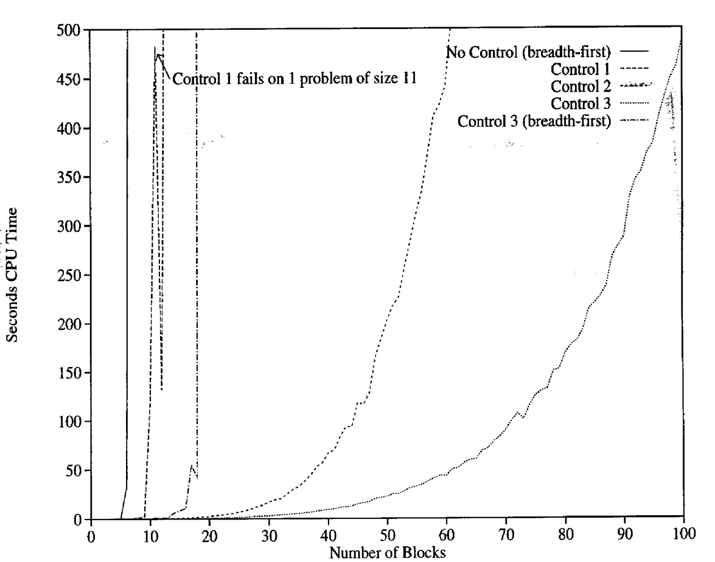
Block Stacking

Slide 28
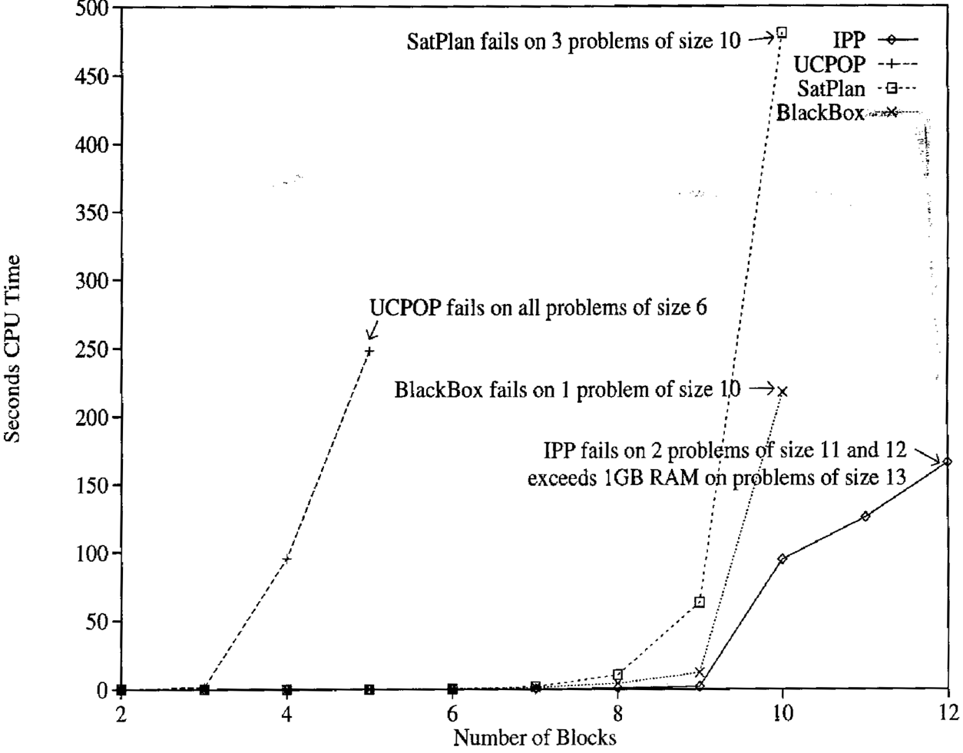
Block Stacking

