Slide 1
Chapter 1
Introduction
Dana S. Nau
University of Maryland
with contributions from
Mark “mak” Roberts

Slide 2
Deliberative Action
Poll
Name one component of “deliberative action”.
For AI, deliberation often means:
  An abstraction of the problem: Model
  A solver: a search algorithm
  An end to aim at: a goal or task
  Potential application of experience: learning
For AI, acting implies:
  An actor
  An external world or environment
Scientific focus: how do we compute deliberative action: models and algorithms!
Need not imply consciousness; we generally will not dwell on philosophy in this course
Deliberation (or thinking) implies:
  A representation of the problem
  A solver
  An end to aim at
  Potential application of experience
Acting implies:
  A boundary: exogenous and endogenous
  Agency to modify the external world
  Potential for exogenous activity

Slide 3
Ethical considerations
Governing AI for Humanity, Interim Report (UN AI Advisory Board, 2023)
Blueprint for AI Bill of Rights (White House OSTP, 2022)
Reflections on AI for Humanity (Braunschweig and Ghallab, eds., 2021)
100 Year Study on AI (Stanford University, 2021, 2016)
The alignment problem: How can machines learn human values? (Christian, 2021)
Ethics guidelines for Trustworthy AI (EU High-level Group on AI, 2019)
Responsible AI: requirements and Challenges (Ghallab, 2019)
Lethal Autonomous Systems Pledge (Future of Life Institute, 2018)
Study on Autonomy (US Defense Science Board, 2016)
Suggested readings on this topic:
Human compatible: AI and the problem of control (Russell, 2019)
Life 3.0 (Tegmark, 2017)
The Myth of Artificial Intelligence (Larson, 2021)

Slide 4
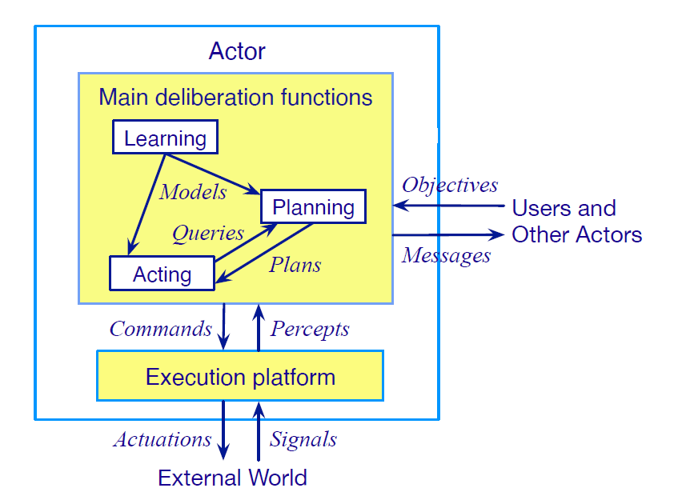
Motivation
Actor: agent that performs actions
Deliberation functions
  Planning
    What actions to perform
  Acting
    How to perform them
  Learning
    Acquire models and decide When to act or plan

Slide 5
Planning
Relies on prediction + search
Uses descriptive models of the actions
  Predict what the actions will do
  Don’t tell how to do them
Search over predicted states and possible organizations of feasible actions
Different types of actions ⇒
  Different predictive models
  Different planning problems and techniques
  Motion and manipulation planning
  Perception planning
  Navigation planning
  Communication planning
  Task planning
a
s′ = γ(s,a)
s
• • •
Most AI planning

Slide 6
Acting
Traditional “AI planning” view:
  Carrying out an action is just execution
  Can ignore how it’s done
Sometimes that’s OK
  If the environment has been engineered to make actions predictable
  Example on next slide
Usually acting is more complicated
  Example later

Slide 7
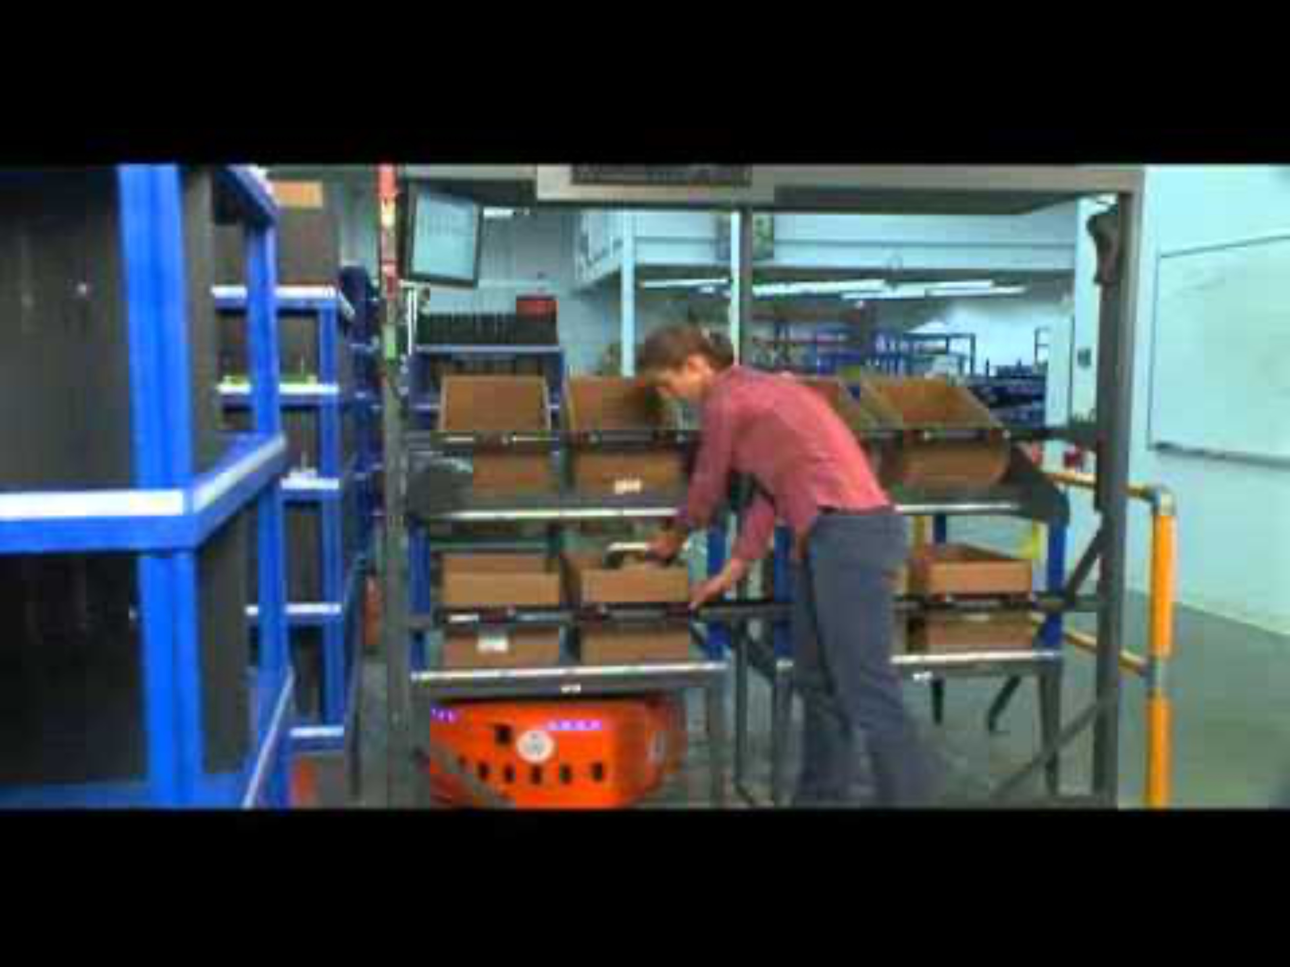
Acting as Execution
Kiva Systems
  (now part of Amazon Robotics)
Warehouse with items stored in “pods”
  Portable warehouse-shelving units
When an order comes in for an item
  Software locates closest mobile robot
  Directs it to go to the correct pod
To navigate around the warehouse
  Robot follows bar-code stickers on the floor
When the robot reaches the target location
  Slides underneath the pod
  Lifts it off the floor
  Carries it to the specified human operator
  Operator picks items from the pod
https://youtu.be/1FKMniE_q1Q
Notes:
Warehouse distribution center. Automated platforms to bring cabinets to people preparing orders.
Platforms follow a precise network of guides painted on the floor. Don’t need to deliberate about how to act;
environment engineered to cover all cases they’ll need to cope with.

Slide 8

Deliberative Acting
Experiment:
  New Caledonian crow wants to retrieve
  a bucket of food from a vertical pipe
  Nearby is a piece of wire
  Crow tries to use the wire, fails
  Bends the wire into a hook
  Uses the bent hook to retrieve the bucket
Crows make hooks in the wild
  From sticks and leaves, not wire
Adapted the technique to a new material
https://youtu.be/nTtDbyQTQV0

Slide 9
Interleaving Planning and Acting
Actor is in a dynamic unpredictable environment
  Adapt actions to current context
  React to events
Relies on
  Operational models telling how to perform the actions
  Observations of current state

Slide 10
Planning and Acting
Multiple levels of abstraction
  Actors are organized into physical subsystems
  Deliberation reflects this
Heterogeneous reasoning
  Different techniques
    at different levels
    different subsystems at same level
Continual online planning
  Can’t plan everything in advance
  Plans are abstract and partial
  until more detail is needed

Slide 11
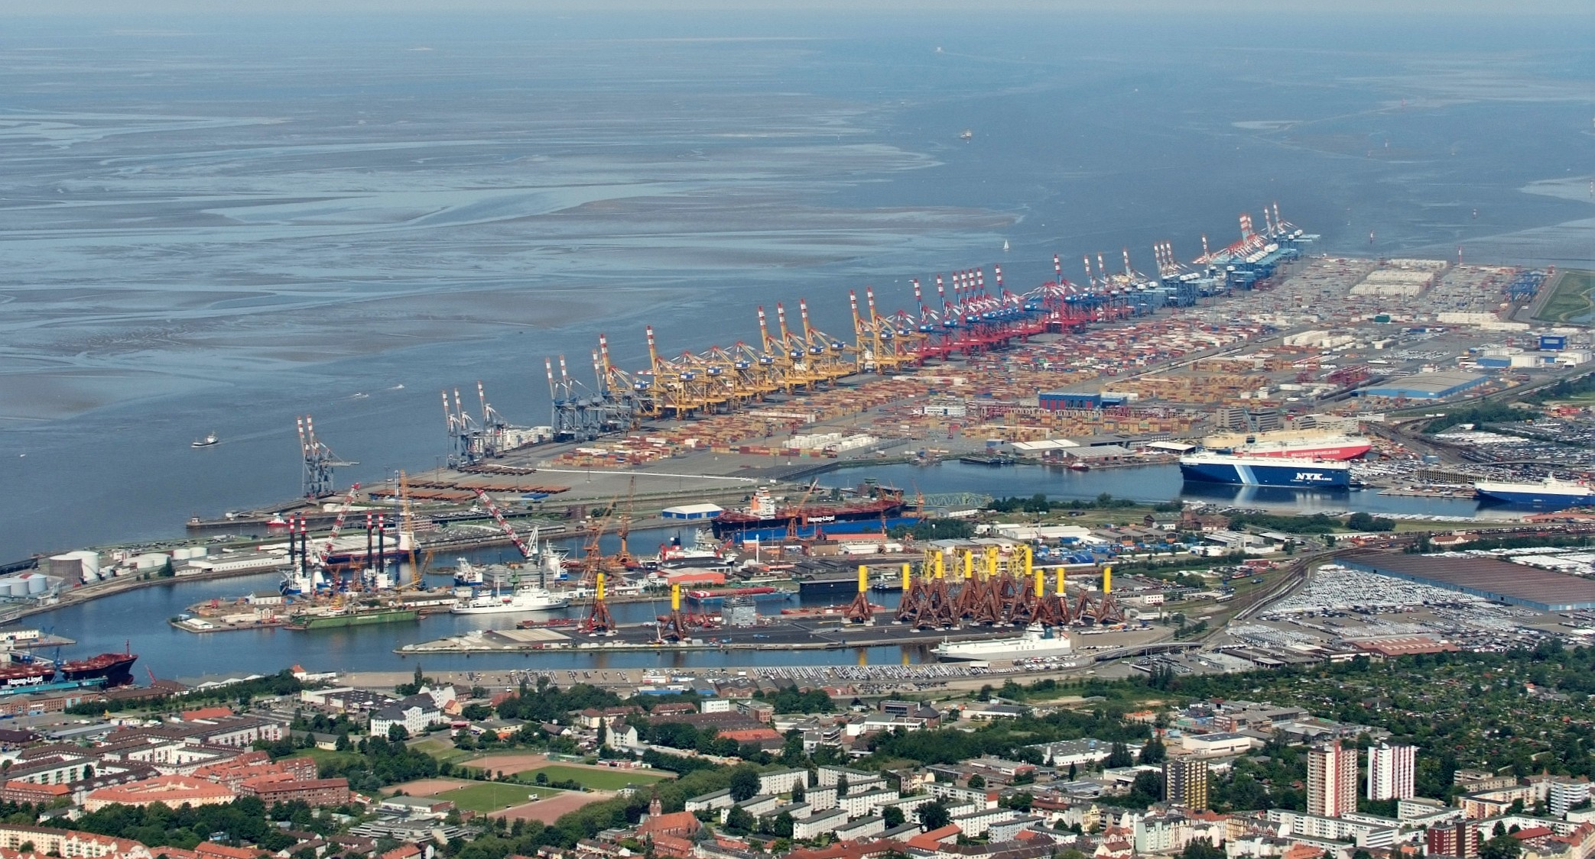
Bremen Harbor
Credit: Martina Nolte, CC BY-SA 3.0 DE
Notes:
One of the most important European ports for transporting cars. ≈ 400,000 m², > 120,000 storage places, ≈ dozen technical treatment stations. Each year, about 6 Million cars, 18 different brands.

Slide 12
Example: Harbor Management
Planning
Acting
Importing/exporting cars
  Based on Bremen Harbor
Multiple levels of abstraction
  Reflect physical organization of harbor
Continual online planning
  Top level can be planned offline
  The rest is online, based on current conditions
Heterogeneous reasoning
  Different components work in different ways
  Online synthesis of automata to control their interactions

Slide 13
Example: Service Robot
Planning
Acting
Multiple levels of abstraction
  Higher levels: more planning
  Lower levels: more acting
Continual online planning
  What room is o7 in?
  What route?
  What kind of door?
  Close enough to door handle?
Heterogeneous reasoning
  planning abstract tasks
  path planning
  reactive (e.g., open door)

Slide 14
Models
"All models are wrong, but some are useful.”
- George Box
Models are an abstraction of the world
  Good abstractions capture salient details
Planning and Acting models approximate the causality of taking action:
  Describe the necessary preconditions and expected effects for each action
  May indicate the expected utility of taking action toward some end
Hierarchical models describe how to break down a complex task
  Example: a recipe describes how to cook a dish without reference to a specific kitchen

Slide 15
The Challenges of Using Models
Models are often created and curated by humans, but this means they can be:
  expensive to write and debug
  sensitive to original assumptions
  less adaptable to new environments
Deployed systems may need to change models to account for
  Adaptation to a new task or situation
  The preferences of different humans
  Failure to successfully complete an action
  …
Furthermore, acting systems often require multiple, simultaneous models at different levels of abstraction

Slide 16
Learning
Learning consolidates experience
Learning can overcome some of the challenges of producing models
  Automates model production
  Provides mechanism to adapt models
For acting, learning acquires or adapts knowledge about how to do something
For planning, learning acquires or adapts the effect of what was done

Slide 17
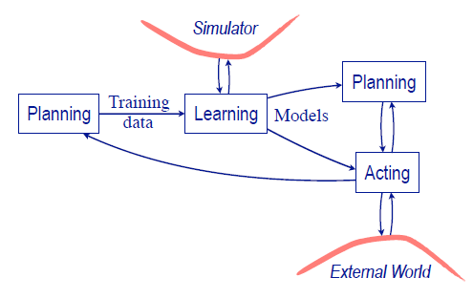
Integrating Acting, Planning, and Learning
Models can be learned:
  Using planning to produce traces
  By interacting with a simulator
Learning might iterate with:
  Planning: to determine what needs learn or how to invest learning effort
  Acting: by sampling the simulator or external world to determine the preconditions or effects of actions

Slide 18

Any questions?
The Music Lesson. Johannes Vermeer (c. 1662–1665)

