Slide 1
Chapter 10
Reinforcement Learning
Dana S. Nau
University of Maryland

Slide 2
Introduction
Idea: agent interacts directly with the world
  Improves performance by trial and error
  Might or might not have a domain model
Requires a reward function
  r(s,a,s′) = reward for going from s to s′ with action a
Agent tries to
  remember which states/actions led to good/bad rewards
  generalize
  maximize long-term perceived benefits of its actions
Simple RL: no teacher

Slide 3
Value-Based RL
Estimate V* or Q* by trial and error
Example:
  Three paella recipes a₁, a₂, a₃
  Rewards = ratings by guests
recipe trial 1 trial 2 trial 3
a₁ 7.2
a₂ 5.4 8 7.6
a₃ 6.8
–––––––––––––––––––––––––––––––––––––––––
a₂ avg 5.4 6.7 7
r(a,i) = reward for running a the i’th time
Update rule: Q(a) ← Q(a) + α (r(a) – Q(a))
  α = 1/(k+1) = learning rate
Begin with initial value Q(a) = q₀

Slide 4
Value-Based RL
Estimate V* or Q* by trial and error
Example:
  Three paella recipes a₁, a₂, a₃
  Rewards = ratings by guests
recipe trial 1 trial 2 trial 3
a₁ 7.2
a₂ 5.4 8 7.6
a₃ 6.8
–––––––––––––––––––––––––––––––––––––––––
a₂ avg 5.4 6.7 7
Let r(a,i) = reward for running a
the i’th time
Temporal difference update rule:
  Q(a) ← Q(a) + α (r(a) – Q(a))
  α = learning rate
Which a to run next:
  argmax_{a} Q(a) with probability 1 – ε
  other random with probability ε
Poll: What to use for α?
A. 1/(k+1)
B. any monotonically
decreasing f(k) > 0
C. any constant > 0
D. any of the above
E. don’t know

Slide 5
Value-Based RL
Estimate V and Q by trial and error
Example:
  Three paella recipes a₁, a₂, a₃
  Rewards = ratings by guests
recipe trial 1 trial 2 trial 3
a₁ 7.2
a₂ 5.4 8 7.6
a₃ 6.8
–––––––––––––––––––––––––––––––––––––––––
a₂ avg 5.4 6.7 7
Let r(a,i) = reward for running a
the i’th time
Temporal difference update rule:
  Q(a) ← Q(a) + α (r(a) – Q(a))
  α = learning rate
Which a to run next:
  argmax_{a} Q(a) with probability 1 – ε
  other random with probability ε
Poll: What to use for Q(a) here if a hasn’t been tried yet?
A. ∞ B. max possible r
C. 0 D. anything > – ∞
E. other F. don’t know

Slide 6
Q-learning
Consider an MDP in which we don’t know γ
Adapt temporal-difference learning
  Modified MDP model: maximize reward
Same as before:
  Σ = (S, A, γ, Pr, cost)
  γ(s,a) = {all possible “next states” after applying action a in state s}
  Pr(s′ | s, a) = probability that a takes us to s′
    Pr(s′ | s, a) ≠ 0 iff s′ ∈ γ(s,a)
Instead of cost(s,a,s′), we have
  r(s,a,s′) = reward if a takes us to s′ from s
Want a policy π that maximizes
  E(reward for getting from s₀ to S_{g})
Value function:
  was V^{π}(s) = ∑_{s′ ∈ γ(s,π(s))} Pr(s′ | s, π(s))[cost(s,π(s),s′ )+ V^{π}(s′)]
  now V^{π}(s) = ∑_{s′ ∈ γ(s,π(s))} Pr(s′ | s, π(s))[r(s,π(s),s′ )+ V^{π}(s′)]
Bellman-update:
  was Q(s,a) ← ∑_{s′∈γ(s,a)} Pr (s′|s,a) [cost(s,a,s′) + V(s′)]
        where V(s′) = min_{a} Q(s′,a)
  now Q(s,a) ← ∑_{s′∈γ(s,a)} Pr (s′|s,a) [r(s,a,s′) + V(s′)]
        where V(s′) = max_{a} Q(s′,a)
Temporal-difference update rule:
  Q(a) ← Q(a) + α (r(a) – Q(a))
Temporal-difference update for MDPs:
  Q(s,a) ← Q(s,a) + α (r(s,a,s′) + V(s′) – Q(s,a))
Equivalently:
  Q(s,a) ← Q(s,a) + α (r(s,a,s′) + max_{a′} Q(s′,a′) – Q(s,a))

Slide 7
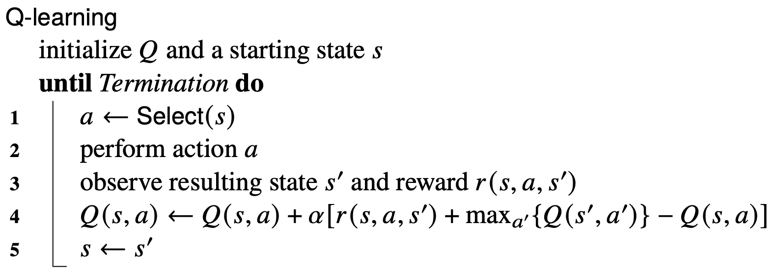
Q-learning
Consider an MDP in which we don’t know γ
Adapt temporal-difference learning
  Modified MDP model: maximize reward
From previous slide
Poll. Is line 2 practical?
A. Yes B. No C. don’t know

Slide 8
Q-learning
Learn in two stages:
  Learn from simulated acting:
    Replace lines 2, 3 with
    (s′, r(s,a,s′)) ← Simulate(a,s)
  Learn from real-world acting
    Use lines 2, 3 as shown
Poll. Is Stage 2 needed?
A. Yes B. No C. don’t know
Poll. Is it practical to store Q(s,a) for every s and a?
A. Yes B. No C. don’t know

Slide 9
Parametric Learning
Input: a set of numeric (x,y) pairs
  D = {(x^{(i)}, y^{(i)}) | i = 1, …, N}
Parametric function f_{θ}(x)
  θ is a parameter that changes f
  adjust θ to try to make f_{θ} (x^{(i)}) ≈ y^{(i)} for each i
Example: linear regression
  f_{θ} (x) = θ₀ + θ₁x
  θ = (θ₀, θ₁)
Empirical loss function
Loss is minimized when both of these are 0:
f_{θ} (x)
Credit: Stuart Russell

Slide 10
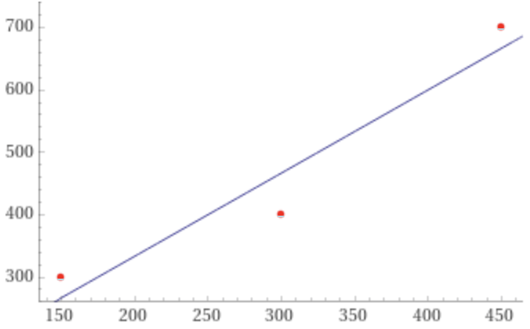
Linear Regression Example
Example: (seafood,rice) proportions in paella
  D = {(150,300), (300,400), (450,700)}
= (2/3) [(θ0 + 150 θ1 – 300)
+ (θ0 + 300 θ1 – 400)
+ (θ0 + 450 θ1 – 700)]
    = (2/3) [3 θ0 + 900 θ1 – 1400]
= (2/3) [150(θ0 + 150 θ1 – 300)
+ 300(θ0 + 300 θ1 – 400)
+ 450(θ0 + 450 θ1 – 700)]
    = (2/3) [900 θ0 + 315,000 θ1 – 480,000]
Solve:
    3 θ₀ + 900 θ₁ – 1400 = 0
    900 θ₀ + 315,000 θ₁ – 480,000 = 0
Answer:
    θ₀ = 200/3 ≈ 66.6
    θ₁ = 4/3 ≈ 1.33
f_{θ} (x,y) = θ₀ + θ₁x = 1.33x + 66.6

Slide 11
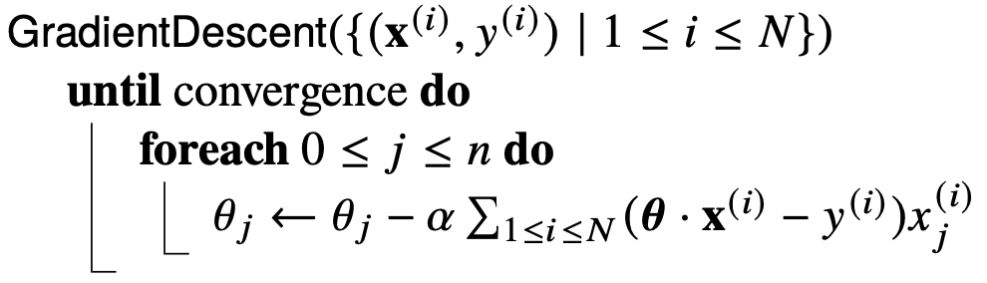
Multivariable Linear Regression
D = {(x^{(i)}, y^{(i)}) | i = 1, …, N}
  Each x^{(i)} is a column vector [x₁, …, x_{n}]⊤
𝜽 is a column vector [𝜃₀, …, 𝜃_{n}]⊤
  f_{θ} (x) = θ₀ + ∑_{1≤j≤n} θ_{j} x_{j}
Extend x to [x₀, x₁, …, x_{n}]⊤
  x₀ = 1 for every x ∈ D
  f_{θ} (x) = ∑_{0≤j≤n} θ_{j} x_{j} = θ · x
  Loss = (1/|D|) ∑_{(x,y)∈D} (θ · x – y)²
Partial derivatives:
  ∂Loss/∂𝜃_{j} = (2/|D|) ∑ _{j} (θ · x – y) x_{j}
  ∇ Loss = [∂Loss/∂𝜃₁, …, ∂Loss/∂θ_{n}]⊤
Can solve analytically to minimize Loss
  but it’s more complicated
In each iteration of the outer loop
  Move each θ_{j} in the direction of ∂Loss/∂𝜃_{j}
  How far depends on ∂Loss/∂𝜃_{j} and α
Stop when each θ stops changing very much
Two ways to call GradientDescent:
  Batch: argument is all of D
  Stochastic: argument is random subset of D
Can generalize to nonlinear f_{θ}
  update rule θ ← θ – α ∇Loss(f_{θ})

Slide 12
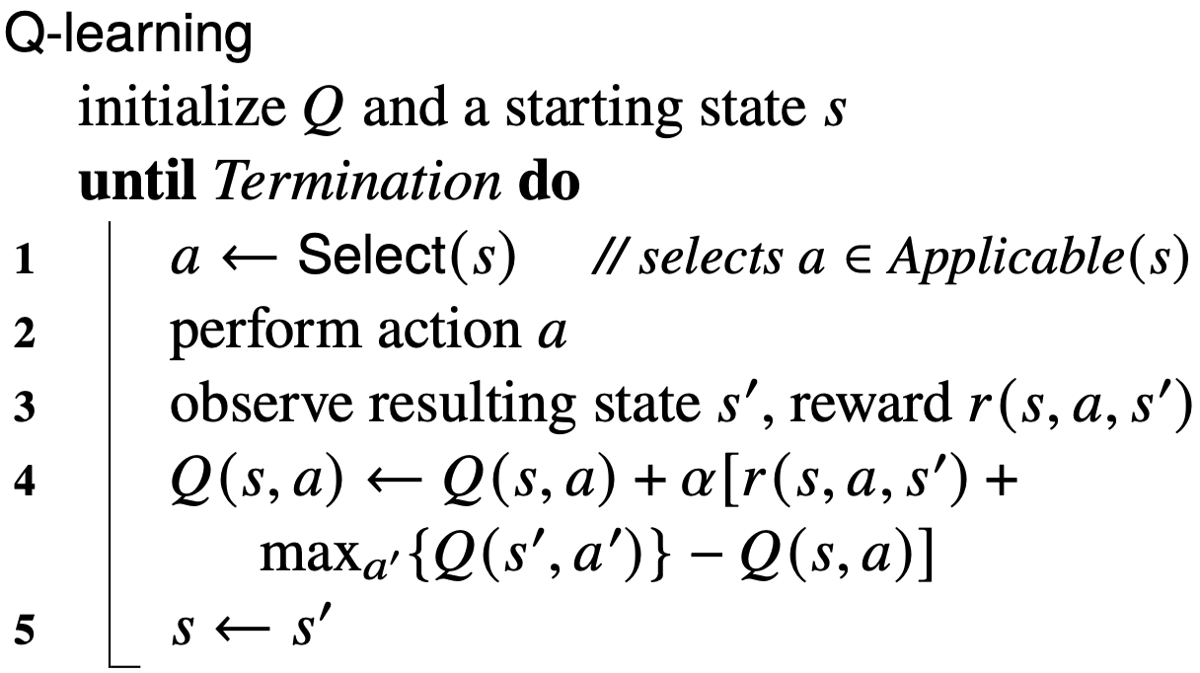
Parametric Q-Learning (Motivation)
From before:
Problems with Q-learning:
  Need a large table to store Q(s,a)
  Doesn’t generalize to new situations
Idea: develop a parameterized formula
Q_{θ}(s,a) ≈ Q(s,a)
  Adjust θ to make Q_{θ}(s,a) fit observed rewards
  Use gradient descent

Slide 13
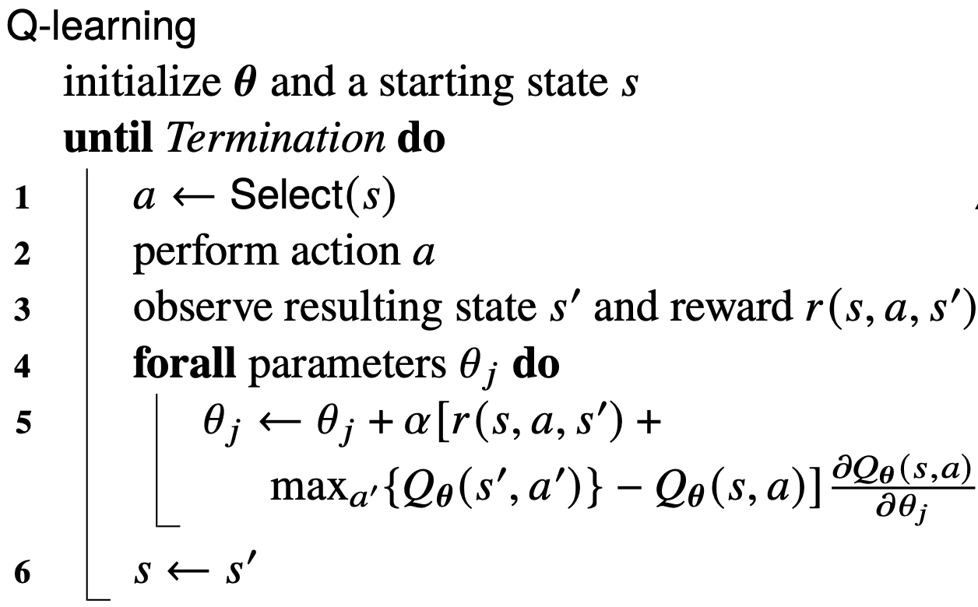
Parametric Q-Learning
Use gradient descent to learn Q_{θ}
Poll. Should this be –2α instead?
A. Yes B. No C. don’t know

Slide 14
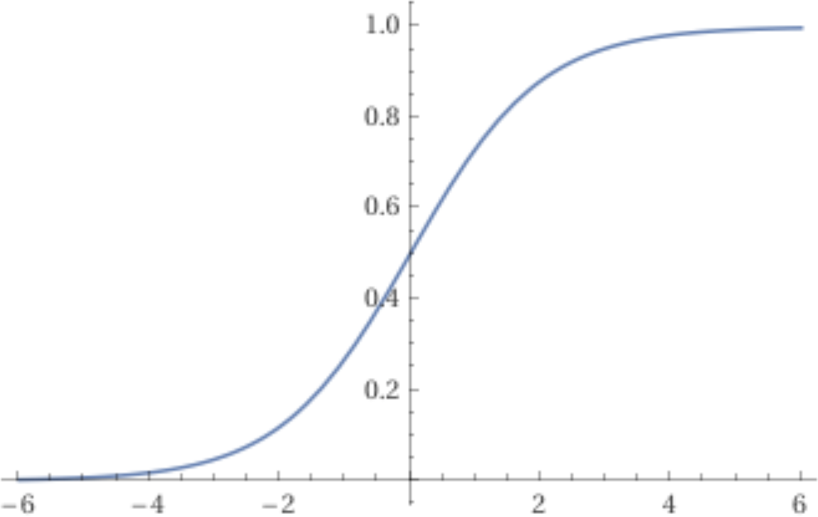
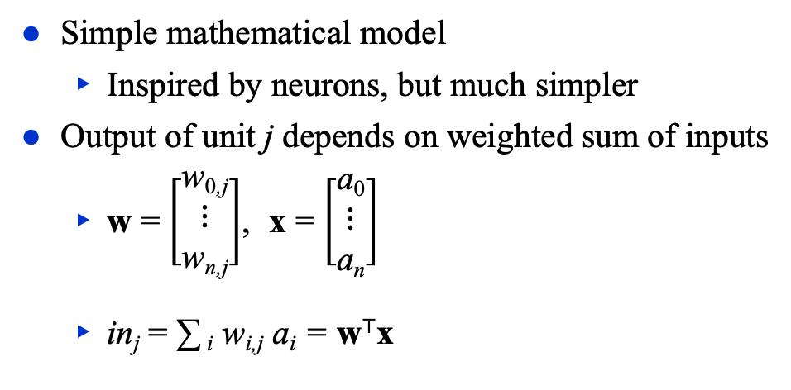
McCulloch-Pitts “unit”
Output: a_{j} = g(in_{j})
g: activation function
  nondecreasing
  usually positive, often nonlinear
  e.g., logistic (sigmoid):
    g(z) = 1/(1+e^{–z})
Simple mathematical model
  Inspired by neurons, but much simpler
Output of unit j depends on weighted sum of inputs
  w = $\left[\begin{matrix}\text{w}\text{0}\text{,}\text{j} \\ \text{⋮} \\ \text{w}\text{n}\text{,}\text{j}\end{matrix}\right]$, x = $\left[\begin{matrix}\text{a}\text{0} \\ \text{⋮} \\ \text{a}\text{n}\end{matrix}\right]$
  in_{j} = ∑ _{i} w_{i,j} a_{i} = w⊤x

Slide 15
Expressiveness
With 2 layers and enough units in those layers, can approximate all continuous functions
  with exponentially many units, can get any desired accuracy
With 3 layers, all functions
Combine two opposite-facing threshold functions to make a ridge
Combine two perpendicular ridges to make a bump
Add bumps of various sizes and locations to fit any surface

Slide 16
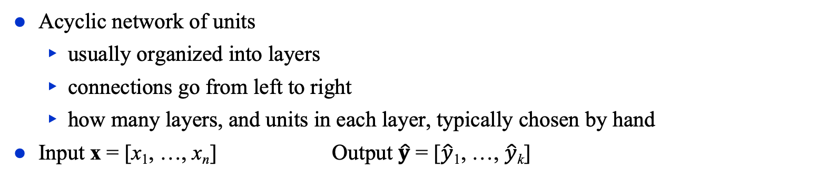
Multilayer Feed-Forward Networks
x w, a w, a w, a w, a $\hat{y}$
Acyclic network of units
  usually organized into layers
  connections go from left to right
  how many layers, and units in each layer, typically chosen by hand
Input x = [x₁, …, x_{n}] Output $\hat{y}$ = [$\hat{y}$₁, …, $\hat{y}$_{k}]

Slide 17
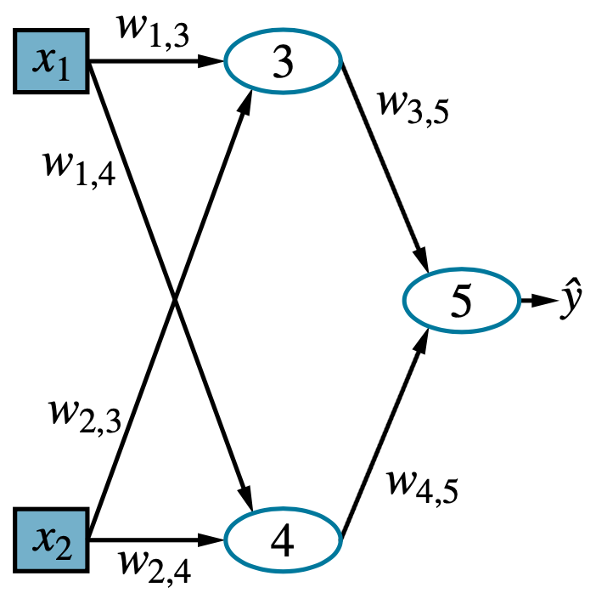
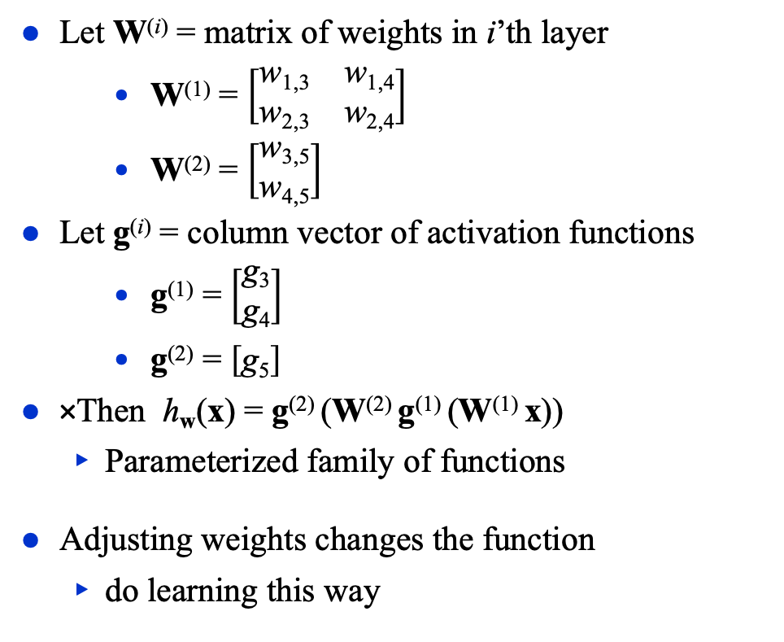
Example
Let W^{(i)} = matrix of weights in i’th layer
    W⁽¹⁾ = $\left[\begin{matrix}\text{w}\text{1,3} & \text{w}\text{1,}\text{4} \\ \text{w}\text{2}\text{,3} & \text{w}\text{2}\text{,}\text{4}\end{matrix}\right]$
    W⁽²⁾ = $\left[\begin{matrix}\text{w}\text{3,5} \\ \text{w}\text{4,5}\end{matrix}\right]$
Let g^{(i)} = column vector of activation functions
    g⁽¹⁾ = $\left[\begin{matrix}\text{g}\text{3} \\ \text{g}\text{4}\end{matrix}\right]$
    g⁽²⁾ = $\left[\text{g}\text{5}\right]$
﻿﻿Then h_{w}(x) = g⁽²⁾ (W⁽²⁾ g⁽¹⁾ (W⁽¹⁾ x))
  Parameterized family of functions
Adjusting weights changes the function
  do learning this way

Slide 18
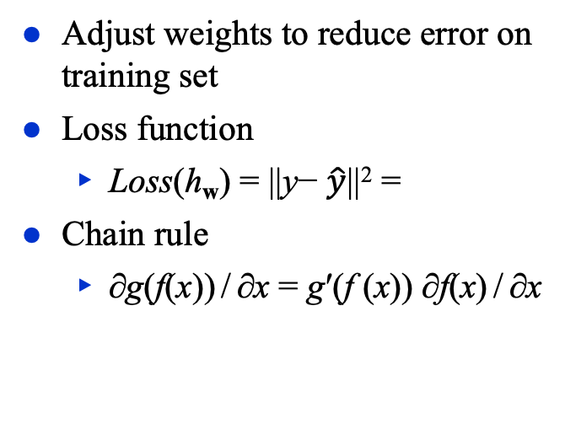
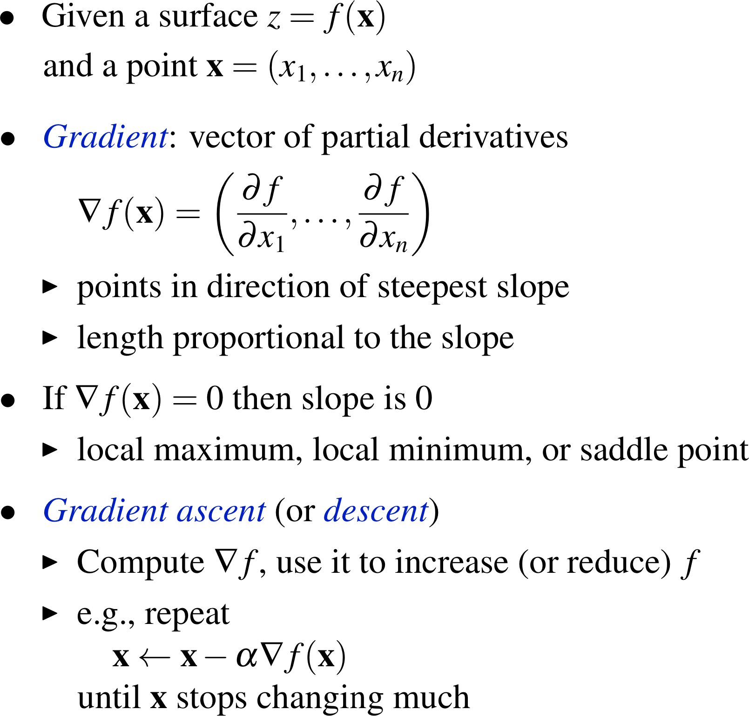
Back-Propagation Learning
Adjust weights to reduce error on training set
Loss function
  Loss(h_{w}) = ||y− $\hat{y}$||² =
Chain rule
  ∂g(f(x)) / ∂x = g′(f (x)) ∂f(x) / ∂x

Slide 19
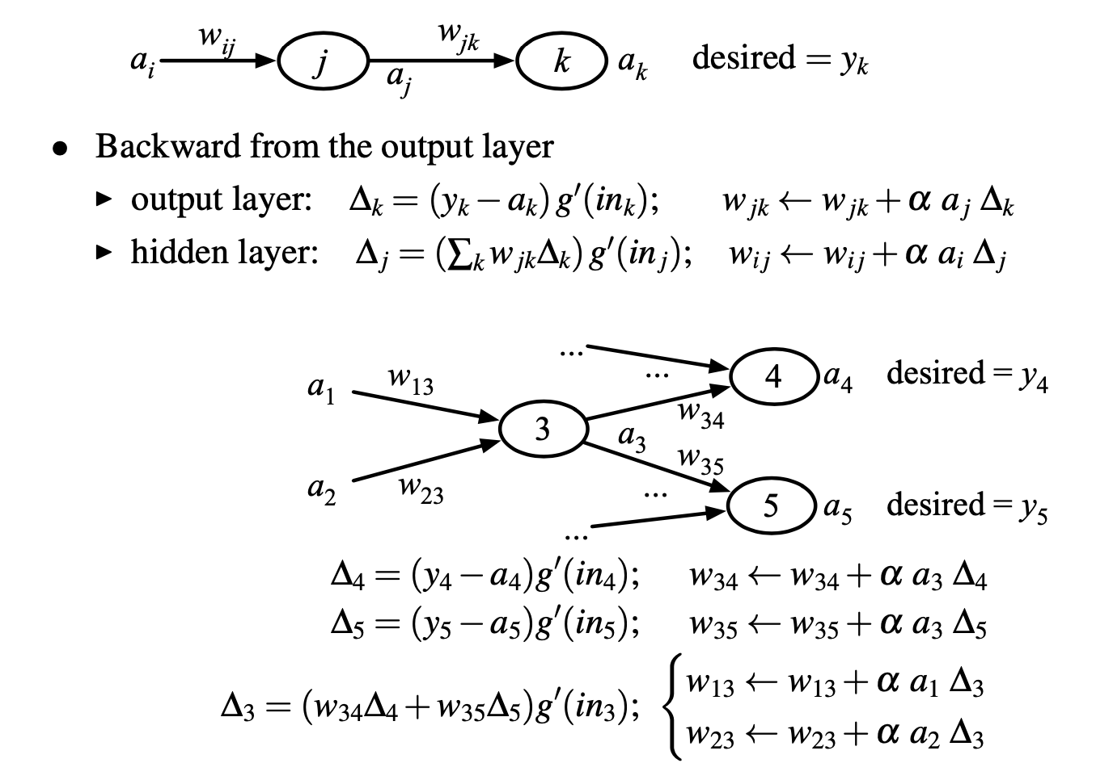
Back-Propagation Learning
Two ways:
Batch:
  At each epoch, compute the updates for all examples, then apply
  Don’t apply any of the updates until you’ve seen all the examples
Online:
  Update after each example
Can lead to different results
  At one time, batch was thought to be theoretically superior
  In practice, online seems to work better

Slide 20
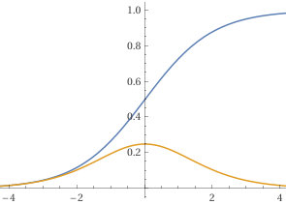
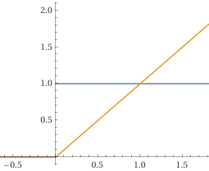
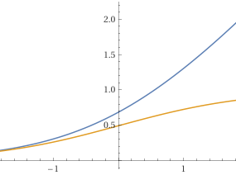
Activation Functions
logistic (sigmoid):
  g(z) = 1/(1+e^{–z})
  g′(z) = e^{–z}/(1+e^{–z})²
In deep multilayer networks, sigmoid has a vanishing gradient problem
  g′ too small to be useful
Rectified linear (ReLU) or softplus are widely used instead
ReLU:
  g(z) = max(0,z)
  g′(z) = 0 if z < 0, 1 if z > 0
softplus:
  g(z) = log(1+e^{z})
  g′(z) = 1/(1+e^{–z})

Slide 21
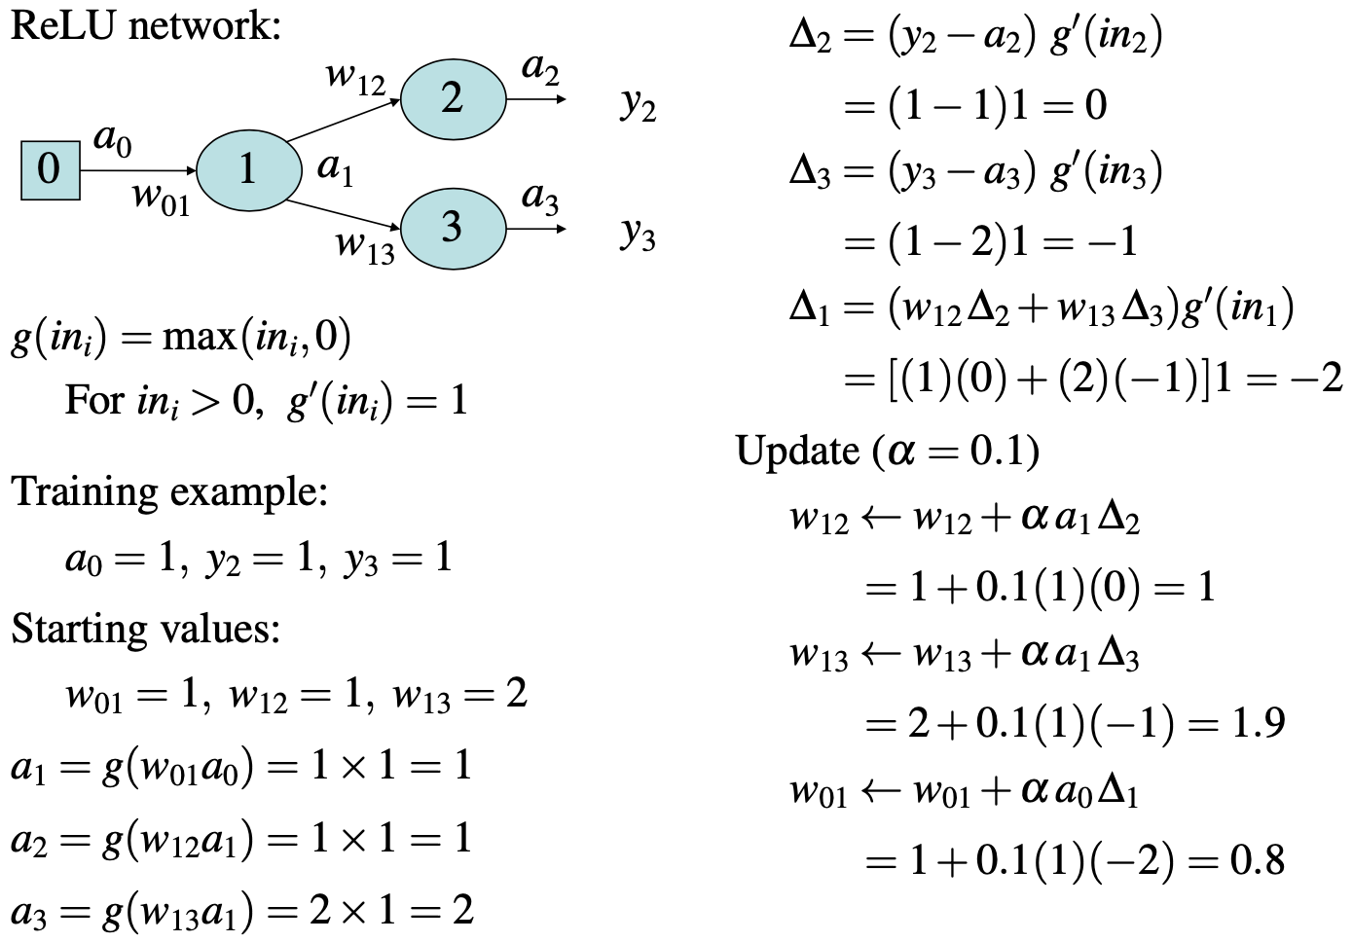
Example Computation
Poll. Is this a sensible
way to design a network?
  yes
  no
  don’t know

Slide 22
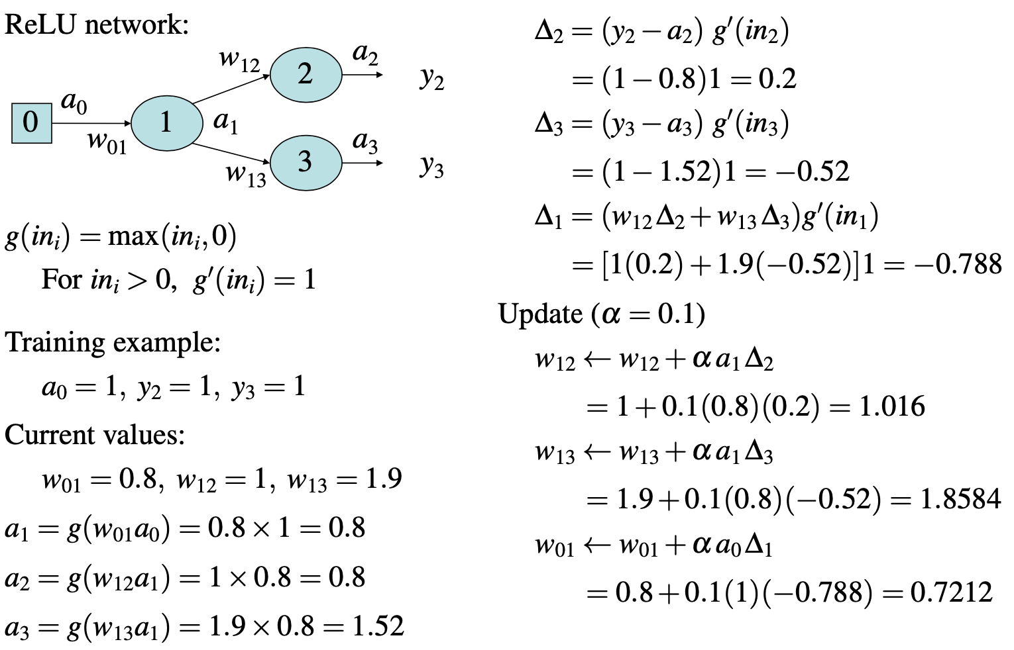
Example Computation (Continued)

Slide 23
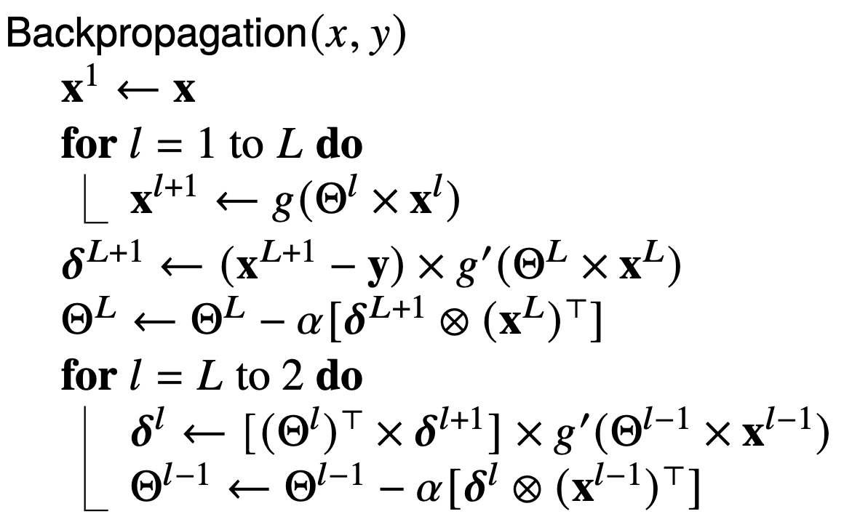
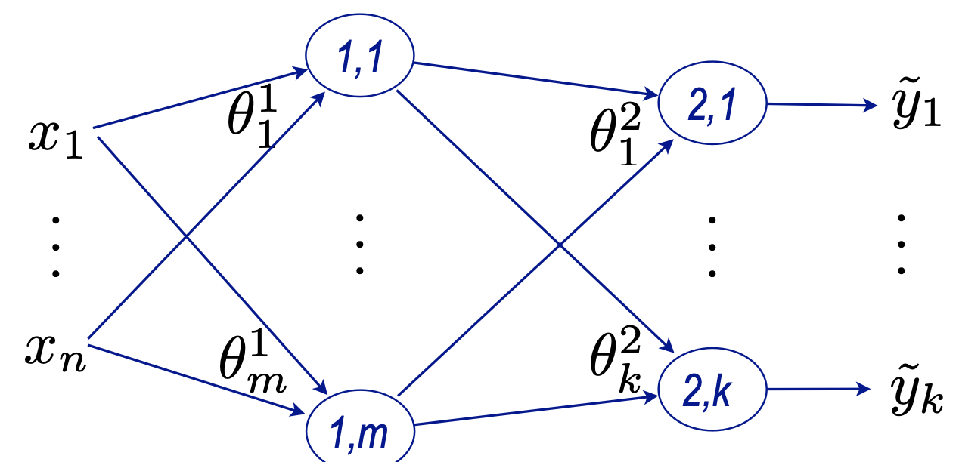

Relation to the Book
$\hat{y}$ → $\tilde{y}$
w → θ (with subscript, superscript)
w → θ

Slide 24
Summary
McCulloch-Pitts “units”
  weighted input, bias weight
  activation function
Expressivity
Multi-layer feed-forward networks
Back-propagation learning
  Gradient descent
  ReLU

