Slide 1
Chapter 11
Acting with Nondeterministic Models
Dana S. Nau
University of Maryland

Slide 2
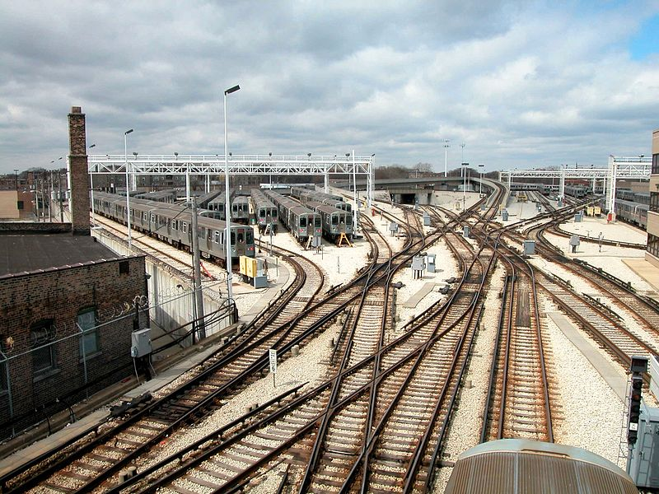
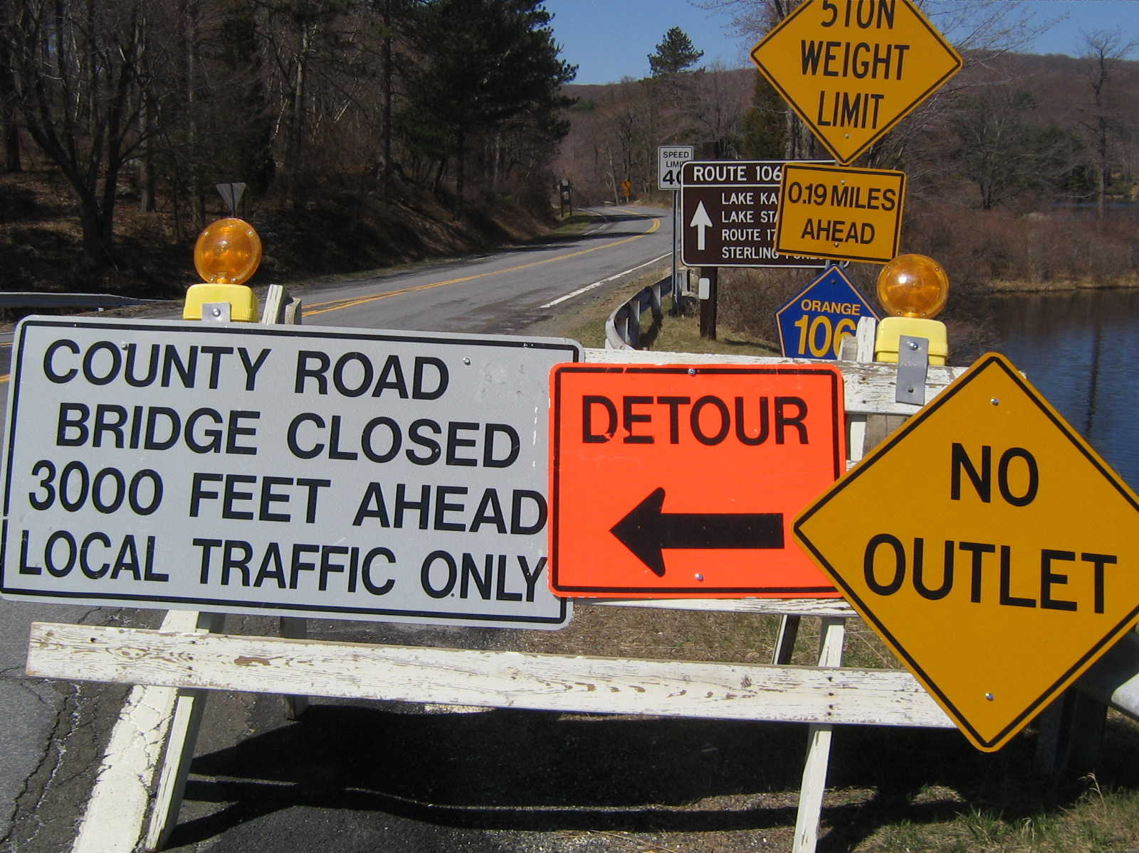
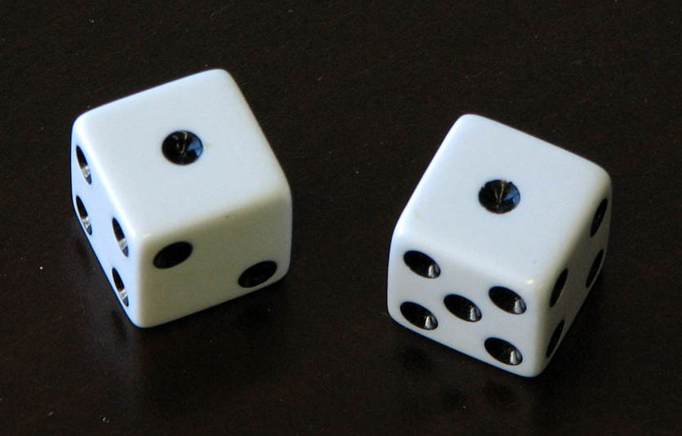
Motivation
In Chapters 8–10, we had probability distributions over the possible outcomes of actions
Sometimes we want to reason about nondeterminism without the probability distributions
  Probabilities might not be available
  We might want policies that satisfy safety conditions:
    Guaranteed to work for all possible action outcomes
c
a
b
grasp(c)
c
a
b
a
b
c
Credit: Dennis Hill, CC BY 2.0
Credit: Airtuna08, CC BY-SA 3.0
Credit: David Wilson, CC BY 2.0

Slide 3
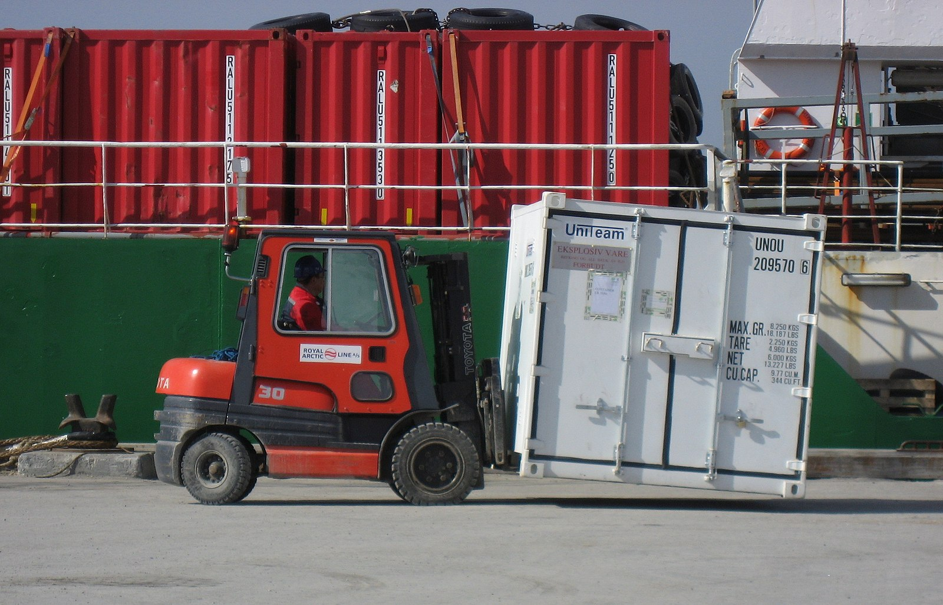
Example
Credit: Slaunger, CC BY-SA 3.0
Very simple harbor management domain
  Unload a single item from a ship
  Move it around a harbor
One state variable: pos(item)
  Simplified names for states
  For {pos(item)=on_ship}, just write on_ship

Slide 4

Nondeterministic Planning Domains
3-tuple (S, A, γ)
  S and A – finite sets of states and actions
  γ: S × A → 2^{S}
γ(s,a) = {all possible “next states” after
applying action a in state s}
  a is applicable in state s iff γ(s,a) ≠ $∅$
Applicable(s) = {all actions applicable in s}
= {a $∈$ A | γ(s,a) ≠ $∅$}
Example:
  Applicable(at_harbor) = {park}
  park has three possible outcomes
    put item in parking1 or parking2 if one of them has space
    or in transit1 if there’s no parking space
  γ(at_harbor, park) = {parking1, parking2, transit1}

Slide 5
Nondeterministic Planning Domains
One possible action representation:
  like classical, but with n mutually exclusive “effects” lists
e.g., park:
pre: pos(item) = at_harbor
eff₁: pos(item) ← parking1
eff₂: pos(item) ← parking2
eff₃: pos(item) ← transit1
Problem:
  number of effects lists may be combinatorially large
  Suppose a can cause any possible
  combination of effects e₁, e₂, …, e_{k}
  Need eff₁ , eff₂ , …, eff₂k
    One for for each combination
  Section 12.3: a different representation that can alleviate this
For now, ignore most of that, just look at the underlying semantics
  states, actions ⇔ nodes, edges in a graph

Slide 6
Nondeterministic Planning Domains
For deterministic planning problems, search space was a graph
Now it’s an AND/OR graph
  OR branch:
    several applicable actions,
    which one to choose?
  AND branch:
    multiple possible outcomes,
    must handle all of them
Analogy to PSP in Chapter 2
  OR branch ⇔ action selection
  AND branch ⇔ flaw selection

Slide 7
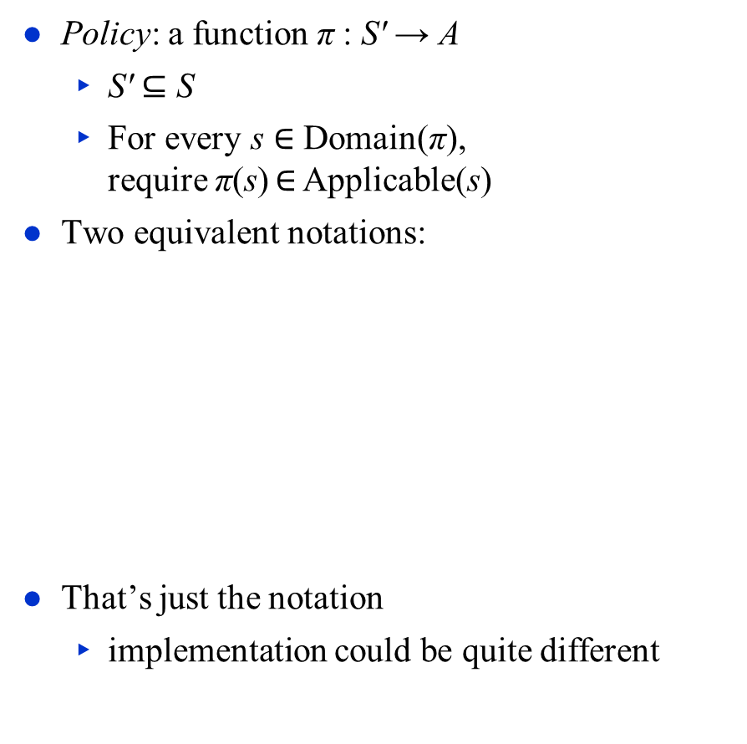
Policies
Policy: a function π : S′ → A
  S′ $⊆$ S
  For every s $∈$ Domain(π),
  require π(s) $∈$ Applicable(s)
Two equivalent notations:
That’s just the notation
  implementation could be quite different
π₁(on_ship) = unload,
π₁ (at_harbor) = park,
π₁ (parking1) = deliver
π₁ = {(on_ship, unload),
(at_harbor, park),
(parking1, deliver)}

Slide 8
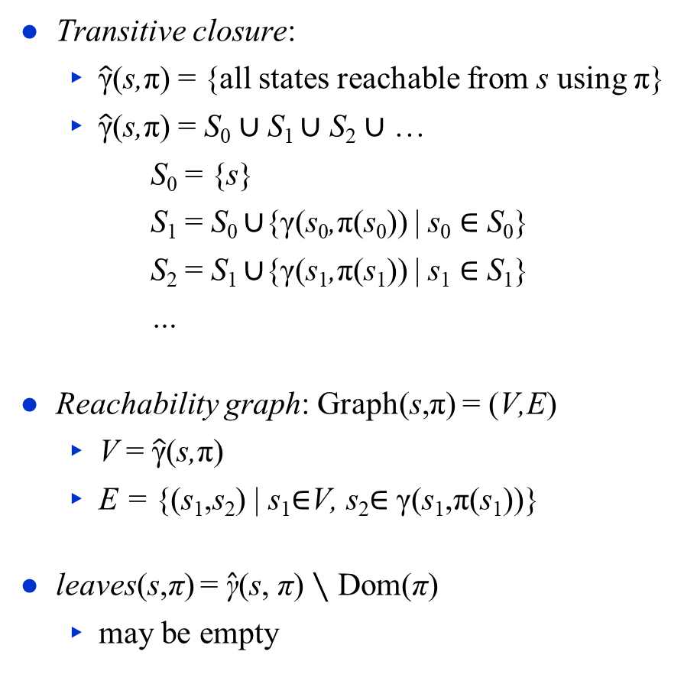
Definitions Over Policies
Transitive closure:
  $\hat{\text{γ}}$(s,π) = {all states reachable from s using π}
  $\hat{\text{γ}}$(s,π) = S₀ ∪ S₁ ∪ S₂ ∪ …
      S₀ = {s}
      S₁ = S₀ ∪{γ(s₀,π(s₀)) | s₀ ∈ S₀}
      S₂ = S₁ ∪{γ(s₁,π(s₁)) | s₁ ∈ S₁}
      …
Reachability graph: Graph(s,π) = (V,E)
  V = $\hat{\text{γ}}$(s,π)
  E = {(s₁,s₂) | s₁$∈$V, s₂$∈$ γ(s₁,π(s₁))}
leaves(s,π) = $\hat{\text{γ}}$(s, π) ∖ Dom(π)
  may be empty
π₁ = {(on_ship, unload),
(at_harbor, park),
(parking1, deliver)}

Slide 9

Acting with a Policy
ActPolicy(π)
s ← observe current state
while s $∈$ Domain(π) do
perform action π(s)
s ← observe current state
π₁ = {(on_ship, unload),
(at_harbor, park),
(parking1, deliver)}

Slide 10
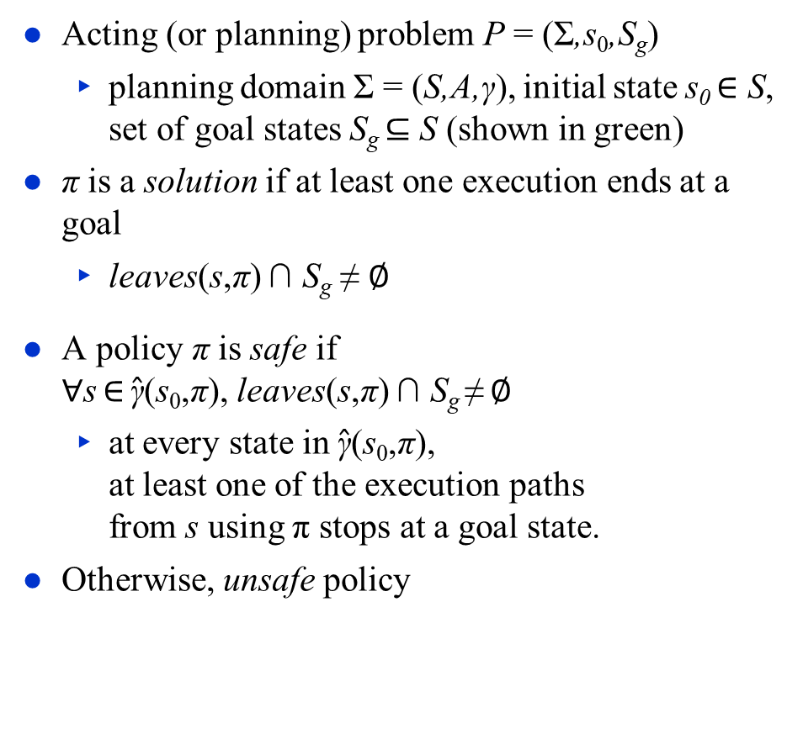
Types of Policies
Acting (or planning) problem P = (Σ,s₀,S_{g})
  planning domain Σ = (S,A,γ), initial state s₀ $∈$ S,
  set of goal states S_{g} $⊆$ S (shown in green)
π is a solution if at least one execution ends at a goal
  leaves(s,π) ∩ S_{g} ≠ $∅$
A policy π is safe if
$∀$s $∈$ $\hat{\text{γ}}$(s₀,π), leaves(s,π) ∩ S_{g} ≠ $∅$
  at every state in $\hat{\text{γ}}$(s₀,π),
  at least one of the execution paths
  from s using π stops at a goal state.
Otherwise, unsafe policy
S_{g}
s₀
π₁ = {(on_ship, unload),
(at_harbor, park),
(parking1, deliver)}
Poll: Is π₁ safe or unsafe?

Slide 11
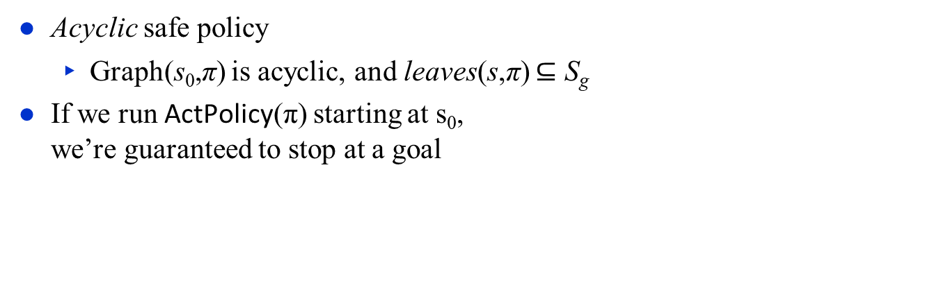
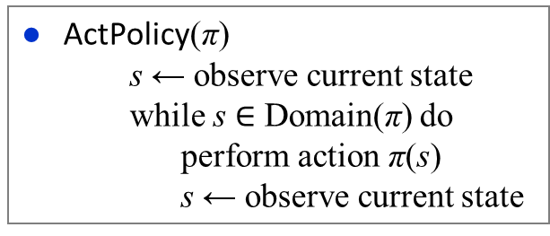
Safe Policies
ActPolicy(π)
s ← observe current state
while s $∈$ Domain(π) do
perform action π(s)
s ← observe current state
Acyclic safe policy
  Graph(s₀,π) is acyclic, and leaves(s,π) $⊆$ S_{g}
If we run ActPolicy(π) starting at s₀,
we’re guaranteed to stop at a goal
  π₂ = {(on_ship, unload), (at_harbor, park),
  (parking1, deliver), (parking2, deliver),
  (transit1, move), (transit2, move),
  (transit3, move)}

Slide 12

Safe Policies
ActPolicy(π)
s ← observe current state
while s $∈$ Domain(π) do
perform action π(s)
s ← observe current state
Cyclic safe policy
  Graph(s₀, π) is cyclic, and leaves(s,π) $⊆$ S_{g} ,
  and $∀$s $∈$ $\hat{\text{γ}}$(s₀,π), leaves(s,π) ∩ S_{g} ≠ $∅$
    At every state s in $\hat{\text{γ}}$(s₀,π),
    at least one of the execution
    paths from s using π
    ends at a goal state
  Will never get caught in
  a dead end
Poll: Let π be a cyclic safe solution. Suppose we run ActPolicy(π) starting at s₀.
Are there situations where we can be sure π will reach a goal?
Are there situations where we can’t be sure π will reach a goal?
back
  π₃ = {(on_ship, unload), (at_harbor, park),
  (parking1, deliver), (parking2, back),
  (transit1, move), (transit2, move),
  (gate1, back)}
move
move

Slide 13

Safe Policies
ActPolicy(π)
s ← observe current state
while s ∈ Domain(π) do
perform action π(s)
s ← observe current state
Cyclic safe policy
  Graph(s₀, π) is cyclic, and leaves(s,π) $⊆$ S_{g},
  and $∀$s $∈$ $\hat{\text{γ}}$(s₀,π), leaves(s,π) ∩ S_{g} ≠ $∅$
    At every state s in $\hat{\text{γ}}$(s₀,π),
    at least one of the execution
    paths from s using π
    ends at a goal state
  Will never get caught in
  a dead end
  Every “fair”
  execution will
  reach a goal
Poll:
Can you think of a real-world situation in which all executions are “fair”?
Can you think of a real-world situation in which there are “unfair” executions?
back
  π₃ = {(on_ship, unload), (at_harbor, park),
  (parking1, deliver), (parking2, back),
  (transit1, move), (transit2, move),
  (gate1, back)}
move
move

Slide 14
Kinds of Solution Policies
Goal States
  acyclic
  policies
  a
  safe policies
  cyclic policies
  c
  solution
  policies
  unsafe policies
  b

Slide 15
Beyond Policies
Sometimes we want to give the actor instructions that can’t be described as a policy, e.g.,
    Try to open the door twice.
    If it opens, go through it.
    If it doesn’t, go to another door
The book describes two other ways to represent instructions to the actor
  Input/Output Automata
  Behavior Trees
I’ll discuss behavior trees in a separate set of slides
same state of the world
actor’s internal state is different
door closed
go elsewhere
s₂
door closed
open
door
door closed
open
door
go thru door
door open
s₃

Slide 16
Summary
Actions, plans, policies, planning problems
Types of solution policies:
  unsafe, safe (acyclic, cyclic)
Motivation for instructions other than policies

