Slide 1
Chapter 12
Planning with Nondeterministic Models
Dana S. Nau
University of Maryland

Slide 2
Kinds of Solution Policies
Goal States
  acyclic
  policies
  a
  safe policies
  cyclic policies
  c
  solution
  policies
  unsafe policies
  b

Slide 3
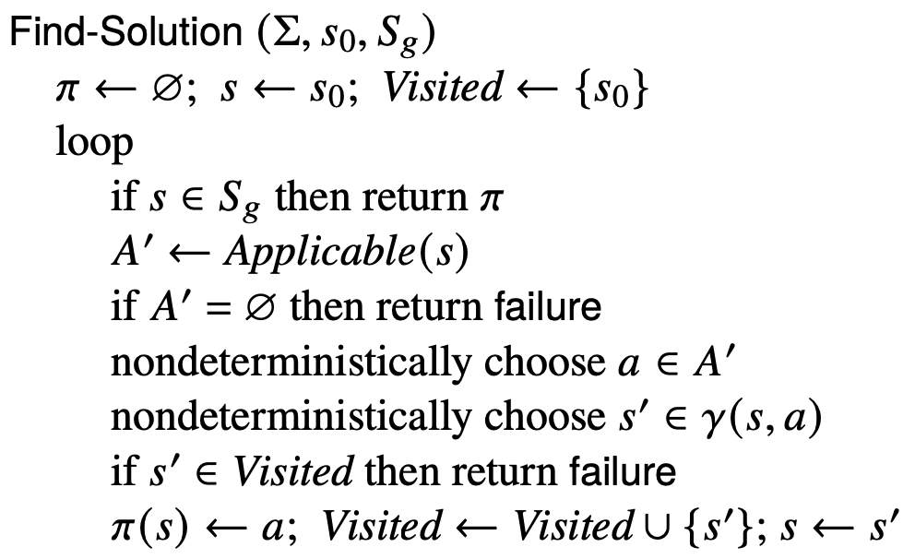
Finding (Unsafe) Solutions
For comparison:
Forward-search (Σ, s₀, g)
  s ← s₀; π ← ⟨⟩
  while s ⊭ g do
    if Applicable(s) = ∅ then return failure
    nondeterministically choose a ∈ Applicable(s)
    s ← γ(s,a); π ← π·a
  return π
(*)
Decide which state to plan for
Cycle-checking

Slide 4
Finding (Unsafe) Solutions
Poll: which should (*) be?
A. nondeterministically choose
B. arbitrarily choose
C. don’t know
(*)
Decide which state to plan for
Cycle-checking

Slide 5
Example
s = on_ship
S_{g}
s
π = {}
Visited = {on_ship}

Slide 6
Example
s = on_ship
a = unload
γ(s,a) = {at_harbor}
s ← s′ = at_harbor
S_{g}
a
s
s′
π = {(on_ship, unload)}
Visited = {on_ship, at_harbor}

Slide 7
Example
s = at_harbor
a = park
γ(s,a) = {parking1,
parking2,
transit1}
s ← s′ = parking1
S_{g}
a
s
π = {(on_ship, unload),
(at_harbor, park)}
s′
Visited = {on_ship, at_harbor, parking1}

Slide 8
Example
s = parking1
a = deliver
γ(s,a) = {gate1,
gate2,
transit2}
s ← s′ = gate1
S_{g}
s′
a
π = {(on_ship, unload),
(at_harbor, park),
(parking1, deliver)}
s
Visited = {on_ship, at_harbor, parking1, gate1}

Slide 9
Example
s = gate1
S_{g}
s
gate1 is a goal,
so return π
π = {(on_ship, unload),
(at_harbor, park),
(parking1, deliver)}
Visited = {on_ship, at_harbor, parking1, gate1}

Slide 10
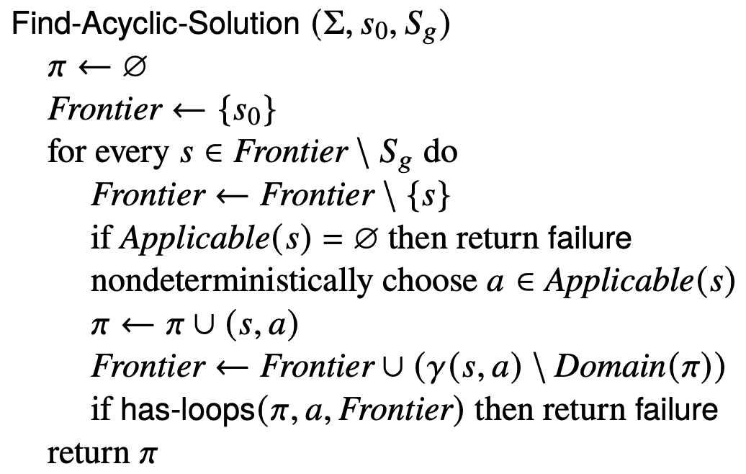
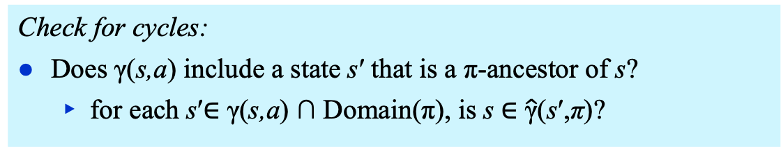
Find-Acyclic-Solution
Keep track of unexpanded states, as in A*
Add all states s such that
π(s) isn’t already defined
Check for cycles:
Does γ(s,a) include a state s′ that is a π-ancestor of s?
  for each s′∈ γ(s,a) ∩ Domain(π), is s ∈ $\hat{\text{γ}}$(s′,π)?

Slide 11
Example
S_{g}
Frontier = {on_ship}
π = {}

Slide 12
Example
S_{g}
Frontier = {at_harbor}
π = {(on_ship, unload)}

Slide 13
Example
S_{g}
Frontier = {parking1, parking2, transit1}
π = {(on_ship, unload),
(at_harbor, park)}

Slide 14
Example
S_{g}
Frontier = {parking2, transit1, transit2,
gate1, gate2}
π = {(on_ship, unload),
(at_harbor, park),
(parking1, deliver)}

Slide 15
Example
nondeterministically choose back or deliver
back ⇒ cycle, so return failure
deliver ⇒ no cycle, so continue
S_{g}
Frontier = {transit1, transit2, transit3 ,
gate1, gate2}
π = {(on_ship, unload),
(at_harbor, park),
(parking1, deliver),
(parking2, deliver)}

Slide 16
Example
S_{g}
Frontier = {transit2, transit3,
gate1, gate2}
π = {(on_ship, unload),
(at_harbor, park),
(parking1, deliver),
(parking2, deliver),
(transit1, move)}

Slide 17
Example
S_{g}
Frontier = {transit3,
gate1, gate2}
π = {(on_ship, unload),
(at_harbor, park),
(parking1, deliver),
(parking2, deliver),
(transit1, move),
(transit2, move)}

Slide 18
Example
S_{g}
Frontier = {gate1, gate2} ⊆ S_{g}
Found a solution
π = {(on_ship, unload),
(at_harbor, park),
(parking1, deliver),
(parking2, deliver),
(transit1, move),
(transit2, move),
(transit3, move)}

Slide 19
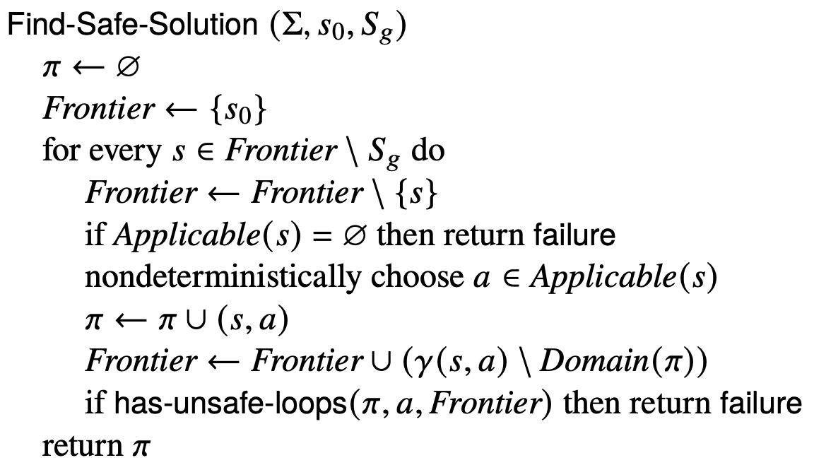
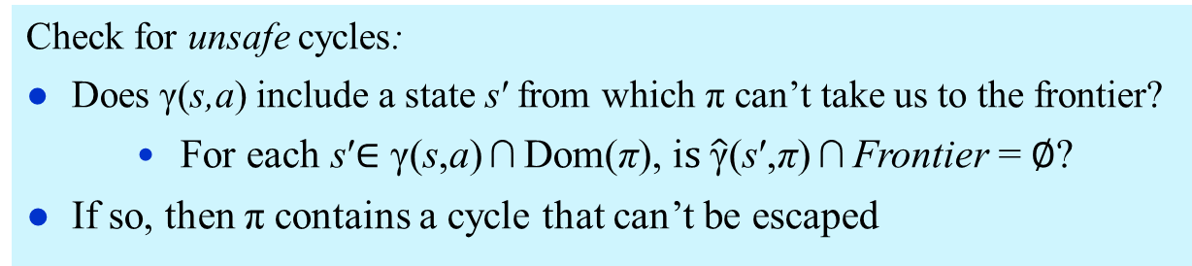
Find-Safe-Solution
Like
Find-Acyclic-Solution
except here:
Check for unsafe cycles:
Does γ(s,a) include a state s′ from which π can’t take us to the frontier?
    For each s′$∈$ γ(s,a) ∩ Dom(π), i$s \hat{\text{γ}}$(s′,π) ∩ Frontier = $∅$?
If so, then π contains a cycle that can’t be escaped

Slide 20
Example
S_{g}
Frontier = {on_ship}
π = {}

Slide 21
Example
S_{g}
Frontier = {at_harbor}
π = {(on_ship, unload)}

Slide 22
Example
S_{g}
Frontier = {parking1, parking2, transit1}
π = {(on_ship, unload),
(at_harbor, park)}

Slide 23
Example
S_{g}
Frontier = {parking2, transit1, transit2,
gate1, gate2}
π = {(on_ship, unload),
(at_harbor, park),
(parking1, deliver)}

Slide 24
Example
Nondeterministically choose either back or deliver
back is OK because cycle is escapable
S_{g}
Frontier = {parking2, transit1, transit2,
gate1, gate2}
π = {(on_ship, unload),
(at_harbor, park),
(parking1, deliver)}

Slide 25
Example
S_{g}
Frontier = {transit1, transit2,
gate1, gate2}
π = {(on_ship, unload),
(at_harbor, park),
(parking1, deliver),
(parking2, back)}

Slide 26
Example
S_{g}
Frontier = {transit2,
gate1, gate2}
π = {(on_ship, unload),
(at_harbor, park),
(parking1, deliver),
(parking2, back),
(transit1, move)}

Slide 27
Example
S_{g}
Frontier = {gate1, gate2} ⊆ S_{g}
π = {(on_ship, unload),
(at_harbor, park),
(parking1, deliver),
(parking2, back),
(transit1, move),
(transit2, move)}

Slide 28
Guided-Find-Safe-Solution
Motivation: much easier to find solutions if they don’t have to be safe
  Find-Safe-Solution needs plans for all possible outcomes of actions
  Find-Solution only needs a plan for one of them
Idea:
  loop
    Find a (possibly unsafe) solution π
    For each each leaf node of π
      If the leaf node isn’t a goal,
        find a (possibly unsafe) solution
        and incorporate it into π

Slide 29
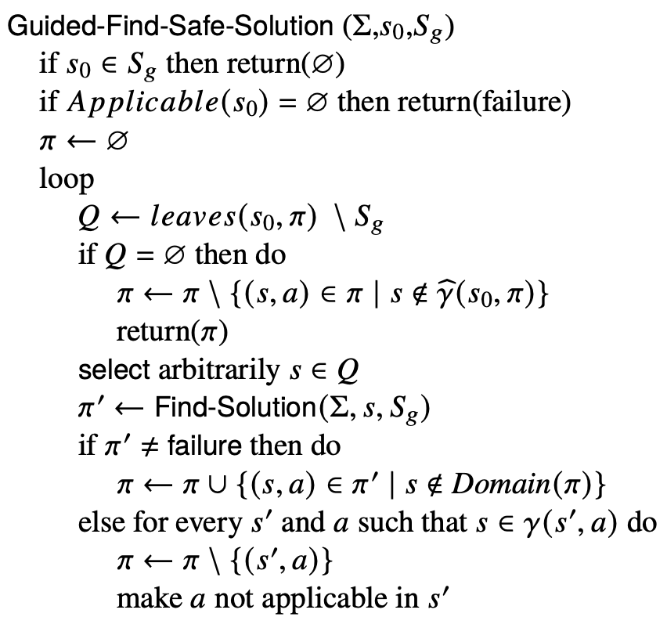
Guided-Find-Safe-Solution
π is a solution. Return the part that’s reachable from s₀.
Choose any leaf s that isn’t a goal.
Find a (possibly unsafe) solution π′ for s.
For each (s,a) in π′, add to π
unless π already has an action at s
s is unsolvable. For each (s′,a) that can produce s, modify π and Σ so we’ll never use a at s′

Slide 30
Example
tr5
tr4
S_{g}

Slide 31
Example
tr5
tr4
S_{g}
π = {(on_ship, unload),
(at_harbor, park),
(parking1, deliver)}
Q = {parking2, transit1,
transit2}

Slide 32
Example
tr5
tr4
S_{g}
π = {(on_ship, unload),
(at_harbor, park),
(parking1, deliver),
(parking2, deliver)}
Q = {transit1, transit2,
transit3}

Slide 33
Example
tr5
tr4
S_{g}
π = {(on_ship, unload),
(at_harbor, park),
(parking1, deliver),
(parking2, deliver),
(transit3, move),
(tr4, move)}
Q = {transit1, transit2, tr5}

Slide 34
Example
fail
tr5
tr4
S_{g}
π = {(on_ship, unload),
(at_harbor, park),
(parking1, deliver),
(parking2, deliver),
(transit3, move),
(tr4, move)}
Q = {transit1, transit2, tr5}

Slide 35
Example
Modify Σ to make move inapplicable at transit3
tr5
tr4
S_{g}
π = {(on_ship, unload),
(at_harbor, park),
(parking1, deliver),
(parking2, deliver),
(tr4, move)}
Q = {transit1, transit2,
transit3}
Notes:
I removed \Sigma_d here since we haven’t yet discussed determinization. Correct?

Slide 36
Example
fail
tr5
tr4
S_{g}
π = {(on_ship, unload),
(at_harbor, park),
(parking1, deliver),
(parking2, deliver),
(tr4, move)}
Q = {transit1, transit2,
transit3}

Slide 37
Example
Modify Σ to make deliver inapplicable at parking2
tr5
tr4
S_{g}
π = {(on_ship, unload),
(at_harbor, park),
(parking1, deliver),
(tr4, move)}
Q = {transit1, transit2,
parking2}
Notes:
I removed \Sigma_d here since we haven’t yet discussed determinization. Correct?

Slide 38
Example
tr5
tr4
S_{g}
π = {(on_ship, unload),
(at_harbor, park),
(parking1, deliver),
(tr4, move),
(parking2, back)}
Q = {transit1, transit2}

Slide 39
Example
tr5
tr4
S_{g}
π = {(on_ship, unload),
(at_harbor, park),
(parking1, deliver),
(tr4, move),
(parking2, back),
(transit1, move)}
Q = {transit2}

Slide 40
Example
tr5
tr4
S_{g}
π = {(on_ship, unload),
(at_harbor, park),
(parking1, deliver),
(tr4, move),
(parking2, back),
(transit1, move),
(transit2, move)}
Q = ∅

Slide 41
Example
Remove (tr4,move) from π because π can’t ever reach tr4
tr5
tr4
S_{g}
π = {(on_ship, unload),
(at_harbor, park),
(parking1, deliver),
(tr4, move),
(parking2, back),
(transit1, move),
(transit2, move)}
Q = ∅

Slide 42
Discussion
How to implement it?
  Need implementation of Find-Solution
  Need it to be very efficient
    We’ll call it many times
Idea: instead of Find-Solution,
use a classical planner
  Any of the algorithms from Chapter 2
  Efficient algorithms, search heuristics
Need to convert the actions into something the classical planner can use …

Slide 43
Determinization
Let a_{i} be a nondeterministic action with n possible outcomes
Determinization of a_{i} =
  {n deterministic actions, one for each outcome of a_{i} }
at_harbor
park
parking1
transit1
parking2
at_harbor
park1
park3
park2
parking1
transit1
parking2

Slide 44
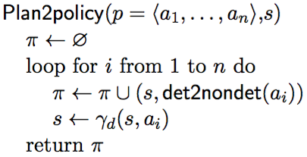
Determinization
Suppose a classical planner returns an acyclic plan p = ⟨a₁, a₂, …, a_{n}⟩
Actions and states: ⟨s₀, a₁, s₁, a₂, s₂, a₃, …, a_{n}, s_{n}⟩
Convert p to a policy ⟨(s₀,a₁), (s₁,a₂), …, (s_{n–1},a_{n})⟩
  a₁ = the nondeterministic action whose determinization includes a_{i}

Slide 45
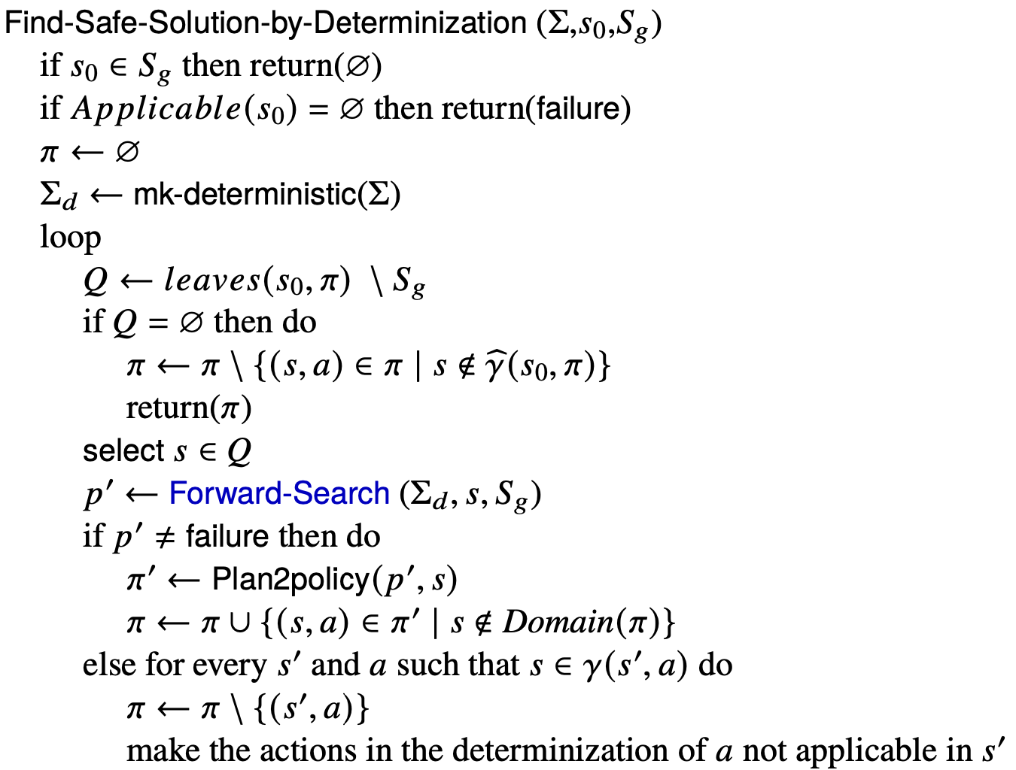
Find-Safe-Solution-by-Determinization
Any classical planner that doesn’t return cyclic plans

Slide 46
Example
tr5
tr4
S_{g}

Slide 47
Example
tr5
tr4
S_{g}

Slide 48
Example
tr5
tr4
S_{g}

Slide 49
Example
tr5
tr4
S_{g}

Slide 50
Example
tr5
tr4
S_{g}

Slide 51
Example
tr5
tr4
S_{g}

Slide 52
Example
fail
tr5
tr4
S_{g}

Slide 53
Example
Modify Σ_{d} to make move inapplicable at transit3
tr5
tr4
S_{g}

Slide 54
Example
fail
tr5
tr4
S_{g}

Slide 55
Example
Modify Σ_{d} to make deliver inapplicable at parking2
tr5
tr4
S_{g}

Slide 56
Example
tr5
tr4
S_{g}

Slide 57
Example
tr5
tr4
S_{g}

Slide 58
Example
tr5
tr4
S_{g}

Slide 59
Example
tr5
tr4
S_{g}

Slide 60
Example
tr5
tr4
S_{g}

Slide 61
Example
Remove (tr4,move) from π because π can’t ever reach tr4
tr5
tr4
S_{g}

Slide 62
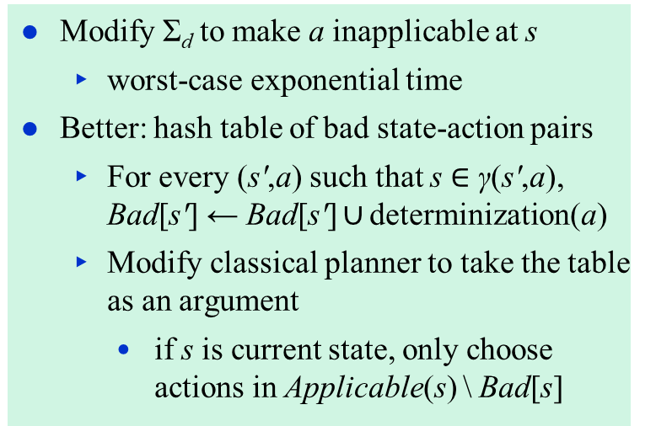
Making Actions Inapplicable
Modify Σ_{d} to make a inapplicable at s
  worst-case exponential time
Better: hash table of bad state-action pairs
  For every (s′,a) such that s $∈$ γ(s′,a),
  Bad[s′] ← Bad[s′] $∪$ determinization(a)
  Modify classical planner to take the table as an argument
    if s is current state, only choose
    actions in Applicable(s) \ Bad[s]

Slide 63
12.1.3 Online Approaches
Motivation
  Planning models are approximate – execution seldom works out as planned
  Large problems may require too much planning time
2nd motivation even more stronger in nondeterministic domains
  Nondeterminism makes planning exponentially harder
    Exponentially more time, exponentially larger policies
Offline vs Runtime
Search Spaces

Slide 64
Online Approaches
Need to identify good actions without exploring entire search space
  Can be done using heuristic estimates
Some domains are safely explorable
  Safe to create partial plans, because goal states are always reachable
In domains with dead-ends, partial planning won’t guarantee success
  Can get trapped in dead ends that we would have detected if we had planned fully
    No applicable actions
      robot’s battery goes dead
    Applicable actions, but caught in a loop
      robot goes into a collection of rooms from which there’s no exit
  But partial planning can still make success more likely

Slide 65
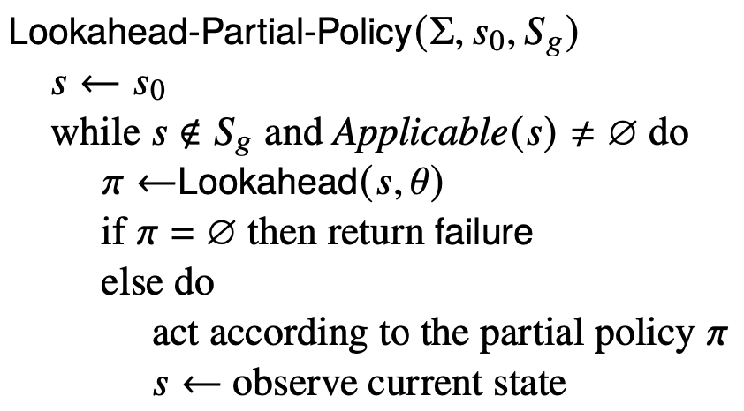
Lookahead-Partial-Plan
Adaptation of Run-Lazy-Lookahead (Chapter 2)
Lookahead is any planning
algorithm that returns a policy π
  π may be partial or unsafe solution
Execute π as far as it will go, then call Lookahead again
tr5
tr4
S_{g}

Slide 66
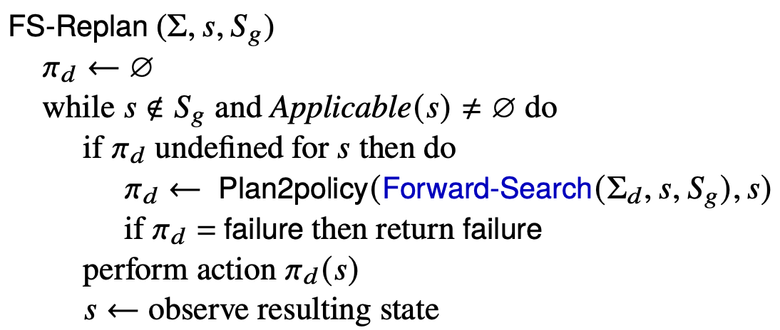
FS-Replan
tr5
tr4
S_{g}
Adaptation of Lookahead-Partial-Plan
  Calls classical planner on determinized domain
  Gets plan, converts converts to policy
    Unsafe solution
  Executes policy as far as it will go, then calls classical planner again

Slide 67
More Possibilities for Lookahead
What if Lookahead doesn’t
have time to run to completion?
  Can use the same techniques
  we discussed in Chapter 3
    Receding horizon
    Sampling
    Subgoaling
    Iterative deepening
  A few others …
Planning
Acting

Slide 68
More Possibilities for Lookahead
Full horizon, limited breadth:
  look for solution that works for some of the outcomes
  E.g., modify Find-Acyclic-Solution to examine i outcomes of each action
Iterative broadening:
  for i = 1 by 1 until time runs out
    look for a solution that handles i outcomes per action
S_{g}
T ← i elements of γ(s,a) \ Domain(π)
Frontier ← Frontier ∪ T

Slide 69
Safely Explorable Domains
Safely explorable domain
  for every state s, at least one goal state is reachable from s
For Lookahead, suppose we use Lookahead-Partial-Plan or FS-Replan
  Then Lookahead never returns failure
Every “fair” execution will eventually reach a goal
Poll: Suppose we just choose a random action each time. Is every “fair” execution guaranteed to reach a goal?

Slide 70
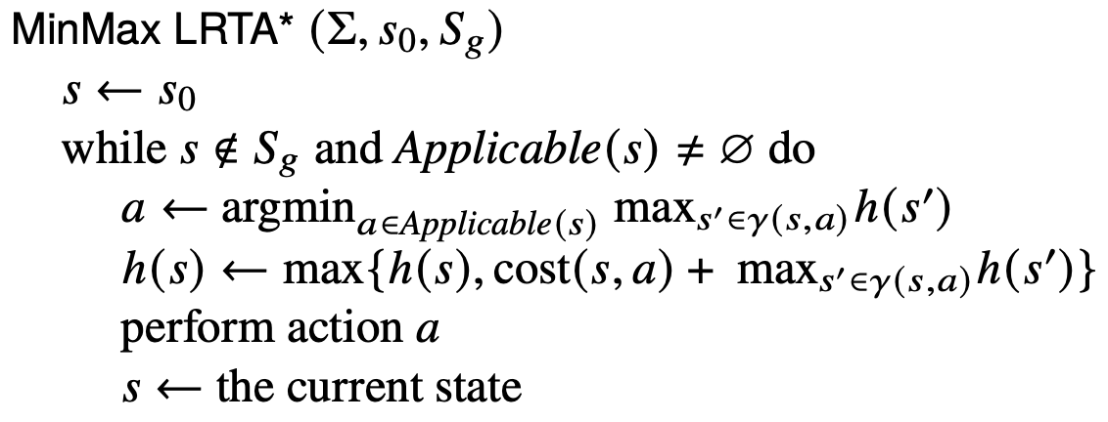
Min-Max LRTA*
loop
  choose an action a that (according to h) has optimal worst-case cost
    Update h(s) to use a’s worst-case cost
    Perform a
In safely explorable domains with no “unfair” executions, guaranteed to reach a goal

Slide 71
Example
S_{g}
Suppose that initially,
h(s) = 0 for every s
h = 0

Slide 72
Example
S_{g}
a = unload
h = 1
Suppose that initially,
h(s) = 0 for every s
h = 0

Slide 73
Example
h = 0
S_{g}
a = unload
h = 1
h = 0
a = park
h = 1+max(0,0,0)
= 1
h = 0

Slide 74
Example
h = 0
a = deliver
h = 1
1+ 1 = 2
h = 0
1+ max(0,0) = 1
S_{g}
a = unload
h = 1
a = park
h = 1+max(0,0,0)
= 1

Slide 75
Summary
Types of solutions: unsafe, safe (acyclic, cyclic)
Find-Solution,
Find-Acyclic-Solution
Find-Safe-Solution
Guided-Find-Safe-Solution
  call Find-Solution to get an unsafe solution
  call Find-Solution again on the leaves
  if dead-ends are encountered, modify actions that lead to them
Find-Safe-Solution-by-Determinization
  Like Guided-Find-Safe-Solution, but
  call classical planner on determinized domain, convert plan into policy
Online approaches
  Lookahead-Partial-Plan
    adaptation of Run-Lazy-Lookahead
  FS-Replan
    adaptation of Run-Lookahead
Ways to do the lookahead
  full breadth with limited depth,
    iterative deepening
  full depth with limited breadth
    iterative broadening
  convergence in safely explorable domains
Min-Max LRTA*

