Slide 1
Chapter 14
Acting with Hierarchical Refinement
Dana S. Nau
University of Maryland

Slide 2


Planning and Acting
Actor
Planning
Tasks
Planning: prediction + search
  Search over predicted states, possible
  organizations of tasks and actions
  Uses descriptive models (e.g., PDDL)
    predict what the actions will do
    don’t include instructions for performing it
Acting: performing
  Dynamic, unpredictable, partially observable environment
    Adapt to context, react to events
  Uses operational models
    instructions telling how to perform the tasks
    usually hierarchical
Queries
Plans
Acting
State
Actions
Events
Execution Platform
Actuation
Sensing
⟵ We’ll use hierarchical refinement methods
  Extended version of HTN methods

Slide 3
Example
Consider an actor that controls two robots
Environment is partially observable
  Each robot can only see what’s at the current location
Objects
  Robots = {r1, r2}
  Containers = {c1, c2}
  Locations = {loc0, loc1, loc2, loc3, loc4}
Rigid relations (properties that won’t change)
  adjacent(loc0,loc1), adjacent(loc1,loc0), adjacent(loc1,loc2), adjacent(loc2,loc1), adjacent(loc2,loc3), adjacent(loc3,loc2), adjacent(loc3,loc4), adjacent(loc4,loc3)
c2
loc4
loc3
r2
c1
r1
loc2
loc1
loc0
State variables (fluents)
    where r ∈ Robots, c ∈ Containers, l ∈ Locations
  loc(r) ∈ Locations
  cargo(r) ∈ Containers ⋃ {empty}
  pos(c) ∈ Locations ⋃ Robots ⋃ {unknown}
  view(l) ∈ {T, F}
    Whether a robot has looked at location l
    If view(l) = T then pos(c) = l for every container c at l

Slide 4
Example (continued)
c2
loc4
loc3
r2
c1
Actor
Planning
r1
Tasks
loc2
loc1
loc0
Queries
Plans
Acting
Actions:
  take(r,o,l): r takes object o at location l
  put(r,o,l): r puts o at location l
  perceive(r,l): robot r perceives what objects are at l
  move-to(r,l): robot r moves to location l
These are not classical actions
  Commands to the execution platform
State
Actions
Events
Execution Platform
Actuation
Sensing

Slide 5
Tasks and Refinement Methods
Task: an activity for the actor to perform
  taskname(arg₁, …, arg_{k})
For each task, one or more refinement methods
  Operational models telling how to perform the task
  Like extended versions of HTN methods
c2
loc4
loc3
r2
c1
r1
loc2
loc1
loc0
method-name(arg₁, …, arg_{k})
task: task-identifier
pre: test
body: a program
m-fetch1(r,c)
task: fetch(r,c)
pre: pos(c) = unknown
body:
if ∃l (view(l) = F) then
  move-to(r,l)
  perceive(r,l)
  if pos(c) = l then
  take(r,c,l)
  else fetch(r,c)
  else fail
m-fetch2(r,c)
task: fetch(r,c)
pre: pos(c) ≠ unknown
body:
if loc(r) = pos(c) then
take(r,c,pos(c))
else do
move-to(r,pos(c))
take(r,c,pos(c))
assignment statements
control constructs:
  if-then-else, while, … .
tasks
  can extend to include events, goals
actions
action
task

Slide 6
RAE (Refinement Acting Engine)
Tasks
Actor
Hierarchical
Operational
Models
Acting Engine
(RAE)
Performs multiple tasks in parallel
  Purely reactive, no lookahead
For each task τ, a refinement stack
  execution stack
Agenda = {all current refinement stacks}
Refinement stack for a task τ
⬄ current path in the refinement tree
State
Actions
Events
Execution Platform
Actuation
Sensing
procedure RAE:
  loop:
    for every new external task or event τ do
      choose a method instance m for τ
      create a refinement stack for τ, m
      add the stack to Agenda
    for each stack σ in Agenda
    call Progress(σ)
    if σ is finished then remove it
,
,
τ₁
τ₂
τ₃

Slide 7
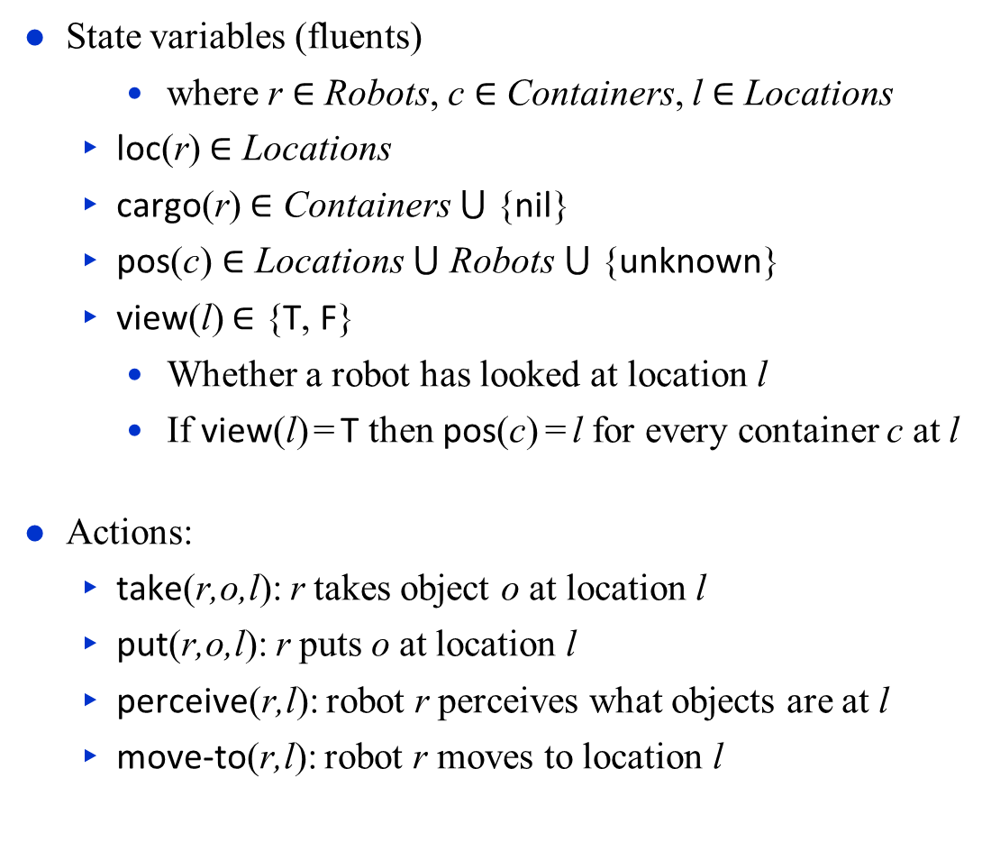
Example (reminder)
c2
State variables (fluents)
    where r ∈ Robots, c ∈ Containers, l ∈ Locations
  loc(r) $∈$ Locations
  cargo(r) $∈$ Containers ⋃ {nil}
  pos(c) $∈$ Locations ⋃ Robots ⋃ {unknown}
  view(l) $∈$ {T, F}
    Whether a robot has looked at location l
    If view(l) = T then pos(c) = l for every container c at l
Actions:
  take(r,o,l): r takes object o at location l
  put(r,o,l): r puts o at location l
  perceive(r,l): robot r perceives what objects are at l
  move-to(r,l): robot r moves to location l
loc4
loc3
r2
c1
r1
loc2
loc1
loc0
Objects
  Robots = {r1, r2}
  Containers = {c1, c2}
  Locations = {loc1, loc2, loc3, loc4}
Rigid relations (properties that won’t change)
  adjacent(loc0,loc1), adjacent(loc1,loc0), adjacent(loc1,loc2), adjacent(loc2,loc1), adjacent(loc2,loc3), adjacent(loc3,loc2), adjacent(loc3,loc4), adjacent(loc4,loc3)

Slide 8
Example
m-fetch1(r,c)
task: fetch(r,c)
pre: pos(c) = unknown
body:
if ∃l (view(l) = F) then
  move-to(r,l)
  perceive(r,l)
  if pos(c) = l then
  take(r,c,l)
  else fetch(r,c)
  else fail
Refinement tree
τ
procedure RAE:
  loop:
    for every new external task or event τ do
      choose a method instance m for τ
      create a refinement stack for τ, m
      add the stack to Agenda
    for each stack σ in Agenda
    call Progress(σ)
    if σ is finished then remove it
m-fetch2(r,c)
task: fetch(r,c)
pre: pos(c) ≠ unknown
body:
if loc(r) = pos(c) then
take(r,c,pos(c))
else do
move-to(r,pos(c))
take(r,c,pos(c))
Container locations unknown
Partially observable
  Robot only sees current location
c2
loc4
loc3
r2
c1
r1
loc2
loc1
loc0

Slide 9
Example
r = r₀, c = c2
m-fetch1(r,c)
task: fetch(r,c)
pre: pos(c) = unknown
body:
if ∃l (view(l) = F) then
  move-to(r,l)
  perceive(r,l)
  if pos(c) = l then
  take(r,c,l)
  else fetch(r,c)
  else fail
Refinement tree
Candidates
= {m-fetch1(r1,c2),
m-fetch1(r2,c2)}
τ
procedure RAE:
  loop:
    for every new external task or event τ do
      choose a method instance m for τ
      create a refinement stack for τ, m
      add the stack to Agenda
    for each stack σ in Agenda
    call Progress(σ)
    if σ is finished then remove it
m-fetch2(r,c)
task: fetch(r,c)
pre: pos(c) ≠ unknown
body:
if loc(r) = pos(c) then
take(r,c,pos(c))
else do
move-to(r,pos(c))
take(r,c,pos(c))
Container locations unknown
Partially observable
  Robot only sees current location
c2
loc4
loc3
r2
c1
r1
loc2
loc1
loc0

Slide 10
Example
r = r1, c = c2
m-fetch1(r,c)
task: fetch(r,c)
pre: pos(c) = unknown
body:
if ∃l (view(l) = F) then
  move-to(r,l)
  perceive(r,l)
  if pos(c) = l then
  take(r,c,l)
  else fetch(r,c)
  else fail
Refinement tree
Candidates
= {m-fetch1(r1,c2),
m-fetch1(r2,c2)}
τ
r₀ = r1
m
procedure RAE:
  loop:
    for every new external task or event τ do
      choose a method instance m for τ
      create a refinement stack for τ, m
      add the stack to Agenda
    for each stack σ in Agenda
    call Progress(σ)
    if σ is finished then remove it
m-fetch2(r,c)
task: fetch(r,c)
pre: pos(c) ≠ unknown
body:
if loc(r) = pos(c) then
take(r,c,pos(c))
else do
move-to(r,pos(c))
take(r,c,pos(c))
Container locations unknown
Partially observable
  Robot only sees current location
c2
loc4
loc3
r2
c1
r1
loc2
loc1
loc0

Slide 11
Example
r = r1, c = c2
m-fetch1(r,c)
task: fetch(r,c)
pre: pos(c) = unknown
body:
if ∃l (view(l) = F) then
  move-to(r,l)
  perceive(r,l)
  if pos(c) = l then
  take(r,c,l)
  else fetch(r,c)
  else fail
Refinement tree
Candidates
= {m-fetch1(r1,c2),
m-fetch1(r2,c2)}
τ
r₀ = r1
σ
m
procedure RAE:
  loop:
    for every new external task or event τ do
      choose a method instance m for τ
      create a refinement stack for τ, m
      add the stack to Agenda
    for each stack σ in Agenda
    call Progress(σ)
    if σ is finished then remove it
m-fetch2(r,c)
task: fetch(r,c)
pre: pos(c) ≠ unknown
body:
if loc(r) = pos(c) then
take(r,c,pos(c))
else do
move-to(r,pos(c))
take(r,c,pos(c))
Container locations unknown
Partially observable
  Robot only sees current location
c2
loc4
loc3
r2
c1
r1
loc2
loc1
loc0

Slide 12
Example
r = r1, c = c2
m-fetch1(r,c)
task: fetch(r,c)
pre: pos(c) = unknown
body:
if ∃l (view(l) = F) then
  move-to(r,l)
  perceive(r,l)
  if pos(c) = l then
  take(r,c,l)
  else fetch(r,c)
  else fail
Refinement tree
Candidates
= {m-fetch1(r1,c2),
m-fetch1(r2,c2)}
τ
r₀ = r1
σ
m
m-fetch2(r,c)
task: fetch(r,c)
pre: pos(c) ≠ unknown
body:
if loc(r) = pos(c) then
take(r,c,pos(c))
else do
move-to(r,pos(c))
take(r,c,pos(c))
Container locations unknown
Partially observable
  Robot only sees current location
c2
loc4
loc3
r2
c1
r1
loc2
loc1
loc0

Slide 13
Example
r = r1, c = c2
m-fetch1(r,c)
task: fetch(r,c)
pre: pos(c) = unknown
body:
if ∃l (view(l) = F) then
  move-to(r,l)
  perceive(r,l)
  if pos(c) = l then
  take(r,c,l)
  else fetch(r,c)
  else fail
Refinement tree
τ
l = loc1
r₀ = r1
m
τ′
m-fetch2(r,c)
task: fetch(r,c)
pre: pos(c) ≠ unknown
body:
if loc(r) = pos(c) then
take(r,c,pos(c))
else do
move-to(r,pos(c))
take(r,c,pos(c))
Container locations unknown
Partially observable
  Robot only sees current location
c2
loc4
loc3
r2
c1
r1
loc2
loc1
loc0

Slide 14
Example
r = r1, c = c2
m-fetch1(r,c)
task: fetch(r,c)
pre: pos(c) = unknown
body:
if ∃l (view(l) = F) then
  move-to(r,l)
  perceive(r,l)
  if pos(c) = l then
  take(r,c,l)
  else fetch(r,c)
  else fail
Refinement tree
τ
l = loc1
r₀ = r1
m
τ′
m-fetch2(r,c)
task: fetch(r,c)
pre: pos(c) ≠ unknown
body:
if loc(r) = pos(c) then
take(r,c,pos(c))
else do
move-to(r,pos(c))
take(r,c,pos(c))
Container locations unknown
Partially observable
  Robot only sees current location
c2
loc4
loc3
r2
c1
r1
loc2
loc1
loc0

Slide 15
Example
r = r1, c = c2
m-fetch1(r,c)
task: fetch(r,c)
pre: pos(c) = unknown
body:
if ∃l (view(l) = F) then
  move-to(r,l)
  perceive(r,l)
  if pos(c) = l then
  take(r,c,l)
  else fetch(r,c)
  else fail
Refinement tree
τ
l = loc1
r₀ = r1
m
σ
τ′
procedure RAE:
  loop:
    for every new external task or event τ do
      choose a method instance m for τ
      create a refinement stack for τ, m
      add the stack to Agenda
    for each stack σ in Agenda
    call Progress(σ)
    if σ is finished then remove it
m-fetch2(r,c)
task: fetch(r,c)
pre: pos(c) ≠ unknown
body:
if loc(r) = pos(c) then
take(r,c,pos(c))
else do
move-to(r,pos(c))
take(r,c,pos(c))

Slide 16
Example
r = r1, c = c2
m-fetch1(r,c)
task: fetch(r,c)
pre: pos(c) = unknown
body:
if ∃l (view(l) = F) then
  move-to(r,l)
  perceive(r,l)
  if pos(c) = l then
  take(r,c,l)
  else fetch(r,c)
  else fail
Refinement tree
τ
l = loc1
r₀ = r1
← running …
m
m-fetch2(r,c)
task: fetch(r,c)
pre: pos(c) ≠ unknown
body:
if loc(r) = pos(c) then
take(r,c,pos(c))
else do
move-to(r,pos(c))
take(r,c,pos(c))
c2
loc4
loc3
r2
c1
r1
loc2
loc1
loc0

Slide 17
Example
r = r1, c = c2
m-fetch1(r,c)
task: fetch(r,c)
pre: pos(c) = unknown
body:
if ∃l (view(l) = F) then
  move-to(r,l)
  perceive(r,l)
  if pos(c) = l then
  take(r,c,l)
  else fetch(r,c)
  else fail
Refinement tree
τ
l = loc1
r₀ = r1
← succeeded
m
m-fetch2(r,c)
task: fetch(r,c)
pre: pos(c) ≠ unknown
body:
if loc(r) = pos(c) then
take(r,c,pos(c))
else do
move-to(r,pos(c))
take(r,c,pos(c))
c2
loc4
loc3
r2
c1
r1
loc2
loc1
loc0

Slide 18
Example
r = r1, c = c2
m-fetch1(r,c)
task: fetch(r,c)
pre: pos(c) = unknown
body:
if ∃l (view(l) = F) then
  move-to(r,l)
  perceive(r,l)
  if pos(c) = l then
  take(r,c,l)
  else fetch(r,c)
  else fail
Refinement tree
τ
l = loc1
r₀ = r1
m
τ′
m-fetch2(r,c)
task: fetch(r,c)
pre: pos(c) ≠ unknown
body:
if loc(r) = pos(c) then
take(r,c,pos(c))
else do
move-to(r,pos(c))
take(r,c,pos(c))
c2
loc4
loc3
r2
c1
r1
loc2
loc1
loc0

Slide 19
Example
r = r1, c = c2
m-fetch1(r,c)
task: fetch(r,c)
pre: pos(c) = unknown
body:
if ∃l (view(l) = F) then
  move-to(r,l)
  perceive(r,l)
  if pos(c) = l then
  take(r,c,l)
  else fetch(r,c)
  else fail
Refinement tree
τ
l = loc1
r₀ = r1
m
← failed
τ′
sensor failure
m-fetch2(r,c)
task: fetch(r,c)
pre: pos(c) ≠ unknown
body:
if loc(r) = pos(c) then
take(r,c,pos(c))
else do
move-to(r,pos(c))
take(r,c,pos(c))
c2
loc4
loc3
r2
c1
r1
loc2
loc1
loc0

Slide 20
Example
r = r1, c = c2
m-fetch1(r,c)
task: fetch(r,c)
pre: pos(c) = unknown
body:
if ∃l (view(l) = F) then
  move-to(r,l)
  perceive(r,l)
  if pos(c) = l then
  take(r,c,l)
  else fetch(r,c)
  else fail
Refinement tree
τ
l = loc1
r₀ = r1
m
← failed
τ′
sensor failure
m-fetch2(r,c)
task: fetch(r,c)
pre: pos(c) ≠ unknown
body:
if loc(r) = pos(c) then
take(r,c,pos(c))
else do
move-to(r,pos(c))
take(r,c,pos(c))
c2
loc4
loc3
r2
c1
r1
loc2
loc1
loc0

Slide 21
Example
r = r2, c = c2
m-fetch1(r,c)
task: fetch(r,c)
pre: pos(c) = unknown
body:
if ∃l (view(l) = F) then
  move-to(r,l)
  perceive(r,l)
  if pos(c) = l then
  take(r,c,l)
  else fetch(r,c)
  else fail
Refinement tree
Candidates
= {m-fetch1(r1,c2),
m-fetch1(r2,c2)}
τ
retry
r₀ = r2
m-fetch1(r2,c2)
Retry(σ):
sensor failure
m-fetch2(r,c)
task: fetch(r,c)
pre: pos(c) ≠ unknown
body:
if loc(r) = pos(c) then
take(r,c,pos(c))
else do
move-to(r,pos(c))
take(r,c,pos(c))
c2
loc4
loc3
r2
c1
r1
loc2
loc1
loc0

Slide 22
Example
r = r2, c = c2
m-fetch1(r,c)
task: fetch(r,c)
pre: pos(c) = unknown
body:
if ∃l (view(l) = F) then
  move-to(r,l)
  perceive(r,l)
  if pos(c) = l then
  take(r,c,l)
  else fetch(r,c)
  else fail
Refinement tree
Candidates
= {m-fetch1(r1,c2),
m-fetch1(r2,c2)}
τ
retry
r₀ = r2
m-fetch1(r2,c2)
sensor failure
m-fetch2(r,c)
task: fetch(r,c)
pre: pos(c) ≠ unknown
body:
if loc(r) = pos(c) then
take(r,c,pos(c))
else do
move-to(r,pos(c))
take(r,c,pos(c))
Poll: Is this the same as a backtracking search?
c2
loc4
loc3
r2
c1
r1
loc2
loc1
loc0

Slide 23
Extensions to RAE
Methods for events
  e.g., an emergency
Methods for goals
  special kind of task: achieve(goal)
  sets up a monitor to see if the goal has been achieved
Concurrent subtasks

Slide 24
Summary
Section 14.1: Representation
  Tasks, events, actions
  Refinement methods
    Extended version of HTN methods
    name, task/event, preconditions, body
  Example: fetch a container
Sections 14.2-3: Refinement Acting Engine (RAE)
  Purely reactive: select a method and apply it
  Rae: input stream, Candidates, Instances, Agenda, refinement stacks
  Progress:
    command status, nextstep, type of step
  Retry: Candidates \ tried
    comparison to backtracking
  Refinement trees

