Slide 1
Chapters 15, 16
Hierarchical Refinement Planning, Learning
Dana S. Nau
University of Maryland
with contributions from
Mark “mak” Roberts

Slide 2


Outline
Planning for Rae
Acting with Planning (RAE+UPOM)
Learning
Evaluation, Application
Actor
Planner
Tasks
Hierarchical
Operational
Models
Queries
Plans
Acting Engine (RAE)
State
Actions
Events
Execution Platform
Actuation
Sensing

Slide 3
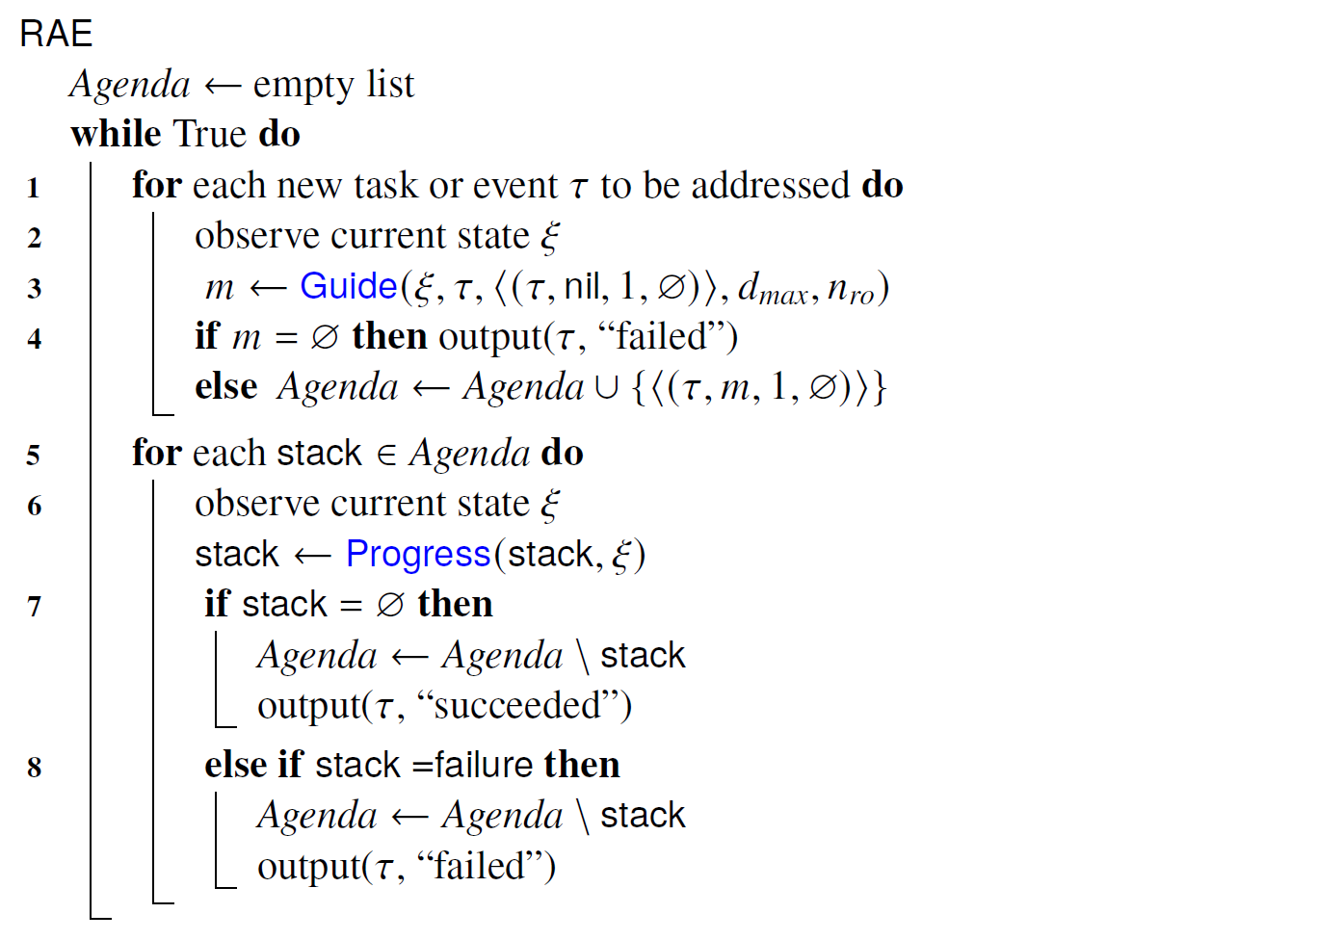
RAE (Ch. 14 Review)
An abstraction of RAE we will use:
procedure RAE:
  loop:
    for every new external task or event τ do
      choose a method instance m for τ
      create a refinement stack for τ, m
      add the stack to Agenda
    for each stack σ in Agenda
    call Progress(σ)
    if σ is finished then remove it
In Ch. 14, Guide was a heuristic choice.
We will explore some possible ways to do Guide.

Slide 4
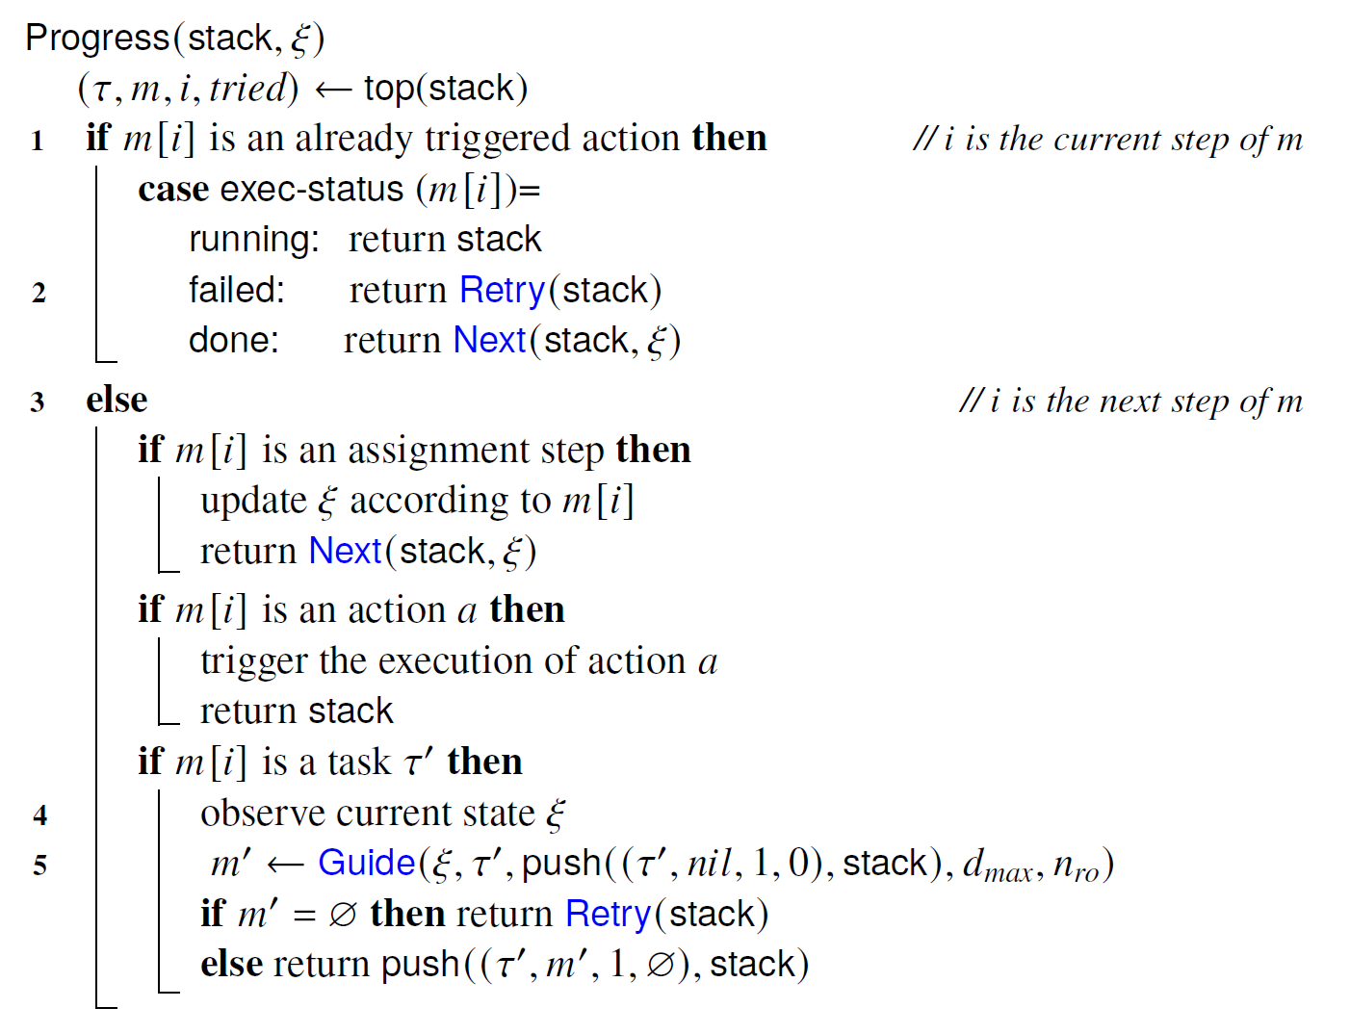
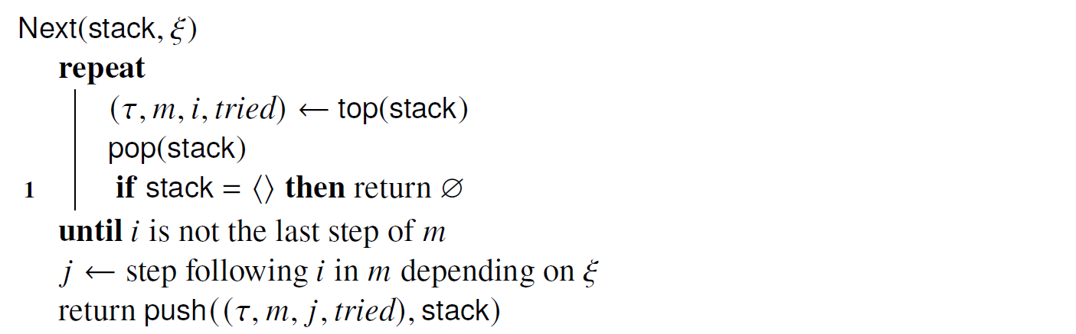
Progress (Ch. 14 Review)

Slide 5
Planning for Rae?
procedure RAE:
  loop:
    for every new external task or event τ do
      choose a method instance m for τ
      create a refinement stack for τ, m
      add the stack to Agenda
    for each stack σ in Agenda
    call Progress(σ)
    if σ is finished then remove it
retry τ using an
untried candidate
Four places where Rae and Progress choose a method instance for a task
Bad choice may lead to
  more costly solution
  failure - need to recover, sometimes unrecoverable
Solution:
  call a planner, choose the method instance it suggests
choose a candidate m′
push (τ′,m′, …) onto σ
retry τ using an
untried candidate

Slide 6
Planning and Acting Integration
Planner’s action models are abstractions
  The planned actions are tasks for the actor to refine
Consistency problem:
  How to get action models that
  describe what the actor will do?
One possible solution:
  Actor and planner both use the same representation
    Must be operational; descriptive models too abstract
    Need planning algorithms that can use operational models
Actor
Descriptive models
What the
actions do
Planning
Consistent?
Queries
Plans
Operational models
How to
perform tasks
Acting (RAE)

Slide 7
Planning and Acting Integration
Planner’s action models are abstractions
  The planned actions are tasks for the actor to refine
Consistency problem:
  How to get action models that
  describe what the actor will do?
One possible solution:
  Actor and planner both use the same representation
    Must be operational; descriptive models too abstract
    Need planning algorithms that can use operational models
Actor
Descriptive models
What the
actions do
Planning
Consistent?
Queries
Plans
Operational models
How to
perform tasks
Acting (RAE)
Idea 1:
  Planner uses Rae’s tasks and refinement methods
  For each of Rae’s actions, have a classical action model
  DFS or GBFS search among alternatives to see which works best

Slide 8
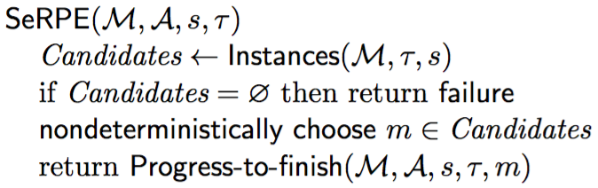
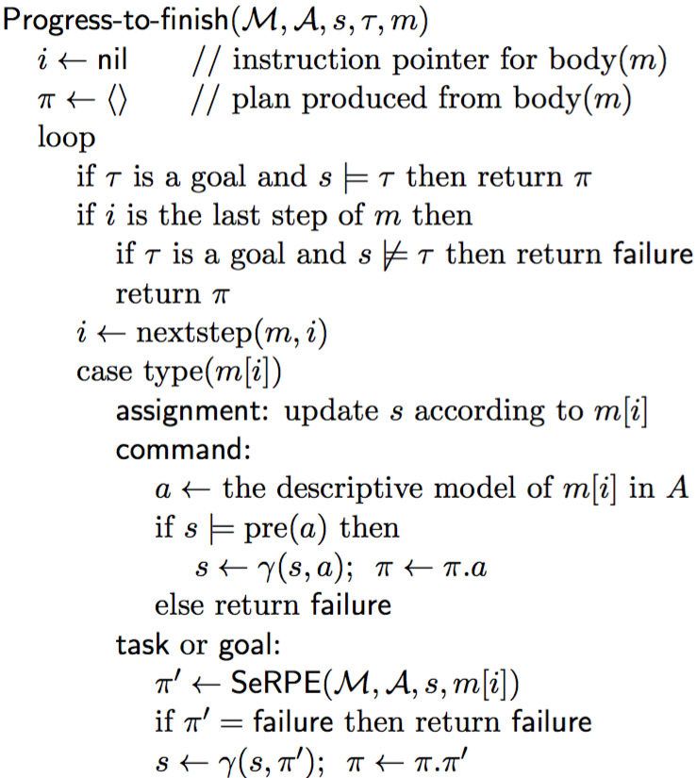
SeRPE (Sequential Refinement Planning Engine)
Automated Planning and Acting Ch. 3.3
M = {methods}
A = {action models}
s = initial state
τ = task or goal
Like Rae with just one external task
  Progress it all the way to the end,
  like Progress with a loop around it
  Plan rather than act
    For each action, use a classical action model
This has some problems …

Slide 9
Problems with SeRPE
Automated Planning and Acting Ch. 3.3
Problem 1: difficult to implement
Each time a method invokes a subtask, SeRPE makes a nondeterministic choice
To implement deterministically
  Each path in the search space is an execution trace of the body of a method
  Need to backtrack over code execution
Need to write a compiler that can do backtracking
  Is it worth the effort?
Example:
Suppose that
  Each task has two applicable methods
  When i=2, the 1st method for baz(2) fails
Backtracking:
  Try 2nd method for baz(2)
  If it fails, try 2nd method for bar(2)
  If it fails, backtrack to i = 1
    Try 2nd method for baz(1)
    If it fails, try 2nd method for bar(1)
  If it fails, backtrack to task foo(k) …
m-foo(k)
task: foo(k)
pre: …
body:
for i ← 1 to k:
  bar(i)
  baz(i)

Slide 10
Problems with SeRPE
Problem 2: limitations of classical action models
  e.g., the fetch example
We don’t know in advance what perceive’s effects will be
  If we did, perceive wouldn’t actually be needed
  take(r,o,l)
  // robot r takes object o at location l
  pre: cargo(r) = nil, loc(r) = l, loc(o) = l
  eff: cargo(r) ← o, loc(o) ← r
  put(r,o,l)
  // r puts o at location l
  pre: loc(r) = l, loc(o) = r
  eff: cargo(r) ← nil, loc(o) ← l
  perceive(r,l):
  // robot r sees what objects are at l
  pre: loc(r) = l
  eff: ?
c2
loc4
loc3
r2
c1
r1
loc2
loc1
loc0

Slide 11
Planning for Rae
Progress(σ):
procedure RAE:
  loop:
    for every new external task or event τ do
      choose a method instance m for τ
      create a refinement stack for τ, m
      add the stack to Agenda
    for each stack σ in Agenda
    call Progress(σ)
    if σ is finished then remove it
retry τ using an
untried candidate
Idea 2: simulation with multithreading or multiprocessing
  Run Rae in simulated environment
    Simulate the actions (see next page)
  To choose among method instances, try all of them
Planner returns the method instance m having the highest
expected utility (≈ least expected cost)
Poll: is this a reasonable approach?
A) Yes B) No C) It depends
choose a candidate m′
push (τ′, m′, …) onto σ
retry τ using an untried candidate

Slide 12
Simulating Actions
Simplest case:
  probabilistic action template
    a(x₁, …, x_{k})
    pre: …
    (p₁) effects₁: e₁₁, e₁₂, …
    …
    (p_{m}) effects_{m}: e_{m1}, e_{m2}, …
  Choose effects_{i} at random with probability p_{i}
  and use it to update the current state
More general:
  Arbitrary computation, e.g.,
  physics-based simulation
  Run the code to get simulated effects
subtree below m_{k}

Slide 13
Planning for Rae
Progress(σ):
procedure RAE:
  loop:
    for every new external task or event τ do
      choose a method instance m for τ
      create a refinement stack for τ, m
      add the stack to Agenda
    for each stack σ in Agenda
    call Progress(σ)
    if σ is finished then remove it
retry τ using an
untried candidate
Idea 3: simulation with Monte Carlo rollouts
  Multiple runs
    Random choices and outcomes in each run
  Maintain statistics to estimate each choice’s expected utility
  Return the method instance m that has the highest estimated utility
Patra, Mason, Kumar, Traverso, Ghallab, and Nau. Integrating Acting, Planning, and Learning in Hierarchical Operational Models. ICAPS, 2020. Best student paper honorable mention award. https://doi.org/10.1609/aaai.v33i01.33017691
Patra, Mason, Kumar, Ghallab, Nau, and Traverso. Deliberative acting, planning and learning with hierarchical operational models. Art. Intel. Journal. Vol. 299, 2021. https://doi.org/10.1016/j.artint.2021.103523
choose a candidate m′
push (τ′, m′, …) onto σ
retry τ using an untried candidate

Slide 14
Planner
Simulate-Progress(σ):
Plan-with-UPOM (task τ):
  Candidates ← {method instances relevant for τ}
  for i ← 1 to n
  call UPOM(τ)
  update estimates of methods’ expected utility
  return the m ∈ Candidates that has
  the highest estimated utility
simulation
status
UPOM(τ):
  choose a method instance m for τ
  create refinement stack σ for τ and m
  loop while Simulate-Progress(σ) ≠ failure
  if σ is completed then return (m, utility)
  return failure
start simulation of τ′
Each call to UPOM does a Monte Carlo rollout
  Simulated execution of RAE on τ

Slide 15
Monte-Carlo rollouts
Plan-with-UPOM (task τ):
  Candidates ← {method instances relevant for τ}
  for i ← 1 to n
  call UPOM(τ)
  update estimates of methods’ expected utility
  return the m ∈ Candidates with the highest estimated utility
UPOM(τ):
  choose a method instance m for τ
  create refinement stack σ for τ and m
  loop while Simulate-Progress(σ) ≠ failure
  if σ is completed then return (m, utility)
  return failure
subtree below m_{k}
Each call to UPOM does a Monte Carlo rollout
  Simulated execution of RAE on τ

Slide 16
UCT and UPOM
UCT algorithm:
  Monte Carlo rollouts on MDPs
  Call it many times, choice converges to optimal
UPOM search tree more complicated
  tasks, method instances, actions, code execution
If no exogenous events,
  Can map it to UCT search of a complicated MDP
  Proof of convergence to optimal

Slide 17
Outline
Planning for Rae
Acting with Planning (RAE+UPOM)
Learning
Evaluation, Application
Actor
Planner (UPOM)
Tasks
Hierarchical
Operational
Models
Queries
Plans
Acting Engine (RAE)
State
Actions
Events
Execution Platform
Actuation
Sensing

Slide 18
RAE + UPOM
Progress(σ):
procedure RAE:
  loop:
    for every new external task or event τ do
      choose a method instance m for τ
      create a refinement stack for τ, m
      add the stack to Agenda
    for each stack σ in Agenda
    call Progress(σ)
    if σ is finished then remove it
retry τ using an
untried candidate
Whenever RAE needs to choose a method instance
  call Plan-with-UPOM, use the method instance it returns
Open-source Python implementation: https://bitbucket.org/sunandita/RAE/
choose a candidate m′
push (τ′, m′, …) onto σ
retry τ using an untried candidate

Slide 19
Could we use UPOM with HTN-Run-Lookahead?
Suppose we try to use Run-Lookahead with a
modified version of UPOM (call it UPOM′)
  Instead of returning method instance m₁, return
  the actions in the last Monte Carlo rollout
    π = ⟨a₁, a₂, a₃, a₄, a₅⟩
Problem
  Run-lookahead calls UPOM′, gets π,
  executes a₁, then calls UPOM′ again
  This time, UPOM′ needs to plan for t₁
  in state s₁ rather than s₀
  There might not be an applicable method
If we want to use Run-Lookahead, we need to
ensure that methods can work in unexpected states

Slide 20
Could we use UPOM with HTN-Run-Lazy-Lookahead?
Run-Lazy-Lookahead calls UPOM′,
UPOM′ returns π = ⟨a₁, a₂, a₃, a₄, a₅⟩
Run-Lazy-Lookahead executes a₁, a₂, a₃, a₄, a₅,
won’t call UPOM′ again unless
something unexpected happens, e.g.,
    action a₂ has an execution failure
    a₂ produces a state in which a₃ is inapplicable
    an exogenous event makes a₃ inapplicable
  Method m₂ fails; we need to replan task t₂
Need to modify Run-Lazy-Lookahead so that
when a failure occurs, it knows which task to replan
  Need to modify the methods to work in unexpected states

Slide 21
Comparison
Rae + UPOM has tighter coupling between planning and acting
  works better than Run-Lazy-Lookahead + UPOM′
Example
  Case 1: Run-Lazy-Lookahead calls UPOM′ for t₁ in state s₀
    UPOM′ returns π = ⟨a₁, a₂, a₃, a₄, a₅⟩
    Run-Lazy-Lookahead executes a₁, gets state s₁′ (not s₁)
      Suppose this makes a₂ redundant
    Run-Lazy-Lookahead doesn’t have a way to
    detect this; continues with the rest of π
  Case 2: Rae calls UPOM for t₁ in state s₀
    UPOM returns m₁, Rae executes a₁, gets state s₁′
    Rae calls UPOM for t₂ in state s₁′
      UPOM might return a better method instance
      Or maybe UPOM returns m₂, but m₂’s body
      includes an if-test to omit a₂ if it’s redundant

Slide 22
Outline
Planning for Rae
Acting with Planning (RAE+UPOM)
Learning
Evaluation, Application
Actor
Planner
(UPOM)
Learning
Tasks
Hierarchical
Operational
Models
Acting Engine (RAE)
State
Actions
Events
Execution Platform
Actuation
Sensing

Slide 23
Motivation
Plan-with-UPOM is called by RAE, runs online
  Time constraints might not allow complete search
Case 1: no time to search at all
  need a choice function
Case 2: enough time to do partial search
  Receding horizon
    Cut off search at depth d_{max}
    or when we run out of time
    At leaf nodes, use heuristic function
    to estimated expected utility
Learning algorithms:
  Learnπ: learns a choice function
  LearnH: learns a heuristic function

Slide 24
Integration with Learning
Gather training data from acting-and-planning traces of RAE and Plan-with-UPOM
Train classifiers (feed-forward neural nets)
Learnπ
  Learns function for choosing a method
  Given current task and context (state
  and other information), choose m from
  the set of available refinement methods
  Useful if there isn’t enough time to use UPOM
Actor:
Planning
(UPOM)
Learnπ
Task, context
m
Acting Engine (RAE)

Slide 25
Integration with Learning
Gather training data from acting-and-planning traces of RAE and Plan-with-UPOM
Train classifiers (feed-forward neural nets)
LearnH
  Learns a heuristic function to guide UPOM’s search
  UPOM can use it to estimate expected utility at leaf nodes
  Useful if there isn’t enough time to search all the way to the end
Actor:
m, task,
context
Planning
(UPOM)
LearnH
Learnπ
h(m)
Task, context
m
Acting Engine (RAE)

Slide 26
Outline
Planning for Rae
Acting with Planning (RAE+UPOM)
Learning
Evaluation, Application
Actor
Planning
(UPOM)
Learning
Tasks
Hierarchical
Operational
Models
Acting Engine (RAE)
State
Actions
Events
Execution Platform
Actuation
Sensing

Slide 27
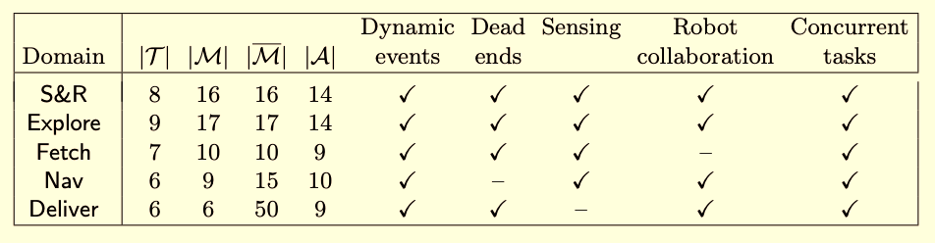
Experimental Evaluation
Five different domains, different combinations of characteristics
Evaluation criteria: efficiency (reciprocal of cost), successes vs failures
Result: Planning and learning help
  RAE operates better with UPOM or learning than without
  RAE’s performance improves with more planning

Slide 28
Prototype Application
Software-defined networks
  Decoupled control and data layers
  Prone to high-volume, fast-paced online attacks
  Need automated attack recovery
Prototype solution using RAE+UPOM
  Expert writes recovery procedures as refinement methods
Experimental results
  Improved efficiency, retry ratio, success ratio,
  resilience compared to human expert
Billions of Data Points
Millions of Alerts
High-volume, fast-paced
Cyber Events
. . .
Cyber Warriors
S. Patra, A. Velasquez, M. Kang, and D. Nau. Using online planning and acting to recover from cyberattacks on software-defined networks. In Proc. Innovative Applications of AI Conference (IAAI), Feb. 2021. https://www.cs.umd.edu/~nau/papers/patra2021using.pdf
Complex
Systems to Defend

Slide 29
Summary
Chapter 15: Hierarchical Refinement Planning
Plan by simulating Rae on a single external task/event/goal
  SeRPE uses classical action models
  UPOM simulates the actor’s actions, does Monte Carlo rollouts
Acting and planning
  Rae + UPOM
  Comparison: Run-Lazy-Lookahead + UPOM′
  Open-source Python implementation:
    https://bitbucket.org/sunandita/RAE/
Chapter 16: Learning
  Learning a function to choose a method
  Learning heuristics to guide search
Additional material not in the book
  Experimental evaluation
  Prototype application

