Slide 1
Chapters 17, 18
Temporal Represention, Acting, Planning
Dana S. Nau
University of Maryland
with contributions from
Mark “mak” Roberts

Slide 2

Some Example Applications
RAX/PS
  Planning/control of Deep Space One spacecraft
  NASA Ames and JPL, 1999
CASPER
  Planning/control of spacecraft
  NASA JPL, ≈ 1999–2017
T-ReX
  Planning/control of AUVs
  Monterey Bay Aquarium Research Institute, ≈ 2005-2010
Notes:
Exploring the Borrelly comet and Braille asteroid (99-01)
environment well structured and predictable

Slide 3
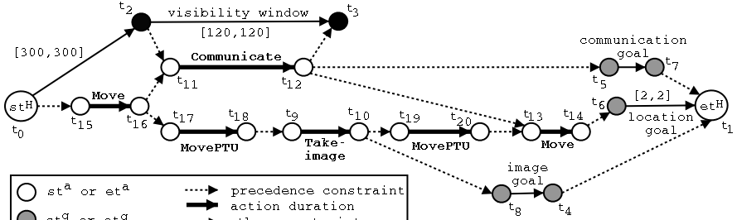
Temporal Models
Constraints on state variables and events
  Reflect predicted actions and events
Actions have duration
  preconditions and effects may occur at times other than start and end
Time constraints on goals
  relative or absolute
Exogenous events expected to occur in the future
Maintenance actions: maintain a property
  e.g., track a moving target, keep a door closed
Concurrent actions
  interacting effects, joint effects
Delayed commitment
  instantiation at acting time

Slide 4
Outline
Topic Section
Introduction 17.1
Representation 17.2
Planning (briefly) 18.2
Consistency and controllability 18.3
Acting (Part 1: refinement) 17.3.1
Acting (Part 2: dispatching) 17.3.1

Slide 5
Timelines
Up to now, we’ve used a “state-oriented view”
    Time is a sequence of states s₀, s₁, s₂
    Instantaneous actions transform each state into the next one
    No overlapping actions
Switch to a “time-oriented view”
  Discrete: time points are integers
    t = 1, 2, 3, …
  For each state variable x, a timeline
    values of x during different time intervals
  State at time t = {values of all state variables at time t}
different positions on the y axis represent qualitative changes, not numeric values
x
state variables
y
t
t + 1
time

Slide 6
Timeline
A pair (T,C )
  T = {temporal assertions}; C = {constraints}
  partially predicted evolution of one state variable
    doesn’t necessarily specify a value at every timepoint
  T = {
    [t₁, t₂] loc(r1) = loc1
    [t₃, t₄] loc(r1) : (l, loc2)
    }
  C = {
    t₁ < t₂ < t₃ < t₄,
    l ≠ loc2
    }
If T contains [t,t′] x : (v,v′) or [t,t′] x = v then C always contains t ≤ t′
  To simplify the examples, we usually won’t write t ≤ t′ explicitly
persistence
requires t₁ ≤ t₂
change
Reminder: qualitative changes, not numeric values
requires t₃ ≤ t₄
and l ≠ loc2
loc2
loc(r1)
loc1
l
time
t₁
t₂
t₃
t₄
temporal constraints
object constraints

Slide 7
Consistency
Poll 1: Is (T₁ , C₁) consistent?
Poll 2: are the two temporal assertions conflicting?
  A. Yes
  B. No
  C. don’t know
Timeline:
  T₁ = {[t₁,t₂] loc(r) = loc1,
  [t₃,t₄] loc(r) : (l, loc2)}
  C₁ = {t₁< t₂, t₃< t₄, l ≠ loc2}
Let (T,C) be a timeline,
Let (T ′,C′) be a ground instance of (T,C)
  (T ′,C′) is consistent if both
    T ′ satisfies C′
    no state variable in (T′,C′) has more than one value at a time
(T,C) is consistent if it has at least one consistent ground instance
Two temporal assertions are conflicting
if they have at least one inconsistent instance
  May also have consistent instances,
  so “possibly conflicting” would be more accurate
loc2
loc(r)
loc1
l
time
t₁
t₂
t₃
t₄
loc1
loc2
loc2
loc(r1)
loc1
loc1
loc3
loc(r2)
time
time
1
3
4
9
1
3
4
9
  a consistent ground instance an inconsistent ground instance

Slide 8
Security
(T,C) is secure if
  it’s consistent (at least one ground instance is consistent)
  every ground instance that satisfies
  the constraints is consistent
In PSP (Chapter 2), analogous to a partial plan that has no threats
Can make a consistent timeline secure
by adding separation constraints to C
  additional temporal and object constraints
Analogous to resolvers in PSP
Not secure:
  T₁ = {[t₁,t₂] loc(r) = loc1,
  [t₃,t₄] loc(r) : (l, loc2)}
  C₁ = {t₁< t₂, t₃< t₄, l ≠ loc2}
Separation constraints:
  t₂ < t₃
  or
  t₂ = t₃, l = loc1
loc2
loc(r)
loc1
l
time
t₁
t₂
t₃
t₄
loc1
loc2
loc2
loc(r1)
loc1
loc1
loc3
loc(r2)
time
time
1
3
4
9
1
3
4
9
  a consistent ground instance an inconsistent ground instance

Slide 9
Causal support
Consider the assertion [t₃,t₄] loc(r) : (l, loc2)
  How did r1 get to location l?
Let α be a persistence [t₁,t₂] x = v₁ or change [t₁,t₂] x : (v₁, v₂)
Causal support for α
  Information saying α is supported a priori
  Or another assertion that produces x = v₁ at time t₁
      [t₀,t₁] x = v₁
      [t₀,t₁] x : (v₀, v₁)
A timeline (T,C) is causally supported if every assertion α in T has a causal support
Three ways to modify a timeline to add causal support …
T₁ = {[t₁,t₂] loc(r) = loc1,
[t₃,t₄] loc(r) : (l, loc2)}
C₁ = {t₁< t₂, t₃< t₄, l ≠ loc2}
loc2
loc(r)
loc1
l
time
t₁
t₂
t₃
t₄

Slide 10
Establishing causal support
(1) Add a persistence assertion
loc2
loc2
loc(r1)
loc1
Persistence
loc3
Change
T = {[t₁,t₂] loc(r1):(loc1,loc2),
[t₃,t₄] loc(r1):(loc2,loc3)}
C = {t₁< t₂ < t₃< t₄}
t1
t2
t3
t4
time
loc2
Add [t₂,t₃] loc(r1) = loc2
  Supported by the first
  temporal assertion
  Supports the second one
loc(r1)
loc1
Persistence
loc2
Change
t1
t2
t3
t4
time

Slide 11
Establishing causal support
loc2
(2) Add constraints
loc1
l
loc(r1)
loc(r)
T = {[t₁,t₂] loc(r1):(loc1,loc2),
[t₃,t₄] loc(r) = l}
C = {t₁< t₂, t₃< t₄}
t₁ t₂ t₃ t₄
time
loc2
loc2
loc1
loc(r1)
Add t₂ = t₃, r = r1, l = loc2
loc(r1)
t₁ t₂ = t₃ t₄
time

Slide 12
Establishing causal support
(3) Add an action
loc1
loc4
loc(r1)
loc3
T = {[t₁,t₂] loc(r1) = loc1,
[t₃,t₄] loc(r1):(loc3,loc4)}
C = {t₁< t₂ < t₃< t₄}
t1
t2
t3
t4
time
loc1
loc4
Add an action that includes
  [t₂,t₃] loc(r1):(loc1,loc3)
loc(r1)
loc3
t1
t2
t3
t4
time

Slide 13
Action Schemas
Action schema (book also calls it a primitive):
  a triple (head,T,C)
    head is the name and parameters
    (T,C) is the union of a set of timelines
Always two additional parameters
  starting time t_{s} , ending time t_{e}
In each temporal assertion in T,
    left endpoint is like a precondition
      ⬄ need for causal support
    right endpoint is like an effect
w
r
d
leave(r,d,w)
// robot r goes from loading dock d to waypoint w
assertions:
[t_{s},t_{e}] loc(r): (d,w)
[t_{s},t_{e}] occupant(d): (r,empty)
  constraints:
t_{e} ≤ t_{s} + δ₁
adjacent(d,w)
  Action duration t_{e} – t_{s} ≤ δ₁
    (I’m not sure why it’s ≤ )

Slide 14
Action Schemas
k
r
c
w
r
d
    enter(r,d,w)
    // robot r goes from waypoint w to loading dock d
    assertions:
    [t_{s},t_{e}] loc(r): (w,d)
    [t_{s},t_{e}] occupant(d): (empty,r)
    constraints:
    t_{e} ≤ t_{s} + δ₂
    adjacent(d,w)
  Action duration t_{e} – t_{s} ≤ δ₂
  Dock d becomes occupied by r
d
take(k,c,r,d)
// crane k takes container c from robot r
assertions:
[t_{s},t_{e}] pos(c): (r, k) // where c is
[t_{s},t_{e}] grip(k): (empty, c) // what’s in k’s gripper
[t_{s},t_{e}] freight(r): (c,empty) // what r is carrying
[t_{s},t_{e}] loc(r) = d // where r is
constraints:
attached(k,d)

Slide 15
Action Schemas
leave(r,d,w) robot r leaves dock d to an adjacent waypoint w
enter(r,d,w) r enters d from an adjacent waypoint w
take(k,c,r) crane k takes container c from robot r
put(k,c,r) crane k puts container c onto robot r
navigate(r,w,w′) r navigates from waypoint w to adjacent waypoint w′
connected(w,w′) waypoint w is connected waypoint w′
stack(k,c,p) crane k stacks container c on top of pile p
unstack(k,c,p) crane k takes a container c from top of pile p
k
c
• w
r
c, c′ - containers
d, d′ - loading docks
k, k′ - cranes
p, p′ - piles
r - robot
w, w′ - waypoints
p
d
k′
• w′
p′
d′

Slide 16
Tasks and Methods
  [t_{s} ,t_{e}] move(r,d)
navigate
Task: move robot r to dock d
  [t_{s} ,t_{e}] move(r,d)
Method:
  m-move1(r,d,d′,w,w′)
  task: move(r,d)
  refinement:
  [t_{s},t₁] leave(r,d′,w′)
  [t₂,t₃] navigate(r,w′,w)
  [t₄,t_{e}] enter(r,d,w)
  assertions:
  [t_{s},t_{s}+1] loc(r) = d′
  constraints:
  adjacent(d,w),
  adjacent(d′,w′), d ≠ d′,
  connected(w,w′),
  t₁ ≤ t₂, t₃ ≤ t₄
leave
enter
t_{s} t₁ t₂ t₃ t₄ t_{e}
ts
t1
t2
t3
t4
te
r
•w
•w′
tasks and actions
d
d′
r
•w
•w′
need causal establishment
d
d′
r
like C
•w
•w′
d
d′
r
•w
•w′
d
d′

Slide 17
Chronicles
ϕ₀:
tasks: [t₀,t₁] bring(r,c1,d4)
supported: [t_{s}] loc(r1)=d1
[t_{s}] loc(r2)=d2
[t_{s}+10,t_{s}+δ] docked(ship1)=d3
[t_{s}] top(pile-ship1)=c1
[t_{s}] pos(c1)=pallet
assertions: [t_{e}] loc(r1)=d1
[t_{e}] loc(r2)=d2
constraints: t_{s} = 0 < t₀ < t₁ < t_{e} , 20 ≤ δ ≤ 30
Chronicle ϕ = (A,S,T,C)
  A: temporally qualified tasks
  S : a priori supported assertions
  T: temporally qualified assertions
  C: constraints
ϕ can include
  Current state, future predicted events
  Tasks to perform
  Assertions and constraints to satisfy
Can represent
  a planning problem
  a plan or partial plan
[t_{s} , t_{e}] bring(r,c1,d4)
like partial
plans in PSP
loc(r1)=d1
top(pile-ship1)=c1
docked(ship1)=d3
loc(r1)=d1
t_{s} t₀ t_{s}+10 t_{s}+ δ t₁ t_{e}

Slide 18
Outline
Topic Section
Introduction 17.1
Representation 17.2
Planning (briefly) 18.2
Consistency and controllability 18.3
Acting (Part 1: refinement) 17.3.1
Acting (Part 2: dispatching) 17.3.1

Slide 19
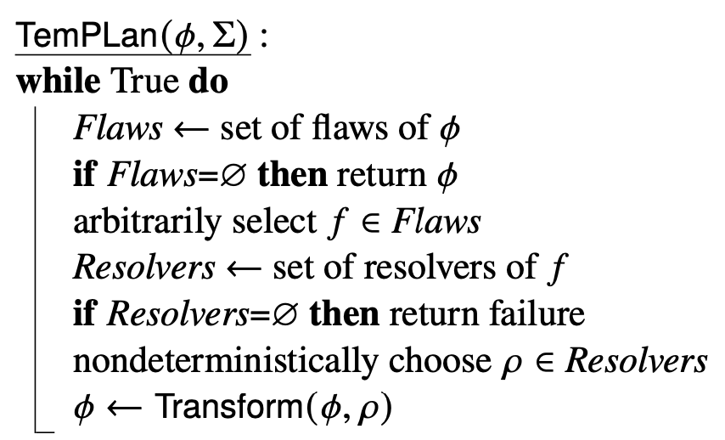
Planning
Planning problem: a chronicle ϕ₀ that has some flaws
  Temporal assertions that aren’t causally supported
      like open goals in PSP
  Temporal assertions that are (possibly) conflicting
    like threats in PSP
  Non-refined tasks
    like tasks in HTN planning
Resolvers
  persistence assertions
  constraints
  actions
  tasks
  refinement methods
If it’s possible to resolve all flaws, then
at least one of the nondeterministic execution traces will do so
The details are intricate and tedious
  If this interests you, I can point you to some good references

Slide 20
Outline
Topic Section
Introduction 17.1
Representation 17.2
Planning (briefly) 18.2
Consistency and controllability 18.3
Acting (Part 1: refinement) 17.3.1
Acting (Part 2: dispatching) 17.3.1

Slide 21
Consistency of Constraints
When TemPlan applies resolvers, it modifies ϕ = (A,S,T,C)
  Some resolvers will make ϕ inconsistent
      No solution in this part of the search space
  Would like to detect inconsistency, prune that part of the search space
    Otherwise we’ll waste time searching it
Analogy: PSP checks simple cases of inconsistency
  E.g., if there’s already a constraint c ≺ b,
  don’t resolve a threat by adding a constraint b ≺ c
But PSP ignores more complicated cases
  Suppose Range(c) = Containers = {c1, c2, c3}
  To resolve three different threats, suppose PSP chooses
  c ≠ c1 , c ≠ c2 , c ≠ c3
    No solutions in this part of the search
    space, but PSP searches it anyway
loc(r1) = x
a: move(r1, d1, x)
b: move(r1, x, d2)
loc(r1) = x
c: move(r, d2, y)
threat
loc(r) = y

Slide 22
Consistency of Constraints
ϕ = (A,S,T,C)
At various points, have TemPlan check whether C is consistent
  If it isn’t, then ϕ isn’t either
  Can prune this part of the search space
Doesn’t detect every possible inconsistency
  If C is consistent, ϕ still may have other inconsistencies
But if TemPlan can detect some of the inconsistencies, it may prune large parts of the search space
C contains two kinds of constraints
  Object constraints
    loc(r) ≠ l₂ , l ∈ {loc3, loc4}, r = r1, o ≠ o′
  Temporal constraints
    t₁ < t₃ , a < t, t < t′, a ≤ t′ − t ≤ b
Assume the two kinds of constraints are independent
  exclude things like t = distance (l,l′) / speed(r)
Then two separate subproblems
  (1) are the object constraints consistent?
  (2) are the temporal constraints consistent?
C is consistent iff both are consistent

Slide 23
(1) Object Constraints
Constraint-satisfaction problem (CSP): NP-hard
Can write a CSP algorithm that’s complete but runs in exponential time
    If there’s an inconsistency, always finds it
    Might enable a lot of pruning
    But the calls to the CSP algorithm will take lots of time
Instead, use a technique that’s incomplete but takes polynomial time
    arc consistency, path consistency*
Detects some inconsistencies but not others
  Runs much faster, but prunes fewer nodes
__________
*See Russell & Norvig, Artificial Intelligence: A Modern Approach

Slide 24
(2) Time Constraints
t₂
To represent time constraints:
Simple Temporal Networks (STNs)
  Networks of constraints on time points
Synthesize incrementally them starting from ϕ₀
  can check time constraints in time O(n³)
Instantiate them incrementally during acting
Keep them consistent throughout planning and acting
[3, 4]
[1, 2]
[1, 7]
t₁
t₄
t₃
[1, 2]
[6, 7]
[4, 5]
t₅

Slide 25
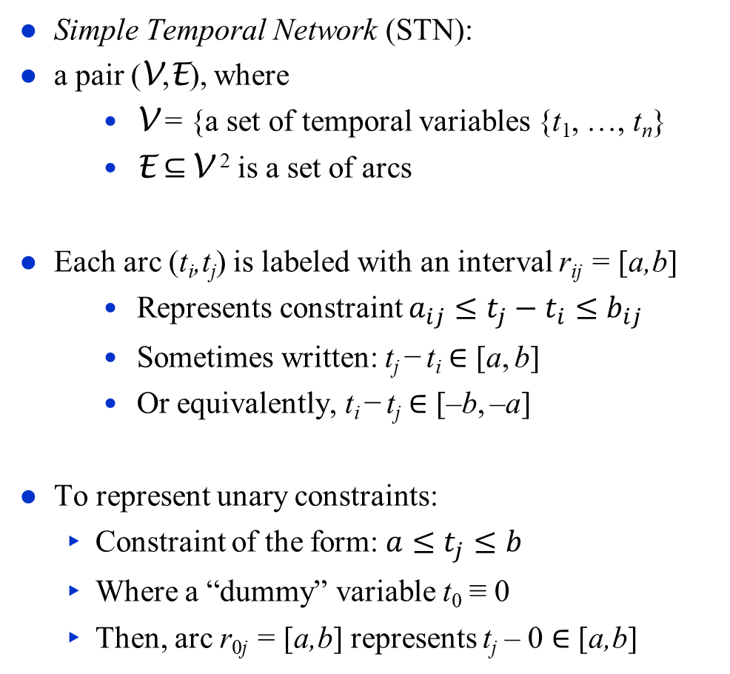
Time Constraints
Simple Temporal Network (STN):
a pair (V,E), where
    V = {a set of temporal variables {t₁, …, t_{n}}
    E ⊆ V ² is a set of arcs
Each arc (t_{i},t_{j}) is labeled with an interval r_{ij} = [a,b]
    Represents constraint $a_{ij}≤t_{j}−t_{i}≤b_{ij}$
    Sometimes written: t_{j} − t_{i} ∈ [a, b]
    Or equivalently, t_{i} − t_{j} ∈ [–b, –a]
To represent unary constraints:
  Constraint of the form: $a≤t_{j}≤b$
  Where a “dummy” variable t₀ ≡ 0
  Then, arc r_{0j} = [a,b] represents t_{j} – 0 ∈ [a,b]
t₂
[1,2]
[3,4]
t₁
t₃
[3,7]
t₂
[1,2]
[3,4]
t₁
t₃
[–7,–3]
t₂
[1,2]
[3,4]
t₀
t₃
[3,7]

Slide 26
Operations on STNs
Intersection, ∩
      t_{j} – t_{i} ∈ r_{ij} = [a_{ij} , b_{ij}]
      t_{j} – t_{i} ∈ r′_{ij} = [a′_{ij} , b′_{ij}]
  Infer t_{j} – t_{i} ∈ r_{ij} ∩ r′_{ij} = [max(a_{ij},a′_{ij}), min(b_{ij},b′_{ij})]
Composition, •
      t_{k} – t_{i} ∈ r_{ik} = [a_{ik},b_{ik}]
      t_{j} – t_{k} ∈ r_{kj} = [a_{kj},b_{kj}]
  Infer t_{j} – t_{i} ∈ r_{ik} • r_{kj} = [a_{ik} +a_{kj}, b_{ik} +b_{kj}]
  Reason: shortest and longest times for the two intervals
Consistency checking
  r_{ik} , r_{kj} , r_{ij} are consistent iff r_{ij} ∩ (r_{ik} • r_{kj}) ≠ ∅
r_{ij}
t_{i}
t_{j}
r′_{ij}
r_{ij} ∩ r′_{ij}
r_{ik}
t_{k}
r_{kj}
t_{i}
t_{j}
r_{ik} • r_{kj}
t_{k}
r_{kj}
r_{ik}
r_{ij}
t_{j}
t_{i}
r_{ik} • r_{kj}
r_{ij} ∩ (r_{ik} • r_{kj})

Slide 27
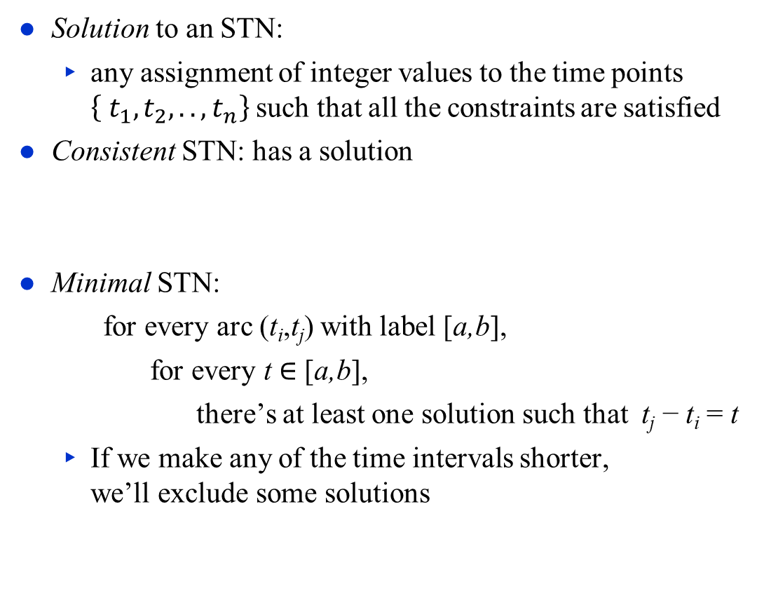
Time Constraints
t₂
[1,2]
[1,2]
Solution to an STN:
  any assignment of integer values to the time points
  $\left\{ t_{1}, t_{2},.., t_{n}\right\}$ such that all the constraints are satisfied
Consistent STN: has a solution
Minimal STN:
    for every arc (t_{i},t_{j}) with label [a,b],
      for every t ∈ [a,b],
        there’s at least one solution such that t_{j} − t_{i} = t
  If we make any of the time intervals shorter,
  we’ll exclude some solutions
t₁
t₃
[0,100]
Solutions:
t₂ – t₁ | t₃ – t₂ | t₃ – t₁
1 | 1 | 2
1 | 2 | 3
2 | 1 | 3
2 | 2 | 4
t₂
[1,2]
[1,2]
t₁
t₃
[2,4]

Slide 28
Two Examples
t₂
t₂
t₂
[3,4]
[1,2]
[3,4]
[3,4]
[1,2]
[1,2]
t₃
t₁
t₃
t₃
t₁
t₁
[2,5]
[4,5]
[2,3]
  V = {t₁, t₂, t₃}
  E = {r₁₂=[1,2], r₂₃=[3,4], r₁₃=[2,3]}
Composition:
  r′₁₃ = r₁₂ • r₂₃ = [1+3, 2+4] = [4,6]
Thus
  r₁₃ ∩ r′₁₃ = [2,3] ∩ [4,6] = ∅
Can’t satisfy both r₁₃ and r′₁₃
(V,E) is inconsistent
  V = {t₁, t₂, t₃}
  E = {r₁₂=[1,2], r₂₃=[3,4], r₁₃=[2,5]}
As before, r′₁₃ = r₁₂ • r₂₃ = [4,6]
  r₁₃ ∩ r′₁₃ = [2,5] ∩ [4,6] = [4,5]
(V,E) is consistent
  r₁₃ ← [4,5] will make it minimal
Same set of solutions:
t₂–t₁ | t₃–t₂ | t₃–t₁
1 | 3 | 4
1 | 4 | 5
2 | 3 | 5
2 | 4 | 6

Slide 29
Time Constraints
Solution to an STN:
  any assignment of integer values to the time points
  $\left\{ t_{1}, t_{2},.., t_{n}\right\}$ such that all the constraints are satisfied
Consistent STN: has a solution
Minimal STN:
    for every arc (t_{i},t_{j}) with label [a,b],
      for every t ∈ [a,b],
        there’s at least one solution such that t_{j} − t_{i} = t
  If we make any of the time intervals shorter,
  we’ll exclude some solutions
Poll: Is this network consistent?
t₂
[1,2]
[3,4]
t₁
t₃
[2,3]
Poll: Is this network minimal?
t₂
[1,2]
[3,4]
t₁
t₃
[1,7]

Slide 30
Path Consistency
PC(V,E):
for 1 ≤ k ≤ n do
for 1 ≤ i < j ≤ n, i ≠ k, j ≠ k do
r_{ij} ← r_{ij} ∩ [r_{ik} • r_{kj}]
if r_{ij} = ∅ then
return inconsistent
Makes network minimal
  Reduce each r_{ij} to exclude values that aren’t in any solution
Detects inconsistent networks
  inconsistent if
  r_{ij} shrinks to ∅
i, j, k each go ≈ from 1 to n
  O(n³) triples
  total time O(n³)
PC (Path Consistency) algorithm
Iterate over each combination of k, i, j
If an arc has no constraint, use [−∞, +∞]
k
r_{kj}
r_{ik}
i
j
r_{ij} ∩ [r_{ik} • r_{kj}]
Dashed lines: constraints shrunk from [–∞, ∞]

Slide 31
Pruning TemPlan’s search space
Take the time constraints in C
  Write them as an STN
  Use Path Consistency to check whether STN is consistent
  If it’s inconsistent, TemPlan can backtrack
TemPlan needs to add new constraints incrementally
  Can modify PC to make it incremental
  Given a consistent, minimal STN,
  incorporate a new constraint r′_{ij}
    time O(n²)

Slide 32
Controllability
Section 18.3.3 of the book
Suppose TemPlan gives you a chronicle and you want to execute it
  Constraints on time points
  Need to reason about these in order to decide when to start each action
Solid lines: duration constraints
  Robot will do bring&move, will take 30 to 50 time units
  Crane will do uncover, will take 5 to 10 time units
Dashed line: synchronization constraint
  At most 5 seconds between the two ending times
  Objective
  Choose starting times that will satisfy the constraints

Slide 33
Controllability
bring&move
uncover
Suppose we run PC
  Returns a minimal and consistent network
There exist time points that satisfy all the constraints
Would work if we could choose all four time points
  But we can’t choose t₂ and t₄
Actor can control when each action starts
  t₁ and t₃ are controllable
Can’t control how long the actions take
  t₂ and t₄ are contingent
  random variables that are known
  to satisfy the duration constraints
    t₂ ∈ [t₁+30, t₁+50]
    t₄ ∈ [t₃+5, t₃+10]
Want to choose t₁, t₃ that will work for every t₂, t₄

Slide 34
Controllability
bring&move
Suppose the durations are
    bring&move 50
    uncover 5
  Then d_{b} – d_{u} = 45
    40 ≤ t₃ ≤ 50
Suppose the durations are
    bring&move 30
    uncover 10
  Then d_{b} – d_{u} = 20
    15 ≤ t₃ ≤ 25
There’s no t₃ that works in both cases
uncover
Start bring&move at time t₁ = 0
Let d_{b} = duration of bring&move
  Then t₂ = d_{b}
Start uncover at time t₃
Let d_{u} = duration of uncover
  Then t₄ = t₃ + d_{u}
r₂₄: –5 ≤ t₄ – t₂ ≤ 5
      –5 ≤ t₃ + d_{u} – d_{b} ≤ 5
–5 + (d_{b} – d_{u}) ≤ t₃ ≤ 5 + (d_{b} – d_{u})

Slide 35
STNUs
STNU (Simple Temporal Network with Uncertainty):
  A 4-tuple (V,Ṽ,E,Ẽ )
    V ={controllable time points}, e.g., starting times of actions
    Ṽ ={contingent time points}, e.g., ending times of actions
    E ={controllable constraints},
    Ẽ ={contingent constraints},
  Synchronization between starting times of two actions: controllable
  Synchronization between ending times of two actions: contingent
  Synchronization between end of action a₁ and start of action a₂
    If a₂ starts after a₁ ends, controllable
    If a₂ starts before a₁ ends, contingent
Want a way for the actor to choose time points in V (starting times)
that guarantee that the constraints are satisfied
bring&move
uncover
Poll. is r₃₂ controllable?

Slide 36
Three kinds of controllability
bring&move
(V,Ṽ,E,Ẽ ) is strongly controllable if the actor can choose values for V that satisfy E, such that success occurs for all values of Ṽ that satisfy Ẽ
  Actor can choose the values for V offline
  The right choice works regardless of Ṽ
(V,Ṽ,E,Ẽ ) is weakly controllable if the actor can choose values for V that satisfy E, such that success occurs for at least one combination of values for Ṽ that satisfy Ẽ
  To make the right choice, the actor needs to know in advance what the values of Ṽ will be
Dynamic execution strategy: procedure the actor calls at each time point t, to assign the value t to zero or more unassigned variables in V.
  Input: t and a list of previous assignments to some variables in V and Ṽ. Previous assignments will always be values in [0, t–1] that satisfy E and Ẽ.
(V,Ṽ,E,Ẽ ) is dynamically controllable if there exists a dynamic execution strategy for it that can guarantee that the constraints in E are satisfied.
uncover
Poll. Is the above STNU strongly controllable?
Poll. Is it weakly controllable?
Poll. Is it dynamically controllable?

Slide 37
Game-Theoretic Model
Can model dynamic execution as a zero-sum game between actor and environment
  For t = 0, 1, 2, …
  Actor chooses an unassigned set of variables V_{t} ⊆ V that all can be assigned the value t without violating any constraints in E
      ≈ actions the actor chooses to start at time t
  Simultaneously, environment chooses an unassigned set of variables Ṽ_{t} ⊆ Ṽ that all can be assigned the value t without violating any constraints in Ẽ
      ≈ actions that finish at time t
  Each chosen time point v is assigned v ← t
  Failure if any of the constraints in E ∪ Ẽ are violated
    There might be violations that neither V_{t} nor Ṽ_{t} caused individually
  Success if all variables in V ∪ Ṽ have values and no constraints are violated
Dynamic execution strategy σ_{A} for actor, σ_{E} for environment
  σ_{A}(h_{t–1}) = {what events in V to trigger at time t, given h_{t–1}}
  σ_{E}(h_{t–1}) = {what events in Ṽ to trigger at time t, given h_{t–1}}
    h_{t} = h_{t–1} . (σ_{A}(h_{t–1}) ∪ σ_{E}(h_{t–1}))
  (V,Ṽ,E,Ẽ ) is dynamically controllable if ∃ σ_{A} that will guarantee success ∀ σ_{E}
r_{ij} = [l,u] is violated if t_{i} and t_{j} have values such that t_{j} – t_{i} ∉ [l,u]

Slide 38
Example
Instead of a single bring&move task, two separate bring and move tasks
  Then it’s dynamically controllable
Actor’s dynamic execution strategy
  trigger t₁ at whatever time you want
  wait and observe t
  trigger t′ at any time from t to t + 5
  trigger t₃ = t′ + 10
  t₂ ∈ [t′ + 15, t′ + 20]
  t₄ ∈ [t₃ + 5, t₃ + 10] = [t′ + 15, t′ + 20]
      t₄ – t₂ ≤ max value for t₄ – min value for t₂
          = (t′ + 20) – (t′ + 15) = 5
      t₄ – t₂ ≥ min value for t₄ – max value for t₂
          = (t′ + 15) – (t′ + 20) = –5
      so t₄ – t₂ ∈ [–5, 5]
  The constraints are satisfied
t₁
[15, 25]
t
[0, 5]
t′
[15, 20]
t₂
bring
move
[-5, 5]
uncover
t₃
[5, 10]
t₄
V = {t₁, t′, t₃}
Ṽ = {t, t₂, t₄}
E = {t′ – t}
Ẽ = {t₄ – t₃}

Slide 39
Dynamic Controllability Checking
For a chronicle ϕ = (A, ST, T, C)
  Temporal constraints in C correspond to an STNU
  Put code into TemPlan to keep the STNU dynamically controllable
If we detect cases where it isn’t dynamically controllable, then backtrack
If PC(V ∪ Ṽ, E ∪ Ẽ ) reduces a contingent constraint
then (V, Ṽ, E, Ẽ ) isn’t dynamically controllable
  ⇒ can prune this branch
If it doesn’t reduce any contingent contraints,
we don’t know whether (V, Ṽ, E, Ẽ ) is dynamically controllable
Two options
  Either continue down this branch and backtrack later if necessary, or
  Extend PC to detect more cases where (V, Ṽ, E, Ẽ ) isn’t dynamically controllable
    additional constraint propagation rules
    I’ll skip the details
PC(V,E):
for 1 ≤ i ≤ n, 1 ≤ j ≤ n, 1 ≤ k ≤ n,
i ≠ j, i ≠ k, j ≠ k do
r_{ij} ← r_{ij} ∩ [r_{ik} • r_{kj}]
if r_{ij} = ∅ then
return inconsistent

Slide 40
Outline
Topic Section
Introduction 17.1
Representation 17.2
Planning (briefly) 18.2
Consistency and controllability 18.3
Acting (Part 1: refinement) 17.3.1
Acting (Part 2: dispatching) 17.3.1

Slide 41
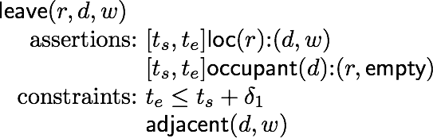
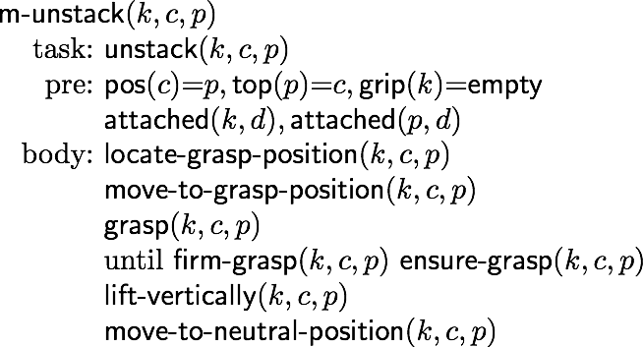
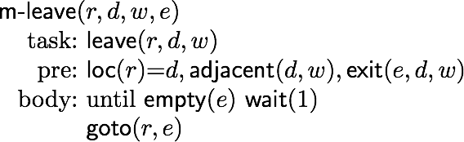
Atemporal Refinement of Actions
Templan’s actions may correspond to compound tasks
  In RAE, use refinement methods to refine them into commands
Templan’s
action schema
(descriptive model)
RAE’s
refinement method
(operational model)
unstack(k,c,p)
assertions: …
constraints: …

Slide 42
Discussion
Atemporal Refinement of Actions
  Advantages
    Simple online refinement with RAE
    Can be augmented to include some temporal monitoring functions in RAE
  Disadvantages
    Does not handle temporal requirements at the command level,
      e.g., synchronize two robots that must act concurrently

Slide 43
Outline
Topic Section
Introduction 17.1
Representation 17.2
Planning (briefly) 18.2
Consistency and controllability 18.3
Acting (Part 1: refinement) 17.3.1
Acting (Part 2: dispatching) 17.3.1

Slide 44
Dispatching
Dispatching procedure: a dynamic execution strategy
  Controls when to start each action
  Given a dynamically controllable plan with executable primitives, triggers actions from online observations
t₁
[15, 25]
t₂
[0, 5]
t₃
[15, 20]
t₄
bring
move
[-5, 5]
[10,10]
uncover
t₅
[5, 10]
t₆

Slide 45
Dispatching
Let t₁ = 0. Then:
  t₂ ∈ [15,25]
  t₃ ∈ [t₂, t₂+5]
  t₄ ∈ [t₃+15, t₃+20]
  t₅ ∈ [t₃+10, t₃+10]
  t₆ ∈ [t₅+5, t₅+10] ∩ [t₄–5, t₄+5]
Suppose bring finishes at t₂=20
  t₃ is enabled during [20, 25]
Suppose we start move at t₃ = 22
  t₅ is enabled during [32,32]
Let (V,Ṽ,E,Ẽ ) be a grounded controllable STNU
Different from a grounded expression in logic
  At least one time point in (V,Ṽ,E,Ẽ ) is instantiated
Bounds every time point t_{i} within an interval [l_{i},u_{i}]
Controllable time point t in the future:
t_{i} is alive if current time now ∈ [l_{i} , u_{i}]
t_{i} is enabled if
  it’s alive
  every precedence constraint t′ < t_{i} has occurred
  for every wait constraint ⟨t_{e}, α⟩,
    t_{e} has occurred or α has expired
t₁
[15, 25]
t₂
[0, 5]
t₃
[15, 20]
t₄
bring
move
[-5, 5]
[10,10]
uncover
t₅
[5, 10]
t₆

Slide 46
Dispatching
Dispatch(V,Ṽ,E,Ẽ )
initialize the network
while there are time points in V that
haven’t been triggered, do
  update now
  update the time points in Ṽ that were triggered since the last iteration
  update enabled
  trigger every t_{i} ∈ enabled such that now = u_{i}
  arbitrarily choose other time points in enabled, and trigger them
  propagate values of triggered timepoints (change [l_{j},u_{j}] for each future timepoint t_{j})
Let (V,Ṽ,E,Ẽ ) be a grounded controllable STNU
Different from a grounded expression in logic
  At least one time point in (V,Ṽ,E,Ẽ ) is instantiated
Bounds every time point t_{i} within an interval [l_{i},u_{i}]
Controllable time point t in the future:
t_{i} is alive if current time now ∈ [l_{i} , u_{i}]
t_{i} is enabled if
  it’s alive
  every precedence constraint t′ < t_{i} has occurred
  for every wait constraint ⟨t_{e}, α⟩,
    t_{e} has occurred or α has expired
t_{i} is bounded
by [l_{i} , u_{i}]
t₁
[15, 25]
t₂
[0, 5]
t₃
[15, 20]
t₄
bring
move
[-5, 5]
[10,10]
uncover
t₅
[5, 10]
t₆

Slide 47
Example
Dispatch(V,Ṽ,E,Ẽ )
initialize the network
while there are time points in V that
haven’t been triggered, do
  update now
  update the time points in Ṽ that were triggered since the last iteration
  update enabled
  trigger every t_{i} ∈ enabled such that now = u_{i}
  arbitrarily choose other time points in enabled, and trigger them
  propagate values of triggered timepoints (change [l_{j},u_{j}] for each future timepoint t_{j})
Initially:
  t₂ ∈ [t₁+15, t₁+25], t₃ ∈ [t₂, t₂+5], t₄ ∈ [t₃+15, t₃+20],
  t₅ ∈ [t₃+10, t₃+10], t₆ ∈ [t₅+5, t₅+10] ∩ [t₄–5, t₄+5]
now = 0: trigger t₁
  propagate [l_{j},u_{j}] values: t₁ = 0, t₂ ∈ [15,25]
now = 20: bring finishes, update t₂ ← 20, add t₃ to enabled
  propagate [l_{j},u_{j}] values:
    t₂ = 20, t₃ = [20, 25]
now = 22: trigger t₃, propagate [l_{j},u_{j}] values:
    t₃ = 22, t₄ ∈ [37, 42], t₅ ∈ [32, 32]
now = 32: add t₅ to enabled; now = u₅ so we must trigger t₅
  propagate values:
    t₅ = 32, t₆ ∈ [37, 42] ∩ [t₄–5, t₄+5]
now = 37: move finishes, update t₄ ← 37
  propagate values:
    t₄ = 37, t₆ ∈ [37, 42] ∩ [32, 42]
now = 42: uncover finishes, update t₆ ← 42
t_{i} is bounded
by [l_{i} , u_{i}]
t₁
[15, 25]
t₂
[0, 5]
t₃
[15, 20]
t₄
bring
move
[-5, 5]
[10,10]
uncover
t₅
[5, 10]
t₆

Slide 48
Deadline Failures
Suppose something makes it impossible to start an action on time
Do one of the following:
  stop the delayed action, and look for new plan
  let the delayed action finish; try to repair the plan by resolving violated constraints at the STNU propagation level
    e.g., accommodate a delay in bring by delaying the whole plan
  let the delayed action finish; try to repair the plan some other way
t₁
[15, 25]
t₂
[0, 5]
t₃
[15, 20]
t₄
bring
move
[-5, 5]
[10,10]
uncover
t₅
[5, 10]
t₆

Slide 49
Partial Observability
Tacit assumption: all occurrences of contingent events are observable
  Observation needed for dynamic controllability
In general, not all events are observable
POSTNU (Partially Observable STNU)
Dynamically controllable?
Controllable
Timepoints Invisible
Contingent
Observable

Slide 50
Observation Actions
t0
[19:00, 19:30]
t1
t
[1, 2]
t′
[20, 25]
t2
working
driving
[-5, 10]
[25, 30]
t3
cooking
t4
Controllable
Contingent
Invisible
observable

Slide 51
Dynamic Controllability
A POSTNU is dynamically controllable if
  there exists an execution strategy that chooses future controllable points to meet all the constraints, given the observation of past visible points
Observable ≠ visible
Observable means it will be known when observed
It can be temporarily hidden
t0
[19:00, 19:30]
t1
t
[1, 2]
t′
[20, 25]
t2
working
driving
[-5, 10]
Controllable
Timepoints Invisible
Contingent Visible
Observable
Hidden
[25, 30]
t3
cooking
t4

Slide 52
Summary
Representation
  Time-oriented view
  Timelines
    Temporal assertions, object constraints, temporal constraints
  Causal support
  Action schemas, Methods
  Chronicles
Material from Chapter 18
  Flaws, resolvers, TemPlan
  Temporal constraints: STNs, PC algorithm (path consistency)
Acting
  Dynamic controllability
  STNUs
  RAE and eRAE
  Dispatching

