Slide 1
Chapter 5
HTN Representation and Planning
Dana S. Nau
University of Maryland
with contributions from
Mark “mak” Roberts

Slide 2
Hierarchical Task Network (HTN) Planning
For some planning problems, we may already have ideas for how to look for solutions
Example: travel to a destination that’s far away:
  Brute-force search:
    many combinations of vehicles and routes
  Experienced human: small number of “recipes”
    e.g., flying:
      buy ticket from local airport to remote airport
      travel to local airport
      fly to remote airport
      travel to final destination
Two ways to put such information into a planner
  Domain-specific algorithm
  Domain-independent planning engine + domain-specific planning information
    HTN planning (this Part)
Ingredients:
  state-variable planning domain (Part I)
  tasks: activities to perform
  HTN methods: ways to perform tasks

Slide 3
Total-Order HTN Planning
Three kinds of tasks
  Primitive task: head of an action
  Compound task: name(args)
    name is a compound-task name
  Goal task: goal(g)
    g is any classical goal formula
Method: a tuple
(head, nonprimitive task, preconditions, subtasks)
Write it as pseudocode:
  method-name(args)
  Task: nonprimitive task
  Pre: preconditions
  Sub: list of subtasks
TOHTN planning domain: a pair (Σ,M)
  Σ: state-variable planning domain
  M: set of methods
TOHTN planning problem P = (Σ,M,s₀,T)
  T = ⟨t₁, t₂, …, t_{k}⟩
Solution for P:
  any executable plan that can be generated for T by applying
    methods to nonprimitive tasks
    actions to primitive tasks
task
method
task
task
method
task
task
s₀
action
s₁
action
s₂
action
s₃

Slide 4
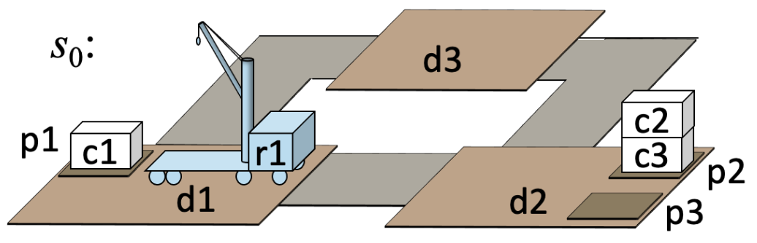
The DWR Domain from Chapter 2
The slides for Chapter 2 used a simpler domain than the one in the book
  Too simple to illustrate what HTNs can do
Here’s the DWR domain from the book
State variables:
    cargo(r) ∈ Containers ∪ {nil}
    loc(r) ∈ Docks
    occupied(d) ∈ {T, F}
    pile(c) ∈ Piles ∪ {nil}
    pos(c) ∈ Robots ∪ Containers ∪ {nil}
    top(p) ∈ Containers ∪ {nil}
  where r ∈ Robots, c ∈ Containers, p ∈ Piles
𝑠₀ = {cargo(r1) = nil, cargo(r2) = nil,
    loc(r1) = d1, loc(r2) = d2,
    occupied(d1)=T, occupied(d2)=F, occupied(d3)=F,
    pile(c1) = p1, pile(c2) = p2, pile(c3) = p2,
    pos(c1) = nil, pos(c2) = c3, pos(c3) = nil,
    top(p1)=c1, top(p2) = c2, top(p3) = nil}
Objects:
  robots r1, r2
  loading docks d1, d2, d3
  containers c1, c2, c3
  piles p1, p2, p3
Rigid relations:
  adjacent = {(d1,d2), (d2,d1), (d2,d3),
  (d3,d2), (d3,d1), (d1,d3)};
  at = {(p1, d1), (p2, d2), (p3, d2)}.

Slide 5
The DWR Domain from Chapter 2
  Action schemas:
  take(r, c, c′, p, d)
    pre: at(p,d), cargo(r) = nil, loc(r) = d, pos(c)= c′, top(p) = c
    eff: cargo(r) ← c, pile(c) ← nil, pos(c) ← r, top(p) ← c′
  put(r, c, c′, p, d)
    pre: at(p,d), pos(c) = r, loc(r) = d, top(p) = c′
    eff: cargo(r) ← nil, pile(c) ← p, pos(c) ← c′, top(p) ← c
  move(r, d, d′ )
    pre: adjacent(d,d′), loc(r) = d, occupied(d ′) = F
    eff: loc(r) ← d′, occupied(d) ← F, occupied(d ′) ← T
  where
  c ∈ Containers; c′ ∈ Containers ∪ Robots ∪ {nil};
  d, d ′ ∈ Docks; p ∈ Piles; r ∈ Robots.
State variables:
    cargo(r) ∈ Containers ∪ {nil}
    loc(r) ∈ Docks
    occupied(d) ∈ {T, F}
    pile(c) ∈ Piles ∪ {nil}
    pos(c) ∈ Robots ∪ Containers ∪ {nil}
    top(p) ∈ Containers ∪ {nil}
  where r ∈ Robots, c ∈ Containers, p ∈ Piles
𝑠₀ = {cargo(r1) = nil, cargo(r2) = nil,
    loc(r1) = d1, loc(r2) = d2,
    occupied(d1)=T, occupied(d2)=F, occupied(d3)=F,
    pile(c1) = p1, pile(c2) = p2, pile(c3) = p2,
    pos(c1) = nil, pos(c2) = c3, pos(c3) = nil,
    top(p1)=c1, top(p2) = c2, top(p3) = nil}
Poll: Notice that cargo(r) = c iff pos(c) = r. Can we rewrite the domain to eliminate cargo(r)?
A. yes B. no C. don’t know

Slide 6

TOHTN Planning Domain
If I say “HTN” assume TOHTN unless stated otherwise
TOHTN planning domain Σ = (Σ_{c}, M)
  Σ_{c} = DWR domain on the previous pages
  M = a set of eight methods:
Compound task put-in-pile(r,c,p,d): put container c into pile p if it isn’t there already
  Preconditions:
    1st one ensures d has the correct value
    Others check for applicability
  Last subtask: one of the args is a state variable, top(p)
    Violates a restriction in Chapter 2
    But many HTN algorithms don’t need the restriction

Slide 7


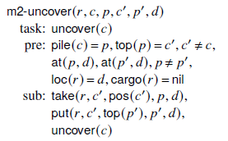
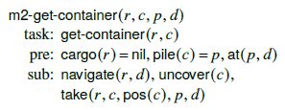
TOHTN Planning Domain (continued)
Goal task: goal(cargo(r)=c)
  Get c onto r
  Subtask of m2-put-in-pile
We aren’t doing classical planning,
so we need a method:
Compound task uncover(c):
  Subtask of m1-fetch
Remove any containers that may be piled on top of c
Poll: Can we rewrite m2-uncover to eliminate c′ ?
A. yes B. no C. don’t know

Slide 8
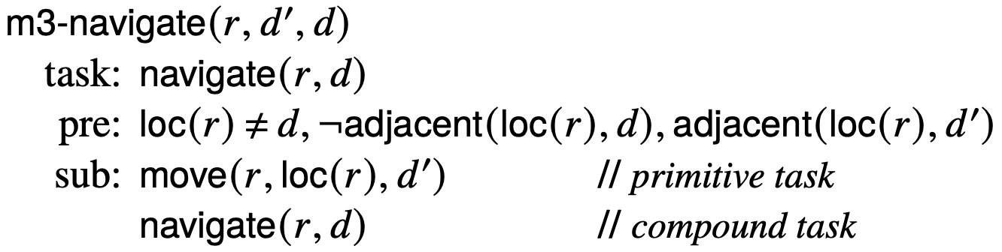
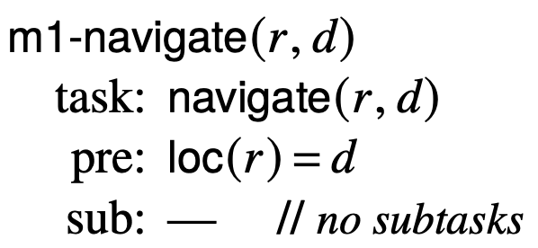
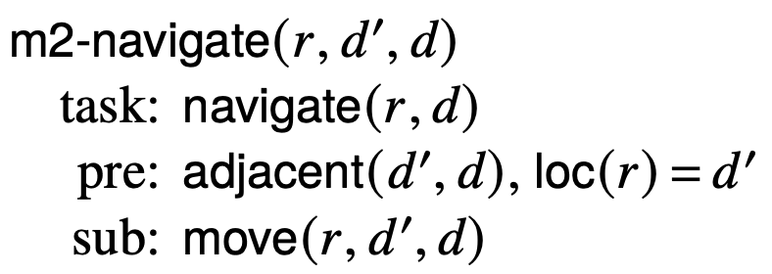
TOHTN Planning Domain (continued)
Compound task navigate(r,d):
  Get robot r from current location to d
  May require several move actions
These methods are just for illustration,
I don’t recommend using them
  Use a route planner instead
Method for the case where loc(r) = d
Method for cases where loc(r) is adjacent to d
Method for cases where loc(r) isn’t adjacent to d
Methods in M:
  m1-put-in-pile, m2-put-in-pile, m1-get-container, m2-get-container, m1-uncover, m2-uncover, m1-navigate, m2-navigate, m3-navigate
Tasks in Σ:
  Primitive: all instances of
    move(r,l,m), take(r,c,l), put(r,c,l)
  Compound: all instances of
    put-in-pile(c,p), uncover(c), and navigate(r,d)
  Goal tasks: all instances of goal(cargo(r) = c)

Slide 9
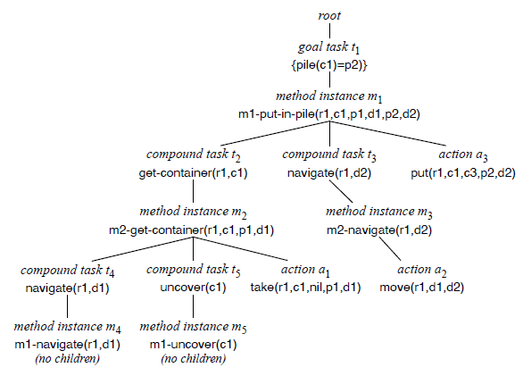
TOHTN Planning problem
Planning problem: P = (Σ, s₀, T)
Solution (detailed definition in book)
  any executable plan produced by applying method instances to nonprimitive tasks, actions to primitive tasks
Refinement tree (detailed definition in book)
  tree showing how the solution was derived
  Nodes:
  root, compound tasks, goal tasks,
  method instances, actions
  Edges:
  root → top-level tasks,
  task → method instance,
  method instance → subtasks
P = (Σ, s₀, ⟨{pile(c1)=p2}⟩)
π = ⟨take(r1,c1,c2,p1,d1), move(r1,d1,d2), put(r1,c1,c3,p2,d2)⟩

Slide 10
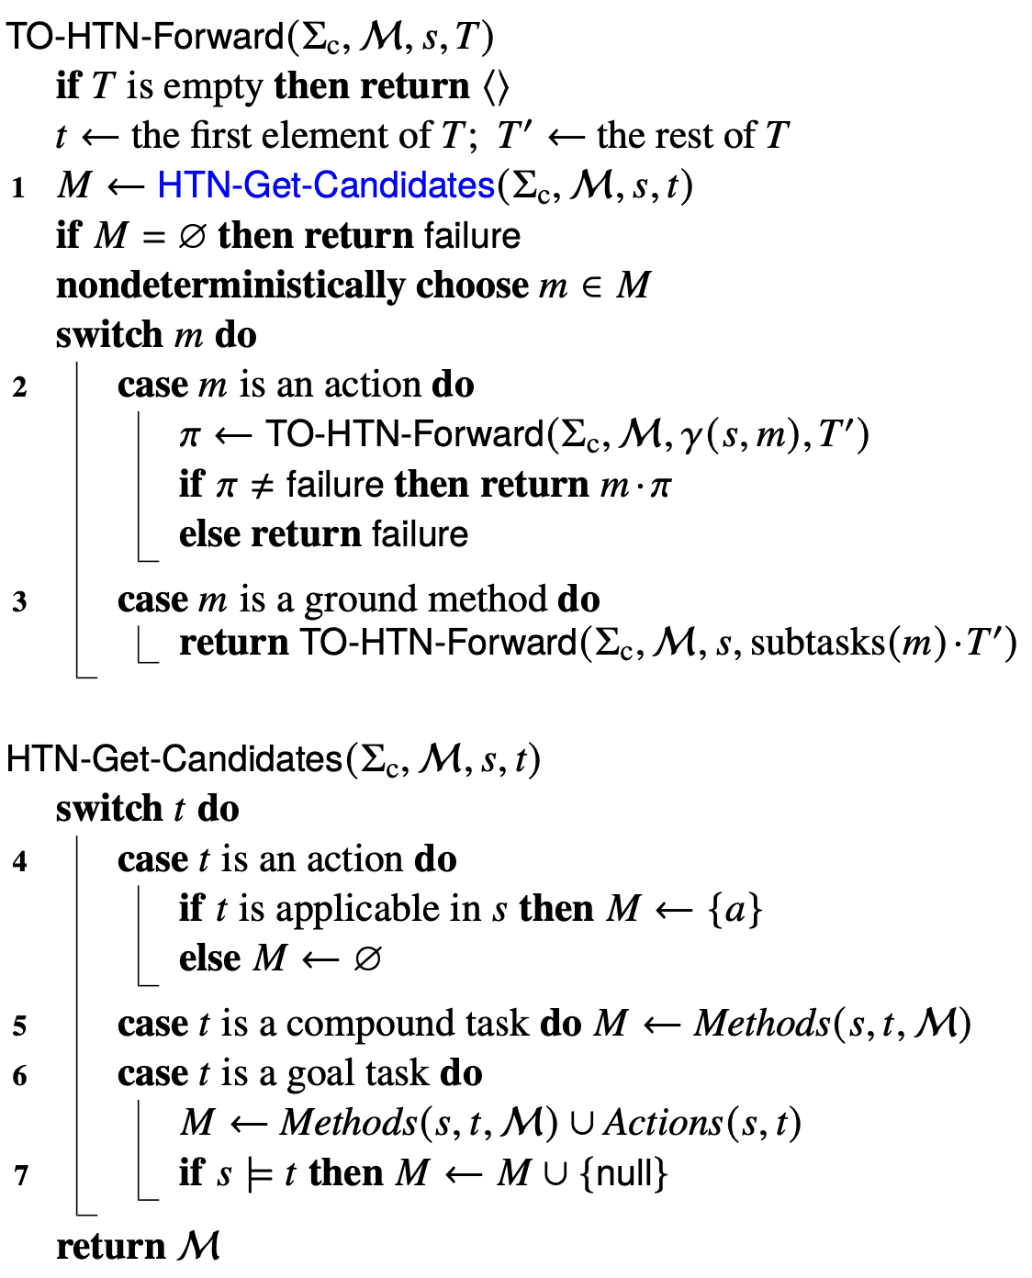
Planning Algorithm
Definitions
Three cases: primitive, compound, goal task
  Primitive task: apply action
  Compound task: apply method instance
  Goal task: apply method instance or action
state s; T = ⟨t, t₂, …, t_{k}⟩
new state γ(s,t) ; T′ = ⟨t₂, …, t_{k}⟩
state s; T = ⟨t, t₂, …, t_{k}⟩
method instance m
⟨ u₁, …, u_{j} , t₂, …, t_{k}⟩

Slide 11
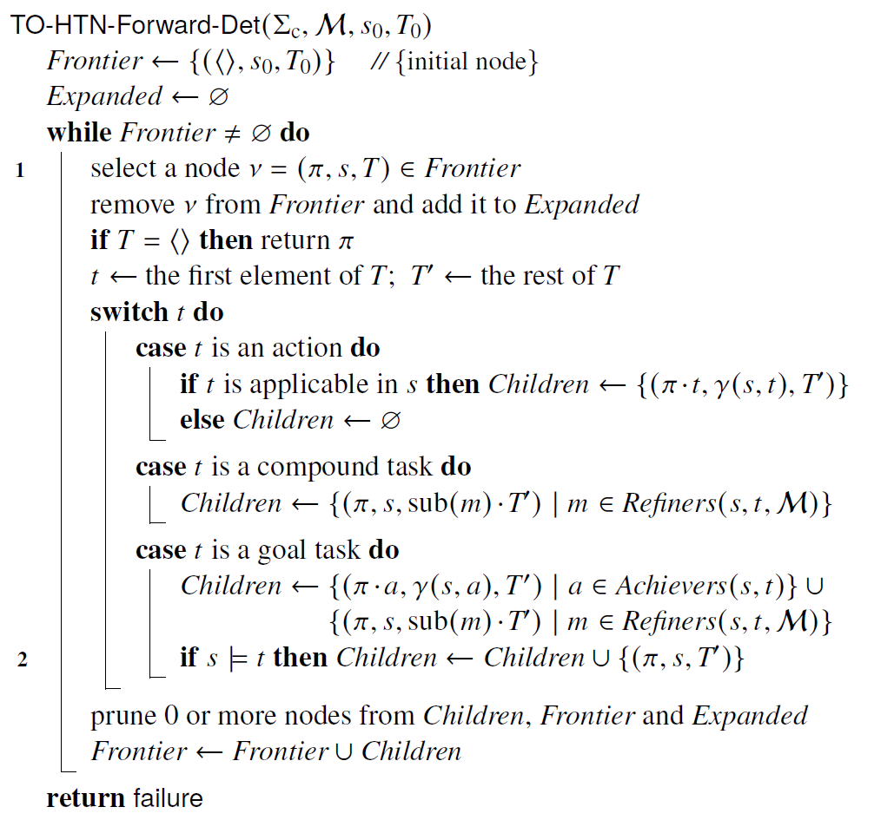
Planning Algorithm
Most implementations do depth-first
  Can use heuristic function, but the ones in Chapter 3 will probably need modification
  Primitive task: apply action
  Compound task: apply all method instances
  Goal task: apply all method instances
  and actions
state s; T = ⟨t, t₂, …, t_{k}⟩
new state γ(s,t) ; T = ⟨t₂, …, t_{k}⟩
state s; T = ⟨t, t₂, …, t_{k}⟩
method instance m
⟨ u₁, …, u_{j} , t₂, …, t_{k}⟩

Slide 12
Search Direction, Search Strategies
Down, then forward (progression)
  totally-ordered compound tasks: SHOP, Pyhop, GTPyhop
  partially-ordered compound tasks: SHOP2, SHOP3
  totally-ordered goal tasks: GDP, GoDeL
  acting, task refinement: RAE
  Monte Carlo rollouts: UPOM
Down and backward (regression)
  plan-space planning: SIPE, O-Plan, UMCP
Forward, then down (level 1, level 2, level 3, …)
  AHA*: A* search
  Bridge Baron 1997: game-tree generation
task
task
task
task
task
task
task
task
…
task
task
…
task
task
…
task
task
…
task

Slide 13
Complexity and Expressivity
HTN planning is Turing-complete
  There are HTN planning problems that are undecidable
TOHTN planning is decidable, but is more expressive than classical planning
  Every classical planning problem can be translated into an equivalent TOHTN planning problem
  There are TOHTN planning problems that cannot be translated into classical planning problems
Some subsets of TOHTN planning can be translated into classical planning problems
Some subsets of TOHTN planning can be translated into propositional logic
These translation techniques have been used to produce efficient TOHTN planners
All of these are worst-case results
  Most TOHTN planning problems are much simpler (e.g., in NP)
  Example later

Slide 14
Pyhop
A simple HTN planner written in Python
    import pyhop
  Depth-first version of TO-HTN-Forward with no goal tasks
  Less than 150 lines of code, works in both Python 2 and 3
State: Python object that contains state variables
    s = gtpyhop.State('Current state')
  To say r1 is at d1 in state s:
    s.loc['r1'] = 'd1'
Actions and methods: ordinary Python functions
Some limitations compared to most other HTN planners
  I’ll discuss later
Open-source software, Apache license
  http://bitbucket.org/dananau/pyhop

Slide 15
Comparison
Pyhop method: ordinary Python function
  Args: state s and the task parameters
Task: transport(c,y,z) – transport c from y to z
TOHTN method:
def m_transport(s,c,y,z):
(r,x) = find_suitable_robot('transport’,s,c,y,z)
if r != 'failure':
return [('move',r,x,y), ('take',r,c,y), \
('move',r,y,z), ('put',r,c,z)]
else: return False
Method m_transport(r,x,c,y,z)
  Task: transport(c,y,z)
  Pre: loc(r) = x, cargo(r) = nil, loc(c) = y
  Sub: move(r,x,y), take(r,c,y), move(r,y,z), put(r,c,z)
Most HTN planners:
Write in a planning language the planner can read and analyze
Can have parameters not mentioned in the task
    robot r, location x
  Backtrack over multiple possibilities
Planner knows in advance what the subtasks are
  Helps with implementing heuristic functions
Advantages
  Don’t need to learn a planning language: write methods and actions in Python
Disadvantages:
  Planner doesn’t know in advance what the subtasks are
    How to implement a heuristic function?
  What about parameters not mentioned in the task?

Slide 16
GTPyhop
GTPyhop (2021):
Like Pyhop, but has both compound tasks and goal tasks
  declare task methods for compound tasks
  declare goal methods for goal tasks
Open-source: https://github.com/dananau/GTPyhop
Mostly backward-compatible with Pyhop
Two kinds of goals:
Unigoal: a single atom
  represented as a triple (name, arg, value)
      ('pos', 'a', 'b’)
  goal: get to a state s in which
      s.pos['a']=='b'
Multigoal: a conjunction of atoms
  represented as a state-like object
    g = gtpyhop.Multigoal('Sussman goal’)
    g.pos = {'a':'b', 'b':'c’}
  goal: get to a state s in which
    s.pos['a']=='b' and s.pos['b']=='c'

Slide 17
Example: Blocks World
Simple classical planning domain
  Blocks, robot hand for stacking them,
  infinitely large table
State-variable notation:
pickup(x)
  pre: loc(x)=table, clear(x)=T, holding=nil
  eff: loc(x)=crane, clear(x)=F, holding=x
putdown(x)
  pre: holding=x
  eff: holding=nil, loc(x)=table, clear(x)=T
unstack(x,y)
  pre: loc(x)=y, clear(x)=T, holding=nil
  eff: loc(x)=crane, clear(x)=F, holding=x, clear(y)=T
stack(x,y)
  pre: holding=x, clear(y)=T
  eff: holding=nil, clear(y)=F, loc(x)=y, clear(x)=T
The “Sussman anomaly”
  Planning problem that caused problems for early classical planners
s₀ = {clear(a)=F, clear(b)=T,
clear(c)=T, loc(a)=table, loc(b)=table, loc(c)=a, holding(hand)=nil}
s₀
c
a
b
g
g = {loc(a)=b, loc(b)=c}
a
b
c
π = ⟨unstack(c,a), putdown(c),
pickup(b), stack(b,c),
pickup(a), stack(a,b)⟩

Slide 18
Domain-Specific Algorithm
loop
if there’s clear block that needs to be moved
and it can immediately be moved to a place
where it won’t need to be moved again
then move it there
else if there’s a clear block that needs to be moved
then move it to the table
else if the current state satisfies the goal
then return success
else return failure
s₀
g
π = ⟨unstack(c,b),
putdown(c),
pickup(b),
stack(b,c),
pickup(a),
stack(a,b)⟩
a
c
b
a
b
c
Sound, complete, guaranteed to terminate
Runs in time O(n³)
  Can be modified to run in time O(n)
Often finds optimal (shortest) solutions, but sometimes only near-optimal
  For block-stacking problems,
  plan-length is NP-complete
Can implement as GTPyhop methods
Situations in which c needs to be moved:
  loc(c)=d, goal contains loc(c)=e, and d ≠ e
  loc(c)=d, d is a block, goal contains loc(b)=d for some b ≠ c
  loc(c)=d and d is a block that needs to be moved
Can extend this to include situations involving clear and holding

Slide 19
States and Goals
s₀
g
Initial state:
Goal:
a
c
b
a
b
c
Two ways to write goals:
Unigoal: a single atom
  represented as a triple (name, arg, value)
    ('pos', 'a', 'b')
  get to a state s in which
    s.pos['a']=='b'
Multigoal: a conjunction of atoms
  represented as a state-like object
    g = gtpyhop.Multigoal('Sussman goal')
    g.pos = {'a':'b', 'b':'c'}
  get to a state s in which
    s.pos['a']=='b' and s.pos['b']=='c'
A State object to hold all the state-variable bindings:
  s0 = gtpyhop.State('Sussman initial state')
  s0.pos = {'a':'table', 'b':'table', 'c':'a'}
  s0.clear = {'a':False, 'b':True, 'c':True}
  s0.holding = {'hand':False}
  s0.pos = {'a':'table’, 'b':'table', 'c':'a’}
    is Python dictionary notation for
    s0.pos['a'] = 'table'
    s0.pos['b'] = 'table'
    s0.pos['c'] = 'a'

Slide 20
Actions
pickup(x)
  pre: loc(x)=table, clear(x)=T, holding=nil
  eff: loc(x)=crane, clear(x)=F, holding=x
putdown(x)
  pre: holding=x
  eff: holding=nil, loc(x)=table, clear(x)=T
unstack(x,y)
  pre: loc(x)=y, clear(x)=T, holding=nil
  eff: loc(x)=crane, clear(x)=F, holding=x, clear(y)=T
stack(x,y)
  pre: holding=x, clear(y)=T
  eff: holding=nil, clear(y)=F, loc(x)=y, clear(x)=T
Args: current state s, block x
def pickup(s,x):
if s.pos[x] == 'table’ \
and s.clear[x] == True \
and s.holding['hand'] == False:
s.pos[x] = 'hand’
s.clear[x] = False
s.holding['hand'] = x
return s
def putdown(s,x):
if s.holding['hand'] = x:
s.pos[x] = 'table’
s.clear[x] = True
s.holding['hand'] = False
return s
gtpyhop.declare_actions(pickup,putdown)
Preconditions:
if test
Effects: modify
variable bindings in s
Poll. How many arguments does the unstack task have?
A. 1 B. 2 C. 3 D. other E. don’t know
Tell GTPyhop these are actions

Slide 21
Task Methods
m_take: method to pick up a clear block x,
regardless of what it’s on
  Args: current state s, block x.
  if x is clear:
    return one task list if x is on the table,
    another task list if x isn’t on the table
  Else return nothing
    means method is inapplicable
    (also OK to return false like Pyhop does)
  Declare m_take to be a task method
    relevant for all tasks of the form
    (take, ...)
m_put: similar
def m_take(s,x):
if s.clear[x] == True:
if s.pos[x] == 'table’:
return [('pickup', x)]
else: return [('unstack',x,s.pos[x])]
gtpyhop.declare_task_methods('take',m_take)
def m_put(s,x,y):
if s.holding['hand'] == x:
if y == 'table’: return [('putdown',x)]
else: return [('stack',x,y)]
else: return False
gtpyhop.declare_task_methods('put',m_put)
optional
declare
relevant for task ‘put’
Poll. In a TOHTN planning domain, how many methods would we need for take?
A. 1 B. 2 C. 3 D. other E. don’t know

Slide 22
Goal Methods
s = current state
mgoal = a multigoal
boldface: helper functions
def m_moveblocks(s, mgoal):
for x in all_clear_blocks(s):
stat = status(x, s, mgoal)
if stat == 'move-to-block':
where = mgoal.pos[x]
return [('take',x), ('put',x,where), mgoal]
elif stat == 'move-to-table':
return [('take',x), (put,x,'table'), mgoal]
for x in all_clear_blocks(s):
if status(x,s,mgoal) == 'waiting' \
and s.pos[x] != 'table':
return [('take',x), ('put',x,'table'), mgoal]
return [ ]
gtpyhop.declare_multigoal_methods(m_moveblocks)
loop
if there’s clear block that needs to be moved
and it can immediately be moved to a place
where it won’t need to be moved again
then move it there
else if there’s a clear block that needs to be moved
then move it to the table
else if the current state satisfies the goal
then return success
else return failure
declare relevant for every
multigoal
s₀
g
a
gtpyhop.find_plan(s0,g)
returns
[('unstack','c','a'), ('putdown','c'), ('pickup','b’), ('stack','b','c'), ('pickup','a'), ('stack','a','b')]
Poll. Can we rewrite this as a set of TOHTN methods?
A. Yes B. No
C. Don’t know
c
b
a
b
c

Slide 23
POHTN (Partially Ordered HTN) Planning
Sometimes we don’t want to specify a total ordering on tasks
Represent partially ordered tasks as a task network:
  a pair T = (T, ≺)
  T is a set of task nodes
  ≺ is a partial ordering of T
Task node: a pair τ = (l, t)
  t is a task
  l is a name that uniquely identifies τ
Need labels so we can have multiple occurrences of t
POHTN Method: a tuple
(head, task, pre, sub, ≺)
As usual, write POHTN methods as pseudocode:
  method-name(args)
  Task: nonprimitive task
  Pre: preconditions
  Sub: subtask nodes
  ≺: partial ordering of the subtask nodes
TOHTN planning is a special case of POHTN planning
  ≺ is a total ordering
Details on the following slides
  We’ll skip them

Slide 24
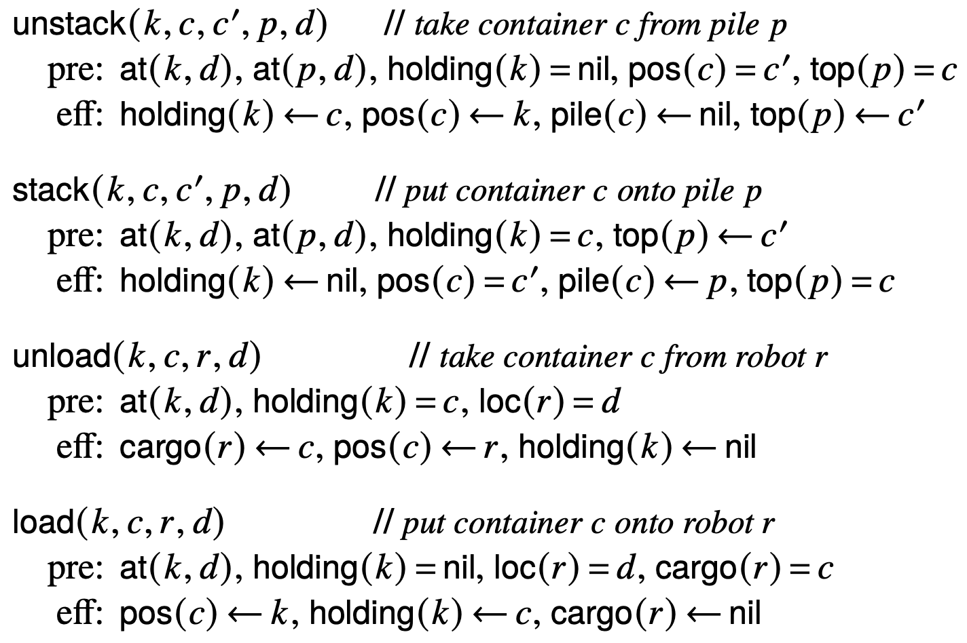
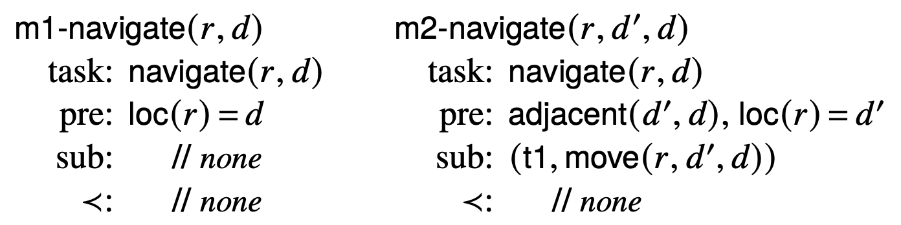
Example POHTN Problem
k1
k2
c1
r1
c2
Σ_{c} : DWR with cranes attached to loading docks, not robots
c3
p1
p2
d1
d2
P = (Σ, s₀, (T, ≺))
  𝑇 = {put-on-robot(c1,r1)}; ≺ = ∅
m1-put-on-robot(k, c, c′, r, d, p)
task: put-on-robot(c, r)
pre: cargo(r) = nil, top(p) = c, at(p,d),
attached(k,d), holding(k) = nil
sub: (t1, navigate(r, d))
(t2, unstack(k,c,c′,p,d))
(t3, load(k,r,c,d))
≺: t1 ≺ t3, t2 ≺ t3
Σ = (Σ_{c}, M)
  M : three
  methods
Poll. How many solution plans?
A. 1 B. 2 C. 3 D. 4 E. other

Slide 25
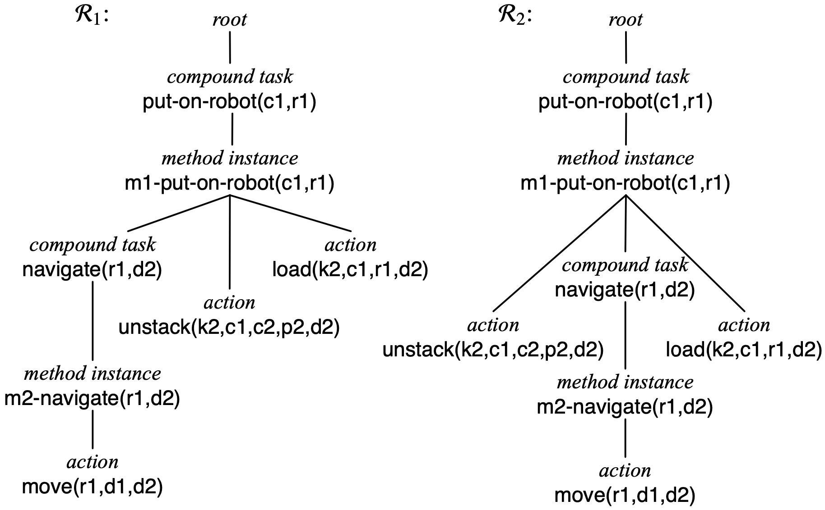
Solution Trees
k1
k2
c1
r1
c2
c3
p1
p2
d1
d2
P = (Σ, s₀, (T, ≺))
  𝑇 = {put-on-robot(c1,r1)}; ≺ = ∅
m1-put-on-robot(k, c, c′, r, d, p)
task: put-on-robot(c, r)
pre: cargo(r) = nil, top(p) = c, at(p,d),
attached(k,d), holding(k) = nil
sub: (t1, navigate(r, d))
(t2, unstack(k,c,c′,p,d))
(t3, load(k,r,c,d))
≺: t1 ≺ t3, t2 ≺ t3
π₁ = move(r1,d1,d2), unstack(k2,c1,c2,p2,d2), load(k2,c1,r1,d2)
π₂ = unstack(k2,c1,c2,p2,d2), move(r1,d1,d2), load(k2,c1,r1,d2)

Slide 26
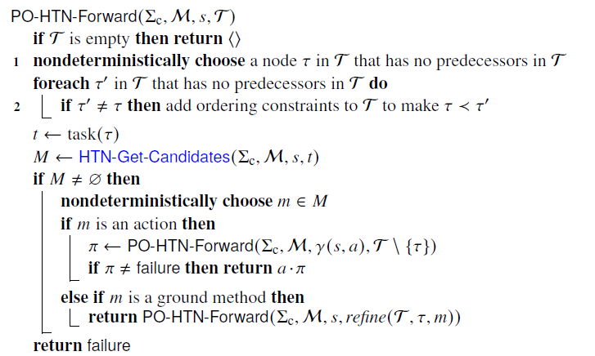
Planning Algorithm
Three cases: primitive, compound, goal task
Primitive task node: apply action
Compound task node: apply method instance
T = (T,≺), T = {τ, τ₂, …, τ_{k}}, nothing precedes τ
state s₀ i.e., ∄τ′ ∈ T s.t. τ′ ≺ τ
new state γ(s₀, τ) ; {τ₂, …, τ_{k}}
T = (T,≺), T = {τ, τ₂, …, τ_{k}}, nothing precedes τ
method instance m i.e., ∄τ′ ∈ T s.t. τ′ ≺ τ
state s₀
{ υ₁, …, υ_{j} , τ₂, …, τ_{k}}
make υ₁, …, υ_{j} precede everything τ preceded

Slide 27
Summary
HTN planning
  Planning problem: initial state, list of tasks
  Apply HTN methods to tasks to get subtasks (smaller tasks)
    Do this recursively to get smaller and smaller subtasks
      At the bottom: primitive tasks that correspond to actions
  TOHTN: tasks are totally ordered
    Planning algorithm: TO-HTN-Forward
  POHTN: tasks are partially ordered
    Planning algorithm: PO-HTN-Forward
Pyhop: Python implementation of total-order HTN planning
  Open source: http://bitbucket.org/dananau/pyhop
GTPyhop: Python implementation of HTN + HGN planning
  Open source: https://github.com/dananau/GTPyhop
Examples: DWR, blocks world, cranes

