Slide 1
Chapter 6
Acting with HTNs
Dana S. Nau
University of Maryland
with contributions from
Mark “mak” Roberts

Slide 2
Using HTN Domain Models for Acting
Unlike an HTN domain model, the actor’s environment is not necessarily deterministic or static
  Exogenous events, unanticipated action outcomes ⇒ current state may be different from what an HTN model would predict
Actor can’t backtrack to a previous state; prior actions are in the past
HTN domain models still are very useful for providing operational models to the actor
  How to carry out “standard operating procedures”
  How to perform complex tasks without searching through a large state space
  How to avoid situations where unanticipated events are likely to cause bad outcomes
  How to recover when unanticipated events occur

Slide 3
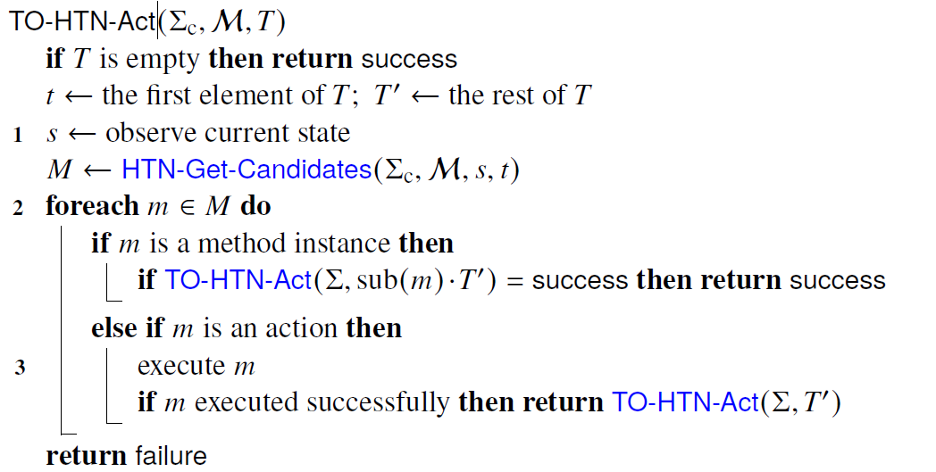
Reactive HTN Actor
Like TO-HTN-Forward but executes each action
  Can similarly modify other Chapter 5 algorithms
Line
0 Return success or failure, not a plan
1 s isn’t an argument, observe it instead
3 Instead of computing γ, execute action
2 Failure recovery: if m fails, try next one
  if they all fail, return failure to next higher level in the recursion stack,
  to try other methods there
0
At Line 2, a bad method instance can lead to non-optimal solution or failure
  Can use a heuristic function
  Can call an HTN planner – but other ways have less computational overhead
Poll 1. Is line doing backtracking?
    A. Yes B. No C. Unsure

Slide 4
Run-HLookahead
HTN-Run-Lookahead(Σ, T)
  while True do:
    s ← observed current state
    π = Lookahead(Σ, s, T)
    if π = failure then return failure
    if π = ⟨ ⟩ then return success
    a ← pop(π)
    trigger execution of a
Here, Lookahead is an HTN planner
Goal formula may not exist
  Cannot rely on s ⊨ g
  Need Lookahead to return ⟨ ⟩ iff no actions are needed to accomplish T
Call Lookahead, get π, perform 1st action, call HLookahead again …
Useful when unexpected things are likely to happen
  Replans immediately
Lookahead needs to return quickly
  Otherwise, HTN-Run-Lookahead may pause repeatedly waiting for Lookahead to return
  May want Lookahead to look a limited distance or horizon ahead

Slide 5
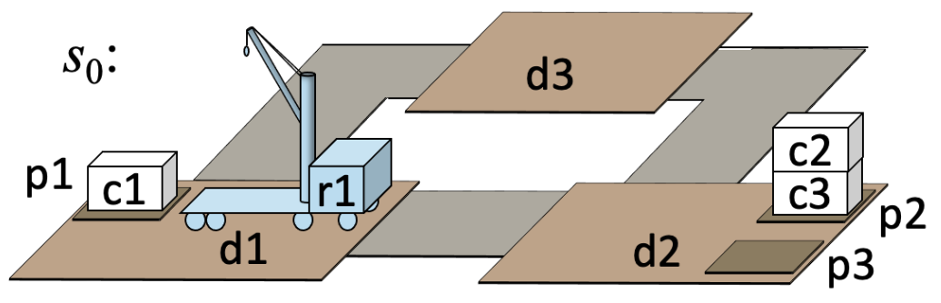
Run-HLookahead (Example 1)
HTN-Run-Lookahead(Σ, T )
  while True do:
    s ← observed current state
    π = Lookahead(Σ, s, T )
    if π = failure then return failure
    if π = ⟨ ⟩ then return success
    a ← pop(π)
    trigger execution of a
Call HTN-Run-Lookahead with Lookahead = TO-HTN-Forward (THF)
  Σ = the TOHTN domain in Example 5.8
  P = (Σ, s₀, T = ⟨{pile(c1)=p2}⟩)
If nothing unexpected happens:
  Call TO-HTN-Forward(Σ, s₀, T )
    π = ⟨take(r1,c1,c2,p1,d1), move(r1,d1,d2), put(r1,c1,c3,p2,d2)⟩
  Execute take(r1,c1,c2,p1,d1)
  Call THF(..), get π = ⟨move(r1,d1,d2), put(r1,c1,c3,p2,d2)⟩
  execute move(r1,d1,d2),
  call THF(..), get π = ⟨put(r1,c1,c3,p2,d2)⟩
  execute put(r1,c1,c3,p2,d2),
  Call THF(..), get π = ⟨ ⟩, return success
If something unexpected happens but the problem is still solvable:
  Call THF(..) with latest observed state, it returns a new plan
  This could fail if there is no applicable method for the new state!

Slide 6
Run-Lazy-HLookahead
HTN-Run-Lazy-Lookahead(Σ, T )
  π ← ⟨ ⟩; a ← nil
  while True do:
    if π = ⟨ ⟩ or execution of a failed then
      s ← observed state
      π = Lookahead(Σ, s, T )
      if π = failure then return failure
      if π = ⟨ ⟩ then return success
    a ← pop(π)
    trigger execution of a
Two different tests for ⟨ ⟩
  If we’ve exhausted the current plan, call Lookahead
  If Lookahead returns ⟨ ⟩, return success
Requires Lookahead to return ⟨ ⟩ iff no actions are needed to accomplish T
Could also add a Simulate program as in Run-Lazy-Lookahead

Slide 7
Run-Lazy-HLookahead (Example 1)
HTN-Run-Lazy-Lookahead(Σ, T )
  π ← ⟨ ⟩; a ← nil
  while True do:
    if π = ⟨ ⟩ or execution of a failed then
      s ← observed state
      π = Lookahead(Σ, s, T )
      if π = failure then return failure
      if π = ⟨ ⟩ then return success
    a ← pop(π)
    trigger execution of a
Call HTN-Run-Lazy-Lookahead with Lookahead = TO-HTN-Forward (THF)
  Σ = TOHTN domain in Example 5.8
  initial state s₀, T = ⟨{pile(c1)=p2}⟩
If nothing unexpected happens:
  Call THF(Σ, s₀, T)
    π = ⟨take(r1,c1,c2,p1,d1), move(r1,d1,d2), put(r1,c1,c3,p2,d2)⟩
  Pop actions from π and execute them, until π = ⟨ ⟩
  Call THF again, get π = ⟨ ⟩, return success
If something unexpected happens but the problem is still solvable:
  Eventually, either π = ⟨ ⟩ or a has failed
  Call THF with observed state, it returns a new plan
HTN-Run-Lookahead is similar but it calls Lookahead before each action is executed

Slide 8
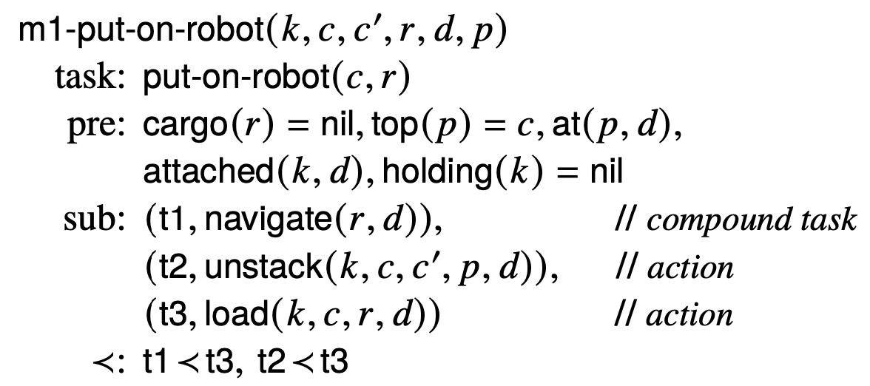
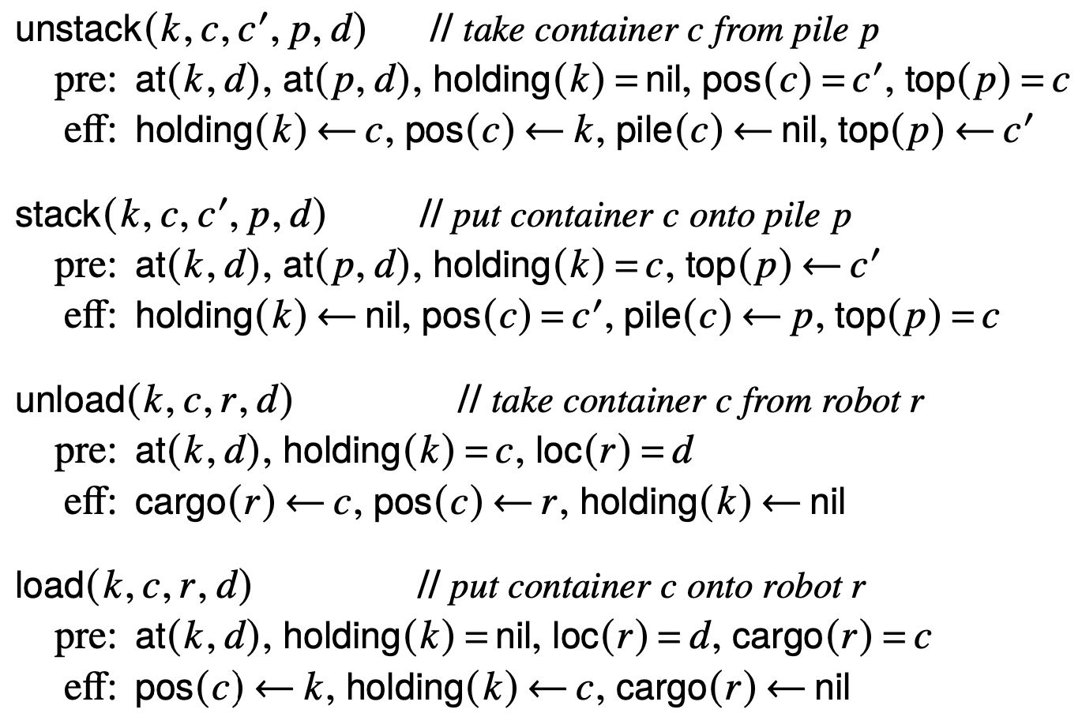
Example 2
POHTN planning domain
  Cranes at loading docks, not on the robots
Actions:
  The usual move action, and these:
Methods
The usual navigate methods
k1
k2
c1
r1
c2
c3
p1
p2
d1
d2

Slide 9
Example 2
Call HTN-Run-Lazy-Lookahead with Lookahead = POHTN-Forward
  Σ = POHTN domain on previous page
  initial state s₀, the only task in T is put-on-robot(c1,r1)
If nothing unexpected happens:
  Call POTHN-Forward(Σ, s₀, T )
    Two solution plans, suppose it returns this one:
    π₂ = ⟨unstack(k2,c1,c2,p2,d2), move(r1,d1,d2), load(k2,c1,r1,d2)⟩
  Pop actions from π and execute them, until π = ⟨ ⟩
  Call POHTN-Forward again, get π = ⟨ ⟩, return success
Suppose move fails without changing the current state:
  Call POHTN-Forward(Σ, s₀, T )
    failure: no applicable methods when k2 is holding c1
Run-Lookahead
  Call POHTN-Forward, get plan, execute unstack, call PPlan, PPlan fails
Run-Lazy-HLookahead(Σ, T )
  π ← ⟨ ⟩; a ← nil
  while True do:
    if π = ⟨ ⟩ or execution of a failed then
      s ← observed state
      π = HTN-Lookahead(Σ, s, T )
      if π = failure then return failure
      if π = ⟨ ⟩ then return success
    a ← pop(π)
    trigger execution of a
k1
k2
c1
r1
c2
c3
p1
p2
d1
d2

Slide 10
Error Recovery in HTN Domains
HTN methods require the solution plan to follow a particular trajectory
Encode requirements that aren’t explicit in the classical planning domain
  Safety requirements:
    Secure a container onto the robot before starting to move the robot
  Commitments to other agents
    Don’t use a particular resource, because others may need it
  A company’s standard operating procedures
HTN-Run-Lookahead and HTN-Run-Lazy-Lookahead don’t know anything about the trajectory requirements
That’s OK if nothing goes wrong
If unexpected events occur, need to recover in a way that still satisfies the trajectory requirements
Three approaches
  Modify TO-HTN-Act to call an HTN planner
    HTN planner returns a method selection
  Modify HTN planner to return a solution tree
    Actor traverses the tree
  Actor calls HTN planner to do replanning in a modified domain

Slide 11
TO-HTN-Act (modified) with an HTN Planner
HTN planner similar to TO-HTN-Forward, but returns the top-level method in its solution tree
Suppose there’s an execution error here
  TO-HTN-Act calls the planner here, tells it to use a different method
task
method inst.
task
task
method inst.
. . .
method inst.
task
task
task
task
task
task
method inst.
method inst.
. . .
method inst.
…
method inst.
method inst.
. . .
method inst.
act.
act.
…
act.
act.
act.
…
act.
…
act.
act.
…
act.
…
act.
act.
…
act.
act.
act.
…
act.
…
act.
act.
…
act.

Slide 12
Traversing a Solution Tree
HTN planner returns a solution tree, actor traverses the tree
Time vs. space tradeoff
  Here, we need the entire tree
  In TO-HTN-Act, we don’t but the actor and planner duplicate effort, repeatedly recreating the current part of the tree
HTN planner returns a solution tree
Actor traverses the tree
Suppose there’s an execution error here
  Actor calls the planner here, tells it to use a different method
task
method inst.
task
task
method inst.
. . .
method inst.
task
task
task
task
task
task
method inst.
method inst.
. . .
method inst.
…
method inst.
method inst.
. . .
method inst.
act.
act.
…
act.
act.
act.
…
act.
…
act.
act.
…
act.
…
act.
act.
…
act.
act.
act.
…
act.
…
act.
act.
…
act.

Slide 13
Modifying the Planning Domain
Actor calls TO-HTN-Forward again, with the same initial state s₀ and task t as before
Modified planning domain
  Methods are modified so that the initial actions of the plan must be a₁₁, …, a_{kn}
  Action a_{k2} is modified so that γ(s_{k1}, a_{k2}) = s_{k2}′
Modified version of HTN-Run-Lazy-Lookahead
  Calls TPlan to get a plan
Suppose there’s an execution error here
  a_{k2} was supposed to produce
  state s_{k2}
  it produced state s_{k2}′ instead
initial task t
task
method inst.
initial state s₀
task
task
method inst.
. . .
method inst.
task
task
task
task
task
task
m₁
m₂
. . .
m_{k}
…
method inst.
method inst.
. . .
method inst.
a₁₁
a₁₂
…
a_{1n}
a₂₁
a₂₂
…
a_{2n}
…
a_{k1}
a_{k2}
…
a_{kn}
…
act.
act.
…
act.
act.
act.
…
act.
…
act.
act.
…
act.

Slide 14
Summary
Issues
  Actor’s environment may not be deterministic or static
  Actor can’t backtrack to a previous state
TO-HTN-Act: reactive actor similar to TO-HTN-Forward
HTN-Run-Lookahead, HTN-Run-Lazy-Lookahead
  Examples where they work well, where they don’t
Error recovery in HTN domains
Three approaches
  TO-HTN-Act modified to call an HTN planner
  Actor that traverses a solution tree
  Actor that re-invokes TO-HTN-Forward on the original problem in a modified planning domain
Tradeoff: time versus space

