Slide 1
Chapter 9
Planning with Probabilistic Models
Dana S. Nau
University of Maryland

Slide 2
Introduction
d6
d7
m52
d5
Stochastic Shortest Path (SSP) problem:
an MDP problem P = (Σ, s₀, S_{g}) such that
  there is at least one safe solution
  cost(s,a,s′) is always > 0
Let V*(s) = expected cost of an optimal safe solution
Optimality principle (Bellman’s theorem)
  V*(s) = 0, if s is a goal
  min_{a∈Applicable(s)} ∑_{s′∈γ(s,a)} Pr(s′ | s,a) [cost(s,a,s′) + V*(s′)], otherwise
We’ll only consider safe SSP’s
  no dead-end states
0.2
d8
d2
m23
0.8
d3
d9
m12
m21
m54
m43
m34
m41
m45
Start:
s₀= d1
d1
d4
m14
0.5
0.5
Goal: S_{g}= {d4}
Safe solution: Pr (S_{g} | s₀, π) = 1

Slide 3
Planning and Acting
0.2
d5
c = 1
d2
d3
0.8
Run-Lookahead(Σ,s₀,S_{g})
  s ← s₀
  while s ∉ S_{g} and Applicable(s) ≠ ∅ do
    a ←Lookahead(Σ, s, S_{g})
    if a = failure then return failure
    perform action a
    s ← observe resulting state
c = 100
c = 100
d1
c = 1
d4
0.5
0.5
Start:
s₀= d1
Goal:
S_{g}= {d4}
Like Run-Lookahead from Chapter 2
Differences:
  Explicit starting state s₀
    Not necessary, could observe s₀ instead
  Doesn’t abstract s (to simplify the presentation)
  Lookahead returns an action instead of a plan
As in Chapter 2, Lookahead can be modified to cut off its search before reaching S_{g}
What to use for Lookahead?
  Classical planner on determinized domain
    next page
  AO*, LAO*, …
    Modify to search part of the space
  Stochastic sampling algorithms

Slide 4
Planning and Acting
Algorithm 5.15 in
Automated Planning and Acting
(see supplemental materials)
d5
m23
0.2
FS-Replan(Σ, s, S_{g})
π ← ∅
while s ∉ S_{g} and Applicable(s) ≠ ∅ do
if π(s) is undefined then do
π ← Plan2policy(Lookahead(Σ_{d}, s, S_{g}))
if π = failure then return failure
perform action π(s)
s ← observe resulting state
d2
d3
c = 1
0.8
m54
m12
m34
c=20
c = 10
c= 10
d6
m64
0.95
c = 300
m14
c = 500
d1
0.05
d4
Start: s₀= d1
Goal: S_{g}= {d4}
d5
Generalization of a well-known planner called FF-Replan
Like Run-Lazy-lookahead from Chapter 2
  Lookahead = classical planner on determinized domain
Example:
  Forward-Search returns ⟨m12, m23₁, m34⟩
  Plan2policy returns π = ⟨(d1,m12), (d2,m23), (d3,m34)⟩
  If m23 goes to d5, then call Forward-search again
m23₂
d2
c = 1
m23₁
d3
m54
m12
m34
c=20
c = 10
c= 10
d6
m64
m14₂
c = 300
c = 500
d1
d4
m14₁
Start: s₀= d1
Goal: S_{g}= {d4}

Slide 5
Planning and Acting
Algorithm 5.15 in
Automated Planning and Acting
(see supplemental materials)
d5
m23
0.2
FS-Replan(Σ, s, S_{g})
π ← ∅
while s ∉ S_{g} and Applicable(s) ≠ ∅ do
if π(s) is undefined then do
π ← Plan2policy(Lookahead(Σ_{d}, s, S_{g}))
if π = failure then return failure
perform action π(s)
s ← observe resulting state
d2
d3
c = 1
0.8
m54
m12
m34
c=20
c = 10
c= 10
d6
m64
0.95
c = 300
m14
c = 5
d1
0.05
d4
Start: s₀= d1
Goal: S_{g}= {d4}
d5
Problem: classical planner may choose a plan that depends on low-probability outcome
Example: Forward-search returns ⟨m14₁⟩, cost 5
  Plan2policy returns π = ⟨(d1,m14)⟩
  m14 very likely to go to d6 ⇒ cost 305
RFF algorithm (see book) attempts to alleviate this
m23₂
d2
c = 1
m23₁
d3
m54
m12
m34
c=20
c = 10
c= 10
d6
m64
m14₂
c = 300
c = 5
d1
d4
m14₁
Start: s₀= d1
Goal: S_{g}= {d4}

Slide 6
Cost to Go
d5
Let π be a safe solution that’s defined at all non-goal states
  Pr (S_{g} | s₀, π) = 1
  Domain(π) = S ∖ S_{g}
Compute V^{π} as |S| equations, |S| unknowns
Cost-to-go:
  expected cost at s if we first use a, then use π afterward
  Q^{π}(s,a) = ∑_{s′∈γ(s,a′)} Pr (s′ | s,a′) [cost(s,a,s′) + V^{π}(s′)]
For every s ∈ S ∖ S_{g}
  {a′ | a′∈Applicable(s)} includes π(s)
  so {Q^{π}(s,a′) | a′∈Applicable(s)} includes V^{π}(s)
  so min{Q^{π}(s,a′) | a′∈Applicable(s)} ≤ V^{π}(s)
  so let π′(s) ∈ argmin_{a′∈Applicable(s)} Q^{π}(s,a′)
c = 1
0.2
d2
0.8
d3
c = 100
c = 100
Start:
s₀= d1
d1
c = 1
d4
Goal:
S_{g}= {d4}
0.5
0.5
Poll: Does π′ dominate π?
A. always
B. sometimes
C. never

Slide 7
Example
d5
d5
c = 1
0.2
c = 1
0.2
d2
d2
0.8
d3
0.8
d3
Q^{π}(d1,m12) = 100 + 101 = 201
Q^{π}(d1,m14) = 1 + ½(201) + ½(0) = 101.5
  min = 101.5, argmin = m14
Q^{π}(d2,m23) = (0.8(1 + 100) + 0.2(1 + 100))
= 101
Q^{π}(d2,m21) = 100 + 201 = 301
  min = 101, argmin = m23
Q^{π}(d3,m34) = 100 + 0 = 100
Q^{π}(d3,m32) = 1 + 101 = 102
  min = 100, argmin = m34
Q^{π}(d5,m54) = 100 + 0 = 100
Q^{π}(d5,m52) = 1+101 = 102
  min = 100, argmin = m54
new action m32
c = 100
c = 100
c = 100
c = 100
d1
c = 1
d4
d1
c = 1
d4
Start:
s₀= d1
0.5
0.5
Goal:
S_{g}= {d4}
Start:
s₀= d1
0.5
0.5
Goal:
S_{g}= {d4}
π = {(d1, m12), (d2, m23),
(d3, m34), (d5, m54)}
π′ = {(d1,m14), (d2,m23),
(d3,m34), (d5,m54)}
V^{π′}(d4) = 0
V^{π′}(d3) = 100 + V^{π′}(d4) = 100
V^{π′}(d5) = 100 + V^{π′}(d4) = 100
V^{π′}(d2) = 1 + (0.8 V^{π′}(d3) + 0.2 V^{π′}(d5))
= 101
V^{π′}(d1) = 1 + ½V^{π′}(d1) + ½V^{π′}(d4)
⇒ V^{π′}(d1) = 2
V^{π}(d4) = 0
V^{π}(d3) = 100 + V^{π}(d4) = 100
V^{π}(d5) = 100 + V^{π}(d4) = 100
V^{π}(d2) = 0.8(1+V^{π}(d3)) + 0.2(1+V^{π}(d5))
= 101
V^{π}(d1) = 100 + V^{π}(d2) = 201

Slide 8
Policy Iteration
PI(Σ, π)
until π stops changing do
compute {V^{π}(s) | s ∈ S}
for each s ∈ S ∖ S_{g} do
π(s) ← argmin_{a∈Applicable(s)} Q^{π}(s,a)
|S| equations, |S| unknowns
Converges in a finite number of iterations
E[cost of using a then π]
  iteration 1 iteration 2
d5
d5
d5
c = 1
0.2
c = 1
0.2
c = 1
0.2
d2
d2
d2
0.8
d3
0.8
d3
0.8
d3
c = 100
c = 100
c = 100
c = 100
c = 100
c = 100
Start:
s₀= d1
Start:
s₀= d1
Start:
s₀= d1
d1
c = 1
d4
d1
c = 1
d1
c = 1
Goal:
S_{g}= {d4}
d4
Goal:
S_{g}= {d4}
d4
Goal:
S_{g}= {d4}
0.5
0.5
0.5
0.5
0.5
0.5

Slide 9
Value Iteration
VI(Σ, S_{g},V₀)
  V ← V₀
  until reaching an approximate fixed point do
    for each s ∈ S ∖ S_{g} do
      Bellman-Update(s)
Bellman-Update(s)
  for every a ∈ Applicable(s) do
    Q(s,a) ← ∑_{s′∈γ(s,a)} Pr (s′|s,a) [cost(s,a,s′) + V(s′)]
  V(s) ← min_{a} Q(s,a)
  π(s) ← argmin_{a} Q(s,a)
residual ≤ η
V₀: a heuristic function
    e.g., adapt an h heuristic from Chapter 2
  V₀(s) = estimated cost of getting from s to S_{g}
  Require V₀(s) = 0 for every s ∈ S_{g}
V and π are global arrays
Initially V(s) = V₀(s) ∀s
In each iteration, V ← improved estimate
approximate fixed point: V stops changing very much
  usually when the residual (max change to V) is ≤ η
  The book gives several other possibilities
V doesn’t depend on π
  Could wait and compute π at the very end

Slide 10
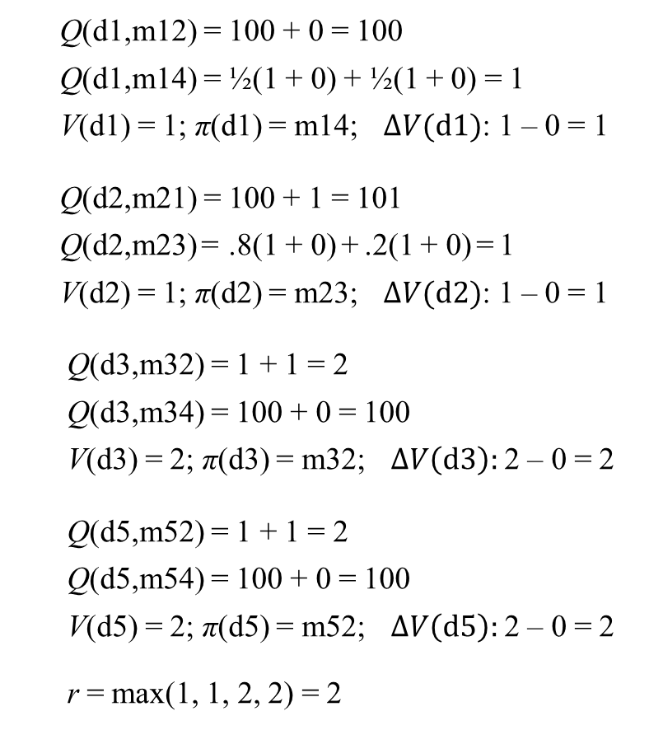
Iteration 1
VI(Σ, S_{g},V₀)
  V ← V₀
  until reaching an approximate fixed point do
    for each s ∈ S ∖ S_{g} do
      Bellman-Update(s)
Bellman-Update(s)
  for every a ∈ Applicable(s) do
    Q(s,a) ← ∑_{s′∈γ(s,a)} Pr (s′|s,a) [cost(s,a,s′) + V(s′)]
  V(s) ← min_{a} Q(s,a)
  π(s) ← argmin_{a} Q(s,a)
  Q(d1,m12) = 100 + 0 = 100
  Q(d1,m14) = ½(1 + 0) + ½(1 + 0) = 1
  V(d1) = 1; π(d1) = m14; $ΔV(d1)$: 1 – 0 = 1
  Q(d2,m21) = 100 + 1 = 101
  Q(d2,m23) = .8(1 + 0) + .2(1 + 0) = 1
  V(d2) = 1; π(d2) = m23; $ΔV(d2)$: 1 – 0 = 1
  Q(d3,m32) = 1 + 1 = 2
  Q(d3,m34) = 100 + 0 = 100
  V(d3) = 2; π(d3) = m32; $ΔV\left(d3\right):$2 – 0 = 2
  Q(d5,m52) = 1 + 1 = 2
  Q(d5,m54) = 100 + 0 = 100
  V(d5) = 2; π(d5) = m52; $ΔV\left(d5\right):$2 – 0 = 2
  r = max(1, 1, 2, 2) = 2
η = 0.25
initial values
V(d1) = 0
V(d2) = 0
V(d3) = 0
V(d5) = 0
0.2
d5
c = 1
d2
d3
0.8
c = 100
c = 100
d1
c = 1
d4
0.5
0.5
Start:
s₀= d1
Goal:
S_{g}= {d4}

Slide 11
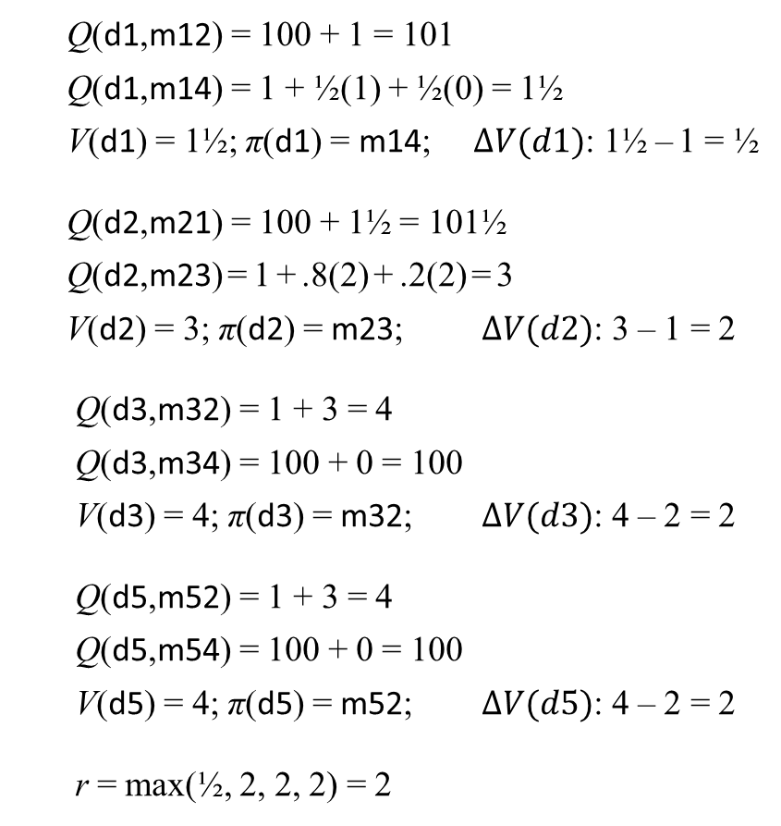
Iteration 2
VI(Σ, S_{g},V₀)
  V ← V₀
  until reaching an approximate fixed point do
    for each s ∈ S ∖ S_{g} do
      Bellman-Update(s)
Bellman-Update(s)
  for every a ∈ Applicable(s) do
    Q(s,a) ← ∑_{s′∈γ(s,a)} Pr (s′|s,a) [cost(s,a,s′) + V(s′)]
  V(s) ← min_{a} Q(s,a)
  π(s) ← argmin_{a} Q(s,a)
from iteration 1
V(d1) = 1
V(d2) = 1
V(d3) = 2
V(d5) = 2
π(d1) = m14
π(d2) = m23
π(d2) = m32
π(d5) = m52
  Q(d1,m12) = 100 + 1 = 101
  Q(d1,m14) = 1 + ½(1) + ½(0) = 1½
  V(d1) = 1½; π(d1) = m14; $ΔV(d1)$: 1½ – 1 = ½
  Q(d2,m21) = 100 + 1½ = 101½
  Q(d2,m23) = 1 + .8(2) + .2(2) = 3
  V(d2) = 3; π(d2) = m23; $ΔV(d2)$: 3 – 1 = 2
  Q(d3,m32) = 1 + 3 = 4
  Q(d3,m34) = 100 + 0 = 100
  V(d3) = 4; π(d3) = m32; $ΔV(d3)$: 4 – 2 = 2
  Q(d5,m52) = 1 + 3 = 4
  Q(d5,m54) = 100 + 0 = 100
  V(d5) = 4; π(d5) = m52; $ΔV(d5)$: 4 – 2 = 2
  r = max(½, 2, 2, 2) = 2
η = 0.25
0.2
d5
c = 1
d2
d3
0.8
c = 100
c = 100
d1
c = 1
d4
0.5
0.5
Start:
s₀= d1
Goal:
S_{g}= {d4}

Slide 12
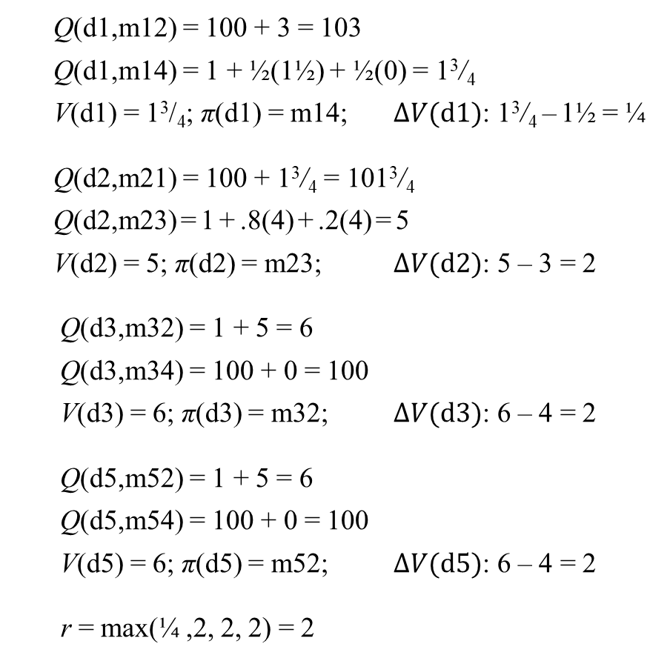
Iteration 3
VI(Σ, S_{g},V₀)
  V ← V₀
  until reaching an approximate fixed point do
    for each s ∈ S ∖ S_{g} do
      Bellman-Update(s)
Bellman-Update(s)
  for every a ∈ Applicable(s) do
    Q(s,a) ← ∑_{s′∈γ(s,a)} Pr (s′|s,a) [cost(s,a,s′) + V(s′)]
  V(s) ← min_{a} Q(s,a)
  π(s) ← argmin_{a} Q(s,a)
from iteration 2
V(d1) = 1½
V(d2) = 3
V(d3) = 4
V(d5) = 4
π(d1) = m14
π(d2) = m23
π(d2) = m32
π(d5) = m52
  Q(d1,m12) = 100 + 3 = 103
  Q(d1,m14) = 1 + ½(1½) + ½(0) = 1³/₄
  V(d1) = 1³/₄; π(d1) = m14; $ΔV(d1)$: 1³/₄ – 1½ = ¼
  Q(d2,m21) = 100 + 1³/₄ = 101³/₄
  Q(d2,m23) = 1 + .8(4) + .2(4) = 5
  V(d2) = 5; π(d2) = m23; $ΔV(d2)$: 5 – 3 = 2
  Q(d3,m32) = 1 + 5 = 6
  Q(d3,m34) = 100 + 0 = 100
  V(d3) = 6; π(d3) = m32; $ΔV(d3)$: 6 – 4 = 2
  Q(d5,m52) = 1 + 5 = 6
  Q(d5,m54) = 100 + 0 = 100
  V(d5) = 6; π(d5) = m52; $ΔV(d5)$: 6 – 4 = 2
  r = max(¼ ,2, 2, 2) = 2
η = 0.25
0.2
d5
c = 1
d2
d3
0.8
c = 100
c = 100
d1
c = 1
d4
0.5
0.5
Start:
s₀= d1
Goal:
S_{g}= {d4}

Slide 13
Iteration 4
VI(Σ, S_{g},V₀)
  V ← V₀
  until reaching an approximate fixed point do
    for each s ∈ S ∖ S_{g} do
      Bellman-Update(s)
Bellman-Update(s)
  for every a ∈ Applicable(s) do
    Q(s,a) ← ∑_{s′∈γ(s,a)} Pr (s′|s,a) [cost(s,a,s′) + V(s′)]
  V(s) ← min_{a} Q(s,a)
  π(s) ← argmin_{a} Q(s,a)
from iteration 3
V(d1) = 1³/₄
V(d2) = 5
V(d3) = 6
V(d5) = 6
π(d1) = m14
π(d2) = m23
π(d2) = m32
π(d5) = m52
  Q(d1,m12) = 100 + 5 = 105
  Q(d1,m14) = 1 + ½(1³/₄) + ½(0) = 1⁷/₈
  V(d1) = 1⁷/₈; π(d1) = m14; 1⁷/₈ – 1³/₄ = ¹/₈
  Q(d2,m21) = 100 + 1⁷/₈ = 101⁷/₈
  Q(d2,m23) = 1 + .8(6) + .2(6) = 7
  V(d2) = 7; π(d2) = m23; 7 – 5 = 2
  Q(d3,m32) = 1 + 7 = 8
  Q(d3,m34) = 100 + 0 = 100
  V(d3) = 8; π(d3) = m32; 8 – 6 = 2
  Q(d5,m52) = 1 + 7 = 8
  Q(d5,m54) = 100 + 0 = 100
  V(d5) = 8; π(d5) = m52; 8 – 6 = 2
  r = max(¹/₈ , 2, 2, 2) = 2
η = 0.25
0.2
d5
c = 1
d2
d3
0.8
c = 100
c = 100
  Poll: Total number of iterations?
  A. i ≤ 10 D. 40 < i ≤ 80
  B. 10 < i ≤ 20 E. 80 < i ≤ 160
  C. 20 < i ≤ 40 F. 160 < i
d1
c = 1
d4
0.5
0.5
Start:
s₀= d1
Goal:
S_{g}= {d4}

Slide 14
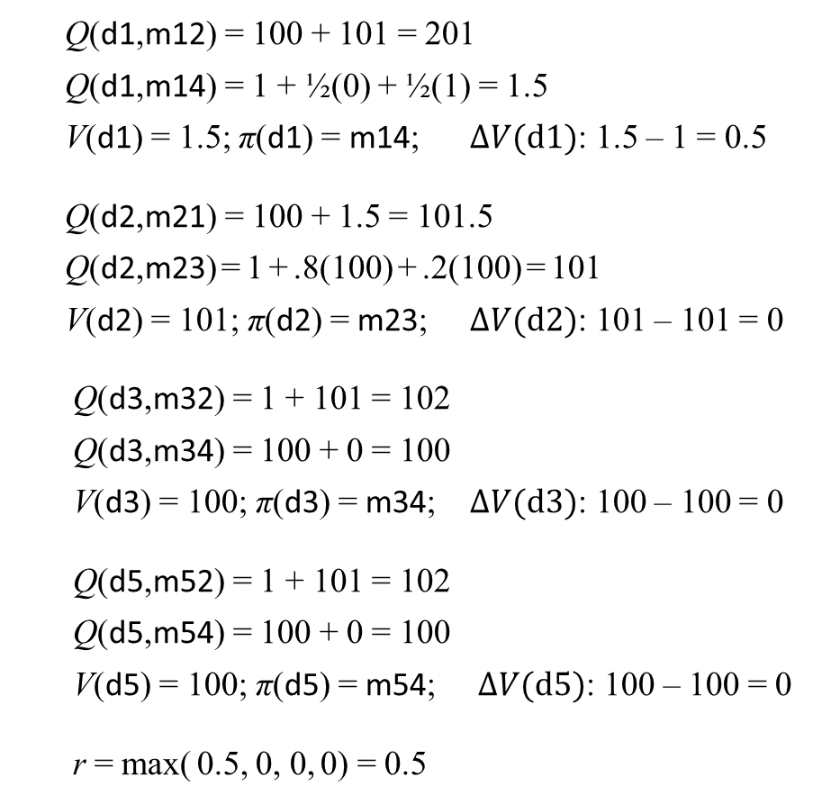
Iteration 1, with a better V₀
VI(Σ, S_{g},V₀)
  V ← V₀
  until reaching an approximate fixed point do
    for each s ∈ S ∖ S_{g} do
      Bellman-Update(s)
Bellman-Update(s)
  for every a ∈ Applicable(s) do
    Q(s,a) ← ∑_{s′∈γ(s,a)} Pr (s′|s,a) [cost(s,a,s′) + V(s′)]
  V(s) ← min_{a} Q(s,a)
  π(s) ← argmin_{a} Q(s,a)
  Q(d1,m12) = 100 + 101 = 201
  Q(d1,m14) = 1 + ½(0) + ½(1) = 1.5
  V(d1) = 1.5; π(d1) = m14; $ΔV(d1)$: 1.5 – 1 = 0.5
  Q(d2,m21) = 100 + 1.5 = 101.5
  Q(d2,m23) = 1 + .8(100) + .2(100) = 101
  V(d2) = 101; π(d2) = m23; $ΔV(d2)$: 101 – 101 = 0
  Q(d3,m32) = 1 + 101 = 102
  Q(d3,m34) = 100 + 0 = 100
  V(d3) = 100; π(d3) = m34; $ΔV(d3)$: 100 – 100 = 0
  Q(d5,m52) = 1 + 101 = 102
  Q(d5,m54) = 100 + 0 = 100
  V(d5) = 100; π(d5) = m54; $ΔV(d5)$: 100 – 100 = 0
  r = max( 0.5, 0, 0, 0) = 0.5
η = 0.25
V₀(s) = min
cost of path
to d4
V(d1) = 1
V(d2) = 101
V(d3) = 100
V(d5) = 100
0.2
d5
c = 1
d2
d3
0.8
c = 100
c = 100
d1
c = 1
d4
0.5
0.5
Start:
s₀= d1
Goal:
S_{g}= {d4}

Slide 15
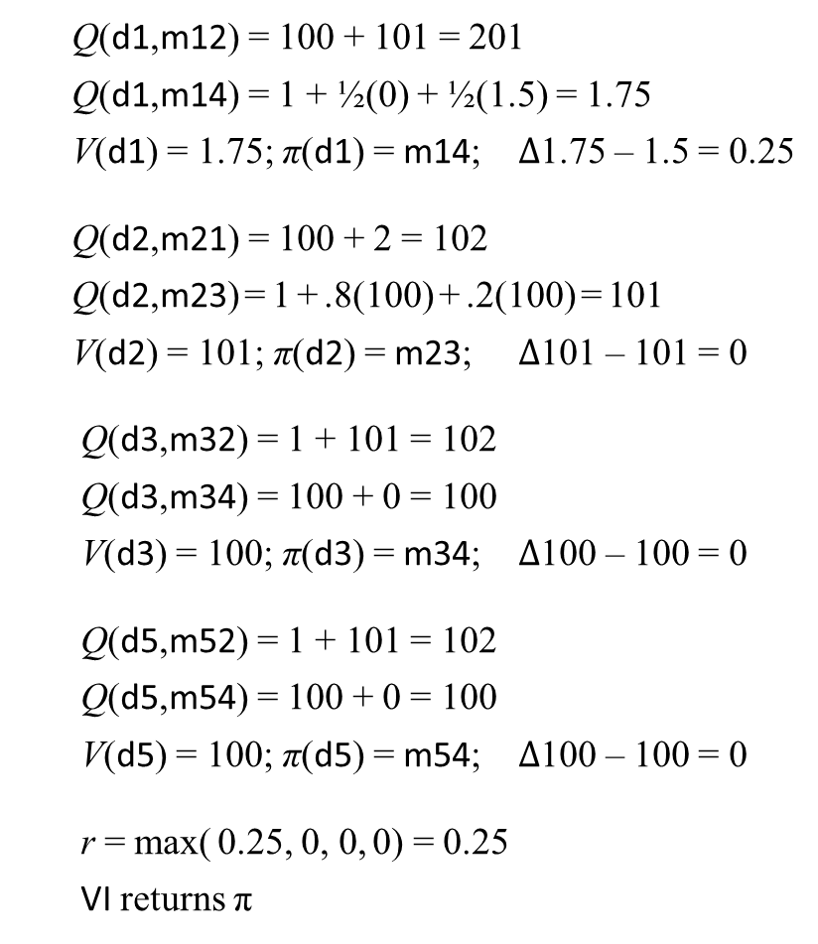
Iteration 2
VI(Σ, S_{g},V₀)
  V ← V₀
  until reaching an approximate fixed point do
    for each s ∈ S ∖ S_{g} do
      Bellman-Update(s)
Bellman-Update(s)
  for every a ∈ Applicable(s) do
    Q(s,a) ← ∑_{s′∈γ(s,a)} Pr (s′|s,a) [cost(s,a,s′) + V(s′)]
  V(s) ← min_{a} Q(s,a)
  π(s) ← argmin_{a} Q(s,a)
from iteration 1
V(d1) = 1.5
V(d2) = 101
V(d3) = 100
V(d5) = 100
π(d1) = m14
π(d2) = m23
π(d2) = m34
π(d5) = m54
  Q(d1,m12) = 100 + 101 = 201
  Q(d1,m14) = 1 + ½(0) + ½(1.5) = 1.75
  V(d1) = 1.75; π(d1) = m14; $Δ$1.75 – 1.5 = 0.25
  Q(d2,m21) = 100 + 2 = 102
  Q(d2,m23) = 1 + .8(100) + .2(100) = 101
  V(d2) = 101; π(d2) = m23; $Δ$101 – 101 = 0
  Q(d3,m32) = 1 + 101 = 102
  Q(d3,m34) = 100 + 0 = 100
  V(d3) = 100; π(d3) = m34; $Δ$100 – 100 = 0
  Q(d5,m52) = 1 + 101 = 102
  Q(d5,m54) = 100 + 0 = 100
  V(d5) = 100; π(d5) = m54; $Δ$100 – 100 = 0
  r = max( 0.25, 0, 0, 0) = 0.25
  VI returns π
η = 0.25
0.2
d5
c = 1
d2
d3
0.8
c = 100
c = 100
d1
c = 1
d4
0.5
0.5
Start:
s₀= d1
Goal:
S_{g}= {d4}

Slide 16
Discussion
In each iteration of Policy Iteration
  Compute V^{π} for current π
    |S| linear equations, |S| unknowns
  Use V^{π} to choose new π
    argmin Q^{π}(s,a) at each state
More work per iteration than value iteration
  Needs to solve simultaneous equations
In each iteration of Value Iteration
  Compute new V: min Q(s,a) at each state
  New V is a revised set of heuristic estimates
    Doesn’t depend on any π
  new π = argmin Q(s,a) at each state
    But V ≠ V^{π}
  Less work per iteration: doesn’t need to solve a set of equations
More iterations to converge unless V₀ is good
At each iteration, both algorithms need to examine the entire state space
  Number of iterations polynomial in |S|, but |S| may be quite large
Next: use search techniques to avoid searching the entire space

Slide 17
Digression: A* Search as Value Iteration
s′₁ –→ …
π: a₁ a_{i} a_{n}
s₀ —––––→ … ––→ … ––––––→ s_{n}
f(s₀) = h(s₀) f(𝜈_{n}) = cost(⟨a₁,…,a_{n}⟩) + h(s_{n})
V(s₀) = cost(⟨a₁,…,a_{n}⟩) + h(s_{n}) V(s_{n}) = h(s_{n})
a′₁
frontier state
with smallest f
At each iteration, A* chooses frontier node with smallest f value
  = frontier node with min cost(⟨a₁,…,a_{n}⟩) + h(s_{n})
For i = 1, …, n, let
  V(s_{i}) = min[(cost of path from s_{i} to frontier) + h(frontier state)]
    = cost(⟨a_{i+1},…,a_{n}⟩) + h(s_{i})
Can do A* search with either f or V
Make ⟨a₁,…,a_{n}⟩ a policy:
  π(s₀) = a₁, π(s₁) = a₂, …, π(s_{n–1}) = a_{n}
while True do
  starting at s₀ , follow π to a frontier state s
  if s is a goal then return π
  expand s
  do A*’s usual pruning
  for each s′ on the path from s back to s₀ do
    for each a ∈ Applicable(s′) do
      Q(s′, a) = cost(a) + V(γ(s′, a))
      V(s′) = min_{a} Q(s′, a)
      π(s′) = argmin_{a} Q(s′, a)
Bellman update

Slide 18
Digression: A* Search as Value Iteration
s′₁ –→ … s′_{n+1}
π: a₁ a_{i} a_{n} a_{n+1}
s₀ —––––→ … ––→ … ––––––→ s_{n} —––––––––––––––––––––––––––––→ s_{n+1}
f(s₀) = h(s₀) f(𝜈_{n}) = cost(⟨a₁,…,a_{n}⟩) + h(s_{n}) f(𝜈_{n+1}) = cost(⟨a₁,…,a_{n},a_{n+1}⟩) + h(s_{n+1})
V(s₀) = cost(⟨a₁,…,a_{n}⟩) + h(s_{n}) V(s_{n}) = h(s_{n}) V(s_{n+1}) = h(s_{n+1})
a′₁
a′_{n+1}
frontier state
with smallest f
At each iteration, A* chooses frontier node with smallest f value
  = frontier node with min cost(⟨a₁,…,a_{n}⟩) + h(s_{n})
For i = 1, …, n, let
  V(s_{i}) = min[(cost of path from s_{i} to frontier) + h(frontier state)]
    = cost(⟨a_{i+1},…,a_{n}⟩) + h(s_{i})
Can do A* search with either f or V
Make ⟨a₁,…,a_{n}⟩ a policy:
  π(s₀) = a₁, π(s₁) = a₂, …, π(s_{n–1}) = a_{n}
while True do
  starting at s₀ , follow π to a frontier state s
  if s is a goal then return π
  expand s
  do A*’s usual pruning
  for each s′ on the path from s back to s₀ do
    for each a ∈ Applicable(s′) do
      Q(s′, a) = cost(a) + V(γ(s′, a))
      V(s′) = min_{a} Q(s′, a)
      π(s′) = argmin_{a} Q(s′, a)
Bellman update

Slide 19
Digression: A* Search as Value Iteration
s′₁ –→ … s′_{n+1}
π: a₁ a_{i} a_{n} a_{n+1}
s₀ —––––→ … ––→ … ––––––→ s_{n} —––––––––––––––––––––––––––––→ s_{n+1}
f(s₀) = h(s₀) f(𝜈_{n}) = cost(⟨a₁,…,a_{n}⟩) + h(s_{n}) f(𝜈_{n+1}) = cost(⟨a₁,…,a_{n},a_{n+1}⟩) + h(s_{n+1})
V(s₀) = min{c₁+V(s₁), c′₁+V(s′₁)} V(s_{n}) = min{c_{n+1}+V(s_{n+1}), c′_{n+1}+V(s′_{n+1})} V(s_{n+1}) = h(s_{n+1})
= cost(a₁)+V(s₁) = cost(a_{n+1})+V(s_{n+1})
= cost(⟨a₁,…,a_{n},a_{n+1}⟩) + h(s_{n+1}) = cost(⟨a_{n+1}⟩) + h(s_{n+1})
a′₁
a′_{n+1}
frontier state
with smallest f
At each iteration, A* chooses frontier node with smallest f value
  = frontier node with min cost(⟨a₁,…,a_{n}⟩) + h(s_{n})
For i = 1, …, n, let
  V(s_{i}) = min[(cost of path from s_{i} to frontier) + h(frontier state)]
    = cost(⟨a_{i+1},…,a_{n}⟩) + h(s_{i})
Can do A* search with either f or V
Make ⟨a₁,…,a_{n}⟩ a policy:
  π(s₀) = a₁, π(s₁) = a₂, …, π(s_{n–1}) = a_{n}
while True do
  starting at s₀ , follow π to a frontier state s
  if s is a goal then return π
  expand s
  do A*’s usual pruning
  for each s′ on the path from s back to s₀ do
    for each a ∈ Applicable(s′) do
      Q(s′, a) = cost(a) + V(γ(s′, a))
      V(s′) = min_{a} Q(s′, a)
      π(s′) = argmin_{a} Q(s′, a)
Bellman update

Slide 20
AO* (Basic Idea)
An SSP can be represented as an AND/OR graph
  OR nodes: choose an action
  AND nodes: action’s outcomes
AO*: generalization of A* for acyclic MDPs
leaves(s₀,π) = {s₇, s₈, s₁₁, s₁₂}
  Expand one of them, e.g., s₁₁
Going bottom-up, update V and π values
for s₁₁ and its ancestors
  V(s) = min _{a∈Applicable(s)} ∑ _{s′∈γ(s,a)} P(s′ |s,a) [cost(s,a,s′) + V(s′)}
  π(s) = argmin _{a∈Applicable(s)} ∑ _{s′∈γ(s,a)} P(s′ |s,a) [cost(s,a,s′) + V(s′)}
e.g.,
  V(s₂) = min(Q(s₂,a₅), Q(s₂,a₆))
Poll: Can this work correctly on an acyclic AND/OR graph that isn’t a tree?
A. yes
B. no
C. don’t know

Slide 21
AO* (Basic Idea)
An SSP can be represented as an AND/OR graph
  OR nodes: choose an action
  AND nodes: action’s outcomes
AO*: generalization of A* for acyclic MDPs
leaves(s₀,π) = {s₇, s₈, s₁₁, s₁₂}
  Expand one of them, e.g., s₁₁
Going bottom-up, update V and π values
for s₁₁ and its ancestors
  V(s) = min _{a∈Applicable(s)} ∑ _{s′∈γ(s,a)} P(s′ |s,a) [cost(s,a,s′) + V(s′)}
  π(s) = argmin _{a∈Applicable(s)} ∑ _{s′∈γ(s,a)} P(s′ |s,a) [cost(s,a,s′) + V(s′)}
e.g.,
  V(s₂) = min(Q(s₂,a₅), Q(s₂,a₆))
Poll: If V(s) changes and s has more than one parent, do we need to update all of them?
A. yes
B. no
C. sometimes
D. don’t know

Slide 22
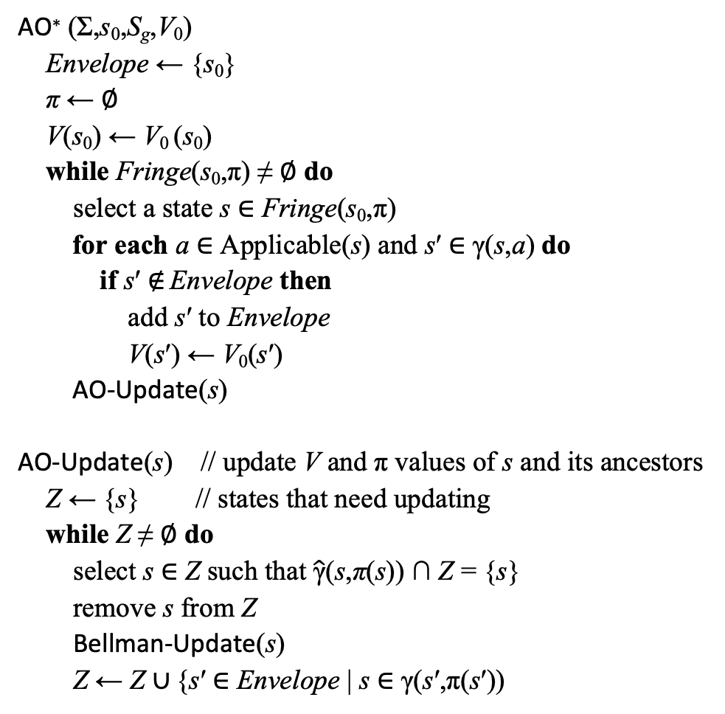
AO*
AO∗ (Σ,s₀,S_{g},V₀)
  Envelope ← {s₀}
  π ← ∅
  V(s₀) ← V₀ (s₀)
  while Fringe(s₀,π) ≠ ∅ do
  select a state s ∈ Fringe(s₀,π)
    for each a ∈ Applicable(s) and s′ ∈ γ(s,a) do
      if s′ ∉ Envelope then
      add s′ to Envelope
      V(s′) ← V₀(s′)
    AO-Update(s)
AO-Update(s) // update V and π values of s and its ancestors
  Z ← {s} // states that need updating
  while Z ≠ ∅ do
    select s ∈ Z such that $\hat{\text{γ}}$(s,π(s)) ∩ Z = {s}
    remove s from Z
      Bellman-Update(s)
      Z ← Z ∪ {s′ ∈ Envelope | s ∈ γ(s′,π(s′))
like Expanded ∪ Frontier in A*
Bellman-Update(s)
  for every a ∈ Applicable(s) do
    Q(s,a) ← ∑_{s′∈γ(s,a)} Pr (s′|s,a) [cost(s,a,s′) + V(s′)]
  V(s) ← min_{a} Q(s,a)
  π(s) ← argmin_{a} Q(s,a)
global
Fringe(s₀,π) = leaves(s₀,π) ∖ S_{g}
expand
s
s has no descendants in Z
add s’s parents to Z
Fringe(s₀,π)

Slide 23
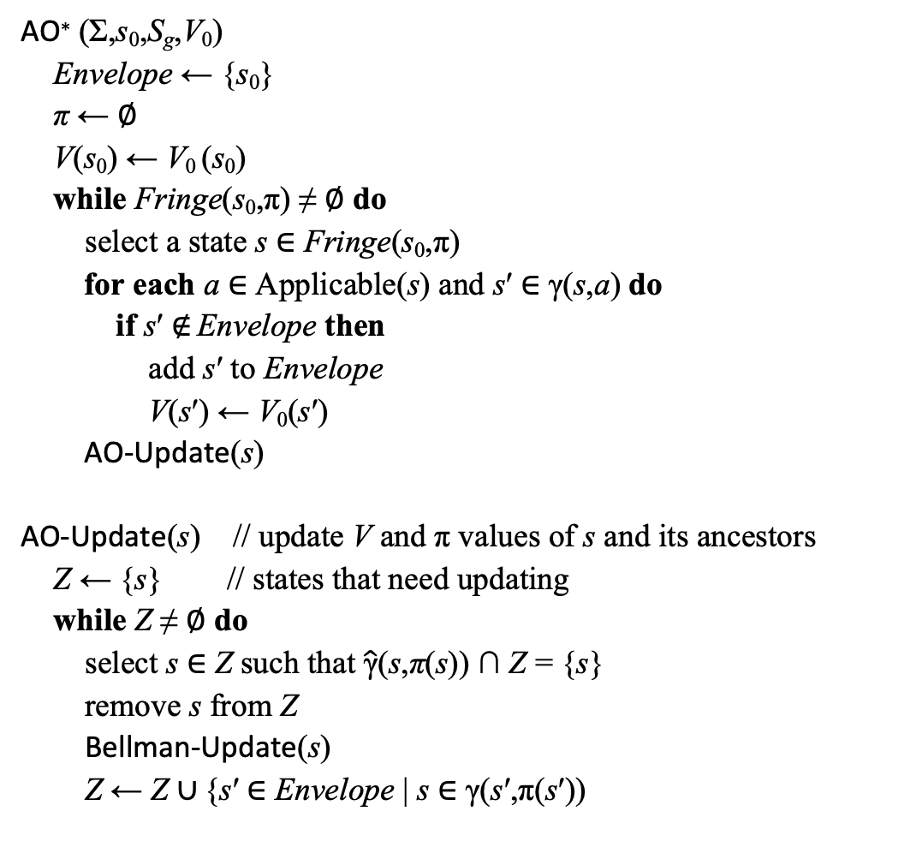
AO* Example
AO∗ (Σ,s₀,S_{g},V₀)
  Envelope ← {s₀}
  π ← ∅
  V(s₀) ← V₀ (s₀)
  while Fringe(s₀,π) ≠ ∅ do
  select a state s ∈ Fringe(s₀,π)
    for each a ∈ Applicable(s) and s′ ∈ γ(s,a) do
      if s′ ∉ Envelope then
      add s′ to Envelope
      V(s′) ← V₀(s′)
    AO-Update(s)
AO-Update(s) // update V and π values of s and its ancestors
  Z ← {s} // states that need updating
  while Z ≠ ∅ do
    select s ∈ Z such that $\hat{\text{γ}}$(s,π(s)) ∩ Z = {s}
    remove s from Z
      Bellman-Update(s)
      Z ← Z ∪ {s′ ∈ Envelope | s ∈ γ(s′,π(s′))
Bellman-Update(s)
  for every a ∈ Applicable(s) do
    Q(s,a) ← ∑_{s′∈γ(s,a)} Pr (s′|s,a) [cost(s,a,s′) + V(s′)]
  V(s) ← min_{a} Q(s,a)
  π(s) ← argmin_{a} Q(s,a)
d5
0.2
d2
d3
c = 15
0.8
V(d6) = 0
c = 100
c = 10
c = 1
d6
0.5
V(d1) = V₀(d1) = 0
c = 20
d1
0.5
d4
V(d4) = 0
Start:
s₀= d1
Suppose V₀(s) = 0 for all s
Goal:
S_{g}= {d4}

Slide 24
Iteration 1
AO∗ (Σ,s₀,S_{g},V₀)
  Envelope ← {s₀}
  π ← ∅
  V(s₀) ← V₀ (s₀)
  while Fringe(s₀,π) ≠ ∅ do
  select a state s ∈ Fringe(s₀,π)
    for each a ∈ Applicable(s) and s′ ∈ γ(s,a) do
      if s′ ∉ Envelope then
      add s′ to Envelope
      V(s′) ← V₀(s′)
    AO-Update(s)
AO-Update(s) // update V and π values of s and its ancestors
  Z ← {s} // states that need updating
  while Z ≠ ∅ do
    select s ∈ Z such that $\hat{\text{γ}}$(s,π(s)) ∩ Z = {s}
    remove s from Z
      Bellman-Update(s)
      Z ← Z ∪ {s′ ∈ Envelope | s ∈ γ(s′,π(s′))
Bellman-Update(s)
  for every a ∈ Applicable(s) do
    Q(s,a) ← ∑_{s′∈γ(s,a)} Pr (s′|s,a) [cost(s,a,s′) + V(s′)]
  V(s) ← min_{a} Q(s,a)
  π(s) ← argmin_{a} Q(s,a)
Poll: Which states are currently in Envelope? (choose 1 or more)
A. d1 B. d2 C. d3 D. d4 E. d5
V(d2) = 0
d5
0.2
d2
d3
c = 15
0.8
V(d6) = 0
c = 100
c = 10
c = 1
V(d1) = 10
π(d1) = m12
d6
0.5
c = 20
d1
0.5
d4
V(d4) = 0
Start:
s₀= d1
Suppose V₀(s) = 0 for all s
Goal:
S_{g}= {d4}

Slide 25
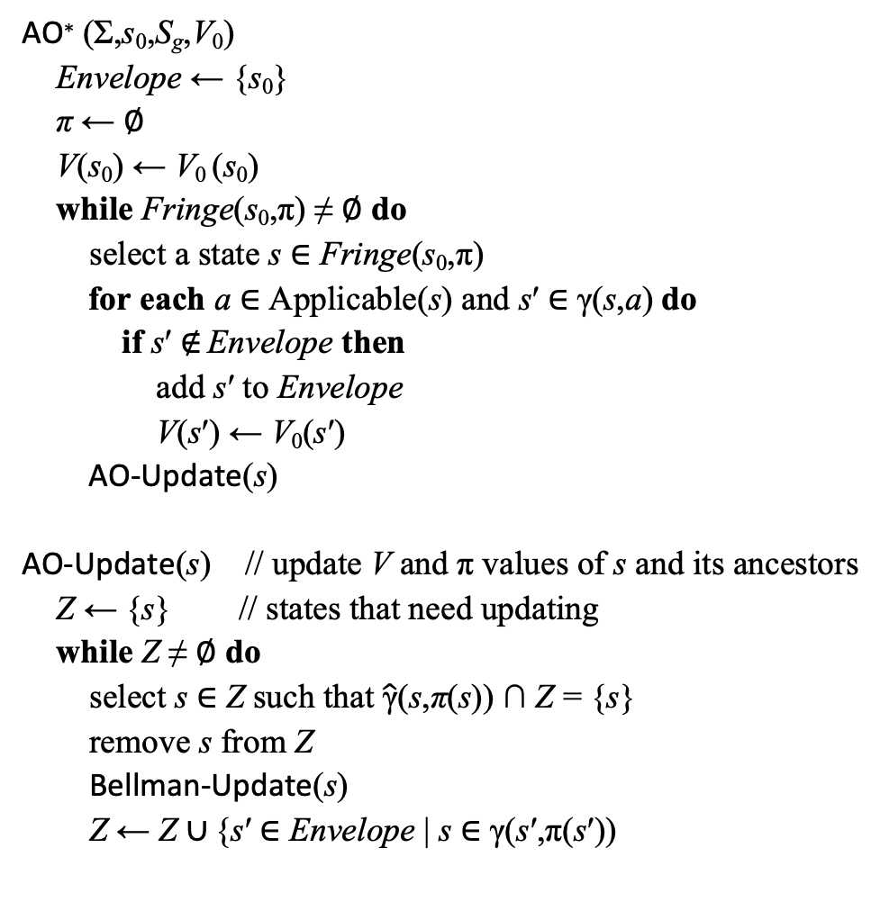
Iteration 2
AO∗ (Σ,s₀,S_{g},V₀)
  Envelope ← {s₀}
  π ← ∅
  V(s₀) ← V₀ (s₀)
  while Fringe(s₀,π) ≠ ∅ do
  select a state s ∈ Fringe(s₀,π)
    for each a ∈ Applicable(s) and s′ ∈ γ(s,a) do
      if s′ ∉ Envelope then
      add s′ to Envelope
      V(s′) ← V₀(s′)
    AO-Update(s)
AO-Update(s) // update V and π values of s and its ancestors
  Z ← {s} // states that need updating
  while Z ≠ ∅ do
    select s ∈ Z such that $\hat{\text{γ}}$(s,π(s)) ∩ Z = {s}
    remove s from Z
      Bellman-Update(s)
      Z ← Z ∪ {s′ ∈ Envelope | s ∈ γ(s′,π(s′))
Bellman-Update(s)
  for every a ∈ Applicable(s) do
    Q(s,a) ← ∑_{s′∈γ(s,a)} Pr (s′|s,a) [cost(s,a,s′) + V(s′)]
  V(s) ← min_{a} Q(s,a)
  π(s) ← argmin_{a} Q(s,a)
V(d5) = 0
V(d2) = 15
π(d2) = m23
d5
0.2
d2
d3
c = 15
0.8
V(d3) = 0
V(d6) = 0
c = 100
c = 10
c = 1
V(d1) = 25
π(d1) = m12
d6
0.5
c = 20
d1
0.5
d4
V(d4) = 0
Start:
s₀= d1
Suppose V₀(s) = 0 for all s
Goal:
S_{g}= {d4}

Slide 26
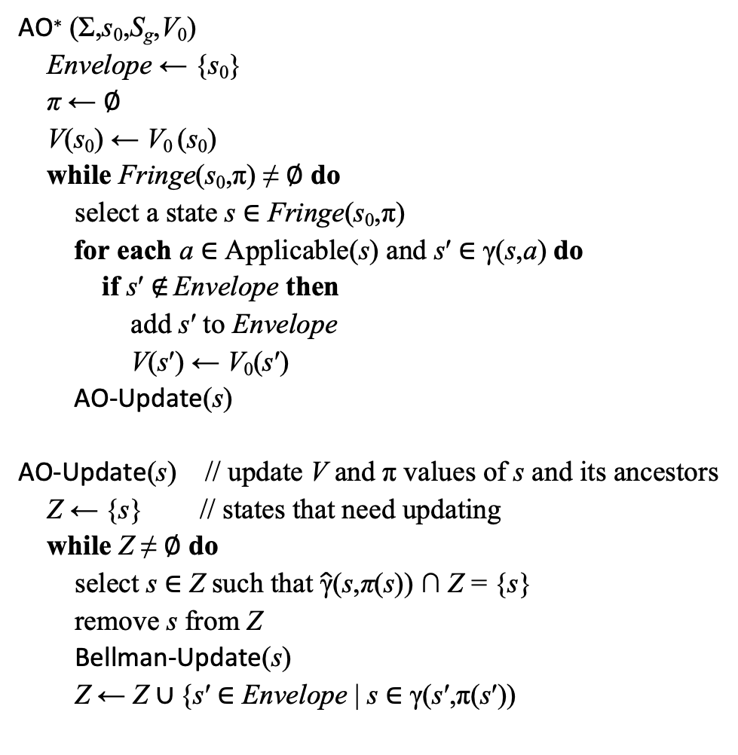
Iteration 3
AO∗ (Σ,s₀,S_{g},V₀)
  Envelope ← {s₀}
  π ← ∅
  V(s₀) ← V₀ (s₀)
  while Fringe(s₀,π) ≠ ∅ do
  select a state s ∈ Fringe(s₀,π)
    for each a ∈ Applicable(s) and s′ ∈ γ(s,a) do
      if s′ ∉ Envelope then
      add s′ to Envelope
      V(s′) ← V₀(s′)
    AO-Update(s)
AO-Update(s) // update V and π values of s and its ancestors
  Z ← {s} // states that need updating
  while Z ≠ ∅ do
    select s ∈ Z such that $\hat{\text{γ}}$(s,π(s)) ∩ Z = {s}
    remove s from Z
      Bellman-Update(s)
      Z ← Z ∪ {s′ ∈ Envelope | s ∈ γ(s′,π(s′))
Bellman-Update(s)
  for every a ∈ Applicable(s) do
    Q(s,a) ← ∑_{s′∈γ(s,a)} Pr (s′|s,a) [cost(s,a,s′) + V(s′)]
  V(s) ← min_{a} Q(s,a)
  π(s) ← argmin_{a} Q(s,a)
V(d5) = 0
V(d2) = 15
π(d2) = m23
d5
0.2
d2
d3
c = 15
0.8
V(d3) = 0
V(d6) = 0
c = 100
c = 10
c = 1
V(d1) = 20
π(d1) = m14
d6
0.5
c = 20
d1
0.5
d4
V(d4) = 0
Start:
s₀= d1
Suppose V₀(s) = 0 for all s
Goal:
S_{g}= {d4}

Slide 27
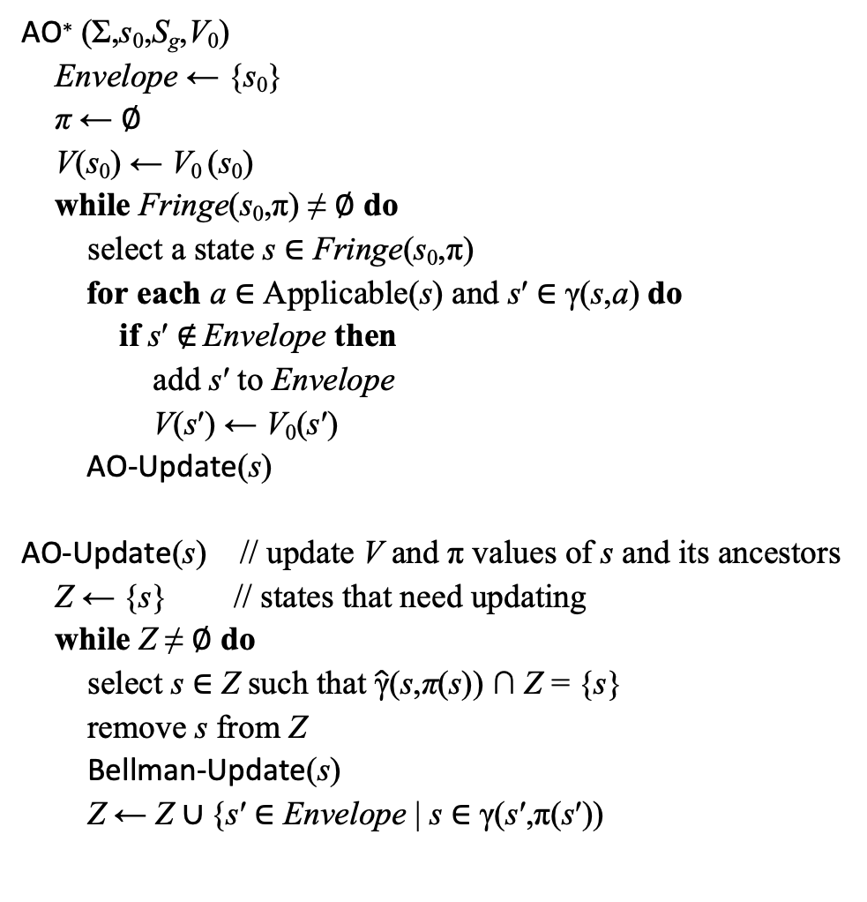
Iteration 4
AO∗ (Σ,s₀,S_{g},V₀)
  Envelope ← {s₀}
  π ← ∅
  V(s₀) ← V₀ (s₀)
  while Fringe(s₀,π) ≠ ∅ do
  select a state s ∈ Fringe(s₀,π)
    for each a ∈ Applicable(s) and s′ ∈ γ(s,a) do
      if s′ ∉ Envelope then
      add s′ to Envelope
      V(s′) ← V₀(s′)
    AO-Update(s)
AO-Update(s) // update V and π values of s and its ancestors
  Z ← {s} // states that need updating
  while Z ≠ ∅ do
    select s ∈ Z such that $\hat{\text{γ}}$(s,π(s)) ∩ Z = {s}
    remove s from Z
      Bellman-Update(s)
      Z ← Z ∪ {s′ ∈ Envelope | s ∈ γ(s′,π(s′))
Bellman-Update(s)
  for every a ∈ Applicable(s) do
    Q(s,a) ← ∑_{s′∈γ(s,a)} Pr (s′|s,a) [cost(s,a,s′) + V(s′)]
  V(s) ← min_{a} Q(s,a)
  π(s) ← argmin_{a} Q(s,a)
V(d5) = 0
V(d2) = 15
π(d2) = m23
d5
0.2
d2
d3
c = 15
0.8
V(d3) = 0
V(d6) = 1
π(d6) = m54
c = 100
c = 10
c = 1
V(d1) = 20.5
π(d1) = m14
d6
0.5
c = 20
d1
0.5
d4
V(d4) = 0
Start:
s₀= d1
Suppose V₀(s) = 0 for all s
Goal:
S_{g}= {d4}

Slide 28
Heuristics through Determinization
d5
What to use for V₀(s)?
One possibility: a heuristic for the determinized domain Σ_{d}
For each action a of Σ
  If a has k possible outcomes, then
    Σ_{d} contains k deterministic actions a₁, …, a_{k}
    one for each of a’s outcome
Let h be a classical heuristic function for Σ_{d}
If h is admissible for Σ_{d} then also admissible for Σ
Proof:
  Let π* be any optimal solution for (Σ, s, g)
  Then V*(s) = E(cost(π*))
  = weighted avg. of all executions of π*
  Let p* be the least costly execution of π*
    p* is a solution for (Σ_{d}, s, g)
    so h(s) ≤ cost(p*) ≤ E(cost(π))
m23
0.2
d2
d3
c = 15
0.8
m54
m12
m34
c = 100
c = 10
d6
m64
0.5
c = 1
m14
d1
0.5
c = 20
d4
d5
m23₂
d2
d3
m23₁
c = 15
m54
m12
m34
c = 100
c = 10
d6
m64
m14₂
c = 1
c = 20
d1
d4
m14₁

Slide 29
Heuristics through Determinization
d5
What to use for V₀(s)?
Another possibility: call a classical planner on the determinized problem (Σ_{d},s,g)
      Get plan p = ⟨a₁, a₂, …, a_{n}⟩
      Return V₀(s) = cost(p)
If the classical planner always returns optimal solutions, then V₀ is admissible for Σ
Proof:
  Let s be any state, π* be any optimal solution for (Σ, s, g)
  Let p* = least costly execution of π*
  Then
  p* is an optimal solution for (Σ_{d},s,g),
    so V₀(s) = cost(p) = cost(p*) ≤ E(cost(π))
m23
0.2
d2
d3
c = 15
0.8
m54
m12
m34
c = 100
c = 10
d6
m64
0.5
c = 1
m14
d1
0.5
c = 20
d4
d5
m23₂
d2
d3
m23₁
c = 15
m54
m12
m34
c = 100
c = 10
d6
m64
m14₂
c = 1
c = 20
d1
d4
m14₁

Slide 30
Heuristics through Determinization
d5
What to use for V₀(s)?
Another possibility: call a classical planner on the determinized problem (Σ_{d},s,g)
    Get plan p = ⟨a₁, a₂, …, a_{n}⟩
    Return V₀(s) = cost(p)
Theorem. If the classical planner always returns optimal solutions, then V₀ is admissible
Outline of proof:
  Let π* be any optimal solution for (Σ,s,g)
  Then V*(s) = E(cost(π*))
  = weighted avg. of all executions of π
  Let p* be the least costly execution of π
    p* is a solution for (Σ_{d},s,g), so the classical planner returns a plan p of ≤ cost
    So V₀(s) = cost(p) ≤ cost(p*) ≤ E(cost(π))
m23
0.2
d2
d3
c = 15
0.8
m54
m12
m34
c = 100
c = 10
d6
m64
0.5
c = 1
m14
d1
0.5
c = 20
d4
V₀(d5) = 100
V₀(d2) = 115
d5
m23₂
V₀(d3) = 100
d2
d3
m23₁
c = 15
m54
m12
V₀(d6) = 1
m34
c = 100
c = 10
d6
m64
m14₂
c = 1
c = 20
V₀(d1) = 20
d1
d4
V₀(d4) = 0
m14₁

Slide 31
Example
AO∗ (Σ,s₀,S_{g},V₀)
  Envelope ← {s₀}
  π ← ∅
  V(s₀) ← V₀ (s₀)
  while Fringe(s₀,π) ≠ ∅ do
  select a state s ∈ Fringe(s₀,π)
    for each a ∈ Applicable(s) and s′ ∈ γ(s,a) do
      if s′ ∉ Envelope then
      add s′ to Envelope
      V(s′) ← V₀(s′)
    AO-Update(s)
AO-Update(s) // update V and π values of s and its ancestors
  Z ← {s} // states that need updating
  while Z ≠ ∅ do
    select s ∈ Z such that $\hat{\text{γ}}$(s,π(s)) ∩ Z = {s}
    remove s from Z
      Bellman-Update(s)
      Z ← Z ∪ {s′ ∈ Envelope | s ∈ γ(s′,π(s′))
Bellman-Update(s)
  for every a ∈ Applicable(s) do
    Q(s,a) ← ∑_{s′∈γ(s,a)} Pr (s′|s,a) [cost(s,a,s′) + V(s′)]
  V(s) ← min_{a} Q(s,a)
  π(s) ← argmin_{a} Q(s,a)
100
d5
0.2
115
d2
c = 15
0.8
d3
100
c = 100
c = 10
1
c = 1
d6
0.5
c = 20
d1
0.5
d4
Start:
s₀= d1
20
0
V₀ in blue italics
Goal:
S_{g}= {d4}

Slide 32
Iteration 1
AO∗ (Σ,s₀,S_{g},V₀)
  Envelope ← {s₀}
  π ← ∅
  V(s₀) ← V₀ (s₀)
  while Fringe(s₀,π) ≠ ∅ do
  select a state s ∈ Fringe(s₀,π)
    for each a ∈ Applicable(s) and s′ ∈ γ(s,a) do
      if s′ ∉ Envelope then
      add s′ to Envelope
      V(s′) ← V₀(s′)
    AO-Update(s)
AO-Update(s) // update V and π values of s and its ancestors
  Z ← {s} // states that need updating
  while Z ≠ ∅ do
    select s ∈ Z such that $\hat{\text{γ}}$(s,π(s)) ∩ Z = {s}
    remove s from Z
      Bellman-Update(s)
      Z ← Z ∪ {s′ ∈ Envelope | s ∈ γ(s′,π(s′))
Bellman-Update(s)
  for every a ∈ Applicable(s) do
    Q(s,a) ← ∑_{s′∈γ(s,a)} Pr (s′|s,a) [cost(s,a,s′) + V(s′)]
  V(s) ← min_{a} Q(s,a)
  π(s) ← argmin_{a} Q(s,a)
100
V(d2) = 115
d5
0.2
115
d2
c = 15
0.8
d3
100
V(d6) = 1
c = 100
c = 10
1
c = 1
V(d1) = 20.5
π(d1) = m14
d6
0.5
c = 20
d1
0.5
d4
V(d4) = 0
Start:
s₀= d1
20
0
V₀ in blue italics
Goal:
S_{g}= {d4}

Slide 33
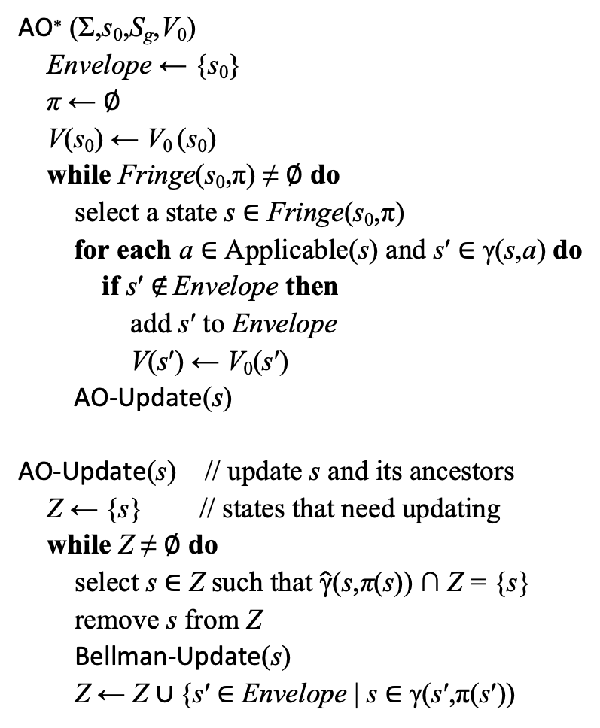
Iterations 2, 3
AO∗ (Σ,s₀,S_{g},V₀)
  Envelope ← {s₀}
  π ← ∅
  V(s₀) ← V₀ (s₀)
  while Fringe(s₀,π) ≠ ∅ do
  select a state s ∈ Fringe(s₀,π)
    for each a ∈ Applicable(s) and s′ ∈ γ(s,a) do
      if s′ ∉ Envelope then
      add s′ to Envelope
      V(s′) ← V₀(s′)
    AO-Update(s)
AO-Update(s) // update s and its ancestors
  Z ← {s} // states that need updating
  while Z ≠ ∅ do
    select s ∈ Z such that $\hat{\text{γ}}$(s,π(s)) ∩ Z = {s}
    remove s from Z
      Bellman-Update(s)
      Z ← Z ∪ {s′ ∈ Envelope | s ∈ γ(s′,π(s′))
Bellman-Update(s)
  for every a ∈ Applicable(s) do
    Q(s,a) ← ∑_{s′∈γ(s,a)} Pr (s′|s,a) [cost(s,a,s′) + V(s′)]
  V(s) ← min_{a} Q(s,a)
  π(s) ← argmin_{a} Q(s,a)
100
V(d2) = 115
d5
0.2
115
d2
c = 15
0.8
d3
100
V(d6) = 1
c = 100
c = 10
1
c = 1
V(d1) = 20.5
π(d1) = m14
d6
0.5
c = 20
d1
0.5
d4
V(d4) = 0
Start:
s₀= d1
20
0
V₀ in blue italics
Goal:
S_{g}= {d4}

Slide 34
LAO* (Basic Idea)
LAO*: generalization of AO* for cyclic MDPs
Fringe(s₀,π) = leaves(s₀,π) ∖ S_{g} = {s₇, s₈, s₁₁, s₁₂}
  Expand one of them, e.g., s₇

Slide 35
LAO* (Basic Idea)
LAO*: generalization of AO* for cyclic MDPs
Fringe(s₀,π) = leaves(s₀,π) ∖ S_{g} = {s₇, s₈, s₁₁, s₁₂}
  Expand one of them, e.g., s₇
Do value iteration on the cyclic part
  Stop if either
    V stops changing very much
    for some s, π(s) changes to
    go to other states

Slide 36
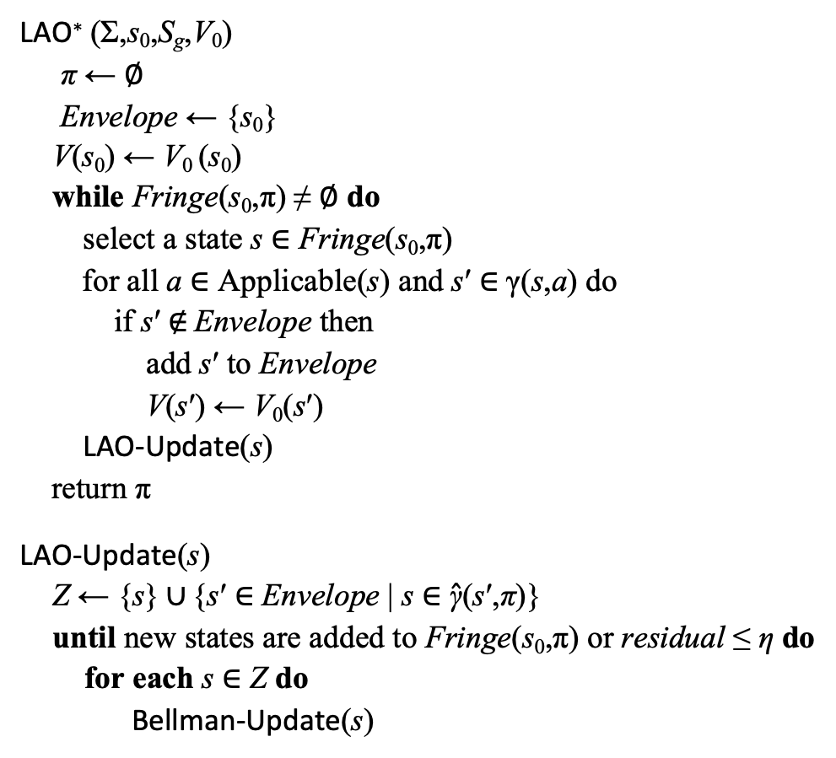
LAO*
may be cyclic
LAO∗ (Σ,s₀,S_{g},V₀)
  π ← ∅
  Envelope ← {s₀}
  V(s₀) ← V₀ (s₀)
  while Fringe(s₀,π) ≠ ∅ do
  select a state s ∈ Fringe(s₀,π)
    for all a ∈ Applicable(s) and s′ ∈ γ(s,a) do
      if s′ ∉ Envelope then
      add s′ to Envelope
      V(s′) ← V₀(s′)
    LAO-Update(s)
    return π
LAO-Update(s)
  Z ← {s} ∪ {s′ ∈ Envelope | s ∈ $\hat{\text{γ}}$(s′,π)}
    until new states are added to Fringe(s₀,π) or residual ≤ η do
      for each s ∈ Z do
        Bellman-Update(s)
Bellman-Update(s)
  for every a ∈ Applicable(s) do
    Q(s,a) ← ∑_{s′∈γ(s,a)} Pr (s′|s,a) [cost(s,a,s′) + V(s′)]
  V(s) ← min_{a} Q(s,a)
  π(s) ← argmin_{a} Q(s,a)
Same
as
AO*
s’s ancestors in π
Value iteration, restricted to Z

Slide 37
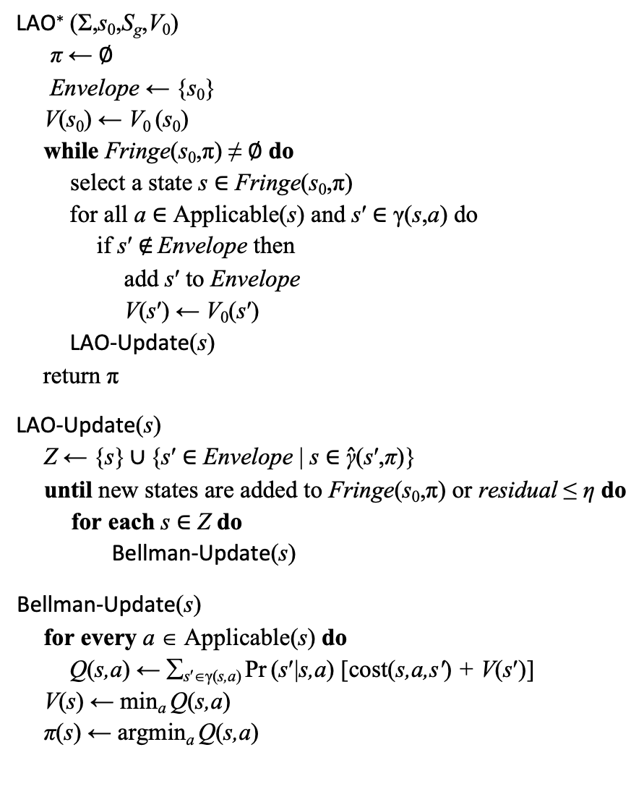
Example 1
LAO∗ (Σ,s₀,S_{g},V₀)
  π ← ∅
  Envelope ← {s₀}
  V(s₀) ← V₀ (s₀)
  while Fringe(s₀,π) ≠ ∅ do
  select a state s ∈ Fringe(s₀,π)
    for all a ∈ Applicable(s) and s′ ∈ γ(s,a) do
      if s′ ∉ Envelope then
      add s′ to Envelope
      V(s′) ← V₀(s′)
    LAO-Update(s)
    return π
LAO-Update(s)
  Z ← {s} ∪ {s′ ∈ Envelope | s ∈ $\hat{\text{γ}}$(s′,π)}
    until new states are added to Fringe(s₀,π) or residual ≤ η do
      for each s ∈ Z do
        Bellman-Update(s)
Bellman-Update(s)
  for every a ∈ Applicable(s) do
    Q(s,a) ← ∑_{s′∈γ(s,a)} Pr (s′|s,a) [cost(s,a,s′) + V(s′)]
  V(s) ← min_{a} Q(s,a)
  π(s) ← argmin_{a} Q(s,a)
η = 0.25; V₀(s) = 0 for all s
π = ∅; Envelope = {d1}; V(s₀) = 0
Iteration 1:
  π = ∅, so Fringe(s₀,π) = {s₀} = {d1}
  select s = d1
  Applicable(d1) = {m12, m14}
  add d2 to Envelope; V(d2) ← 0
  add d4 to Envelope; V(d4) ← 0
  Call LAO-Update(d1)
  π is empty, so Z = {d1}
  Call Bellman-update(d1):
    v_{old} = V(d1) = 0
    Q(d1,m12) = 100 + 0 = 100
    Q(d1,m14) = 1 + (½(0) + ½(0)) = 1
    V(d1) = 1; π(d1) = m14
  r = |V(d1) – 0| = 1
  Keep iterating until r ≤ 0.2
    V(d1) = 1.875; r = 0.0625
Iteration 2:
  Fringe(s₀,π) = ∅, so return π = {(d1,m14)}
0.2
d5
c = 1
d2
d3
0.8
c = 100
c = 100
Start:
s₀= d1
d1
c = 1
Goal:
S_{g}={d4}
d4
0.5
0.5
Iteration 1
V(d2) = 0
0.2
d5
c = 1
d2
d3
0.8
c = 100
c = 100
V(d1) = 1.875
Start:
s₀= d1
d1
c = 1
Goal:
S_{g}={d4}
d4
0.5
0.5
V(d4) = 0

Slide 38
Example 2
LAO∗ (Σ,s₀,S_{g},V₀)
  π ← ∅
  Envelope ← {s₀}
  V(s₀) ← V₀ (s₀)
  while Fringe(s₀,π) ≠ ∅ do
  select a state s ∈ Fringe(s₀,π)
    for all a ∈ Applicable(s) and s′ ∈ γ(s,a) do
      if s′ ∉ Envelope then
      add s′ to Envelope
      V(s′) ← V₀(s′)
    LAO-Update(s)
    return π
LAO-Update(s)
  Z ← {s} ∪ {s′ ∈ Envelope | s ∈ $\hat{\text{γ}}$(s′,π)}
    until new states are added to Fringe(s₀,π) or residual ≤ η do
      for each s ∈ Z do
        Bellman-Update(s)
Bellman-Update(s)
  for every a ∈ Applicable(s) do
    Q(s,a) ← ∑_{s′∈γ(s,a)} Pr (s′|s,a) [cost(s,a,s′) + V(s′)]
  V(s) ← min_{a} Q(s,a)
  π(s) ← argmin_{a} Q(s,a)
π = ∅; Envelope = {d1}; V(s₀) = 0
Iteration 1:
  π = ∅, so Fringe(s₀,π) = {s₀} = {d1}
  select s = d1; Applicable(d1) = {m12, m14}
  add d2 to Envelope; V(d2) ← 0
  add d4 to Envelope; V(d4) ← 0
  Call LAO-Update(d1)
    π = ∅, so Z = {d1}
    loop iteration 1:
    call Bellman-update(d1):
      v_{old} = V(d1) = 0
      Q(d1,m12) = 100 + 0 = 100
      Q(d1,m14) = 80 + (½(0) + ½(0)) = 80
      V(d1) = 80; π(d1) = m14
      return |80 – 0| = 80
    call Bellman-update(d1) again:
      v_{old} = V(d1) = 80
      Q(d1,m12) = 100 + 0 = 100
      Q(d1,m14) = 80 + (½(80) + ½(0)) = 120
      V(d1) = 100; π(d1) = m12
      return |100 – 80| = 20
    new state d2 in Fringe(s₀,π)
  LAO-Update returns; more on next page
η = 0.25; V₀(s) = 0 for all s
0.2
d5
c = 1
d2
d3
0.8
c = 100
c = 1
Start:
s₀= d1
d1
Goal:
S_{g}={d4}
c = 80
d4
0.5
0.5
Iteration 1
V(d2) = 0
0.2
d5
c = 1
d2
d3
0.8
c = 100
c = 1
V(d1) = 100
Start:
s₀= d1
d1
Goal:
S_{g}={d4}
c = 80
d4
0.5
0.5
V(d4) = 0

Slide 39
Example 2 continued
LAO∗ (Σ,s₀,S_{g},V₀)
  π ← ∅
  Envelope ← {s₀}
  V(s₀) ← V₀ (s₀)
  while Fringe(s₀,π) ≠ ∅ do
  select a state s ∈ Fringe(s₀,π)
    for all a ∈ Applicable(s) and s′ ∈ γ(s,a) do
      if s′ ∉ Envelope then
      add s′ to Envelope
      V(s′) ← V₀(s′)
    LAO-Update(s)
    return π
LAO-Update(s)
  Z ← {s} ∪ {s′ ∈ Envelope | s ∈ $\hat{\text{γ}}$(s′,π)}
    until new states are added to Fringe(s₀,π) or residual ≤ η do
      for each s ∈ Z do
        Bellman-Update(s)
Bellman-Update(s)
  for every a ∈ Applicable(s) do
    Q(s,a) ← ∑_{s′∈γ(s,a)} Pr (s′|s,a) [cost(s,a,s′) + V(s′)]
  V(s) ← min_{a} Q(s,a)
  π(s) ← argmin_{a} Q(s,a)
Iteration 2:
  π = {(d1,m12)}, so Fringe(s₀,π) = {d2}
  select s = d2; Applicable(d2) = {m21, m23}
  add d3, d5 to Envelope; V(d3) = V(d5) = 0
  Call LAO-Update(d2)
    Z = {d2} ∪ {d1}
    loop iteration 1:
    call Bellman-update(d1):
      v_{old} = 100
      Q(d1,m12) = 100 + 0 = 100
      Q(d1,m14) = 80 + (½(80) + ½(0)) = 120
      V(d1) = 100; π(d1) = m12
      return |100 – 100| = 0
    call Bellman-update(d2):
      v_{old} = 0
      Q(d2,m21) = 100 + 100 = 200
      Q(d1,m23) = 1 + (.8(0) + .2(0)) = 1
      V(d2) = 1; π(d2) = m23
    r = max(|1 – 0|) = 1
    new states d3,d5 in Fringe(s₀,π)
    LAO-Update returns
After more iterations, LAO* eventually returns
  π = {(d1,m12),(d2,m23),(d3,m34),(d5,m54)}
η = 0.25; V₀(s) = 0 for all s
V(d2) = 0
0.2
d5
c = 1
d2
d3
0.8
c = 100
c = 1
V(d1) = 100
Start:
s₀= d1
d1
Goal:
S_{g}={d4}
c = 80
d4
0.5
0.5
V(d4) = 0
Iteration 2
V(d5) = 0
V(d2) = 1
0.2
d5
c = 1
d2
d3
0.8
V(d3) = 0
c = 100
c = 1
V(d1) = 100
Start:
s₀= d1
d1
Goal:
S_{g}={d4}
c = 80
d4
0.5
0.5
V(d4) = 0

Slide 40
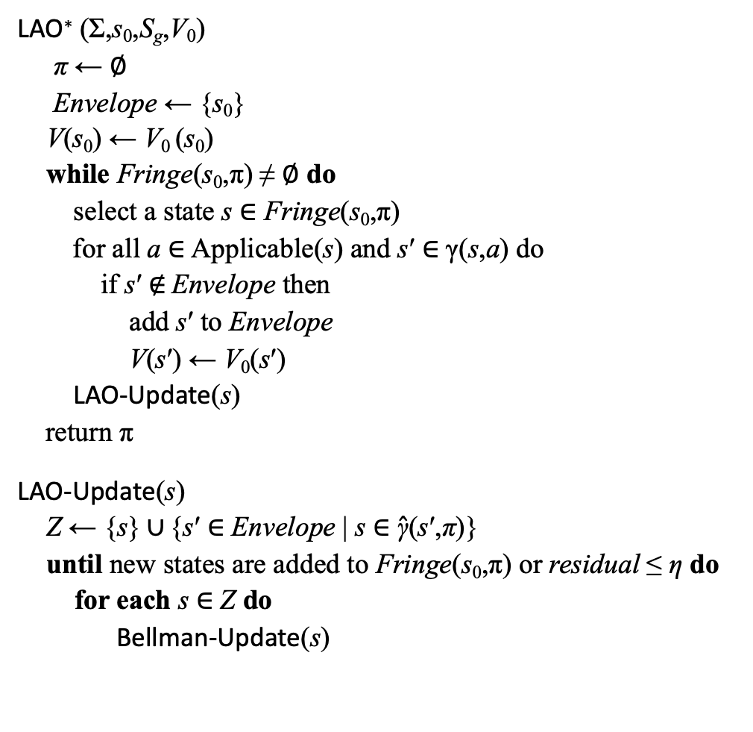
Dead Ends
LAO∗ (Σ,s₀,S_{g},V₀)
  π ← ∅
  Envelope ← {s₀}
  V(s₀) ← V₀ (s₀)
  while Fringe(s₀,π) ≠ ∅ do
  select a state s ∈ Fringe(s₀,π)
    for all a ∈ Applicable(s) and s′ ∈ γ(s,a) do
      if s′ ∉ Envelope then
      add s′ to Envelope
      V(s′) ← V₀(s′)
    LAO-Update(s)
    return π
LAO-Update(s)
  Z ← {s} ∪ {s′ ∈ Envelope | s ∈ $\hat{\text{γ}}$(s′,π)}
    until new states are added to Fringe(s₀,π) or residual ≤ η do
      for each s ∈ Z do
        Bellman-Update(s)
Bellman-Update(s)
  for every a ∈ Applicable(s) do
    Q(s,a) ← ∑_{s′∈γ(s,a)} Pr (s′|s,a) [cost(s,a,s′) + V(s′)]
  V(s) ← min_{a} Q(s,a)
  π(s) ← argmin_{a} Q(s,a)
d5
0.2
d2
d3
c = 15
0.8
a_{deadend}
c = 100
c = 80
d6
0.5
c = 10
Start:
s₀= d1
d1
0.5
d4
Goal:
S_{g}= {d4}
At dead-end states, add a dummy action a_{deadend}
γ(s, a_{deadend}) = s
cost = a constant > 0

Slide 41
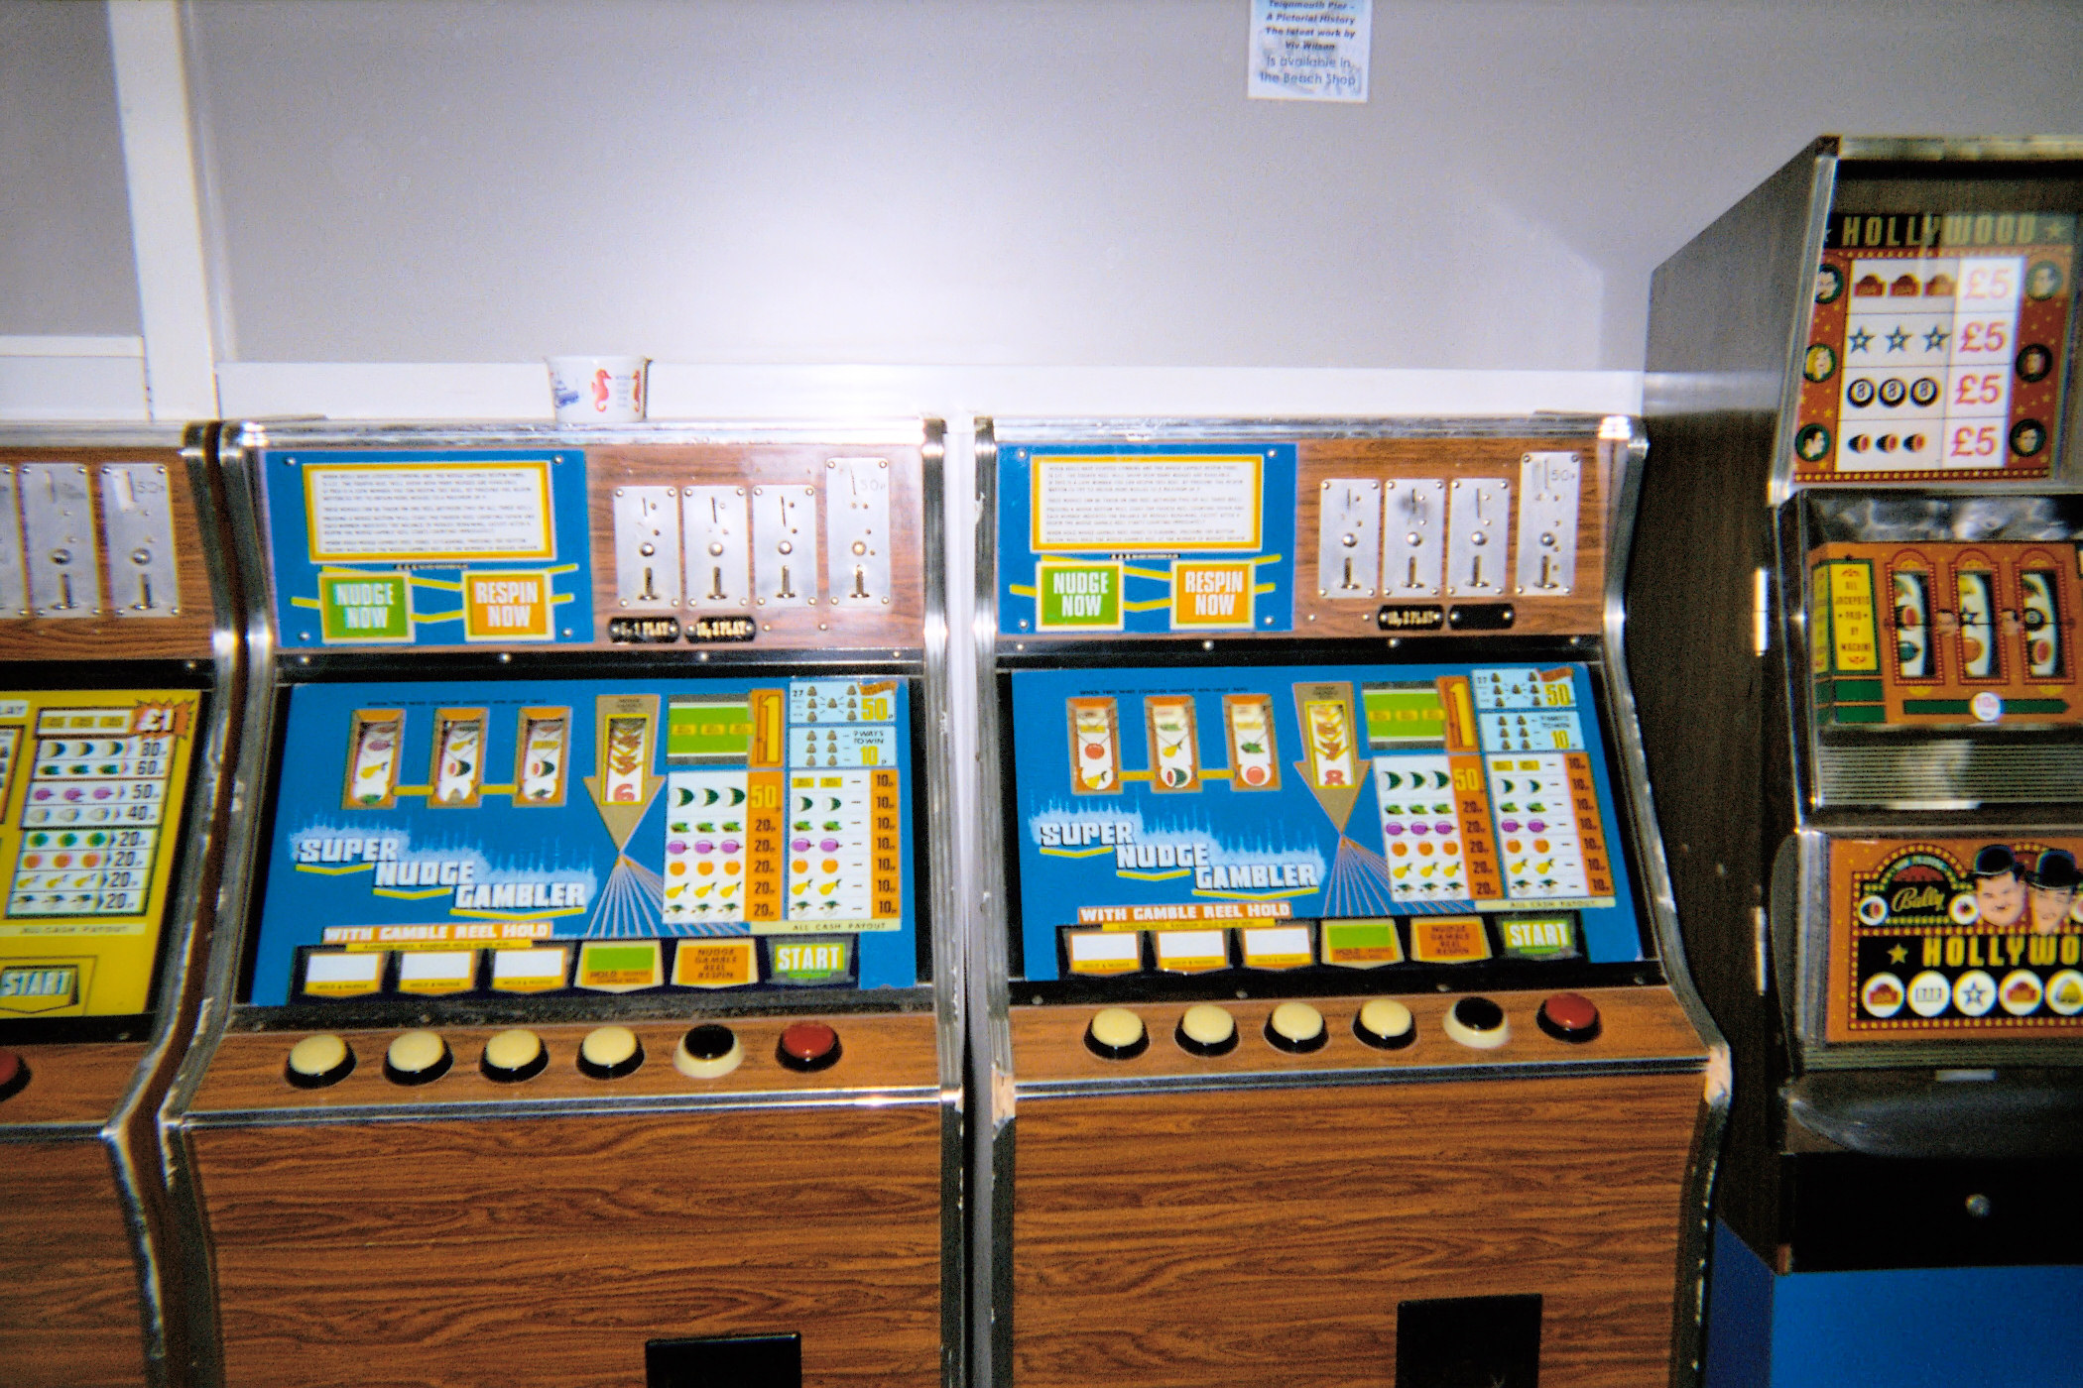
Digression: Monte Carlo rollouts
Multi-arm bandit problem: statistical model of sequential experiments
  Name derived from one-armed bandit (slot machine)
Multiple actions a₁, a₂, …, a_{n}, e.g., a_{n} = play machine i
Each a_{i} provides a reward from an
unknown probability distribution p_{i}
  Assume every p_{i} is stationary
    same every time, regardless of history
    (not true for real slot machines)
  Objective: maximize expected utility of
  a sequence of actions
Exploitation vs exploration dilemma:
  Exploitation: choose an action that has
  given you high rewards in the past
  Exploration: choose a less-familiar action
  in hopes that it might produce a higher reward
Credit: Billy Hicks, CC BY-SA 4.0

Slide 42
UCB (Upper Confidence Bound) Algorithm
Assume all rewards are between 0 and 1
  If they aren’t, normalize them
For each action a, let
  r(a) = average reward you’ve gotten from a
  n(a) = number of times you’ve tried a
  t = ∑_{a} n(a) _______________
  Q(a) = r(a) + √ 2(ln t)/n(a)
Theorem (given some assumptions):
  As t → ∞, argmax_{ã∈A} Q(a) → optimal choice
UCB algorithm
  if there are any untried actions:
  ã ← any untried action
  else: ã ← argmax_{a} Q(a)
  perform ã and get reward
  update r(ã), n(ã), t , Q(ã)
Credit: Billy Hicks, CC BY-SA 4.0

Slide 43
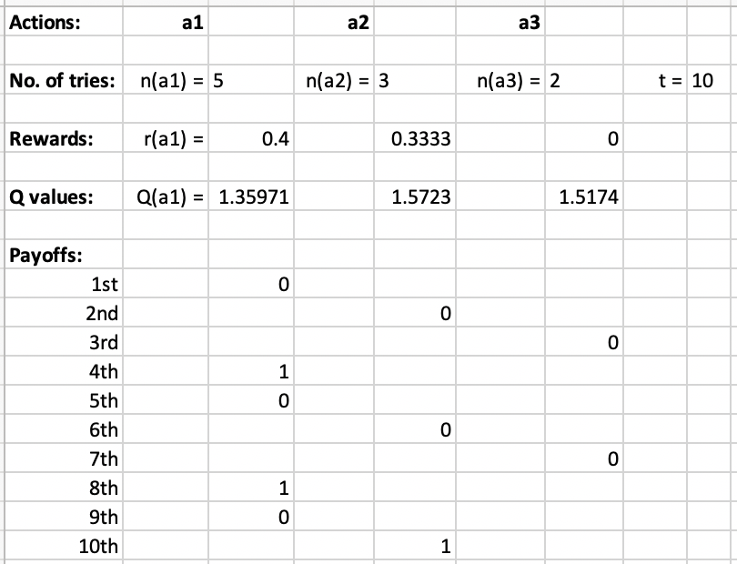
UCB (Upper Confidence Bound) Algorithm
For each action a, let
  r(a) = average reward you’ve gotten from a
  n(a) = number of times you’ve tried a
  t = ∑_{a} n(a) _______________
  Q(a) = r(a) + √ 2(ln t)/n(a)
Example: actions a1, a2, a3
  a1 pays every other time
  a2 pays every third time
  a3 never pays
UCB:
  if there are any untried actions:
  ã ← any untried action
  else:
  ã ← argmax_{a} Q(a)
  perform ã and get reward
  update r(ã), n(ã), t , Q(ã)
Poll: what action will UCB choose the 11th time?

Slide 44
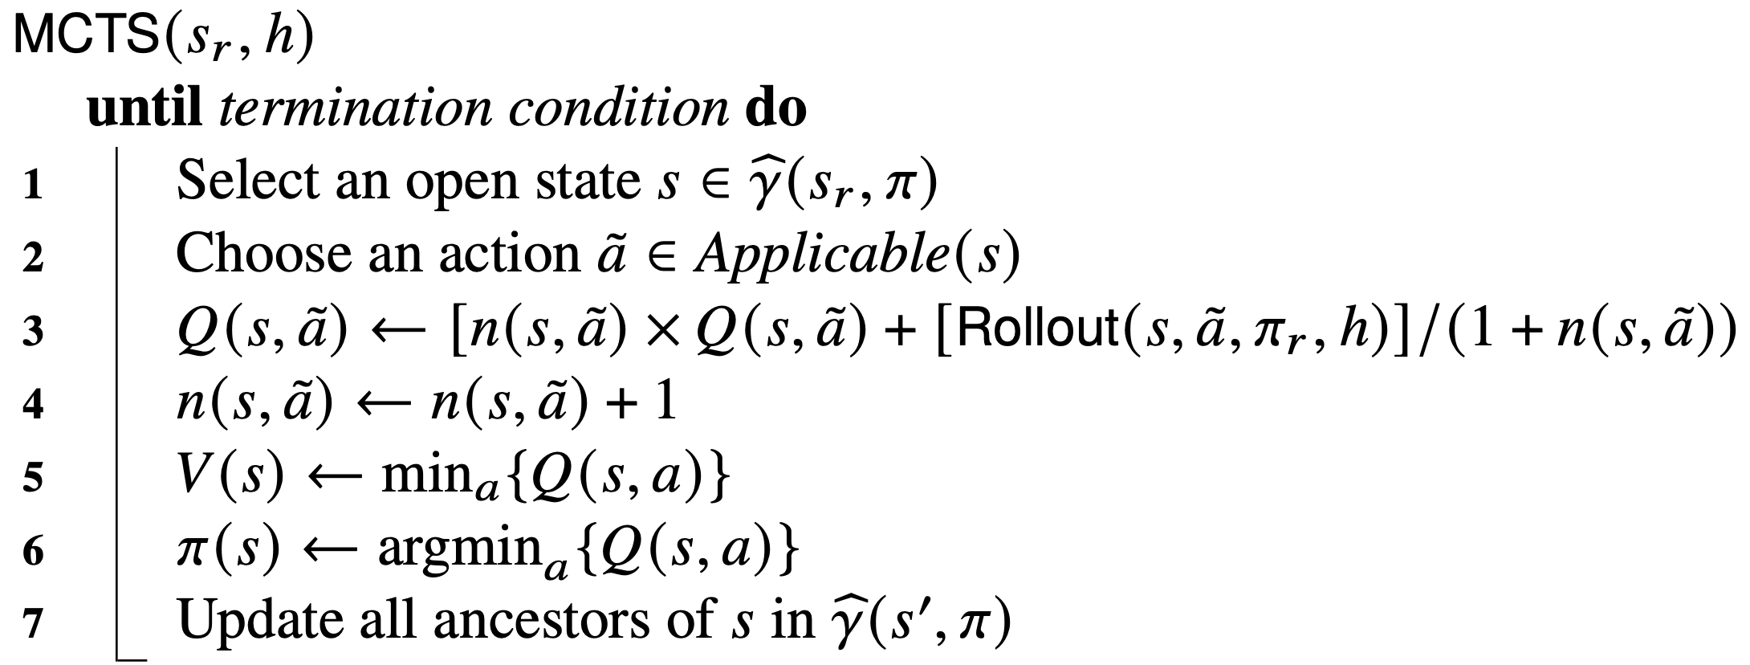

Monte Carlo Tree Search
root
max search depth
number of rollouts of $\tilde{a}$

Slide 45
UCT Algorithm
Statistics for each action a:
  r(a) = average reward
  n(a) = number of times
  you’ve tried a
  t = ∑_{a} n(a) _______________
  Q(a) = r(a) + √ 2(ln t)/n(a)
UCB:
  if there are untried actions:
  ã ← any untried action
  else: ã ← argmax_{a} Q(a)
  perform ã and get reward
  update r(ã), n(ã), t , Q(ã)
Recursive UCB computation on an SSP
  Adapted for minimization rather than maximization
Monte Carlo rollout:
  At s, choose action ã using UCB computation
    Perform ã, get state s′
    Do the same thing recursively at s′
    Continue until reaching a goal,
    dead end, or depth h
  At each state visited, keep
  statistics on choices, utilities

Slide 46
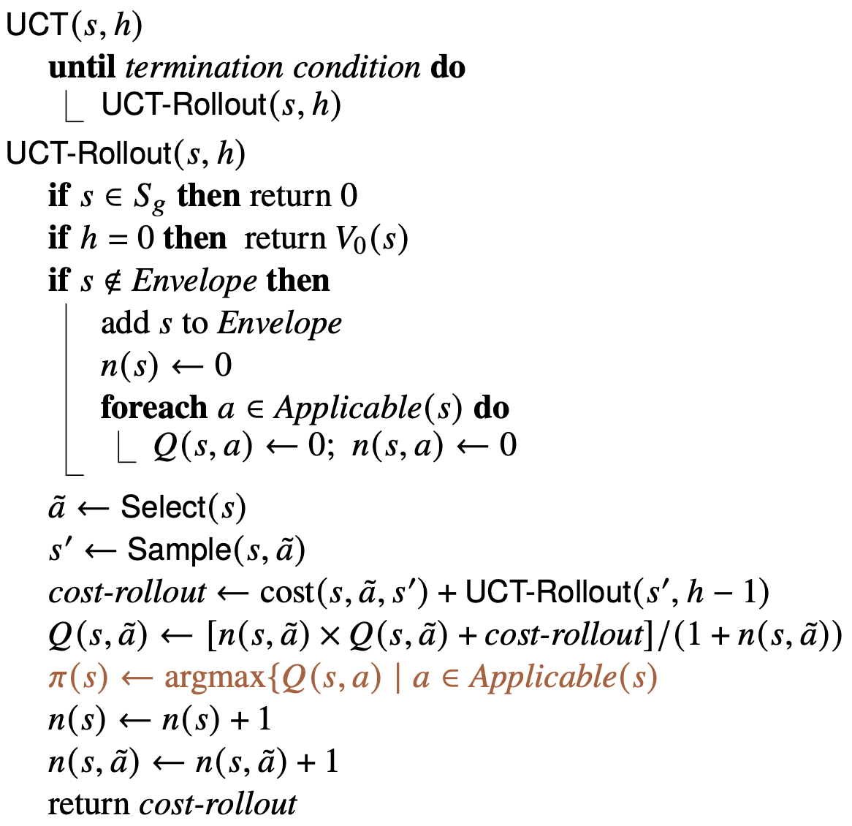
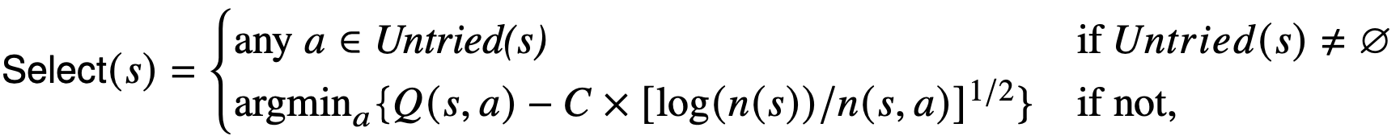
UCT Algorithm
Statistics for each action a:
  r(a) = average reward
  n(a) = number of times
  you’ve tried a
  t = ∑_{a} n(a) _______________
  Q(a) = r(a) + √ 2(ln t)/n(a)
UCB:
  if there are untried actions:
  ã ← any untried action
  else: ã ← argmax_{a} Q(a)
  perform ã and get reward
  update r(ã), n(ã), t , Q(ã)
max search depth
like t in UCB
like Q(a), n(a) in UCB
choose s′ with probability Pr(s′ | s,ã)
ln, I think

Slide 47
Using UCT Offline
Suppose we do n calls to UCT-Rollout
As n → ∞, π converges to optimal
  Problem: finding optimal π may take many iterations

Slide 48
Using UCT Online
Works better for online planning
  π(s₀) approaches optimal must faster than the rest of π
Lookahead procedure for Run-Lookahead:
  call UCT-Rollout(s,h) multiple times
  at current state s
  e.g., until
    allotted time runs out, or
    max change in Q(s,a) is ≤ η
  return π(s)

Slide 49
Using UCT Online
Suppose Run-Lazy-Lookahead uses the same Lookahead procedure:
  call UCT-Rollout(s,h) multiple times at current state s
  return π(s)
Problem: the farther you follow π,
the less likely that π(s) is optimal
  Near the bottom of the tree, π(s)
  might be ≈ random choice
Possible workaround
  Make Run-Lazy-Lookahead
  call UCT more frequently

Slide 50
Using UCT with a Simulator
Suppose you don’t know the probabilities and costs
  But you have a fast, accurate simulator for the environment
Run UCT many times in the simulated environment
  Learn state-transition probabilities, expected utilities
simulate a; observe s′

Slide 51
Using UCT for Exploration
Suppose you don’t know the probabilities and costs
  But you can restart your actor
  as many times as you want
Can modify UCT to be an acting procedure
  use it to explore the environment
Caveat: usually not very feasible in real environments
perform a; observe s′

Slide 52
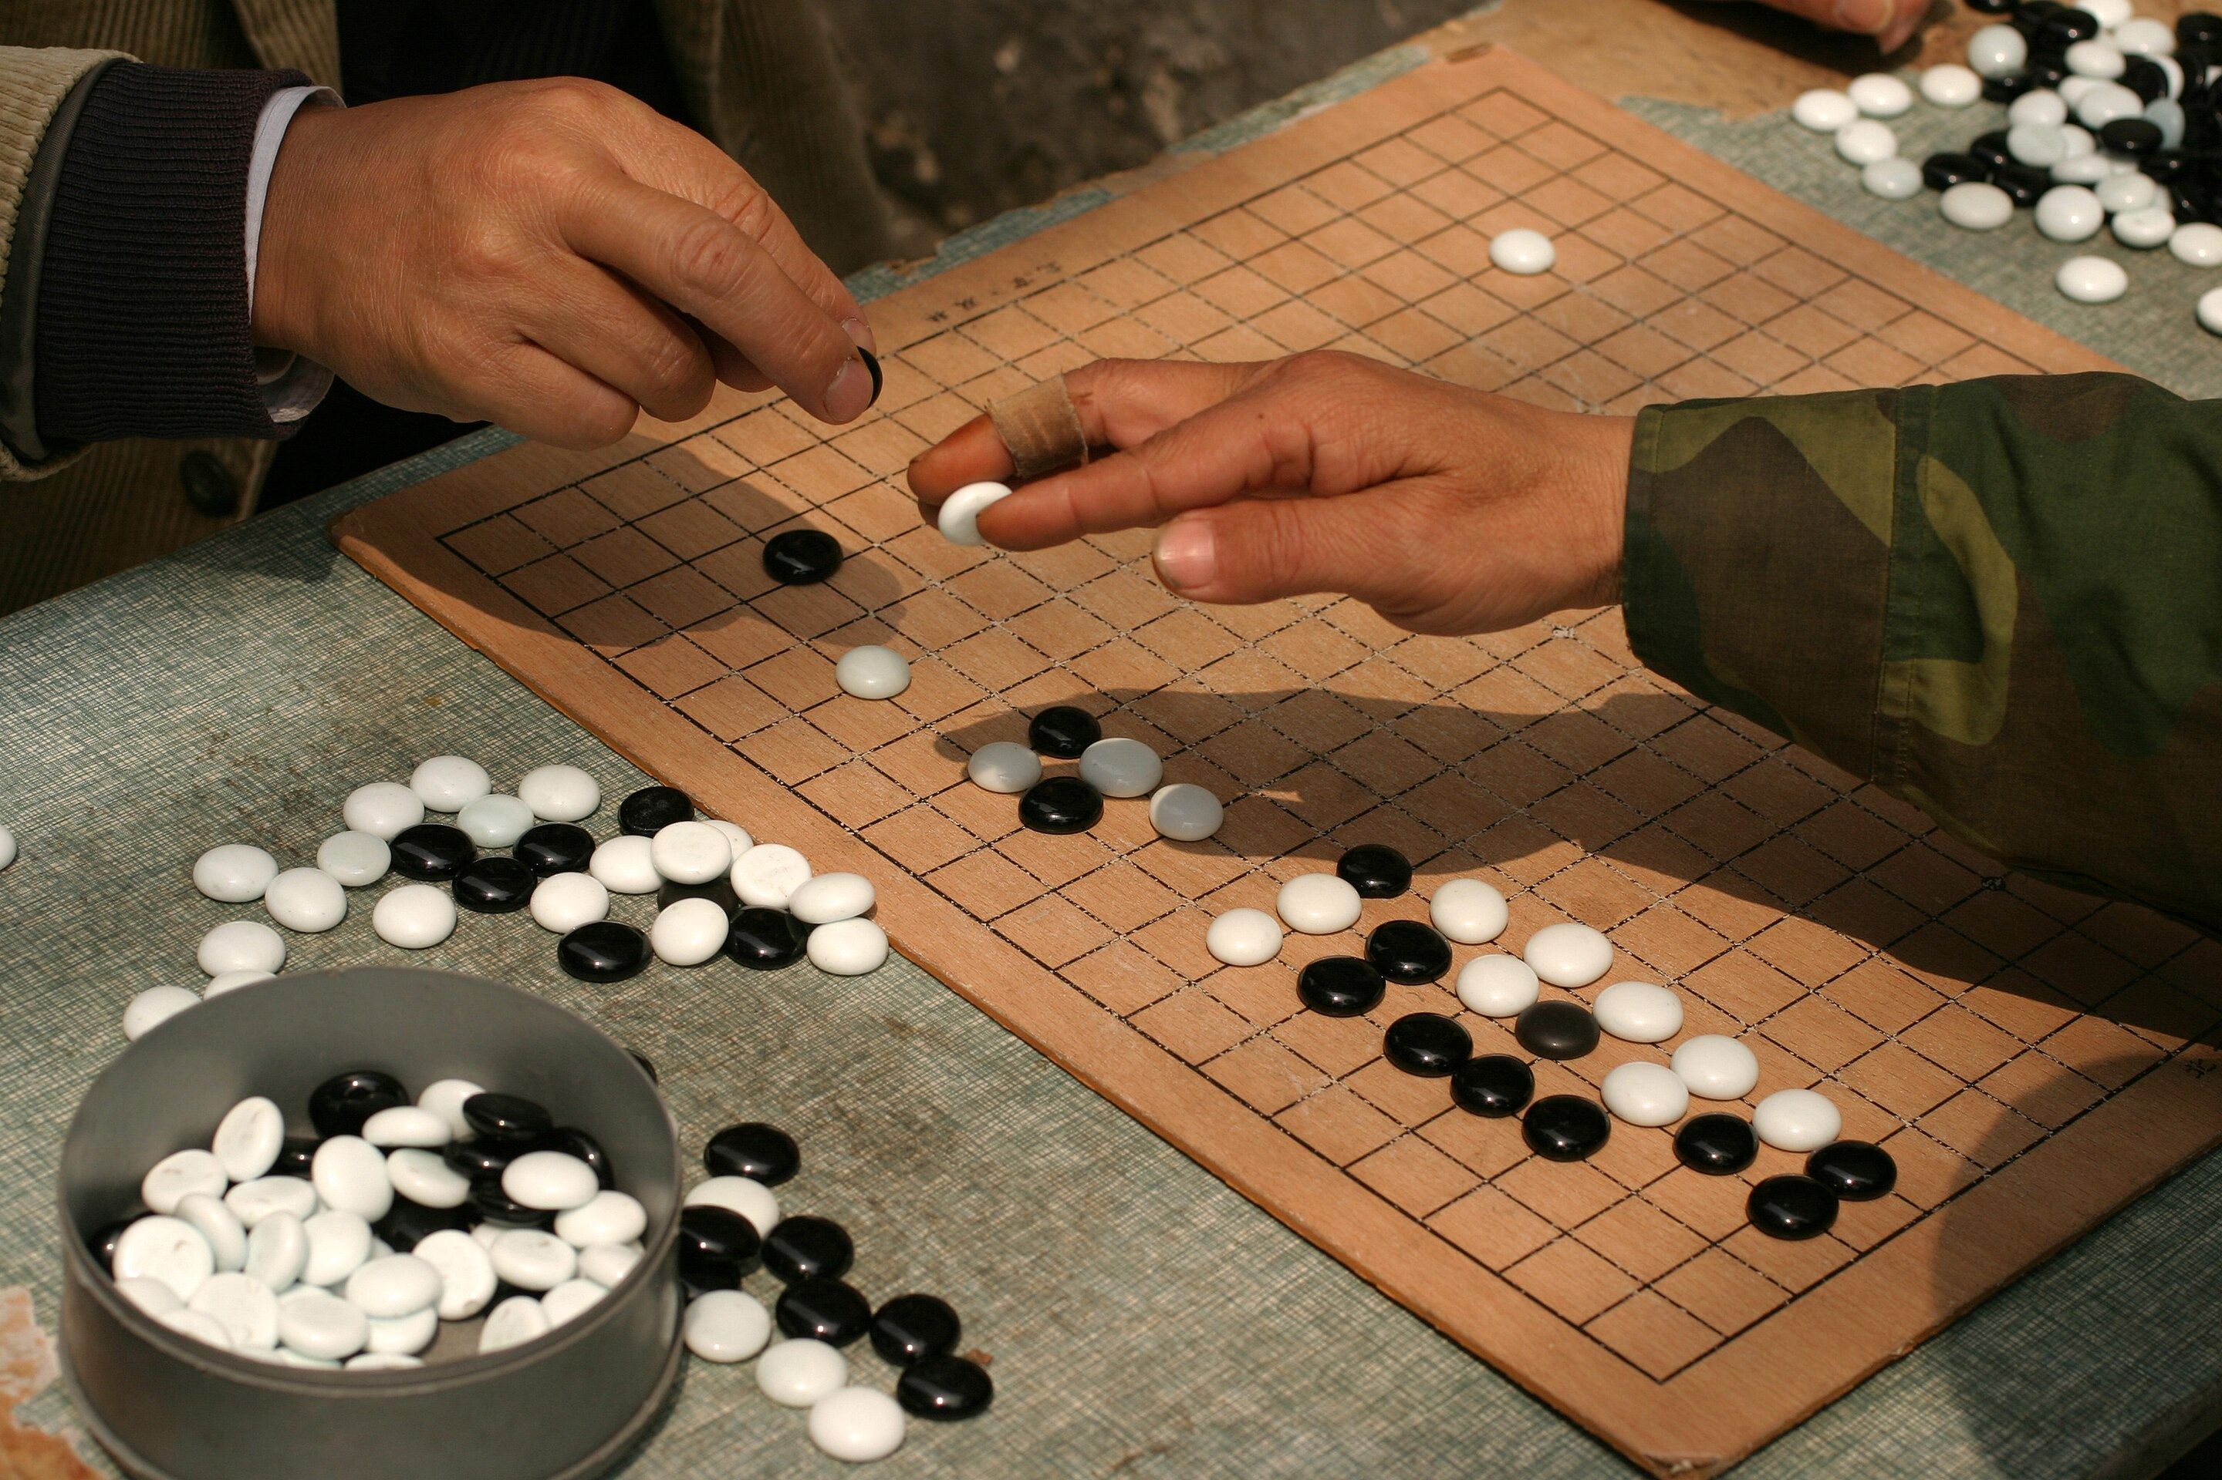
UCT in Two-Player Games
Generate Monte Carlo rollouts using a modified version of UCT
Main differences:
  Instead of accumulated cost, use heuristic evaluation function values
  UCT for player 1 recursively calls
  UCT for player 2
    Choose opponent’s action
  UCT for player 2 recursively calls
  UCT for player 1
First competent computer programs for go
  ≈ 2008–2012
Monte Carlo rollout techniques similar
to UCT were used to train AlphaGo
Credit: Brian Jeffery Beggerly, CC BY 2.0

Slide 53
Summary
MDPs and SSPs
solutions, closed solutions, histories
unsafe solutions, acyclic safe solutions, cyclic safe solutions
expected cost, planning as optimization
policy iteration
value iteration (asynchronous version)
  Bellman-update
AO*, LAO*
Planning and Acting
  Run-Lookahead
  FS-Replan
UCB, UCT

