Slide 1

MARS
Processing-In-Memory Acceleration of Raw Signal Genome Analysis
Inside the Storage Subsystem
Melina Soysal
Konstantina Koliogeorgi Can Firtina Nika Mansouri Ghiasi
Rakesh Nadig Haiyu Mao Geraldo F. Oliveira Yu Liang Klea Zambaku
Mohammad Sadrosadati Onur Mutlu

Slide 2
Outline
Background
Motivation and Goal
MARS
Evaluation
Conclusion

Slide 3







Genome Sequence Analysis
Study of genome to understand genetic variation, species and evolution has led to groundbreaking advances:
Evolutionary biology
Outbreak tracing
Personalized medicine
Genome analysis typically starts with sequencing and mapping
Sequencing
Mapping
reference
raw signals
mapping positions
generates small DNA fragments
aligns signals to reference genome

Slide 4

Raw Signal Genome Analysis (RSGA)
Raw Signal Genome Analysis (RSGA)
  novel approach that operates directly on raw electrical signals
  exploits high throughput of modern sequencing technologies
  enables real-time analysis
High Level Overview of RSGA Read Mapping
Indexing (offline)
Mapping (online)
Reference Genome
Query Sequence
AAGCCT
AAGCCT
Sketching
Sketching
Hash Table
events
Hash
Positions
0x00
2,64,…
query
Hash
0x01
0x01
1,101,…
0x00
Hash
store
…
0xFF
13,21
matches
Chaining
x
x
x
Deep Dive on mapping following

Slide 5
Raw Signal Genome Analysis (RSGA)
Raw Signal Genome Analysis (RSGA)
  novel approach that operates directly on raw electrical signals
  exploits high throughput of modern sequencing technologies
  enables real-time analysis
High Level Overview of RSGA Read Mapping
Mapping (online)
Query Sequence
Sketching
I
EVENT DETECTION
Hash Table
events
Hash
Positions
II
SEEDING
0x00
2,64,…
query
hash and query
0x01
1,101,…
0x00
Hash
…
0xFF
13,21
matches
Chaining
III
CHAINING
x
x
sorting and DP-based
x

Slide 6
Outline
Background
Motivation and Goal
MARS
Evaluation
Conclusion

Slide 7
Motivation
Sequencing throughput is growing rapidly
Modern sequencers can generate 100Ks of signal samples per second
RSGA struggles to keep up with increasing real-time requirements
Software pipelines cannot keep up with the pace of raw signal generation
There is a critical need for acceleration
Goal: Identify key performance bottlenecks in the RSGA pipeline
Target the most time- and energy-intensive steps for hardware acceleration
Chaining & seeding consistently dominate runtime
Event detection &
I/O overhead are also non-negligible

Slide 8
Impact of I/O data movement
We model I/O data movement overhead when accelerating commonly targeted steps in the pipeline: seeding and chaining
As compute latency is reduced, I/O becomes the dominant contributor to total execution time
I/O data movement from SSD becomes dominant overhead as compute steps are accelerated in RSGA

Slide 9
Our Goal
Design a high-performance and energy-efficient system for RSGA by addressing both the
I/O data movement and
computational bottlenecks

Slide 10
Outline
Background
Motivation and Goal
MARS
Evaluation
Conclusion

Slide 11
MARS: PIM Acceleration of RSGA Inside Storage
First In-Storage-Processing system for RSGA
Key Idea: Enable multiple Processing-In-Memory paradigms within the SSD and leverage high SSD-internal bandwidth to create a highly-parallel and energy-efficient system for RSGA
Co-design between targeted software modifications and dedicated hardware components within the storage system
Targeted software modifications to optimize RSGA for in-storage executions
Tailored to SSD parallelization capabilities and architecture
Processing-In-Memory within the SSD to accelerate RSGA steps
Processing using the SSD-internal DRAM
Processing near the SSD-internal DRAM

Slide 12
MARS Genome Analysis Workflow
Software modifications to reduce computational workload and intermediate storage requirements
Filtering Techniques
  Discard candidates unlikely to result in valid mapping
  Includes frequency and vote-based filtering
Arithmetic Conversion Techniques
  Convert floating-point to fixed-point representations (16 bits)
  Reduces memory footprint and computational cost
Challenge: Preserve accuracy in the presence of raw signal noise
Requires careful placement of both techniques in the pipeline
Involves fine-tuning filter parameters

Slide 13
Impact of SW Modification on Accuracy
We conduct an accuracy analysis to show the benefits of our SW improvements and evaluate the usage of fixed-point arithmetic
Ground Truth
Basecalling (Dorado) and Read Mapping (minimap2)
Datasets: SARS-CoV-2, E.coli, Yeast, Green Algae, Human
Comparison points:
  RawHash2 (RH2) [Firtina+, Bioinformatics’24]: state-of-the-art RSGA algorithm
  MS-CPU_{Float} : RSGA + filtering techniques
  MS_CPU_{Fixed} : RSGA + filtering + arithmetic conversion techniques

Slide 14
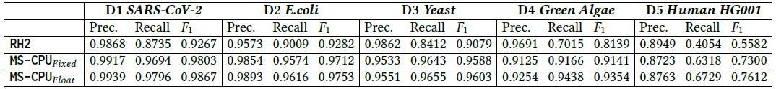
Accuracy Evaluation
Key Observations

Slide 15
Accuracy Evaluation
MS-CPU improves recall and F1-score over RH2
Our filtering techniques are effective in eliminating ambiguous and redundant candidate matches & allow pipeline to focus on more informative regions that are more likely to represent the correct match
Key Observations

Slide 16
Accuracy Evaluation
MS-CPU improves recall and F1-score over RH2
Our filtering techniques are effective in eliminating ambiguous and redundant candidate matches & allow pipeline to focus on more informative regions that are more likely to represent the correct match
Key Observations
Using fixed-point arithmetic in MS-CPU only leads to minimal accuracy loss
We apply earlier normalization & quantization to ensure fixed-point arithmetic has no significant impact on our results

Slide 17
MARS Architecture & System - Overview
In-Storage-Processing system for RSGA
Conventional Mode: SSD performs standard SSD storage operations
Accelerator Mode: SSD executes the full RSGA pipeline without host intervention
SSD Controller
Flash Controller
I
MARS
Control
Unit
FTL
II
III
Sorter
Unit
Merger
Unit
.
Flash Memory
Cores
.
.
SSD-Internal DRAM
Bank
V
Querying Unit
V
Querying Unit
…
…
…
…
…
…
…
Subarrays
Bank
IV
Arithmetic Unit
Arithmetic Unit

Slide 18
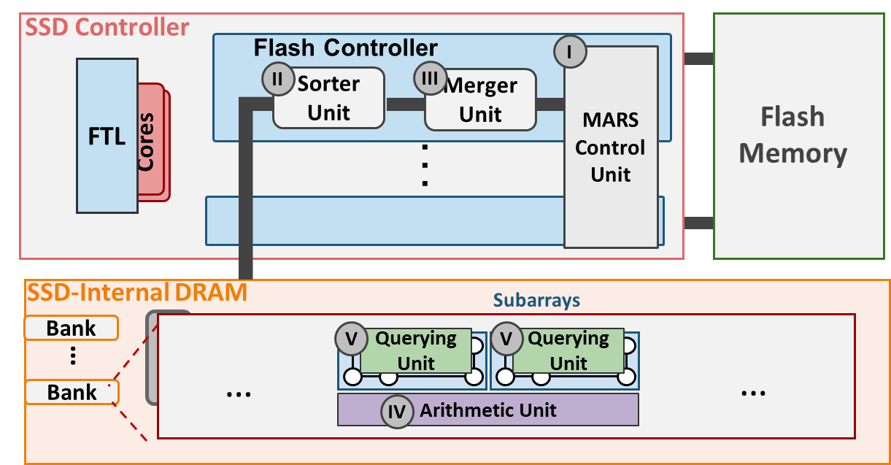
MARS Architecture & System (I/IV)
SSD Controller Components
SSD Controller
Flash Controller
I
FTL
II
III
MARS
Control
Unit
Sorter
Unit
Merger
Unit
.
Flash Memory
Cores
.
.
I
MARS Control Unit
Finite State Machine that orchestrates pipeline execution, control and data flow

Slide 19
MARS Architecture & System (II/IV)
SSD Controller Components
SSD Controller
Flash Controller
I
FTL
II
III
MARS
Control
Unit
Sorter
Unit
Merger
Unit
.
Flash Memory
Cores
.
.
I
II
III
MARS Control Unit
Sorter Unit
Merger Unit
Finite State Machine that orchestrates pipeline execution, control and data flow
Performs parallel sorting of sequences using dedicated logic
Combines sorted subsequences into longer sorted ones
Paradigm: Implements Processing Near DRAM
1 Sorter-Merger pair per flash controller

Slide 20
MARS Architecture & System (III/IV)
SSD-Internal DRAM Components
SSD-Internal DRAM
Bank
V
Querying Unit
V
Querying Unit
…
…
…
…
…
Subarrays
…
…
Bank
Arithmetic Unit
IV
IV
Arithmetic Unit
Performs arithmetic and logical operations required for RSGA
Paradigm: Implements Processing Near DRAM
Design: Based on the FULCRUM architecture for leveraging DRAM subarray proximity for low-latency parallel arithmetic operations
1 per two subarrays

Slide 21
MARS Architecture & System (IV/IV)
SSD-Internal DRAM Components
SSD-Internal DRAM
Bank
V
Querying Unit
V
Querying Unit
…
…
…
…
…
Subarrays
…
…
Bank
Arithmetic Unit
IV
IV
V
Arithmetic Unit
Querying Unit
Performs arithmetic and logical operations required for RSGA
Performs efficient, in-memory hash table lookups for seeding
Paradigm: Implements Processing Near DRAM
Paradigm: Implements Processing Using DRAM
Design: Based on the FULCRUM¹ architecture for leveraging DRAM subarray proximity for low-latency parallel arithmetic operations
Design: Based on the PLUTO² architecture leveraging DRAM row activation for massively parallel hash-table lookup operations
1 per two subarrays
1 per subarray
1: [Lenjani, HPCA’20]; 2: [Ferreira+, MICRO’22]

Slide 22
Mapping RSGA Workflow to MARS Architecture
Break down RSGA steps into fine-grained tasks
  Arithmetic, querying and sorting operations

Slide 23
Mapping RSGA Workflow to MARS Architecture
Break down RSGA steps into fine-grained tasks
  Arithmetic, querying and sorting operations
Implement MARS as a pipeline
  Each task mapped to a dedicated compute unit
  e.g., multiplications mapped to arithmetic unit

Slide 24
Mapping RSGA Workflow to MARS Architecture
Break down RSGA steps into fine-grained tasks
  Arithmetic, querying and sorting operations
Implement MARS as a pipeline
  Each task mapped to a dedicated compute unit
  e.g., multiplications mapped to arithmetic unit
MARS Control Unit encodes pipeline into a Finite State Machine
  Defines a fixed execution sequence
  Dynamically triggers tasks when input data is ready

Slide 25
Control and Data Flow
SSD Controller
Flash Controller
I
MARS
Control
Unit
FTL
II
III
Sorter
Unit
Merger
Unit
.
Flash Memory
Cores
.
.
SSD-Internal DRAM
Bank
V
Querying Unit
V
Querying Unit
…
…
…
…
…
…
…
Subarrays
Bank
IV
Arithmetic Unit
Arithmetic Unit

Slide 26
Control and Data Flow (I/VI)
SSD Controller
Flash Controller
I
MARS
Control
Unit
FTL
II
III
Sorter
Unit
Merger
Unit
.
Flash Memory
Cores
.
.
raw input signals
SSD-Internal DRAM
Bank
V
Querying Unit
V
Querying Unit
…
…
…
…
…
…
…
Subarrays
Bank
IV
Arithmetic Unit
Arithmetic Unit
1
Event Detection

Slide 27
Control and Data Flow (II/VI)
SSD Controller
Flash Controller
I
MARS
Control
Unit
FTL
II
III
Sorter
Unit
Merger
Unit
.
Flash Memory
Cores
.
.
SSD-Internal DRAM
Bank
V
Querying Unit
V
Querying Unit
…
…
…
…
…
…
…
Subarrays
Bank
IV
Arithmetic Unit
Arithmetic Unit
Seeding
(Hash-value generation & filtering)
2

Slide 28
Control and Data Flow (III/VI)
SSD Controller
Flash Controller
I
MARS
Control
Unit
FTL
II
III
Sorter
Unit
Merger
Unit
.
Flash Memory
Cores
.
.
SSD-Internal DRAM
Bank
V
Querying Unit
V
Querying Unit
…
…
…
…
…
…
…
Subarrays
Bank
IV
Arithmetic Unit
Arithmetic Unit
Seeding
(Hash-table querying)
2

Slide 29
Control and Data Flow (IV/VI)
SSD Controller
Flash Controller
I
MARS
Control
Unit
FTL
II
III
Sorter
Unit
Merger
Unit
.
Flash Memory
Cores
.
.
SSD-Internal DRAM
Bank
V
Querying Unit
V
Querying Unit
…
…
…
…
…
…
…
Subarrays
Bank
IV
Arithmetic Unit
Arithmetic Unit
Chaining
(Create batches of sequences)
3

Slide 30
Control and Data Flow (V/VI)
SSD Controller
Flash Controller
I
MARS
Control
Unit
FTL
II
III
Sorter
Unit
Merger
Unit
.
Flash Memory
Cores
.
.
SSD-Internal DRAM
Bank
unsorted
sequences
in batches
V
Querying Unit
V
Querying Unit
…
…
…
…
…
…
…
Subarrays
Bank
IV
Arithmetic Unit
Arithmetic Unit
Chaining
(Sorting & Merging)
3

Slide 31
Control and Data Flow (VI/VI)
SSD Controller
Flash Controller
I
MARS
Control
Unit
FTL
II
III
Sorter
Unit
Merger
Unit
.
Flash Memory
Cores
.
.
sorted
sequences
SSD-Internal DRAM
Bank
V
Querying Unit
V
Querying Unit
…
…
…
…
…
…
…
Subarrays
Bank
IV
Arithmetic Unit
Arithmetic Unit
Chaining
(Dynamic programming)
3

Slide 32
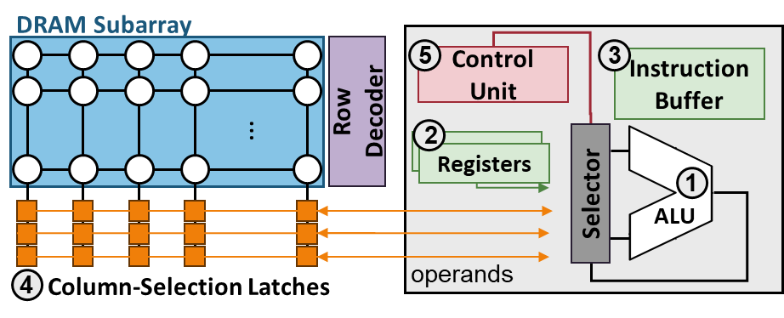
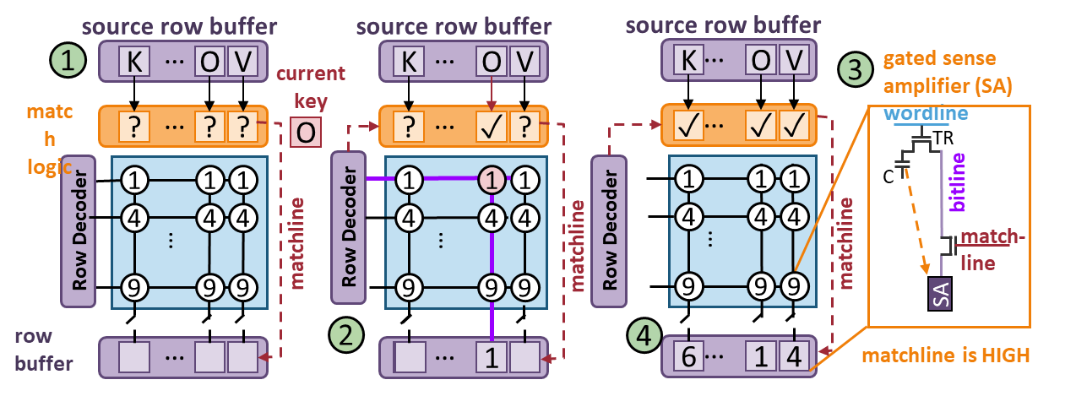
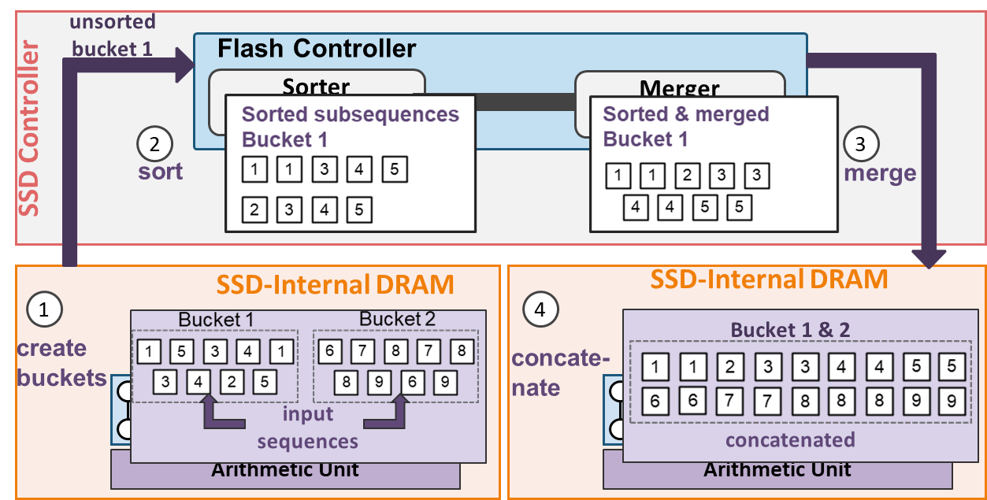
Computational Units & System Integration
Arithmetic Unit
    Processing-Near-Memory
    Add Logic near the subarrays
    Column-Selection Latches
Querying Unit
  Processing-Using-Memory
  Add Custom Hash-key Match logic
  and Gated Sense Amplifiers
More details on the Mechanism and System Integration
can be found in the paper
Sorter and Merger Unit
Inside the SSD controller
Processing-Near-Memory
Bitonic Sorter and Merger

Slide 33
Outline
Background
Motivation and Goal
MARS
Evaluation
Conclusion

Slide 34
Evaluation Methodology (I/II)
We compare MARS against four systems for our performance and energy analysis
BC
GenPIP
RH2
MARS-CPU
MARS
Conventional pipeline with GPU-based basecalling (dorado) and CPU-based read mapping (minimap2)
NVM-based hardware-accelerated pipeline for basecalling & read mapping
State-of the art CPU-based RSGA pipeline
MARS software-only RSGA pipeline executed on CPU
Full MARS hardware-accelerated RSGA system inside the storage subsystem
[MICRO’22]
[Bioinformatics’24]
Basecalling-based pipeline
RSGA-based pipeline

Slide 35
Evaluation Methodology (II/II)
We use the following hardware setup and simulate elements of our system setup
Hardware Components
CPU-based baseline
  state-of-the-art server with two AMD® EPYC® CPUs with 64 physical cores
  1-TB DDR4 DRAM
  NVIDIA RTX A6000 GPU (for the BC baseline)
SSD configurations
  8 channels with each 8 flash chips, PCIe 4.0 interface
  4GB LPDDR4 DRAM with 16 banks and 512 subarrays
Simulators Used
Synopsis Design Compiler - for accelerators
MQSim [Tavakkol+, FAST’18] - for SSD-internal operations
CACTI7 [Kim+, CAL’15] - for SSD-internal LPDDR4 DRAM

Slide 36
Performance Evaluation
BC
GenPIP
MS-CPU
MARS
RawHash2
100
10
Speedup
1
0.1
D1
D2
D3
D4
D5
GEOMEAN
Basecalling-based pipeline
RSGA-based pipeline
MARS outperforms all other baselines across all datasets
MARS outperforms GenPIP adopting PIM outside storage
Key Observations
We fundamentally solve the I/O data movement overhead problem
MARS-CPU provide speedup of ∅1.7x over RH2
Our SW modifications are effective in reducing the computational load

Slide 37
Energy Evaluation
BC
GenPIP
MS-CPU
MARS
RawHash2
10²
10
Energy Reduction
1
0.1
D1
D2
D3
D4
D5
GEOMEAN
Basecalling-based pipeline
RSGA-based pipeline
MARS reduces energy consumption over all other baselines across all datasets
Key Observation
Improvement stems from
reduced execution time
fundamentally addressing the I/O data movement overhead

Slide 38
Outline
Background
Motivation and Goal
MARS
Evaluation
Conclusion

Slide 39



Conclusion
MARS
The first in-storage processing system for end-to-end raw signal genome analysis enables through SW improvements and a HW system inside the storage system
High accuracy
matches basecalling-based pipelines
improves F1 scores over state-of-the-art RSGA pipeline
Improves performance
93× over state-of-the-art software-based basecalling read mapping pipeline
40× over state-of-the-art hardware-accelerated basecalling read mapping pipeline
28× over state-of-the-art software-based RSGA read mapping pipeline
Reduces energy consumption
427× over state-of-the-art software-based read mapping pipeline
72× over state-of-the-art hardware-accelerated read mapping pipeline
180× over state-of-the-art software-based RSGA read mapping pipeline

Slide 40
MARS
Processing-In-Memory Acceleration of Raw Signal Genome Analysis
Inside the Storage Subsystem
Melina Soysal
Konstantina Koliogeorgi Can Firtina Nika Mansouri Ghiasi
Rakesh Nadig Haiyu Mao Geraldo F. Oliveira Yu Liang Klea Zambaku
Mohammad Sadrosadati Onur Mutlu

Slide 41
BACKUP SLIDES
BACKUP – To be improved

Slide 42
Ablation Study - Methodology
We conduct an ablation study to find the most suitable system setup of MARS
MARS
MARS-SIMDRAM
SmartSSD
MARS-EXTERNAL
Full MARS hardware-accelerated RSGA system inside the storage subsystem
MARS with bit-serial PUM-based arithmetic units instead near-DRAM accelerators
MARS with offloaded sorting using an external FPGA near the SSD, replacing in-SSD logic
MARS with conventional SSD, sorting on ASIC near CPU and external PIM-based DRAM
RSGA-based pipeline

Slide 43
Ablation Study - Performance Evaluation
MS-SIMDRAM
MS-EXT
SmartSSD
MARS
RawHash2
100
10
8.0
Speedup
1
0.1
D1
D2
D3
D4
D5
GEOMEAN
MARS outperforms all ablation variants across all datasets
MS-EXT lags behind due to high I/O data movement to storage-external compute
Key Observations
MS-EXT is not able to fundamentally tackle the I/O data movement overhead
SmartSSD performs moderately, but is limited due to FPGA interface BW
MARS as only system combining high compute with fundamentally addressing I/O data movement overhead

Slide 44
Ablation Study - Energy Evaluation
MS-SIMDRAM
MS-EXT
MARS
RawHash2
10³
10²
Energy Reduction
10
1
0.1
D1
D2
D3
D4
D5
GEOMEAN
MS-SIMDRAM achieves highest energy reduction, but lowest performance among the ablation variants
Small bit-serial arithmetic unit trades off energy consumption for performance
Key Observation
MS-EXT incurs higher energy cost due to off-chip data movement and increased host involvement
MARS provides the best performance-energy trade-off

Slide 45
Computational Units
Arithmetic Unit
    Processing-Near-Memory
    Add Logic near the subarrays
    Column-Selection Latches
Querying Unit
  Processing-Using-Memory
  Add Custom Hash-key Match logic
  and Gated Sense Amplifiers
Sorter and Merger Unit
Inside the SSD controller
Processing-Near-Memory
Bitonic Sorter and Merger

Slide 46
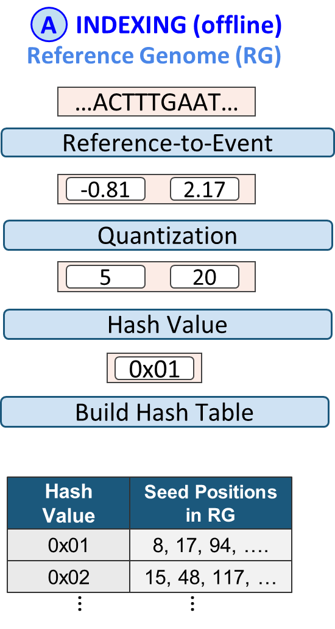
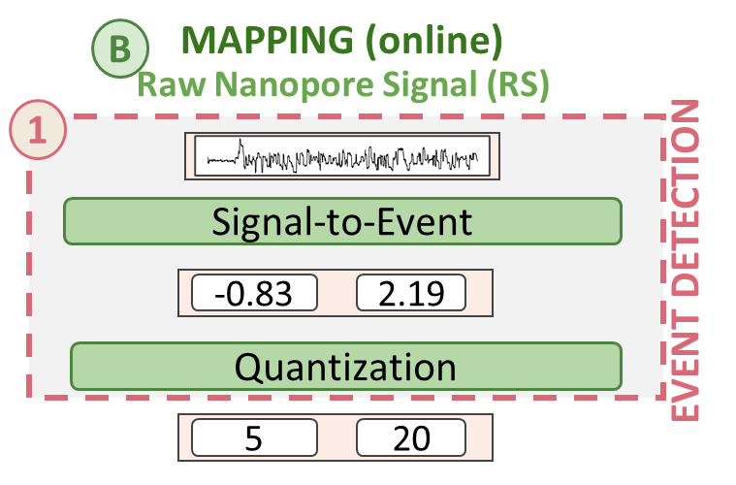
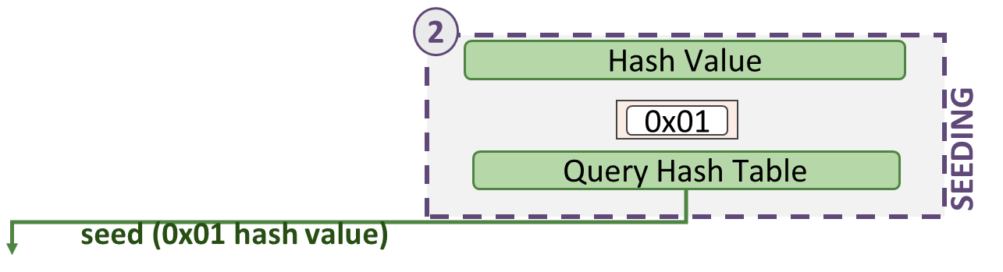
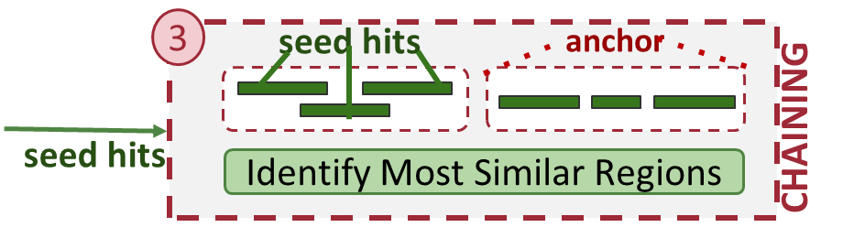
MARS detailed workflow
Notes:
Present workflow here?
Hardware acceleration?

