Slide 1


Real-time Sequence Analysis from Raw Nanopore Electrical Signals with Accurate Hash-based Search Mechanisms
Can Firtina
canfirtina@gmail.com
https://cfirtina.com
10 May 2024
The Broad Institute of MIT and Harvard

Slide 2
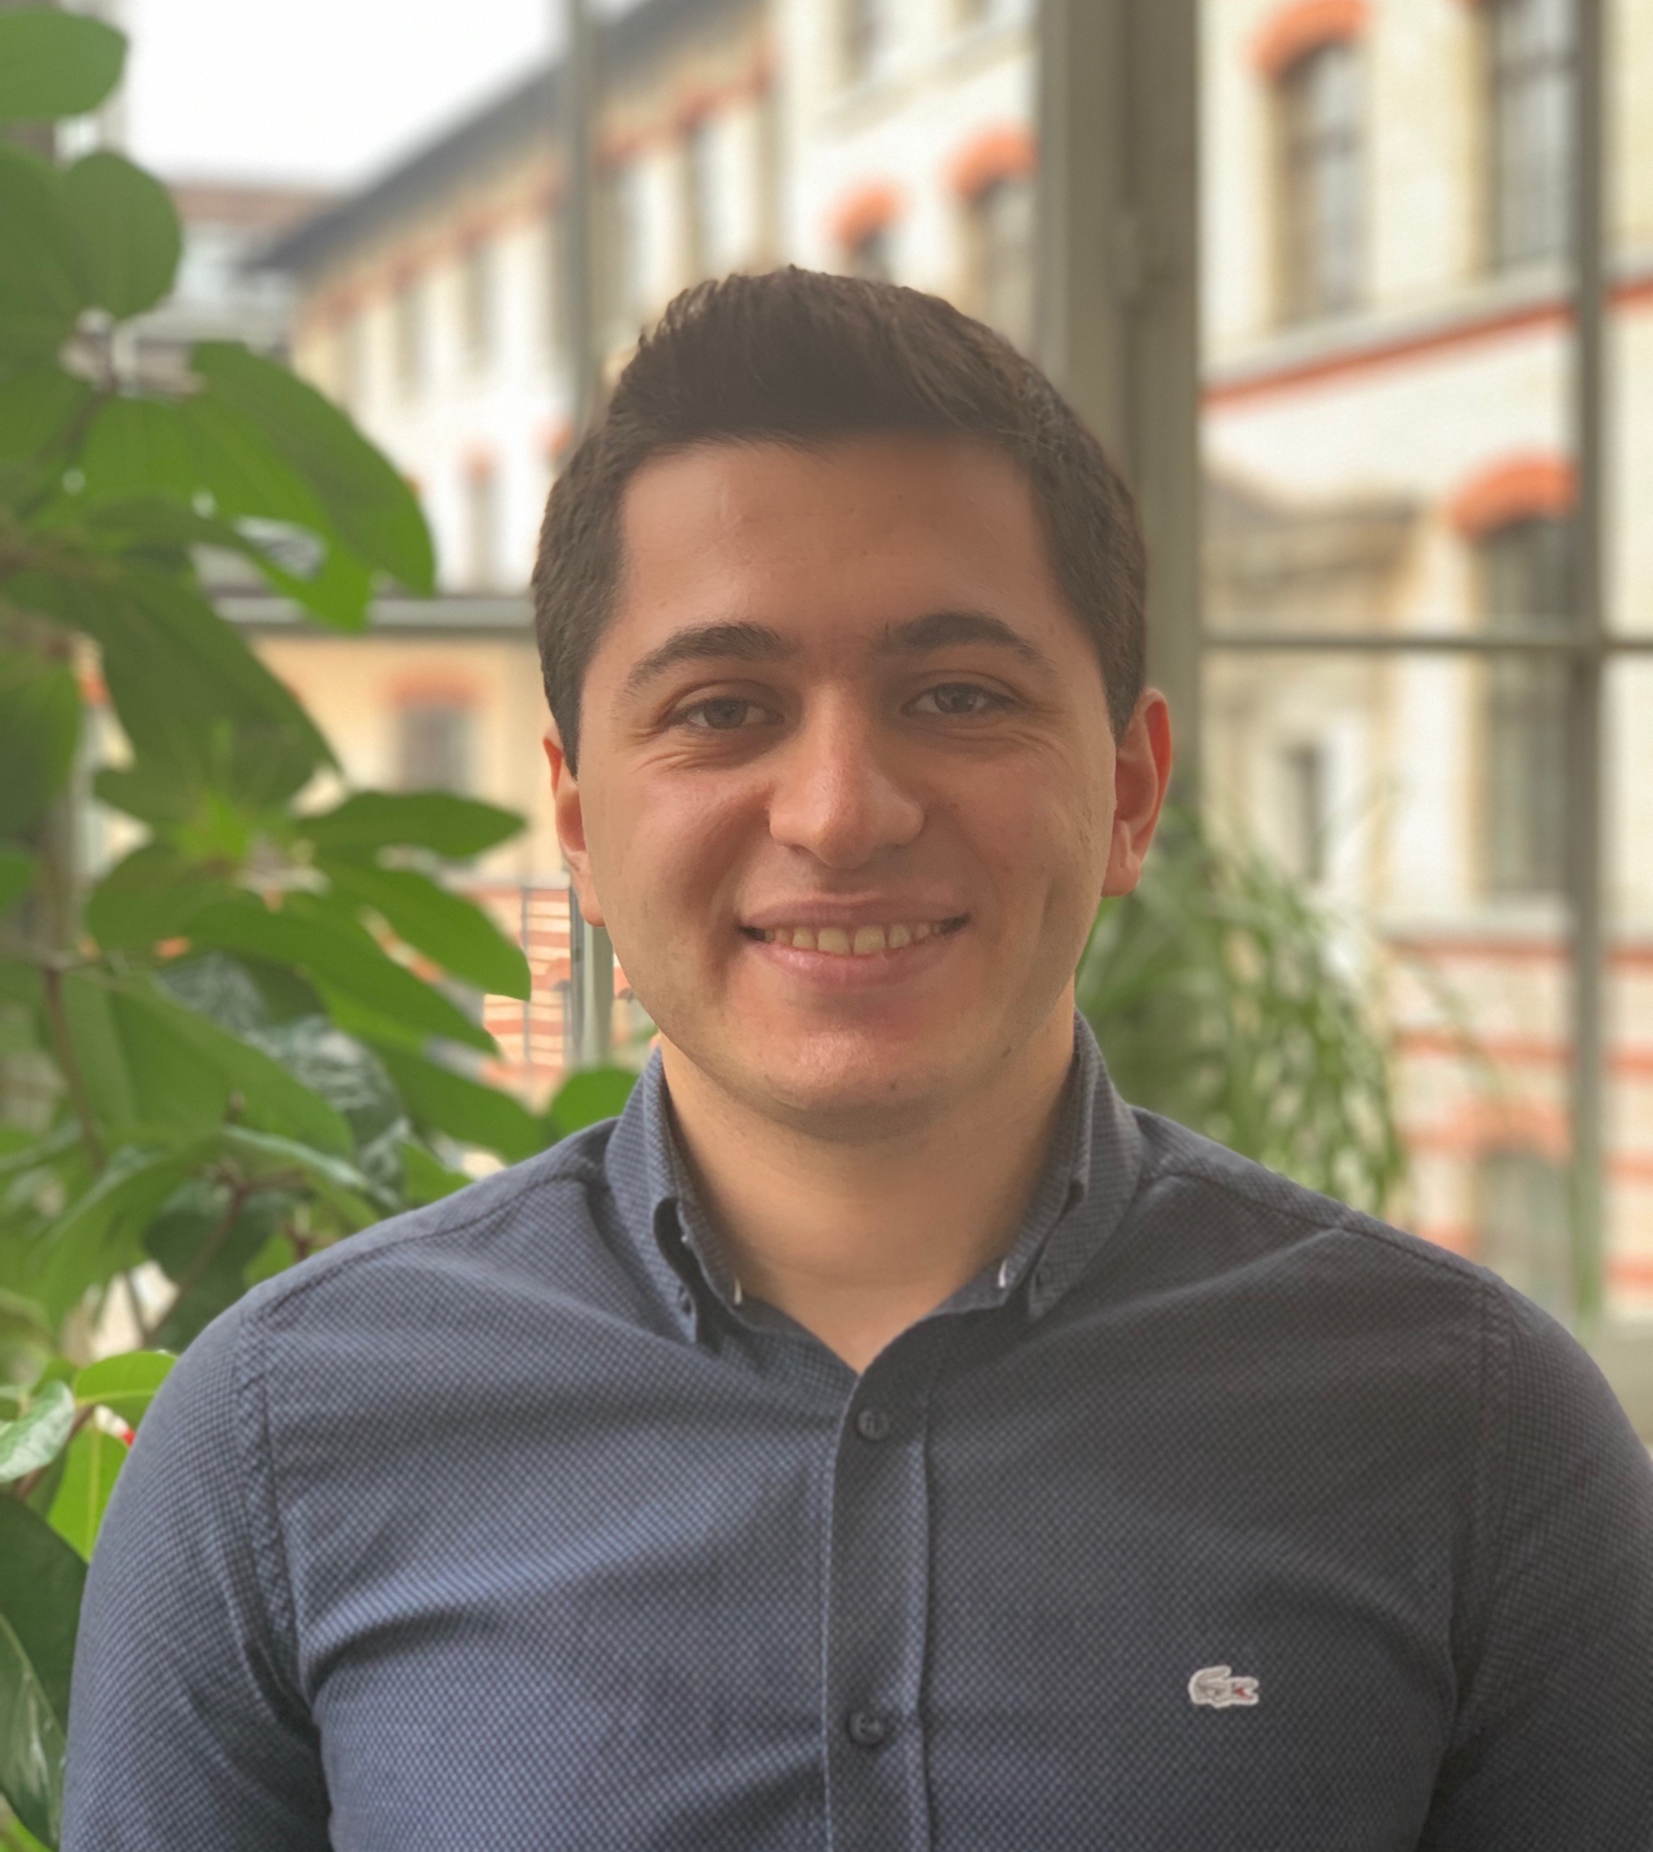
Brief Self Introduction
Can Firtina
Senior Ph.D. student in the SAFARI Research Group at ETH Zurich
Research interests: Bioinformatics & Computer Architecture
Real-time genome analysis
Similarity search in a large space of genomic data
Hardware-Algorithm co-design to accelerate genome analysis
Genome editing
Error correction
Get to know our group and our research
Group website: https://safari.ethz.ch/
Contact me: canfirtina@gmail.com
Website: https://cfirtina.com
Twitter (aka X): https://twitter.com/FirtinaC

Slide 3
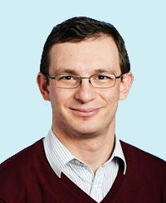
Professor Mutlu
Onur Mutlu
Full Professor @ ETH Zurich ITET (INFK), since September 2015
Strecker Professor @ Carnegie Mellon University ECE/CS, 2009-2016, 2016-…
PhD from UT-Austin, worked at Google, VMware, Microsoft Research, Intel, AMD
https://people.inf.ethz.ch/omutlu/
omutlu@gmail.com (Best way to reach)
https://people.inf.ethz.ch/omutlu/projects.htm
Research and Teaching in:
Computer architecture, computer systems, hardware security, bioinformatics
Memory and storage systems
Hardware security, safety, predictability
Fault tolerance
Hardware/software cooperation
Architectures for bioinformatics, health, medicine
…
Notes:
Our group is led by Professor Onur Mutlu. He is a professor at ETH Zurich in the Information Tech. and Electrical Engineering department and also affifiliated with the CS department since 2015. Previously he was a professor at Carnegie Mellon university.
He received his PhD from UT-Austin and later worked at many companies such as Microsoft research, Google, Vmware, Intel and AMD. You can find more about him using his personal website and you can contact him using his gmail.

Slide 4
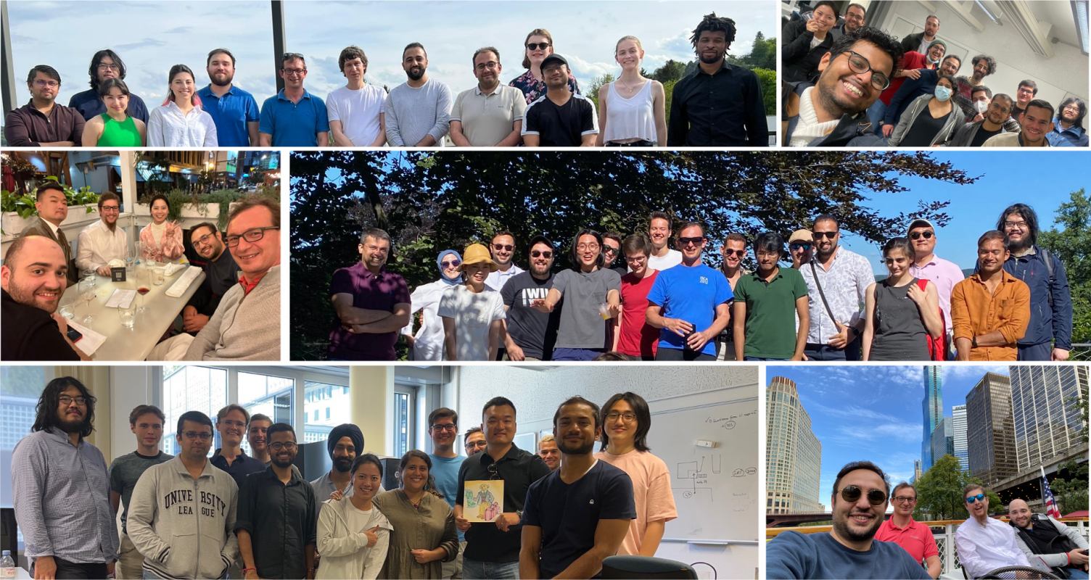

SAFARI Research Group
Computer architecture, HW/SW, systems, bioinformatics, security, memory
40+ Researchers
Think BIG, Aim HIGH!
https://safari.ethz.ch

Slide 5
Four Key Current Directions
Fundamentally Secure/Reliable/Safe Architectures
Fundamentally Energy-Efficient Architectures
Memory-centric (Data-centric) Architectures
Fundamentally Low-Latency and Predictable Architectures
Algorithms & Architectures for AI/ML, Genomics, Medicine

Slide 6
Agenda for Today
Cutting-edge in Accelerating Genome Analysis
Enabling Fast and Accurate Sequence Analysis
Real-Time Analysis Nanopore Raw Signal Analysis
Fuzzy seed matching for accurate sequence analysis
Conclusion

Slide 7
The Goal of Computing: Beyond Numbers
“The purpose of computing is [to gain] insight, not numbers”
Richard Hamming
"Numerical Methods for Scientists and Engineers," Richard Hamming, 1962.
Notes:
The purpose of computing and analyzing data is always to gain insights and more knowledge.

Slide 8
We need to gain insights
and observations
much more efficiently
than ever before
Notes:
We need to process and understand information faster than before. This urgency is driven by the sheer volume and complexity of the 'big data' we now encounter.

Slide 9
Big Data is Everywhere
Astronomy
25 zetta-bytes/year
Twitter (now X)
0.5-15 billion tweets/year
YouTube
500-900 million hours/year
Genomics
1 zetta-bases/year
“Big data: astronomical or genomical?”, PLoS biology, 2015.
Notes:
If you look at AI, ML, Genomics: All important workloads are really data intensive.
They require rapid and efficient analysis of large amount of data. And data is increasing.
We can generate much more data than we can process today
To keep pace with this data explosion, we urgently need faster processing solutions.

Slide 10

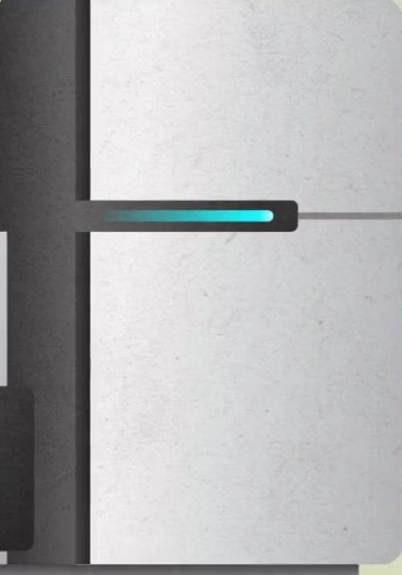

Problems with Data Analysis Today
Special-Purpose Machine
for Data Generation
General-Purpose Machine
for Data Analysis
FAST SLOW
Slow and inefficient processing capability
Large amounts of data movement
Notes:
On the left, we have a special-purpose machine, extremely efficient at generating data at rapid speeds.
However, this brings us to a significant challenge. The data generated needs to be analyzed. And for that, we often rely on general-purpose machines.
These machines, while versatile, often face bottlenecks due to large amounts of data movement, leading to slow and energy-inefficient processing.
This inefficiency becomes a critical roadblock when timely and efficient data analysis is needed.
Today, we are generating data faster than the speed that the transistors become much less costly
We need to process this data intelligently.

Slide 11
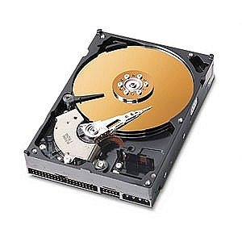
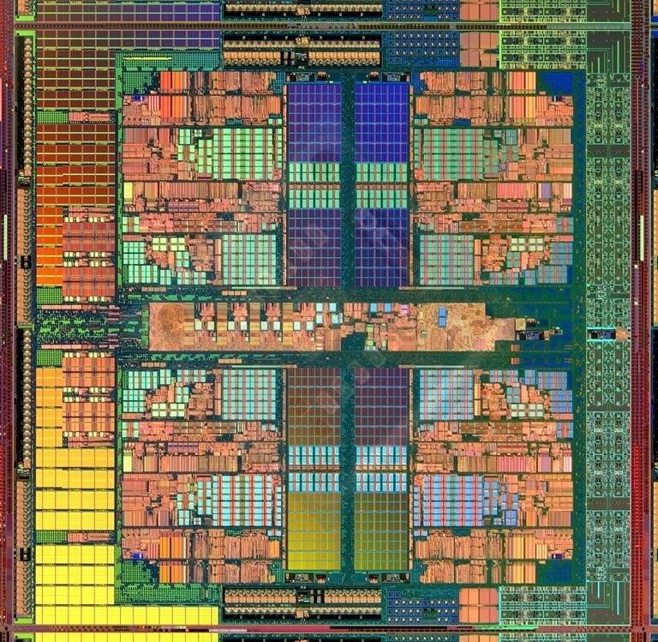
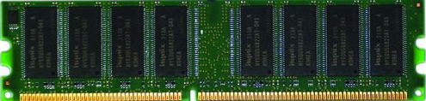
Data Movement Dominates Performance
Data movement dominates performance and is a major system energy bottleneck (accounting for 40%-62%)
Data Movement
Sequencing
Machine
Storage (SSD/HDD)
Main Memory
Microprocessor
Single memory request consumes >160x-800x more energy compared to performing an addition operation
✻ Boroumand et al., “Google Workloads for Consumer Devices: Mitigating Data Movement Bottlenecks,” ASPLOS 2018
★ Kestor et al., “Quantifying the Energy Cost of Data Movement in Scientific Applications,” IISWC 2013
☆ Pandiyan and Wu, “Quantifying the energy cost of data movement for emerging smart phone workloads on mobile platforms,” IISWC 2014
Notes:
Today, data movement dominates the performance because large chunks of data need to be stored in storage systems and
[CLICK]
moved between the CPU and main memory for genome analysis.
The CPU accesses off-chip main memory through a pin-limited bus known as the memory channel,
[CLICK]
and a high amount of data movement across the memory channel is extremely costly in terms of both execution time and energy.

Slide 12
We need intelligent algorithms and intelligent architectures
that handle data well
Notes:
Thus we need both intelligent algorithms that minimize the redundant computations without sacrificing from accuracy and intelligent architectures that are best suitable for the intelligent algorithms for fast and accurate genome analysis.

Slide 13
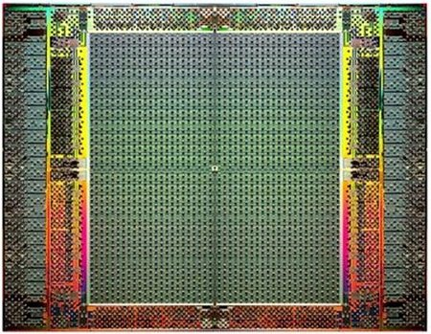
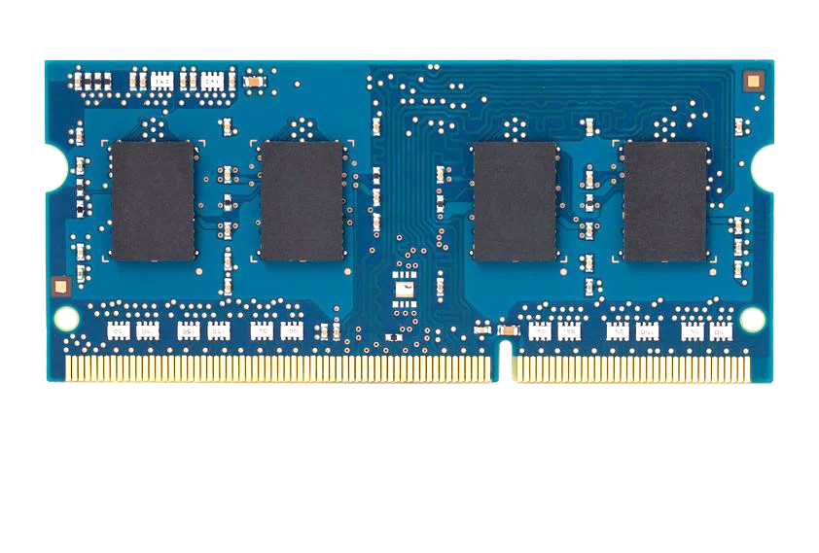
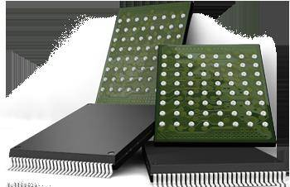
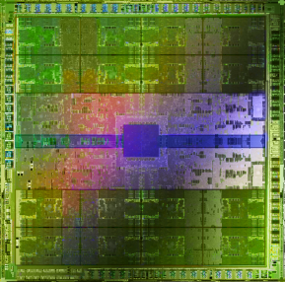
Pushing Towards New Architectures
FPGAs
Modern systems
?
Sequencing
Machine
Hybrid Main Memory
Heterogeneous
Processors and
Accelerators
Persistent Memory/Storage
(General Purpose) GPUs
Notes:
We need to think out of the box here

Slide 14
Pushing Towards New Architectures
FPGAs
Modern systems
?
Sequencing
Machine
Hybrid Main Memory
Heterogeneous
Processors and
Accelerators
Persistent Memory/Storage
(General Purpose) GPUs
https://nanoporetech.com/products/smidgion

Slide 15
Algorithm-Arch-Device Co-Design is Critical
Problem
Algorithm
Program/Language
System Software
Computer Architecture (expanded view)
SW/HW Interface
Micro-architecture
Logic
Devices
Electrons

Slide 16
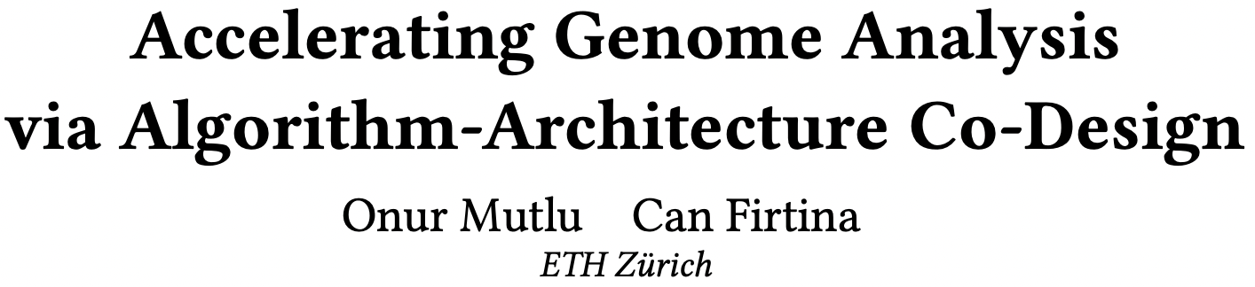
Accelerating Genome Analysis [DAC 2023]
Onur Mutlu and Can Firtina, "Accelerating Genome Analysis via Algorithm-Architecture Co-Design" Invited Special Session Paper in Proceedings of the 60th Design Automation Conference (DAC), San Francisco, CA, USA, July 2023. [Slides (pptx) (pdf)] [Talk Video (38 minutes, including Q&A)] [Related Invited Paper] [arXiv version]
https://ieeexplore.ieee.org/document/10247887

Slide 17
Many opportunities exist with the improvements in sequencing technologies
and emerging hardware

Slide 18
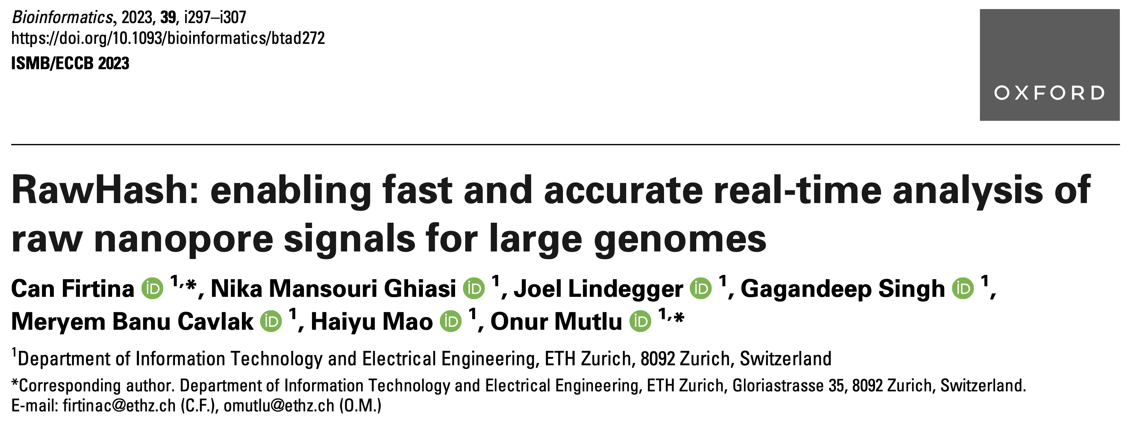
New Frontiers: Raw Signal Analysis [ISMB 2023]
Can Firtina, Nika Mansouri Ghiasi, Joel Lindegger, Gagandeep Singh, Meryem Banu Cavlak, Haiyu Mao, and Onur Mutlu, "RawHash: Enabling Fast and Accurate Real-Time Analysis of Raw Nanopore Signals for Large Genomes" Proceedings of the 31st Annual Conference on Intelligent Systems for Molecular Biology (ISMB) and the 22nd European Conference on Computational Biology (ECCB), Jul 2023 [Bioinformatics Journal version] [Slides (pptx) (pdf)] [RawHash Source Code]

Slide 19
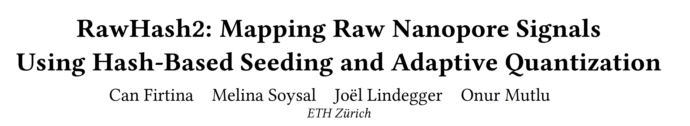
Fast and Accurate Real-Time Genome Analysis
Can Firtina, Melina Soysal, Joel Lindegger, and Onur Mutlu, "RawHash2: Mapping Raw Nanopore Signals Using Hash-Based Seeding and Adaptive Quantization" Preprint on arXiv, September 2023. [arXiv version] [RawHash2 Source Code]

Slide 20
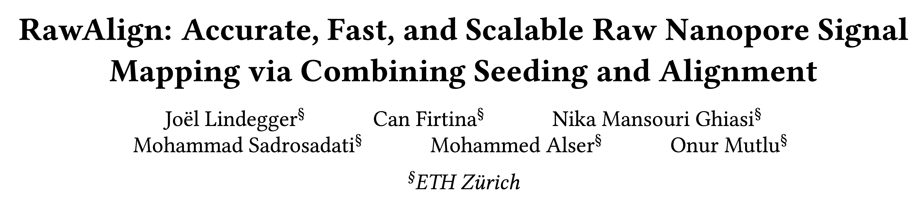
Fast and Accurate Real-Time Genome Analysis
Joel Lindegger, Can Firtina, Nika Mansouri Ghiasi, Mohammad Sadrosadati, Mohammed Alser, and Onur Mutlu, "RawAlign: Accurate, Fast, and Scalable Raw Nanopore Signal Mapping via Combining Seeding and Alignment" Preprint on arXiv, October 2023. [arXiv version] [RawAlign Source Code]

Slide 21
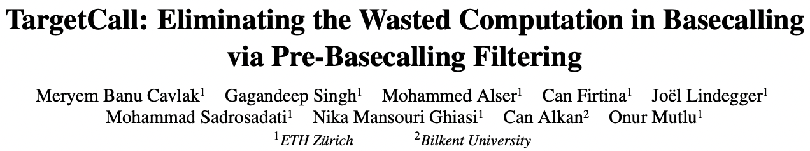
Machine Learning in Genomics
M. Banu Cavlak, Gagandeep Singh, Mohammed Alser, Can Firtina, Joel Lindegger, Mohammad Sadrosadati, Nika Mansouri Ghiasi, Can Alkan, and Onur Mutlu, "TargetCall: Eliminating the Wasted Computation in Basecalling via Pre-Basecalling Filtering" Proceedings of the 21st Asia Pacific Bioinformatics Conference (APBC), Changsha, China, April 2023. [TargetCall Source Code] [arxiv.org Version] [Talk Video at BIO-Arch 2023 Workshop]
https://arxiv.org/pdf/2301.09200.pdf

Slide 22
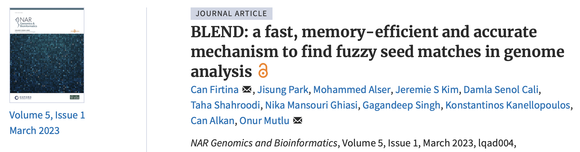
Genome Similarity Identification [NARGAB 2023]
Can Firtina, Jisung Park, Mohammed Alser, Jeremie S. Kim, Damla Senol Cali, Taha Shahroodi, Nika Mansouri Ghiasi, Gagandeep Singh, Konstantinos Kanellopoulos, Can Alkan, and Onur Mutlu, "BLEND: A Fast, Memory-Efficient, and Accurate Mechanism to Find Fuzzy Seed Matches in Genome Analysis" NAR Genomics and Bioinformatics, March 2023. [Online link at NAR Genomics and Bioinformatics Journal] [arXiv preprint] [biorXiv preprint] [BLEND Source Code]

Slide 23
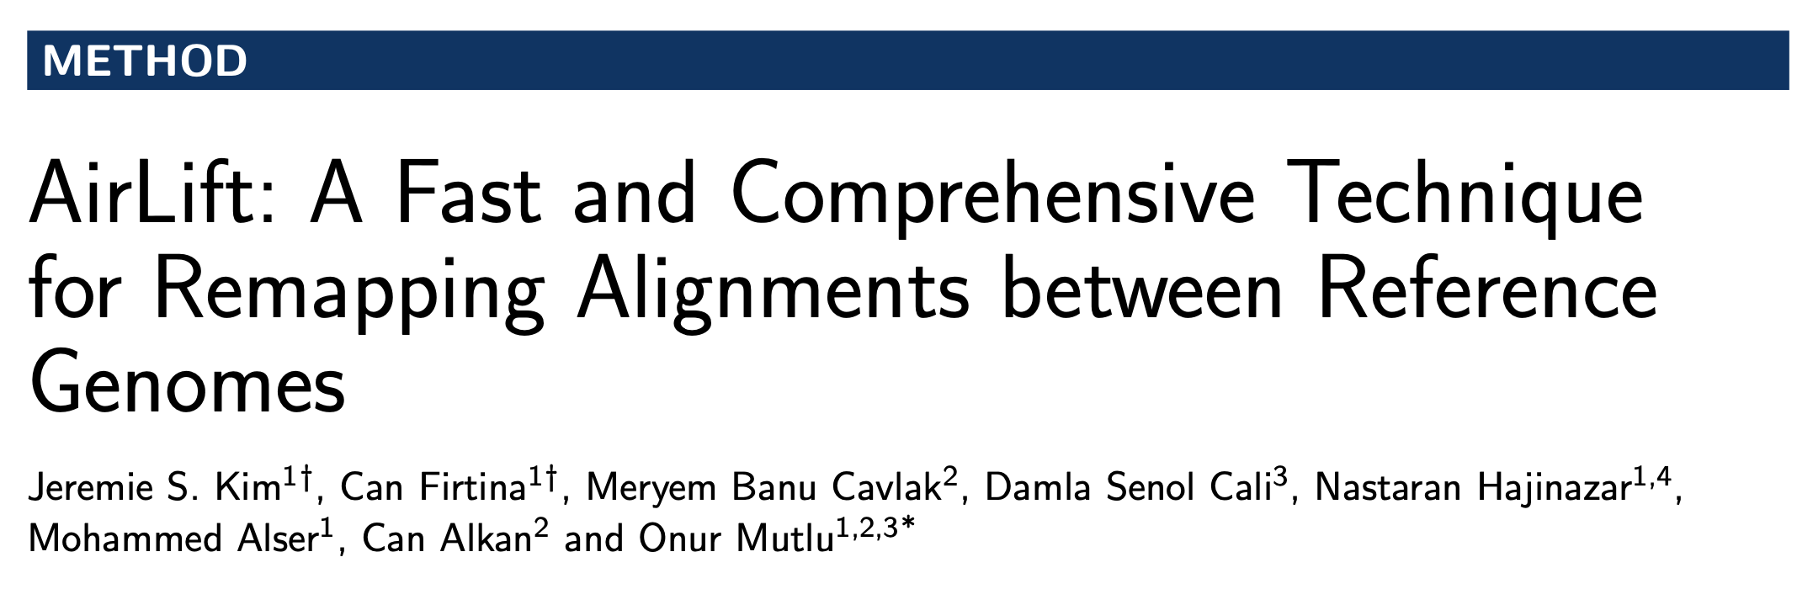
New Applications: Frequent Database Updates
Jeremie S. Kim*, Can Firtina*, M. Banu Cavlak, Damla Senol Cali, Nastaran Hajinazar, Mohammed Alser, Can Alkan, and Onur Mutlu, "AirLift: A Fast and Comprehensive Technique for Remapping Alignments between Reference Genomes" Proceedings of the 21st Asia Pacific Bioinformatics Conference (APBC), Changsha, China, April 2023. [AirLift Source Code] [arxiv.org Version (pdf)] [Talk Video at BIO-Arch 2023 Workshop]
*Equal contribution

Slide 24
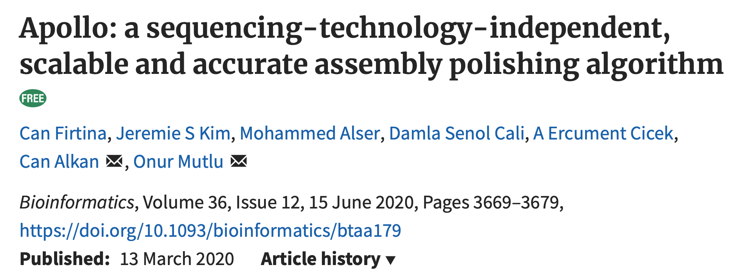
Error Correction using ML [Bioinform. 2020]
Can Firtina, Jeremie S. Kim, Mohammed Alser, Damla Senol Cali, A. Ercument Cicek, Can Alkan, and Onur Mutlu, "Apollo: A Sequencing-Technology-Independent, Scalable, and Accurate Assembly Polishing Algorithm" Bioinformatics, June 2020. [Source Code] [Online link at Bioinformatics Journal]
Notes:
Apollo is a mechanism for correcting errors in genome assemblies using a machine learning technique. It was published in the Bioinformatics journal in 2020.

Slide 25
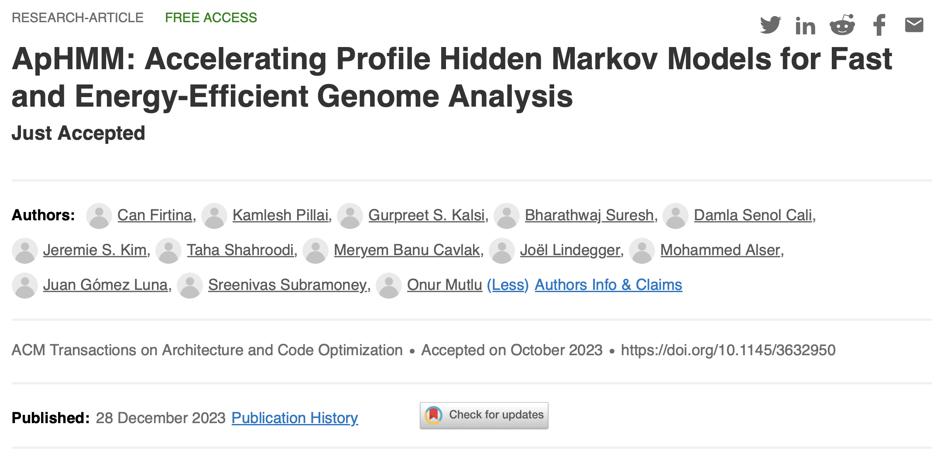
Accelerating ML & Genome Graphs [ACM TACO ‘24]
Can Firtina, Kamlesh Pillai, Gurpreet S. Kalsi, Bharathwaj Suresh, Damla Senol Cali, Jeremie S. Kim, Taha Shahroodi, Meryem Banu Cavlak, Joël Lindegger, Mohammed Alser, Juan Gómez Luna, Sreenivas Subramoney, and Onur Mutlu, "ApHMM: Accelerating Profile Hidden Markov Models for Fast and Energy-Efficient Genome Analysis” ACM TACO, Feb 2024. [Online link at ACM TACO] [arXiv preprint] [ApHMM Source Code]

Slide 26
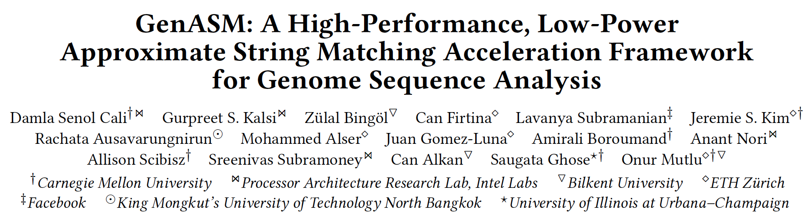
Accelerating String Matching [MICRO 2020]
Damla Senol Cali, Gurpreet S. Kalsi, Zulal Bingol, Can Firtina, Lavanya Subramanian, Jeremie S. Kim, Rachata Ausavarungnirun, Mohammed Alser, Juan Gomez-Luna, Amirali Boroumand, Anant Nori, Allison Scibisz, Sreenivas Subramoney, Can Alkan, Saugata Ghose, and Onur Mutlu, "GenASM: A High-Performance, Low-Power Approximate String Matching Acceleration Framework for Genome Sequence Analysis" Proceedings of the 53rd International Symposium on Microarchitecture (MICRO), Virtual, October 2020. [Lightning Talk Video (1.5 minutes)] [Lightning Talk Slides (pptx) (pdf)] [Talk Video (18 minutes)] [Slides (pptx) (pdf)]

Slide 27
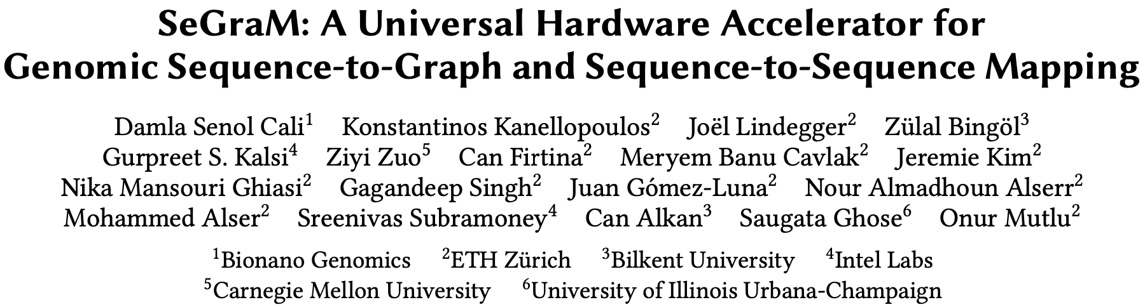
Accelerating Genome Graphs [ISCA 2022]
Damla Senol Cali, Konstantinos Kanellopoulos, Joel Lindegger, Zulal Bingol, Gurpreet S. Kalsi, Ziyi Zuo, Can Firtina, Meryem Banu Cavlak, Jeremie Kim, Nika MansouriGhiasi, Gagandeep Singh, Juan Gomez-Luna, Nour Almadhoun Alserr, Mohammed Alser, Sreenivas Subramoney, Can Alkan, Saugata Ghose, and Onur Mutlu, "SeGraM: A Universal Hardware Accelerator for Genomic Sequence-to-Graph and Sequence-to-Sequence Mapping" Proceedings of the 49th International Symposium on Computer Architecture (ISCA), New York, June 2022. [arXiv version]
https://arxiv.org/pdf/2205.05883.pdf

Slide 28
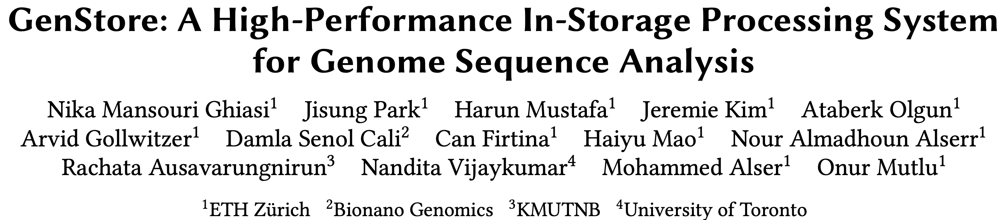
In-Storage Genome Filtering [ASPLOS 2022]
Nika Mansouri Ghiasi, Jisung Park, Harun Mustafa, Jeremie Kim, Ataberk Olgun, Arvid Gollwitzer, Damla Senol Cali, Can Firtina, Haiyu Mao, Nour Almadhoun Alserr, Rachata Ausavarungnirun, Nandita Vijaykumar, Mohammed Alser, and Onur Mutlu, "GenStore: A High-Performance and Energy-Efficient In-Storage Computing System for Genome Sequence Analysis" Proceedings of the 27th International Conference on Architectural Support for Programming Languages and Operating Systems (ASPLOS), Virtual, February-March 2022. [Lightning Talk Slides (pptx) (pdf)] [Lightning Talk Video (90 seconds)]

Slide 29
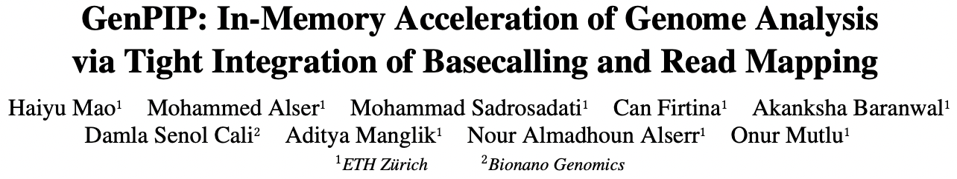
Genome Analysis via PIM [MICRO 2022]
Haiyu Mao, Mohammed Alser, Mohammad Sadrosadati, Can Firtina, Akanksha Baranwal, Damla Senol Cali, Aditya Manglik, Nour Almadhoun Alserr, and Onur Mutlu, "GenPIP: In-Memory Acceleration of Genome Analysis via Tight Integration of Basecalling and Read Mapping" Proceedings of the 55th International Symposium on Microarchitecture (MICRO), Chicago, IL, USA, October 2022. [Slides (pptx) (pdf)] [Longer Lecture Slides (pptx) (pdf)] [Lecture Video (25 minutes)] [arXiv version]
https://arxiv.org/pdf/2209.08600.pdf

Slide 30
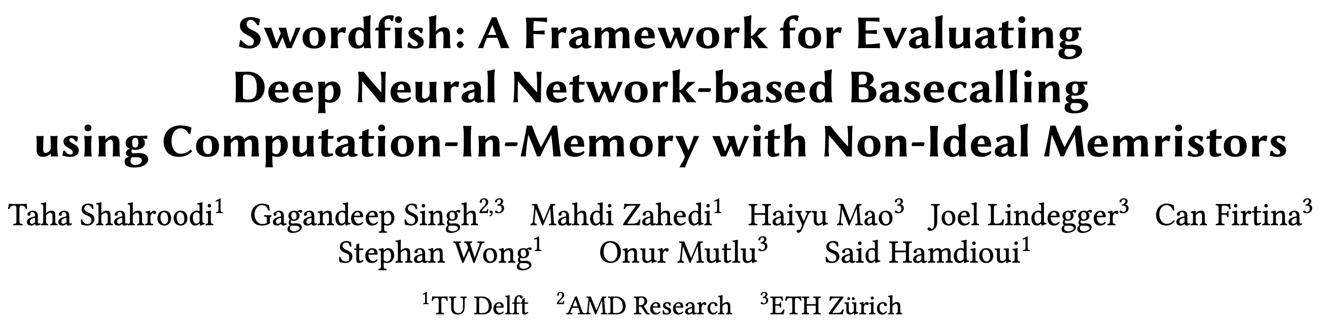
Basecalling using PIM [MICRO 2023]
Taha Shahroodi, Gagandeep Singh, Mahdi Zahedi, Haiyu Mao, Joel Lindegger, Can Firtina, Stephan Wong, Onur Mutlu, and Said Hamdioui, "Swordfish: A Framework for Evaluating Deep Neural Network-based Basecalling using Computation-In-Memory with Non-Ideal Memristors" Proceedings of the 56th International Symposium on Microarchitecture (MICRO), Toronto, ON, Canada, November 2023. [Slides (pptx) (pdf)] [arXiv version]

Slide 31
Accelerating Genome Analysis [DAC 2023]
Onur Mutlu and Can Firtina, "Accelerating Genome Analysis via Algorithm-Architecture Co-Design" Invited Special Session Paper in Proceedings of the 60th Design Automation Conference (DAC), San Francisco, CA, USA, July 2023. [Slides (pptx) (pdf)] [Talk Video (38 minutes, including Q&A)] [Related Invited Paper] [arXiv version]
https://ieeexplore.ieee.org/document/10247887

Slide 32
Agenda for Today
Cutting-edge in Accelerating Genome Analysis
Enabling Fast and Accurate Sequence Analysis
Real-Time Analysis Nanopore Raw Signal Analysis
Fuzzy seed matching for accurate sequence analysis
Conclusion

Slide 33

ISMB/ECCB 2023
RawHash
Enabling Fast and Accurate Real-Time Analysis
of Raw Nanopore Signals for Large Genomes
Can Firtina
Nika Mansouri Ghiasi |  | Joel Lindegger |  | Gagandeep Singh
Meryem Banu Cavlak |  | Haiyu Mao |  | Onur Mutlu
RawHash
RawHash2
Code

Slide 34
Outline
Background
Motivation and Goal
Experimental Methodology
Temperature Analysis
Aggressor Row Active Time Analysis
Spatial Variation Analysis
Implications on Attacks and Defenses
Conclusions
RawHash
RawHash2
Evaluation
Conclusion

Slide 35
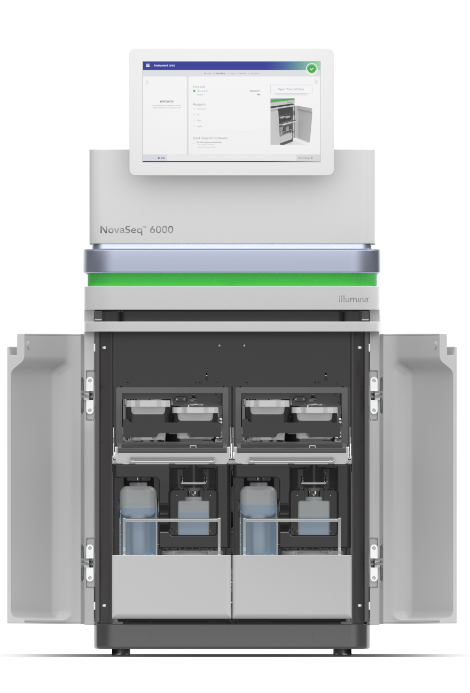
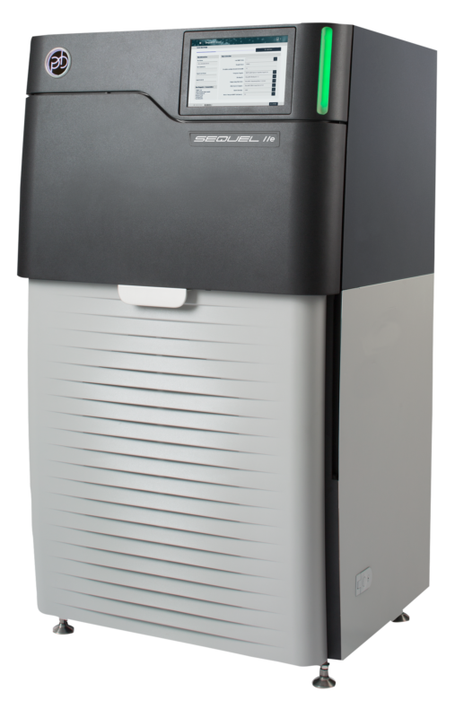
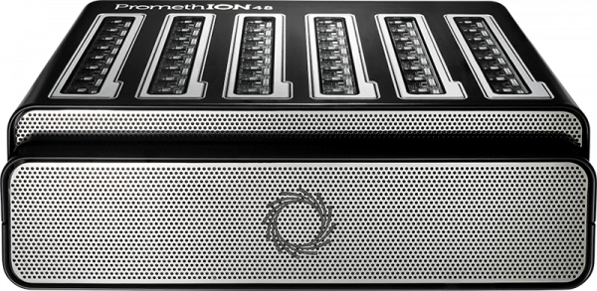
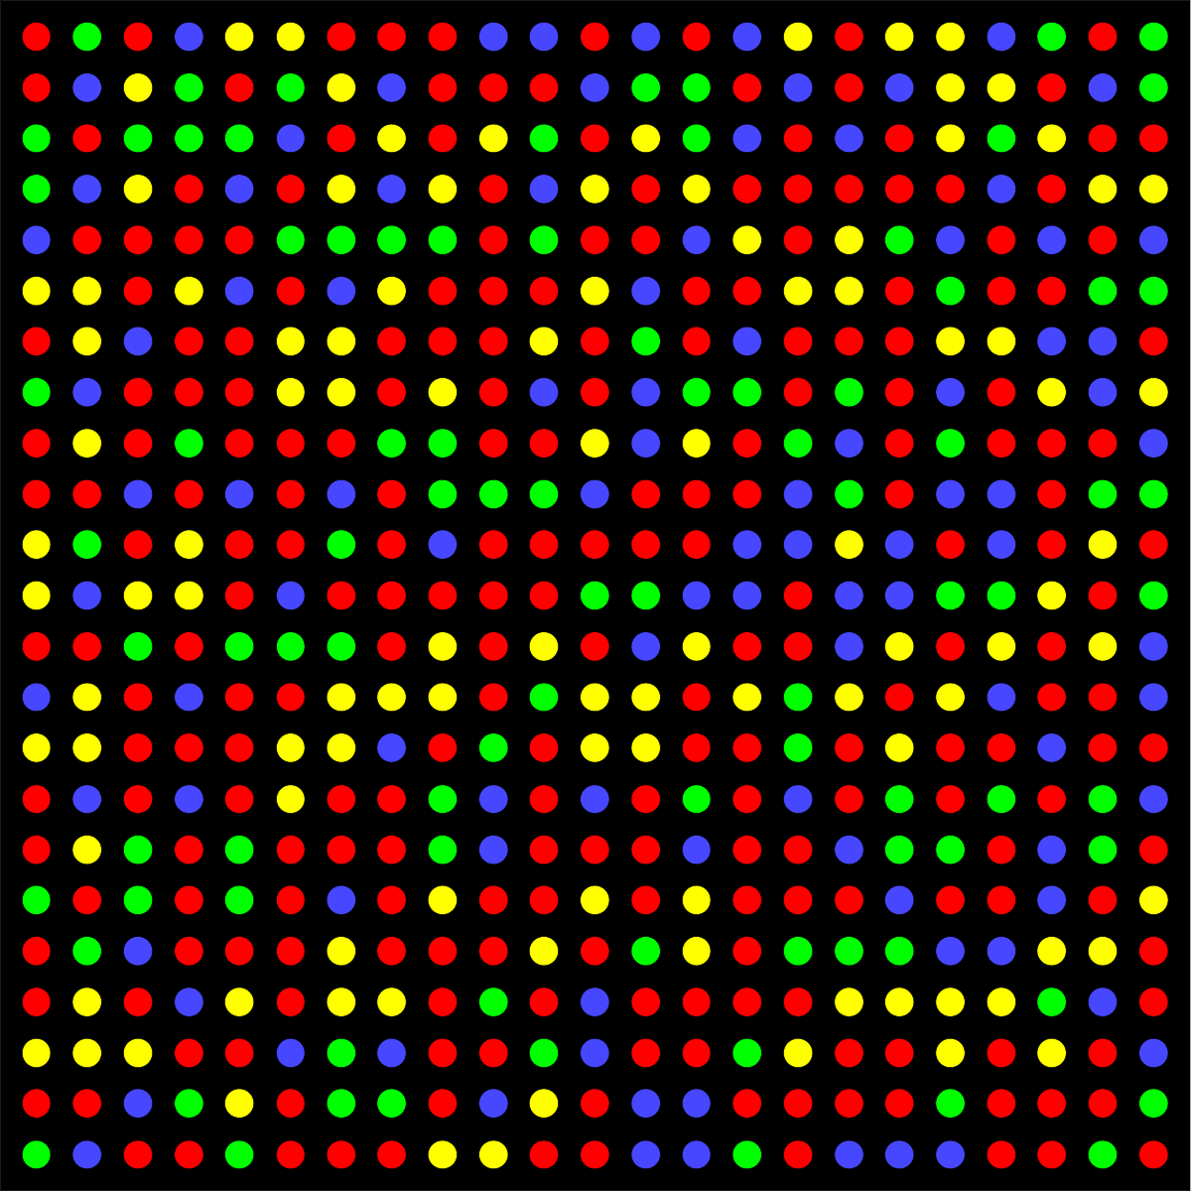


Different Raw Sequencing Data
Illumina
Nanopore
PacBio
Multiple images
Electrical Signal
30-hour movie
.BCL/.CBCL
.POD5
.BAM

Slide 36
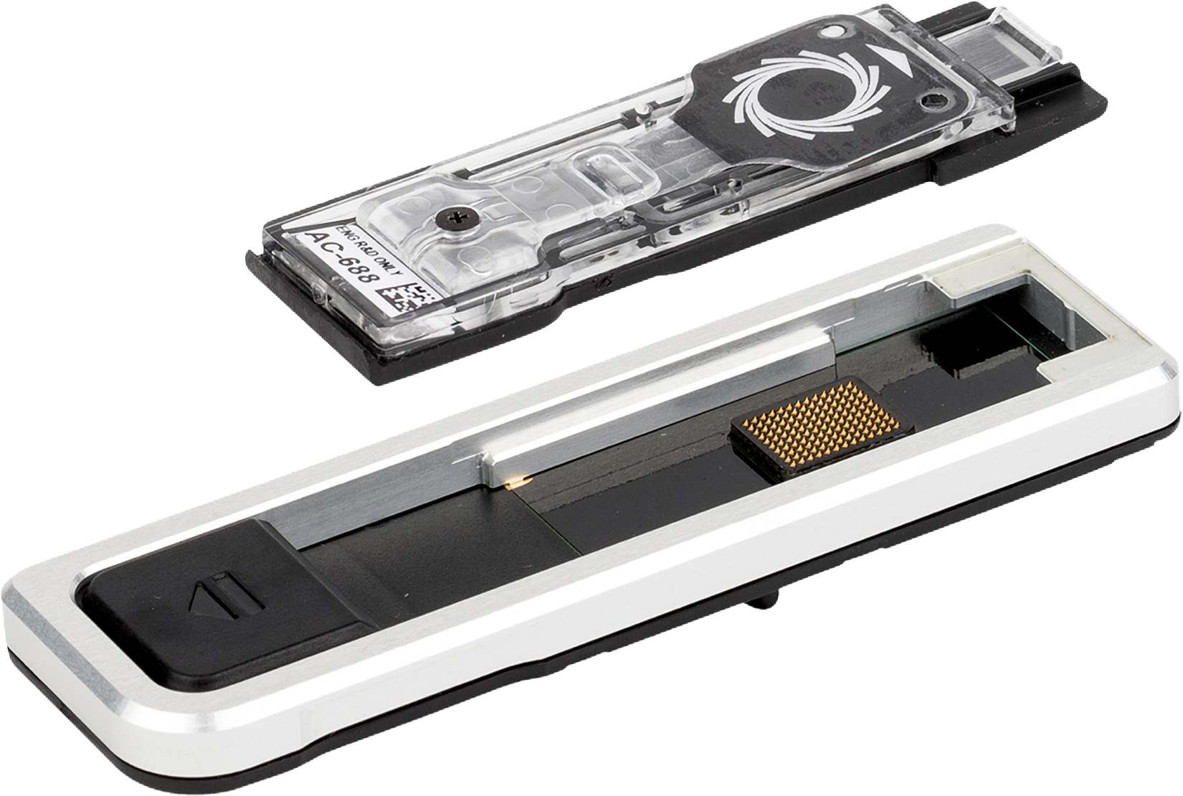
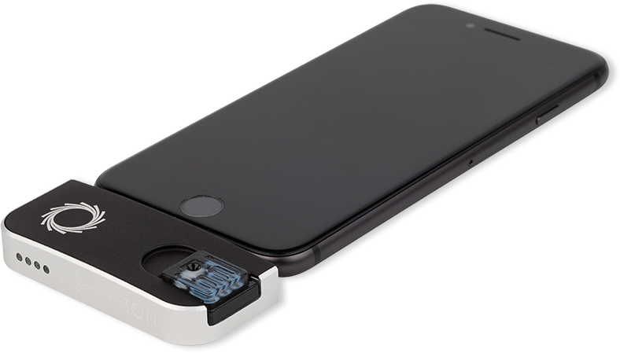
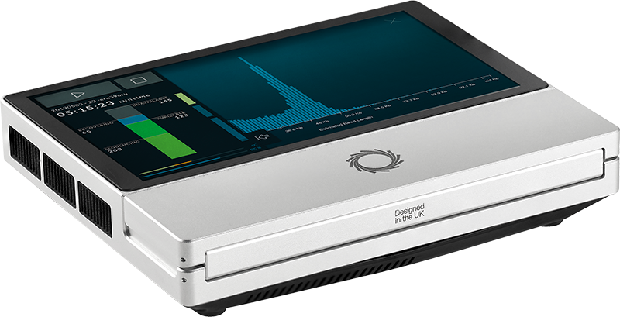
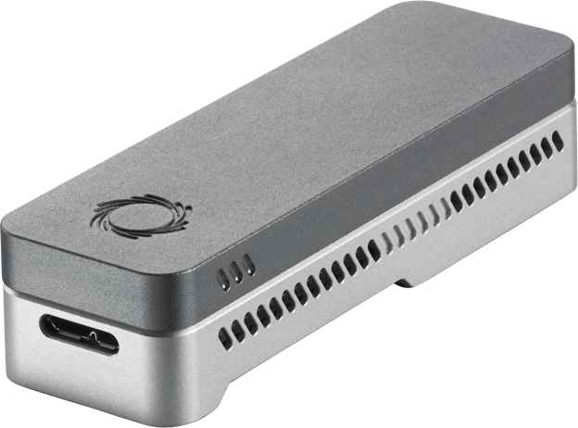
Nanopore Sequencing
Nanopore Sequencing: a widely used sequencing technology
Long reads (up to >2 million nucleotides)
Portable sequencing
Cost-effective
More unique features: real-time analysis

Slide 37


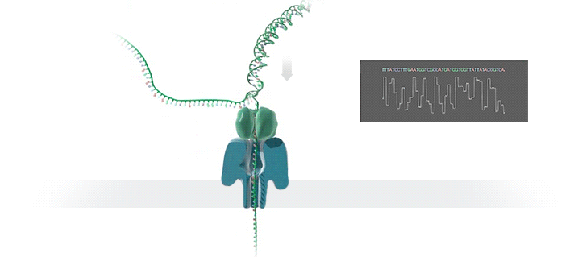



Nanopore Sequencing & Real-time Analysis
Nanopore Sequencing
Raw Electrical Signals
(Real-Time) Analysis
Basecalling:
CTAGATG…
Current
Basecalled Read
Raw Signals: Ionic current measurements generated as DNA passes through the nanopore at a certain speed
(Real-Time) Analysis: Translating to bases or directly analyzing raw signals
Real-Time Decisions: Stopping sequencing early based on real-time analysis

Slide 38

Benefits of Real-Time Analysis
Reducing latency by overlapping the sequencing and analysis steps
Time
Sequencing
Analysis
Reduced Latency
Sequencing & Real-Time Analysis
Reducing sequencing time and cost by stopping sequencing early
Completely Sequenced Read
Reduced Sequencing Time (and Cost)
Partially Sequenced Read
Sequencing is stopped early with a real-time decision

Slide 39




Challenges in Real-Time Analysis
Rapid analysis to match the nanopore sequencer throughput
Timely decisions to stop sequencing as early as possible
Accurate analysis from noisy raw signal data
Power-efficient computation for scalability and portability

Slide 40
Outline
Background
Motivation and Goal
Experimental Methodology
Temperature Analysis
Aggressor Row Active Time Analysis
Spatial Variation Analysis
Implications on Attacks and Defenses
Conclusions
RawHash
RawHash2
Evaluation
Conclusion

Slide 41
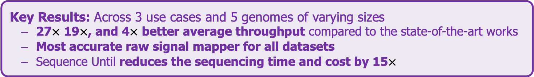
Executive Summary
Problem: Real-time analysis of nanopore raw signals is inaccurate and slow for large genomes
Goal: Enable fast and accurate real-time analysis of raw nanopore signals
Key Contributions:
1) The first hash-based mechanism for mapping raw nanopore signals
2) The novel Sequence Until technique can accurately and dynamically stop the entire sequencing of all reads at once if further sequencing is not necessary
Key Results: Across 3 use cases and 5 genomes of varying sizes
27$×$ 19$×$, and 4$×$ better average throughput compared to the state-of-the-art works
Most accurate raw signal mapper for all datasets
Sequence Until reduces the sequencing time and cost by 15$×$

Slide 42
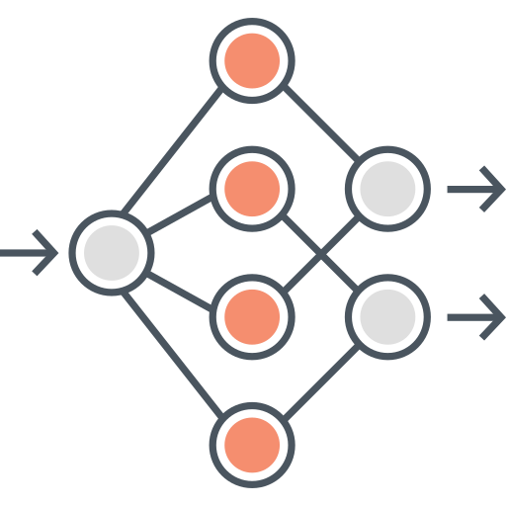

Existing Solutions
Deep neural networks (DNNs) for translating signals to bases
Mapping signals to reference genomes without basecalling
Real-Time Analysis
Real-Time Analysis
Basecalling
Read Mapping
Mapping Raw Signals
A
T
G
G
Less noisy analysis from basecalled sequences
Raw signals contain richer information than bases
Costly and power-hungry computational requirements
Efficient analysis with better scalability and portability

Slide 43
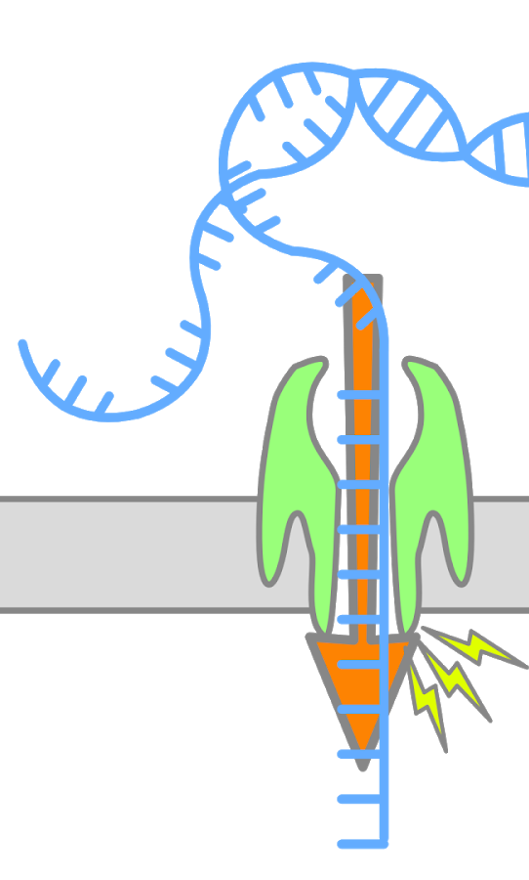
Enabling Analysis From Electrical Signals
K many nucleotides (k-mers) sequenced at a time
Event: A segment of the raw signal
Corresponds to a particular k-mer
Abrupt signal changes show sequencing of a new k-mer
Statistical methods can find these abrupt changes
Event value: average of signals within an event
Observation: Identical k-mers generate similar event values during sequencing
Event
ACTTGG
pAmpere
ACTTGG
k many nucleotides
105.71
Time (s)
Event Value

Slide 44
The Problem – Mapping Raw Signals
Raw Signal
Small Reference Genome
Large Reference Genome (Human)
Fewer candidate regions in small genomes
Substantially larger number of regions to check per read as the genome size increases
Problem: Probabilistic mechanisms
on many regions ➔ inaccurate mapping
Accurate mapping
Problem: Distance calculation
on many regions ➔ reduced throughput
High throughput

Slide 45
The Problem – Mapping Raw Signals
Raw Signal
Existing solutions are
inaccurate or inefficient
for large genomes
Small Reference Genome
Large Reference Genome (Human)
Fewer candidate regions in small genomes
Substantially larger number of regions to check per read as the genome size increases
Problem: Probabilistic mechanisms
on many regions ➔ inaccurate mapping
Accurate mapping
Problem: Distance calculation
on many regions ➔ reduced throughput
High throughput

Slide 46
Goal
Enable fast and accurate real-time analysis
of raw nanopore signals for large genomes

Slide 47
RawHash
The first hash-based search mechanism to quickly and accurately map raw nanopore signals to reference genomes
Sequence Until can accurately and dynamically stop the entire sequencing run at once
if further sequencing is unnecessary

Slide 48
RawHash
The first hash-based search mechanism to quickly and accurately map raw nanopore signals to reference genomes
Sequence Until can accurately and dynamically stop the entire sequencing run at once
if further sequencing is unnecessary

Slide 49
RawHash – Key Idea
Key Observation: Identical nucleotides generate similar raw signals
Raw Signal #1
Distance Calculation
Raw Signal #2
Hash
Hash
Fast Match
0x01
0x01
Challenge #1: Generating the same hash value for similar enough signals
Challenge #2: Accurately finding as few similar regions as possible

Slide 50
RawHash Overview
Reference Genome
Raw Nanopore Signal
…GCTATTACCTTAATGTG…
Reference-to-Event Conversion
Signal-to-Event Conversion
2.21
-0.9
1.15
2.22
-0.91
1.18
Indexing (Offline)
Quantization
Quantization
Mapping (Real-Time)
28
6
18
28
6
18
Hashing
Hashing
Store
Hash Table
Query
0x01
0x01
Matching Regions
Chaining & Mapping
Mapping Positions

Slide 51
RawHash Overview
Reference Genome
Raw Nanopore Signal
…GCTATTACCTTAATGTG…
Reference-to-Event Conversion
Signal-to-Event Conversion
2.21
-0.9
1.15
2.22
-0.91
1.18

Slide 52
Reference-to-Event Conversion
K-mer model: Provides expected event values for each k-mer
Preconstructed based on nanopore sequencer characteristics
Use the k-mer model to convert all k-mers of a reference genome to their expected event values
Reference Genome
Expected Event Values
Normalized Event Values
..GCTATTACC..
GCTATT
K-mer Model
(Lookup Table)
105.757390
Normalize
2.21
CTATTA
81.740642
-0.09
k-mers ($k=6$)
TATTAC
103.170091
1.15
ATTACC
101.082485
1.11

Slide 53
Signal-to-Event Conversion
Event detection: Identifies signal regions corresponding to specific k-mers
Uses statistical test (segmentation) to spot abrupt signal changes
Consecutive events ➔ consecutive k-mers
Raw Nanopore Signal
Event
Event Value
Normalize
2.21
Segment
Calculate
Means
105.71
0.08
1.18
1.14

Slide 54
Signal-to-Event Conversion
Event detection: Identifies signal regions corresponding to specific k-mers
Uses statistical test (segmentation) to spot abrupt signal changes
Consecutive events ➔ consecutive k-mers
Can we directly match signals to each other?
Raw Nanopore Signal
Event
Event Value
Normalize
2.21
Segment
Calculate
Means
105.71
0.08
1.18
1.14

Slide 55
RawHash Overview
Reference Genome
Raw Nanopore Signal
…GCTATTACCTTAATGTG…
Reference-to-Event Conversion
Signal-to-Event Conversion
2.21
-0.9
1.15
2.22
-0.91
1.18
Quantization
Quantization
28
6
18
28
6
18

Slide 56
Quantizing the Event Values
Observation: Slight differences in raw signals from identical k-mers
Challenge: Direct event value matching is not feasible and accurate
Key Idea: Quantize the event values
Enables assigning identical quantized values to similar event values
Normalized event values from the same k-mer
Quantized event values (in binary)
-0.091
Quantize
1
1
0
0
1
-0.084
Quantize
1
1
0
0
1
CTATTA
-0.09
Quantize
1
1
0
0
1
-0.086
Quantize
1
1
0
0
1

Slide 57
RawHash Overview
Reference Genome
Nanopore Raw Signal
…GCTATTACCTTAATGTG…
Reference-to-Event Conversion
Signal-to-Event Conversion
2.21
-0.9
1.15
2.22
-0.91
1.18
Quantization
Quantization
28
6
18
28
6
18
Hashing
Hashing
Store
Hash Table
Query
0x01
0x01

Slide 58
Hashing for Fast Similarity Search
Each event usually represents a very small k-mer (6 to 9 characters)
Challenge: Short k-mers are likely to appear in many locations
Key Idea: Create longer k-mers from many consecutive events
Key Benefit: Directly match hash values to quickly identify similarities
Consecutive k-mers
Consecutive events
CTATTA
-0.09
Quantize
1
1
0
0
1
TATTAC
1.15
Quantize
0
0
1
1
0
…
…
…
…
Pack
ATTACC
1.11
Quantize
0
0
1
0
1
1
1
0
0
1
0
0
1
1
0
…
0
1
0
0
1
Hash value of consecutive events
0x400D70A4
Hash

Slide 59
RawHash Overview
Reference Genome
Raw Nanopore Signal
…GCTATTACCTTAATGTG…
Reference-to-Event Conversion
Signal-to-Event Conversion
2.21
-0.9
1.15
2.22
-0.91
1.18
Indexing (Offline)
Quantization
Quantization
Mapping (Real-Time)
28
6
18
28
6
18
Hashing
Hashing
Store
Hash Table
Query
0x01
0x01
Matching Regions
Chaining & Mapping
Mapping Positions

Slide 60
The Chaining Algorithm
Exact hash value matches: Needed for finding matching regions between a reference genome and a read
What if there are mutations or errors?
No hash (seed) match will occur in such positions
The chaining algorithm links exact matches in a proximity even though there are gaps (no seed matches) between them

Slide 61
Real-Time Mapping using Hash-based Indexing
Indexing (Offline)
Mapping (Real-time)
Reference Genome
Raw Nanopore Signal
…GCTATTACCTTAATGTG…
Reference-to-Event Conversion
Signal-to-Event Conversion
Quantization
Quantization
Hashing
Hashing
Store
Hash Table
Query
0x01
0x01
Matching Positions
Chaining & Mapping
Yes: Process the next chunk
Read Until
or
Run Until
No: Stop mapping
Continue
Mapping?

Slide 62
RawHash
The first hash-based search mechanism to quickly and accurately map raw nanopore signals to reference genomes
Sequence Until can accurately and dynamically stop the entire sequencing run at once
if further sequencing is unnecessary

Slide 63
RawHash
The first hash-based search mechanism to quickly and accurately map raw nanopore signals to reference genomes
Sequence Until can accurately and dynamically stop the entire sequencing run at once
if further sequencing is unnecessary

Slide 64
Outline
Background
Motivation and Goal
Experimental Methodology
Temperature Analysis
Aggressor Row Active Time Analysis
Spatial Variation Analysis
Implications on Attacks and Defenses
Conclusions
RawHash
RawHash2
Evaluation
Conclusion

Slide 65
Key Contributions in RawHash2
A new adaptive quantization to better fit the expected nanopore signal pattern to achieve high accuracy
Improved chaining algorithm with sensitive penalty scores
Weighted decision making for more robust mapping
Frequency filter and minimizer sketching to reduce seed matches for faster and space-efficient mapping

Slide 66
Sketching with Hash-based Indexing
Indexing (Offline)
Mapping (Real-time)
Reference Genome
Raw Nanopore Signal
…GCTATTACCTTAATGTG…
Reference-to-Event Conversion
Signal-to-Event Conversion
Quantization
Quantization
Hashing
Hashing
All k-mers,
Minimizers,
Strobemers,
BLEND,
…
Sketch
Sketch
Store
Hash Table
Query
0x01
0x01
Matching Positions
Chaining & Mapping
Yes: Process the next chunk
Read Until
or
Run Until
No: Stop mapping
Continue
Mapping?

Slide 67
Outline
Background
Motivation and Goal
Experimental Methodology
Temperature Analysis
Aggressor Row Active Time Analysis
Spatial Variation Analysis
Implications on Attacks and Defenses
Conclusions
RawHash
RawHash2
Evaluation
Conclusion

Slide 68
Evaluation Methodology
Two settings for RawHash2:
RawHash2: All hash values without sampling
RawHash2-Minimizer: Minimizer sketching
Compared to UNCALLED [Kovaka+, Nat. Biotech. '21], Sigmap [Zhang+, ISMB '21] and RawHash [Firtina+, ISMB '23]
Use cases for real-time genome analysis:
Read mapping
Relative abundance estimation
Contamination analysis

Slide 69
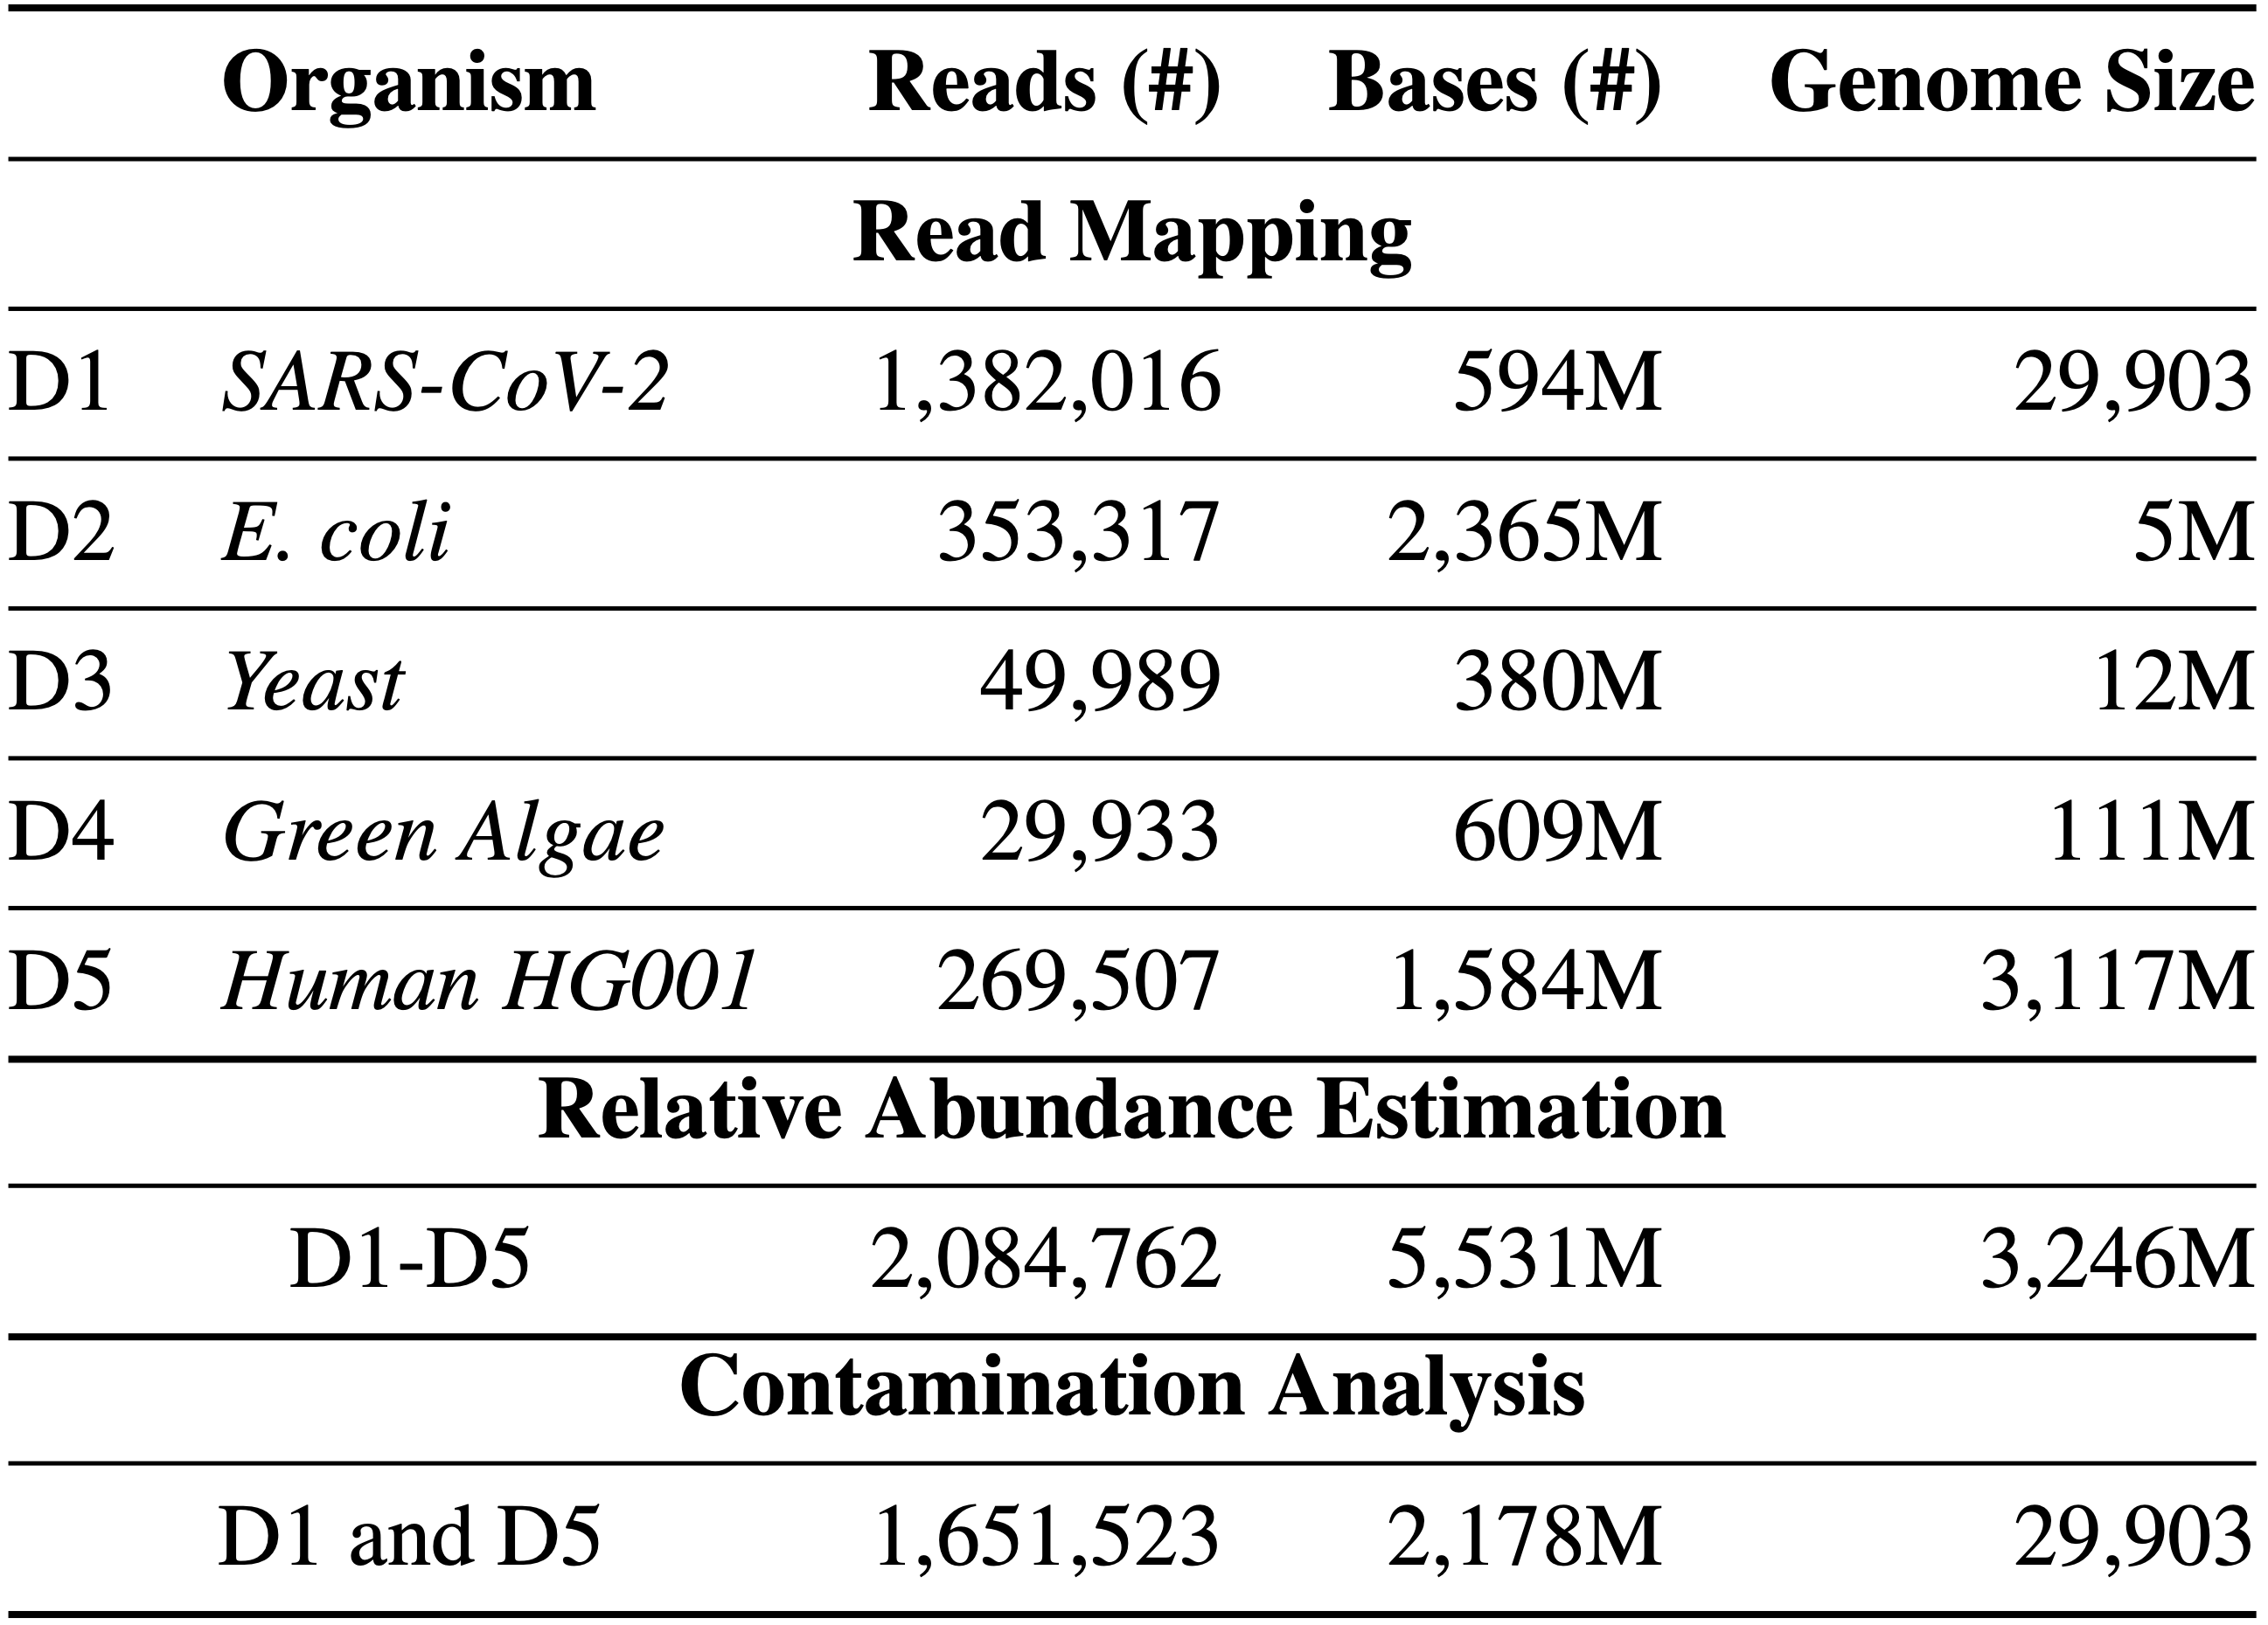
Evaluation Methodology
Evaluation metrics:
Throughput (bases processed per second per CPU thread)
Potential reduction in sequencing time and cost
Accuracy
Baseline: Mapping basecalled reads using minimap2
Precision, recall, and F1 scores
Relative abundance estimation distance to ground truth
Datasets:

Slide 70
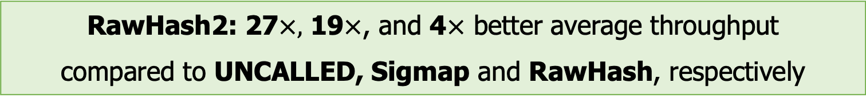
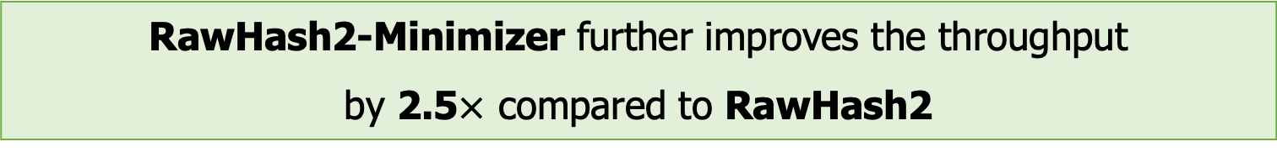
Throughput
Real-time analysis requires faster throughput than sequencer
Throughput from a single pore: ~450 bp/sec (data generation speed)
RawHash2: 27$×,$ 19$×$, and 4$×$ better average throughput compared to UNCALLED, Sigmap and RawHash, respectively
RawHash2-Minimizer further improves the throughput by 2.5$×$ compared to RawHash2

Slide 71
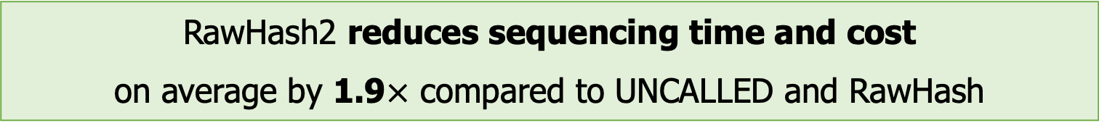
Average Sequenced Length
Fewer bases to sequence ➔ Less unnecessary sequencing
Lower is better
RawHash2 reduces sequencing time and cost
on average by 1.9$×$ compared to UNCALLED and RawHash
RawHash2 leads to sequencing the least amount of bases for larger genomes

Slide 72
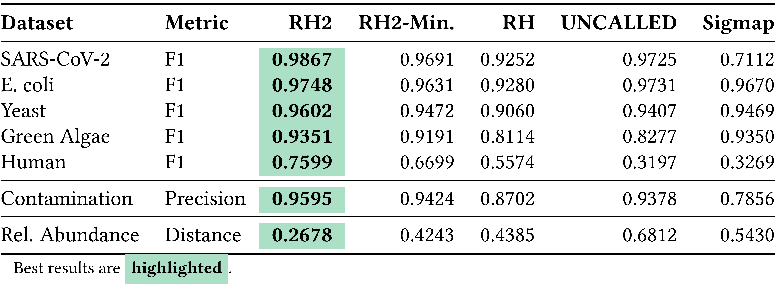
Accuracy
Read mapping, contamination, and relative abundance estimation accuracy (baseline: basecalled mapping)
RawHash2 provides the most accurate read mapping
RawHash2-Minimizer provides an on-par accuracy with RawHash2 while improving the throughput substantially

Slide 73
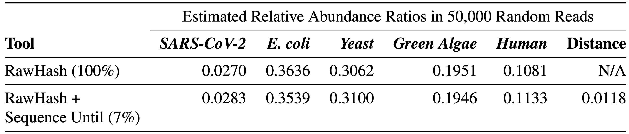
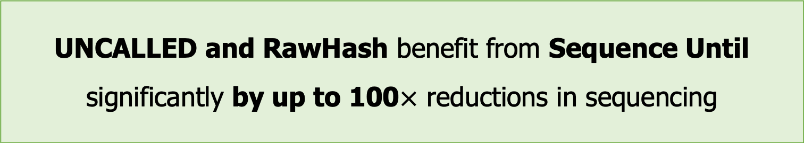
Benefits of Sequence Until
Running RawHash with and without Sequence Until
Sequence Until enables sequencing only 7% (~1/15) of the entire sample with high accuracy
UNCALLED and RawHash benefit from Sequence Until significantly by up to 100$×$ reductions in sequencing

Slide 74
Outline
Background
Motivation and Goal
Experimental Methodology
Temperature Analysis
Aggressor Row Active Time Analysis
Spatial Variation Analysis
Implications on Attacks and Defenses
Conclusions
RawHash
RawHash2
Evaluation
Conclusion

Slide 75
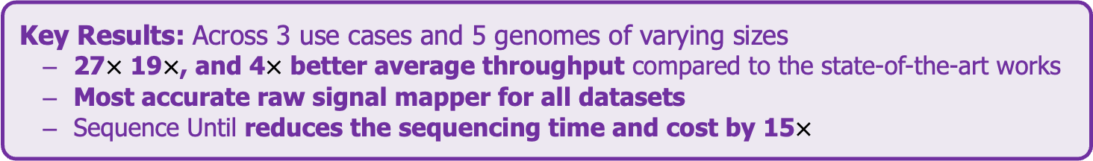
Conclusion
Key Contributions:
1) The first hash-based mechanism for mapping raw nanopore signals
2) The novel Sequence Until technique can accurately and dynamically stop the entire sequencing of all reads at once if further sequencing is not necessary
Key Results: Across 3 use cases and 5 genomes of varying sizes
27$×$ 19$×$, and 4$×$ better average throughput compared to the state-of-the-art works
Most accurate raw signal mapper for all datasets
Sequence Until reduces the sequencing time and cost by 15$×$
Many opportunities for analyzing raw nanopore signals in real-time:
Many hash-based sketching techniques can now be used for raw signals
Indexing is very cheap: Many future use cases with the on-the-fly index construction
We should rethink the algorithms to perform downstream analysis fully using raw signals

Slide 76
ISMB/ECCB 2023
RawHash
Enabling Fast and Accurate Real-Time Analysis
of Raw Nanopore Signals for Large Genomes
Can Firtina
Nika Mansouri Ghiasi |  | Joel Lindegger |  | Gagandeep Singh
Meryem Banu Cavlak |  | Haiyu Mao |  | Onur Mutlu
RawHash
RawHash2
Code

Slide 77
Agenda for Today
Cutting-edge in Accelerating Genome Analysis
Enabling Fast and Accurate Sequence Analysis
Real-Time Analysis Nanopore Raw Signal Analysis
Fuzzy seed matching for accurate sequence analysis
Conclusion

Slide 78


BLEND A Fast, Memory-efficient and Accurate Mechanism to Find Fuzzy Seed Matches in Genome Analysis
Highlight at RECOMB 2023
Can Firtina, Jisung Park, Mohammed Alser, Jeremie S. Kim, Damla Senol Cali,
Taha Shahroodi, Nika Mansouri Ghiasi, Gagandeep Singh,
Konstantinos Kanellopoulos, Can Alkan, Onur Mutlu
Paper (NARGAB)
Source Code

Slide 79
Finding Seed Matches in Hash Tables
Sequence #1:
Seeds
Sequence #2:
GCTATTACCTTAATGTGATGGAC
AGGCTATAACCCTAATGT
Hash
Hash
Hash
Hash
Hash
0x01
0xA4
0x41
0x01
0xFE
Store
Store
Store
Query
Query
Match
0x01
0xA4
0x41
Hash Table
No Match

Slide 80
Hashing the Seeds
Seeds are hashed
To find seed matches with a direct lookup of hash values
CXCCXGG
Hash
0x0C
Hash Table
GXTAXTA
Hash
0xA1
Hash Table
GXCAXTA
Hash
0xFC
Hash Table
Spaced Seeds
Low collision hash functions
Seeds must match exactly to generate the same hash value
Advantage: Dissimilar seeds are unlikely to match
Limitation: Highly similar seeds (fuzzy seeds) are unlikely to match

Slide 81


Challenges - Exact-matching seeds
Limitations when adjusting many seeding parameters
K-mer size
Window length in minimizers (sampling ratio)
Sensitivity
Trade-off between performance, memory, and accuracy
k-mers ($k=13$):
k-mers ($k=7$):
GCTATTA
Hash
GCTATTACCTATG
0xA1
Window:
4 k-mers
CTATTAC
Hash
0x02
TATTACC
Hash
0xFC
Window:
7 k-mers
ATTACCT
Hash
0x45
TTACCTA
TACCTAT
ACCTATG

Slide 82
Opportunities - Fuzzy matches of seeds
A mechanism for finding fuzzy seed matches enables
Assigning the same hash values to highly similar seeds with mismatches at any arbitrary positions
Different hash values for dissimilar seeds
CCCCTGG
Fuzzy
0x0C
Hash Table
GCTATTA
Fuzzy
0xA1
Hash Table
GCCATTA
Fuzzy
0xA1
Hash Table
Better accuracy: Finding useful and novel seed matches that cannot be identified when finding only exact-matching seeds
Rethinking the seeding parameters to achieve better trade-off between performance, memory, and accuracy

Slide 83
Our Goal
Enable finding fuzzy matches of seeds
as well as exact-matching seeds
with a single lookup of hash values of seeds

Slide 84
BLEND
Uses a hashing mechanism, SimHash, that can
generate the same hash values for similar sets
Provides the mechanisms for accurately
and efficiently converting seed sequences into
set of items

Slide 85
The SimHash Technique – Example
Goal: Generate the same hash value for similar set of items
Example input: A sentence (a set of items)
Items: Words in a sentence (hash values of items)
Count the net difference between 0s and 1s at each position
Challenge: Efficiently and accurately
convert seeds to set of items
to use with SimHash
This is an example sentence to generate a hash value
Words
This
is
an
example
sentence
to
generate
a
hash
value
Words
This
is
an
example
sentence
to
generate
a
SimHash
value
Hash Values
0b01111000
0b11011101
0b00011100
0b01000001
0b11110000
0b01011101
0b10011100
0b11000001
0b11111101
0b00101011
Hash Values
0b01111000
0b11011101
0b00011100
0b01000001
0b11110000
0b01011101
0b10011100
0b11000001
0b01001011
0b00101011
Bitwise Sum
(Net difference
between 0s and 1s)
Counter Vector
[0, +4, -2, +4, +4, 0, -8, +2]
[-2, +4, -4, +2, +4, -2, -6, +2]
SimHash Value
0b01011001

Slide 86
BLEND Overview
Goal: Efficiently find fuzzy seed matches with a single lookup
Input: A fixed-length sequence (seed sequence)
Efficiently and accurately convert the seed to its set of items
Two conversion mechanisms: BLEND-I and BLEND-S
Generate the SimHash value of the seed
Efficiently identify fuzzy seed matches by matching the SimHash values using a hash table
GCTATTAATGGA
Sequence (e.g., a strobemer seed)
Sequence to Set
Conversion:
or
Set Items
SimHash
Hash Table
0xA1
Hash Value
BLEND

Slide 87
Evaluation Methodology
Integrated into minimap2 to perform end-to-end mapping
Real and simulated datasets from
PacBio (HiFi and CLR), ONT, and Illumina reads
Human CHM13 and HG002, Fruit fly, Yeast, and E. coli genomes
Use case 1: Read overlapping (all-vs-all overlapping)
Evaluated the accuracy, completeness, and contiguity of de novo assemblies generated from overlaps
Use case 2: Read mapping to a reference genome
Mapping accuracy from simulated reads
Structural variant calling

Slide 88
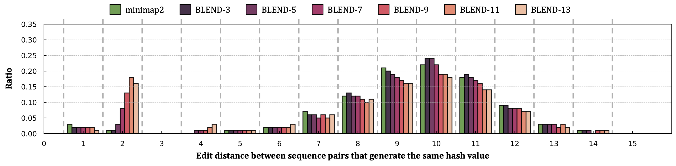
Emprical Analysis on Fuzzy Seed Matching
Edit distance between sequence pairs with a hash collision
Goal in fuzzy seed matching: Increase the collision rate for highly similar seeds
BLEND increases the collision rate for highly similar seeds
while keeping a collision rate similar to minimap2 for dissimilar seeds

Slide 89
Read Overlapping – Performance & Memory
For HiFi: Average speedup of 40.3x (minimap2)
Reducing the memory footprint by 7.2x
Improving critical parameters without hurting the accuracy:
Window length (200) and seed length (31-mers)

Slide 90
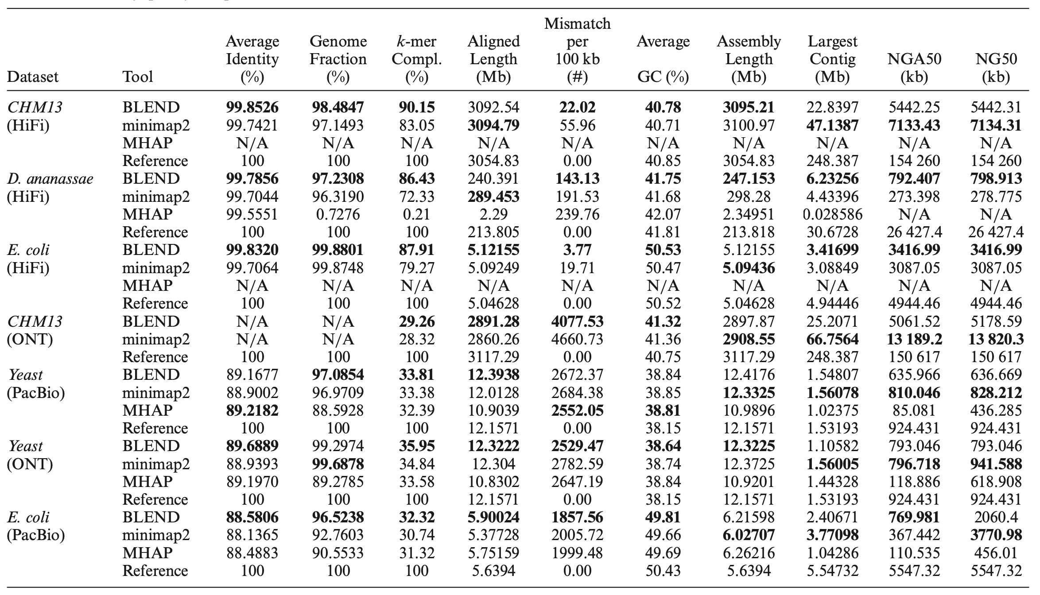
Read Overlapping – Assembly Evaluation
For HiFi: More accurate and complete assemblies
Better contiguity in most cases
Fuzzy seed matches can lead to finding novel and useful overlaps

Slide 91
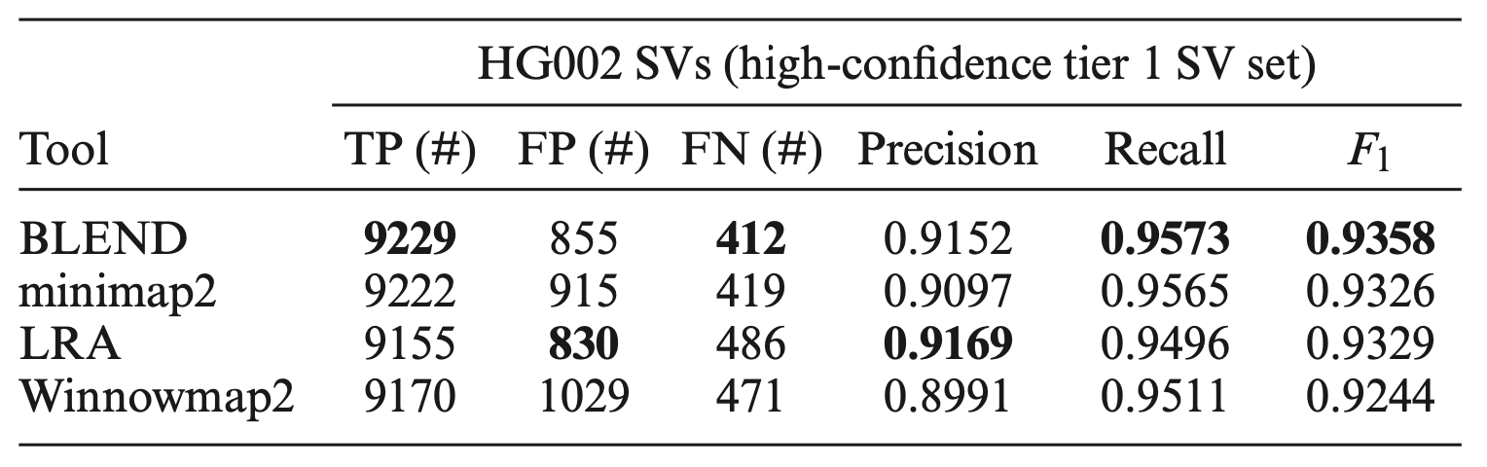
Read Mapping – SV Calling
Structural variant (SV) calling using read mappings from each tool
Sniffles2 to call SVs from HG002 long read mappings
Truvari to compare the resulting SVs with the benchmarking SV set (Tier 1 set from GIAB)
Best overall accuracy in downstream analysis

Slide 92
BLEND Summary
Problem | Finding exact-matching seeds introduce limitations in further improving the performance and accuracy of genome analysis
Goal | Enable finding the fuzzy seed matches as well as the exact-matching seeds accurately and efficiently
BLEND | Provides effective mechanisms for converting seeds into set of items to use with the SimHash technique Uses the SimHash technique to enable generating the same hash value for highly similar seeds to find fuzzy seed matches with a directly lookup of hash values
Key Results | Significant speedups and lower memory footprint especially when using HiFi reads Improves the accuracy of important applications in genome analysis

Slide 93
BLEND A Fast, Memory-efficient and Accurate Mechanism to Find Fuzzy Seed Matches in Genome Analysis
Can Firtina, Jisung Park, Mohammed Alser, Jeremie S. Kim, Damla Senol Cali,
Taha Shahroodi, Nika Mansouri Ghiasi, Gagandeep Singh,
Konstantinos Kanellopoulos, Can Alkan, Onur Mutlu
Paper (NARGAB)
Source Code

Slide 94
Agenda for Today
Cutting-edge in Accelerating Genome Analysis
Enabling Fast and Accurate Sequence Analysis
Real-Time Analysis Nanopore Raw Signal Analysis
Fuzzy seed matching for accurate sequence analysis
Conclusion

Slide 95
Future is Bright for Raw Signal Analysis

Slide 96
Raw Signal Alignment Coupled with Mapping
Joel Lindegger, Can Firtina, Nika Mansouri Ghiasi, Mohammad Sadrosadati, Mohammed Alser, and Onur Mutlu, "RawAlign: Accurate, Fast, and Scalable Raw Nanopore Signal Mapping via Combining Seeding and Alignment" Preprint on arXiv, October 2023. [arXiv version] [RawAlign Source Code]

Slide 97
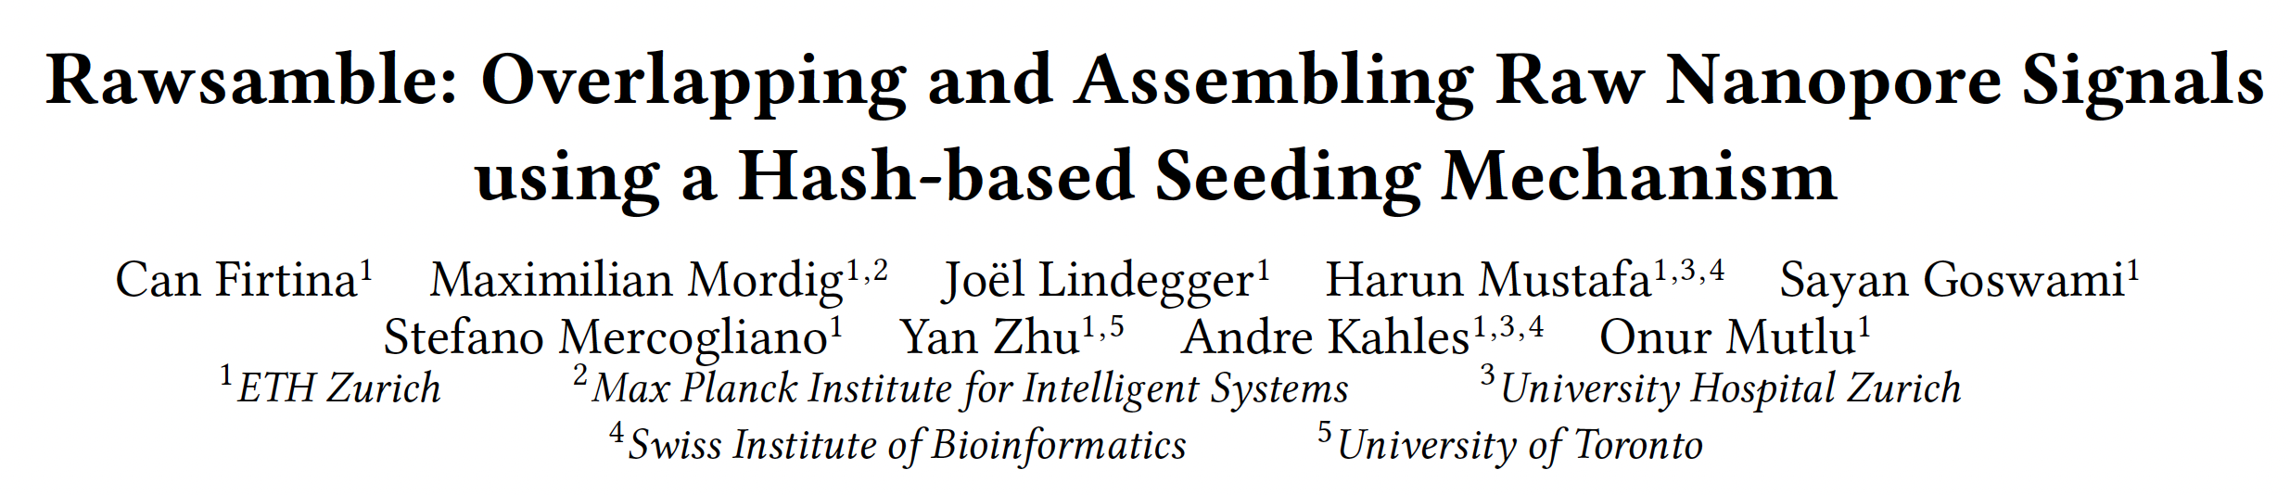
Overlapping Raw Signals in Real-Time

Slide 98
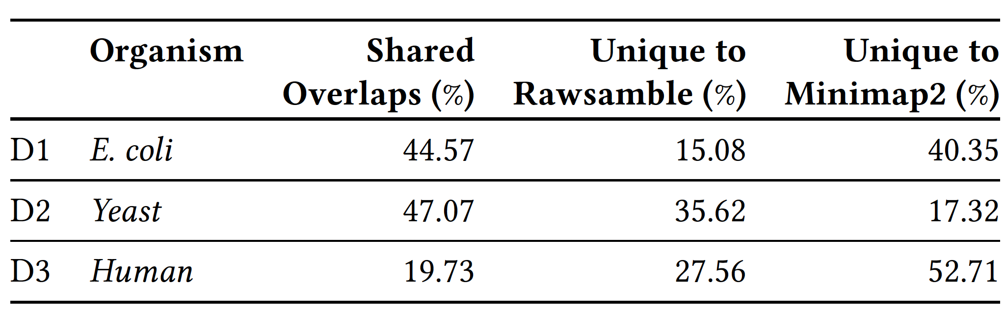

Real-time de novo Assembly Construction
All-vs-all overlapping using raw signals
Building de novo assemblies directly from raw signals

Slide 99

Storage-Centric Design for Raw Signal Analysis

Slide 100
Opportunities for New Applications
Improving the basecalling accuracy
Using the overlapping information
Full downstream analysis fully using raw nanopore signals
Cooperating the raw signal analysis and basecalled sequence analysis together
While also utilizing fuzzy seed matching for better sensitivity
Many, many more keeping the hardware design in mind

Slide 101
Things Are Happening In Industry

Slide 102

Illumina DRAGEN Bio-IT Platform (2018)
Processes whole genome at 34x coverage in ~30 minutes with hardware support for data compression
FPGA board(s)
emea.illumina.com/products/by-type/informatics-products/dragen-bio-it-platform.html
emea.illumina.com/company/news-center/press-releases/2018/2349147.html
illumina.com/content/dam/illumina/gcs/assembled-assets/marketing-literature/dragen-bio-it-data-sheet-m-gl-00680/dragen-bio-it-data-sheet-m-gl-00680.pdf

Slide 103

Nova/NextSeq with Analysis Capability
https://www.illumina.com/content/dam/illumina/gcs/assembled-assets/marketing-literature/dragen-bio-it-data-sheet-m-gl-00680/dragen-bio-it-data-sheet-m-gl-00680.pdf
https://emea.illumina.com/systems/sequencing-platforms/novaseq-x-plus/products-services/software.html

Slide 104

NVIDIA H100 (2022)
NVIDIA is claiming a 7x improvement in dynamic programming algorithm (DPX instructions) performance on a single H100 versus naïve execution on an A100.
https://www.nvidia.com/en-us/data-center/h100/

Slide 105






Bionano & NVIDIA: Accelerating Analysis for Fast Time to Results
We are accelerating the transformation in how we analyze the human genome!
Technological solution to support higher throughput
New high-performance algorithms from Bionano
Powered by NVIDIA RTX™ 6000
Ada Generation GPUs
Analysis of highly complex cancer
whole genomes in less than 2 hours
Workflow tailored for a small lab and
IT footprint
105
Notes:
Partnership
Designed to scale from small labs that do not have datacenters to datacenters and cloud

Slide 106


Cerebras’s Wafer Scale Engine (2021)
The largest ML
accelerator chip (2021)
850,000 cores
Cerebras WSE-2
2.6 Trillion transistors
46,225 mm²
Largest GPU
54.2 Billion transistors
826 mm²
NVIDIA Ampere GA100
https://www.anandtech.com/show/14758/hot-chips-31-live-blogs-cerebras-wafer-scale-deep-learning
https://www.cerebras.net/cerebras-wafer-scale-engine-why-we-need-big-chips-for-deep-learning/
Notes:
The Wafer-Scale Engine is the most massive AI chip ever produced

Slide 107
UPMEM Processing-in-DRAM Engine (2019)
Processing in DRAM Engine
Includes standard DIMM modules, with a large number of DPU processors combined with DRAM chips.
Replaces standard DIMMs
DDR4 R-DIMM modules
8GB+128 DPUs (16 PIM chips)
Standard 2x-nm DRAM process
Large amounts of compute & memory bandwidth
https://www.anandtech.com/show/14750/hot-chips-31-analysis-inmemory-processing-by-upmem
https://www.upmem.com/video-upmem-presenting-its-true-processing-in-memory-solution-hot-chips-2019/
Onur Mutlu, Computer Architecture Lecture 2b, Fall 2019, ETH Zurich

Slide 108
BioPIM (2022)
The vision of BioPIM is the realization of cheap, ultra-fast and ultra-low energy mobile genomics that eliminates the current dependence of sequence analysis on large and power-hungry computing clusters/data-centers.

Slide 109

Fast Genome Analysis…
Onur Mutlu, "Accelerating Genome Analysis: A Primer on an Ongoing Journey" Invited Lecture at Technion, Virtual, 26 January 2021. [Slides (pptx) (pdf)] [Talk Video (1 hour 37 minutes, including Q&A)] [Related Invited Paper (at IEEE Micro, 2020)]

Slide 110

More on Fast Genome Analysis…
Onur Mutlu, "Accelerating Genome Analysis" Invited Talk at the Barcelona Supercomputing Center (BSC), Barcelona, Spain, 6 September 2022. [Slides (pptx) (pdf)] [Talk Video (1 hour 35 minutes, including Q&A)] [Related Invited Paper (at IEEE Micro, 2020)] [Related Invited Paper (at Computational and Structural Biology Journal, 2022)]

Slide 111

More on Accelerating Genome Analysis
Can Firtina, "Enabling Accurate, Fast, and Memory-Efficient Genome Analysis via Efficient and Intelligent Algorithms" Talk at UC Berkeley, Berkeley, CA, United States, May 27, 2022. [Slides (pptx) (pdf)] [Talk Video (1 hour 6 minutes)]

Slide 112

More on Real-Time Genome Analysis
Can Firtina, "RawHash: Enabling Fast and Accurate Real-Time Analysis of Raw Nanopore Signals for Large Genomes" Proceedings Talk at ISMB-ECCB, Lyon, France, 25 July 2023. [Slides (pptx) (pdf)] [Talk Video (18 minutes]

Slide 113
Accelerating Genome Analysis [DAC 2023]
Onur Mutlu and Can Firtina, "Accelerating Genome Analysis via Algorithm-Architecture Co-Design" Invited Special Session Paper in Proceedings of the 60th Design Automation Conference (DAC), San Francisco, CA, USA, July 2023. [Slides (pptx) (pdf)] [Talk Video (38 minutes, including Q&A)] [Related Invited Paper] [arXiv version]
https://ieeexplore.ieee.org/document/10247887

Slide 114


BIO-Arch Workshop at RECOMB 2023
April 14, 2023
https://www.youtube.com/watch?v=2rCsb4-nLmg
https://safari.ethz.ch/recomb23-arch-workshop/

Slide 115

Genomics Course (Spring 24)
Spring 2024 Edition:
https://safari.ethz.ch/projects_and_seminars/spring2024/doku.php?id=bioinformatics
Fall 2023 Edition:
https://safari.ethz.ch/projects_and_seminars/fall2023/doku.php?id=bioinformatics
Youtube Livestream (Fall 2023):
https://youtube.com/playlist?list=PL5Q2soXY2Zi_O0wyOjiMShG4t2QPZoeE3
Project course
Taken by Bachelor’s students
Genomics lectures
Hands-on research exploration
Many research readings
https://www.youtube.com/onurmutlulectures

Slide 116
Conclusion
We covered various recent ideas to
Accelerate genome analysis
Analyze genomes in ways that were not possible before
Enabling cost-effective, portable, fast, and accurate genome analysis has many implications
What are the new applications to enable with these unique benefits?
Can we do even better?
Understanding and modifying the sequencing process for analyzing other types of biological data
Many future opportunities exist
Especially with new sequencing technologies
Especially with new applications and use cases

Slide 117
Real-time Sequence Analysis from Raw Nanopore Electrical Signals with Accurate Hash-based Search Mechanisms
Can Firtina
canfirtina@gmail.com
https://cfirtina.com
10 May 2024
The Broad Institute of MIT and Harvard

Slide 118
Analysis is Bottlenecked in Read Mapping!!
48
1
Human whole
genomes
GAGTCAGAATTTGAC
Human
GAGTCAGAATTTGAC
genome
GAGTCAGAATTTGAC
GAGTCAGAATTTGAC
GAGTCAGAATTTGAC
GAGTCAGAATTTGAC
GAGTCAGAATTTGAC
GAGTCAGAATTTGAC
GAGTCAGAATTTGAC
at 30× coverage
GAGTCAGAATTTGA
GAGTCAGAATTTGAC
GAGTCAGAATTTGAC
GAGTCAGAATTTGAC
32 CPU hours
GAGTCAGAATTTGAC
in about 2 days
GAGTCAGAATTTGAC
on a 48-core processor
Illumina NovaSeq 6000
Goyal+, "Ultra-fast next generation human genome sequencing data processing using DRAGENTM bio-IT processor for precision medicine”, Open Journal of Genetics, 2017.
Notes:
12.48
5.2 CPU hours
144x
60 CPU hours
BWA-MEM
25 minutes
Illumine HiSeq X10
25 minutes
Nanopore MinION
Short reads generated in a day using today’s HTS machines (e.g., Illumine HiSeq X10) can be mapped to the human reference genome using BWA-MEM [36], a popular and widely-used read mapper, in 12.5 CPU (central processing unit) days when running on a single core [66, 67]. BWA-MEM also takes about 2.5 CPU days to map long reads that are generated in 25 minutes using today’s Nanopore MinION sequencer [68]

Slide 119

A Tsunami of Sequencing Data
A Tera-scale increase in sequencing production in the past 25 years

Slide 120

Today’s Computing Systems
von Neumann model, 1945
where the CPU can access data stored in an off-chip main memory only through power-hungry bus
CORE 0
L2 CACHE 1
L2 CACHE 0
CORE 1
DRAM BANKS
*Die photo credit: AMD Barcelona
SHARED L3 CACHE
DRAM MEMORY CONTROLLER
DRAM INTERFACE
L2 CACHE 2
CORE 2
L2 CACHE 3
CORE 3
Storage (SSD/HDD)
Main Memory
Microprocessor
Burks, Goldstein, von Neumann, “Preliminary discussion of the logical design of an electronic computing instrument,” 1946.
Notes:
Today’s computing systems follow von Neumann model where the CPU can access data stored in an 0ff-chip memory only through power-hungry buses.
We call this model a processor-centric.

Slide 121
The Problem
Data analysis
is performed
far away from the data

Slide 122

The Need for Speed
Did we realize the need for faster genome analysis?
Mapper
Alser+, "Technology dictates algorithms: Recent developments in read alignment", Genome Biology, 2021

Slide 123
Sequence Alignment in Unavoidable
Quadratic-time dynamic-programming algorithm
WHY?!
 |  | N | E | T | H | E | R | L | A | N | D | S
 | 0 | 1 | 2 | 3 | 4 | 5 | 6 | 7 | 8 | 9 | 10 | 11
S | 1 | 1 | 2 | 3 | 4 | 5 | 6 | 7 | 8 | 9 | 10 | 10
W | 2 | 2 | 2 | 3 | 4 | 5 | 6 | 7 | 8 | 9 | 10 | 11
I | 3 | 3 | 3 | 3 | 4 | 5 | 6 | 7 | 8 | 9 | 10 | 11
T | 4 | 4 | 4 | 3 | 4 | 5 | 6 | 7 | 8 | 9 | 10 | 11
Z | 5 | 5 | 5 | 4 | 4 | 5 | 6 | 7 | 8 | 9 | 10 | 11
E | 6 | 6 | 5 | 5 | 5 | 4 | 5 | 6 | 7 | 8 | 9 | 10
R | 7 | 7 | 6 | 6 | 6 | 5 | 4 | 5 | 6 | 7 | 8 | 9
L | 8 | 8 | 7 | 7 | 7 | 6 | 5 | 4 | 5 | 6 | 7 | 8
A | 9 | 9 | 8 | 8 | 8 | 7 | 6 | 5 | 4 | 5 | 6 | 7
N | 10 | 9 | 9 | 9 | 9 | 8 | 7 | 6 | 5 | 4 | 5 | 6
D | 11 | 10 | 10 | 10 | 10 | 9 | 8 | 7 | 6 | 5 | 4 | 5
Enumerating all possible prefixes
etc
etc
NETHERLANDS x SWITZERLAND
Data dependencies limit the computation parallelism
NETHERLANDS x S
NETHERLANDS x SW
NETHERLANDS x SWI
NETHERLANDS x SWIT
NETHERLANDS x SWITZ
NETHERLANDS x SWITZE
NETHERLANDS x SWITZER
NETHERLANDS x SWITZERL
NETHERLANDS x SWITZERLA
NETHERLANDS x SWITZERLAN
NETHERLANDS x SWITZERLAND
etc
Processing row (or column) after another
Notes:
1- Read alignment follows the basic dynamic-programming doctrine which runs in a quadratic time.
2- Data dependencies between the entries limits the parallelism. Each cell depends or three pre-computed cells (immediate left, upper, and upper-left cells). Thus, we can compute the vectors one after another but not in parallel. Left-to-right, or top-to-bottom, anti-diagonal.
3- We can solve a significant amount of time, If we can find a way to detect the incorrect mappings with cheap heuristics, much cheaper than computing the alignment.

Slide 124
Sequence Alignment in Unavoidable
Quadratic-time dynamic-programming algorithm
 |  | N | E | T | H | E | R | L | A | N | D | S
 | 0 | 1 | 2 | 3 | 4 | 5 | 6 | 7 | 8 | 9 | 10 | 11
S | 1 | 1 | 2 | 3 | 4 | 5 | 6 | 7 | 8 | 9 | 10 | 10
W | 2 | 2 | 2 | 3 | 4 | 5 | 6 | 7 | 8 | 9 | 10 | 11
I | 3 | 3 | 3 | 3 | 4 | 5 | 6 | 7 | 8 | 9 | 10 | 11
T | 4 | 4 | 4 | 3 | 4 | 5 | 6 | 7 | 8 | 9 | 10 | 11
Z | 5 | 5 | 5 | 4 | 4 | 5 | 6 | 7 | 8 | 9 | 10 | 11
E | 6 | 6 | 5 | 5 | 5 | 4 | 5 | 6 | 7 | 8 | 9 | 10
R | 7 | 7 | 6 | 6 | 6 | 5 | 4 | 5 | 6 | 7 | 8 | 9
L | 8 | 8 | 7 | 7 | 7 | 6 | 5 | 4 | 5 | 6 | 7 | 8
A | 9 | 9 | 8 | 8 | 8 | 7 | 6 | 5 | 4 | 5 | 6 | 7
N | 10 | 9 | 9 | 9 | 9 | 8 | 7 | 6 | 5 | 4 | 5 | 6
D | 11 | 10 | 10 | 10 | 10 | 9 | 8 | 7 | 6 | 5 | 4 | 5
Enumerating all possible prefixes
Data dependencies limit the computation parallelism
Processing row (or column) after another
Entire matrix is computed even though strings can be dissimilar.
Number of differences is computed only at the backtraking step.
Notes:
1- Read alignment follows the basic dynamic-programming doctrine which runs in a quadratic time.
2- Data dependencies between the entries limits the parallelism. Each cell depends or three pre-computed cells (immediate left, upper, and upper-left cells). Thus, we can compute the vectors one after another but not in parallel. Left-to-right, or top-to-bottom, anti-diagonal.
3- We can solve a significant amount of time, If we can find a way to detect the incorrect mappings with cheap heuristics, much cheaper than computing the alignment.

Slide 125
Metagenomics Analysis
Reads from different unknown donors at sequencing time are mapped to many known reference genomes
genetic material recovered directly from environmental samples
Reads
“text format”
Reference Database
Notes:
Read mapping is a post processing procedure after DNA sequencing. It maps the data output from a DNA sequencer, which are many short DNA fragments, to a known reference genome, with some minor differences allowed.
To illustrate the problem better, let us take a closer look at the DNA itself. Logically, the DNA is a double stranded long string. In reality, within a cell they folded into a sphere in the nucleus like a ball of wool. Since it is very hard to disentangle the DNA at molecular level, to extract the information out, a sequencer cuts the mass into many short DNA pieces which are called reads.
A mapper’s job is to find where these DNA short reads are most likely to be originally placed so that later we can assemble them in the correct order to restore the original DNA.
Mapping these short reads, up to billions of them, with each one being 50 to 300 base-pairs long, to the reference genome is challenging.

Slide 126


Genomics vs. Metagenomics
Genomics
Metagenomics

Slide 127

Huge Demand for Performance & Efficiency
Source: https://youtu.be/Bh13Idwcb0Q?t=283

Slide 128

Deeper and Larger Memory Hierarchies
Core Count:
8 cores/16 threads
L1 Caches:
32 KB per core
L2 Caches:
512 KB per core
L3 Cache:
32 MB shared
AMD Ryzen 5000, 2020
https://wccftech.com/amd-ryzen-5000-zen-3-vermeer-undressed-high-res-die-shots-close-ups-pictured-detailed/

Slide 129


AMD’s 3D Last Level Cache (2021)
AMD increases the L3 size of their 8-core Zen 3 processors from 32 MB to 96 MB
Additional 64 MB L3 cache die stacked on top of the processor die
- Connected using Through Silicon Vias (TSVs)
- Total of 96 MB L3 cache
https://community.microcenter.com/discussion/5134/comparing-zen-3-to-zen-2
https://youtu.be/gqAYMx34euU
https://www.tech-critter.com/amd-keynote-computex-2021/
Notes:
CCD = Core Chiplet Die
Structural silicon is used to equalize the height and facilitate heat dissipation from the cores.

Slide 130

Deeper and Larger Memory Hierarchies
IBM POWER10,
2020
Cores:
15-16 cores,
8 threads/core
L2 Caches:
2 MB per core
L3 Cache:
120 MB shared
https://www.it-techblog.de/ibm-power10-prozessor-mehr-speicher-mehr-tempo-mehr-sicherheit/09/2020/

Slide 131

Deeper and Larger Memory Hierarchies
A lot of
SRAM
Storage
DRAM
DRAM
Storage
Apple M1 Ultra System (2022)
https://www.gsmarena.com/apple_announces_m1_ultra_with_20core_cpu_and_64core_gpu-news-53481.php

Slide 132
Data Movement Overwhelms Modern Machines
Amirali Boroumand, Saugata Ghose, Youngsok Kim, Rachata Ausavarungnirun, Eric Shiu, Rahul Thakur, Daehyun Kim, Aki Kuusela, Allan Knies, Parthasarathy Ranganathan, and Onur Mutlu, "Google Workloads for Consumer Devices: Mitigating Data Movement Bottlenecks" Proceedings of the 23rd International Conference on Architectural Support for Programming Languages and Operating Systems (ASPLOS), Williamsburg, VA, USA, March 2018.
62.7% of the total system energy
is spent on data movement

Slide 133







Processing-in-Memory Landscape Today
[Samsung 2021]
[Alibaba 2022]
[SK Hynix 2022]
[Samsung 2021]
[UPMEM 2019]
And, many other experimental chips and startups

Slide 134

The Energy Perspective
Dally, HiPEAC 2015

Slide 135
Data Movement vs. Computation Energy
Dally, HiPEAC 2015
A memory access consumes ~100-1000X
the energy of a complex addition

Slide 136
Data Movement vs. Computation Energy
Han+, “EIE: Efficient Inference Engine on Compressed Deep Neural Network,” ISCA 2016.

Slide 137
Data Movement vs. Computation Energy
6400X
A memory access consumes 6400X
the energy of a simple integer addition
Han+, “EIE: Efficient Inference Engine on Compressed Deep Neural Network,” ISCA 2016.

Slide 138
Practical Similarity Identification
Seeds
> 3 billion characters
Reference
…CAATTTGCCCATATGGTTAAGCTTCCATGGAAATGGGCTTTCGCTTTG…
…
K-mers
Locations
Read
GCCCAAATGGTT
GCC | 7
CCC | 8
CAA | 1
AAA | 31 | 101
CCA | 25 | 230 | 400
… | … | … | …
K-mers
GCC
CCC
…
Index (Hash Table)
Seeding
Determine potential matching regions (seeds) in the reference genome
Seed Filtering
(e.g., Chaining)
Prune some seeds in the reference genome
Alignment
Determine the exact differences between the read and the reference genome

Slide 139
Existing Solutions – Real-time Basecalling
Deep neural networks (DNNs) for translating signals to bases
Nanopore sequencing
Raw Signal
Real-time Analysis
Basecalling
Read mapping
A
T
G
G
Current
DNNs provide less noisy analysis from basecalled sequences
Costly and power-hungry computational requirements

Slide 140
The Problem
The existing solutions are ineffective for large genomes
Real-time Analysis
Real-time Analysis
Basecalling
Read mapping
Signal mapping
A
T
G
G
Costly and energy-hungry computations to basecall each read:
Portable sequencing becomes challenging with resource-constrained devices
Larger number of reference regions cannot be handled accurately or quickly, rendering existing solutions ineffective for large genomes

Slide 141
Applications of Read Until
Depletion: Reads mapping to a particular reference genome is ejected
Removing contaminated reads from a sample
Relative abundance estimation
Controlling low/high-abundance genomes in a sample
Controlling the sequencing of depth of a genome
Enrichment: Reads not mapping to a particular reference genome is ejected
Purifying the sample to ensure it contains only the selected genomes
Removing the host genome (e.g., human) in contamination analysis

Slide 142
Applications of Run Until and Sequence Until
Run Until: Stopping the sequencing without informative decision from analysis
Stopping when reads reach to a particular depth of coverage
Stopping when the abundance of all genomes reach a particular threshold
Sequence Until: Stopping the sequencing based on information decision
Stopping when relative abundance estimations do not change substantially (for high-abundance genomes)
Stopping when finding that the sample is contaminated with a particular set of genomes
…

Slide 143




Details: Quantizing the Event Values
Observation: Identical k-mers generate similar raw signals
Challenge: Their corresponding event values can be slightly different
Key Idea: Quantize the event values
To enable assigning the same quantized value to the similar event values
Slightly Different (Normalized) Event Values
-0.091 in binary:
-0.084 in binary:
1
0
1
1
1
1
0
1
1
0
1
1
…
1
0
1
1
1
1
0
1
1
0
1
0
…
Most significant $Q=9$ bits:
Most significant $Q=9$ bits:
1
0
1
1
1
1
0
1
1
1
0
1
1
1
1
0
1
1
Pruning $p=4$ bits:
Pruning $p=4$ bits:
Matching Quantized
Event Values
1
0
0
1
1
1
0
0
1
1

Slide 144

Breakdown Analysis of the RawHash Steps
The entire runtime is bottlenecked by the chaining step

Slide 145

Full Read Mapping Accuracy

Slide 146

R10.4 Accuracy and Performance Results

Slide 147
Full Read Mapping Accuracy – Spider Plot

Slide 148
Different Metrics Combined – Spider Plot

Slide 149

Required Computation Resources in Indexing
The indexing in RawHash is orders of magnitude faster than
the indexing steps of UNCALLED and Sigmap, especially for large genomes

Slide 150

Required Computation Resources in Mapping
The mapping step of RawHash2 (and RawHash2-Minimizer) is significantly faster than all tools

Slide 151

Required CPU Threads For the Entire Flow Cell
RawHash2 (and RawHash2-Minimizer) requires the least amount of
CPU threads to process the entire MinION flowcell

