Slide 1


Fast and Efficient Genome Analysis via New Algorithms and Architectures
Can Firtina
canfirtina@gmail.com
https://canfirtina.com
6 May 2025
Inria – GenScale & Symbiose

Slide 2
The Goal of Computing: Beyond Numbers
“The purpose of computing is [to gain] insight, not numbers”
Richard Hamming
"Numerical Methods for Scientists and Engineers," Richard Hamming, 1962.

Slide 3
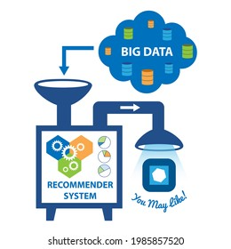



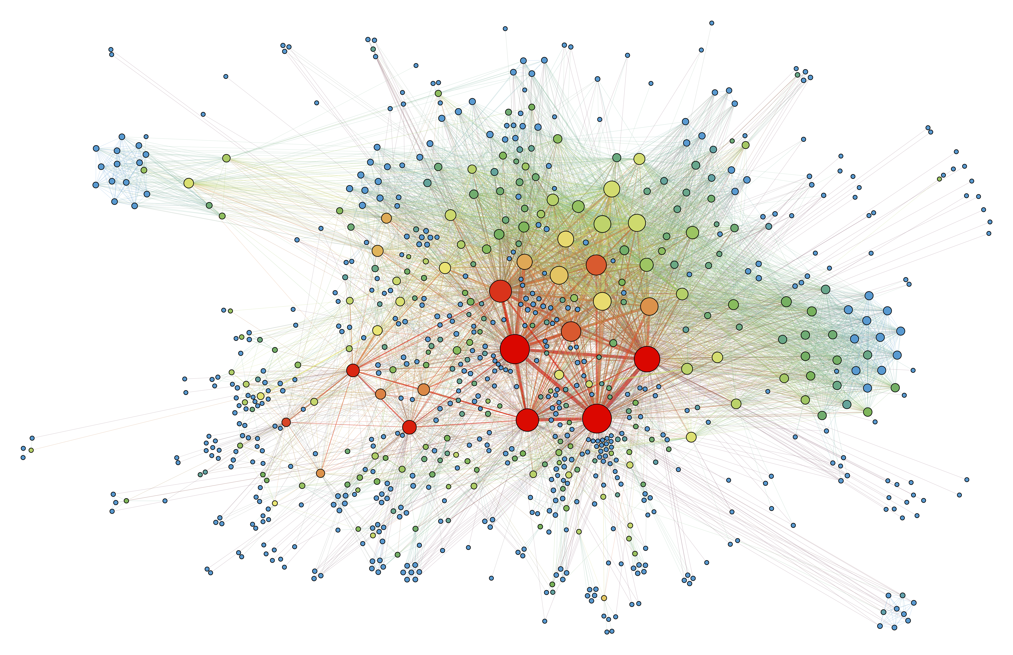

Computing is Bottlenecked by Data
Large recommender systems
Large Language Models
Graph/Tree Processing
Genomics

Slide 4
Computing is Bottlenecked by Data
Data movement →
Performance & Energy Bottleneck
Large recommender systems
Large Language Models
Graph/Tree Processing
Genomics

Slide 5



Problems with Data Analysis Today
Special-Purpose Machine
for Data Generation
General-Purpose Machine
for Data Analysis
FAST
SLOW
Processing capabilities oblivious to data analysis requirements
Large amounts of data movement

Slide 6
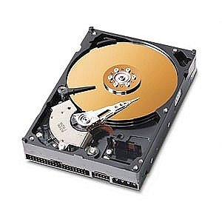
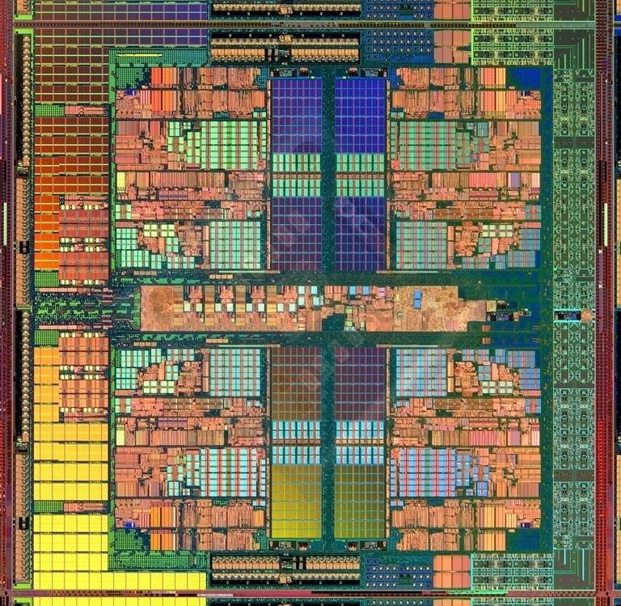
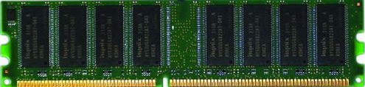
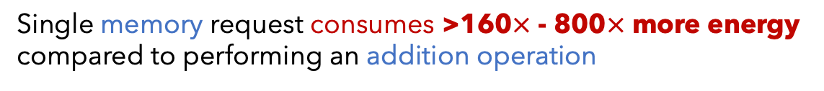
Data Movement Dominates Performance
Data movement dominates performance and
is a major system energy bottleneck (accounting for 40%-62%)
Data Movement
Sequencing
Machine
Storage (SSD/HDD)
Main Memory
Microprocessor
Single memory request consumes >160$×$ - 800$×$ more energy compared to performing an addition operation
⁻ Boroumand et al., “Google Workloads for Consumer Devices: Mitigating Data Movement Bottlenecks,” ASPLOS 2018
⁻ Kestor et al., “Quantifying the Energy Cost of Data Movement in Scientific Applications,” IISWC 2013
⁻ Pandiyan and Wu, “Quantifying the energy cost of data movement for emerging smart phone workloads on mobile platforms,” IISWC 2014

Slide 7
We need to co-design
algorithms and architecture
to handle data well

Slide 8
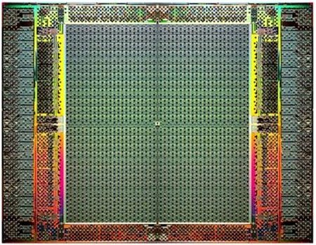
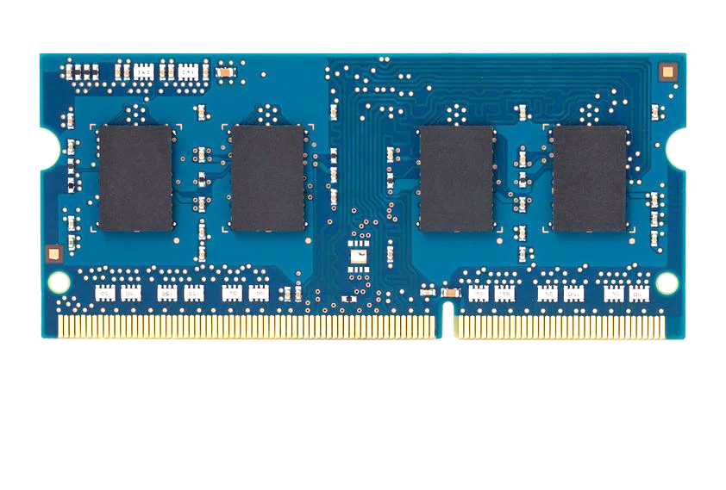
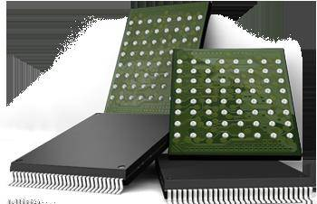
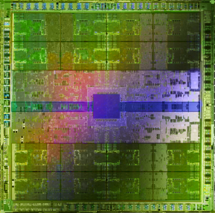
Pushing Towards New Architectures
Modern systems
?
FPGAs
Sequencing Machine
Hybrid Main Memory
Heterogeneous
Processors &
Accelerators
Persistent Memory/Storage
GPUs

Slide 9
Pushing Towards New Architectures
Modern systems
?
FPGAs
Sequencing Machine
Hybrid Main Memory
Heterogeneous
Processors &
Accelerators
Persistent Memory/Storage
GPUs

Slide 10
Algorithm-Architecture Co-design is Critical
Problem
Algorithm
Program/Language
System Software
Computer Architecture (expanded view)
SW/HW Interface
Micro-architecture
Logic
Devices
Electrons

Slide 11
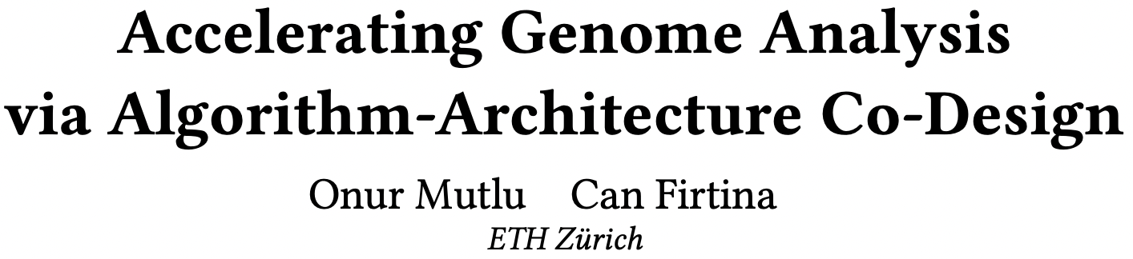
Accelerating Genome Analysis [DAC ‘23]
Onur Mutlu and Can Firtina,
"Accelerating Genome Analysis via Algorithm-Architecture Co-Design"
Invited Special Session Paper in Proceedings of the 60th Design Automation Conference (DAC), San Francisco, CA, USA, July 2023.
[Related Invited Paper]
[arXiv version]
[Slides (pptx) (pdf)]
[Talk Video at DAC 2023] (38 minutes, including Q&A)

Slide 12

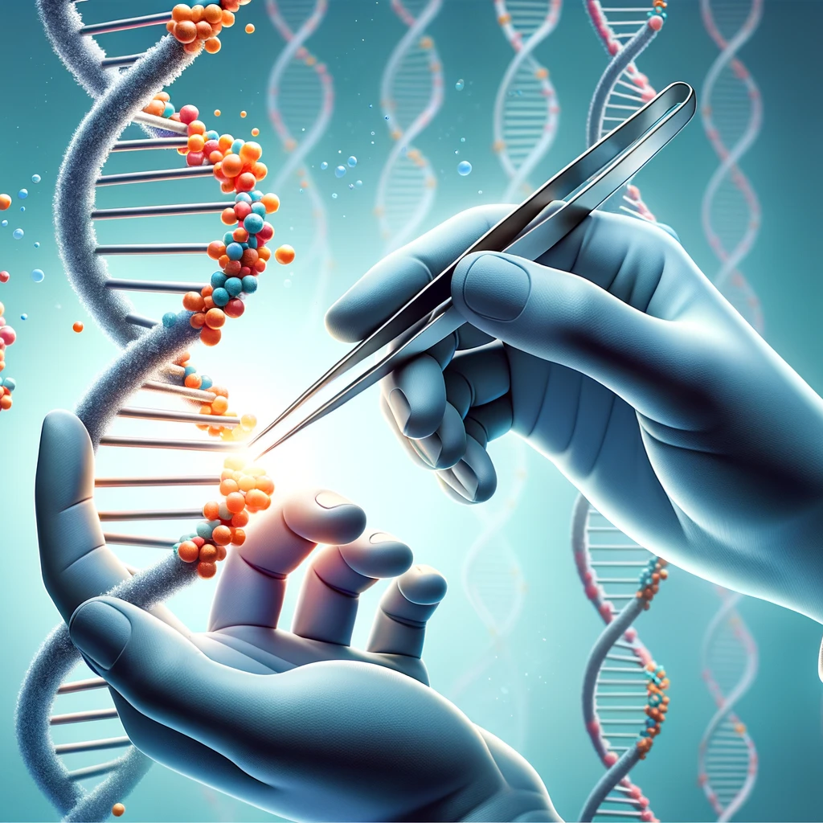


Analyzing Genomes Reveals Key Insights
Altering genomes to solve
fundamental challenges of life
Personalized Medicine
Detecting pathogens
in the environment
Rapid surveillance of
disease outbreaks

Slide 13
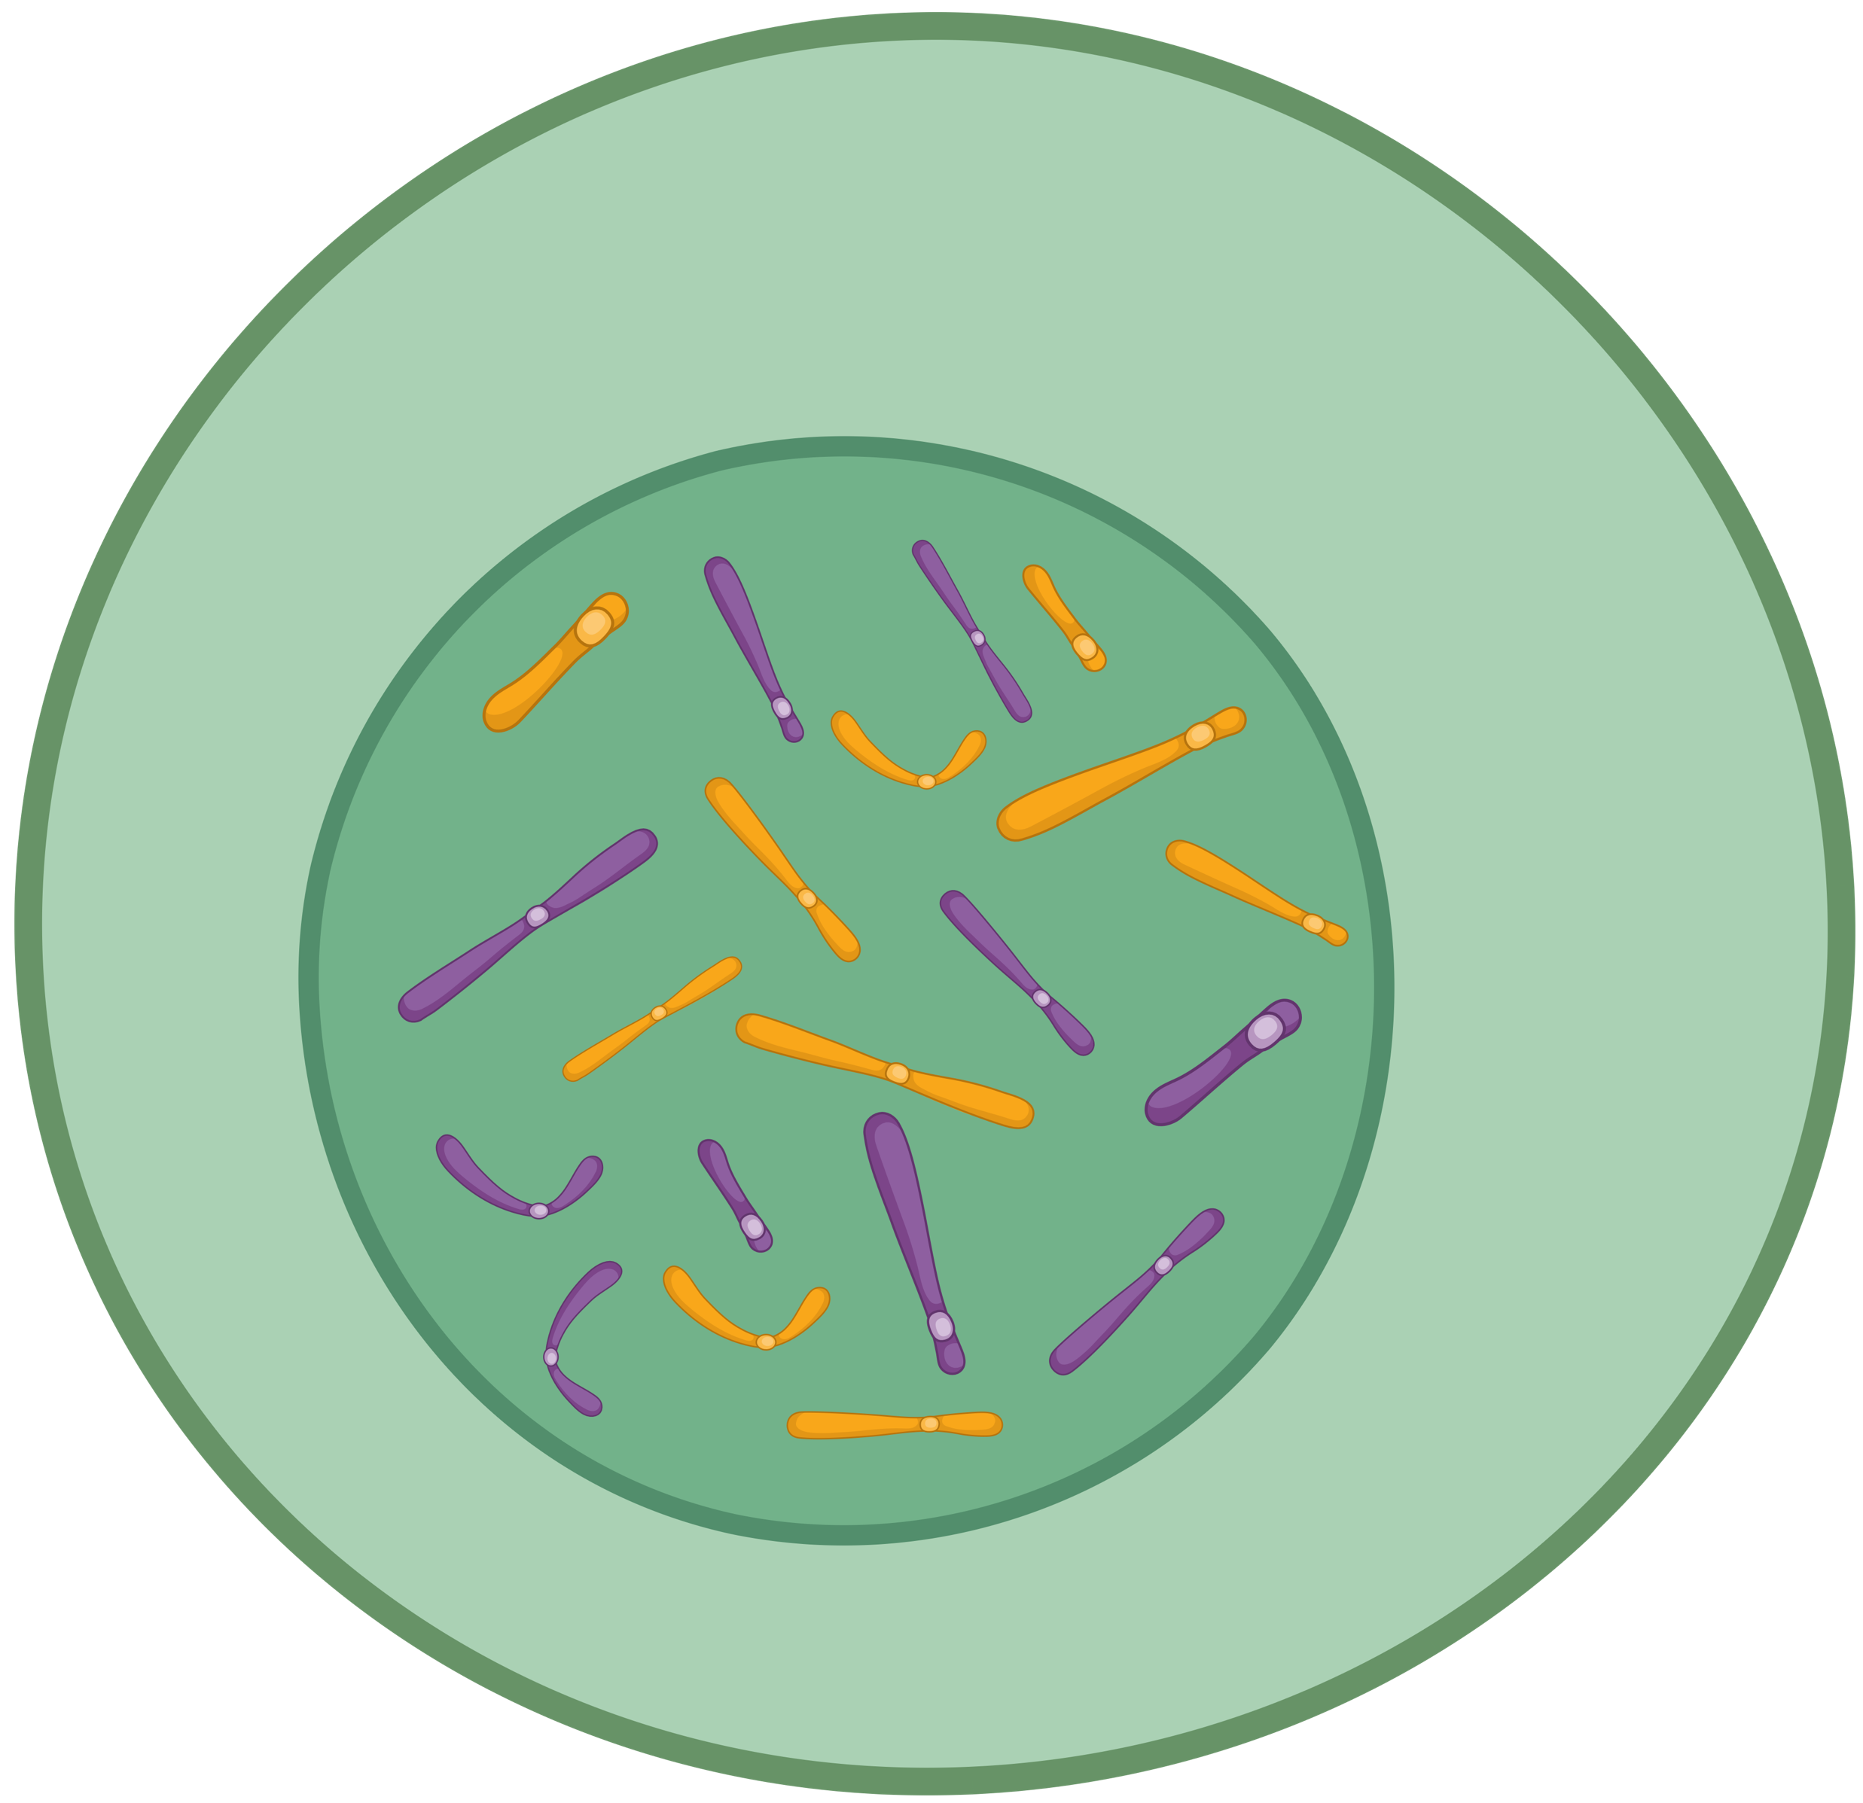
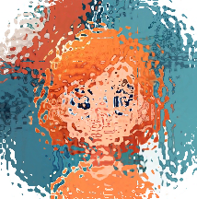
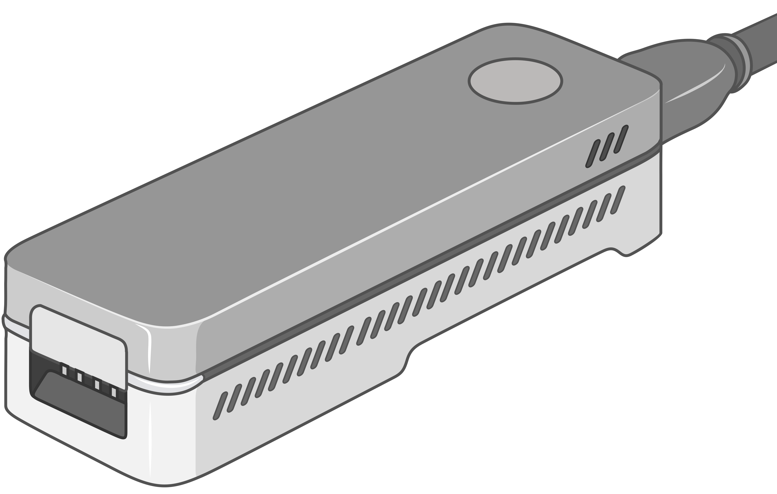
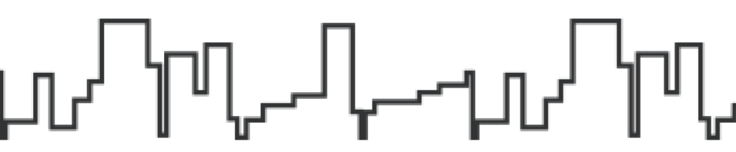
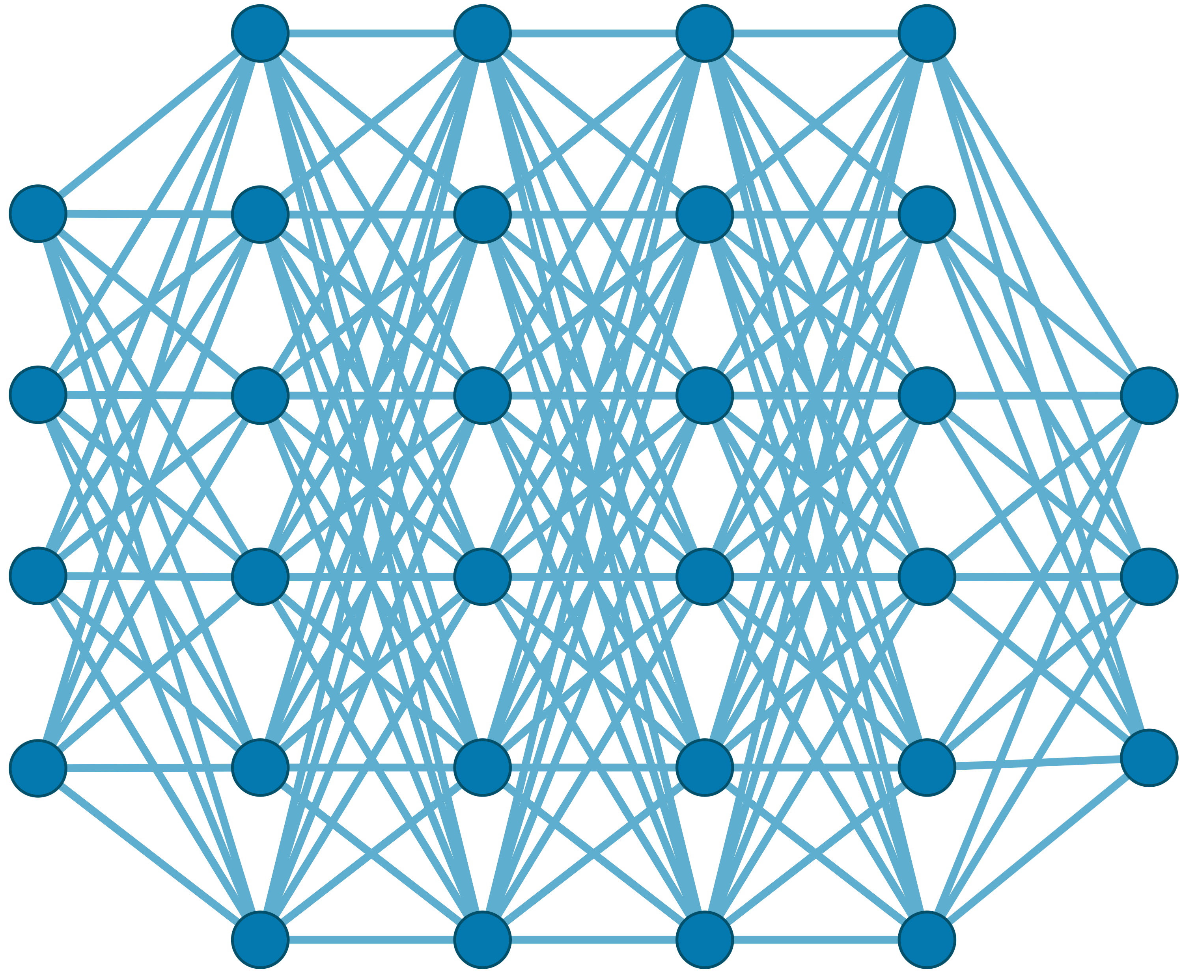

Generating the Entire Genomic Sequence
Whole Genome: 6.4B bps
(Non-human-readable)
Sequencing Device
Raw Genomic Data
(Human-readable?)
Translator (Basecalling)
AI
CGAAATGCC...AGATTAAACGCT...TGCCCTAA...GAATGGCGT
Whole Human Genome: 6.4B bps (Human-readable)

Slide 14



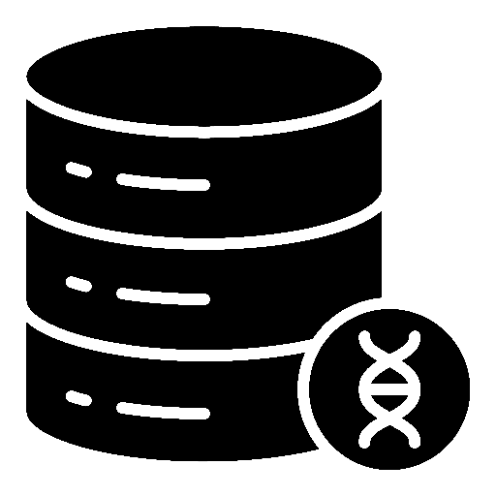





Genomic Data: Giant Jigsaw Puzzle to Solve
Human (Reference) Genome: 3.2 Billion bps (haploid)
CGAAATGCC...AGATTAAACGCT...TGCCCTAA...GAATGGCGT
?
Scale: ~$1/{10}^{8}$
AAATGG
CGAAATGCC...AGATTAAATGGT...TGCCCTAA...GAATGGCGT
Entire Genomic Sequence of an Organism
Read: ~100 – 100,000 bps
Small pieces (reads)
?
Unknown origins
Non-identical reference genome
Data Science for Massive Datasets
(TBs to PBs)
Large volume of data to analyze

Slide 15

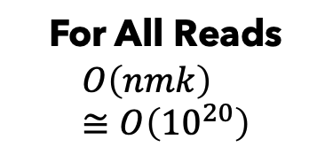
Solving the Puzzle: The Naïve Way
Human (Reference) Genome: 3.2 Billion bps (haploid)
CGAAATGCC...AGATTAAACGCT...TGCCCTAA...GAATGGCGT
AAATGG
Pairwise Approximate String Matching
(Alignment)
For All Reads
$$O\left(nmk\right) \\ ≅O\left({10}^{20}\right)$$
Entire Genome
$≅$Years

Slide 16
Solving the Puzzle: The Practical Way
Goal: Quickly and accurately reduce the search space
CGAAATGCC...AGATTAAACGCT...TGCCCTAA...GAATGGCGT
Performing
the costly computations
only for a few regions
AAA
AAA
CTA
AAT
AAATGG
AAATGG
Exact Match
AAA
AAATGG
Read Mapping
Indexing
Seeding
Chaining
Alignment
Reference Genome
Hash Table
Read
0x00
2,64,…
Sketching
0x01
1,101,…
Query
Sketching
Store
…
0xFF
13,21
Hash
Positions
Hash
0x01
0x00
Hash
Hash Matches
DP Calculations

Slide 17


A Common Genome Analysis Pipeline
Raw
Reads
Basecalling (Translator)
Basecalled
(Translated)
Reads
Read
Mapping
AAATGTGGTCCATTG
Assembly
Variant Calling
Metagenomics
Downstream Analysis

Slide 18
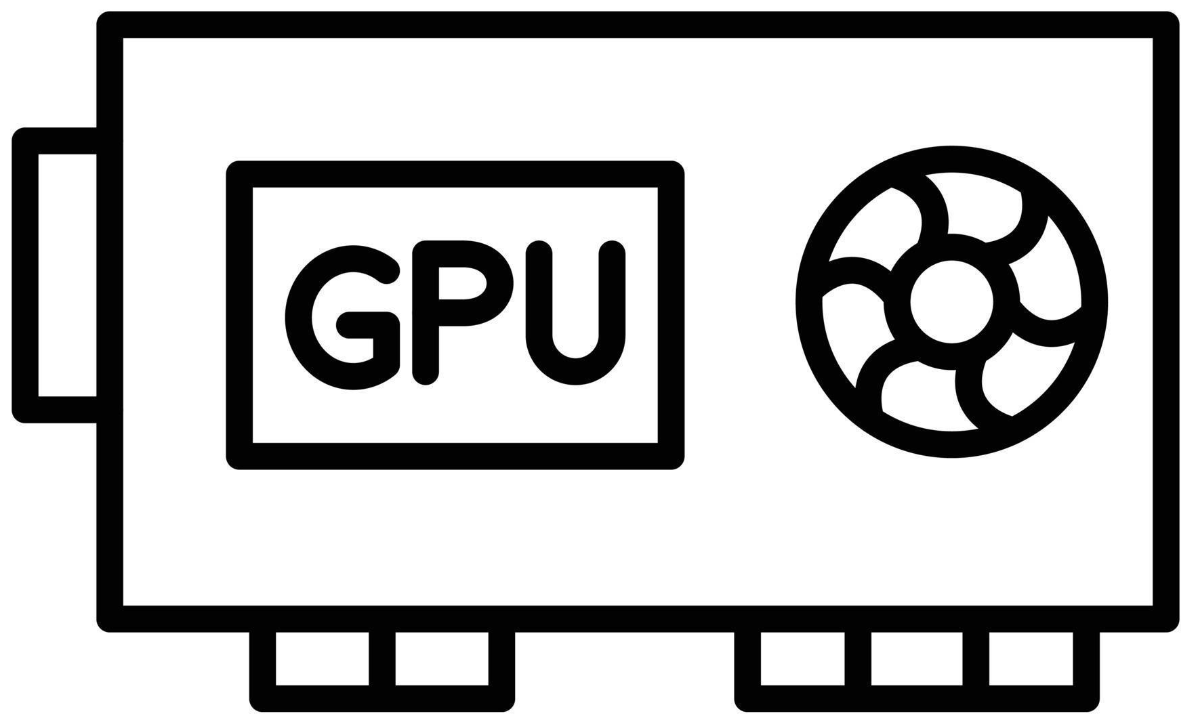
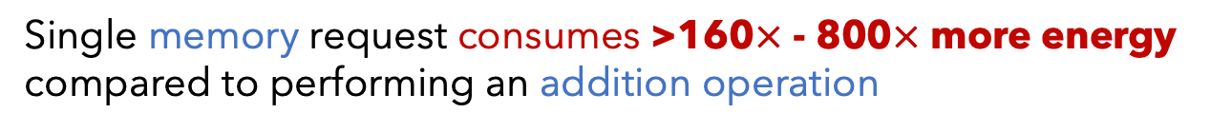
Genome Analysis is Energy Inefficient
Raw
Reads
Basecalling (Translator)
Basecalled
(Translated)
Reads
Read
Mapping
AAATGTGGTCCATTG
Power-Hungry Devices
Costly and large volumes
of data movement
Single memory request consumes >160$×$ - 800$×$ more energy compared to performing an addition operation
⁻ Boroumand et al., “Google Workloads for Consumer Devices: Mitigating Data Movement Bottlenecks,” ASPLOS 2018
⁻ Kestor et al., “Quantifying the Energy Cost of Data Movement in Scientific Applications,” IISWC 2013
⁻ Pandiyan and Wu, “Quantifying the energy cost of data movement for emerging smart phone workloads on mobile platforms,” IISWC 2014

Slide 19


Genome Analysis is Computationally Costly
Significant computation and energy overhead

Slide 20
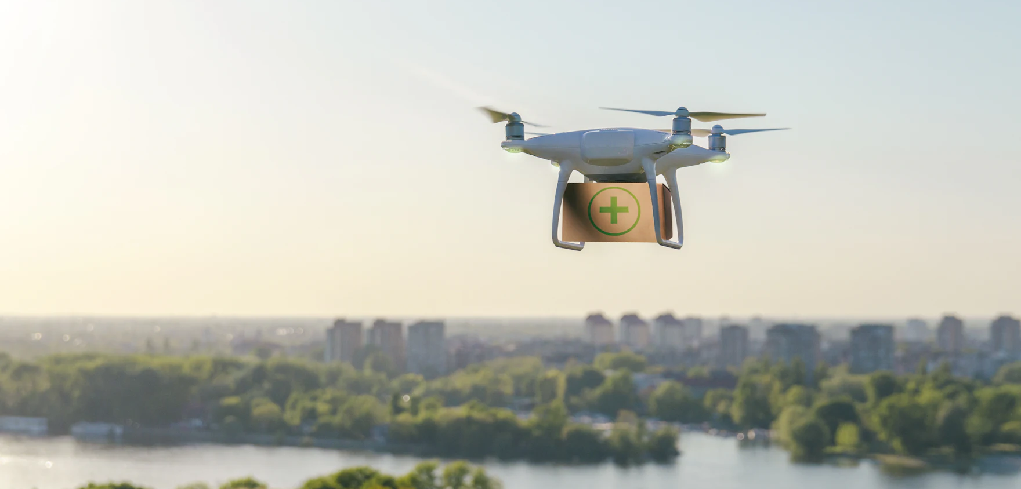

Limited Application Scope and Accuracy
Energy-efficient analysis for Resource-constrained devices
Urgent analysis within minutes
Large-scale analysis
without sacrificing accuracy
and performance

Slide 21
Enabling New Directions in Genome Analysis
via New Algorithms

Slide 22
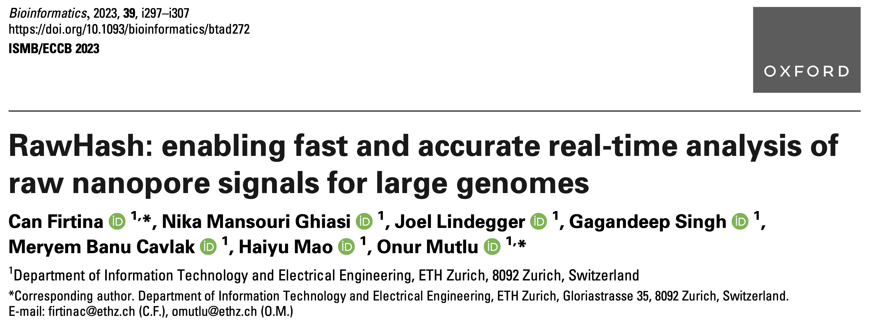
New Frontiers: Raw Signal Analysis [ISMB ‘23]
Can Firtina, Nika Mansouri Ghiasi, Joel Lindegger, Gagandeep Singh,
Meryem Banu Cavlak, Haiyu Mao, and Onur Mutlu,
"RawHash: Enabling Fast and Accurate Real-Time Analysis
of Raw Nanopore Signals for Large Genomes"
Proceedings of the 31st Annual Conference on Intelligent Systems for Molecular Biology (ISMB) and the 22nd European Conference on Computational Biology (ECCB), July 2023
[Online link at Bioinformatics Journal]
[arXiv version]
[Slides (pptx) (pdf)]
[Talk Video at ISMB/ECCB 2023] (19 minutes)
[RawHash Source Code]

Slide 23
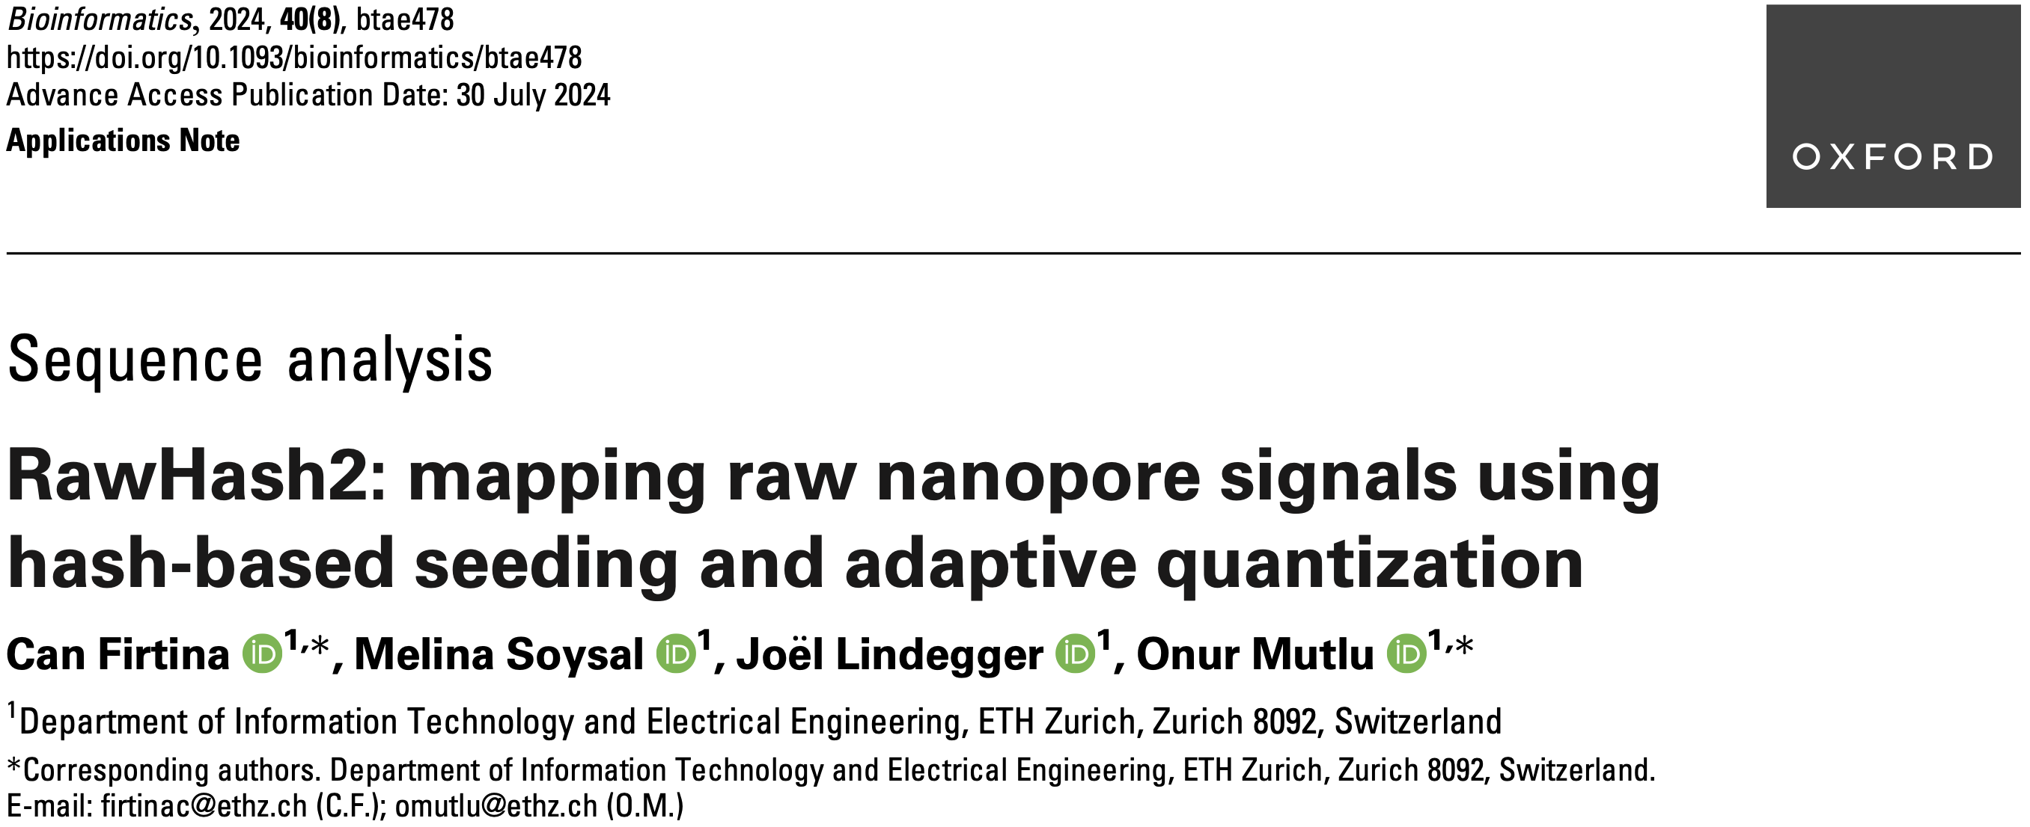
Real-Time Raw Signal Analysis [Bioinform. ‘24]
Can Firtina, Melina Soysal, Joël Lindegger, and Onur Mutlu,
"RawHash2: Mapping Raw Nanopore Signals Using
Hash-Based Seeding and Adaptive Quantization"
Bioinformatics, July 2024.
[Online link at Bioinformatics Journal]
[arXiv version]
[RawHash Talk Video] (19 minutes)
[RawHash2 Source Code]

Slide 24
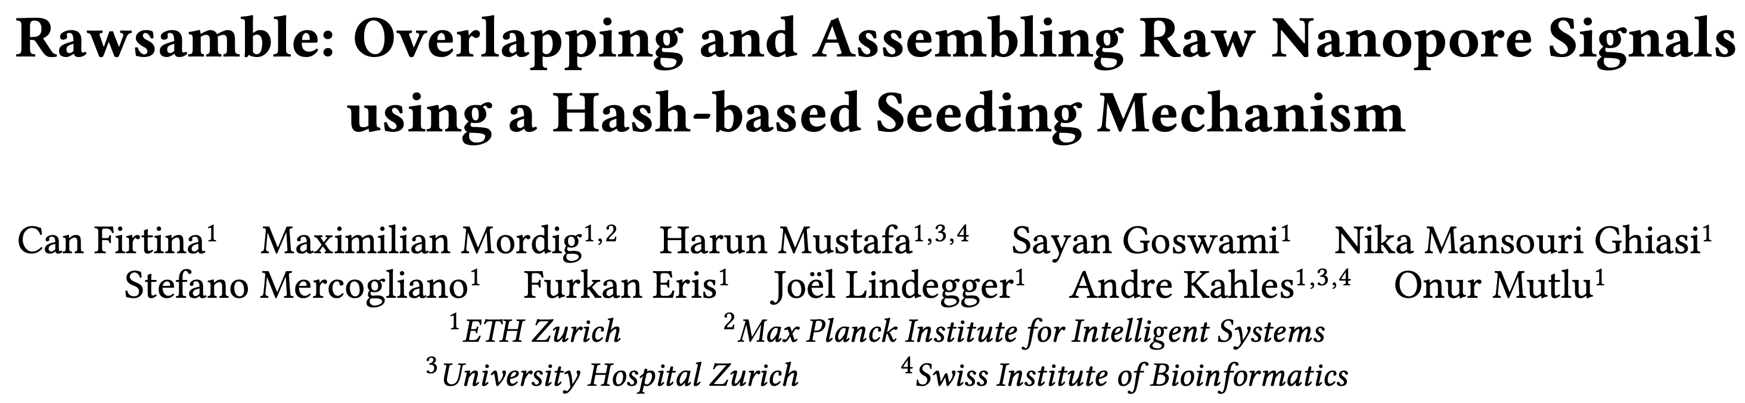
New Directions: Assembling Raw Signals
Can Firtina, Maximilian Mordig, Harun Mustafa, Sayan Goswami,
Nika Mansouri Ghiasi, Stefano Mercogliano, Furkan Eris, Joël Lindegger,
Andre Kahles, and Onur Mutlu
"Rawsamble: Overlapping and Assembling Raw Nanopore Signals using a Hash-based Seeding Mechanism"
arXiv, October 2024
[arXiv version]
[Talk Video at CSHL Data Science 2024] (16 minutes)
[Source Code]
arXiv
Source code

Slide 25
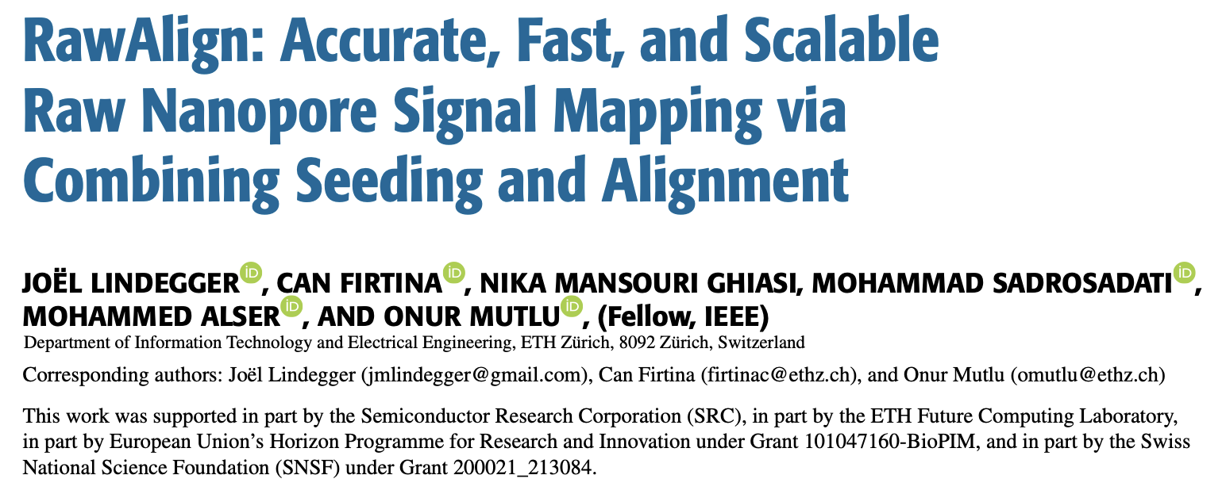
Quickly Aligning Raw Signals
Joel Lindegger, Can Firtina, Nika Mansouri Ghiasi, Mohammad Sadrosadati,
Mohammed Alser, and Onur Mutlu,
"RawAlign: Accurate, Fast, and Scalable Raw Nanopore Signal Mapping
via Combining Seeding and Alignment"
IEEE Access, December 2024.
[Online link at IEEE Access Journal]
[arXiv version]
[RawAlign Source Code]

Slide 26
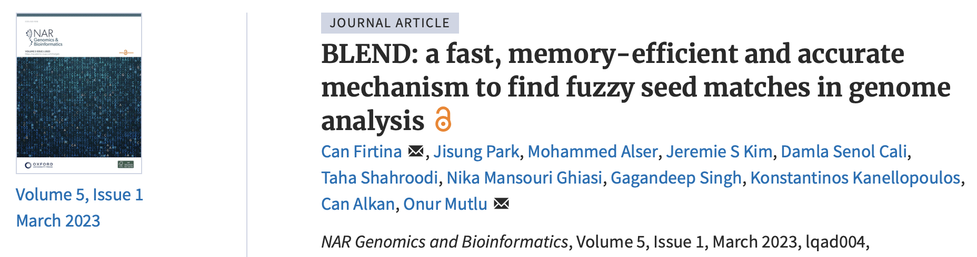
Tolerating Noise in String Matching [NARGAB ‘23]
Can Firtina, Jisung Park, Mohammed Alser, Jeremie S. Kim, Damla Senol Cali,
Taha Shahroodi, Nika Mansouri Ghiasi, Gagandeep Singh, Konstantinos Kanellopoulos, Can Alkan, and Onur Mutlu,
"BLEND: A Fast, Memory-Efficient, and Accurate Mechanism
to Find Fuzzy Seed Matches in Genome Analysis"
NAR Genomics and Bioinformatics, March 2023.
[Online link at NAR Genomics and Bioinformatics Journal]
[arXiv version]
[bioRxiv version]
[Talk Video at RECOMB 2023] (23 minutes)
[BLEND Source Code]

Slide 27
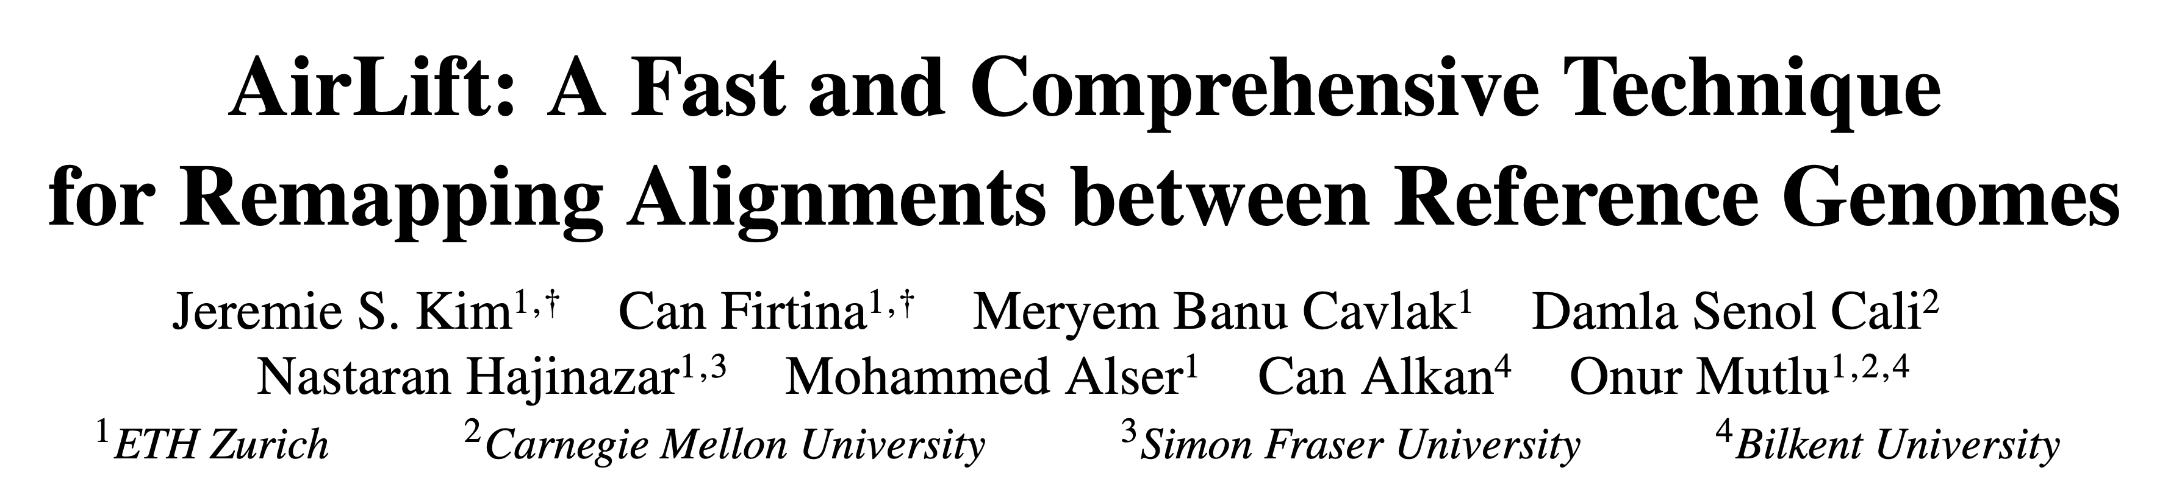
Mitigating Useless Computations [TCBB ‘24]
Jeremie S. Kim*, Can Firtina*, Meryem Banu Cavlak, Damla Senol Cali,
Nastaran Hajinazar, Mohammed Alser, Can Alkan, and Onur Mutlu,
"AirLift: A Fast and Comprehensive Technique
for Remapping Alignments between Reference Genomes"
IEEE/ACM TCBB, August 2024.
[Online link at IEEE/ACM TCBB Journal]
[arXiv version]
Presented at the 21st Asia Pacific Bioinformatics Conference (APBC),
Changsha, China, April 2023.
[Slides (pptx) (pdf)]
[Talk Video at BIO-Arch 2023 Workshop] (22 minutes)
[AirLift Source Code]
*Equal contribution

Slide 28
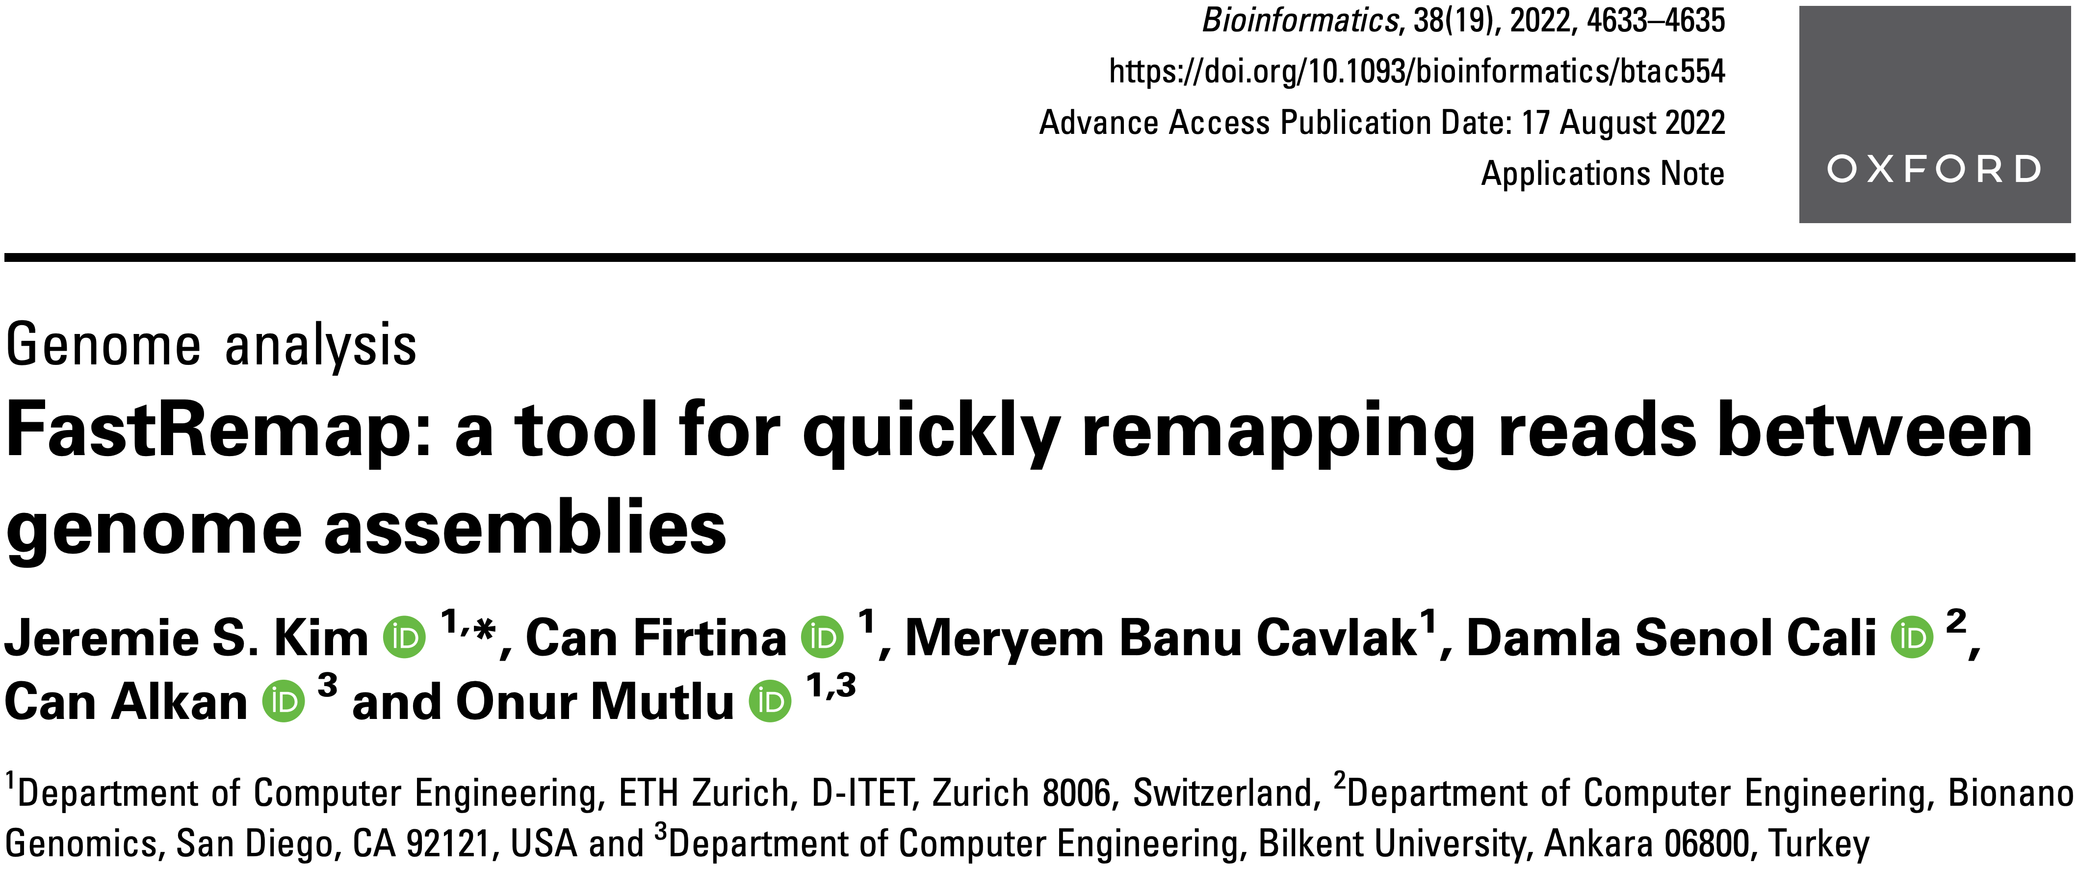
Mitigating Useless Computations [Bioinform. ‘22]
Jeremie S. Kim, Can Firtina, Meryem Banu Cavlak, Damla Senol Cali,
Can Alkan, and Onur Mutlu,
"FastRemap: A Tool for Quickly Remapping Reads
between Genome Assemblies"
Bioinformatics, October 2022.
[Online link at Bioinformatics Journal]
[arXiv preprint]
[FastRemap Source Code]

Slide 29
Utilizing AI/ML in
Genome Analysis
via New Algorithms and Architectures

Slide 30
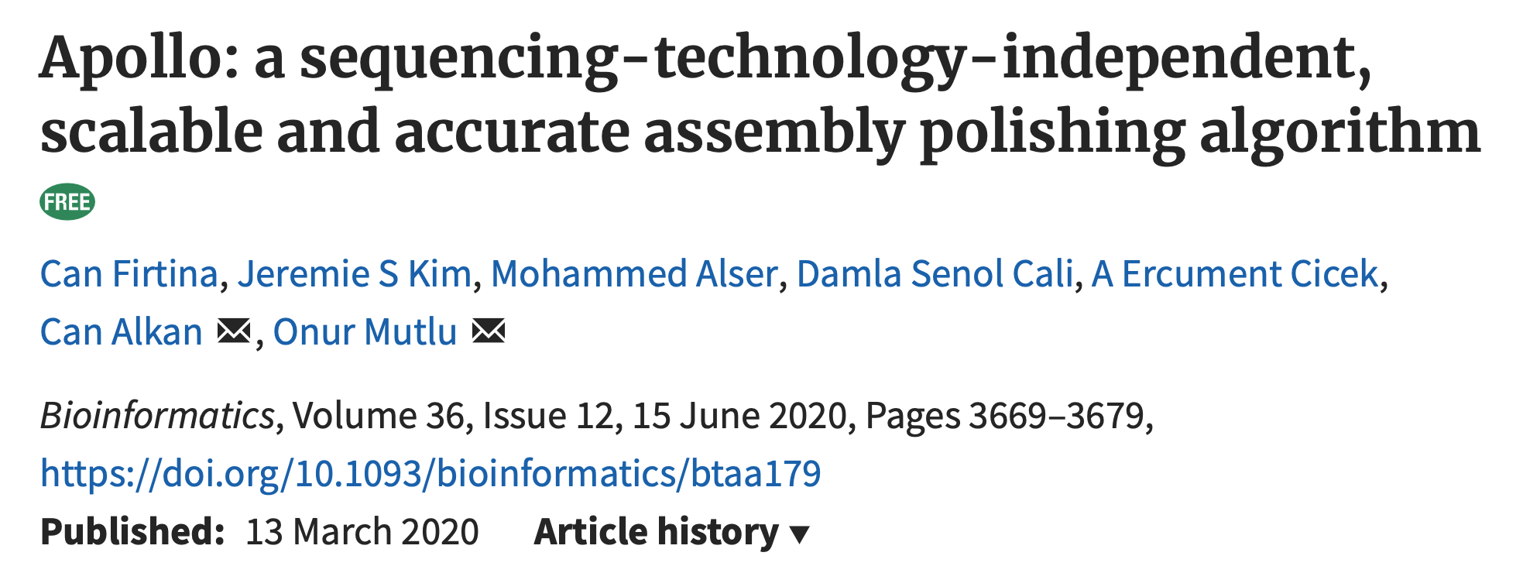
Error Correction using ML [Bioinform. ‘20]
Can Firtina, Jeremie S. Kim, Mohammed Alser, Damla Senol Cali,
A. Ercument Cicek, Can Alkan, and Onur Mutlu,
"Apollo: A Sequencing-Technology-Independent, Scalable, and Accurate Assembly Polishing Algorithm"
Bioinformatics, June 2020.
[Online link at Bioinformatics Journal]
[arXiv version]
[Slides (pptx)][(pdf)]
[Source Code]

Slide 31
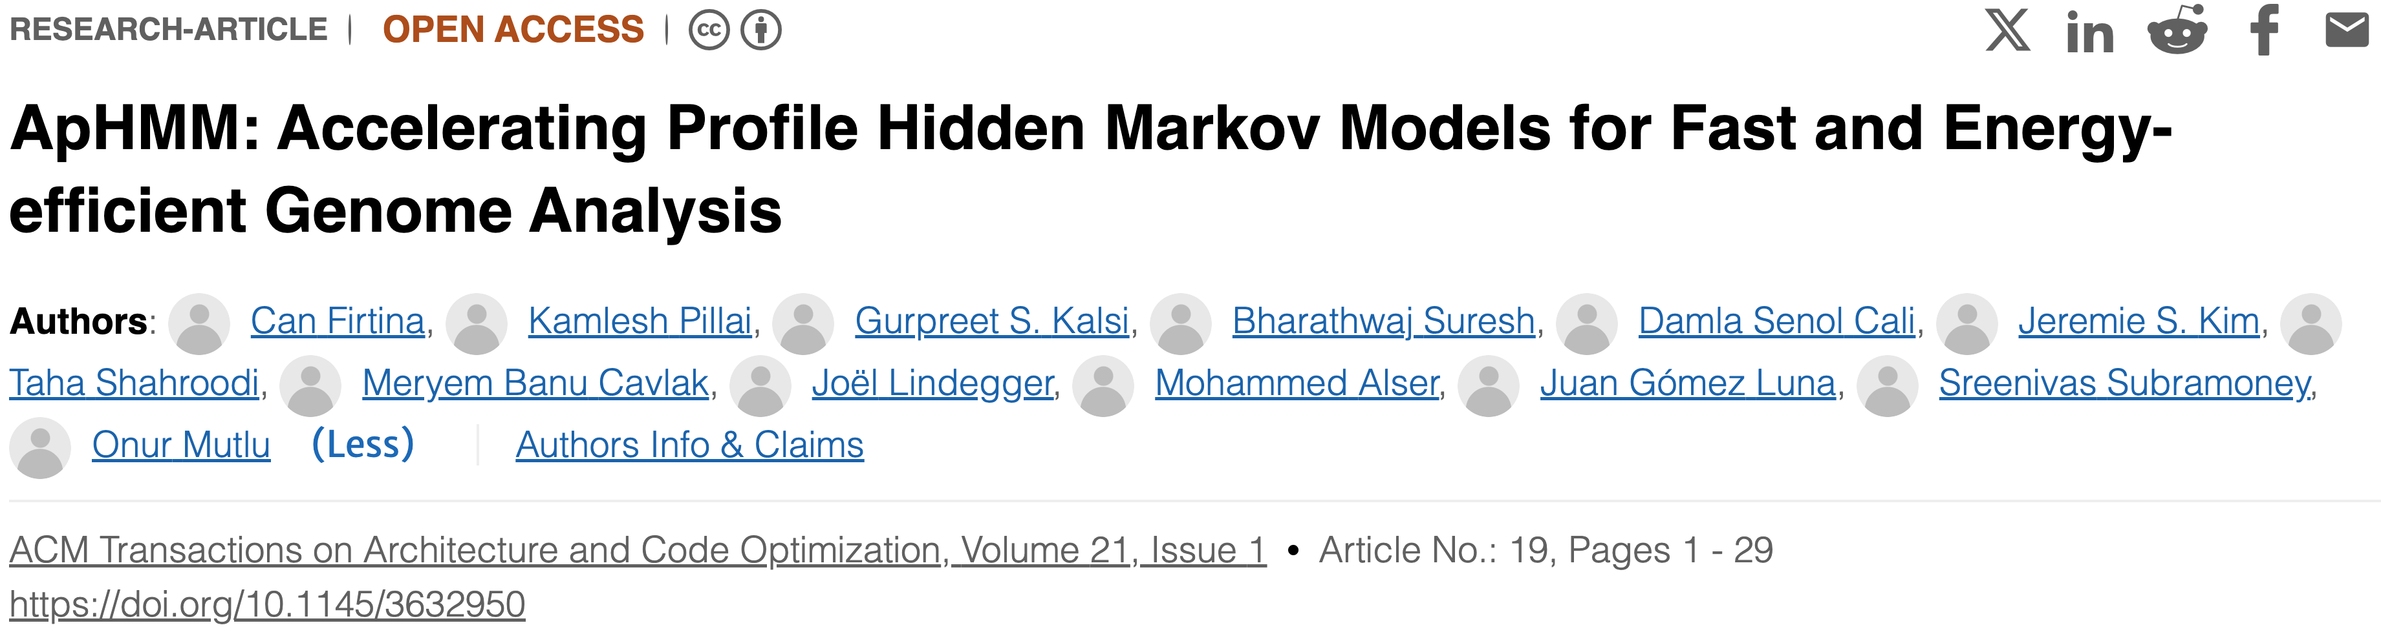
Accelerating ML & Genome Graphs [TACO ‘24]
Can Firtina, Kamlesh Pillai, Gurpreet S. Kalsi, Bharathwaj Suresh, Damla Senol Cali, Jeremie S. Kim, Taha Shahroodi, Meryem Banu Cavlak, Joel Lindegger, Mohammed Alser, Juan Gomez Luna, Sreenivas Subramoney and Onur Mutlu,
"ApHMM: Accelerating Profile Hidden Markov Models for Fast and Energy-efficient Genome Analysis"
ACM Transactions on Architecture and Code Optimization (TACO), Feb 2024.
[ACM Digital Library version]
[arXiv version]
Presented at the 19th HiPEAC Conference, Munich, Germany, January 2024.
[Slides (pptx) (pdf)]
[Talk Video HiPEAC 2024] (35 minutes)
[ApHMM Source Code]

Slide 32
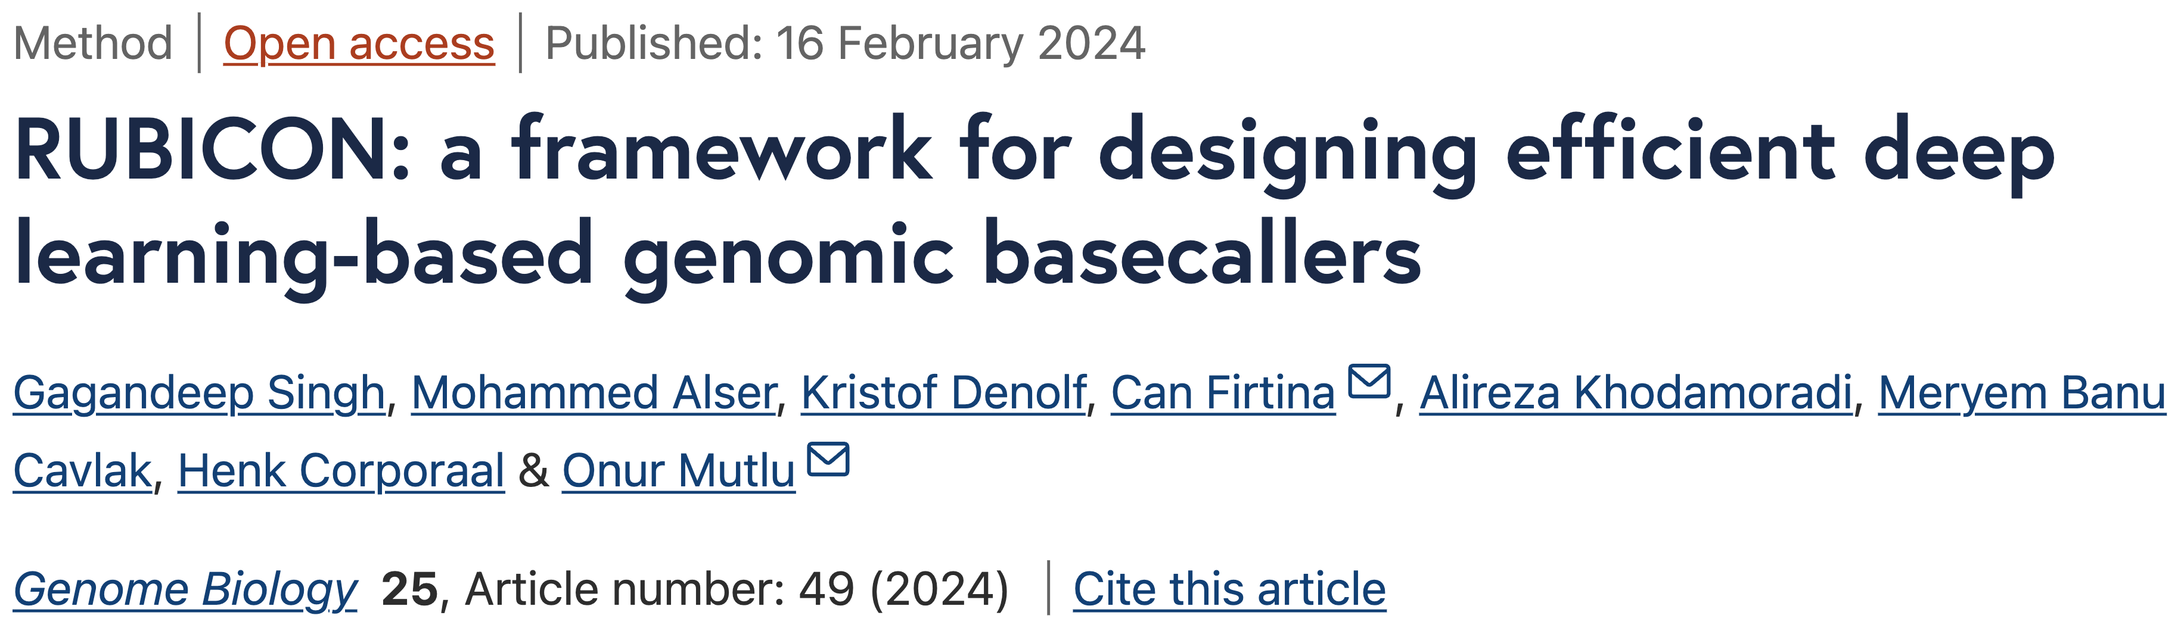
Translating Raw Signals using ML [Genome. Biol. ‘24]
Gagandeep Singh, Mohammed Alser, Kristof Denolf, Can Firtina,
Alireza Khodamoradi, Meryem Banu Cavlak, Henk Corporaal and Onur Mutlu,
"RUBICON: A Framework for Designing Efficient Deep Learning-Based Genomic Basecallers"
Genome Biology, February 2024.
[arXiv version]
[Online link at Genome Biology Journal]
[RUBICON Source Code]

Slide 33
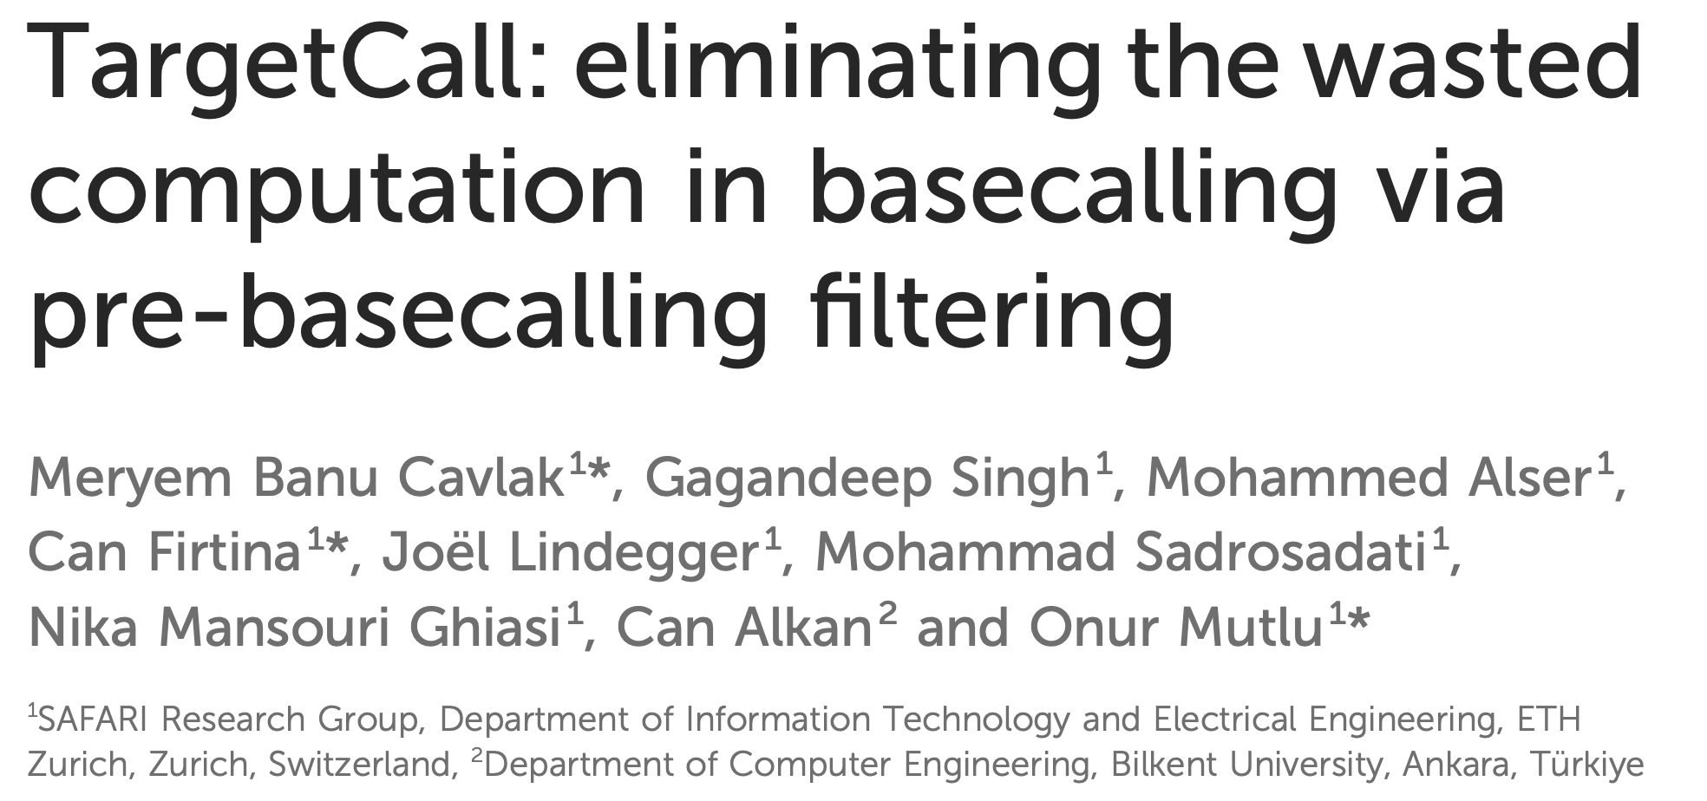
Eliminating Useless Basecalling [Front. In Genetics ‘24]
M. Banu Cavlak, Gagandeep Singh, Mohammed Alser, Can Firtina, Joel Lindegger, Mohammad Sadrosadati, Nika Mansouri Ghiasi, Can Alkan,
and Onur Mutlu,
"TargetCall: Eliminating the Wasted Computation in Basecalling via Pre-Basecalling Filtering"
Frontiers in Genetics, October 2024.
[Online link at Frontiers in Genetics Journal]
[arXiv Version]
[Talk Video at BIO-Arch 2023 Workshop]
[TargetCall Source Code]

Slide 34
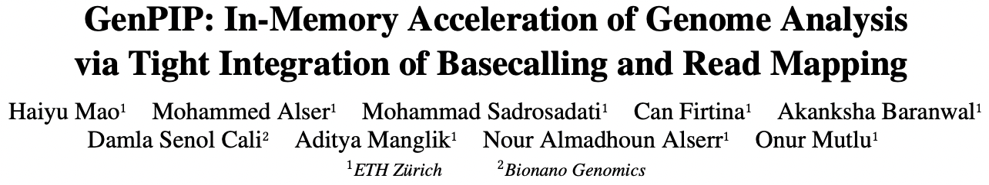
ML-based Genome Analysis via PIM [MICRO ‘22]
Haiyu Mao, Mohammed Alser, Mohammad Sadrosadati, Can Firtina, Akanksha Baranwal, Damla Senol Cali, Aditya Manglik, Nour Almadhoun Alserr, and Onur Mutlu,
"GenPIP: In-Memory Acceleration of Genome Analysis via Tight Integration of Basecalling and Read Mapping"
Proceedings of the 55th International Symposium on Microarchitecture (MICRO), Chicago, IL, USA, October 2022.
[Slides (pptx) (pdf)]
[Longer Lecture Slides (pptx) (pdf)]
[Lecture Video (25 minutes)]
[arXiv version]

Slide 35
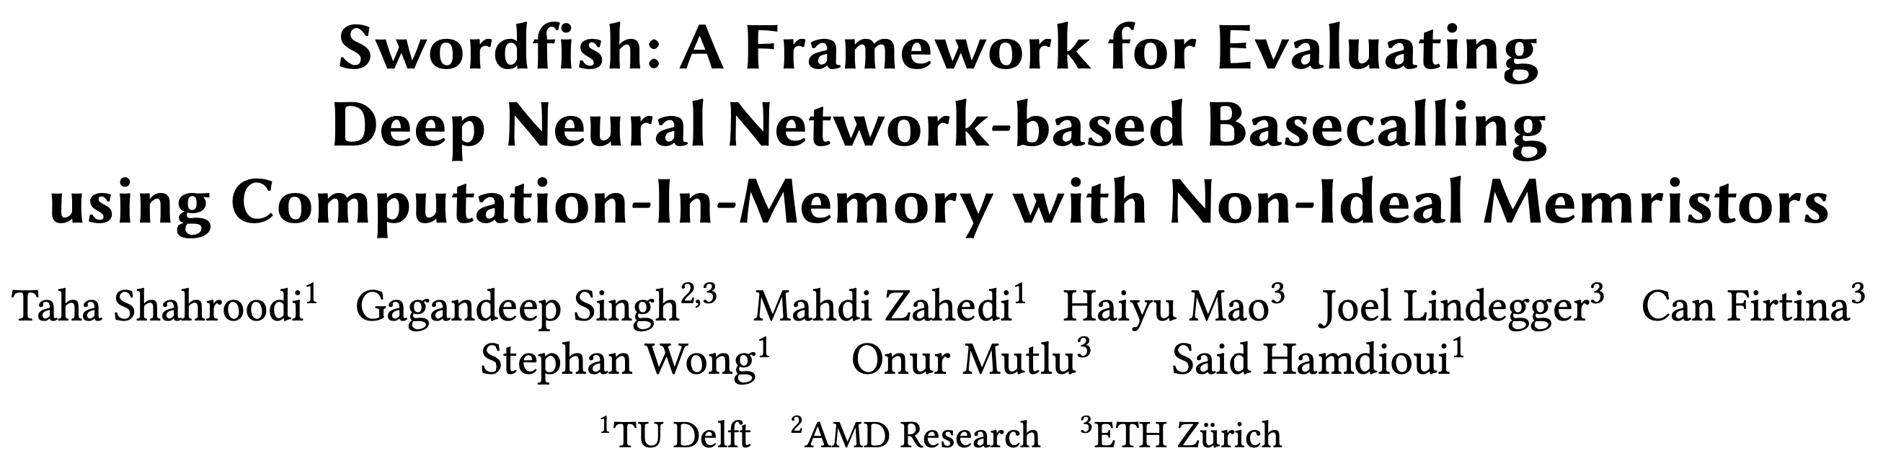
Basecalling using PIM [MICRO ‘23]
Taha Shahroodi, Gagandeep Singh, Mahdi Zahedi, Haiyu Mao, Joel Lindegger,
Can Firtina, Stephan Wong, Onur Mutlu, and Said Hamdioui,
"Swordfish: A Framework for Evaluating Deep Neural Network-based Basecalling using Computation-In-Memory with Non-Ideal Memristors"
Proceedings of the 56th International Symposium on Microarchitecture (MICRO), Toronto, ON, Canada, November 2023.
[Slides (pptx) (pdf)]
[arXiv version]

Slide 36
Fast, Accurate, and Efficient
Genome Analysis
via Algorithm-Architecture
co-design

Slide 37
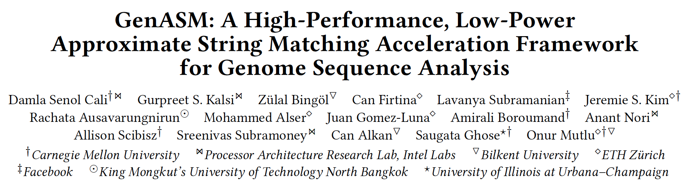
Accelerating String Matching [MICRO ‘20]
Damla Senol Cali, Gurpreet S. Kalsi, Zulal Bingol, Can Firtina, Lavanya Subramanian, Jeremie S. Kim, Rachata Ausavarungnirun, Mohammed Alser,
Juan Gomez-Luna, Amirali Boroumand, Anant Nori, Allison Scibisz,
Sreenivas Subramoney, Can Alkan, Saugata Ghose, and Onur Mutlu,
"GenASM: A High-Performance, Low-Power Approximate String Matching Acceleration Framework for Genome Sequence Analysis"
Proceedings of the 53rd International Symposium on Microarchitecture (MICRO), Virtual, October 2020.
[Lightning Talk Video (1.5 minutes)]
[Lightning Talk Slides (pptx) (pdf)]
[Talk Video (18 minutes)]
[Slides (pptx) (pdf)]

Slide 38
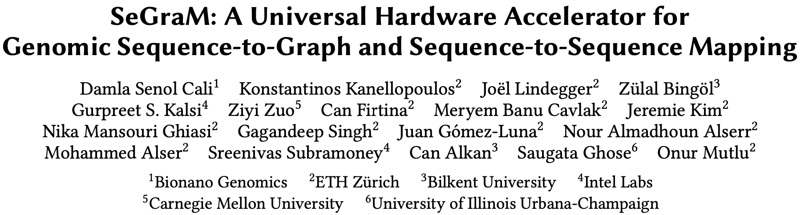
Accelerating Genome Graphs [ISCA ‘22]
Damla Senol Cali, Konstantinos Kanellopoulos, Joel Lindegger, Zulal Bingol,
Gurpreet S. Kalsi, Ziyi Zuo, Can Firtina, Meryem Banu Cavlak, Jeremie Kim,
Nika Mansouri Ghiasi, Gagandeep Singh, Juan Gomez-Luna,
Nour Almadhoun Alserr, Mohammed Alser, Sreenivas Subramoney, Can Alkan, Saugata Ghose, and Onur Mutlu,
"SeGraM: A Universal Hardware Accelerator for Genomic Sequence-to-Graph and Sequence-to-Sequence Mapping"
Proceedings of the 49th International Symposium on Computer Architecture (ISCA), New York, June 2022.
[Slides (pptx) (pdf)]
[arXiv version]
[SeGraM Source Code and Datasets]
[Talk Video (22 minutes)]

Slide 39
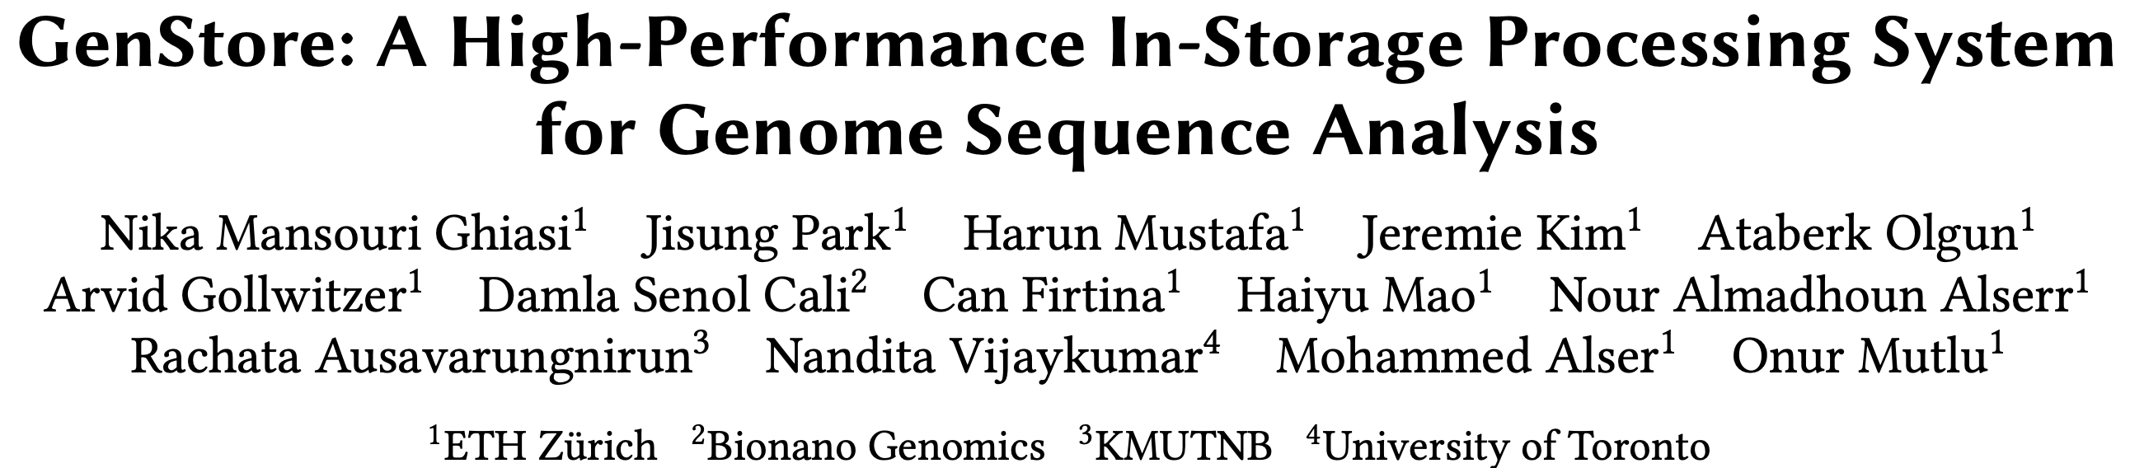
In-Storage Filtering for Genomics [ASPLOS ‘22]
Nika Mansouri Ghiasi, Jisung Park, Harun Mustafa, Jeremie Kim, Ataberk Olgun,
Arvid Gollwitzer, Damla Senol Cali, Can Firtina, Haiyu Mao,
Nour Almadhoun Alserr, Rachata Ausavarungnirun, Nandita Vijaykumar, Mohammed Alser, and Onur Mutlu,
"GenStore: A High-Performance and Energy-Efficient In-Storage Computing System for Genome Sequence Analysis"
Proceedings of the 27th International Conference on Architectural Support for Programming Languages and Operating Systems (ASPLOS), Virtual, Feb 2022.
[Lightning Talk Slides (pptx) (pdf)]
[Lightning Talk Video (90 seconds)]

Slide 40
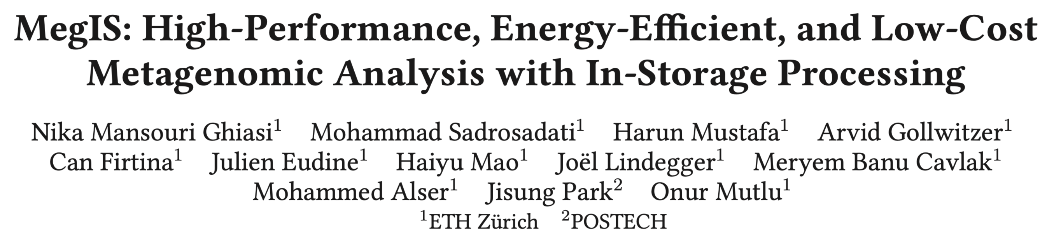
In-Storage Metagenomics [ISCA ‘24]
Nika Mansouri Ghiasi, Mohammad Sadrosadati, Harun Mustafa, Arvid Gollwitzer,
Can Firtina, Julien Eudine, Haiyu Mao, Joel Lindegger, Meryem Banu Cavlak,
Mohammed Alser, Jisung Park, and Onur Mutlu,
"MegIS: High-Performance and Low-Cost Metagenomic Analysis with In-Storage Processing"
Proceedings of the 51st Annual International Symposium on Computer Architecture (ISCA), Buenos Aires, Argentina, July 2024.
[Slides (pptx) (pdf)]
[arXiv version]

Slide 41
Accelerating Genome Analysis [DAC ‘23]
Onur Mutlu and Can Firtina,
"Accelerating Genome Analysis via Algorithm-Architecture Co-Design"
Invited Special Session Paper in Proceedings of the 60th Design Automation Conference (DAC), San Francisco, CA, USA, July 2023.
[Related Invited Paper]
[arXiv version]
[Slides (pptx) (pdf)]
[Talk Video at DAC 2023] (38 minutes, including Q&A)

Slide 42



My Involvements During my Ph.D.
Goal: Enable Fast, Energy-Efficient, Accurate,
and Scalable Genome Analysis
by Designing Algorithms and Architectures
Today’s Talk
Real-Time and
Raw Sequencing Data Analysis
Accurate and Fast Algorithm Design
for Read Mapping
[Bioinformatics'22]
Data-Centric
Architectures for Genome Analysis
[ISMB/ECCB'23]
[Bioinformatics'24]
[NARGAB'23 & RECOMB'23]
[IEEE Access'24]
Algorithm & Hardware Design for AI
in Genome Analysis
[arXiv'23]
[MICRO'20]
[arXiv'24 & HiTSeq'24]
[arXiv'23]
[MICRO'22]
[Bioinformatics'20]
[IEEE/ACM TCBB'24]
[ISCA'22]
[ACM TACO'24]
[ASPLOS'22]
[Genome Biology'24]
[IEEE Access'22]
[Front. in Genetics'24]
[MICRO'23]
[ISCA'24]
First/Co-First Author Publications
Reviews: [CSBJ'22] [DAC'23] [Nature Protocols'24]

Slide 43




Today’s Talk
Significant computation and energy overhead
Limited accuracy and application scope
Real-Time and
Raw Sequencing Data Analysis
Algorithm & Hardware Design
for AI in Genome Analysis
RawHash
(ISMB/ECCB'23)
  Enabling real-time and accurate
  read mapping without basecalling
1
ApHMM
(TACO'24 &
HiPEAC'24)
  Accelerating ML operations in Genome Graphs
3
Rawsamble
(arXiv'24 &
HiTSeq'24)
  Enabling new applications by assembling raw sequencing data
2

Slide 44
Today’s Talk
Significant computation and energy overhead
Limited accuracy and application scope
Real-Time and
Raw Sequencing Data Analysis
Algorithm & Hardware Design
for AI in Genome Analysis
RawHash
(ISMB/ECCB'23)
  Enabling real-time and accurate
  read mapping without basecalling
1
ApHMM
(TACO'24 &
HiPEAC'24)
  Accelerating ML operations in Genome Graphs
3
Rawsamble
(arXiv'24 &
HiTSeq'24)
  Enabling new applications by assembling raw sequencing data
2
RawHash
Rawsamble
ApHMM
Future Research

Slide 45
Basecalling is Accurate yet Costly
Raw
Reads
Basecalling (Translator)
Basecalled
Reads
Read
Mapping
AAATGTGGTCCATTG
Noisy
Raw Signals
Costly
AI Models
Highly accurate reads
How to make this pipeline cheaper?
RawHash
Rawsamble
ApHMM
Future Research

Slide 46
Can We Survive Without Translation?
Raw
Reads
Read
Mapping
Noisy
Raw Signals
Reference Genome
...
...
CTGCGTAGCAGCGTAATAG
How to communicate
without an accurate translator?
RawHash
Rawsamble
ApHMM
Future Research

Slide 47
Can We Survive With Noisy Signal Analysis?
Raw
Reads
Read
Mapping
Noisy
Raw Signals
Reference Genome
...
...
CTGCGTAGCAGCGTAATAG
Reference-to-Signal Conversion
How to identify similarity between noisy signals?
...
...
-0.06,0.24,-0.74,
Raw Signal Analysis
RawHash
Rawsamble
ApHMM
Future Research

Slide 48

Noise in Raw Electrical Signals
Observation: Identical molecules generate
similar raw signals
Sequencing CTGCGTAGCA
Raw
Signals:
[ , , , , ]
-0.06
-0.22
-0.75
0.96
-0.49
Key Idea: Perform similarity estimation
based on vector similarity search
Nearest Neighbor Search
Raw
Signals:
[ , , , , ]
-0.05
-0.21
-0.76
1.01
-0.51
Sequencing CTGCGTAGCA
Problem: Too Costly for Large Genomes
RawHash
Rawsamble
ApHMM
Future Research

Slide 49




Scalability Issues Limit Real-Time Analysis
Genome Size Increase: 150$×$
2.4$×$
9.2$×$
28$×$
No Real-Time Analysis for Larger Genomes:
Searching mechanism does not scale well
RawHash
Rawsamble
ApHMM
Future Research

Slide 50
Benefits of Real-Time Analysis
✓
Reducing latency by overlapping analysis with sequencing
Time
Sequencing
Analysis
Reduced Latency
Sequencing & Real-Time Analysis
✓
Reducing sequencing time and cost by stopping sequencing early
Sequenced Bases
Completely Sequenced Read
Reduced Sequencing Time (and Cost)
Partially Sequenced Read
Sequencing is stopped early with a real-time decision
RawHash
Rawsamble
ApHMM
Future Research

Slide 51
Goal
Enable Fast, Accurate, and Scalable
Real-Time Analysis for Larger Genomes
RawHash
Rawsamble
ApHMM
Future Research

Slide 52
Key Idea
Key Idea: Perform similarity estimation
based on quick exact matches
Raw
Signals:
[ , , , , ]
-0.06
-0.22
-0.75
0.96
-0.49
Hash
0x77db
Fast Match
CTGCGT
Hash
0x77db
Raw
Signals:
[ , , , , ]
-0.05
-0.21
-0.76
1.01
-0.51
Challenge: How to generate the same hash value
for similar enough signals with various noise types?
RawHash
Rawsamble
ApHMM
Future Research

Slide 53
RawHash Key Idea – Quantization
CTGCGT
-0.05
-0.07
-0.06
-0.05
-0.06
Quantize
Quantize
Quantize
Quantize
Quantize
Bucket #
0
1
2
3
4
5
6
7
8
9
10
11
12
13
14
15
-3.00
Range of raw signals (normalized)
+3.00
✓
Enables matching raw signals by eliminating slight differences
RawHash
Rawsamble
ApHMM
Future Research

Slide 54
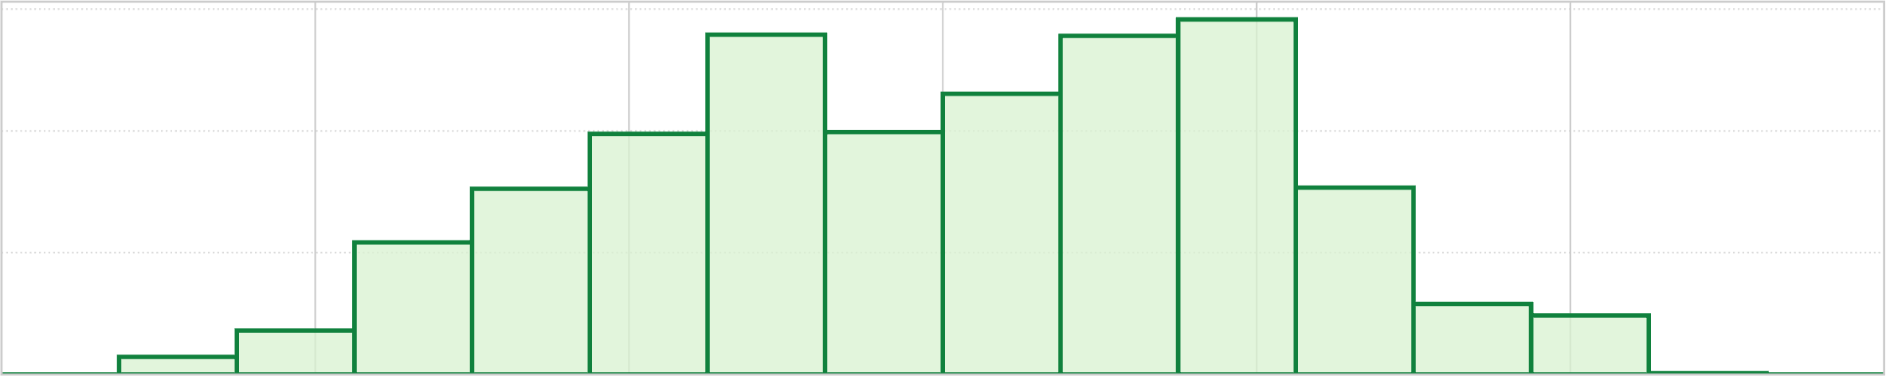
How to Better Quantize Signals?
Bucket #
0
1
2
3
4
5
6
7
8
9
10
11
12
13
14
15
-3.00
Range of raw signals (normalized)
+3.00
✕
Equal-width buckets leads to
unbalanced bucket loading
600
400
K-mer count
200
0
1
2
3
4
5
6
7
8
9
10
11
12
13
14
15
-3.00
+3.00
✕
Reduced uniqueness and poor resource utilization
RawHash
Rawsamble
ApHMM
Future Research

Slide 55
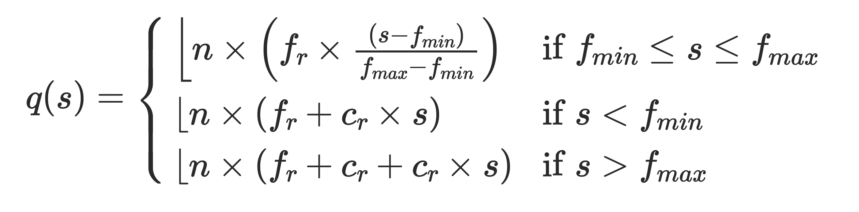
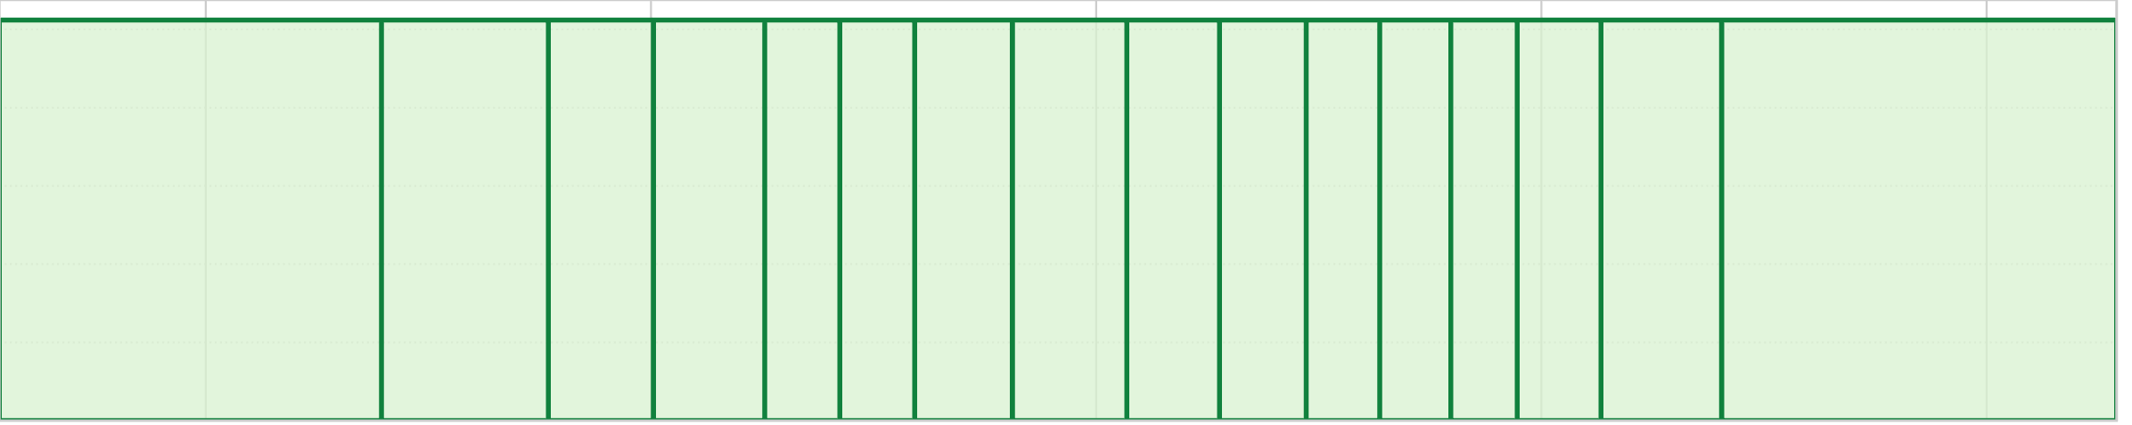
Adaptive Quantization
Key Idea: Quantizing raw signals with non-equal bucket widths
by leveraging raw signal distribution
Bucket #
0
1
2
3
4
5
6
7
8
9
10
11
12
13
14
15
-3.00
Range of raw signals (normalized)
+3.00
K-mer count
-3.00
3.00
✓
Better bucket utilization
RawHash
Rawsamble
ApHMM
Future Research

Slide 56
RawHash Key Idea – Hash-based Matching
Sequencing CTGCGTAGCA
[ , , , , ]
-0.06
-0.22
-0.75
0.96
-0.49
Quantize
Quantize
Quantize
Quantize
Quantize
Hash
0x77db
0b0111
0b0111
0b0110
0b1011
0b0110
Pack
0b01110111011010110110
Hash
0x77db
Fast and Accurate Match
Key Contribution: The first hash-based search
(and indexing) mechanism for raw signals
RawHash
Rawsamble
ApHMM
Future Research

Slide 57
Real-Time Analysis Benefits from Fast Search
Genome Size Increase: 150$×$
2.4$×$
9.2$×$
28$×$
Real-time Analysis for Human Genomes:
Fast search instead of costly neighbor search
RawHash
Rawsamble
ApHMM
Future Research

Slide 58
Fast Search Leads to Accurate Search
Best accuracy for all genomes:
Hash values span longer sequences than vectors ->
More unique and informative matches
(Almost) Identical accuracy to basecalled analysis:
Is the small difference because RawHash is even better?
RawHash
Rawsamble
ApHMM
Future Research

Slide 59
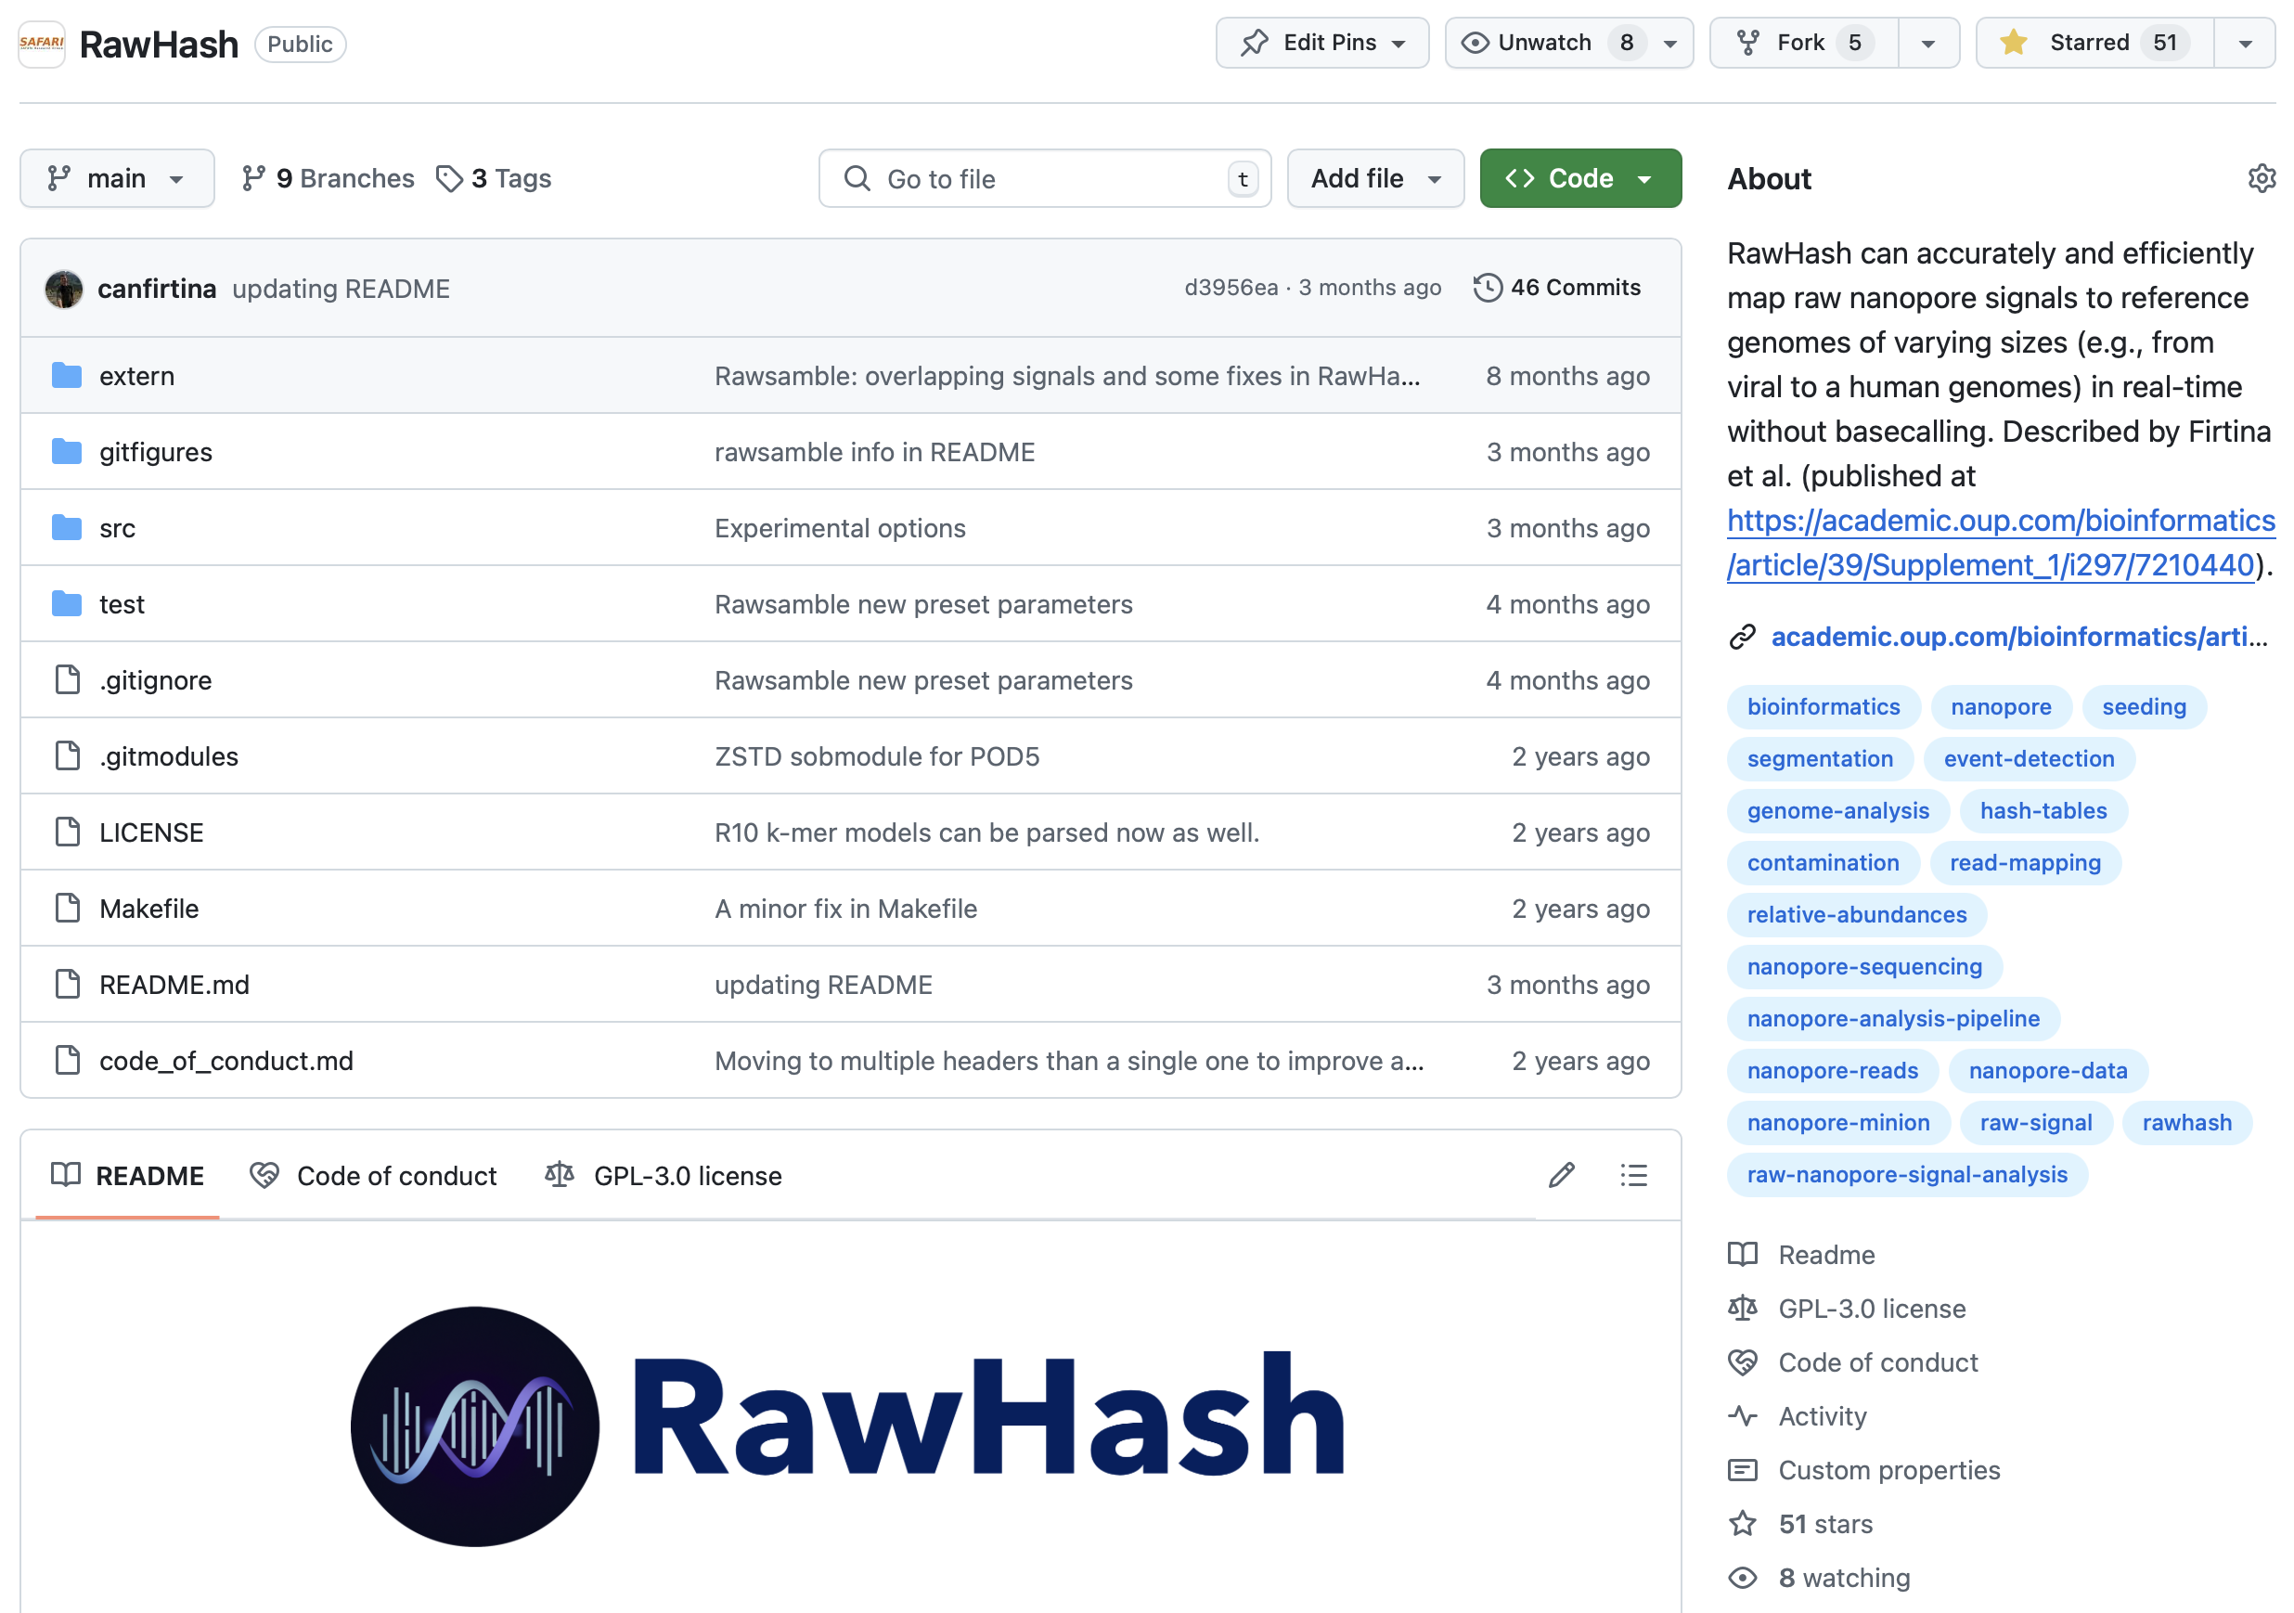
RawHash is Open Source
RawHash
Rawsamble
ApHMM
Future Research

Slide 60


RawHash’s Impact
RawHash
Several works
building on RawHash:
Collaboration
with Industry
to Accelerate Genome Analysis
Alignment without basecalling [IEEE Access'24]
Assembly without basecalling [arXiv’24]
In-storage processing [Accepted to ICS'25]
[Ongoing]
Collaboration
with Medical Centers
to Accelerate Sequence-to-Answer
In-memory processing [Unpublished work]
RawHash
Rawsamble
ApHMM
[Ongoing]
Future Research

Slide 61
Today’s Talk
Significant computation and energy overhead
Limited accuracy and application scope
Real-Time and
Raw Sequencing Data Analysis
Algorithm & Hardware Design
for AI in Genome Analysis
RawHash
(ISMB/ECCB'23)
  Enabling real-time and accurate
  read mapping without basecalling
1
ApHMM
(TACO'24 &
HiPEAC'24)
  Accelerating ML operations in Genome Graphs
3
Rawsamble
(arXiv'24 &
HiTSeq'24)
  Enabling new applications by assembling raw sequencing data
2
RawHash
Rawsamble
ApHMM
Future Research

Slide 62
Today’s Talk
Significant computation and energy overhead
Limited accuracy and application scope
Real-Time and
Raw Sequencing Data Analysis
Algorithm & Hardware Design
for AI in Genome Analysis
RawHash
(ISMB/ECCB'23)
  Enabling real-time and accurate
  read mapping without basecalling
1
ApHMM
(TACO'24 &
HiPEAC'24)
  Accelerating ML operations in Genome Graphs
3
Rawsamble
(arXiv'24 &
HiTSeq'24)
  Enabling new applications by assembling raw sequencing data
2
RawHash
Rawsamble
ApHMM
Future Research

Slide 63
Pushing the Boundaries of Application Scope
via New Algorithms

Slide 64


Beyond Reference Mapping: Overlapping
Reference Genome (Converted to Signals)
Raw Nanopore Signals
Raw Nanopore Signals
TGCTGCAA
CGAAGTCA
CGTAGTGG
CCACCGGT
Reference Signals
CTGCAATC
TGATCCGA
TCAGCCGT
AGTGGACC
GGTAAGCT
TGCTGCAATCGTGATCCGAAGTCAGCCGTAGTGGACCACCGGTAAGCT
Hash-Based
Seeding and Mapping
Challenge: Reference genome is not always available
Assembly: Constructing genome from overlapping reads
✕
Existing solutions cannot find overlapping reads without basecalling
RawHash
Rawsamble
ApHMM
Future Research

Slide 65




Challenges with Overlapping Raw Signals
Hash-Based
Seeding and Mapping
Challenge: Identifying hash matches when both signals are noisy
Challenge: Finding many useful overlapping pairs (all-vs-all overlapping)
Challenge: Generating long paths from useful overlaps
RawHash
Rawsamble
ApHMM
Future Research

Slide 66
Rawsamble
The first mechanism that can perform
all-vs-all overlapping from raw signals
RawHash
Rawsamble
ApHMM
Future Research

Slide 67
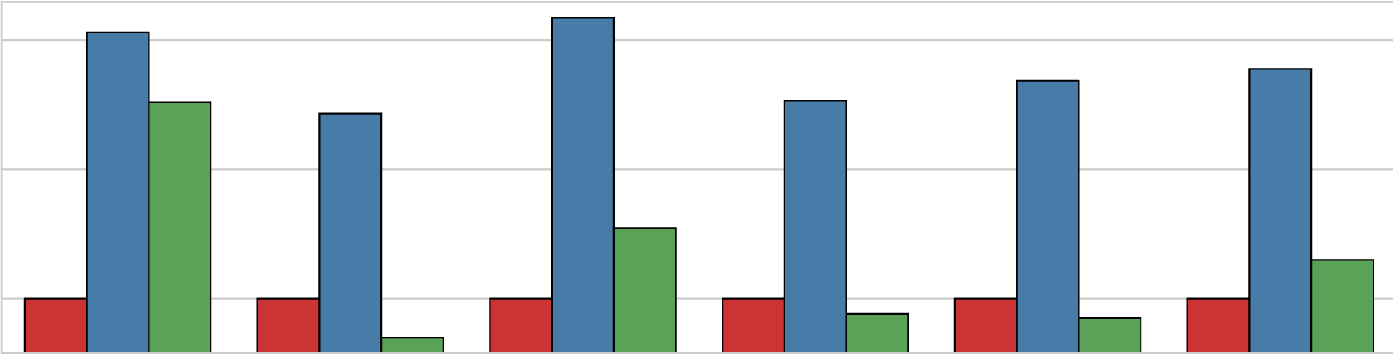
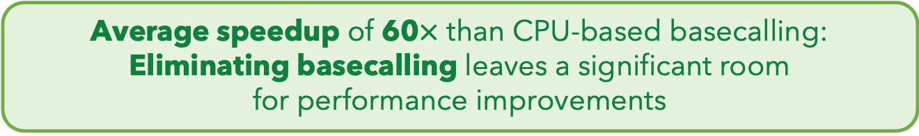





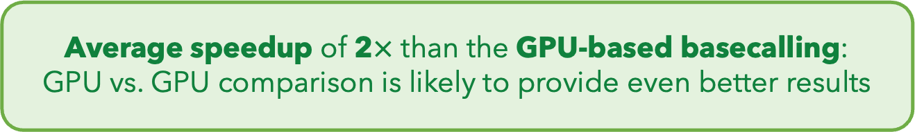
Eliminating Basecalling from the Pipeline
Rawsamble
Basecalling (CPU)
+ Overlapping
Basecalling (GPU)
+ Overlapping
$${10}^{2}$$
Elapsed Time
(Normalized to Rawsamble)
59.70$×$
$${10}^{1}$$
$${10}^{0}$$
1.99$×$
SARS-CoV-2
E. coli
Yeast
Green Algae
Human
Geo. Mean
Average speedup of 60$×$ than CPU-based basecalling: Eliminating basecalling leaves a significant room
for performance improvements
Average speedup of 2$×$ than the GPU-based basecalling:
GPU vs. GPU comparison is likely to provide even better results
RawHash
Rawsamble
ApHMM
Future Research

Slide 68
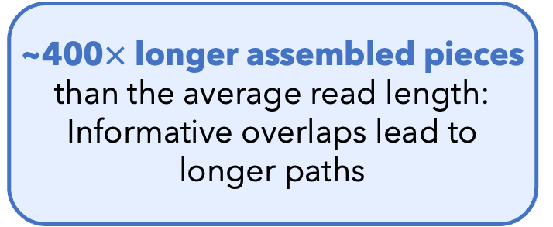
Key Results – First Ever Assemblies
First assemblies
ever constructed
without basecalling
E. coli Assembly
(From the Rawsamble Overlaps)
~400$×$ longer assembled pieces than the average read length:
Informative overlaps lead to longer paths
It is time to rethink if we want to translate individual reads separately
RawHash
Rawsamble
ApHMM
Future Research

Slide 69
Today’s Talk
Significant computation and energy overhead
Limited accuracy and application scope
Real-Time and
Raw Sequencing Data Analysis
Algorithm & Hardware Design
for AI in Genome Analysis
RawHash
(ISMB/ECCB'23)
  Enabling real-time and accurate
  read mapping without basecalling
1
ApHMM
(TACO'24 &
HiPEAC'24)
  Accelerating ML operations in Genome Graphs
3
Rawsamble
(arXiv'24 &
HiTSeq'24)
  Enabling new applications by assembling raw sequencing data
2
RawHash
Rawsamble
ApHMM
Future Research

Slide 70
Today’s Talk
Significant computation and energy overhead
Limited accuracy and application scope
Real-Time and
Raw Sequencing Data Analysis
Algorithm & Hardware Design
for AI in Genome Analysis
RawHash
(ISMB/ECCB'23)
  Enabling real-time and accurate
  read mapping without basecalling
1
ApHMM
(TACO'24 &
HiPEAC'24)
  Accelerating ML operations in Genome Graphs
3
Rawsamble
(arXiv'24 &
HiTSeq'24)
  Enabling new applications by assembling raw sequencing data
2
RawHash
Rawsamble
ApHMM
Future Research

Slide 71

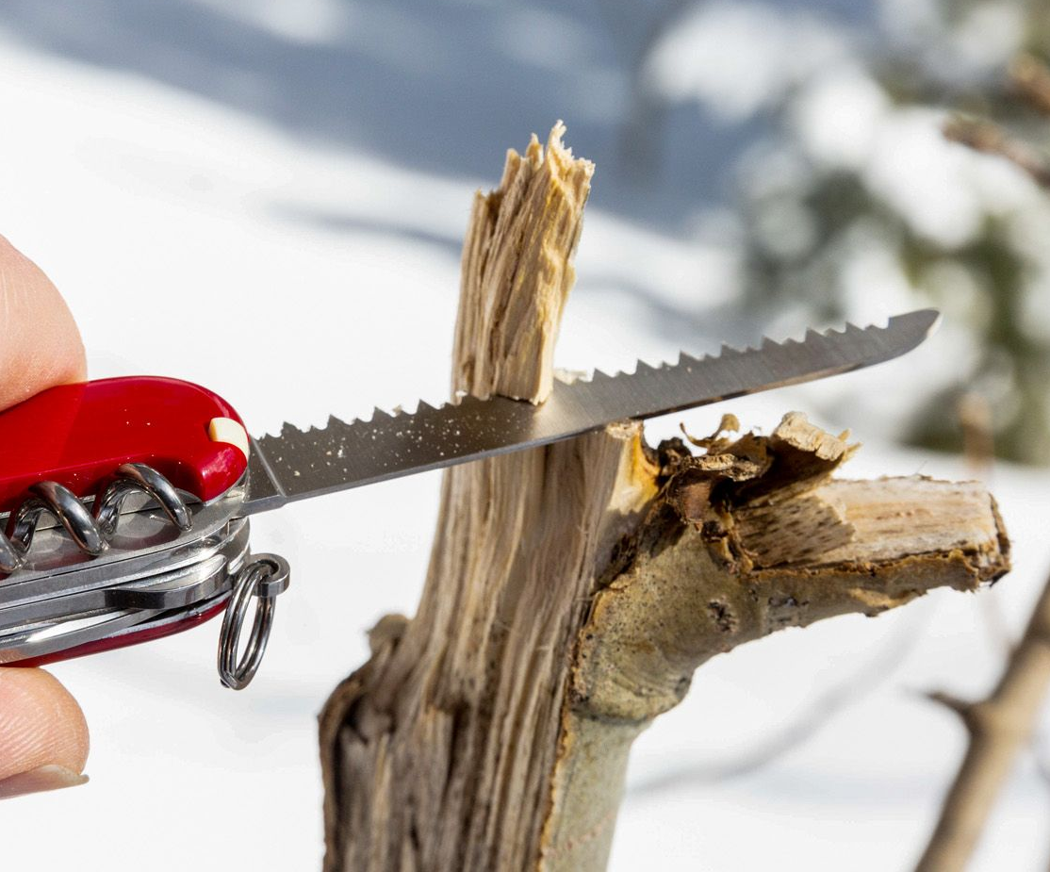
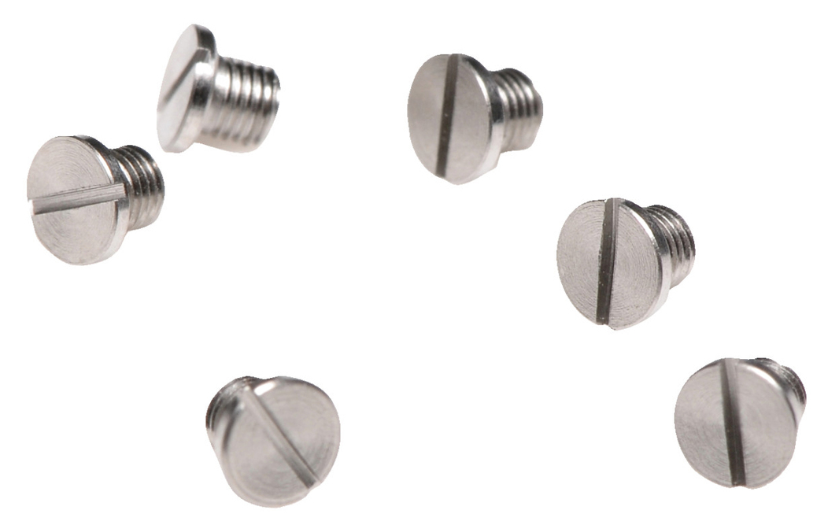

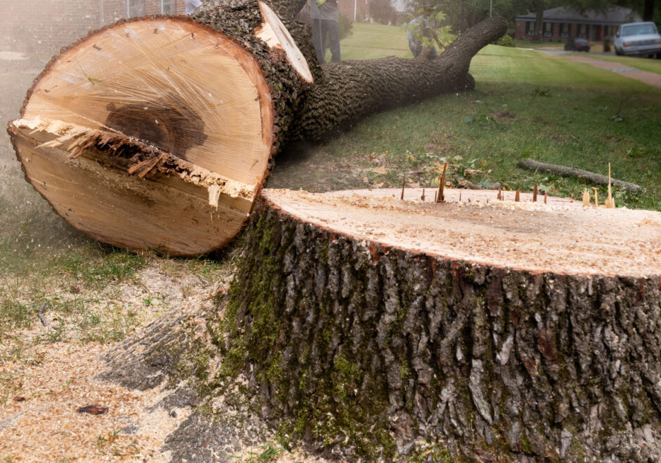

Algorithm Design Demands
General-Purpose Computing Capabilities
RawHash
Rawsamble
ApHMM
Future Research

Slide 72
Algorithm Design Demand
General-Purpose Computing Capabilities
Your Favorite
Algorithm
Function 1
Function 2
Function 4
Function 3
Your Favorite
Output
General-Purpose Systems
(e.g., CPUs)
Paid Costs for Generality:
Supporting unnecessary operations
Inefficient data and control flow
Limited parallelism & bandwidth
High latency &
Substantial energy
RawHash
Rawsamble
ApHMM
Future Research

Slide 73
Great Algorithms Demand Specialization
Application-Specific Architecture
Everyone’s Favorite
Algorithm
Function 1
Function 1
Function 2
Function 2
Function 3
Function 3
Goal: Avoid wasting computation & energy
Opportunities:
Better data flow with minimal latency & power
Paid Costs for Specialization:
Poor programmability
High manufacturing and engineering costs
Efficient processors customized for the task
Better parallelism
RawHash
Rawsamble
ApHMM
Future Research

Slide 74





Acceleration Efforts for AI and Genomics
Cerebras WSE-3
The largest ML accelerator chip
Google’s TPUs:
NVIDIA H100
RawHash
Rawsamble
ApHMM
Future Research

Slide 75
Important and
Commonly Used Applications
Demand Specialization

Slide 76




Graphs in Genomics
Graphs are commonly used
to identify variations between sequences
To avoid redundant comparisons
and storage
To provide rich information
on expected variations
Reference Genome Graph
RawHash
Rawsamble
ApHMM
Future Research

Slide 77


Graph-Based Applications in Genomics
Protein Family Search
with Graph Alignment
Error Correction
with Probabilistic Graphs
Multiple Sequence
Alignment
Protein
GCCC-TATGGTTAAGCTT
GCCCATATGGTTAAGCTT
GCCCATATGATTAAGCTT
CCCT
TGCT
GCTA
GCCCATATGGTTAAGCTT
CCTA
GCTT
GCCCGTATGGTT--GCTT
Protein
Family #1
Protein
Family #2
ATGC
AAGC
GCCCATATGCTTAAGCTT
GCCC---TGGTTAAGCT-
CCCT
GCTT
GCCCATATCCTTAAGCTT
GCCCTTATGCTTAAGCTA
GCCCATATGGTTAAGCTT
RawHash
Rawsamble
ApHMM
Future Research

Slide 78
A Common Graph Structure in Genomics
Profile Hidden Markov Models (PHMMs):
A probabilistic graph structure
0.4
0.3
A: 0.1
T: 0.2
G: 0.6
C: 0.1
A: 0.2
T: 0.2
G: 0.2
C: 0.4
I
I
I
I
0.6
0.2
0.1
A
C
T
T
A: 0.9
T: 0.1
G: 0.0
C: 0.0
A: 0.1
T: 0.1
G: 0.1
C: 0.7
0.7
D
D
D
RawHash
Rawsamble
ApHMM
Future Research

Slide 79
Underlying ML Technique in Genomic Graphs
Forward Calculations
Backward Calculations
Updating
Transition Probabilities
Updating
Emission Probabilities
RawHash
Rawsamble
ApHMM
Future Research

Slide 80
Underlying ML Technique in Genomic Graphs
Forward Calculations
Backward Calculations
Function 1
Function 1
Function 2
Function 2
Updating
Transition Probabilities
Updating
Emission Probabilities
Function 3
Function 4
RawHash
Rawsamble
ApHMM
Future Research

Slide 81
Costly Use of ML in Genomic Graphs
Cost of Using Machine Learning (ML) in pHMMs:
51.44%
45.76%
98.57%
RawHash
Rawsamble
ApHMM
Future Research

Slide 82
Goal
Enable rapid and power-efficient
use of the underlying ML technique in genome graphs
RawHash
Rawsamble
ApHMM
Future Research

Slide 83
Key Approach: HW-SW Co-Design
SW
Reduce redundant data storage by utilizing
the fixed data pattern
Reduce unnecessary computations with quick filtering
Avoid repeated operations by utilizing lookup tables
Reduce data movement by processing data where it makes sense
Flexible and efficient hardware design
HW
RawHash
Rawsamble
ApHMM
Future Research

Slide 84





HW: Simple Data Pattern in DP Calculations
DP Operations
in pHMMs:
Dynamic Programming
(DP) Operations:
$$F_{t}\left(i\right)$$
$$i$$
$$i$$
A
I
D
C
I
D
T
I
D
$$t$$
$$t$$
A
T
G
T
Many Different Patterns
Simple Pattern
Frequent off-chip access
MUL
MUL
ADD
FP DIV
Fast On-chip Memory Access
DP Computation in pHMMs
Store and access data
where it makes sense
RawHash
Rawsamble
ApHMM
Future Research

Slide 85




SW: Reducing Unnecessary Computations
Observation:
Calculating the entire DP
is not needed
$$F_{t}\left(i\right)$$
$$F_{t}\left(i\right)$$
$$i$$
A
I
D
C
I
D
T
I
D
$$i$$
A
I
D
C
I
D
T
I
D
$$t$$
$$t$$
A
Filter by sorting
A
T
T
G
G
T
T
Dense DP Calculations
Sparse (Filtered) DP Calculations
Challenge:
Sorting is costly in hardware
RawHash
Rawsamble
ApHMM
Future Research

Slide 86

SW: Reducing Unnecessary Computations
Software co-design:
Replace sorting with a cheaper filtering
State IDs
Range
8, 9
1.00 – 0.94
10, 14
0.94 – 0.88
15, 16, 18
0.88 – 0.82
11, 20, 21, …
0.82 – 0.76
13, 17, 19, …
0.76 – 0.70
.
.
.
.
.
.
0.06 – 0.00
Histogram Filter
RawHash
Rawsamble
ApHMM
Future Research

Slide 87
Putting the Optimizations Together
Effectively implementing the hardware and software optimizations
to improve performance and reduce power requirements
RawHash
Rawsamble
ApHMM
Future Research

Slide 88
Integrating ApHMM in a Complete System
The specialized task can be offloaded
to an accelerator whenever needed
RawHash
Rawsamble
ApHMM
Future Research

Slide 89
Key Results: Performance
Specialized design enables computation
up to two orders of magnitude faster:
Better data flow with reduced latency and improved parallelism
RawHash
Rawsamble
ApHMM
Future Research

Slide 90
Key Results: Energy Consumption
…and a significant reduction in energy consumption
by up to three orders of magnitude:
simpler hardware with a minimized off-chip memory accesses and data movement
RawHash
Rawsamble
ApHMM
Future Research

Slide 91
Specialization Provides
Significant Performance
and Energy Benefits

Slide 92
Today’s Talk
Significant computation and energy overhead
Limited accuracy and application scope
Real-Time and
Raw Sequencing Data Analysis
Algorithm & Hardware Design
for AI in Genome Analysis
RawHash
(ISMB/ECCB'23)
  Enabling real-time and accurate
  read mapping without basecalling
1
ApHMM
(TACO'24 &
HiPEAC'24)
  Accelerating ML operations in Genome Graphs
3
Rawsamble
(arXiv'24 &
HiTSeq'24)
  Enabling new applications by assembling raw sequencing data
2

Slide 93








Acknowledgements
Collaborators:
Funding agencies and industry sponsors:
  BioPIM, SNSF, Intel, Google, Huawei, Microsoft, VMware, and SRC

Slide 94
Fast and Efficient Genome Analysis via New Algorithms and Architectures
Can Firtina
canfirtina@gmail.com
https://canfirtina.com
6 May 2025
Inria – GenScale & Symbiose

Slide 95
Sequencing Data Analysis
Heuristic Algorithms
Data Structures
Filters
TATGG
AAGCC
TATAT
TGGTA
GCCTA
AGATA
TGCAC
CCTGG
✓
Quick, accurate, and energy-efficient analysis
Distributed
Computing
Imperfections in sequencing data
impacts design choices
Hardware Accelerators
✕

Slide 96

Data Movement Overhead
William Dally,
HiPEAC 2015
A memory access consumes ~100-1000X
the energy of a complex addition
RawHash
Rawsamble
ApHMM
Future Research

Slide 97


Minimizer Sketching
GCTATTACCT
GCTATTA
Hash
0xA1
Find
Minimum
Window of
k-mers
($w = 4$)
CTATTAC
Hash
0x02
Hash Table
0x02
TATTACC
Hash
0xFC
ATTACCT
Hash
0x45
CTATTAC
Overlapping
k-mers ($k=7$)
Sampled
k-mer (Minimizer)

Slide 98
Spaced Seeding
GCTATTA
Pattern
GXTAXTA
Hash
0xA1
GATACTA
Pattern
GXTAXTA
Hash
0xA1
GACACTA
Pattern
GXCAXTA
Hash
0xFC
Spaced Seeds

Slide 99
Strobemer Sketches
GCTATTACCTTAATGTGATGGAC
Link
GCTATTAATGGA
Hash
0xA1
GCTATCCCCTTAATGGGATGGAC
Link
GCTATTAATGGA
Hash
0xA1
GCCCTCCCCTTAAAGGGAATGGA
Link
CCTCTAAATGGA
Hash
0xFC
Selected k-mers (e.g., minimizers)
Strobemers

Slide 100
Hash-Based Sketching and Seed Matching
Target Sequence
Query Sequence
GCTATTACCTTAATGTGATGGACGA
CAGGCTATAACCCTAATGTTGC
Sketching
Sketching
GCTA
TAAT
GACG
GCTA
ATGT
Hash
Hash
Hash
Hash
Hash
0x01
0xA4
0x41
0x01
0xFE
Store
Store
Store
Query
Query
<List of Positional Information>
Match
0x01
0xA4
0x41
Hash Table
No Match

Slide 101













Chaining (Two Points)
$$xj$$
$$xi$$
Chaining
Target Seq.
Target Seq.
$$aj$$
$$ai$$
Anchor
(Seed match)
$$wi$$
$$(xi−xj)$$
$$aj$$
$$yj$$
$$yi$$
Query Seq.
Query Seq.
$$aj$$
$$ai$$
$$(yi−yj)$$
$$wi$$

Slide 102
Chaining (Multiple Points)
Exact hash value matches: Needed for finding matching regions between a reference genome and a read
What if there are mutations or errors?
  No hash (seed) match will occur in such positions
The chaining algorithm links exact matches in a proximity even though there are gaps (no seed matches) between them

Slide 103
Sequence Alignment

Slide 104
Nanopore Sequencing

Slide 105
Source of Noise in Nanopore Sequencing
Stochastic thermal fluctuations in the ionic current
  Random ionic movement due to inherent thermal energy (Brownian motion)
Variations in the translocation speed
  Mainly due to the motor protein
Environmental factors
  Temperature: Affecting enzymes including the motor protein
  pH levels: Affecting charge and the shape of molecules
Maybe: Aging & material-related noise between nanopores
  Their effects potentially can be minimized with normalization techniques

Slide 106

R9 vs. R10 Chemistries
Dual reader head
Motor protein with more consistent translocation speed in R10
Duplex sequencing in R10

Slide 107

Proteomics with Nanopores
Motone+, “Multi-pass, single-molecule nanopore reading of long protein strands”, Nature 2024.

Slide 108



Processing Raw Nanopore Signals
K many nucleotides (k-mers) sequenced at a time
Observation: Abrupt change in the signal as DNA moves
inside a nanopore (e.g., when sequencing a new k-mer)
Goal: Identify raw signal segments corresponding each sequenced k-mer
  Statistical tests (segmentation) to identify abrupt changes
  Event: A raw signal segment corresponding to a particular k-mer
Event
…
…
pAmpere
Segment
…
…
Time
-0.06
-0.22
TGCGTC
ATGCGT
6-mer

Slide 109
Scalability Issues with Costly Calculations
A Small Genome (Bacteria)
CGAAATGCC...AGATTAAATGGGCTTTCT
Real-Time
Analysis:
Data is consumed before next one
arrives
Data Generation
Speed
Data
Waiting for Data
Waiting for Data
Computation Cost
(per Region)
A Large Genome (Human)
CGAAATGCC...AGATTAAATGGGCTTTCT...TGCCCTAA...GAATGGCGT
Data Generation
Speed
Data
Waiting for Data
Waiting for Data
Computation Cost
(per Region)
Increased Latency
No Real-Time Analysis

Slide 110
Reference-to-Signal Conversion
Goal: Enable direct comparison to raw signals by converting reference genome into its synthetic signal (one-time task)
K-mer model: Provides expected signal values for every possible k-mer
  A lookup table preconstructed based on nanopore’s characteristics
Use the k-mer model to convert all k-mers of a reference genome
to their expected signal values
Reference Genome
Reference Signals
...
...
...
...
CTGCGTAGCAGCGTAATAG
-0.06,0.24,-0.74,
CTGCGT
K-mer model
K-mer model
-0.06
AAAAAA
-0.29
TGCGTA
K-mer model
0.24
…
…
GCGTAG
TTTTTT
0.04
K-mer model
-0.74
K-mer
Signal
Expected Signal

Slide 111




Challenges in Real-Time Analysis
Rapid analysis to match the nanopore sequencer throughput
Timely decisions to stop sequencing as early as possible
Accurate analysis from noisy raw signal data
Power-efficient computation for scalability and portability

Slide 112
Applications of Read Until
Depletion: Reads mapping to a particular reference genome is ejected
Microbiome studies by removing host DNA
Eliminating known residual DNA or RNA (e.g., mitochondrial DNA)
High abundance genome removal
Enrichment: Reads not mapping to a particular reference genome is ejected
Removing contaminated organisms
Targeted sequencing (e.g., to a particular region of interest in the genome)
Low abundance genome enrichment

Slide 113
Applications of Run Until & Sequence Until
Run Until: Stopping the entire sequencing run
Stopping when reads reach to a particular depth of coverage
Stopping when the abundance of all genomes reach a particular threshold
Sequence Until: Run Until with accuracy-aware decision making
Stopping when relative abundance estimations do not change substantially (for high-abundance genomes)
Stopping when finding that the sample is contaminated with a particular set of genomes
…

Slide 114
In Vitro (e.g., PCR) vs. In Silico
Polymerase Chain Reaction (PCR) as a way of in vitro “analysis”
  Can increase the quantity of DNA in a sample
  Non-dynamic targeted sequencing (e.g., low abundance known targets)
  Requires additional resources: Time and money for preparation and execution of PCR
Adaptive sampling as a way of in silico (i.e., computational) analysis
  Cannot increase the existing quantity of DNA in a sample
  Dynamic targeted sequencing: Decisions can be made based on real-time analysis (e.g., Sequence Until)
  Minimal additional resources
    Almost no additional resources for preparation and execution
    Simultaneous enrichment and depletion is possible
    Better suited for rapid whole genome sequencing
  Beauty of computational analysis (e.g., high flexibility – no need for primers)
PCR and adaptive sampling can be combined depending on the analysis type

Slide 115
Finding Mapping Positions
Useful for any application that requires exact genomic position
  Variant calling in downstream analysis
  Specifically: Identifying rare variants in cancer genomics
  Methylation profiling
Accurate and flexible depth of coverage estimation
  Alternative: DNA quantification (without computational analysis)
    DNA quantification is challenging for metagenomics analysis
  Computational method: We can map to almost entire set of known reference genomes to accurately estimate the coverage of a metagenomics sample
Transcriptome analysis
  Accurately quantifying expression levels & alternative splicing
Better resolution (i.e., more sensitive analysis) for any other application that does not specifically require mapping positions

Slide 116


Analyzing Raw Nanopore Signals
Traditional: Translating (basecalling) signals to bases before analysis
Recent Work: Directly analyzing signals without basecalling
Basecalling
Read Mapping
Raw Signal Mapping
Raw Signal
Raw Signal
A
T
G
G
Basecalled sequences are
less noisy than raw signals
Efficient analysis with better scalability and portability
Many analysis tools use basecalled sequences
Raw signals retain more information than just bases
Costly and power-hungry computational requirements

Slide 117
The Problem – Mapping Raw Signals
Raw Signal
Small Reference Genome
Large Reference Genome (Human)
Fewer candidate regions in small genomes
Substantially larger number of regions to check per read as the genome size increases
Problem: Probabilistic mechanisms
on many regions ➔ inaccurate mapping
Accurate mapping
Problem: Distance calculation
on many regions ➔ reduced throughput
High throughput

Slide 118
RawHash – Key Idea
Key Observation: Identical nucleotides generate similar raw signals
Raw Signal #1
Distance Calculation
Raw Signal #2
Hash
Hash
Fast Match
0x01
0x01
Challenge #1: Generating the same hash value for similar enough signals
Challenge #2: Accurately finding as few similar regions as possible

Slide 119

Reference-to-Event Conversion
K-mer model: Provides expected event values for each k-mer
  Preconstructed based on nanopore sequencer characteristics
Use the k-mer model to convert all k-mers
of a reference genome to their expected event values
Reference Genome
Expected Event Values
Normalized Event Values
GCTATTACC
GCTATT
K-mer Model
(Lookup Table)
105.757390
Normalize
2.21
CTATTA
81.740642
-0.09
k-mers ($k=6$)
TATTAC
103.170091
1.15
ATTACC
101.082485
1.11

Slide 120

Enabling Analysis From Electrical Signals
K many nucleotides (k-mers) sequenced at a time
Event: A segment of the raw signal
  Corresponds to a particular k-mer
Observation: Event values generated after sequencing the same k-mer are similar in value (not necessarily the same)
Event
Event Value
Raw Nanopore Signal
Normalize
ACTTGG
pAmpere
Segment
Calculate
Means
2.21
Time
k-mer
ACTTGG

Slide 121
Quantization -- RawHash

Slide 122
Packing and Hashing
Consecutive k-mers
Consecutive events
CTATTA
-0.09
Quantize
1
1
0
0
1
TATTAC
1.15
Quantize
0
0
1
1
0
…
…
…
…
Pack
ATTACC
1.11
Quantize
0
0
1
0
1
1
1
0
0
1
0
0
1
1
0
…
0
1
0
0
1
Hash value of consecutive events
0x400D70A4
Hash

Slide 123
The Sequence Until Mechanism
Problem:
  Unnecessary sequencing waste time, power and money
Key Idea:
  Dynamically decide if further sequencing of the entire sample is necessary to achieve high accuracy
  Stop sequencing early without sacrificing accuracy
Potential Benefits:
  Significant reduction in sequencing time and cost
Example real-time genome analysis use case:
  Relative abundance estimation

Slide 124





The Sequence Until Mechanism
Key Steps:
  Continuously generate relative abundance estimation after every $n$ reads
  Keep the last $t$ estimation results
  Detect outliers in the results via cross-correlation of the recent $t$ results
  Absence of outliers indicates consistent results
  Further sequencing is likely to generate consistent results ➔ Stop the sequencing
Relative Abundance Estimation
Keep Sequencing
$n$ Reads Sequenced
Estimation #1
Yes
Relative Abundance Estimation
$2n$ Reads Sequenced
Estimation #2
Outlier?
…
…
…
No
Relative Abundance Estimation
$t×n$ Reads Sequenced
Estimation #$t$
Stop Sequencing

Slide 125

Sequence Until – RawHash & UNCALLED

Slide 126

Sequence Until – RawHash

Slide 127

Presets

Slide 128

Versions – RawHash

Slide 129
Related Works
Basecalled real-time analysis
  ReadFish, ReadBouncer, RUBRIC: Basecalled read mapping
  SPUMONI, SPUMONI 2: Basecalled binary classification using r-index
  Coriolis: Basecalled metagenomics classification
  baseLess: k-mer calling for classification
Raw signal analysis without basecalling
  SquiggleNet, DeepSelectNet, RawMap: Target/non-target classification
  Sigmoni: Target/non-target classification using r-index
  UNCALLED, Sigmap, RawHash: Read mapping

Slide 130

Adaptive Quantization

Slide 131




Chaining Scores – RawHash vs RawHash2
RawHash Chaining
RawHash2 Chaining

Slide 132

Datasets

Slide 133

Accuracy

Slide 134
Mapping Accuracy – Radar

Slide 135

Mapping Accuracy – All Metrics

Slide 136
Combined Benefits – Radar

Slide 137

Sequenced Length

Slide 138

Computational Resources #1

Slide 139

Computational Resources #2

Slide 140
Average Time Spent per Read

Slide 141

FAST5 vs. POD5. vs S/BLOW5

Slide 142

Flow Cell Types R9 vs R10.4

Slide 143

Ratio of Filtered Seed Hits

Slide 144

Presets

Slide 145

Versions

Slide 146
Indexing using Raw Signals
Constructing the hash table index from raw nanopore signals
  Reference-to-signal conversion is mainly free from noise (e.g., stay errors)
  Indexed raw nanopore signals are not free from noise
Aggressively filtering consecutive and similar signals
to substantially reduce noise at the cost of data loss
Raw Nanopore Signals
2.21
2.12
2.35
-0.9
-1.05
-0.85
-0.89
-1.01
1.15
1.25
1.20
Aggressive Filtering
2.21
2.12
2.35
-0.9
-1.05
-0.85
-0.89
-1.01
1.15
1.25
1.20

Slide 147


Chaining and Outputting Overlaps
Adjusting the minimum chaining score to avoid false chains
  All-vs-all overlapping tends to find a larger number of
  seed hits than mapping to a reference genome
  Minimum score for a chain during overlapping is set to be
  ~5× larger than mapping
  All such chains are reported (instead of a single best mapping)
Avoid cyclic overlaps with deterministic comparisons
Query
Query
Target
Target

Slide 148
Low-Coverage Human Genome Assembly
Results are shown relative to the best result from each metric
  Metrics: auN, longest unitig, largest connected unitigs (component)
  Coverage: 0.6x
Rawsamble
Minimap2
Flye
Rawsamble leads to
better contiguity
than using basecalled reads
at a low coverage dataset
Longest unitig
auN
Can the richer information
in raw signals
improve assembly quality
where basecalled analysis falls short?
Largest component

Slide 149

Datasets

Slide 150

Throughput

Slide 151

Performance

Slide 152

Overlapping Statistics

Slide 153

Assembly Statistics

Slide 154
Visualizing the E. coli Assembly Graph

Slide 155
Visualizing the Yeast Assembly Graph

Slide 156
Visualizing the Green Algae Assembly Graph

Slide 157
Visualizing the Human Assembly Graph

Slide 158

HERRO Correction Before and After

Slide 159

Parameters

Slide 160

Presets

Slide 161

Versions

Slide 162
Utilizing Probabilities in pHMMs
The Baum-Welch algorithm is commonly used with pHMMs
  For both inference and training by effectively utilizing the probabilities
Inference: Identifying the variations between sequences
Training: Maximizing parameters to observe certain variations
Forward Calculations
Backward Calculations
Training Step
Updating
Transition Probabilities
Updating
Emission Probabilities

Slide 163




Forward & Backward Calculations
A dynamic programming approach
  Calculate the ‘possibility’ of visiting each state in a pHMM
  Given an observed sequence (from both directions of the sequence)
Observed Sequence: ATGT
$$F_{t}\left(i\right)$$
$$B_{t}\left(i\right)$$
$$i$$
A
I
D
C
I
D
T
I
D
$$i$$
A
I
D
C
I
D
T
I
D
$$t$$
$$t$$
A
A
T
T
G
G
T
T
Forward Calculations
Backward Calculations

Slide 164






Inference using pHMMs
Goal: Identifying the variations between sequences
  Inference by using decoding algorithms (e.g., the Viterbi Algorithm)
Observed Sequence: ATGT
$$F_{t}\left(i\right)$$
$$B_{t}\left(i\right)$$
$$i$$
A
I
D
C
I
D
T
I
D
$$i$$
A
I
D
C
I
D
T
I
D
$$t$$
$$t$$
A
A
T
T
G
G
T
T
Forward Calculations
Backward Calculations
Inference:
G
A
C
T
T
D

Slide 165

Training using pHMMs
Goal: Maximizing parameters to observe certain variations
  Training using the parameter updating steps in the Baum-Welch algorithm
Observed Sequence: ATGT
$$F_{t}\left(i\right)$$
$$B_{t}\left(i\right)$$
$$i$$
A
I
D
C
I
D
T
I
D
$$i$$
A
I
D
C
I
D
T
I
D
$$t$$
$$t$$
A
A
T
T
G
G
T
T
Forward Calculations
Backward Calculations
Training

Slide 166




SW: Minimizing Redundant Storage
Observation: Filling the entire Backward table is unnecessary
  Pipelining opportunities to directly consume a Backward value
Observed Sequence: ATGT
$$F_{t}\left(i\right)$$
$$B_{t}\left(i\right)$$
$$i$$
A
I
D
C
I
D
T
I
D
$$i$$
A
I
D
C
I
D
T
I
D
$$t$$
$$t$$
A
✓
A
Needed
No need
T
T
G
G
T
T
Forward Calculations
Backward Calculations
Training

Slide 167
SW: Minimizing Redundant Storage
Observation: Filling the entire Backward table is unnecessary
  Pipelining opportunities to directly consume a Backward value
  Partial compute approach: Only a single row should be fully stored
Observed Sequence: ATGT
$$F_{t}\left(i\right)$$
$$B_{t}\left(i\right)$$
$$i$$
A
I
D
C
I
D
T
I
D
$$i$$
A
I
D
C
I
D
T
I
D
$$t$$
$$t$$
A
A
T
T
G
G
T
T
Forward Calculations
Backward Calculations
Training

Slide 168
SW: Minimizing Redundant Storage
Observation: Filling the entire Backward table is unnecessary
  Pipelining opportunities to directly consume a Backward value
  Partial compute approach: Only a single row should be fully stored
Observed Sequence: ATGT
$$F_{t}\left(i\right)$$
$$B_{t}\left(i\right)$$
$$i$$
A
I
D
C
I
D
T
I
D
$$i$$
A
I
D
C
I
D
T
I
D
$$t$$
$$t$$
A
A
T
T
G
G
T
T
Forward Calculations
Backward Calculations
Training

Slide 169
SW: Minimizing Redundant Storage
Observation: Filling the entire Backward table is unnecessary
  Pipelining opportunities to directly consume a Backward value
  Partial compute approach: Only a single row should be fully stored
  Reduces the storage requirements during training
Observed Sequence: ATGT
$$F_{t}\left(i\right)$$
$$B_{t}\left(i\right)$$
$$i$$
A
I
D
C
I
D
T
I
D
$$i$$
A
I
D
C
I
D
T
I
D
$$t$$
$$t$$
A
A
T
T
G
G
T
T
Forward Calculations
Backward Calculations
Training

Slide 170


SW: Reducing Unnecessary Computations
Observation: ‘Negligible’ cells can be ignored
without significantly reducing overall accuracy
  Filtering: Non-negligible states are identified by sorting
  Sorting to find exactly $n$ states with largest Forward or Backward values
Sorting is complex to implement in hardware (and costly)
  Can we filter without sorting?
$$F_{t}\left(i\right)$$
$$F_{t}\left(i\right)$$
$$i$$
A
I
D
C
I
D
T
I
D
$$i$$
A
I
D
C
I
D
T
I
D
$$t$$
$$t$$
A
Filter by sorting
A
T
T
G
G
T
T
Forward Calculations
Filtered Forward Calculations

Slide 171

SW: Reducing Unnecessary Computations
Observation: ‘Negligible’ cells can be ignored
without significantly reducing overall accuracy
  Goal: Find at least $n$ states with largest Forward and Backward values
  Histogram-based filtering: Placing the states into buckets
  corresponding to a range of values
  Filter is full as soon we find at least $n$ states (e.g., $n = 10$)
States
Range
8, 9
1.00 – 0.94
Filter size = 2 < 10
10, 14
0.94 – 0.88
Filter size = 4 < 10
15, 16, 18
0.88 – 0.82
Filter size = 7 < 10
11, 20, 21, …
0.82 – 0.76
Filter is full
Filter size = 13 > 10
13, 17, 19, …
0.76 – 0.70
The rest is ignored
from further calculation
.
.
.
.
.
.
0.06 – 0.00
Histogram Filter

Slide 172

SW: Avoiding Repeated Operations
Observation: Same multiplications are redundantly performed
  Same default values are used for each possible connection in pHMMs
  Fixed connection patterns generate a fixed set of multiplication results
Goal: Avoid redundant computations
  By enabling efficient reuse of the common multiplications results
A: 0.1
T: 0.2
G: 0.3
C: 0.4
A: 0.1
T: 0.2
G: 0.3
C: 0.4
A: 0.1
T: 0.2
G: 0.3
C: 0.4
$$0.6 × 0.2$$
Costly FP Operations
…
…
0.6
0.6
0.6
Same output
A
T
T

Slide 173
SW: Avoiding Repeated Operations
Observation: Same multiplications are redundantly performed
  Same default values are used for each possible connection in pHMMs
  Fixed connection patterns generate a fixed set of multiplication results
Goal: Avoid redundant computations
  By enabling efficient reuse of the common multiplications results
  Lookup tables (LUTs) to efficiently store and use these common results
A: 0.1
T: 0.2
G: 0.3
C: 0.4
A: 0.1
T: 0.2
G: 0.3
C: 0.4
A: 0.1
T: 0.2
G: 0.3
C: 0.4
$$0.6 × 0.2$$
Cheap LUTs
…
…
0.6
0.6
0.6
Same output
A
T
T

Slide 174
Overview of ApHMM Design
CPU
Memory (DRAM/L2/L1)
Parameters
Calculate Forward (Full)
Update Emission Probabilities
(Step-by-Step)
Data Control
Index Control
LUT
Update Transition Probabilities
(Step-by-Step)
Histogram
Filter
Calculate Backward (Step-by-Step)
Transition Scratchpad
Control Block
Compute Block
ApHMM Core
Flexible and efficient control logic & hardware design
✓

Slide 175
Evaluation Methodology
Comparison Points
  CPU: Apollo, HMMER
  GPU: ApHMM-GPU, HMM_cuda
  FPGA: FPGA D&C
Datasets
  Error correction: Real 10,000 DNA sequences from Escherichia coli
  (E. coli) with average 5,128 read length
  Protein family search: Entire Pfam database (19,632 pHMMs) and
  real 214,393 protein sequences from Mitochondrial carrier
  Multiple sequence alignment: Aligning over ~1 million protein sequences from Pfam database

Slide 176

Performance: Workload Acceleration
Up to 60$×$ (CPU-1), 1.75$×$ (GPU), and 1.95$×$ (FPGA) faster
execution of the end-to-end applications
Error correction benefits most from the acceleration
due to frequent and costly training

Slide 177
More in the Paper
More results
  Detailed discussion on the results generated per use case
  Justification of the dataset and baseline choices
Details of all mechanisms and configurations
  Details of our design space exploration
  Data distribution and memory layout
  Control and execution flow of ApHMM cores
  Related work discussion (e.g., Pair HMMs vs pHMMs)
  Detailed background on the equations and algorithms

Slide 178
Filtering – Performance Benefits
Filtering heuristics aim to reduce unnecessary computations
Motivational Study: ~2.5x performance improvements with filtering

Slide 179
Filtering – Accurate but Costly Sorting
Software-based filtering heuristics aim to reduce unnecessary computations
  High-accuracy can be achieved with filtering with correct setting
Filtering takes up ~8.5% of the overall execution time
due to sorting

Slide 180
Choosing the Right Amount of Cores
We analyze maximum number of cores that ApHMM can utilize
  Before it is bottlenecked by memory bandwidth for genomics applications
ApHMM with 4 cores (ApHMM-4) provides the best overall speedup

