Slide 1
Enabling Real-Time Analysis
of Human Genomes
via New Algorithms and Architectures
2025 CS Research Seminar Series at UMD
November 21, 2025
Can Firtina | canfirtina@gmail.com | cs.umd.edu/~firtina
Assistant Professor of Computer Science at UMD

Slide 2
The Goal of Computing: Beyond Numbers
"The purpose of computing is insight, not numbers"
Richard Hamming
"Numerical Methods for Scientists and Engineers," Richard Hamming, 1962.

Slide 3
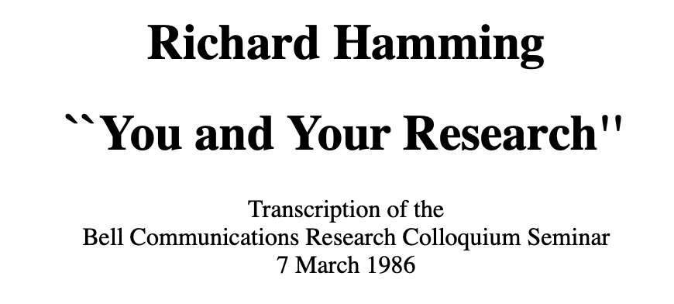
Recommended: You and Your Research
Richard Hamming,
"You and Your Research"
Bell Communications Research Colloquium Seminar, 1986.
[Lecture Video]

Slide 4
The Goal of Computing: Beyond Numbers
"The purpose of (scientific) computing is insight, not numbers"
Richard Hamming
"Numerical Methods for Scientists and Engineers," Richard Hamming, 1962.

Slide 5
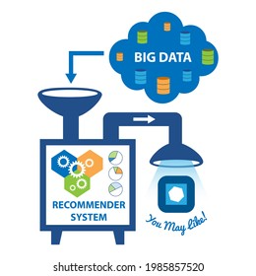


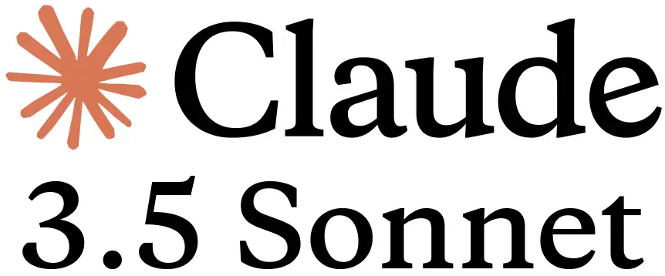
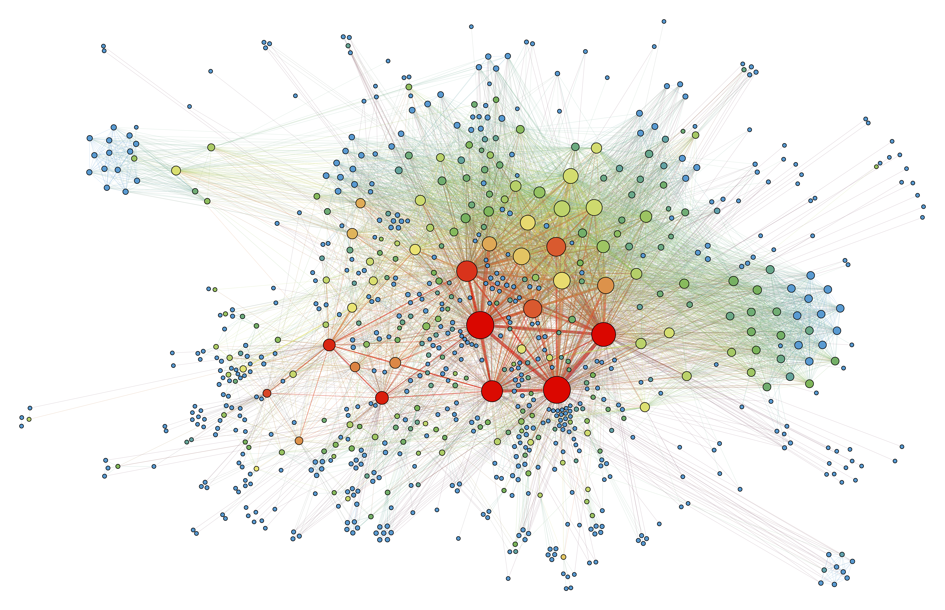
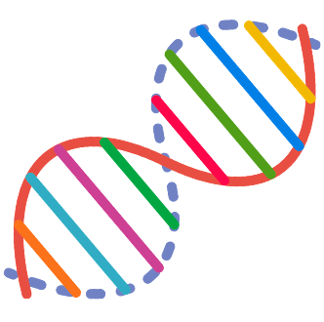
Big Data is Everywhere
Large recommender systems
Large Language Models
Graph/Tree Processing
Genomics

Slide 6
Computing is Bottlenecked by Data
Data movement →
Performance & Energy Bottleneck
Large recommender systems
Large Language Models
Graph/Tree Processing
Genomics

Slide 7

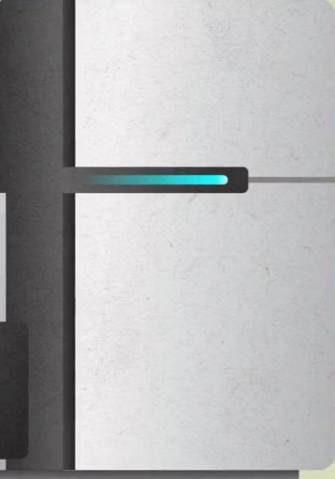

Problems with Data Analysis Today
Special-Purpose Machine
for Data Generation
General-Purpose Machine
for Data Analysis
FAST
SLOW
Processing capabilities oblivious to data analysis requirements
Large amounts of data movement

Slide 8
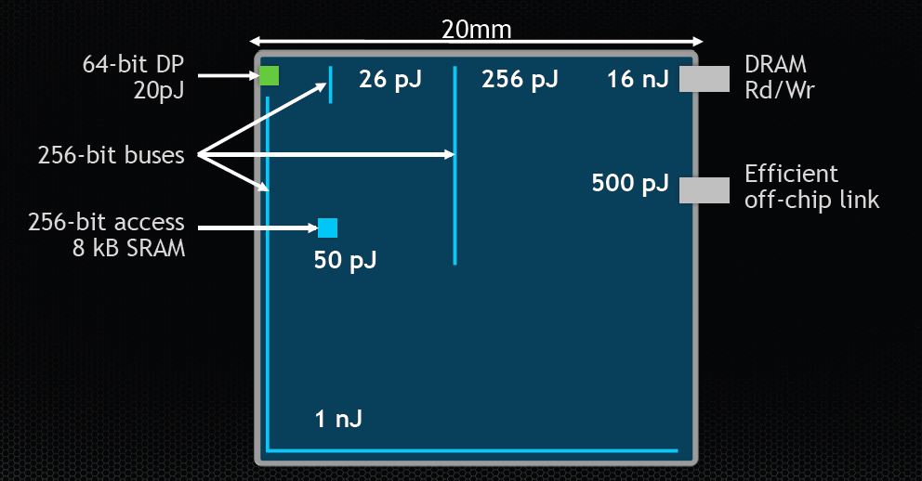

Communication Dominates Arithmetic
Single memory request consumes >160$×$ - 800$×$ more energy compared to performing an addition operation
William Dally, HiPEAC 2015

Slide 9
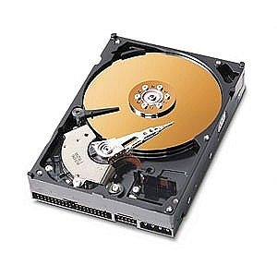
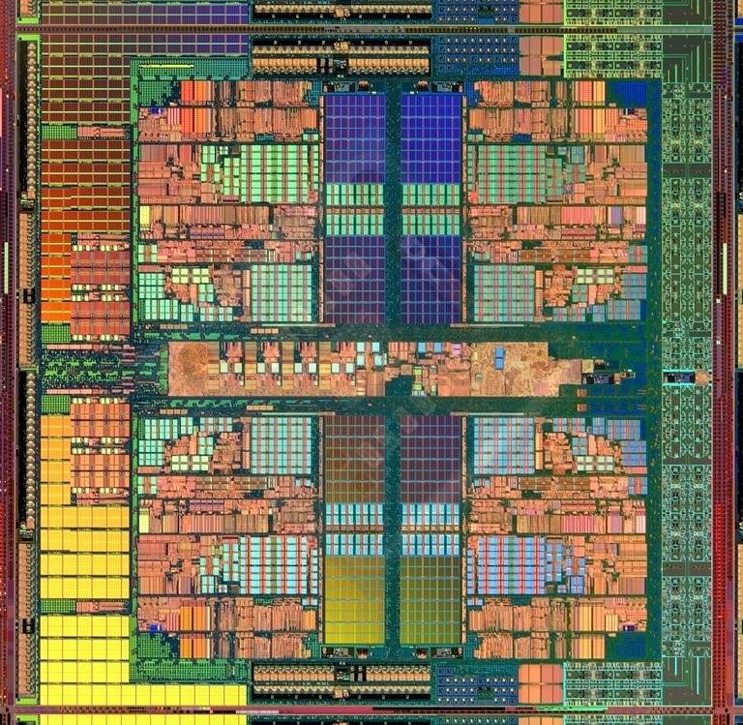
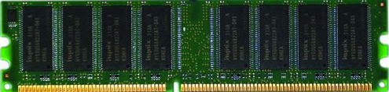
Data Movement Dominates Performance
Data movement dominates performance and is a major system
energy bottleneck (accounting for 40% - 62%)
Data Movement
Sequencing
Machine
Storage (SSD/HDD)
Main Memory
Microprocessor
⁻ Boroumand et al., “Google Workloads for Consumer Devices: Mitigating Data Movement Bottlenecks,” ASPLOS 2018
⁻ Kestor et al., “Quantifying the Energy Cost of Data Movement in Scientific Applications,” IISWC 2013
⁻ Pandiyan and Wu, “Quantifying the energy cost of data movement for emerging smart phone workloads on mobile platforms,” IISWC 2014

Slide 10

A Typical (Biological) Data Analysis
Data Movement from Storage
Costly Operations
Storage
System
AAGCTTCCATGG
Main
Memory
Cache
Computation
Unit
(CPU or Accelerator)
CGTTCCTTGGCA
GGGCCAGAATG
CCTTTGGGTCCA
AAAATTCCATGG
GAATGGGGCCA
TTTTTTCCAAAA
TCCCCGGGGCCA
GCTTCCAGAATG
Data Movement
Overhead
Computation
Overhead
Overall Time/Energy Spent

Slide 11



A Typical Accelerated (Biological) Data Analysis
Heuristics
Accelerators
Filters
Storage
System
AAGCTTCCATGG
Main
Memory
Cache
Computation
Unit
(CPU or Accelerator)
CGTTCCTTGGCA
GGGCCAGAATG
CCTTTGGGTCCA
AAAATTCCATGG
GAATGGGGCCA
TTTTTTCCAAAA
TCCCCGGGGCCA
GCTTCCAGAATG
✓
Computation
Overhead
Computation
Overhead

Slide 12
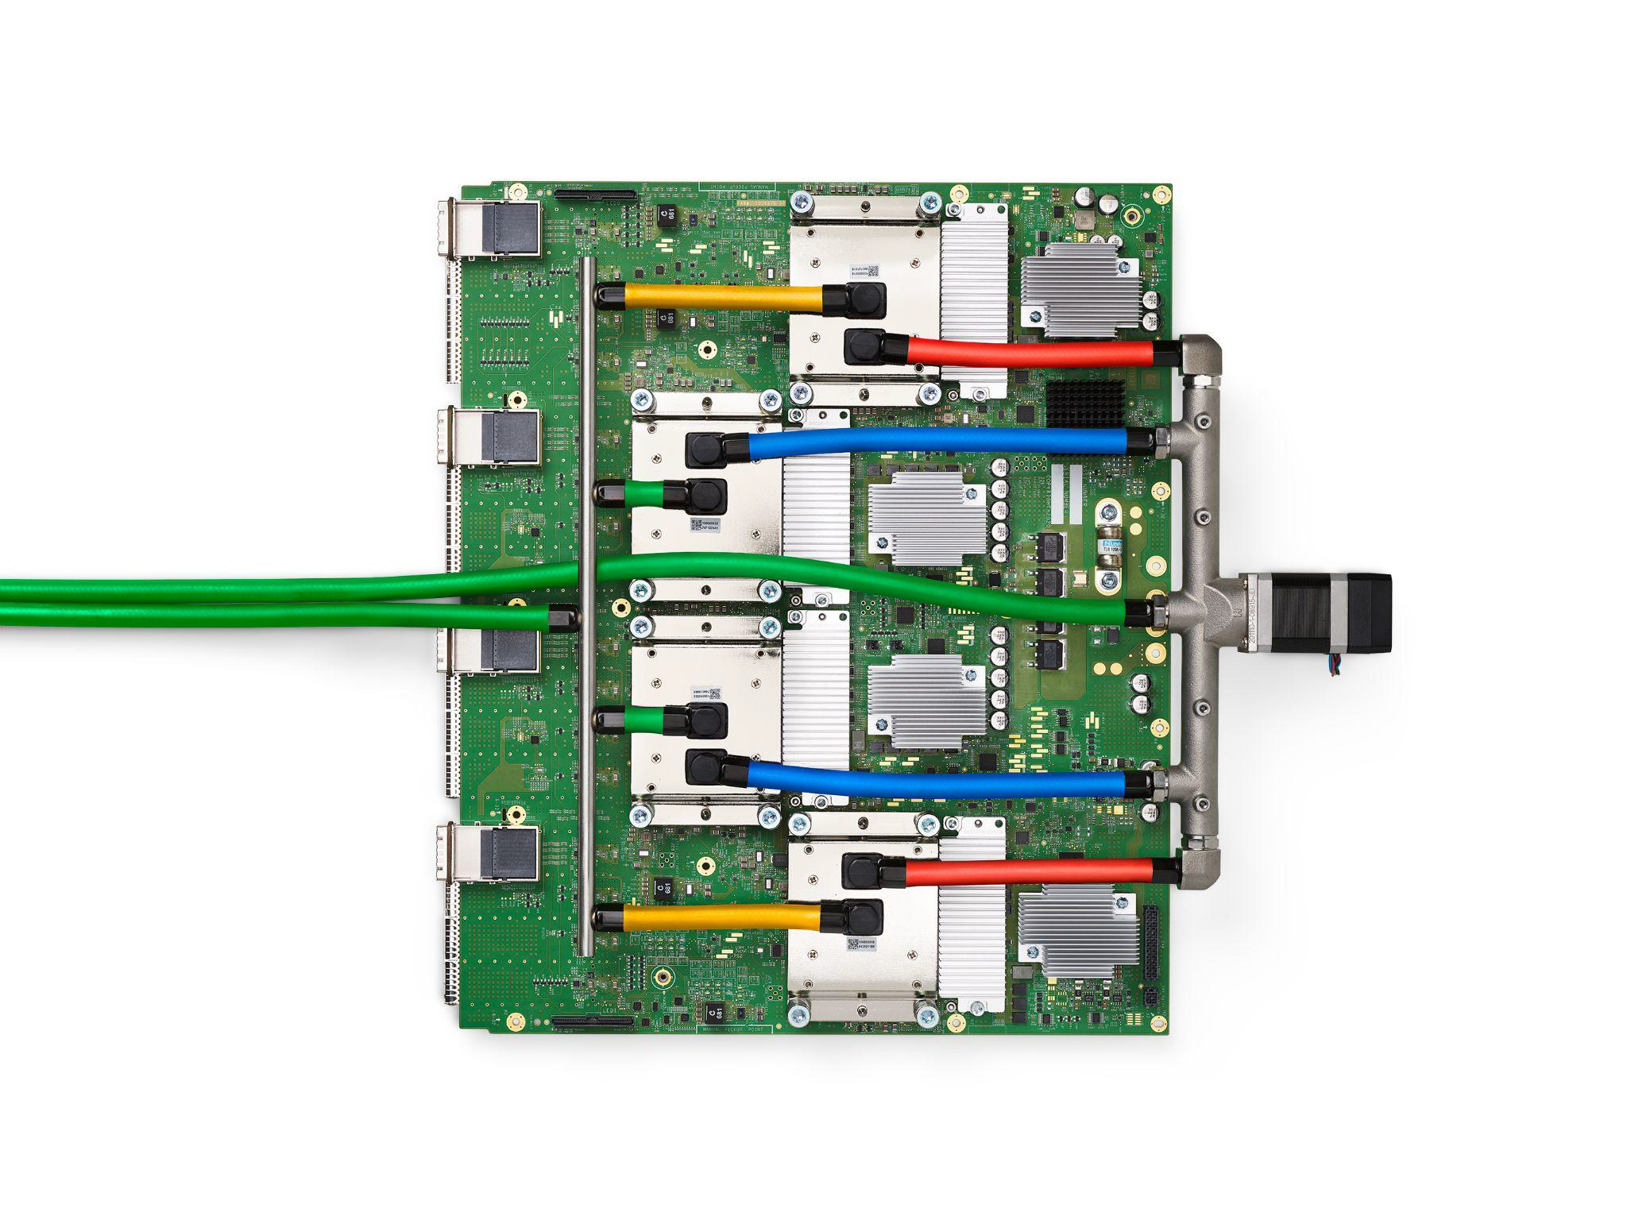
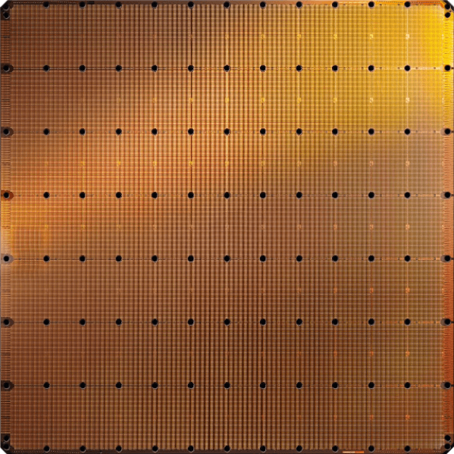
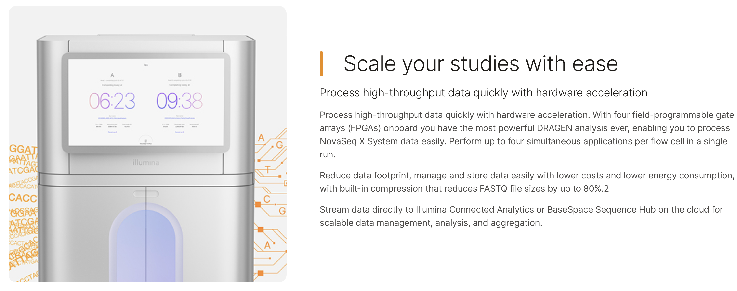
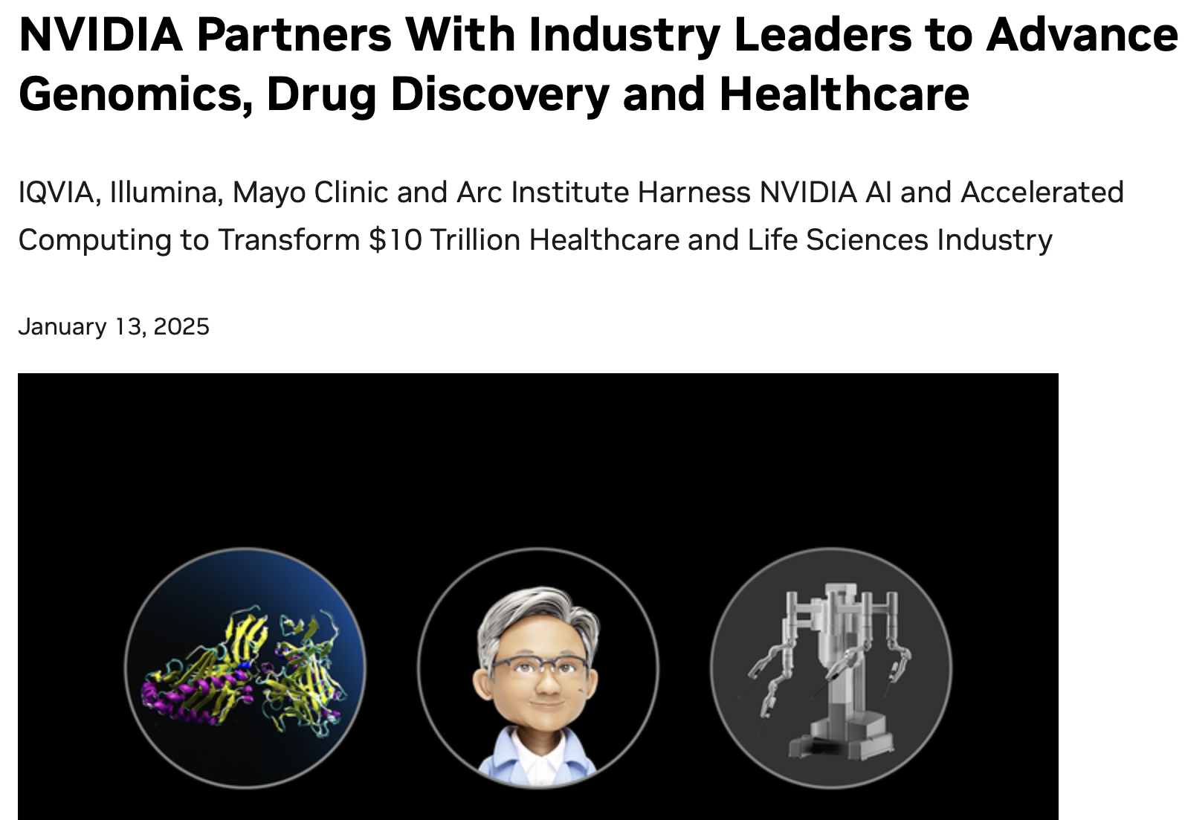
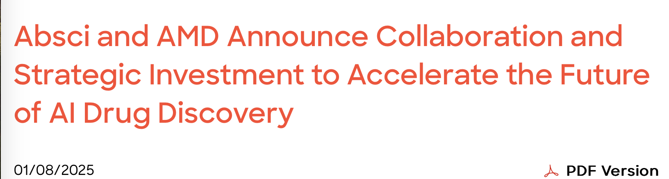
Acceleration Efforts for AI and Genomics
Cerebras WSE-3
Wafer-scale ML accelerator chip
Google’s TPUs:
NVIDIA H100

Slide 13
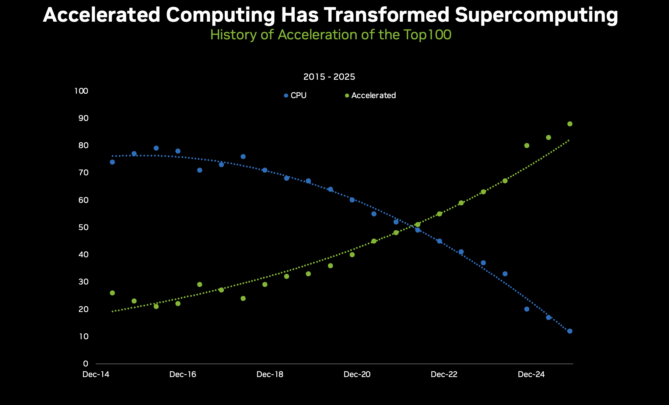
Accelerated Computing is Mainstream Now
https://blogs.nvidia.com/blog/accelerated-scientific-systems/?linkId=100000392637737

Slide 14
Data Movement Dominates Performance
Heuristics
Accelerators
Filters
Storage
System
AAGCTTCCATGG
Main
Memory
Cache
Computation
Unit
(CPU or Accelerator)
CGTTCCTTGGCA
GGGCCAGAATG
CCTTTGGGTCCA
AAAATTCCATGG
GAATGGGGCCA
TTTTTTCCAAAA
TCCCCGGGGCCA
GCTTCCAGAATG
Data Movement
Overhead
✓
Computation
Overhead
Overall Time/Energy Spent

Slide 15
We need to co-design algorithms and architecture to handle data well

Slide 16
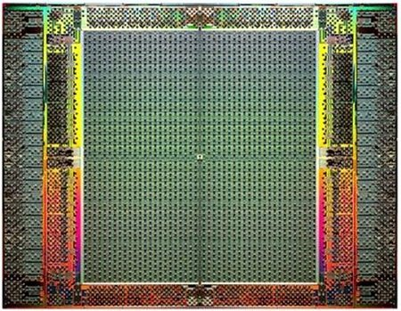
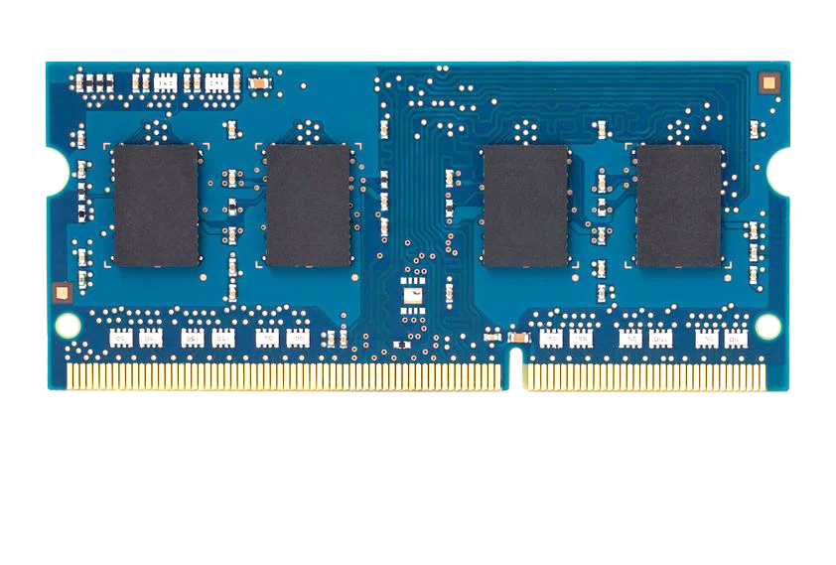
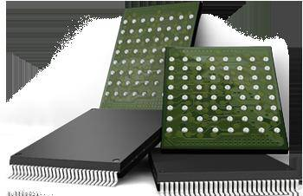
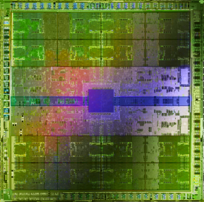
Pushing Towards New Architectures
Modern systems
?
FPGAs
Sequencing Machine
Hybrid Main Memory
Heterogeneous
Processors &
Accelerators
Persistent Memory/Storage
GPUs

Slide 17
Algorithm-Architecture Co-design is Critical
Problem
Algorithm
Program/Language
System Software
Computer Architecture (expanded view)
SW/HW Interface
Micro-architecture
Logic
Devices
Electrons

Slide 18
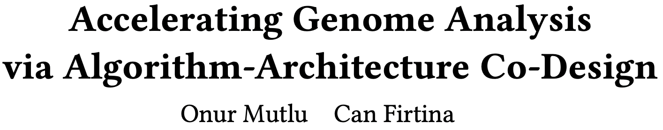
Recommended: Accelerating Genome Analysis [DAC '23]
Onur Mutlu and Can Firtina,
"Invited: Accelerating Genome Analysis via Algorithm-Architecture Co-Design"
Proceedings of the 60th Design Automation Conference (DAC 2023), San Francisco, CA, USA, July 2023.
Paper [online] [pdf]

Slide 19

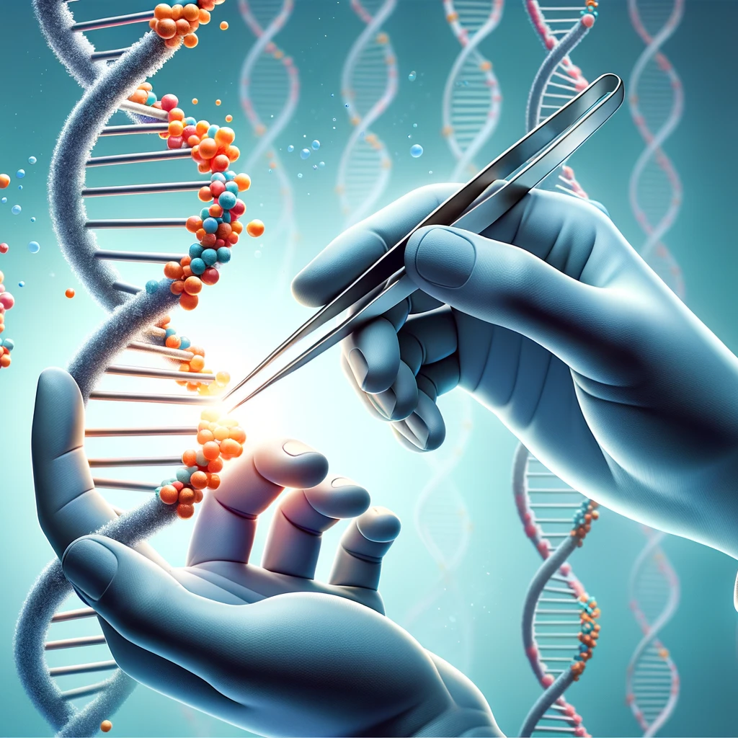


Analyzing Genomes Reveals Key Insights
Altering genomes to solve
fundamental challenges of life
Personalized Medicine
Detecting pathogens
in the environment
Rapid surveillance of
disease outbreaks

Slide 20
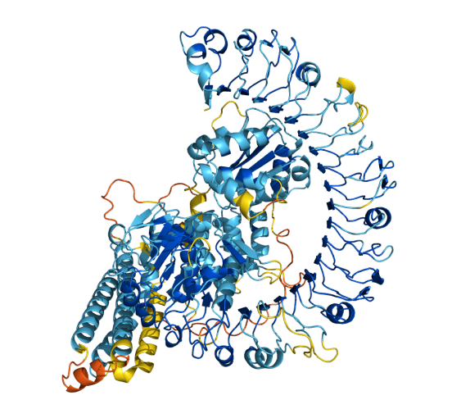
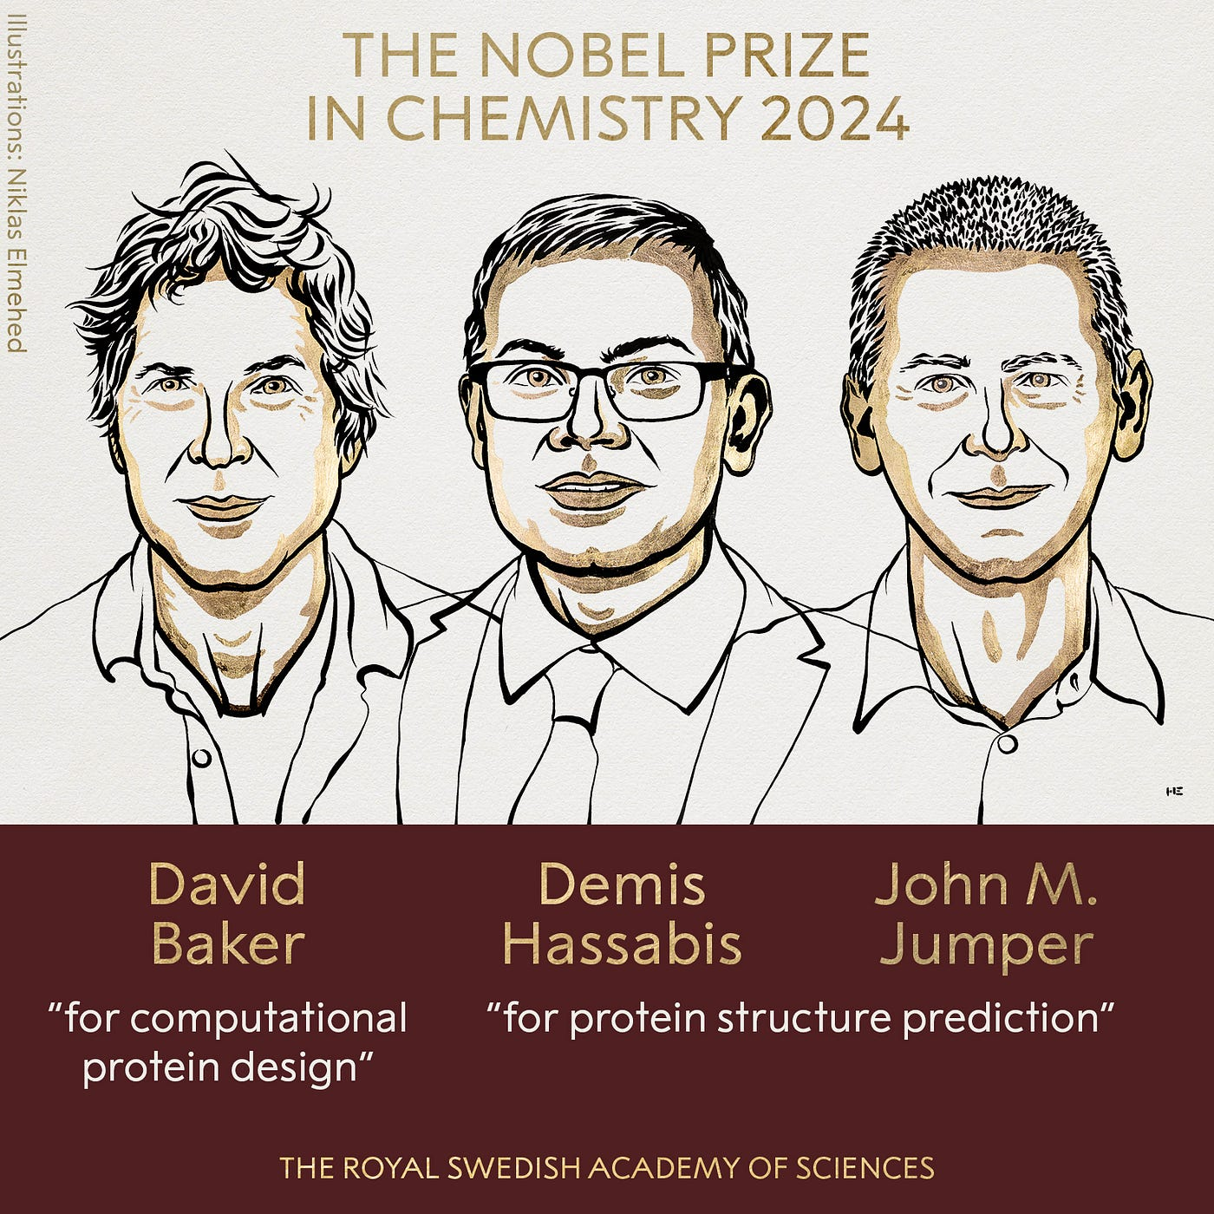
Protein Structure Prediction with AI
https://www.nobelprize.org/prizes/chemistry/2024/press-release/

Slide 21
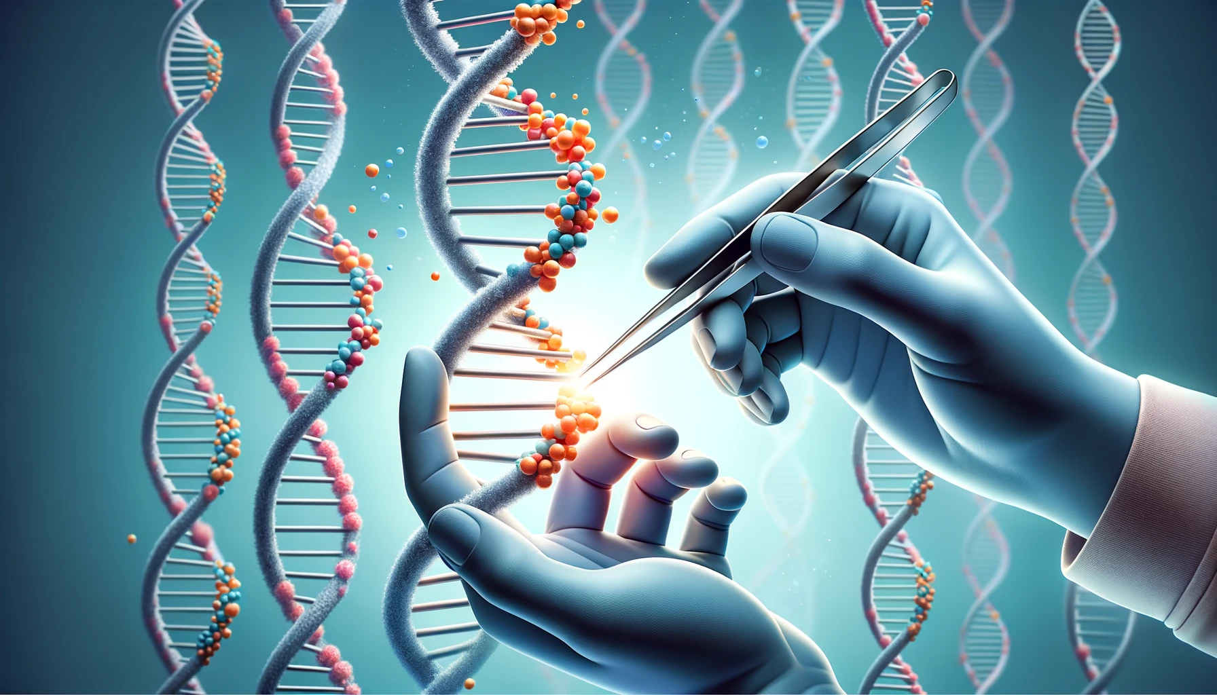
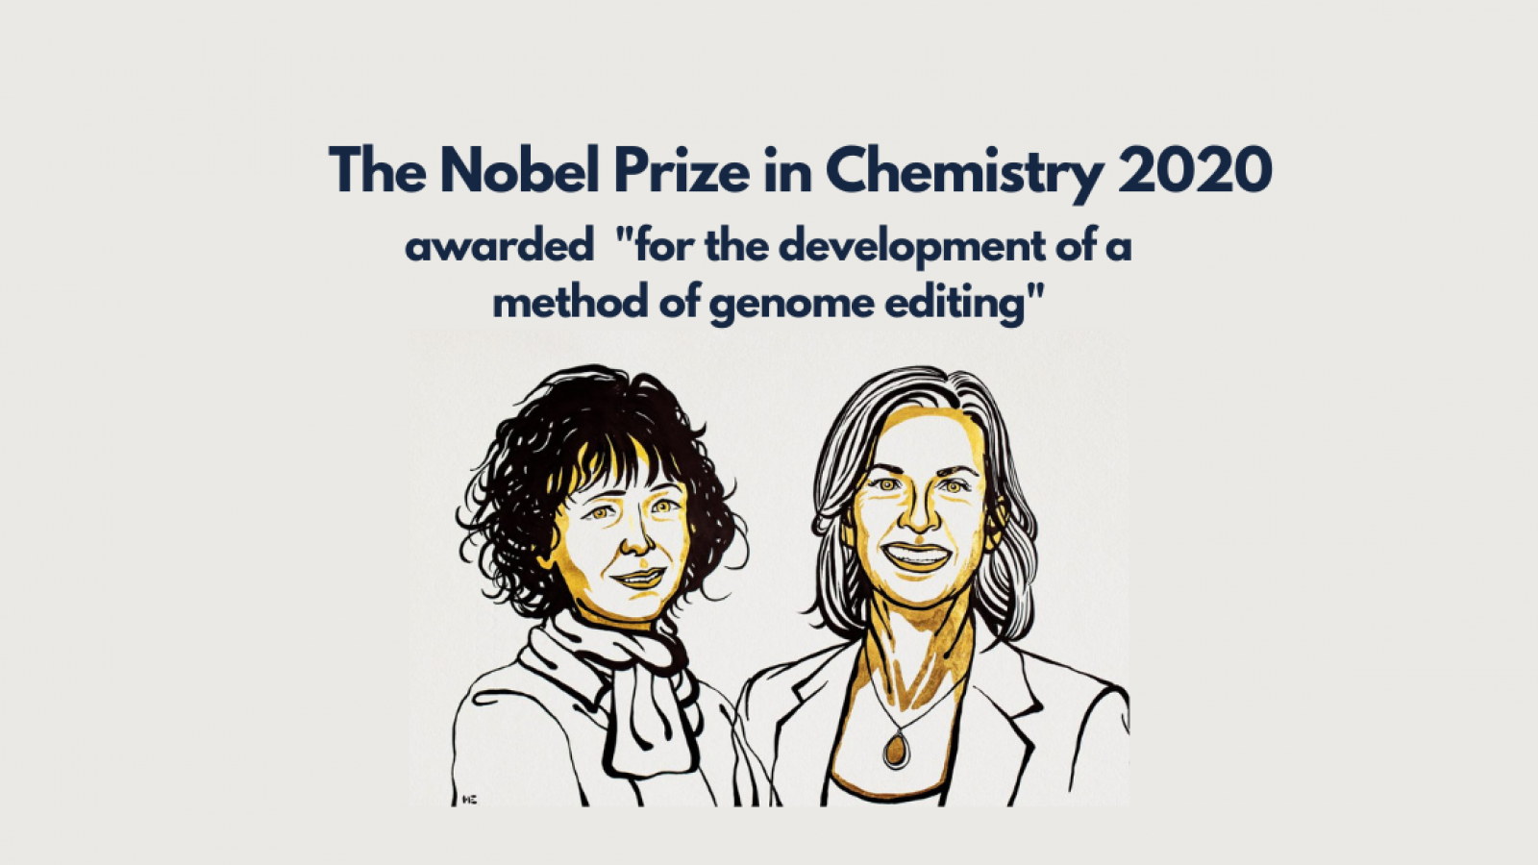
Genome Editing
https://www.nobelprize.org/prizes/chemistry/2020/press-release/

Slide 22

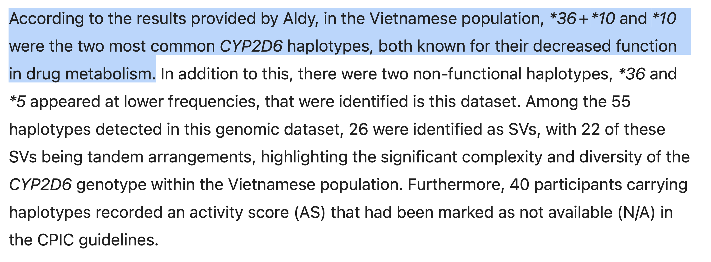
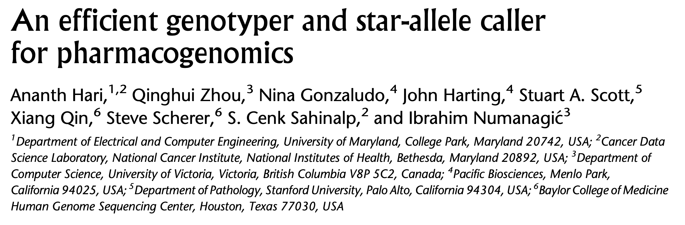
Population-Scale Analysis
Nguyen+, “A comprehensive assessment of pharmacogenomic annotation tools for next-generation sequencing data: an emphasis on cyp2d6 and vietnamese genomic data,” Journal of Human Genetics 2025
Hari+, “An efficient genotyper and star-allele caller for pharmacogenomics”, Genome Research 2023.

Slide 23
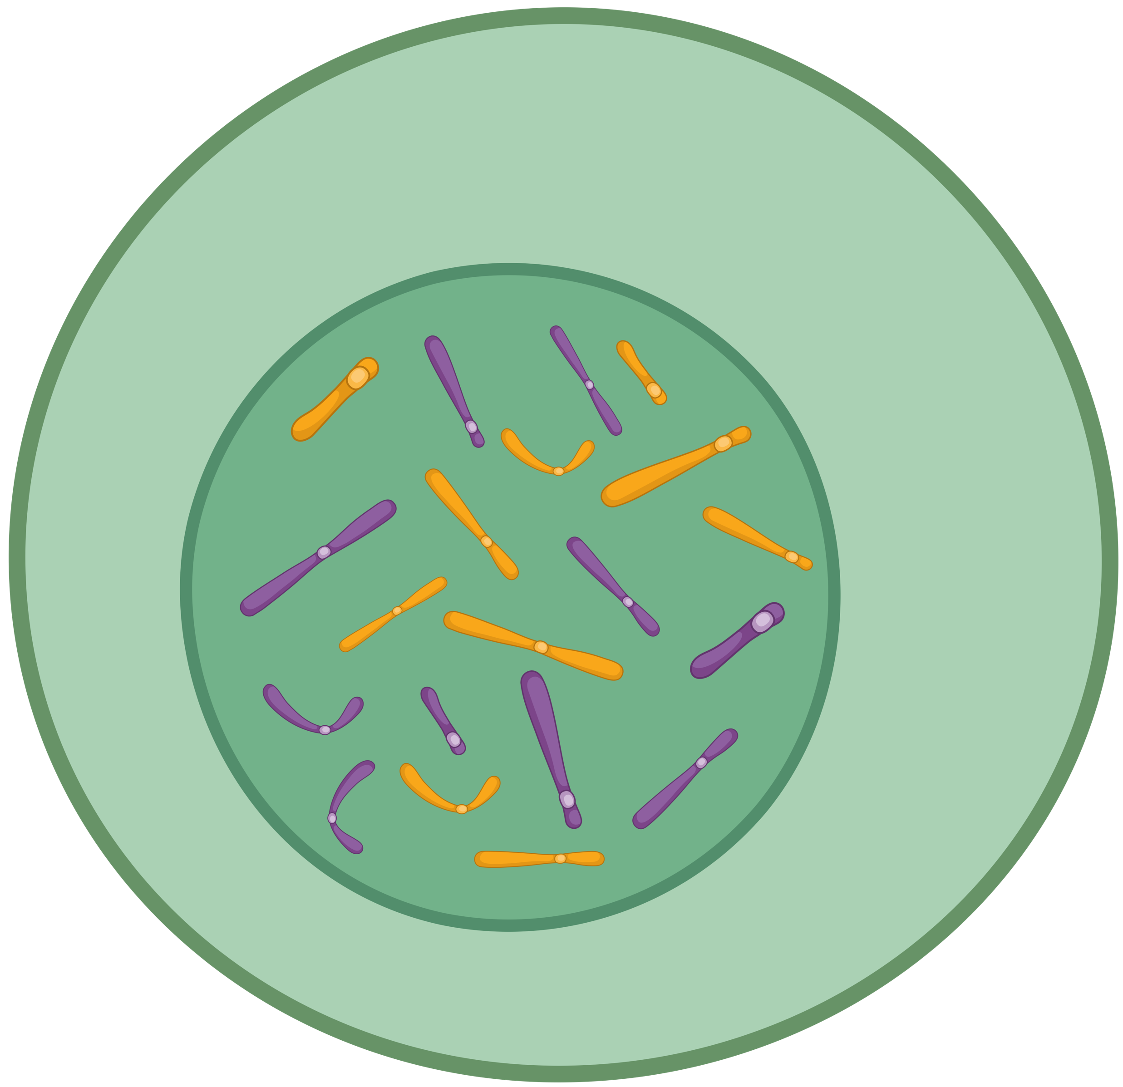
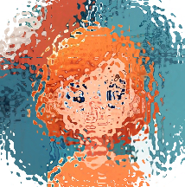
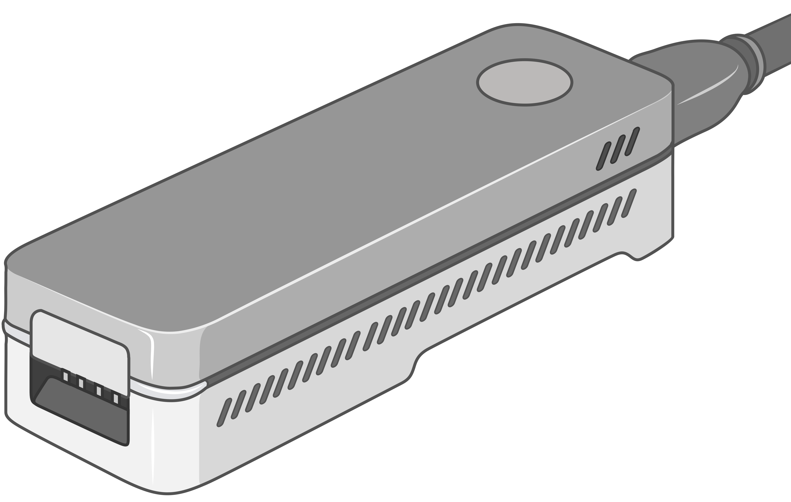
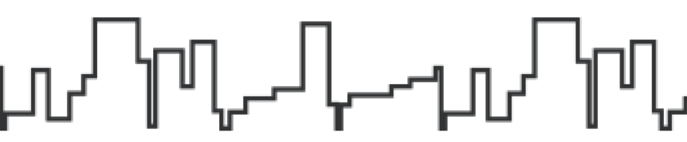

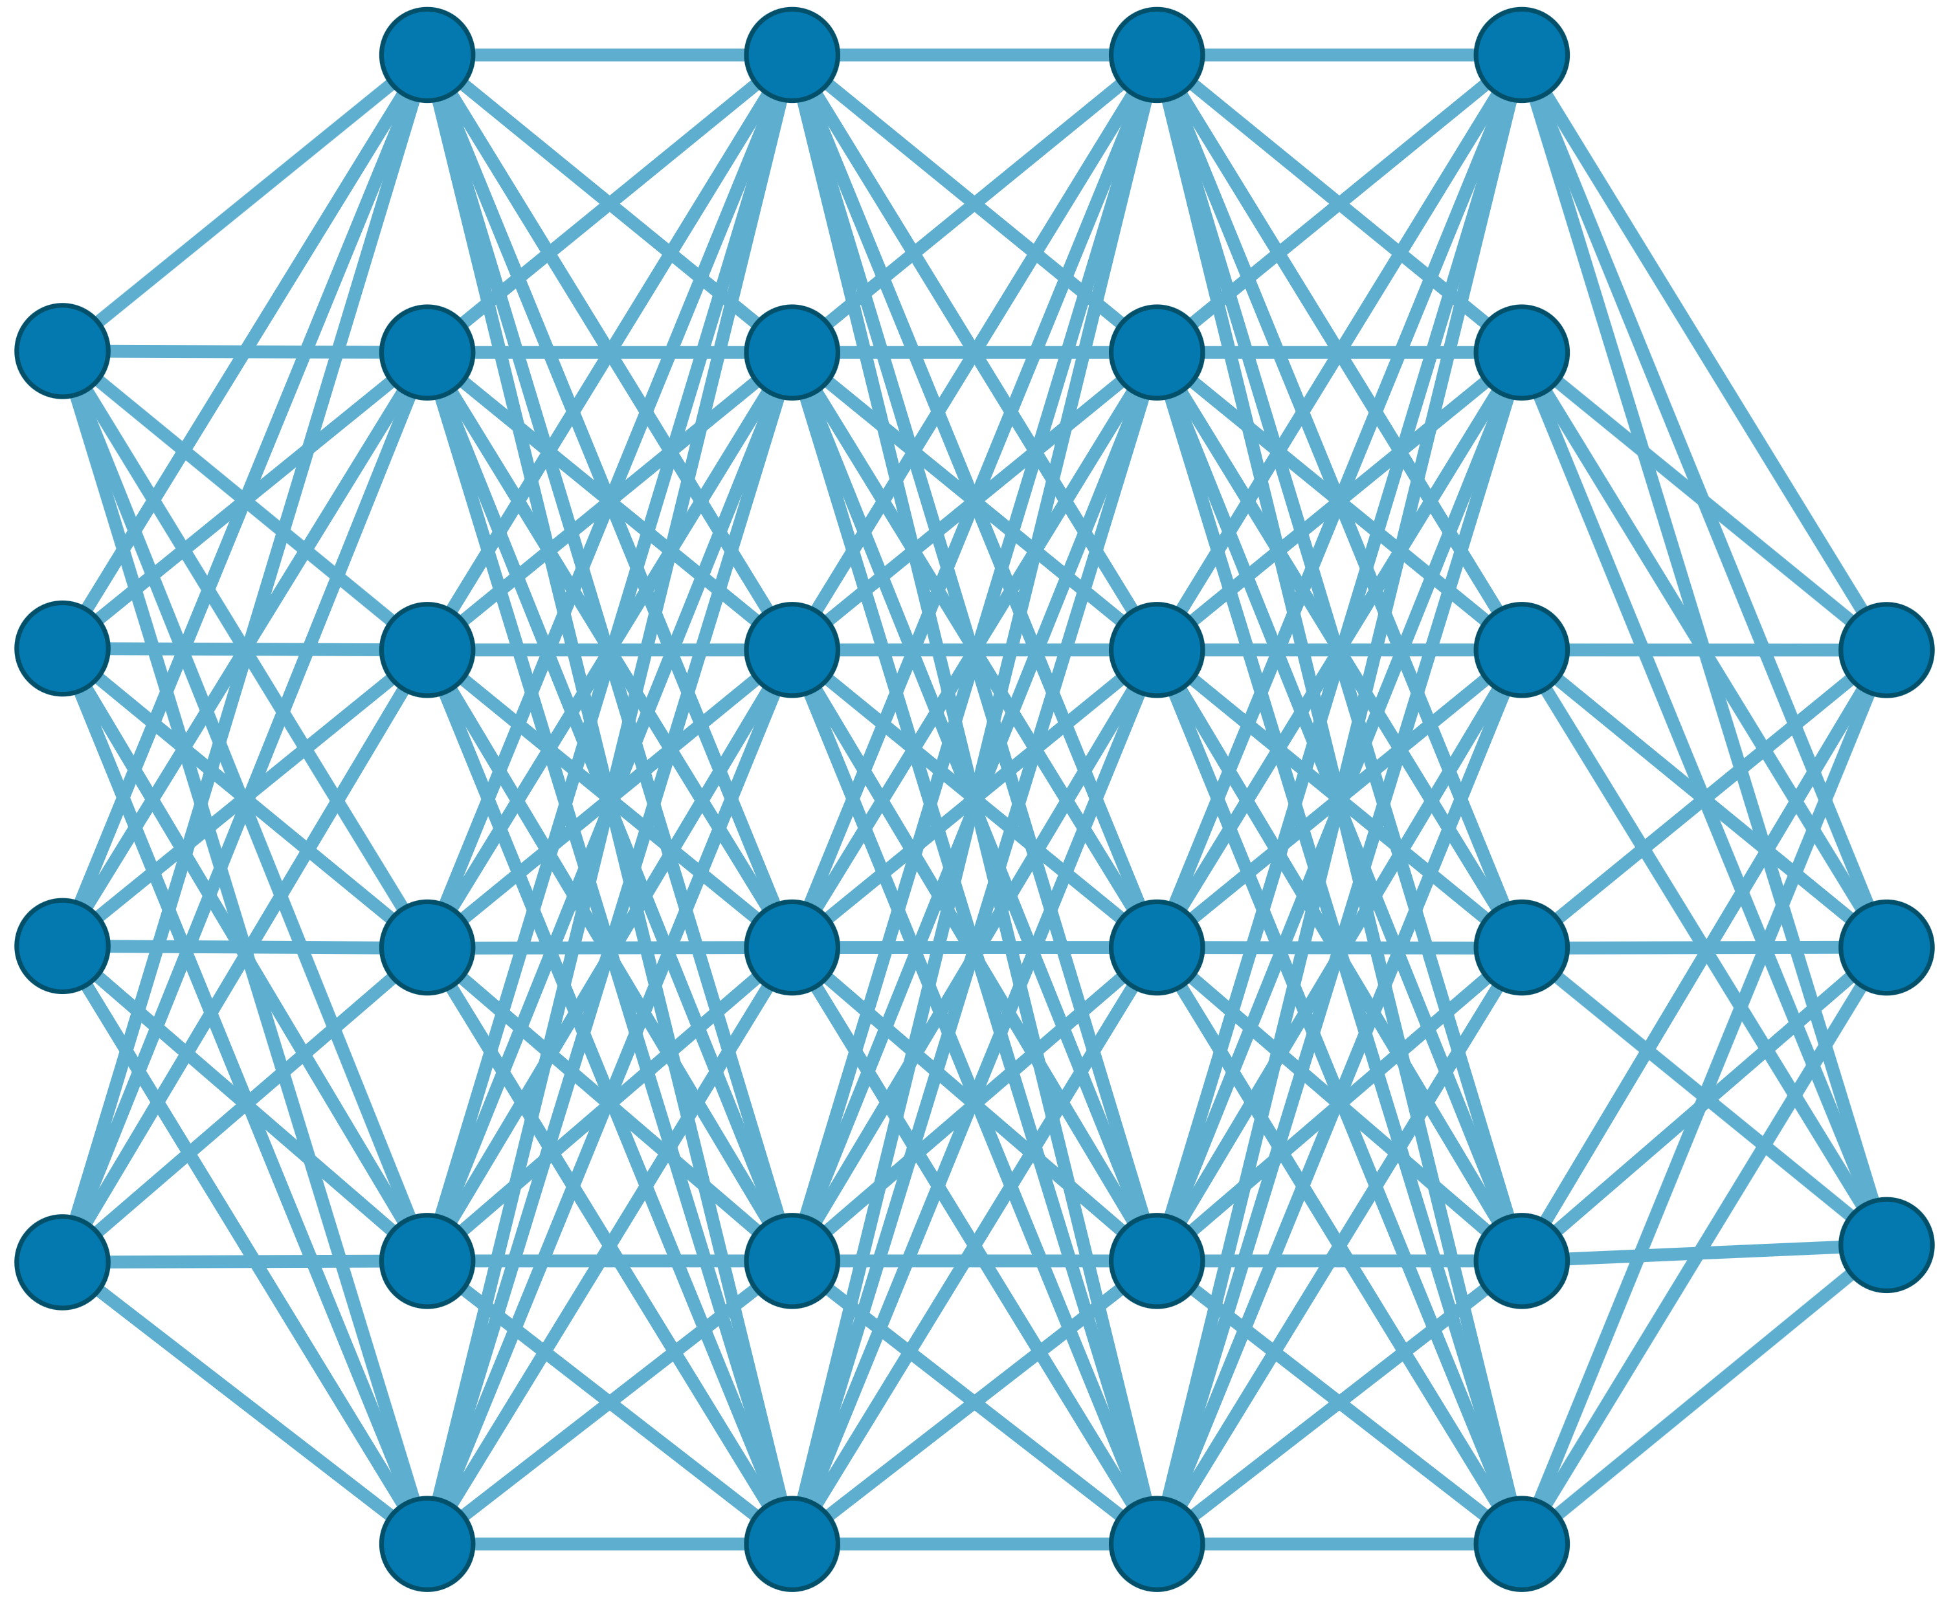

Generating the Entire Genomic Sequence
Whole Genome: 6.4B bps
(Non-human-readable)
Sequencing Device
Raw Genomic Data
(Human-readable?)
Translator (Basecalling)
AI
CGAAATGCC...AGATTAAACGCT...TGCCCTAA...GAATGGCGT
Whole Human Genome: 6.4B bps (Human-readable)

Slide 24









Genomic Data: Giant Jigsaw Puzzle to Solve
Human (Reference) Genome: 3.2 Billion bps (haploid)
CGAAATGCC...AGATTAAACGCT...TGCCCTAA...GAATGGCGT
?
Scale: ~$1/{10}^{8}$
AAATGG
CGAAATGCC...AGATTAAATGGT...TGCCCTAA...GAATGGCGT
Entire Genomic Sequence of an Organism
Read: ~100 – 100,000 bps
Small pieces (reads)
?
Unknown origins
Dealing with Massive and Noisy Datasets
(TBs to PBs)
Non-identical reference genome
Large volume of data to analyze

Slide 25
Solving the Puzzle: The Practical Way
Goal: Quickly and accurately reduce the search space
CGAAATGCC...AGATTAAACGCT...TGCCCTAA...GAATGGCGT
Performing
the costly computations
only for a few regions
AAA
AAA
CTA
AAT
AAATGG
AAATGG
Exact Match
AAA
AAATGG
Read Mapping
Indexing
Seeding
Chaining
Alignment
Reference Genome
Hash Table
Read
0x00
2,64,…
Sketching
0x01
1,101,…
Query
Sketching
Store
…
0xFF
13,21
Hash
Positions
Hash
0x01
0x00
Hash
Hash Matches
DP Calculations

Slide 26


A Common Genome Analysis Pipeline
Raw
Reads
Basecalling (Translator)
Basecalled
(Translated)
Reads
Read
Mapping
AAATGTGGTCCATTG
Assembly
Variant Calling
Metagenomics
Downstream Analysis

Slide 27
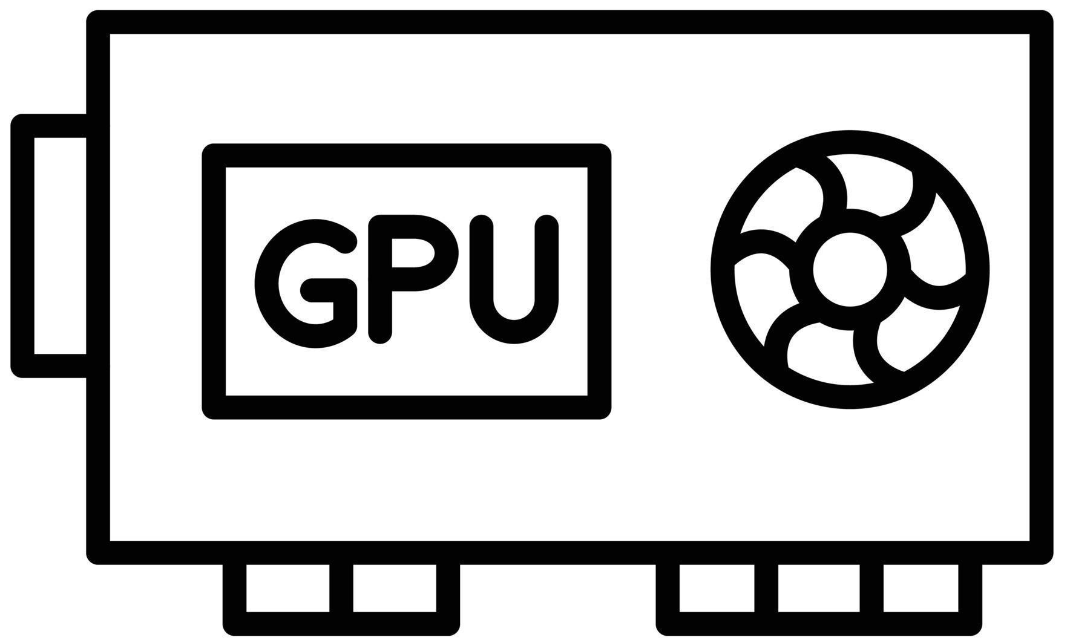
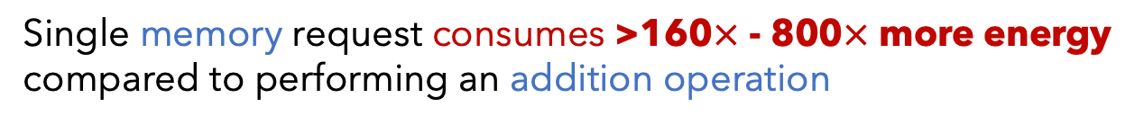
Genome Analysis is Energy Inefficient
Raw
Reads
Basecalling (Translator)
Basecalled
(Translated)
Reads
Read
Mapping
AAATGTGGTCCATTG
Power-Hungry Devices
Costly and large volumes
of data movement
Single memory request consumes >160$×$ - 800$×$ more energy compared to performing an addition operation
⁻ Boroumand et al., “Google Workloads for Consumer Devices: Mitigating Data Movement Bottlenecks,” ASPLOS 2018
⁻ Kestor et al., “Quantifying the Energy Cost of Data Movement in Scientific Applications,” IISWC 2013
⁻ Pandiyan and Wu, “Quantifying the energy cost of data movement for emerging smart phone workloads on mobile platforms,” IISWC 2014

Slide 28


Genome Analysis is Computationally Costly
Significant computation and energy overhead

Slide 29
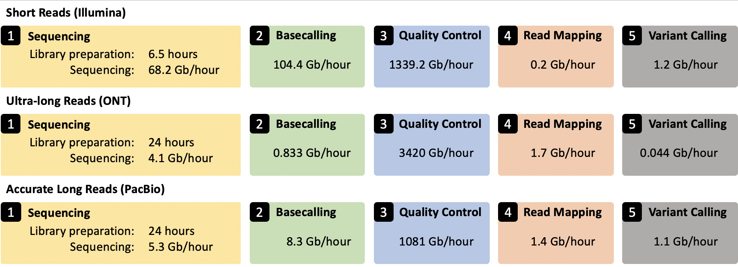
Genome Analysis Pipeline is Unbalanced
Alser+, “From molecules to genomic variations: Accelerating genome analysis via intelligent algorithms and architectures,” CSBJ 2022

Slide 30
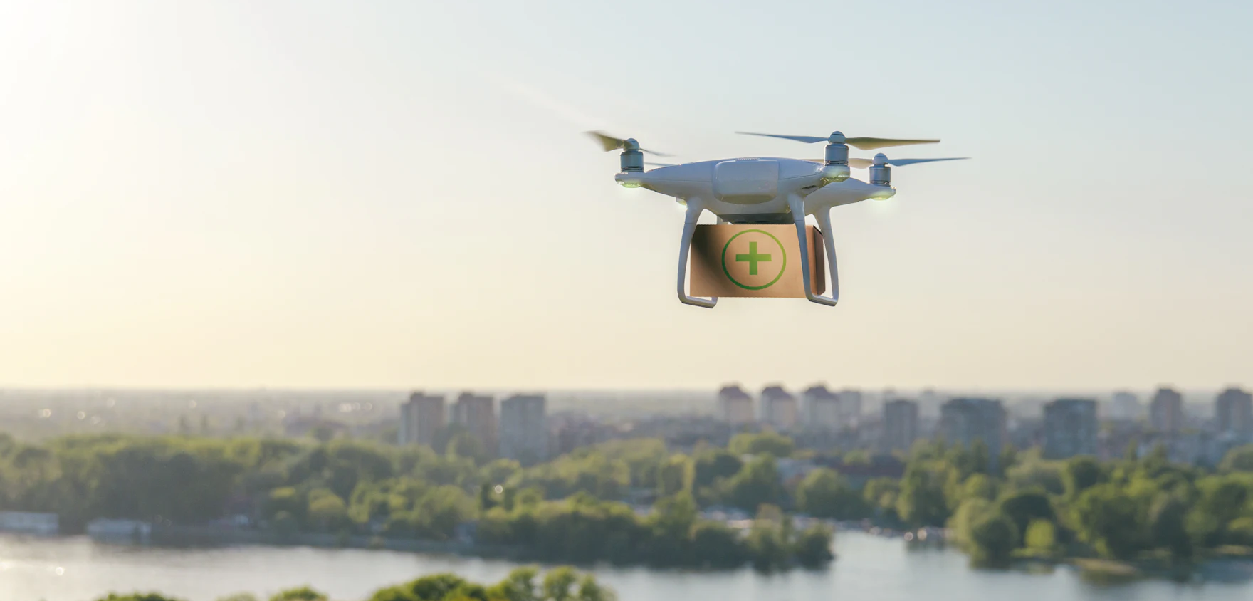

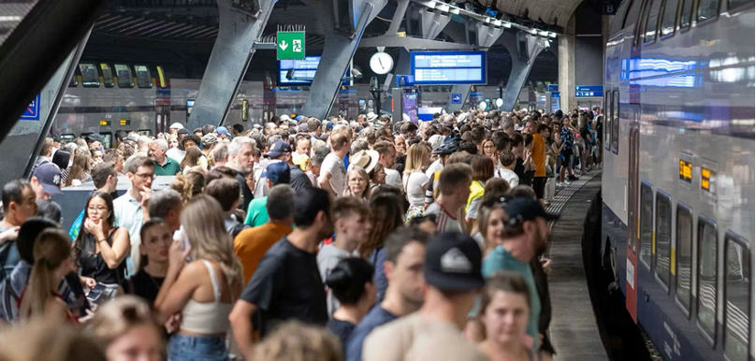
Limited Application Scope and Accuracy
Energy-efficient analysis for Resource-constrained devices
Urgent analysis within minutes
Large-scale analysis
without sacrificing accuracy
and performance

Slide 31
We need to co-design algorithms and architecture to handle data well

Slide 32
Enabling New Directions in
Genome Analysis via New Algorithms

Slide 33
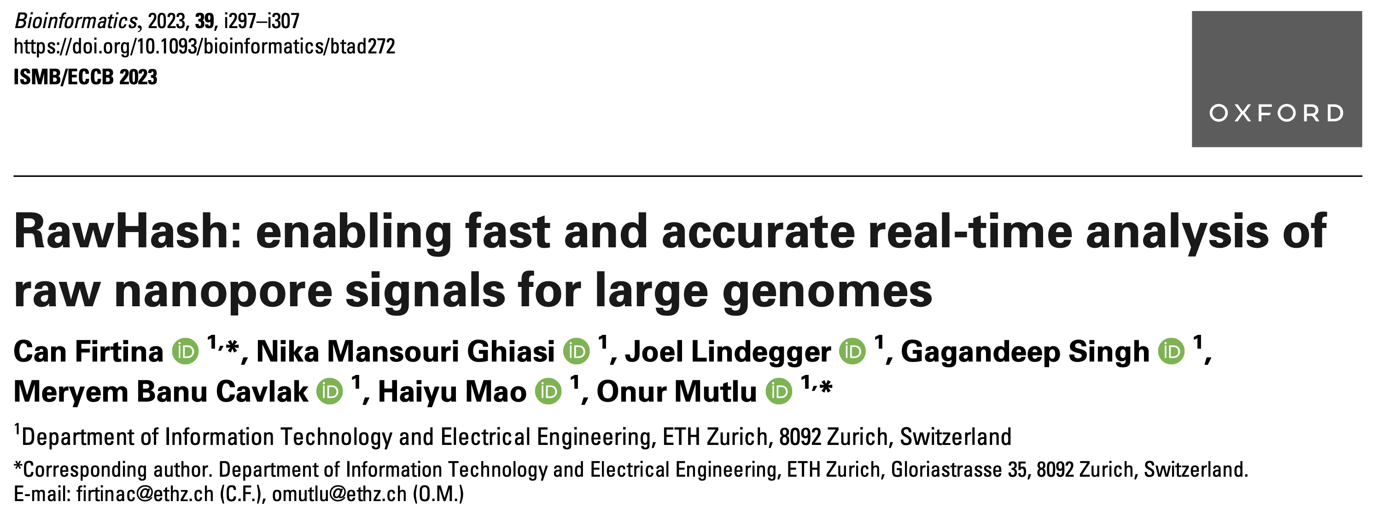
New Frontiers: Raw Signal Analysis [ISMB '23]
Can Firtina, Nika Mansouri Ghiasi, Joel Lindegger, Gagandeep Singh, Meryem Banu Cavlak,
Haiyu Mao, and Onur Mutlu,
"RawHash: enabling fast and accurate real-time analysis of
raw nanopore signals for large genomes"
Proceedings of the 31st Annual Conference on Intelligent Systems for Molecular Biology (ISMB 2023) and the 22nd European Conference on Computational Biology (ECCB 2023), Lyon, France, July 2023.
Paper [online] [pdf] [code]
Conference Talk [video] [pptx] [pdf]
Preprint (bioRxiv) [online] [pdf]
Social Media Thread [Twitter (X)]

Slide 34
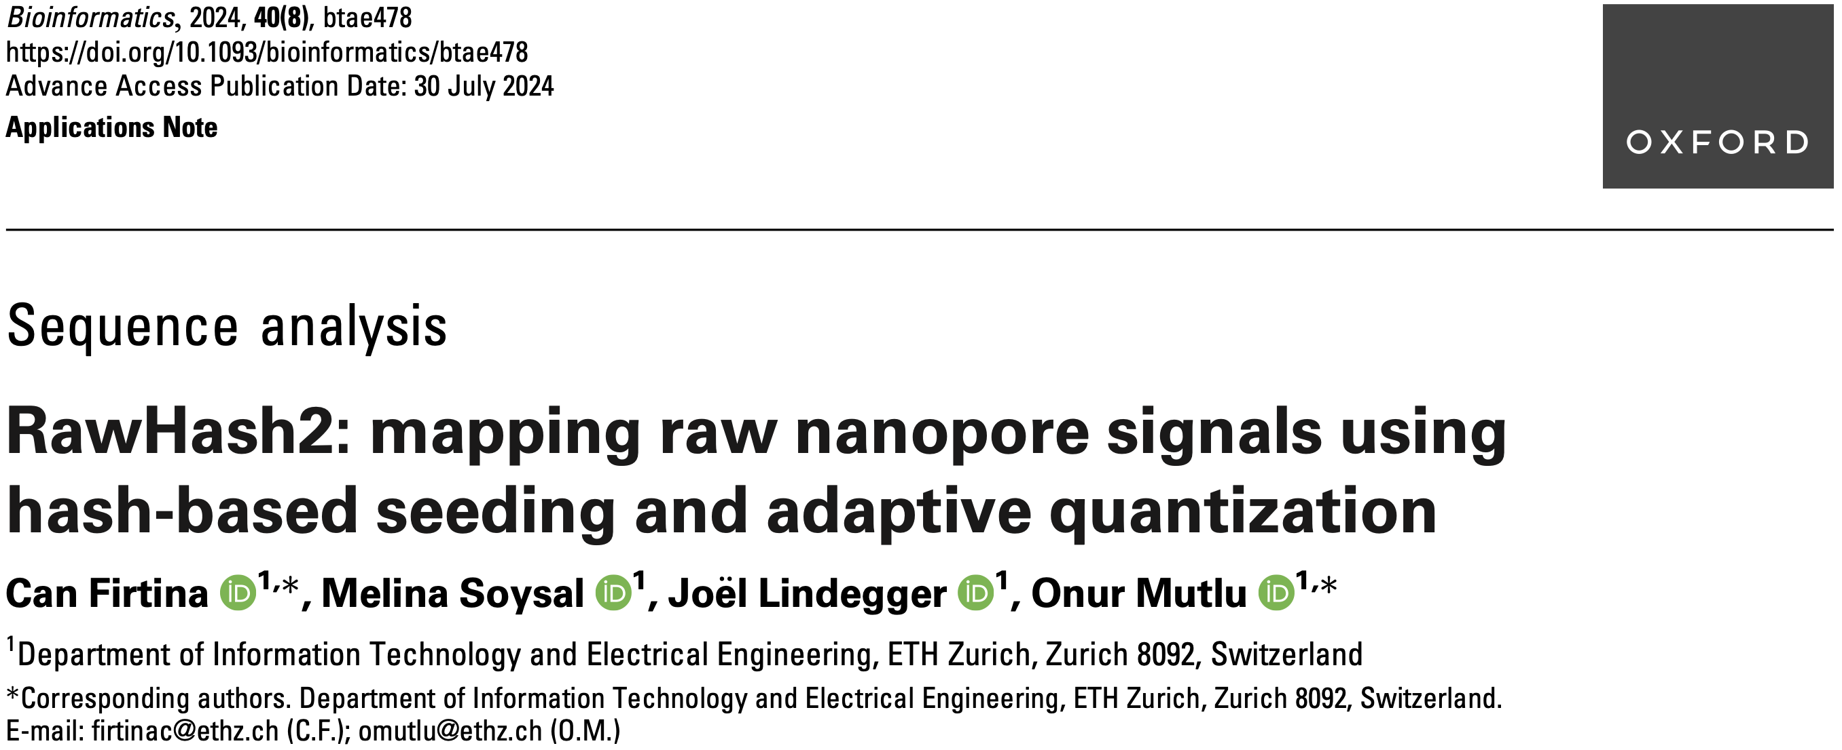
Real-Time Raw Signal Analysis [Bioinformatics '24]
Can Firtina, Melina Soysal, Joël Lindegger, and Onur Mutlu,
"RawHash2: Mapping Raw Nanopore Signals Using
Hash-Based Seeding and Adaptive Quantization"
Bioinformatics, July 2024.
Paper [online] [pdf] [code]

Slide 35
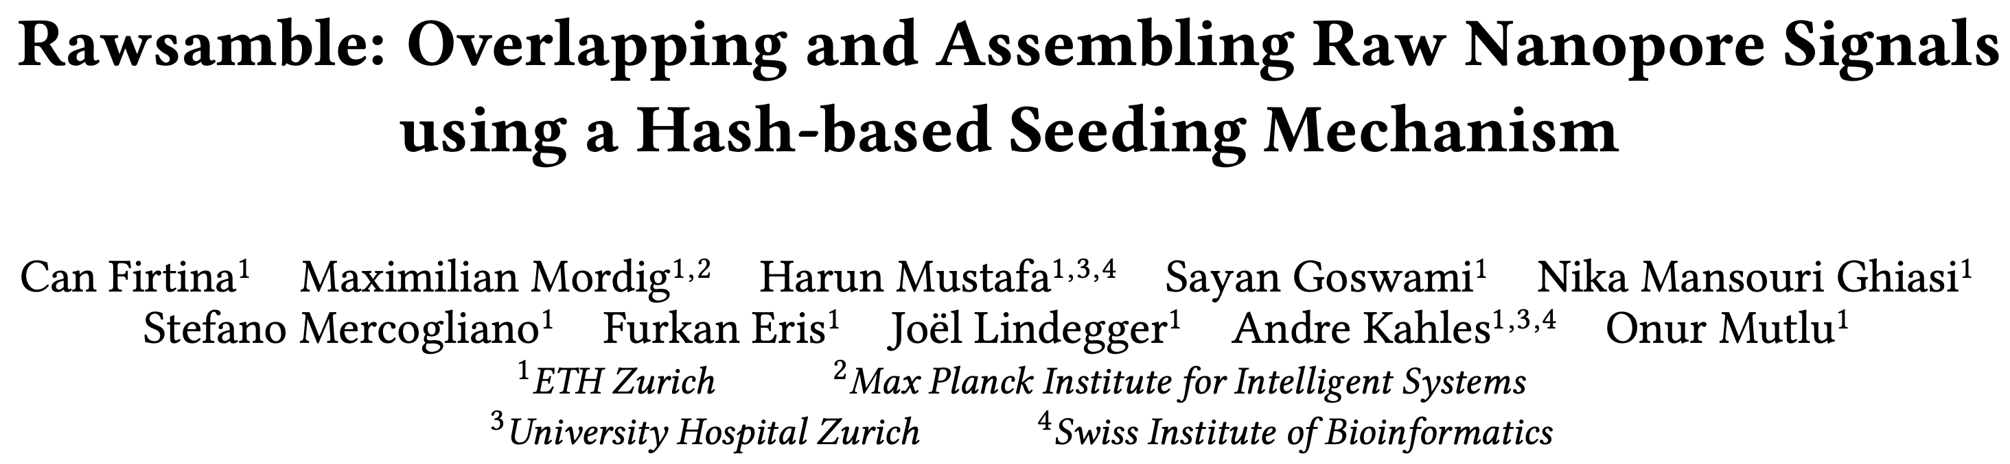
New Directions: Assembling Raw Signals
Can Firtina, Maximilian Mordig, Harun Mustafa, Sayan Goswami, Nika Mansouri Ghiasi,
Stefano Mercogliano, Furkan Eris, Joel Lindegger, Andre Kahles, and Onur Mutlu,
"Rawsamble: Overlapping and Assembling Raw Nanopore Signals using a Hash-based Seeding Mechanism"
arXiv, October 2024.
Paper [online] [pdf] [code]
ISMB 2024 Talk [video] [pptx] [pdf]
CSHL 2024 (Biological Data Science) Talk [video] [pptx] [pdf]
Social Media Thread [Twitter (X)] [LinkedIn]

Slide 36
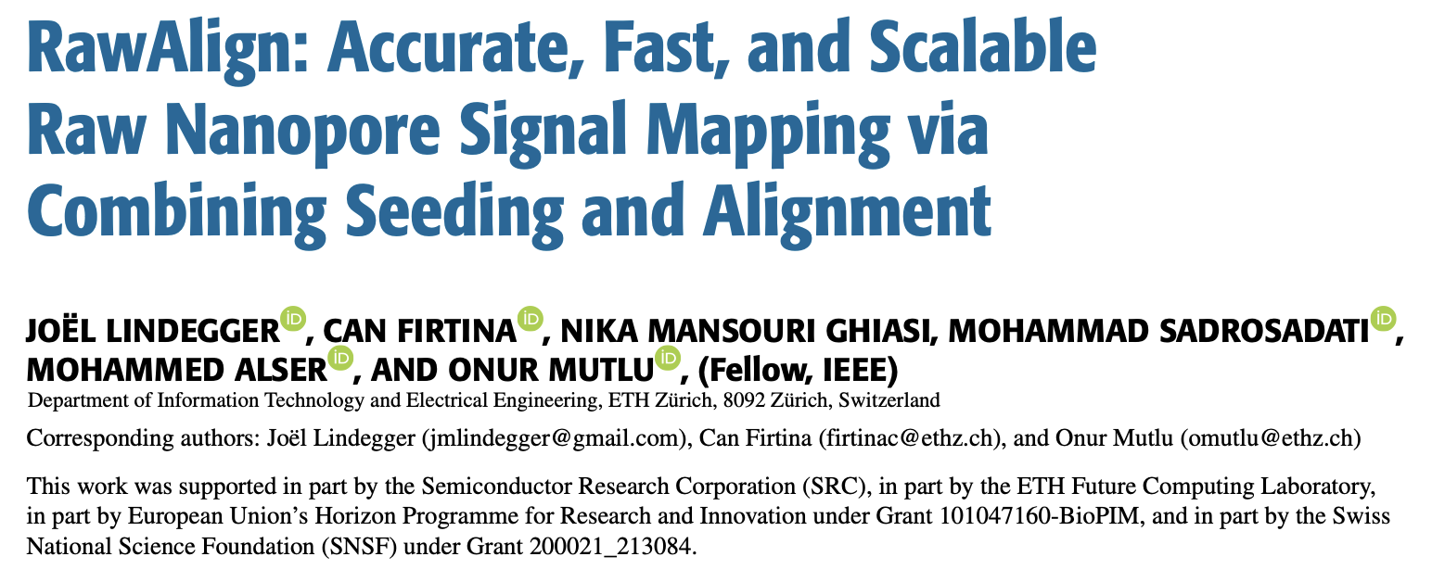
Quickly Aligning Raw Signals [IEEE Access '24]
Joël Lindegger, Can Firtina, Nika Mansouri Ghiasi, Mohammad Sadrosadati, Mohammed Alser, and Onur Mutlu,
"RawAlign: Accurate, Fast, and Scalable Raw Nanopore Signal Mapping via Combining Seeding and Alignment"
IEEE Access, December 2024.
Paper [online] [pdf] [code]

Slide 37
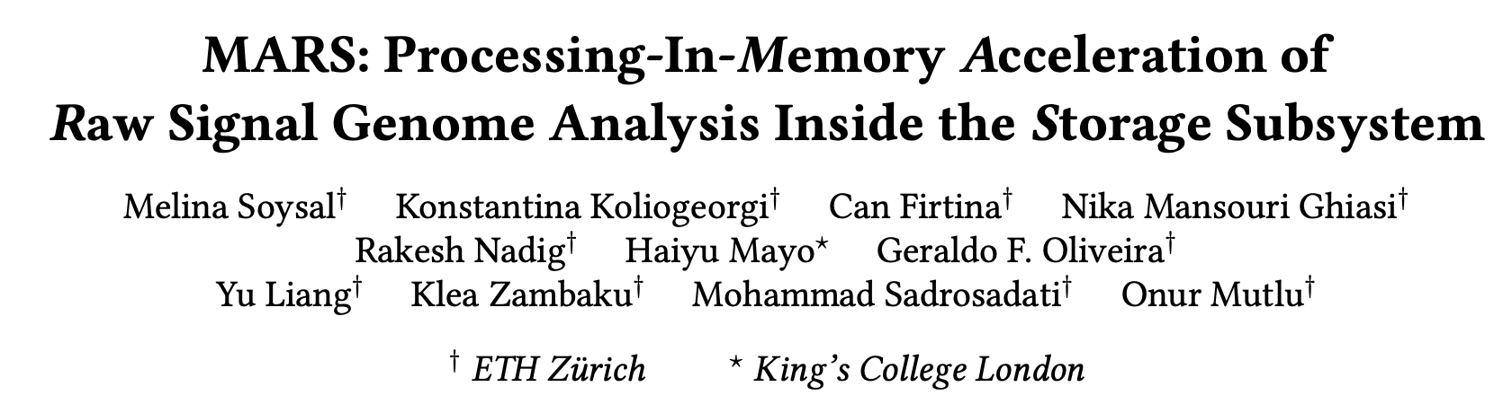
In-Storage Raw Signal Analysis [ICS '25]
Melina Soysal, Konstantina Koliogeorgi, Can Firtina, Nika Mansouri Ghiasi, Rakesh Nadig,
Haiyu Mao, Geraldo Francisco Oliveira Junior, Yu Liang, Klea Zambaku, Mohammad Sadrosadati, and Onur Mutlu,
"MARS: Processing-In-Memory Acceleration of
Raw Signal Genome Analysis Inside the Storage Subsystem"
Proceedings of the 39th International Conference on Supercomputing (ICS 2025), Salt Lake City, Utah, USA, June 2025.
Paper [online] [pdf]
Conference Talk [video] [pptx] [pdf]

Slide 38
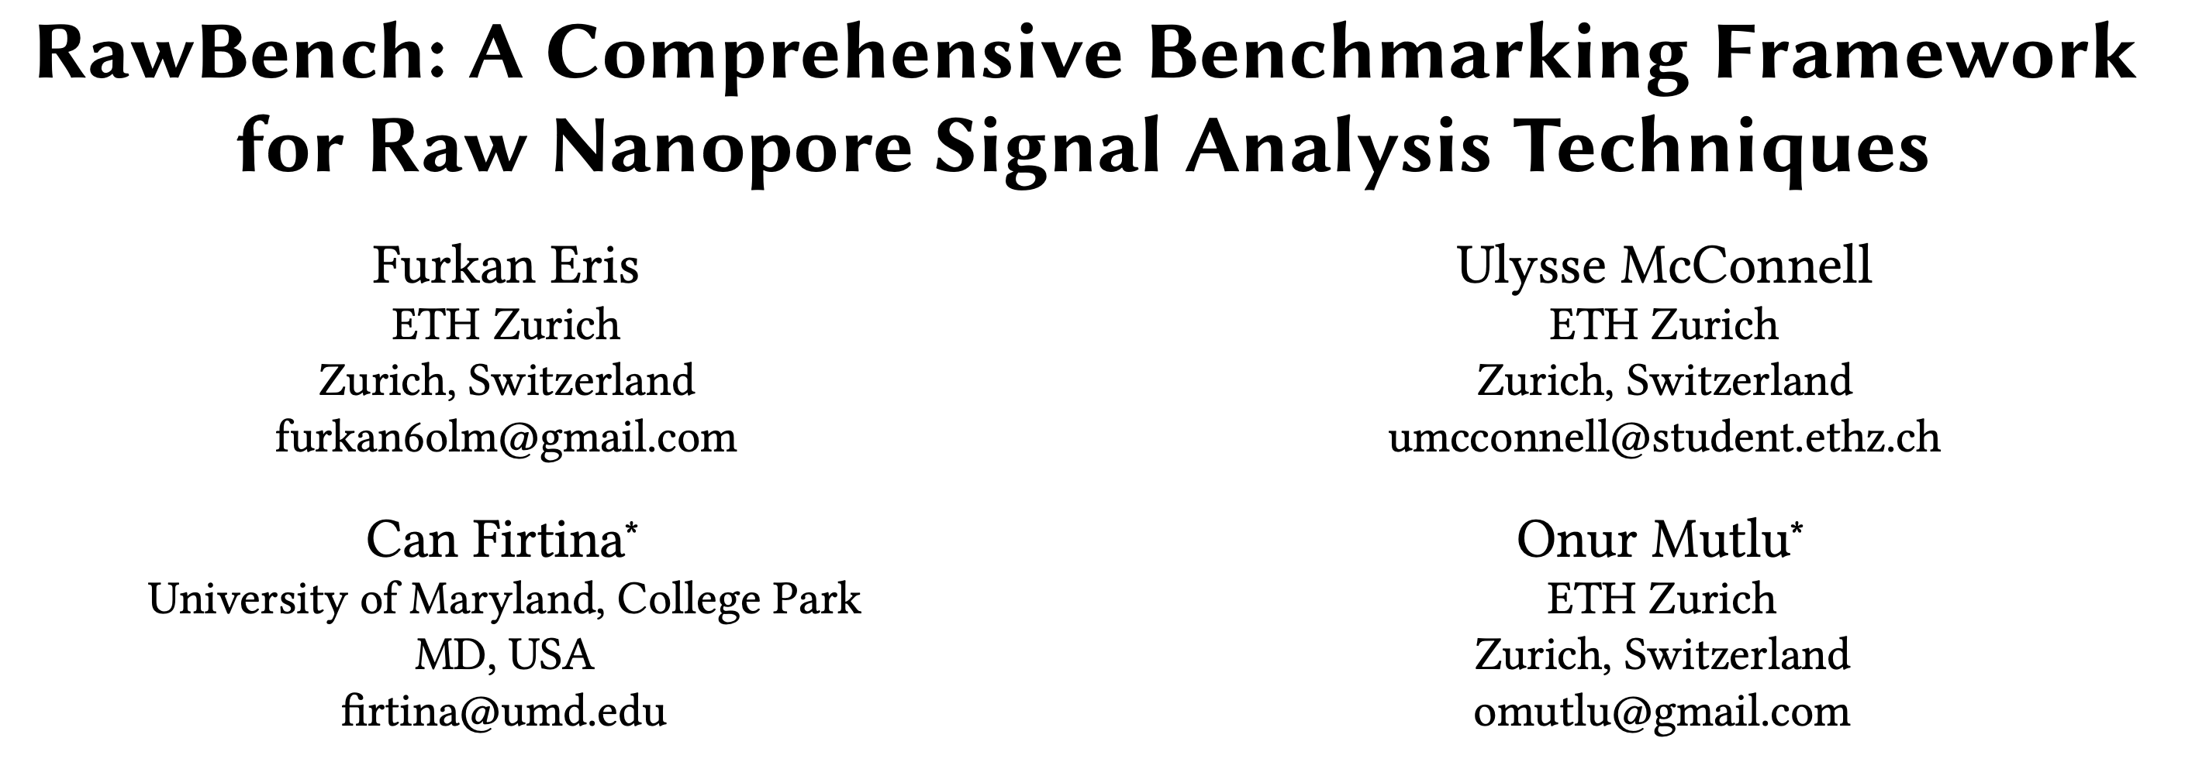
Benchmarking Raw Signal Analysis [ACM-BCB '25]
Furkan Eris, Ulysse McConnell, Can Firtina, and Onur Mutlu,
"RawBench: A Comprehensive Benchmarking Framework
for Raw Nanopore Signal Analysis Techniques"
Proceedings of the 16th ACM Conference on Bioinformatics, Computational Biology, and Health Informatics (ACM-BCB 2025), Philadelphia, PA, USA, October 2025.
Paper [online] [pdf]
Conference Talk [pptx] [pdf]

Slide 39
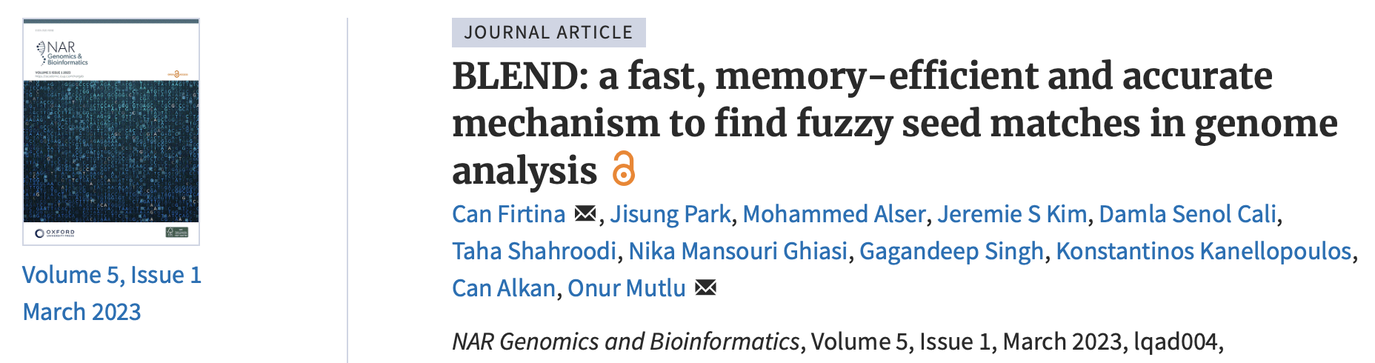
Tolerating Noise in String Matching [NARGAB '23]
Can Firtina, Jisung Park, Mohammed Alser, Jeremie S Kim, Damla Senol Cali, Taha Shahroodi, Nika Mansouri Ghiasi, Gagandeep Singh, Konstantinos Kanellopoulos, Can Alkan,
and Onur Mutlu,
"BLEND: a fast, memory-efficient and accurate mechanism
to find fuzzy seed matches in genome analysis"
NAR Genomics and Bioinformatics (NARGAB), March 2023.
Paper [online] [pdf] [code]
Preprint (bioRxiv) [online] [pdf]
RECOMB 2023 Talk [video] [pptx] [pdf]
Social Media Thread [Twitter (X)] [Twitter (X)]

Slide 40
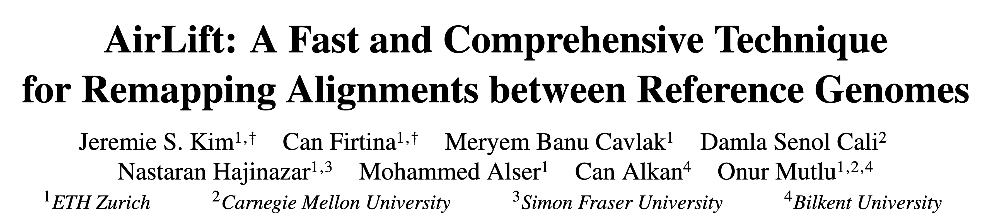
Mitigating Useless Computations [IEEE/ACM TCBB '24]
Jeremie S. Kim, Can Firtina, Meryem Banu Cavlak, Damla Senol Cali, Nastaran Hajinazar, Mohammed Alser, Can Alkan, and Onur Mutlu,
"AirLift: A Fast and Comprehensive Technique
for Remapping Alignments between Reference Genomes"
IEEE/ACM Transactions on Computational Biology and Bioinformatics (TCBB), August 2024.
Paper [online] [pdf] [code]
APBC 2023 Talk [video] [pptx] [pdf]

Slide 41
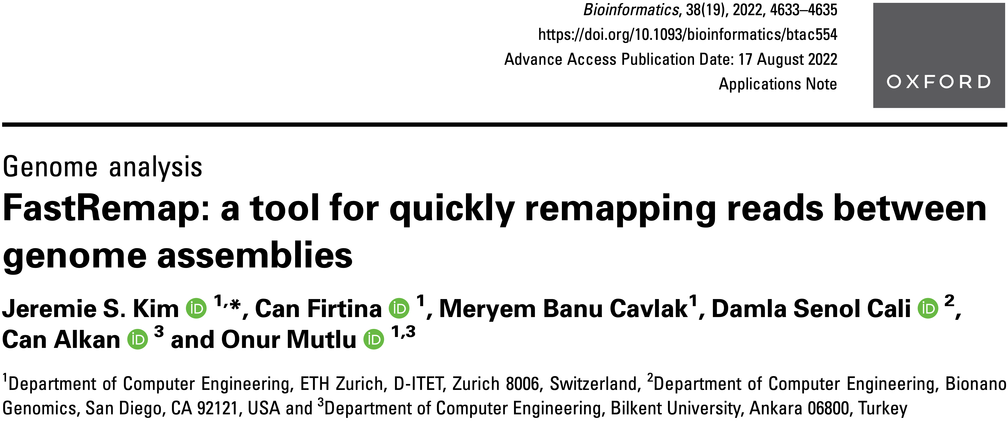
Mitigating Useless Computations [Bioinformatics '22]
Jeremie S Kim, Can Firtina, Meryem Banu Cavlak, Damla Senol Cali, Can Alkan, and Onur Mutlu,
"FastRemap: a tool for quickly remapping reads between genome assemblies"
Bioinformatics, September 2022.
Paper [online] [pdf] [code]

Slide 42
Utilizing AI/ML in
Genome Analysis via New Algorithms and
Architectures

Slide 43
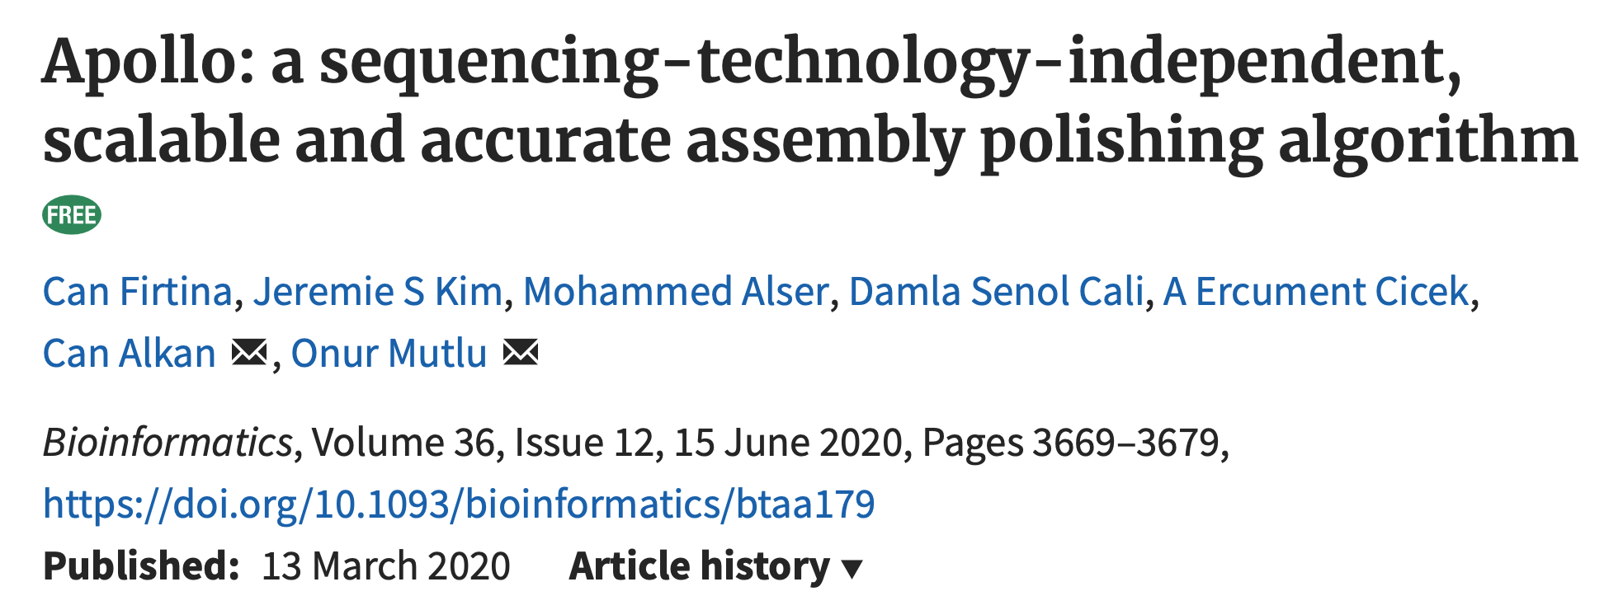
Error Correction using ML [Bioinformatics '20]
Can Firtina, Jeremie S. Kim, Mohammed Alser, Damla Senol Cali, A Ercument Cicek,
Can Alkan, and Onur Mutlu,
"Apollo: a sequencing-technology-independent, scalable and accurate
assembly polishing algorithm"
Bioinformatics, June 2020.
Paper [online] [pdf] [code]

Slide 44
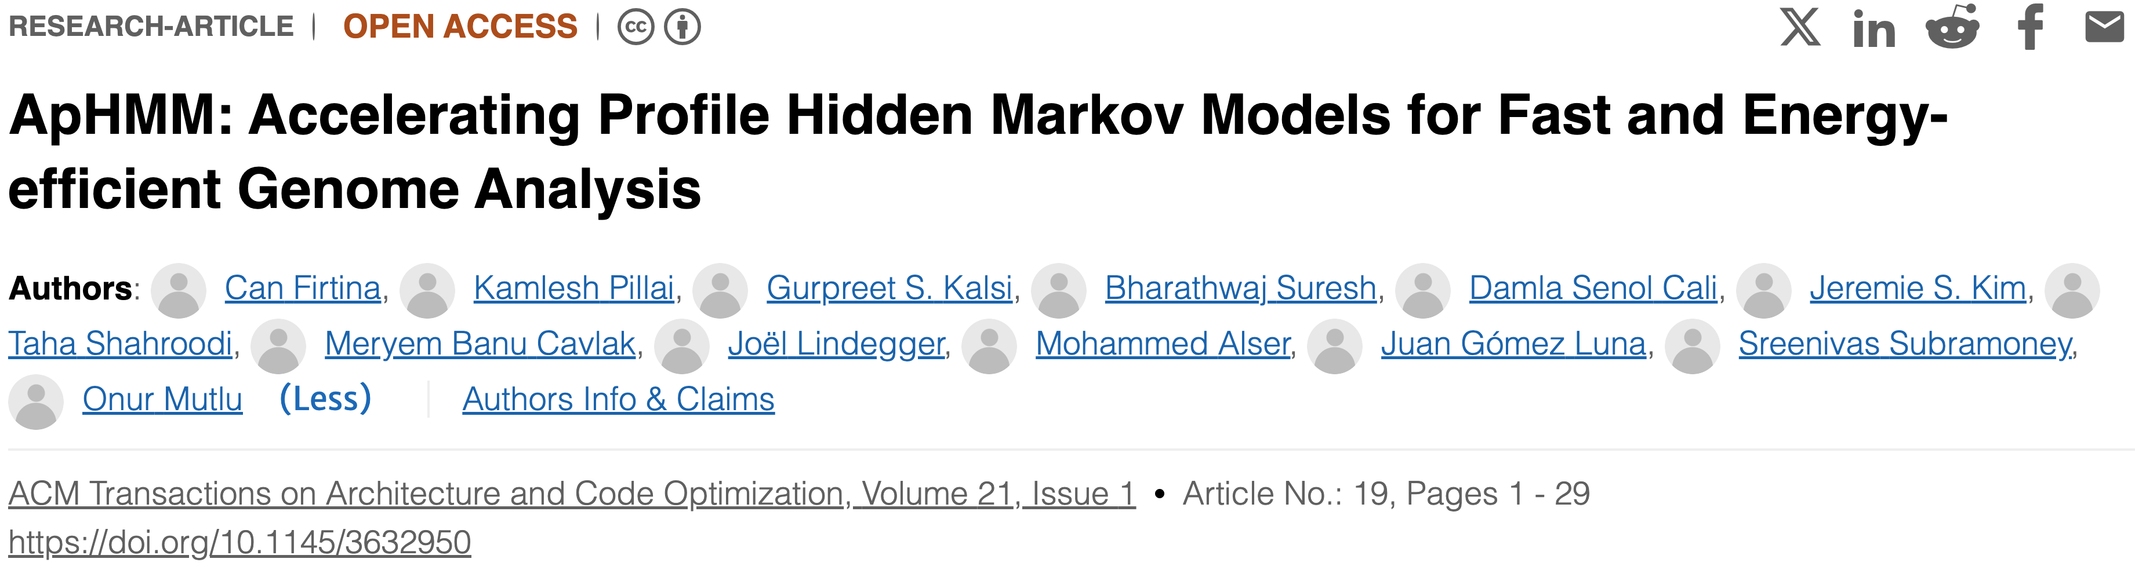
Accelerating ML & Genome Graphs [ACM TACO '24]
Can Firtina, Kamlesh Pillai, Gurpreet S. Kalsi, Bharathwaj Suresh, Damla Senol Cali, Jeremie S. Kim, Taha Shahroodi, Meryem Banu Cavlak, Joël Lindegger, Mohammed Alser, Juan Gómez Luna, Sreenivas Subramoney, and Onur Mutlu,
"ApHMM: Accelerating Profile Hidden Markov Models for Fast and
Energy-efficient Genome Analysis"
ACM Transactions on Architecture and Code Optimization (TACO), February 2024.
Paper [online] [pdf] [code]
HiPEAC 2024 Talk [video] [pptx] [pdf]

Slide 45

Translating Raw Signals using ML [Genome Biology '24]
Gagandeep Singh, Mohammed Alser, Kristof Denolf, Can Firtina, Alireza Khodamoradi,
Meryem Banu Cavlak, Henk Corporaal, and Onur Mutlu,
"RUBICON: a framework for designing efficient deep learning-based genomic basecallers"
Genome Biology, February 2024.
Paper [online] [pdf] [code]

Slide 46

Eliminating Useless Basecalling [Frontiers In Genetics '24]
Meryem Banu Cavlak, Gagandeep Singh, Mohammed Alser, Can Firtina, Joel Lindegger, Mohammad Sadrosadati, Nika Mansouri Ghiasi, Can Alkan, and Onur Mutlu,
"TargetCall: Eliminating the Wasted Computation in Basecalling
via Pre-Basecalling Filtering"
Frontiers in Genetics, September 2024.
Paper [online] [pdf] [code]

Slide 47

ML-based Genome Analysis via PIM [MICRO '22]
Haiyu Mao, Mohammed Alser, Mohammad Sadrosadati, Can Firtina, Akanksha Baranwal,
Damla Senol Cali, Aditya Manglik, Nour Almadhoun Alserr, and Onur Mutlu,
"GenPIP: In-Memory Acceleration of Genome Analysis
via Tight Integration of Basecalling and Read Mapping"
Proceedings of the 55th International Symposium on Microarchitecture (MICRO 2022), Chicago, IL, USA, October 2022.
Paper [online] [pdf]
Conference Talk [pptx] [pdf]

Slide 48
Problem 1: Large Data Movement
Raw Signals
Basecalling
Reads
Read quality
control
High-quality
reads
Read
mapping
Mapped
reads
3913 GB
546 GB
437 GB
382 GB
Large data movement between genome analysis steps
Bowden+ “Sequencing of human genomes with nanopore technology,” Nature Communications, 2019.

Slide 49
Problem 2: Wasted Computation
100%
79.5%
69.5%
Raw Signals
Basecalling
Reads
Read quality
control
High-quality
reads
Read
mapping
Mapped
reads
Low-quality
reads
Unmapped
reads
20.5%
10%
A considerable amount of computation on useless data due to
Low-quality reads
Unmapped reads

Slide 50
Goal and Opportunities
Goal: Efficiently accelerate the entire genome analysis pipeline while minimizing data movement and useless computation
We perform a study to quantify potential performance benefits
NVM-based PIM accelerators for separate basecalling and read mapping
No Data Movement
between the accelerators of analysis steps
no data movement
and
no useless reads
(ideal case)

Slide 51
GenPIP Overview
Raw signals from the sequencing machine
GenPIP
In-memory
Read Mapping
[PARC, ASPDAC’20]
+ Our design
In-memory
Basecaller
[Helix, PACT’20]
Signal
chunk
eDRAM
Basecalled
chunk
Chunk
Average Calculator
Read Mapping Controller
Base quality score
Chunk quality score
Quality score
PIM-CQS
PIM chunk quality score calculation
ER
Controller
Chunk mapping score
Read mapping result
To storage
Basecalling Module
ER
GenPIP Controller
ER
Read Mapping Module

Slide 52

Basecalling using PIM [MICRO '23]
Taha Shahroodi, Gagandeep Singh, Mahdi Zahedi, Haiyu Mao, Joel Lindegger,
Can Firtina, Stephan Wong, Onur Mutlu, and Said Hamdioui,
"Swordfish: A Framework for Evaluating Deep Neural Network-Based Basecalling
Using Computation-In-Memory with Non-Ideal Memristors"
Proceedings of the 56th International Symposium on Microarchitecture (MICRO 2023), Toronto, ON, Canada, November 2023.
Paper [online] [pdf]
Conference Talk [pptx] [pdf]

Slide 53
DNN Hardware Acceleration
DNN execution is dominated by:
Vector-Matrix Multiplication (VMM)
Data movement between memory and accelerator
(e.g., GPU or TPU)
Memristor-based PIM for DNN Acceleration
Memristor-based crossbars support VMM
Processing in Memory (PIM) minimizes data movement
  [Ankit+, ASPLOS 2019], [Chi+, ISCA 2016], [Lou+, PACT2020], [Shafiee+, ISCA 2016]

Slide 54
VMM in Memristor-based Crossbars
Digital to Analog Converters
Analog to Digital Converters

Slide 55
Non-idealities in Memristor-based Crossbars
Variation in
Synaptic Conductance
Non-ideal DAC
Digital to Analog Converters
Wire Resistance
Analog to Digital Converters
Non-ideal ADC
Subpar utilization of trained models due to non-idealities

Slide 56

Accuracy: All Non-idealities without Mitigation
D1
Baseline
D2
Baseline
Accuracy (%)
Non-idealities
Combined non-idealities leads to significant accuracy loss (>18%)

Slide 57

Accuracy: Enhancement Techniques on All Non-idealities
D1
Baseline
D3
Baseline
Accuracy (%)
Enhancement Technique
Accuracy loss drops to 6% from 18% after handling all non-idealities

Slide 58
Fast, Accurate, and Efficient
Genome Analysis
via Algorithm-Architecture
co-design

Slide 59

Accelerating String Matching [MICRO '20]
Damla Senol Cali, Gurpreet S. Kalsi, Zülal Bingöl, Can Firtina, Lavanya Subramanian, Jeremie S. Kim, Rachata Ausavarungnirun, Mohammed Alser, Juan Gómez-Luna, Amirali Boroumand, Anant Norion, Allison Scibisz, Sreenivas Subramoney, Can Alkan, Saugata Ghose, and Onur Mutlu,
"GenASM: A High-Performance, Low-Power Approximate String Matching Acceleration Framework for Genome Sequence Analysis"
Proceedings of the 53rd International Symposium on Microarchitecture (MICRO 2020), Virtual, October 2020.
Paper [online] [pdf] [code]
Conference Talk [video] [pptx] [pdf]

Slide 60

Accelerating Genome Graphs [ISCA '22]
Damla Senol Cali, Konstantinos Kanellopoulos, Joël Lindegger, Zülal Bingöl, Gurpreet S. Kalsi,
Ziyi Zuo, Can Firtina, Meryem Banu Cavlak, Jeremie Kim, Nika Mansouri Ghiasi, Gagandeep Singh, Juan Gómez-Luna, Nour Almadhoun Alserr, Mohammed Alser, Sreenivas Subramoney, Can Alkan, Saugata Ghose, and Onur Mutlu,
"SeGraM: A Universal Hardware Accelerator for Genomic Sequence-to-Graph
and Sequence-to-Sequence Mapping"
Proceedings of the 49th Annual International Symposium on Computer Architecture (ISCA 2022), New York City, NY, USA, June 2022.
Paper [online] [pdf] [code]
Conference Talk [video] [pptx] [pdf]

Slide 61

In-Storage Filtering for Genomics [ASPLOS '22]
Nika Mansouri Ghiasi, Jisung Park, Harun Mustafa, Jeremie Kim, Ataberk Olgun, Arvid Gollwitzer, Damla Senol Cali, Can Firtina, Haiyu Mao, Nour Almadhoun Alserr, Rachata Ausavarungnirun, Nandita Vijaykumar, Mohammed Alser, and Onur Mutlu,
"GenStore: A High-Performance in-Storage Processing System
for Genome Sequence Analysis"
Proceedings of the 27th International Conference on Architectural Support for Programming Languages and Operating Systems (ASPLOS 2022), Lusanne, Switzerland, February 2022.
Paper [online] [pdf] [code]
Conference Talk [video] [pptx] [pdf]

Slide 62

In-Storage Metagenomics [ISCA '24]
Nika Mansouri Ghiasi, Mohammad Sadrosadati, Harun Mustafa, Arvid Gollwitzer,
Can Firtina, Julien Eudine, Haiyu Mao, Joël Lindegger, Meryem Banu Cavlak, Mohammed Alser, Jisung Park, and Onur Mutlu,
"MegIS: High-Performance, Energy-Efficient, and Low-Cost Metagenomic Analysis
with In-Storage Processing"
Proceedings of the 51st Annual International Symposium on Computer Architecture (ISCA 2024), Buenos Aires, Argentina, July 2024.
Paper [online] [pdf] [code]
Conference Talk [pptx] [pdf]

Slide 63
Recommended: Accelerating Genome Analysis [DAC '23]
Onur Mutlu and Can Firtina,
"Invited: Accelerating Genome Analysis via Algorithm-Architecture Co-Design"
Proceedings of the 60th Design Automation Conference (DAC 2023), San Francisco, CA, USA, July 2023.
Paper [online] [pdf]

Slide 64
Agenda
Data-centric computing for genomics
Fundamentally rethinking how we analyze genomic data

Slide 65
Agenda
Data-centric computing for genomics
Fundamentally rethinking how we analyze genomic data

Slide 66
New Frontiers: Raw Signal Analysis [ISMB '23]
Can Firtina, Nika Mansouri Ghiasi, Joel Lindegger, Gagandeep Singh, Meryem Banu Cavlak,
Haiyu Mao, and Onur Mutlu,
"RawHash: enabling fast and accurate real-time analysis of
raw nanopore signals for large genomes"
Proceedings of the 31st Annual Conference on Intelligent Systems for Molecular Biology (ISMB 2023) and the 22nd European Conference on Computational Biology (ECCB 2023), Lyon, France, July 2023.
Paper [online] [pdf] [code]
Conference Talk [video] [pptx] [pdf]
Preprint (bioRxiv) [online] [pdf]
Social Media Thread [Twitter (X)]

Slide 67
Basecalling is Accurate yet Costly
Significant computation and energy overhead
Raw
Reads
Basecalling (Translator)
Basecalled
Reads
Read
Mapping
AAATGTGGTCCATTG
Noisy
Raw Signals
Costly
AI Models
Highly accurate reads
How to make this pipeline cheaper?
Notes:
Remember that basecalling is useful in this pipeline
to make a highly accurate translation from noisy raw electrical signals to human readable reads in DNA letters.
However we mainly rely on complex large neural models to perform the translation, which usually require using power hungry devices such as GPUs. This can be problematic especially for resource constrained devices and it is always better to achieve better scalability in terms of performance and energy
We asked the question how can we make this pipeline more efficient. And one idea is to…

Slide 68
Can We Survive Without Translation?
Raw
Reads
Read
Mapping
Noisy
Raw Signals
Reference Genome
...
...
CTGCGTAGCAGCGTAATAG
How to communicate
without an accurate translator?

Slide 69
Can We Survive With Noisy Signal Analysis?
Raw
Reads
Read
Mapping
Noisy
Raw Signals
Reference Genome
...
...
CTGCGTAGCAGCGTAATAG
Reference-to-Signal Conversion
How to identify similarity between noisy signals?
...
...
-0.06,0.24,-0.74,
Raw Signal Analysis

Slide 70







Generating Electrical Signals from DNA
Single Nanopore
Nanopore Sequencer
Raw Signals
(~5000 signals/sec)
Real-Time
Analysis
Raw Signals: Ionic current measurements generated at a certain throughput
Real-Time Analysis: Analyzing raw signals instantly as they are generated
Real-Time Decisions: Stopping sequencing early based on real-time analysis
https://nanoporetech.com/platform/technology/basecalling
https://blogs.ed.ac.uk/institute-genetics-cancer/2020/04/08/nanopore-sequencing-controversial-world-records-and-whale-watching/
Notes:
Let's look at how nanopore sequencing works. This is a nanopore sequencer that contains many tiny pores, called nanopores.
[CLICK] As a nucleic acid molecule passes through a single nanopore from the negatively charged side to the positively charged side,
[CLICK] we can measure the ionic current disruptions that are distinctive to identify each nucleotide passing through. These disruptions are generated
as raw electrical signals
at a certain throughput.
[CLICK] We can analyze these raw signals instantly
as they are generated, which we call real-time analysis.
[CLICK] Based on the real-time analysis, we can stop sequencing a read or the entire sequencing run.

Slide 71

Noise in Raw Electrical Signals
Observation: Identical molecules generate
similar raw signals
Sequencing CTGCGTAGCA
Raw
Signals:
[ , , , , ]
-0.06
-0.22
-0.75
0.96
-0.49
Key Idea: Perform similarity estimation
based on vector similarity search
Nearest Neighbor Search
Raw
Signals:
[ , , , , ]
-0.05
-0.21
-0.76
1.01
-0.51
Sequencing CTGCGTAGCA
Problem: Too Costly for Large Genomes

Slide 72




Scalability Issues Limit Real-Time Analysis
Genome Size Increase: 150$×$
2.4$×$
9.2$×$
28$×$
No Real-Time Analysis for Larger Genomes:
Searching mechanism does not scale well

Slide 73
Benefits of Real-Time Analysis
✓
Reducing latency by overlapping analysis with sequencing
Time
Sequencing
Analysis
Reduced Latency
Sequencing & Real-Time Analysis
✓
Reducing sequencing time and cost by stopping sequencing early
Sequenced Bases
Completely Sequenced Read
Reduced Sequencing Time (and Cost)
Partially Sequenced Read
Sequencing is stopped early with a real-time decision

Slide 74
Goal
Enable Fast, Accurate, and Scalable
Real-Time Analysis for Larger Genomes

Slide 75
Key Idea
Key Idea: Perform similarity estimation
based on quick exact matches
Raw
Signals:
[ , , , , ]
-0.06
-0.22
-0.75
0.96
-0.49
Hash
0x77db
Fast Match
CTGCGT
Hash
0x77db
Raw
Signals:
[ , , , , ]
-0.05
-0.21
-0.76
1.01
-0.51
Challenge: How to generate the same hash value
for similar enough signals with various noise types?

Slide 76
RawHash Key Idea – Quantization
CTGCGT
-0.05
-0.07
-0.06
-0.05
-0.06
Quantize
Quantize
Quantize
Quantize
Quantize
Bucket #
0
1
2
3
4
5
6
7
8
9
10
11
12
13
14
15
-3.00
Range of raw signals (normalized)
+3.00
✓
Enables matching raw signals by eliminating slight differences

Slide 77

How to Better Quantize Signals?
Bucket #
0
1
2
3
4
5
6
7
8
9
10
11
12
13
14
15
-3.00
Range of raw signals (normalized)
+3.00
✕
Equal-width buckets leads to
unbalanced bucket loading
600
400
K-mer count
200
0
1
2
3
4
5
6
7
8
9
10
11
12
13
14
15
-3.00
+3.00
✕
Reduced uniqueness and poor resource utilization

Slide 78


Adaptive Quantization
Key Idea: Quantizing raw signals with non-equal bucket widths
by leveraging raw signal distribution
Bucket #
0
1
2
3
4
5
6
7
8
9
10
11
12
13
14
15
-3.00
Range of raw signals (normalized)
+3.00
K-mer count
-3.00
3.00
✓
Better bucket utilization

Slide 79
RawHash Key Idea – Hash-based Matching
Sequencing CTGCGTAGCA
[ , , , , ]
-0.06
-0.22
-0.75
0.96
-0.49
Quantize
Quantize
Quantize
Quantize
Quantize
Hash
0x77db
0b0111
0b0111
0b0110
0b1011
0b0110
Pack
0b01110111011010110110
Hash
0x77db
Fast and Accurate Match
Key Contribution: The first hash-based search
(and indexing) mechanism for raw signals

Slide 80
Real-Time Analysis Benefits from Fast Search
Genome Size Increase: 150$×$
2.4$×$
9.2$×$
28$×$
Real-time Analysis for Human Genomes:
Fast search instead of costly neighbor search

Slide 81
Fast Search Leads to Accurate Search
Best accuracy for all genomes:
Hash values span longer sequences than vectors ->
More unique and informative matches
(Almost) Identical accuracy to basecalled analysis:
Is the small difference because RawHash is even better?

Slide 82

RawHash is Open Source

Slide 83
Can We Do Better?

Slide 84
In-Storage Raw Signal Analysis [ICS '25]
Melina Soysal, Konstantina Koliogeorgi, Can Firtina, Nika Mansouri Ghiasi, Rakesh Nadig,
Haiyu Mao, Geraldo Francisco Oliveira Junior, Yu Liang, Klea Zambaku, Mohammad Sadrosadati, and Onur Mutlu,
"MARS: Processing-In-Memory Acceleration of
Raw Signal Genome Analysis Inside the Storage Subsystem"
Proceedings of the 39th International Conference on Supercomputing (ICS 2025), Salt Lake City, Utah, USA, June 2025.
Paper [online] [pdf]
Conference Talk [video] [pptx] [pdf]

Slide 85

Read Mapping with Raw Signals
High Level Overview of Read Mapping in
Raw Signal Genome Analysis (RSGA)
Mapping (online)
Query Sequence
Sketching
I
EVENT DETECTION
Hash Table
events
Hash
Positions
II
SEEDING
0x00
2,64,…
query
hash and query
0x01
1,101,…
0x00
Hash
…
0xFF
13,21
matches
Chaining
III
CHAINING
x
x
sorting and DP-based
x
chains
Notes:
The first one is event detection where the raw electrical signals are transformed into discrete events that represent segments of the signal.
The second one is the seeding step where events are compressed into hash values and then queried from the pre-built index hash table to find potential matches between the reference genome from the indexing step and the input sequence.
And the last step is called chaining where the matching seed positions are grouped to form consistent and colinear regions that represent the final alignment.
This steps computational relies on sorting operations and dynamic programming techniques to obtain the chains

Slide 86
Motivation
Chaining & seeding consistently dominate runtime
Event detection & I/O overhead are non-negligible for some datasets

Slide 87
Impact of I/O data movement
We model I/O data movement overhead when accelerating commonly targeted steps in the pipeline: seeding and chaining
As compute latency is reduced, I/O becomes the dominant contributor to total execution time
I/O data movement from SSD becomes dominant overhead as compute steps are accelerated in RSGA
Notes:
So we did um a modeling experiment to understand the role of the IO a bit more deeply
we model a scenario where the seeding and chaining steps, so the last two steps of mapping are accelerated.
So here in this graph. On the x- axis you can see the degree of acceleration of these two steps while on the y-axis it displays a percentage of the IO data movement as part of the end execution time
you can see IO quickly becomes the dominant bottleneck accounting for up to 78% even for the larger genomes
we conclude that compute only acceleration isn’t sufficient but we need to fundamentally reduce the data movement

Slide 88
MARS Architecture & System - Overview
In-Storage-Processing system for RSGA
Conventional Mode: SSD performs standard SSD storage operations
Accelerator Mode: SSD executes the full RSGA pipeline without host intervention
SSD Controller
Flash Controller
I
MARS
Control
Unit
FTL
II
III
Sorter
Unit
Merger
Unit
.
Flash Memory
Cores
.
.
SSD-Internal DRAM
Bank
V
Querying Unit
V
Querying Unit
…
…
…
…
…
…
…
Subarrays
Bank
IV
Arithmetic Unit
Arithmetic Unit
Notes:
Let's now have a closer look into the hardware system we designed.
our system Mars operates in two modes.
The first mode is the conventional mode where the SSD continues to behave like a normal storage device
the second mode is the accelerator mode where Mars takes over and executes the entire RSGA pipeline inside the SSD without any further host intervention.

Slide 89
MARS Architecture & System (I/IV)
SSD Controller Components
SSD Controller
Flash Controller
I
FTL
II
III
MARS
Control
Unit
Sorter
Unit
Merger
Unit
.
Flash Memory
Cores
.
.
I
MARS Control Unit
Finite State Machine that orchestrates pipeline execution, control and data flow
Notes:
Let's now have a closer look at the components that make the system possible.
The first one is the Mars control unit which implements a final state machine that orchestrates the complete RSGA pipeline steps including control and data flow.

Slide 90
MARS Architecture & System (II/IV)
SSD Controller Components
SSD Controller
Flash Controller
I
FTL
II
III
MARS
Control
Unit
Sorter
Unit
Merger
Unit
.
Flash Memory
Cores
.
.
I
II
III
MARS Control Unit
Sorter Unit
Merger Unit
Finite State Machine that orchestrates pipeline execution, control and data flow
Performs parallel sorting of sequences using dedicated logic
Combines sorted subsequences into longer sorted ones
Paradigm: Implements Processing Near DRAM
1 Sorter-Merger pair per flash controller
Notes:
We then have dedicated sortter and merger units within the SSD controller.
We have one per flash controller, so eight in total in our design.
they can perform highly parallel hardware accelerated sorting and merging which is a core step of the chaining step within read mapping.

Slide 91
MARS Architecture & System (III/IV)
SSD-Internal DRAM Components
SSD-Internal DRAM
Bank
V
Querying Unit
V
Querying Unit
…
…
…
…
…
Subarrays
…
…
Bank
Arithmetic Unit
IV
IV
Arithmetic Unit
Performs arithmetic and logical operations required for RSGA
Paradigm: Implements Processing Near DRAM
Design: Based on the FULCRUM¹ architecture for leveraging DRAM subarray proximity for low-latency parallel arithmetic operations
1 per two subarrays
1: [Lenjani, HPCA’20];
Notes:
Additionally, we also modify the SSD internal DRAM. There we add two units.
The first one is the arithmetic unit: they perform arithmetic and logical operations that are required for RSGA
.And our design uses processing near memory.
It's based on the fulcrum design that leverages the DM subarray proximity for low latency parallel arithmetic operations.
we have one per two subarrays. So 256 in total in our design.

Slide 92
MARS Architecture & System (IV/IV)
SSD-Internal DRAM Components
SSD-Internal DRAM
Bank
V
Querying Unit
V
Querying Unit
…
…
…
…
…
Subarrays
…
…
Bank
Arithmetic Unit
IV
IV
V
Arithmetic Unit
Querying Unit
Performs arithmetic and logical operations required for RSGA
Performs efficient, in-memory hash table lookups for seeding
Paradigm: Implements Processing Near DRAM
Paradigm: Implements Processing Using DRAM
Design: Based on the FULCRUM¹ architecture for leveraging DRAM subarray proximity for low-latency parallel arithmetic operations
Design: Based on the PLUTO² architecture leveraging DRAM row activation for massively parallel hash-table lookup operations
1 per two subarrays
1 per subarray
1: [Lenjani, HPCA’20]; 2: [Ferreira+, MICRO’22]
Notes:
The second element we add is a querying unit
they perform efficient in-memory hash table lookup for seeding where we need it
this design implement here is based on Pluto that leverages the processing using memory paradigm to enable massively parallel hash table lookups directly within the DM.
We place a querying unit per subarray, so 512 elements

Slide 93
Performance Evaluation
BC
GenPIP
MS-CPU
MARS
RawHash2
100
10
Speedup
1
0.1
D1
D2
D3
D4
D5
GEOMEAN
Basecalling-based pipeline
RSGA-based pipeline
MARS outperforms all other baselines across all datasets
MARS outperforms GenPIP adopting PIM outside storage
Key Observations
We fundamentally solve the I/O data movement overhead problem
MARS-CPU provide speedup of 1.7x over RH2
Our SW modifications are effective in reducing the computational load

Slide 94
Energy Evaluation
BC
GenPIP
MS-CPU
MARS
RawHash2
10²
10
Energy Reduction
1
0.1
D1
D2
D3
D4
D5
GEOMEAN
Basecalling-based pipeline
RSGA-based pipeline
MARS reduces energy consumption over all other baselines across all datasets
Key Observation
Improvement stems from
reduced execution time
fundamentally addressing the I/O data movement overhead

Slide 95
Processing Data Where It Makes Sense Provides Significant Performance
and Energy Benefits

Slide 96
Agenda
Data-centric computing for genomics
Fundamentally rethinking how we analyze genomic data

Slide 97












STORM Group
Research Directions
Multimodal Systems for Biological Data Analysis
Goal
Enable effortless
integration of
genome-analysis-driven solutions in our
everyday lives
End-to-End Portable Systems for Everyday Genome Analysis
I am recruiting motivated students!
Algorithms and AI
for Sequence Analysis

Slide 98
Enabling Real-Time Analysis
of Human Genomes
via New Algorithms and Architectures
2025 CS Research Seminar Series at UMD
November 21, 2025
Can Firtina | canfirtina@gmail.com | cs.umd.edu/~firtina
Assistant Professor of Computer Science at UMD

