Slide 1
Lost in Translation: Harnessing the Power of Nanopore Electrical Signals in Genomics
Arch4Health Workshop (in conj. with HPCA 2026), Sydney, Australia
January 31, 2026
Can Firtina | canfirtina@gmail.com | cs.umd.edu/~firtina
Assistant Professor of Computer Science at UMD

Slide 2

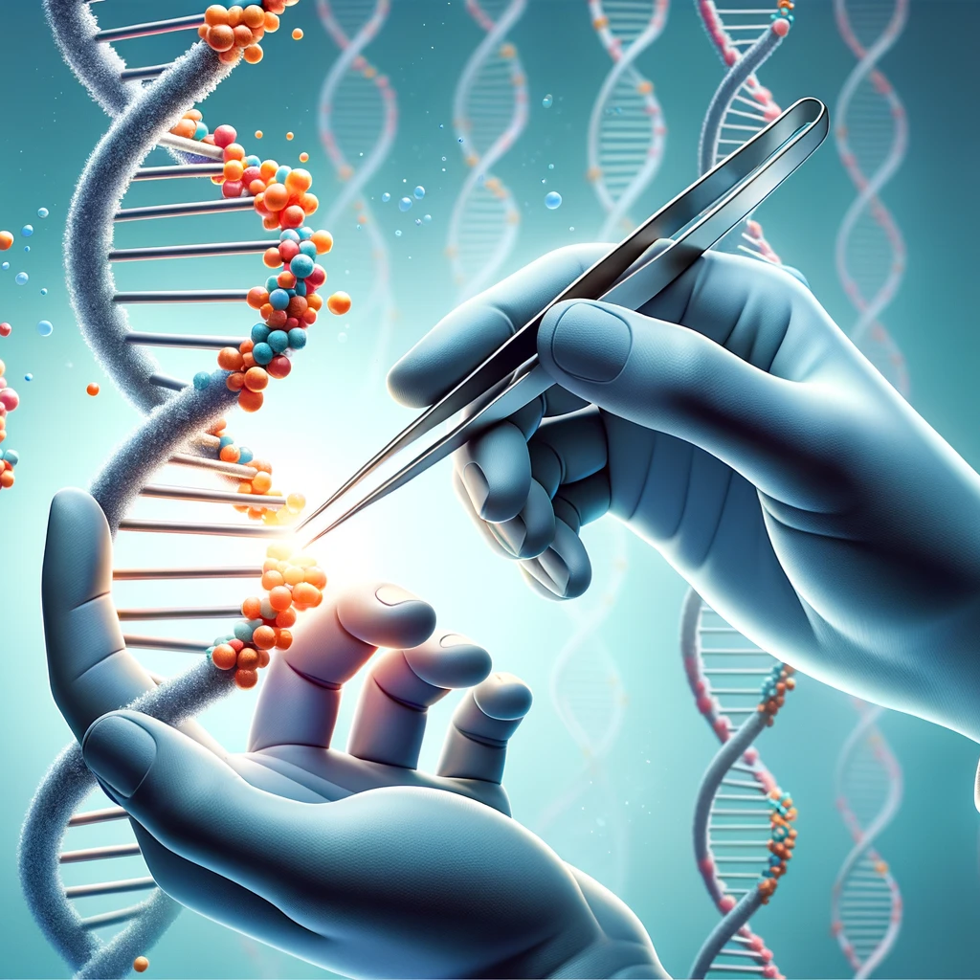

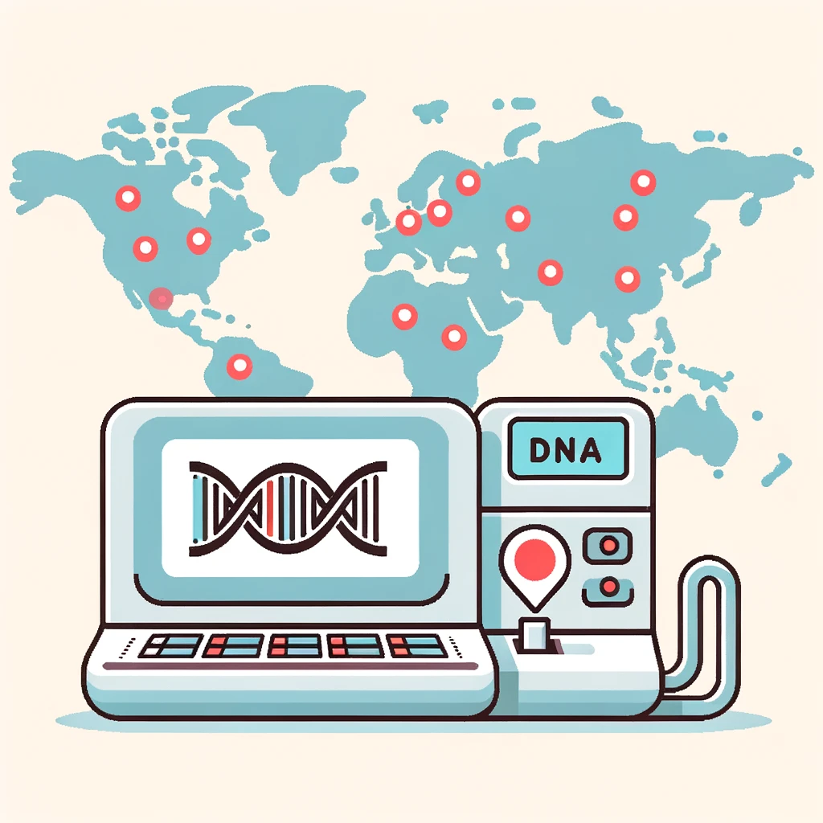
Analyzing Genomes Reveals Key Insights
Altering genomes to solve
fundamental challenges of life
Personalized Medicine
Detecting pathogens
in the environment
Rapid surveillance of
disease outbreaks

Slide 3
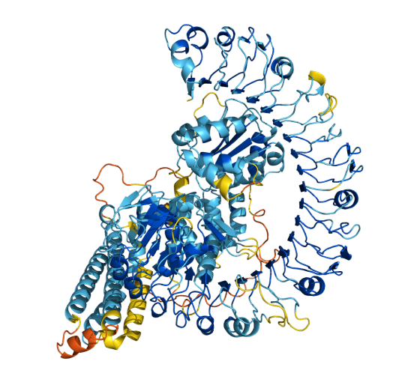
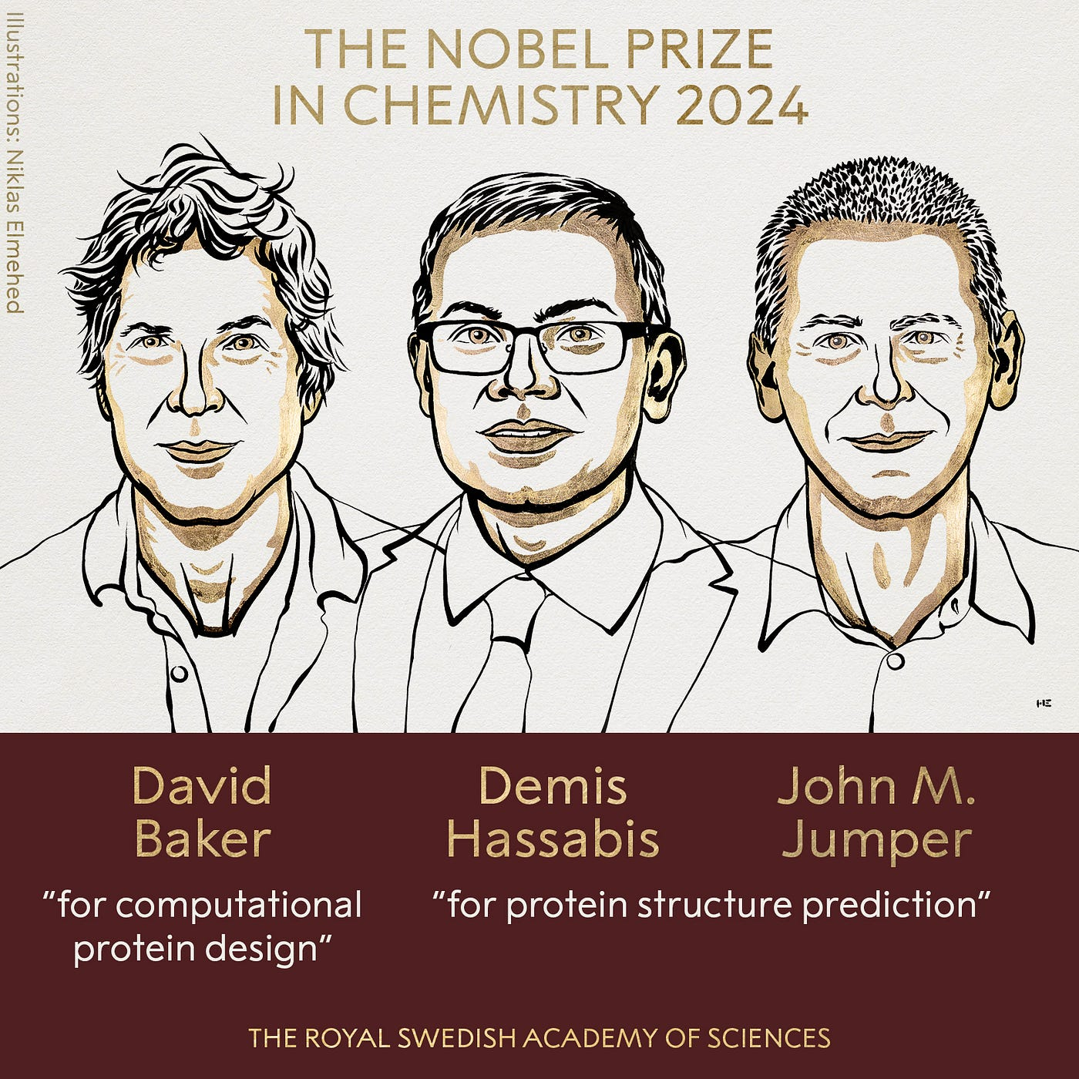
Protein Structure Prediction with AI
https://www.nobelprize.org/prizes/chemistry/2024/press-release/

Slide 4
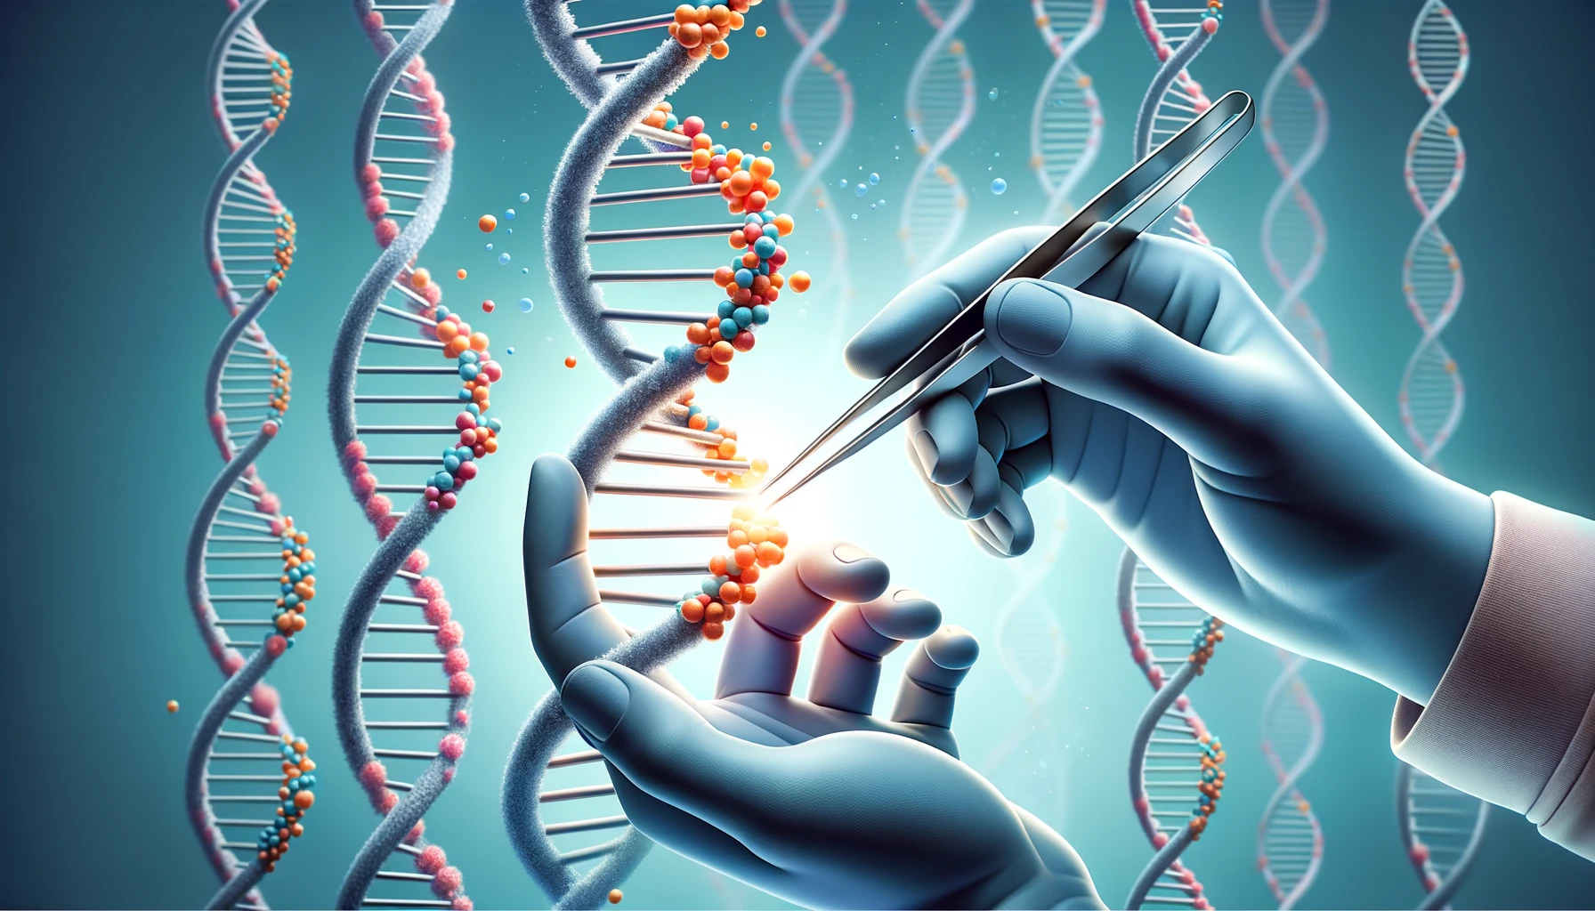
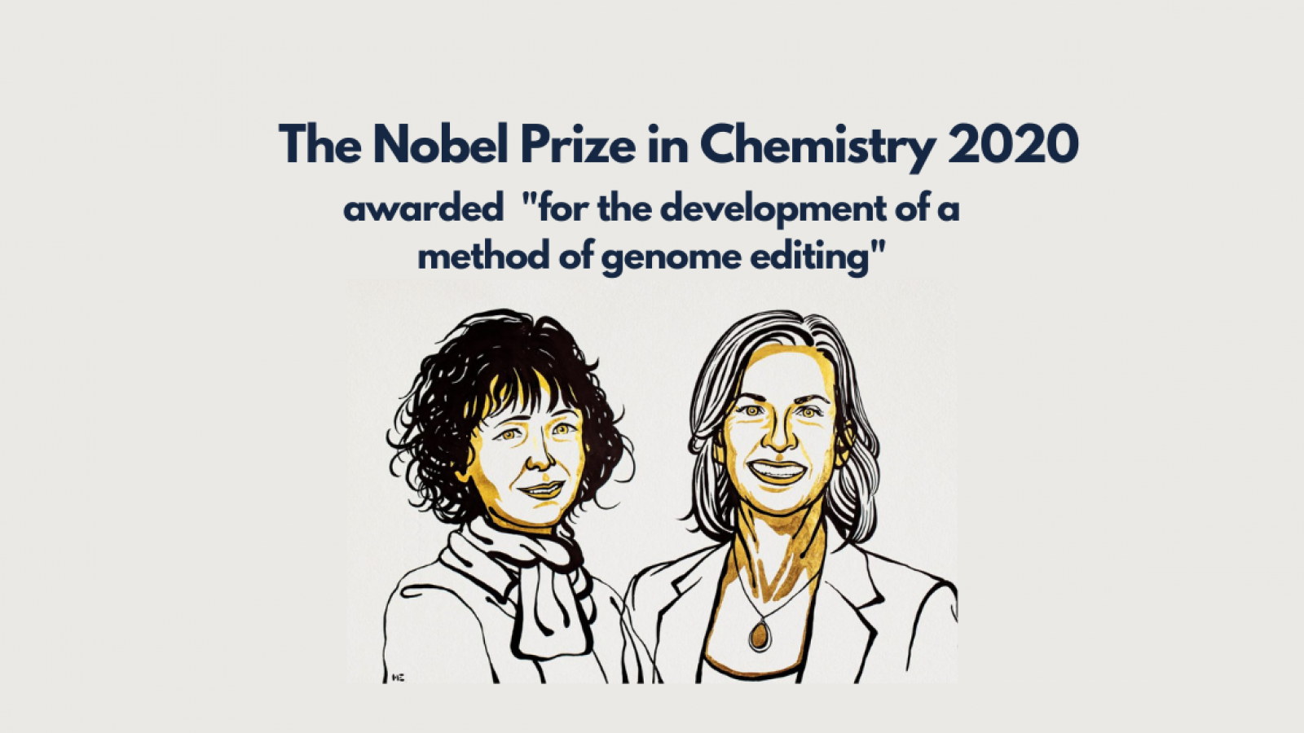
Genome Editing
https://www.nobelprize.org/prizes/chemistry/2020/press-release/

Slide 5

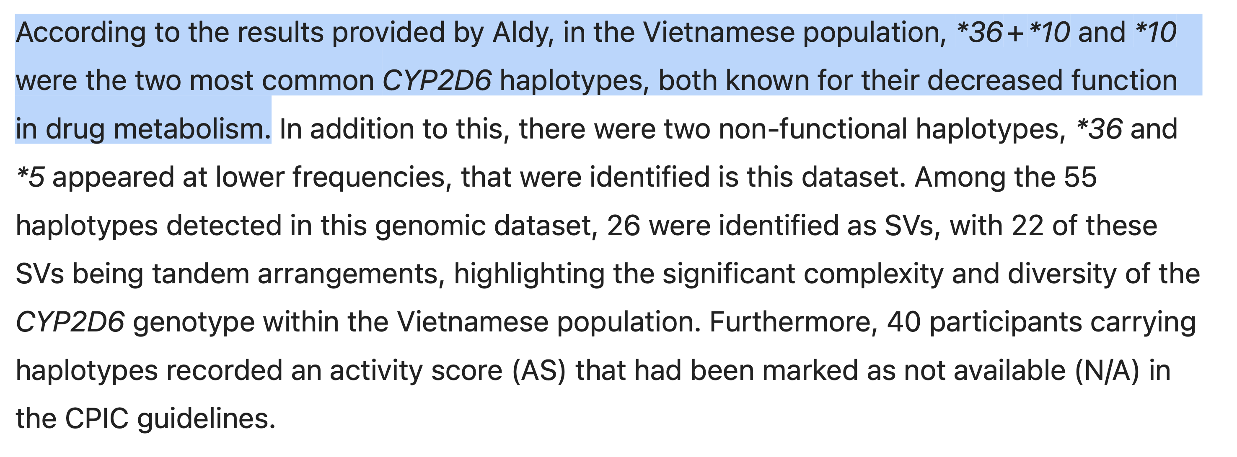
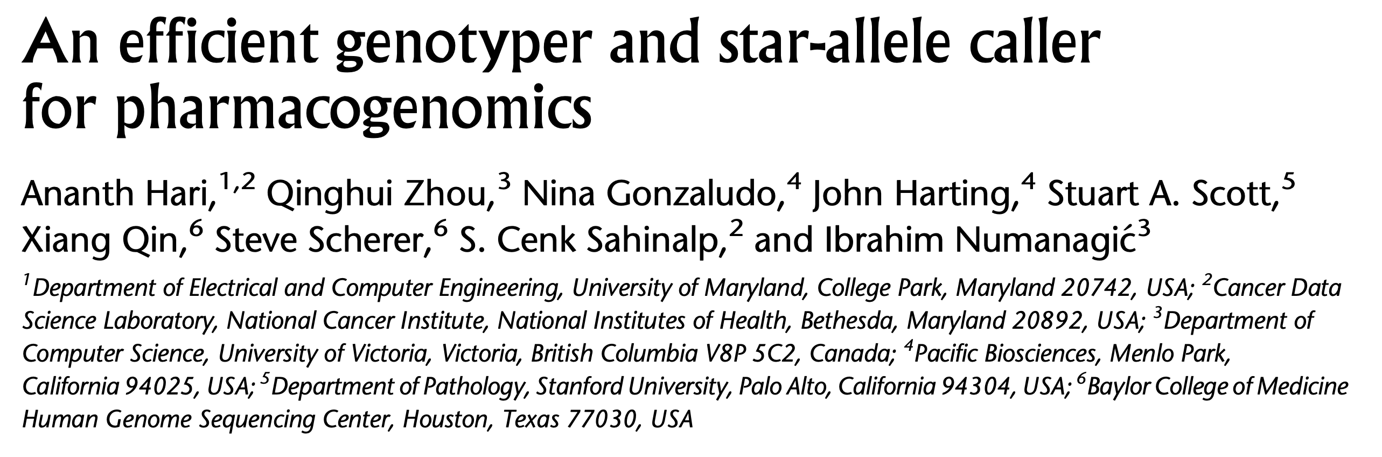
Population-Scale Analysis
Nguyen+, “A comprehensive assessment of pharmacogenomic annotation tools for next-generation sequencing data: an emphasis on cyp2d6 and vietnamese genomic data,” Journal of Human Genetics 2025
Hari+, “An efficient genotyper and star-allele caller for pharmacogenomics”, Genome Research 2023.

Slide 6
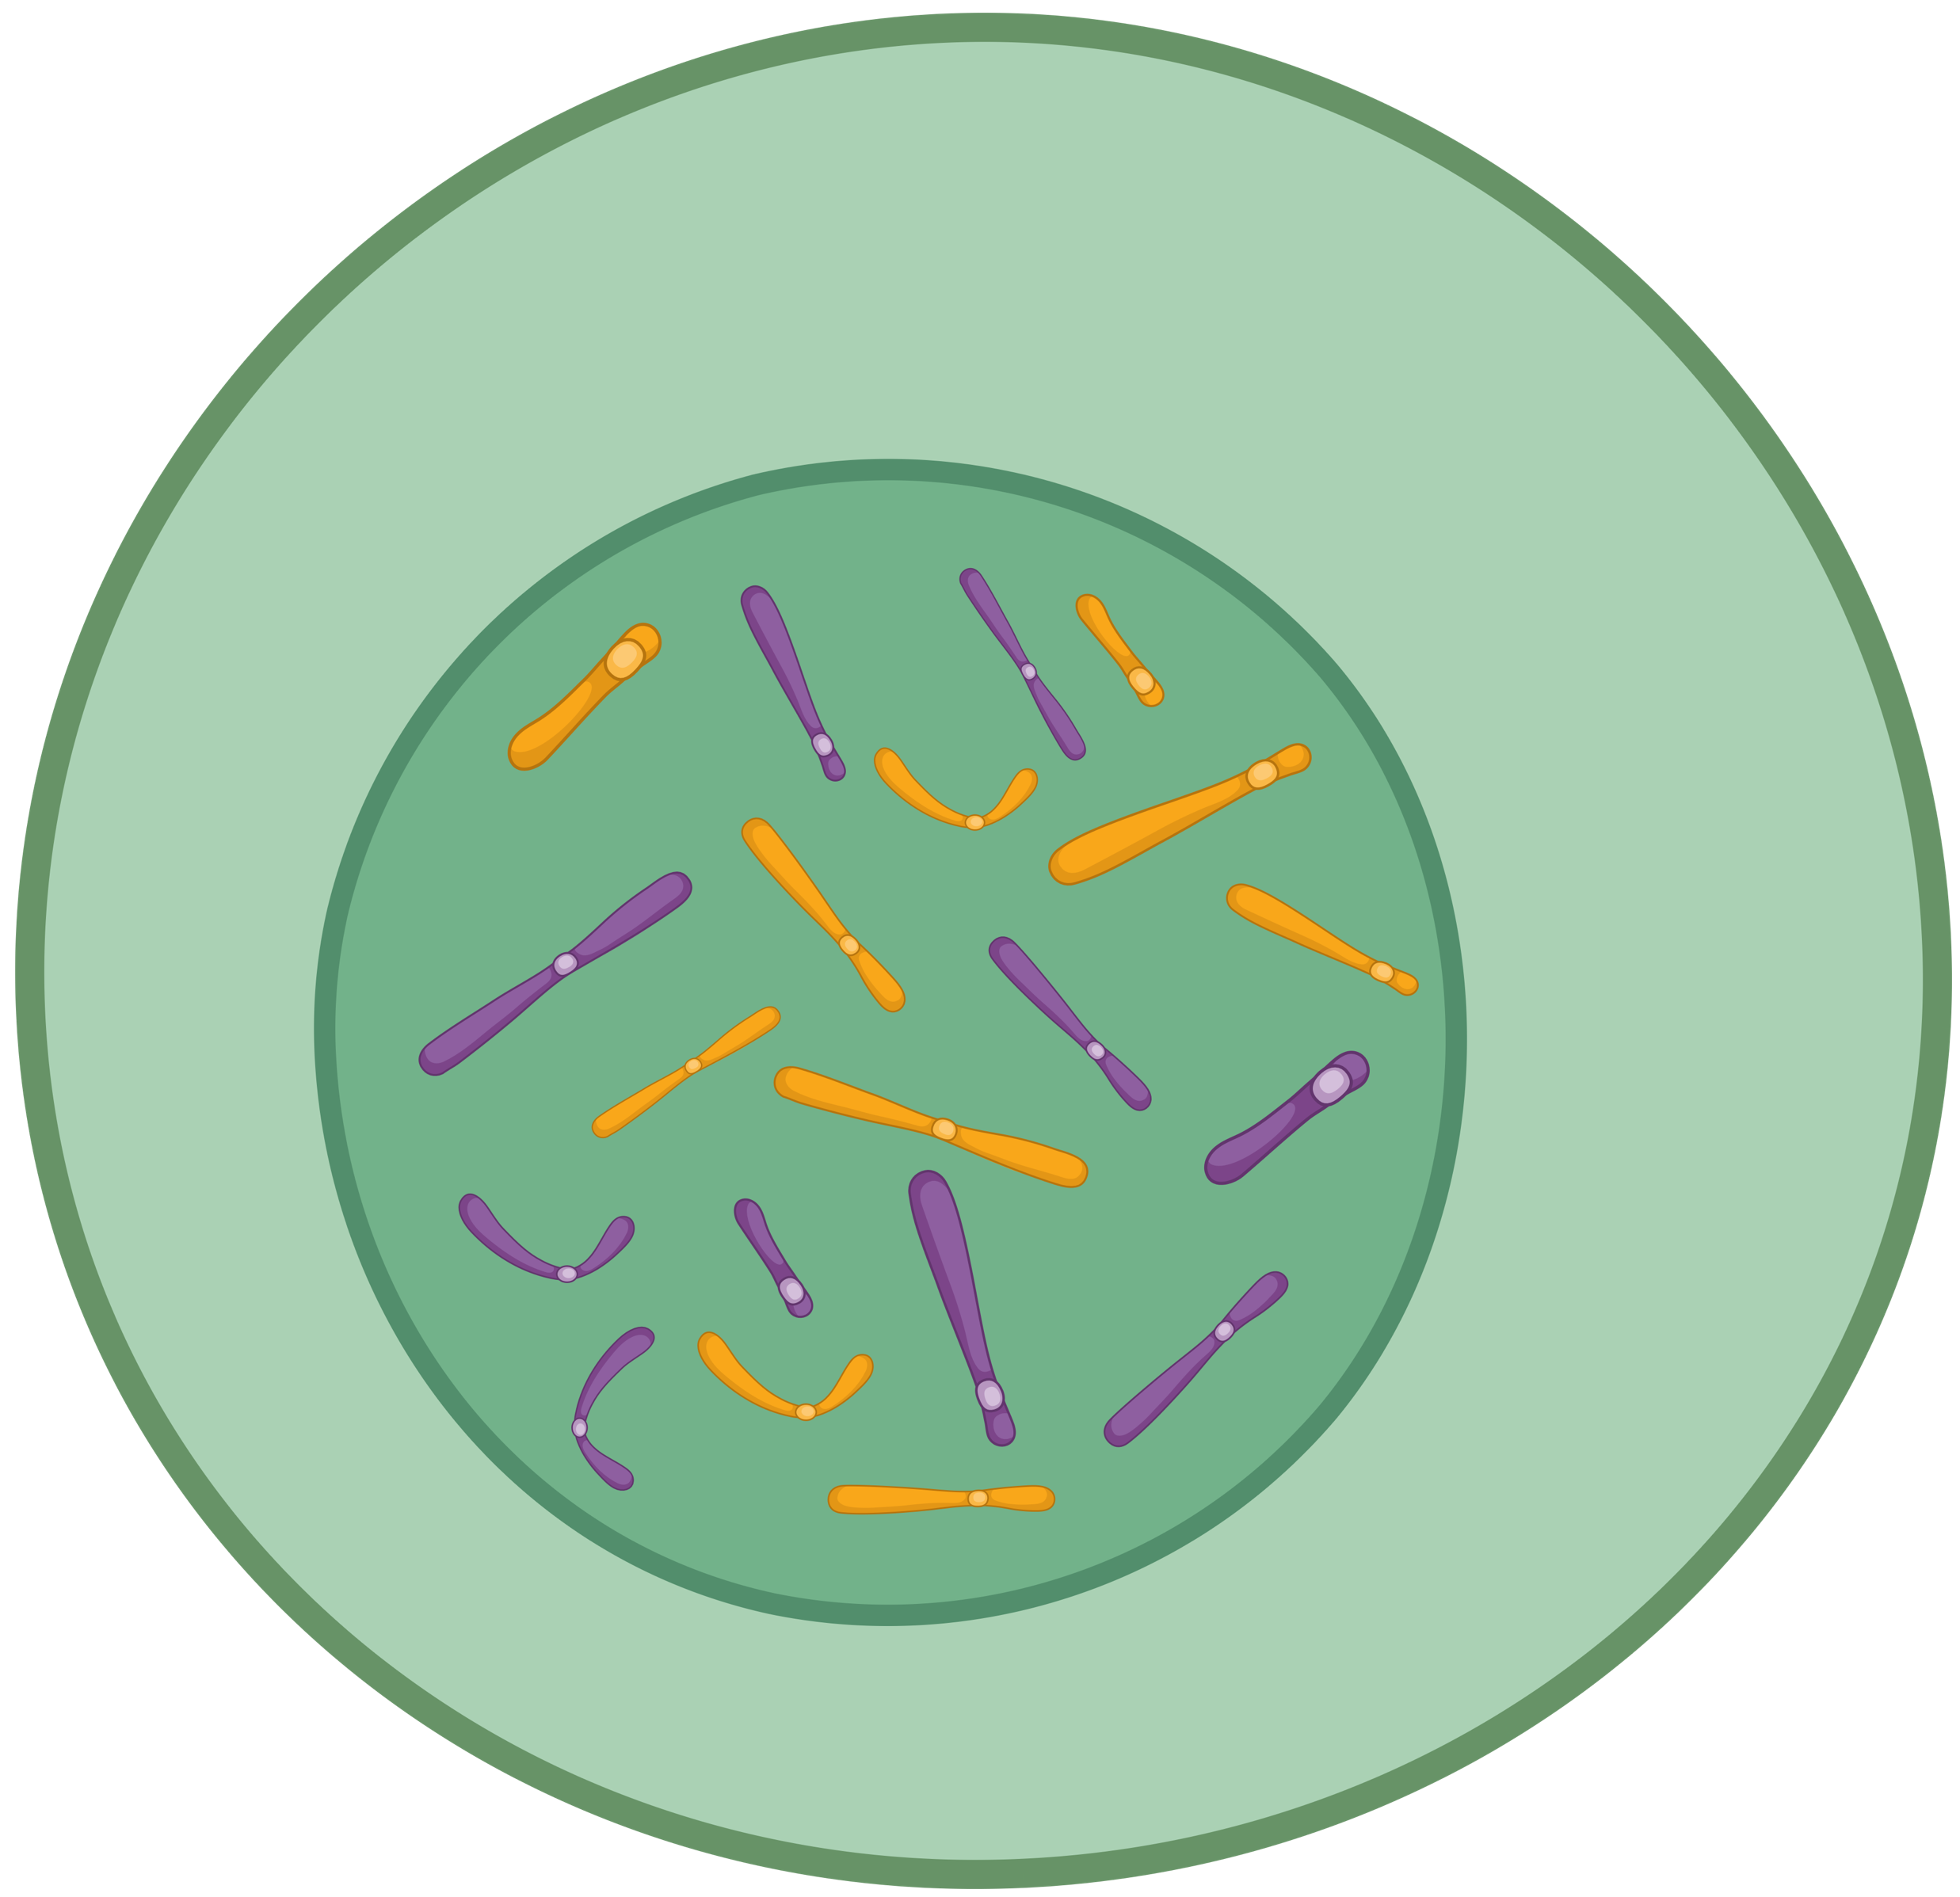
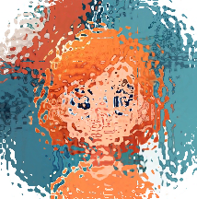
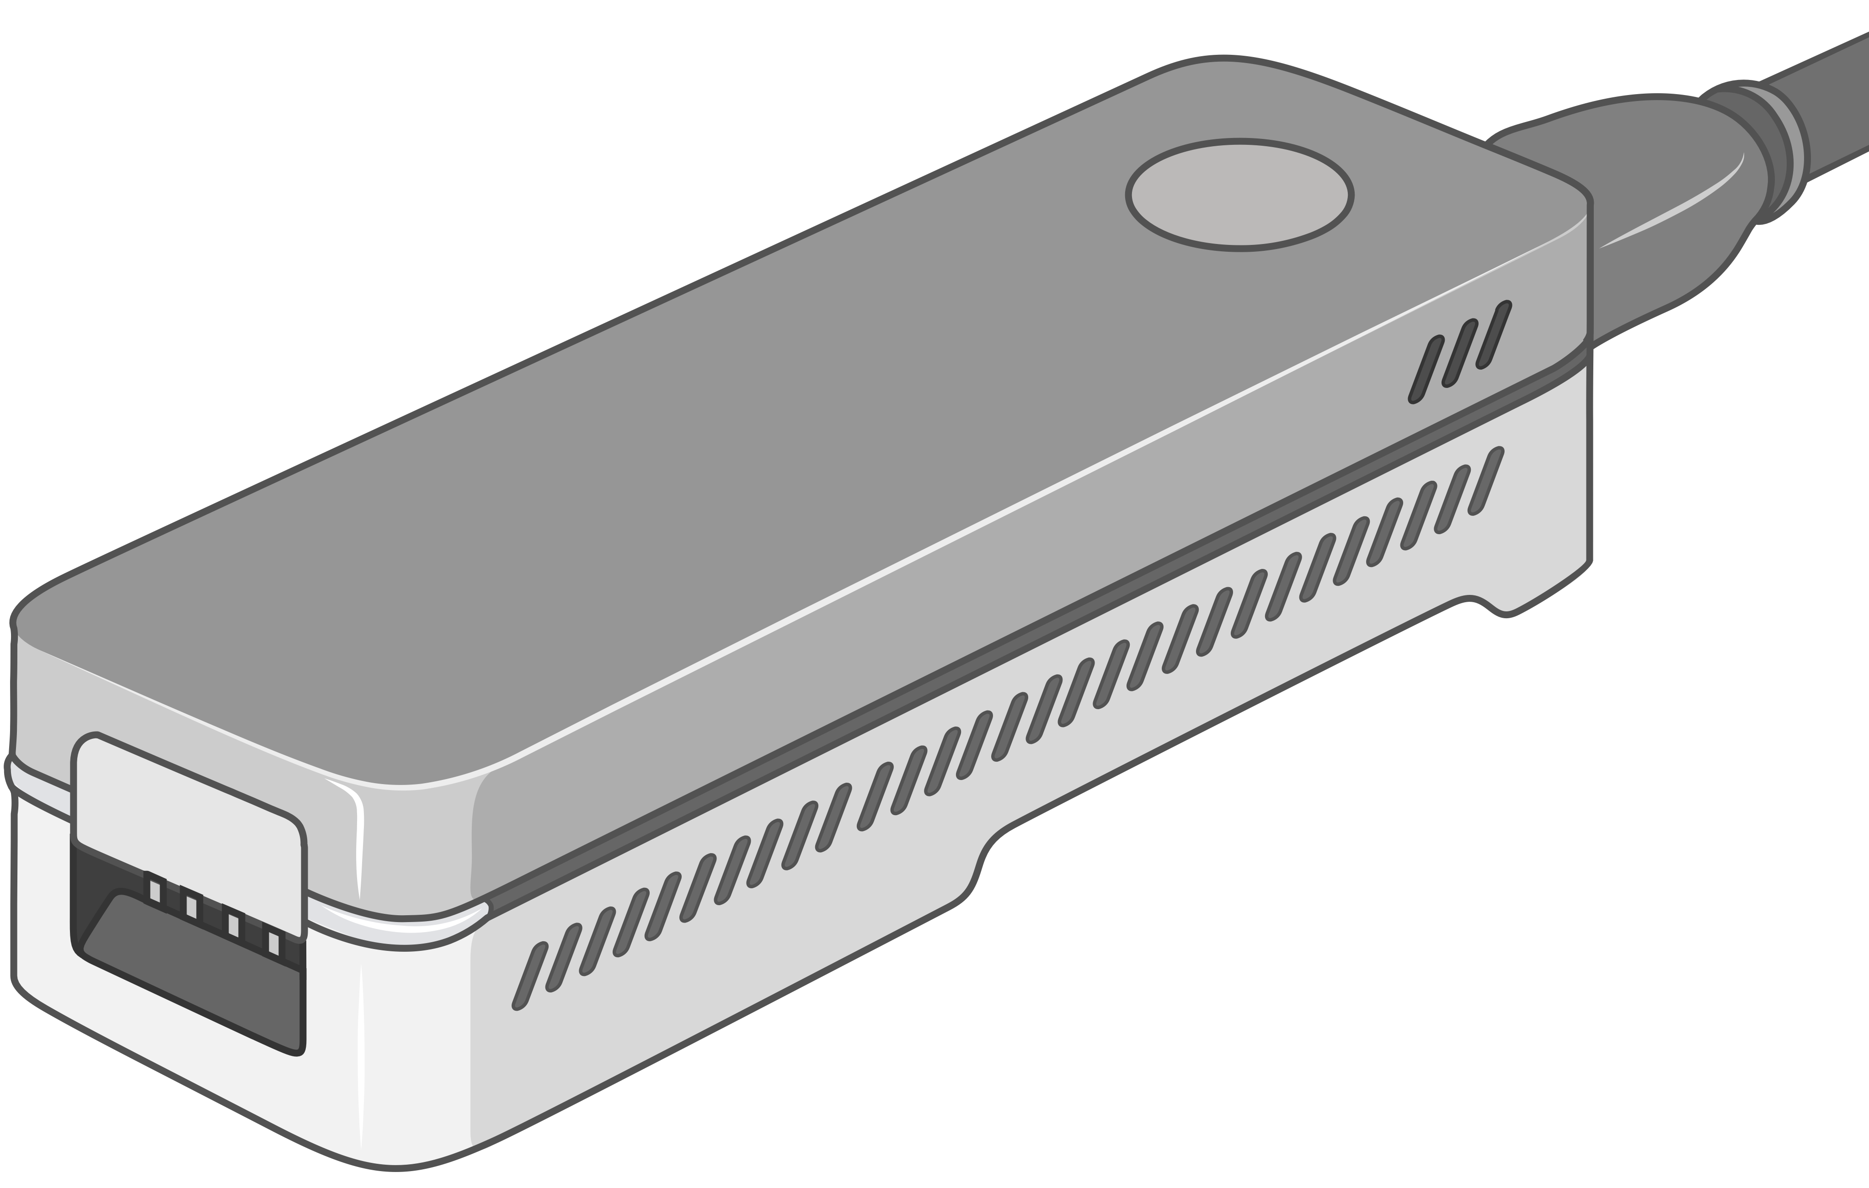
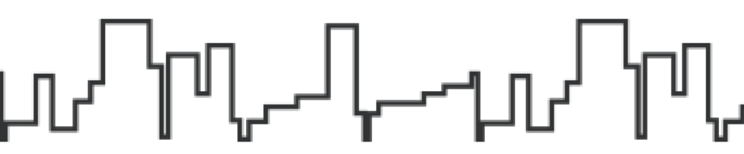

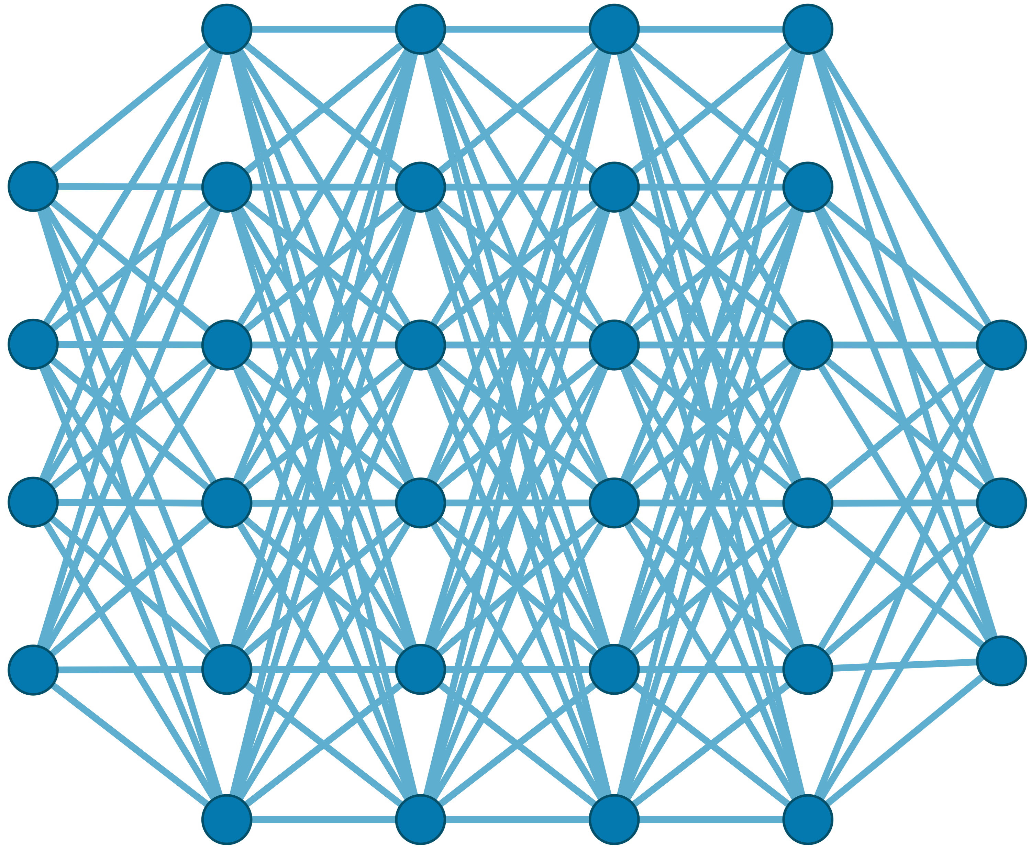

Generating the Entire Genomic Sequence
Whole Genome: 6.4B bps
(Non-human-readable)
Sequencing Device
Raw Genomic Data
(Human-readable?)
Translator (Basecalling)
AI
CGAAATGCC...AGATTAAACGCT...TGCCCTAA...GAATGGCGT
Whole Human Genome: 6.4B bps (Human-readable)

Slide 7



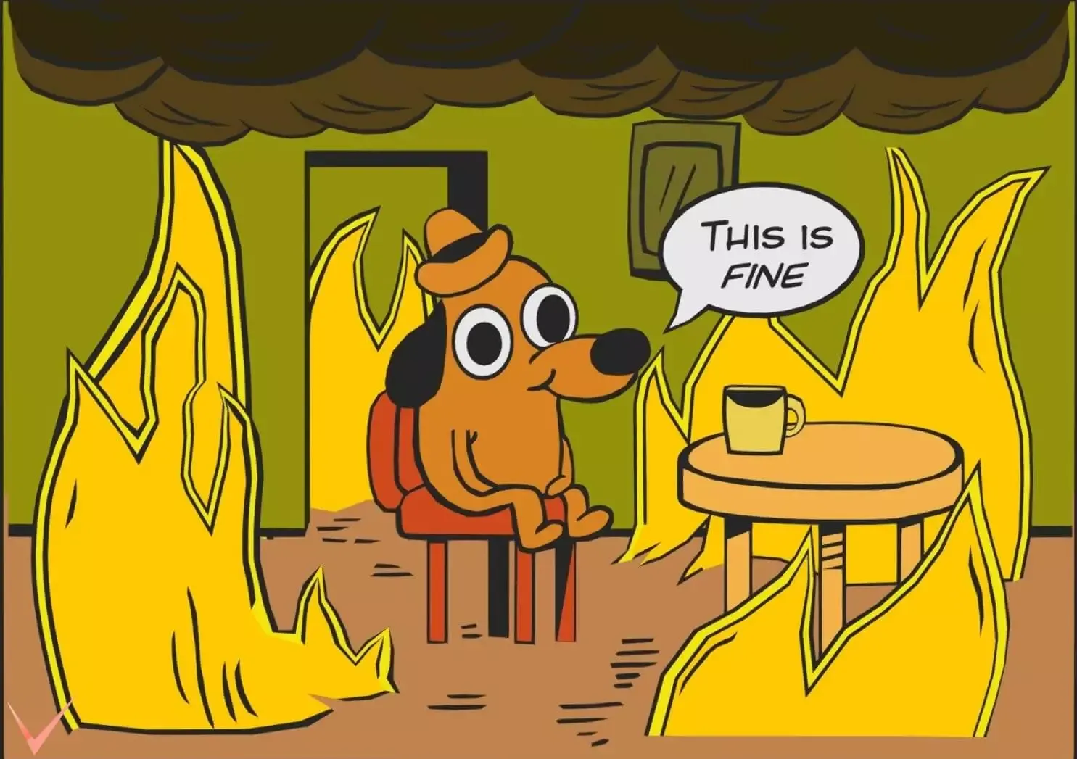





Genomic Data: Giant Jigsaw Puzzle to Solve
Human (Reference) Genome: 3.2 Billion bps (haploid)
CGAAATGCC...AGATTAAACGCT...TGCCCTAA...GAATGGCGT
?
Scale: ~$1/{10}^{8}$
AAATGG
CGAAATGCC...AGATTAAATGGT...TGCCCTAA...GAATGGCGT
Entire Genomic Sequence of an Organism
Read: ~100 – 100,000 bps
Small pieces (reads)
?
Unknown origins
Dealing with Massive and Noisy Datasets
(TBs to PBs)
Non-identical reference genome
Large volume of data to analyze

Slide 8
Solving the Puzzle: The Practical Way
Goal: Quickly and accurately reduce the search space
CGAAATGCC...AGATTAAACGCT...TGCCCTAA...GAATGGCGT
Performing
the costly computations
only for a few regions
AAA
AAA
CTA
AAT
AAATGG
AAATGG
Exact Match
AAA
AAATGG
Read Mapping
Indexing
Seeding
Chaining
Alignment
Reference Genome
Hash Table
Read
0x00
2,64,…
Sketching
0x01
1,101,…
Query
Sketching
Store
…
0xFF
13,21
Hash
Positions
Hash
0x01
0x00
Hash
Hash Matches
DP Calculations

Slide 9


A Common Genome Analysis Pipeline
Raw
Reads
Basecalling (Translator)
Basecalled
(Translated)
Reads
Read
Mapping
AAATGTGGTCCATTG
Assembly
Variant Calling
Metagenomics
Downstream Analysis

Slide 10


Genome Analysis is Computationally Costly
Significant computation and energy overhead

Slide 11
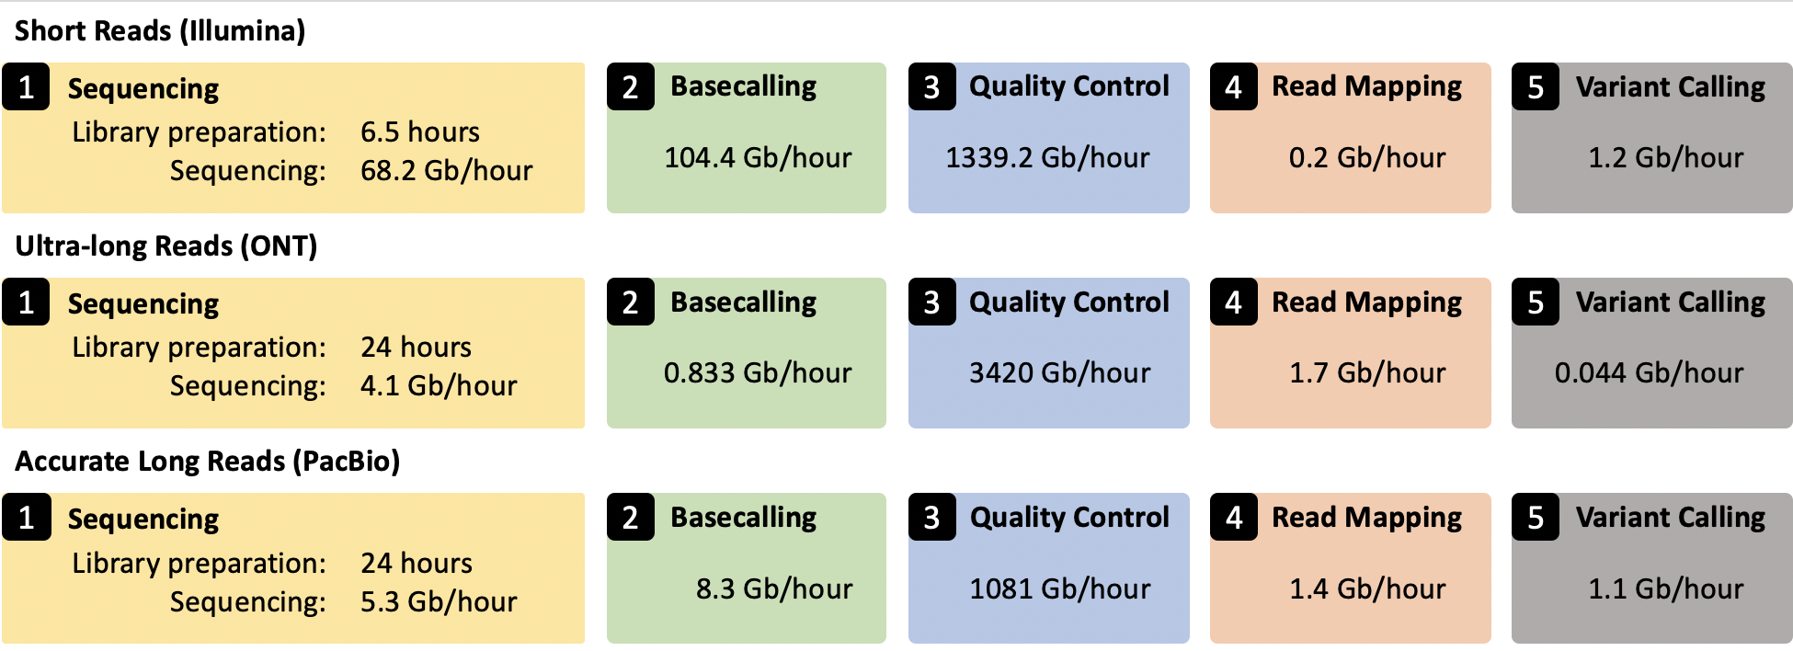
Genome Analysis Pipeline is Unbalanced
Alser+, “From molecules to genomic variations: Accelerating genome analysis via intelligent algorithms and architectures,” CSBJ 2022

Slide 12
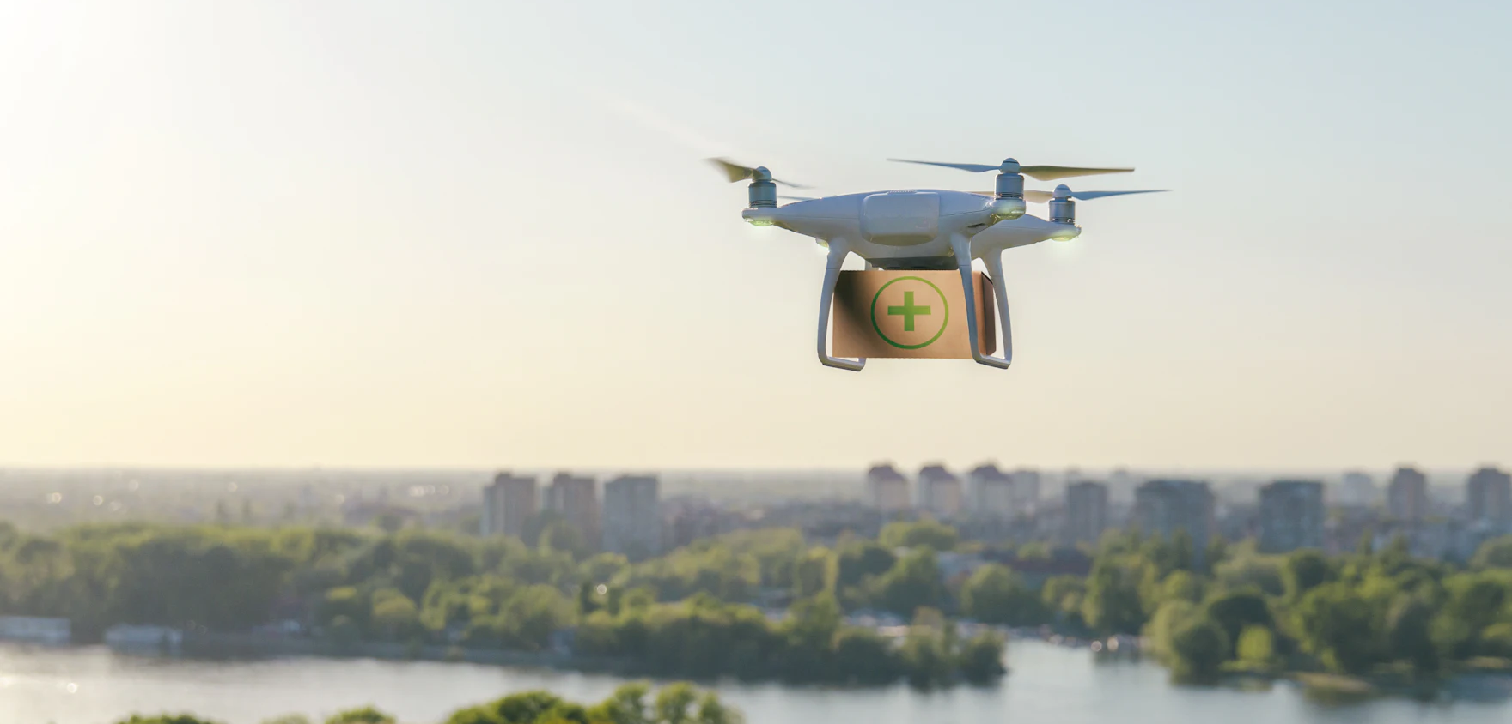

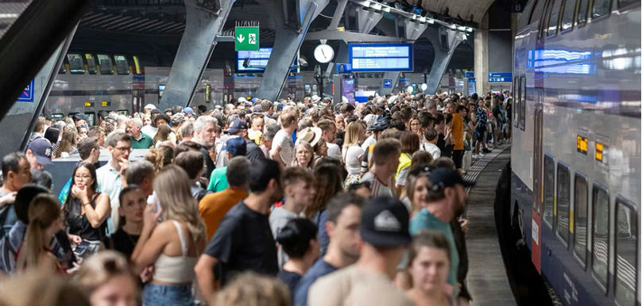
Limited Application Scope and Accuracy
Energy-efficient analysis for Resource-constrained devices
Urgent analysis within minutes
Large-scale analysis
without sacrificing accuracy
and performance

Slide 13


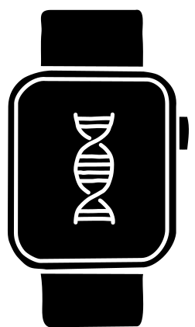


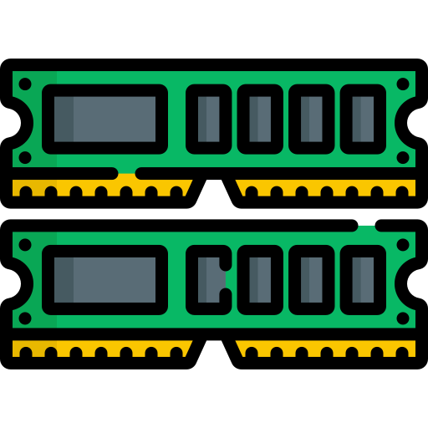
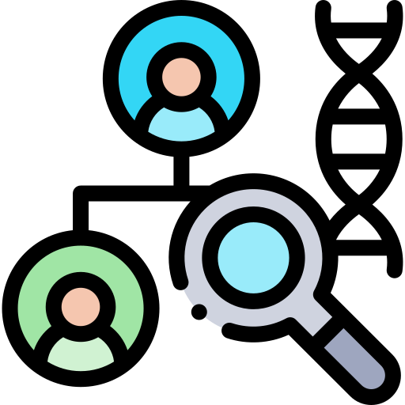



STORM Group
Research Directions
Real-Time and Portable Genomic Signal Analysis
Today’s
Talk
Goal
Enable fundamentally better integration of biological data analysis in our everyday lives
Data-centric and
AI-Driven Solutions to Analyze Genomic Data
Accurate and Fast
Algorithms Scalable to
Large Volumes of Genomic Data

Slide 14
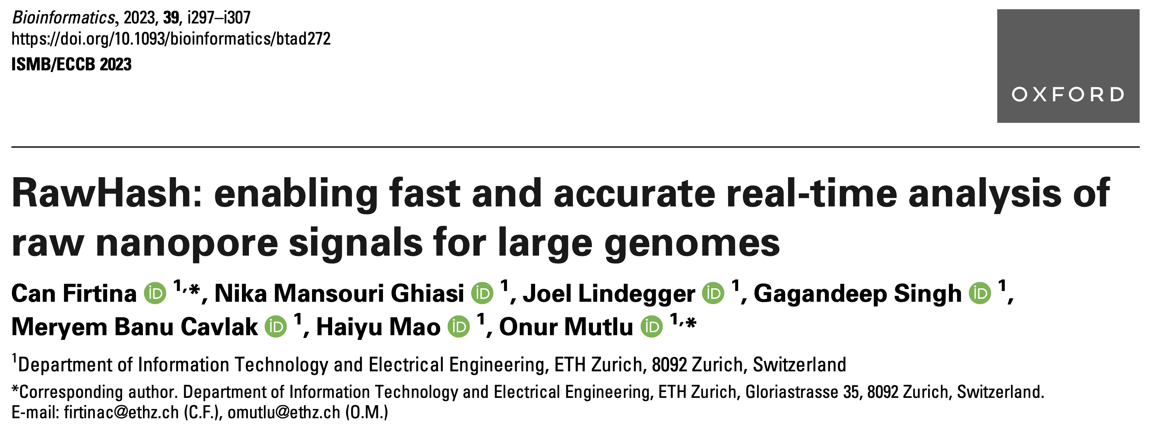
New Frontiers: Raw Signal Analysis [ISMB '23]
Can Firtina, Nika Mansouri Ghiasi, Joel Lindegger, Gagandeep Singh, Meryem Banu Cavlak,
Haiyu Mao, and Onur Mutlu,
"RawHash: enabling fast and accurate real-time analysis of
raw nanopore signals for large genomes"
Proceedings of the 31st Annual Conference on Intelligent Systems for Molecular Biology (ISMB 2023) and the 22nd European Conference on Computational Biology (ECCB 2023), Lyon, France, July 2023.
Paper [online] [pdf] [code]
Conference Talk [video] [pptx] [pdf]
Preprint (bioRxiv) [online] [pdf]
Social Media Thread [Twitter (X)]

Slide 15
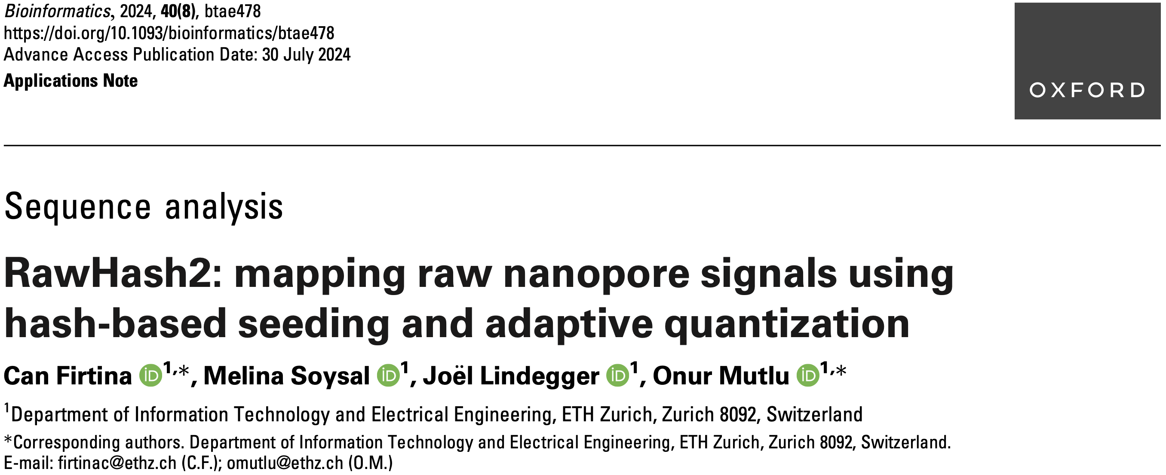
Real-Time Raw Signal Analysis [Bioinformatics '24]
Can Firtina, Melina Soysal, Joël Lindegger, and Onur Mutlu,
"RawHash2: Mapping Raw Nanopore Signals Using
Hash-Based Seeding and Adaptive Quantization"
Bioinformatics, July 2024.
Paper [online] [pdf] [code]

Slide 16
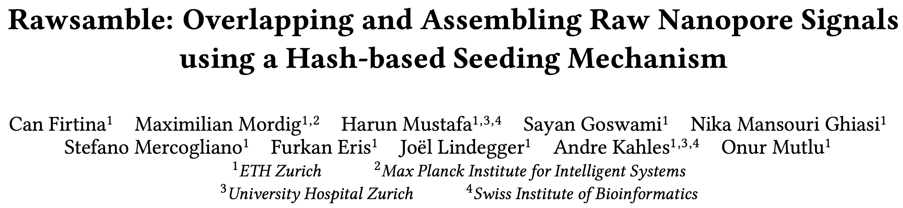
New Directions: Assembling Raw Signals
Can Firtina, Maximilian Mordig, Harun Mustafa, Sayan Goswami, Nika Mansouri Ghiasi,
Stefano Mercogliano, Furkan Eris, Joel Lindegger, Andre Kahles, and Onur Mutlu,
"Rawsamble: Overlapping and Assembling Raw Nanopore Signals using a Hash-based Seeding Mechanism"
arXiv, October 2024.
Paper [online] [pdf] [code]
ISMB 2024 Talk [video] [pptx] [pdf]
CSHL 2024 (Biological Data Science) Talk [video] [pptx] [pdf]
Social Media Thread [Twitter (X)] [LinkedIn]

Slide 17
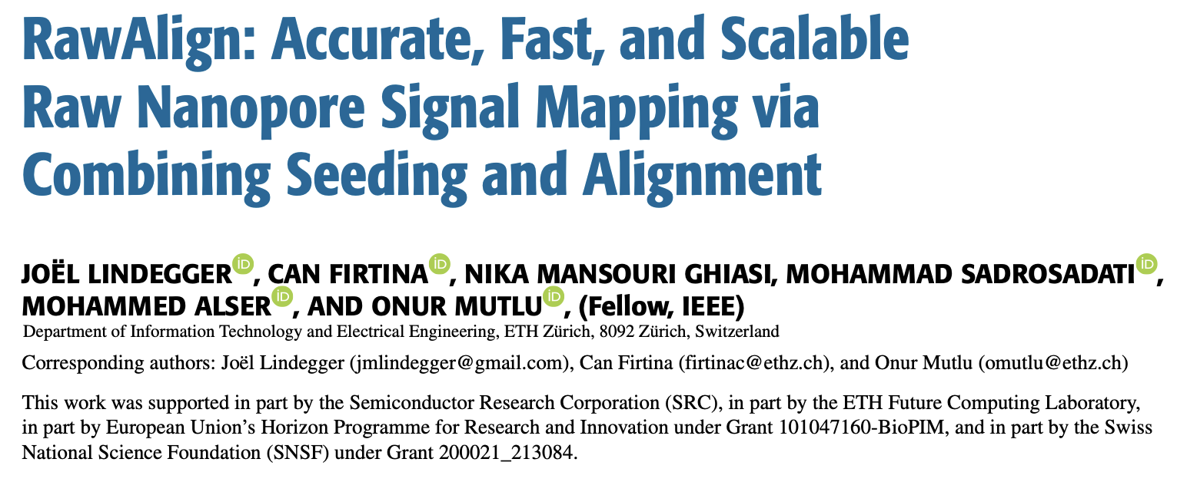
Quickly Aligning Raw Signals [IEEE Access '24]
Joël Lindegger, Can Firtina, Nika Mansouri Ghiasi, Mohammad Sadrosadati, Mohammed Alser, and Onur Mutlu,
"RawAlign: Accurate, Fast, and Scalable Raw Nanopore Signal Mapping via Combining Seeding and Alignment"
IEEE Access, December 2024.
Paper [online] [pdf] [code]

Slide 18
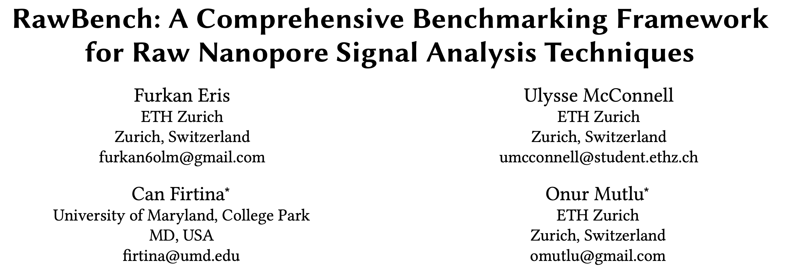
Benchmarking Raw Signal Analysis [ACM-BCB '25]
Furkan Eris, Ulysse McConnell, Can Firtina, and Onur Mutlu,
"RawBench: A Comprehensive Benchmarking Framework
for Raw Nanopore Signal Analysis Techniques"
Proceedings of the 16th ACM Conference on Bioinformatics, Computational Biology, and Health Informatics (ACM-BCB 2025), Philadelphia, PA, USA, October 2025.
Paper [online] [pdf]
Conference Talk [pptx] [pdf]

Slide 19
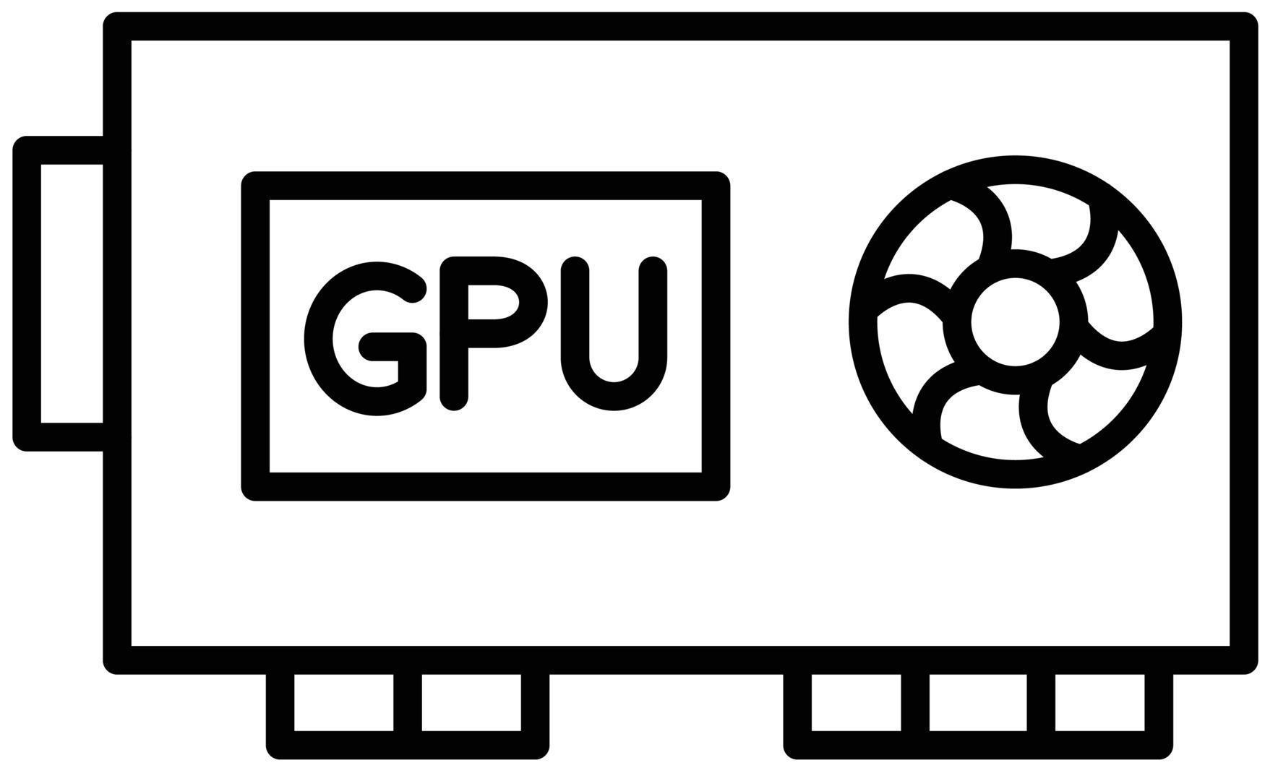
Basecalling is Accurate yet Costly
Significant computation and energy overhead
Raw
Reads
Basecalling (Translator)
Basecalled
Reads
Read
Mapping
AAATGTGGTCCATTG
Noisy
Raw Signals
Costly
AI Models
Highly accurate reads
How to make this pipeline cheaper?

Slide 20
Can We Survive Without Translation?
Raw
Reads
Read
Mapping
Noisy
Raw Signals
Reference Genome
...
...
CTGCGTAGCAGCGTAATAG
How to communicate
without an accurate translator?

Slide 21
Can We Survive With Noisy Signal Analysis?
Raw
Reads
Read
Mapping
Noisy
Raw Signals
Reference Genome
...
...
CTGCGTAGCAGCGTAATAG
Reference-to-Signal Conversion
How to identify similarity between noisy signals?
...
...
-0.06,0.24,-0.74,
Raw Signal Analysis

Slide 22

Noise in Raw Electrical Signals
Observation: Identical molecules generate
similar raw signals
Sequencing CTGCGTAGCA
Raw
Signals:
[ , , , , ]
-0.06
-0.22
-0.75
0.96
-0.49
Key Idea: Perform similarity estimation
based on vector similarity search
Nearest Neighbor Search
Raw
Signals:
[ , , , , ]
-0.05
-0.21
-0.76
1.01
-0.51
Sequencing CTGCGTAGCA
Problem: Too Costly for Large Genomes

Slide 23




Scalability Issues Limit Real-Time Analysis
Genome Size Increase: 150$×$
2.4$×$
9.2$×$
28$×$
No Real-Time Analysis for Larger Genomes:
Searching mechanism does not scale well

Slide 24
Benefits of Real-Time Analysis
✓
Reducing latency by overlapping analysis with sequencing
Time
Sequencing
Analysis
Reduced Latency
Sequencing & Real-Time Analysis
✓
Reducing sequencing time and cost by stopping sequencing early
Sequenced Bases
Completely Sequenced Read
Reduced Sequencing Time (and Cost)
Partially Sequenced Read
Sequencing is stopped early with a real-time decision

Slide 25
RawHash’s Goal
Enable Fast, Accurate, and Scalable
Real-Time Analysis for Larger Genomes

Slide 26
RawHash’s Key Idea
Key Idea: Perform similarity estimation
based on quick exact matches
Raw
Signals:
[ , , , , ]
-0.06
-0.22
-0.75
0.96
-0.49
Hash
0x77db
Fast Match
CTGCGT
Hash
0x77db
Raw
Signals:
[ , , , , ]
-0.05
-0.21
-0.76
1.01
-0.51
Challenge: How to generate the same hash value
for similar enough signals with various noise types?

Slide 27
RawHash’s Key Idea – Quantization
CTGCGT
-0.05
-0.07
-0.06
-0.05
-0.06
Quantize
Quantize
Quantize
Quantize
Quantize
Bucket #
0
1
2
3
4
5
6
7
8
9
10
11
12
13
14
15
-3.00
Range of raw signals (normalized)
+3.00
✓
Enables matching raw signals by eliminating slight differences

Slide 28
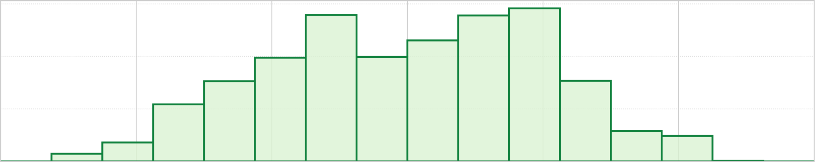
How to Better Quantize Signals
Bucket #
0
1
2
3
4
5
6
7
8
9
10
11
12
13
14
15
-3.00
Range of raw signals (normalized)
+3.00
✕
Equal-width buckets leads to
unbalanced bucket loading
600
400
K-mer count
200
0
1
2
3
4
5
6
7
8
9
10
11
12
13
14
15
-3.00
+3.00
✕
Reduced uniqueness and poor resource utilization

Slide 29
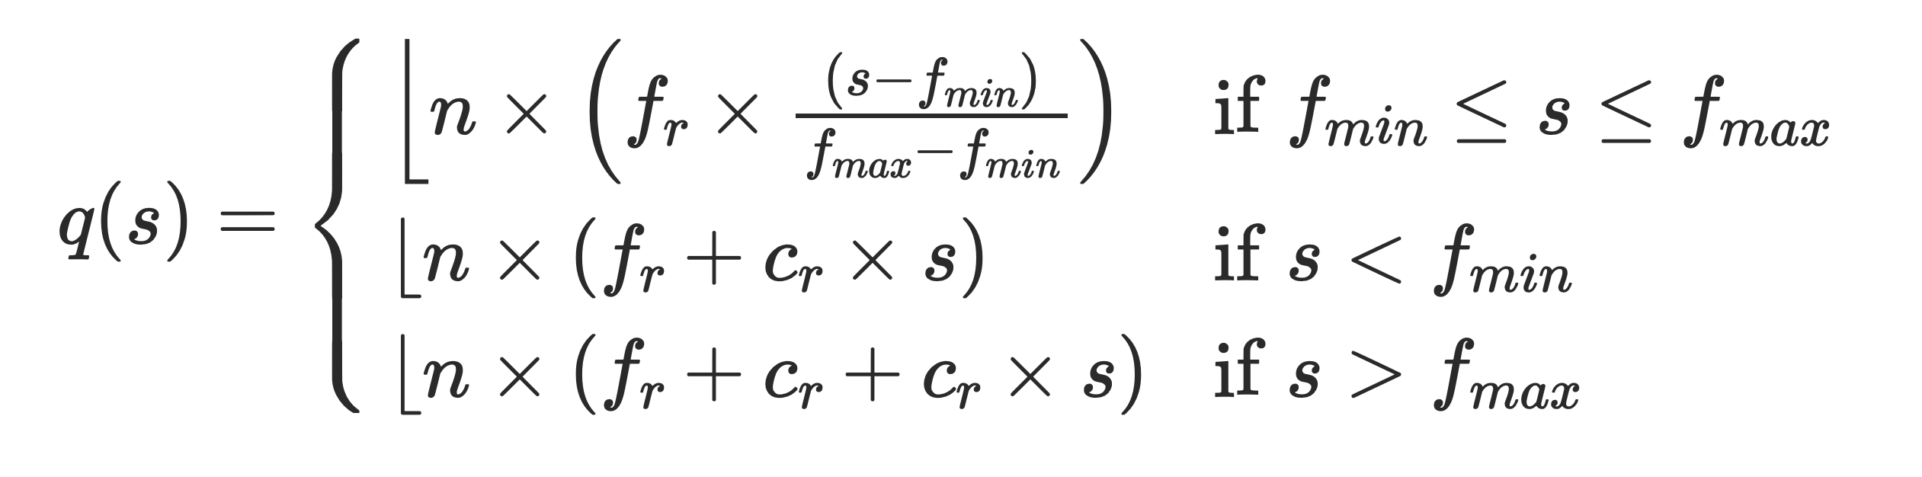
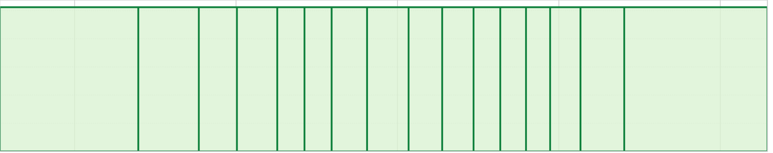
Adaptive Quantization
Key Idea: Quantizing raw signals with non-equal bucket widths
by leveraging raw signal distribution
Bucket #
0
1
2
3
4
5
6
7
8
9
10
11
12
13
14
15
-3.00
Range of raw signals (normalized)
+3.00
K-mer count
-3.00
3.00
✓
Better bucket utilization

Slide 30
RawHash Key Idea – Hash-based Matching
Sequencing CTGCGTAGCA
[ , , , , ]
-0.06
-0.22
-0.75
0.96
-0.49
Quantize
Quantize
Quantize
Quantize
Quantize
Hash
0x77db
0b0111
0b0111
0b0110
0b1011
0b0110
Pack
0b01110111011010110110
Hash
0x77db
Fast and Accurate Match
Key Contribution: The first hash-based search
(and indexing) mechanism for raw signals

Slide 31
Real-Time Analysis Benefits from Fast Search
Genome Size Increase: 150$×$
2.4$×$
9.2$×$
28$×$
Real-time Analysis for Human Genomes:
Fast search instead of costly neighbor search

Slide 32
Fast Search Leads to Accurate Search
Best accuracy for all genomes:
Hash values span longer sequences than vectors ->
More unique and informative matches
(Almost) Identical accuracy to basecalled analysis:
Is the small difference because RawHash is even better?

Slide 33
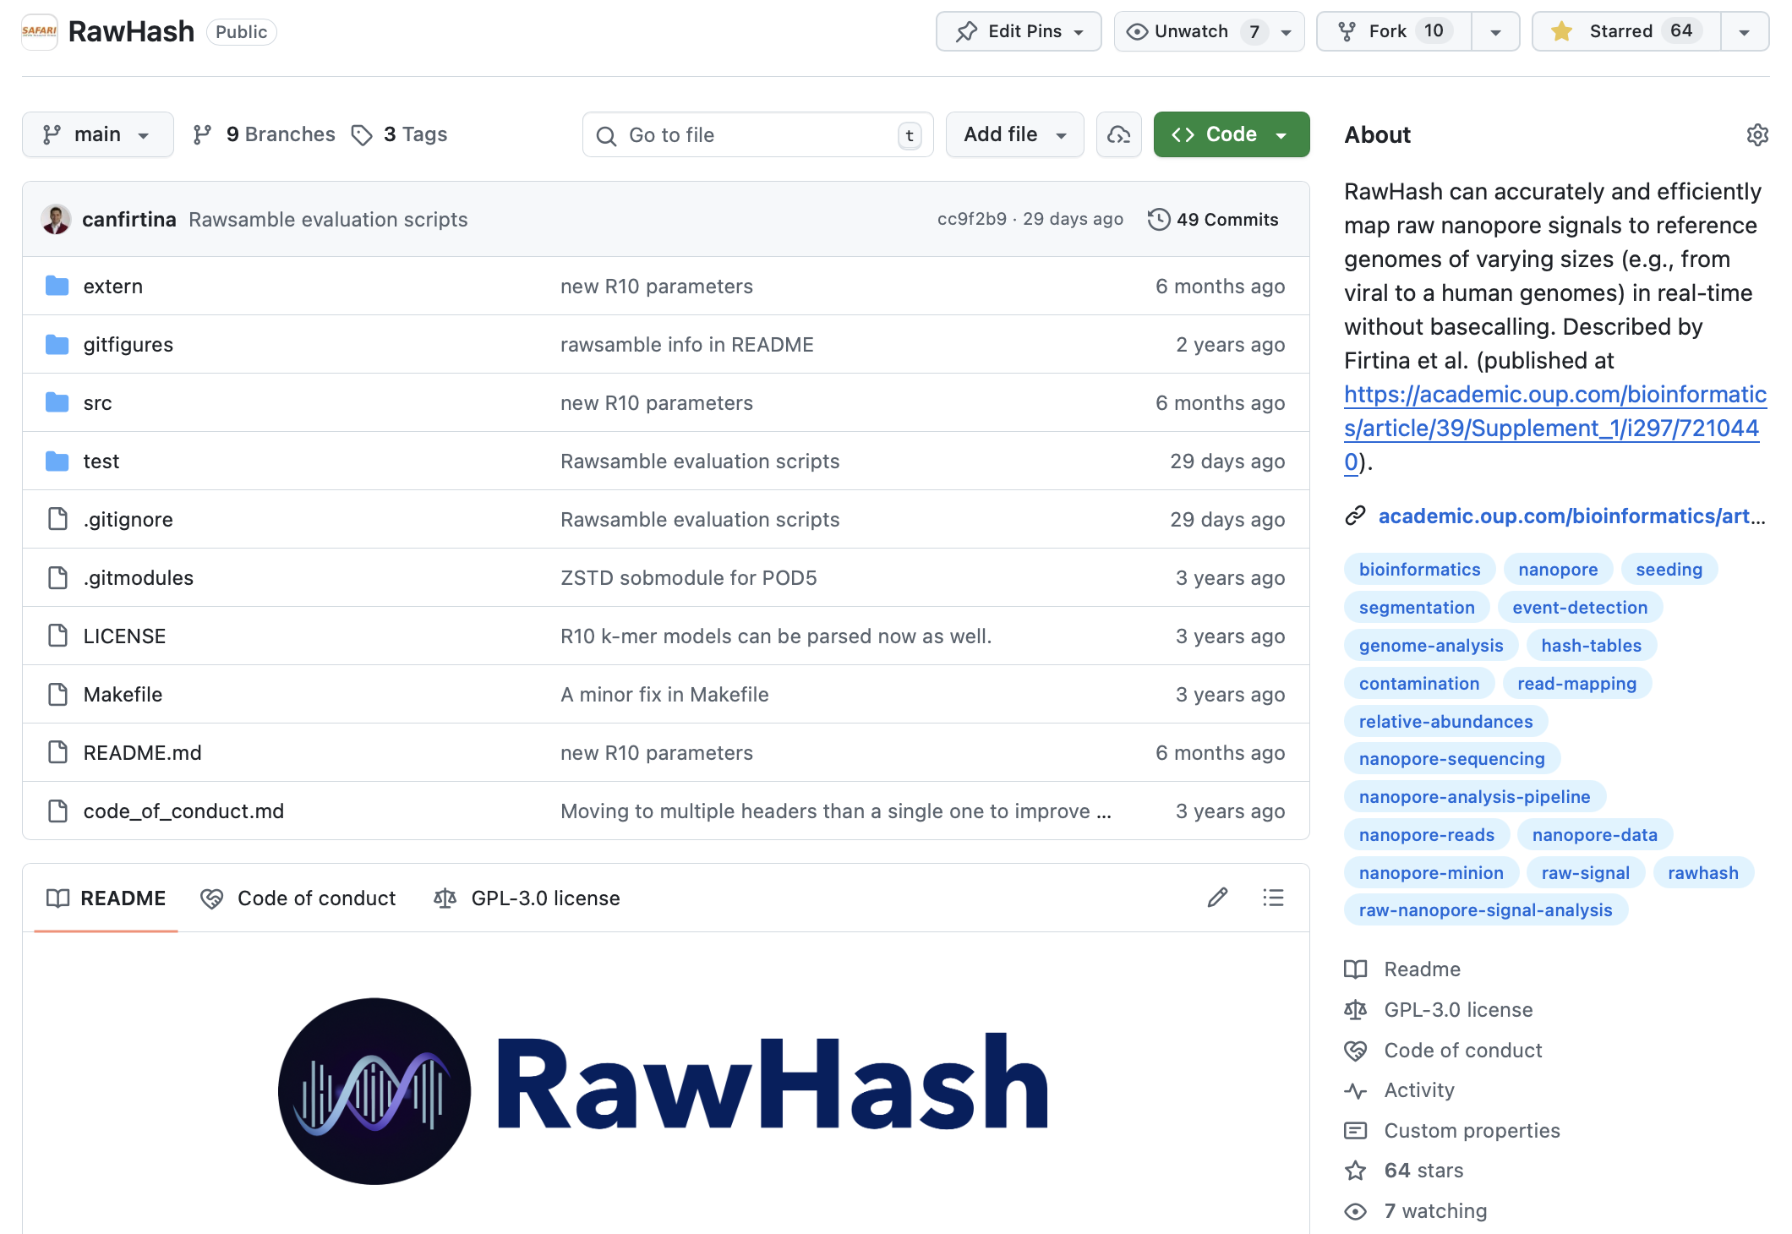
RawHash is Open Source
https://github.com/CMU-SAFARI/RawHash

Slide 34
So What?

Slide 35
New Directions: Assembling Raw Signals
Can Firtina, Maximilian Mordig, Harun Mustafa, Sayan Goswami, Nika Mansouri Ghiasi,
Stefano Mercogliano, Furkan Eris, Joel Lindegger, Andre Kahles, and Onur Mutlu,
"Rawsamble: Overlapping and Assembling Raw Nanopore Signals using a Hash-based Seeding Mechanism"
arXiv, October 2024.
Paper [online] [pdf] [code]
ISMB 2024 Talk [video] [pptx] [pdf]
CSHL 2024 (Biological Data Science) Talk [video] [pptx] [pdf]
Social Media Thread [Twitter (X)] [LinkedIn]

Slide 36


Beyond Reference Mapping: Overlapping
Reference Genome (Converted to Signals)
Raw Nanopore Signals
Raw Nanopore Signals
TGCTGCAA
CGAAGTCA
CGTAGTGG
CCACCGGT
Reference Signals
CTGCAATC
TGATCCGA
TCAGCCGT
AGTGGACC
GGTAAGCT
TGCTGCAATCGTGATCCGAAGTCAGCCGTAGTGGACCACCGGTAAGCT
Hash-Based
Seeding and Mapping
Challenge: Reference genome is not always available
Assembly: Constructing genome from overlapping reads
✕
Existing solutions cannot find overlapping reads without basecalling

Slide 37
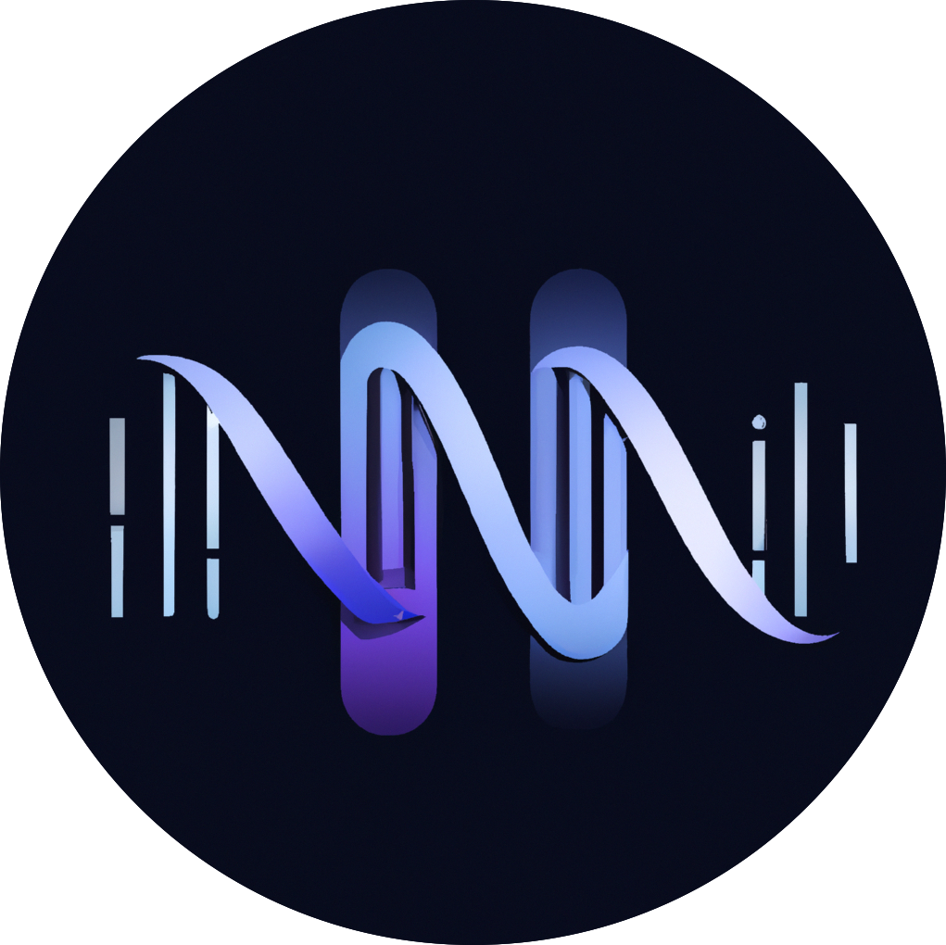
Rawsamble
The first mechanism that can perform
all-vs-all overlapping from raw signals

Slide 38
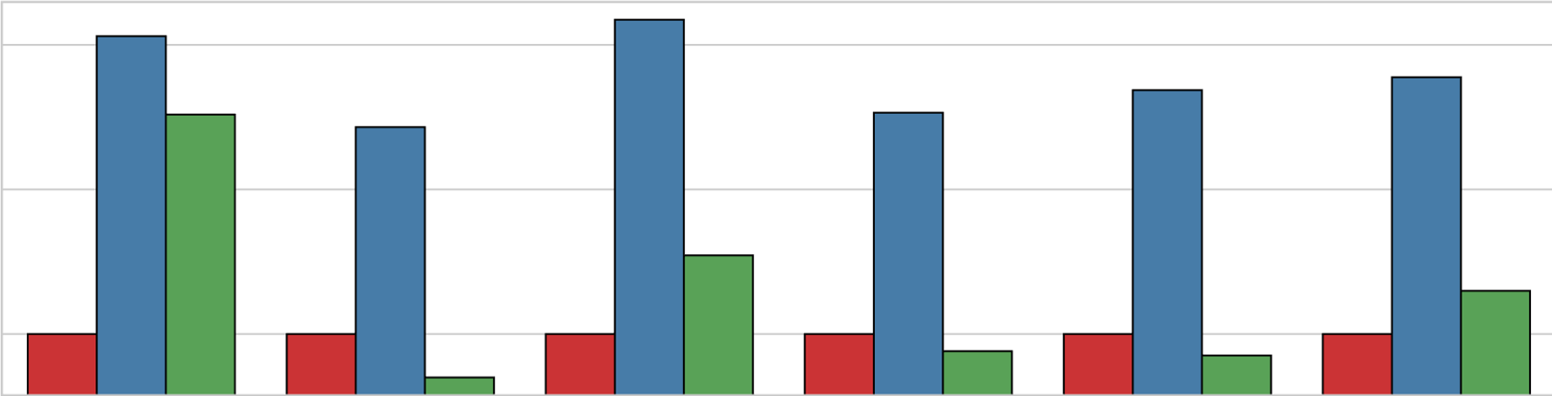
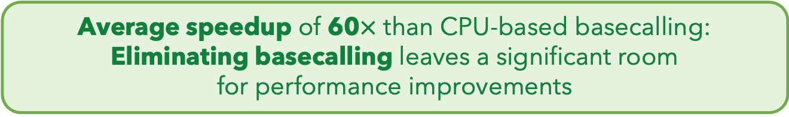





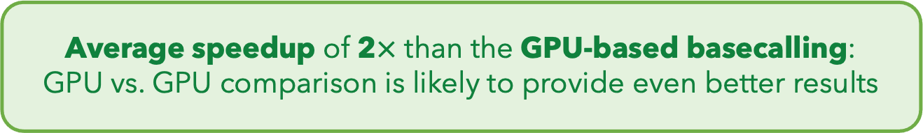
Eliminating Basecalling from the Pipeline
Rawsamble
Basecalling (CPU)
+ Overlapping
Basecalling (GPU)
+ Overlapping
$${10}^{2}$$
Elapsed Time
(Normalized to Rawsamble)
59.70$×$
$${10}^{1}$$
$${10}^{0}$$
1.99$×$
SARS-CoV-2
E. coli
Yeast
Green Algae
Human
Geo. Mean
Average speedup of 60$×$ than CPU-based basecalling: Eliminating basecalling leaves a significant room
for performance improvements
Average speedup of 2$×$ than the GPU-based basecalling:
GPU vs. GPU comparison is likely to provide even better results

Slide 39
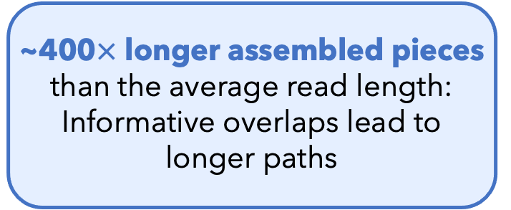
Key Results – First Ever Assemblies
First assemblies
ever constructed
without basecalling
E. coli Assembly
(From the Rawsamble Overlaps)
~400$×$ longer assembled pieces than the average read length:
Informative overlaps lead to longer paths
It is time to rethink if we want to translate individual reads separately

Slide 40
Quickly Aligning Raw Signals [IEEE Access '24]
Joël Lindegger, Can Firtina, Nika Mansouri Ghiasi, Mohammad Sadrosadati, Mohammed Alser, and Onur Mutlu,
"RawAlign: Accurate, Fast, and Scalable Raw Nanopore Signal Mapping via Combining Seeding and Alignment"
IEEE Access, December 2024.
Paper [online] [pdf] [code]

Slide 41
RawAlign Overview
Coarse-Grained
Fast
Fine-Grained
Accurate

Slide 42
Benchmarking Raw Signal Analysis [ACM-BCB '25]
Furkan Eris, Ulysse McConnell, Can Firtina, and Onur Mutlu,
"RawBench: A Comprehensive Benchmarking Framework
for Raw Nanopore Signal Analysis Techniques"
Proceedings of the 16th ACM Conference on Bioinformatics, Computational Biology, and Health Informatics (ACM-BCB 2025), Philadelphia, PA, USA, October 2025.
Paper [online] [pdf]
Conference Talk [pptx] [pdf]

Slide 43
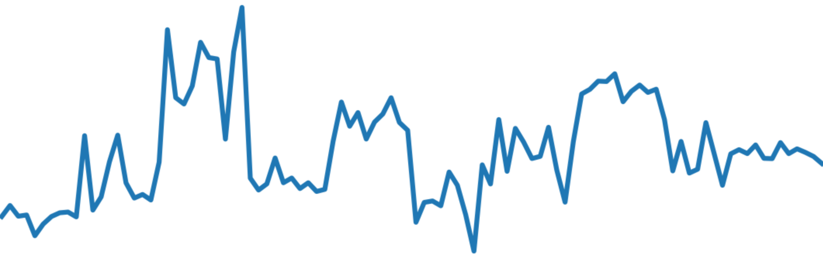
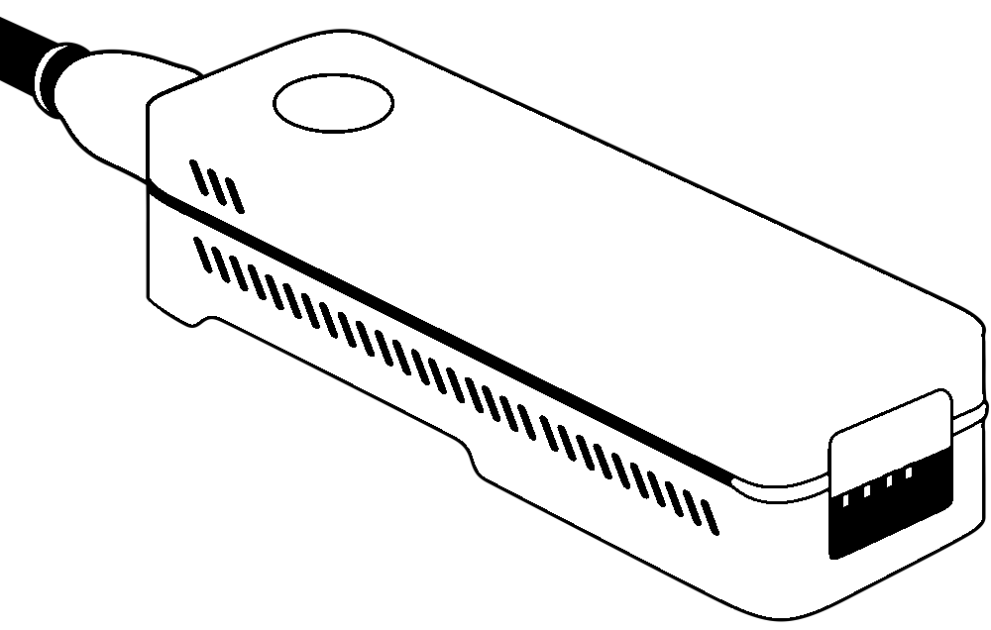
RawBench Benchmarking Framework
ACGT
Encoding reference genome
Matching encoded representations
2
Encoding raw signal
Input
Raw Signals
1
3
ONT
pore model
Hash-based
FM-index
t-test
Uncalled4
pore model
Vector
distance
R-index
Move tables
Input Reference
Add-on
DTW
Add-on
Add-on
1
Encoding Reference Genome
  Uses learned pore models by ONT and community
2
Encoding Raw Signal
  Utilizes statistical and ML-based encoding techniques
3
Matching Encoded Representations
  Compares representations that are now encoded into the same space

Slide 44
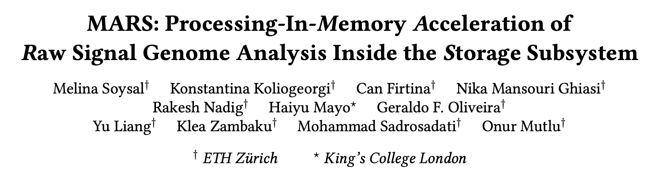
In-Storage Raw Signal Analysis [ICS '25]
Melina Soysal, Konstantina Koliogeorgi, Can Firtina, Nika Mansouri Ghiasi, Rakesh Nadig,
Haiyu Mao, Geraldo Francisco Oliveira Junior, Yu Liang, Klea Zambaku, Mohammad Sadrosadati, and Onur Mutlu,
"MARS: Processing-In-Memory Acceleration of
Raw Signal Genome Analysis Inside the Storage Subsystem"
Proceedings of the 39th International Conference on Supercomputing (ICS 2025), Salt Lake City, Utah, USA, June 2025.
Paper [online] [pdf]
Conference Talk [video] [pptx] [pdf]

Slide 45
So What?

Slide 46
Some Interesting Challenges in Signal Analysis
Figuring out how to better utilize raw signal analysis
  Should we combine with basecalled analysis?
  Should (and can) we perform the full analysis pipelines using only raw signals
Distinguishing noise from useful information
Redesigning effective solutions for storage
Enabling end-to-end and energy-efficient analysis with (portable) sequencing devices

Slide 47
STORM Group
Research Directions
Real-Time and Portable Genomic Signal Analysis
Today’s
Talk
Goal
Enable fundamentally better integration of biological data analysis in our everyday lives
Data-centric and
AI-Driven Solutions to Analyze Genomic Data
Accurate and Fast
Algorithms Scalable to
Large Volumes of Genomic Data

Slide 48
Lost in Translation: Harnessing the Power of Nanopore Electrical Signals in Genomics
Arch4Health Workshop (in conj. with HPCA 2026), Sydney, Australia
January 31, 2026
Can Firtina | canfirtina@gmail.com | cs.umd.edu/~firtina
Assistant Professor of Computer Science at UMD

Slide 49
Backup Slides

Slide 50
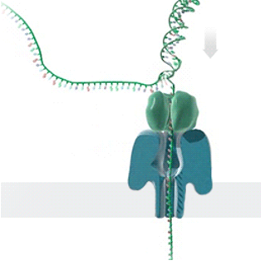
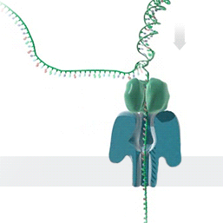



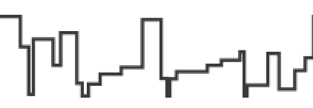


Generating Electrical Signals from DNA
Single Nanopore
Nanopore Sequencer
Raw Signals
(~5000 signals/sec)
Real-Time
Analysis
https://nanoporetech.com/platform/technology/basecalling
https://blogs.ed.ac.uk/institute-genetics-cancer/2020/04/08/nanopore-sequencing-controversial-world-records-and-whale-watching/

