Slide 1
Lost in Translation: Harnessing the Power of Nanopore Electrical Signals in Genomics
IMET Seminar Series, UMBC, MD, USA
February 18, 2026
Can Firtina | canfirtina@gmail.com | cs.umd.edu/~firtina
Assistant Professor of Computer Science at UMD

Slide 2
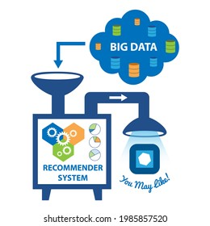



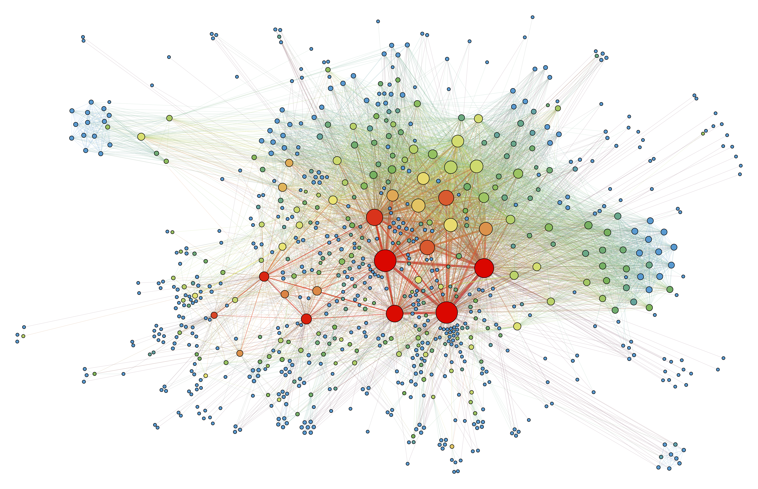
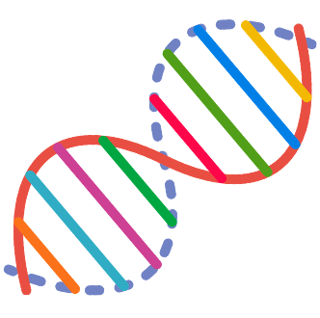
Big Data is Everywhere
Large recommender systems
Large Language Models
Graph/Tree Processing
Genomics

Slide 3
Computing is Bottlenecked by Data
Data movement →
Performance & Energy Bottleneck
Large recommender systems
Large Language Models
Graph/Tree Processing
Genomics

Slide 4

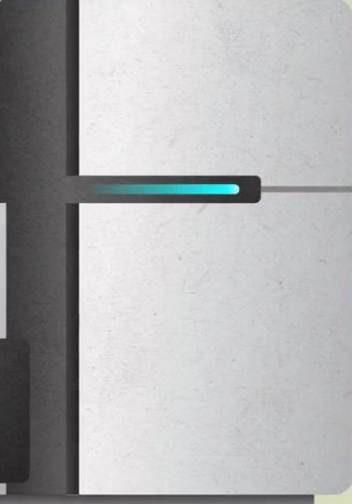

Problems with Data Analysis Today
Special-Purpose Machine
for Data Generation
General-Purpose Machine
for Data Analysis
FAST
SLOW
Processing capabilities oblivious to data analysis requirements
Large amounts of data movement

Slide 5

A Typical (Biological) Data Analysis
Data Movement from Storage
Costly Operations
Storage
System
AAGCTTCCATGG
Main
Memory
Cache
Computation
Unit
(CPU or Accelerator)
CGTTCCTTGGCA
GGGCCAGAATG
CCTTTGGGTCCA
AAAATTCCATGG
GAATGGGGCCA
TTTTTTCCAAAA
TCCCCGGGGCCA
GCTTCCAGAATG
Data Movement
Overhead
Computation
Overhead
Overall Time/Energy Spent

Slide 6



A Typical Accelerated (Biological) Data Analysis
Heuristics
Accelerators
Filters
Storage
System
AAGCTTCCATGG
Main
Memory
Cache
Computation
Unit
(CPU or Accelerator)
CGTTCCTTGGCA
GGGCCAGAATG
CCTTTGGGTCCA
AAAATTCCATGG
GAATGGGGCCA
TTTTTTCCAAAA
TCCCCGGGGCCA
GCTTCCAGAATG
✓
Computation
Overhead
Computation
Overhead

Slide 7
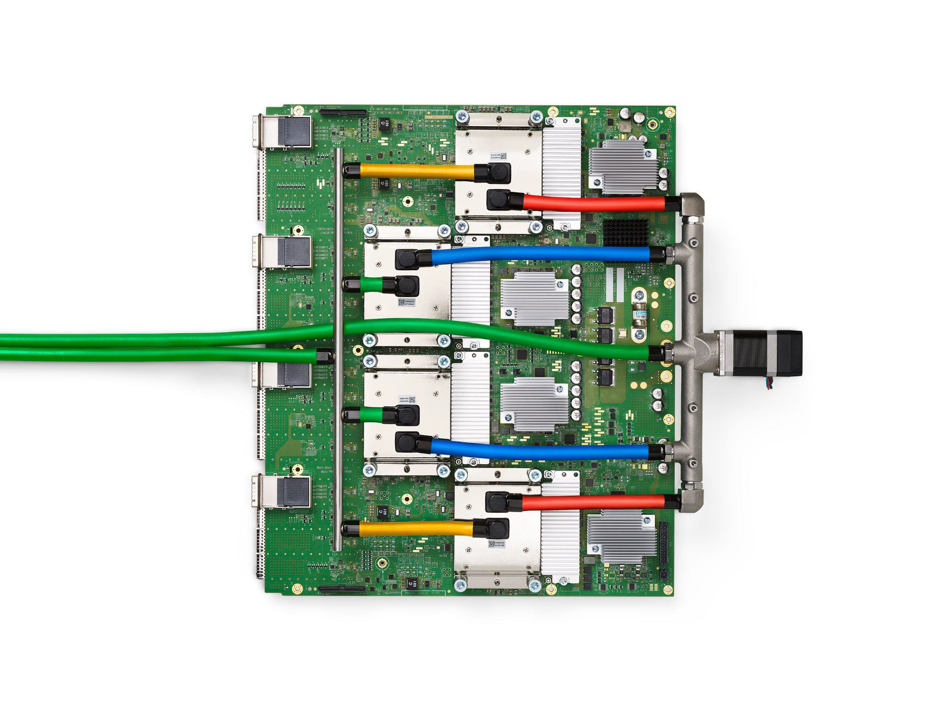
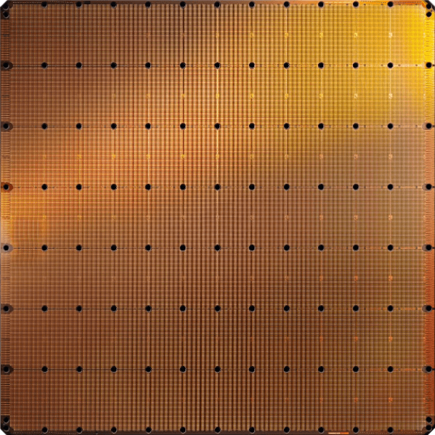
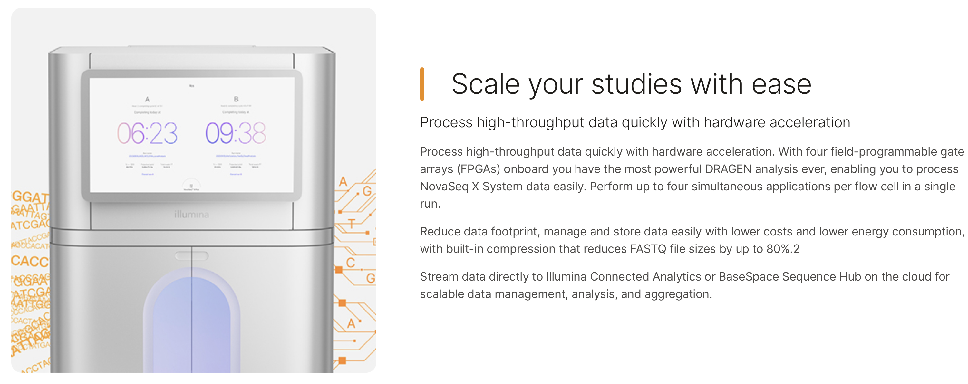
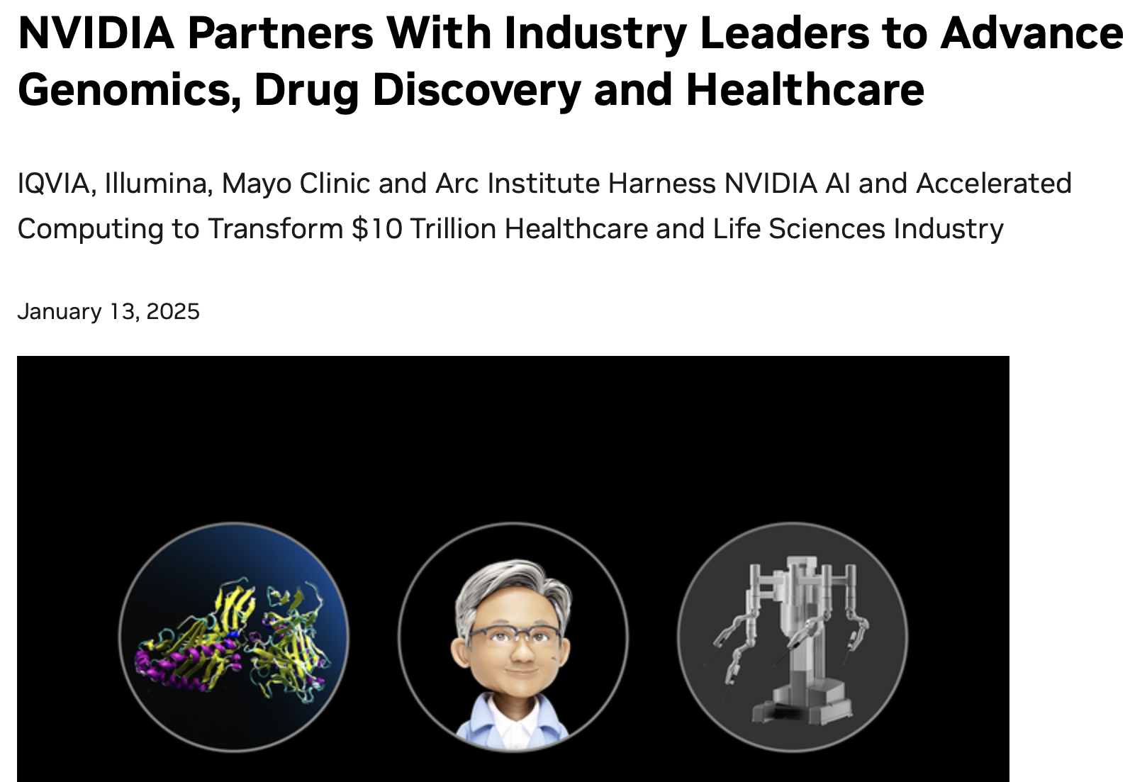
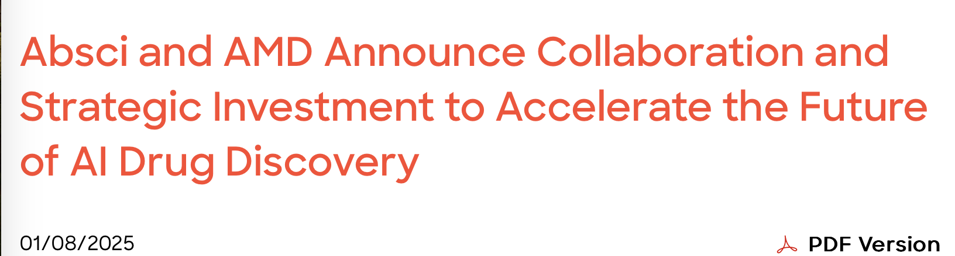
Acceleration Efforts for AI and Genomics
Cerebras WSE-3
Wafer-scale ML accelerator chip
Google’s TPUs:
NVIDIA H100

Slide 8
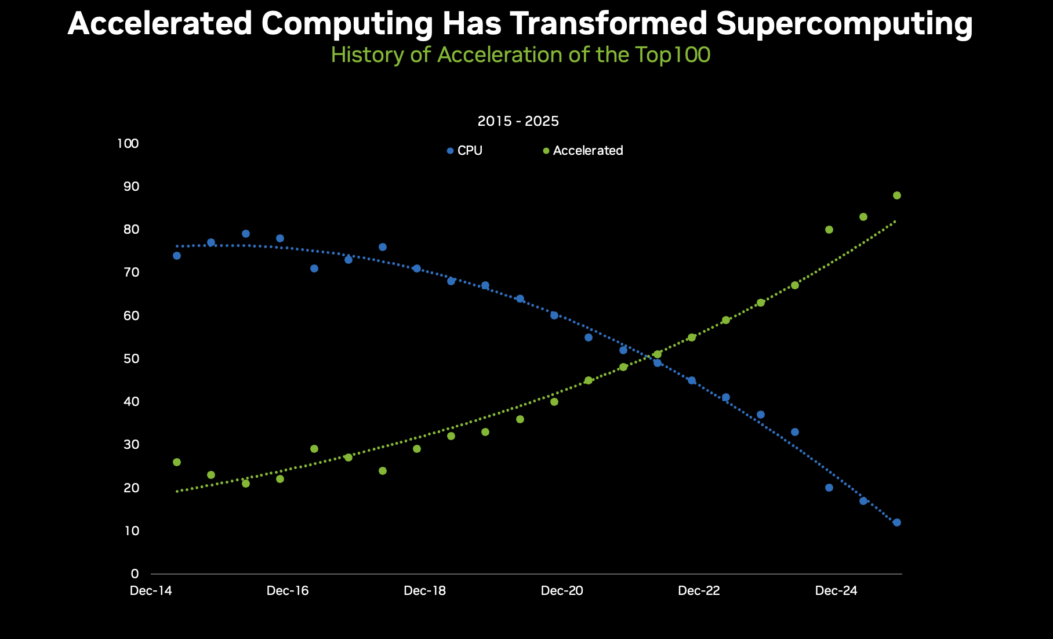
Accelerated Computing is Mainstream Now
https://blogs.nvidia.com/blog/accelerated-scientific-systems/?linkId=100000392637737

Slide 9
Data Movement Dominates Performance
Heuristics
Accelerators
Filters
Storage
System
AAGCTTCCATGG
Main
Memory
Cache
Computation
Unit
(CPU or Accelerator)
CGTTCCTTGGCA
GGGCCAGAATG
CCTTTGGGTCCA
AAAATTCCATGG
GAATGGGGCCA
TTTTTTCCAAAA
TCCCCGGGGCCA
GCTTCCAGAATG
Data Movement
Overhead
✓
Computation
Overhead
Overall Time/Energy Spent

Slide 10
We need to co-design algorithms and architecture to handle data well

Slide 11
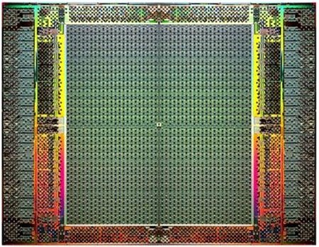
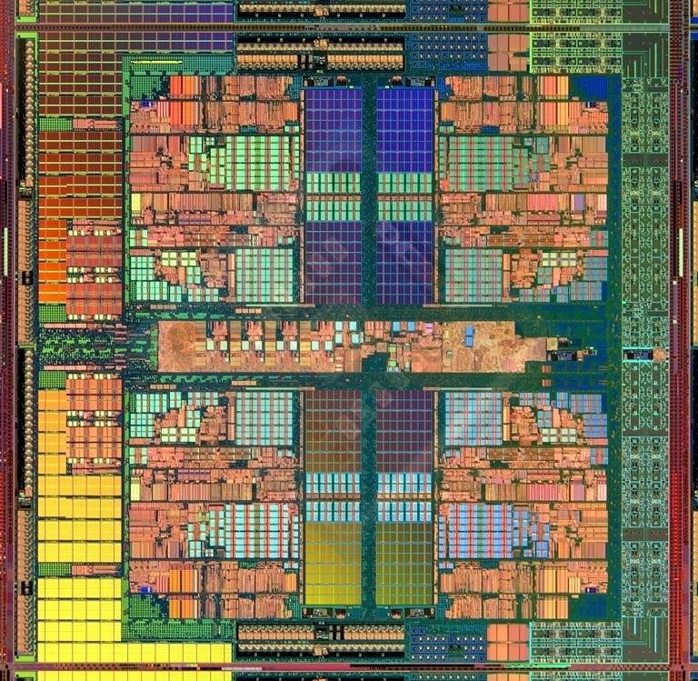
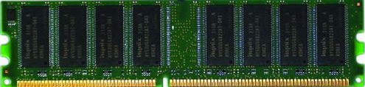
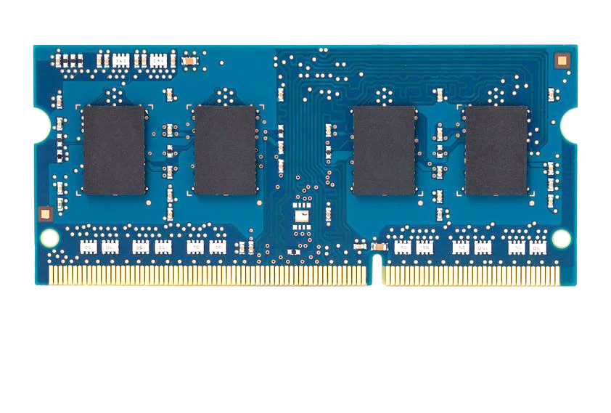
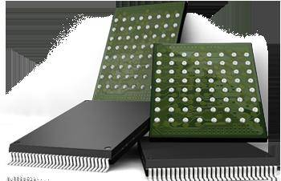
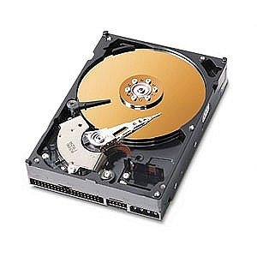
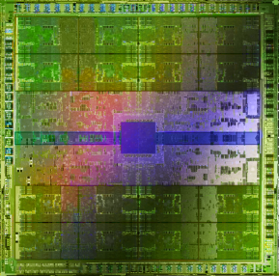
Pushing Towards New Architectures
Modern systems
?
FPGAs
Sequencing Machine
Hybrid Main Memory
Heterogeneous
Processors &
Accelerators
Persistent Memory/Storage
GPUs

Slide 12
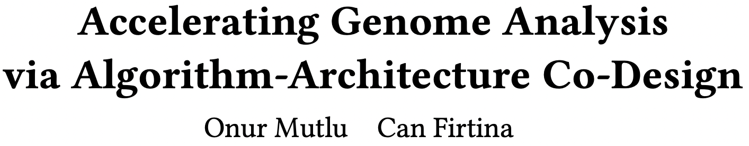
Recommended: Accelerating Genome Analysis [DAC '23]
Onur Mutlu and Can Firtina,
"Invited: Accelerating Genome Analysis via Algorithm-Architecture Co-Design"
Proceedings of the 60th Design Automation Conference (DAC 2023), San Francisco, CA, USA, July 2023.
Paper [online] [pdf]

Slide 13

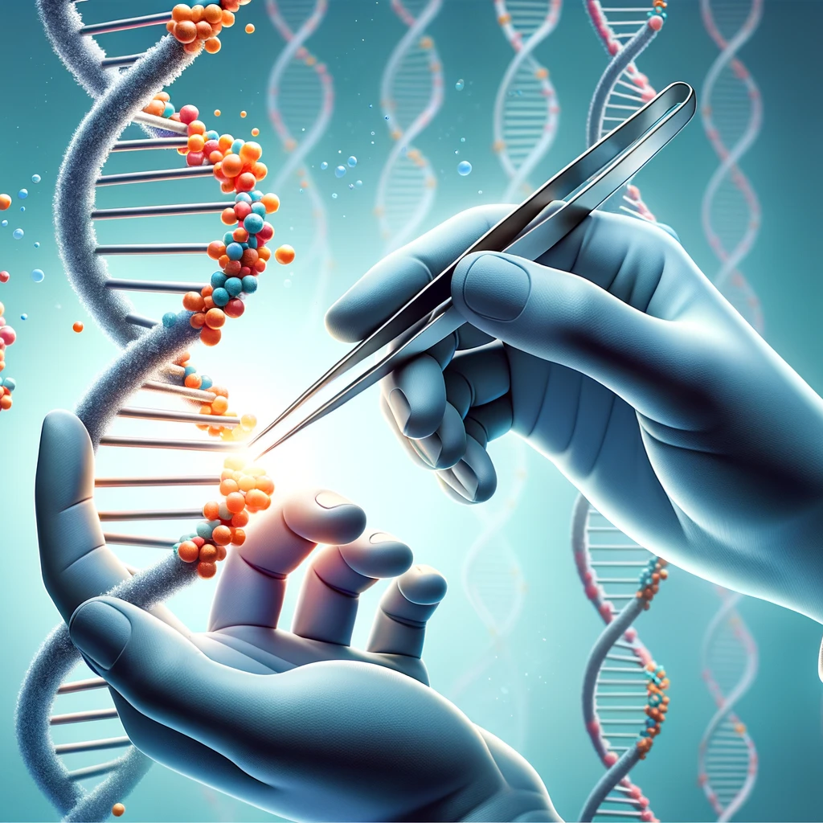


Analyzing Genomes Reveals Key Insights
Personalized Medicine
Genome Editing
Detecting pathogens
in the environment
Rapid surveillance of
disease outbreaks

Slide 14
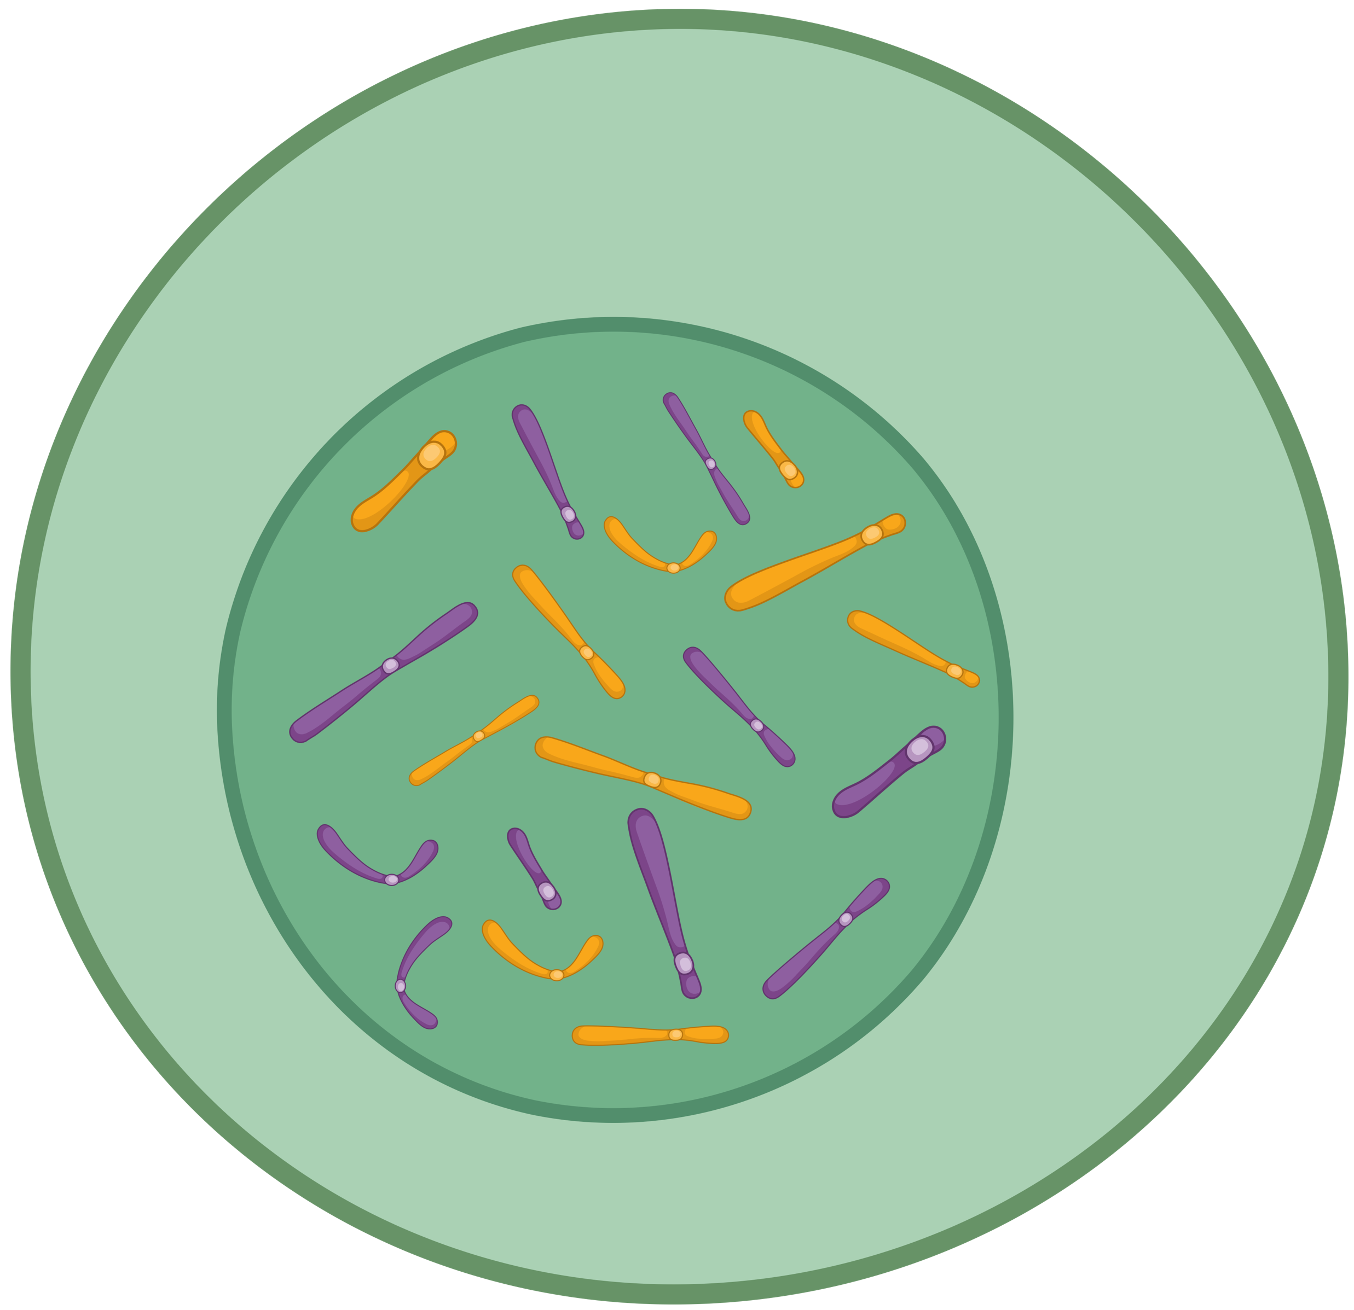
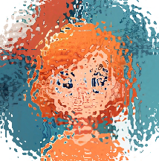
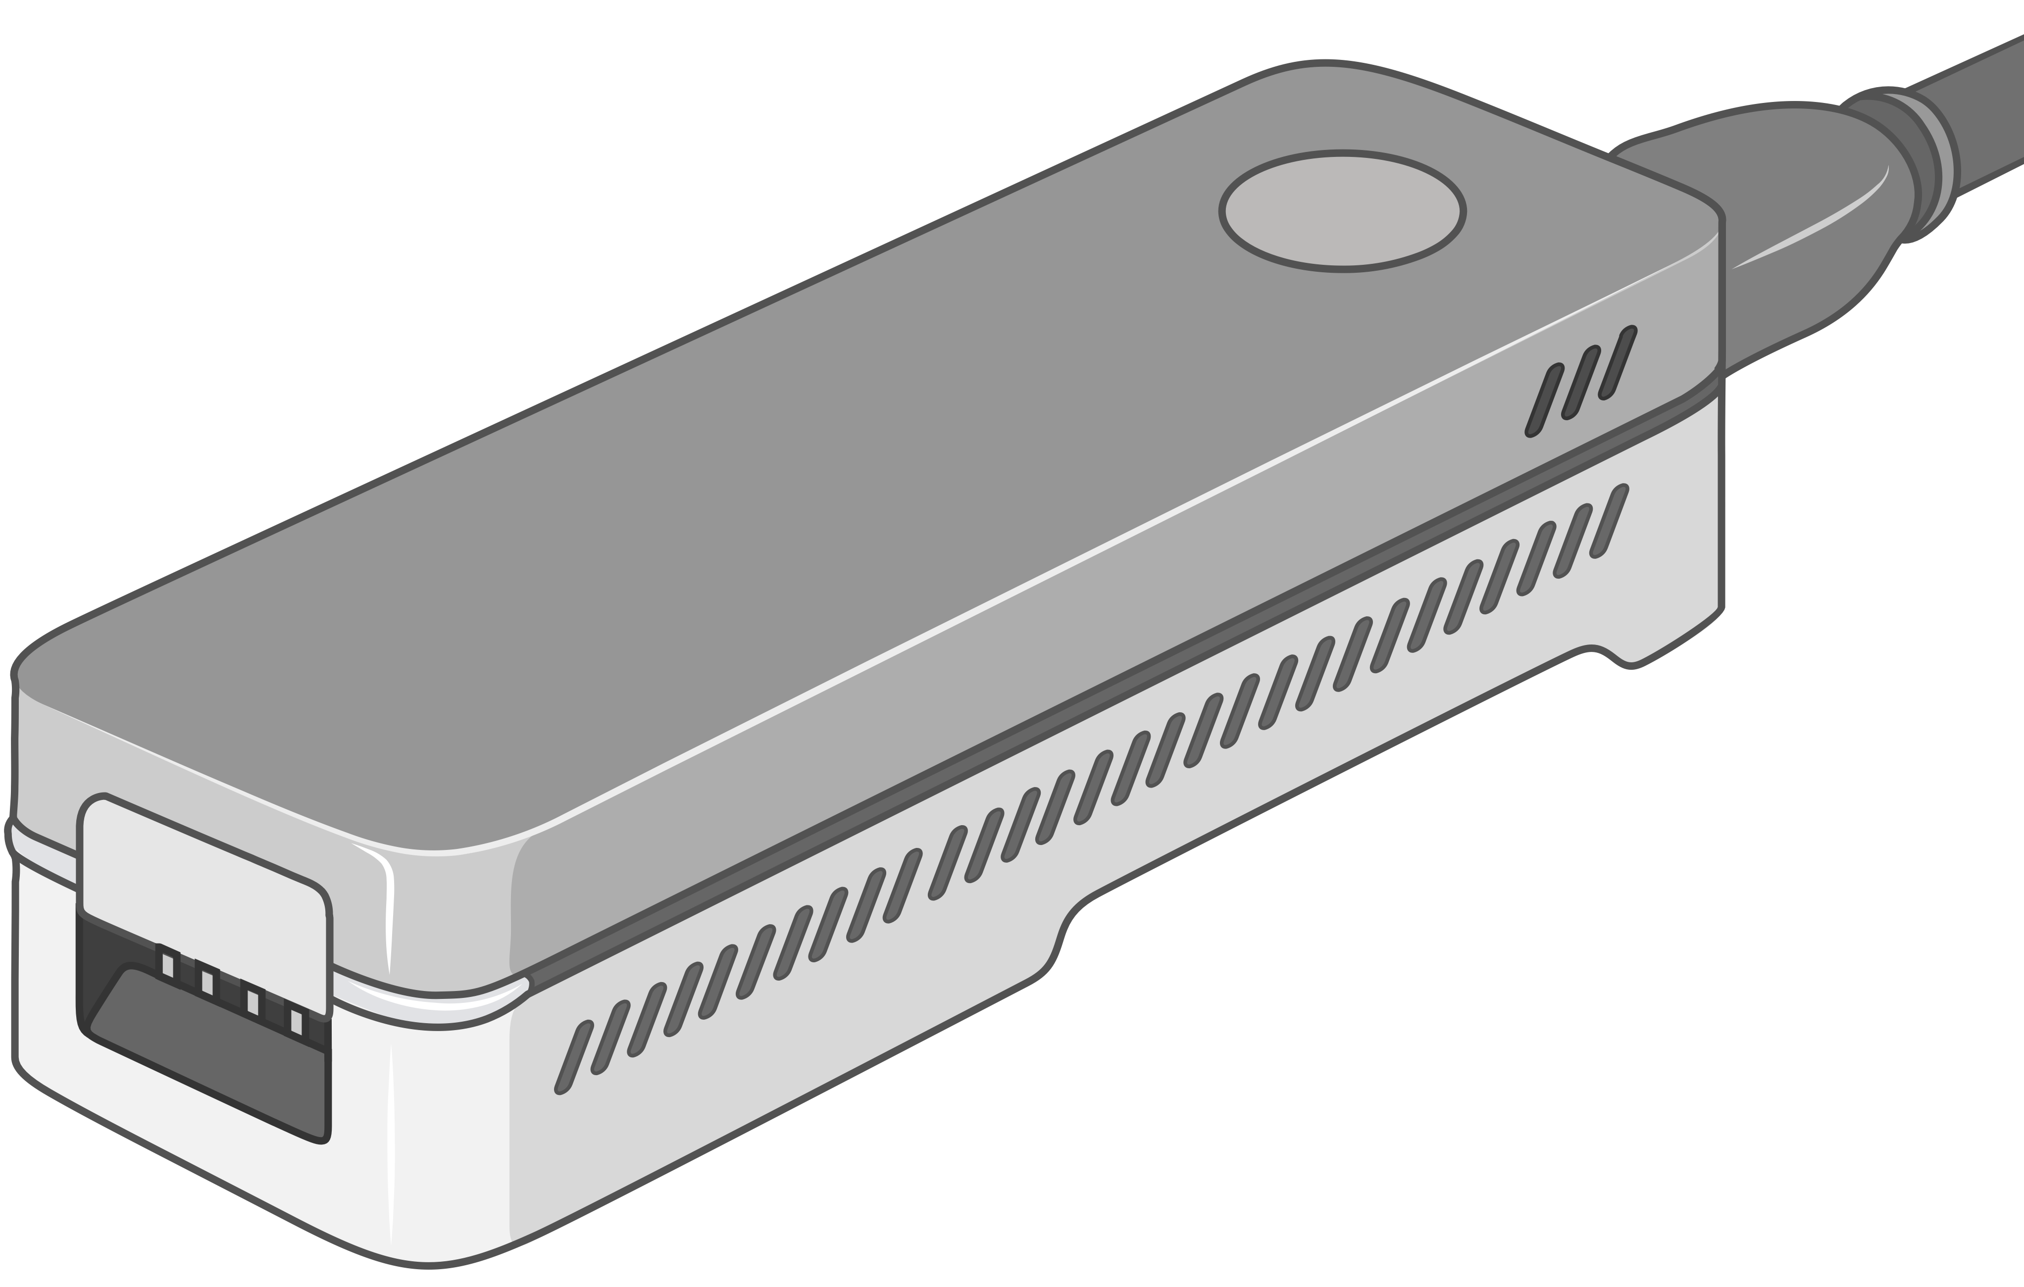
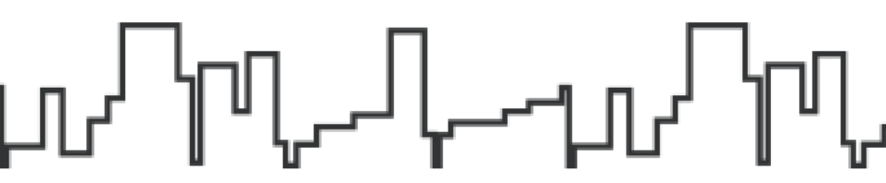

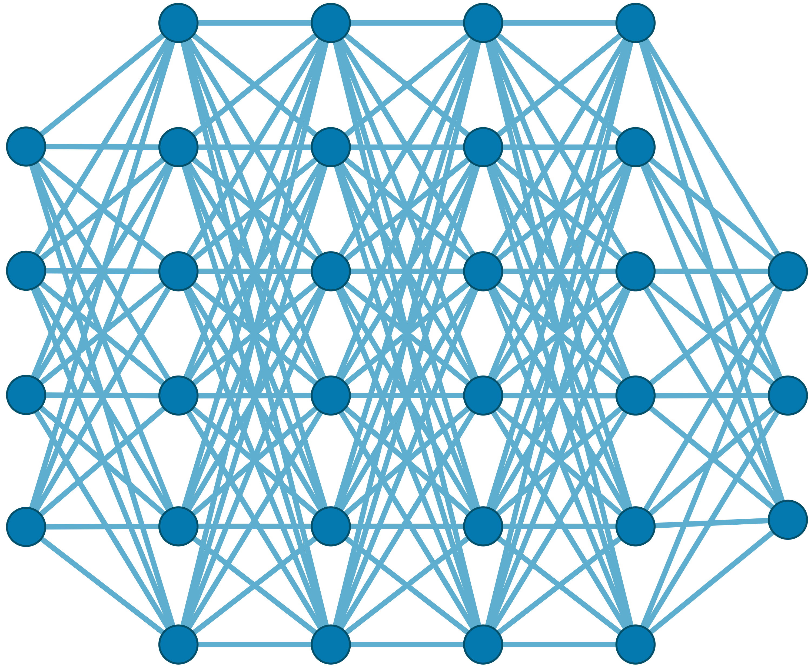

Generating the Entire Genomic Sequence
Whole Genome: 6.4B bps
(Non-human-readable)
Sequencing Device
Raw Genomic Data
(Human-readable?)
Translator (Basecalling)
AI
CGAAATGCC...AGATTAAACGCT...TGCCCTAA...GAATGGCGT
Whole Human Genome: 6.4B bps (Human-readable)

Slide 15









Genomic Data: Giant Jigsaw Puzzle to Solve
Human (Reference) Genome: 3.2 Billion bps (haploid)
CGAAATGCC...AGATTAAACGCT...TGCCCTAA...GAATGGCGT
?
Scale: ~$1/{10}^{8}$
AAATGG
CGAAATGCC...AGATTAAATGGT...TGCCCTAA...GAATGGCGT
Entire Genomic Sequence of an Organism
Read: ~100 – 100,000 bps
Small pieces (reads)
?
Unknown origins
Dealing with Massive and Noisy Datasets
(TBs to PBs)
Non-identical reference genome
Large volume of data to analyze

Slide 16
Solving the Puzzle: The Practical Way
Goal: Quickly and accurately reduce the search space
CGAAATGCC...AGATTAAACGCT...TGCCCTAA...GAATGGCGT
Performing
the costly computations
only for a few regions
AAA
AAA
CTA
AAT
AAATGG
AAATGG
Exact Match
AAA
AAATGG
Read Mapping
Indexing
Seeding
Chaining
Alignment
Reference Genome
Hash Table
Read
0x00
2,64,…
Sketching
0x01
1,101,…
Query
Sketching
Store
…
0xFF
13,21
Hash
Positions
Hash
0x01
0x00
Hash
Hash Matches
DP Calculations

Slide 17


A Common Genome Analysis Pipeline
Raw
Reads
Basecalling (Translator)
Basecalled
(Translated)
Reads
Read
Mapping
AAATGTGGTCCATTG
Assembly
Variant Calling
Metagenomics
Downstream Analysis

Slide 18
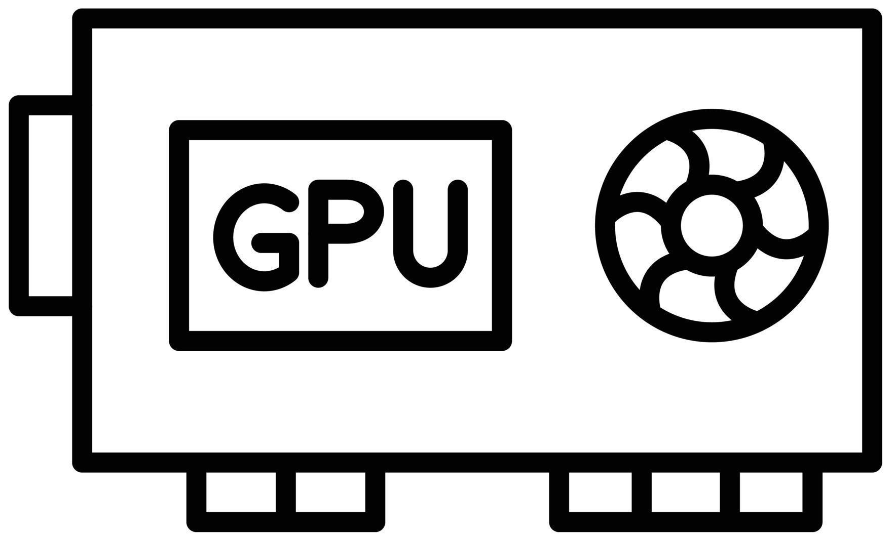
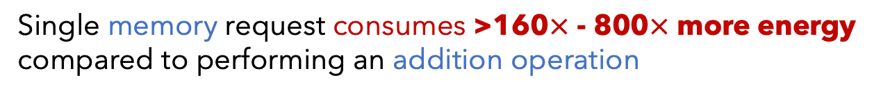
Genome Analysis is Energy Inefficient
Raw
Reads
Basecalling (Translator)
Basecalled
(Translated)
Reads
Read
Mapping
AAATGTGGTCCATTG
Power-Hungry Devices
Costly and large volumes
of data movement
Single memory request consumes >160$×$ - 800$×$ more energy compared to performing an addition operation
⁻ Boroumand et al., “Google Workloads for Consumer Devices: Mitigating Data Movement Bottlenecks,” ASPLOS 2018
⁻ Kestor et al., “Quantifying the Energy Cost of Data Movement in Scientific Applications,” IISWC 2013
⁻ Pandiyan and Wu, “Quantifying the energy cost of data movement for emerging smart phone workloads on mobile platforms,” IISWC 2014

Slide 19


Genome Analysis is Computationally Costly
Significant computational overhead

Slide 20
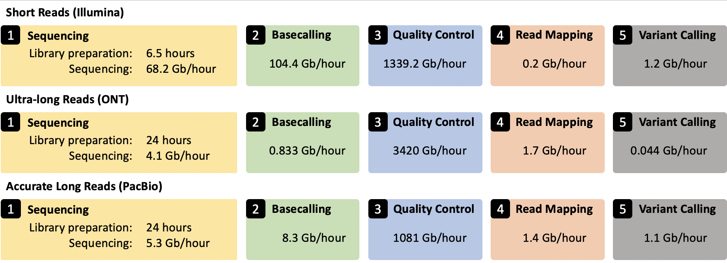
Genome Analysis Pipeline is Unbalanced
Alser+, “From molecules to genomic variations: Accelerating genome analysis via intelligent algorithms and architectures,” CSBJ 2022

Slide 21
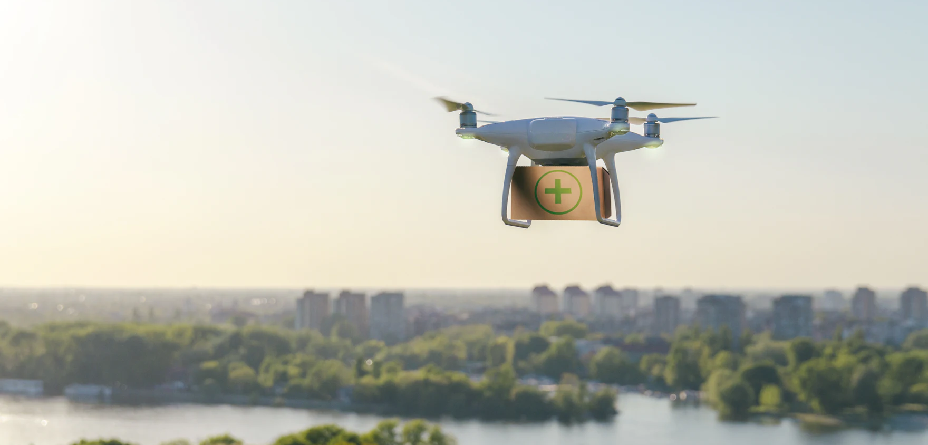


Limited Application Scope and Accuracy
Energy-efficient analysis for Resource-constrained devices
Urgent analysis within minutes
Large-scale analysis
without sacrificing accuracy
and performance

Slide 22


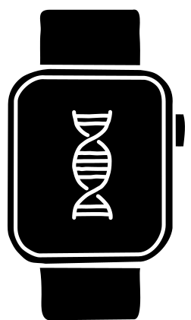



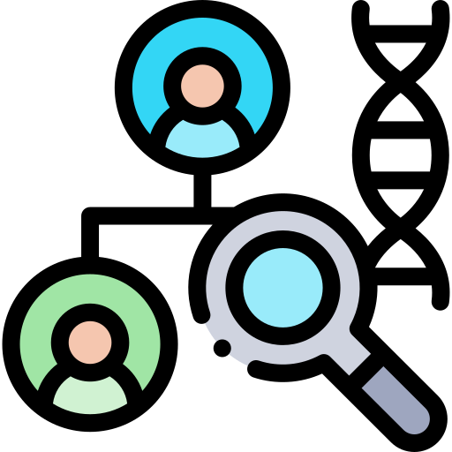



STORM Research Group
Research Directions
Real-Time and Portable Genomic Signal Analysis
Today’s
Talk
Goal
Enable fundamentally better integration of biological data analysis in our everyday lives
Data-centric and
AI-Driven Solutions to Analyze Genomic Data
Accurate and Fast
Algorithms Scalable to
Large Volumes of Genomic Data

Slide 23
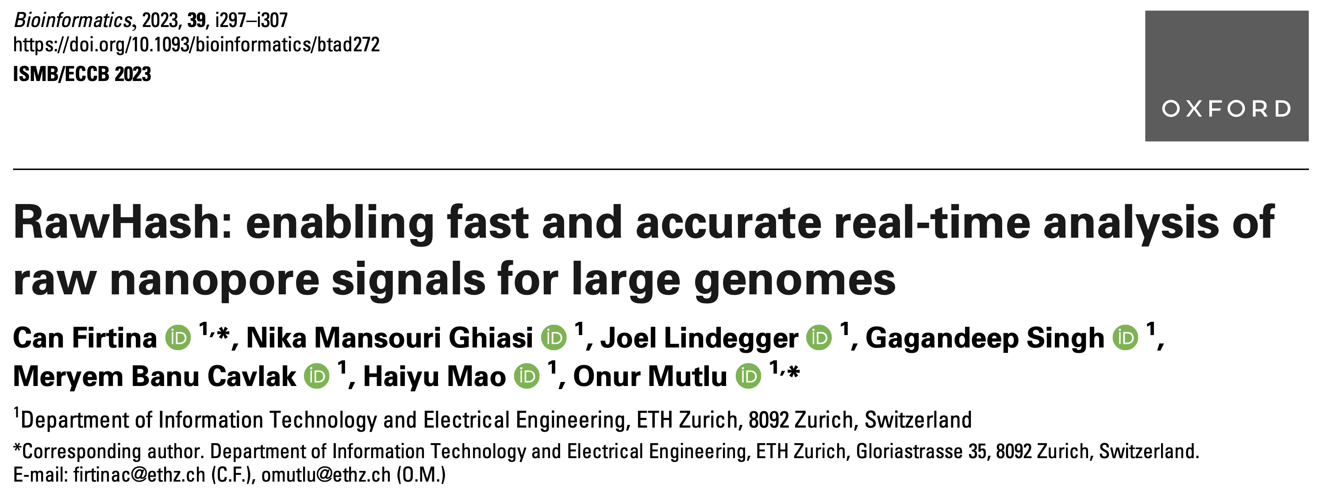
New Frontiers: Raw Signal Analysis [ISMB '23]
Can Firtina, Nika Mansouri Ghiasi, Joel Lindegger, Gagandeep Singh, Meryem Banu Cavlak,
Haiyu Mao, and Onur Mutlu,
"RawHash: enabling fast and accurate real-time analysis of
raw nanopore signals for large genomes"
Proceedings of the 31st Annual Conference on Intelligent Systems for Molecular Biology (ISMB 2023) and the 22nd European Conference on Computational Biology (ECCB 2023), Lyon, France, July 2023.
Paper [online] [pdf] [code]
Conference Talk [video] [pptx] [pdf]
Preprint (bioRxiv) [online] [pdf]
Social Media Thread [Twitter (X)]

Slide 24
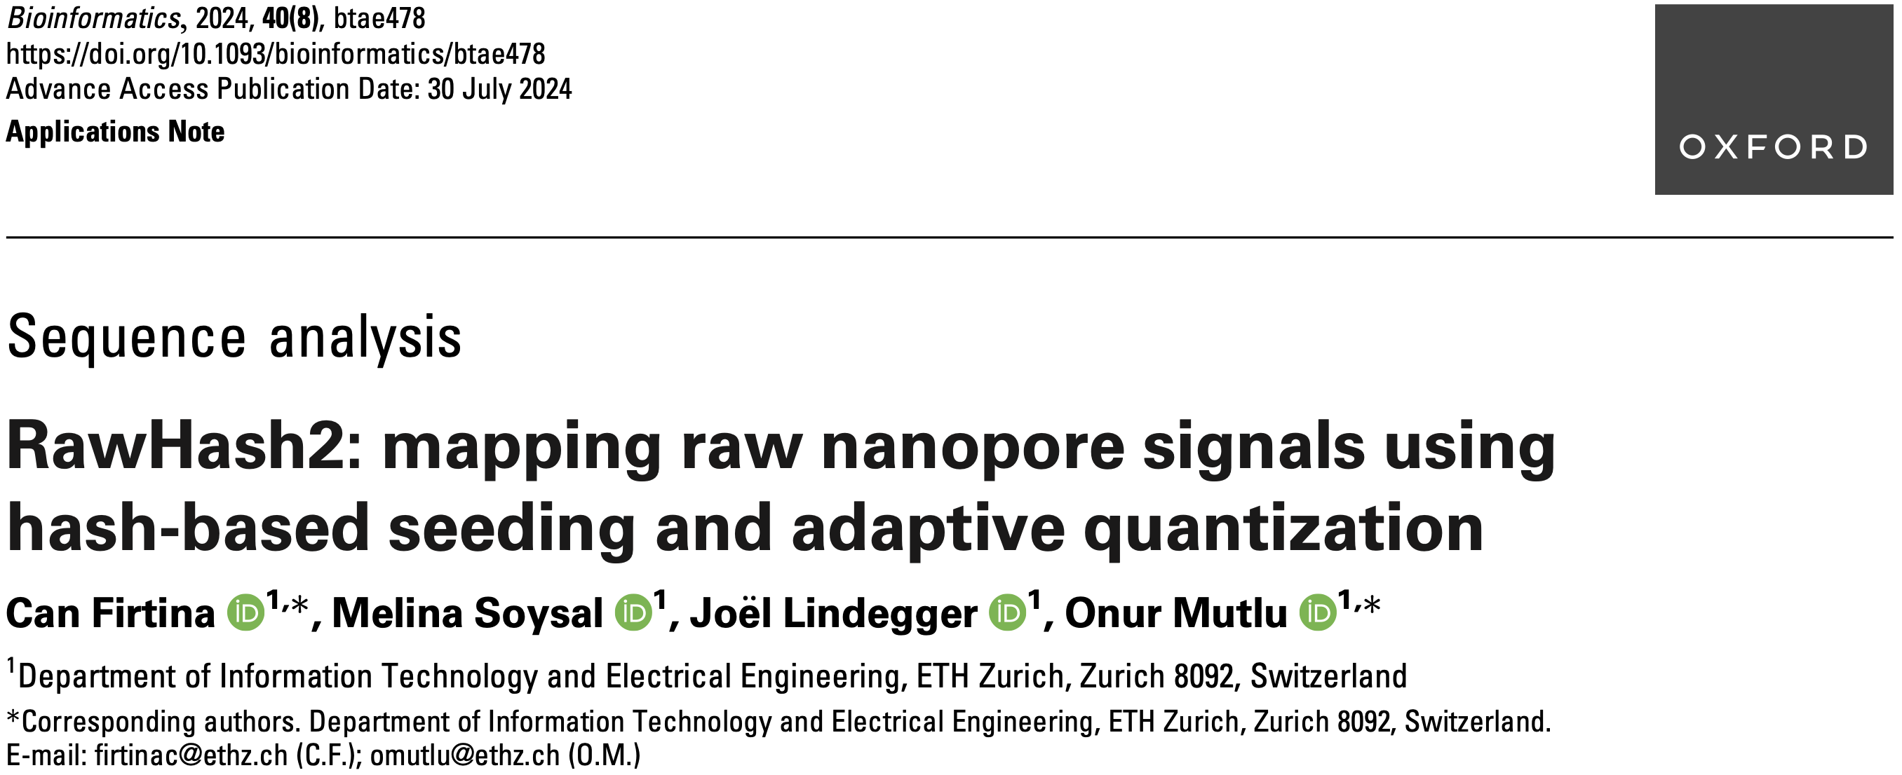
Real-Time Raw Signal Analysis [Bioinformatics '24]
Can Firtina, Melina Soysal, Joël Lindegger, and Onur Mutlu,
"RawHash2: Mapping Raw Nanopore Signals Using
Hash-Based Seeding and Adaptive Quantization"
Bioinformatics, July 2024.
Paper [online] [pdf] [code]

Slide 25
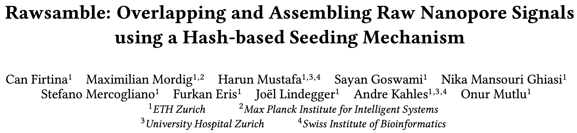
New Directions: Assembling Raw Signals
Can Firtina, Maximilian Mordig, Harun Mustafa, Sayan Goswami, Nika Mansouri Ghiasi,
Stefano Mercogliano, Furkan Eris, Joel Lindegger, Andre Kahles, and Onur Mutlu,
"Rawsamble: Overlapping and Assembling Raw Nanopore Signals using a Hash-based Seeding Mechanism"
[Accepted to Bioinformatics] arXiv, October 2024.
Paper [online] [pdf] [code]
ISMB 2024 Talk [video] [pptx] [pdf]
CSHL 2024 (Biological Data Science) Talk [video] [pptx] [pdf]
Social Media Thread [Twitter (X)] [LinkedIn]

Slide 26
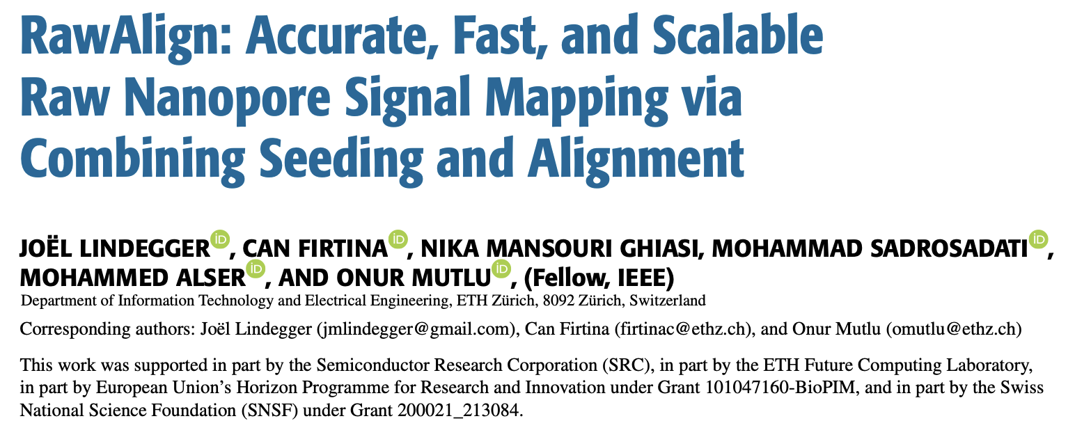
Quickly Aligning Raw Signals [IEEE Access '24]
Joël Lindegger, Can Firtina, Nika Mansouri Ghiasi, Mohammad Sadrosadati, Mohammed Alser, and Onur Mutlu,
"RawAlign: Accurate, Fast, and Scalable Raw Nanopore Signal Mapping via Combining Seeding and Alignment"
IEEE Access, December 2024.
Paper [online] [pdf] [code]

Slide 27
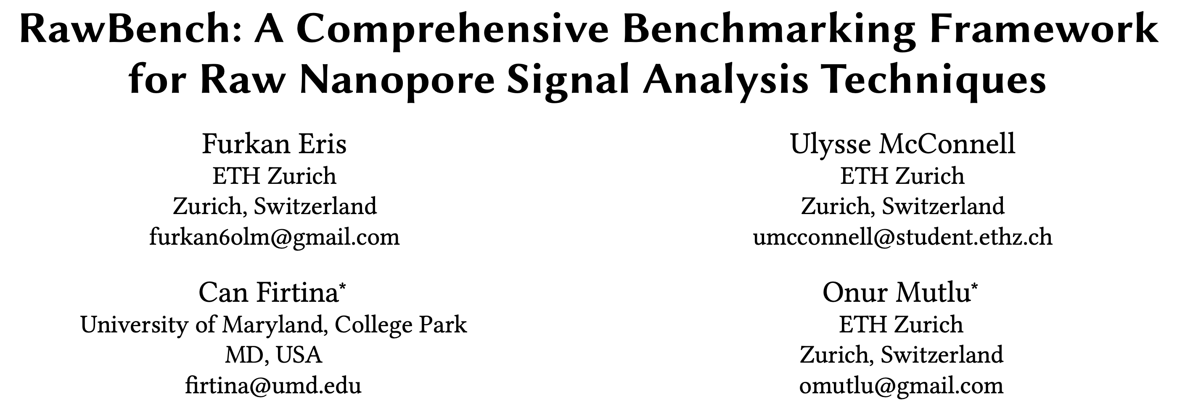
Benchmarking Raw Signal Analysis [ACM-BCB '25]
Furkan Eris, Ulysse McConnell, Can Firtina, and Onur Mutlu,
"RawBench: A Comprehensive Benchmarking Framework
for Raw Nanopore Signal Analysis Techniques"
Proceedings of the 16th ACM Conference on Bioinformatics, Computational Biology, and Health Informatics (ACM-BCB 2025), Philadelphia, PA, USA, October 2025.
Paper [online] [pdf]
Conference Talk [pptx] [pdf]

Slide 28
Basecalling is Accurate yet Costly
Significant computation and energy overhead
Raw
Reads
Basecalling (Translator)
Basecalled
Reads
Read
Mapping
AAATGTGGTCCATTG
Noisy
Raw Signals
Costly
AI Models
Highly accurate reads
How to make this pipeline cheaper?

Slide 29
Can We Survive Without Translation?
Raw
Reads
Read
Mapping
Noisy
Raw Signals
Reference Genome
...
...
CTGCGTAGCAGCGTAATAG
How to communicate
without an accurate translator?

Slide 30
Can We Survive With Noisy Signal Analysis?
Raw
Reads
Read
Mapping
Noisy
Raw Signals
Reference Genome
...
...
CTGCGTAGCAGCGTAATAG
Reference-to-Signal Conversion
How to identify similarity between noisy signals?
...
...
-0.06,0.24,-0.74,
Raw Signal Analysis

Slide 31

Noise in Raw Electrical Signals
Observation: Identical molecules generate
similar raw signals
Sequencing CTGCGTAGCA
Raw
Signals:
[ , , , , ]
-0.06
-0.22
-0.75
0.96
-0.49
Key Idea: Perform similarity estimation
based on vector similarity search
Nearest Neighbor Search
Raw
Signals:
[ , , , , ]
-0.05
-0.21
-0.76
1.01
-0.51
Sequencing CTGCGTAGCA
Problem: Too Costly for Large Genomes

Slide 32




Scalability Issues Limit Real-Time Analysis
Genome Size Increase: 150$×$
2.4$×$
9.2$×$
28$×$
No Real-Time Analysis for Larger Genomes:
Searching mechanism does not scale well

Slide 33
Benefits of Real-Time Analysis
✓
Reducing latency by overlapping analysis with sequencing
Time
Sequencing
Analysis
Reduced Latency
Sequencing & Real-Time Analysis
✓
Reducing sequencing time and cost by stopping sequencing early
Sequenced Bases
Completely Sequenced Read
Reduced Sequencing Time (and Cost)
Partially Sequenced Read
Sequencing is stopped early with a real-time decision

Slide 34
RawHash’s Goal
Enable Fast, Accurate, and Scalable
Real-Time Analysis for Larger Genomes

Slide 35
RawHash’s Key Idea
Key Idea: Perform similarity estimation
based on quick exact matches
Raw
Signals:
[ , , , , ]
-0.06
-0.22
-0.75
0.96
-0.49
Hash
0x77db
Fast Match
CTGCGT
Hash
0x77db
Raw
Signals:
[ , , , , ]
-0.05
-0.21
-0.76
1.01
-0.51
Challenge: How to generate the same hash value
for similar enough signals with various noise types?

Slide 36
RawHash’s Key Idea – Quantization
CTGCGT
-0.05
-0.07
-0.06
-0.05
-0.06
Quantize
Quantize
Quantize
Quantize
Quantize
Bucket #
0
1
2
3
4
5
6
7
8
9
10
11
12
13
14
15
-3.00
Range of raw signals (normalized)
+3.00
✓
Enables matching raw signals by eliminating slight differences

Slide 37
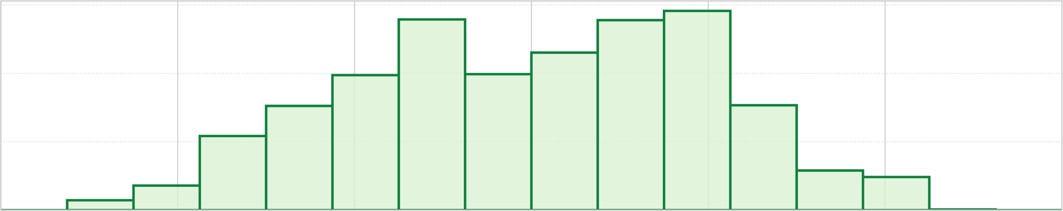
How to Better Quantize Signals
Bucket #
0
1
2
3
4
5
6
7
8
9
10
11
12
13
14
15
-3.00
Range of raw signals (normalized)
+3.00
✕
Equal-width buckets leads to
unbalanced bucket loading
600
400
K-mer count
200
0
1
2
3
4
5
6
7
8
9
10
11
12
13
14
15
-3.00
+3.00
✕
Reduced uniqueness and poor resource utilization

Slide 38
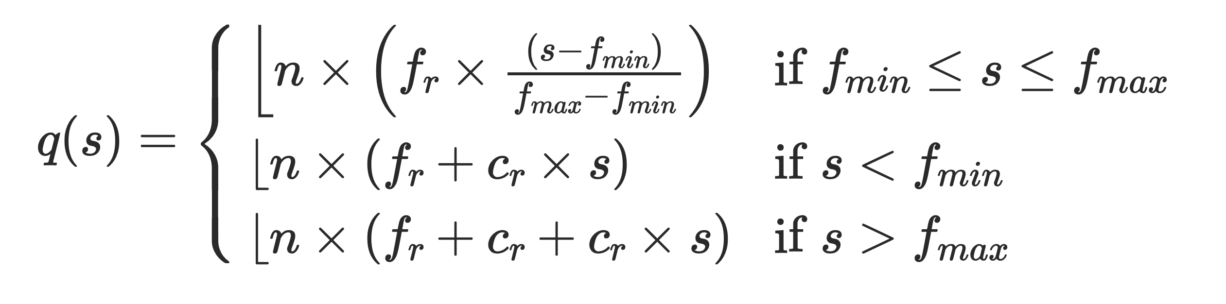
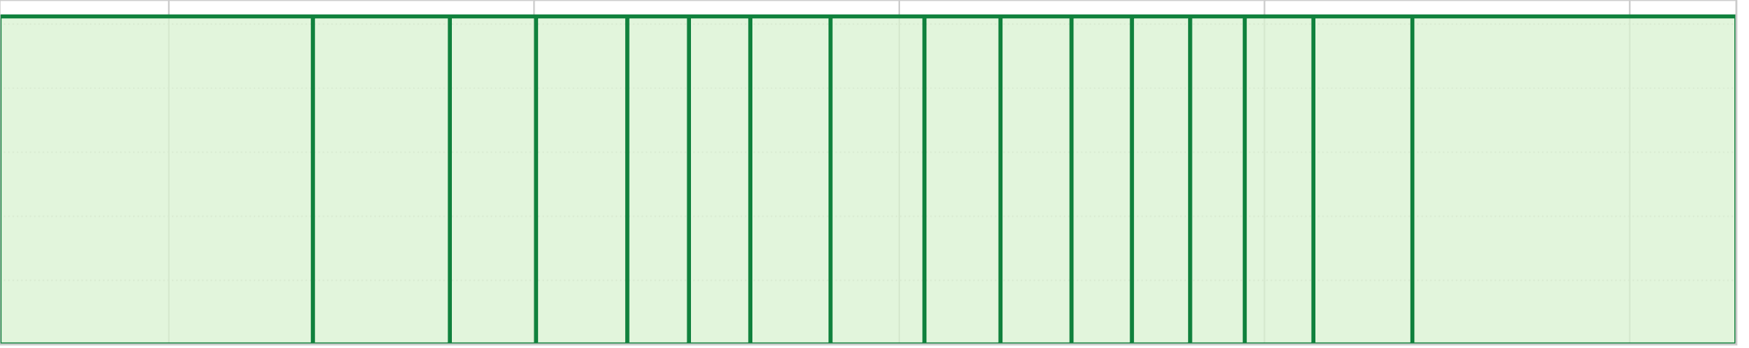
Adaptive Quantization
Key Idea: Quantizing raw signals with non-equal bucket widths
by leveraging raw signal distribution
Bucket #
0
1
2
3
4
5
6
7
8
9
10
11
12
13
14
15
-3.00
Range of raw signals (normalized)
+3.00
K-mer count
-3.00
3.00
✓
Better bucket utilization

Slide 39
RawHash Key Idea – Hash-based Matching
Sequencing CTGCGTAGCA
[ , , , , ]
-0.06
-0.22
-0.75
0.96
-0.49
Quantize
Quantize
Quantize
Quantize
Quantize
Hash
0x77db
0b0111
0b0111
0b0110
0b1011
0b0110
Pack
0b01110111011010110110
Hash
0x77db
Fast and Accurate Match
Key Contribution: The first hash-based search
(and indexing) mechanism for raw signals

Slide 40
Real-Time Analysis Benefits from Fast Search
Genome Size Increase: 150$×$
2.4$×$
9.2$×$
28$×$
Real-time Analysis for Human Genomes:
Fast search instead of costly neighbor search

Slide 41
Fast Search Leads to Accurate Search
Best accuracy for all genomes:
Hash values span longer sequences than vectors ->
More unique and informative matches
(Almost) Identical accuracy to basecalled analysis:
Is the small difference because RawHash is even better?

Slide 42
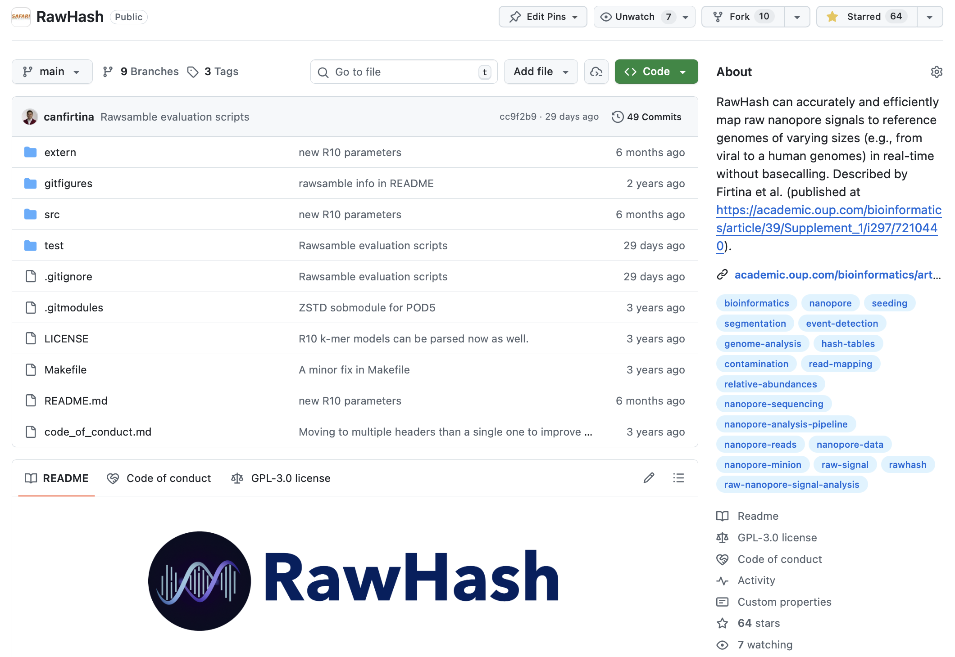
RawHash is Open Source
https://github.com/CMU-SAFARI/RawHash

Slide 43
So What?

Slide 44
New Directions: Assembling Raw Signals
Can Firtina, Maximilian Mordig, Harun Mustafa, Sayan Goswami, Nika Mansouri Ghiasi,
Stefano Mercogliano, Furkan Eris, Joel Lindegger, Andre Kahles, and Onur Mutlu,
"Rawsamble: Overlapping and Assembling Raw Nanopore Signals using a Hash-based Seeding Mechanism"
[Accepted to Bioinformatics] arXiv, October 2024.
Paper [online] [pdf] [code]
ISMB 2024 Talk [video] [pptx] [pdf]
CSHL 2024 (Biological Data Science) Talk [video] [pptx] [pdf]
Social Media Thread [Twitter (X)] [LinkedIn]

Slide 45


Beyond Reference Mapping: Overlapping
Reference Genome (Converted to Signals)
Raw Nanopore Signals
Raw Nanopore Signals
TGCTGCAA
CGAAGTCA
CGTAGTGG
CCACCGGT
Reference Signals
CTGCAATC
TGATCCGA
TCAGCCGT
AGTGGACC
GGTAAGCT
TGCTGCAATCGTGATCCGAAGTCAGCCGTAGTGGACCACCGGTAAGCT
Hash-Based
Seeding and Mapping
Challenge: Reference genome is not always available
Assembly: Constructing genome from overlapping reads
✕
Existing solutions cannot find overlapping reads without basecalling

Slide 46

Rawsamble
The first mechanism that can perform
all-vs-all overlapping from raw signals

Slide 47
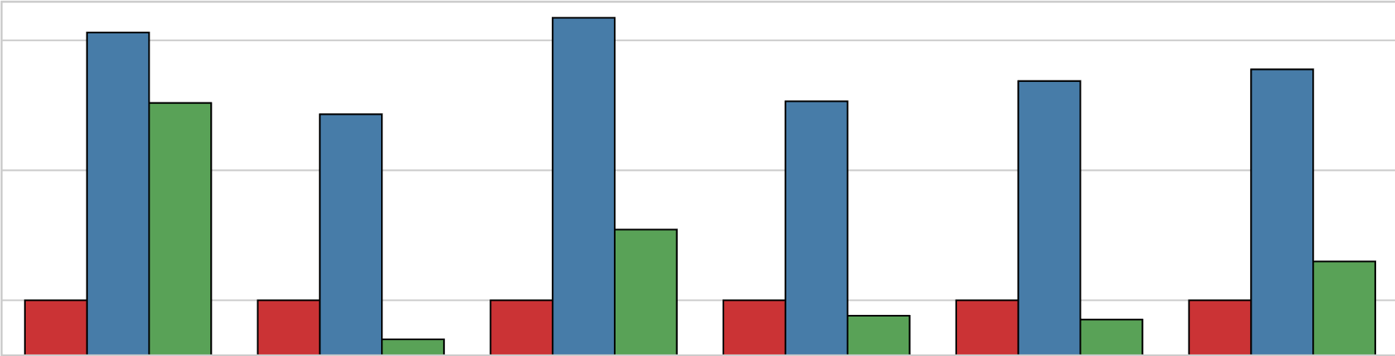
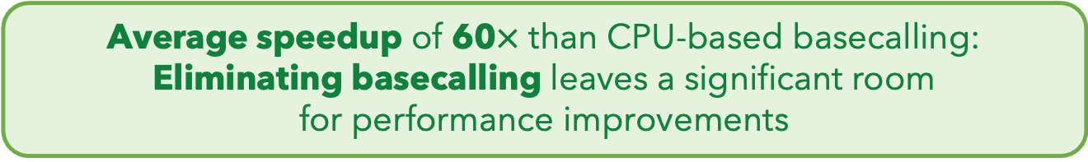





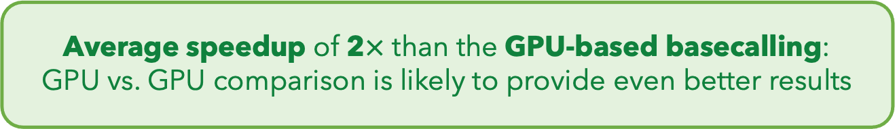
Eliminating Basecalling from the Pipeline
Rawsamble
Basecalling (CPU)
+ Overlapping
Basecalling (GPU)
+ Overlapping
$${10}^{2}$$
Elapsed Time
(Normalized to Rawsamble)
59.70$×$
$${10}^{1}$$
$${10}^{0}$$
1.99$×$
SARS-CoV-2
E. coli
Yeast
Green Algae
Human
Geo. Mean
Average speedup of 60$×$ than CPU-based basecalling: Eliminating basecalling leaves a significant room
for performance improvements
Average speedup of 2$×$ than the GPU-based basecalling:
GPU vs. GPU comparison is likely to provide even better results

Slide 48
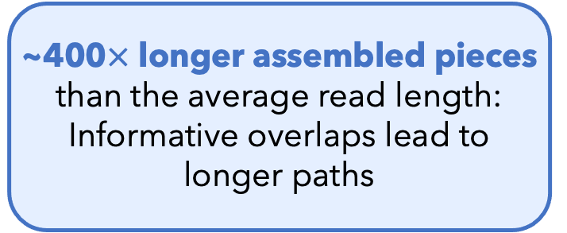
Key Results – First Ever Assemblies
First assemblies
ever constructed
without basecalling
E. coli Assembly
(From the Rawsamble Overlaps)
~400$×$ longer assembled pieces than the average read length:
Informative overlaps lead to longer paths
It is time to rethink if we want to translate individual reads separately

Slide 49
Quickly Aligning Raw Signals [IEEE Access '24]
Joël Lindegger, Can Firtina, Nika Mansouri Ghiasi, Mohammad Sadrosadati, Mohammed Alser, and Onur Mutlu,
"RawAlign: Accurate, Fast, and Scalable Raw Nanopore Signal Mapping via Combining Seeding and Alignment"
IEEE Access, December 2024.
Paper [online] [pdf] [code]

Slide 50
RawAlign Overview
Coarse-Grained
Fast
Fine-Grained
Accurate

Slide 51
Benchmarking Raw Signal Analysis [ACM-BCB '25]
Furkan Eris, Ulysse McConnell, Can Firtina, and Onur Mutlu,
"RawBench: A Comprehensive Benchmarking Framework
for Raw Nanopore Signal Analysis Techniques"
Proceedings of the 16th ACM Conference on Bioinformatics, Computational Biology, and Health Informatics (ACM-BCB 2025), Philadelphia, PA, USA, October 2025.
Paper [online] [pdf]
Conference Talk [pptx] [pdf]

Slide 52
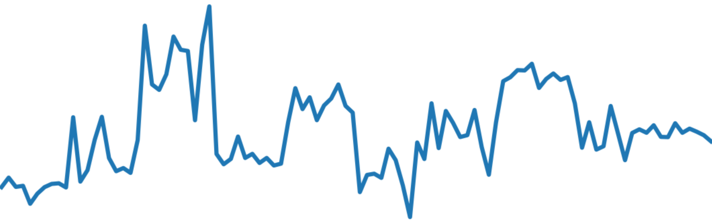
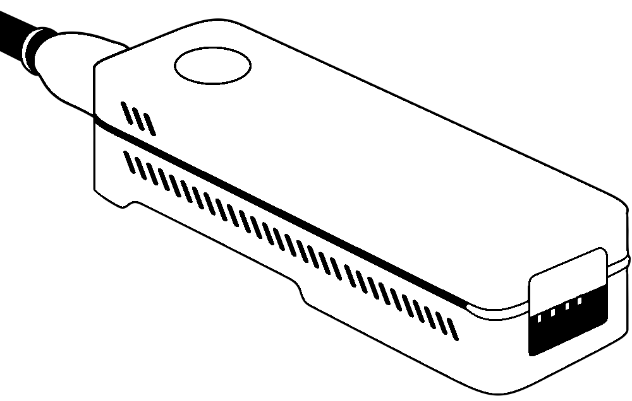
RawBench Benchmarking Framework
ACGT
Encoding reference genome
Matching encoded representations
2
Encoding raw signal
Input
Raw Signals
1
3
ONT
pore model
Hash-based
FM-index
t-test
Uncalled4
pore model
Vector
distance
R-index
Move tables
Input Reference
Add-on
DTW
Add-on
Add-on
1
Encoding Reference Genome
  Uses learned pore models by ONT and community
2
Encoding Raw Signal
  Utilizes statistical and ML-based encoding techniques
3
Matching Encoded Representations
  Compares representations that are now encoded into the same space

Slide 53
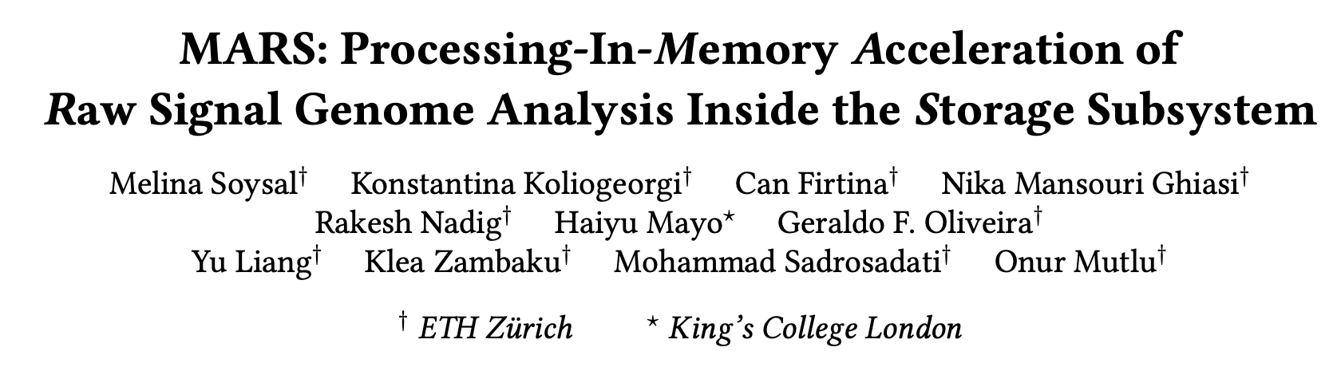
In-Storage Raw Signal Analysis [ICS '25]
Melina Soysal, Konstantina Koliogeorgi, Can Firtina, Nika Mansouri Ghiasi, Rakesh Nadig,
Haiyu Mao, Geraldo Francisco Oliveira Junior, Yu Liang, Klea Zambaku, Mohammad Sadrosadati, and Onur Mutlu,
"MARS: Processing-In-Memory Acceleration of
Raw Signal Genome Analysis Inside the Storage Subsystem"
Proceedings of the 39th International Conference on Supercomputing (ICS 2025), Salt Lake City, Utah, USA, June 2025.
Paper [online] [pdf]
Conference Talk [video] [pptx] [pdf]

Slide 54

Read Mapping with Raw Signals
High Level Overview of Read Mapping in
Raw Signal Genome Analysis (RSGA)
Mapping (online)
Query Sequence
Sketching
I
EVENT DETECTION
Hash Table
events
Hash
Positions
II
SEEDING
0x00
2,64,…
query
hash and query
0x01
1,101,…
0x00
Hash
…
0xFF
13,21
matches
Chaining
III
CHAINING
x
x
sorting and DP-based
x
chains

Slide 55
Motivation
Chaining & seeding consistently dominate runtime
Event detection & I/O overhead are non-negligible for some datasets

Slide 56
Impact of I/O data movement
We model I/O data movement overhead when accelerating commonly targeted steps in the pipeline: seeding and chaining
As compute latency is reduced, I/O becomes the dominant contributor to total execution time
I/O data movement from SSD becomes dominant overhead as compute steps are accelerated in RSGA

Slide 57
MARS Architecture & System - Overview
In-Storage-Processing system for RSGA
Conventional Mode: SSD performs standard SSD storage operations
Accelerator Mode: SSD executes the full RSGA pipeline without host intervention
SSD Controller
Flash Controller
I
MARS
Control
Unit
FTL
II
III
Sorter
Unit
Merger
Unit
.
Flash Memory
Cores
.
.
SSD-Internal DRAM
Bank
V
Querying Unit
V
Querying Unit
…
…
…
…
…
…
…
Subarrays
Bank
IV
Arithmetic Unit
Arithmetic Unit

Slide 58
MARS Architecture & System (I/IV)
SSD Controller Components
SSD Controller
Flash Controller
I
FTL
II
III
MARS
Control
Unit
Sorter
Unit
Merger
Unit
.
Flash Memory
Cores
.
.
I
MARS Control Unit
Finite State Machine that orchestrates pipeline execution, control and data flow

Slide 59
MARS Architecture & System (II/IV)
SSD Controller Components
SSD Controller
Flash Controller
I
FTL
II
III
MARS
Control
Unit
Sorter
Unit
Merger
Unit
.
Flash Memory
Cores
.
.
I
II
III
MARS Control Unit
Sorter Unit
Merger Unit
Finite State Machine that orchestrates pipeline execution, control and data flow
Performs parallel sorting of sequences using dedicated logic
Combines sorted subsequences into longer sorted ones
Paradigm: Implements Processing Near DRAM
1 Sorter-Merger pair per flash controller

Slide 60
MARS Architecture & System (III/IV)
SSD-Internal DRAM Components
SSD-Internal DRAM
Bank
V
Querying Unit
V
Querying Unit
…
…
…
…
…
Subarrays
…
…
Bank
Arithmetic Unit
IV
IV
Arithmetic Unit
Performs arithmetic and logical operations required for RSGA
Paradigm: Implements Processing Near DRAM
Design: Based on the FULCRUM¹ architecture for leveraging DRAM subarray proximity for low-latency parallel arithmetic operations
1 per two subarrays
1: [Lenjani, HPCA’20];

Slide 61
MARS Architecture & System (IV/IV)
SSD-Internal DRAM Components
SSD-Internal DRAM
Bank
V
Querying Unit
V
Querying Unit
…
…
…
…
…
Subarrays
…
…
Bank
Arithmetic Unit
IV
IV
V
Arithmetic Unit
Querying Unit
Performs arithmetic and logical operations required for RSGA
Performs efficient, in-memory hash table lookups for seeding
Paradigm: Implements Processing Near DRAM
Paradigm: Implements Processing Using DRAM
Design: Based on the FULCRUM¹ architecture for leveraging DRAM subarray proximity for low-latency parallel arithmetic operations
Design: Based on the PLUTO² architecture leveraging DRAM row activation for massively parallel hash-table lookup operations
1 per two subarrays
1 per subarray
1: [Lenjani, HPCA’20]; 2: [Ferreira+, MICRO’22]

Slide 62
Performance Evaluation
BC
GenPIP
MS-CPU
MARS
RawHash2
100
10
Speedup
1
0.1
D1
D2
D3
D4
D5
GEOMEAN
Basecalling-based pipeline
RSGA-based pipeline
MARS outperforms all other baselines across all datasets
MARS outperforms GenPIP adopting PIM outside storage
Key Observations
We fundamentally solve the I/O data movement overhead problem
MARS-CPU provide speedup of 1.7x over RH2
Our SW modifications are effective in reducing the computational load

Slide 63
Energy Evaluation
BC
GenPIP
MS-CPU
MARS
RawHash2
10²
10
Energy Reduction
1
0.1
D1
D2
D3
D4
D5
GEOMEAN
Basecalling-based pipeline
RSGA-based pipeline
MARS reduces energy consumption over all other baselines across all datasets
Key Observation
Improvement stems from
reduced execution time
fundamentally addressing the I/O data movement overhead

Slide 64
Processing Data Where It Makes Sense Provides Significant Performance
and Energy Benefits

Slide 65
Some Interesting Challenges in Signal Analysis
Identifying novel base modifications in various organisms
Better integrating the chemical structure information in genomics
  Distinguishing noise from useful information
Redesigning effective solutions for storage
Enabling end-to-end and energy-efficient analysis with (portable) sequencing devices

Slide 66
STORM Research Group
Research Directions
Real-Time and Portable Genomic Signal Analysis
Today’s
Talk
Goal
Enable fundamentally better integration of biological data analysis in our everyday lives
Data-centric and
AI-Driven Solutions to Analyze Genomic Data
Accurate and Fast
Algorithms Scalable to
Large Volumes of Genomic Data

Slide 67
Lost in Translation: Harnessing the Power of Nanopore Electrical Signals in Genomics
IMET Seminar Series, UMBC, MD, USA
February 18, 2026
Can Firtina | canfirtina@gmail.com | cs.umd.edu/~firtina
Assistant Professor of Computer Science at UMD

Slide 68
Backup Slides

Slide 69
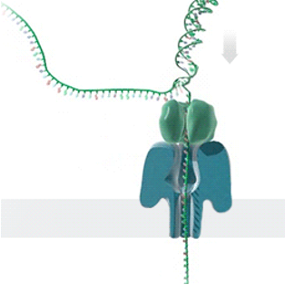
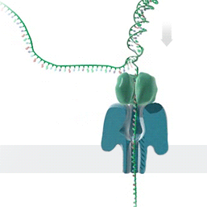


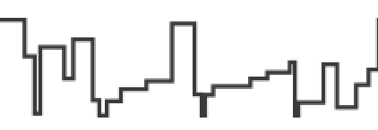


Generating Electrical Signals from DNA
Single Nanopore
Nanopore Sequencer
Raw Signals
(~5000 signals/sec)
Real-Time
Analysis
https://nanoporetech.com/platform/technology/basecalling
https://blogs.ed.ac.uk/institute-genetics-cancer/2020/04/08/nanopore-sequencing-controversial-world-records-and-whale-watching/

Slide 70
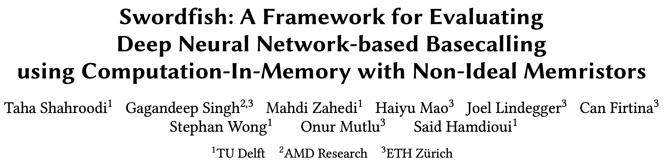
Basecalling using PIM [MICRO '23]
Taha Shahroodi, Gagandeep Singh, Mahdi Zahedi, Haiyu Mao, Joel Lindegger, Can Firtina,
Stephan Wong, Onur Mutlu, and Said Hamdioui,
"Swordfish: A Framework for Evaluating Deep Neural Network-based Basecalling
using Computation-In-Memory with Non-Ideal Memristors"
Proceedings of the 56th International Symposium on Microarchitecture (MICRO), Toronto, ON, Canada, November 2023.
[Slides (pptx) (pdf)]
[arXiv version]

Slide 71
DNN Hardware Acceleration
DNN execution is dominated by:
Vector-Matrix Multiplication (VMM)
Data movement between memory and accelerator
(e.g., GPU or TPU)
Memristor-based PIM for DNN Acceleration
Memristor-based crossbars support VMM
Processing in Memory (PIM) minimizes data movement
  [Ankit+, ASPLOS 2019], [Chi+, ISCA 2016], [Lou+, PACT2020], [Shafiee+, ISCA 2016]

Slide 72
VMM in Memristor-based Crossbars
Digital to Analog Converters
Analog to Digital Converters

Slide 73
Non-idealities in Memristor-based Crossbars
Variation in
Synaptic Conductance
Non-ideal DAC
Digital to Analog Converters
Wire Resistance
Analog to Digital Converters
Non-ideal ADC
Subpar utilization of trained models
due to non-idealities

Slide 74

Accuracy: All Non-idealities without Mitigation
D1
Baseline
D2
Baseline
Accuracy (%)
Non-idealities
Combined non-idealities leads to significant accuracy loss (>18%)

Slide 75

Accuracy: Enhancement Techniques on All Non-idealities
D1
Baseline
D3
Baseline
Accuracy (%)
Enhancement Technique
Accuracy loss drops to 6% from 18% after handling all non-idealities

Slide 76

ML-based Genome Analysis via PIM [MICRO '22]
Haiyu Mao, Mohammed Alser, Mohammad Sadrosadati, Can Firtina, Akanksha Baranwal,
Damla Senol Cali, Aditya Manglik, Nour Almadhoun Alserr, and Onur Mutlu,
"GenPIP: In-Memory Acceleration of Genome Analysis via Tight Integration
of Basecalling and Read Mapping"
Proceedings of the 55th International Symposium on Microarchitecture (MICRO), Chicago, IL, USA, October 2022.
[Slides (pptx) (pdf)]
[Longer Lecture Slides (pptx) (pdf)]
[Lecture Video (25 minutes)]
[arXiv version]

Slide 77
Problem 1: Large Data Movement
Raw Signals
Basecalling
Reads
Read quality
control
High-quality
reads
Read
mapping
Mapped
reads
3913 GB
546 GB
437 GB
382 GB
Large data movement between genome analysis steps
[NC'19] Rory Bowden, Robert W Davies, Andreas Heger, Alistair T Pagnamenta, Mariateresa de Cesare, Laura E Oikkonen, Duncan Parkes, Colin Freeman, Fatima Dhalla, Smita Y Patel, et al. Sequencing of human genomes with nanopore technology. Nature Communications, 2019.

Slide 78
Problem 2: Wasted Computation
100%
79.5%
69.5%
Raw Signals
Basecalling
Reads
Read quality
control
High-quality
reads
Read
mapping
Mapped
reads
Low-quality
reads
Unmapped
reads
20.5%
10%
A considerable amount of computation on useless data due to
Low-quality reads
Unmapped reads

Slide 79
Goal and Opportunities
Goal: Efficiently accelerate the entire genome analysis pipeline while minimizing data movement and useless computation
We perform a study to quantify potential performance benefits
NVM-based PIM accelerators for separate basecalling and read mapping
no data movement
between the accelerators of analysis steps
no data movement
and
no useless reads
(ideal case)

Slide 80
GenPIP Overview
Raw signals from the sequencing machine
GenPIP
In-memory
Read Mapping
[PARC, ASPDAC’20]
+ Our design
In-memory
Basecaller
[Helix, PACT’20]
Signal
chunk
eDRAM
Basecalled
chunk
Chunk
Average Calculator
Read Mapping Controller
Base quality score
Chunk quality score
Quality score
PIM-CQS
PIM chunk quality score calculation
ER
Controller
Chunk mapping score
Read mapping result
To storage
Basecalling Module
ER
GenPIP Controller
ER
Read Mapping Module
https://arxiv.org/pdf/2209.08600.pdf

Slide 81






General-Purpose "Things"

Slide 82
Algorithm Design Demands General-Purpose Computing
Your Favorite
Algorithm
Function 1
Function 2
Function 4
Function 3
Your Favorite
Output
General-Purpose Systems
(e.g., CPUs)
Paid Costs for Generality:
Supporting unnecessary operations
Inefficient data and control flow
Limited parallelism & bandwidth
High latency &
Substantial energy

Slide 83
Great Algorithms Demand Specialization
Application-Specific Architecture
Everyone’s Favorite
Algorithm
Function 1
Function 1
Function 2
Function 2
Function 3
Function 3
Goal: Avoid wasting computation & energy
Opportunities:
Better data flow with minimal latency & power
Paid Costs for Specialization:
Poor programmability
High manufacturing and engineering costs
Efficient processors customized for the task
Better parallelism

Slide 84
Acceleration Efforts for AI and Genomics
Cerebras WSE-3
The largest ML accelerator chip
Google’s TPUs:
NVIDIA H100

Slide 85
Important and
Commonly Used Applications
Demand Specialization

Slide 86




Probabilistic Graphs in Genomics
Probabilistic graphs are commonly used
to identify variations between sequences
To avoid redundant comparisons
and storage
To provide rich information
on expected variations
Reference Genome Graph

Slide 87


Graph-Based Applications in Genomics
Protein Family Search
with Graph Alignment
Error Correction
with Probabilistic Graphs
Multiple Sequence
Alignment
Protein
GCCC-TATGGTTAAGCTT
GCCCATATGGTTAAGCTT
GCCCATATGATTAAGCTT
CCCT
TGCT
GCTA
GCCCATATGGTTAAGCTT
CCTA
GCTT
GCCCGTATGGTT--GCTT
Protein
Family #1
Protein
Family #2
ATGC
AAGC
GCCCATATGCTTAAGCTT
GCCC---TGGTTAAGCT-
CCCT
GCTT
GCCCATATCCTTAAGCTT
GCCCTTATGCTTAAGCTA
GCCCATATGGTTAAGCTT

Slide 88
A Common Graph Structure in Genomics
Profile Hidden Markov Models (PHMMs):
A probabilistic graph structure
0.4
0.3
A: 0.1
T: 0.2
G: 0.6
C: 0.1
A: 0.2
T: 0.2
G: 0.2
C: 0.4
I
I
I
I
0.6
0.2
0.1
A
C
T
T
A: 0.9
T: 0.1
G: 0.0
C: 0.0
A: 0.1
T: 0.1
G: 0.1
C: 0.7
0.7
D
D
D

Slide 89
Underlying ML Technique in Genomic Graphs
Forward Calculations
Backward Calculations
Updating
Transition Probabilities
Updating
Emission Probabilities

Slide 90
Underlying ML Technique in Genomic Graphs
Forward Calculations
Backward Calculations
Function 1
Function 1
Function 2
Function 2
Updating
Transition Probabilities
Updating
Emission Probabilities
Function 3
Function 4

Slide 91
Costly Use of ML in Genomic Graphs
Cost of Using Machine Learning (ML) in pHMMs:
51.44%
45.76%
98.57%

Slide 92
Goal
Enable rapid and power-efficient
use of the underlying ML technique in genome graphs

Slide 93
Key Approach: HW-SW Co-Design
SW
Reduce redundant data storage by utilizing
the fixed data pattern
Reduce unnecessary computations with quick filtering
Avoid repeated operations by utilizing lookup tables
Reduce data movement by processing data where it makes sense
Flexible and efficient hardware design
HW

Slide 94





HW: Simple Data Pattern in DP Calculations
DP Operations
in pHMMs:
Dynamic Programming
(DP) Operations:
$$F_{t}\left(i\right)$$
$$i$$
$$i$$
A
I
D
C
I
D
T
I
D
$$t$$
$$t$$
A
T
G
T
Many Different Patterns
Simple Pattern
Frequent off-chip access
MUL
MUL
ADD
FP DIV
Fast On-chip Memory Access
DP Computation in pHMMs
Store and access data
where it makes sense

Slide 95




SW: Reducing Unnecessary Computations
Observation:
Calculating the entire DP
is not needed
$$F_{t}\left(i\right)$$
$$F_{t}\left(i\right)$$
$$i$$
A
I
D
C
I
D
T
I
D
$$i$$
A
I
D
C
I
D
T
I
D
$$t$$
$$t$$
A
Filter by sorting
A
T
T
G
G
T
T
Dense DP Calculations
Sparse (Filtered) DP Calculations
Challenge:
Sorting is costly in hardware

Slide 96

SW: Reducing Unnecessary Computations
Software co-design:
Replace sorting with a cheaper filtering
State IDs
Range
8, 9
1.00 – 0.94
10, 14
0.94 – 0.88
15, 16, 18
0.88 – 0.82
11, 20, 21, …
0.82 – 0.76
13, 17, 19, …
0.76 – 0.70
.
.
.
.
.
.
0.06 – 0.00
Histogram Filter

Slide 97
Putting the Optimizations Together
Effectively implementing the hardware and software optimizations
to improve performance and reduce power requirements

Slide 98
Integrating ApHMM in a Complete System
The specialized task can be offloaded
to an accelerator whenever needed

Slide 99
Key Results: Performance
Specialized design enables computation
up to two orders of magnitude faster:
Better data flow with reduced latency and improved parallelism

Slide 100
Key Results: Energy Consumption
…and a significant reduction in energy consumption
by up to three orders of magnitude:
simpler hardware with a minimized off-chip memory accesses and data movement

