Slide 1
Lost in Translation: Harnessing the Power of Nanopore Electrical Signals in Genomics
Computational Genomics Summer Institute (CGSI 2026)
Rancho Palos Verdes, CA, USA. July 9 2026
Can Firtina | canfirtina@gmail.com | cs.umd.edu/~firtina
Assistant Professor of Computer Science at UMD

Slide 2

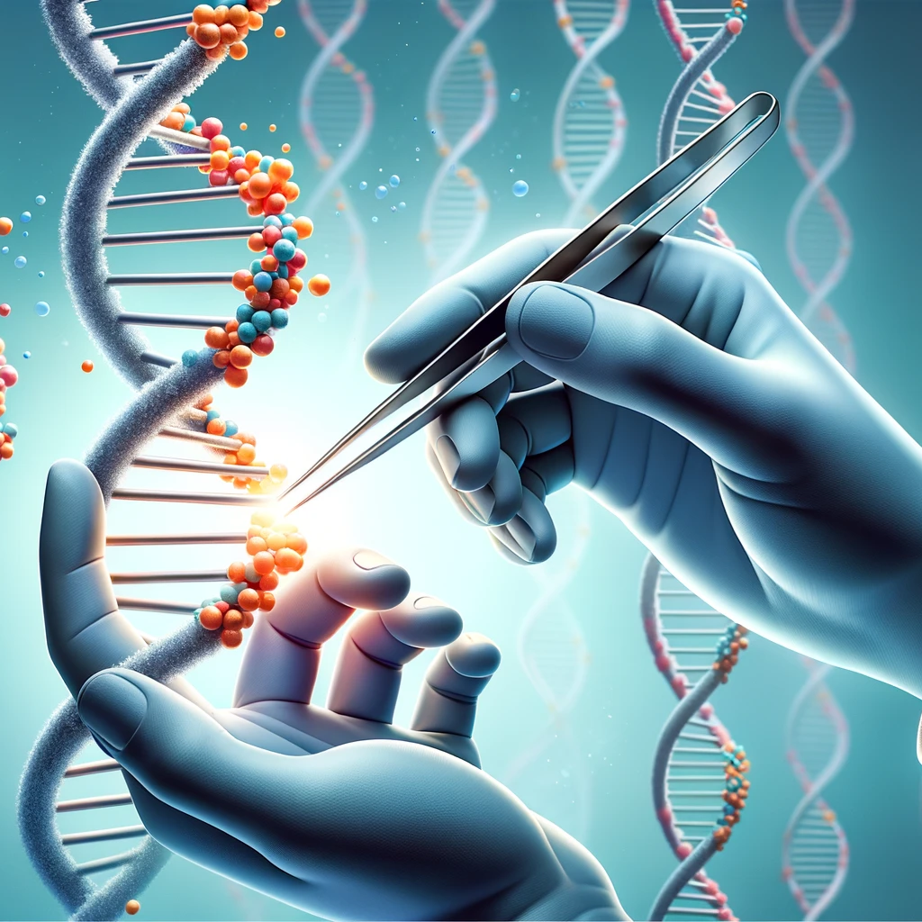


Analyzing Genomes Reveals Key Insights
Personalized Medicine
Genome Editing
Detecting pathogens
in the environment
Rapid surveillance of
disease outbreaks

Slide 3
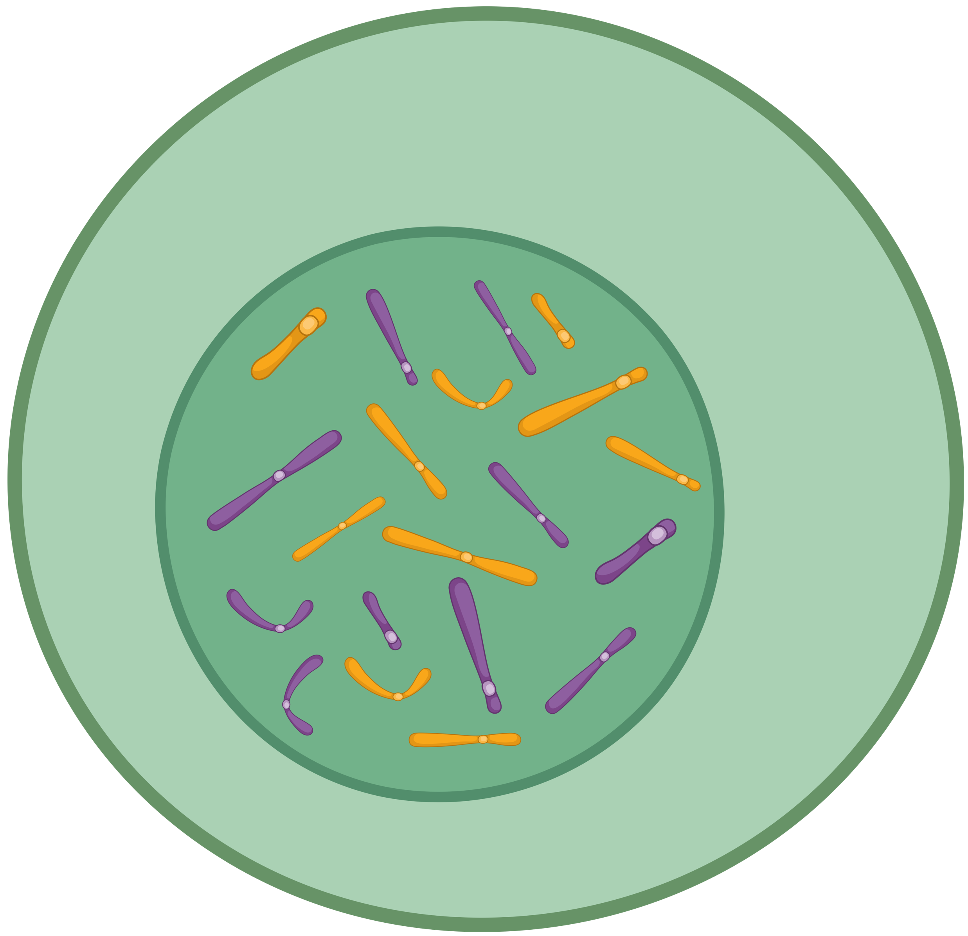
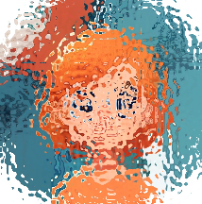
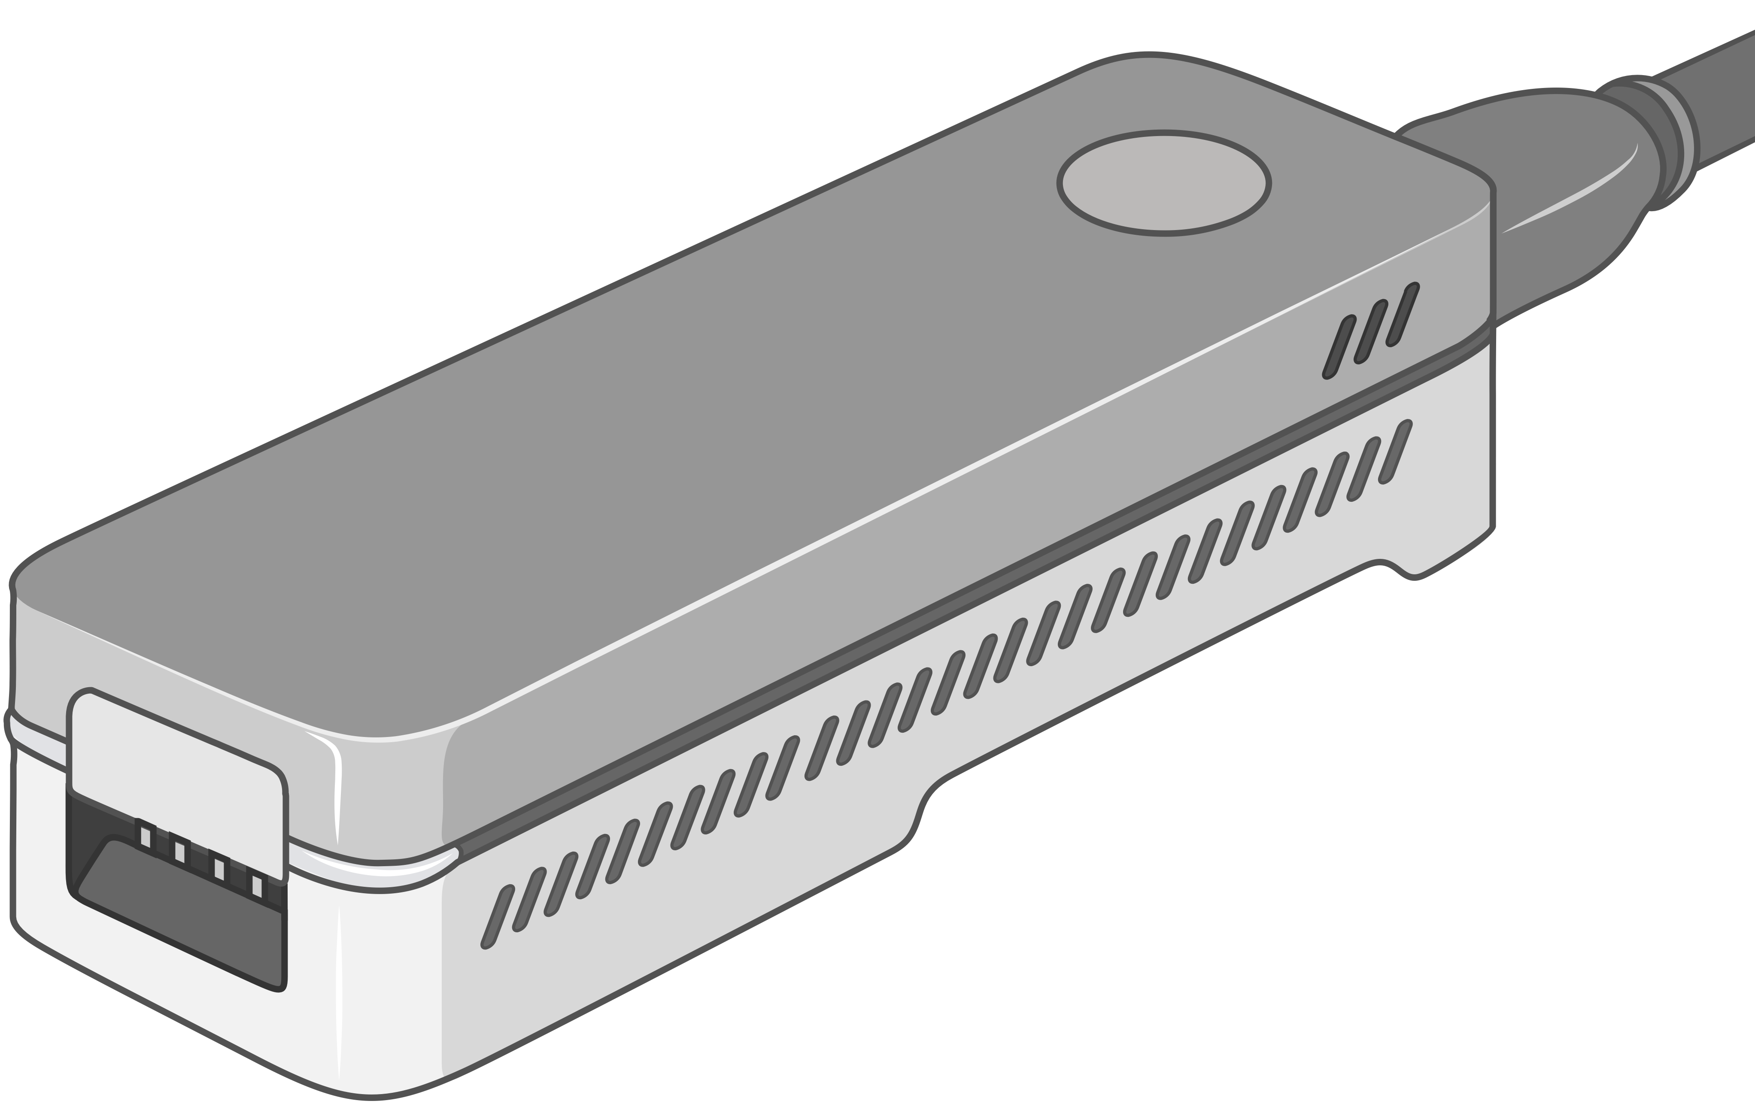
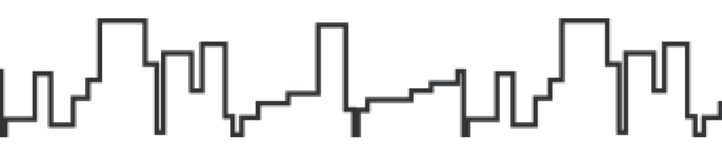
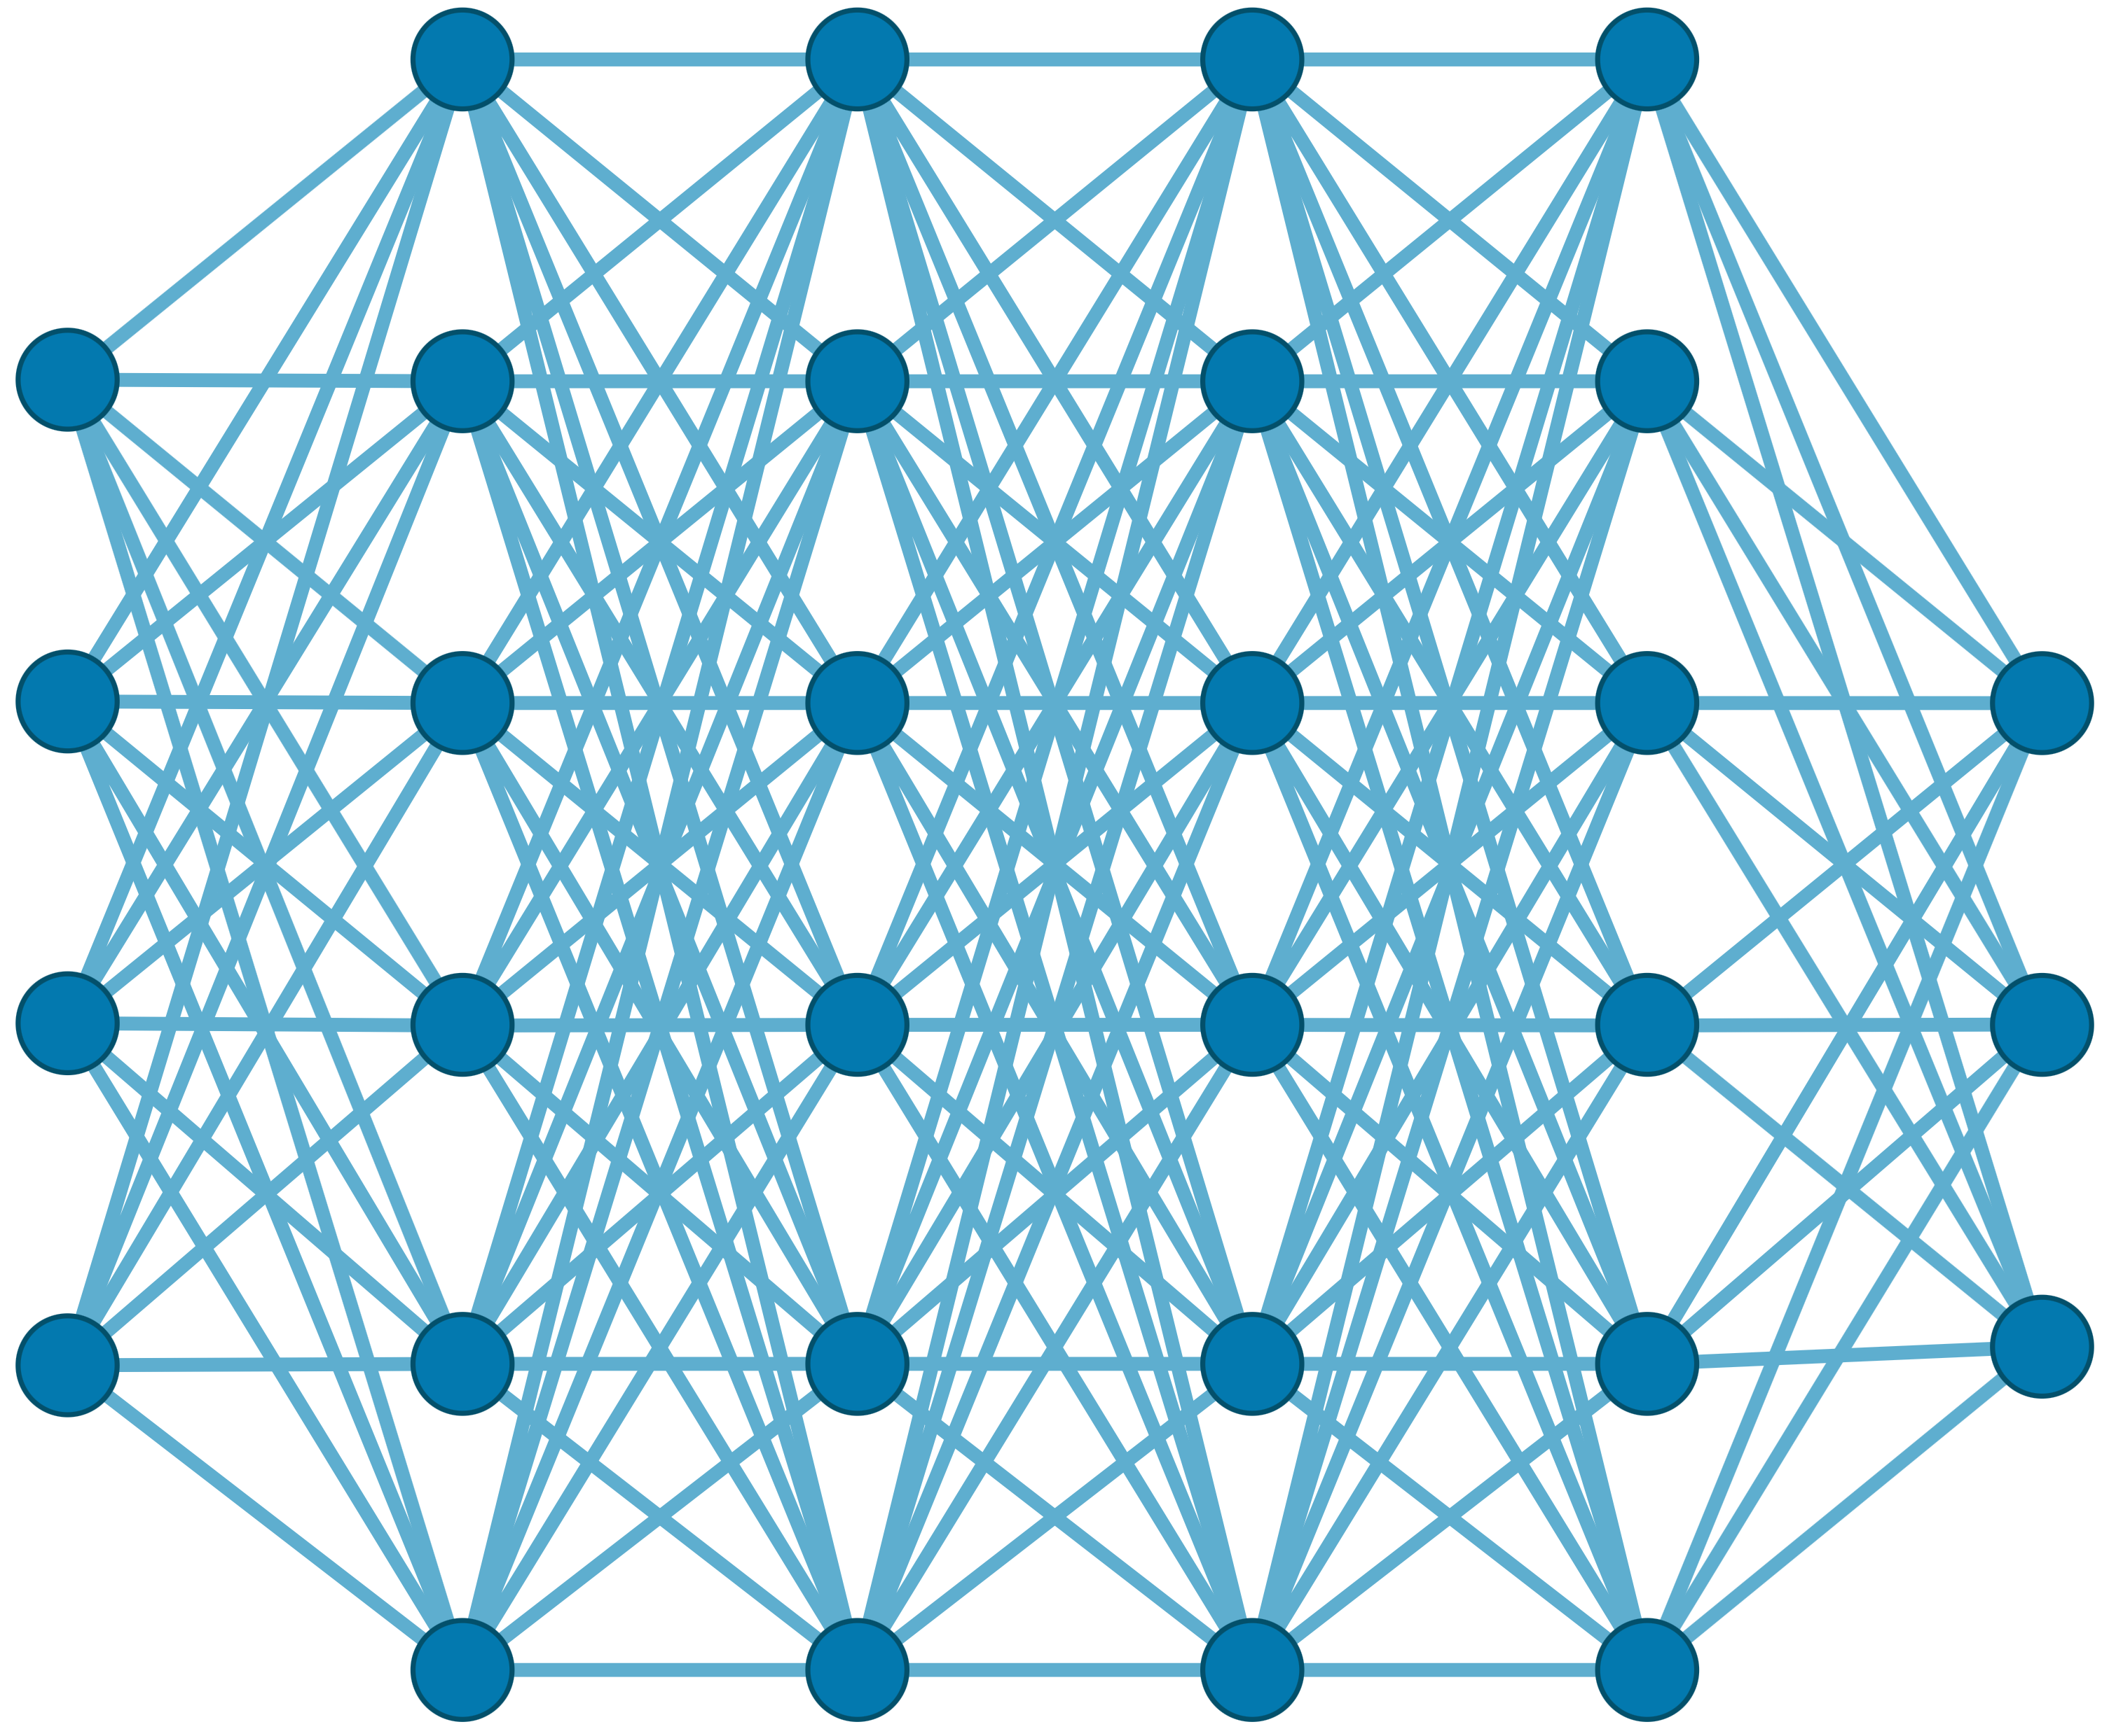

Generating the Entire Genomic Sequence
Whole Genome: 6.4B bps
(Non-human-readable)
Sequencing Device
Raw Genomic Data
(Human-readable?)
Translator (Basecalling)
AI
CGAAATGCC...AGATTAAACGCT...TGCCCTAA...GAATGGCGT
Whole Human Genome: 6.4B bps (Human-readable)

Slide 4




Genomic Data: Giant Jigsaw Puzzle to Solve
Human (Reference) Genome: 3.2 Billion bps (haploid)
CGAAATGCC...AGATTAAACGCT...TGCCCTAA...GAATGGCGT
?
Scale: ~$1/{10}^{8}$
AAATGG
CGAAATGCC...AGATTAAATGGT...TGCCCTAA...GAATGGCGT
Entire Genomic Sequence of an Organism
Read: ~100 – 100,000 bps
Small pieces (reads)
?
Unknown origins
Dealing with Massive and Noisy Datasets
(TBs to PBs)
Non-identical reference genome
Large volume of data to analyze

Slide 5

A Common Genome Analysis Pipeline
Raw
Reads
Basecalling (Translator)
Basecalled
(Translated)
Reads
Read
Mapping
AAATGTGGTCCATTG
Assembly
Variant Calling
Metagenomics
Downstream Analysis

Slide 6
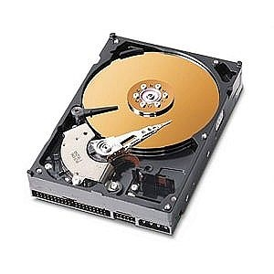
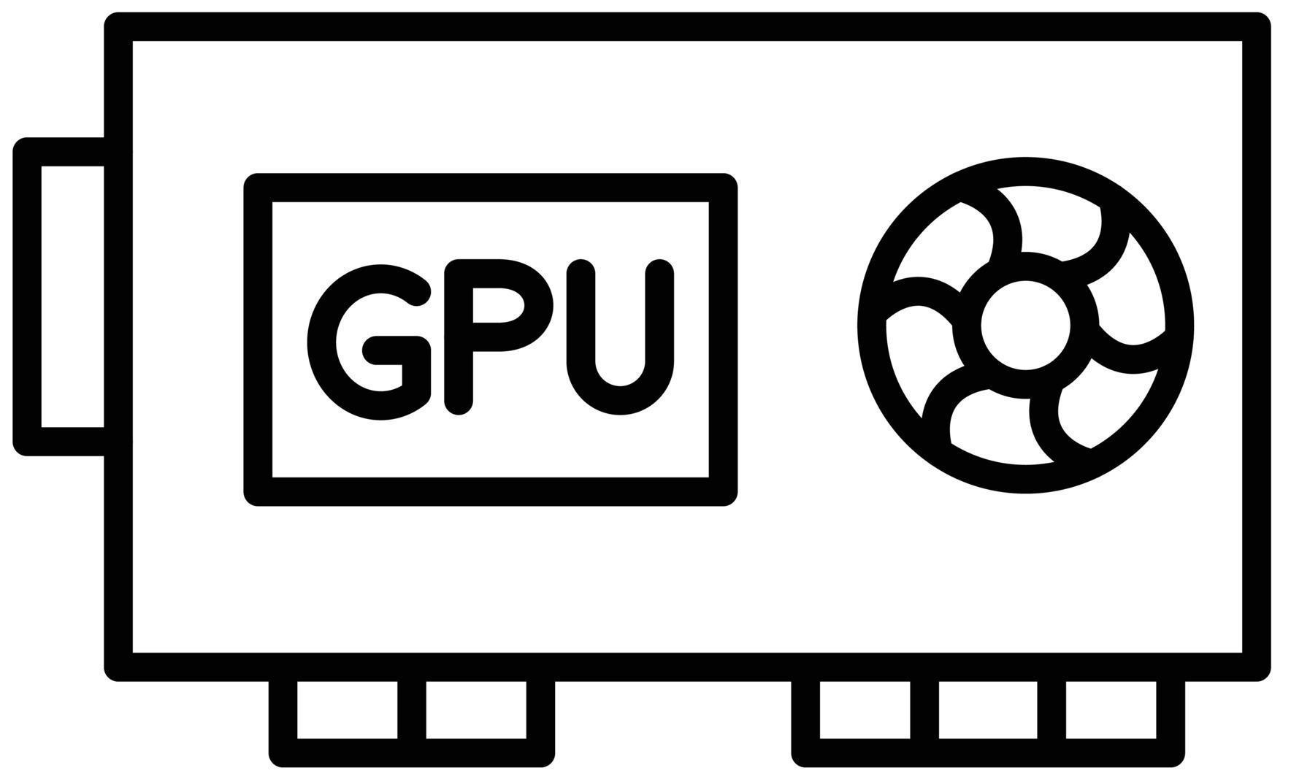
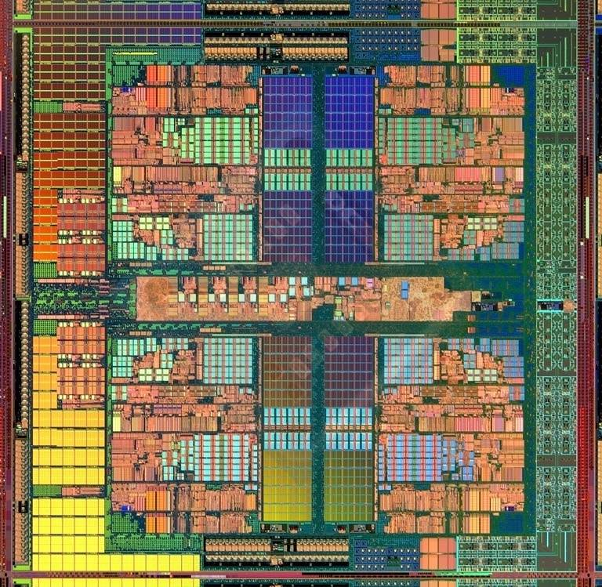
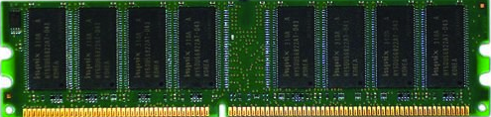
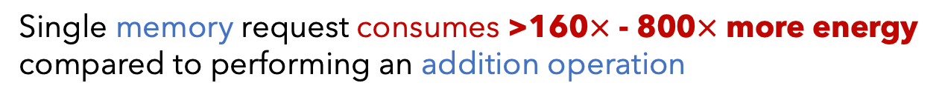
A Pipeline That Wastes Resources
Useless
Useless
Useless
Whole Dataset (~TBs)
Useful
Useful
Useful
Costly and large volumes of data movement
Wasted money, time, energy
Single memory request consumes >160$×$ - 800$×$ more energy compared to performing an addition operation
⁻ Boroumand et al., “Google Workloads for Consumer Devices: Mitigating Data Movement Bottlenecks,” ASPLOS 2018
⁻ Kestor et al., “Quantifying the Energy Cost of Data Movement in Scientific Applications,” IISWC 2013
⁻ Pandiyan and Wu, “Quantifying the energy cost of data movement for emerging smart phone workloads on mobile platforms,” IISWC 2014

Slide 7

A Pipeline That is Computationally Costly
Significant computational overhead

Slide 8
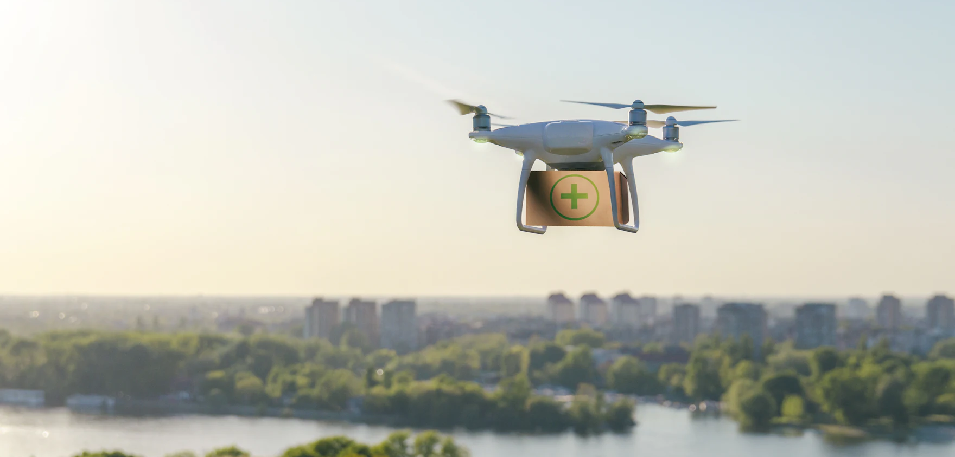

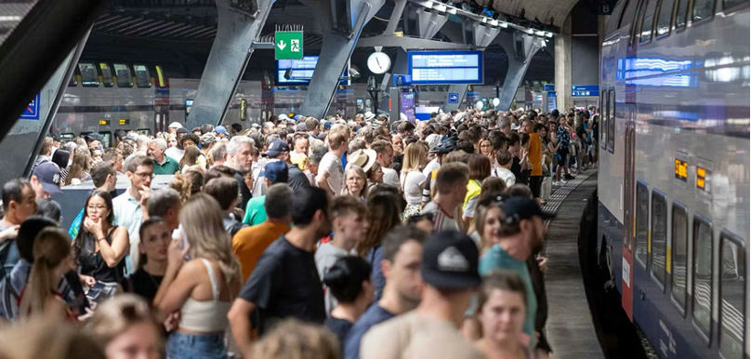
Limited Application Scope and Accuracy
Energy-efficient analysis for Resource-constrained devices
Urgent analysis within minutes
Large-scale analysis
without sacrificing accuracy
and performance

Slide 9


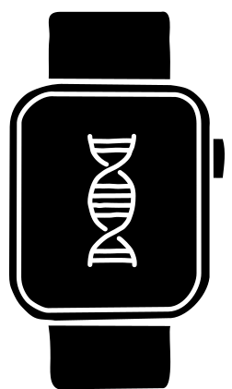


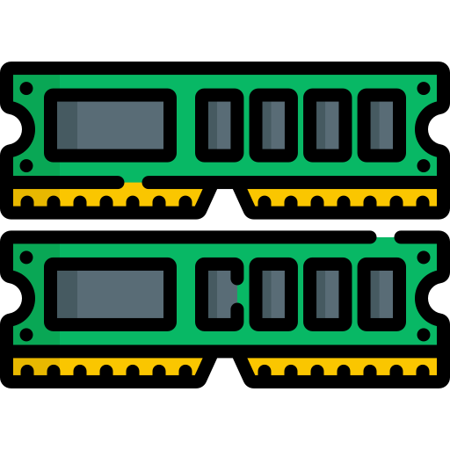
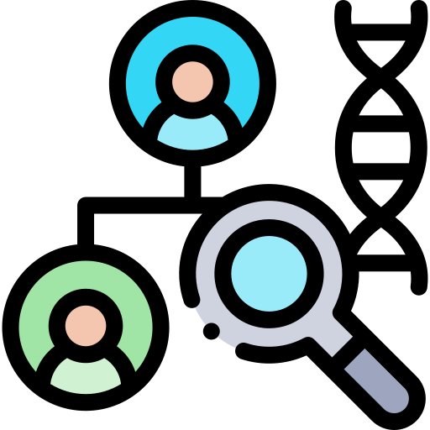



STORM Research Group
Research Directions
Real-Time and Portable Genomic Signal Analysis
Today’s
Talk
Goal
Enable fundamentally better integration of biological data analysis in our everyday lives
Data-centric and
AI-Driven Solutions to Analyze Genomic Data
Accurate and Fast
Algorithms Scalable to
Large Volumes of Genomic Data

Slide 10
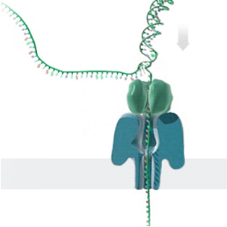
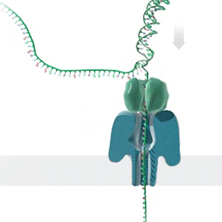

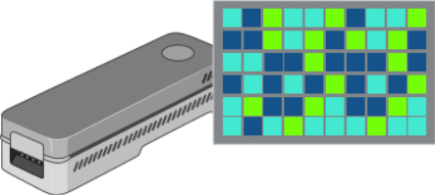

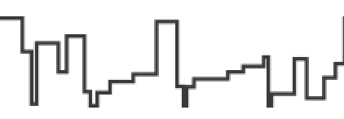
Generating Electrical Signals from DNA
Single Nanopore
Nanopore Sequencer
Raw Signals
(~5000 signals/sec)
Real-Time
Analysis
https://nanoporetech.com/platform/technology/basecalling
https://blogs.ed.ac.uk/institute-genetics-cancer/2020/04/08/nanopore-sequencing-controversial-world-records-and-whale-watching/

Slide 11
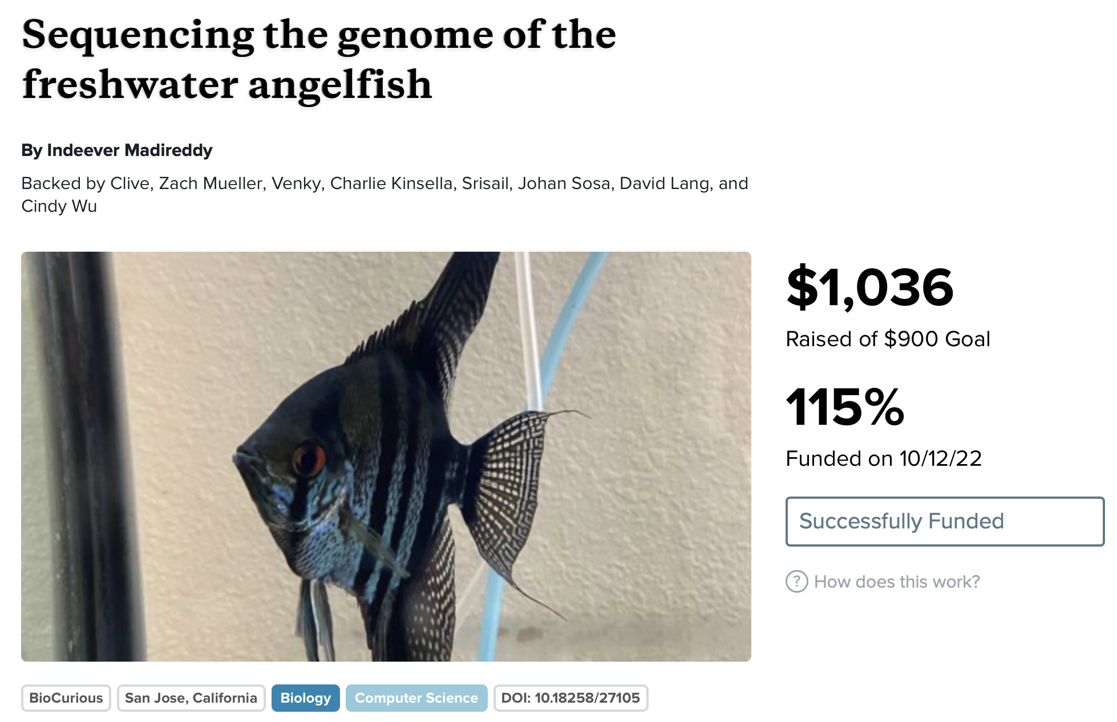
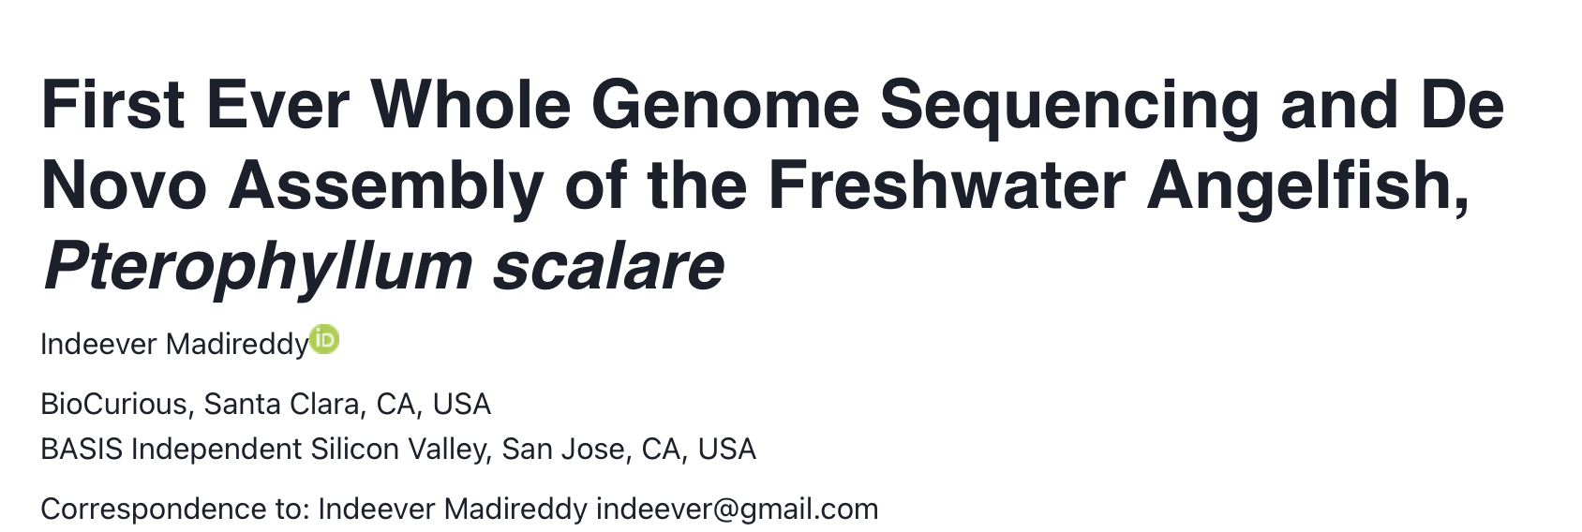
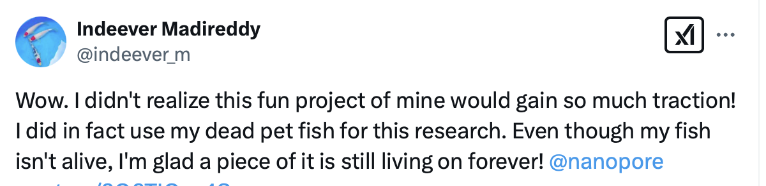
Democratizing Genome Analysis
https://experiment.com/projects/sequencing-the-genome-of-the-freshwater-angelfish

Slide 12
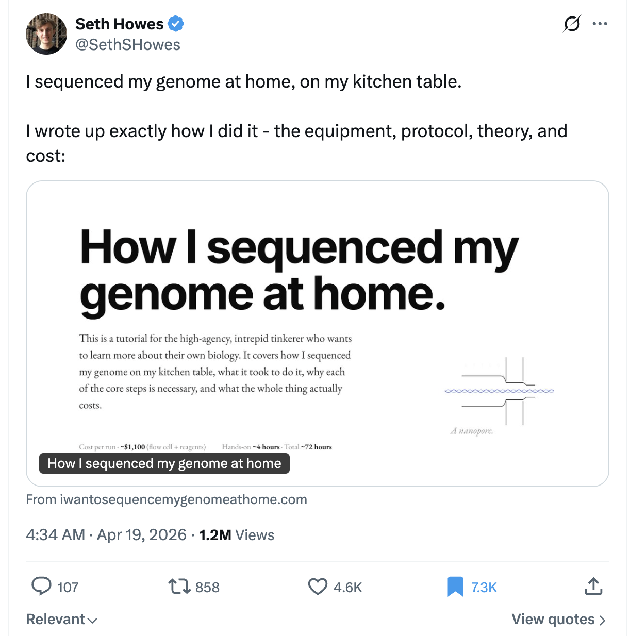
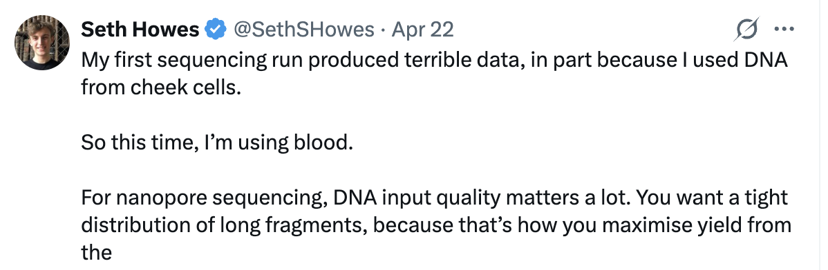
Democratizing Genome Analysis
https://x.com/SethSHowes/status/2045782975380406623

Slide 13
Future of genomic analysis demands portable, scalable, secure, and private solutions

Slide 14
A Common Genome Analysis Pipeline
Raw
Signals
Basecalling (Translator)
Basecalled
(Translated)
Reads
Analysis
AAATGTGGTCCATTG

Slide 15
Key Perspective: Analyze Signals (Before Translation)
Raw Signal
Mapping
Effective
Basecalling
Noisy
Raw
Signals
Signal Overlapping
Efficient
Analysis
Error Correction
Base
Modifications

Slide 16
Noise in Raw Electrical Signals
Observation: Identical molecules generate
similar raw signals
Sequencing CTGCGTAGCA
Raw
Signals:
[ , , , , ]
-0.06
-0.22
-0.75
0.96
-0.49
Key Idea: Perform similarity estimation
based on vector similarity search
Nearest Neighbor Search
Raw
Signals:
[ , , , , ]
-0.05
-0.21
-0.76
1.01
-0.51
Sequencing CTGCGTAGCA
Problem: Too Costly for Large Genomes

Slide 17
Raw Signal Mapping
Raw Signal
Mapping
Effective
Basecalling
Noisy
Raw
Signals
Signal Overlapping
Efficient
Analysis
Signal
Denoising
Base
Modifications

Slide 18
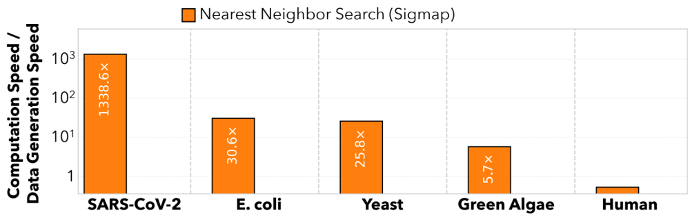




Scalability Issues Limit Real-Time Analysis
Genome Size Increase: 150$×$
2.4$×$
9.2$×$
28$×$
No Real-Time Analysis for Larger Genomes:
Searching mechanism does not scale well

Slide 19
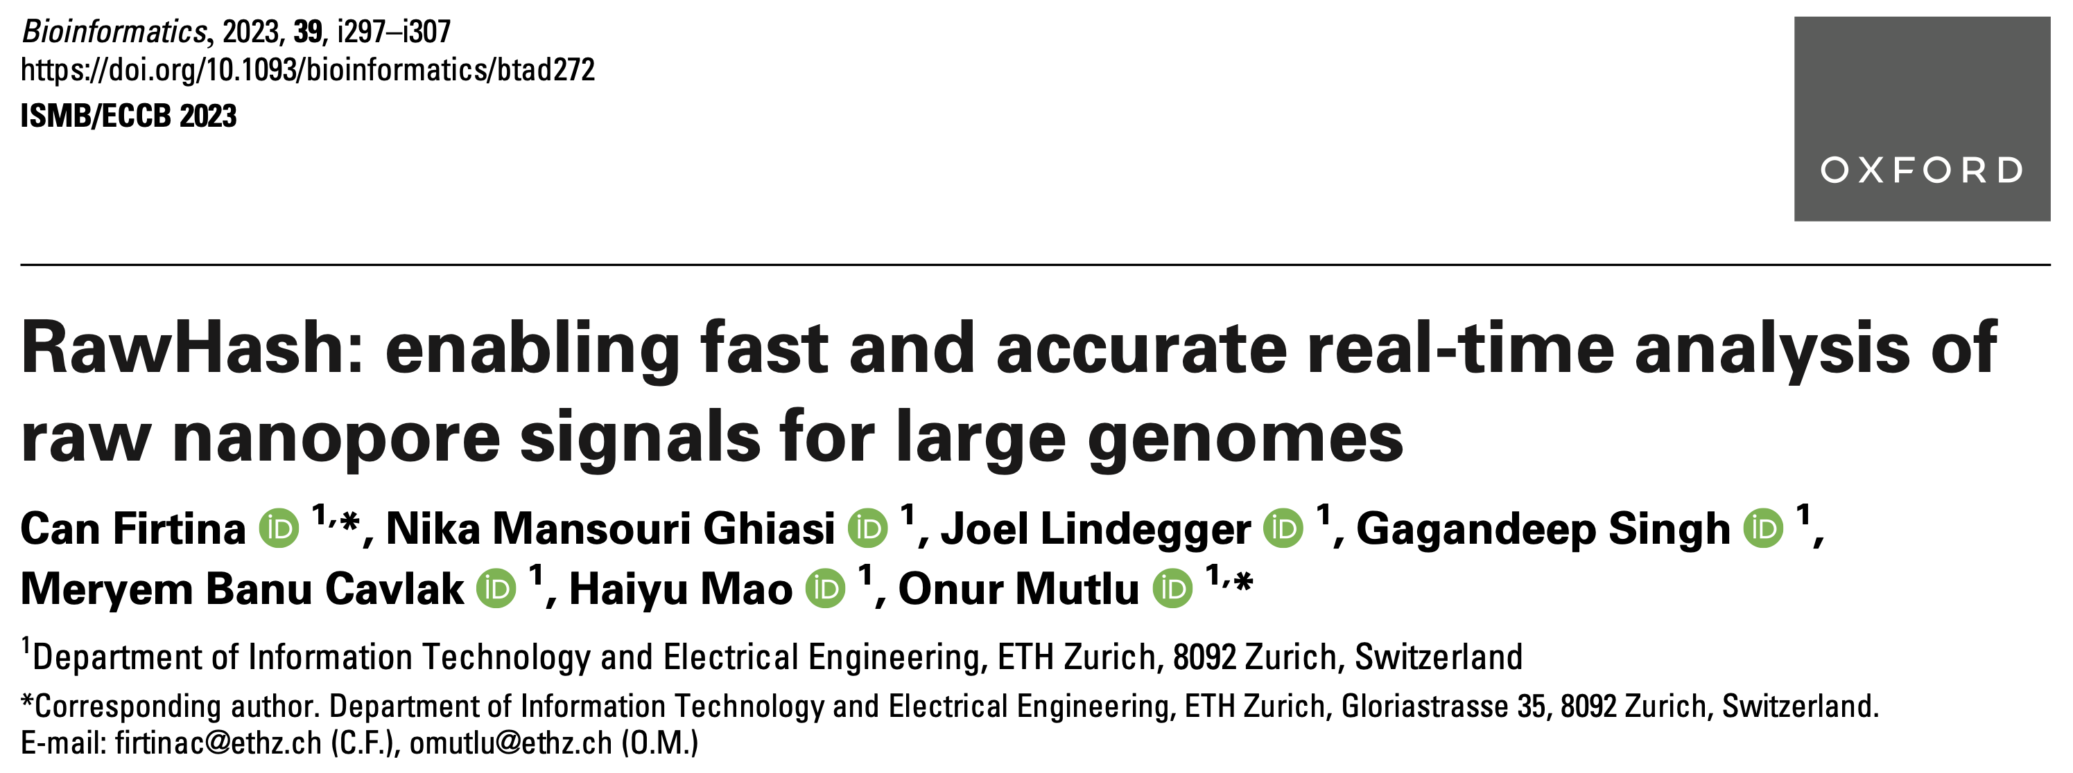
New Frontiers: Raw Signal Analysis [ISMB '23]
Can Firtina, Nika Mansouri Ghiasi, Joel Lindegger, Gagandeep Singh, Meryem Banu Cavlak,
Haiyu Mao, and Onur Mutlu,
"RawHash: enabling fast and accurate real-time analysis of
raw nanopore signals for large genomes"
Proceedings of the 31st Annual Conference on Intelligent Systems for Molecular Biology (ISMB 2023) and the 22nd European Conference on Computational Biology (ECCB 2023), Lyon, France, July 2023.
Paper [online] [pdf] [code]
Conference Talk [video] [pptx] [pdf]
Preprint (bioRxiv) [online] [pdf]
Social Media Thread [Twitter (X)]

Slide 20
RawHash’s Key Idea
Key Idea: Perform similarity estimation
based on quick exact matches
Raw
Signals:
[ , , , , ]
-0.06
-0.22
-0.75
0.96
-0.49
Hash
0x77db
Fast Match
CTGCGT
Hash
0x77db
Raw
Signals:
[ , , , , ]
-0.05
-0.21
-0.76
1.01
-0.51
Challenge: How to generate the same hash value
for similar enough signals with various noise types?

Slide 21
RawHash’s Key Idea – Quantization
CTGCGT
-0.05
-0.07
-0.06
-0.05
-0.06
Quantize
Quantize
Quantize
Quantize
Quantize
Bucket #
0
1
2
3
4
5
6
7
8
9
10
11
12
13
14
15
-3.00
Range of raw signals (normalized)
+3.00
✓
Enables matching raw signals by eliminating slight differences

Slide 22
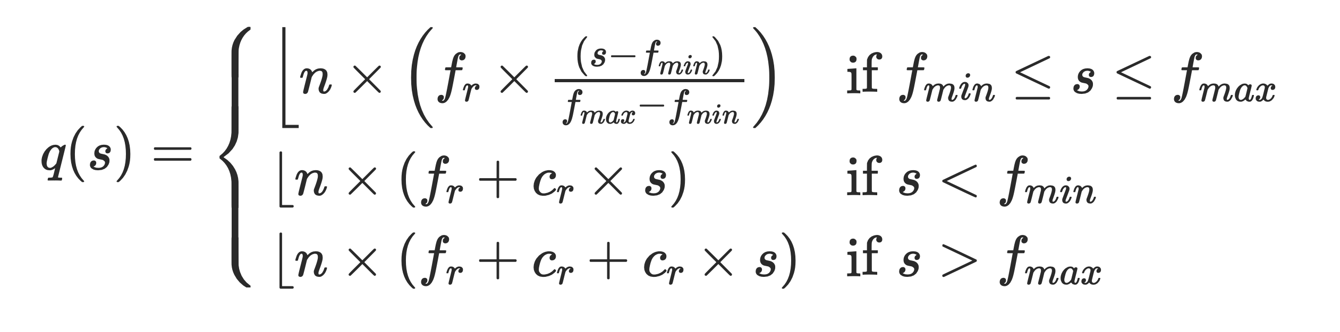
Adaptive Quantization
Key Idea: Quantizing raw signals with non-equal bucket widths
by leveraging raw signal distribution
Bucket #
0
1
2
3
4
5
6
7
8
9
10
11
12
13
14
15
-3.00
Range of raw signals (normalized)
+3.00
K-mer count
-3.00
3.00
✓
Better bucket utilization

Slide 23
RawHash Key Idea – Hash-based Matching
Sequencing CTGCGTAGCA
[ , , , , ]
-0.06
-0.22
-0.75
0.96
-0.49
Quantize
Quantize
Quantize
Quantize
Quantize
Hash
0x77db
0b0111
0b0111
0b0110
0b1011
0b0110
Pack
0b01110111011010110110
Hash
0x77db
Fast and Accurate Match
Key Contribution: The first hash-based search
(and indexing) mechanism for raw signals

Slide 24

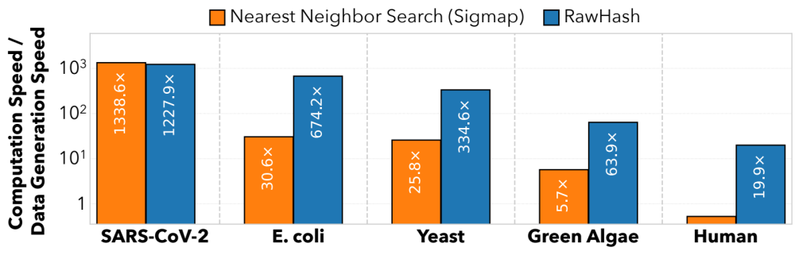
Real-Time Analysis Benefits from Fast Search
Genome Size Increase: 150$×$
2.4$×$
9.2$×$
28$×$
Real-time Analysis for Human Genomes:
Fast search instead of costly neighbor search

Slide 25
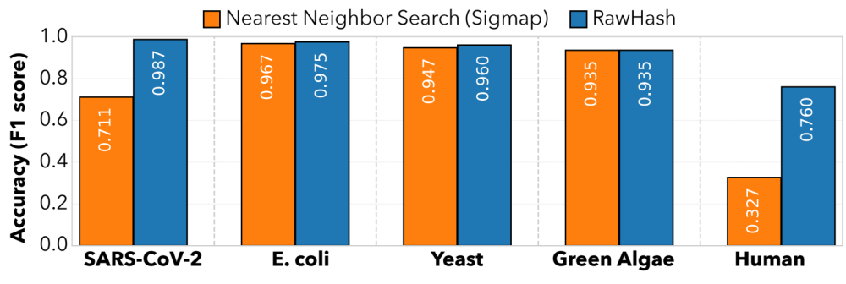
Fast Search Leads to Accurate Search
Best accuracy for all genomes:
Hash values span longer sequences than vectors ->
More unique and informative matches
(Almost) Identical accuracy to basecalled analysis:
Is the small difference because RawHash is even better?

Slide 26
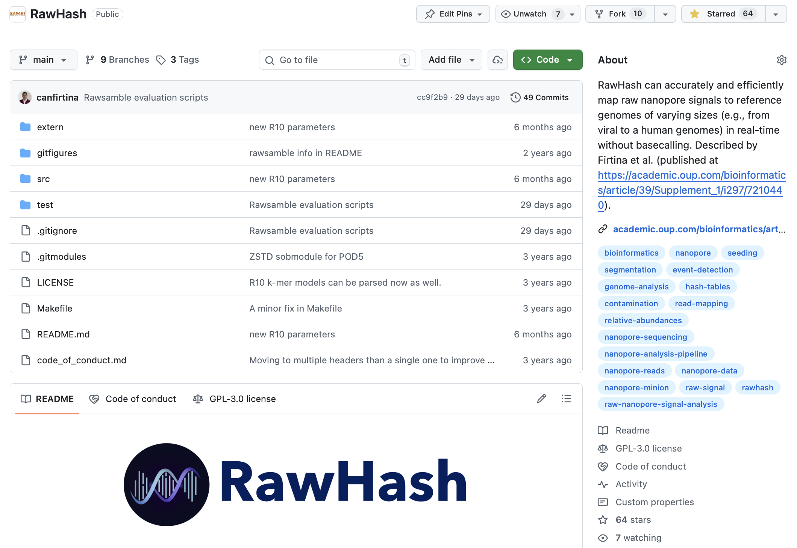
RawHash is Open Source
https://github.com/CMU-SAFARI/RawHash
https://github.com/STORMGroup/RawHash2

Slide 27
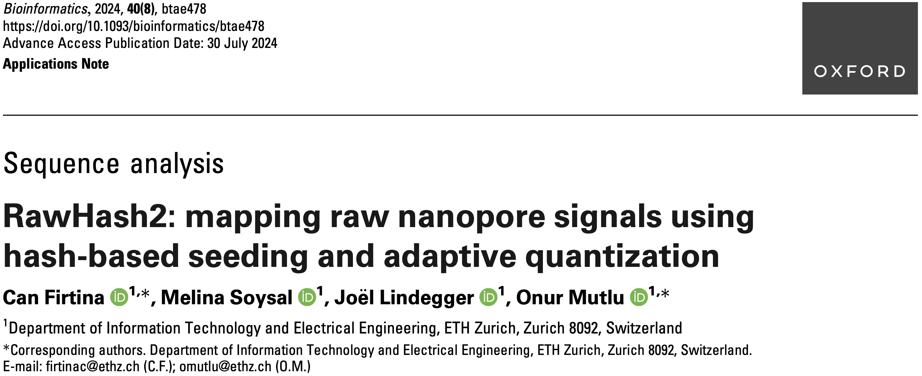
Real-Time Raw Signal Analysis [Bioinformatics '24]
Can Firtina, Melina Soysal, Joël Lindegger, and Onur Mutlu,
"RawHash2: Mapping Raw Nanopore Signals Using
Hash-Based Seeding and Adaptive Quantization"
Bioinformatics, July 2024.
Paper [online] [pdf] [code]

Slide 28
Raw Signal Mapping
Raw Signal
Mapping
Effective
Basecalling
Noisy
Raw
Signals
Signal Overlapping
Efficient
Analysis
Error Correction
Base
Modifications

Slide 29
Signal Overlapping
Raw Signal
Mapping
Effective
Basecalling
Noisy
Raw
Signals
Signal Overlapping
Efficient
Analysis
Error Correction
Base
Modifications

Slide 30
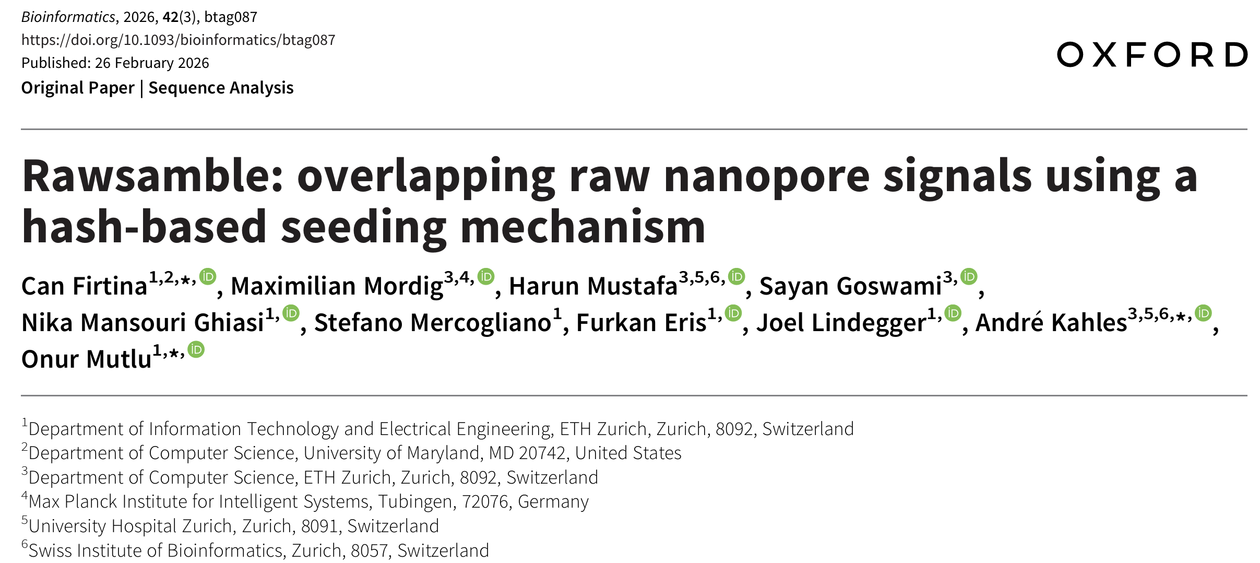
New Directions: Overlapping Raw Signals
Rawsamble: Overlapping Raw Nanopore Signals using a Hash-based Seeding Mechanism
Can Firtina, Maximilian Mordig, Harun Mustafa, Sayan Goswami, Nika Mansouri Ghiasi, Stefano Mercogliano, Furkan Eris, Joel Lindegger, Andre Kahles, and Onur Mutlu
Bioinformatics, February 2026
[online link] [pdf] [code]
ISMB 2024 Talk [video] [pptx] [pdf]
CSHL 2024 (Biological Data Science) Talk [video] [pptx] [pdf]
Social Media Thread [Twitter (X)] [LinkedIn]

Slide 31
Beyond Reference Mapping: Overlapping
Reference Genome (Converted to Signals)
Raw Nanopore Signals
Raw Nanopore Signals
TGCTGCAA
CGAAGTCA
CGTAGTGG
CCACCGGT
Reference Signals
CTGCAATC
TGATCCGA
TCAGCCGT
AGTGGACC
GGTAAGCT
TGCTGCAATCGTGATCCGAAGTCAGCCGTAGTGGACCACCGGTAAGCT
Hash-Based
Seeding and Mapping
Challenge: Reference genome is not always available
Assembly: Constructing genome from overlapping reads
✕
Existing solutions cannot find overlapping reads without basecalling

Slide 32
Rawsamble Overview
Raw Nanopore Signals
Raw Nanopore Signals
Aggressive
Filtering
Aggressive
Filtering
Indexing
Adaptive
Quantization
Hash Table
(Signal Index)
Adaptive
Quantization
Overlapping
Hash
Hash
Store
Query
Sketching
Sketching
Matching Regions
RawHash
Chaining & Mapping
Output: All-vs-all Overlapping Pairs
Filtering
RawHash2
Assembly
Rawsamble

Slide 33
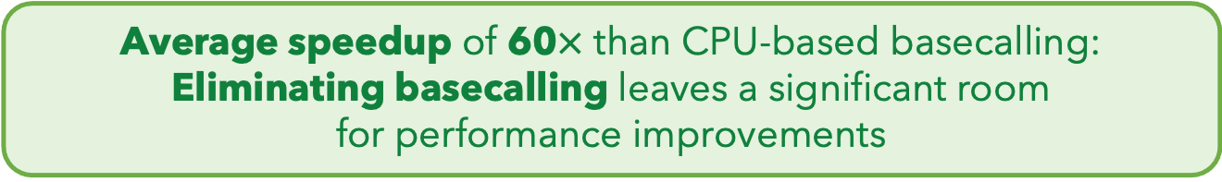





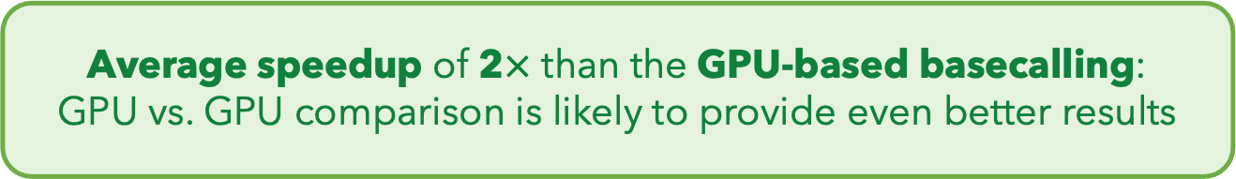
Eliminating Basecalling from the Pipeline
Rawsamble
Basecalling (CPU)
+ Overlapping
Basecalling (GPU)
+ Overlapping
$${10}^{2}$$
Elapsed Time
(Normalized to Rawsamble)
59.70$×$
$${10}^{1}$$
$${10}^{0}$$
1.99$×$
SARS-CoV-2
E. coli
Yeast
Green Algae
Human
Geo. Mean
Average speedup of 60$×$ than CPU-based basecalling: Eliminating basecalling leaves a significant room
for performance improvements
Average speedup of 2$×$ than the GPU-based basecalling:
GPU vs. GPU comparison is likely to provide even better results

Slide 34
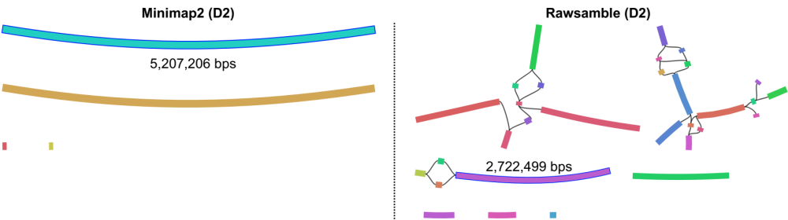
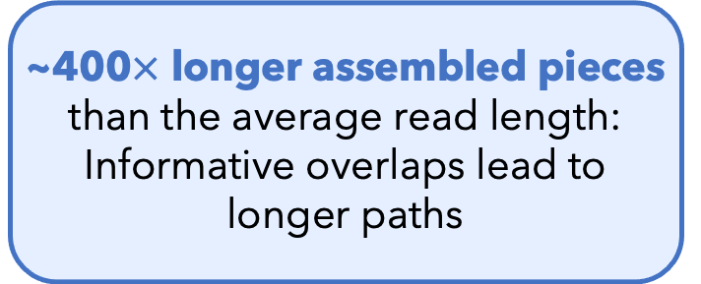
Key Results – Miniasm Assemblies from Overlaps
E. coli Assembly
(From the Rawsamble Overlaps)
~400$×$ longer assembled pieces than the average read length:
Informative overlaps lead to longer paths
It is time to rethink if we want to translate individual reads separately

Slide 35
Signal Overlapping
Raw Signal
Mapping
Effective
Basecalling
Noisy
Raw
Signals
Signal Overlapping
Efficient
Analysis
Error Correction
Base
Modifications

Slide 36
Signal Denoising / Error Correction
Raw Signal
Mapping
Effective
Basecalling
Noisy
Raw
Signals
Signal Overlapping
Efficient
Analysis
Error Correction
Base
Modifications

Slide 37
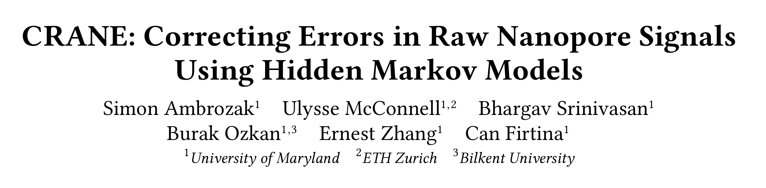
Correcting Raw Signals [arXiv '26 & ISMB'26]
CRANE: Correcting Errors in Raw Nanopore Signals Using Hidden Markov Models
Simon Ambrozak, Ulysse McConnell, Bhargav Srinivasan, Burak Ozkan, Ernest Zhang,
and Can Firtina
arXiv, March 2026
[online link] [pdf] [code]
Talk at ISMB 2026 (HiTSeq Track) on Tuesday, July 14!

Slide 38
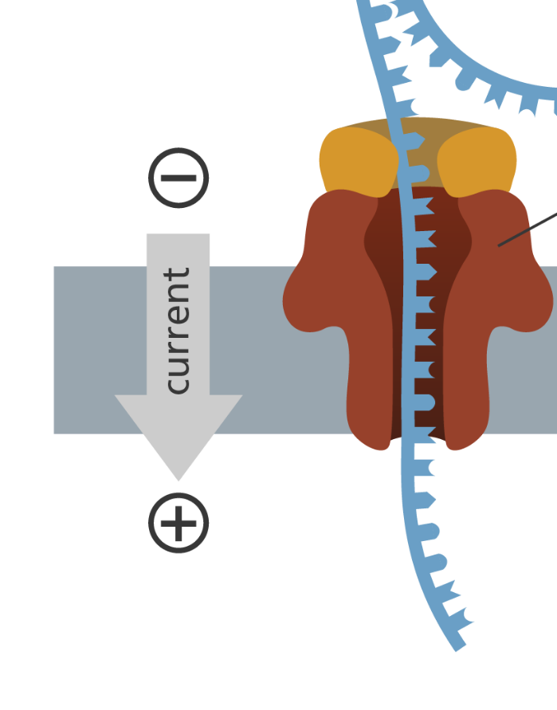
Segmenting Raw Signals Combats Noise
Multiple measurements are taken for each k-mer
Segmentation: Identify regions of signals corresponding to a particular k-mer
Event
-0.3
1.79
-0.03
0.48
k many nucleotides
Event Values

Slide 39
Segmenting Raw Signals Combats Noise
Multiple measurements are taken for each k-mer
Segmentation: Identify regions of signals corresponding to a particular k-mer
Errors: Noise can distort events, causing segmentation errors
Event
-0.3
1.79
-0.17
0.1
0.48
k many nucleotides
Event Values

Slide 40
Segmenting Raw Signals Combats Noise
Multiple measurements are taken for each k-mer
Segmentation: Identify regions of signals corresponding to a particular k-mer
Errors: Noise can distort events, causing segmentation errors
Event
-0.3
1.79
0.07
k many nucleotides
Event Values

Slide 41
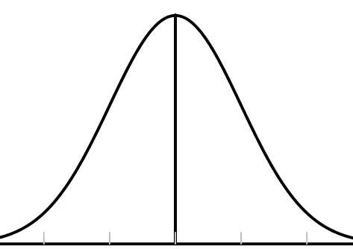

Key Observation: HMMs Can Model Nanopores
$$𝒩(μ, σ)$$
Observations:
Measured current
Hidden State:
k-mer inside pore
0.43
-1.56
-0.48
1.01
0.78
-0.23
-0.78
1.56
0.50

Slide 42
Key Idea: Train An HMM To Model A Nanopore
Synthetic DNA Sequence
…ACGATTATCGACTA…
DNA-to-Event Conversion
Nanopore Event Modeling HMM
(NEMO-HMM)
0.43
-1.56
-0.48
…
…
Initial Gaussian HMM
1
1
5
2
Baum-Welch Training
5
2
4
3
4
3

Slide 43
CRANE Error Correction
Raw Signals
1
5
2
4
3
Segmentation
Viterbi Algorithm
0.43
-1.56
-0.48
…
…
Event Merging & Noise Reduction
4
2
5
…
…
0.45
-1.52
-0.45
…
…

Slide 44
We Evaluate Our Approach Using RawHash2
RawHash2 is the state-of-the-art raw signal read-mapping tool
Raw Signal
Segmentation
Segmentation
Basecalling
CRANE
RawHash2
RawHash2
minimap2
Baseline
Read Mappings
Corrected
Read Mappings
Ground Truth Read Mappings

Slide 45
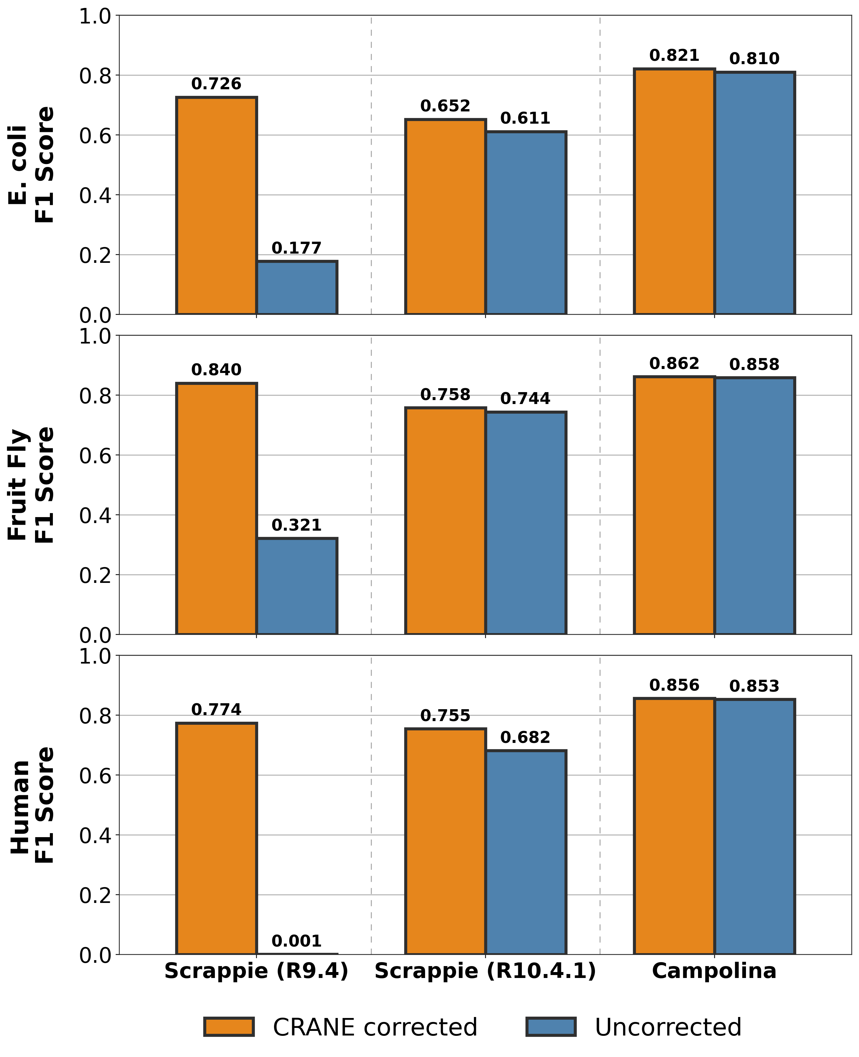
Accuracy Results - RawHash2 Read-mapping w/o HPC
CRANE improves state of the art
read mapping F1 score by
up to 11%

Slide 46
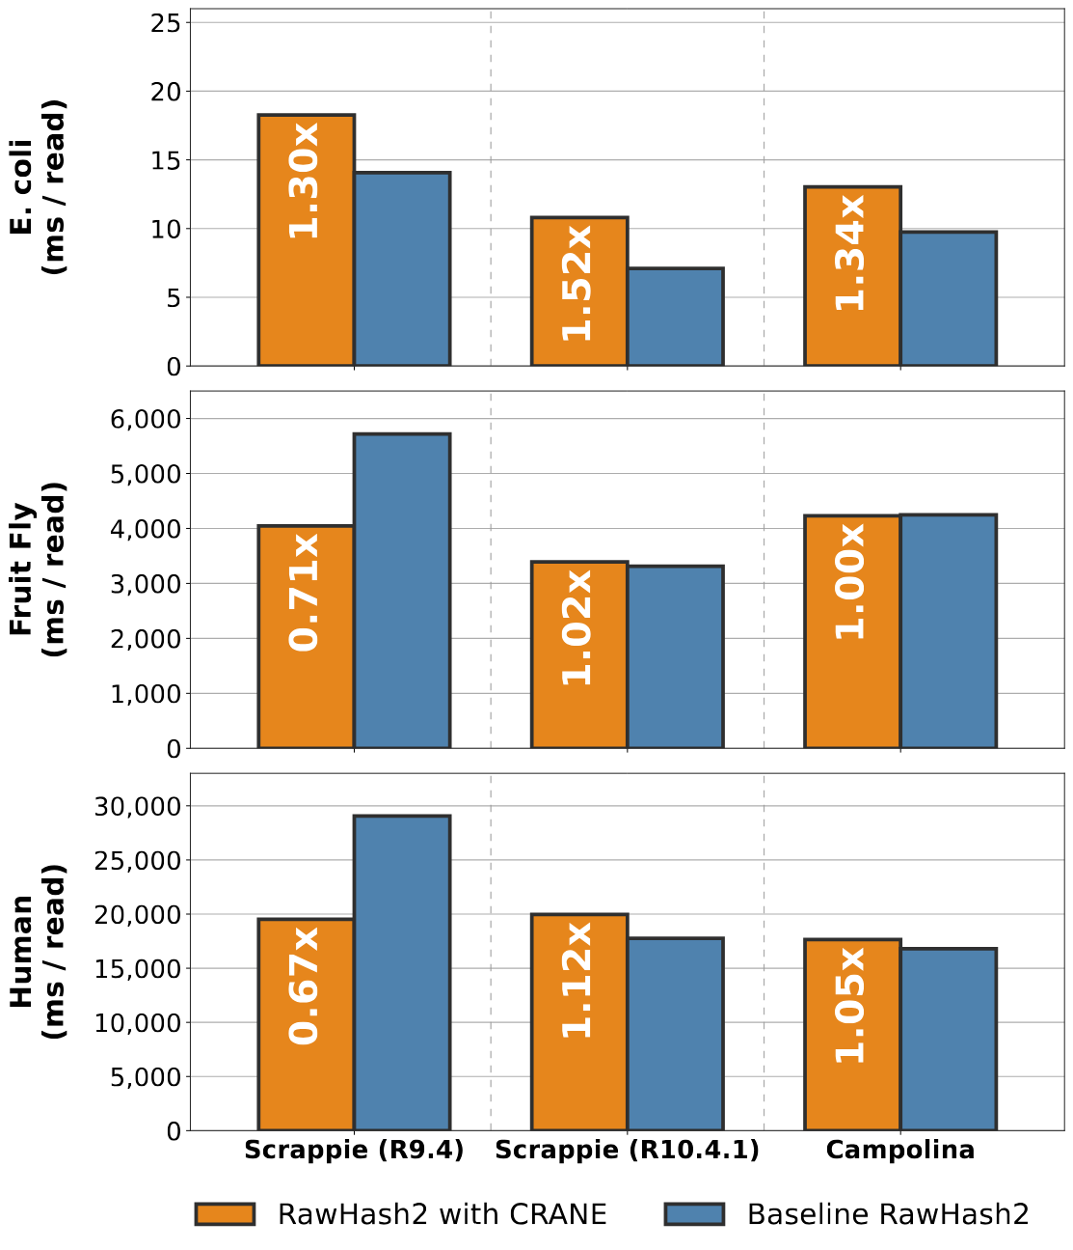
Runtime Results - CRANE + RawHash2 w/o HPC
CRANE accounts for <1% of total runtime for human genome

Slide 47
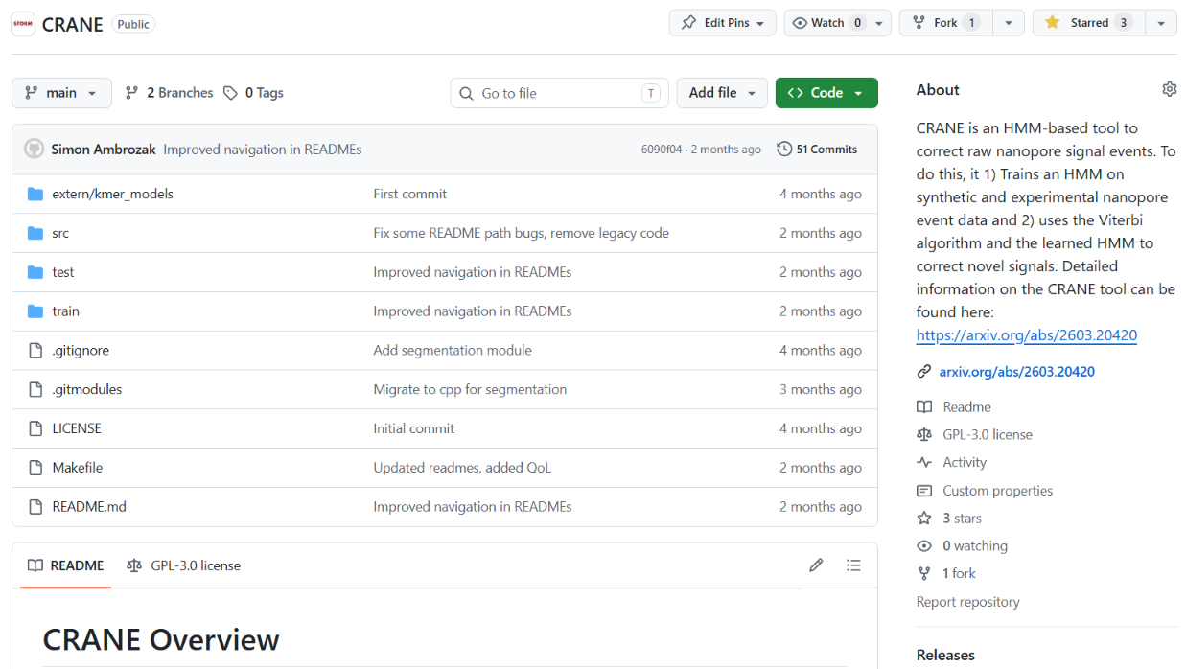

Source Code
Easily reproduce results
Train your own HMMs
Parameter search scripts
Code

Slide 48
Correcting Raw Signals [arXiv '26 & ISMB'26]
CRANE: Correcting Errors in Raw Nanopore Signals Using Hidden Markov Models
Simon Ambrozak, Ulysse McConnell, Bhargav Srinivasan, Burak Ozkan, Ernest Zhang,
and Can Firtina
arXiv, March 2026
[online link] [pdf] [code]
Talk at ISMB 2026 (HiTSeq Track) on Tuesday, July 14!

Slide 49
Signal Denoising / Error Correction
Raw Signal
Mapping
Effective
Basecalling
Noisy
Raw
Signals
Signal Overlapping
Efficient
Analysis
Error Correction
Base
Modifications

Slide 50
Identify Base Modifications
Raw Signal
Mapping
Effective
Basecalling
Noisy
Raw
Signals
Signal Overlapping
Efficient
Analysis
Error Correction
Base
Modifications

Slide 51
Motivation: Understanding Beyond DNA Letters
Human (Reference) Genome: 3.2 Billion bps (haploid)
CGAAATGCC...AGATTAAACGCT...TGCCCTAA...GAATGGCGT
5mC
5mC
5mC
6mA
6mA
6mA
m6A
6mA
5hmC
5mC
6mA
m6A
DNA Modification Profiles

Slide 52
Our Approach: RawMod
Pileup signals to identify if a position is modified/unmodified (binary)

Slide 53
Poster Presentation at ISMB on Monday (#A-153)

Slide 54
Key Perspective: Analyze Signals (Before Translation)
Raw Signal
Mapping
Effective
Basecalling
Noisy
Raw
Signals
Signal Overlapping
Efficient
Analysis
Error Correction
Base
Modifications

Slide 55
STORM Research Group
Research Directions
Real-Time and Portable Genomic Signal Analysis
Today’s
Talk
Goal
Enable fundamentally better integration of biological data analysis in our everyday lives
Data-centric and
AI-Driven Solutions to Analyze Genomic Data
Accurate and Fast
Algorithms Scalable to
Large Volumes of Genomic Data

Slide 56
Lost in Translation: Harnessing the Power of Nanopore Electrical Signals in Genomics
Computational Genomics Summer Institute (CGSI 2026)
Rancho Palos Verdes, CA, USA. July 9 2026
Can Firtina | canfirtina@gmail.com | cs.umd.edu/~firtina
Assistant Professor of Computer Science at UMD

Slide 57
Backup Slides

Slide 58
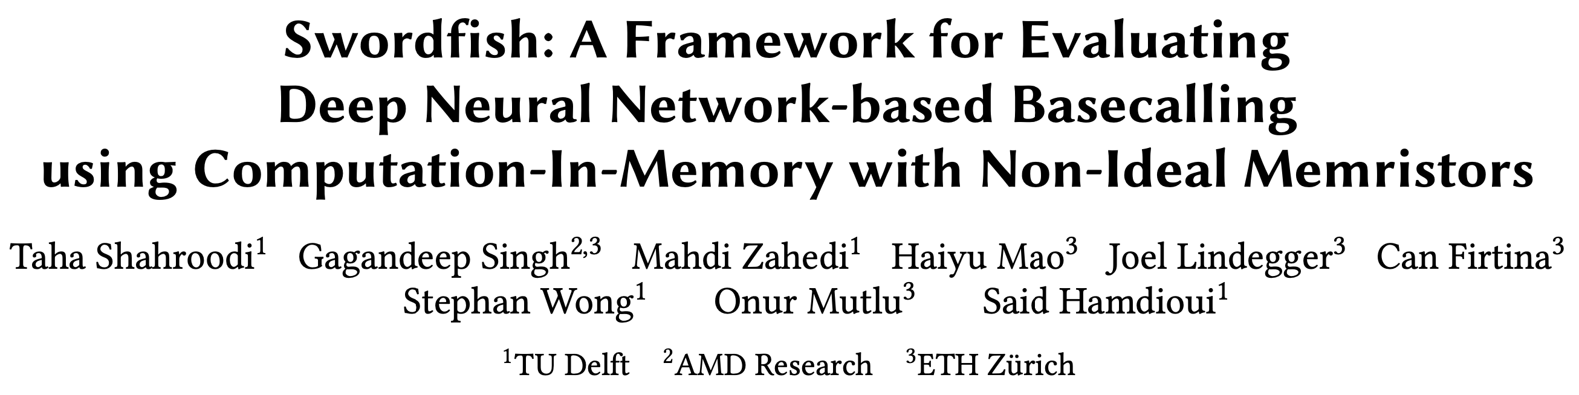
Basecalling using PIM [MICRO '23]
Taha Shahroodi, Gagandeep Singh, Mahdi Zahedi, Haiyu Mao, Joel Lindegger, Can Firtina,
Stephan Wong, Onur Mutlu, and Said Hamdioui,
"Swordfish: A Framework for Evaluating Deep Neural Network-based Basecalling
using Computation-In-Memory with Non-Ideal Memristors"
Proceedings of the 56th International Symposium on Microarchitecture (MICRO), Toronto, ON, Canada, November 2023.
[Slides (pptx) (pdf)]
[arXiv version]

Slide 59
DNN Hardware Acceleration
DNN execution is dominated by:
Vector-Matrix Multiplication (VMM)
Data movement between memory and accelerator
(e.g., GPU or TPU)
Memristor-based PIM for DNN Acceleration
Memristor-based crossbars support VMM
Processing in Memory (PIM) minimizes data movement
  [Ankit+, ASPLOS 2019], [Chi+, ISCA 2016], [Lou+, PACT2020], [Shafiee+, ISCA 2016]

Slide 60
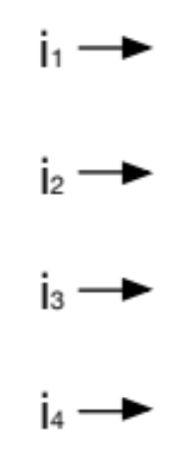
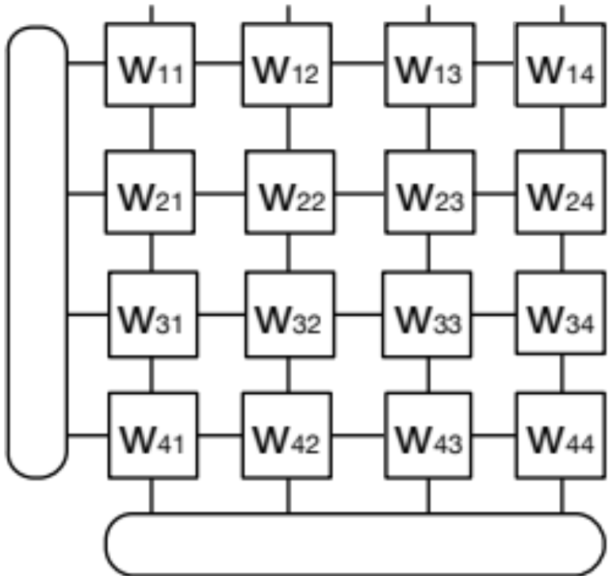
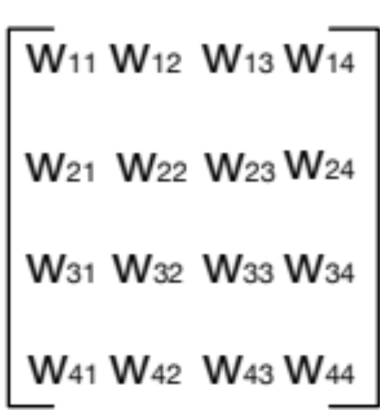
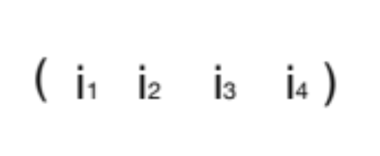
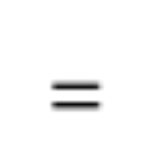
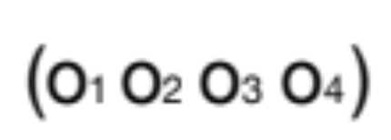


VMM in Memristor-based Crossbars
Digital to Analog Converters
Analog to Digital Converters

Slide 61
Non-idealities in Memristor-based Crossbars
Variation in
Synaptic Conductance
Non-ideal DAC
Digital to Analog Converters
Wire Resistance
Analog to Digital Converters
Non-ideal ADC
Subpar utilization of trained models
due to non-idealities

Slide 62

Accuracy: All Non-idealities without Mitigation
D1
Baseline
D2
Baseline
Accuracy (%)
Non-idealities
Combined non-idealities leads to significant accuracy loss (>18%)

Slide 63

Accuracy: Enhancement Techniques on All Non-idealities
D1
Baseline
D3
Baseline
Accuracy (%)
Enhancement Technique
Accuracy loss drops to 6% from 18% after handling all non-idealities

Slide 64

ML-based Genome Analysis via PIM [MICRO '22]
Haiyu Mao, Mohammed Alser, Mohammad Sadrosadati, Can Firtina, Akanksha Baranwal,
Damla Senol Cali, Aditya Manglik, Nour Almadhoun Alserr, and Onur Mutlu,
"GenPIP: In-Memory Acceleration of Genome Analysis via Tight Integration
of Basecalling and Read Mapping"
Proceedings of the 55th International Symposium on Microarchitecture (MICRO), Chicago, IL, USA, October 2022.
[Slides (pptx) (pdf)]
[Longer Lecture Slides (pptx) (pdf)]
[Lecture Video (25 minutes)]
[arXiv version]

Slide 65
Problem 1: Large Data Movement
Raw Signals
Basecalling
Reads
Read quality
control
High-quality
reads
Read
mapping
Mapped
reads
3913 GB
546 GB
437 GB
382 GB
Large data movement between genome analysis steps
[NC'19] Rory Bowden, Robert W Davies, Andreas Heger, Alistair T Pagnamenta, Mariateresa de Cesare, Laura E Oikkonen, Duncan Parkes, Colin Freeman, Fatima Dhalla, Smita Y Patel, et al. Sequencing of human genomes with nanopore technology. Nature Communications, 2019.

Slide 66
Problem 2: Wasted Computation
100%
79.5%
69.5%
Raw Signals
Basecalling
Reads
Read quality
control
High-quality
reads
Read
mapping
Mapped
reads
Low-quality
reads
Unmapped
reads
20.5%
10%
A considerable amount of computation on useless data due to
Low-quality reads
Unmapped reads

Slide 67
Goal and Opportunities
Goal: Efficiently accelerate the entire genome analysis pipeline while minimizing data movement and useless computation
We perform a study to quantify potential performance benefits
NVM-based PIM accelerators for separate basecalling and read mapping
no data movement
between the accelerators of analysis steps
no data movement
and
no useless reads
(ideal case)

Slide 68
GenPIP Overview
Raw signals from the sequencing machine
GenPIP
In-memory
Read Mapping
[PARC, ASPDAC’20]
+ Our design
In-memory
Basecaller
[Helix, PACT’20]
Signal
chunk
eDRAM
Basecalled
chunk
Chunk
Average Calculator
Read Mapping Controller
Base quality score
Chunk quality score
Quality score
PIM-CQS
PIM chunk quality score calculation
ER
Controller
Chunk mapping score
Read mapping result
To storage
Basecalling Module
ER
GenPIP Controller
ER
Read Mapping Module
https://arxiv.org/pdf/2209.08600.pdf

Slide 69





Acceleration Efforts for AI and Genomics
Cerebras WSE-3
The largest ML accelerator chip
Google’s TPUs:
NVIDIA H100

Slide 70

Quickly Aligning Raw Signals [IEEE Access '24]
Joël Lindegger, Can Firtina, Nika Mansouri Ghiasi, Mohammad Sadrosadati, Mohammed Alser, and Onur Mutlu,
"RawAlign: Accurate, Fast, and Scalable Raw Nanopore Signal Mapping via Combining Seeding and Alignment"
IEEE Access, December 2024.
Paper [online] [pdf] [code]

Slide 71

RawAlign Overview
Coarse-Grained
Fast
Fine-Grained
Accurate

Slide 72

Benchmarking Raw Signal Analysis [ACM-BCB '25]
Furkan Eris, Ulysse McConnell, Can Firtina, and Onur Mutlu,
"RawBench: A Comprehensive Benchmarking Framework
for Raw Nanopore Signal Analysis Techniques"
Proceedings of the 16th ACM Conference on Bioinformatics, Computational Biology, and Health Informatics (ACM-BCB 2025), Philadelphia, PA, USA, October 2025.
Paper [online] [pdf]
Conference Talk [pptx] [pdf]

Slide 73


RawBench Benchmarking Framework
ACGT
Encoding reference genome
Matching encoded representations
2
Encoding raw signal
Input
Raw Signals
1
3
ONT
pore model
Hash-based
FM-index
t-test
Uncalled4
pore model
Vector
distance
R-index
Move tables
Input Reference
Add-on
DTW
Add-on
Add-on
1
Encoding Reference Genome
  Uses learned pore models by ONT and community
2
Encoding Raw Signal
  Utilizes statistical and ML-based encoding techniques
3
Matching Encoded Representations
  Compares representations that are now encoded into the same space

Slide 74

In-Storage Raw Signal Analysis [ICS '25]
Melina Soysal, Konstantina Koliogeorgi, Can Firtina, Nika Mansouri Ghiasi, Rakesh Nadig,
Haiyu Mao, Geraldo Francisco Oliveira Junior, Yu Liang, Klea Zambaku, Mohammad Sadrosadati, and Onur Mutlu,
"MARS: Processing-In-Memory Acceleration of
Raw Signal Genome Analysis Inside the Storage Subsystem"
Proceedings of the 39th International Conference on Supercomputing (ICS 2025), Salt Lake City, Utah, USA, June 2025.
Paper [online] [pdf]
Conference Talk [video] [pptx] [pdf]

Slide 75

Read Mapping with Raw Signals
High Level Overview of Read Mapping in
Raw Signal Genome Analysis (RSGA)
Mapping (online)
Query Sequence
Sketching
I
EVENT DETECTION
Hash Table
events
Hash
Positions
II
SEEDING
0x00
2,64,…
query
hash and query
0x01
1,101,…
0x00
Hash
…
0xFF
13,21
matches
Chaining
III
CHAINING
x
x
sorting and DP-based
x
chains

Slide 76
Motivation
Chaining & seeding consistently dominate runtime
Event detection & I/O overhead are non-negligible for some datasets

Slide 77
Impact of I/O data movement
We model I/O data movement overhead when accelerating commonly targeted steps in the pipeline: seeding and chaining
As compute latency is reduced, I/O becomes the dominant contributor to total execution time
I/O data movement from SSD becomes dominant overhead as compute steps are accelerated in RSGA

Slide 78
MARS Architecture & System - Overview
In-Storage-Processing system for RSGA
Conventional Mode: SSD performs standard SSD storage operations
Accelerator Mode: SSD executes the full RSGA pipeline without host intervention
SSD Controller
Flash Controller
I
MARS
Control
Unit
FTL
II
III
Sorter
Unit
Merger
Unit
.
Flash Memory
Cores
.
.
SSD-Internal DRAM
Bank
V
Querying Unit
V
Querying Unit
…
…
…
…
…
…
…
Subarrays
Bank
IV
Arithmetic Unit
Arithmetic Unit

Slide 79
MARS Architecture & System (I/IV)
SSD Controller Components
SSD Controller
Flash Controller
I
FTL
II
III
MARS
Control
Unit
Sorter
Unit
Merger
Unit
.
Flash Memory
Cores
.
.
I
MARS Control Unit
Finite State Machine that orchestrates pipeline execution, control and data flow

Slide 80
MARS Architecture & System (II/IV)
SSD Controller Components
SSD Controller
Flash Controller
I
FTL
II
III
MARS
Control
Unit
Sorter
Unit
Merger
Unit
.
Flash Memory
Cores
.
.
I
II
III
MARS Control Unit
Sorter Unit
Merger Unit
Finite State Machine that orchestrates pipeline execution, control and data flow
Performs parallel sorting of sequences using dedicated logic
Combines sorted subsequences into longer sorted ones
Paradigm: Implements Processing Near DRAM
1 Sorter-Merger pair per flash controller

Slide 81
MARS Architecture & System (III/IV)
SSD-Internal DRAM Components
SSD-Internal DRAM
Bank
V
Querying Unit
V
Querying Unit
…
…
…
…
…
Subarrays
…
…
Bank
Arithmetic Unit
IV
IV
Arithmetic Unit
Performs arithmetic and logical operations required for RSGA
Paradigm: Implements Processing Near DRAM
Design: Based on the FULCRUM¹ architecture for leveraging DRAM subarray proximity for low-latency parallel arithmetic operations
1 per two subarrays
1: [Lenjani, HPCA’20];

Slide 82
MARS Architecture & System (IV/IV)
SSD-Internal DRAM Components
SSD-Internal DRAM
Bank
V
Querying Unit
V
Querying Unit
…
…
…
…
…
Subarrays
…
…
Bank
Arithmetic Unit
IV
IV
V
Arithmetic Unit
Querying Unit
Performs arithmetic and logical operations required for RSGA
Performs efficient, in-memory hash table lookups for seeding
Paradigm: Implements Processing Near DRAM
Paradigm: Implements Processing Using DRAM
Design: Based on the FULCRUM¹ architecture for leveraging DRAM subarray proximity for low-latency parallel arithmetic operations
Design: Based on the PLUTO² architecture leveraging DRAM row activation for massively parallel hash-table lookup operations
1 per two subarrays
1 per subarray
1: [Lenjani, HPCA’20]; 2: [Ferreira+, MICRO’22]

Slide 83
Performance Evaluation
BC
GenPIP
MS-CPU
MARS
RawHash2
100
10
Speedup
1
0.1
D1
D2
D3
D4
D5
GEOMEAN
Basecalling-based pipeline
RSGA-based pipeline
MARS outperforms all other baselines across all datasets
MARS outperforms GenPIP adopting PIM outside storage
Key Observations
We fundamentally solve the I/O data movement overhead problem
MARS-CPU provide speedup of 1.7x over RH2
Our SW modifications are effective in reducing the computational load

Slide 84
Energy Evaluation
BC
GenPIP
MS-CPU
MARS
RawHash2
10²
10
Energy Reduction
1
0.1
D1
D2
D3
D4
D5
GEOMEAN
Basecalling-based pipeline
RSGA-based pipeline
MARS reduces energy consumption over all other baselines across all datasets
Key Observation
Improvement stems from
reduced execution time
fundamentally addressing the I/O data movement overhead

Slide 85
Processing Data Where It Makes Sense Provides Significant Performance
and Energy Benefits

Slide 86
Executive Summary
Problem:
Noise and signal processing errors reduce the accuracy of raw signal analyses
Goal:
Detect and correct errors in raw signal data
Key Contributions:
CRANE - the first sophisticated mechanism for removing errors in raw signals
Framework which can optimize CRANE for various signal analysis pipelines
Key Results: CRANE consistently increases SOTA read mapping F1 score by up to 11% while accounting for less than 1% of total runtime for large genomes

Slide 87
Existing Error Correction Methods Are Heuristic
DNA Sequence
Homopolymer Compression
Nanopore Events
Homopolymer Compression
A
0.45
A
-1.52
0.45
Combine Runs
A
Combine Runs
A
-1.42
-1.52
G
G
-1.60
(Diff <0.3)
1.20
T
T
1.20
1.99
T
1.99

Slide 88
Existing Error Correction Methods Are Heuristic
DNA Sequence
Homopolymer Compression
Nanopore Events
Homopolymer Compression
How can we quickly and accurately correct errors
in raw nanopore events?
A
0.45
A
-1.52
0.45
Combine Runs
A
Combine Runs
A
-1.42
-1.52
G
G
-1.60
(Diff <0.3)
1.20
T
T
1.20
1.99
T
1.99

Slide 89
HMMs Model Unobservable Processes
0.15
Fair Die
Loaded Die
0.85
0.9
0.1
1
1
2
2
3
3
4
4
5
5
6
6
2
3
2
4
6
6
6
6
6

Slide 90
HMMs Can Model Nanopores
$$𝒩(μ, σ)$$
Observations:
Measured current
Hidden State:
k-mer inside pore
0.43
-1.56
-0.48
1.01
0.78
-0.23
-0.78
1.56
0.50

Slide 91
Outline
Background
CRANE
Results
Conclusion

Slide 92
Key Idea: Train An HMM To Model A Nanopore
Synthetic DNA Sequence
…ACGATTATCGACTA…
DNA-to-Event Conversion
Nanopore Event Modeling HMM
(NEMO-HMM)
0.43
-1.56
-0.48
…
…
Initial Gaussian HMM
1
1
5
2
Baum-Welch Training
5
2
4
3
4
3

Slide 93
CRANE Can Be Tuned For Any Raw Signal Pipeline
      A parameter search is performed over:
      P(stay)
        P(skip)
Training Dataset
CRANE Error Correction
CRANE Error Correction
CRANE Error Correction
CRANE Error Correction
Parameter Sweep
0.44
-1.54
-0.46
…
…
Segmentation
Raw Signal Analysis
Best P(stay), P(skip)
0.43
-1.56
-0.48
…
…

Slide 94
CRANE Error Correction
1
1
Introduce P(stay), P(skip)
5
2
5
2
4
3
4
3
NEMO-HMM

Slide 95
CRANE Error Correction
Raw Signals
1
5
2
4
3
Segmentation
Viterbi Algorithm
0.43
-1.56
-0.48
…
…
Event Merging & Noise Reduction
4
2
5
…
…
0.45
-1.52
-0.45
…
…

Slide 96
CRANE Merges Duplicate Events
Segmentation algorithms may oversegment the signal
Events
Viterbi Path
Merged Events
0.45
5
0.45
-1.52
2
Merge
Events
-1.52
-0.45
Viterbi
3
Noise Reduction
-0.46
-0.47
3
1.20
1.20
4
1.99
1.99
1

Slide 97
CRANE Reduces Noise In The Raw Signal
CRANE can detect background noise which spans multiple events
Merged Events
State Emission Means
Viterbi Path
0.45
5
0.44
-1.52
2
-1.54
-0.46
3
-0.52
1.20
4
1.21
1.99
1
1.98

Slide 98
CRANE Reduces Noise In The Raw Signal
CRANE can detect background noise which spans multiple events
Merged Events
State Emission Means
Windowed Average
Differences
0.45
0.44
0.01
---
-1.52
-1.54
0.02
0.03
-0.46
-0.52
0.06
0.02
1.20
1.21
-0.01
0.02
1.99
1.98
0.01
---

Slide 99
CRANE Reduces Noise In The Raw Signal
CRANE can detect background noise which spans multiple events
Merged Events
Windowed Average
Corrected
Events
0.45
---
0.45
-1.52
0.03
-1.55
-0.46
0.02
-0.48
1.20
0.02
1.18
1.99
---
1.99

Slide 100
Outline
Background
CRANE
Results
Conclusion

Slide 101
We Evaluate Our Approach Using RawHash2
RawHash2 is a raw signal read-mapping tool
Raw Signal
Segmentation
Segmentation
Basecalling
CRANE
RawHash2
RawHash2
minimap2
Baseline
Read Mappings
Corrected
Read Mappings
Ground Truth Read Mappings

Slide 102

Datasets
4 datasets
12,000 E. coli reads for parameter searches
10,000 E. coli, Fruit Fly, and Human reads for evaluation

Slide 103
Evaluation Methodology
We evaluate CRANE’s impact on RawHash2’s read-mapping F1 score:
Across three segmentation algorithms
  Scrappie R9
  Scrappie R10
  Campolina (ML-based)
With and without an existing error correction mechanism
  Homopolymer Compression (HPC)

Slide 104
Accuracy Results - RawHash2 Read-mapping w/o HPC
CRANE improves state of the art
read mapping F1 score by
up to 11%

Slide 105
Accuracy Results - RawHash2 Read-mapping w/o HPC
CRANE improves state of the art
read mapping F1 score by
up to 11%

Slide 106
Accuracy Results - RawHash2 Read-mapping w/o HPC
CRANE improves state of the art
read mapping F1 score by
up to 11%

Slide 107

Accuracy Results - RawHash2 Read-mapping w/ HPC
CRANE consistently improves
the F1 score of RawHash2,
with and without HPC

Slide 108
Runtime Results - CRANE + RawHash2 w/o HPC
CRANE adds a small total runtime increase (<1.12x) for larger genomes
CRANE accounts for <1% of total runtime for human genome

Slide 109

Runtime Results - CRANE + RawHash2 w/ HPC
With HPC, CRANE has a negligible effect on runtime (<1.06x)

