Slide 1


Enabling Fast, Accurate, and Efficient Real-Time Genome Analysis via New Algorithms and Techniques
Can Firtina
Doctoral Examination
11.11.2024
Advisor:
Onur Mutlu (ETH Zurich)
Co-Examiners:
Reetuparna Das (University of Michigan)
Hasindu Gamaarachchi (UNSW Sydney)
Benjamin Langmead (Johns Hopkins University)
Heng Li (Harvard Medical School)
Notes:
Hi everyone, I’m Can. Thank you for attending my doctoral examination.
Today, I will provide a high-level overview of my thesis
entitled Enabling ….

Slide 2




Key Applications of Genome Analysis
Uncovering and treating diseases linked to genomic variations
Altering genomes to solve fundamental challenges of life
Detecting pathogens in the environment
Rapid surveillance of disease outbreaks
Notes:
Let's start by looking at some key applications in genome analysis.
[CLICK] For example, we can uncover, …
To enable many of these applications, we need to analyze the genomic data.

Slide 3
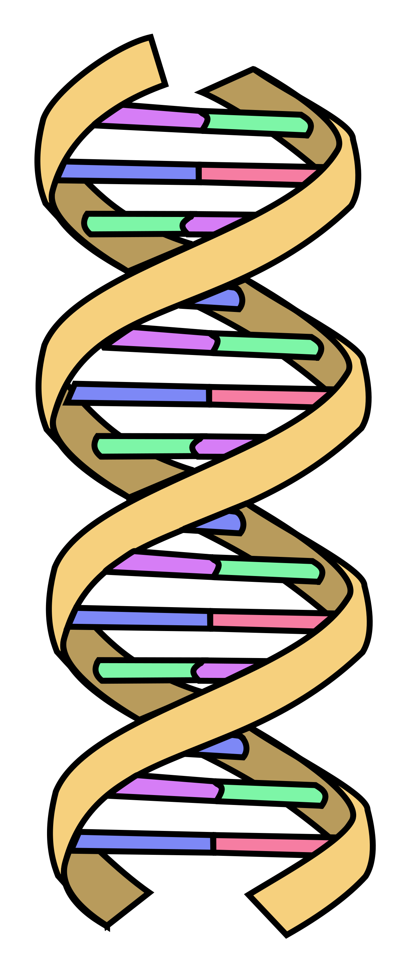
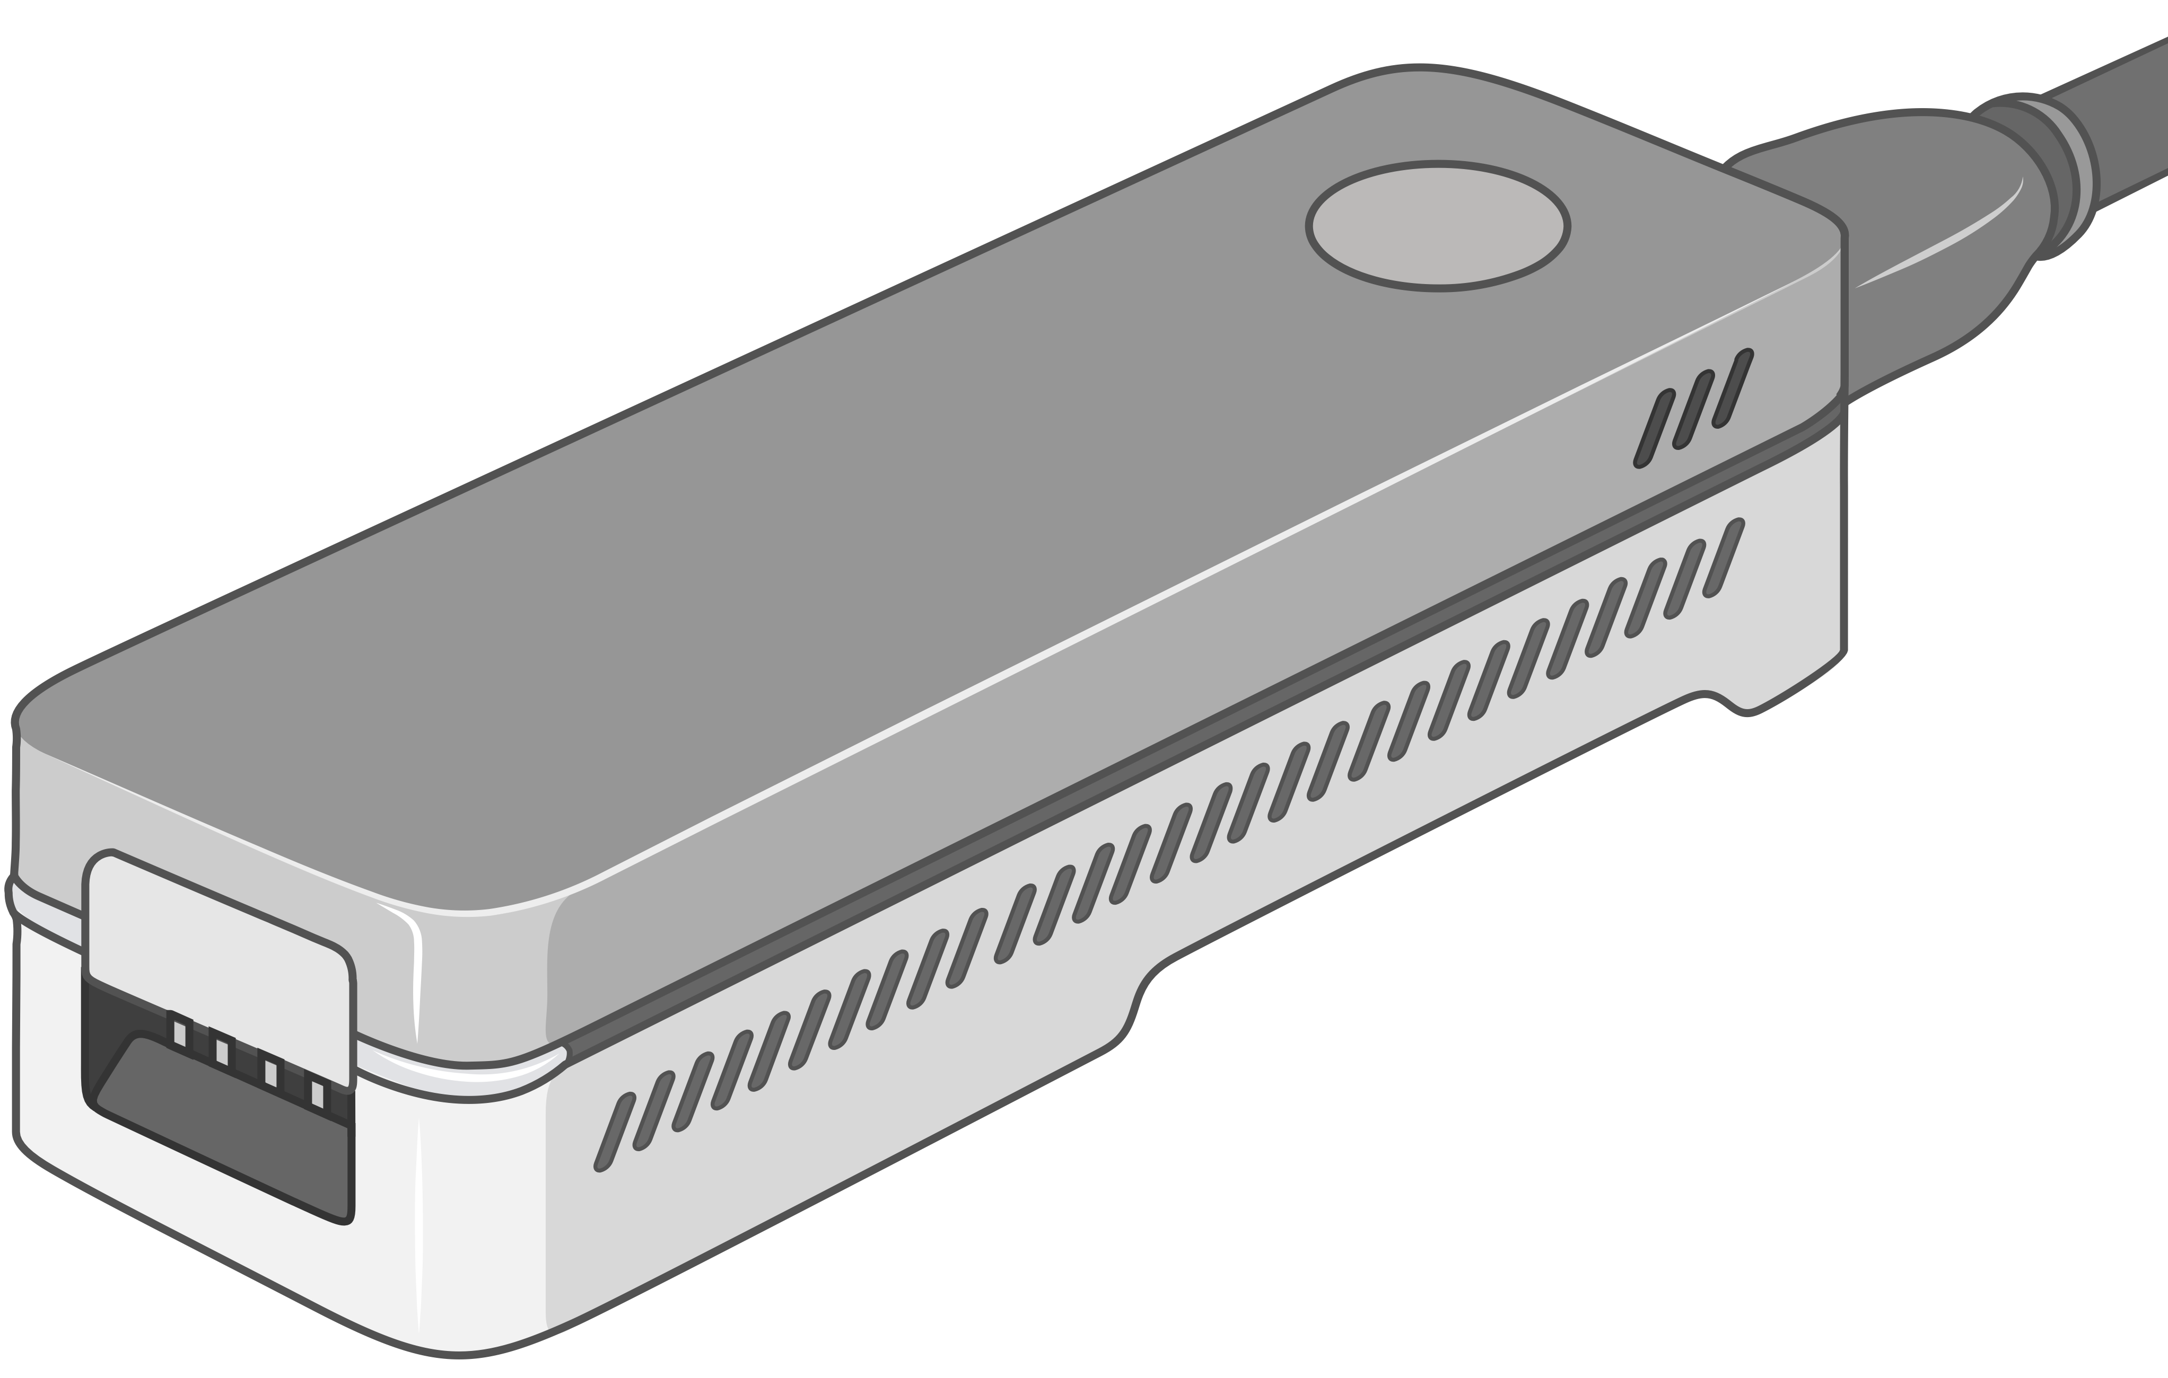


Genome Sequencing Data Generation
Sequencing process converts biological molecules
into digital nucleotide sequences called reads
Sequencing Device
AAGCTTCCATGG
AAATGGGCTTTC
GCTTCCAGAATG
GCCCAAATGGTT
Biological Molecule (e.g., DNA)
Sequencing Data (Reads)
?
Challenge: Unknown origins
Challenge: Large volume of data to analyze
Notes:
The analysis of genomic data starts by converting the biological molecules
[CLICK] into digital nucleotide sequences that we call reads
However, there are certain challenges to analyzing genomic data.
[CLICK] First, the genomic origins of these reads are lost after sequencing.
[CLICK] Second, we need to analyze a large volume of data.

Slide 4



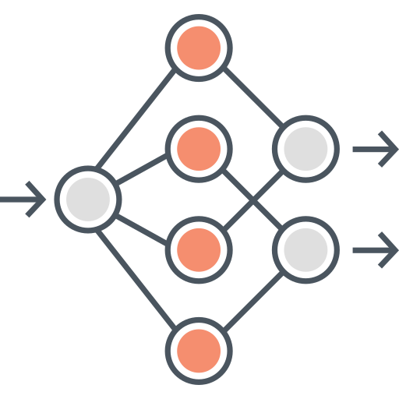



A Common Genome Analysis Pipeline
DNA Molecule
Library Preparation
Sequencing
Raw Sequencing Data
Sequencing Data Generation
TATGG
TGGTA
GCCTA
AAGCC
TATAT
Basecalling
Basecalled Sequencing Data
Denoised Raw Sequencing Data
Denoising
Translating
AAGCCTATATGGTAGTC
-2.1,0.3,2.3,-1.4
Preprocessing
Indexing
Seeding
Chaining
Alignment
Target Sequence
Hash Table
Query Sequence
Target Seq.
Target
Sequencing Data (Query):
AAGCCTATATGGTAGTC
0x00
2,64,…
Sketching
0x01
1,101,…
Sketching
Identifying the origin
Query
Query
Read Mapping
Store
…
Query Seq.
0xFF
13,21
Hash
Positions
Reference Genome (Target):
...
AAGCCTATATGCGTAATCAGATAGGATCGTCACGACTGT
...
Alignment Matrix
Hash
0x01
0x00
Hash
Seed Matches
Assembly
Variant Calling
Metagenomics
Downstream Analysis
Notes:
Generating the genomic data is usually the first step in a common genome analysis pipeline.
[CLICK] And initially these sequencing devices produce raw sequencing data
[CLICK] Which either needs to be translated into nucleotide sequences with a process called basecalling
[CLICK] Or preprocessed to reduce the inherent noise in raw sequencing data before further analysis
[CLICK] To identify the origin of sequencing data
[CLICK] we compare it with a representative sequence of a species, called a reference genome.
This process is known as read mapping and involves several steps.
[CLICK] First, we build an index, a hash table from the subsequences of a reference genome as a target sequence
[CLICK] Second, we extract subsequences, called seeds, from the sequencing data and query the index to find seed matches in the seeding step
[CLICK] Third, we identify nearby seed matches, called chains, to locate potential genomic regions of origin
[CLICK] Fourth, we optionally find exact matches and differences within the chaining region.
[CLICK] The information we generate from read mapping can be used for several purposes in downstream analysis, such as genome assembly, variant calling, and metagenomics.

Slide 5


Problem: Noise in Genome Analysis
Imperfections in sequencing data and its analysis negatively impact genome analysis
Noise
TATGG
Noise
AAGCC
GCCTACCTGG
TATAT
TGGTA
GCCTA
GCCTCCCTGG
AGATA
TGCAC
GCCTTCCTGG
CCTGG
Unwanted variations
Unhandled variations
Significant computation overhead
Limited accuracy and application scope
Notes:
We find that the imperfections both in sequencing data
and the analysis of this sequencing data negatively impact the entire genome analysis pipeline.
[CLICK] For example, we have unwanted variations in raw sequencing data
[CLICK] and variations that are left unhandled when analyzing basecalled sequencing data
[CLICK] which we refer to as noise
[CLICK] Noise causes significant computational overhead
[CLICK] limiting the accuracy and application scope of genome analysis.

Slide 6
Thesis Statement
We can mitigate noise in sequencing data and analysis by
1
Building a better understanding of the types of noise, and
Developing new algorithms and techniques that can tolerate and reduce noise
2
Thereby providing
Accurate, scalable, and real-time analysis of sequencing data and enabling new applications in genome analysis
Notes:
To address this problem, my thesis statement is as follows:
[CLICK] We can mitigate noise
[CLICK] building...
[CLICK] developing...
[CLICK] thereby providing ...

Slide 7



Core Contributions
TATGG
AAGCC
TATAT
Noise
GCCTA
Noise
TGGTA
AGATA
TGCAC
CCTGG
RawHash (ISMB/ECCB'23)
Enable hash-based search by reducing noise in raw nanopore signals
BLEND (NARGAB'23 & RECOMB'23)
Tolerate arbitrary noise with a hash-based search
2
1
2
Rawsamble (arXiv'24 & HitSeq'24)
Enabling new applications by overlapping and assembling raw nanopore signals
RawHash2 (Bioinformatics'24)
Better noise reduction by leveraging novel insights
3
4
Notes:
Now I will present the core contributions of this thesis
in terms of the types of noise they address
and the new applications they enable.
[CLICK] Our first contribution, BLEND, addresses noise in
the analysis of basecalled sequencing data by providing an effective hash-based search method for noise tolerance.
[CLICK] Second, RawHash targets noise in raw nanopore sequencing data
to reduce noise and enable hash-based search for raw signals.
[CLICK] Third, RawHash2 improves our understanding of noise in raw nanopore signals, allowing for better noise reduction.
[CLICK] Our fourth contribution, Rawsamble, enables a new application
by overlapping raw nanopore signals to build assemblies without basecalling.

Slide 8
Core Contributions – BLEND
TATGG
AAGCC
TATAT
Noise
GCCTA
Noise
TGGTA
AGATA
TGCAC
CCTGG
RawHash (ISMB/ECCB'23)
Enable hash-based search by reducing noise in raw nanopore signals
BLEND (NARGAB'23 & RECOMB'23)
Tolerate arbitrary noise with a hash-based search
2
1
2
Rawsamble (arXiv'24 & HitSeq'24)
Enabling new applications by overlapping and assembling raw nanopore signals
RawHash2 (Bioinformatics'24)
Better noise reduction by leveraging novel insights
3
4
BLEND
RawHash
RawHash2
Rawsamble
Notes:
I will start by discussing BLEND.

Slide 9
Traditional Hash-Based Seed Matching
Reference Genome (Target)
...
...
Hash
AAGCCTATATGCGTAATAG
0x01
Seed Match
...
...
Hash
AAGCCTATATGCGTAATAG
0x01
Read (Query)
✓
Fast and memory—efficient exact seed matching
✓
Dissimilar seeds are unlikely to match
BLEND
RawHash
RawHash2
Rawsamble
Notes:
Let's start by looking at the traditional mechanisms we use for finding seed matches between a reference genome and a read sequence.
[CLICK] First, we identify certain subsequences or segments
[CLICK] and generate their hash values to use as seeds.
[CLICK] Second, we find seed matches if their corresponding sequence segments exactly match.
[CLICK] This hash-based mechanism enables ...
[CLICK] while ensuring that hash values from dissimilar sequences are unlikely to match, avoiding false matches.

Slide 10
Limitations of Traditional Hashing
Reference Genome (Target)
...
...
Hash
AAGCCTATATGCGTAATAG
0x01
No Match
Noise
...
...
Hash
AAGCCGATATGCGTAATAG
0x05
Read (Query)
Low-collision hash functions
✕
Highly similar seeds are unlikely to match
BLEND
RawHash
RawHash2
Rawsamble
Notes:
However, large segments or seeds are unlikely to exactly match due to potential mutations and sequencing errors
[CLICK] which we call noise
[CLICK] This leads to generating completely different hash values
[CLICK] due to the nature of low-collision hash functions used in seeding
[CLICK] which prevents us from identifying highly similar sequence segments
with quick matching.

Slide 11
Problems with Low-Collision Hashing
Reference Genome (Target)
...
...
Hash
AAGCCTATATGCGTAATAG
0x02
Seed Match
...
...
Hash
AAGCCGATATGCGTAATAG
0x02
Read (Query)
✕
Larger number of shorter exact seed matches to analyze
✕
Leading to computational overhead and inaccuracy
BLEND
RawHash
RawHash2
Rawsamble
Notes:
The common solution to identify such highly similar regions is to reduce the seed length used for matching
[CLICK] which can help avoid non-matching regions
[CLICK] However, using shorter seeds is problematic as it results in a larger number of shorter exact matches to analyze
[CLICK] leading to ...

Slide 12
Goal – Fuzzy Seed Matching
...
Reference Genome (Target)
...
Hash
AAGCCGATATGCGTAATAG
0x01
Match
...
...
Hash
AAGCCTATATGCGTAATAG
0x01
No Match
...
...
Hash
TCAGTGCAGTACGGGACGA
0x05
✓
Fast highly similar seed matching with mismatches at any arbitrary positions
✓
Highly dissimilar seeds are unlikely to match
Fuzzy seed matching
BLEND
RawHash
RawHash2
Rawsamble
Notes:
Our goal is to
[CLICK] enable generating the same hash value for highly similar seeds
[CLICK] while generating different hash values for dissimilar ones
[CLICK] which we call fuzzy seed matching

Slide 13
BLEND Key Idea – Integrate SimHash
Hash
Sequence-to-Vector Conversion
SimHash
GCCGATATGCGTAATAG
0x01
Hash
Sequence-to-Vector Conversion
SimHash
GCCTATATGCGTAATAG
0x01
Hash
Sequence-to-Vector Conversion
SimHash
AGTGCAGTACGGGACGA
0x05
Key Idea: Replace the existing low-collision hash functions with SimHash to enable fuzzy seed matching
SimHash can generate the same hash value for similar vectors
Challenge: Accurately encoding a seed as a vector (of items)
BLEND provides sequence-to-vector conversion strategies to effectively integrate SimHash in seed matching
BLEND
RawHash
RawHash2
Rawsamble
Notes:
To do so, we replace the existing low-collision hash functions in seed matching
[CLICK] with a hashing technique called SimHash
[CLICK] which can generate the same hash value for highly similar vectors
[CLICK] and different hash values for dissimilar ones
[CLICK] However, due to its mechanism, we cannot directly use SimHash to generate hash values from seeds
[CLICK] To enable the use of SimHash and its properties, BLEND provides effective sequence-to-vector conversion strategies

Slide 14
Evaluation Methodology
Integrated into minimap2 [Li, Bioinformatics'18] to perform end-to-end mapping
Real and simulated datasets from
PacBio (HiFi and CLR), ONT, and Illumina reads
Human CHM13 and HG002, Fruit fly, Yeast, and bacterial genomes
Use case 1: Read overlapping (all-vs-all overlapping)
Evaluated the accuracy, completeness, and contiguity of de novo assemblies generated from overlaps
Use case 2: Read mapping to a reference genome
Mapping accuracy from simulated reads
Structural variant calling
BLEND
RawHash
RawHash2
Rawsamble
Notes:
Let's look at our evaluation methodology.
[CLICK] We integrate BLEND into minimap2 to perform end-to-end read mapping
[CLICK] We use real and simulated datasets from various sequencing devices, including highly accurate reads from PacBio HiFi
[CLICK] We evaluate BLEND in terms of two use cases: read overlapping
[CLICK] and read mapping.

Slide 15
Empirical Analysis on Fuzzy Seed Matching
We calculate cumulative proportion of hash collisions based on the edit distance between seeds (16-mers) with hash collisions
Goal: Increasing the proportion of hash collisions at lower edit distances
BLEND enables fuzzy seed matching by systematically increasing the collision rate for highly similar seeds
BLEND
RawHash
RawHash2
Rawsamble
Notes:
Before discussing the results, we first conduct an empirical analysis of BLEND's fuzzy seed matching capabilities.
[CLICK] We calculate the cumulative proportion of hash collisions on the Y-axis
based on the edit distance between seeds with collisions on the X-axis.
[CLICK] The goal of BLEND’s fuzzy seed matching is to increase this proportion
for highly similar seeds at lower edit distances.
[CLICK] Here, we show the proportion of hash collisions at certain edit distances for minimap2. We find that only a small portion of seed pairs with hash collisions are similar.
[CLICK] We observe that BLEND increases the proportion of hash collisions
between highly similar seeds.
[CLICK] And BLEND can be configured to further improve this collision rate.
[CLICK] We find that BLEND ...

Slide 16
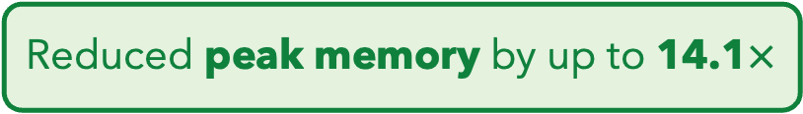
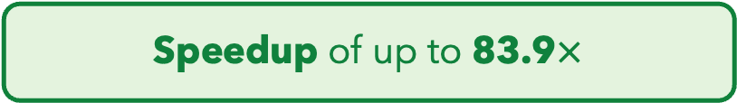
Key Results – Overlapping and Assembly
Speedup of up to 83.9$×$
Reduced peak memory by up to 14.1$×$
Most accurate de novo assemblies
Effectively tolerating noise improves both performance and accuracy
BLEND
RawHash
RawHash2
Rawsamble
Notes:
These figures show CPU time, peak memory, and assembly accuracy when using highly accurate reads for overlapping.
[CLICK] Compared to minimap2, BLEND provides a speedup of up to 84 times
[CLICK] Reduces peak memory requirements by 14 times
[CLICK] while providing the most accurate assemblies generated from the overlaps identified by BLEND
[CLICK] We conclude that ...

Slide 17
Core Contributions – BLEND
TATGG
AAGCC
TATAT
Noise
GCCTA
Noise
TGGTA
AGATA
TGCAC
CCTGG
RawHash (ISMB/ECCB'23)
Enable hash-based search by reducing noise in raw nanopore signals
BLEND (NARGAB'23 & RECOMB'23)
Tolerate arbitrary noise with a hash-based search
2
1
2
Rawsamble (arXiv'24 & HitSeq'24)
Enabling new applications by overlapping and assembling raw nanopore signals
RawHash2 (Bioinformatics'24)
Better noise reduction by leveraging novel insights
3
4
BLEND
RawHash
RawHash2
Rawsamble
Notes:
This concludes our first contribution, BLEND.
Motivated by the potential to improve both performance and accuracy by tolerating noise effectively, we switch our focus to an analysis where we have significantly increased noise.

Slide 18
Core Contributions – RawHash
TATGG
AAGCC
TATAT
Noise
GCCTA
Noise
TGGTA
AGATA
TGCAC
CCTGG
RawHash (ISMB/ECCB'23)
Enable hash-based search by reducing noise in raw nanopore signals
BLEND (NARGAB'23 & RECOMB'23)
Tolerate arbitrary noise with a hash-based search
2
1
2
Rawsamble (arXiv'24 & HitSeq'24)
Enabling new applications by overlapping and assembling raw nanopore signals
RawHash2 (Bioinformatics'24)
Better noise reduction by leveraging novel insights
3
4
BLEND
RawHash
RawHash2
Rawsamble
Notes:
For this, we look at raw nanopore signal analysis in our second contribution, RawHash

Slide 19
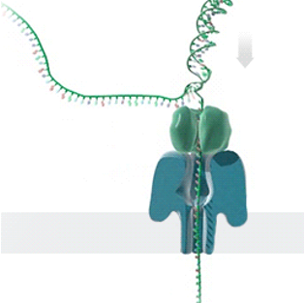
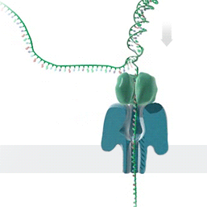



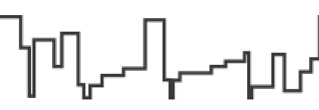


Nanopore Sequencing & Real-Time Analysis
Single Nanopore
Nanopore Sequencer
Raw Signals
(~5000 signals/sec)
Real-Time Analysis
Raw Signals: Ionic current measurements generated at a certain throughput
Real-Time Analysis: Analyzing raw signals instantly as they are generated
Real-Time Decisions: Stopping sequencing early based on real-time analysis
BLEND
RawHash
RawHash2
Rawsamble
https://nanoporetech.com/platform/technology/basecalling
https://blogs.ed.ac.uk/institute-genetics-cancer/2020/04/08/nanopore-sequencing-controversial-world-records-and-whale-watching/
Notes:
Let's look at how nanopore sequencing works. This is a nanopore sequencer that contains many tiny pores, called nanopores.
[CLICK] As a nucleic acid molecule passes through a single nanopore from the negatively charged side to the positively charged side,
[CLICK] we can measure the ionic current disruptions that are distinctive to identify each nucleotide passing through. These disruptions are generated
as raw electrical signals
at a certain throughput.
[CLICK] We can analyze these raw signals instantly
as they are generated, which we call real-time analysis.
[CLICK] Based on the real-time analysis, we can stop sequencing a read or the entire sequencing run.

Slide 20
Benefits of Real-Time Analysis
✓
Reducing latency by overlapping analysis with sequencing
Time
Sequencing
Analysis
Reduced Latency
Sequencing & Real-Time Analysis
✓
Reducing sequencing time and cost by stopping sequencing early
Sequenced Bases
Completely Sequenced Read
Reduced Sequencing Time (and Cost)
Partially Sequenced Read
Sequencing is stopped early with a real-time decision
BLEND
RawHash
RawHash2
Rawsamble
Notes:
There are two main benefits of real-time analysis.
First, we can reduce latency
[CLICK] by overlapping analysis with sequencing
[CLICK] Second, we can reduce sequencing time and cost
[CLICK] by stopping the sequencing early.

Slide 21
Real-Time Raw Signal Analysis
Raw Signals
Basecalling
Read Mapping
CTGCGT...
✓
We can avoid the costly basecalling step by directly analyzing raw signals
Reference Genome
...
...
CTGCGTAGCAGCGTAATAG
Converting the reference genome to its expected signal values using a pre-constructed sequence-to-signal conversion model
Reference-to-Signal Conversion
...
...
-0.06,0.24,-0.74,
Raw Signal Analysis
BLEND
RawHash
RawHash2
Rawsamble
Notes:
There are two main ways of analyzing raw nanopore signals in real time.
[CLICK] The traditional way is to translate these electrical signals into nucleotide sequences with a basecalling step that mainly utilizes complex deep neural models.
[CLICK] These basecalled sequences can then be analyzed using regular read mapping steps.
[CLICK] An alternative way is to avoid the costly basecalling step by directly analyzing raw signals.
[CLICK] This approach typically starts by converting the reference genome into its expected electrical signal values using a pre-constructed conversion model, followed by the analysis of raw signals.

Slide 22
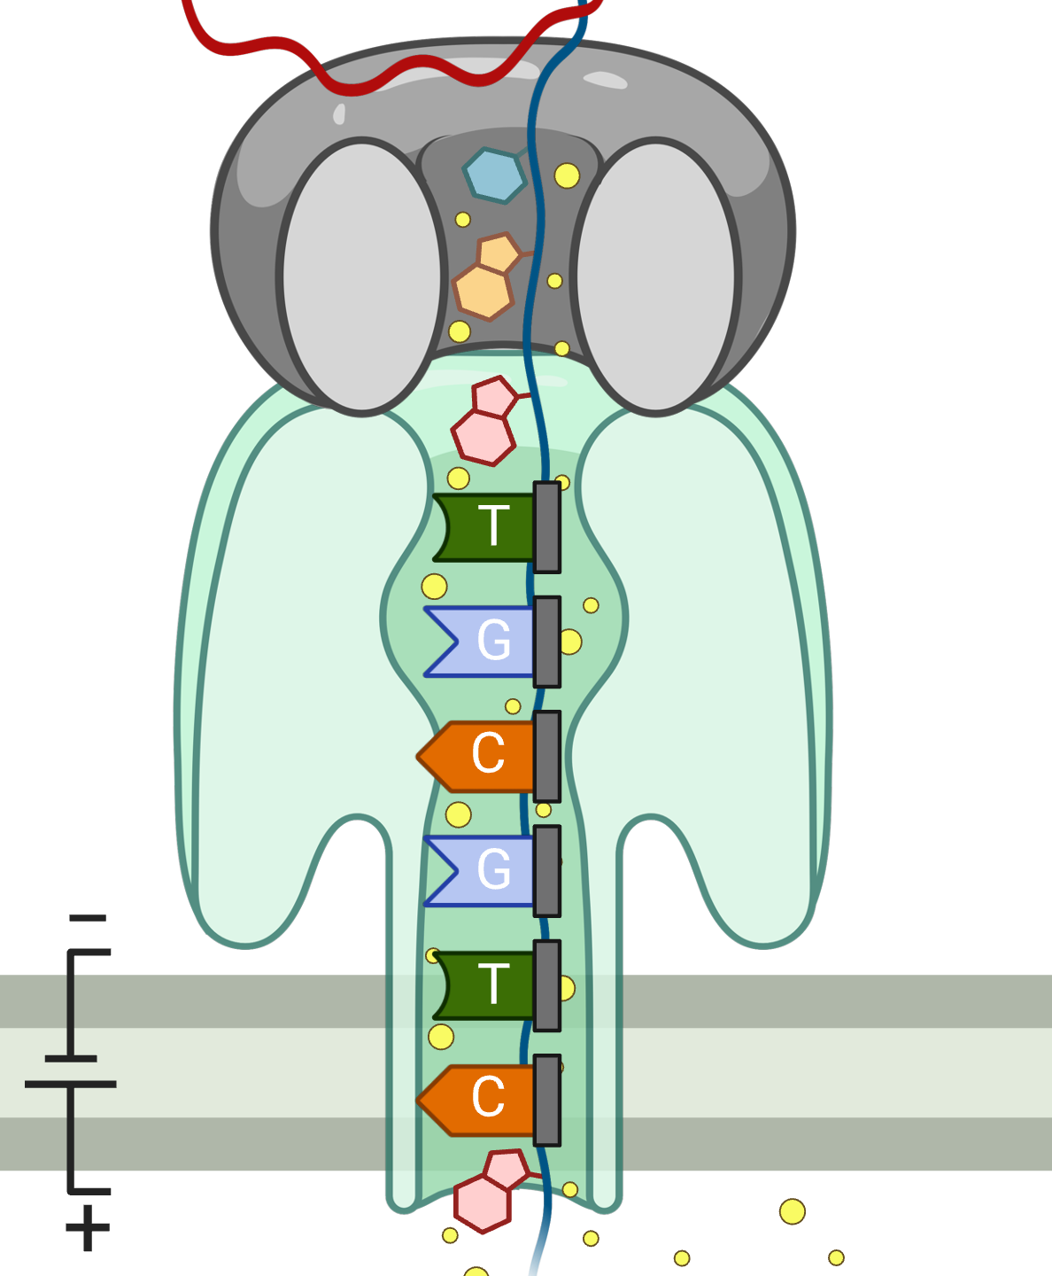
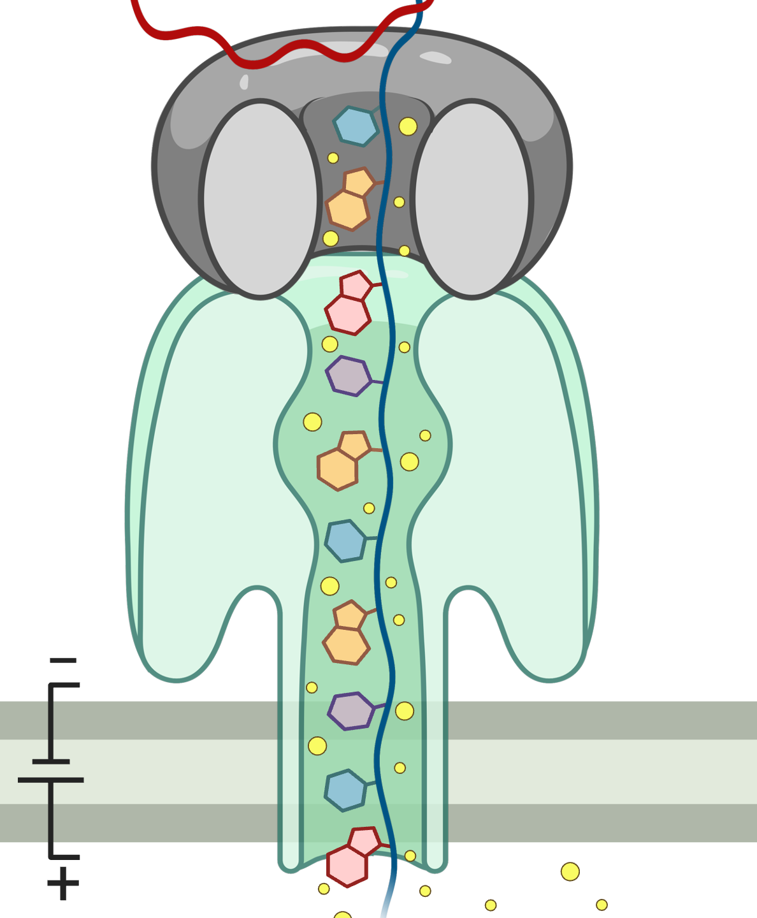


Noise in Raw Signal Analysis
Sequencing CTGCGT with Different Nanopores
Raw Signals:
-0.05
-0.07
-0.06
-0.05
-0.06
✕
Noise causes slight differences in raw signals from the same k-mer
Challenge: Directly matching raw signals is not feasible
Challenge: A single k-mer is too short for accurate matching
BLEND
RawHash
RawHash2
Rawsamble
Notes:
However, raw signal analysis is noisy. Let's look at why.
[CLICK] Ionic current disruptions are caused by the presence
of a certain small number of nucleotides inside the nanopore, called a k-mer.
[CLICK] It is possible to sequence this short k-mer at different times or in different nanopores.
[CLICK] Each will report ionic current disruptions as an electrical signal measurement.
[CLICK] However, noise ...
[CLICK] This means we cannot directly match raw signals, as this is not feasible.
[CLICK] And even if we could, a single k-mer is too short and likely to appear in many places in a reference genome.

Slide 23
RawHash Key Idea – Quantization
Sequenced k-mer:
CTGCGT
-0.05
-0.07
-0.06
-0.05
-0.06
Quantize
Quantize
Quantize
Quantize
Quantize
Bucket #
0
1
2
3
4
5
6
7
8
9
10
11
12
13
14
15
-3.00
Range of raw signals (normalized)
+3.00
✓
Reducing noise by quantizing raw signals into equal-width buckets
✓
Enables matching raw signals by eliminating slight differences
BLEND
RawHash
RawHash2
Rawsamble
Notes:
To enable assigning the same values to similar raw signals
[CLICK] The key idea in RawHash is to perform quantization in two steps.
[CLICK] First, the quantization step creates a certain number of equal-width buckets across the entire raw signal range.
[CLICK] Second, we assign similar raw signals within the same signal range to the same bucket.
[CLICK] This reduces noise by quantizing raw signals into equal-width buckets
[CLICK] By doing so, RawHash enables ...

Slide 24
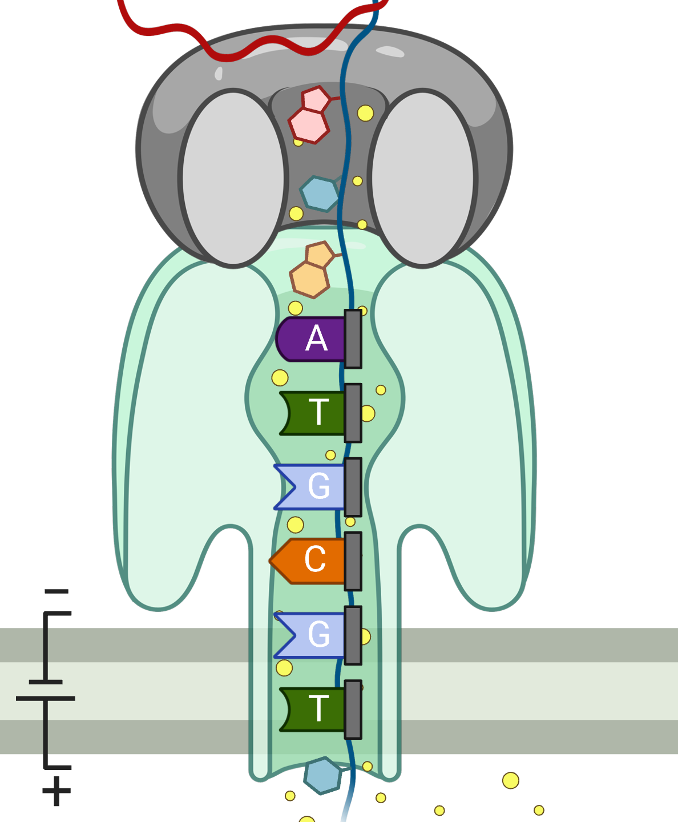
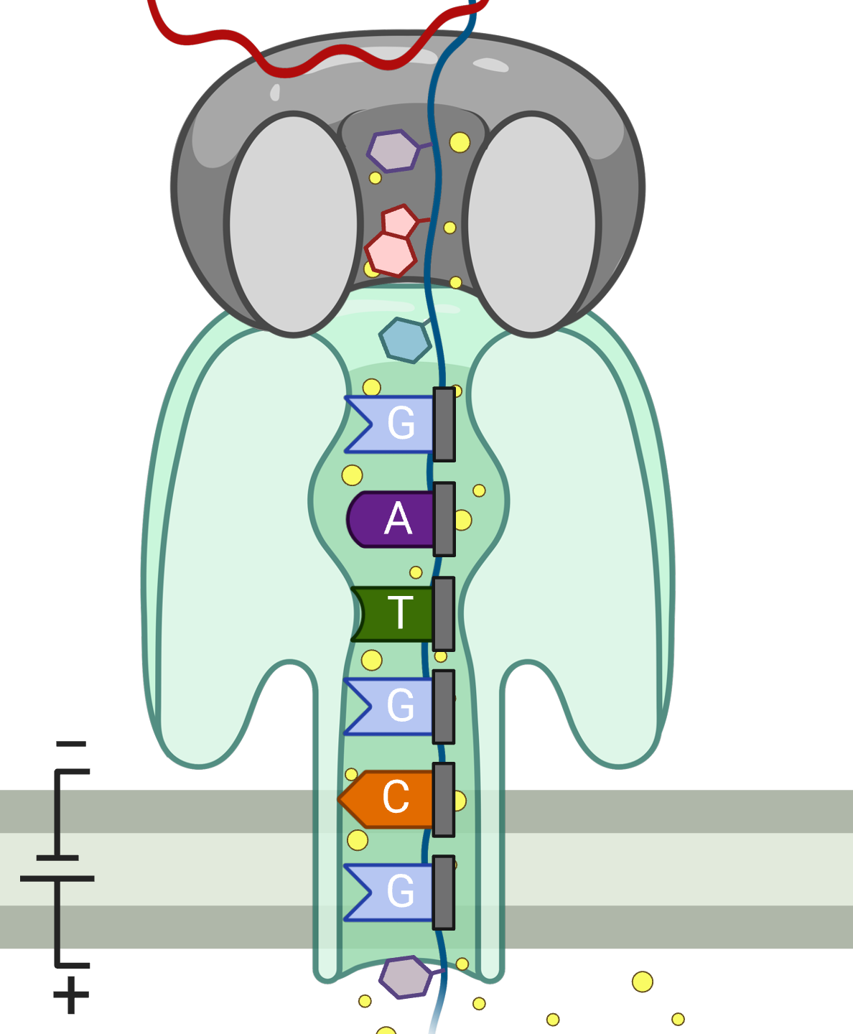
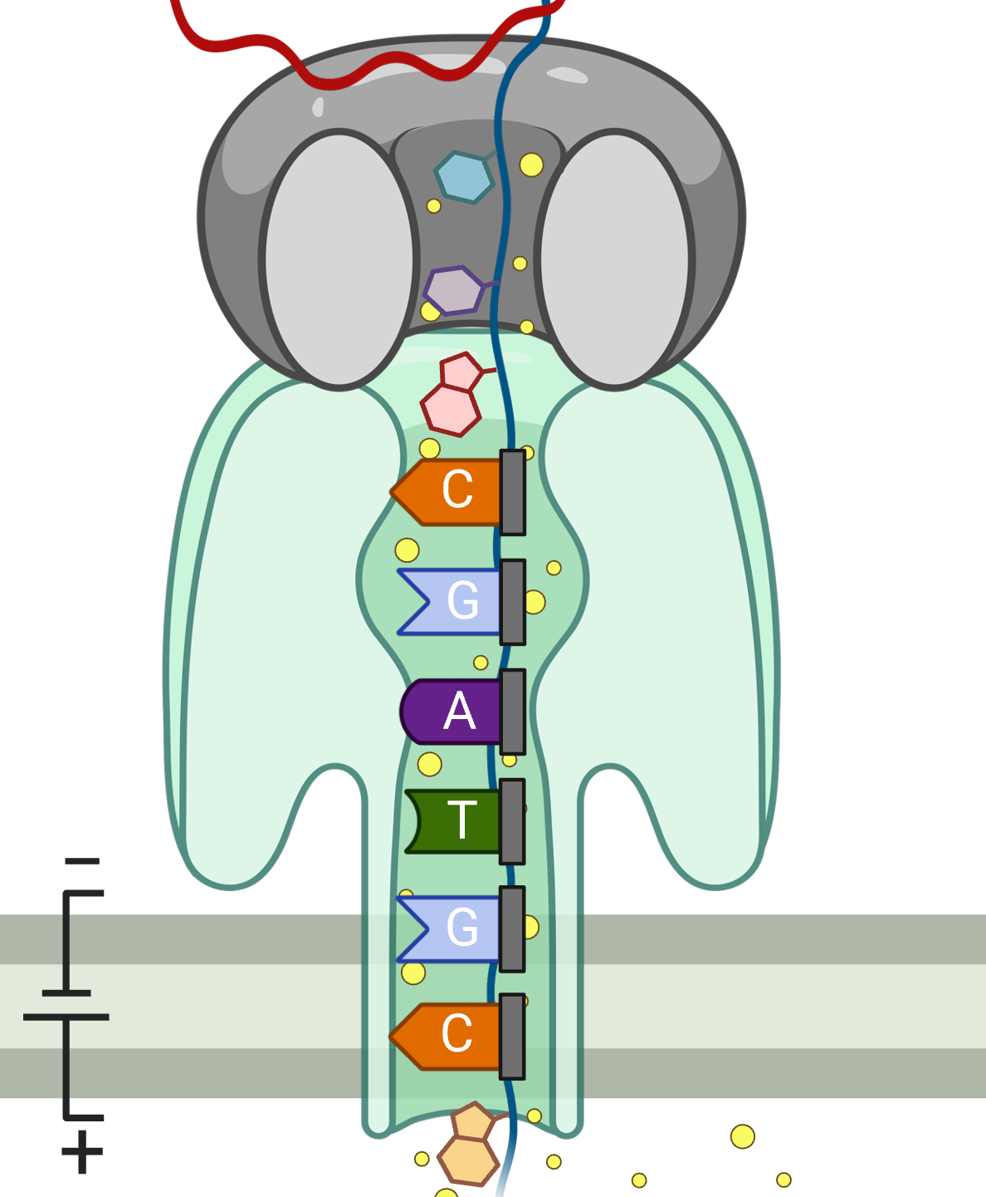
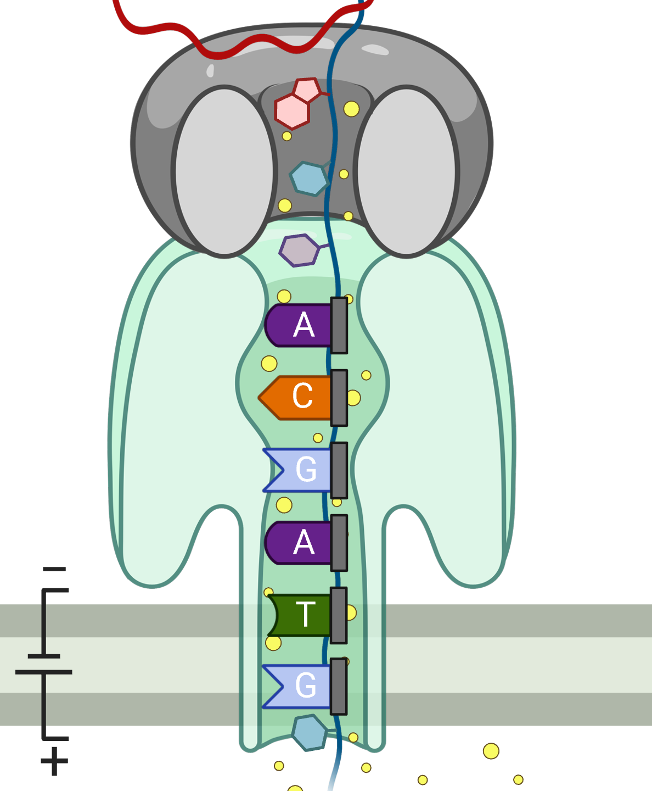
RawHash Key Idea – Hash-based Seeding
Sequencing CTGCGTAGCA
-0.06
-0.22
-0.75
0.96
-0.49
Quantize
Quantize
Quantize
Quantize
Quantize
0b0111
0b0111
0b0110
0b1011
0b0110
Pack
0b01110111011010110110
Hash
0x77db
Seeding, Chaining & Mapping
✓
Packing enables directly matching fewer and more accurate k-mers
BLEND
RawHash
RawHash2
Rawsamble
Notes:
Although we are limited by the length of k-mers we can sequence at a time, we can still increase the k-mer length used for hash-based seeding.
[MULTI CLICKS] To do this, we use multiple raw signals generated when sequencing a longer sequence segment from consecutive overlapping k-mers.
These quantized values shown in binary
[CLICK] can be packed together using simple bitwise operations and hashed.
Our packing strategy captures both the content and order of multiple consecutive k-mers, providing more detailed information than a single quantized value.
[CLICK] We can reliably use the hash value after packing to find fewer
and more accurate matches in the genome
[CLICK] by following the regular steps in hash-based read mapping, including seeding, chaining, and mapping.

Slide 25

Real-Time Mapping with RawHash
Reference Genome (Converted to Signals)
Raw Signals
(~5000 signals/sec)
Reference Signals
Offline Indexing
Hash Table
(Index)
Quantize
Quantize
Store
Query
Hash
Hash
Real-Time Mapping
Yes: Analyze the next chunk
Matching Regions
Chaining & Mapping
Continue Mapping?
No: Stop Sequencing
BLEND
RawHash
RawHash2
Rawsamble
Notes:
Effective noise reduction enables us to perform accurate and real-time analysis in several steps.
[CLICK] First, we store the hash values we construct from the reference genome and use them as an index. This is an offline, one-time task.
[CLICK] Second, in real time, we query the hash values we generate from streaming raw signal data, which identifies matching regions between the reference genome and a read based on hash matches.
[CLICK] Third, we use the classical chaining and mapping process to determine if a read is mapped based on the chaining information we have so far.
[CLICK] If we need to sequence more to answer this question, we retrieve the next chunk of streaming data and perform similar computations in real time.
[CLICK] If not, we can stop sequencing, reducing sequencing time and cost.

Slide 26
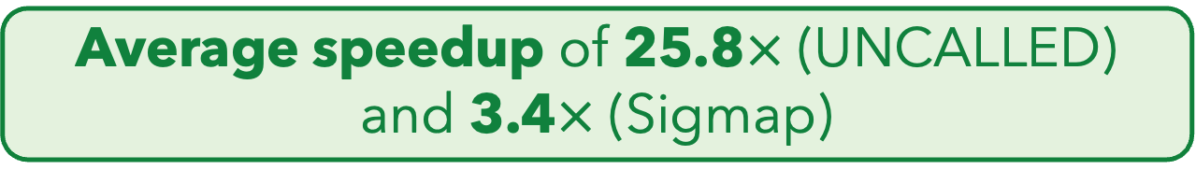

Key Results
Compared to the state-of-the-art raw signal analysis tools UNCALLED [Kovaka+'21] and Sigmap [Zhang+'21]:
Average speedup of 25.8$×$ (UNCALLED) and 3.4$×$ (Sigmap)
Effective noise reduction improves both performance and accuracy
Up to ~1.75$×$ better accuracy for large (human) genomes
BLEND
RawHash
RawHash2
Rawsamble
Notes:
We quickly show our initial comparisons of RawHash with the state-of-the-art tools UNCALLED and Sigmap.
[CLICK] We find that RawHash achieves a throughput speedup of around 26x and 3.4x compared to these tools
[CLICK] and up to 1.75x better accuracy when mapping reads to large human genomes.
[CLICK] We find that ...

Slide 27
Core Contributions – RawHash
TATGG
AAGCC
TATAT
Noise
GCCTA
Noise
TGGTA
AGATA
TGCAC
CCTGG
RawHash (ISMB/ECCB'23)
Enable hash-based search by reducing noise in raw nanopore signals
BLEND (NARGAB'23 & RECOMB'23)
Tolerate arbitrary noise with a hash-based search
2
1
2
Rawsamble (arXiv'24 & HitSeq'24)
Enabling new applications by overlapping and assembling raw nanopore signals
RawHash2 (Bioinformatics'24)
Better noise reduction by leveraging novel insights
3
4
BLEND
RawHash
RawHash2
Rawsamble
Notes:
This concludes our second contribution. Now, I will discuss our third contribution, RawHash2.

Slide 28
Core Contributions – RawHash2
TATGG
AAGCC
TATAT
Noise
GCCTA
Noise
TGGTA
AGATA
TGCAC
CCTGG
RawHash (ISMB/ECCB'23)
Enable hash-based search by reducing noise in raw nanopore signals
BLEND (NARGAB'23 & RECOMB'23)
Tolerate arbitrary noise with a hash-based search
2
1
2
Rawsamble (arXiv'24 & HitSeq'24)
Enabling new applications by overlapping and assembling raw nanopore signals
RawHash2 (Bioinformatics'24)
Better noise reduction by leveraging novel insights
3
4
BLEND
RawHash
RawHash2
Rawsamble
Notes:
In RawHash2, we enable a better understanding and handling of noise in raw signals, which allows us to further improve raw signal analysis.

Slide 29
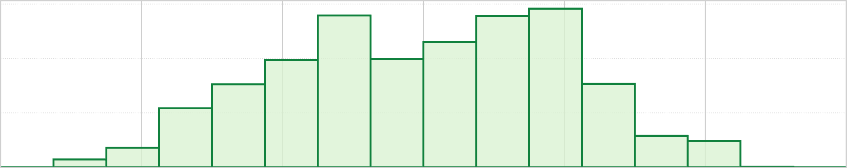
Better Understanding of Noise
Bucket #
0
1
2
3
4
5
6
7
8
9
10
11
12
13
14
15
-3.00
Range of raw signals (normalized)
+3.00
✕
Equal-width buckets leads to unbalanced loading
600
400
K-mer count
200
0
1
2
3
4
5
6
7
8
9
10
11
12
13
14
15
-3.00
+3.00
✕
More false hash matches due to reduced uniqueness
BLEND
RawHash
RawHash2
Rawsamble
Notes:
Although constructing equal-width buckets enables noise reduction in RawHash,
[CLICK] we find that ...
[CLICK] which can cause more false hash matches due to reduced uniqueness, impacting several parameters related to accuracy and performance.

Slide 30
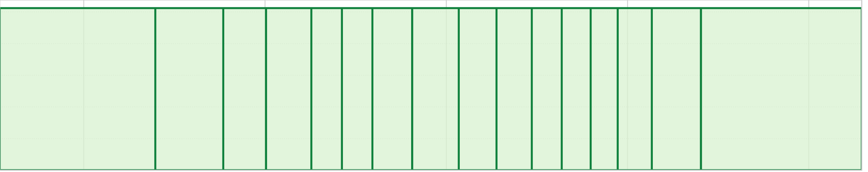
Adaptive Quantization
Key Idea: Quantizing raw signals with non-equal bucket widths to maximize load balancing
K-mer count
-3.00
3.00
Goal: Ideal Load Balance
K-mer count
-3.00
3.00
✓
Adaptive quantization reduces collisions caused due to skewed raw signal distributions
BLEND
RawHash
RawHash2
Rawsamble
Notes:
The key idea in RawHash2 is to generate buckets with varying sizes
[CLICK] with the goal of balancing the amount of raw signals placed in each bucket, which we call adaptive quantization.
[CLICK] By doing so, we can reduce collisions caused by skewed raw signal distributions.

Slide 31
Other Key Improvements in RawHash2
Weighted mapping decisions
Sampling strategies for reduced storage and computation overheads
Frequency filter and minimizer sketching
Improved chaining algorithm
More sensitive scoring functions
Feature List
Chaining Score
Mapping Quality
Number of Seed Matches
…
w₂
w₃
w₄
w₁
+
>
Map
Frequency Filter
Do not Use Matching Regions
Matching Regions
True
Number of matching regions > Threshold
False
Use Matching Regions
BLEND
RawHash
RawHash2
Rawsamble
Notes:
RawHash2 provides three other key improvements over RawHash.
[CLICK] First, rather than using a simple chaining score threshold, we generate multiple features to collectively decide if mapping should continue.
[CLICK] We assign weights to these features and update the weights to optimize mapping accuracy and performance.
We believe this idea should not be limited to raw signal mapping, but should be utilized in general read mappers.
[CLICK] Second, we use sampling strategies to reduce the amount of raw signal data we process
with frequency filtering and minimizer sketching.
[CLICK] For example, the frequency filter excludes matching regions if the number of matches from a hash value is above a certain threshold.
[CLICK] Otherwise, these matching regions proceed to steps such as chaining.
[CLICK] Third, we improve the chaining algorithm with more sensitive scoring functions.

Slide 32
Real-Time Mapping with RawHash2
Reference Genome (Converted to Signals)
Raw Signals
(~5000 signals/sec)
Reference Signals
Offline Indexing
Adaptive Quantization
Adaptive Quantization
Hash Table
(Index)
Hash
Hash
Real-Time Mapping
Store
Query
Yes: Analyze the next chunk
Sketching
Sketching
Matching Regions
Chaining & Mapping
Continue Mapping?
Filtering
RawHash
RawHash2
No: Stop Sequencing
BLEND
RawHash
RawHash2
Rawsamble
Notes:
We modify the earlier RawHash pipeline by integrating adaptive quantization
[CLICK] followed by the same hashing technique from RawHash and the new sketching step
[CLICK] We use the hash values after sketching to construct the index and query the index as before.
[CLICK] Matching regions we receive after querying are filtered with a frequency filter
[CLICK] followed by a more sensitive chaining mechanism
[CLICK] and we decide on the mapping based on a weighted mapping strategy.

Slide 33
Evaluation Methodology
Two settings for RawHash2:
RawHash2: All hash values without sampling
RawHash2-Minimizer: Minimizer sketching
Compared to UNCALLED [Kovaka+, Nat. Biotech.'21], Sigmap [Zhang+, ISMB/ECCB'21], and RawHash [Firtina+, ISMB/ECCB'23]
Use cases for real-time genome analysis:
Read mapping
Relative abundance estimation
Contamination analysis
BLEND
RawHash
RawHash2
Rawsamble
Notes:
We evaluate two different versions of RawHash2: first, the default case without any sketching technique, and second, RawHash2 with the minimizer sketching technique.
[CLICK] We compare RawHash2 with ...
[CLICK] We evaluate based on three different use cases, including read mapping.

Slide 34
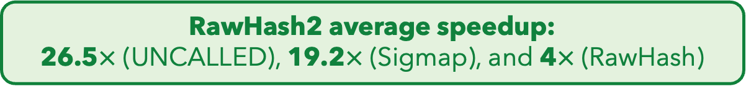
Key Results – Throughput
Data generation throughput of a single nanopore: ~450 bp/sec
A single nanopore device contains roughly 512 to 2500 nanopores
Computation throughput of a single CPU thread: bases processed/sec
Scalability: The number of nanopores that a single CPU thread can process
RawHash2 average speedup: 26.5$×$ (UNCALLED), 19.2$×$ (Sigmap), and 4$×$ (RawHash)
RawHash2-Minimizer average speedup: 2.5$×$ (RawHash2)
BLEND
RawHash
RawHash2
Rawsamble
Notes:
Let’s first look at the throughput comparisons. A single nanopore generates roughly 4 to 5000 signals per second, corresponding to around 450 bases per second.
A single nanopore device contains around 500 to 2500 of these nanopores.
[CLICK] We define computational throughput as the number of bases a tool can process per second per CPU thread.
A tool's scalability is based on how many nanopores it can process with a single CPU thread.
[CLICK] First, we show the throughput results for UNCALLED and Sigmap,
with different datasets on the x-axis
and throughput on the y-axis.
The number of nanopores they can process with a single CPU thread is shown inside the bars.
Sigmap falls short of real-time analysis, as its throughput is below the data generation speed of a single nanopore for human genomes.
[CLICK] RawHash achieves significant speedup due to its fast hash-based search,
[CLICK] while RawHash2 and RawHash2-Minimizer further improve throughput with effective sampling strategies.
[CLICK] RawHash2 provides an average speedup of 26 times, 19 times, and 4 times compared to UNCALLED, Sigmap, and RawHash
[CLICK] RawHash2-Minimizer further increases throughput by 2.5x compared to RawHash2.

Slide 35
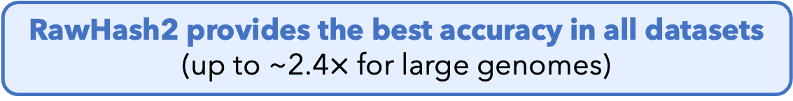
Key Results – Mapping Accuracy
Accuracy of mapping positions (F1 score)
Ground truth: Mapping positions of basecalled sequences using minimap2
RawHash2 provides the best accuracy in all datasets (up to ~2.4$×$ for large genomes)
RawHash2-Minimizer provides mapping accuracy comparable to RawHash2
BLEND
RawHash
RawHash2
Rawsamble
Notes:
Next, we look at the mapping accuracy by identifying the correct mapping positions that each tool reports
based on the ground truth mapping positions
and calculating their F1 scores accordingly.
[CLICK] This figure shows the mapping accuracy results on the y-axis
using the datasets on the x-axis.
The accuracies of UNCALLED and Sigmap significantly drop for the human genome.
[CLICK] RawHash provides comparable accuracy on smaller genomes and substantially better accuracy for the human genome,
[CLICK] while RawHash2 and RawHash2-Minimizer substantially improve accuracy with the new and effective quantization and chaining mechanisms.
[CLICK] We find that RawHash2 ...
[CLICK] And ...

Slide 36
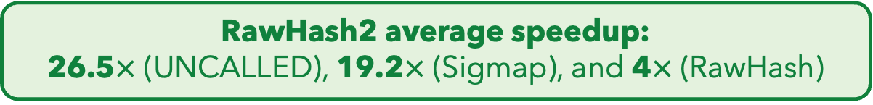
Conclusion – RawHash2
RawHash2 average speedup: 26.5$×$ (UNCALLED), 19.2$×$ (Sigmap), and 4$×$ (RawHash)
RawHash2-Minimizer average speedup: 2.5$×$ (RawHash2)
Better understanding of noise can be utilized to further improve performance and accuracy
RawHash2 provides the best accuracy in all datasets (up to ~2.4$×$ for large genomes)
RawHash2-Minimizer provides mapping accuracy comparable to RawHash2
BLEND
RawHash
RawHash2
Rawsamble
Notes:
By looking at both performance and accuracy results
[CLICK] We conclude that

Slide 37
Core Contributions – RawHash2
TATGG
AAGCC
TATAT
Noise
GCCTA
Noise
TGGTA
AGATA
TGCAC
CCTGG
RawHash (ISMB/ECCB'23)
Enable hash-based search by reducing noise in raw nanopore signals
BLEND (NARGAB'23 & RECOMB'23)
Tolerate arbitrary noise with a hash-based search
2
1
2
Rawsamble (arXiv'24 & HitSeq'24)
Enabling new applications by overlapping and assembling raw nanopore signals
RawHash2 (Bioinformatics'24)
Better noise reduction by leveraging novel insights
3
4
BLEND
RawHash
RawHash2
Rawsamble
Notes:
This concludes our third contribution, RawHash2.

Slide 38
Core Contributions – Rawsamble
TATGG
AAGCC
TATAT
Noise
GCCTA
Noise
TGGTA
AGATA
TGCAC
CCTGG
RawHash (ISMB/ECCB'23)
Enable hash-based search by reducing noise in raw nanopore signals
BLEND (NARGAB'23 & RECOMB'23)
Tolerate arbitrary noise with a hash-based search
2
1
2
Rawsamble (arXiv'24 & HitSeq'24)
Enabling new applications by overlapping and assembling raw nanopore signals
RawHash2 (Bioinformatics'24)
Better noise reduction by leveraging novel insights
3
4
BLEND
RawHash
RawHash2
Rawsamble
Notes:
Let’s now move on to Rawsamble, where we enable a new application
in raw signal analysis
by utilizing the improvements provided in RawHash and RawHash2.

Slide 39


Beyond Reference Mapping: Overlapping
Reference Genome (Converted to Signals)
Raw Nanopore Signals
Raw Nanopore Signals
TGCTGCAA
CGAAGTCA
CGTAGTGG
CCACCGGT
Reference Signals
CTGCAATC
TGATCCGA
TCAGCCGT
AGTGGACC
GGTAAGCT
TGCTGCAATCGTGATCCGAAGTCAGCCGTAGTGGACCACCGGTAAGCT
Hash-Based Seeding and Mapping
Challenge: Reference genome is not always available
Assembly: Constructing genome from overlapping reads
✕
Existing solutions cannot find overlapping reads without basecalling
BLEND
RawHash
RawHash2
Rawsamble
Notes:
Although reference-based raw signal analysis provides accurate mapping,
[CLICK] reference genomes are not always available or ideal for certain applications.
[CLICK] In such cases, we can construct an individual’s genome from scratch by finding overlaps between reads.
[CLICK] However, we cannot do this without basecalling.

Slide 40




Challenges with Overlapping Raw Signals
Hash-Based Seeding and Mapping
Challenge: Identifying hash matches when both signals are noisy
Challenge: Finding many useful overlapping pairs (all-vs-all overlapping)
Challenge: Generating long paths from useful overlaps
BLEND
RawHash
RawHash2
Rawsamble
Notes:
Identifying overlaps between raw signals with existing hash-based seeding mechanisms is challenging because
[CLICK] it requires identifying ...
[CLICK] finding ...
[CLICK] and generating ...

Slide 41


Key Improvements in Rawsamble
Aggressively filtering consecutive and similar signals to substantially reduce noise at the cost of data loss
Avoid cyclic overlaps with deterministic comparisons
Identifying and reporting all highly accurate chains to generate all-vs-all overlapping pairs
Generating the hash table index from raw nanopore signals
Raw Nanopore Signals
2.21
2.12
2.35
-0.9
-1.05
-0.85
-0.89
-1.01
1.15
1.25
1.20
Aggressive Filtering
2.21
2.12
2.35
-0.9
-1.05
-0.85
-0.89
-1.01
1.15
1.25
1.20
Query
Query
Target
Target
BLEND
RawHash
RawHash2
Rawsamble
Notes:
To address these challenges, Rawsamble provides several key improvements in raw signal analysis.
[CLICK] First, to reduce noise when comparing noisy raw signals,
we apply aggressive filtering.
This removes similar signals that appear consecutively, often generated by sequencing errors such as stay errors,
though it may result in some data loss.
[CLICK] Second, overlapping reads can map to each other cyclically
[CLICK] when using the target signal as query and vice versa due to shared regions.
[CLICK] To prevent cyclic overlaps, we perform a simple deterministic comparison and report each overlapping pair only once.
[CLICK] Third, we identify highly accurate chains to effectively prune incorrect overlapping pairs.
[CLICK] Fourth, we enable constructing an index directly from raw nanopore signals instead of reference signals.

Slide 42

Integrating Rawsamble into RawHash2
Raw Nanopore Signals
Raw Nanopore Signals
Aggressive Filtering
Aggressive Filtering
Indexing
Adaptive Quantization
Hash Table
(Signal Index)
Adaptive Quantization
Overlapping
Hash
Hash
Store
Query
Sketching
Sketching
Matching Regions
RawHash
Chaining & Mapping
Output: All-vs-all Overlapping Pairs
Filtering
RawHash2
Assembly
Rawsamble
BLEND
RawHash
RawHash2
Rawsamble
Notes:
We integrate the improvements made in Rawsamble into the RawHash2 pipeline as follows.
[CLICK] We perform aggressive filtering on both target and query signals.
[CLICK] Followed by the existing quantization, hashing, and sketching steps in RawHash and RawHash2.
The index contains hash values from raw nanopore signals instead of reference signals.
[CLICK] From matching hash values, we identify many highly accurate chains,
[CLICK] and report these chains as all-vs-all overlapping pairs.
[CLICK] These overlapping pairs can be directly used by off-the-shelf assemblers to construct de novo assemblies.

Slide 43
Evaluation Methodology
Rawsamble is integrated into RawHash2 [Firtina+, Bioinformatics'24]
Compared to the minimap2 [Li, Bioinformatics'18] overlaps (forward strand)
Basecalling with Dorado’s various models (using CPUs & GPUs)
Use case for raw signal overlapping:
De novo assembly construction using miniasm [Li, Bioinformatics'16]
Real datasets with
Various coverage (0.6× – 445×) and
Genome lengths (viral to human genomes)
BLEND
RawHash
RawHash2
Rawsamble
Notes:
We compare the overlaps generated by Rawsamble
with those generated by minimap2 on the forward strand.
For basecalling, we use various Dorado models on both CPUs and GPUs.
[CLICK] We use the miniasm assembler off-the-shelf to construct and evaluate de novo assemblies from raw signal overlaps,
[CLICK] using real datasets with various configurations.

Slide 44
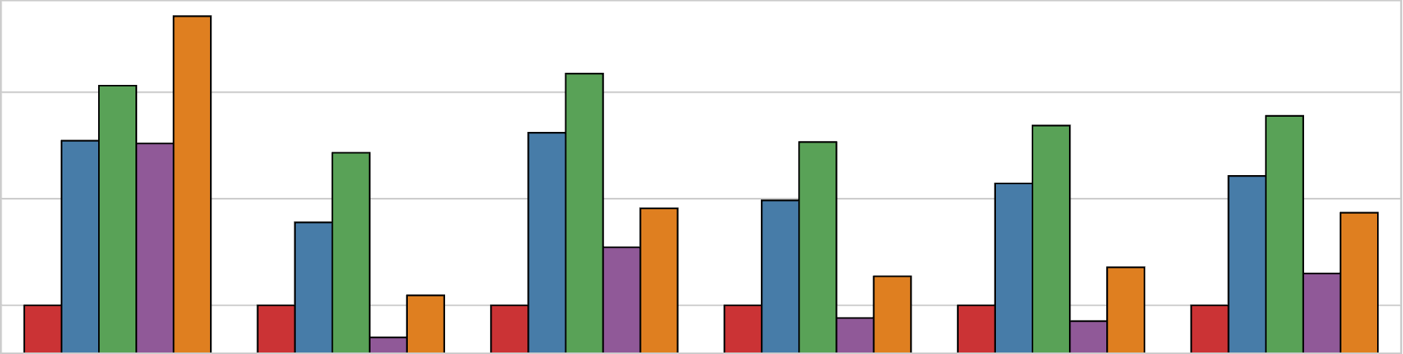
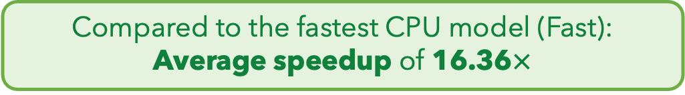







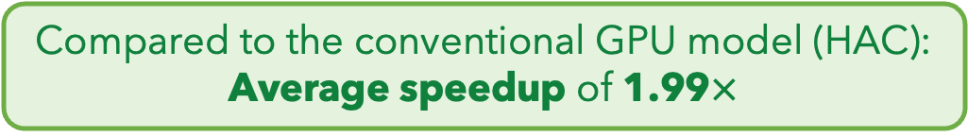
Key Results – Performance
Rawsamble
Minimap2 + Dorado CPU (Fast)
Minimap2 + Dorado CPU (HAC)
Minimap2 + Dorado GPU (HAC)
Minimap2 + Dorado GPU (SUP)
$${10}^{2}$$
Elapsed Time (Normalized to Rawsamble)
59.70$×$
$${10}^{1}$$
16.36$×$
7.40$×$
$${10}^{0}$$
1.99$×$
SARS-CoV-2
E. coli
Yeast
Green Algae
Human
Geo. Mean
Compared to the fastest CPU model (Fast): Average speedup of 16.36$×$
Compared to the conventional GPU model (HAC): Average speedup of 1.99$×$
BLEND
RawHash
RawHash2
Rawsamble
Notes:
We first look at the performance results in terms of runtime for both Rawsamble
and the Dorado basecaller with different configurations followed by minimap2.
The Y-axis shows runtimes normalized to Rawsamble's runtime
across different datasets on the X axis.
[CLICK] We find that Rawsamble provides an average speedup of 16 times compared to the configuration when using Dorado's fastest CPU model
[CLICK] And an average speedup of 2 times compared to the configuration when using Dorado's conventional GPU model.

Slide 45
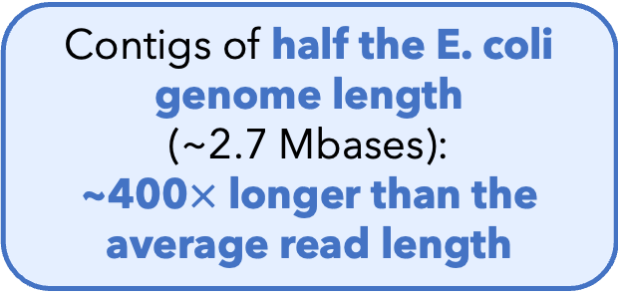
Key Results – de novo Assemblies
First de novo assemblies ever constructed from raw signal overlaps without basecalling
E. coli Assembly (From the Rawsamble Overlaps)
Contigs of half the E. coli genome length (~2.7 Mbases): ~400$×$ longer than the average read length
New directions in genome analysis can be enabled without basecalling
BLEND
RawHash
RawHash2
Rawsamble
Notes:
Next, we look at de novo assembly construction.
This figure shows the visualization of the assembly graph we construct from raw signal overlaps.
[CLICK] The biggest takeaway is that we construct the first de novo assemblies ...
[CLICK] These assemblies are not necessarily short.
For example, we can construct contigs of the half the E. coli genome length, which is 400 times larger than the average read length for that dataset.
[CLICK] We conclude that ...

Slide 46
Core Contributions
TATGG
AAGCC
TATAT
Noise
GCCTA
Noise
TGGTA
AGATA
TGCAC
CCTGG
RawHash (ISMB/ECCB'23)
Enable hash-based search by reducing noise in raw nanopore signals
BLEND (NARGAB'23 & RECOMB'23)
Tolerate arbitrary noise with a hash-based search
2
1
2
Rawsamble (arXiv'24 & HitSeq'24)
Enabling new applications by overlapping and assembling raw nanopore signals
RawHash2 (Bioinformatics'24)
Better noise reduction by leveraging novel insights
3
4
Notes:
With this, we cover all our contributions.

Slide 47
Conclusion
We can mitigate noise in sequencing data and analysis by
1
Building a better understanding of the types of noise, and
RawHash &
RawHash2
Developing new algorithms and techniques that can tolerate and reduce noise
2
BLEND
Thereby providing
Accurate, scalable, and real-time analysis of sequencing data and enabling new applications in genome analysis
Rawsamble
Notes:
To conclude, we state that
[CLICK] We can ...
[CLICK] Building ...
[CLICK] developing ...
[CLICK] We tolerate noise with BLEND
[CLICK] and understand and reduce noise with RawHash and RawHash2
[CLICK] By doing so we provide ...
[CLICK] which we demonstrate by enabling de novo assemblies from raw signal overlaps.

Slide 48



Future Research Directions
Pre-basecalling filtering
Guiding Basecalling with Raw Signal Analysis
Utilizing raw signal overlaps with basecallers
Specialized assemblers for raw signals
Full Genome Analysis without Basecalling
Full downstream analysis
Rethinking
Heuristic Techniques for Highly Accurate Reads
Very long seeds with fuzzy seed matching
Reference-free comparisons
Notes:
We identify three key future research directions.
[CLICK] First, to improve the basecalling performance and accuracy, we should guide ...
[CLICK] by filtering reads with raw signal analysis before basecalling
[CLICK] and using overlapping signal information to train and use basecallers for improved accuracy and performance.
[CLICK] Second, to improve the accuracy of genome analysis, we should aim to perform full genome analysis without basecalling,
[CLICK] by designing specialized assemblers for raw signals
[CLICK] and performing downstream analysis up to variant calling.
[CLICK] Third, to improve the performance and accuracy of read mapping,
we should rethink heuristic techniques in read mapping
as generating highly accurate reads becomes a common practice,
[CLICK] by using very long seeds with fuzzy seed matching capabilities
[CLICK] and enabling reference-free comparisons through accurate de novo assembly constructions.

Slide 49
My Involvements During my Ph.D.
First/Co-First Author Publications
Firtina+ NARGAB
Firtina+ Bioinformatics
Thesis Publications
Firtina+ ISMB/ECCB
Firtina+ arXiv
Nanopore Signal Analysis & Basecalling
Singh+ Gen. Bio.
Cavlak+ Frnt. Gn.
Lindegger+ IEEE Access
Error Correction
Firtina+ Bioinformatics
Hardware Accelerators
Ghiasi+ ASPLOS
Kanellopoulos+ MICRO
Firtina+ ACM TACO
Cali+ MICRO
Cali+ ISCA
Shahroodi+ MICRO
Mao+ MICRO
Ghiasi+ ISCA
Metagenomics
Shahroodi+ IEEE Access
Gollwitzer+ arXiv
Filters & Liftover
Kim+ Bioinformatics
Rumpf+ arXiv
Kim & Firtina+ IEEE/ACM TCBB
Surveys
Alser+ CSBJ
Mutlu & Firtina DAC
Alser+ Nature Protocols
2020
2021
2022
2023
2024
Notes:
During my PhD, I was fortunate to be involved in many projects from our research group,
including four my other first/co-first author publications outside the scope of my thesis.
We addressed a variety of problems in genome analysis.

Slide 50
Acknowledgements
Advisor: Onur Mutlu
Committee Members: Reetuparna Das, Hasindu Gamaarachchi, Benjamin Langmead, and Heng Li
Chair: Janos Vörös
Funding agencies and industry sponsors:
BioPIM, SNSF, Intel, Google, Huawei, Microsoft, VMware, and SRC
Colleagues, mentors, collaborators, and friends worldwide:
SAFARI Research Group members
Can Alkan & Alkan Lab
Family:
My parents, Emine and Turan
My wife, Çiçek
Notes:
I would like to thank my advisor, Onur Mutlu, my committee members, and the chair,
as well as funding agencies, industry sponsors, colleagues, mentors, collaborators, and friends worldwide.
A special thanks goes to my family: my parents, Emine and Turan, and my wife, Cicek.

Slide 51
Enabling Fast, Accurate, and Efficient Real-Time Genome Analysis via New Algorithms and Techniques
Can Firtina
Doctoral Examination
11.11.2024
Advisor:
Onur Mutlu (ETH Zurich)
Co-Examiners:
Reetuparna Das (University of Michigan)
Hasindu Gamaarachchi (UNSW Sydney)
Benjamin Langmead (Johns Hopkins University)
Heng Li (Harvard Medical School)
Notes:
This concludes my talk, and I am happy to take questions.

Slide 52
Sequencing Data Analysis
Heuristic Algorithms
Data Structures
Filters
TATGG
AAGCC
TATAT
TGGTA
GCCTA
AGATA
TGCAC
CCTGG
✓
Quick, accurate, and energy-efficient analysis
Distributed Computing
Imperfections in sequencing data impacts design choices
Hardware Accelerators
✕
Notes:
Since we need to analyze a large volume of sequencing data, there are many types of optimizations to make the genome analysis practical

Slide 53
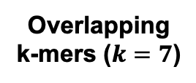
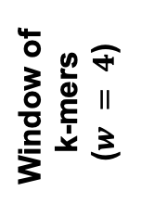
Minimizer Sketching
GCTATTACCT
GCTATTA
Hash
0xA1
Find
Minimum
Window of
k-mers ($w = 4$)
CTATTAC
Hash
0x02
Hash Table
0x02
TATTACC
Hash
0xFC
ATTACCT
Hash
0x45
CTATTAC
Overlapping k-mers ($k=7$)
Sampled
k-mer (Minimizer)

Slide 54
Spaced Seeding
GCTATTA
Pattern
GXTAXTA
Hash
0xA1
GATACTA
Pattern
GXTAXTA
Hash
0xA1
GACACTA
Pattern
GXCAXTA
Hash
0xFC
Spaced Seeds

Slide 55
Strobemer Sketches
GCTATTACCTTAATGTGATGGAC
Link
GCTATTAATGGA
Hash
0xA1
GCTATCCCCTTAATGGGATGGAC
Link
GCTATTAATGGA
Hash
0xA1
GCCCTCCCCTTAAAGGGAATGGA
Link
CCTCTAAATGGA
Hash
0xFC
Selected k-mers (e.g., minimizers)
Strobemers

Slide 56
Hash-Based Sketching and Seed Matching
Target Sequence
Query Sequence
GCTATTACCTTAATGTGATGGACGA
CAGGCTATAACCCTAATGTTGC
Sketching
Sketching
GCTA
TAAT
GACG
GCTA
ATGT
Hash
Hash
Hash
Hash
Hash
0x01
0xA4
0x41
0x01
0xFE
Store
Store
Store
Query
Query
<List of Positional Information>
Match
0x01
0xA4
0x41
Hash Table
No Match
Notes:
hashing.pdf

Slide 57

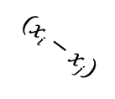










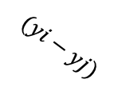
Chaining (Two Points)
$$xj$$
$$xi$$
Chaining
Target Seq.
Target Seq.
$$aj$$
$$ai$$
Anchor (Seed match)
$$wi$$
$$(xi−xj)$$
$$aj$$
$$yj$$
$$yi$$
Query Seq.
Query Seq.
$$aj$$
$$ai$$
$$(yi−yj)$$
$$wi$$

Slide 58
Chaining (Multiple Points)
Exact hash value matches: Needed for finding matching regions between a reference genome and a read
What if there are mutations or errors?
No hash (seed) match will occur in such positions
The chaining algorithm links exact matches in a proximity even though there are gaps (no seed matches) between them

Slide 59
Sequence Alignment

Slide 60
Nanopore Sequencing
Notes:
Nanopore technology consists of a nanometre-sized pore in an insulating membrane that separates two electrolyte-filled wells
DNA/RNA: negatively charged due to their phosphate-sugar backbones, which contain phosphate groups that carry negative charges.

Slide 61
Source of Noise in Nanopore Sequencing
Stochastic thermal fluctuations in the ionic current
Random ionic movement due to inherent thermal energy (Brownian motion)
Variations in the translocation speed
Mainly due to the motor protein
Environmental factors
Temperature: Affecting enzymes including the motor protein
pH levels: Affecting charge and the shape of molecules
Maybe: Aging & material-related noise between nanopores
Their effects potentially can be minimized with normalization techniques
Notes:
Thermal fluctuations: Stochastic thermal fluctuations refer to random, small-scale variations in “ion movement” due to inherent thermal energy at the molecular level. These fluctuations occur at any temperature above absolute zero.
Brownian motion and even at quantum levels
Variations: due to the design of motor protein -> can be affected by environmental factors like temperature (below)
Temperature: can alter enzyme performance, leading to signal inconsistencies. -> higher temperatures may speedup translocation. Increases molecular Kinetic energy

Slide 62
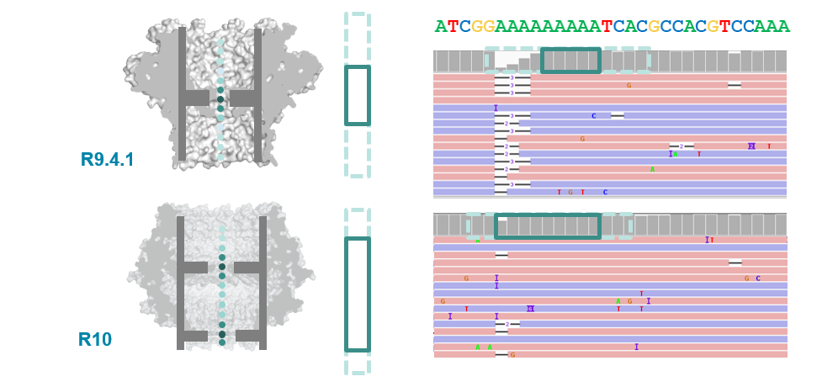
R9 vs. R10 Chemistries
Dual reader head
Motor protein with more consistent translocation speed in R10
Duplex sequencing in R10

Slide 63
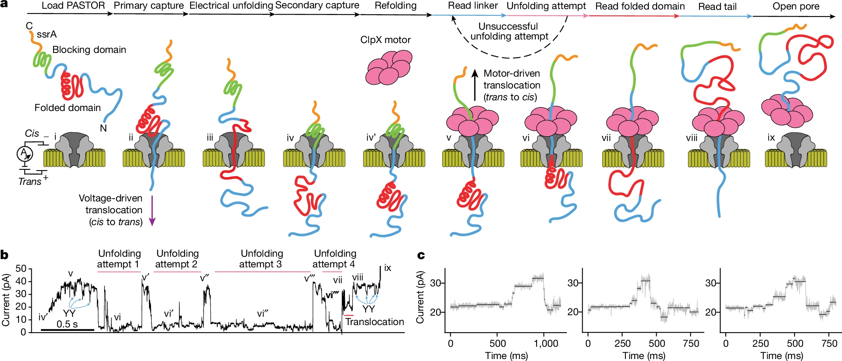
Proteomics with Nanopores
Motone+, “Multi-pass, single-molecule nanopore reading of long protein strands”, Nature 2024.
Notes:
PTMs: post-translational modifications, PTM code: unique and specific roles in driving biological processes Peptide vs protein
Challenge: neutrally charged polypeptide backbone (lacking a consistent charge distribution): complicates the application of techniques that rely on charge-based separation or detection
Challenge: varying charge states of amino acid side chains: 20 different amino acids, each with unique side chains that can carry positive, negative, or neutral charges depending on the pH and local environment. Canceling out behavior?
Challenge: Rigid/Stable 3D protein structures. Challenging to sequence full length molecule
Control pH to control the movement of the protein

Slide 64
Related Works
Noise-tolerant sketching
Sampling mechanisms (e.g., minimizers, syncmers, strobemers, MinHash)
Generated sketches must still exactly match
BLEND can be applied to generate their hash values to find similar sketches
Spaced seeds
Cannot tolerate arbitrary mismatches due to fixed patterns
BLEND can be applied to generate hash values of spaced seeds
Different masking and hashing techniques
LexicHash: Similar to finding maximal exact match with MinHash properties
Order-insensitive hashing
Other locality sensitive hashing mechanisms
Identifying similarity with multiple hash matches, instead of a single one
Future work: DenseFly, FlyHash … (some of them use Random Matrices)
BLEND
RawHash
RawHash2
Rawsamble
Notes:
Winnowing: Multiple minimum k-mers in a window. Select the already selected one, instead of selecting all minimum. ACACACA…
LexicHash: Two bit encoding of sequences. Create multiple masks from random k-mers and use their two bit encoding as masks when XORing with original k-mers from the sequence.
This is similar to MinHash but now rather than different hash functions, we have different masks. Each mask determines a different lexicographic ordering (this is probably to mitigate the ordering bias caused when assigning bits to A,T,G,Cs)
In a window of k-mers, for each mask, select the minimum k-mer (after xoring with the particular mask), let’s call them minmers. Similar to MinHash, create a vector of minmers (using each mask). For each mask, calculate the number of most significant bits between a pair of minmers between two sequences. This gives an intuition about the number of matching bases (e.g., 8 bits ~= 4 bases). Among all masks, choose the largest number of matching bits [1,4,1,1] = choose 4 because second mask gives 8 bits (4 bases) most significant match.
This is useful if you do not want to set k-mer in a very fixed way. Rather here the chosen k is a CAP for us (if 10-mer is chosen, we can still find 4-mer matches). They have a tree structure to find these.
Winnowmap: Assign weights to minimizers to balance the frequency of minimizers (instead of using a frequency filter)
Winnowmap2: minimal confidently alignable substrings (MCASs) Others: Score-based hashing like Nilsimsa hash (0 for dissimilar to 128 for very similar)

Slide 65
The SimHash Technique
Goal: Generate the same hash value for similar vector of items
Example input: A sentence (a vector of items)
Items: Words in a sentence (hash values of items)
Count the net difference between 0s and 1s at each position
This is an example sentence to generate a hash value
Words
This
is
an
example
sentence
to
generate
a
hash
value
Words
This
is
an
example
sentence
to
generate
a
SimHash
value
Hash Values
0b01111000
0b11011101
0b00011100
0b01000001
0b11110000
0b01011101
0b10011100
0b11000001
0b11111101
0b00101011
Hash Values
0b01111000
0b11011101
0b00011100
0b01000001
0b11110000
0b01011101
0b10011100
0b11000001
0b01001011
0b00101011
Bitwise Sum
(Net difference
between 0s and 1s)
Counter Vector
[0, +4, -2, +4, +4, 0, -8, +2]
[-2, +4, -4, +2, +4, -2, -6, +2]
SimHash Value
0b01011001
BLEND
RawHash
RawHash2
Rawsamble

Slide 66
Integrating BLEND for Seeding
Sequences
Seeding + BLEND
Hash Values
Hash Table
Hash Table
GCTATTA
0x02
Find
Min
0x02
CTATTAC
0x02
TATTACC
TATTACC
0x02
ATTACCT
0x45
Finding minimizers with BLEND
GCTATTAATGGA
0xA1
Hash Table
GCTATTAATGGA
0xA1
CCTCTAAATGGA
0xA1
Strobemer seeds
Hashing strobemer seeds with BLEND
BLEND
RawHash
RawHash2
Rawsamble

Slide 67
Sequence-to-Vector Conversion (BLEND-I)
Goal: Convert seed sequences into vector of items
Input: A fixed-length sequence (seed sequence)
Extract all overlapping k-mers of the seed (neighbors)
Generate the hash values of neighbors using any hash function
Vector items: Hash values of neighbors
GCTATTAATGGA
GCTATTAA
Hash
0b0110
All Overlapping k-mers
CTATTAAT
Hash
0b1110
Vector
Items
TATTAATG
Hash
0b0111
ATTAATGG
Hash
0b1000
TTAATGGA
Hash
0b0010
Neighbors
BLEND
RawHash
RawHash2
Rawsamble

Slide 68
Sequence-to-Vector Conversion (BLEND-S)
Goal: Convert seed sequences into vector of items
Input: A fixed-length sequence (seed sequence)
BLEND
RawHash
RawHash2
Rawsamble

Slide 69
Sequence-to-Vector Conversion (SIMD)
BLEND
RawHash
RawHash2
Rawsamble
Notes:
To enable 1,-1 encoding for a given hash value (more detailed description in the next slide)
Encoding. Set to 1 or -1 if the bits are either 0 or 1. Funnily, the native function is also called blend here. (more detailed description in the next slide)
Inverse of movemask inverse (from 1)

Slide 70
Sequence-to-Vector Conversion (SIMD)
BLEND
RawHash
RawHash2
Rawsamble

Slide 71
Generating the SimHash values
Goal: Generate the SimHash value of a seed
Input: Vector items from BLEND-I or BLEND-S
Encode hash values using vectors of -1s and +1s
Bitwise sum in SimHash: Vector summation
Decode the counter vector into a SimHash value for the seed
Vector Items from or
0b0110
Binary to Vector Encoding
(SIMD)
[-1, 1, 1,-1]
Sum
(SIMD)
Decoding
(SIMD)
0b1110
[ 1, 1, 1,-1]
0b0111
[-1, 1, 1, 1]
0b1000
[ 1,-1,-1,-1]
[-1, 1, 3, -3]
0b0110
Hash Table
0b0010
[-1,-1, 1,-1]
Counter Vector
Hash Value
SimHash
BLEND
RawHash
RawHash2
Rawsamble

Slide 72
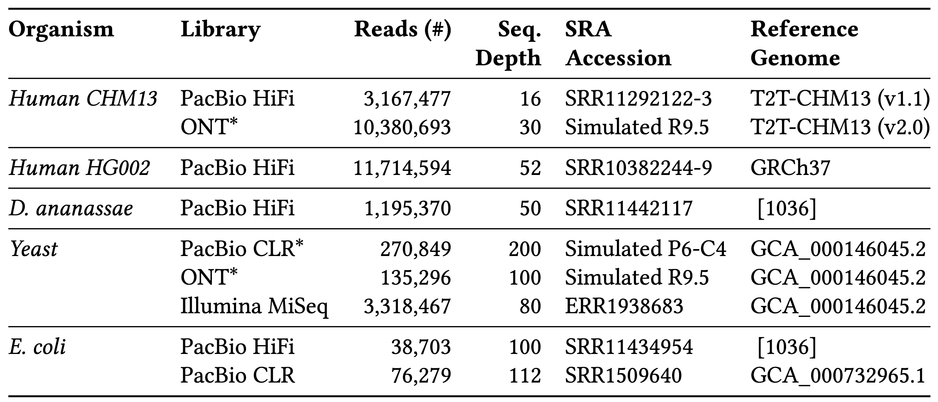
Datasets
BLEND
RawHash
RawHash2
Rawsamble
Notes:
HG002 was on h37 because of the SV calling evaluation where the ground truth was generated using hg37

Slide 73
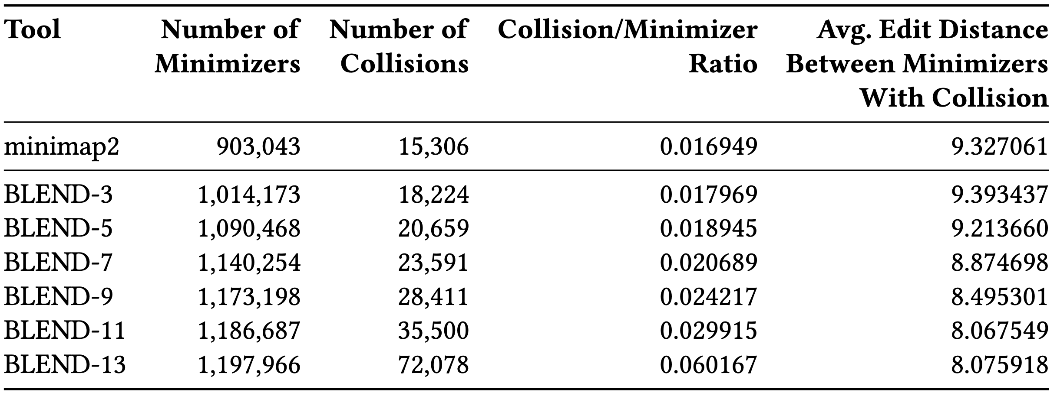
Hash Collisions
BLEND
RawHash
RawHash2
Rawsamble
Notes:
Collision rate increases, while avg edit distance decreases

Slide 74
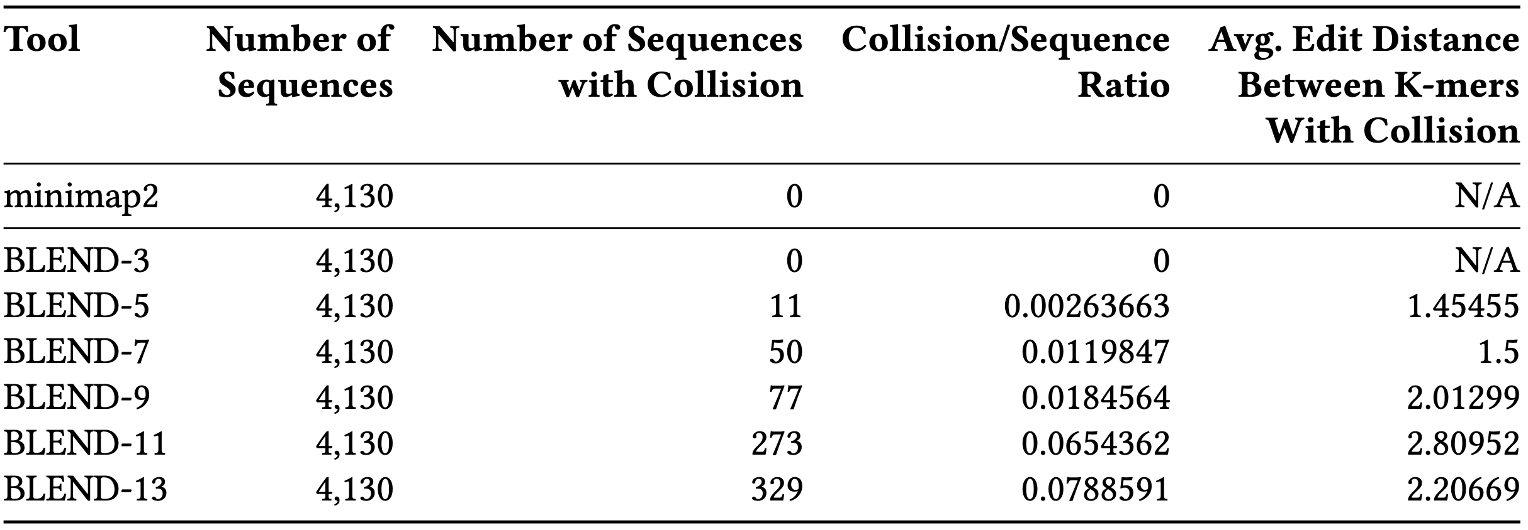
Hash Collisions between Similar Seeds
BLEND
RawHash
RawHash2
Rawsamble
Notes:
Collisions only between previously known similar sequences. BLEND ‘generates’ collisions, although low collision hash function cannot

Slide 75
Empirical Analysis on Fuzzy Seed Matching
BLEND
RawHash
RawHash2
Rawsamble

Slide 76
Read Overlapping – Performance & Memory
For HiFi: Average speedup of 40.3x (minimap2)
Reducing the memory footprint by 7.2x
Improving critical parameters without hurting the accuracy:
Window length (200) and seed length (31-mers)
BLEND
RawHash
RawHash2
Rawsamble

Slide 77
Overlapping Statistics
BLEND
RawHash
RawHash2
Rawsamble
Notes:
Shorter overlaps cannot be found? It’s OK because of the assembly results. (especially for HiFi)

Slide 78
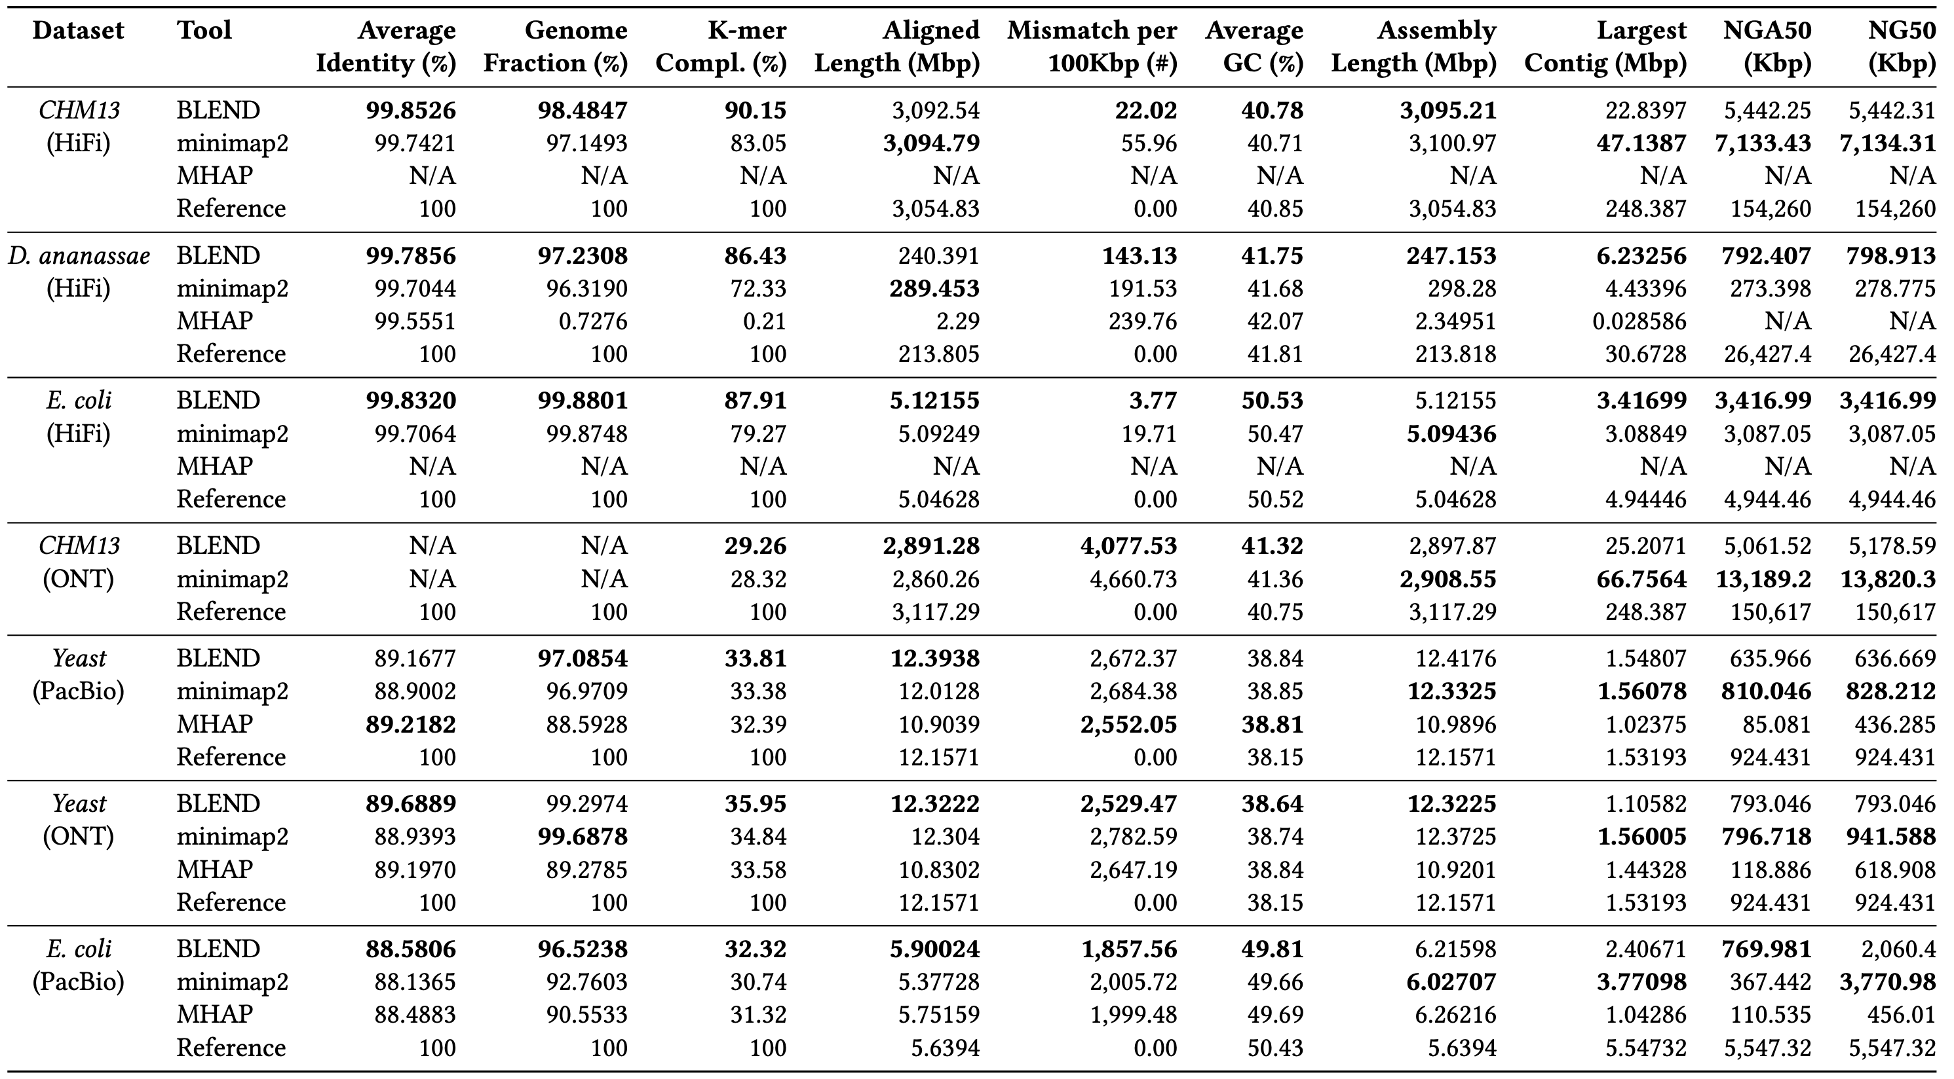
Assembly Results
BLEND
RawHash
RawHash2
Rawsamble
Notes:
Best accuracy for Hifi
Usually better contiguity for HiFi
Still usually better accuracy for non-HiFi
Usually poor contiguity

Slide 79
Read Mapping Results
BLEND
RawHash
RawHash2
Rawsamble
Notes:
Better performance for HiFi,
Similar performance,memory for non-HiFi

Slide 80
Read Mapping Accuracy – BLEND
BLEND
RawHash
RawHash2
Rawsamble
Notes:
You want to be on the top and towards left.
Left: more accurate
Top: more reads mapped

Slide 81
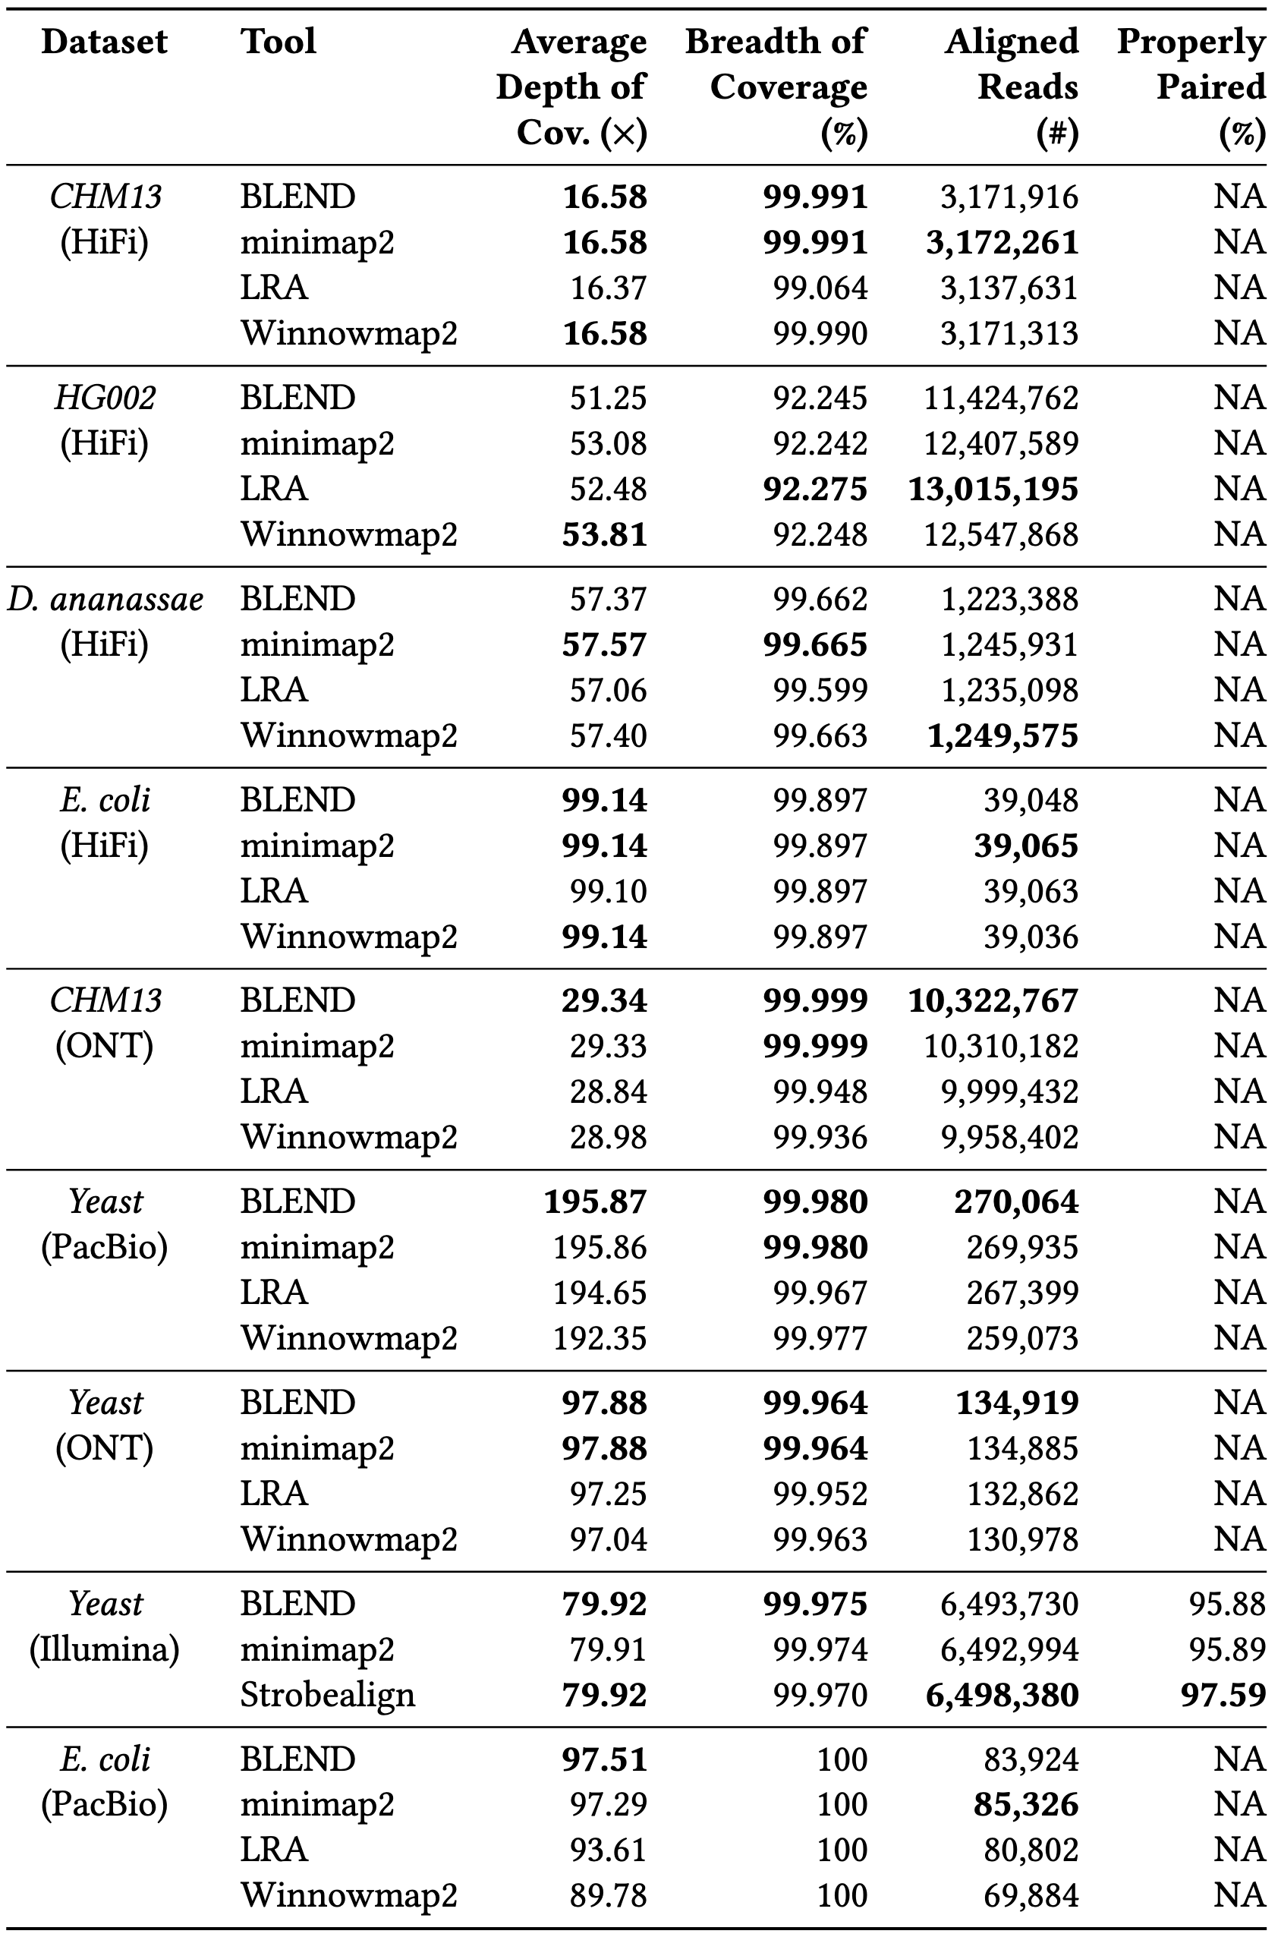
Read Mapping Quality
BLEND
RawHash
RawHash2
Rawsamble
Notes:
Most results are similar

Slide 82
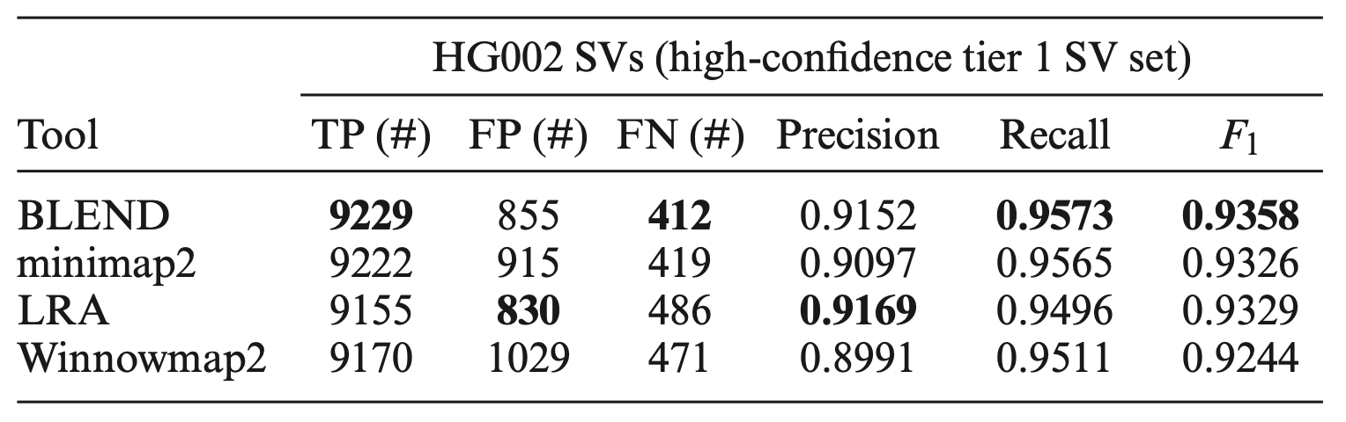
Read Mapping – SV Calling
Structural variant (SV) calling using read mappings from each tool
Sniffles2 to call SVs from HG002 long read mappings
Truvari to compare the resulting SVs with the benchmarking SV set (Tier 1 set from GIAB)
Best overall accuracy in downstream analysis
BLEND
RawHash
RawHash2
Rawsamble
Notes:
Best SV, almost best precision

Slide 83
Overlapping Perf. – BLEND-I vs BLEND-S
BLEND
RawHash
RawHash2
Rawsamble
Notes:
BLEND-S faster, more memory efficient as expected for HiFi. Longer runs of seeds are likely to appear (their spanning region is much longer). This observation is later exploited in mapquik too.

Slide 84
Overlapping Perf. – BLEND-I vs. minimap2
BLEND
RawHash
RawHash2
Rawsamble
Notes:
We do not have this same comparison for read mapping because the parameters in the main results already show them under the same parameter configurations. No HiFi here because k-mer length we span was 31-mer, which was not possible in minimap2 (without a serious implementation modification). So we focused on non-HiFi

Slide 85
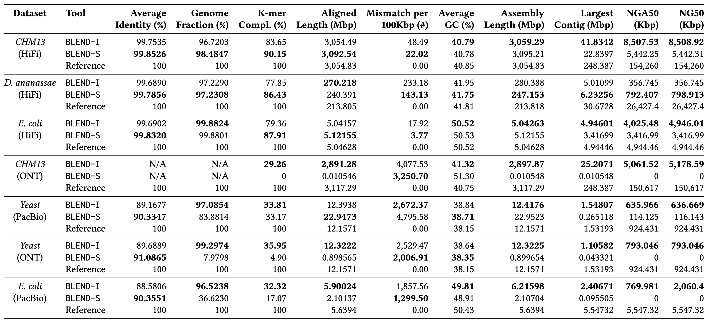
Assembly Stats. – BLEND-I vs. BLEND-S
BLEND
RawHash
RawHash2
Rawsamble
Notes:
BLEND-S accuracy is better for HiFi.
BLEND-S is much less contiguous for non-HiFi, although sometimes provides better accuracy. This shows we need non-strobemer like seed matches in non-HiFi, hence BLEND-S

Slide 86
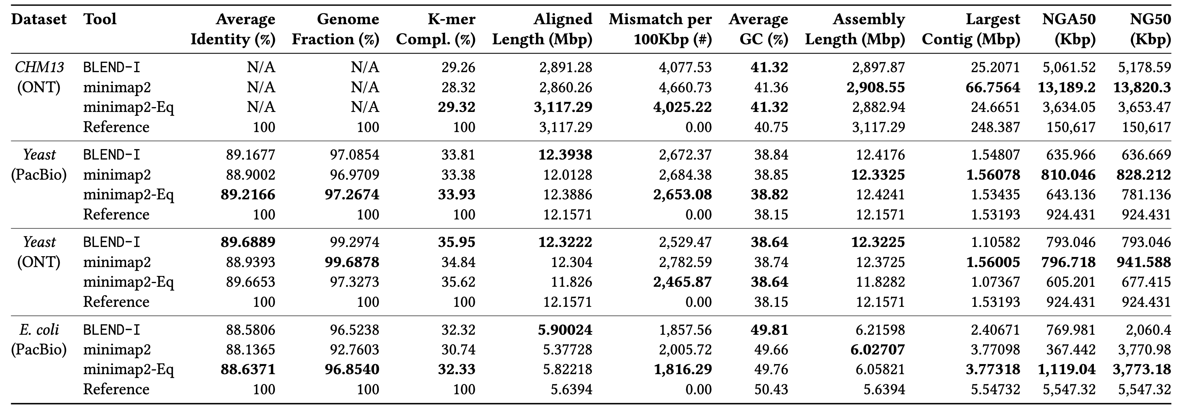
Assembly Stats. – BLEND-I vs. minimap2
BLEND
RawHash
RawHash2
Rawsamble
Notes:
We do not have this same comparison for read mapping because the parameters in the main results already show them under the same parameter configurations. Mixed results, sometimes BLEND-I is better sometimes minimap2-Eq. But we know BLEND-S was consistently better than BLEND-I for HiFi while it was mixed for non-HiFi for accuracy. So we expect consistent better accuracy for HiFi if we could compare to minimap-Eq.

Slide 87
Mapping Perf. – BLEND-I vs. BLEND-S
BLEND
RawHash
RawHash2
Rawsamble
Notes:
Better perf for HiFi: longer regions we span, quicker to find chains (fewer anchors to chain). For non-Hifi, we are probably trying RMQ chaining
Same number of sketches but probably BLEND-S k-mers are more unique: hence more memory usage
Probably this is also why we have poor performance for BLEND-S in non-HiFi

Slide 88
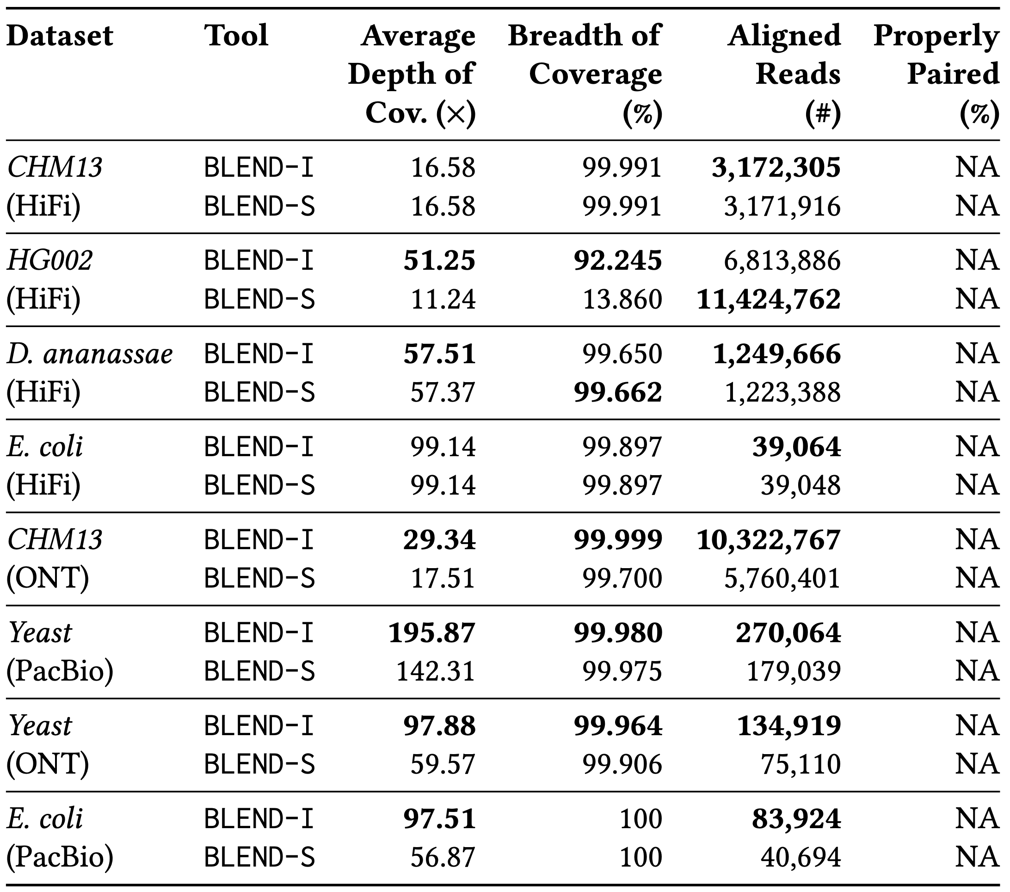
Mapping Quality – BLEND-I vs. BLEND-S
BLEND
RawHash
RawHash2
Rawsamble
Notes:
Note: Substantially better aligned reads for HG002. Ref was hg37!!
Other results are similar

Slide 89
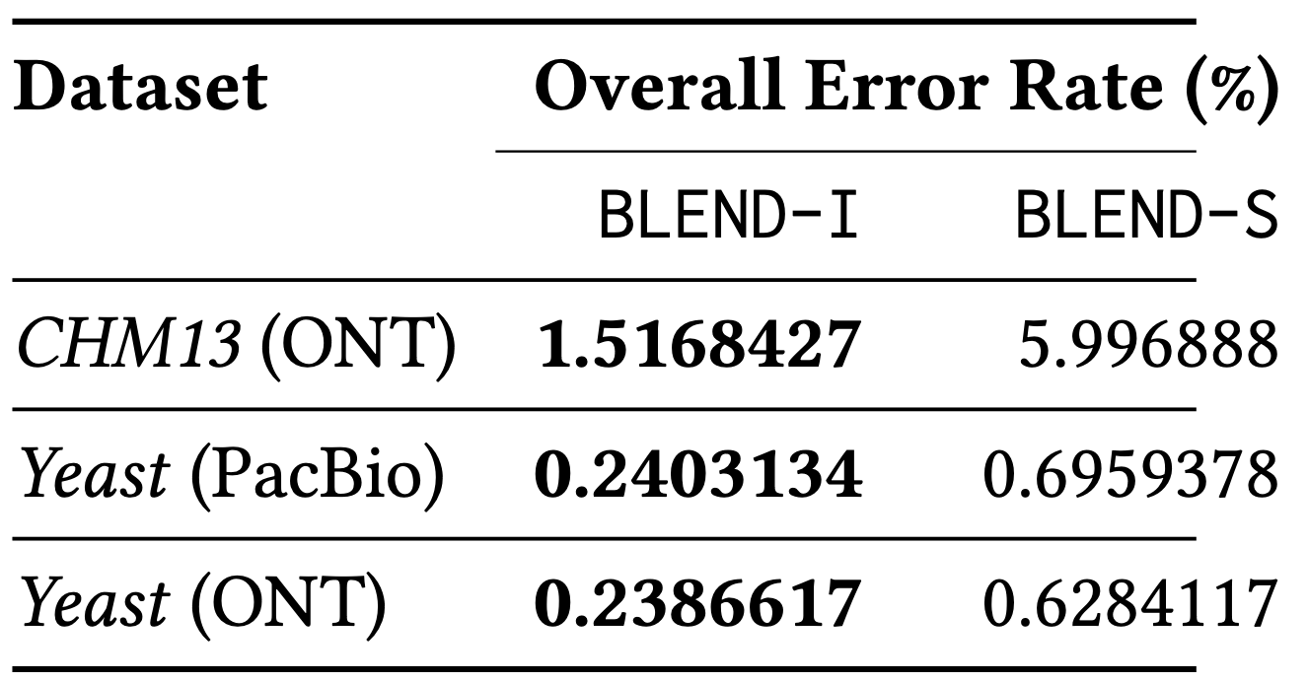
Mapping Acc. – BLEND-I vs. BLEND-S
BLEND
RawHash
RawHash2
Rawsamble

Slide 90
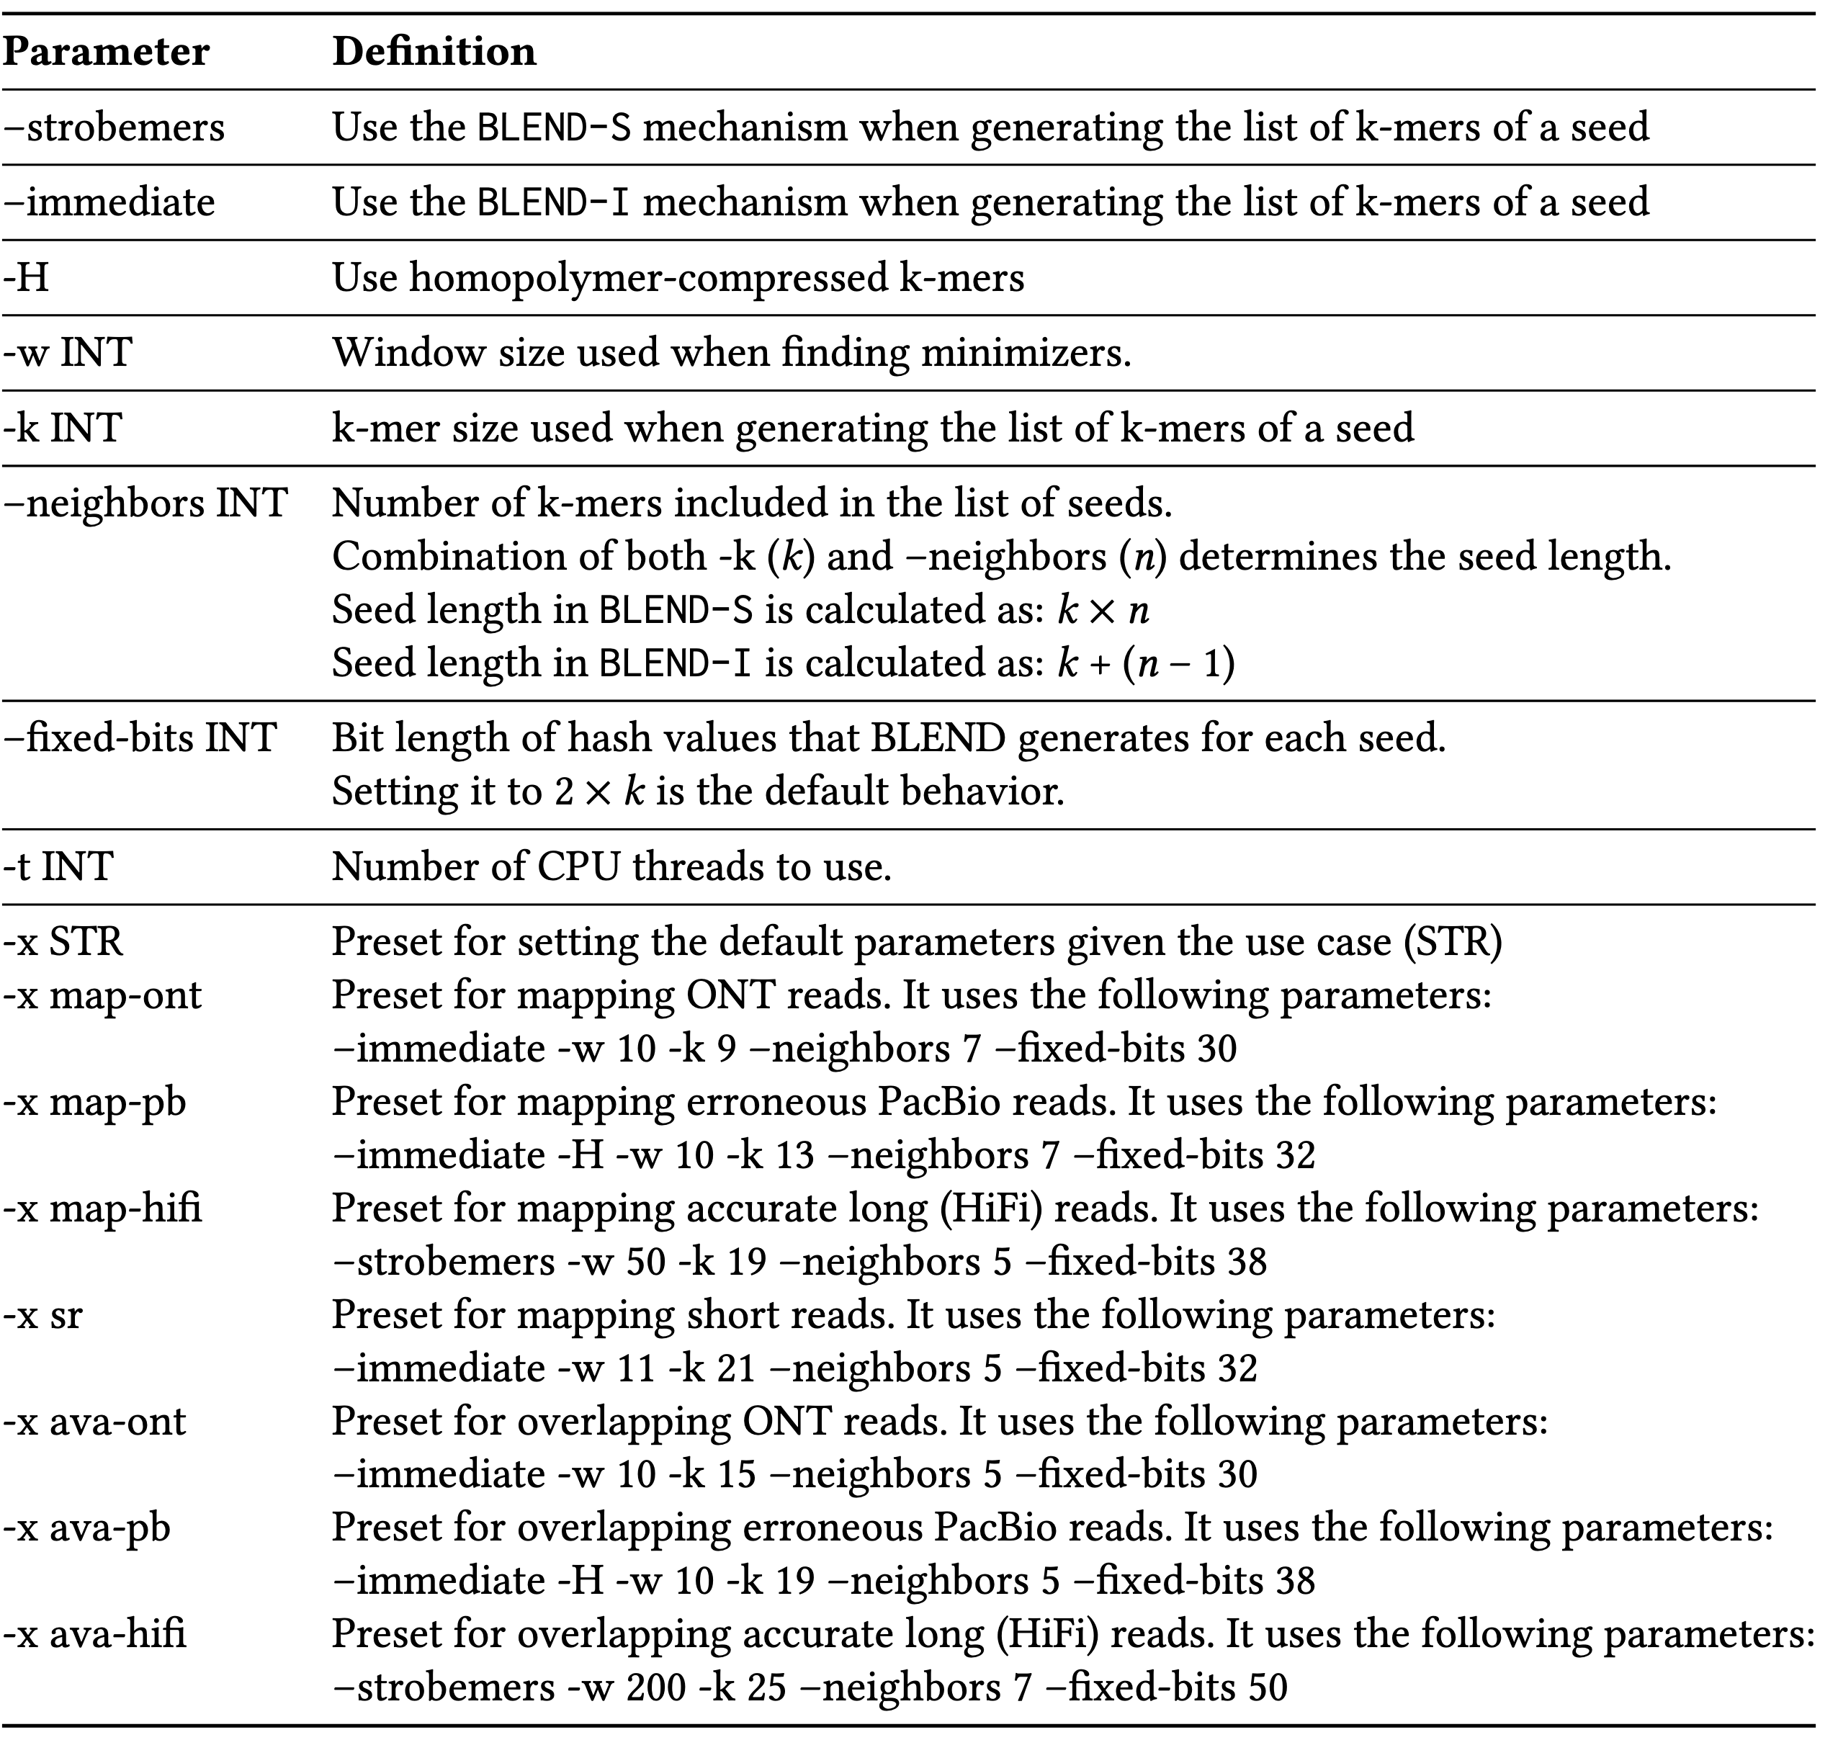
BLEND Parameter Definitions
BLEND
RawHash
RawHash2
Rawsamble

Slide 91
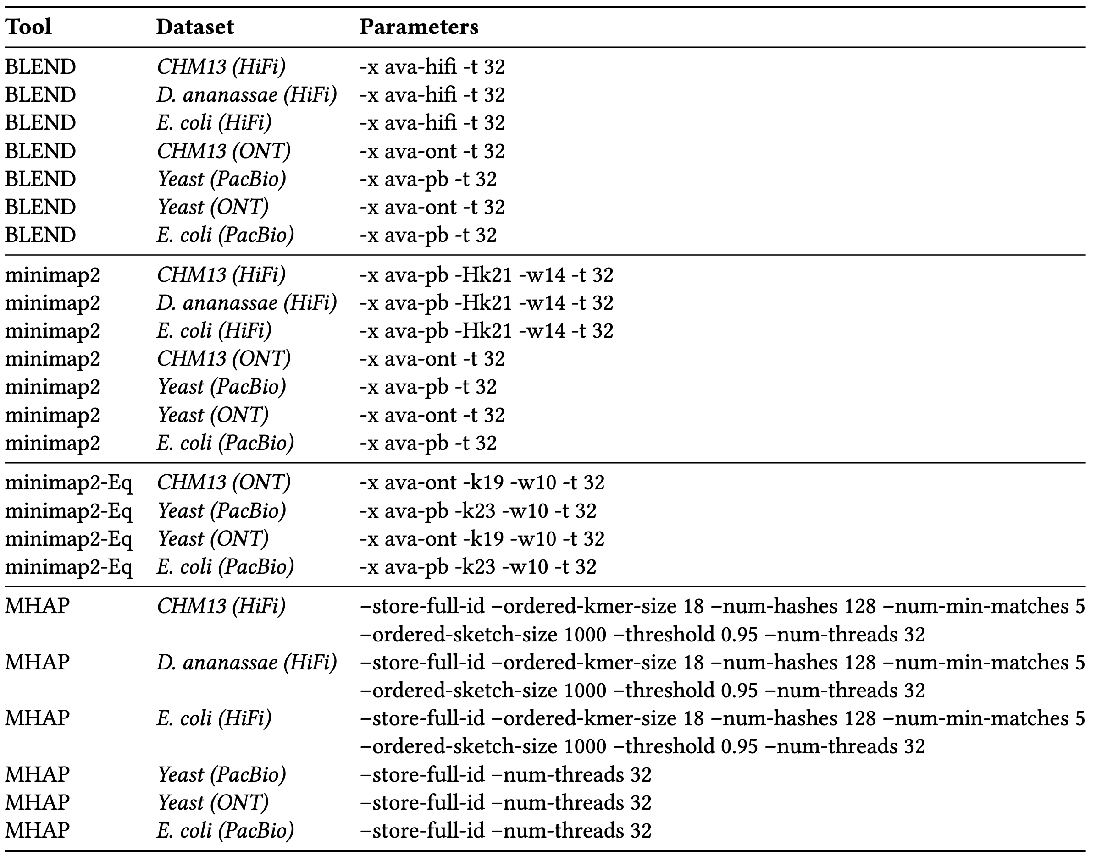
Parameter Settings – Overlapping
BLEND
RawHash
RawHash2
Rawsamble
Notes:
Overlapping parameters for minimap2 ava-hifi was suggested by HiCanu (they use these parameters for overlapping hifi reads with minimap2)

Slide 92
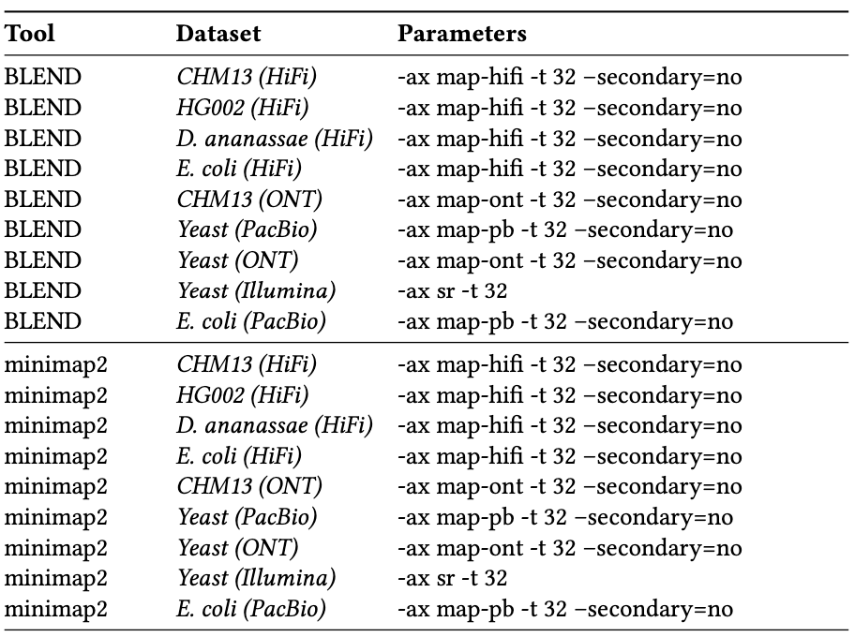
Parameter Settings – Read Mapping #1
BLEND
RawHash
RawHash2
Rawsamble

Slide 93
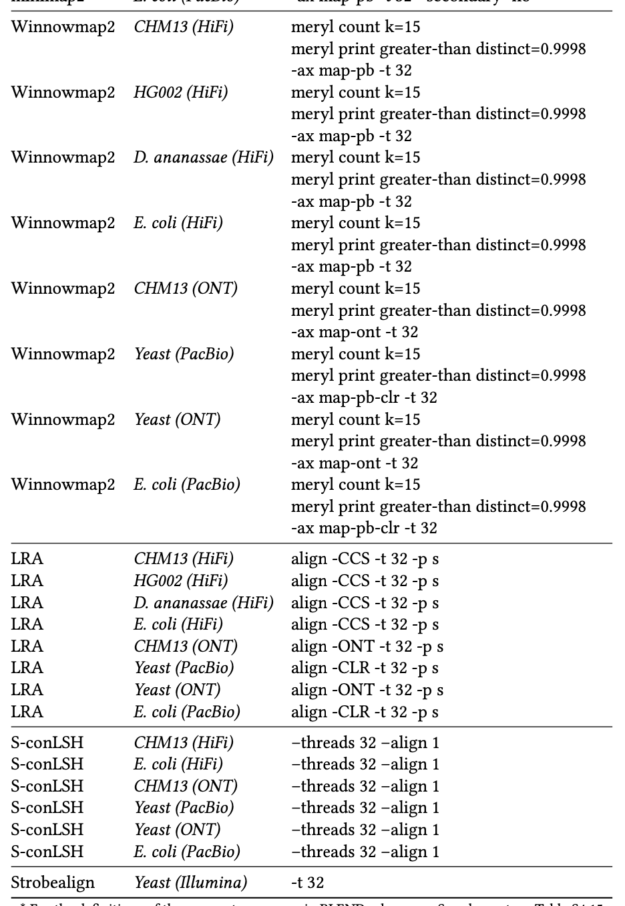
Parameter Settings – Read Mapping #1
BLEND
RawHash
RawHash2
Rawsamble

Slide 94




Challenges in Real-Time Analysis
Rapid analysis to match the nanopore sequencer throughput
Timely decisions to stop sequencing as early as possible
Accurate analysis from noisy raw signal data
Power-efficient computation for scalability and portability
BLEND
RawHash
RawHash2
Rawsamble

Slide 95
Applications of Read Until
Depletion: Reads mapping to a particular reference genome is ejected
Microbiome studies by removing host DNA
Eliminating known residual DNA or RNA (e.g., mitochondrial DNA)
High abundance genome removal
Enrichment: Reads not mapping to a particular reference genome is ejected
Removing contaminated organisms
Targeted sequencing (e.g., to a particular region of interest in the genome)
Low abundance genome enrichment
BLEND
RawHash
RawHash2
Rawsamble

Slide 96
Applications of Run Until & Sequence Until
Run Until: Stopping the entire sequencing run
Stopping when reads reach to a particular depth of coverage
Stopping when the abundance of all genomes reach a particular threshold
Sequence Until: Run Until with accuracy-aware decision making
Stopping when relative abundance estimations do not change substantially (for high-abundance genomes)
Stopping when finding that the sample is contaminated with a particular set of genomes
…
BLEND
RawHash
RawHash2
Rawsamble

Slide 97
In Vitro (e.g., PCR) vs. In Silico
Polymerase Chain Reaction (PCR) as a way of in vitro “analysis”
Can increase the quantity of DNA in a sample
Non-dynamic targeted sequencing (e.g., low abundance known targets)
Requires additional resources: Time and money for preparation and execution of PCR
Adaptive sampling as a way of in silico (i.e., computational) analysis
Cannot increase the existing quantity of DNA in a sample
Dynamic targeted sequencing: Decisions can be made based on real-time analysis (e.g., Sequence Until)
Minimal additional resources
Almost no additional resources for preparation and execution
Simultaneous enrichment and depletion is possible
Better suited for rapid whole genome sequencing
Beauty of computational analysis (e.g., high flexibility – no need for primers)
PCR and adaptive sampling can be combined depending on the analysis type

Slide 98
Finding Mapping Positions
Useful for any application that requires exact genomic position
Variant calling in downstream analysis
Specifically: Identifying rare variants in cancer genomics
Methylation profiling
Accurate and flexible depth of coverage estimation
Alternative: DNA quantification (without computational analysis)
DNA quantification is challenging for metagenomics analysis
Computational method: We can map to almost entire set of known reference genomes to accurately estimate the coverage of a metagenomics sample
Transcriptome analysis
Accurately quantifying expression levels & alternative splicing
Better resolution (i.e., more sensitive analysis) for any other application that does not specifically require mapping positions

Slide 99

Analyzing Raw Nanopore Signals
Traditional: Translating (basecalling) signals to bases before analysis
Recent Work: Directly analyzing signals without basecalling
Basecalling
Read Mapping
Raw Signal Mapping
Raw Signal
Raw Signal
A
T
G
G
Basecalled sequences are less noisy than raw signals
Efficient analysis with better scalability and portability
Many analysis tools use basecalled sequences
Raw signals retain more information than just bases
Costly and power-hungry computational requirements
BLEND
RawHash
RawHash2
Rawsamble

Slide 100
The Problem – Mapping Raw Signals
Raw Signal
Small Reference Genome
Large Reference Genome (Human)
Fewer candidate regions in small genomes
Substantially larger number of regions to check per read as the genome size increases
Problem: Probabilistic mechanisms
on many regions ➔ inaccurate mapping
Accurate mapping
Problem: Distance calculation
on many regions ➔ reduced throughput
High throughput
BLEND
RawHash
RawHash2
Rawsamble

Slide 101
RawHash – Key Idea
Key Observation: Identical nucleotides generate similar raw signals
Raw Signal #1
Distance Calculation
Raw Signal #2
Hash
Hash
Fast Match
0x01
0x01
Challenge #1: Generating the same hash value for similar enough signals
Challenge #2: Accurately finding as few similar regions as possible
BLEND
RawHash
RawHash2
Rawsamble

Slide 102

Reference-to-Event Conversion
K-mer model: Provides expected event values for each k-mer
Preconstructed based on nanopore sequencer characteristics
Use the k-mer model to convert all k-mers of a reference genome to their expected event values
Reference Genome
Expected Event Values
Normalized Event Values
GCTATTACC
GCTATT
K-mer Model
(Lookup Table)
105.757390
Normalize
2.21
CTATTA
81.740642
-0.09
k-mers ($k=6$)
TATTAC
103.170091
1.15
ATTACC
101.082485
1.11
BLEND
RawHash
RawHash2
Rawsamble

Slide 103
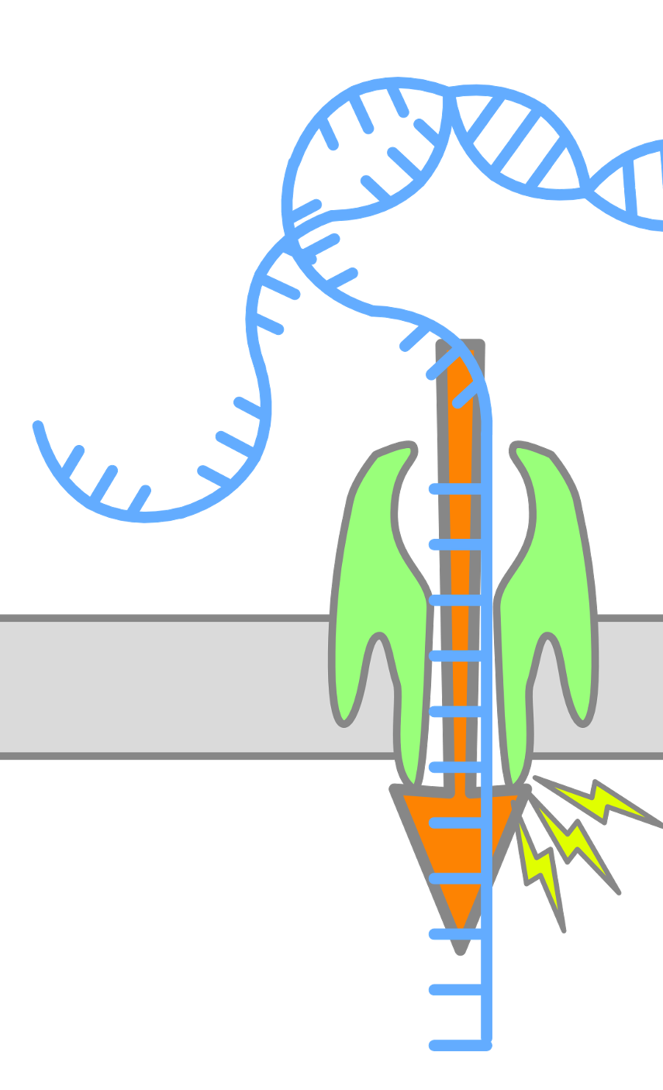
Enabling Analysis From Electrical Signals
K many nucleotides (k-mers) sequenced at a time
Event: A segment of the raw signal
Corresponds to a particular k-mer
Observation: Event values generated after sequencing the same k-mer are similar in value (not necessarily the same)
Event
Event Value
Raw Nanopore Signal
Normalize
ACTTGG
pAmpere
Segment
Calculate
Means
2.21
Time
k-mer
ACTTGG
BLEND
RawHash
RawHash2
Rawsamble

Slide 104
Quantization -- RawHash
BLEND
RawHash
RawHash2
Rawsamble

Slide 105
Packing and Hashing
Consecutive k-mers
Consecutive events
CTATTA
-0.09
Quantize
1
1
0
0
1
TATTAC
1.15
Quantize
0
0
1
1
0
…
…
…
…
Pack
ATTACC
1.11
Quantize
0
0
1
0
1
1
1
0
0
1
0
0
1
1
0
…
0
1
0
0
1
Hash value of consecutive events
0x400D70A4
Hash
BLEND
RawHash
RawHash2
Rawsamble

Slide 106
The Sequence Until Mechanism
Problem:
Unnecessary sequencing waste time, power and money
Key Idea:
Dynamically decide if further sequencing of the entire sample is necessary to achieve high accuracy
Stop sequencing early without sacrificing accuracy
Potential Benefits:
Significant reduction in sequencing time and cost
Example real-time genome analysis use case:
Relative abundance estimation
BLEND
RawHash
RawHash2
Rawsamble

Slide 107





The Sequence Until Mechanism
Key Steps:
Continuously generate relative abundance estimation after every $n$ reads
Keep the last $t$ estimation results
Detect outliers in the results via cross-correlation of the recent $t$ results
Absence of outliers indicates consistent results
Further sequencing is likely to generate consistent results ➔ Stop the sequencing
Relative Abundance Estimation
Keep Sequencing
$n$ Reads Sequenced
Estimation #1
Yes
Relative Abundance Estimation
$2n$ Reads Sequenced
Estimation #2
Outlier?
…
…
…
No
Relative Abundance Estimation
$t×n$ Reads Sequenced
Estimation #$t$
Stop Sequencing
BLEND
RawHash
RawHash2
Rawsamble

Slide 108
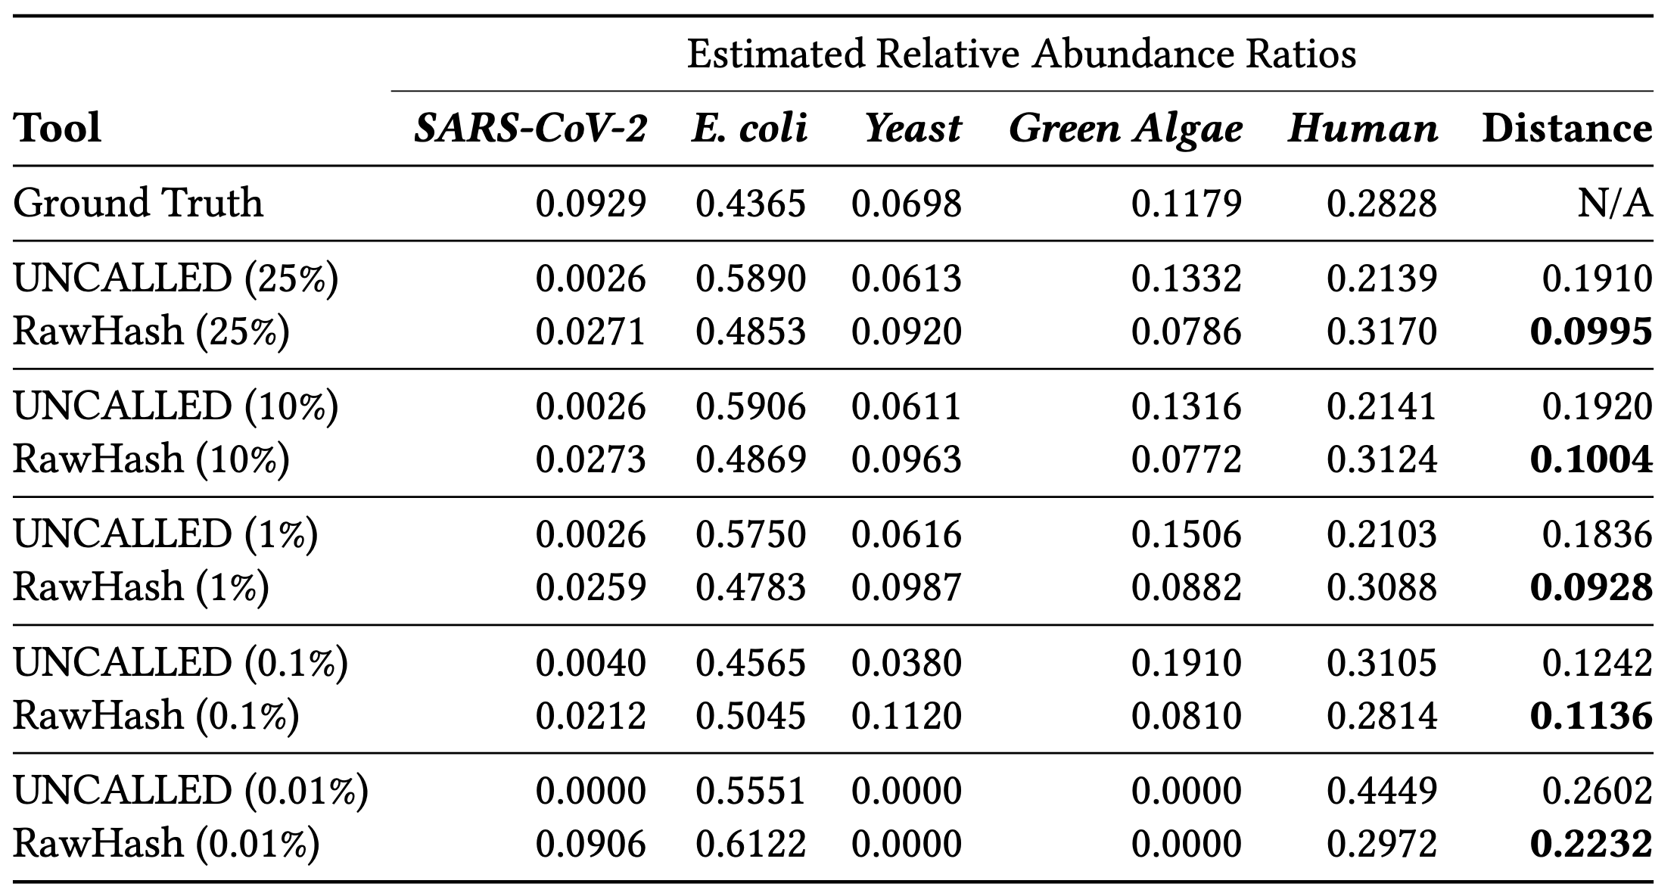
Sequence Until – RawHash & UNCALLED
BLEND
RawHash
RawHash2
Rawsamble

Slide 109
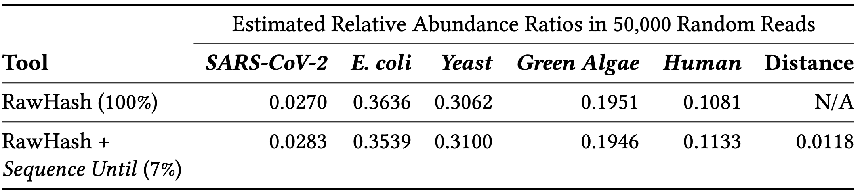
Sequence Until – RawHash
BLEND
RawHash
RawHash2
Rawsamble

Slide 110
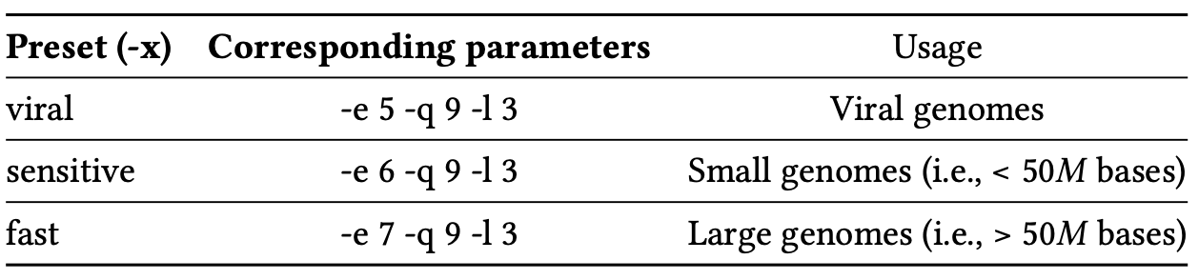
Presets
BLEND
RawHash
RawHash2
Rawsamble

Slide 111
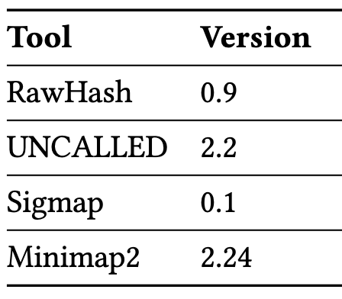
Versions – RawHash
BLEND
RawHash
RawHash2
Rawsamble

Slide 112
Related Works
Basecalled real-time analysis
ReadFish, ReadBouncer, RUBRIC: Basecalled read mapping
SPUMONI, SPUMONI 2: Basecalled binary classification using r-index
Coriolis: Basecalled metagenomics classification
baseLess: k-mer calling for classification
Raw signal analysis without basecalling
SquiggleNet, DeepSelectNet, RawMap: Target/non-target classification
Sigmoni: Target/non-target classification using r-index
UNCALLED, Sigmap, RawHash: Read mapping
BLEND
RawHash
RawHash2
Rawsamble
Notes:
UNCALLED: Searching with ambiguity in FM-index. Find all possible k-mers that a event can represent. Query all in FM-index, then start a node from each match, and edge to the next ”event” where the next event can also represent multiple k-mers. Keep doing this until you uniquely reach a region. Forest of trees.

Slide 113

Adaptive Quantization
BLEND
RawHash
RawHash2
Rawsamble

Slide 114




Chaining Scores – RawHash vs RawHash2
RawHash Chaining
RawHash2 Chaining
BLEND
RawHash
RawHash2
Rawsamble

Slide 115

Datasets
BLEND
RawHash
RawHash2
Rawsamble
Notes:
Staphylococcus aureus

Slide 116

Accuracy
BLEND
RawHash
RawHash2
Rawsamble

Slide 117
Mapping Accuracy – Radar
BLEND
RawHash
RawHash2
Rawsamble
Notes:
Focus on larger genomes.

Slide 118

Mapping Accuracy – All Metrics
BLEND
RawHash
RawHash2
Rawsamble

Slide 119
Combined Benefits – Radar
BLEND
RawHash
RawHash2
Rawsamble
Notes:
Focus on larger genomes.

Slide 120

Sequenced Length
BLEND
RawHash
RawHash2
Rawsamble

Slide 121

Computational Resources #1
BLEND
RawHash
RawHash2
Rawsamble

Slide 122

Computational Resources #2
BLEND
RawHash
RawHash2
Rawsamble

Slide 123
Average Time Spent per Read
BLEND
RawHash
RawHash2
Rawsamble
Notes:
This does not show how many bases they sequence. Not a great metric. If they were sequencing the same amount, would be good.
That’s why throughput + sequenced bases is better.
RawHash2/RawHash2-Minimizer is still better because of lower sequenced bases and higher throughput.

Slide 124

FAST5 vs. POD5. vs S/BLOW5
BLEND
RawHash
RawHash2
Rawsamble
Notes:
FAST5 supports zlib and vbz (zstd+streamvbyte) as compression methods.
Default used to be zlib which ONT at once point made vbz the default.
BLOW5 also has zlib and vbz and the default is zlib.
POD5 only has vbz (actually an SIMD accelerated version of vbz).
zlib is much more CPU-intensive than zstd.

Slide 125

Flow Cell Types R9 vs R10.4
BLEND
RawHash
RawHash2
Rawsamble
Notes:
Two reasons: 1) Better basecalled mapping, so we are further away from ground truth -> significant drop in recall
2) Worse segmentation. -> still some drop in precision (this can be explained by 1 too)

Slide 126

Ratio of Filtered Seed Hits
BLEND
RawHash
RawHash2
Rawsamble
Notes:
Filtering: finding mid point index, min and max values for number of positions in the mid points. If within min,max range use the value we find. If not, use either min or max depending on where the actual mid value is.
Using this for filtering.

Slide 127

Presets
BLEND
RawHash
RawHash2
Rawsamble

Slide 128

Versions
BLEND
RawHash
RawHash2
Rawsamble

Slide 129

Datasets
BLEND
RawHash
RawHash2
Rawsamble

Slide 130

Throughput
BLEND
RawHash
RawHash2
Rawsamble

Slide 131

Performance
BLEND
RawHash
RawHash2
Rawsamble

Slide 132

Overlapping Statistics
BLEND
RawHash
RawHash2
Rawsamble

Slide 133

Assembly Statistics
BLEND
RawHash
RawHash2
Rawsamble

Slide 134
Visualizing the E. coli Assembly Graph
BLEND
RawHash
RawHash2
Rawsamble

Slide 135
Visualizing the Yeast Assembly Graph
BLEND
RawHash
RawHash2
Rawsamble

Slide 136
Visualizing the Green Algae Assembly Graph
BLEND
RawHash
RawHash2
Rawsamble

Slide 137
Visualizing the Human Assembly Graph
BLEND
RawHash
RawHash2
Rawsamble

Slide 138

HERRO Correction Before and After
BLEND
RawHash
RawHash2
Rawsamble

Slide 139

Parameters
BLEND
RawHash
RawHash2
Rawsamble

Slide 140

Presets
BLEND
RawHash
RawHash2
Rawsamble

Slide 141

Versions
BLEND
RawHash
RawHash2
Rawsamble

