Slide 1


RawBench A Comprehensive Benchmarking Framework for Raw Nanopore Signal Analysis Techniques
Furkan Eris
Ulysse McConnell Can Firtina Onur Mutlu
Notes:
Hi everyone. I am Furkan Eris from SAFARI Research Group at ETH Zurich. Today, I will present RawBench A comprehensive benchmarking framework for raw nanopore signal analysis techniques

Slide 2
Outline
Background
Motivation and Goal
RawBench
Evaluation
Conclusion
Notes:
First, I will give some background

Slide 3





Genomic Data Analysis
Study of genomics through the lens of growing sequencing data has shaped groundbreaking advances in
Evolutionary biology
Personalized medicine
Outbreak tracing
Gene editing
Novel mutation identification
Notes:
Genomics through the lens of growing sequencing data including new modalities has shaped groundbreaking advances in fields including evolutionary biology _ gene editing _ personalized medicine _ novel mutation identification _ and tracing outbreaks such as Covid-19

Slide 4

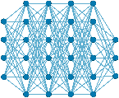

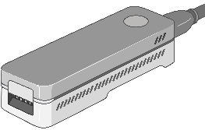

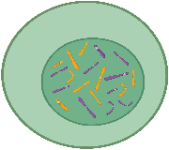

A Common Genome Analysis Pipeline
Raw Reads
Basecalling (Translator)
Basecalled (Translated) Reads
Read Mapping
AAATGTGGTCCATTG
ONT MinION
Assembly
Variant Calling
Metagenomics
Downstream Analysis
Notes:
But how does a common genome analysis pipeline look like? _ Let’s say we have some DNA sample from an unidentified origin. _ This sample is sequenced by a sequencing device, in this case a nanopore sequencer. _ As a result, this nanopore sequencer yields us some raw reads in the form of signals. _ these raw reads are processed by a basecaller so that they can be translated into a format that looks just like our reference genome. _ This ensures that we can map these reads to a reference genome _ and reap benefits such as identifying the source of our DNA sample_ along with enabling various types of downstream analyses such as genome assembly, variant calling and metagenomics.

Slide 5

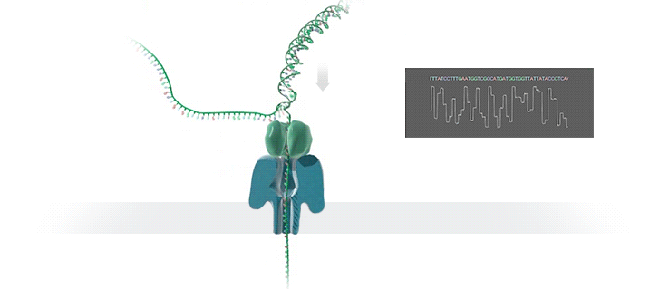



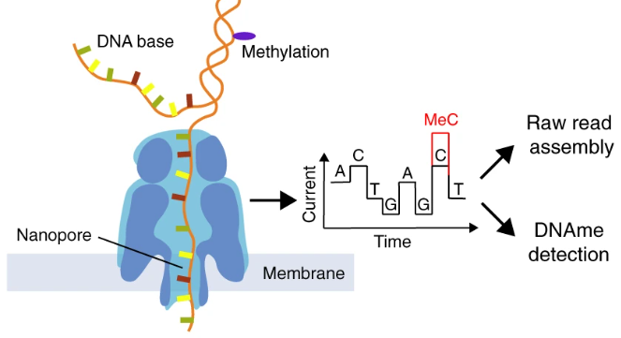
Benefits of Nanopore Sequencing
Adaptive sampling as a unique feature
Nanopore Sequencing
Raw Signals
Real-Time Analysis
Current
Raw nanopore signals are inherently rich
Methylation detection
Notes:
Now, let’s see some benefits of nanopore sequencing. _ First of all, nanopore sequencing uniquely enables adaptive sampling. _ As the DNA molecule passes through the nanopore, it causes fluctuations in the electrical current of the pore. _ These are reflected on the raw signal output. _ We can analyze these signals as they are generated and even make real-time decisions to stop sequencing a read without fully sequencing it. This is useful as it can reduce the overall sequencing time and cost.
Next, nanopore sequencing makes it easier to perform some downstream analyses like methylation detection. This is particularly because it’s not only DNA bases passing through but also other factors such as methylation that affect the raw signals. This means methylation can also be inferred from raw signals.

Slide 6
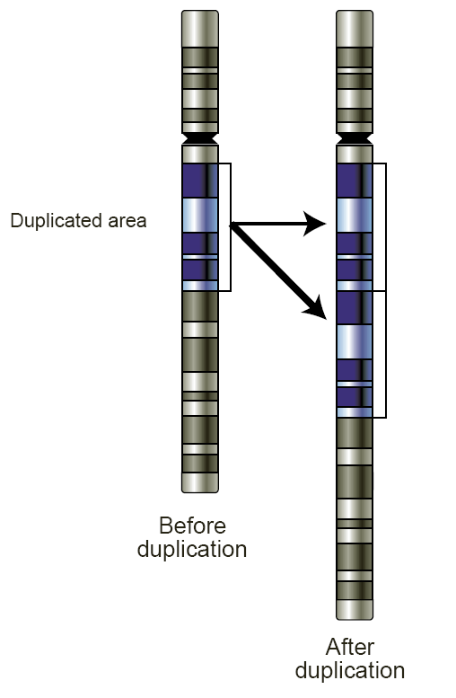
Benefits of Nanopore Sequencing
Ultra-long reads (up to 4 million bases)
Copy number variant detection
Portable sequencing (enables field deployment)
ONT MinION
Notes:
Another benefit is ultra-long reads which can go up to 4 million bases. This is particularly useful for cases such as copy number variant detection where copy number variants can be as long as 10 million bases.
Nanopore sequencing also enables deployment in resource-constrained settings with sequencing devices that are equal in size to a large usb stick.

Slide 7

Basecalling is Accurate yet Costly
Raw Reads
Basecalling (Translator)
Basecalled (Translated) Reads
Read Mapping
AAATGTGGTCCATTG
Noisy Raw Signals
Costly
AI Models
Highly accurate reads
Notes:
Now, back to our genome analysis pipeline…
Here it is important to note that these signals are noisy and they require costly AI models accompanied by expensive GPUs to produce highly accurate reads.

Slide 8
Can We Manage without Basecalling?
Raw Reads
Read Mapping
Noisy Raw Signals
Reference Genome
...
...
CTGCGTAGCAGCGTAATAG
How to communicate without an accurate basecaller?
Notes:
Now, can we manage without this expensive step for translation and directly map noisy raw signals to a reference?

Slide 9
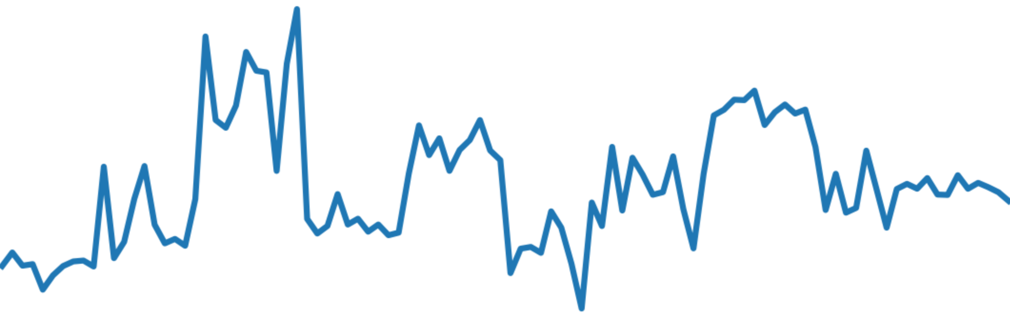
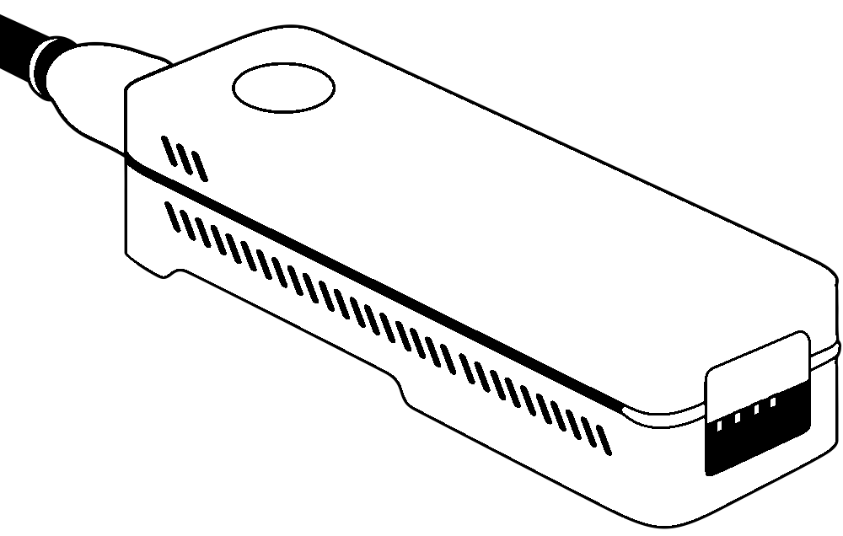
Raw Signal Analysis (RSA) Overview
First, the reference genome is encoded into a comparable representation
Second, raw signals are encoded similarly
Third, these representations are matched
ACGT
Encoding reference genome
Matching encoded representations
2
Encoding raw signal
Input Raw Signals
1
3
Input Reference
Read classification
Read mapping
Assisted basecalling
Notes:
And this is exactly where raw signal analysis comes in.
We first have to encode the reference genome such that it is now comparable to raw signals.
Next we encode raw signals similarly and finally in the third step we match these representations that now look alike.

Slide 10
Outline
Background
Motivation and Goal
RawBench
Evaluation
Conclusion
Notes:
Now lets talk about our motivation and goal.

Slide 11
Motivation
Traditional pipelines struggle with increasing real-time requirements RSA techniques emerged as competitive alternatives
Existing benchmarking frameworks overlook RSA RSA techniques differ in quality, speed and resource usage
There is a critical need for fair and extensive comparison of emerging RSA techniques
Goal: Compare quality and performance for different RSA techniques Target different downstream tasks and organism complexities
Notes:
Our first observation was that traditional pipelines centered around basecalling struggle with increasing real-time analysis demands.
This led raw signal analysis or RSA techniques to emerge as competitive alternatives.
However, existing few benchmarking works overlook RSA .
RSA techniques also differ in quality, speed and resource demands.
This shows a critical need for fair and extensive comparison of RSA techniques.
Our goal is then to compare quality and performance for different RSA techniques. In doing so, we target different downstream tasks and organism complexities to make it comprehensive.

Slide 12
Problems of Existing Works
Do not include raw signal analysis (RSA) tools
Lack the flexibility to incorporate newly developed methods
Lack access to standardized datasets from latest chemistry
Notes:
When we take a look at prior works, we observed the following shortcomings:
They lack access to standardized datasets from latest chemistry and this hurts the insightfulness of benchmarks as changing nanopore chemistries change characteristics of the data and how RSA techniques perform

Slide 13
Our Goal
Design a comprehensive, extensible and up-to-date benchmarking framework for RSA
Notes:
Our goal in this work is to

Slide 14
Outline
Background
Motivation and Goal
RawBench
Evaluation
Conclusion

Slide 15


RawBench: Comprehensive Benchmarking for RSA
First Benchmarking Framework for RSA
Key Idea: Enable systematic evaluation of existing and future RSA techniques in a flexible, comprehensive and up-to-date framework.
Holistic design combining a modular structure for different RSA stages and different nanopore sequencing datasets
Modular RSA stages to increase resolution of RSA benchmarking
Allows better exploring quality and performance trends
Wide range of datasets for a fair and comprehensive evaluation of RSA techniques on multiple downstream tasks
Covers a spectrum of datasets from different genome complexities
Includes datasets from the latest nanopore chemistry
Notes:
RawBench is the first benchmarking framework for raw signal analysis or RSA.
Key idea is to…
In this direction, we aimed for a holistic design…
We first paid attention to the modularity aspect as modular RSA stages increases resolution and insightfulness
Next we provided a wide range of...
We made sure RawBench covers…
Includes … as we want to observe how RSA techniques perform as data characteristics change

Slide 16
Towards a Modular RawBench
Aim: Break RSA down to different stages for in-depth benchmarking of different RSA techniques
Challenge: Preserve applicability for a wide range of existing (e.g., Sigmap and Uncalled) and future RSA tools
ACGT
Encoding reference genome
Matching encoded representations
Encoding raw signal
Input Raw Signals
1
3
2
ONT pore model
Hash-based
FM-index
t-test
Uncalled4 pore model
Vector distance
R-index
Move tables
Input Reference
DTW
Notes:
Going towards a modular rawbench, our aim was to…
One challenge we faced was to preserve…

Slide 17
Closer Look at RawBench Pipeline
ACGT
Encoding reference genome
Matching encoded representations
2
Encoding raw signal
Input Raw Signals
1
3
ONT pore model
Hash-based
FM-index
t-test
Uncalled4 pore model
Vector distance
R-index
Move tables
Input Reference
Add-on
DTW
Add-on
Add-on
1
Encoding Reference Genome
Uses learned pore models by ONT and community
2
Encoding Raw Signal
Utilizes statistical and ML-based encoding techniques
3
Matching Encoded Representations
Compares representations that are now encoded into the same space
Notes:
Now if we take a closer look at our pipeline,
In the first step, there exist pore models which are constructed using signal values of synthetic reads. So they hold kmer to signal value information.
In the second step, prior works utilize statistical and ML-based techniques to encode raw signals into easier-to-match representations. There is also a recent work using deep learning for this step which we will mention in the results. This shows that add-ons keep coming.
In the last step, different matching techniques with various tradeoffs are used to match now encoded representations.

Slide 18



A RawBench Example
ACGT
Encoding reference genome
Matching encoded representations
2
Encoding raw signal
Input Raw Signals
1
3
ONT pore model
Hash-based
FM-index
t-test
Uncalled4 pore model
Vector distance
R-index
Move tables
Input Reference
Add-on
DTW
Add-on
Add-on
Modify
Sigmoni (Shivakumar et al.)
Sigmovie
Performs read classification using raw signals
1
ONT pore model
1
ONT pore model
2
t-test
2
Move tables
3
R-index
3
R-index

Slide 19
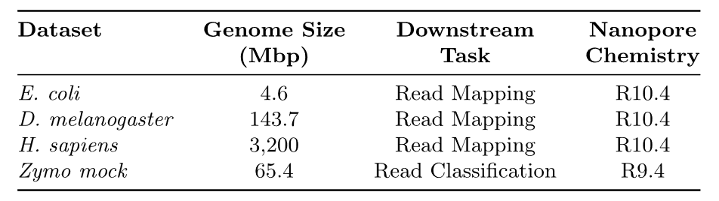
RawBench Datasets
Insight: Datasets from different chemistries and genomic complexities is a prerequisite for comprehensive and future-proof analysis.
These are all real datasets. We intend to release simulated data for new downstream tasks.
Notes:
Along with modularity, we also wanted to make RawBench comprehensive. Our insight was that ….

Slide 20
Mapping any RSA Workflow to RawBench
Break down RSA tool into three RSA stages
Encoding of both reference genome and raw signal and matching these encoded representations
Implement RSA stages as C++ modules
Each stage mapped to a dedicated Nextflow process
e.g., t-test segmentation or FM-index matching
Some existing tools are already implemented
More details on the implementation
can be found in the paper
RawBench runs custom RSA setup across datasets and downstream tasks
New datasets and tasks can be integrated
e.g., simulated data and structural variant calling
Notes:
Now that we built RawBench, how do you map…

Slide 21
Outline
Background
Motivation and Goal
RawBench
Evaluation
Conclusion
Notes:
Let’s move on to evaluation of our results

Slide 22
Evaluation Methodology
Experimental Setup
CPU baseline: Intel Xeon Gold 6226R @2.90GHz
64 threads for each analysis
GPU baseline: NVIDIA A6000
Currently available downstream analysis tasks
Read mapping
Read classification
RSA-assisted basecalling
Notes:
…and RSA-assisted basecalling where RSA-assistance refers to a lightweight RSA pipeline determining which reads should be basecalled or not

Slide 23
Evaluation Methodology
Evaluation metrics
Performance (runtime and memory footprint)
Coverage statistics
Quality
Baseline: Mapping basecalled reads using Dorado SUP + minimap2
Precision, recall and F1 scores
4 real datasets with
Various coverage (0.11x-225x) and
Genome complexities (bacterial to human genomes)

Slide 24
Encoding Reference Genome
ACGT
Encoding reference genome
Matching encoded representations
2
Encoding raw signal
Input Raw Signals
1
3
ONT pore model
Hash-based
FM-index
t-test
Uncalled4 pore model
Vector distance
R-index
Move tables
Input Reference
Add-on
DTW
Add-on
Campolina
Notes:
Now let’s see results for the first step in RawBench. First pore model here is provided by ONT and the other one Uncalled4 by community.

Slide 25
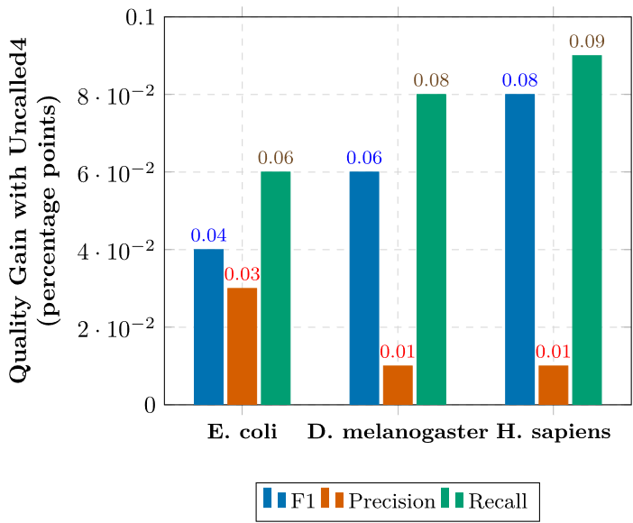

Encoding Reference Genome – Quality
Uncalled4 provides the best quality in all metrics, with
increasing benefits in recall for larger genomes
Notes:
We observe that … and when we plot the Uncalled4’s benefits over the ONT4 pore model in terms of percentage points, we see that benefits increase with larger genomes especially pronounced in recall implying that previously unmapped reads are now being mapped

Slide 26
Encoding Raw Signal
ACGT
Encoding reference genome
Matching encoded representations
2
Encoding raw signal
Input Raw Signals
1
3
ONT pore model
Hash-based
FM-index
t-test
Uncalled4 pore model
Vector distance
R-index
Move tables
Input Reference
Add-on
DTW
Add-on
Campolina

Slide 27
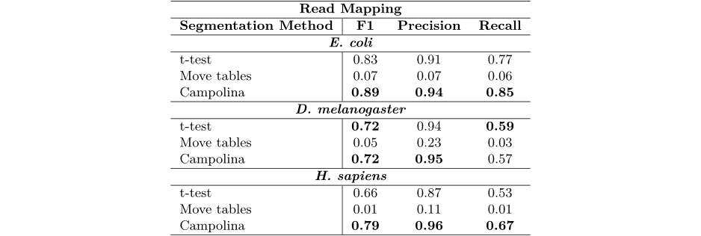

Encoding Raw Signal – Quality
Campolina enables better quality, resulting in
1.07$×$ - 1.2$×$ improvement in $F_{1} \text{score}$
Move tables perform poorly, pointing out to the need for
more intelligent use of intermediate basecalling output
Notes:
Resulting in up to 20% higher F1 score
Now, a second takeaway is that move tables perform poorly when they are directly used for this step without any further processing. This means that… as Dorado basecaller itself is highly accurate but this clearly is the exact opposite

Slide 28
Matching Encoded Representations
ACGT
Encoding reference genome
Matching encoded representations
2
Encoding raw signal
Input Raw Signals
1
3
ONT pore model
Hash-based
FM-index
t-test
Uncalled4 pore model
Vector distance
R-index
Move tables
Input Reference
Add-on
DTW
Add-on
Campolina
Notes:
Third, matching encoded representations. Here, prior works used different techniques with different levels of sensitivity and resource demands.

Slide 29
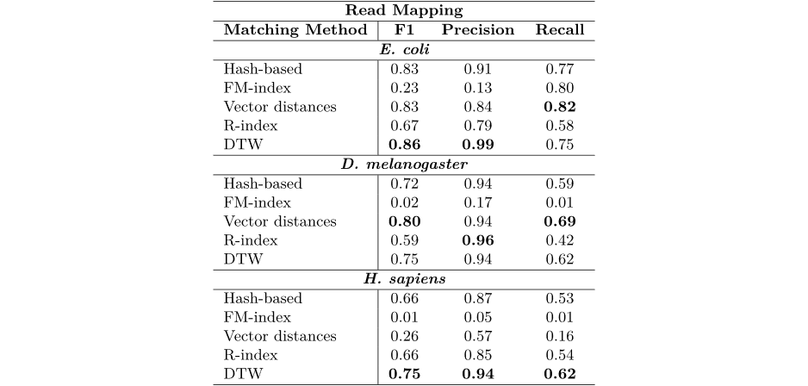
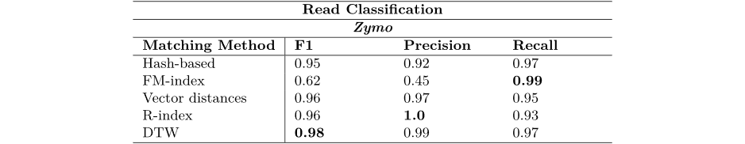
Matching Encoded Representations – Quality
DTW-based matching shows a consistently strong F1 score while vector distances remains a competitive approach for smaller genomes
R-index and hash-based methods catch up in read classification, trends indicate that matching should be designed on a case-by-case basis

Slide 30
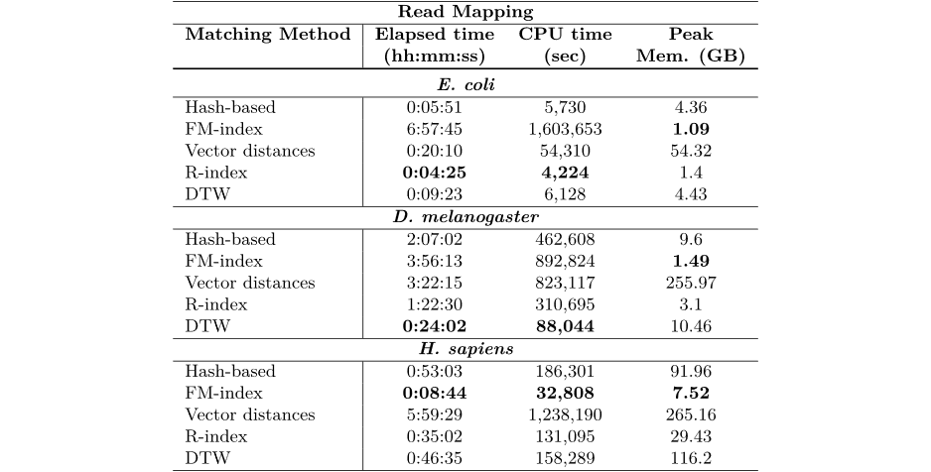
Matching Representations – Performance
FM-index enables read mapping in resource-constrained settings
despite its existing headroom for quality

Slide 31
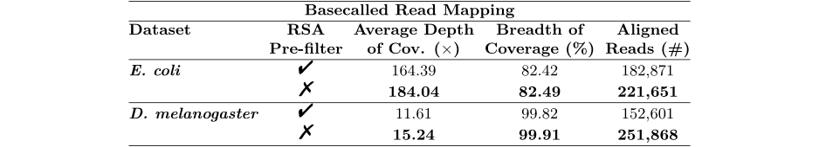
RSA-assisted Basecalling
Running RSA as a pre-filter to basecalling
Discard reads unmapped by a RSA pipeline
Reduce the expensive basecalling load
More details on the results
can be found in the paper
Basecalling load is reduced by 17-39% using a lightweight RSA pre-filter
with only 0.07-0.09% drop in genome completeness

Slide 32
Outline
Background
Motivation and Goal
RawBench
Evaluation
Conclusion

Slide 33


Conclusion
RawBench
The first benchmarking framework for raw signal analysis (RSA) enabling end-to-end fair and systematic evaluation of different raw signal analysis techniques
Currently supports
30 different RSA combinations
4 different raw nanopore signal datasets from 2 different nanopore chemistries
2 different downstream tasks and 2 RSA-assisted basecalling tasks
High modularity
enables
combination of existing and new RSA techniques from across the RSA literature
integration of new datasets and downstream tasks
fair comparison of newly developed methods

Slide 34

RawBench A Comprehensive Benchmarking Framework for Raw Nanopore Signal Analysis Techniques
Furkan Eris
Ulysse McConnell Can Firtina Onur Mutlu

Slide 35
Backup Slides

Slide 36
Encoding the Reference Genome
Raw Reads
Read Mapping
Noisy Raw Signals
Reference Genome
...
...
CTGCGTAGCAGCGTAATAG
Reference-to-Signal Conversion
How to identify similarity between noisy signals?
...
...
2.21,0.08,1.18,
Raw Signal Analysis

Slide 37
Dealing with Noisy Signals
Signal regions corresponding to specific k-mers are identified
Consecutive events ➔ consecutive k-mers
Raw Nanopore Signal
Event
Event Value
Normalize
2.21
Segment
Calculate
Means
105.71
0.08
1.18
1.14
Can we match events (k-mers) between reference genome and raw signals?

Slide 38
Matching Encoded Representations
Reference Genome
1
...
...
CTGCGTAGCAGCGTAATAG
Reference-to-Signal Conversion
...
...
2.21,0.08,1.18,
Raw Nanopore Signal
Event
Event Value
2
Normalize
2.21
Segment
Calculate
Means
105.71
0.08
1.18
1.14
Matching encoded representations
3
Hash-based
FM-index
Vector distance
R-index
DTW
Add-on

Slide 39
Existing Benchmarking Frameworks
ACGT
Encoding reference genome
Matching encoded representations
Encoding raw signal
1
3
2
Input Raw Signals
ONT pore model
Hash-based
FM-index
t-test
Uncalled4 pore model
Vector distance
R-index
Move tables
Input Reference
Add-on
DTW
Add-on
Campolina
Read classification
Read mapping
Assisted basecalling
Few existing works do not benchmark RSA techniques at all – let alone in an extensive and extensible manner

