Slide 1
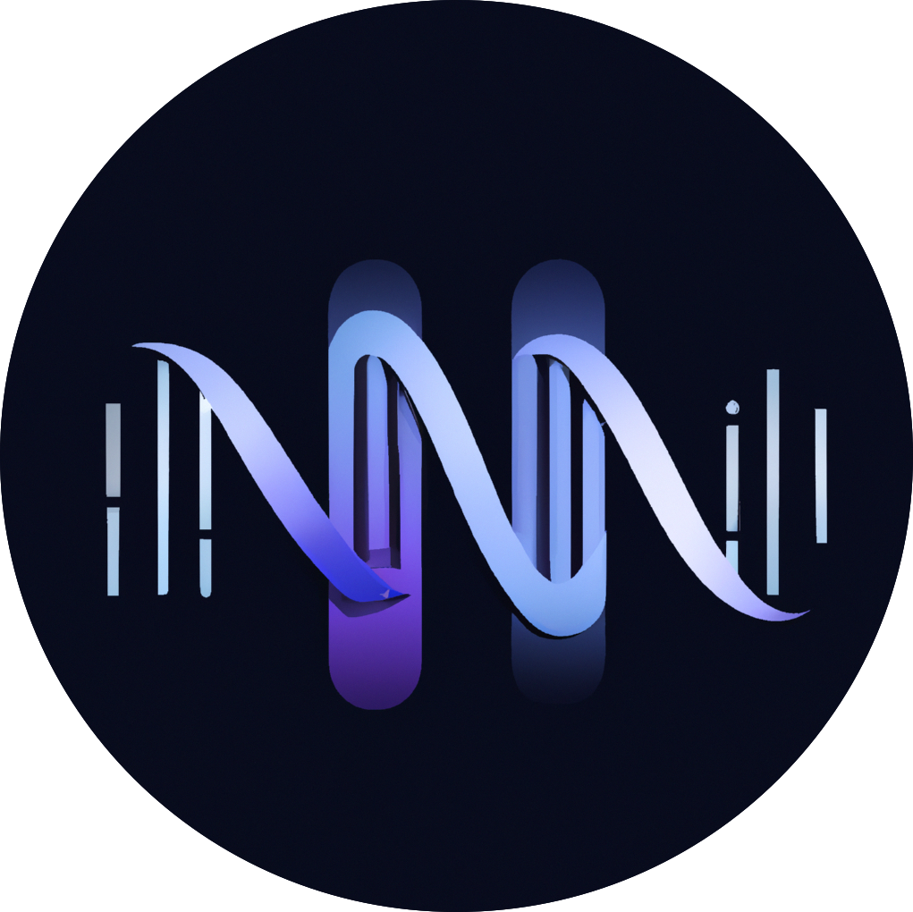







ISMB 2024
Rawsamble
Overlapping and Assembling Raw Nanopore Signals
Using a Hash-based Seeding Mechanism
Can Firtina
Maximilian Mordig |  | Joel Lindegger |  | Harun Mustafa
Sayan Goswami |  | Stefano Mercogliano |  | Yan Zhu
Andre Kahles |  | Onur Mutlu

Slide 2
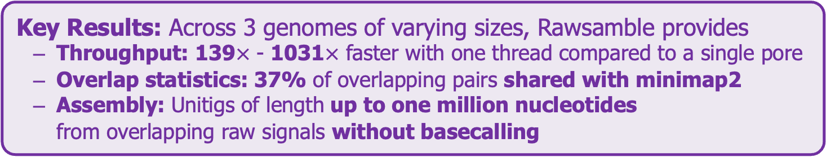
Executive Summary
Problem: Existing solutions cannot interpret raw signals directly if a reference genome is unknown or does not exist
Goal: Enable raw signal analysis without a reference genome
Key Contributions:
Rawsamble: The first mechanism that can find all-vs-all overlapping pairs between raw nanopore signals
The first de novo assembly constructed directly from raw signal overlaps without basecalling
A new assembler to build and output the assemblies of signals
Key Results: Across 3 genomes of varying sizes, Rawsamble provides
Throughput: 139$×$ - 1031$×$ faster with one thread compared to a single pore
Overlap statistics: 37% of overlapping pairs shared with minimap2
Assembly: Unitigs of length up to one million nucleotides from overlapping raw signals without basecalling

Slide 3
Outline
Background
Motivation and Goal
Experimental Methodology
Temperature Analysis
Aggressor Row Active Time Analysis
Spatial Variation Analysis
Implications on Attacks and Defenses
Conclusions
Rawsamble Mechanism
Evaluation
Conclusion

Slide 4
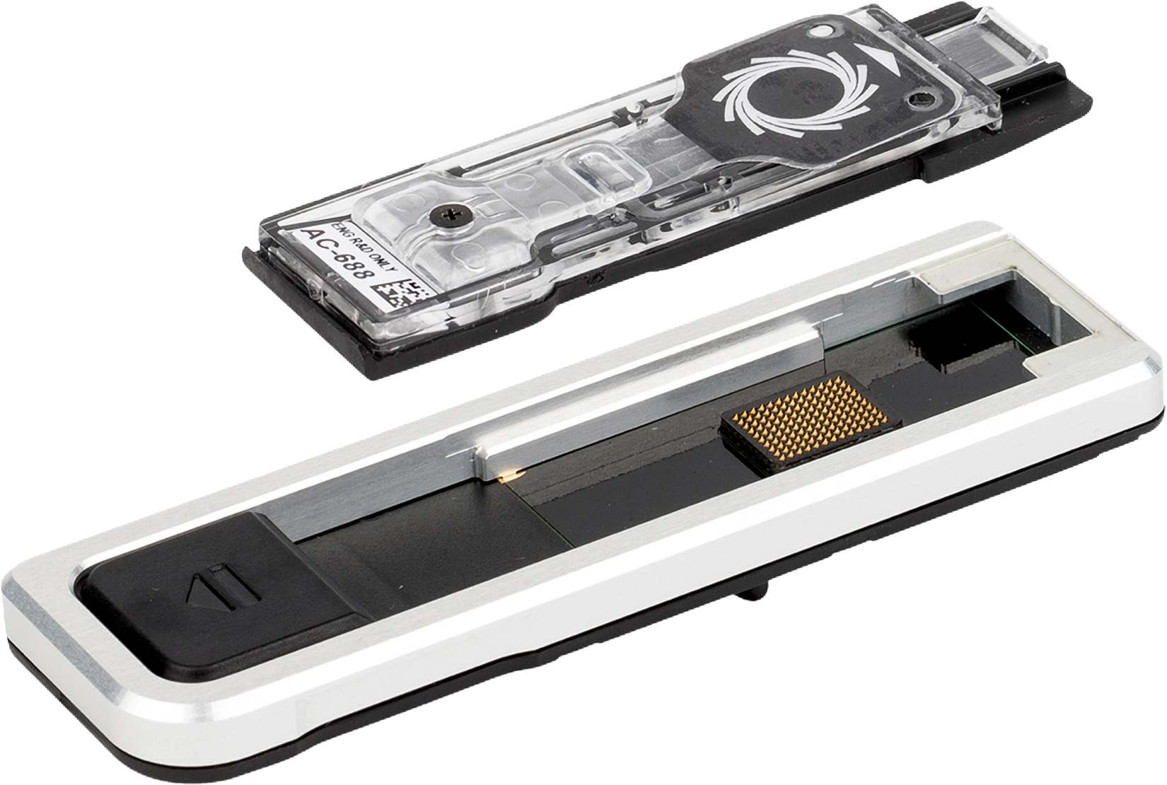
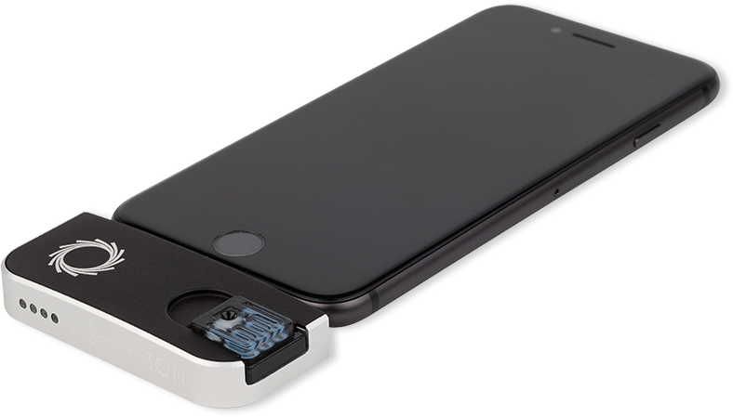
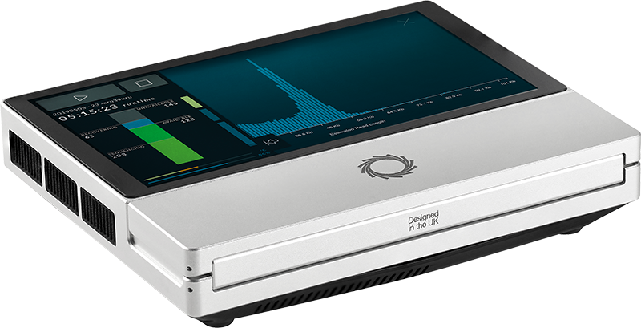
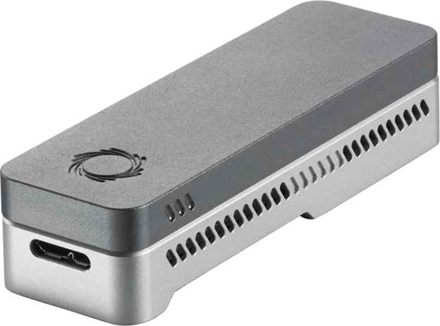
Nanopore Sequencing
Nanopore Sequencing: a widely used sequencing technology
Can sequence large fragments of nucleic acid molecules (up to ~4Mbp)
Offers high throughput
Cost-effective
Enables real-time and portable genome analysis

Slide 5


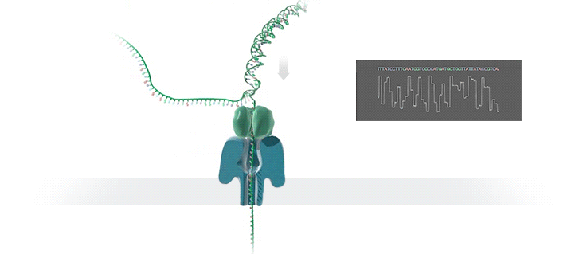



Nanopore Sequencing
Nanopore Sequencing
Raw Signals
(Real-Time) Analysis
Current
Raw Signals: Ionic current measurements generated at a certain throughput
(Real-Time) Analysis: Signals can be analyzed while they are generated
Real-Time Decisions: Stopping sequencing early based on real-time analysis

Slide 6

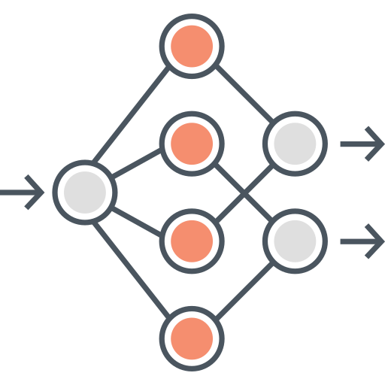

Analyzing Raw Nanopore Signals
Traditional: Translating (basecalling) signals to bases before analysis
Recent Work: Directly analyzing signals without basecalling
Basecalling
Read Mapping
Raw Signal Mapping
Raw Signal
Raw Signal
A
T
G
G
Basecalled sequences are less noisy than raw signals
Efficient analysis with better scalability and portability
Many analysis tools use basecalled sequences
Raw signals retain more information than just bases
Costly and power-hungry computational requirements
Lack of established tools for downstream analysis

Slide 7
The State-of-the-Art Raw Signal Mapper
Reference Genome
Raw Signal
GCTAAATATTTCTTC…
Synthetic signals are mainly free from noises
Sequence-to-Signal Conversion Table
Synthetic Signal
A reference genome must exist for mapping
Hash
Hash
Hash-based Seeding and Mapping
0x01
0x01
RawHash [Firtina+, ISMB/ECCB’23]; RawHash2 [Firtina+, arXiv];

Slide 8
The State-of-the-Art Raw Signal Mapper
Reference Genome
Raw Signal
GCTAAATATTTCTTC…
Synthetic signals are mainly free from noises
Existing solutions cannot analyze raw signals directly without a reference genome
Sequence-to-Signal Conversion Table
Synthetic Signal
A reference genome must exist for mapping
Hash
Hash
Hash-based Seeding and Mapping
0x01
0x01
RawHash [Firtina+, ISMB/ECCB’23]; RawHash2 [Firtina+, arXiv];

Slide 9
Beyond Reference Mapping: Overlapping
Synthetic Signal
Raw Signal
Hash
Hash
Hash-based Seeding and Mapping
0x01
0x01

Slide 10

Beyond Reference Mapping: Overlapping
Raw Signal #1
Raw Signal #2
…
Hash
Hash
Hash-based Seeding and Mapping
0x01
0x01
Challenge #1: Identifying accurate matches when both signals are noisy
Challenge #2: Finding all overlapping read pairs

Slide 11
Beyond Reference Mapping: Overlapping
Raw Signal #1
Raw Signal #5
Raw Signal #2
Raw Signal #3
Raw Signal #4
Challenge #1: Identifying accurate matches when both signals are noisy
Challenge #2: Finding all overlapping read pairs
Challenge #3: Generating long paths from many overlaps to build assemblies

Slide 12
Outline
Background
Motivation and Goal
Experimental Methodology
Temperature Analysis
Aggressor Row Active Time Analysis
Spatial Variation Analysis
Implications on Attacks and Defenses
Conclusions
Rawsamble Mechanism
Evaluation
Conclusion

Slide 13
Goal
Enable raw signal analysis without a reference genome

Slide 14
Rawsamble
The first mechanism that can quickly and accurately find all-vs-all overlapping of raw signals
The first de novo assembly constructed directly from raw signal overlaps without basecalling
A new assembler to build and output
the assemblies from raw signals

Slide 15
Rawsamble Key Ideas
Build on the existing state-of-the-art raw signal mapper: RawHash
Extend RawHash to support overlapping

Slide 16
RawHash Overview
Reference Genome
Raw Nanopore Signal
…GCTATTACCTTAATGTG…
Reference-to-Event Conversion
Signal-to-Event Conversion
2.21
-0.9
1.15
2.22
-0.91
1.18
Indexing
Quantization
Quantization
Mapping
28
6
18
28
6
18
Hashing
Hashing
Store
Hash Table
Query
0x01
0x01
Matching Regions
Chaining & Mapping
Mapping Positions

Slide 17
Rawsamble Overview
Raw Nanopore Signal
Raw Nanopore Signal
Signal-to-Event Conversion
Signal-to-Event Conversion
2.21
-0.9
1.15
2.22
-0.91
1.18
Indexing
Quantization
Quantization
Mapping
28
6
18
28
6
18
Hashing
Hashing
Store
Hash Table
Query
0x01
0x01
Matching Regions
Chaining & Mapping
Overlapping pairs

Slide 18
Indexing using Raw Signals
Raw Nanopore Signal
Building the index directly from raw signals
Free from the conversion table used while converting the sequences to signals
Converted signals are filtered aggressively:
To avoid nanopore-related errors better
Based on the similarity between adjacent signals
Signal-to-Event Conversion
2.21
-0.9
1.15
Signal-to-Event Conversion
2.21
2.12
2.35
-0.9
-1.05
-0.85
-0.89
-1.01
1.15
1.25
1.20
Filter
2.21
2.12
2.35
-0.9
-1.05
-0.85
-0.89
-1.01
1.15
1.25
1.20

Slide 19

Chaining and Outputting Overlaps
Adjusting the minimum chaining score to avoid false chains
All-vs-all overlapping tends to find a larger number of seed hits than mapping to a reference genome
Minimum score for a chain during overlapping is set to be ~5$×$ larger than mapping
Adjusting the outputting strategy for accurate assembly
All chains are reported to enable a raw signal overlapping with many raw signals (all-vs-all)
Cyclic overlaps are avoided with simple comparisons between read names (minimap2 strategy)
Matching Regions
Chaining & Mapping
Chaining & Mapping
Overlapping pairs
Raw Signal #1
Raw Signal #2
Raw Signal #2
Raw Signal #1

Slide 20
Outline
Background
Motivation and Goal
Experimental Methodology
Temperature Analysis
Aggressor Row Active Time Analysis
Spatial Variation Analysis
Implications on Attacks and Defenses
Conclusions
Rawsamble Mechanism
Evaluation
Conclusion

Slide 21
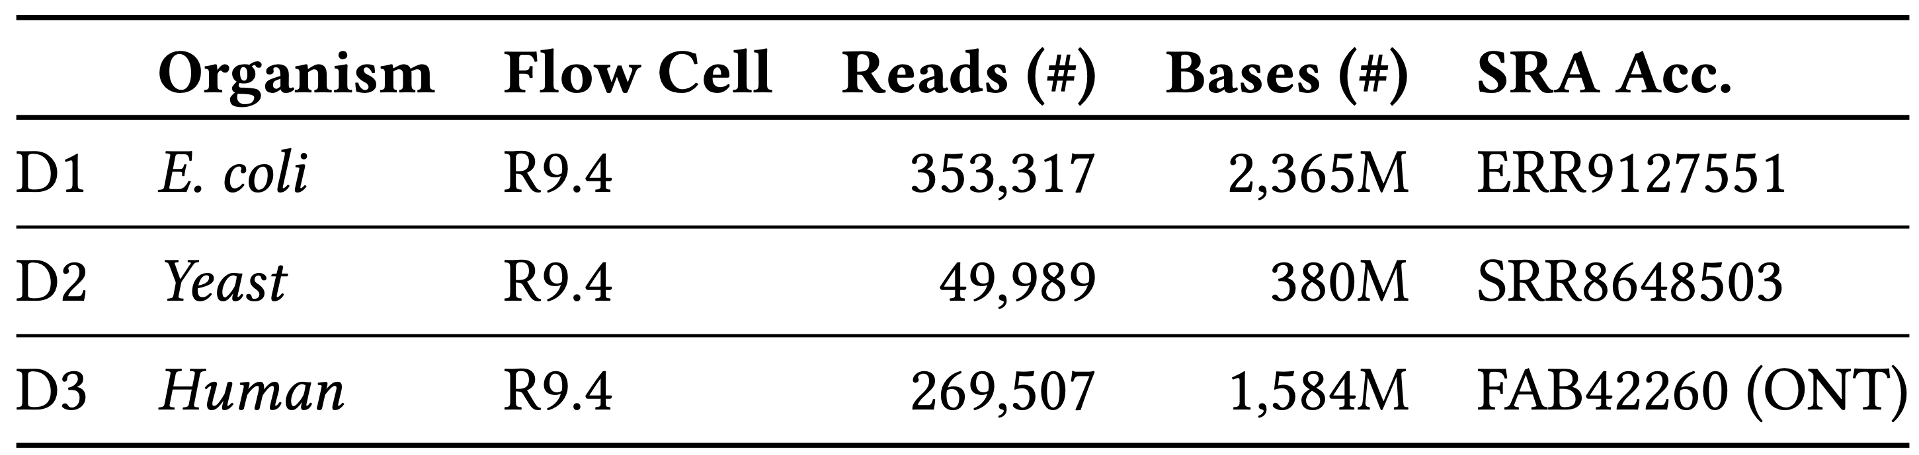
Evaluation Methodology
Compared to minimap2 overlaps (forward strand only) [Li, Bioinformatics’18]
Rawsamble is integrated into RawHash2 [Firtina+, ISMB/ECCB’23, Firtina+, arXiv]
Use case(s) for raw signal overlapping
De novo assembly construction using miniasm [Li, Bioinformatics’16]
More new directions to be discussed
Evaluation metrics:
Throughput (bases processed per second per CPU thread) and overall time
Percentage of shared and unique overlapping pairs between tools
Assembly statistics
Datasets:

Slide 22
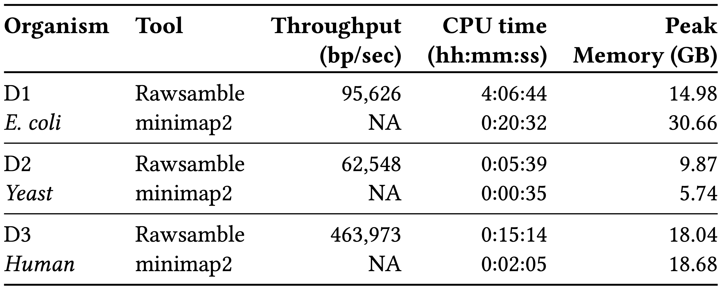
Performance & Peak Memory
Although minimap2 is substantially faster, Rawsamble avoids the basecalling step
Real-time analysis requires faster throughput than sequencer
Throughput of a single nanopore: ~450 bp/sec (data generation speed)
139× - 1031× faster throughput with a single CPU thread compared to a single pore

Slide 23

All-vs-All Overlapping Statistics
Percentage of overlapping pairs
Shared between Rawsamble and minimap2
Unique to either Rawsamble or minimap2
Shared Overlaps
Rawsamble
Minimap2
15.08
35.62
27.56
44.57
47.07
19.73
40.35
17.32
52.71
D1 E. coli
D2 Yeast
D3 Human
On average, 37.12% of overlapping pairs is shared with minimap2
How can we evaluate the impact of these ratios?

Slide 24
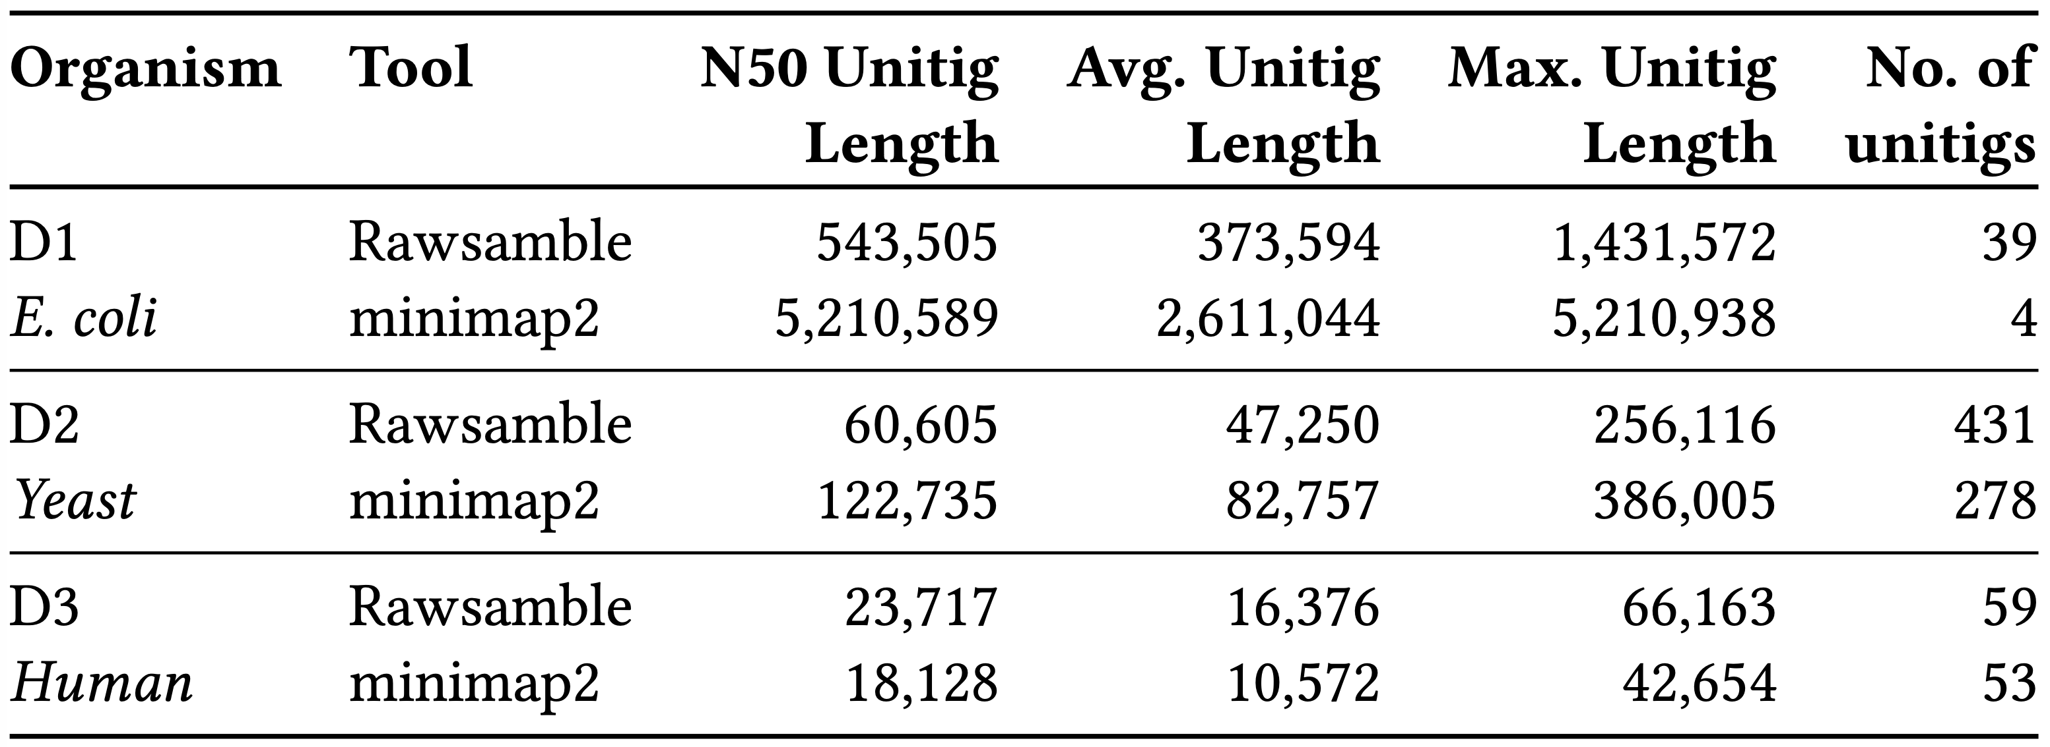
De novo Assembly From Overlaps
Goal: To build long de novo assemblies from raw signal overlaps
Miniasm can be used off-the-shelf as both tools provide PAF outputs
Raw signal overlaps can be used for constructing de novo assemblies without basecalling
Overlaps from minimap2 lead to longer unitigs
mainly due to using less noisy sequencing data

Slide 25
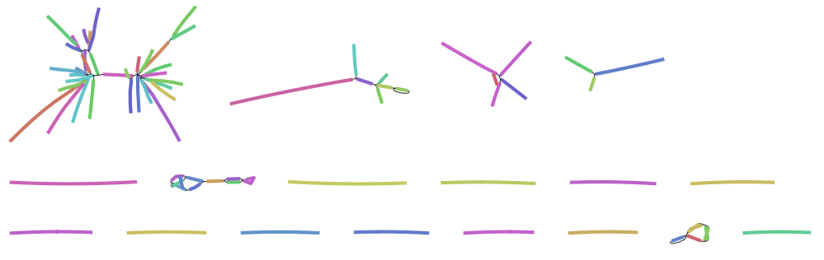
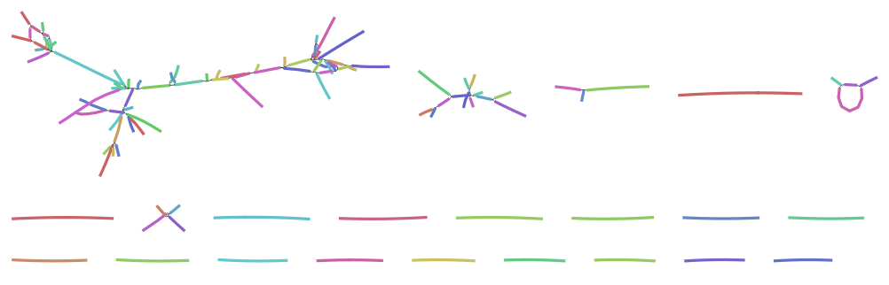
De novo Assembly From Overlaps
Visualizing the miniasm outputs with Bandage [Wick+, Bioinformatics’15]
Minimap2 (Yeast):
386,005 bps
Rawsamble (Yeast):
256,116 bps
Unitigs can be assembled into long components using raw signals

Slide 26

New Directions in Raw Signal Analysis
Constructing (and analyzing) de novo assemblies
Utilizing the overlap information for more accurate basecalling
Basecalling
Raw Signal
Utilizing the constructed assembly for basecalling
Basecalling
Error correction & assembly:

Slide 27
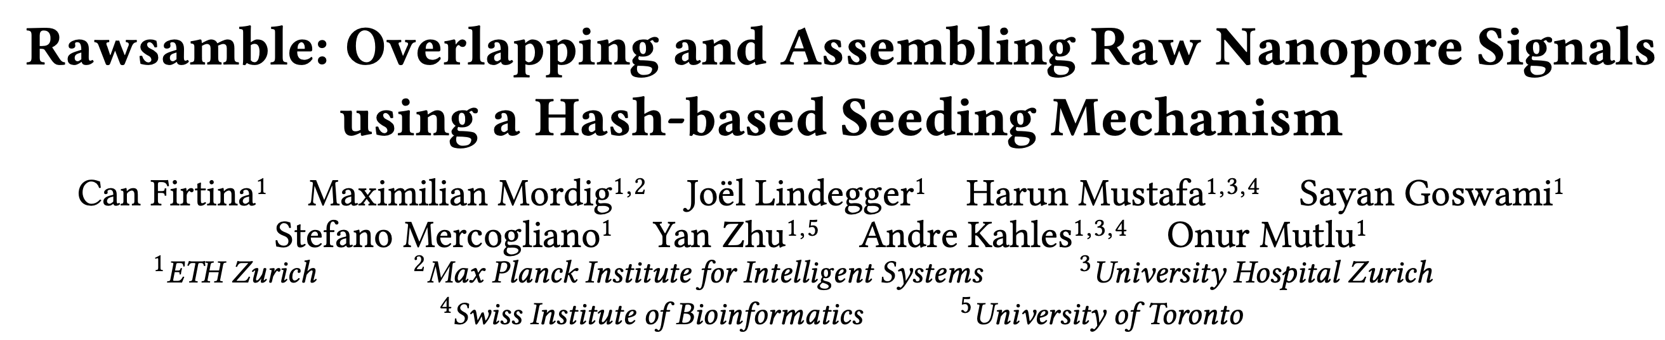
Rawsamble
Source code
Can Firtina, Maximilian Mordig, Joël Lindegger, Harun Mustafa, Sayan Goswami, Stefano Mercogliano, Yan Zhu, Andre Kahles, and Onur Mutlu, "Rawsamble: Overlapping and Assembling Raw Nanopore Signals using a Hash-based Seeding Mechanism" 32nd Annual Conference on Intelligent Systems for Molecular Biology (ISMB), Jul 2024 [Source Code] [Preprint to be available soon]

Slide 28
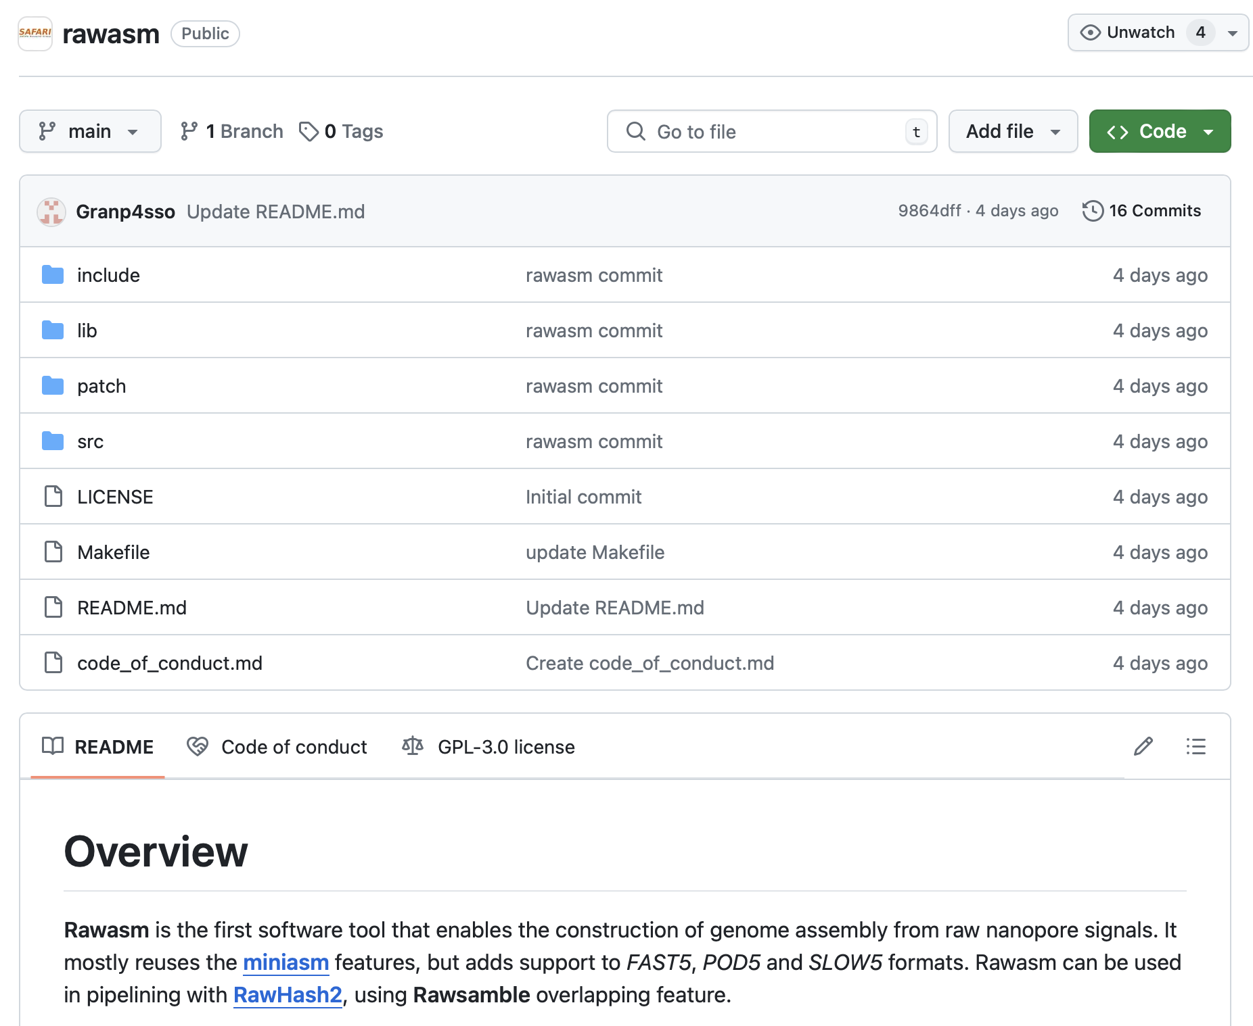
Rawasm: Raw Signal Assembler [Beta]
Slightly modified version of miniasm
To output assembled raw signals instead of basecalled sequences
Supports all major raw signal file formats
FAST5, POD5, S/BLOW5 file formats
Still in a testing phase: Feedback is appreciated!
https://github.com/CMU-SAFARI/rawasm

Slide 29
Outline
Background
Motivation and Goal
Experimental Methodology
Temperature Analysis
Aggressor Row Active Time Analysis
Spatial Variation Analysis
Implications on Attacks and Defenses
Conclusions
Rawsamble Mechanism
Evaluation
Conclusion

Slide 30
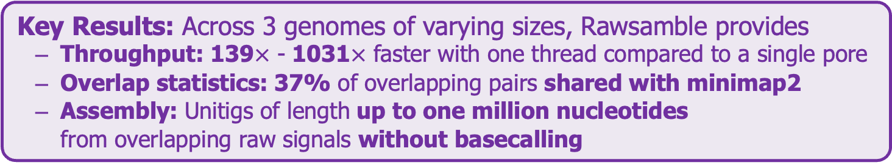
Conclusion
Key Contributions:
Rawsamble: The first mechanism that can find all-vs-all overlapping pairs between raw nanopore signals
The first de novo assembly constructed directly from raw signal overlaps without basecalling
A new assembler to build and output the assemblies of signals
Key Results: Across 3 genomes of varying sizes, Rawsamble provides
Throughput: 139$×$ - 1031$×$ faster with one thread compared to a single pore
Overlap statistics: 37% of overlapping pairs shared with minimap2
Assembly: Unitigs of length up to one million nucleotides from overlapping raw signals without basecalling
Many opportunities for analyzing raw nanopore signals:
Indexing is very cheap: Many future use cases with the on-the-fly index construction
We should rethink the algorithms to perform downstream analysis fully using raw signals
We should rethink the basecalling approaches to integrate information from raw signal analysis

Slide 31
ISMB 2024
Rawsamble
Overlapping and Assembling Raw Nanopore Signals
Using a Hash-based Seeding Mechanism
Can Firtina
Maximilian Mordig |  | Joel Lindegger |  | Harun Mustafa
Sayan Goswami |  | Stefano Mercogliano |  | Yan Zhu
Andre Kahles |  | Onur Mutlu

Slide 32
Motivation and Goal
Experimental Methodology
Temperature Analysis
Aggressor Row Active Time Analysis
Spatial Variation Analysis
Implications on Attacks and Defenses
Conclusions
Backup Slides

Slide 33
Future Work
Reverse Complementing Raw Nanopore Signals
Without reverse complementing, we are missing half of the useful information
Dynamically Building the Hash Table in Real-Time
Needed for real-time de novo assembly construction
What are the useful applications for real-time de novo assembly construction?

Slide 34
Real-Time Mapping using Hash-based Indexing
Indexing (Offline)
Mapping (Real-time)
Reference Genome
Raw Nanopore Signal
…GCTATTACCTTAATGTG…
Reference-to-Event Conversion
Signal-to-Event Conversion
Quantization
Quantization
Hashing
Hashing
Store
Hash Table
Query
0x01
0x01
Matching Positions
Chaining & Mapping
Yes: Process the next chunk
Read Until
or
Run Until
No: Stop mapping
Continue
Mapping?

Slide 35
Sketching with Hash-based Indexing
Indexing (Offline)
Mapping (Real-time)
Reference Genome
Raw Nanopore Signal
…GCTATTACCTTAATGTG…
Reference-to-Event Conversion
Signal-to-Event Conversion
Quantization
Quantization
Hashing
Hashing
All k-mers,
Minimizers,
Strobemers,
BLEND,
…
Sketch
Sketch
Store
Hash Table
Query
0x01
0x01
Matching Positions
Chaining & Mapping
Yes: Process the next chunk
Read Until
or
Run Until
No: Stop mapping
Continue
Mapping?

Slide 36
Practical Similarity Identification
Seeds
> 3 billion characters
Reference
…CAATTTGCCCATATGGTTAAGCTTCCATGGAAATGGGCTTTCGCTTTG…
…
K-mers
Locations
Read
GCCCAAATGGTT
GCC | 7
CCC | 8
CAA | 1
AAA | 31 | 101
CCA | 25 | 230 | 400
… | … | … | …
K-mers
GCC
CCC
…
Index (Hash Table)
Seeding
Determine potential matching regions (seeds) in the reference genome
Seed Filtering
(e.g., Chaining)
Prune some seeds in the reference genome
Alignment
Determine the exact differences between the read and the reference genome

Slide 37
Existing Solutions – Real-time Basecalling
Deep neural networks (DNNs) for translating signals to bases
Nanopore sequencing
Raw Signal
Real-time Analysis
Basecalling
Read mapping
A
T
G
G
Current
DNNs provide less noisy analysis from basecalled sequences
Costly and power-hungry computational requirements

Slide 38
Applications of Read Until
Depletion: Reads mapping to a particular reference genome is ejected
Removing contaminated reads from a sample
Relative abundance estimation
Controlling low/high-abundance genomes in a sample
Controlling the sequencing of depth of a genome
Enrichment: Reads not mapping to a particular reference genome is ejected
Purifying the sample to ensure it contains only the selected genomes
Removing the host genome (e.g., human) in contamination analysis

Slide 39
ISMB 2024
Rawsamble
Overlapping and Assembling Raw Nanopore Signals
Using a Hash-based Seeding Mechanism
Can Firtina
Maximilian Mordig |  | Joel Lindegger |  | Harun Mustafa
Sayan Goswami |  | Stefano Mercogliano |  | Yan Zhu
Andre Kahles |  | Onur Mutlu

