Slide 1
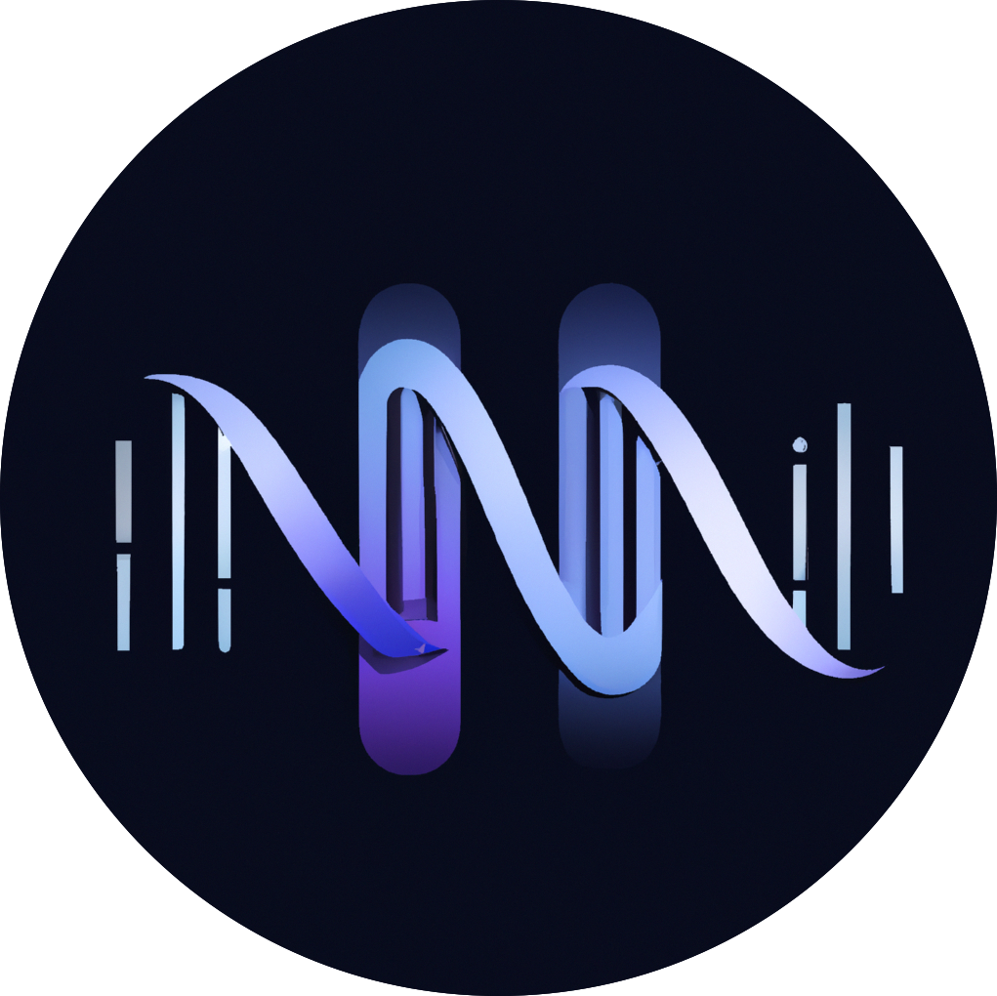






CSHL Biological Data Science 2024
Rawsamble
Overlapping and Assembling
Raw Nanopore Signals
Using a Hash-based Seeding Mechanism
Can Firtina
Maximilian Mordig |  | Harun Mustafa |  | Sayan Goswami
Nika Mansouri Ghiasi |  | Stefano Mercogliano |  | Furkan Eris
Joël Lindegger |  | Andre Kahles |  | Onur Mutlu

Slide 2
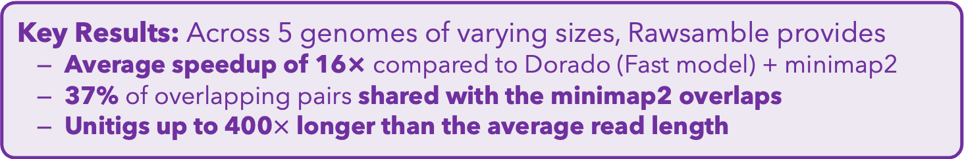
Executive Summary
Problem: Existing solutions cannot interpret raw signals directly
for reference-free applications
Goal: Enable raw signal analysis without a reference genome
Key Contributions:
Rawsamble: the first mechanism that can find overlapping pairs between raw nanopore signals
First de novo assemblies ever constructed directly from
raw signal overlaps without basecalling
A new assembler to build and output the assemblies of signals
Key Results: Across 5 genomes of varying sizes, Rawsamble provides
  Average speedup of 16× compared to Dorado (Fast model) + minimap2
  37% of overlapping pairs shared with the minimap2 overlaps
  Unitigs up to 400$×$ longer than the average read length
Notes:
There are many recent works that aim to map raw nanopore signals to reference genomes without basecalling them.
But we also find that ..

Slide 3
Outline
Background
Rawsamble Mechanism
Evaluation
Conclusion

Slide 4
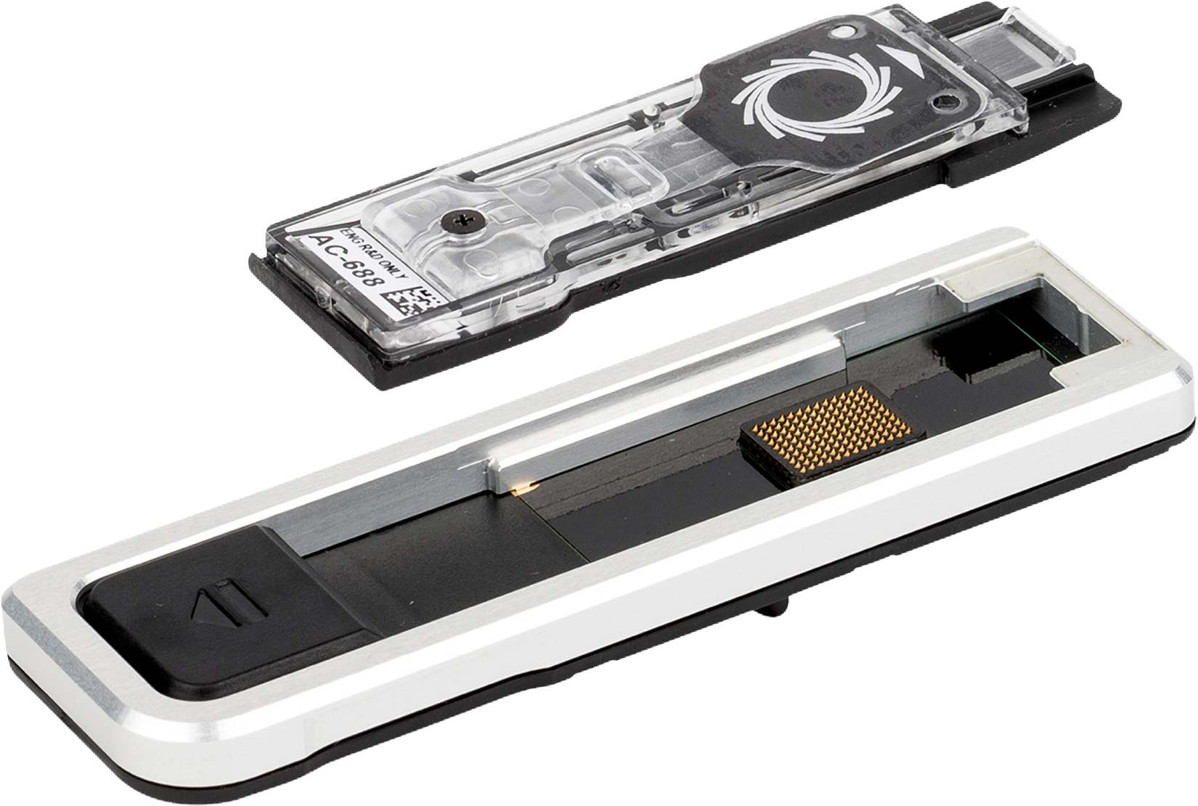
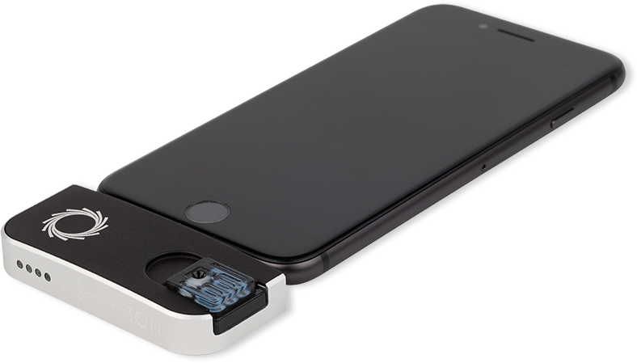
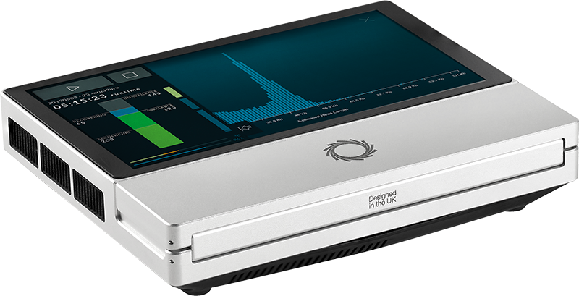
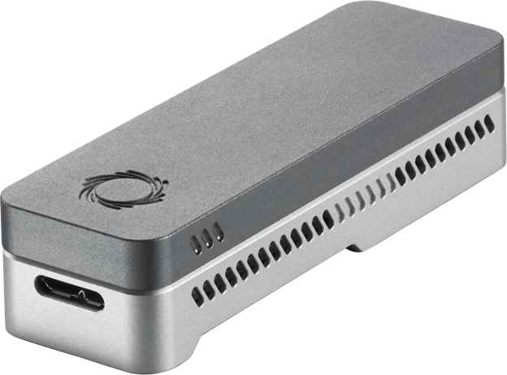
Nanopore Sequencing
Nanopore Sequencing: a widely used sequencing technology
  Can sequence large fragments of nucleic acid molecules
  Offers high throughput
  Cost-effective
  Enables real-time and portable genome analysis

Slide 5
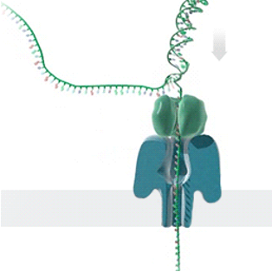
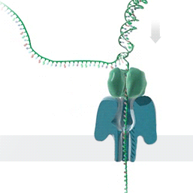




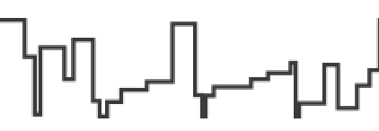


Nanopore Sequencing – How it Works
Single Nanopore
Nanopore Sequencer
Raw Signals
(~5000 signals/sec)
(Real-Time)
Analysis
Raw Signals: Ionic current measurements generated at a certain throughput
(Real-Time) Analysis: Analyzing raw signals instantly as they are generated
Real-Time Decisions: Stopping sequencing early based on real-time analysis
https://nanoporetech.com/platform/technology/basecalling
https://blogs.ed.ac.uk/institute-genetics-cancer/2020/04/08/nanopore-sequencing-controversial-world-records-and-whale-watching/
Notes:
Let's look at how nanopore sequencing works. This is a nanopore sequencer that contains many tiny pores, called nanopores.
[CLICK] As a nucleic acid molecule passes through a single nanopore from the negatively charged side to the positively charged side,
[CLICK] we can measure the ionic current disruptions that are distinctive to identify each nucleotide passing through. These disruptions are generated
as raw electrical signals
at a certain throughput.
[CLICK] We can analyze these raw signals instantly
as they are generated, which we call real-time analysis.
[CLICK] Based on the real-time analysis, we can stop sequencing a read or the entire sequencing run.

Slide 6

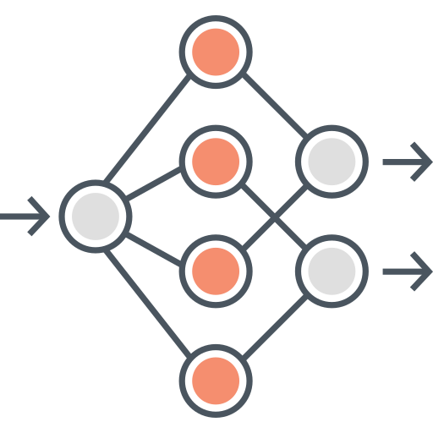
Analyzing Raw Nanopore Signals
Traditional: Translating (basecalling) signals to bases before analysis
Recent Works: Directly analyzing signals without basecalling
Raw Signals
Basecalling
Read Mapping
Raw Signals
Raw Signal Mapping
A
T
G
G
✓
Basecalled sequences are
less noisy than raw signals
✓
Efficient analysis with better scalability and portability
✓
Many analysis tools use basecalled sequences
✓
Raw signals retain more information than just bases
✕
Costly and power-hungry
computational requirements
✕
Lack of established tools for downstream analysis

Slide 7
The State-of-the-Art Raw Signal Mapper
Reference Genome
Raw Nanopore Signals
...
...
CTGCGTAGCAGCGTAATAG
Reference-to-Signal Conversion
Synthetic Reference Signals
Hash
Hash-Based
Seeding and Mapping
Hash
✓
Synthetic signals are mainly free from noise
✕
A reference genome must exist for mapping
RawHash [Firtina+, ISMB/ECCB’23]; RawHash2 [Firtina+, Bioinformatics’24]
Notes:
Let’s see how we can map raw nanopore signals to a reference genome without basecalling them by looking at the state-of-the-art raw signal mapper

Slide 8
The State-of-the-Art Raw Signal Mapper
Reference Genome
Raw Nanopore Signals
...
...
CTGCGTAGCAGCGTAATAG
Existing solutions cannot analyze raw signals
directly without a reference genome
Reference-to-Signal Conversion
...
...
Synthetic Reference Signals
Hash
Hash-Based
Seeding and Mapping
Hash
✓
Synthetic signals are mainly free from noise
✕
A reference genome must exist for mapping
RawHash [Firtina+, ISMB/ECCB’23]; RawHash2 [Firtina+, Bioinformatics’24]

Slide 9


Beyond Reference Mapping: Overlapping
Reference Genome (Converted to Signals)
Raw Nanopore Signals
Raw Nanopore Signals
TGCTGCAA
CGAAGTCA
CGTAGTGG
CCACCGGT
Reference Signals
CTGCAATC
TGATCCGA
TCAGCCGT
AGTGGACC
GGTAAGCT
TGCTGCAATCGTGATCCGAAGTCAGCCGTAGTGGACCACCGGTAAGCT
Hash-Based
Seeding and Mapping
Challenge: Reference genomes are not always available
Assembly: Constructing genome from overlapping reads
✕
Existing solutions cannot find overlapping reads without basecalling
Notes:
Although reference-based raw signal analysis provides accurate mapping,
[CLICK] reference genomes are not always available or ideal for certain applications.
[CLICK] In such cases, we can construct an individual’s genome from scratch by finding overlaps between reads.
[CLICK] However, we cannot do this without basecalling.

Slide 10




Challenges with Overlapping Raw Signals
Hash-Based
Seeding and Mapping
Challenge: Identifying hash matches when both signals are noisy
Challenge: Finding many useful overlapping pairs (all-vs-all overlapping)
Challenge: Generating long paths from useful overlaps
Notes:
Identifying overlaps between raw signals with existing hash-based seeding mechanisms is challenging because
[CLICK] it requires identifying ...
[CLICK] finding ...
[CLICK] and generating ...

Slide 11
Outline
Background
Rawsamble Mechanism
Evaluation
Conclusion

Slide 12
Goal
Enable raw signal analysis
without a reference genome

Slide 13
Rawsamble
The first mechanism that can perform
all-vs-all overlapping from raw signals
First de novo assemblies ever constructed directly from raw signal overlaps without basecalling
A new assembler to build and output
the assemblies from raw signals

Slide 14
Rawsamble Key Ideas
Build on the existing state-of-the-art
raw signal mapper: RawHash2
Extend RawHash2 to support overlapping
RawHash2 [Firtina+, Bioinformatics’24]

Slide 15
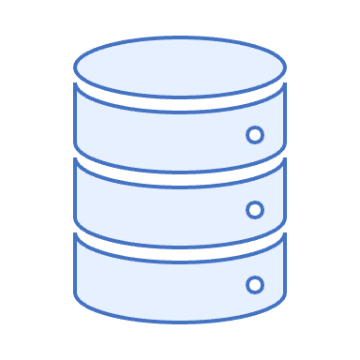
Raw Signal Mapping with RawHash2
Reference Genome
Raw Nanopore Signals
Reference Signals
Indexing
Adaptive
Quantization
Hash Table
(Index)
Adaptive
Quantization
Mapping
Hash
Query
Hash
Store
Sketching
Sketching
Matching Regions
Chaining & Mapping
Output:
Mapping Positions
Filtering
Notes:
We integrate the improvements made in Rawsamble into the RawHash2 pipeline as follows.
[CLICK] We perform aggressive filtering on both target and query signals.
[CLICK] Followed by the existing quantization, hashing, and sketching steps in RawHash and RawHash2.
The index contains hash values from raw nanopore signals instead of reference signals.
[CLICK] From matching hash values, we identify many highly accurate chains,
[CLICK] and report these chains as all-vs-all overlapping pairs.
[CLICK] These overlapping pairs can be directly used by off-the-shelf assemblers to construct de novo assemblies.

Slide 16


Integrating Rawsamble into RawHash2
Raw Nanopore Signals
Raw Nanopore Signals
Aggressive
Filtering
Aggressive
Filtering
Indexing
Adaptive
Quantization
Hash Table
(Signal Index)
Adaptive
Quantization
Overlapping
Hash
Query
Hash
Store
Sketching
Sketching
Matching Regions
Chaining & Mapping
Output: All-vs-all Overlapping Pairs
Filtering
RawHash2
Assembly
Rawsamble
Notes:
We integrate the improvements made in Rawsamble into the RawHash2 pipeline as follows.
[CLICK] We perform aggressive filtering on both target and query signals.
[CLICK] Followed by the existing quantization, hashing, and sketching steps in RawHash and RawHash2.
The index contains hash values from raw nanopore signals instead of reference signals.
[CLICK] From matching hash values, we identify many highly accurate chains,
[CLICK] and report these chains as all-vs-all overlapping pairs.
[CLICK] These overlapping pairs can be directly used by off-the-shelf assemblers to construct de novo assemblies.

Slide 17
Indexing using Raw Signals
Constructing the hash table index from raw nanopore signals
  Reference-to-signal conversion is mainly free from noise (e.g., stay errors)
  Indexed raw nanopore signals are not free from noise
Aggressively filtering consecutive and similar signals
to substantially reduce noise at the cost of data loss
Raw Nanopore Signals
2.21
2.12
2.35
-0.9
-1.05
-0.85
-0.89
-1.01
1.15
1.25
1.20
Aggressive Filtering
2.21
2.12
2.35
-0.9
-1.05
-0.85
-0.89
-1.01
1.15
1.25
1.20
Notes:
To address these challenges, Rawsamble provides several key improvements in raw signal analysis.
[CLICK] First, to reduce noise when comparing noisy raw signals,
we apply aggressive filtering.
This removes similar signals that appear consecutively, often generated by sequencing errors such as stay errors,
though it may result in some data loss.
[CLICK] Second, overlapping reads can map to each other cyclically
[CLICK] when using the target signal as query and vice versa due to shared regions.
[CLICK] To prevent cyclic overlaps, we perform a simple deterministic comparison and report each overlapping pair only once.
[CLICK] Third, we identify highly accurate chains to effectively prune incorrect overlapping pairs.
[CLICK] Fourth, we enable constructing an index directly from raw nanopore signals instead of reference signals.

Slide 18


Chaining and Outputting Overlaps
Adjusting the minimum chaining score to avoid false chains
  All-vs-all overlapping tends to find a larger number of
  seed hits than mapping to a reference genome
  Minimum score for a chain during overlapping is set to be
  ~5× larger than mapping
  All such chains are reported (instead of a single best mapping)
Avoid cyclic overlaps with deterministic comparisons
Query
Query
Target
Target
Notes:
[CLICK] Third, we identify highly accurate chains to effectively prune incorrect overlapping pairs.
[CLICK] Second, overlapping reads can map to each other cyclically
[CLICK] when using the target signal as query and vice versa due to shared regions.
[CLICK] To prevent cyclic overlaps, we perform a simple deterministic comparison and report each overlapping pair only once.

Slide 19
Outline
Background
Rawsamble Mechanism
Evaluation
Conclusion

Slide 20
Evaluation Methodology
Rawsamble is integrated into RawHash2 [Firtina+, Bioinformatics'24]
Compared to the minimap2 [Li, Bioinformatics'18] overlaps (forward strand)
  Basecalling with Dorado’s various models (using CPUs & GPUs)
Use case for raw signal overlapping:
  De novo assembly construction using miniasm [Li, Bioinformatics’16]
  New exciting directions to be discussed as future work
Evaluation metrics:
  Overall runtime when performing all-vs-all overlapping
  Percentage of shared overlaps between tools
  Assembly statistics
5 real datasets with
  Various coverage (0.6× – 445×) and
  Genome lengths (viral to human genomes)
Notes:
We compare the overlaps generated by Rawsamble
with those generated by minimap2 on the forward strand.
For basecalling, we use various Dorado models on both CPUs and GPUs.
[CLICK] We use the miniasm assembler off-the-shelf to construct and evaluate de novo assemblies from raw signal overlaps,
[CLICK] using real datasets with various configurations.

Slide 21
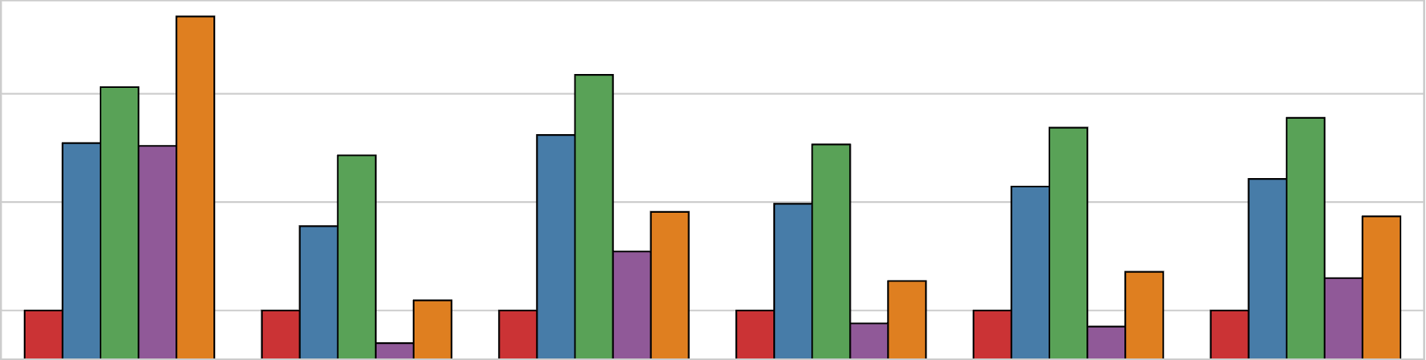
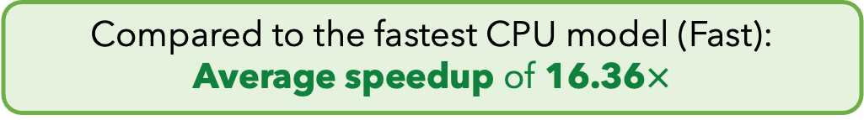







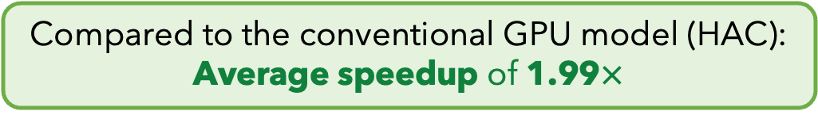
Normalized Runtime Results
Rawsamble
Minimap2 +
Dorado CPU (Fast)
Minimap2 +
Dorado CPU (HAC)
Minimap2 +
Dorado GPU (HAC)
Minimap2 +
Dorado GPU (SUP)
$${10}^{2}$$
Elapsed Time
(Normalized to Rawsamble)
59.70$×$
$${10}^{1}$$
16.36$×$
7.40$×$
$${10}^{0}$$
1.99$×$
SARS-CoV-2
E. coli
Yeast
Green Algae
Human
Geo. Mean
Compared to the fastest CPU model (Fast):
Average speedup of 16.36$×$
Compared to the conventional GPU model (HAC):
Average speedup of 1.99$×$
Notes:
We first look at the performance results in terms of runtime for both Rawsamble
and the Dorado basecaller with different configurations followed by minimap2.
The Y-axis shows runtimes normalized to Rawsamble's runtime
across different datasets on the X axis.
[CLICK] We find that Rawsamble provides an average speedup of 16 times compared to the configuration when using Dorado's fastest CPU model
[CLICK] And an average speedup of 2 times compared to the configuration when using Dorado's conventional GPU model.

Slide 22
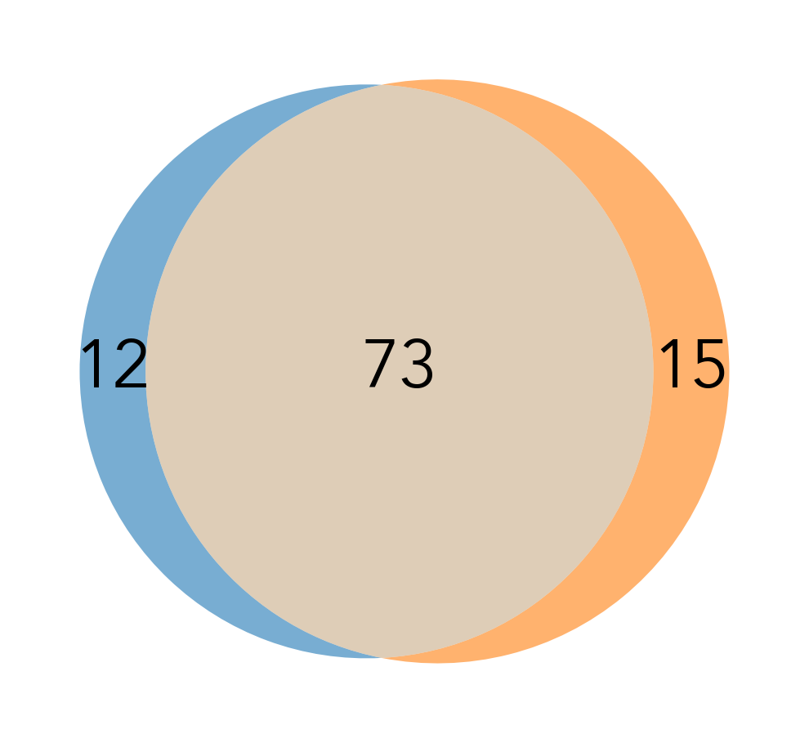
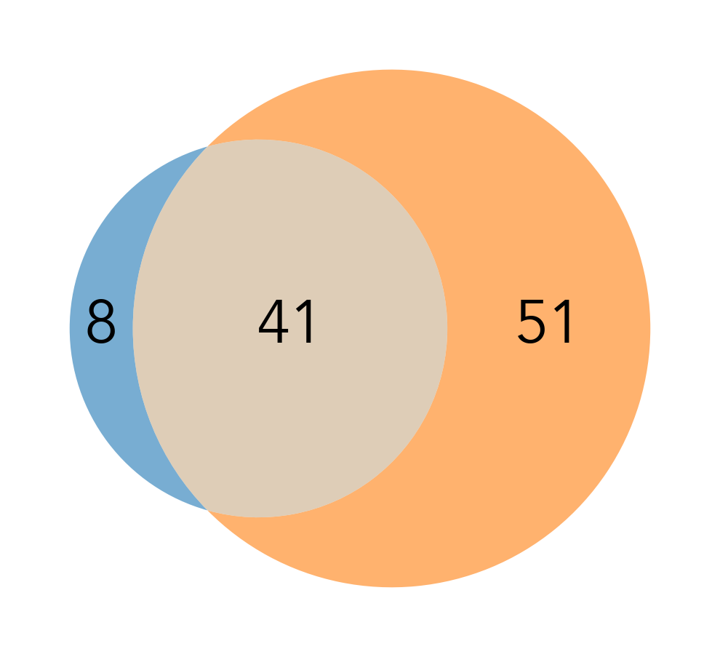
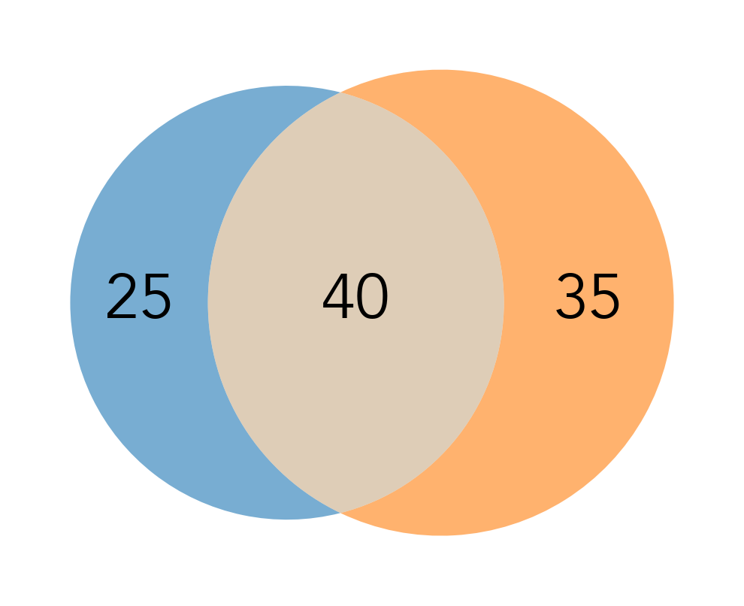
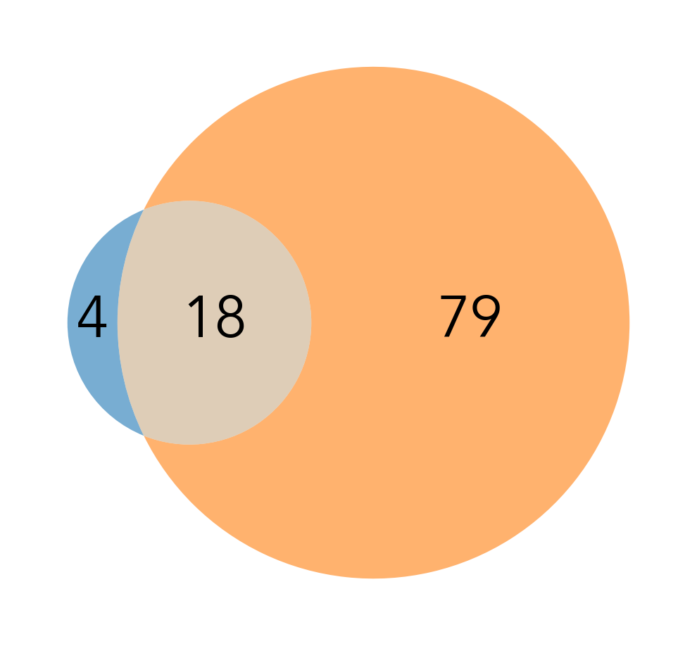
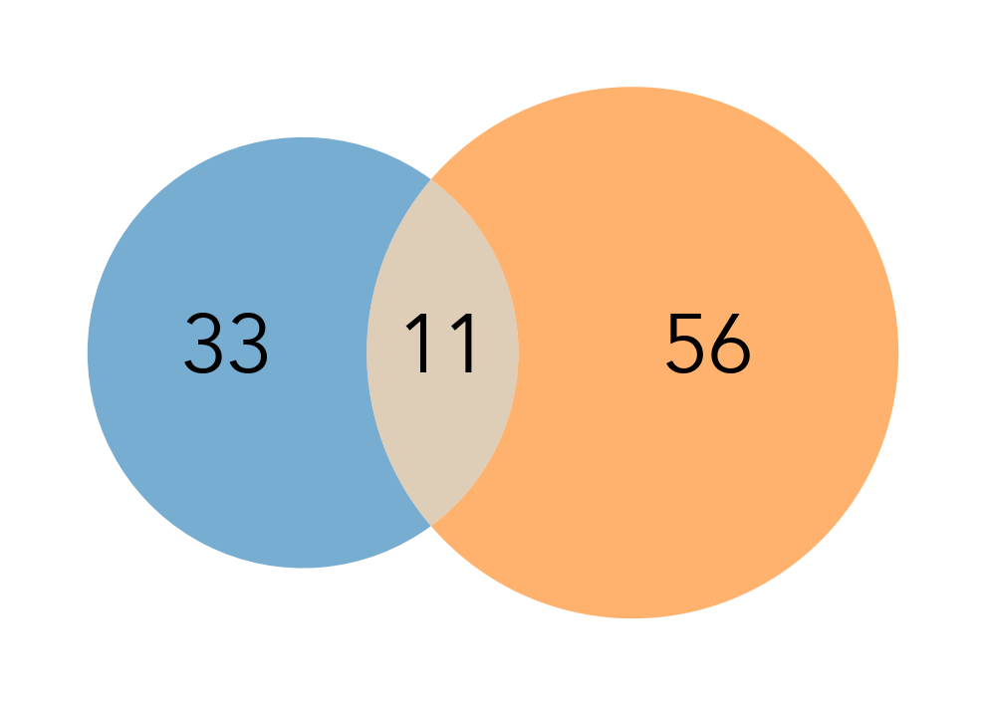
All-vs-All Overlapping Statistics
Percentage of overlapping pairs that are:
Shared Overlaps
Unique to Rawsamble
Unique to Minimap2
SARS-CoV-2
E. coli
Yeast
Green Algae
Human
~37% of overlapping pairs are shared with the minimap2 overlaps
How to evaluate the usefulness of these overlaps?

Slide 23
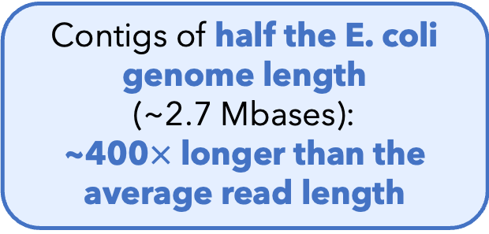
de novo Assemblies from Raw Signals
First de novo assemblies ever constructed
from raw signal overlaps without basecalling
E. coli Assembly
(From the Rawsamble Overlaps)
Contigs of half the E. coli genome length
(~2.7 Mbases):
~400$×$ longer than the average read length
Future work: Utilize the overlap and assembly information
when training and using basecallers
Notes:
Next, we look at de novo assembly construction.
This figure shows the visualization of the assembly graph we construct from raw signal overlaps.
[CLICK] The biggest takeaway is that we construct the first de novo assemblies ...
[CLICK] These assemblies are not necessarily short.
For example, we can construct contigs of the half the E. coli genome length, which is 400 times larger than the average read length for that dataset.
[CLICK] We conclude that ...
Visualizer tool: bandage

Slide 24
Low-Coverage Human Genome Assembly
Results are shown relative to the best result from each metric
  Metrics: auN, longest unitig, largest connected unitigs (component)
  Coverage: 0.6x
Rawsamble
Minimap2
Flye
Rawsamble leads to
better contiguity
than using basecalled reads
at a low coverage dataset
Longest unitig
auN
Can the richer information
in raw signals
improve assembly quality
where basecalled analysis falls short?
Largest component
Notes:
auN: area under the Nx curve

Slide 25
New Directions in Raw Signal Analysis
✓
Constructing (and analyzing) de novo assemblies
Utilizing the overlap information for more accurate (and faster) basecalling
Overlapping Raw Signals
Raw Signals
Basecalling
Utilizing the constructed assembly for basecalling
Error correction & assembly:
Basecalling

Slide 26
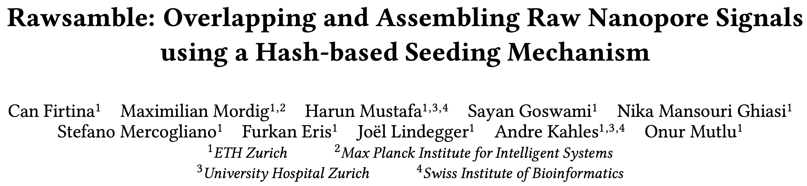
Rawsamble
Can Firtina, Maximilian Mordig, Harun Mustafa, Sayan Goswami,
Nika Mansouri Ghiasi, Stefano Mercogliano, Furkan Eris, Joël Lindegger, Andre Kahles, and Onur Mutlu
"Rawsamble: Overlapping and Assembling Raw Nanopore Signals using a Hash-based Seeding Mechanism"
arXiv, Oct 2024
[Source Code]
arXiv
Source code

Slide 27
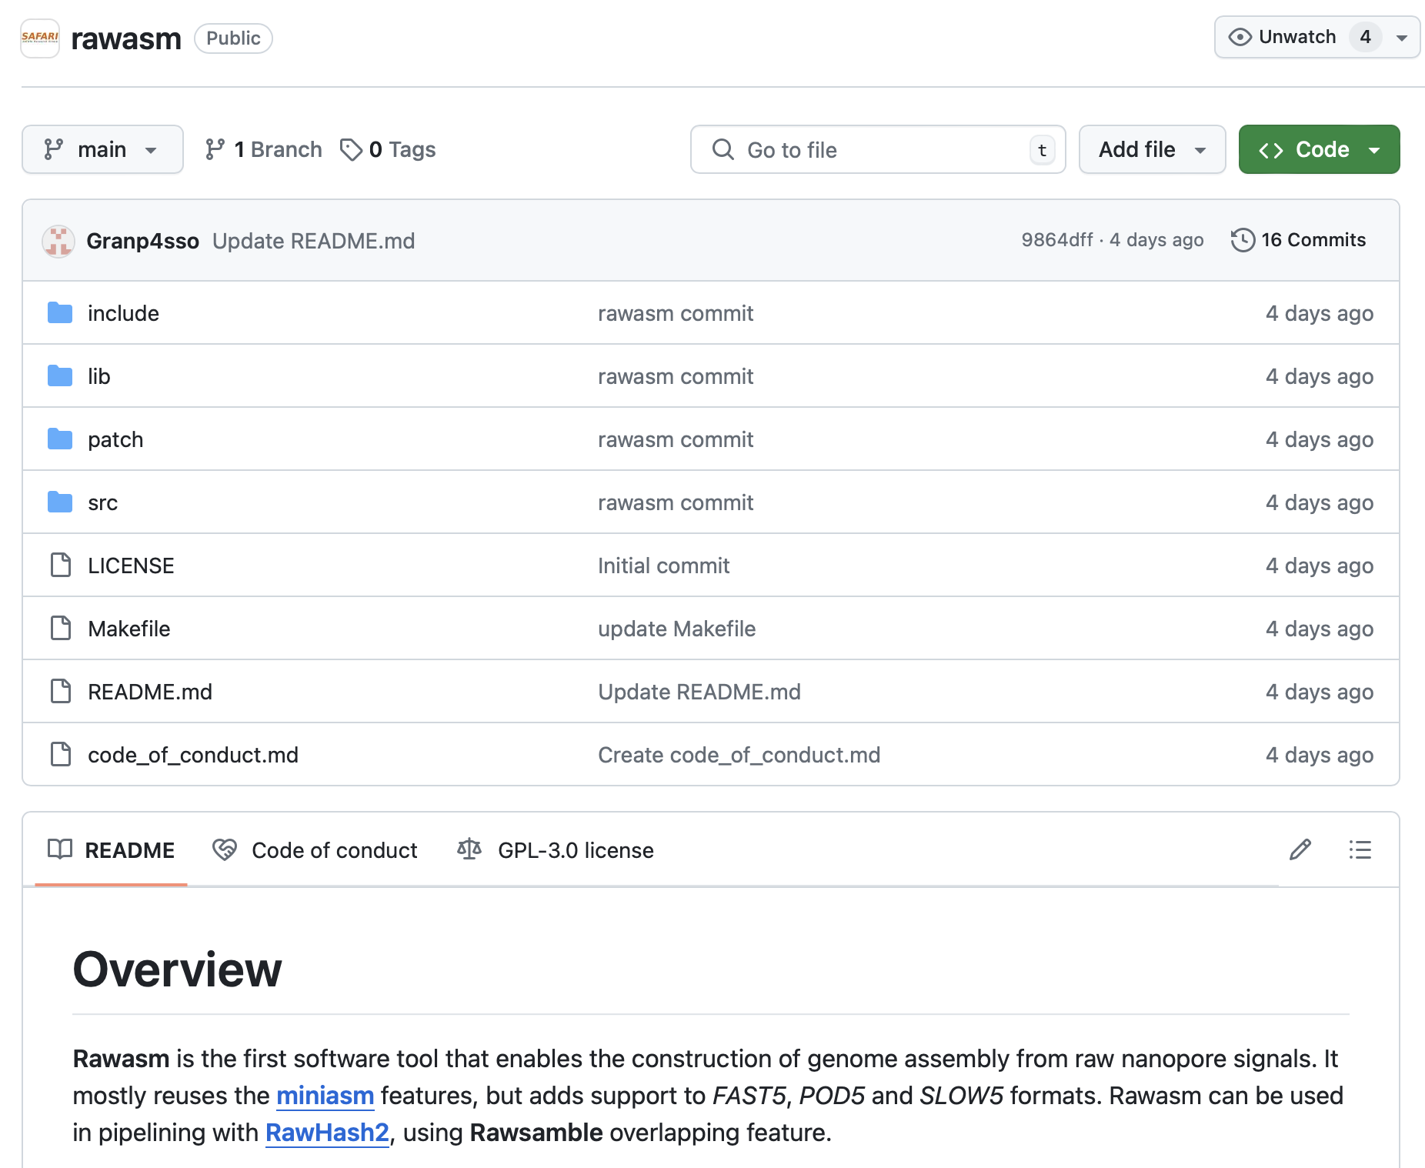
Rawasm: Raw Signal Assembler [Beta]
Slightly modified version of miniasm
  To output assembled raw signals instead of basecalled sequences
Supports all major
raw signal file formats
  FAST5, POD5, S/BLOW5 file formats
Still in a testing phase:
Feedback is appreciated!
https://github.com/CMU-SAFARI/rawasm

Slide 28
Outline
Background
Rawsamble Mechanism
Evaluation
Conclusion

Slide 29
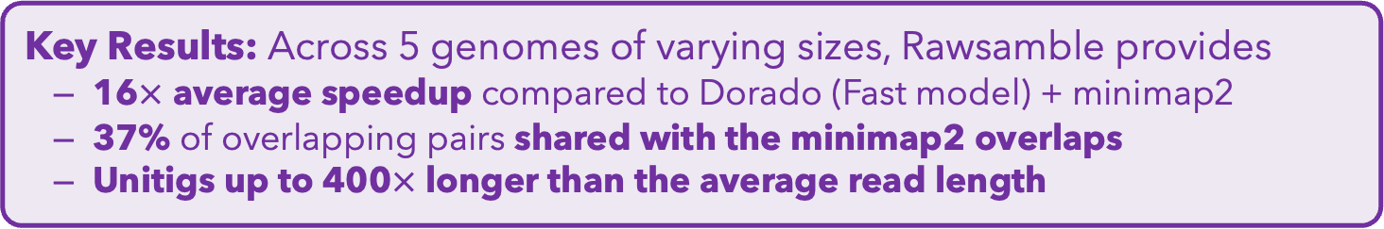
Conclusion
Key Contributions:
Rawsamble: the first mechanism that can find overlapping pairs between raw nanopore signals
First de novo assemblies ever constructed directly from
raw signal overlaps without basecalling
A new assembler to build and output the assemblies of signals
Key Results: Across 5 genomes of varying sizes, Rawsamble provides
  16$×$ average speedup compared to Dorado (Fast model) + minimap2
  37% of overlapping pairs shared with the minimap2 overlaps
  Unitigs up to 400$×$ longer than the average read length
Many opportunities for analyzing raw nanopore signals:
  Indexing is cheap: Future use cases with the on-the-fly index construction
  We should rethink the algorithms to perform downstream analysis
  fully using raw signals
  We should rethink the basecalling approaches by integrating
  raw signal analysis

Slide 30
CSHL Biological Data Science 2024
Rawsamble
Overlapping and Assembling
Raw Nanopore Signals
Using a Hash-based Seeding Mechanism
Can Firtina
Maximilian Mordig |  | Harun Mustafa |  | Sayan Goswami
Nika Mansouri Ghiasi |  | Stefano Mercogliano |  | Furkan Eris
Joël Lindegger |  | Andre Kahles |  | Onur Mutlu

Slide 31
Backup Slides

Slide 32
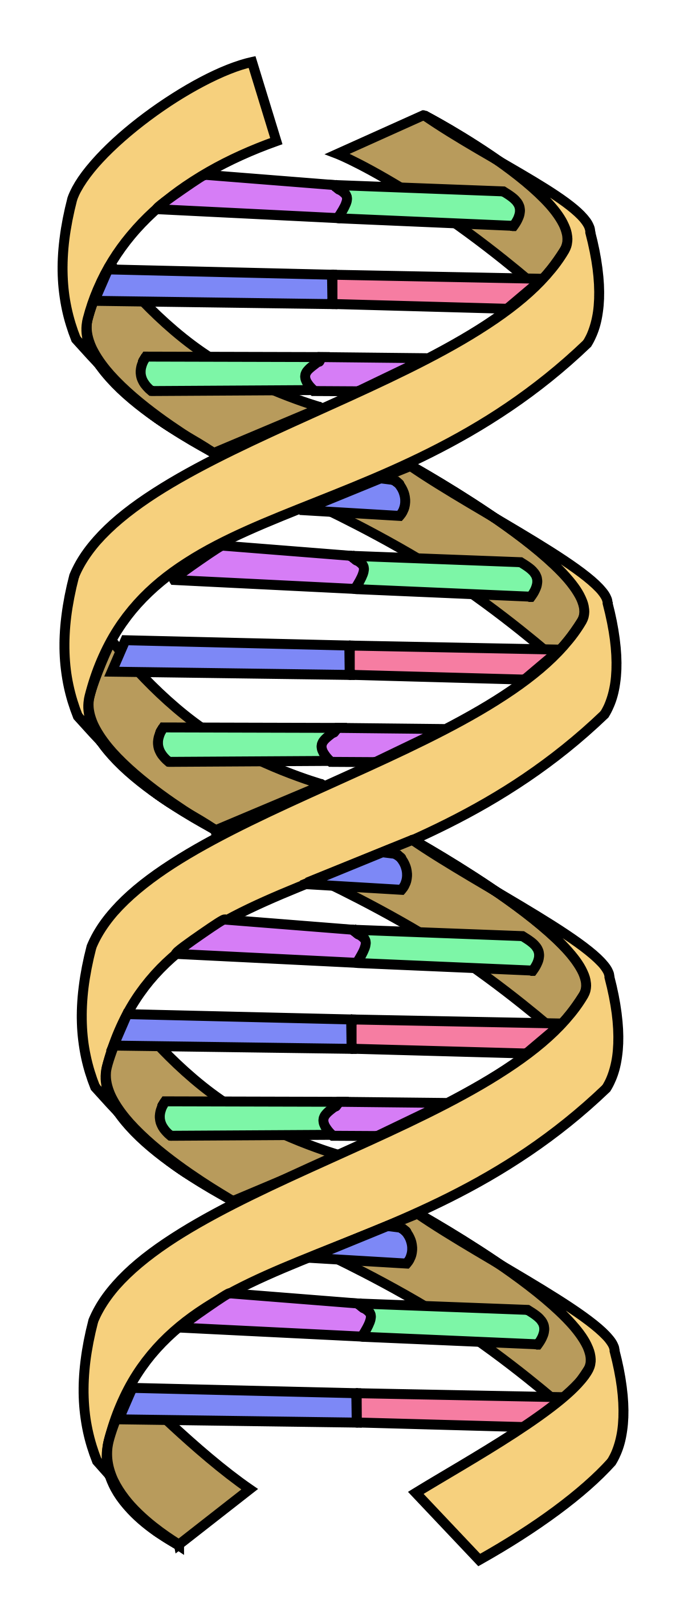
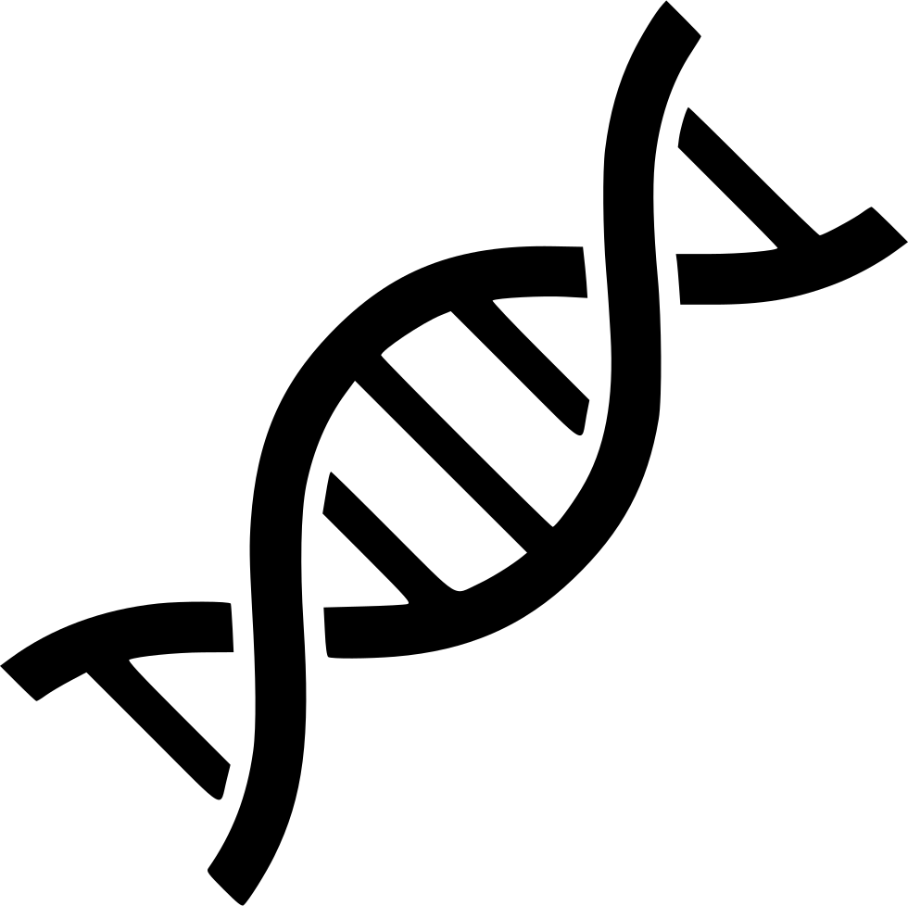
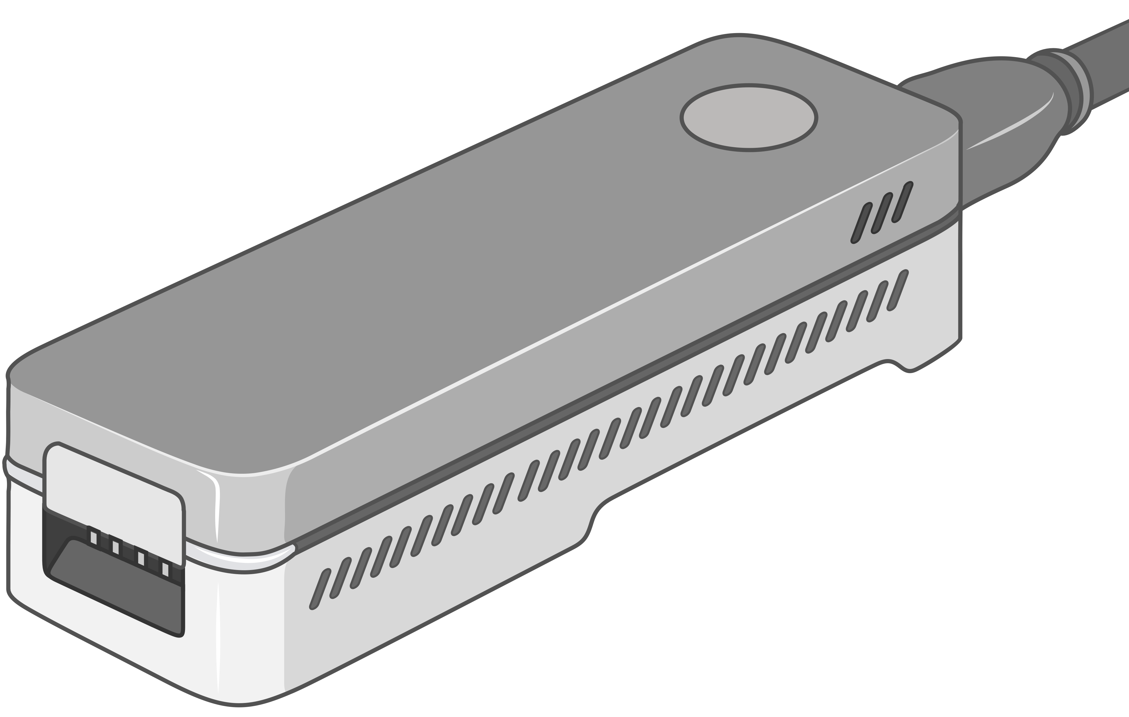
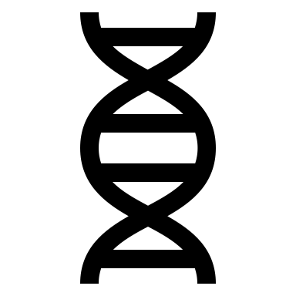


A Common Genome Analysis Pipeline
DNA
Molecule
Library Preparation
Sequencing
Raw
Sequencing Data
Sequencing Data Generation
TATGG
TGGTA
GCCTA
AAGCC
TATAT
Basecalling
Basecalled Sequencing Data
Denoised Raw Sequencing Data
Denoising
Translating
AAGCCTATATGGTAGTC
-2.1,0.3,2.3,-1.4
Preprocessing
Indexing
Seeding
Chaining
Alignment
Target Sequence
Hash Table
Query Sequence
Target Seq.
Target
Sequencing Data (Query):
AAGCCTATATGGTAGTC
0x00
2,64,…
Sketching
0x01
1,101,…
Sketching
Identifying the origin
Query
Query
Read Mapping
Store
…
Query Seq.
0xFF
13,21
Hash
Positions
Reference Genome (Target):
...
AAGCCTATATGCGTAATCAGATAGGATCGTCACGACTGT
...
Alignment Matrix
Hash
0x01
0x00
Hash
Seed Matches
Assembly
Variant Calling
Metagenomics
Downstream Analysis
Notes:
Generating the genomic data is usually the first step in a common genome analysis pipeline.
[CLICK] And initially these sequencing devices produce raw sequencing data
[CLICK] Which either needs to be translated into nucleotide sequences with a process called basecalling
[CLICK] Or preprocessed to reduce the inherent noise in raw sequencing data before further analysis
[CLICK] To identify the origin of sequencing data
[CLICK] we compare it with a representative sequence of a species, called a reference genome.
This process is known as read mapping and involves several steps.
[CLICK] First, we build an index, a hash table from the subsequences of a reference genome as a target sequence
[CLICK] Second, we extract subsequences, called seeds, from the sequencing data and query the index to find seed matches in the seeding step
[CLICK] Third, we identify nearby seed matches, called chains, to locate potential genomic regions of origin
[CLICK] Fourth, we optionally find exact matches and differences within the chaining region.
[CLICK] The information we generate from read mapping can be used for several purposes in downstream analysis, such as genome assembly, variant calling, and metagenomics.

Slide 33
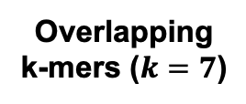
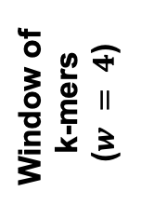
Minimizer Sketching
GCTATTACCT
GCTATTA
Hash
0xA1
Find
Minimum
Window of
k-mers
($w = 4$)
CTATTAC
Hash
0x02
Hash Table
0x02
TATTACC
Hash
0xFC
ATTACCT
Hash
0x45
CTATTAC
Overlapping
k-mers ($k=7$)
Sampled
k-mer (Minimizer)

Slide 34
Hash-Based Sketching and Seed Matching
Target Sequence
Query Sequence
GCTATTACCTTAATGTGATGGACGA
CAGGCTATAACCCTAATGTTGC
Sketching
Sketching
GCTA
TAAT
GACG
GCTA
ATGT
Hash
Hash
Hash
Hash
Hash
0x01
0xA4
0x41
0x01
0xFE
Store
Store
Store
Query
Query
<List of Positional Information>
Match
0x01
0xA4
0x41
Hash Table
No Match
Notes:
hashing.pdf

Slide 35

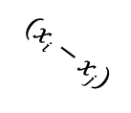










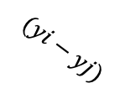
Chaining (Two Points)
$$xj$$
$$xi$$
Chaining
Target Seq.
Target Seq.
$$aj$$
$$ai$$
Anchor
(Seed match)
$$wi$$
$$(xi−xj)$$
$$aj$$
$$yj$$
$$yi$$
Query Seq.
Query Seq.
$$aj$$
$$ai$$
$$(yi−yj)$$
$$wi$$

Slide 36
Chaining (Multiple Points)
Exact hash value matches: Needed for finding matching regions between a reference genome and a read
What if there are mutations or errors?
  No hash (seed) match will occur in such positions
The chaining algorithm links exact matches in a proximity even though there are gaps (no seed matches) between them

Slide 37
Nanopore Sequencing
Notes:
Nanopore technology consists of a nanometre-sized pore in an insulating membrane that separates two electrolyte-filled wells
DNA/RNA: negatively charged due to their phosphate-sugar backbones, which contain phosphate groups that carry negative charges.

Slide 38
Source of Noise in Nanopore Sequencing
Stochastic thermal fluctuations in the ionic current
  Random ionic movement due to inherent thermal energy (Brownian motion)
Variations in the translocation speed
  Mainly due to the motor protein
Environmental factors
  Temperature: Affecting enzymes including the motor protein
  pH levels: Affecting charge and the shape of molecules
Maybe: Aging & material-related noise between nanopores
  Their effects potentially can be minimized with normalization techniques
Notes:
Thermal fluctuations: Stochastic thermal fluctuations refer to random, small-scale variations in “ion movement” due to inherent thermal energy at the molecular level. These fluctuations occur at any temperature above absolute zero.
Brownian motion and even at quantum levels
Variations: due to the design of motor protein -> can be affected by environmental factors like temperature (below)
Temperature: can alter enzyme performance, leading to signal inconsistencies. -> higher temperatures may speedup translocation. Increases molecular Kinetic energy

Slide 39
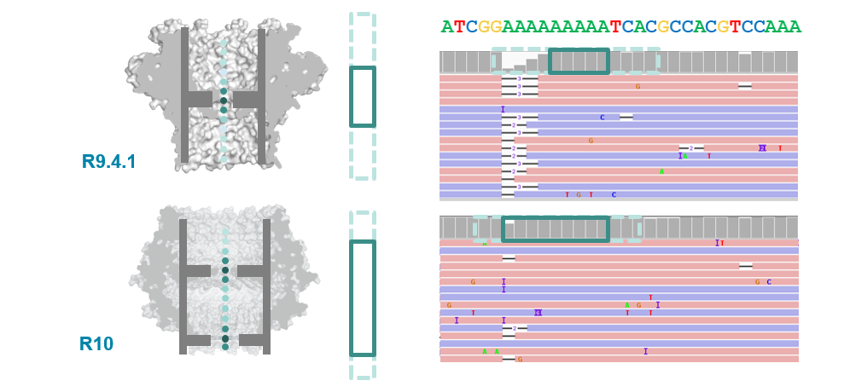
R9 vs. R10 Chemistries
Dual reader head
Motor protein with more consistent translocation speed in R10
Duplex sequencing in R10

Slide 40




Challenges in Real-Time Analysis
Rapid analysis to match the nanopore sequencer throughput
Timely decisions to stop sequencing as early as possible
Accurate analysis from noisy raw signal data
Power-efficient computation for scalability and portability

Slide 41
Applications of Read Until
Depletion: Reads mapping to a particular reference genome is ejected
Microbiome studies by removing host DNA
Eliminating known residual DNA or RNA (e.g., mitochondrial DNA)
High abundance genome removal
Enrichment: Reads not mapping to a particular reference genome is ejected
Removing contaminated organisms
Targeted sequencing (e.g., to a particular region of interest in the genome)
Low abundance genome enrichment

Slide 42

Reference-to-Event Conversion
K-mer model: Provides expected event values for each k-mer
  Preconstructed based on nanopore sequencer characteristics
Use the k-mer model to convert all k-mers
of a reference genome to their expected event values
Reference Genome
Expected Event Values
Normalized Event Values
GCTATTACC
GCTATT
K-mer Model
(Lookup Table)
105.757390
Normalize
2.21
CTATTA
81.740642
-0.09
k-mers ($k=6$)
TATTAC
103.170091
1.15
ATTACC
101.082485
1.11

Slide 43
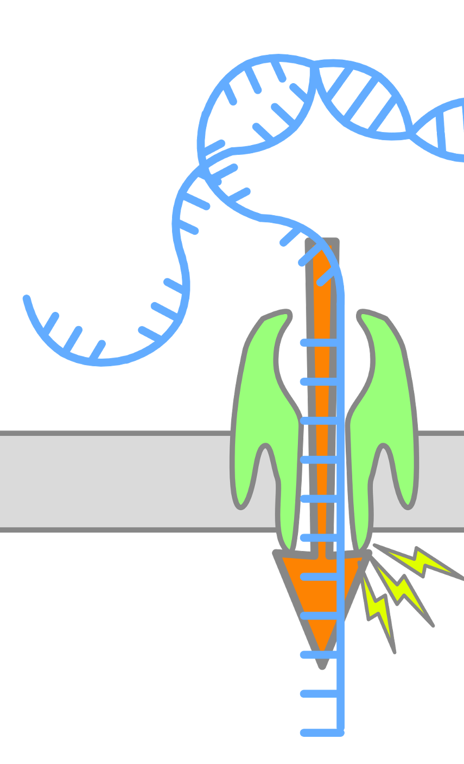
Enabling Analysis From Electrical Signals
K many nucleotides (k-mers) sequenced at a time
Event: A segment of the raw signal
  Corresponds to a particular k-mer
Observation: Event values generated after sequencing the same k-mer are similar in value (not necessarily the same)
Event
Event Value
Raw Nanopore Signal
Normalize
ACTTGG
pAmpere
Segment
Calculate
Means
2.21
Time
k-mer
ACTTGG

Slide 44
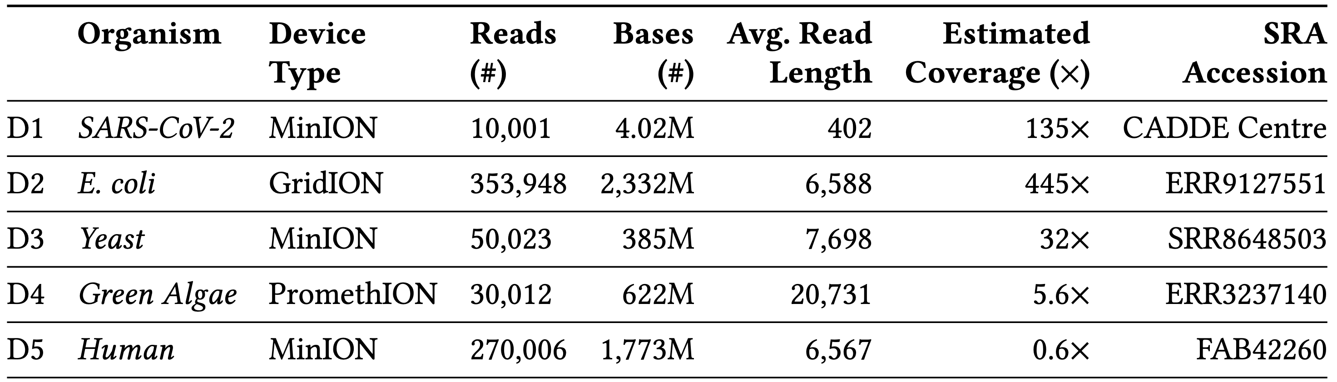
Datasets

Slide 45
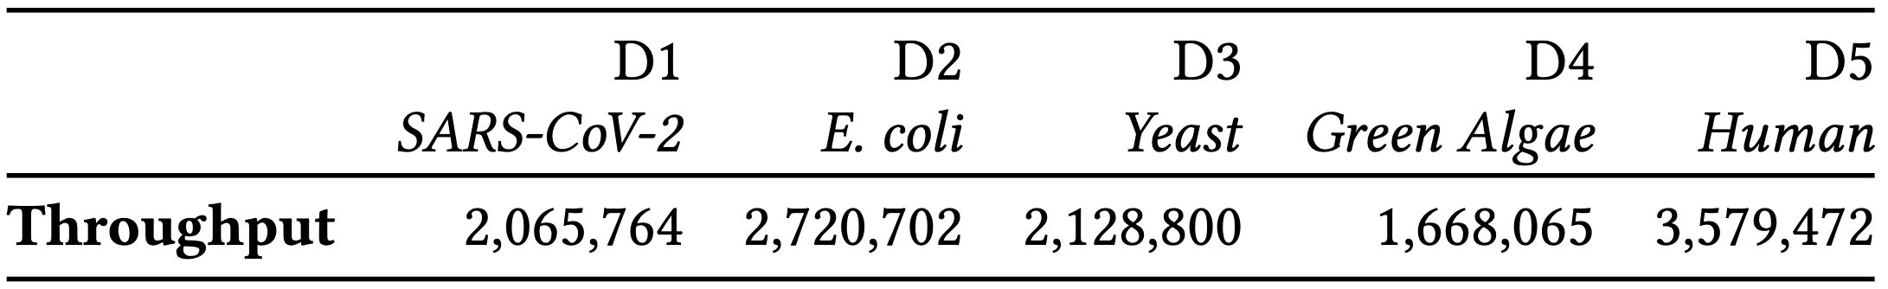
Throughput

Slide 46
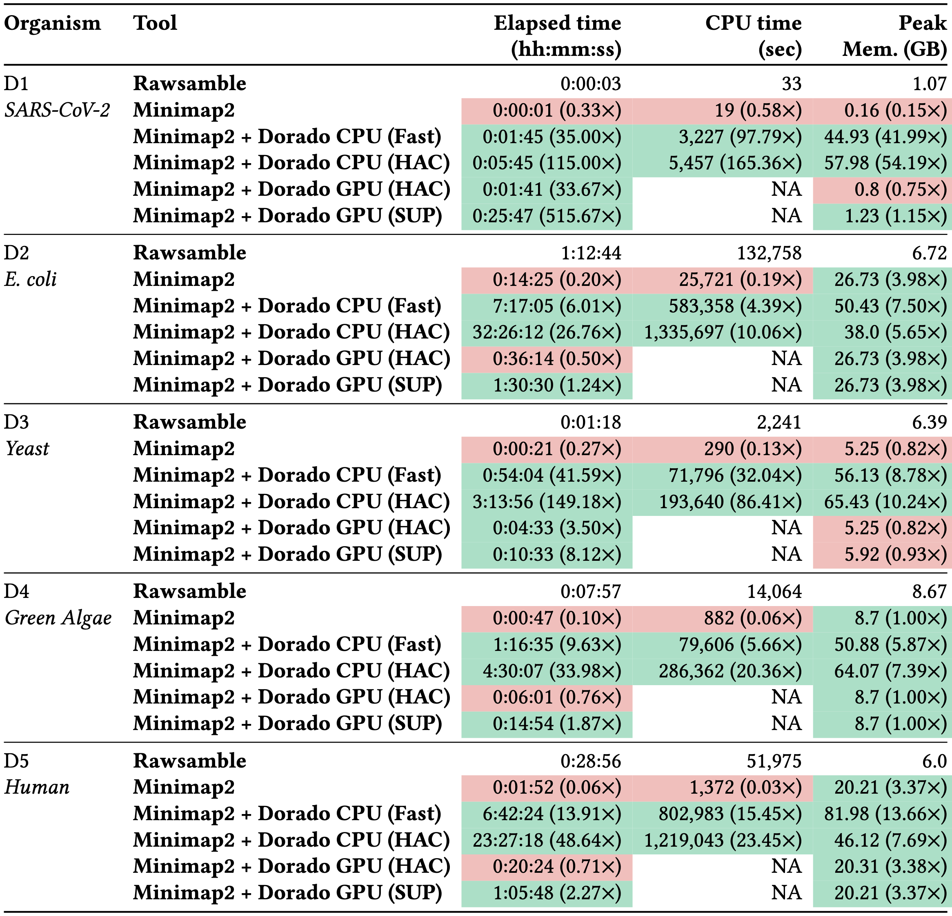
Performance

Slide 47
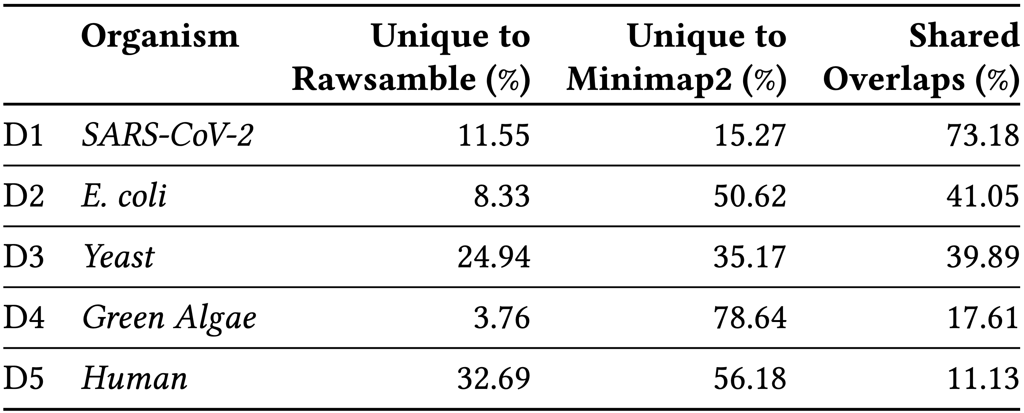
Overlapping Statistics

Slide 48
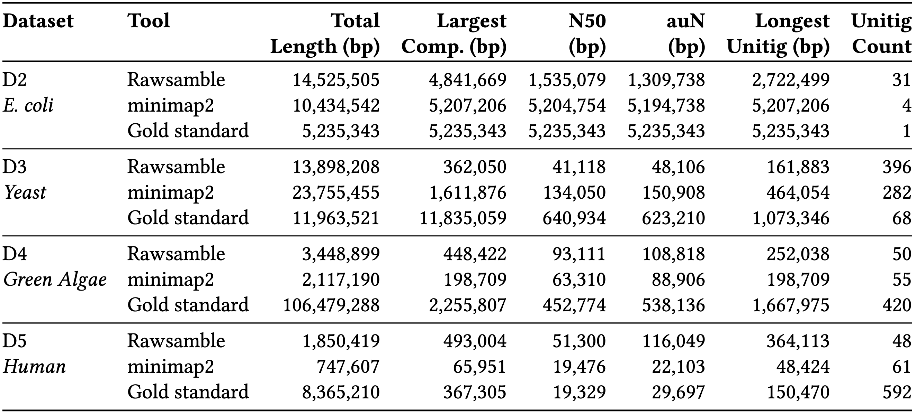
Assembly Statistics

Slide 49
Visualizing the E. coli Assembly Graph

Slide 50
Visualizing the Yeast Assembly Graph

Slide 51
Visualizing the Green Algae Assembly Graph

Slide 52
Visualizing the Human Assembly Graph

Slide 53
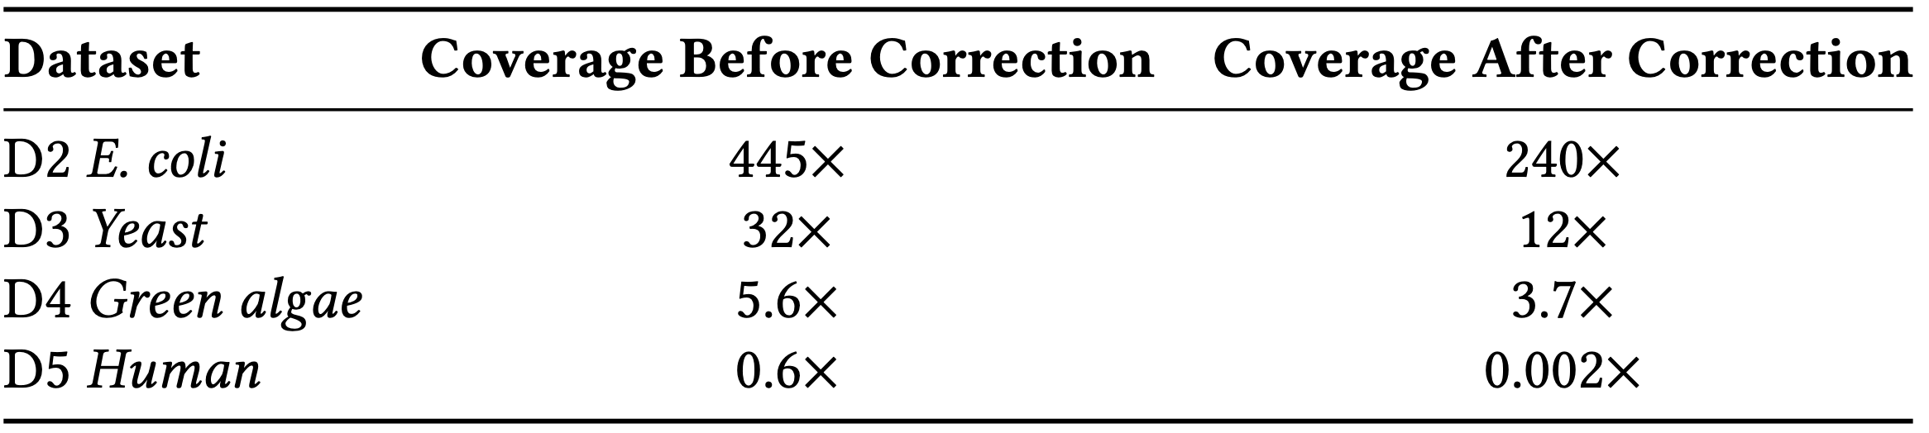
HERRO Correction Before and After

Slide 54
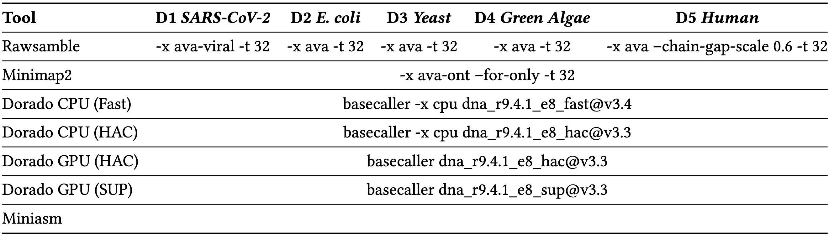
Parameters

Slide 55
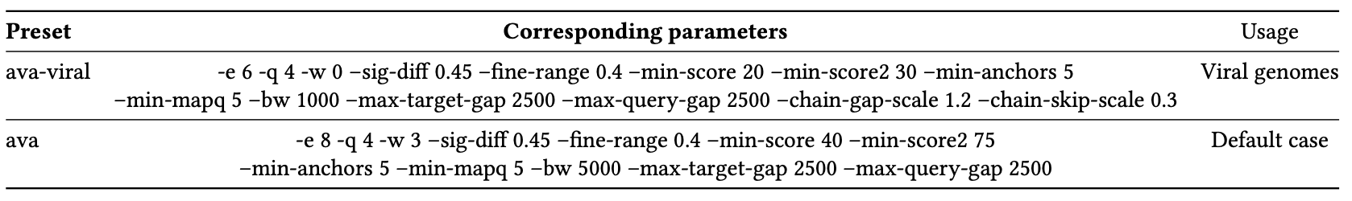
Presets

Slide 56
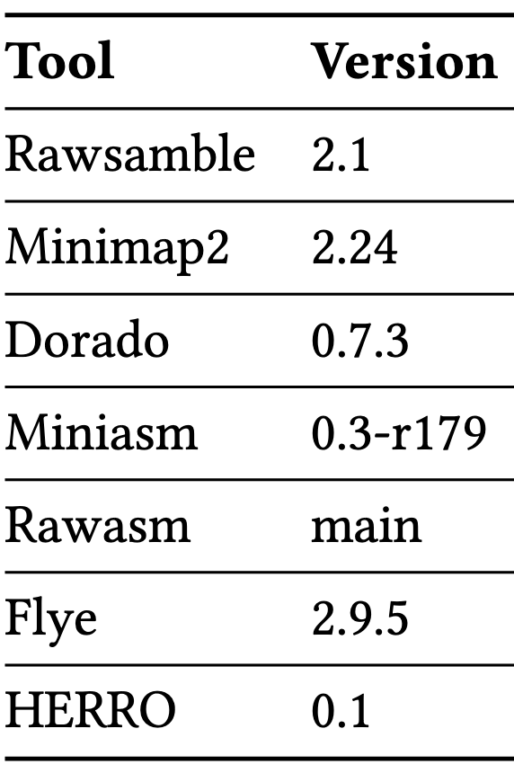
Versions

Slide 57
Future Work
Reverse Complementing Raw Nanopore Signals
Without reverse complementing, we are missing half of the useful information
Dynamically Building the Hash Table in Real-Time
Needed for real-time de novo assembly construction
What are the useful applications for real-time de novo assembly construction?

