Slide 1
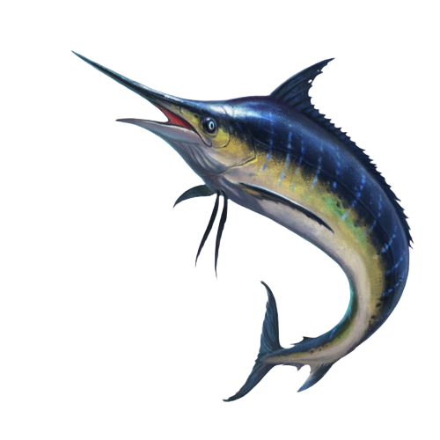





Swordfish: A Framework for Evaluating
Deep Neural Network-based Basecalling
using Computation-in-Memory
with Non-Ideal Memristors
Taha Michael Shahroodi,
Gagandeep Singh, Mahdi Zahedi, Haiyu Mao,
Joel Lindegger, Can Firtina, Stephan Wong,
Onur Mutlu, Said Hamdioui
Notes:
1

Slide 2
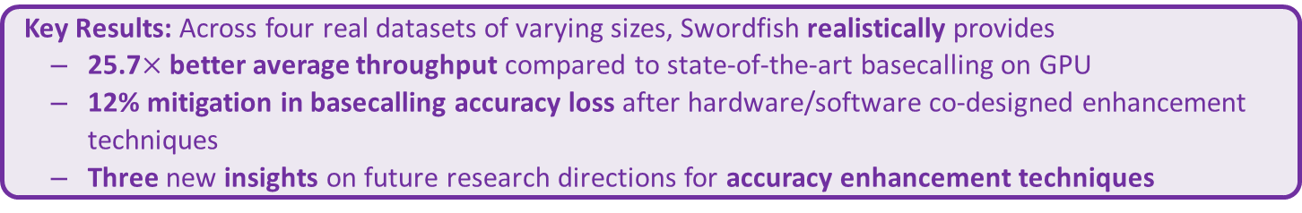
Executive Summary
Context: Basecalling is the first step and a major throughput bottleneck
Basecallers use deep neural networks (DNNs)
DNN-based basecalling accuracy and throughput impact accuracy and throughput of next analysis
Prior research uses memristor-based Computation-in-Memory (CIM) to accelerate DNNs
Non-idealities in memristor-based CIM known to hinder accuracy
Problem: Prior frameworks for memristor-based CIM accelerators targeting large DNNs either
overlook existing non-idealities,
overestimates achievable accuracy by studying non-idealities in isolation or using imprecise models/methodology
overlook the effects of non-idealities mitigation techniques on the achievable throughput
Goal: Enable accurate and realistic evaluation of accuracy and throughput for DNN-based basecalling on memristor-based CIM
Key Contribution: Swordfish; the first framework for memristor-based CIM that uses characterized memories and accurate models to
1) accurately and realistically evaluate the effects of non-idealities on basecalling accuracy and throughput
2) comprehensively investigate the impact of accuracy enhancement techniques on basecalling accuracy and throughput
Key Results: Across four real datasets of varying sizes, Swordfish realistically provides
25.7$×$ better average throughput compared to state-of-the-art basecalling on GPU
12% mitigation in basecalling accuracy loss after hardware/software co-designed enhancement techniques
Three new insights on future research directions for accuracy enhancement techniques

Slide 3
Outline
Background & Motivation
Swordfish: Design & Implementation
Evaluation & Key Results
Takeaways & Summary

Slide 4
Outline
Background & Motivation
Swordfish: Design & Implementation
Evaluation & Key Results
Takeaways & Summary

Slide 5
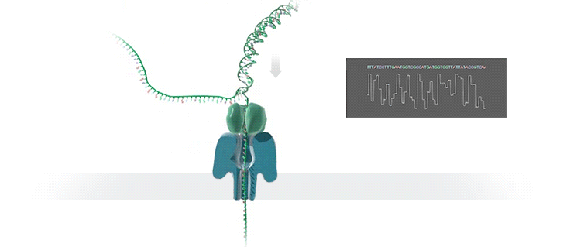

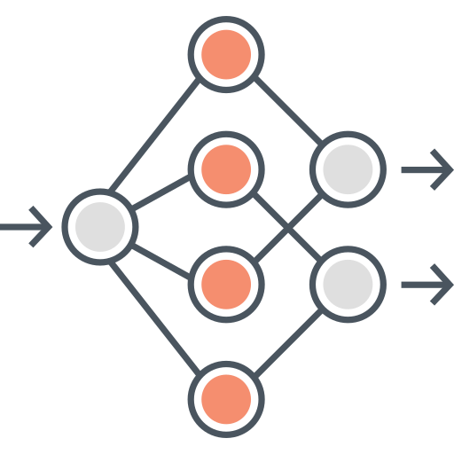


Nanopore Genome Sequencing and Analysis Pipeline
Genome Sequencing: Determining DNA sequence order for
Personalized medicine,
Outbreak tracing,
Understanding evolution
Nanopore Sequencing: A widely used sequencing technology
Nanopore Genome Analysis Pipeline
Nanopore Sequencing
Basecalling
in GPU
Downstream Analysis
Examples:
Read Mapping
Variant Calling
…
A
T
G
C
Current
Basecalling consumes up to 84.2% of the execution time [Bowden+ 2019]

Slide 6
Nanopore Genome Sequencing and Analysis Pipeline
Genome Sequencing: Determining DNA sequence order for
Personalized medicine,
Outbreak tracing,
Understanding evolution
Nanopore Sequencing: A widely used sequencing technology
Basecalling is
Accuracy-critical
Performance Bottleneck
Nanopore Genome Analysis Pipeline
Nanopore Sequencing
Basecalling
in GPU
Downstream Analysis
Examples:
Read Mapping
Variant Calling
…
A
T
G
C
Current
Basecalling consumes up to 84.2% of the execution time [Bowden+ 2019]
Basecallers are just large DNNs

Slide 7
DNN Hardware Acceleration
DNN execution is dominated by:
Vector-Matrix Multiplication (VMM)
Data movement between memory and accelerator
(e.g., GPU or TPU)
Memristor-based crossbars support VMM
Computation in Memory (CIM) minimizes data movement

Slide 8
DNN Hardware Acceleration
DNN execution is dominated by:
Vector-Matrix Multiplication (VMM)
Data movement between memory and accelerator
(e.g., GPU or TPU)
Memristor-based CIM for DNN Acceleration
Memristor-based crossbars support VMM
Computation in Memory (CIM) minimizes data movement
[Ankit+, ASPLOS 2019], [Chi+, ISCA 2016], [Lou+, PACT2020], [Shafiee+, ISCA 2016]

Slide 9
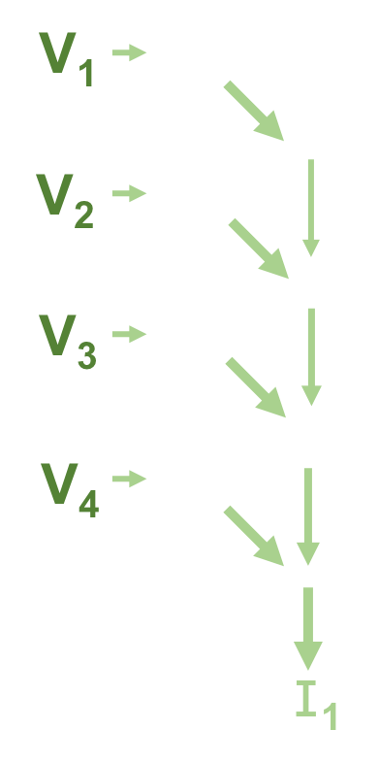
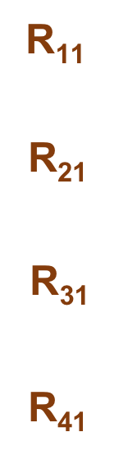
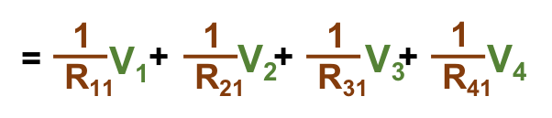
Memristor-based Crossbars

Slide 10
VMM in Memristor-based Crossbars
Digital to Analog Converters (DACs)
Analog to Digital Converters (ADCs)

Slide 11
VMM in Memristor-based Crossbars
VMM in Accelerators
In Accelerators
Accurate
VMM in Memristor-based Crossbars
In Memory

Slide 12
Non-idealities in Memristor-based Crossbars
Variation in
Synaptic Conductance
Non-ideal DAC
Digital to Analog Converters (DACs)
Wire Resistance
Analog to Digital Converters (ADCs)
Non-ideal ADC
Non-idealities are everywhere

Slide 13
VMM in Memristor-based Crossbars
VMM in Memristor-based Crossbars
In Memory

Slide 14
VMM in Memristor-based Crossbars
VMM in Ideal Memristor-based Crossbars
In Memory
Accurate

Slide 15
VMM in Memristor-based Crossbars
VMM in Ideal Memristor-based Crossbars
In Memory
Accurate
VMM in Real Memristor-based Crossbars
In Memory
In Memory
Inaccurate
Accurate

Slide 16
Our Goal
To realistically evaluate end-to-end basecalling
accuracy and throughput for memristor-based CIM

Slide 17
Key Idea
To account for the non-idealities in device, circuit and architecture of memristor-based CIM and the overhead of non-idealities mitigation techniques

Slide 18
Outline
Background & Motivation
Swordfish: Design & Implementation
Evaluation & Key Results
Takeaways & Summary

Slide 19
Swordfish vs Other Frameworks
Ideal Memristor-based CIM Frameworks for DNNs
User Input
Traditional ideal Frameworks
DNN
Architecture
Weights
Partition & Map
Kernel Chunks
(i.e., ideal VMMs)
System Evaluator
Layer 1
…
…
Performance
Area
Layer N
CIM Hardware
Architecture

Slide 20
Swordfish Framework - Overview
Realistic Memristor-based CIM Frameworks for DNNs
User Input
Swordfish
DNN
Architecture
Weights
Partition & Map
Kernel Chunks
System Evaluator
Layer 1
Accuracy
…
…
Performance
Area
Layer N
CIM Hardware
Architecture
Circuit Params
Device Params
VMM Model Generator
Non-ideal
VMMs
Accuracy Enhancer
Hyperparameters
Updated Weights

Slide 21
Swordfish Framework - Overview
Realistic Memristor-based CIM Frameworks for DNNs
User Input
Swordfish
DNN
Architecture
Weights
Partition & Map
Kernel Chunks
System Evaluator
Layer 1
Accuracy
…
…
Performance
Area
Layer N
CIM Hardware
Architecture
Circuit Params
Device Params
VMM Model Generator
Non-ideal
VMMs
Accuracy Enhancer
Hyperparameters
Updated Weights

Slide 22
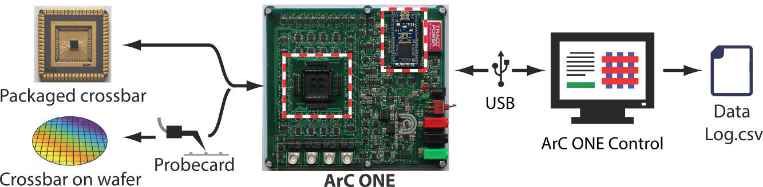
VMM Model Generator
Goal: Capture real output of VMM in presence of non-idealities
Swordfish supports two approaches:
Approach 1:
Real chip measurement and characterizations
Approach 2:
Analytical Modeling using component’s models
Input Vector
Non-Ideal Input Voltages
Non-Ideal Output Currents
Non-Ideal Output Vector
Model for
Non-Ideal DAC
Model for
Non-Ideal Crossbar
Model for
Non-Ideal ADC
© Copyright 2023, ArC INSTRUMENTS

Slide 23
VMM Model Generator
Goal: Capture real output of VMM in presence of non-idealities
Swordfish supports two approaches:
Approach 1:
Real chip measurement and characterizations
Approach 2:
Analytical Modeling using component’s models
Input Vector
Non-Ideal Input Voltages
Non-Ideal Output Currents
Non-Ideal Output Vector
Model for
Non-Ideal DAC
Model for
Non-Ideal Crossbar
Model for
Non-Ideal ADC
© Copyright 2023, ArC INSTRUMENTS
Most Accurate
More Flexible
Less Flexible
Less Accurate

Slide 24
Swordfish Framework - Overview
Realistic Memristor-based CIM Frameworks for DNNs
User Input
Swordfish
DNN
Architecture
Weights
Partition & Map
Kernel Chunks
System Evaluator
Layer 1
Accuracy
…
…
Performance
Area
Layer N
CIM Hardware
Architecture
Circuit Params
Device Params
VMM Model Generator
Non-ideal
VMMs
Accuracy Enhancer
Hyperparameters
Updated Weights

Slide 25
Accuracy Enhancement
Goal: Enhance the accuracy of a VMM by adapting input currents and resistance of memristors based on non-idealities
Swordfish supports four techniques:
1. Analytical Variation Aware Training (VAT)
2. Knowledge Distillation-based (KD) VAT
3. Read-Verify-Write (R-V-W) Training
4. Random Sparse Adaptation (RSA) Training

Slide 26

Example of Accuracy Enhancement
Goal: Enhance the accuracy of a VMM by adapting input currents and resistance of memristors based on non-idealities
Read more about
other techniques in the paper
1. Analytical Variation Aware Training (VAT) [Offline]
2. Knowledge Distillation-based (KD) VAT [Offline]
3. Read-Verify-Write (R-V-W) Training [Offline]
4. Random Sparse Adaptation (RSA) Training

Slide 27
Accuracy Enhancement via Random Sparse Adaptation
Key idea?
Key idea? Map the weights
Key idea? Map the weights that otherwise would map to error-prone memristor devices
Key idea? Map the weights that otherwise would map to error-prone memristor devices to reliable SRAM cells.
RSA in 3 Steps:
Initial Training (one-time, on GPU) and distribution of weights
VMM operation using both memories
Retraining all weights and reload those on SRAM (only)
Load Weights to Memristors + SRAM
Digital Labeled Input Squiggle
1
Initial Training
Memristor Array
3
VMM/Layer Output
+
SRAM
Retraining
In Software
e.g., using KD
Load Weights to SRAM
2
VMM Output

Slide 28
More in the Paper
Details of capturing non-idealities at VMM level
Implementation details of Swordfish components:
Partition & Map
Accuracy Enhancer
VMM Model Generator
System Evaluator
Elaborations on accuracy enhancement techniques
Analytical Variation Aware Training (VAT)
Knowledge Distillation-based (KD) using VAT
Read-Verify-Write (R-V-W) Training
Random Sparse Adaptation (RSA) Training

Slide 29
Outline
Background & Motivation
Swordfish: Design & Implementation
Evaluation & Key Results
Takeaways & Summary

Slide 30
Evaluation Methodology: Experimental Setup
We evaluate
Basecaller: Bonito [Oxford Nanopore 2023]
CIM Architecture: PUMA [Ankit+, ASPLOS 2019]
Infrastructure
2x AMD EPYC 7742 CPU with 500 GB DDR4 DRAM
8x NVIDIA V100
Datasets and Workloads [Wick+ 2019, Zook+ 2019, CADDE 2020]
4 real read and reference genomes with various genome size (D1, D2, D3, and D4)

Slide 31
Evaluated Non-idealities & Enhancement techniques
Non-idealities
1
Synaptic+Wires
Analytical
Models
(Approach 2)
2
Sensing+ADC Circuitry
3
DAC+Driver Circuitry
4
Combined
5
Measured
(Approach 1)
Accuracy Enhancement Techniques
1
Variation Aware Training (VAT)
2
Knowledge Distillation (KD)
3
Read-Verify-Write (R-V-W)
4
Random Sparse Adaptation (RSA) + KD
5
All

Slide 32
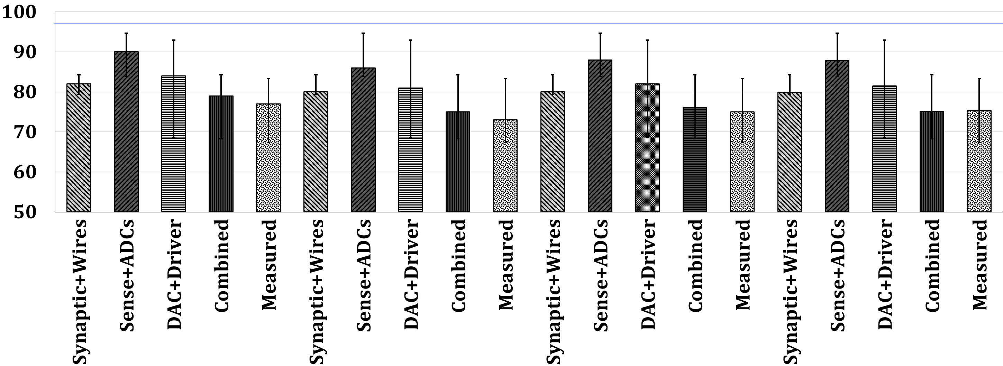
Accuracy: All Non-idealities without Mitigation
D1
Baseline
D2
Baseline
Accuracy (%)
Non-idealities
Combined non-idealities leads to significant accuracy loss (>18%)

Slide 33
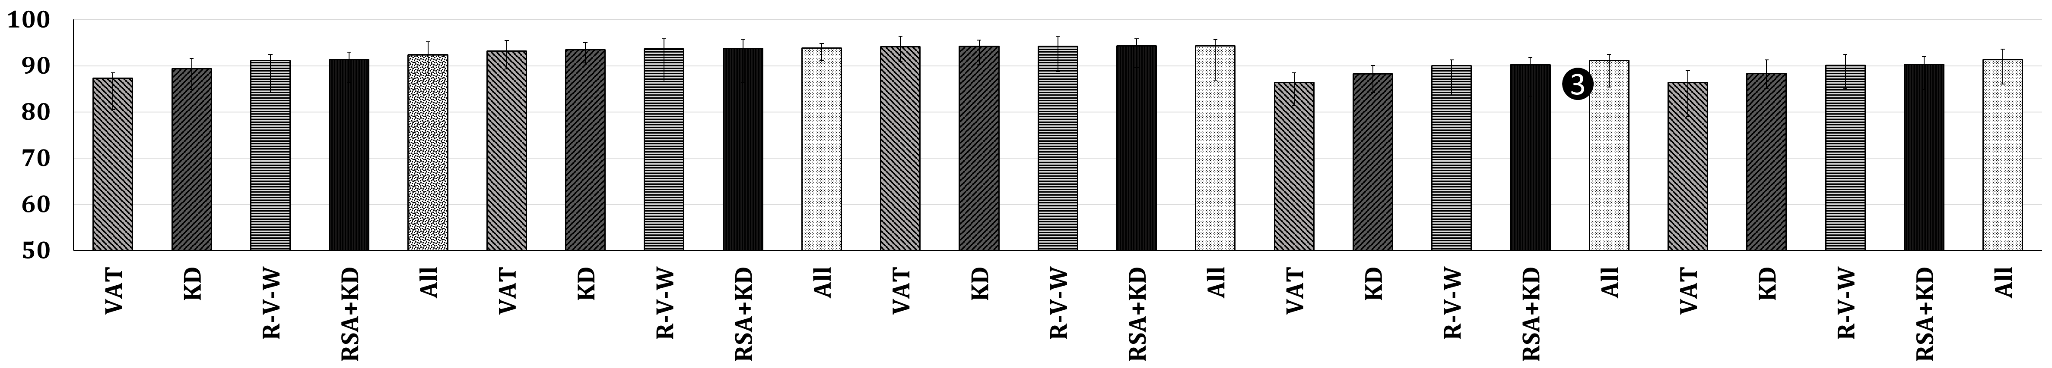
Accuracy: Enhancement Techniques on All Non-idealities
D1
Baseline
D3
Baseline
Accuracy (%)
Enhancement Technique
Accuracy enhancement techniques mitigate non-idealities,
But differently.

Slide 34
Accuracy: Enhancement Techniques on All Non-idealities
D1
Baseline
D3
Baseline
Accuracy (%)
Enhancement Technique
Considerable accuracy loss (>6%) even with All
enhancement techniques.

Slide 35
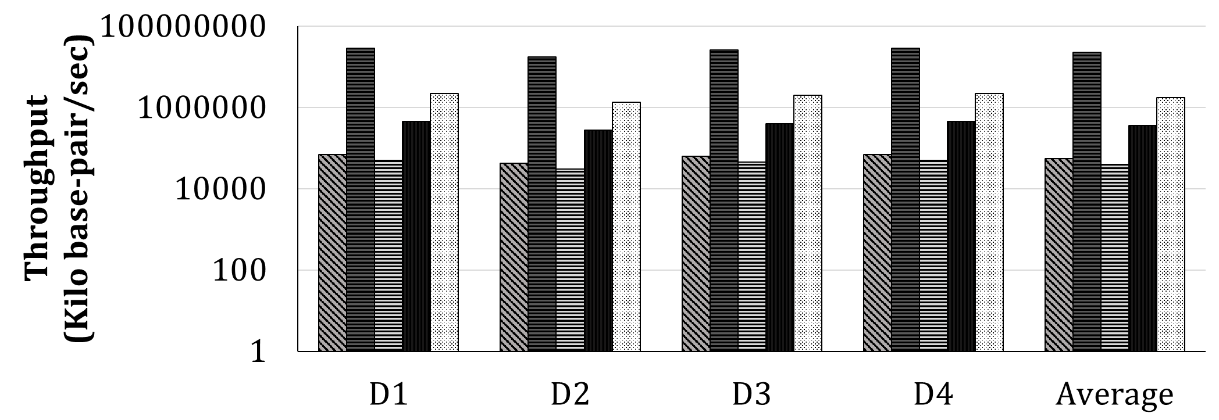
Throughput Analysis
G-Bonito
Ideal-Swordfish
Realistic-Swordfish-RVW
Realistic-Swordfish-RSA
Realistic-Swordfish-RSA+KD
Ideal CIM implementation improves the basecalling throughput over Bonito-GPU by 413.6× on average

Slide 36
Throughput Analysis
G-Bonito
Ideal-Swordfish
Realistic-Swordfish-RVW
Realistic-Swordfish-RSA
Realistic-Swordfish-RSA+KD
Throughput improvement at the high, unacceptable accuracy loss of 18%
Ideal CIM implementation improves the basecalling throughput over Bonito-GPU by 413.6× on average

Slide 37
Throughput Analysis
G-Bonito
Ideal-Swordfish
Realistic-Swordfish-RVW
Realistic-Swordfish-RSA
Realistic-Swordfish-RSA+KD
Realistic CIM designs significantly underperform ideal design

Slide 38
Throughput Analysis
G-Bonito
Ideal-Swordfish
Realistic-Swordfish-RVW
Realistic-Swordfish-RSA
Realistic-Swordfish-RSA+KD
Some realistic CIM designs degrade throughput compared to Bonito-GPU

Slide 39
Throughput Analysis
G-Bonito
Ideal-Swordfish
Realistic-Swordfish-RVW
Realistic-Swordfish-RSA
Realistic-Swordfish-RSA+KD
Realistic CIM design using RSA+KD provides on average 25.7× higher throughput compared to Bonito-GPU

Slide 40
More in the Paper
Details on evaluation methodology
Datasets
Array and devices
Evaluation results
Individual non-idealities and architectural limitations on accuracy
Accuracy enhancements on individual and combined non-idealities and architectural limitations
Accuracy vs. Area analysis
Observations and trends from the presented figures
Results for 256x256 crossbar + comparison with 64x64 crossbars
Discussions, takeaways, and future work

Slide 41
Outline
Background & Motivation
Swordfish: Design & Implementation
Evaluation & Key Results
Takeaways & Summary

Slide 42
Takeaways
The target application for memristor-based CIM matters
Swordfish enables realistic evaluation of accuracy and performance for DNN-based applications on memristor-based CIM
Non-idealities are detrimental to both accuracy and performance
HW/SW co-designed techniques mitigate inaccuracy the most

Slide 43
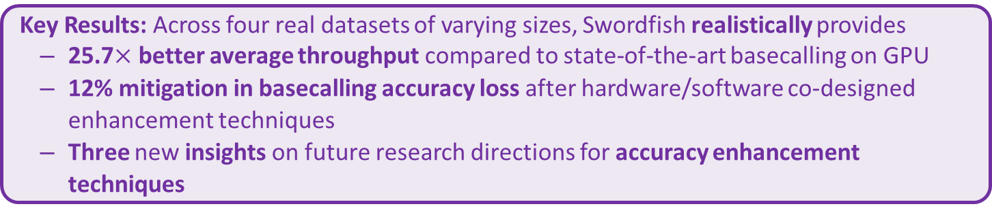
Summary
Key Contribution: Swordfish; the first framework for memristor-based CIM that uses characterized memories and accurate models to
1) accurately and realistically evaluate the effects of non-idealities on basecalling accuracy and throughput
2) comprehensively investigate the impact of accuracy enhancement techniques on basecalling accuracy and throughput
Key Results: Across four real datasets of varying sizes, Swordfish realistically provides
25.7$×$ better average throughput compared to state-of-the-art basecalling on GPU
12% mitigation in basecalling accuracy loss after hardware/software co-designed enhancement techniques
Three new insights on future research directions for accuracy enhancement techniques
Many opportunities for
Realistically evaluating accuracy and throughput other DNNs on memristor-based CIM
Developing and evaluating novel accuracy enhancement techniques, on software, hardware, or both
We should remain cautious applying known acceleration techniques to emerging technologies, architectures, and applications

Slide 44
Swordfish: A Framework for Evaluating
Deep Neural Network-based Basecalling
using Computation-in-Memory
with Non-Ideal Memristors
Questions?
Notes:
44

