Slide 1
Treaty of Versailles
Alex Yu

Slide 2
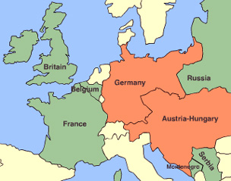
World War I Timeline
Austrian Archduke assassination by Serbian terrorist.
Austrian-Serbian War
Russia joins Serbia
Germany supports Austria and attacks France and Belgium.

Slide 3
World War I Timeline
Great Britain defends Belgium.
The United States joins the Allies later.
Russia drops out while dealing with internal conflict.
Germany could not continue fighting and signed an armistice.
Treaty of Versailles and Peace Conference

Slide 4
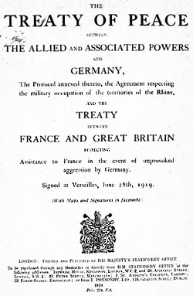
Treaty of Versailles 1919
War Guilt
German Military
Territory- Alsace-Lorraine
Colonies
Reparations

Slide 5
War Guilt
Germany: 30 points
The Germans were strongly against this. They believed that their honor was on the line.
Allies: 10 points
The Allies did not care very much about this clause. They only needed it as justification for reparations.

Slide 6
Germany Military
Germany: 20 points
Disillusioned about the brutality of war.
Less likely to put up a strong fight against military cuts, but still cared about the issue.
Allies: 25 points
Allies, especially France, were still scared of revenge.
Wanted to cripple Germany to lower the risk.

Slide 7
German Territory: Alsace-Lorraine
Germany: 15 points
The land was mineral rich and held a bit of historical value to the Germans.
Allies: 30 points
France lost this land to Germany in 1871 and wanted it back.
It also strengthens their position against Germany geographically.

Slide 8
Colonies
Germany: 5 points
Germany did not have as many colonies compared to some of the other European nations.
Allies: 15 points
France and Great Britain wanted Germany’s colonies for themselves.

Slide 9
War Reparations
Germany: 30 points
The Germans saw this as an extension of war guilt. There was heavy opposition to this part of the treaty as well.
Allies: 20 points
The Allies saw this as a way to repair the wounds they had been dealt and weaken Germany further.

Slide 10
Adjusted Winner Table
 | Germany | Allies
War Guilt | 30* | 10
German Military | 20 | 25*
Territory | 15 | 30*
Colonies | 5 | 15*
Reparations | 30* | 20
Total: | 60 | 70

Slide 11
Splitting the Military
Formula:
60+20x=70-25x
X=2/9
Germany is allowed to keep 2/9ths of it’s Army.

Slide 12
What Actually Happened
This was a treaty to end a war that Germany lost and it was very one sided.
The Germans had little power to negotiate.
War Guilt: Accidental Allies Win
Article 231 of the treaty was translated incorrectly.
It assigned war guilt, but the Germans couldn’t change it.

Slide 13
What Actually Happened
German Military: Allies Win
An army of 100,000 allowed.
Less than 1% of WWI military
Navy was limited.
Submarines and air force banned.
Territory: Allies Win
Alsace-Lorraine given to the French
Others losses as well

Slide 14
What Actually Happened
Colonies: Allies Win
German colonies confiscated by the League of Nations
They were later given to the Allies
Reparations: Allies Win
The Germans were required to pay $5 billion to cover damages.

Slide 15
Work Cited
"Aftermath of World War I." Wikipedia. Wikimedia Foundation, n.d. Web. 20 Apr. 2015.
"Article 231 of the Treaty of Versailles." Wikipedia. Wikimedia Foundation, n.d. Web. 20 Apr. 2015.
Eckhardt, C. C. The Alsace-Lorraine Question. Vol. 6. N.p.: American Association for the Advancement of Science, n.d. Print.
"German Army (German Empire)." Wikipedia. Wikimedia Foundation, n.d. Web. 20 Apr. 2015.
"List of Former German Colonies." Wikipedia. Wikimedia Foundation, n.d. Web. 20 Apr. 2015.
"Map." United States Holocaust Memorial Museum. United States Holocaust Memorial Council, n.d. Web. 20 Apr. 2015.
"The Treaty of Versailles- A Grand Bazaaar." PBS. PBS, n.d. Web. 20 Apr. 2015.
"The Treaty of Versailles and the League of Nations." Ushistory.org. Independence Hall Association, n.d. Web. 20 Apr. 2015.
"Treaty of Versailles." Wikipedia. Wikimedia Foundation, n.d. Web. 20 Apr. 2015.
"World War I: Aftermath." United States Holocaust Memorial Museum. United States Holocaust Memorial Council, 20 June 2014. Web. 20 Apr. 2015.
"World War I Reparations." Wikipedia. Wikimedia Foundation, n.d. Web. 20 Apr. 2015.
"World War I: Treaties and Reparations." United States Holocaust Memorial Museum. United States Holocaust Memorial Council, 20 June 2014. Web. 20 Apr. 2015.
"World War I." Wikipedia. Wikimedia Foundation, n.d. Web. 20 Apr. 2015.

