Slide 1
The Treaty of Paris (1783)
Nicole Wilson and Tori Valcarcel

Slide 2
History
Ended the American Revolutionary War
Beginning of the war: April 19, 1775
Treaty signed September 3rd 1783
Representatives
US: Benjamin Franklin, John Adams, John Jay, Henry Laurens
GB:Richard Oswald and David Hartley

Slide 3
The Treaty
Items
Access to the Mississippi River
Land-British Columbia/North America border
Control of North America
Fishing Rights in Newfoundland
Prisoners of War
Money

Slide 4
Access to the Mississippi River
Britain:
Used the river primarily for trade
Colonies:
Realized this was a valuable resource if they were going to become independent
British Columbia | Colonies
25 | 20

Slide 5
Land
“The English buy peace rather than make it.”
Charles Gravier, French Prime Minister
Britain:
Acknowledged that signing the treaty was unavoidable, and decided to take advantage of the fact that the colonies could quickly become lucrative business partners.
Colonies:
Wanted to expand their land holdings to increase power and access to natural resources
Land=Money=Power
British Columbia | Colonies
15 | 30

Slide 6

Governance
British:
Great Britain was an imperialistic power; they gained most of their power and money through their colonial holdings.
Colonies:
Wanted to be free of British control, govern themselves, and no longer pay taxes without representation.
British Columbia | Colonies
15 | 30

Slide 7


Fishing Rights
British: Source of income
Colonies: Any way they can obtain a resource and potentially sell it is good for them
British Columbia | Colonies
5 | 5

Slide 8
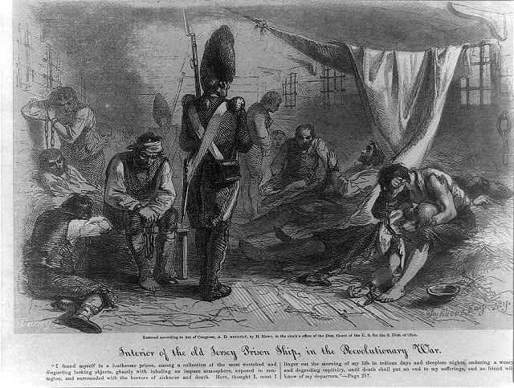
Prisoners of War
Great Britain and the Colonies both had war prisoners they wanted back.
British Columbia | Colonies
10 | 5

Slide 9
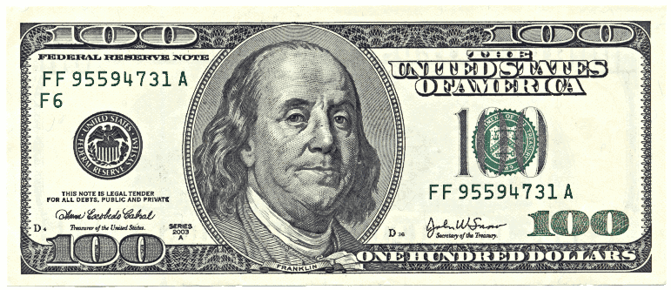
Money
Britain:
Using the colonies to pay off debts from the French-Indian War.
Colonies:
Who doesn’t want money? The Colonies wanted to be able to establish themselves as a governmental power.
British Columbia | Colonies
30 | 10

Slide 10
Adjusted Winner Protocol
 | Great Britain | Colonies
Mississippi River | 25 | 20
Land | 15 | 30
Self Governance | 15 | 30
Fishing Rights | 5 | 5
Prisoners of War | 10 | 5
Money | 30 | 10
Total | 100 | 100

Slide 11
Adjusted Winner Protocol
As of now:
BC: 25+10+30=65 Colonies: 30+30=60
*Fishing Rights is a tie, keep aside for now
Give all of the Fishing Rights to the Colonies:
65-0(x)=60+5(x)
x=1
65-0(1)=60+5(1)
65=65
Final
GB: Mississippi River, POW’s, Money
Colonies: Land, Self Governance, Fishing Rights

Slide 12
Adjusted Winner Protocol
 | Great Britain | Colonies
Mississippi River | 25 | 20
Land | 15 | 30
Self Governance | 15 | 30
Fishing Rights | 5 | 5
Prisoners of War | 10 | 5
Money | 30 | 10
Total | 65 | 65

Slide 13
What actually happened
Britain recognized the colonies as an independent nation
Britain removed all troops
Set borders for the United States:
From the eastern coast to the Mississippi River
Most of Maine all the way to and including Georgia
United States agreed to pay all existing debts and allow troops to leave
(Britain was overly generous to the US in terms of enlarged boundaries)

Slide 14
References
Treaty of Paris . History.com, 2009. Web. 6 Apr. 2015.
Treaty of Paris 1783. Social Studies For Kids, n.d. Web. 6 Apr. 2015.
Treaty of Paris (1783). Wikipedia, n.d. Web. 6 Apr. 2015.
Notes:
http://www.history.com/topics/american-revolution/treaty-of-paris
http://en.wikipedia.org/wiki/Treaty_of_Paris_%281783%29

Slide 15

Thank you! :)

