Slide 1
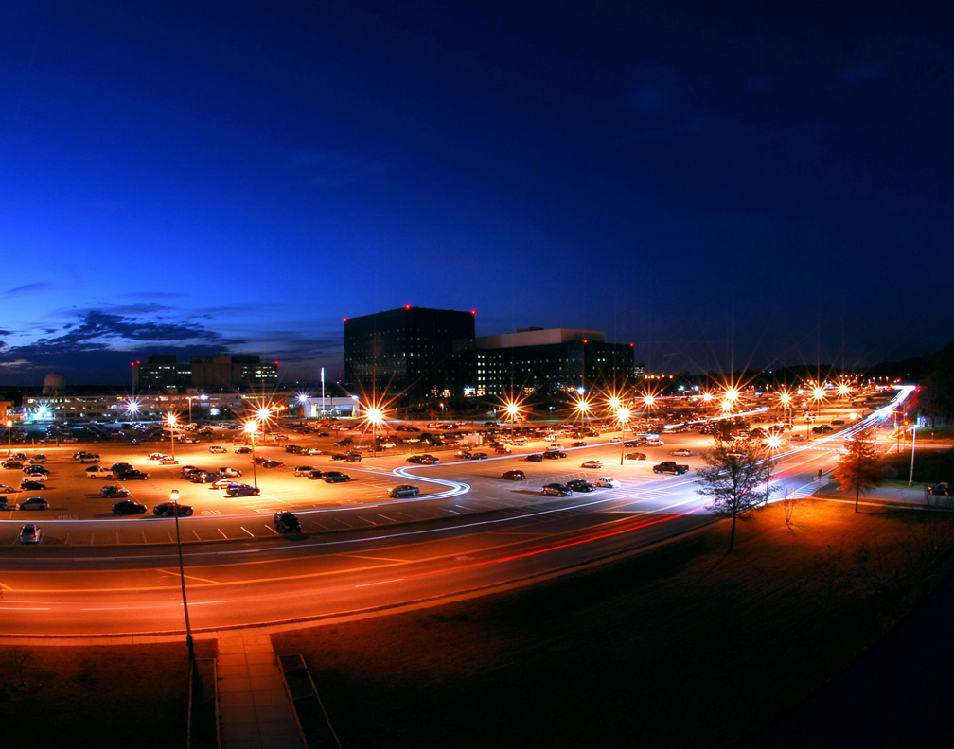
The Secret Lives of Mathematicians

Slide 2
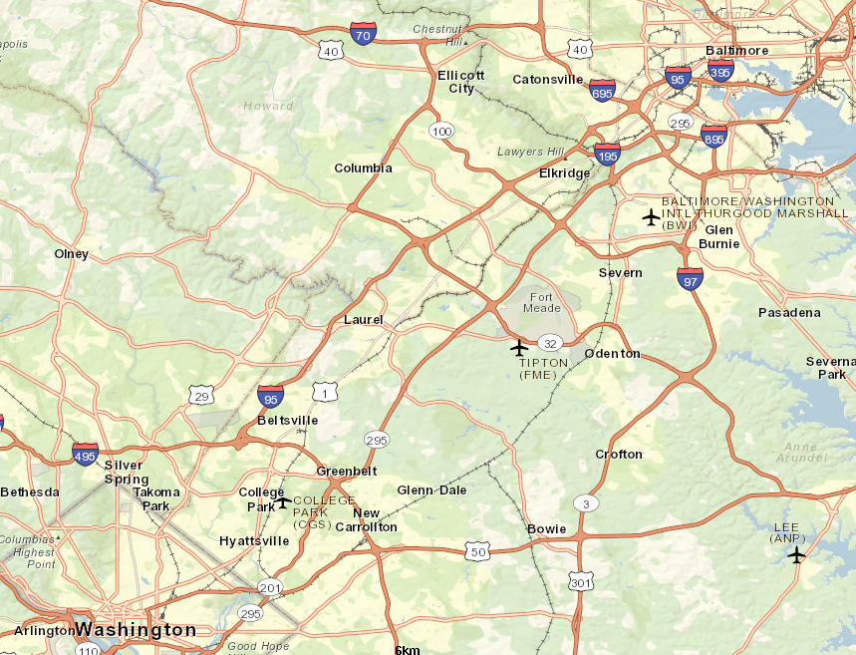
Where in the World?
Baltimore
NSA HQ
Washington DC

Slide 3
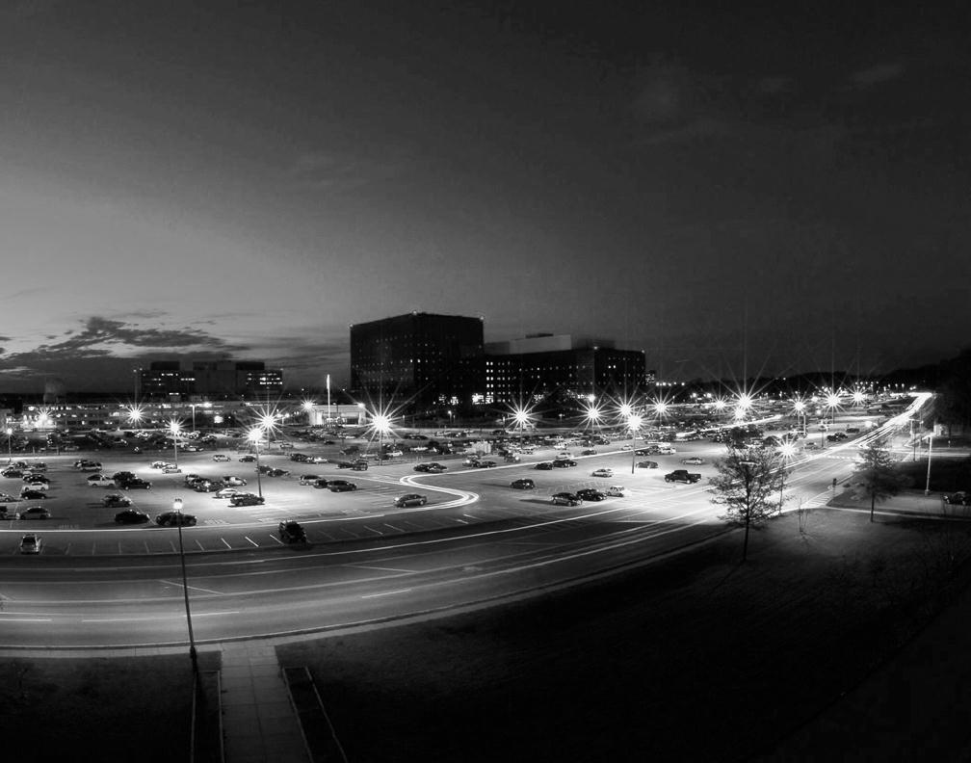
History of No Such Agency
Before the NSA:
Codes were handles by Armed Forces Units
WWI and WWII brought a higher need for cryptologic concentration
Establishment:
Created November 1952 by President Truman
Centralized and joined military and civilian Cryptologic Activity into one organization

Slide 4
What You May Have Heard…

Slide 5
What You May Have Heard…
Books
  Digital Fortress by Dan Brown
  Red Storm Rising by Tom Clancy
Movies
  Enemy of the State (1998)
  xXx (2002): Vin Diesel
  The Simpsons Movie (2007)
TV
  Scandal
  NCIS: Eleanor 'Ellie' Bishop
  Person of Interest
  Chuck: John Casey

Slide 6
Who Are We Really?

Slide 7

Who Are We Really?
Civilians
Military
Lawyers
Engineers
Mathematicians
Language Analysts
Accountants
Computer Scientists
Management
And More!!!

Slide 8
What We Really Do…

Slide 9
What We Really Do…
Workforce Support Activities
Business Management and Acquisition
Engagement & Policy
Research
Capabilities
Operations

Slide 10
What We Really Do…
Research
  Manages research on developing capabilities
  The “Really Big” Problems
Capabilities
  Develops and provides solutions
Operations
  Executes all operations, analysis, and information
  Signals Analysis, Information Assurance, and Cyber Defense

Slide 11
Why Do We Need Mathematicians??

Slide 12
The Role of Mathematicians
We Use:
  …Number Theory, Group Theory, Graph Theory, Linear Algebra, Math Modeling, Probability and Statistics, Combinatorics…
In Combination With:
  … computer science, data processing techniques, advanced technology…
To:
  …search for weaknesses in adversaries’ systems
  … build and strengthen national systems
  … research, discover, and develop new security techniques

Slide 13
What are the
Mathematicians Doing?
They Work in:
Computer and Network Security
Signals Analysis
Data Mining
Information Retrieval
Information Processing
Speech Processing
Analysis of Computer Networks
Data Compression
Super Computing
Biometrics
And much, much more!

Slide 14
How Do You Fit In??

Slide 15
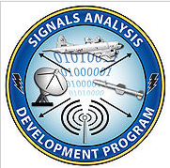


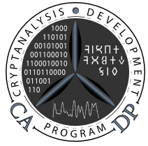

How Do You Fit In?
Workforce Support Activities
Career Development Programs
AMP
CMP
CADP
C2DP
SADP
And More!
3 Year Training Programs with:
4-6 Rotational Tours
One-the-job Classes
Senior Leadership and Mentoring
Permanent Placement Upon
Completion

Slide 16

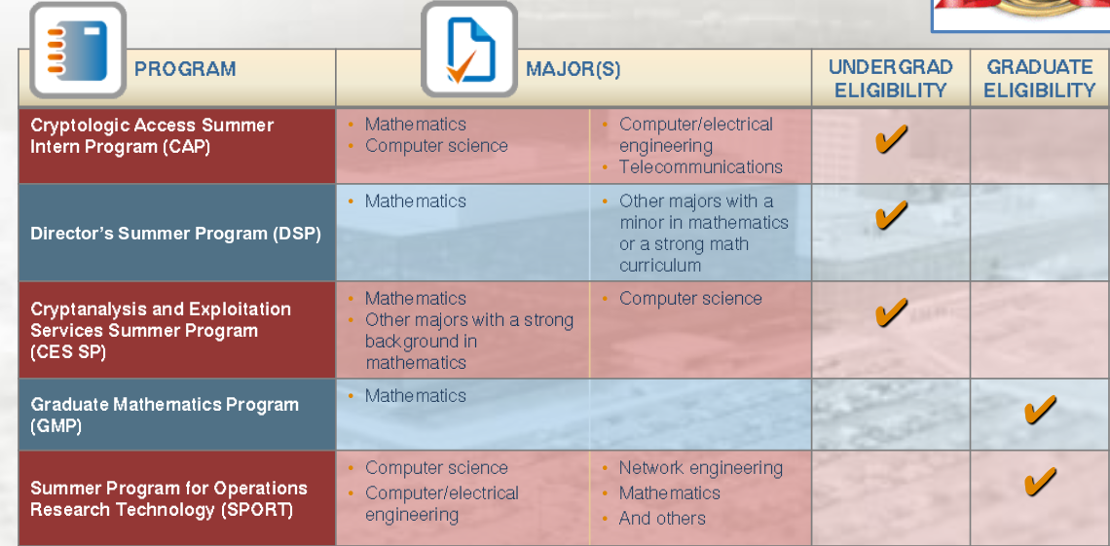
Summer Opportunities
12 Week Paid Internships!
Deadlines typically in mid-October

Slide 17
Top 10 Reasons to Work at NSA

Slide 18
Top 10 Reasons to Work at NSA
Large Expert Community (collaboration and mentoring are highly encouraged)
Casual Dress Code
Excellent Benefits (Health, Retirement, Vacation/Sick)
Flexible Schedule
NSA Supports Furthering Education

Slide 19
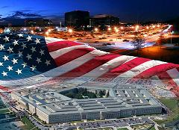
Top 10 Reasons to Work at NSA
Opportunities to Travel
Diversity of Work
Impact
Challenging and Fun
And…

Slide 20

Top 10 Reasons to Work at NSA
… You’ll never turn a Happy Hour into a Sad Hour by talking about work!

Slide 21
Application Requirements

Slide 22
Application Requirements
One must:
Be a US Citizen
Be able to obtain a TS Security Clearance (includes background investigation, polygraph, and psychological evaluation)
Allow 6 to 18 months for application processing

Slide 23
What is Cryptanalysis?

Slide 24
Definitions
Plaintext: Text or file which will be encoded
Cipher Text: Encoded plaintext
Code: Replaces elements of a plaintext by other letters, numbers, words, or symbols
Cipher: Transposes or substitutes elements of plaintext according to a key

Slide 25
Definitions
Cryptanalysis: The decryption of messages into plaintext without having initial knowledge of the key used to encrypt
Cryptography: The science and art of making codes and ciphers
Cryptology: The science and art of making AND breaking codes and ciphers

Slide 26
Definitions
What is a character?
Binary: base 2: (uses 2 distinct symbols) 0 and 1
Each symbol represents 1 bit
This is the “language” a computer uses to talk
Hex: base 16 (uses 16 distinct symbols): a-f and 0-9
each symbol represents 4 bits
ASCII: printable characters (all the letters, numbers, and symbols on these slides)
each symbol represents 8 bits or 1 byte

Slide 27
Definitions
What is a character?
01000011011100100111100101110000011101000110000101101110011000010110110001111001011100110110100101110011

Slide 28
Definitions
What is a character?
01000011011100100111100101110000011101000110000101101110011000010110110001111001011100110110100101110011
0x4372797074616e616c79736973

Slide 29
Definitions
What is a character?
01000011011100100111100101110000011101000110000101101110011000010110110001111001011100110110100101110011
0x4372797074616e616c79736973
Cryptanalysis

Slide 30
Symmetric Key Cryptography

Slide 31
Symmetric Key Cryptography
The General Idea:
Alice sends Bob a message encrypted with key, k
Bob decrypts the message with key, k


Slide 32
Kerckhoff’s Principle

Slide 33
Kerckhoff’s Principle
A cryptosystem should be secure even if everything about the system, except the key, is public knowledge.


Slide 34
Public Key Cryptography

Slide 35
Public Key Cryptography
The General Idea:
Alice and Bob agree on a key system to use
Alice and Bob assume Eve could intercept their communication
The goal is to get a shared value only they know


Slide 36
Diffie-Hellman Key Exchange
“The Silent Exchange”
One of the earliest forms of Key Exchange
Originally designed by Ellis, Cocks, and Williamson at GCHQ
Discovered by Diffie and Hellman in 1976


Slide 37
Diffie-Hellman Key Exchange
Secret Values will be in red
Public values (non-secret) will be in purple
p is a large prime
g is a generator of a group or order p


Slide 38


Diffie-Hellman Key Exchange
Alice
Bob
a: Alice’s value
$$A= g^{a}(mod p)$$
b: Bob’s value
$$B= g^{b}(mod p)$$


Slide 39


Diffie-Hellman Key Exchange
Alice
Bob
a: Alice’s value
$$A= g^{a}(mod p)$$
$$B^{a}= g^{ba}(mod p)=K$$
b: Bob’s value
$$B= g^{b}(mod p)$$
$$A^{b}= g^{ab}(mod p)=K$$


Slide 40


Diffie-Hellman Example
p = 23 g = 5
Alice
Bob
a = 6
$$A= 5^{6}(mod 23)$$
A = 8
$$K={19}^{6}\left(mod 23\right)=2$$
b = 15
$$B= 5^{15}(mod 23)$$
B = 19
$$K=8^{15}\left(mod 23\right)$$
$$=2$$


Slide 41
How is Diffie-Hellman Secure?

Slide 42

How is Diffie-Hellman Secure?
When p is large, recovering a from $g^{a}$ is difficult
(This is also known as the Discrete Logarithm Problem)
This is why choosing g to be a generator of a group order p is a wise idea.


Slide 43
Other Types of Commercial Encryption
AES: Advanced Encryption Standard (Rijndael cipher)
DES: Data Encryption Standard
ECC: Elliptic Curve Cryptography
PGP: Pretty Good Privacy
RSA: Rivest, Shamir, and Adleman
And more!


Slide 44
Types of Cipher Systems

Slide 45
Types of Cipher Systems
Stream Cipher:
Uses a stream of “random” key called the keystream
Each plaintext character is combined with a corresponding character of keystream to become cipher
A character is normally a bit
Encryption/decryption happens “on the fly”
Operation to combine bits normally is an XOR

Slide 46
Types of Cipher Systems
Block Cipher:
2 paired algorithms (one for encryption and its inverse for decryption)
Algorithm uses a fixed-length group of characters called a block
Input is a block size and key size
Encrypts/Decrypts a block at a time.

Slide 47
Types of Cipher Systems
Stream
Keystream Generator
Keystream Generator
Cipher
Plaintext
Plaintext
Encrypt
Decrypt

Slide 48


Types of Cipher Systems
Stream
Keystream Generator
Keystream Generator
Cipher
Plaintext
Plaintext
Encrypt
Decrypt
Block
Pla | inP | lai | nPl | …
Cip | her | Cip | her | …
E
E
E
E
E
$$E^{−1}$$
$$E^{−1}$$
$$E^{−1}$$
$$E^{−1}$$
$$E^{−1}$$
Cip | her | Cip | her | …
Pla | inP | lai | nPl | …

Slide 49


Want More?
www.nsa.gov
Questions?

