Slide 1
Foundations of Generative Adversarial Networks:
An Eight-Week Implementation Journey
Building up to an realistic image generator through the implementation of image classifiers
Students: Jasmine Lei, Sam Liang, Sophya Wu, and Wester J Aldarondo Torres
Mentors: Priyatham Kattakinda and Professor Soheil Feizi
REU CAAR 2021
Notes:
Engage audience, humor
20 minutes typically 10-15 slides
Make slides more fun
Make it accessible, clear (input, output), add neural networks (1 sentence summary)
Add mentor’s name on this slide

Slide 2
Talk Outline
Convolutional Neural Networks (CNNs)
Generative Adversarial Networks (GANs)
Residual Neural Networks (ResNets)
Deep Convolutional Generative Adversarial Networks (DCGANs)
Notes:
Starts gray and then turns to blue when we finish that part

Slide 3
Talk Outline
Convolutional Neural Networks (CNNs)
Generative Adversarial Networks (GANs)
Residual Neural Networks (ResNets)
Deep Convolutional Generative Adversarial Networks (DCGANs)
Notes:
Starts gray and then turns to blue when we finish that part

Slide 4
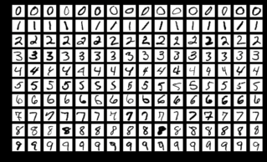
Goal of Convolutional Neural Networks
Classifying MNIST dataset images (classify means determine what class it belongs to (i.e. a one, a nine, etc.)
Our implementation trains the convolutional neural network to classify the lower-res handwritten digits in the MNIST dataset.
MNIST
Notes:
What do we mean by classify? Define this
Clarify which image means what

Slide 5
What are (Convolutional Neural Networks) CNNs?
Your Typical Neural Network
128x128 Input Image
Stretched 16384 vector
Activation
Wx
1
1
16384 Weights
10
16384
Notes:
Explain depth

Slide 6
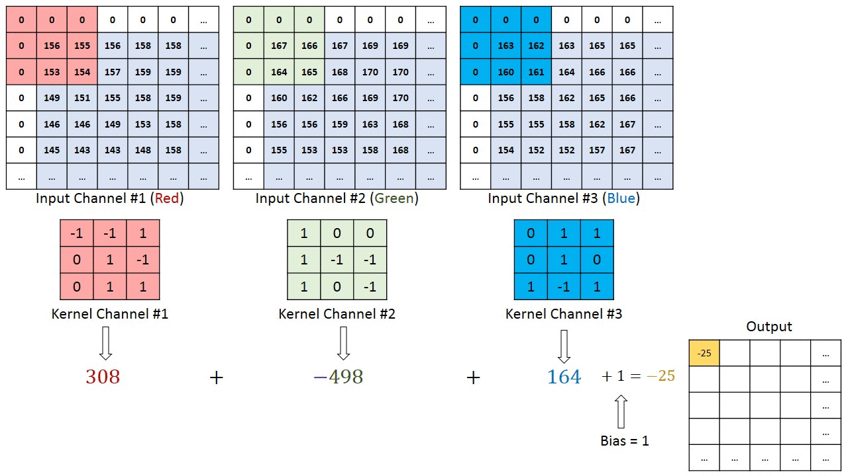
Visual Representation of a Convolution
https://towardsdatascience.com/a-comprehensive-guide-to-convolutional-neural-networks-the-eli5-way-3bd2b1164a53
Notes:
Jumped too quickly here (iamge is too big -> use convolution to shrink & keep the image we need) (too many bits, shrink it somehow)
Ask about fft
Explain weight, size, depth
Make this clearer
Explain this or drop it?

Slide 7
AlexNet (Krizhevsky et al., 2012)
Illustration of AlexNet (Krizhevsky et al., 2012)

Slide 8
AlexNet PyTorch Implementation on MNIST Dataset
Same architecture as AlexNet, but with reduced filter sizes
We used ADAM optimizer with a learning rate of 1e-3
AlexNet uses SGD with momentum 0.9, weight decay 5e-4, and a learning rate of 1e-2
Our implementation obtained a test error rate of 2.2% on the MNIST dataset
Snippet of AlexNet Implementation
Notes:
Pytorch package in python
Reorganize this slide w./ prev. slide

Slide 9
Talk Outline
Convolutional Neural Networks (CNNs)
Generative Adversarial Networks (GANs)
Residual Neural Networks (ResNets)
Deep Convolutional Generative Adversarial Networks (DCGANs)
Notes:
Timeline, high level
Show this every time & highlight the one we’re on

Slide 10
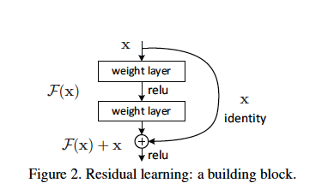
Residual Network (He et al., 2015)
Addresses problem of vanishing gradients
Solves problem of accuracy decreasing when adding layers up to a certain point
Allows creation of very deep networks (more accuracy)
Explicitly defines a residual mapping for a set of layers using shortcut connections
Notes:
Why more layers?
good

Slide 11
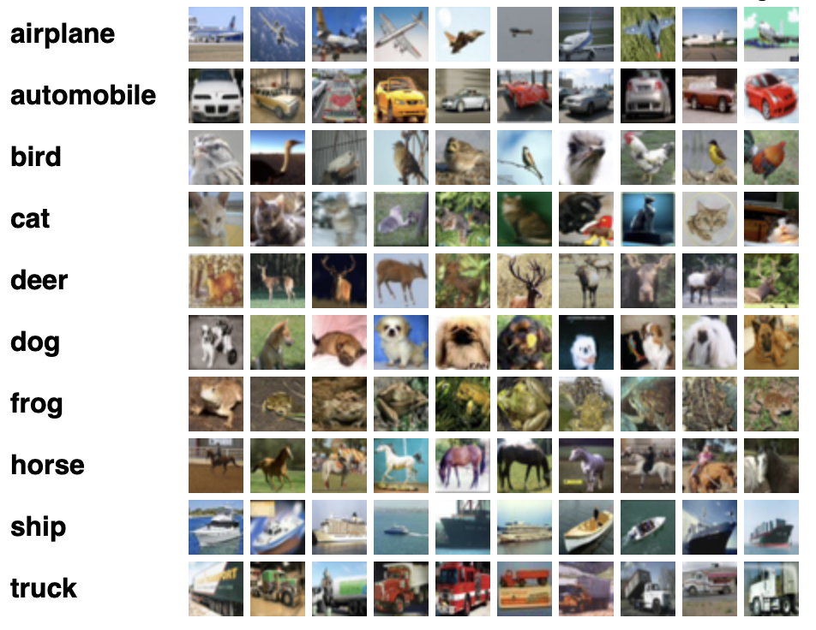
Goal of Our Residual Network
Image classification by label
Accuracy
CIFAR-10 dataset:
10 categories
60,000 images
32x32 color images
More complex images so a more complex model makes more significant gains in accuracy
https://www.cs.toronto.edu/~kriz/cifar.html

Slide 12
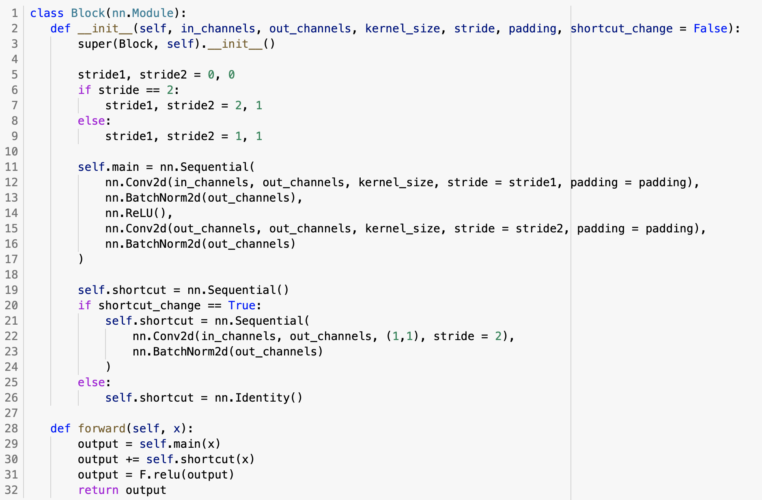
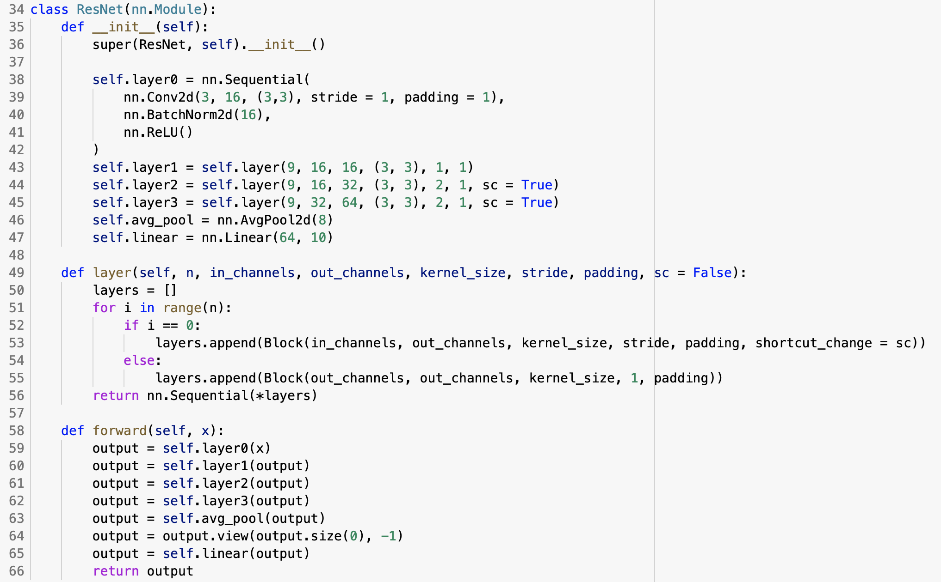
ResNet-56 PyTorch Implementation on CIFAR-10 Dataset
Residual Block Class
Residual Network Class
Notes:
Note that one class creates convolutional block, then the module calls Block class to create and append layers into model
Larger images
Emphasize why pytorch is cool
Is this all the code?

Slide 13
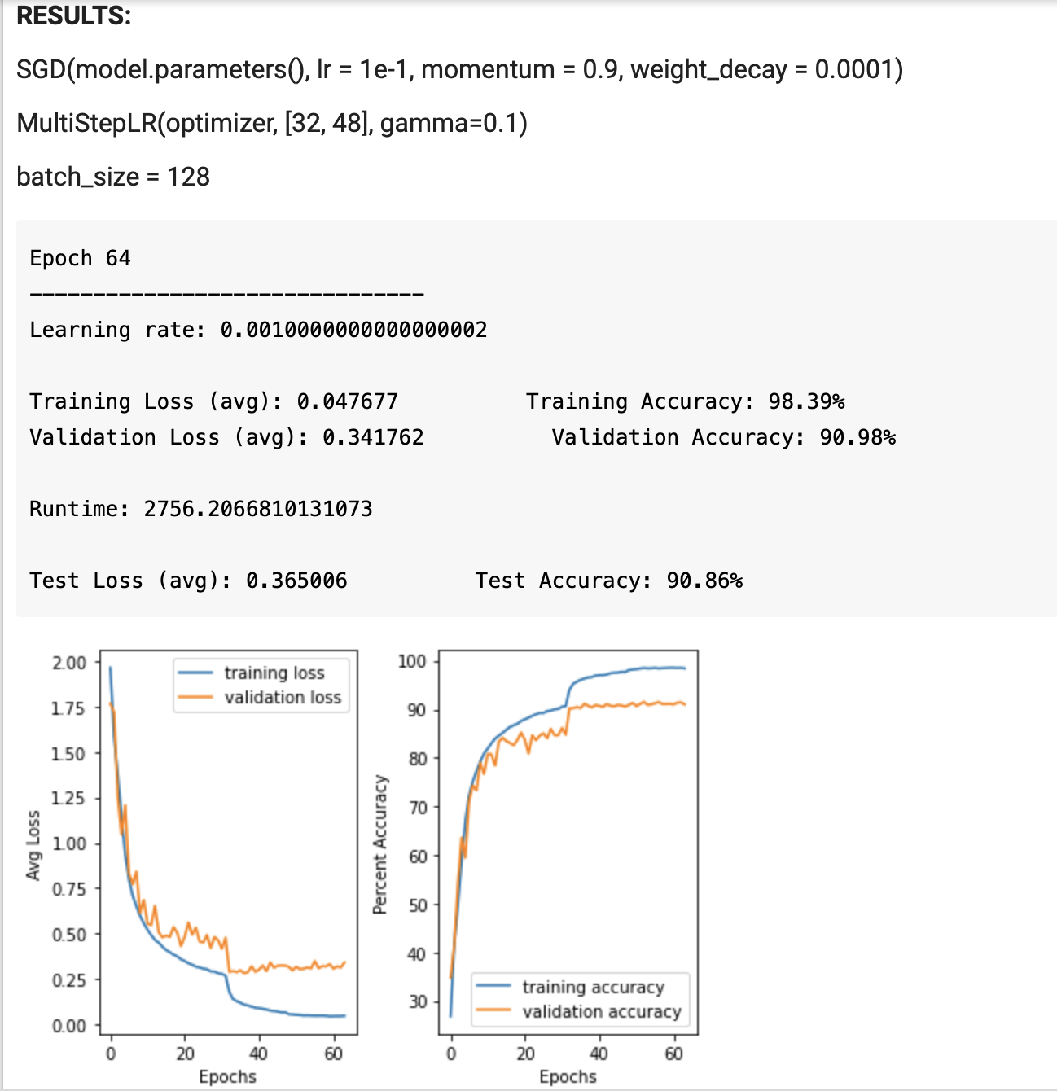
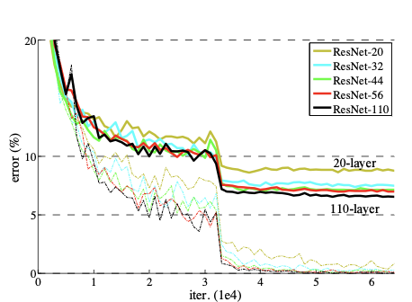
Direct Implementation Results & Bugs
How we build the model matters: must append together layers before calling forward()
Original paper had accuracy of about 93% for CIFAR10 -- did we reach the same result?
Data augmentation issues, too high learning rate causes NaN error
Notes:
Why use CIFAR 10? Expand our knowledge base, the paper had a baseline result so we had something to refer to, MNIST doesn’t need a deep network -> CIFAR lent itself well
Why didn’t we get 93? What explains the difference? Chance, other features
Consistent with our accuracy
Explain what is epoch

Slide 14
Talk Outline
Convolutional Neural Networks (CNNs)
Generative Adversarial Networks (GANs)
Residual Neural Networks (ResNets)
Deep Convolutional Generative Adversarial Networks (DCGANs)
Notes:
Timeline, high level
Show this every time & highlight the one we’re on

Slide 15
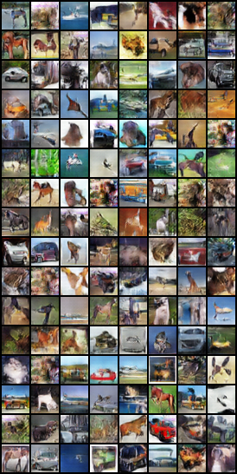
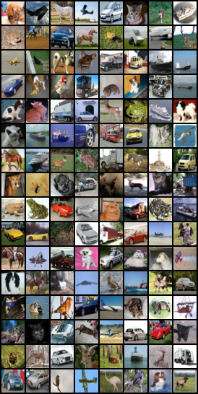
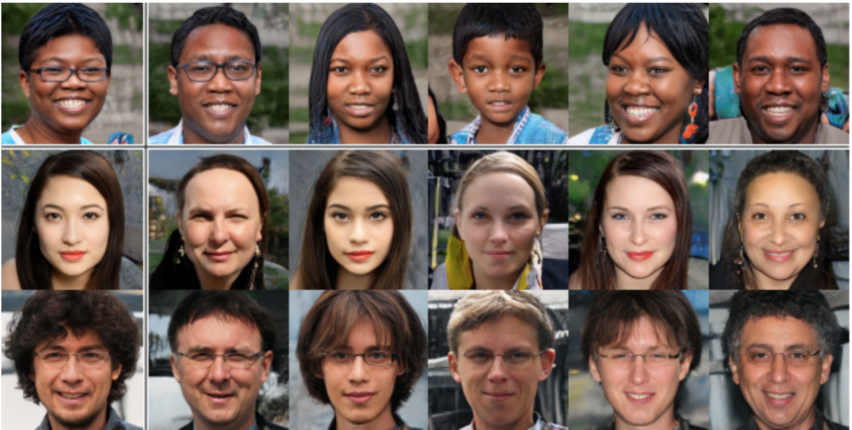
Goal of Generative Adversarial Networks
Goal of GANs is to generate new samples that people will treat as if it were real data
Generated Samples
Training Data
Faces generated by a GAN
Faces from https://www.analyticsvidhya.com/blog/2019/04/top-5-interesting-applications-gans-deep-learning/
Notes:
Faces from https://www.analyticsvidhya.com/blog/2019/04/top-5-interesting-applications-gans-deep-learning/

Slide 16
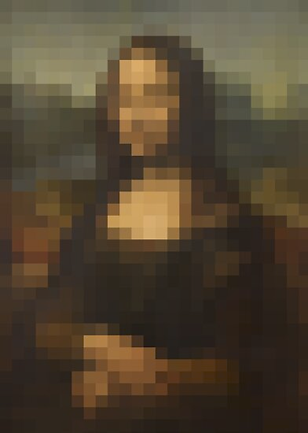
Generative Adversarial Networks (GANs)
GAN: Framework for training a generative model or generator
A generator produces samples from the data distribution of the training input (the real data)
Generator
Discriminator
✅
❌
Loss Function:

Slide 17
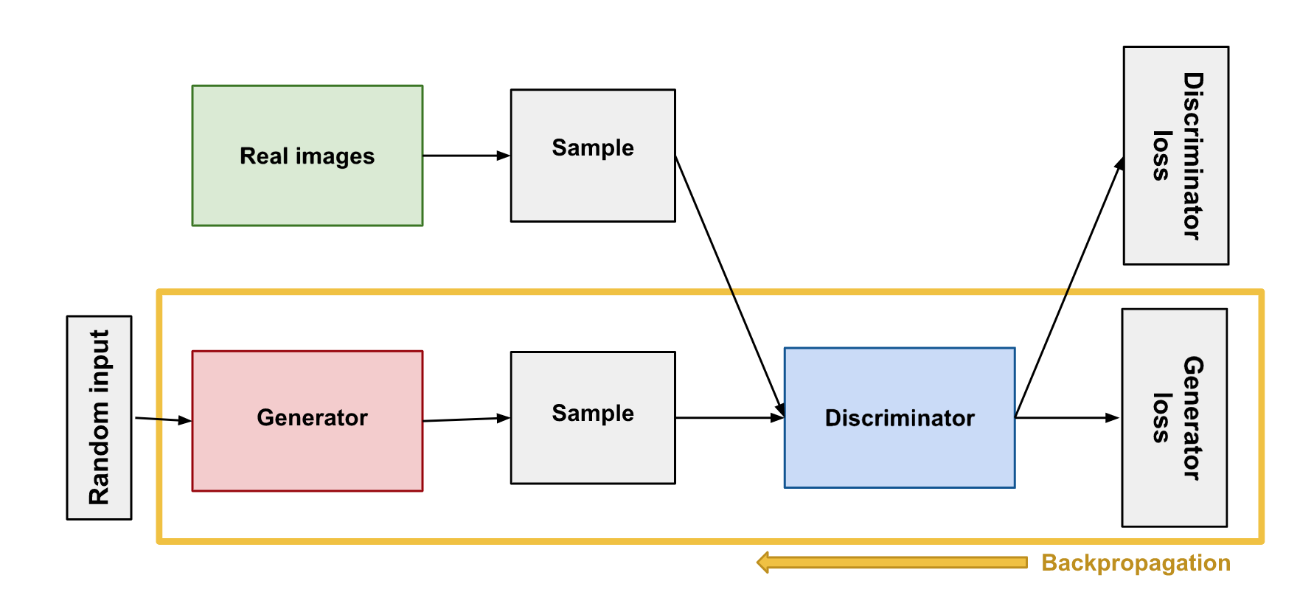
GAN Training (Goodfellow et al., 2014)
GAN Training:
Image from https://developers.google.com/machine-learning/gan/generator
Notes:
Image from https://developers.google.com/machine-learning/gan/generator
Move this earlier
Not sure about

Slide 18
Talk Outline
Convolutional Neural Networks (CNNs)
Generative Adversarial Networks (GANs)
Deep Convolutional Generative Adversarial Networks (DCGANs)
Residual Neural Networks (ResNets)
Notes:
Timeline, high level
Show this every time & highlight the one we’re on

Slide 19
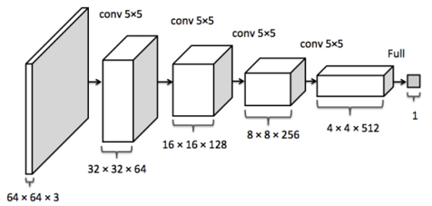
Discriminator Network
Discriminator Network Structure
Notes:
Sophya
Take this out
Discriminator is the opposite from the generator: downscaling the image into a prediction
Same as the cnn classifier for the mnist dataset - connections,modified to classify if it’s real or not/instead of what type of object is in the image

Slide 20
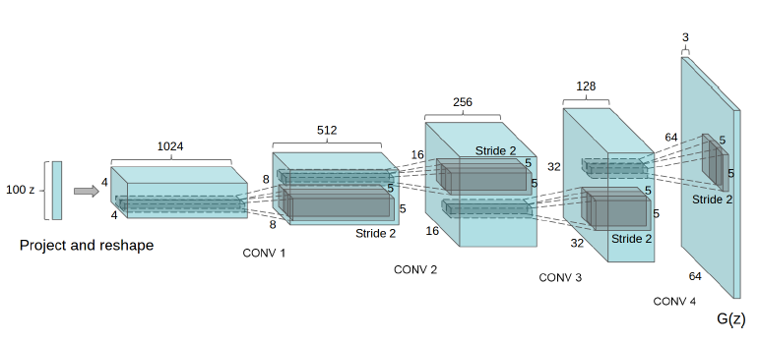
Deep Convolutional Generative Adversarial Network (DCGAN) (Radford, Metz & Chintala, 2016)
Generator Network Structure
CoRR, 2016
Notes:
Sophya
Take out details
Upscaling into an image from a noise vector

Slide 21
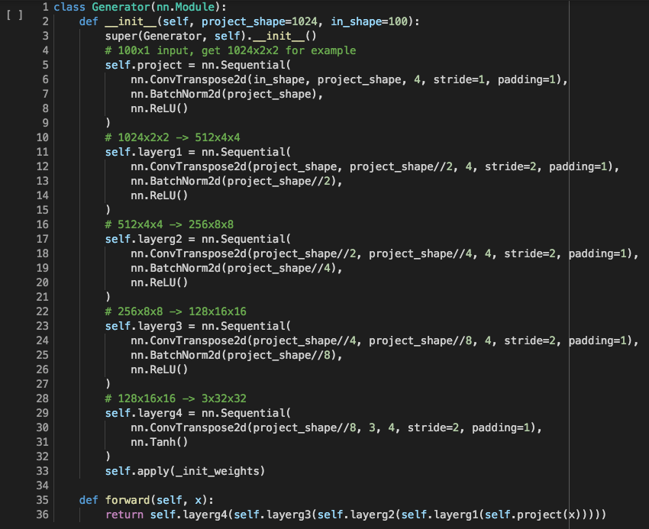
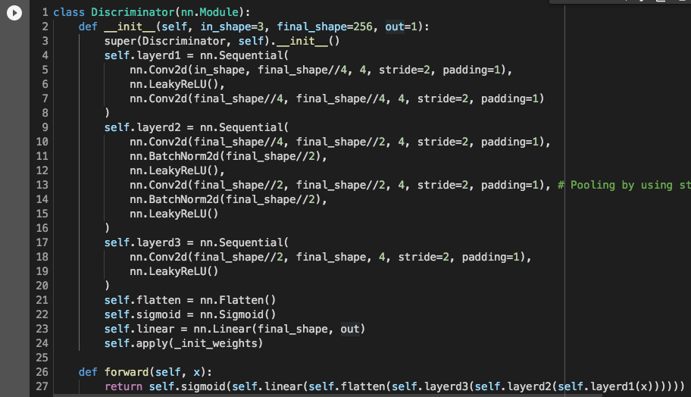
PyTorch Implementation
Generator
Discriminator
Implementation for the discriminator uses is spatially half the model presented previously
Reason: the initial image’s spatial dimension is half that of the image
Notes:
Sophya

Slide 22
Generator Implementation Results
Horse
Ship
Truck
Random Noise
Automobile
Automobile
Deer
Notes:
Sophya
Difference between the classes of the dataset (object type) and the realness of the image (real/fake)

Slide 23
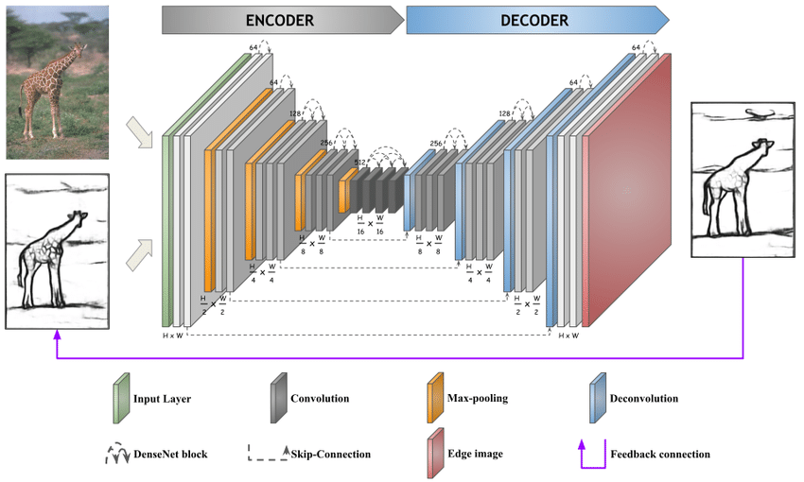
Summary
Thank you!
CNNs
Convolution
AlexNet
Implementation on MNIST Dataset
ResNets
ResNet-56 layer Implementation on CIFAR10 Dataset
GANs
Generator
Used in the DCGAN
Discriminator
https://github.com/ChengBinJin/DCGAN-TensorFlow
Le, Truc & Li, Yuyan & Duan, Ye. (2019). RED-NET: A Recursive Encoder-Decoder Network for Edge Detection.
Notes:
End on an informative slide
Sophya
First 2 things were practice, image of model that connects all the topics together

