Slide 1
2025-06-09
Software Engineering in a Nutshell
Notes:
<number>

Slide 2
What do YOU think is SE?

Slide 3
Let’s play the software game!
I’ll tell you a program, you make it.
If it works, then you win, if not then you lose.
TASK: Tell me if a number is prime
Notes:
I want today to emphasize this point on the difference between product and program.
<number>

Slide 4
Program v. Product
Start -> Programs ->435 -> Prime.exe
or
a.out ??

Slide 5
Program v. Product
% prime 42
← No response
^C
% prime
42
No!
^C

Slide 6
Program v. Product
% prime
42.0
Segmentation fault, core dumped
% prime
fourty two
Segmentation fault, core dumped

Slide 7
Program v. Product
% prime
98723479188736537601762834798798213498727497373010397365382910187234791887365376017628347987982134987274973730103973653829101872347918873653760176283479879821349872749737301039736538291017
<- long wait here

Slide 8
Program v. Product
% prime -help
Yes
% prime 42
2 * 3 * 7
Installer? Deinstaller? Quickstart?

Slide 9
What activities would eliminate those glitches?

Slide 10
What activities would eliminate those glitches?
Engineering activities!

Slide 11
“ENGINEERING”
???

Slide 12
“ENGINEERING”
The application of knowledge of mathematical and physical sciences (acquired by special education, training and experience) to the planning, design and supervision of construction of projects, structures and systems.
Maneuvering; skillful contrivance.

Slide 13
“SCIENCE”
???

Slide 14
“SCIENCE”
A knowledge of facts and laws arranged in an orderly fashion.
A branch of knowledge.
The search for truth.
Skill or technique.

Slide 15
What are SE objectives?
“The program works.”
“The customer succeeds.”
Ensure
  Product quality
  Timely and cost effective delivery
  Safe and responsible use
Actionable information:
Need ways to measure
all of these!
Notes:
We do this by helping you make better and more informed decisions.
OODA loops.
Business value.

Slide 16
All the other stuff besides programming …
  Requirements capture, chartering, contracts
  Team organization, coordination
  Architecture, system design, design patterns
  Testing
  Deployment, configuration, usage

Slide 17
All the other stuff besides programming …
  Requirements capture, chartering, contracts
  Team organization, coordination
  Architecture, system design, design patterns
  Testing
  Deployment, configuration, usage
These are all exercises in communication.
And that’s our definition of software engineering.

Slide 18
The cost of poor communication
ACA: budgeted $93 million, but shot past $1 billion and still counting just for the web site
Standish Group:
Of 3,555 projects from 2003 to 2012 that had labor costs of at least $10 million, only 6.4% were successful. The Standish data showed that 52% of the large projects were "challenged," meaning they were over budget, behind schedule or didn't meet user expectations. The remaining 41.4% were failures -- they were either abandoned or started anew from scratch. ✪
FBI virtual casefiles - $170M abandoned, $500M new start, still counting
Air Force ERP – scraped $1B. Navy ERP –the same.
Why so few private company examples?
Notes:
Remember that cost argument?
Quoting Computerworld article
All this goes to doing engineering, not just development
Why no commercial losses reported?
<number>

Slide 19
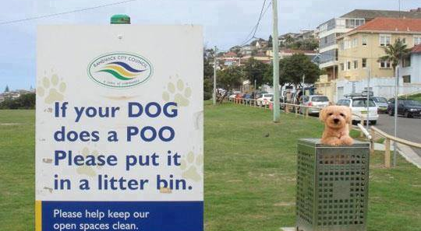
The challenge of communication

Slide 20
Communication is difficult enough
before you confuse it with technology
PUNCTUATION:
  “Purtilo said Gasarch is the best professor at Maryland.”
  “Purtilo, said Gasarch, is the best professor at Maryland.”
  “No mathematicians please.” / “No mathematicians, please.”
SPELLING:
  “Pickled herring merchant” v. “Pickled-herring merchant”
  “extra-marital sex” v. “extra marital sex”
CONTEXT:
  “You can’t run this program too fast.”
  IT manager: “It’s no problem.”

Slide 21
The importance of communicating early in the process
Consider the (normalized) cost of getting a decision ‘final’ in a delivered product. If a needed change costs $1 during definition, then making that change costs …
$5 at design
$10 at coding
$20 at unit testing
$200 post delivery
This makes all the difference in the world for the success of the product. The earlier you can agree on the ‘right’ build, the cheaper and more successful you will be. This makes the case for process and for communication.

Slide 22
Top reasons for failed products
Incomplete requirements
Lack of user involvement
Lack of resources
Unrealistic expectations
Lack of executive support
Changing requirements and specs
Lack of planning
System no longer needed
Notes:
It all comes down to how to negotiate effective and clear agreements between producers and consumers of the software products.
<number>

Slide 23
Important take aways:
SE is exercise in communication
If we believe that, then we do better software engineering with better communication
This is an evidence-based field; our motivation is based on demonstrated costs and values.

Slide 24
Programming is the easy part
Now go back to finding ways to measure:
  Product quality
  Timely and cost effective delivery
  Safe and responsible use
What are topics for study and research for each of the above?
What are issues moving forward?

