Slide 1

Advanced Planning & Preparation for Research and Graduate School
William Gasarch
Director of UMD REU-CAAR
gasarch@umd.edu

Slide 2
Poll
What stage of academic studies?
Freshmen, Sophomores, Juniors, Seniors, BS/MS, PhD students?
Are you thinking about going to Grad School?
  Already accepted to a Grad Program or in a Grad Program?
Are you looking for research projects?
Have you started on any research?

Slide 3
Finding a Research Area: You
Your Strength
Your
Interest
Potential
Impact
Find what interests you that you can do well and where you can have potential impact.

Slide 4
Finding Your Strength
What excites you?
Technology, puzzles, applications, interdisciplinary work?
What is easier for you?
  Building things?
  Proving theorems?
  Analyzing data?
How to ﬁnd it if you don’t know?
  Try various projects/classes

Slide 5
Identifying Potential Impact
What kind of impact will the work have?
What will you become an expert in?
Where will this area take you next?

Slide 6
A good match with an advisor is important!
What’s the advisor’s role?
  research mentor
  career mentor
  your connection to a research community
What makes for a good match ?
  Research sub-area: do some background reading; talk with advisor
  Flexibility: potentially expand to an adjacent sub-area; work with co-advisor
  Working style: talk with current graduate students; know your own style
  Agreeable funding situation
Notes:
Talk with current graduate students to find out about
advisor’s working style & expectations

Slide 7
Research Area vs. Research Problems
Research area is broad (e.g., AI/ML, Theory, Systems, CS+X)
Research problems are specific questions to answer within a research area (e.g., combining supervised and unsupervised learning for image recognition; designing efficient data prefetchers for chip-multiprocessors)
A thesis advances knowledge by addressing important research problem(s)
Notes:
Definitions evolve over time
Some topics are broader than others (examples)

Slide 8
Planning for Research + Grad School
Try out some projects and research first!!!
Identify your motivation: why grad school?
Think about your career goals
What drives and motivates you?
What’s important to YOU?
Start early!!!
BUT…… never too late!!!
  Lifelong Learning……everyday can offer a new lesson

Slide 9
Preparation for Research + Grad School
Take the pre-requisite courses first!!!
  CMSC330 and 351 now required for independent research classes
Each research area/domain may have different requirements for background knowledge & preparation. Find out what they are!!!
Master & excel on background knowledge/skills/libraries/tools
Talk to the faculty who you take classes from
Seek advices from faculty and senior (grad) students you know
Work on what you’re excited and good at
  Don’t chase after what’s perceived to be hot!
  What’s hot today may not last beyond 3-5 years!

Slide 10
Identify the Process
At admission time: each faculty member may (not) admit students specifically to work with them
How advisee-advisor match is done?
  Faculty identify potential students from classes?
  Faculty require trial period through independent study?
  Students identify preferences and approach faculty

Slide 11
Start by Doing YOUR Research
Identify potential faculty research advisors
Talk to students who have worked with them
Take classes from them
Do a small independent study project with them
Consider funding consequences (RA, TA, Fellowship)
Consider your research interests and career goals
Explore broadly (breadth) and then go deep (depth)

Slide 12
Questions to Consider
Is the faculty in a research area you like?
Is their work current and relevant?
Funded? Where published?
How many students do they supervise?
What is the placement of past students?
How responsive are they?
How long to return written materials?
How accessible?
How helpful?

Slide 13
More Questions to Consider
Are students given responsibilities?
How much freedom does the student have?
- Learn to do research, find problems
What is the order of names in pubs?
Who presents the papers that are co-authored?
Do they take students to conferences and help with networking?
Are their work habits compatible with yours?

Slide 14
Interact with Advisors
Listen to your advisor - they won't always be right, but they have (usually) been doing research for longer than you have, and have successfully gone through the PhD process and the academic job market.
E-mailing with your advisor. Make sure you answer your advisor’s e-mails, in a clear and timely fashion. If your adviser hasn’t replied to an important e-mail of yours after a few days, remind them that you are waiting for their reply.
Meet with your advisor. Meet regularly – don’t cancel meetings.
Feedback. Make sure you obtain feedback from your advisor. This should happen regularly
Keep it professional

Slide 15
Research Meetings
Agenda: Make an agenda for every meeting with your advisor. Outline each of the topics that you'd like to cover during the meeting and their relative importance.
Summary: Start each meeting by summarizing the previous meeting. Remind them what you agreed on as next steps, summarize what you've done (and haven’t done) since then, and go over your agenda. • Next steps: – you propose the next steps – revise / refine with advisor – agree on goals for the next meeting
Results: Try to bring results (e.g., graphs, tables, theorems, proofs, figures, demos, etc.) to every meeting. Discuss problems and alternatives, ideally based on explicit examples/counterexamples, data.
Next steps:
– you propose the next steps
– revise / refine with advisor
– agree on goals for the next meeting
Write up meeting notes and share with advisor/group

Slide 16
Combined BS/MS Degree: Eligibility
Hold CSBS at UMD; double majors are acceptable, however, students from non-CS majors are ineligible
Maintain a minimum cumulative GPA of 3.5 (usually higher expected)
Have completed a minimum of 90 credits prior to application
  - Possess no more than 30 remaining credits of CMSC courses for B.S. in CS
  - Have six or less credits of General Education requirements left to graduate
At the time of submitting the Combined BS/MS form, be within two to three semesters away from their undergraduate graduation
Preferably have engaged/initiated research activities under the supervision of a member of the graduate faculty
Have obtained a recommendation letter from that faculty member endorsing the student applying to the M.S. program
Submit a CV detailing relevant experience and qualifications
https://undergrad.cs.umd.edu/combined-bsms-program

Slide 17
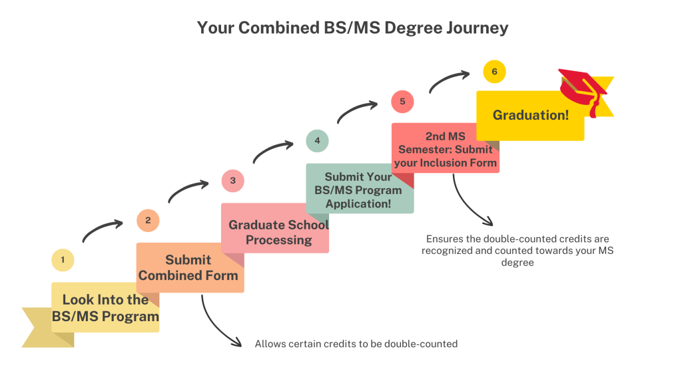

Slide 18
Some DO’s
Take advanced courses beyond pre-requisite courses first!!!
  Beyond 330 & 351
  Take 131, 132, 216, 250, 330, 351 EARLY (by sophomore year, if possible)
  Some can be taken simultaneously without dependency
Each research area/domain may have different requirement for background knowledge & preparation
Talk to your instructors about volunteering to help on projects, even software engineering efforts & building tools/libraries!!!
Participate in programming contests & competitions
Seek summer internship
Broaden your network of friends

Slide 19
Some DO’s
Attend Department Research Fairs (early in semester)
Department Research Seminars (every Friday)
Research first on your own!
  What research has the faculty done?
  What specific topics are interesting to you?
  Have you read their papers?
  Do you know what they publish on?
  Have you talked to their students?
  Do you know their working/advising styles?

Slide 20
Some DON’Ts
“Blanket email” multiple faculty at the same time
Email the faculty without knowing what they actually work on in research, publish, teach, etc.
Sign up for independent research without putting in efforts and regular contacts with the faculty
Expect the faculty to tell you what research you should do
Expect “research listed on CV” to get you into grad school

Slide 21
A Great Article for Every Grad Student (and Advisor)
“How to Succeed in Graduate School: A Guide for Students and Advisors,”
ACM Digital Library

Slide 22
Resources
CRA-W Career Mentoring Workshops:
  http://www.cra-w.org/ArticleDetails/tabid/77/ArticleID/50/Career-Mentoring-Workshop-CMW.aspx
On Academic Life:
  http://blogs.scientificamerican.com/guest-blog/2013/07/21/the-awesomest-7-year-postdoc-or-how-i-learned-to-stop-worrying-and-love-the-tenure-track-faculty-life/
  http://dynamicecology.wordpress.com/2014/02/04/you-do-not-need-to-work-80-hours-a-week-to-succeed-in-academia/
On Post-Docs:
  http://cra.org/resources/bp-view/best_practices_memo_computer_science_postdocs_best_practices/
Tips on doing an academic job search:
  http://matt.might.net/articles/advice-for-academic-job-hunt/
  http://people.mills.edu/spertus/job-search/job.html
  https://homes.cs.washington.edu/~mernst/advice/academic-job.html
Job Ads:
  http://cra.org/ads/

Slide 23
Advanced Planning & Preparation for Research and Graduate School
Open Q&A with Panelists!!!

Slide 24
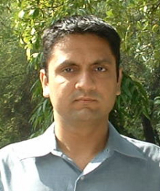
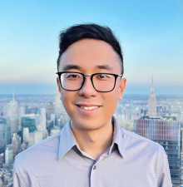
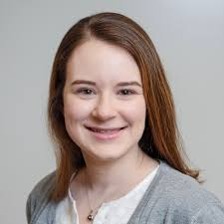
Panelists
Amol Deshpande Alan Zaoxing Liu Sarah Wiegreffe
Grad Studies Director Systems & Networks NLP, LLM & ML
amol@umd.edu zaoxing@umd.edu sarahwie@umd.edu

