Slide 1
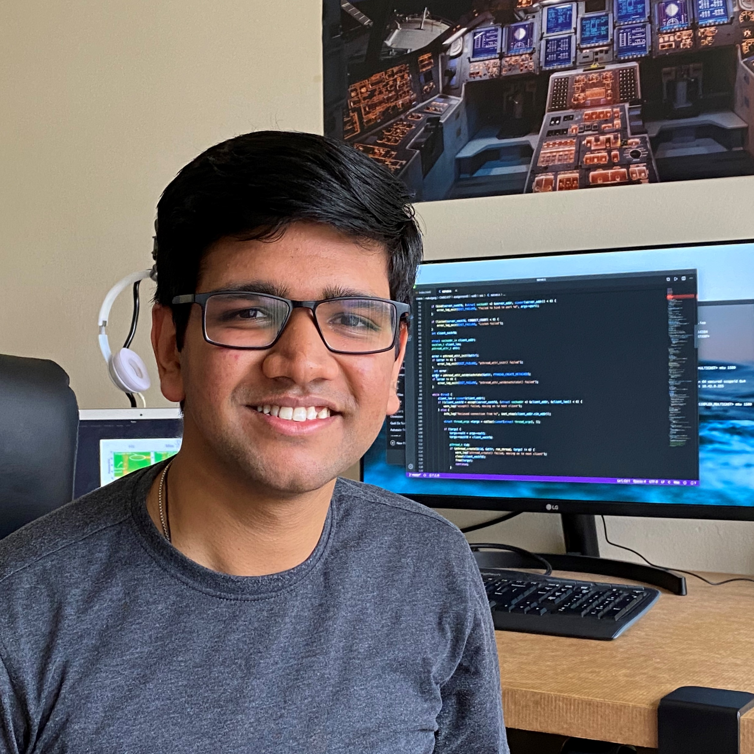
VoiceFind: Noise-Resilient Speech Recovery in Commodity Headphones
Irtaza Shahid
Yang Bai
Nakul Garg
Nirupam Roy
irtaza@umd.edu
yangbai8@umd.edu
nakul22@umd.edu
niruroy@umd.edu
IASA 2022
Notes:
Hello Everyone!
I am Irtaza Shahid, and
today I will be presenting “VoiceFind Noise Resilient Speech Recovery in Commodity Headphones”
This is a joint work with my colleagues Yang Bai, and Nakul Garg and my adviser Nirupam Roy.
We are from University of Maryland

Slide 2
Notes:
Teleconferencing has become an integral part of communication and has its applications in various domains.
Commonly, we use it for business meetings, having remote interviews and for conducting online classes.
And Recent, pandemic has exponentially increased its demand and usage.
And we have observed that the recent pandemic (Covid) has exponentially increased its usage.

Slide 3
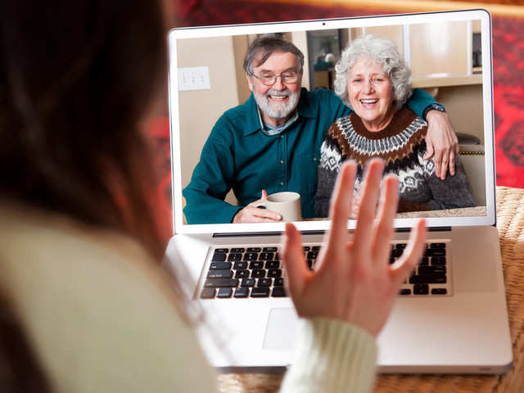
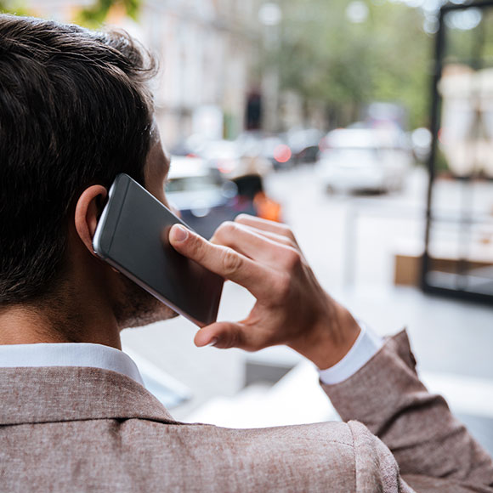
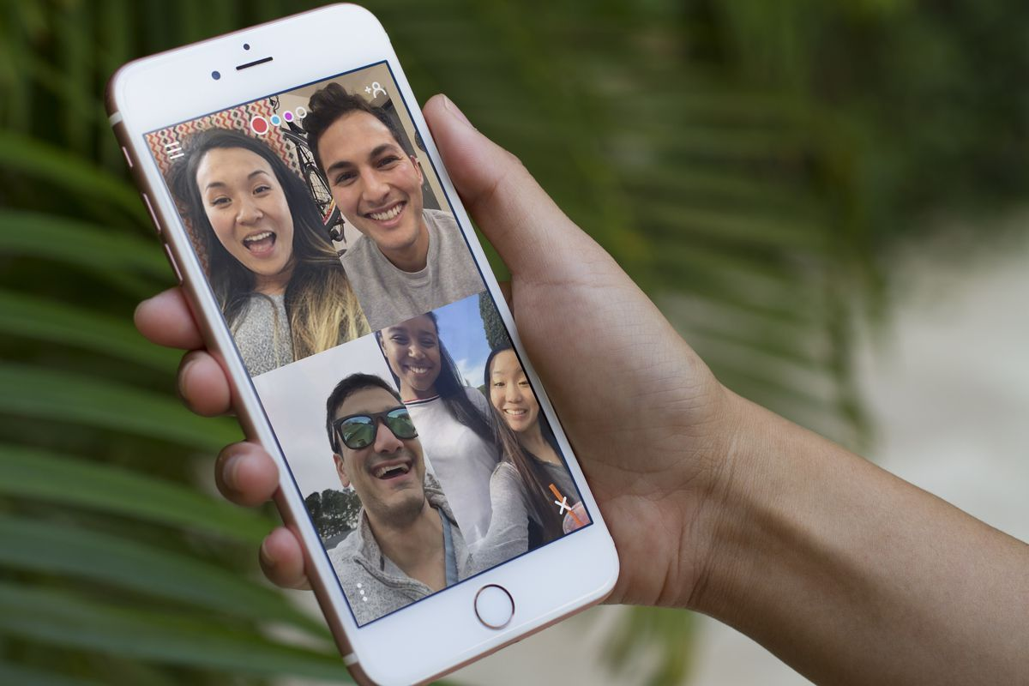
Common audio communication scenarios
Notes:
Audio communication is not only limited to teleconferencing. We use it for many different purposes. Such as
For having a chat with our parents.
Calling some person or some department for a quick query.
Having a fun session with our friends
Interacting with other players while playing multiplayer games.
Growing technologies giving us opportunities to have a video or audio chat virtually in any environment.
As a result, people conversing on headphones is a common sight in restaurants, sidewalk, public transports, and home.

Slide 4
Communication difficult with background noise
Notes:
But having a good quality audio chat becomes difficult
-with a traffic noise in the background -or when multiple people are speaking nearby
-or at home when your kid wants to play with his favourite toy

Slide 5
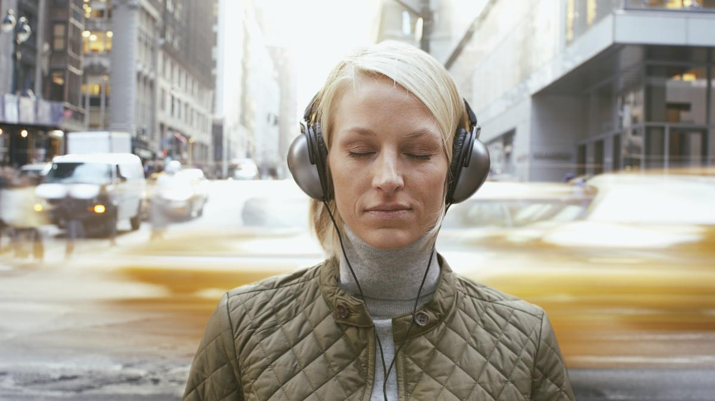
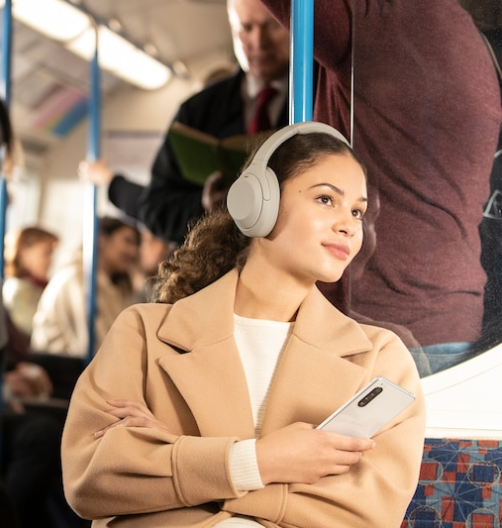
Noise-cancelling Technology
Solve half of the problem
Notes:
Commercial, noise cancelling devices have shown remarkable performance in stopping ambient noise and providing a clear listening experience in noisy environments.
Where these technologies prove to be really helpful in daily life,
(Click)
they only solve one of half of the problem.

Slide 6
Notes:
Let me tell you, what I meant by half of the problem
Imagine a scenario, that you are walking on a sidewalk and having an audio chat over the phone. (Click)
And there is a strong noise in the background such as traffic noise, or people chatting near by. (Click)
These devices have done a very good job in stopping an outside sound to pass through the headphones and reach to our ears. (Click)
Which means It protect us from the background noise and allows us to listen clearly even in the noisy environments.

Slide 7
Interference Speech
Noise
Notes:
Let me tell you, what I meant by half of the problem
Imagine a scenario, that you are walking on a sidewalk and having an audio chat over the phone. (Click)
And there is a strong noise in the background such as traffic noise, or people chatting near by. (Click)
These devices have done a very good job in stopping an outside sound to pass through the headphones and reach to our ears. (Click)
Which means It protect us from the background noise and allows us to listen clearly even in the noisy environments.

Slide 8
Interference Speech
Noise
Notes:
Let me tell you, what I meant by half of the problem
Imagine a scenario, that you are walking on a sidewalk and having an audio chat over the phone. (Click)
And there is a strong noise in the background such as traffic noise, or people chatting near by. (Click)
These devices have done a very good job in blocking outside sound to reach to our ears. (Click)
Which means It protect us from the background noise and allows us to listen clearly even in the noisy environments.

Slide 9
Interference Speech
Noise
Protect listener from outside noise
✗
✗
Notes:
Let me tell you, what I meant by half of the problem
Imagine a scenario, that you are walking on a sidewalk and having an audio chat over the phone. (Click)
And there is a strong noise in the background such as traffic noise, or people chatting near by. (Click)
These devices have done a very good job in stopping an outside sound to pass through the headphones and reach to our ears. (Click)
Which means It protect us from the background noise and allows us to listen clearly even in the noisy environments.

Slide 10
Target Voice
Notes:
> But Listening is only one part of the communication.
You not only want to listen, you want to talk and convey your message as well. (Click)
> And it is microphone’s job to capture your voice. (Click)
> But in addition to your voice, there might be various kinds of noises in your surrounding. (Click)
> Which also get captured by the microphone (Click)
Because microphone has no way to differentiate between desired speech and disturbing noises.
> So, it cannot stop unwanted sound to enter into the microphone and gets transmitted to the other end.
Which makes it difficult for the person on the other end to understand and enjoy the conversation.
> So, the question arises, How can we enforce microphone to only capture target’s voice?

Slide 11
Target Voice
Notes:
> But Listening is only one part of the communication.
You not only want to listen, you want to talk and convey your message as well. (Click)
> And it is microphone’s job to capture your voice. (Click)
> But in addition to your voice, there might be various kinds of noises in your surrounding. (Click)
> Which also get captured by the microphone (Click)
Because microphone has no way to differentiate between desired speech and disturbing noises.
> So, it cannot stop unwanted sound to enter into the microphone and gets transmitted to the other end.
Which makes it difficult for the person on the other end to understand and enjoy the conversation.
> So, the question arises, How can we enforce microphone to only capture target’s voice?

Slide 12
Environmental Noise
Interference speech
Target Voice
Notes:
> But Listening is only one part of the communication.
You not only want to listen, you want to talk and convey your message as well. (Click)
> And it is microphone’s job to capture your voice. (Click)
> But in addition to your voice, there might be various kinds of noises in your surrounding. (Click)
> Which also get captured by the microphone (Click)
Because microphone has no way to differentiate between desired speech and disturbing noises.
> So, it cannot stop unwanted sound to enter into the microphone and gets transmitted to the other end.
Which makes it difficult for the person on the other end to understand and enjoy the conversation.
> So, the question arises, How can we enforce microphone to only capture target’s voice?

Slide 13
Environmental Noise
Interference speech
+
+
Target Voice
Notes:
> But Listening is only one part of the communication.
You not only want to listen, you want to talk and convey your message as well. (Click)
> And it is microphone’s job to capture your voice. (Click)
> But in addition to your voice, there might be various kinds of noises in your surrounding. (Click)
> Which also get captured by the microphone (Click)
Because microphone has no way to differentiate between desired speech and disturbing noises.
> So, it cannot stop unwanted sound to enter into the microphone and gets transmitted to the other end.
Which makes it difficult for the person on the other end to understand and enjoy the conversation.
> So, the question arises, How can we enforce microphone to only capture target’s voice?

Slide 14
Environmental Noise
Interference speech
Microphone captures both target speech and noise
+
+
Target Voice
Notes:
> But Listening is only one part of the communication.
You not only want to listen, you want to talk and convey your message as well. (Click)
> And it is microphone’s job to capture your voice. (Click)
> But in addition to your voice, there might be various kinds of noises in your surrounding. (Click)
> Which also get captured by the microphone (Click)
Because microphone has no way to differentiate between desired speech and disturbing noises.
> So, it cannot stop unwanted sound to enter into the microphone and gets transmitted to the other end.
Which makes it difficult for the person on the other end to understand and enjoy the conversation.
> So, the question arises, How can we enforce microphone to only capture target’s voice?

Slide 15
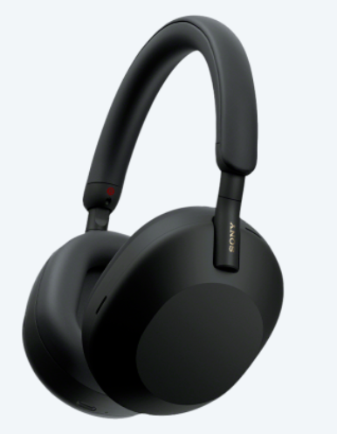
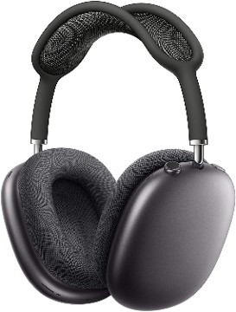
Industrial Solutions
Learning-based
Beamforming
iOS
Voise-Isolation
Sony
Headphones
Apple
Headphones
Notes:
Definitely it is an important problem, and Industry is actively working in this area.
It allows them to provide a better call experience to their user and it also allow users to record an audio even in dense noisy environments.
Currently, commodity devices are either using Learning-based voice isolation methods or multiple microphones for beamforming.
Yesterday in conference, we have seen an exciting paper ClearBuds which is also filtering a speech for the user on the other end by training a deep learning model.

Slide 16
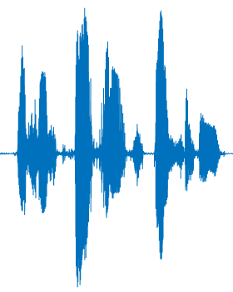
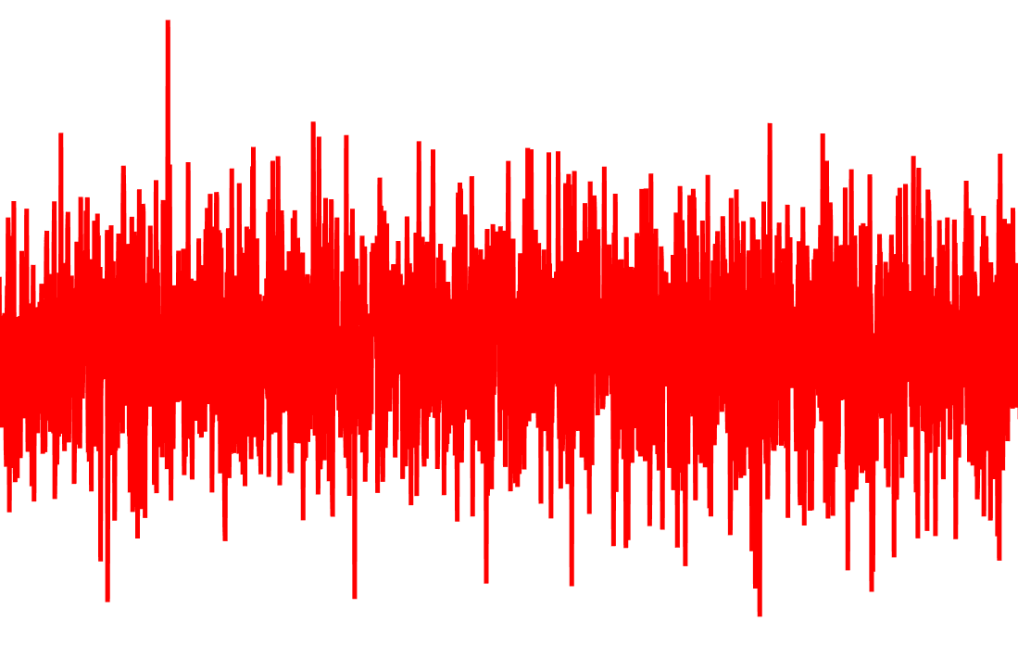
Learning-based Solutions
Recent solutions (such as SEGAN[1], TCNN[2], Phasen[3]) have shown remarkable performance.
Speaker
Speech Enhancement
Clean Speech
Noise Sources
Notes:
Basically, how learning-based method works is
They train a model to extract a clean speech from the mixture of voice and ambient noise.
Current, State of the art networks have shown a great potential in removing noise and generating a clean speech.

Slide 17
Learning-based Solutions
Performance degradation on untrained scenarios [4].
Speaker
Speech
Speech Enhancement
+
Noise
Noise Sources
Untrained noise
Notes:
Often times this type of model does not perform well when there is a new type of noise in the environment or when there are different number of noise sources.
Because during training they tries to learn noise structure or characteristics and then use them for speech separation.
The performance of these trained models degrades in an environment with a new type of ambient noise which is not present in the training process.
It is established in the recent study that the performance of these trained models degrades in those scenarios which are not present in the training process.
Because while training model tries to learn the characteristics of a speech and noise in order to separate them out.
That is why these solutions face difficulty in generalizing over unseen scenarios such as different type of noise, musical instrument or number of sources, so, they suffers from performance degradation in new environments.

Slide 18
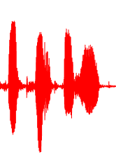
Learning-based Solutions
Recent, state-of-the-art (Conv-TasNet[5], Wavesplit[6]) have shown remarkable performance.
Target Speaker
Speech 1
Speech Enhancement
Which is the target speech?
Speech 2
Interference Speaker
Notes:
The problem however becomes more challenging when multiple speeches are superimposed and we want to separate them out.
Recently deep learning models (such as Conv Tas Net and Wavesplit) are trained to target this problem.
These models learn the differences between the speech of different speakers.
And given the overlapped speech signals they separate them out and provide the speech corresponding to different users.
This is great! But there is one caveat.
Click
These model can separate all speeches, but they cannot link extracted speech to the user.
Because, it has no information about the speaker, so it cannot decide which speech corresponds to the target speaker.

Slide 19
Learning-based Solutions
AudioVisual Zooming [7] leverages visual information.
UltraSE[8] record ultrasound reflection from target’s face.
Can we only use speech for spatial filtering?
Notes:
There are some existing solutions that try to solve this problem by using facial cues, lip motion, or ultrasound reflection from the user’s face
so that the extracted speech can be identified and linked to the speaker.
These solutions are relying on extra modality for identification…
Click
We believe that more useful solution would be to only use audio which in any case being recorded by the microphones.
But in this paper, we restrict ourself from using any other modality and focus only on audio recording of a human speech for spatial filtering.
For example:
AudioVisual Zooming leverages video recording of the speaker’s face to identify the target speech for separation.
Recently, UltraSE uses ultrasound reflection from the user’s face as an extra modality and showed state-of-the-art performance in speech separation.
Try to create a separate channel
Leave a scope of error
Focuses on speech signal as audio recording

Slide 20
Traditional Beamforming
Speech
Noise
✗
Requires sampling from multiple microphones for spatial filtering
Notes:
Other type of solution which only rely on audio signal is spatial filtering.
It uses multiple microphones to only capture a sound coming from specific direction called beamforming.
It can allow us to form a beam towards user’s mouth to only capture his voice, and remove any noise coming from any other direction.
Another solution is to spatially filter and only keep sound coming from user’s mouth. For spatial filtering, the most widely used solution is beamforming.
In which we can use multiple microphones and record a sound coming from a particular direction.
Another obvious solution that comes to our mind for picking a speech coming from a particular direction is traditional beamforming.
Which combines data recorded by array of sensors in a specific way so that the sound received from a desired direction gets amplified.
Here in this figure, multiple microphones are used to form a beam towards a person.
This blue beam depicts that all signals received from this direction get enhanced and the signals from any other direction gets removed such as this noise shown in upper right corner.

Slide 21
Traditional Beamforming
0º
0º
0º
-90º
90º
-90º
90º
-90º
90º
Number of microphones
Notes:
The challenge here is that two microphones are not enough for creating a sharp directional beam.
As per theory of beamforming, large array of microphones is required for creating a precise narrow beam. Which leads to better filtering, and target speech extraction free from any noise.
It is worth mentioning that the width of the beam depends on the number of microphones.
And in commodity devices, we only have two microphones, so it is not possible to create a sharp narrow beam for accurate spatial filtering using traditional beamforming.
Unfortunately, it is not feasible to have so many microphones on small commodity devices due to physical constraints.

Slide 22
Our solution: VoiceFind
Microphones
Target Voice
Beamforming
Notes:
Considering these limitations and importance of speech spatial filtering we take a challenge to develop a system that can
extract user’s voice in a noisy environment and even when multiple people are speaking
using only two microphones which are commonly available in commodity devices.
Click
We call it Voice Find.
Unfortunately, it is not feasible to have large microphone array on smaller commodity headphones.
Beamforming also requires a specific spacing between the microphones.
>> For a 4KHz signal, the spacing between microphones must be less than 4.25cm, but smaller spacing reduce the performance on lower frequencies
We develop a system called VoiceFind that use only two microphones and spatially filter the speech.
Today, we are presenting VoiceFind: a speech spatial filtering solution using only two microphones.

Slide 23
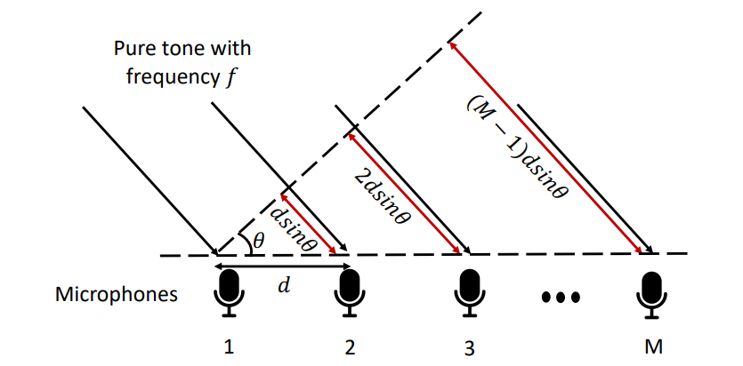
Traditional Beamforming: Steering Vector
Phase
differences
exp($\frac{\text{0}\text{j}\text{2}π\text{f}\text{d} sin(θ)}{c})$
exp($\frac{\text{1}\text{j}\text{2}π\text{fd} sin(θ)}{c})$
exp($\frac{\text{2}\text{j}\text{2}π\text{fd} sin(θ)}{c})$
exp($\frac{\text{3}\text{j}\text{2}π\text{fd} sin(θ)}{c})$
exp($\frac{\text{4}\text{j}\text{2}π\text{fd} sin(θ)}{c})$
$$Steering$$
$$Vector$$
$$=$$
Microphone spacing
exp($\frac{\text{(}\text{M}\text{−1)}\text{j}\text{2}π\text{fd} sin(θ)}{c})$
Number of microphones
Notes:
To develop this system, we start from the fact that
For spatial filtering, beamforming creates a steering vector, consisting of phase differences across multiple microphones.
The length of steering vector depends upon the number of microphones.
Here you can see that the M is the number of microphones
Before I tell you about our intuition, let me tell you about the technical challenges.
But the question is how this harmonic structure is helpful?
Let’s start with the traditional beamforming.
Traditional beamforming creates a steering vector.
By exploiting the phase different across multiple sensors.

Slide 24
Traditional Beamforming: Steering Vector
Pure tone with frequency $f$
exp($\frac{\text{0}\text{j}\text{2}π\text{f}\text{d} sin(θ)}{c})$
exp($\frac{\text{1}\text{j}\text{2}π\text{f}\text{d} sin(θ)}{c})$
$$Steering$$
$$Vector$$
$$=$$
$$θ$$
$$dsinθ$$
Microphones
$$d$$
1
2
Notes:
So, if we only use two microphones, our steering vector reduces to two elements

Slide 25
Traditional Beamforming: Steering Vector
Pure tone with frequency $f$
exp($\frac{\text{0}\text{j}\text{2}π\text{f}\text{d} sin(θ)}{c})$
exp($\frac{\text{1}\text{j}\text{2}π\text{f}\text{d} sin(θ)}{c})$
$$Steering$$
$$Vector$$
$$=$$
$$θ$$
$$dsinθ$$
Microphones
$$d$$
1
2
Performance of beamforming depends on the length of steering vector
Notes:
So, if we only use two microphones, our steering vector reduces to two elements
And the performance of beamforming relies on the length of the steering vector.

Slide 26
Traditional Beamforming: Steering Vector
Pure tone with frequency $f$
Can we increase the length of steering vector using only two microphones?
exp($\frac{\text{0}\text{j}\text{2}π\text{f}\text{d} sin(θ)}{c})$
exp($\frac{\text{1}\text{j}\text{2}π\text{f}\text{d} sin(θ)}{c})$
$$S=$$
$$θ$$
$$dsinθ$$
Microphones
$$d$$
1
2
Notes:
So, we ask a question, Can we somehow increase the length of steering vector without increasing the number of microphones?

Slide 27
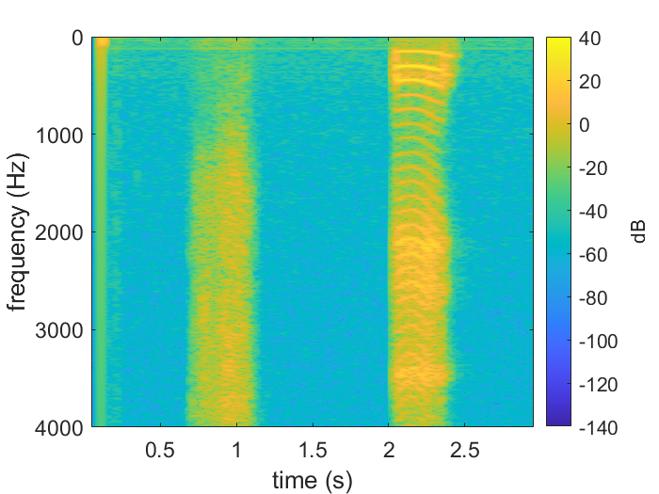
Structure in Human Speech
Notes:
We achieve this by using the structure in human speech.
We observe that human speech produce a harmonic structure when we pronounce a vowel sounds.
Let me start with the intuition which led us in developing VoiceFind.
we look into the spectral structure of human speech.
We observe human speech produce a harmonic structure when we pronounce a voiced sounds.
(Click)
As you can see in this spectrogram, where a person is speaking unvoiced and voiced sound.
During voiced sound, you can observe a pattern which we are calling the harmonic structure.

Slide 28
Structure in Human Speech
Harmonic structure
Notes:
We achieve this by using the structure in human speech.
We observe that human speech produce a harmonic structure when we pronounce a vowel sounds.
We leverage this harmonics in creating a modified steering vector for beamforming.
Let me start with the intuition which led us in developing VoiceFind.
we look into the spectral structure of human speech.
We observe human speech produce a harmonic structure when we pronounce a voiced sounds.
(Click)
As you can see in this spectrogram, where a person is speaking unvoiced and voiced sound.
During voiced sound, you can observe a pattern which we are calling the harmonic structure.

Slide 29
Leveraging Harmonic Structure
exp($\frac{\text{j}\text{2}π\text{f}\text{1}\text{d} sin(θ)}{c})$
exp($\frac{\text{j}\text{2}π\text{f}\text{2}\text{d} sin(θ)}{c})$
exp($\frac{\text{j}\text{2}π\text{f}\text{3}\text{d} sin(θ)}{c})$
exp($\frac{\text{j}\text{2}π\text{f}\text{4}\text{d} sin(θ)}{c})$
exp($\frac{\text{j}\text{2}π\text{f}\text{5}\text{d} sin(θ)}{c})$
$$S=$$
$$d sin(θ)$$
exp($\frac{\text{j}\text{2}π\text{f}\text{N}\text{d} sin(θ)}{c})$
d
Notes:
Instead of using phase difference accumulated in space, we use the phase accumulated in harmonic frequencies to create a modified steering vector.
Because like distance, phase accumulation is also a function of a frequency.
Unlike traditional steering vectors whose resolution depends on the number of sensors and their geometry, our steering vector treats harmonics present in the speech signal as virtual sensors

Slide 30
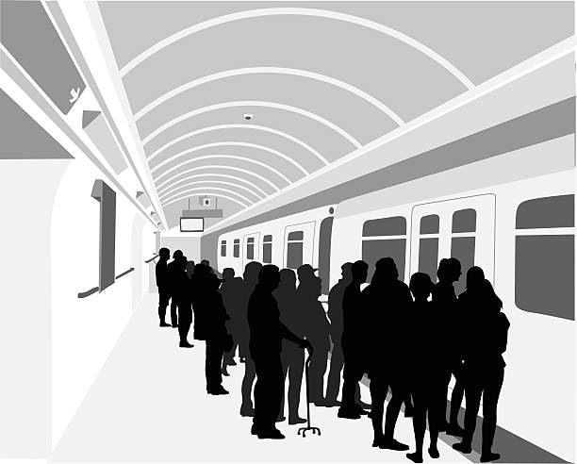
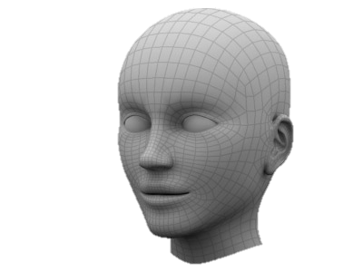
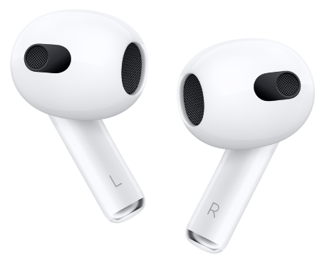
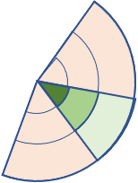
VoiceFind
Dual-channel recording
Extracting voice signal structure
Virtual beamforming
Generative speech recovery
Loud noise field
Clean speech
Voice signal
Notes:
We have breakdown VoiceFind in four modules.
Where intuition is clean in theory, we still need to solve some systematic challenges to realize this system.
The system comprises of four steps.
First we record sound using two microphones
Then we extract the harmonic structure from it.
The we spatially filter the speech using Virtual beamforming
And
Then we have a Gan-based speech enhancement
After this, we finally get a clean speech.
Now I will explain each step in more detail.

Slide 31
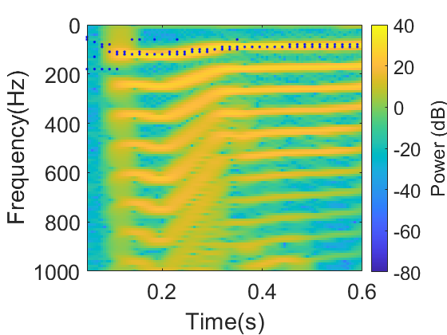
Extracting voice signal structure
Estimate the fundamental frequencies
Filter estimated frequencies and their harmonics
Notes:
Let’s start by looking how we extracted harmonic structure.
A signal received by two microphones contain multiple speeches and environmental noise.
We already know that human speech will have harmonic structure.
So, we first target to extract frequency components corresponding to any speech.
For this purpose, we find all the frequencies under 400Hz for which there exist a spectral structure.
Under 400Hz because human pitch frequency lies between 50 – 400 Hz.
Note here that Those selected frequencies either corresponds to the target speaker or interference speaker. So, all of these selected frequencies act as a candidate for a target speech.
Our next block, will help in filtering out the target speech from these candidates.
For this, we use a cepstral-based approach. Which is nothing but a FFT of the logarithm of the spectrogram.
This is widely use to study the periodic structure in the frequency domain.
Maximum peak of cepstral corresponds to the fundamental frequency of the signal.
But in our case, multiple speeches are present, so multiple periodic signals are present.
So, rather than picking the maximum, we pick all fundamental frequencies above threshold as a candidate for the target speech.
So, now we only left with frequencies corresponding to speech and any other non-harmonic noise gets removed.
Our next block, will help in filtering out the target speech from these candidates.

Slide 32
Virtual Beamforming
Noisy Speech
Spatial Filter
Filtered Speech
X
DOA Estimation
Binary Mask
…
Frequency Candidates
Notes:
For spatial filtering, we create a modified steering vector as described earlier for each candidate frequency from the previous block. And estimate its direction of arrival using the MUSIC algorithm.
After estimating reception angle for all candidate frequencies, we create a binary mask based on the pre-defined threshold. Which means we only keep frequencies received from the defined angle range.

Slide 33
Virtual Beamforming
Noisy Speech
Filtered Speech
Desired speech
Virtual beamforming is not perfect
Interference speech
Notes:
Consider this example,
On the left hand side (Click)
we have a desired speech
And (Click)
An interference speech in the received noisy signal
And on the right hand, we have a spectrogram of the speech after passing through the proposed spatial filter.
Here you can see that we only left with the harmonics corresponding to the desired speech.
(Click)
Like anyother system, proposed beamformer is not perfect as well.

Slide 34
Virtual beamforming (Limitation)
Filtered Speech
Target Speech
Multipath and Environmental noise
Notes:
There are some limitations in the virtual beamformer.
Strong Multipaths and environmental noise leads to erroneous DOA estimation which can mistakenly include or exclude some points

Slide 35
Virtual beamforming (Limitation)
Filtered Speech
Target Speech
Multipath and Environmental noise
Binary Masking cause artifacts
Notes:
There are some limitations in the virtual beamformer.
Strong Multipaths and environmental noise leads to erroneous DOA estimation which can mistakenly include or exclude some points
Moreover, binary mask adds some artifacts to the filtered signal. In clean speech, energy near the harmonic region degrades smoothly, but binary masking completely removes that region, which makes the recovered speech unrealistic.

Slide 36
GAN-based Speech Enhancement
Noisy speech
Spatial filtered speech
Clean speech
Generator
Enhanced speech
Discriminator
Discriminator
False
True
Notes:
To deal with the artifacts added by the spatial filter and to generate a perceptually pleasant speech.
We refer to the Generative Adversarial Networks who have shown remarkable performance in image denoising, and reconstruction.
Spectrogram can also be treated as an image.
Generator is trained to generate clean spectrogram given spatially filtered speech and also a raw received signal.
Rationale behind this additional input is that spatial filtered spectrogram has information about the target speech but due to binary masking there are some missing regions regarding which network has no information.
So, rather than training a model to learn a generic speech structures, we provide received signal which has complete information but convoluted.
Now, model can learn to use information/harmonic trend from spatial filtered spectrogram and extract the missing information from the received signal.
Our discriminator is trained to classify between the real and generated speech signal. Our discriminator not only take clean speech and generated speech.
It also takes filtered speech, this adds a conditional dependance that the generated speech must be linked with the spatially filtered speech.

Slide 37
Noisy Speech
Filtered Speech
Enhanced Speech
Clean Speech
Notes:
Here is one example after passing through VoiceFind.
You can see here that
Noisy signal has multiple speeches
After spatial filtering, we have harmonics corresponding to only target user.
And finally we get an enhanced speech after passing through a trained network.
Visual comparison of the enhanced speech with the target clean speech shows the potential o our proposed system.

Slide 38
Noisy Speech
Filtered Speech
Enhanced Speech
Clean Speech
Notes:
And observe that the artifacts we have in our filtered speech are corrected by the speech enhancement block.

Slide 39
Evaluation
Simulation
Spatial Speech Data Synthetically
Real World
Two Microphones 15 cm apart
Collected from angles 0 – 90
Mixed synthetically
Metric
Short-Time Objective Intelligibility (STOI)
Notes:
We evaluated our system using both simulated and real world data.
For real world data collection, we use two microphones having a 15cm spacing between them. We collected a speech from 0 to 90 degrees with a step of 10 degrees.
After collecting a data from all possible angles, we mixed them synthetically in MATLAB by picking one voice received from zero degree and second voice randomly received from any direction.
We use Short-Time Objective Intelligibility (STOI) as our evaluation metric. STOI ranges from 0 to 1 where 1 means perfect intelligible.

Slide 40
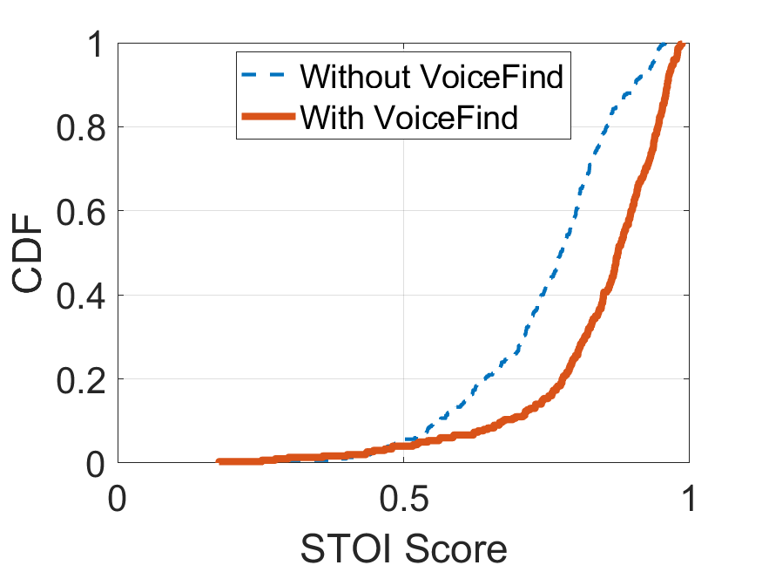
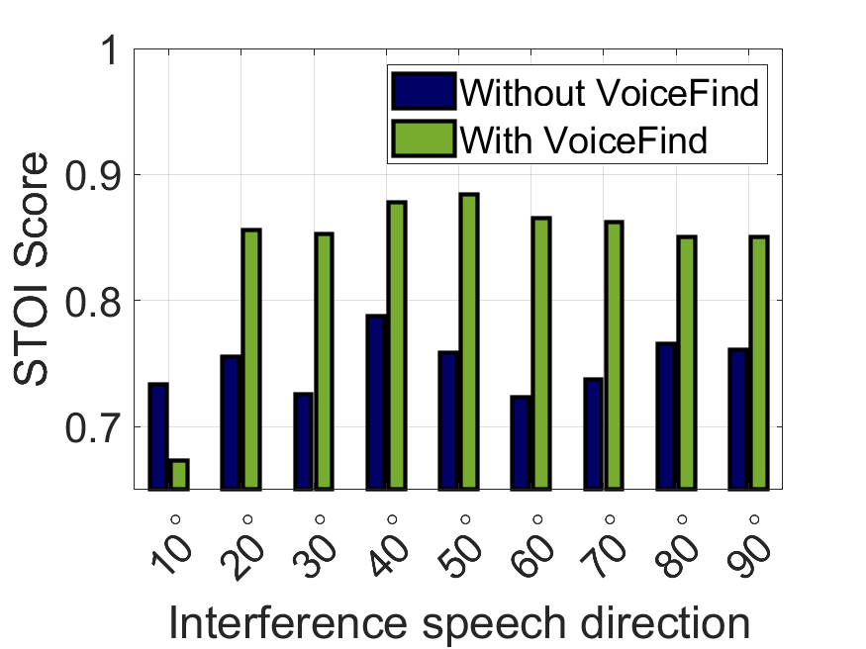
Intelligibility Score on synthetic data
Notes:
Here on left hand side is the cdf of intelligibility score on simulated data with and without using VoiceFind.
And you can observe that the median Intelligibility score has increased after using a proposed system.
To check how performance is varying with the direction of interference speech, we perform same experiments but this time, we deliberately pick the direction of interference speech.
The plot on the right hand side shows that except 10 degrees, VoiceFind is performing better in all other scenarios.

Slide 41
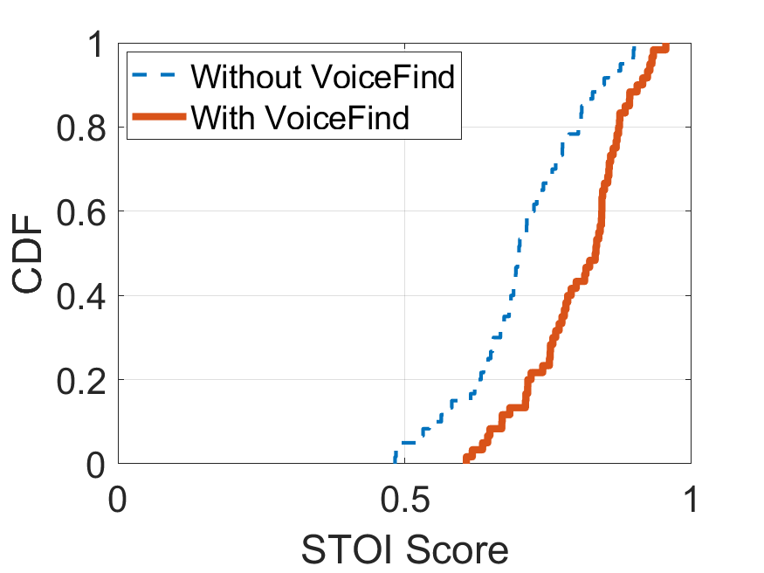
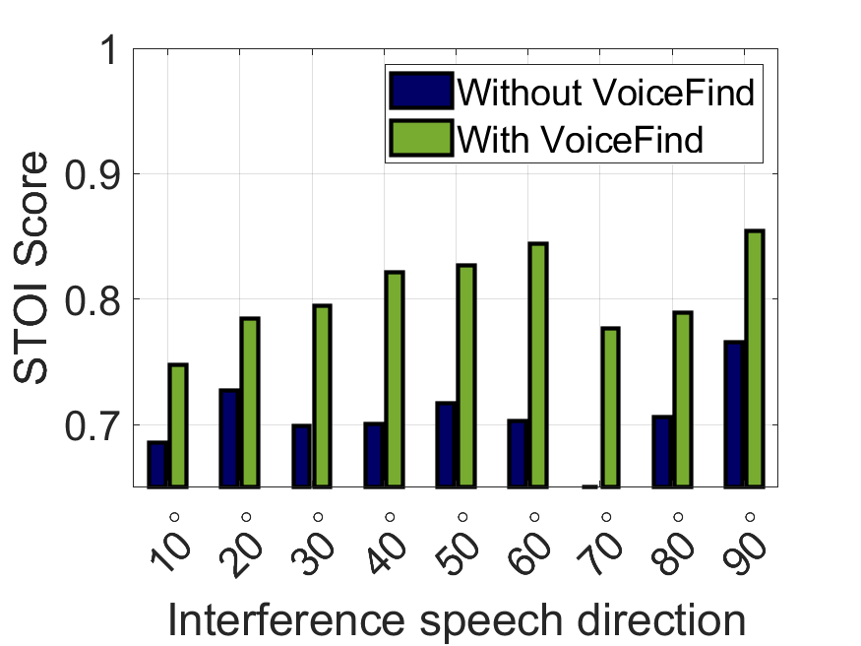
Intelligibility Score on real data
Notes:
Here we performed the same two evaluation using real world data.
We observed similar results with the real world experiments.
The intelligibility score increased after using VoiceFind.

Slide 42
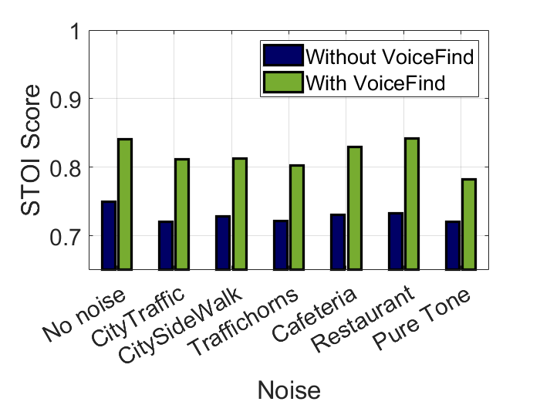
Performance in varying noisy environments
Notes:
Finally, we performed evaluation in different noisy environments.
In all these scenarios, VoiceFind has shown the improvement in speech intelligibility

Slide 43
Summary
VoiceFind:
A two microphone-based speech spatial filter
Use harmonics as virtual sensors
Generative network for speech enhancement
Notes:
To conclude,
We a propose a system called VoiceFind
That use only two microphones and speech harmonics as virtual sensors to spatially filter a speech, and then
Use a GAN-based network for final speech enhancement.

Slide 44
VoiceFind: Noise-Resilient Speech Recovery in Commodity Headphones
Thank You!
Irtaza Shahid
Yang Bai
Nakul Garg
Nirupam Roy
irtaza@umd.edu
yangbai8@umd.edu
nakul22@umd.edu
niruroy@umd.edu
Notes:
That is all for my presentation today.
Thank You for listening to the talk.
I will be happy to take your questions now.

Slide 45
References
Pascual, Santiago, Antonio Bonafonte, and Joan Serra. "SEGAN: Speech enhancement generative adversarial network." arXiv preprint arXiv:1703.09452 (2017).
Pandey, Ashutosh, and DeLiang Wang. "TCNN: Temporal convolutional neural network for real-time speech enhancement in the time domain." ICASSP 2019-2019 IEEE International Conference on Acoustics, Speech and Signal Processing (ICASSP). IEEE, 2019.
Yin, Dacheng, et al. "Phasen: A phase-and-harmonics-aware speech enhancement network." Proceedings of the AAAI Conference on Artificial Intelligence. Vol. 34. No. 05. 2020.
Pandey, Ashutosh, and DeLiang Wang. "On cross-corpus generalization of deep learning based speech enhancement." IEEE/ACM transactions on audio, speech, and language processing 28 (2020): 2489-2499.
Luo, Yi, and Nima Mesgarani. "Conv-tasnet: Surpassing ideal time–frequency magnitude masking for speech separation." IEEE/ACM transactions on audio, speech, and language processing 27.8 (2019): 1256-1266.
Zeghidour, Neil, and David Grangier. "Wavesplit: End-to-end speech separation by speaker clustering." IEEE/ACM Transactions on Audio, Speech, and Language Processing 29 (2021): 2840-2849.
Nair, Arun Asokan, et al. "Audiovisual zooming: what you see is what you hear." Proceedings of the 27th ACM International Conference on Multimedia. 2019.
Sun, Ke, and Xinyu Zhang. "UltraSE: single-channel speech enhancement using ultrasound." Proceedings of the 27th Annual International Conference on Mobile Computing and Networking. 2021.

Slide 46
Notes:
Thank you slide

Slide 47
Target Speaker
Speech Separation
Target Speaker?
Interference Speaker
Noise Sources

Slide 51
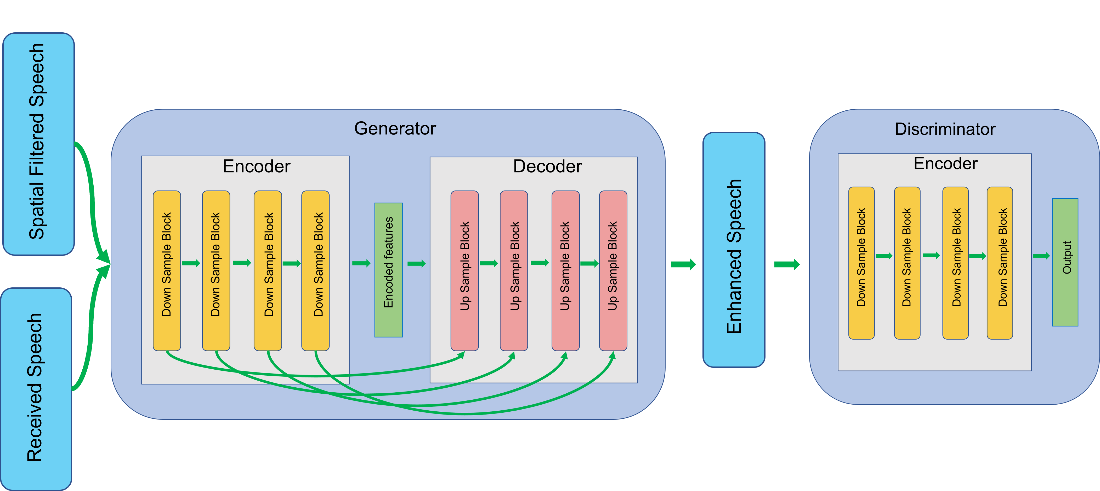
GAN-based Speech Enhancement

Slide 52
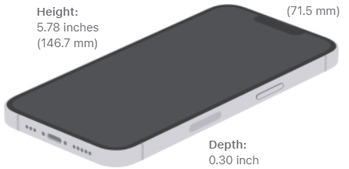
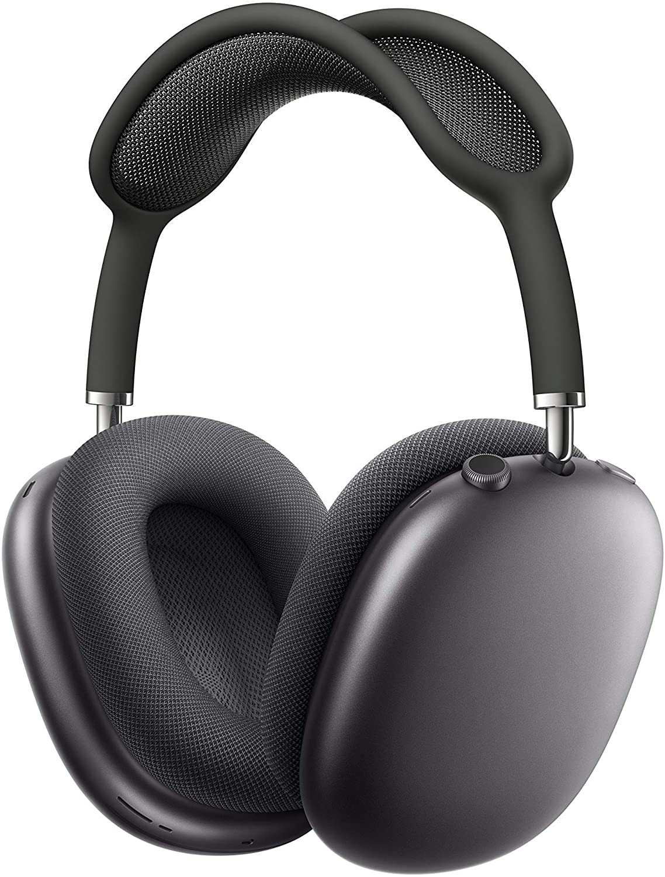
Voice Isolation and Wide Spectrum microphone modes
Sony’s precise Voice Pickup technology uses four beamforming microphones and AI based noise reduction structure to isolate the user’s voice.
Beamforming microphones help isolate your voice on phone calls, so it’s heard clearly.

Slide 53
Desired speech
Missing Regions
GAN enhanced
Clean Speech
Interference speech

Slide 54
Virtual beamforming
Noisy Speech
Filtered Speech
Desired speech
However Virtual beamforming is not perfect
Interference speech

Slide 55
GAN-based Speech Enhancement
Generator
Encoder
Decoder
Down Sample Block
Encoded features
Up Sample Block
Up Sample Block
Down Sample Block
Up Sample Block
Up Sample Block
Down Sample Block
Down Sample Block

Slide 56
Microphones

Slide 57
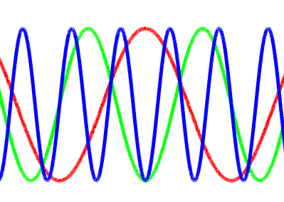
How harmonic structure is helpful?
Beamforming
Phase accumulation across sensors due to different path lengths
Harmonics
Relative phase accumulation across two sensors due to different frequencies
$$\text{d} sin(θ)$$
d
$R(m)$ = exp($\frac{\text{j}\text{2}π\text{fd}\text{(}\text{m}\text{)} sin(θ)}{c})∗R(1)$
$R(f)$ = exp($\frac{\text{j}\text{2}π\text{(}\text{f}\text{)}\text{d} sin(θ)}{c})$ [eq2]

Slide 58
Dual-channel recording
Extracting voice signal structure
Virtual beamforming
Generative speech recovery
Loud noise field
Clean speech
Voice signal

