Slide 1
Cryptography
Lecture 28

Slide 2
Post-quantum cryptography

Slide 3
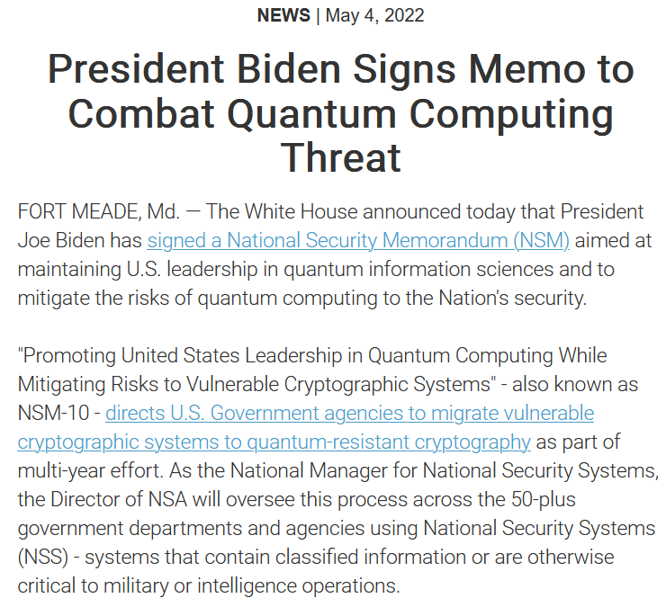

Slide 4
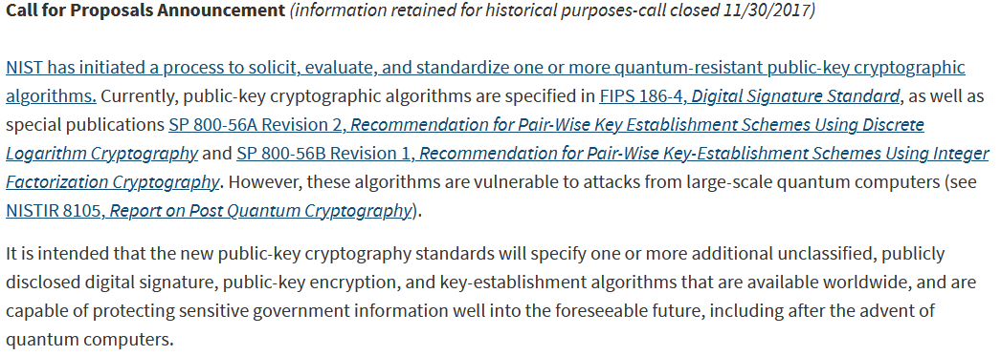
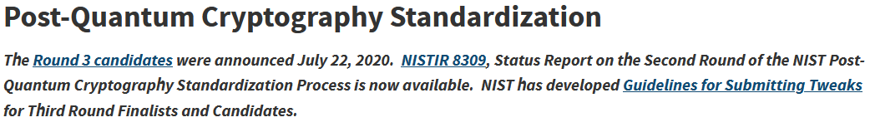

Slide 5
Efficient computation?
So far, our notion of efficient computation has been probabilistic poly-time computation
  On a classical computer
What about quantum computers?
  Will not explain quantum computation here…
  … but it appears to be more powerful than classical computation
  What would the effect on cryptography be?

Slide 6
Are quantum computers a real threat?
In theory…yes!
In practice…unclear!
  Quantum computers have been 10 years away for the last 25 years
  No large-scale quantum computer (QC) yet built
  Many engineering challenges; no clear estimate of when large-scale QCs could be built

Slide 7
Are quantum computers a real threat?
Even if QCs are 20 years away, need to plan for them now
It takes time to design, standardize, and deploy new cryptosystems
Attackers can collect ciphertexts now, and save them to decrypt later

Slide 8
Outline
Quantum attacks on current cryptosystems
  Symmetric-key schemes
  Public-key schemes
“Post-quantum cryptography”
  Hardness assumption
  Example scheme

Slide 9
Quantum vs. post-quantum crypto
Quantum cryptography
  Cryptosystems that are implemented quantumly
  Interesting because there are things that can be done that are impossible classically
    In particular, key exchange against an unbounded (passive) attacker
  Difficult/expensive to use in real world; real-world use cases unclear

Slide 10
Quantum vs. post-quantum crypto
Post-quantum cryptography
  Classical cryptosystems with security against (efficient) quantum attackers
  Could be used as “drop-in” replacements for existing cryptosystems

Slide 11
Quantum algorithms
Quantum algorithms can in some cases be provably faster than classical algorithms
  E.g., exhaustive search

Slide 12
Exhaustive search
Say you are given oracle access to a function
f : [N] → {0, 1}, and want to find x with f(x) = 1
  Classically: requires O(N) evaluations of f
  Quantumly: Grover’s algorithm uses O(N^{1/2}) evaluations of f (!)
So exhaustive search for an n-bit key requires 2^{n/2} time on a quantum computer!
  Need to double key lengths for same security

Slide 13
Finding collisions
Given oracle access to H: {0,1}* → [N]; want to find a collision
  Classically: requires O(N^{1/2}) evaluations of H
  Quantumly: can be done in O(N^{1/3}) evaluations
Need 50% larger output length for the same security

Slide 14
Finding collisions
Compute C = {H(x) | x = 1, …, N^{1/3}}
Let f(x) = 1 iff H(x) ∈ C and N – N^{2/3} < x < N
  There is likely an x such that f(x) = 1
Use Grover’s algorithm to find x using O((N^{2/3})^{1/2}) = O(N^{1/3}) evaluations of H
  This gives a collision

Slide 15
Summarizing
Symmetric-key cryptography is not broken by quantum computers (as far as we know)
But larger key lengths are needed

Slide 16
Public-key cryptography?
All public-key problems studied in this class can be solved in quantum polynomial-time!
Shor’s algorithm is an efficient algorithm for factoring, or computing discrete logarithms (in any group)
Need to look at new public-key assumptions!

Slide 17
Digital signatures
Surprisingly(?), digital signatures do not need “public-key” assumptions
In particular, they can be constructed from hash functions alone
  See book for details
Nevertheless, such signatures are very long (and have other drawbacks)
  Some of the techniques described next can also be used to construct signatures

Slide 18
Public-key encryption/key exchange
Public-key encryption/key exchange does require some form of “public-key” assumption
New assumptions are needed
We consider one example here

Slide 19
Candidate problem…
Consider the following problem:
  Fix a prime q
  Choose uniform matrix B, uniform vector s
  Given: B and t := B⋅s mod q
  Goal: find s’ such that B⋅s’ = t mod q
  This is easy! (Use linear algebra…)

Slide 20
Candidate problem, take 2
Consider the following problem:
  Choose uniform matrix B, uniform vector s, and “short” vector e
  Output B and t := [B⋅s + e mod q]
  Find s’ and short e’ such that B⋅s’ + e’ = t mod q
  This is hard (even for quantum algorithms)!
Learning with errors (LWE) problem

Slide 21
Candidate problem, take 3
Consider the following problem:
  Choose uniform matrix B, uniform s, and short e
  Output B and either t := [B⋅s + e mod q] or uniform vector t
  Determine whether t was uniform or not
  This is hard!
Decisional LWE problem
  Hardness of LWE implies hardness of decisional LWE

Slide 22
Candidate problem, take 4
Consider the following problem:
  Choose uniform matrix B, short s, and short e
  Output B and either t := [B⋅s + e mod q] or uniform vector t
  Determine whether t was uniform or not
  This is hard!
Decisional LWE problem
  Hardness of LWE implies hardness of this version of decisional LWE

Slide 23
Key exchange from (decisional) LWE
B
t’ = B⋅s’ + e’
t^{T} = s^{T}⋅B + e^{T}
Choose s’, e’
Choose s, e
  k’ = t^{T}⋅s’
  k = s^{T}⋅t’
k’ = s^{T}⋅B⋅s’ + e^{T}⋅s’
k = s^{T}⋅B⋅s’ + s^{T}⋅e’
If e, e’, s, s’ are “short,” then k, k’ are “close”

Slide 24
Key exchange from (decisional) LWE
Can use “close” values k, k’ to encrypt a bit b
Encryption: Send c = k + b ⋅ ⎣q/2⎦ mod q
Decryption: Compute c – k’ mod q; output 0/1 depending on whether the result is closer to 0 or q/2
Might be (small) probability of error

Slide 25
Key exchange from (decisional) LWE
Keys of the parties are each indistinguishable from random under the decisional LWE assumption

Slide 26
Current status
NIST actively working on post-quantum standardization
  Signatures
  Key exchange
  Public-key encryption
Ongoing process!
See https://csrc.nist.gov/projects/post-quantum-cryptography/round-3-submissions

Slide 27
Parting thoughts

Slide 28
Modern research in cryptography
Many different directions…interactions with many fields
  Mathematical aspects of cryptography; better algorithms for number-theoretic problems
  Crypto implementations and their security, incl. hardware implementations
  Hash function/stream-cipher/block-cipher design and cryptanalysis
  Theory of cryptography, incl. proofs of security
  Security against quantum adversaries

Slide 29
Modern research in cryptography
Some topics we did not cover at all
  Distributed, multi-party protocols with complex trust assumptions
    Zero knowledge
    Secure computation, fully homomorphic encryption
    Verifiable computing
    Blockchain and cryptocurrencies
  Privacy and anonymity
  Interactions of crypto and PL, ML, HCI, and more

Slide 30
Where to go next
Other chapters in book
Graduate crypto class in spring ‘23
Cryptography conferences and papers
  http://eprint.iacr.org
  Crypto, Eurocrypt
  ACM CCCS, IEEE Symposium on Security and Privacy

Slide 31
Hope you enjoyed the class!

