Slide 1
Cryptography
Lecture 13

Slide 2
Hash functions

Slide 3
Hash functions
(Cryptographic) hash function: deterministic function mapping arbitrary length inputs to a short, fixed-length output
Hash functions can be keyed or unkeyed
  We will assume unkeyed hash functions for simplicity

Slide 4
Collision-resistance
Let H: {0,1}* → {0,1}^{l} be a hash function
A collision is a pair of distinct inputs x, x’ such that H(x) = H(x’)
H is collision-resistant if it is infeasible to find a collision in H

Slide 5
Generic hash-function attacks
What is the best “generic” collision attack on a hash function H: {0,1}* → {0,1}^{l} ?
  Collisions are guaranteed to exist…
If we compute H(x₁), …, H(x_{2l + 1}), we are guaranteed to find a collision (why?)
  Can we do better?

Slide 6
“Birthday” attacks
Compute H(x₁), …, H(x_{t})
  What is the probability of a collision (as a function of t)?
Related to the so-called birthday paradox
  How many people are needed so there is a 50% chance that some two people share a birthday?

Slide 7
Bins: days of the year (N=365)
Balls: k people
Bins: values in {0,1}^{l} (N = 2^{l} )
Balls: k hash-function computations
How many balls do we need
to have a 50% chance of a collision?
N

Slide 8
“Birthday” attacks
Theorem: the collision probability is Θ(t²/N)
When t ≈ N^{1/2}, probability of a collision is ≈ 50%
  Birthdays: 23 people suffice!
  Hash functions: O(2^{l/2}) hash-function evaluations
Need l = 2n to get security against attackers running in time 2^{n}
  Note: twice as long as symmetric keys (e.g., block-cipher keys or PRG seeds) for the same security

Slide 9
“Birthday bound”
The birthday bound comes up in many other cryptographic contexts
Example: IV reuse in CTR-mode encryption
  If k messages are encrypted, what are the chances that some IV is used twice?
  Note: this is much higher than the probability that a specific IV is used again

Slide 10
Building a hash function
Two-stage approach
  Build a compression function h
    I.e., hash function for fixed-length inputs
  Build a full-fledged hash function (for arbitrary length inputs) from a compression function h

Slide 11
Building a hash function
For now…
  Assume we have a “good” compression function h
    I.e., collision-resistant for fixed-length inputs
  Will discuss how to construct such an h later
Construct a hash function H (for arbitrary length inputs) based on h
  Prove that collision resistance of h implies collision resistance of H

Slide 12
Merkle-Damgard transform
m₁
m₂
m_{B}
|M|
z₀
…
h
h
h
h
Note: M = m₁…m_{B} is padded with 0s if necessary

Slide 13
Merkle-Damgard transform
Claim: if h is collision-resistant, than so is H
Proof: Collision in H ⇒ collision in h
  Say H(m₁, …, m_{B}) = H(m’₁, …, m’_{B’})
  |M| ≠ |M’|, obvious
  |M| = |M’|, look at largest i with (z_{i-1}, m_{i}) ≠ (z’_{i-1}, m’_{i})
m₁
m₂
m_{B}
|M| = m_{B+1}
z₀
z₁
z₂
…
z_{B}
z_{B+1}
h
h
h
h

Slide 14
Hash functions in practice
MD5
  Developed in 1991
  128-bit output length
  Collisions found in 2004, should no longer be used
SHA-1
  Introduced in 1995
  160-bit output length
  Collision found by brute force in 2017
  Subsequent improvements in attacks; no longer recommended; should migrate to SHA-2

Slide 15
Hash functions in practice
SHA-2
  Introduced in 2001
  Versions with 224, 256, 384, and 512-bit outputs
  No significant known weaknesses
SHA-3/Keccak
  Result of a public competition from 2008-2012
  Very different design than SHA-1/SHA-2
    Does not use Merkle-Damgard transform
  Supports 224, 256, 384, and 512-bit outputs

Slide 16
Applications of hash functions to message authentication

Slide 17
Recall…
We showed how to construct a secure MAC for short, fixed-length messages based on any PRF/block cipher
We want to extend this to a secure MAC for arbitrary-length messages
  Before: using CBC-MAC
  Here: using hash functions

Slide 18
Intuition…
M
h
M
h =? H(M)
h = H(M)

Slide 19
Hash-and-MAC
M
k
k
h, t
t
M
h = H(M)
Vrfy_{k}(h, t) = 1?
h = H(M)
t = Mac_{k}(h)

Slide 20
Security?
If the MAC is secure for fixed-length messages and H is collision-resistant, then the previous construction is a secure MAC for arbitrary-length messages

Slide 21
Proof sketch
Say the sender authenticates messages m₁, m₂, …
  Let h_{i} = H(m_{i})
Attacker outputs forgery (m, t), m ≠ m_{i} for all i
  Let h = H(m)
Two cases:
  h = H(m) = h_{i} = H(m_{i}) for some i
    Collision in H!
  H(m) = h ≠ h_{i} for all i
    Forgery in the underlying, fixed-length MAC

Slide 22
Instantiation?
Hash function + block-cipher-based MAC?
  Block-length mismatch (e.g., if using AES as the block cipher)
  Need to implement two crypto primitives (block cipher and hash function)

Slide 23
HMAC
Constructed entirely from Merkle-Damgard hash functions
  MD5, SHA-1, SHA-2
  Not SHA-3
Can be viewed as following the hash-and-MAC paradigm
  With (part of the) hash function being used as a pseudorandom function

Slide 24
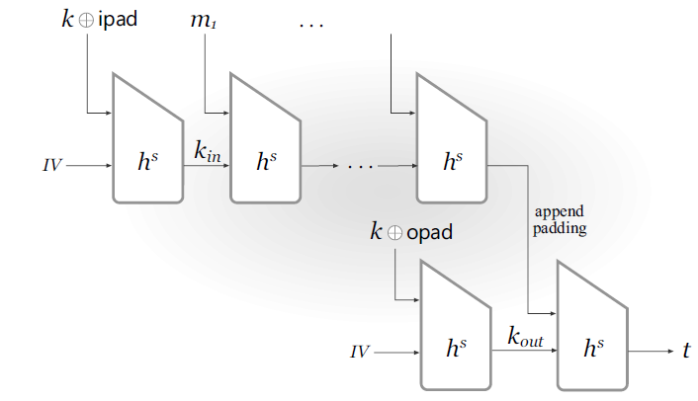
HMAC

Slide 25
Other applications of
hash functions

Slide 26
Hash functions are ubiquitous
Collision-resistance ⇒ “fingerprinting”
Outsourced storage
Used as a “random oracle”
Used as a one-way function
  Password hashing
Key derivation

Slide 27
Fingerprinting
E.g., hash-and-MAC
E.g., virus scanning
E.g., deduplication
E.g., file integrity
  Assuming it is possible to get a reliable copy of H(x) for file x
  Note: different from integrity in the context of message-authentication codes

