Slide 1
Cryptography
Lecture 16

Slide 2
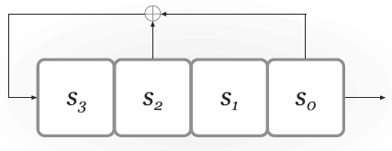
LFSRs
Degree n ⇒ n registers
State: bits s_{n-1}, …, s₀ (contents of the registers)
Feedback coefficients c_{n-1}, …, c₀ (do not change; part of the design, not the state)
Registers updated, and output generated, in each “clock tick”

Slide 3
Nonlinear FSRs
Add nonlinearity to prevent attacks
Nonlinear feedback
Nonlinear output (nonlinear filter)
Multiple LFSRs (combination generator)
…or some combination of the above
Still want to preserve statistical properties of the output, and long cycle length
From now on, assume design (including feedback coefficients) is fixed
Key only determines the initial register contents

Slide 4
Combination generator
⊕
⊕
a₄
a₃
a₂
a₁
a₀
⊕
MAJ
b₃
b₂
b₁
b₀
⊕
c₂
c₁
c₀

Slide 5
Correlation attacks
Consider previous example, and let A, B, and C be the output sequence generated by each LFSR
So the overall output is MAJ(A, B, C)
Let ρ, σ, τ denote the degree of each LFSR
Key has length ρ + σ + τ
Want security for attacks running in time 2^{ρ + σ + τ}

Slide 6
Correlation attacks
Key observation: A, B, and C are each highly correlated with the output
Assuming B, C are unbiased, Pr[A_{i} = output_{i}] = ¾ for all i (and similarly for B, C)
Alternately, for large enough sequences, ¾ of the bits in R should be equal to the corresponding output bits
Can do a brute-force search over the state of each LFSR individually!
Key-recovery attack runs in time 2^{ρ} + 2^{σ} + 2^{τ} < 2^{ρ + σ + τ}

Slide 7
Trivium
Designed by De Cannière and Preneel in 2006 as part of eSTREAM project
Intended to be simple and efficient (especially in hardware)
No attacks better than brute-force search are known!

Slide 8
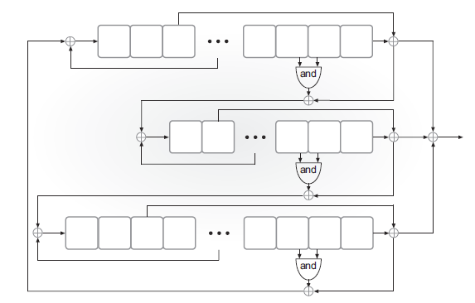
Trivium

Slide 9
Trivium
Three coupled FSRs of degree 93, 84, and 111
288-bit state
Initialization:
80-bit key in left-most registers of first FSR
80-bit IV in left-most registers of second FSR
Remaining registers set to 0, except for three right-most registers of third FSR
Run for 4 x 288 clock ticks (output discarded)

Slide 10
RC4
Designed in 1987
Designed to have good performance in software, rather than hardware
No longer considered secure, but still interesting to study
Simple description; not LFSR-based
Still encountered in practice
Interesting attacks

Slide 11
RC4
State consists of a 256-byte array S, which is always a permutation of {0,1}⁸, along with integers 0 ≤ i, j ≤ 255
Note S can be viewed as a permutation of {0,1}⁸ that is constantly changing

Slide 12
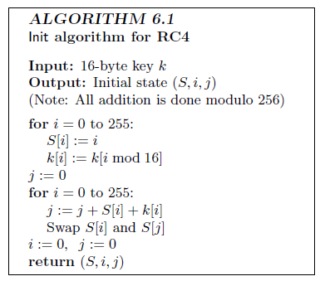
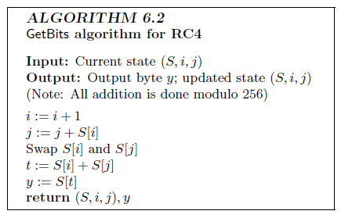
RC4

Slide 13
RC4
Not designed to take an IV, but often used with an IV anyway
E.g., prepend IV to the key

Slide 14
Attack: bias in 2nd output byte
Let S_{t} denote permutation S after t steps
Treat S₀ as uniform for simplicity
Say X = S₀[1] ≠ 2 and S₀[2] = 0
Occurs with probability ≈1/256
Then:
After 1 step, S₁[X]=X, i=1, j=X
After 2 steps, j=X; output S₂[X]=0
Otherwise, S₂[X] is a uniform byte
Pr[2nd byte is 0] ≈2/256

Slide 15
RC4 bias
Statistical bias in other output bytes was determined experimentally
Enough to break pseudo-OTP encryption based on RC4!
See http://www.isg.rhul.ac.uk/tls

Slide 16
Block ciphers

Slide 17
Recall…
Want keyed permutation F: {0,1}^{n} x {0,1}^{l} → {0,1}^{l}
n = key length, l = block length
Want F_{k} (for uniform, unknown key k) to be indistinguishable from a uniform permutation over {0,1}^{l}, for attacks running in time ≈2^{n}

Slide 18
Attack models
A block cipher is not an encryption scheme!!
Nevertheless, some of the terminology used is the same (for historical reasons)
“known-plaintext attack”: attacker given {(x, F_{k}(x)} for arbitrary x (outside control of the attacker)
“chosen-plaintext attack”: attacker can query F_{k}(.)
“chosen-ciphertext attack”: attacker can query both F_{k}(.) and F_{k}⁻¹(.)

Slide 19
Concrete security
As in the case of stream ciphers, we are interested in concrete security for a given key length n
Best attack should take time ≈ 2^{n}
If there is an attack taking time 2^{n/2} then the cipher is considered insecure
Look at both distinguishing attacks and key-recovery attacks

Slide 20
Designing block ciphers
Want F_{k} (for uniform, unknown key k) to be indistinguishable from a uniform permutation over {0,1}^{l}
If x and x’ differ in one bit, what should the relation between F_{k}(x) and F_{k}(x’) be?
How many bits should change (on average)?
Which bits should change?
How to achieve this?

Slide 21
Confusion/diffusion
Two types of steps
“Confusion”: Small change in input to the step yields small, “random” change in output of the step
“Diffusion”: Small change in input to the step should be propagated to affect entire output of the step

Slide 22
Design paradigms
Two design paradigms
Substitution-permutation networks (SPNs)
Feistel networks

Slide 23
SPNs
Build “random-looking” permutation on long input from random permutations on short input
What is the key length for a random permutation on {0,1}^{l} ?
E.g. (assuming 8-byte block length), F_{k}(x) = f_{k1}(x₁) f_{k2}(x₂) … f_{k8}(x₈), where each f is a random permutation on {0,1}⁸
How long is the key for F?

Slide 24
SPN
. . .
f_{k1}
f_{k2}
f_{k8}
Is this a pseudorandom permutation?

Slide 25
SPN
This has confusion but no diffusion
Add a mixing permutation…

