Slide 1
Cryptography
Lecture 2

Slide 2
Byte-wise shift cipher
Work with an alphabet of bytes rather than (English, lowercase) letters
  Works natively for arbitrary data!
Use XOR instead of modular addition
  Essential properties still hold

Slide 3
Byte-wise shift cipher
M = ({0,1}⁸)* (i.e., strings of bytes)
Gen: choose uniform k∈K = {0x00, …, 0xFF}
  256 possible keys
Enc_{k}(m₁…m_{t}): output c₁…c_{t}, where
c_{i} := m_{i} ⊕ k
Dec_{k}(c₁…c_{t}): output m₁…m_{t}, where
m_{i} := c_{i} ⊕ k
Verify that correctness holds…

Slide 4
ASCII
Characters often represented in ASCII
  1 byte/char = 2 hex digits/char

Slide 5
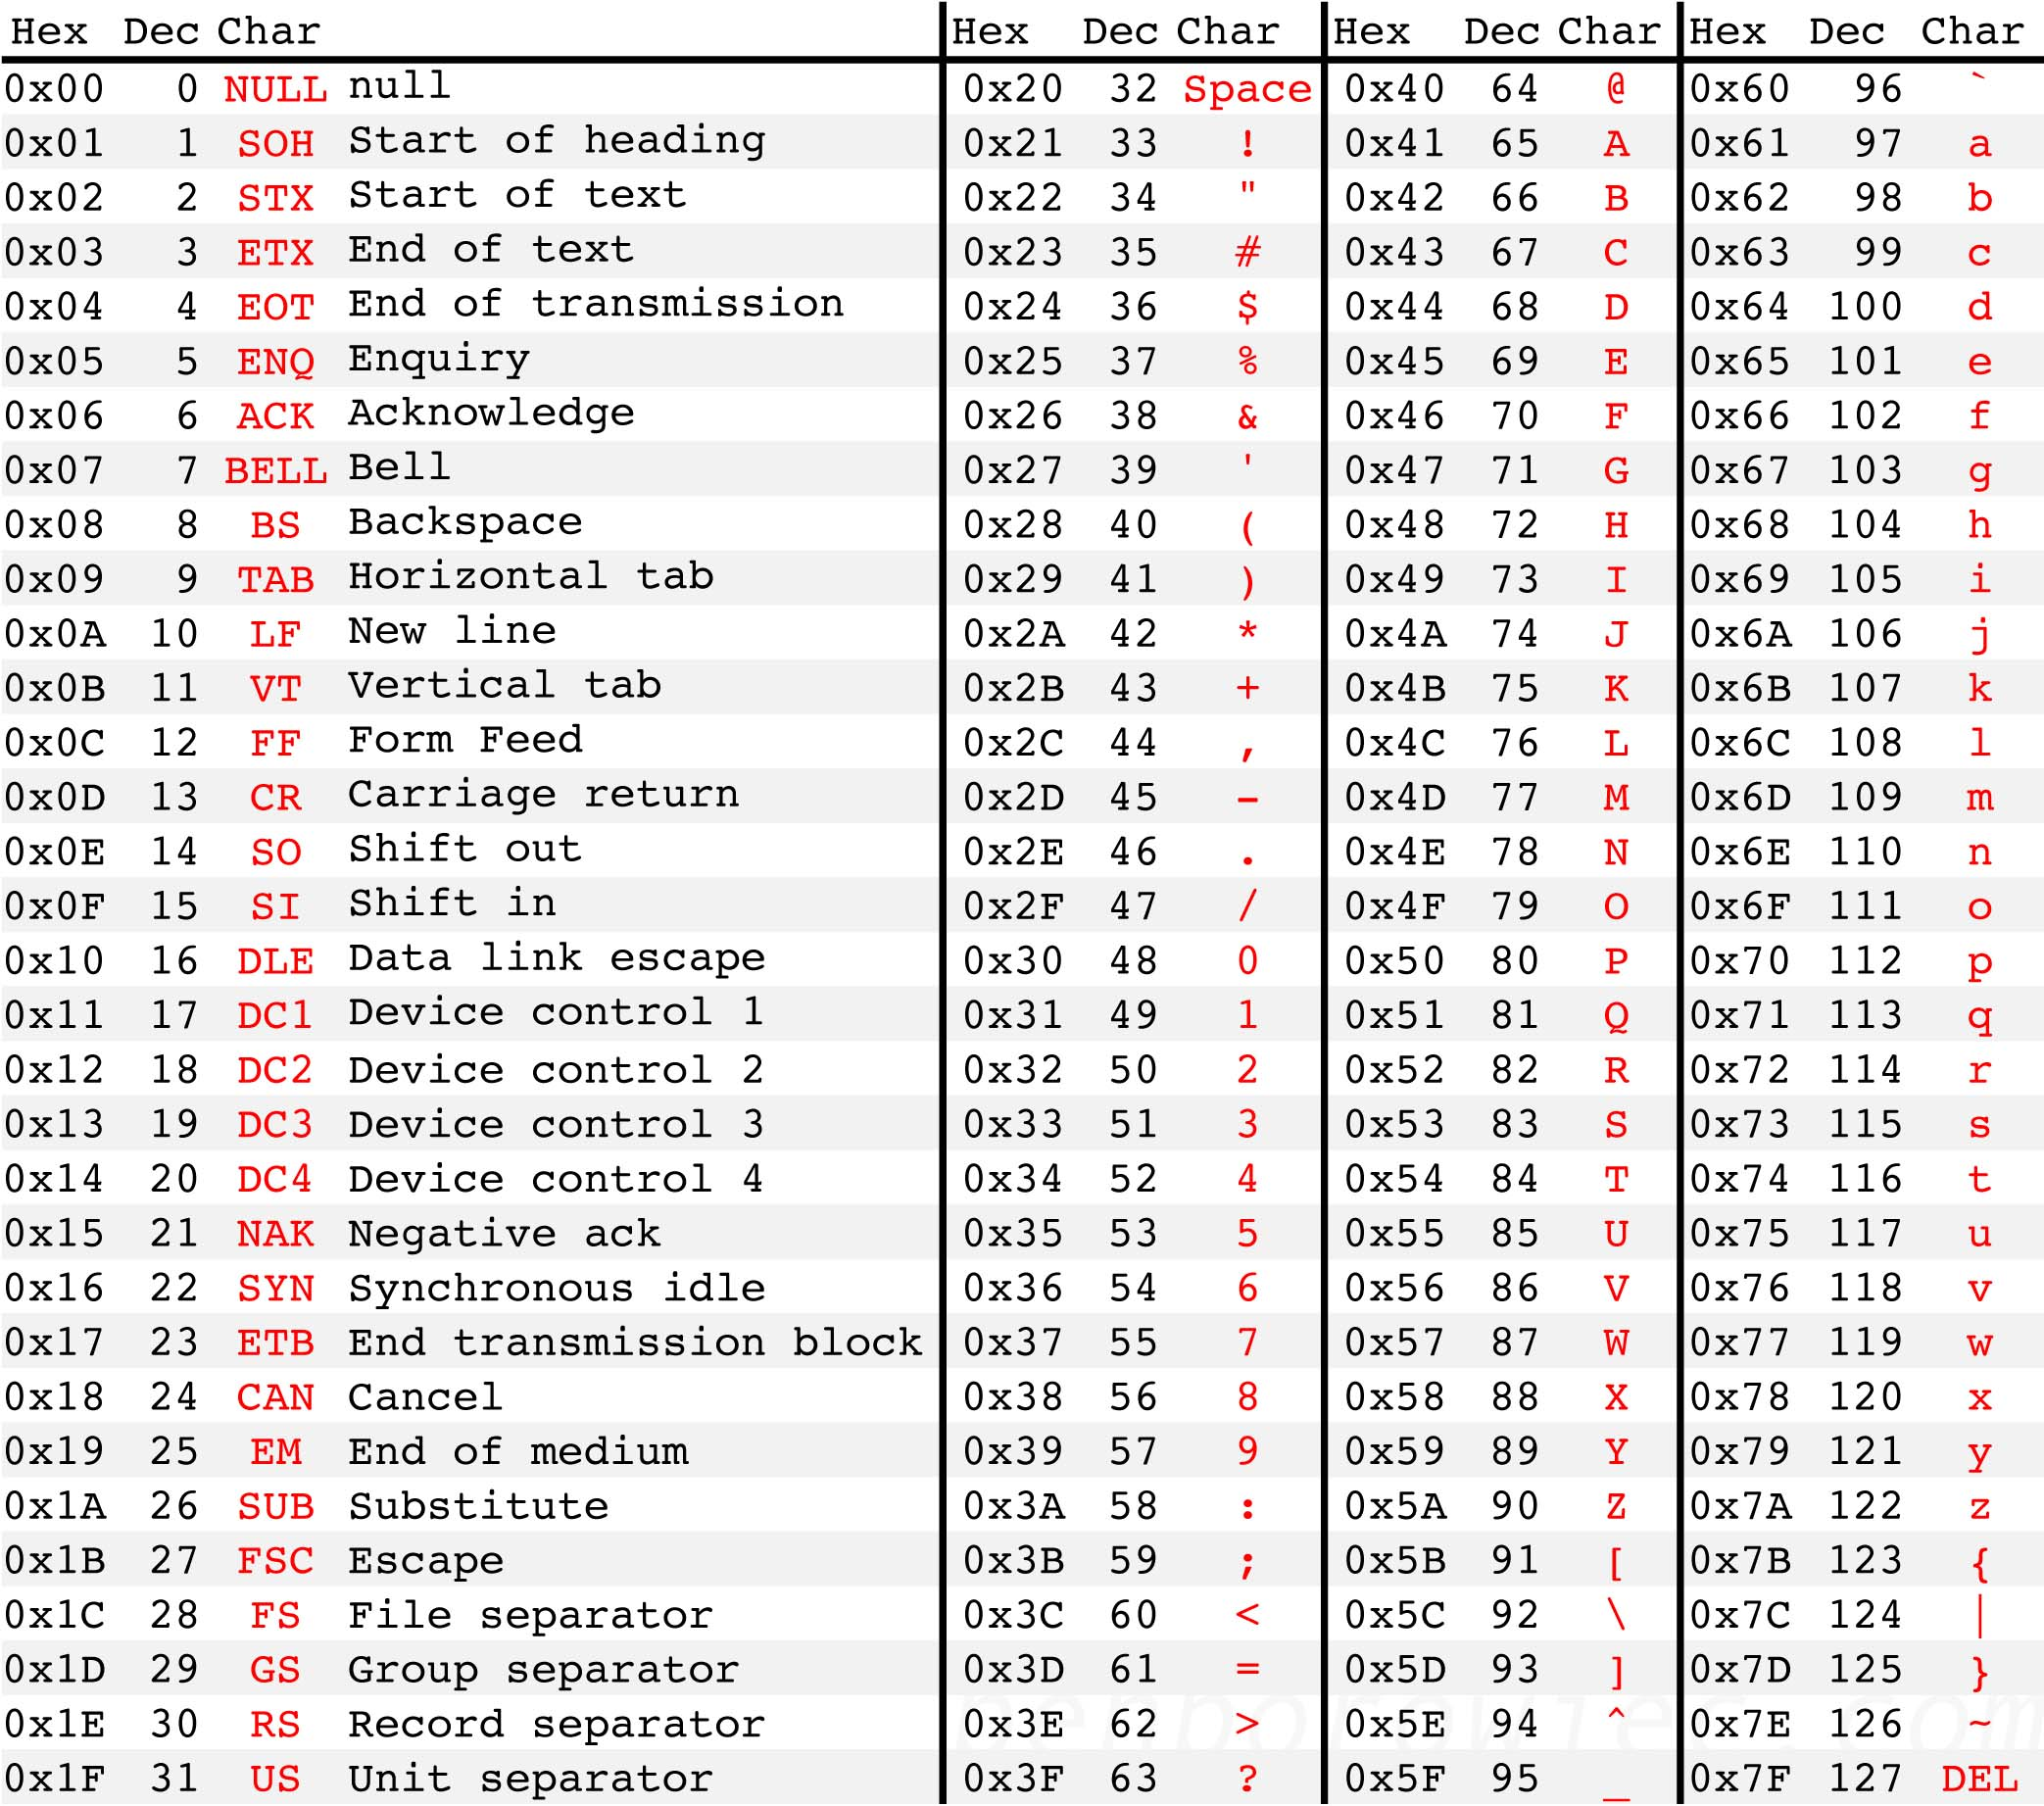
Source: http://benborowiec.com/2011/07/23/better-ascii-table/

Slide 6
Code for byte-wise shift cipher
// read key from key.txt (hex) and message from ptext.txt (ASCII);
// output ciphertext to ctext.txt (hex)
#include <stdio.h>
main(){
FILE *keyfile, *pfile, *cfile;
int i;
unsigned char key, ch;
keyfile = fopen("key.txt", "r"), pfile = fopen("ptext.txt", "r"), cfile = fopen("ctext.txt", "w");
if (fscanf(keyfile, "%2hhX", &key)==EOF) printf("Error reading key.\n");
for (i=0; ; i++){
if (fscanf(pfile, "%c", &ch)==EOF) break;
fprintf(cfile, "%02X", ch^key);
}
fclose(keyfile), fclose(pfile), fclose(cfile);
}

Slide 7
Is this scheme secure?
No -- only 256 possible keys!
  Given a ciphertext, try decrypting with every
  possible key
  If ciphertext is long enough, only one plaintext will “make sense”
Sufficient key space principle
  The key space must be large enough to make exhaustive-search attacks impractical
    How large do you think that is?
  Technical note (more next lecture): only true when the plaintext is sufficiently long

Slide 8
Can we improve the attack?
Useful observations about ASCII
  Only 128 valid ASCII chars (128 bytes invalid)
  Only 0x20-0x7E printable
  0x41-0x7a includes all upper/lowercase letters
    Uppercase letters begin with 0x4 or 0x5
    Lowercase letters begin with 0x6 or 0x7
Can we break the scheme without trying
all 256 possible keys?

Slide 9
The Vigenère cipher
The key is multiple characters, not just one
To encrypt, shift each character in the plaintext by the amount dictated by the next character of the key
  Wrap around in the key as needed
Decryption just reverses the process
tellhimaboutme
cafecafecafeca
veqpjiredozxoe

Slide 10
The Vigenère cipher
Size of key space?
  If keys are 14-character strings over the English alphabet, then key space has size 26¹⁴ ≈ 2⁶⁶
  If variable length keys, even more…
  Brute-force search becomes infeasible
Does that mean the Vigenère cipher is secure?

Slide 11
Attacking the Vigenère cipher
Assume a 14-character key
Observation: every 14th character is “encrypted” using the same shift
Looking at every 14th character is (almost) like looking at a ciphertext encrypted with the shift cipher
  Though a direct brute-force attack doesn’t work (why not?)
veqpjiredozxoeualpcmsdjquiqndnossoscdcusoakjqmxpqrhyycjqoqqodhjcciowieii
veqpjiredozxoeualpcmsdjquiqndnossoscdcusoakjqmxpqrhyycjqoqqodhjcciowieii
veqpjiredozxoeualpcmsdjquiqndnossoscdcusoakjqmxpqrhyycjqoqqodhjcciowieii

Slide 12
Using plaintext letter frequencies

Slide 13
Attacking the Vigenère cipher
Look at every 14th character of the ciphertext, starting with the first
  Call this the first “stream”
Let α be the most common character appearing in this stream
Most likely, α corresponds to the most common character of the plaintext (i.e., ‘e’)
  Guess that the first character of the key is α - ’e’
Repeat for all other positions
This is somewhat haphazard … and does not use all the available information

Slide 14
A better attack
Let p_{i} (0 ≤ i ≤ 25) denote the frequency of the i^{th} English letter in normal English plaintext
  One can compute that Σ_{i} p_{i}² ≈ 0.065
Let q_{i} denote the observed frequency of the i^{th} letter in a given stream of the ciphertext
If the shift for that stream is j, expect q_{i+j} ≈ p_{i} for all i
  So expect Σ_{i} p_{i} q_{i+j} ≈ 0.065
Test for every value of j to find the right one
  Repeat for each stream

Slide 15
Finding the key length
The previous attack assumes we know the key length
  What if we don’t?
Note: can always try the previous attack for all possible key lengths
  # of key lengths << # keys
We can do better!

Slide 16
Finding the key length
When using the correct key length, the ciphertext frequencies {q_{i}} of any stream will be shifted versions of the {p_{i}}
  So Σ q_{i}² ≈ Σ p_{i}² ≈ 0.065
When using an incorrect key length, expect (heuristically) that ciphertext letters are uniform
  So Σ q_{i}² ≈ Σ (1/26)² = 1/26 = 0.038
In fact, good enough to find the key length N that maximizes Σ q_{i}² for some stream
  Can verify key length by looking at other streams…

Slide 17
Byte-wise Vigenère cipher
The key is a string of bytes
The plaintext is a sequence of bytes
To encrypt, XOR each character in the plaintext with the next character of the key
  Wrap around in the key as needed
Decryption just reverses the process

Slide 18
Example
Say plaintext is “Hello!” and key is 0xA1 2F
“Hello!” = 0x48 65 6C 6C 6F 21
XOR with 0xA1 2F A1 2F A1 2F
0x48 ⊕ 0xA1
  0100 1000 ⊕ 1010 0001 = 1110 1001 = 0xE9
Ciphertext: 0xE9 4A CD 43 CE 0E

Slide 19
Attacking the (variant) Vigenère cipher
As before, two steps:
  Determine the key length
  Determine each byte of the key
Let p_{i} (for 0 ≤ i ≤ 255) be the frequency of byte i in normal English (ASCII) plaintext
  I.e., p_{i} =0 for i < 32 or i > 127
  I.e., p₉₇ = frequency of ‘a’
If {p_{i}} are known, use same principles as before…
  What if they are not known?

Slide 20
Determining the key length
If the key length is N, every N^{th} character of plaintext is encrypted using the same “shift”
  If we take every N^{th} character and calculate frequencies, we get the {p_{i}} in permuted order
  If we take every Mth character (M not a multiple
  of N) and calculate frequencies, we get something close to uniform
  We don’t need to know the {p_{i}} to distinguish these two!

Slide 21
Determining the key length
For some candidate key length, tabulate q₀, …, q₂₅₅ for first stream and compute Σ q_{i}²
  If close to uniform, Σ q_{i}² ≈ 256 · (1/256)² = 1/256
  If a permutation of p_{i}, then Σ q_{i}² ≈ Σ p_{i}²
    Main point: will be much larger than 1/256
So: compute Σ q_{i}² for each possible key length, and look for maximum value
  Correct key length N should yield a large value for all N streams

Slide 22
Determining the i^{th} byte of the key
Assume the key length N has been determined
Look at i^{th} ciphertext stream
  As before, all bytes in this stream were generated by XORing plaintext with the same byte of the key
Try decrypting the stream using every possible byte value B
  Get a candidate plaintext stream for each value

Slide 23
Determining the i^{th} byte of the key
When the guess B is correct:
  All bytes in the plaintext stream will be between 32 and 126
  Frequency of space character should be high
  Frequencies of lowercase letters (as a fraction of all lowercase letters) should be close to known English-letter frequencies
    Tabulate observed letter frequencies p’₀, …, p’₂₅ (as fraction of all lowercase letters) in the candidate plaintext
    Should find Σ p’_{i} p_{i} ≈ Σ p_{i}² ≈ 0.065, where p_{i} corresponds to English-letter frequencies
    In practice, take B that maximizes Σ p’_{i} p_{i}, subject to caveats above (and possibly others)

Slide 24
Complexity of the attack?
Say the key length is known to be between
1 and L
Determining the key length: O(L)
Determining all bytes of the key: O(L)
Total work: O(L)
Brute-force key search: > 256^{L}

Slide 25
The attack in practice
Attack is more reliable as the ciphertext length grows
Attack still works for short(er) ciphertexts, but more “tweaking” and manual involvement may be needed

Slide 26
First programming assignment
Decrypt ciphertext (provided online) that was generated using the Vigenère cipher

