Slide 1
Cryptography
Lecture 23

Slide 2
Back to cryptography…

Slide 3
Private-key cryptography
Private-key cryptography allows two users who share a secret key to establish a “secure channel”
The need to share a secret key has several drawbacks…

Slide 4
The key-distribution problem
How do users share a key in the first place?
  Need to share the key using a secure channel…
This problem can be solved in some settings
  E.g., physical proximity, trusted courier, …
  Note: this does not make private-key cryptography useless!
Can be difficult, expensive, or impossible to solve in other settings

Slide 5
The key-management problem
Imagine an organization with N employees, where each pair of employees might need to communicate securely
Solution using private-key cryptography:
  Each user shares a key with all other users
  Each user must store/manage N-1 secret keys!
  O(N²) keys overall!

Slide 6
Lack of support for “open systems”
Say two users who have no prior relationship want to communicate securely
  When would they ever have shared a key?
This happens all the time!
  Customer sending credit-card data to merchant
  Contacting a friend-of-a-friend on social media
  Emailing a colleague

Slide 7
“Classical” cryptography offers no solution to these problems!

Slide 8
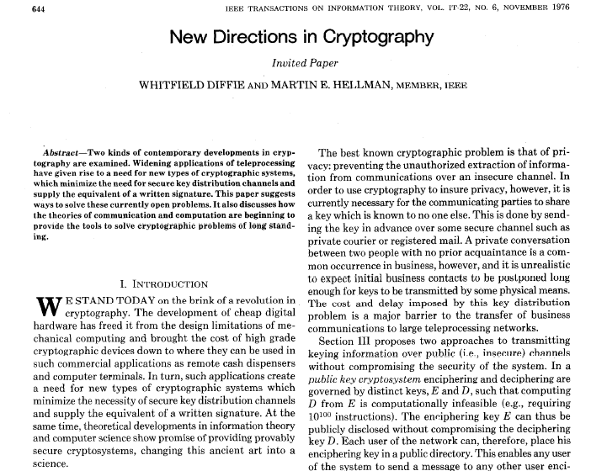

Slide 9
New directions…
Main ideas:
  Some problems exhibit asymmetry – easy to compute, but hard to invert (factoring, RSA, group exponentiation, …)
  Use this asymmetry to enable two parties to agree on a shared secret key via public discussion(!)
    Key exchange

Slide 10
Key exchange
…
…
k
Enc_{k}(m)
k
Secure against an eavesdropper who sees everything!

Slide 11
More formally…
transcript
· · ·
k∈{0,1}^{n}
k∈{0,1}^{n}
Security goal: even after observing the transcript, the shared
key k should be indistinguishable from a uniform key

Slide 12
Formally
Fix a key-exchange protocol Π and an attacker (passive eavesdropper) A
Define the following experiment KE_{A,} _{Π}(n):
  Honest parties run Π using security parameter n, resulting in a transcript trans and (shared) key k
  Choose uniform bit b. If b=0, then set k’=k; if b=1, then choose uniform k’∈{0,1}^{n}
  Give trans and k’ to A, which outputs a bit b’
  Exp’t evaluates to 1 (A succeeds) if b’=b

Slide 13
Security
Key-exchange protocol Π is secure (against passive eavesdropping) if for all probabilistic, poly-time A it holds that
Pr[KE_{A,} _{Π}(n) = 1] ≤ ½ + negl(n)

Slide 14
Notes
Being unable to compute the key given the transcript is not a strong enough guarantee
Indistinguishability of the shared key from uniform is a much stronger guarantee…
  …and is necessary if the shared key will subsequently be used for private-key crypto!

Slide 15
Diffie-Hellman key exchange
G, q, g, h₁
h₂
  (G, q, g) ← G(1^{n})
  x ← ℤ_{q}
  h₁ = g^{x}
  y ← ℤ_{q}
  h₂ = g^{y}
k₁ = (h₂)^{x} = g^{yx}
k₂ = (h₁)^{y} = g^{xy}

Slide 16
In practice…
G, q, g
h₁
h₂
  h₁ = g^{x}
  h₂ = g^{y}
k₁ = (h₂)^{x} = g^{xy}
k₂ = (h₁)^{y} = g^{xy}

Slide 17
Recall…
Decisional Diffie-Hellman (DDH) assumption:
  Given G, q, g, g^{x}, g^{y}, cannot distinguish g^{xy} from a uniform group element

Slide 18
Security?
Eavesdropper sees G, q, g, g^{x}, g^{y}
Shared key k is g^{xy}
Computing k from the transcript is exactly the computational Diffie-Hellman problem
Distinguishing k from a uniform group element is exactly the decisional Diffie-Hellman problem
  ⇒ If the DDH problem is hard relative to G, this is a secure key-exchange protocol!

Slide 19
Example
Work in order-11 subgroup of ℤ*₂₃
  Note: 23 and 11 both prime
  23 = 2*11 + 1
  Let G = {x² | x ∈ ℤ*₂₃}
    How can you find a generator?

Slide 20
A subtlety
We want our key-exchange protocol to give us a uniform(-looking) key k ∈ {0,1}^{n}
Instead we have a uniform(-looking) group element k ∈ G
  Not clear how to use this as, e.g., an AES key
Solution: key derivation
  Set k’ = H(k) for suitable hash function H
    Secure if H is modeled as a random oracle

Slide 21
Modern key-exchange protocols
Security against passive eavesdroppers is insufficient
Generally want authenticated key exchange
  This requires some form of setup in advance
Modern key-exchange protocols provide this
  We will return to this later

Slide 22
The public-key setting

Slide 23
Review: private-key setting
Two (or more) parties who wish to securely communicate share a uniform, secret key k
in advance
Same key k used for sending or receiving
  Either party can send or receive
  If multiple parties share a key, no way to distinguish them from based on the key
Secrecy of k is critical
  No security if attacker knows k

Slide 24
The public-key setting
One party generates a pair of keys: public key pk and private key sk
  Public key is widely disseminated
  Private key is kept secret, and shared with no one
Private key used by the party who generated it; public key used by anyone else
  Also called asymmetric cryptography
Security must hold even if the attacker knows pk

Slide 25
Public-key distribution I
pk
pk
pk
pk, sk

Slide 26
Public-key distribution II
pk
pk, sk

Slide 27
Public-key distribution
Previous figures (implicitly) assume parties are able to obtain correct copies of each others’ public keys
  I.e., the attacker is passive during key distribution
We will revisit this assumption later

Slide 28
How does this address the drawbacks of private-key crypto…?
Key distribution
  Public keys can be distributed over public (but authenticated) channels
Key management in system of N users
  Each user stores 1 private key and N-1 public keys; only N keys overall
  Public keys can be stored in a central, public directory
Applicability to “open systems”
  Even parties who have no prior relationship can find each others’ public keys and use them

Slide 29
Public-key vs. private-key crypto
Note that public-key cryptography is strictly stronger than private-key cryptography
  Parties who wish to securely communicate could each generate public/private keys and then share them with each other
  Use appropriate key depending on who is sending or receiving

Slide 30
Why study private-key crypto?
Public-key crypto is roughly 2-3 orders of magnitude slower than private-key crypto
  Also 2-10× higher communication
Public-key cryptography requires stronger assumptions
If private-key crypto is an option, better to use it!
As we will see, private-key cryptography is used for efficiency even in the public-key setting

Slide 31
Primitives
 | Private-key setting | Public-key setting
Secrecy | Private-key encryption | Public-key encryption
Integrity | Message authentication codes | Digital signature schemes

Slide 32
Public-key encryption
pk
pk
c
pk
pk, sk
c ← Enc_{pk}(m)
m = Dec_{sk}(c)

Slide 33
Public-key encryption
A public-key encryption scheme consists of three PPT algorithms:
  Gen: key-generation algorithm that on input 1^{n} outputs pk, sk
  Enc: encryption algorithm that on input pk and a message m outputs a ciphertext c
  Dec: decryption algorithm that on input sk and a ciphertext c outputs a message m or an error ⊥
For all m and pk, sk output by Gen,
Dec_{sk}(Enc_{pk}(m)) = m

Slide 34
CPA-security
Fix a public-key encryption scheme Π and an adversary A
Define experiment PubK-CPA_{A,} _{Π}(n):
  Run Gen(1^{n}) to get keys pk, sk
  Give pk to A, who outputs (m₀, m₁) of same length
  Choose uniform b ∈ {0,1} and compute the ciphertext c ← Enc_{pk}(m_{b}); give c to A
  A outputs a guess b’, and the experiment evaluates to 1 if b’=b

Slide 35
CPA-security
Public-key encryption scheme Π is CPA-secure if for all PPT adversaries A:
Pr[PubK-CPA_{A,} _{Π}(n) = 1] ≤ ½ + negl(n)

Slide 36
Notes on the definition
No encryption oracle?!
  Encryption oracle redundant in public-key setting
⇒ No perfectly secret public-key encryption
No deterministic public-key encryption scheme can be CPA-secure
CPA-security implies security for encrypting multiple messages (as in the private-key case)

Slide 37
Chosen-ciphertext attacks
c
pk
pk, sk
c ← Enc_{pk}(m)
c’
m’

Slide 38
Chosen-ciphertext attacks
Chosen-ciphertext attacks are arguably even a greater concern in the public-key setting
  Attacker might be a legitimate sender
  Easier for attacker to obtain full decryptions of ciphertexts of its choice
Related concern: malleability
  I.e., given a ciphertext c that is the encryption of an unknown message m, might be possible to produce ciphertext c’ that decrypts to a related message m’
  This is also undesirable in the public-key setting

Slide 39
Chosen-ciphertext attacks
Can define CCA-security for public-key encryption by analogy to the definition for private-key encryption
  See book for details

