Slide 1
Cryptography
Lecture 26

Slide 2
Final exam logistics
Official exam time: May 13, 8-10am
Exam will be available on Gradescope from noon on May 12 until noon on May 13
Once you take the exam, no communication with other students until noon on May 13
Exam itself is 120 minutes
Plus 5 minutes to print, 15 minutes to scan
Will be enforced by Gradescope
Students with ADS accommodations should email me to make arrangements

Slide 3
Final exam logistics
Exam will cover material through Thursday, May 5
Exam is open-book/open-notes
No communication with anyone during the exam
No Internet/WiFi/cellular access during the exam
No opportunity to ask for clarifications
If something is unclear, explain your understanding of the question
Suggestions
Use one sheet of paper per question so you can work on parts of different problems
Skim entire exam before starting
Intended to be easy -- be concise rather than exhaustive
Maximize points if you are running out of time

Slide 4
Digital signatures

Slide 5
Digital signatures
Provide integrity in the public-key setting
Analogous to message authentication codes, but some key differences…

Slide 6
Digital signatures
pk
pk
pk
m, σ
pk
pk, sk
?
1 = Vrfy_{pk}(m, σ)
σ = Sign_{sk}(m)

Slide 7
Signature schemes
A signature scheme is defined by three PPT algorithms (Gen, Sign, Vrfy):
Gen: takes as input 1^{n}; outputs pk, sk
Sign: takes as input a private key sk and a message m∈{0,1}*; outputs signature σ σ ← Sign_{sk}(m)
Vrfy: takes public key pk, message m, and signature σ as input; outputs 1 or 0
For all m and all pk, sk output by Gen, Vrfy_{pk}(m, Sign_{sk}(m)) = 1

Slide 8
Security?
Exactly analogous to security for MACs
Threat model
“Adaptive chosen-message attack”
Assume the attacker can induce the sender to sign messages of the attacker’s choice
Security goal
“Existential unforgeability”
Attacker should be unable to forge valid signature on any message not signed by the sender
Attacker gets the public key…

Slide 9
Formal definition
Fix A, Π
Define randomized experiment Forge_{A,Π}(n):
pk, sk ← Gen(1^{n})
A given pk, and interacts with oracle Sign_{sk}(·) ; let M be the set of messages sent to this oracle
A outputs (m, σ)
A succeeds, and the experiment evaluates to 1, if Vrfy_{pk}(m, σ)=1 and m∉M

Slide 10
Security for signature schemes
Π is secure if for all PPT attackers A, there is a negligible function ε such that Pr[Forge_{A,Π}(n) = 1] ≤ ε(n)

Slide 11
Replay attacks
Replay attacks need to be addressed just as in the symmetric-key setting

Slide 12
Hash-and-sign paradigm
Given
A signature scheme Π = (Gen, Sign, Vrfy) for “short” messages of length n
Hash function H: {0,1}* → {0,1}^{n}
Construct a signature scheme Π’=(Gen, Sign’, Vrfy’) for arbitrary-length messages:
Sign’_{sk}(m) = Sign_{sk}(H(m))
Vrfy’_{pk}(m, σ) = Vrfy_{pk}(H(m), σ)

Slide 13
Hash-and-sign paradigm
Theorem: If Π is secure and H is collision-resistant, then Π’ is secure
Proof: Same as for MACs
Can be viewed as a counterpart of hybrid encryption
The functionality of digital signatures at the asymptotic cost of a symmetric-key solution

Slide 14
Signature schemes
We will discuss how to construct signature schemes for “short” messages
Using hash-and-sign, this implies signatures for arbitrary length messages

Slide 15
Signature schemes in practice
RSA-based signatures
Can be proven secure (based on RSA assumption, in random-oracle model)
Dlog-based signatures
Shorter signatures, faster signing than RSA-based signatures
(EC)DSA
Widely used, no proof of security
Schnorr
Can be proven secure (based on dlog assumption, in random-oracle model)

Slide 16
RSA-based signatures

Slide 17
Recall…
Choose random, equal-length primes p, q
Compute modulus N=pq
Choose e, d such that e · d = 1 mod φ(N)
The e^{th} root of m modulo N is [m^{d} mod N] (m^{d})^{e} = m^{de} = m^{[ed mod φ(N)]} = m mod N
RSA assumption: given N, e only, hard to compute the e^{th} root of a uniform m ∈ ℤ*_{N}

Slide 18
“Plain” RSA signatures
N, e
m, σ
(N, e, d) ← RSAGen(1^{n})
pk = (N, e)
sk = d
?
m = [σ^{e} mod N]
σ = [m^{d} mod N]

Slide 19
Security?
Intuition
Signature of m is the e^{th} root of m – supposedly hard to compute given only the public key!

Slide 20
Attack 1
Can sign specific messages
E.g., easy to compute the e^{th} root of m = 1, or the cube root of m = 8

Slide 21
Attack 2
Can generate signatures on “random” messages
Choose arbitrary σ; set m = [σ^{e} mod N]

Slide 22
Attack 3
Can combine two signatures to obtain a third
Say σ₁, σ₂ are valid signatures on m₁, m₂ with respect to public key N, e
Then σ’ = [σ₁ · σ₂ mod N] is a valid signature on the message m’ = [m₁ · m₂ mod N]
(σ₁ · σ₂)^{e} = σ₁e · σ₂e = m₁ · m₂ mod N

Slide 23
RSA-FDH
Main idea: apply “cryptographic transformation” to messages before signing
Public key: (N, e) private key: d
Sign_{sk}(m) = H(m)^{d} mod N
H must map onto all of ℤ*_{N}
Vrfy_{pk}(m, σ): output 1 iff σ^{e} = H(m) mod N
(This also handles long messages without additional hashing)

Slide 24
Intuition for security?
Look at the three previous attacks…
Not easy to compute the e^{th} root of H(1), …
Choose σ…, but how do you find an m such that H(m) = σ^{e} mod N?
Computing inverses of H should be hard
H(m₁) · H(m₂) = σ₁e · σ₂e = (σ₁ · σ₂)^{e} ≠ H(m₁ · m₂)

Slide 25
Security of RSA-FDH
If the RSA assumption holds, and H is modeled as a random oracle (mapping onto ℤ*_{N}), then RSA-FDH is secure
In practice, H is instantiated with a (modified) cryptographic hash function
Must ensure that the range of H is large enough!

Slide 26
RSA-FDH in practice
The RSA PKCS #1 v2.1 standard includes a signature scheme inspired by RSA-FDH
Essentially a randomized variant of RSA-FDH

Slide 27
dlog-based signatures

Slide 28
Digital signature standard (DSS)
US government standard for digital signatures
DSA, based on discrete-logarithm problem in subgroup of ℤ*_{p}
ECDSA, based on elliptic-curve groups
No security proof, even in RO model
Compared to RSA-based signatures
Shorter signatures and public keys (especially for EDCSA)
Can have faster signing
Slower verification

Slide 29
Signatures from identification schemes
Two signature schemes that can be viewed as being derived from (public-key) identification schemes
Schnorr
DSA/ECDSA
Will return to this in later lecture

Slide 30
Public-key infrastructure (PKI)

Slide 31
Public-key distribution
Alice, pk*
pk
X
Alice, pk
Alice, pk*
Alice, pk
pk, sk

Slide 32
Public-key distribution
pk
Alice, pk
Alice, pk
X
Alice, pk*
pk, sk

Slide 33
Use signatures for secure key distribution!
Assume a trusted party with a public key known to everyone
CA = certificate authority who acts as a “root of trust”
Public key pk_{CA}
Private key sk_{CA}

Slide 34
Use signatures for secure key distribution!
Alice asks the CA to sign the binding (Alice, pk)
cert_{CA→Alice} = Sign_{skCA}(Alice, pk)
(CA must verify Alice’s identity out of band)

Slide 35
Use signatures for secure key distribution!
Bob obtains Alice, pk, and the certificate cert_{CA→Alice} …
… check that Vrfy_{pKCA}((Alice, pk), cert_{CA→Alice}) = 1
Bob is then assured that pk is Alice’s public key
As long as the CA is trustworthy…
Honest, and properly verifies Alice’s identity
…and the CA’s private key has not been compromised

Slide 36
Chicken-and-egg problem?
How does Bob get pk_{CA} in the first place?
Several possibilities…

Slide 37
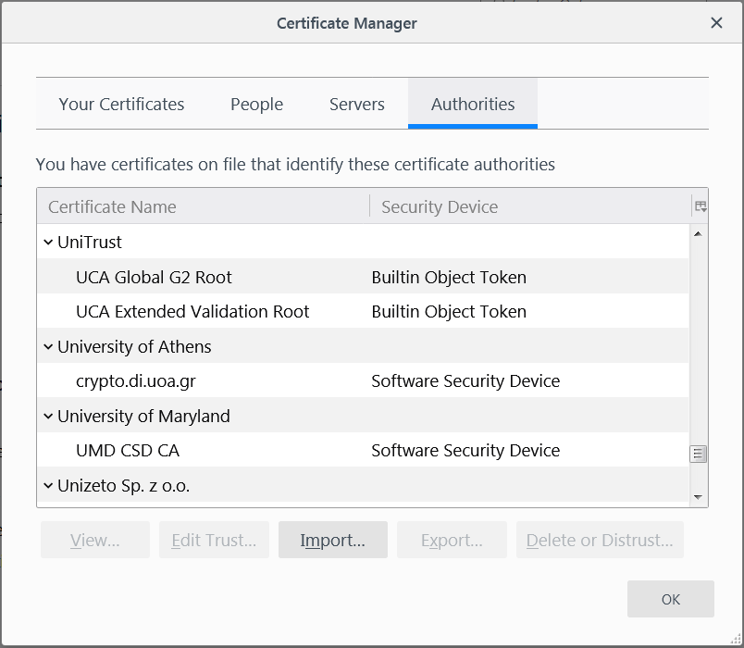
“Roots of trust”
Bob only needs to securely obtain a small number of CA’s public keys
Need to ensure secure distribution only for these few, initial public keys
E.g., distribute as part of an operating system, or web browser
Firefox: Settings->Privacy & Security->View Certificates ->Authorities

