Slide 1
Cryptography
Lecture 4

Slide 2
Perfect secrecy (formal)
Encryption scheme (Gen, Enc, Dec) with message space M and ciphertext space C is perfectly secret if for every distribution over M, every m ∈ M, and every c ∈ C with Pr[C=c] > 0, it holds that
Pr[M = m | C = c] = Pr[M = m].
I.e., the distribution of M does not change, even conditioned on observing the ciphertext

Slide 3
One-time pad (OTP)
Let M = {0,1}^{n}
Gen: choose a uniform key k ∈ {0,1}^{n}
Enc_{k}(m) = k ⊕ m
Dec_{k}(c) = k ⊕ c

Slide 4
Security of OTP
Theorem: The one-time pad is perfectly secret

Slide 5
One-time pad
If we use the one-time pad with k=0…0, then the ciphertext is the same as the message!
  Isn’t that a problem?
  Maybe we should exclude the all-0 key?

Slide 6
One-time pad
The one-time pad achieves perfect secrecy!
One-time pad has historically been used in the real world
  E.g., “red phone” between DC and Moscow
Not currently used!
  Why not?

Slide 7
One-time pad
Several limitations
  The key is as long as the message
  Only secure if each key is used to encrypt a
  single message
⇒ Parties must share keys of (total) length equal to the (total) length of all the messages they might ever send

Slide 8
Using the same key twice?
Completely insecure against a known-plaintext attack!
Say c₁ (= k ⊕ m₁)
c₂ (= k ⊕ m₂)
and the attacker knows m₁
Attacker can compute k := c₁ ⊕ m₁
Attacker can compute m₂ := c₂ ⊕ k

Slide 9
Using the same key twice?
Say c₁ = k ⊕ m₁
c₂ = k ⊕ m₂
Attacker can compute
c₁ ⊕ c₂ = (k ⊕ m₁) ⊕ (k ⊕ m₂) = m₁ ⊕ m₂
This leaks information about m₁, m₂!

Slide 10
Using the same key twice?
m₁ ⊕ m₂ is information about m₁, m₂
Is this significant?
  No longer perfectly secret!
  m₁ ⊕ m₂ reveals where m₁, m₂ differ
  Frequency analysis
  Exploiting characteristics of ASCII…

Slide 11
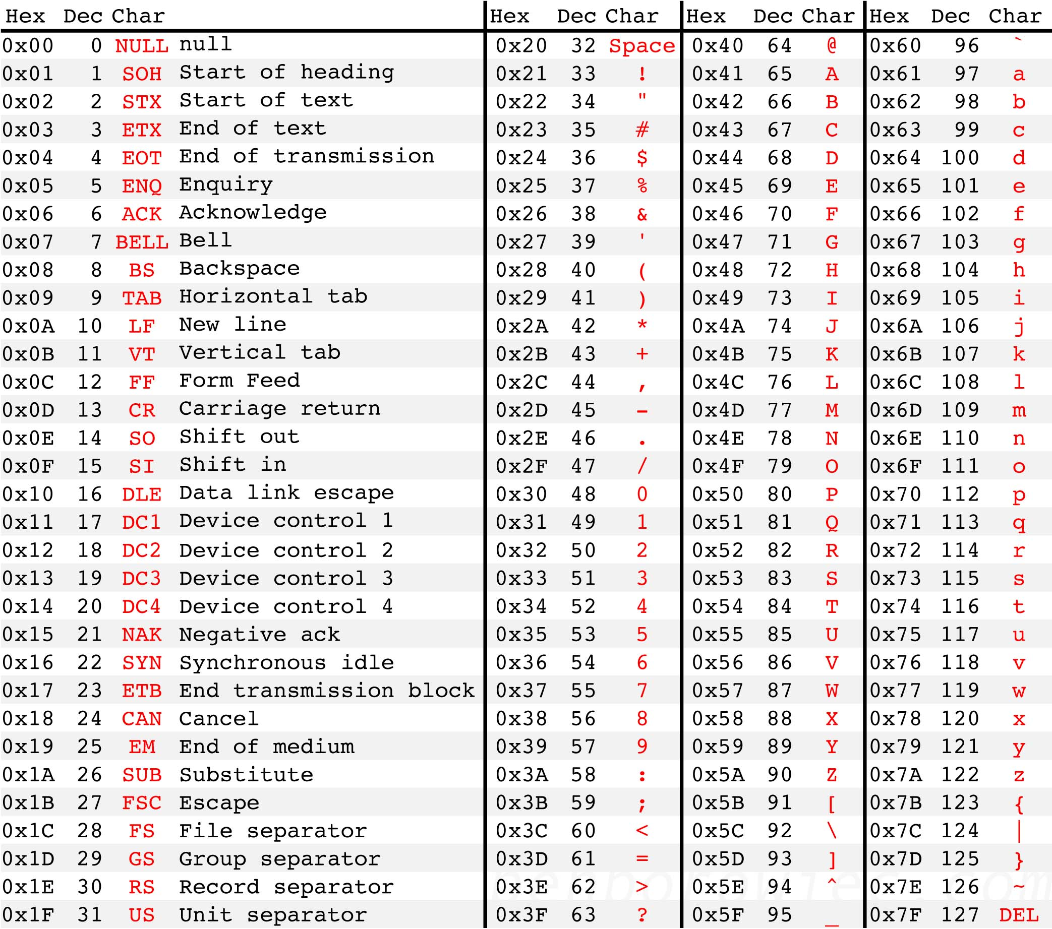
Letters all begin with 01…
The space character begins with 00…
XOR of two letters gives 00…
XOR of letter and space gives 01…
Easy to identify XOR of letter and space!
Source: http://benborowiec.com/2011/07/23/better-ascii-table/

Slide 12
In pictures
01…
01…
01…
00…
…
00…
…
01…
01…
01…
01…
01…
…
00…
00…
00…
01…
01010000
01010000 = 00100000 ⊕ ‘p’
01010000 = 00100000 ⊕ ??

Slide 13
One-time pad
Drawbacks
  Key as long the message
  Only secure if each key is used to encrypt once
  Trivially broken by a known-plaintext attack
All these limitations are inherent for schemes achieving perfect secrecy
  I.e., it’s not just a problem with the OTP

Slide 14
Optimality of the one-time pad
Theorem: if (Gen, Enc, Dec) with message space M is perfectly secret, then |K| ≥ |M|
Intuition:
  Given any ciphertext, try decrypting under every possible key in K
  This gives a list of up to |K| possible messages
  If |K| < |M|, some message is not on the list

Slide 15
Optimality of the one-time pad
Theorem: if (Gen, Enc, Dec) with message space M is perfectly secret, then |K| ≥ |M|.
Proof:
  Assume |K| < |M|
  Need to show that there is a distribution on M,
  a message m, and a ciphertext c such that
  Pr[M=m | C=c] ≠ Pr[M=m]

Slide 16
Optimality of the one-time pad
Proof, continued
  Take the uniform distribution on M
  Take any ciphertext c
  Consider the set M(c) = { Dec_{k}(c) }_{k∈K}
    These are the only possible messages that could yield the ciphertext c
  |M(c)| ≤ |K| < |M|, so there is some m that is not in M(c)
    Pr[M=m | C=c] = 0 ≠ Pr[M=m]

Slide 17
Where do we stand?
We defined the notion of perfect secrecy
We proved that the one-time pad achieves it!
We proved that the one-time pad is optimal!
  E.g., we cannot improve the key length
Are we done?
Do better by relaxing the definition
  But in a meaningful way…

Slide 18
Perfect secrecy
Requires that absolutely no information about the plaintext is leaked, even to eavesdroppers with unlimited computational power
  The definition has some inherent drawbacks
  The definition seems unnecessarily strong…

Slide 19
Computational secrecy
Would be ok if a scheme leaked information with tiny probability to eavesdroppers with bounded computing resources/running time
I.e., we can relax perfect secrecy by
  Allowing security to “fail” with tiny probability
  Restricting attention to “efficient” attackers

Slide 20
Tiny probability of failure?
Say security fails with probability 2⁻⁶⁰
  Should we be concerned about this?
  With probability > 2⁻⁶⁰, the sender and receiver will both be struck by lightning in the next year…
  Something that occurs with probability 2⁻⁶⁰/sec is expected to occur once every 100 billion years

Slide 21
Bounded attackers?
Consider brute-force search of key space; assume one key can be tested per clock cycle
Desktop computer ≈ 2⁵⁷ keys/year
Supercomputer ≈ 10¹⁷ flops ≈ 2⁸⁰ keys/year
Supercomputer since Big Bang ≈ 2¹¹² keys
  Restricting attention to attackers limited to trying 2¹¹² keys is fine!
Modern key spaces: 2¹²⁸ keys or more…

Slide 22
Roadmap
We will give an alternate (but equivalent) definition of perfect secrecy
  Using a randomized experiment
That definition has a natural relaxation

Slide 23
Perfect indistinguishability
Π = (Gen, Enc, Dec), message space M
Informally:
  Two messages m₀, m₁; one is chosen and encrypted (using unknown k) to give c ← Enc_{k}(m_{b})
  Adversary A is given c and tries to determine which message was encrypted
  Π is perfectly indistinguishable if no A can guess correctly with probability any better than ½

Slide 24
Perfect indistinguishability
Let Π = (Gen, Enc, Dec) be an encryption scheme with message space M, and let A be an adversary
Define a randomized exp’t PrivK_{A,Π}:
  A outputs m₀, m₁ ∈ M
  k ← Gen, b ← {0,1}, c ← Enc_{k}(m_{b})
  b’ ← A(c)
  Adversary A succeeds if b = b’, and we say the experiment evaluates to 1 in this case
Challenge ciphertext

Slide 25
Perfect indistinguishability
Easy to succeed with probability ½ …
Scheme Π is perfectly indistinguishable if for all attackers (algorithms) A, it holds that
Pr[PrivK_{A,Π} = 1] = ½

Slide 26
Perfect indistinguishability
Claim: Π is perfectly indistinguishable if and only if Π is perfectly secret
  I.e., perfect indistinguishability is just an alternate definition of perfect secrecy

Slide 27
Computational secrecy?
Idea: relax perfect indistinguishability
Two approaches
  Concrete security
  Asymptotic security

Slide 28
Computational indistinguishability
(concrete)
  (t, ε)-indistinguishability:
  Security may fail with probability ≤ ε
  Restrict attention to attackers running in time ≤ t
    Or, t CPU cycles

Slide 29
Computational indistinguishability
(concrete version)
Π is (t, ε)-indistinguishable if for all attackers A running in time at most t, it holds that
Pr[PrivK_{A,Π} = 1] ≤ ½ + ε
Note: (∞, 0)-indistinguishability = perfect indistinguishability
  Relax definition by taking t < ∞ and ε > 0

Slide 30
Concrete security
Parameters t, ε are what we ultimately care about in the real world
Does not lead to a clean theory...
  Sensitive to exact computational model
  Π can be (t, ε)-secure for many choices of t, ε
Would like to have schemes where users can adjust the achieved security as desired

Slide 31
Asymptotic security
Introduce security parameter n
  For now, think of n as the key length
  Chosen by honest parties when they generate and/or share the key
    Allows users to tailor the security level
  Known by adversary
Measure running times of all parties, and the success probability of the adversary, as functions of n

Slide 32
Computational indistinguishability
(asymptotic)
  Computational indistinguishability:
  Security may fail with probability negligible in n
  Restrict attention to attackers running in time polynomial in n

Slide 33
Definitions
A function f: Z⁺ → Z⁺ is polynomial if there exists c such that f(n) < n^{c}
A function f: Z⁺ → [0,1] is negligible if for every polynomial p it holds that f(n) < 1/p(n) for large enough n
  I.e., decays faster than any inverse polynomial
  Typical example: f(n) = poly(n)∙2^{-cn}

Slide 34
Why these specific choices?
Somewhat arbitrary
“Efficient” = “probabilistic polynomial-time (PPT)” borrowed from complexity theory
Convenient closure properties
  poly * poly = poly
    A PPT algorithm making calls to PPT subroutines is PPT
  poly * negligible = negligible
    Poly-many calls to subroutines that fail with negligible probability fail with negligible probability overall

Slide 35
(Re)defining encryption
A private-key encryption scheme is defined by three PPT algorithms (Gen, Enc, Dec):
  Gen: takes as input 1^{n}; outputs k. (Assume |k|≥n.)
  Enc: takes as input a key k and message m∈{0,1}*; outputs ciphertext c
  c ← Enc_{k}(m)
  Dec: takes key k and ciphertext c as input; outputs a message m or “error”

Slide 36
Computational indistinguishability
(asymptotic version)
Fix a scheme Π and some adversary A
Define a randomized exp’t PrivK_{A,Π}(n):
  A(1^{n}) outputs m₀, m₁ ∈ {0,1}* of equal length
  k ← Gen(1^{n}), b ← {0,1}, c ← Enc_{k}(m_{b})
  b’ ← A(c)
  Adversary A succeeds if b = b’, and we say the experiment evaluates to 1 in this case

Slide 37
Computational indistinguishability
(asymptotic version)
Π is computationally indistinguishable (aka EAV-secure) if for all PPT attackers A, there is a negligible function ε such that
Pr[PrivK_{A,Π}(n) = 1] ≤ ½ + ε(n)

