Slide 1




Efficient Proofs of Software Exploitability for Real-world Processors
Zero-Knowledge
V
Matthew Green
Johns Hopkins University
Mathias Hall-Andersen
Aarhus University
Eric Hennenfent
Trail of Bits
Gabriel Kaptchuk
Boston University
Benjamin Perez
Trail of Bits
Gijs Van Laer
Johns Hopkins University

Slide 2


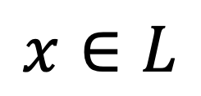
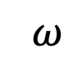

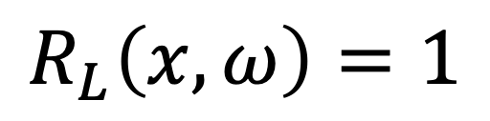
Zero-Knowledge [GMR85, GMW86]
$$x∈L$$
$$π$$
$$ω$$
$$R_{L}\left(x,ω\right)=1$$
Custom Protocol for L
Reduce to NP Complete Problem
(eg. Circuit SAT)

Slide 3
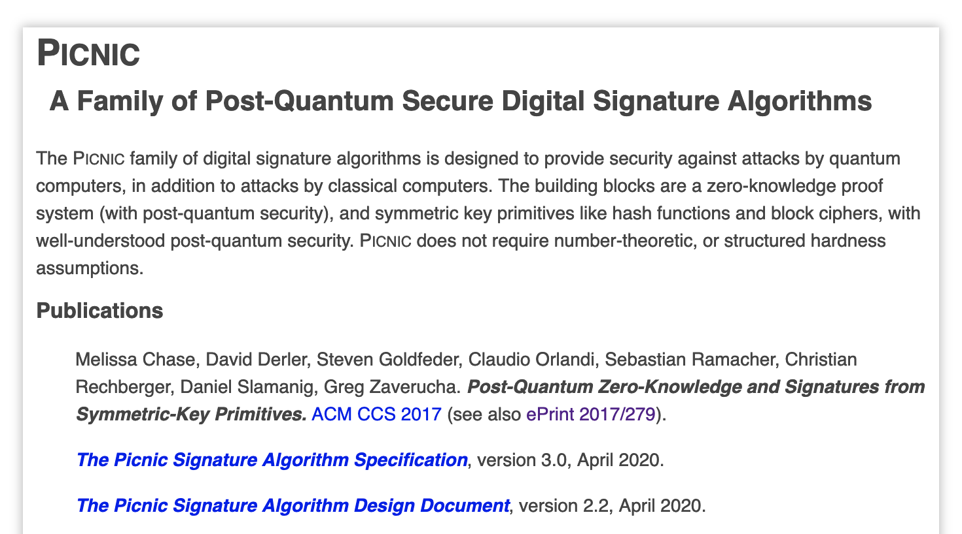
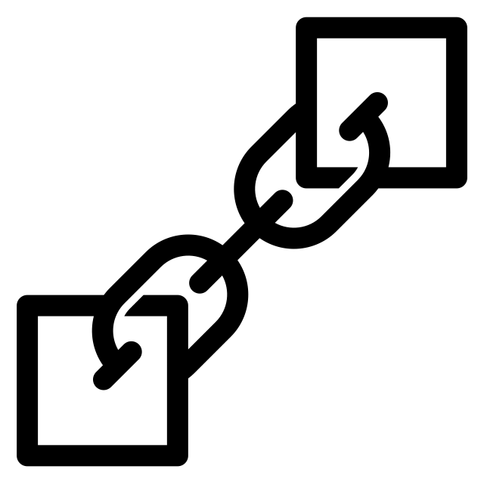

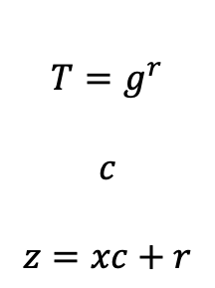

Zero-Knowledge For What?
Schnorr ID Protocol
PQC Signatures
Blockchain Stuff
$$A=g^{x}$$
$${T=g}^{r}$$
$$c$$
$$z=xc+r$$
$$g^{z}= A^{c}T$$

Slide 4

Software Exploitability Ecosystem

Slide 5

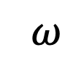

Software Exploitability Ecosystem
Unreliable
Undermines Negation Potential
$$π$$
Exploit
$$ω$$
Reward
Vulnerability Researcher
Bug Bounty Administrator
Other Applications:
Pressuring an unresponsive Bug Bounty Administrator
Demonstrate need to move away from particular software

Slide 6
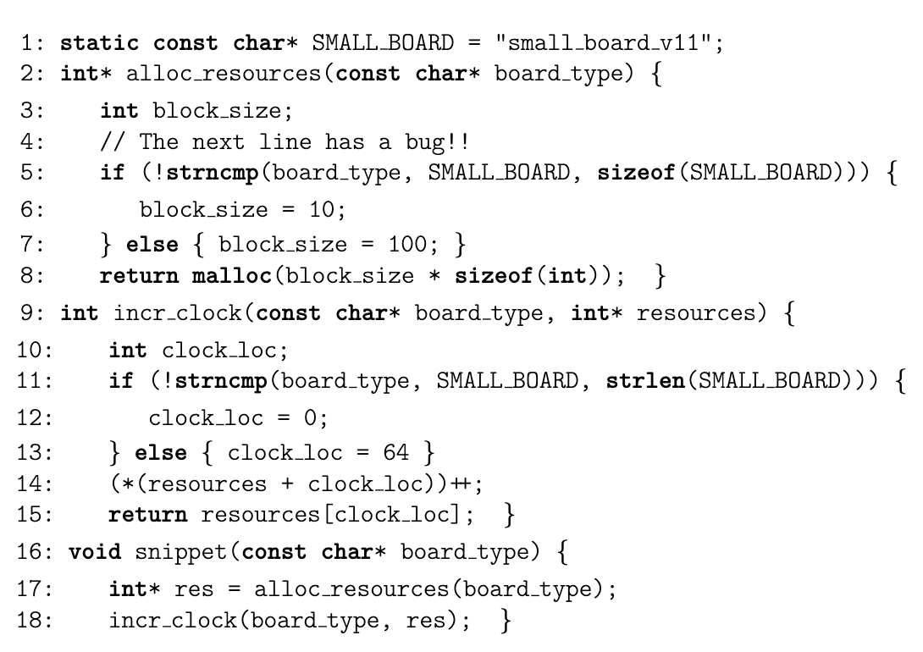
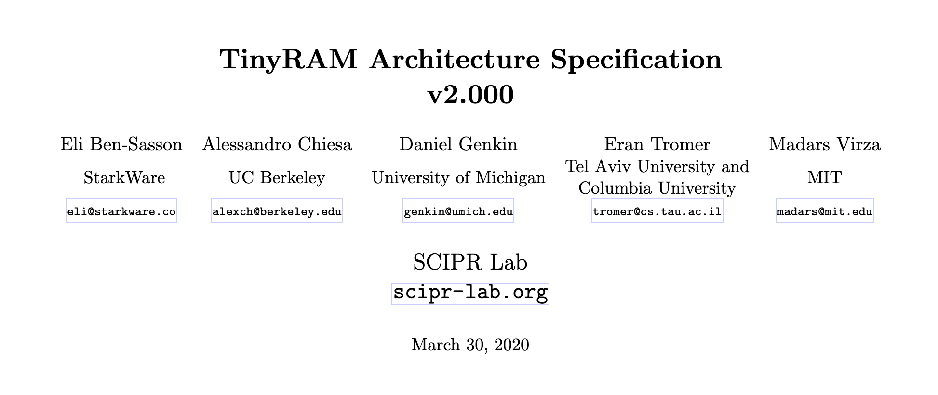

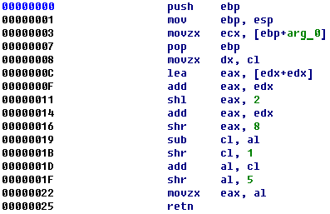
Compile Circuit from Source (eg. [HK20])
Emulate RAM Computation (eg. [BCG+13])
Our Approach

Slide 7
Our System (Inspired by [BCG+13])
Circuit Models Real Processor Semantics
…
Initial Processor State (Public)
Processor State (Hidden)
Processor State (Hidden)
Final Processor State (Public)
READ
WRITE
READ
WRITE
READ
WRITE
Memory
(Public)
Memory
(Hidden)
Memory
(Hidden)
Memory
(Hidden)

Slide 8
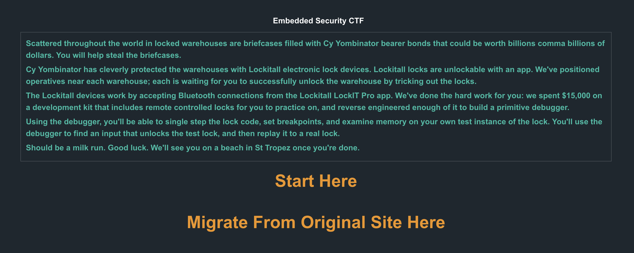
Microcorruption Embedded CTF

Slide 9
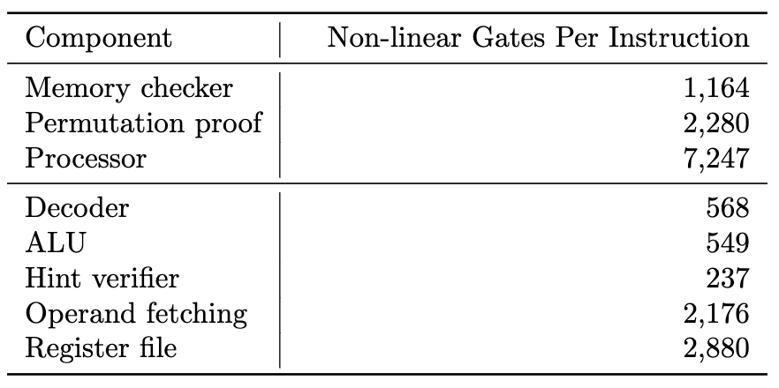
New Challenges When Modeling Processor
Lots of Instructions (bigger circuit, lower efficiency)
Need Syscalls (Implemented via a Co-Processor)
  User Input, System RAND, etc…
Instruction Decoding is non-trivial
  (Multiple addressing modes, etc…)
Self modifying programs requires programs to live in writeable memory

Slide 10
Choosing a Zero-Knowledge Proof System
Yes
VOLE-Based ZK
(Designated Verifier)
Eg. Mac’n’Cheese
So you want to use zero-knowledge?
Application Supports
Interactivity?
Yes
S[NT]AR[KG]s
Eg. Groth16, Plonk, IOP-based
No
Require
Succinctness?
No
MPC-in-the-Head
Eg. ZKBoo, Ligero, KKW

Slide 11
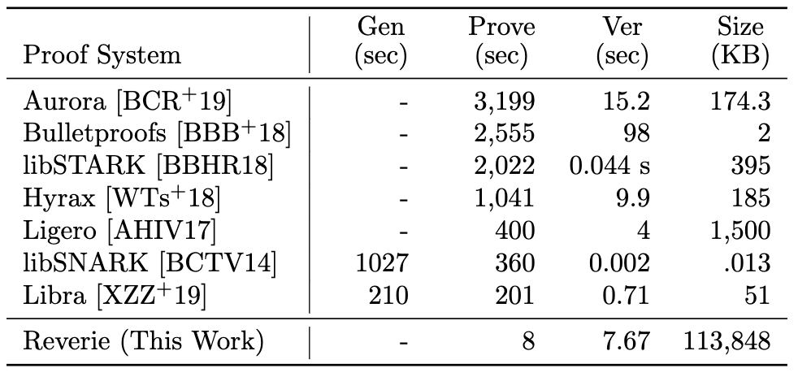
Reverie – Rust Implementation of [KKW18]
Support for Ring Switching
Efficient permutation proof [Neff01]
Streaming & memory reclamation for memory efficiency
Bit slicing across KKW18 parallel runs
Designed for muti-core parallel processing
Notes:
32 virtual cores and 256GB of memory
Amazon EC2 c5.9xlarge with 70GB of RAM and Intel Xeon platinum 8124m CPU with 18 3GHz virtual cores

Slide 12
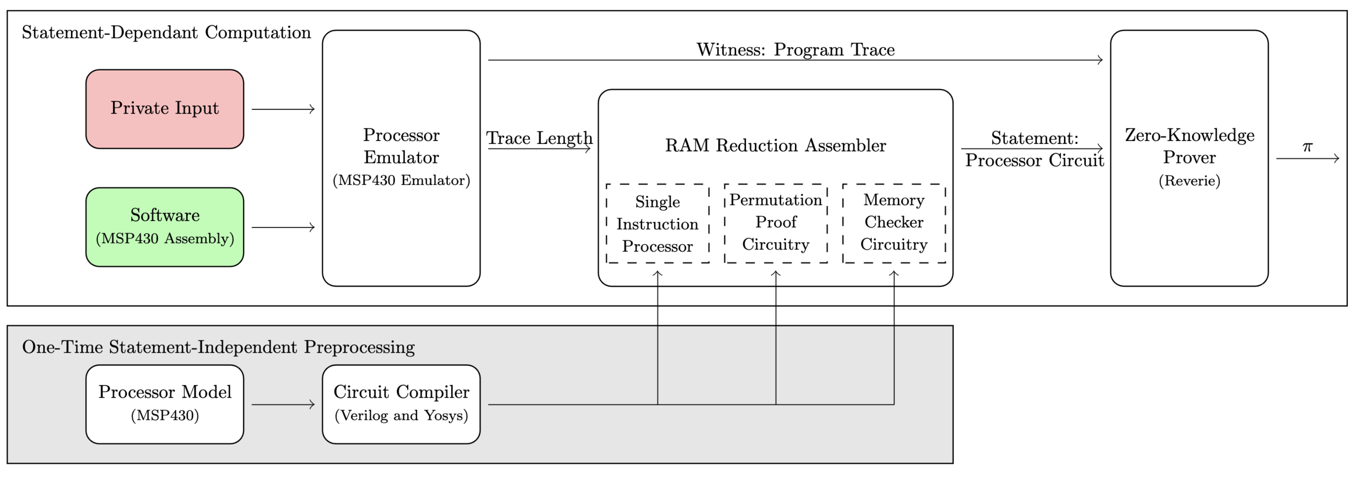
An End-to-End System

Slide 13
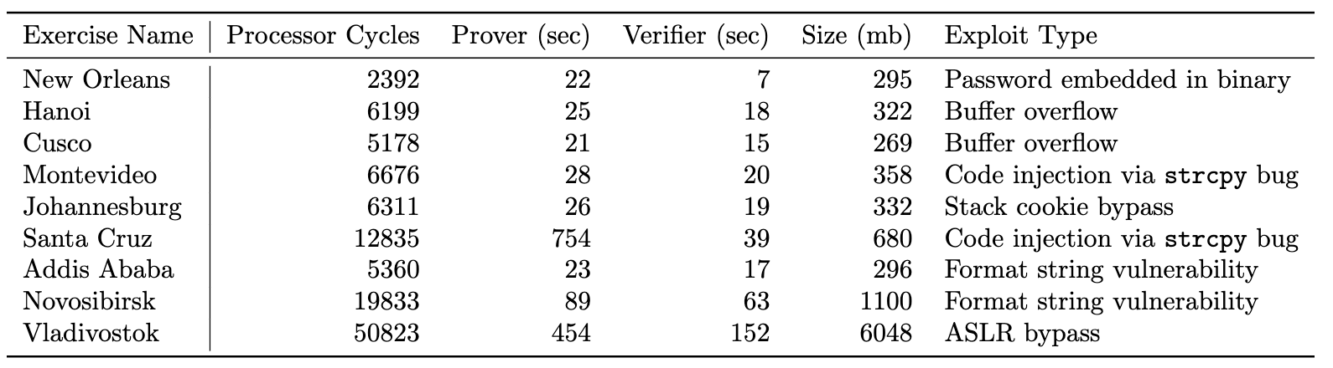

Slide 14
Conclusion
Provide the first working prototype for zero-knowledge proofs of exploit for real-world processors
Provide the first circuit-generic implementation of KKW18 zero-knowledge protocol
Demonstrate that using zero-knowledge for proofs of exploit is a practical approach
Future Work: Optimized ZK for RAM (end of summer), prototype for more complex processors (over next year)

Slide 15
Thank You!
https://github.com/trailofbits/reverie/
Icon from David Khai and Chimol via. Noun Project. Image Captures from Microcorruption, NIST, HackerOne, Hex-rays websites

