Slide 1



Oblivious Data Structures
Xiao Shaun Wang, Kartik Nayak, Chang Liu, T-H. Hubert Chan, Elaine Shi, Emil Stefanov, Yan Huang

Slide 2
Sensitive Data in the Cloud
Emails
Photos
Videos
Financial data
Medical records
Genome data
……
Encrypt your data!

Slide 3





Genome data
Personalized
medication

Slide 4
Genome data
Kidney problem

Slide 5
Access patterns leak sensitive information

Slide 6
Oblivious RAM is a cryptographic primitive for provably obfuscating access patterns to data.
Hierarchical ORAMs
[Goldreich’87]
[GO’96]
[KLO ’12]
Tree-based ORAM
[SCSL’11]
[Path ORAM’13]

Slide 7
How do ORAMs obfuscate access patterns to data?
Intuition:
1. Move blocks around
2. For every single access to memory block, access many blocks.

Slide 8
Path ORAM achieves O(log² N) blowup for small blocks [SDSCFRYD’13]
N = 2³⁰ (1 Giga)
c = 8
c log² N = 7200
N: Number of memory blocks,
c: constant for Path ORAM
Access about 7200 memory blocks per block
Schemes with better asymptotics [KLO’12]
Path ORAM with larger block size performs better

Slide 9
Can we do better for limited access patterns?
Can we do better?

Slide 10
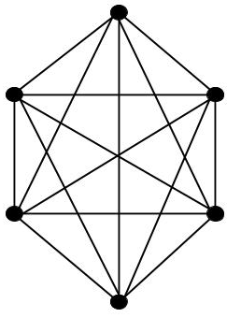
mem[]
Access Pattern Graph for a RAM program
52
…
…
9
…
…
…
2
…
…
…
…
10
…
53
arr[]
55 | 59 | 60 | 85 | 59 | 55 | 64 | 67 | 55 | 61
54
55
10
56
57
computeFrequency(arr[]):
For each x in arr:
freq := mem[x]
mem[x] := freq + 1
58
59
60
61
62
63
64
65
Blowup: O(log² N / log log N) [KLO’12]

Slide 11
Some real world programs may have limited access patterns due to:
1. Inherent structure in the data or
2. Locality of accesses

Slide 12
Bounded-degree trees
Trees, Stack, Queue, Heap
Blowup: O(log N)
Access pattern graphs with low doubling dimensions
Linked list, Deque, 2-dim Grid
Blowup: O(12^{d} log^{2-1/d} N)
d=1: O(log N)
d=2: O(log^{1.5} N)
(d: doubling dim)
ORAM: O(log² N / log log N) [KLO’12]

Slide 13

Access Pattern Graph for a Stack
53
3
5
6
9
65
45
23
2
1
10
54
55
push(stack, value)
value := pop(stack)
56
57
58
59
60
61
62

Slide 14
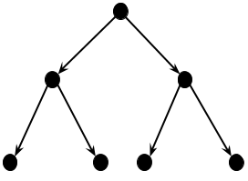
Access Pattern Graph for a Binary Search Tree
6
search(x, root):
while(true):
if x = root.data
return root
else if x < root.data
root := root.left
else root := root.right
2
8
1
4
7
9

Slide 15

For structures with tree-like access patterns, we achieve a blowup of O(log N)
Oblivious RAM achieves O(log²N/log log N) [KLO’12]

Slide 16
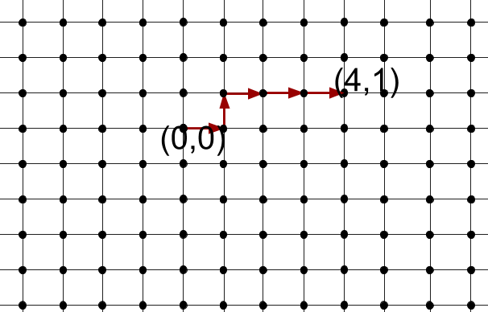
Access Pattern Graph on a Grid-like Structure
After k accesses, the farthest you can go is k hops away
Accesses show “locality”

Slide 17
For the grid structure, we achieve a blowup of
O(log^{1.5} N)
Oblivious RAM achieves O(log²N/log log N)

Slide 18
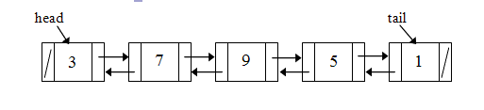

More Data Structures that Exhibit Locality
Linked List
Deque

Slide 19
For graphs with low doubling dimensions, we achieve a blowup of O(12^{d} log^{2-1/d} N)
d: doubling dimension
For linked list and deque, we achieve a blowup of
O(log N)
Oblivious RAM achieves O(log²N/log log N)

Slide 20
How do we reduce the blowup?
Bounded degree trees
Pointer-based technique
Access pattern graphs with low doubling dimensions
Locality-based technique
Tree, Stack,
Queue, Heap
Linked list, Deque, 2-dim Grid
Blowup: O(log N)
Blowup: O(12^{d} log^{2-1/d} N)

Slide 21
Position-based ORAM
ORAM
ReadAndRemove()
Add()
Server
l
Client
l
Position map
Read(x, l)
x

Slide 22
Position-based ORAM
Position tag of a block changes after every access
ORAM
Server
Requires accessing O(log N) blocks per access
r
Client
r
Position map
Read(x, l)
x

Slide 23
Recursion for Tree ORAM
If position map 1 had constant size memory, we do not need recursion. Hence, saving a factor of O(log N).
For a tree, we only need to store the position tag for the root.
O (log N)
Position based ORAM
Position based ORAM for PM1
Server
. . .
. . .
Client
Position Map 2
Position Map 1 - PM1 (size: N/c)
O(1)

Slide 24
Pointer-based Technique for Bounded Degree Trees
ID
Data
R
Pos
Position map for children
A
B
We use an O(log N) cache to solve this problem
Storing position tags of children nodes is an added responsibility.
C

Slide 25
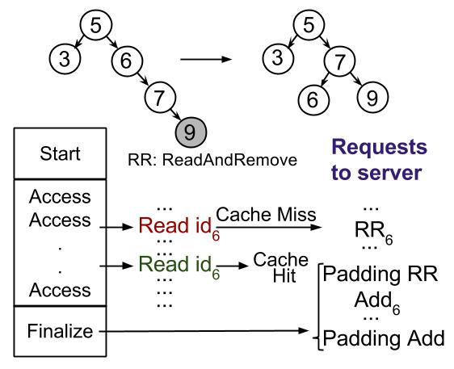
A Bounded-degree Tree Operation
For bounded-degree trees, we achieve a blowup of O(log N).
We save O(log N) by avoiding recursion.
Parent nodes store position tags of children.
Read nodes with keys 5, 6, 7 and store them in cache
Perform all modifications in cache
Update position tags for all nodes
Write back
Pad with dummy accesses

Slide 26
Locality-based Technique - Intuition
Key Idea: Path ORAM achieves O(log N) overhead for block size ≥ O(log² N) bits
Can we leverage this to group smaller data nodes into larger blocks?

Slide 27
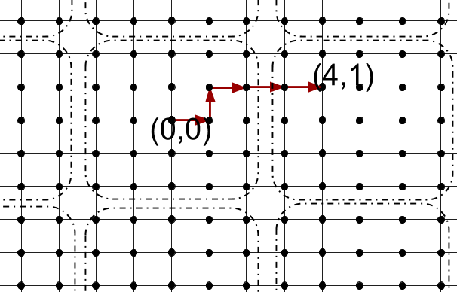
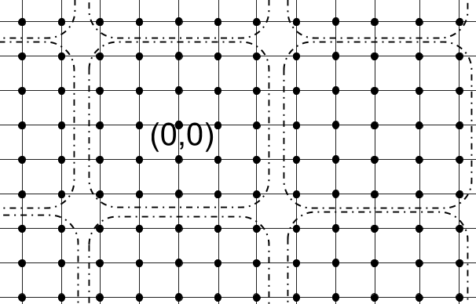
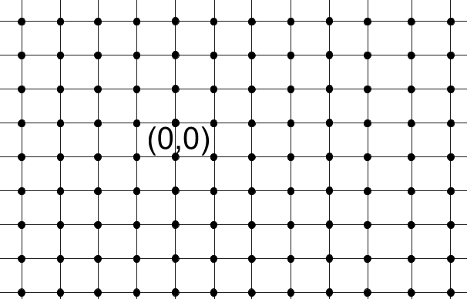
Locality-based Technique
Group smaller nodes to form a large block
e.g. log N = 25
Block size: O(log² N) bits
Download block containing (0,0) and neighboring blocks (O(log³ N) bits)
1 ORAM block access = log^{0.5} N data
node accesses of size O(log N)
Blowup = O(log^{1.5} N)
Can be generalized for graphs with low doubling dimensions

Slide 28
Oblivious Data Structure: Security
Oblivious RAM cannot be directly used.
insert(root, 10)
delete(root, 7)
search(root, 2)
6
2
8
Security requirement:
Do not reveal operands
Do not reveal the operation performed
1
4
7
9

Slide 29
Related Work
Efficient, Oblivious Data Structures for MPC [KS’14]
  Design oblivious priority queue
Secure Data Structures based on Multiparty Computation [T’11]
  Design oblivious priority queue but reveals the type of operation performed
Data-oblivious Data Structures [MZ’14]
  Design oblivious stack, queue and priority queue

Slide 30
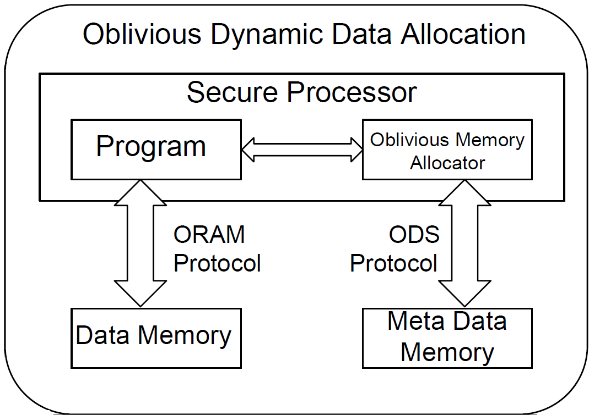
Application – Oblivious Dynamic Memory Allocation
Do not reveal:
  Amount of memory allocated
  Location
Use a segment tree
Each operation requires accessing O(log³ N) bits

Slide 31
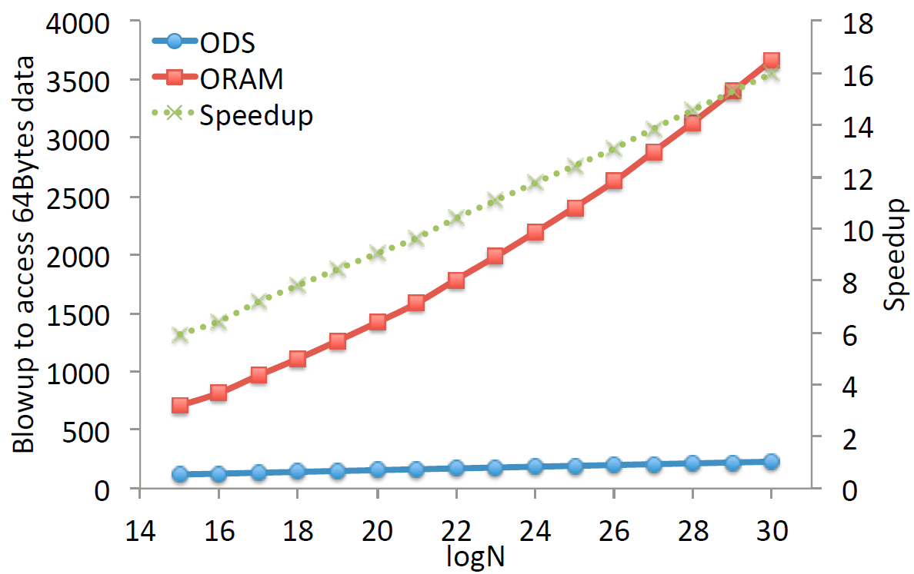
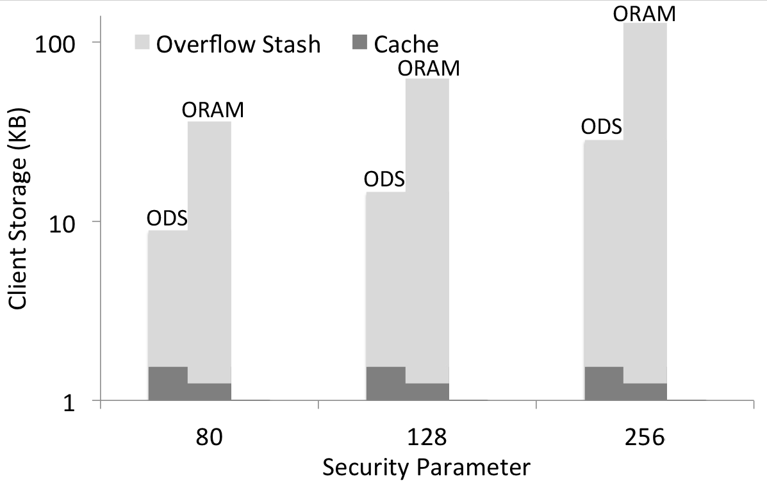
Evaluation – Data Structures – Oblivious map
Speedup: 16x for N=2³⁰
Bandwidth blowup
Client storage

Slide 32
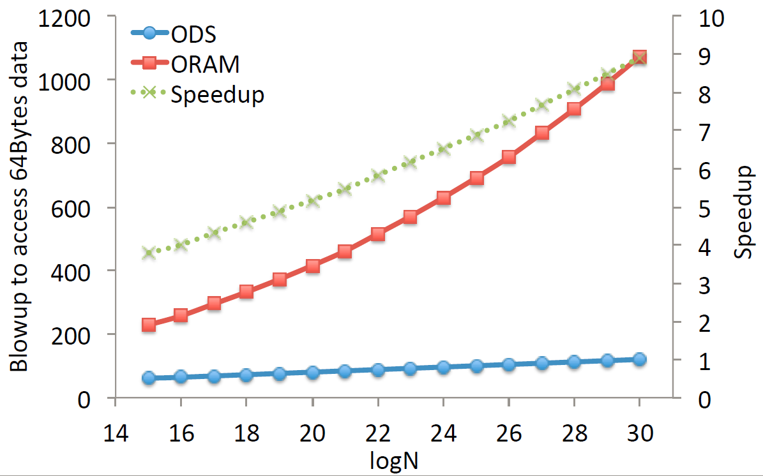
Evaluation – Data Structures - Deque
Speedup: 9x for N=2³⁰
Bandwidth blowup

Slide 33
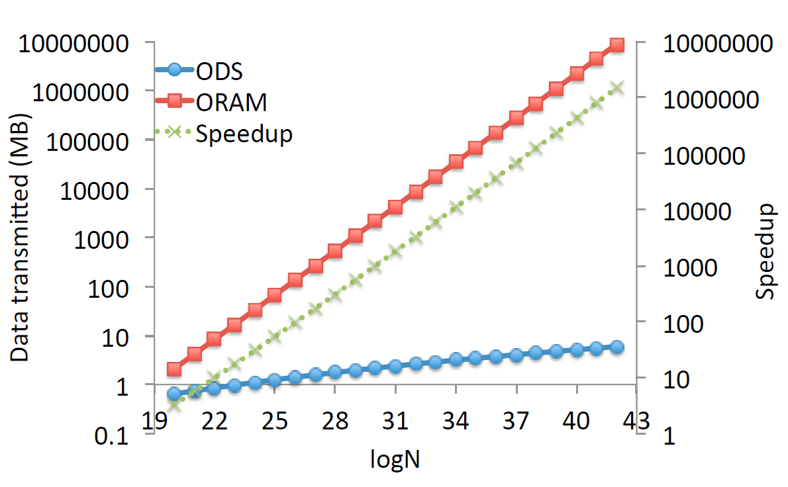
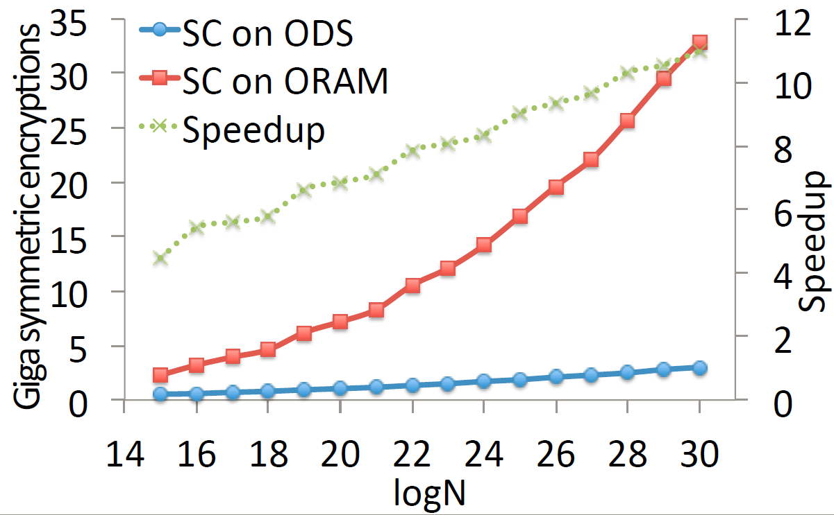
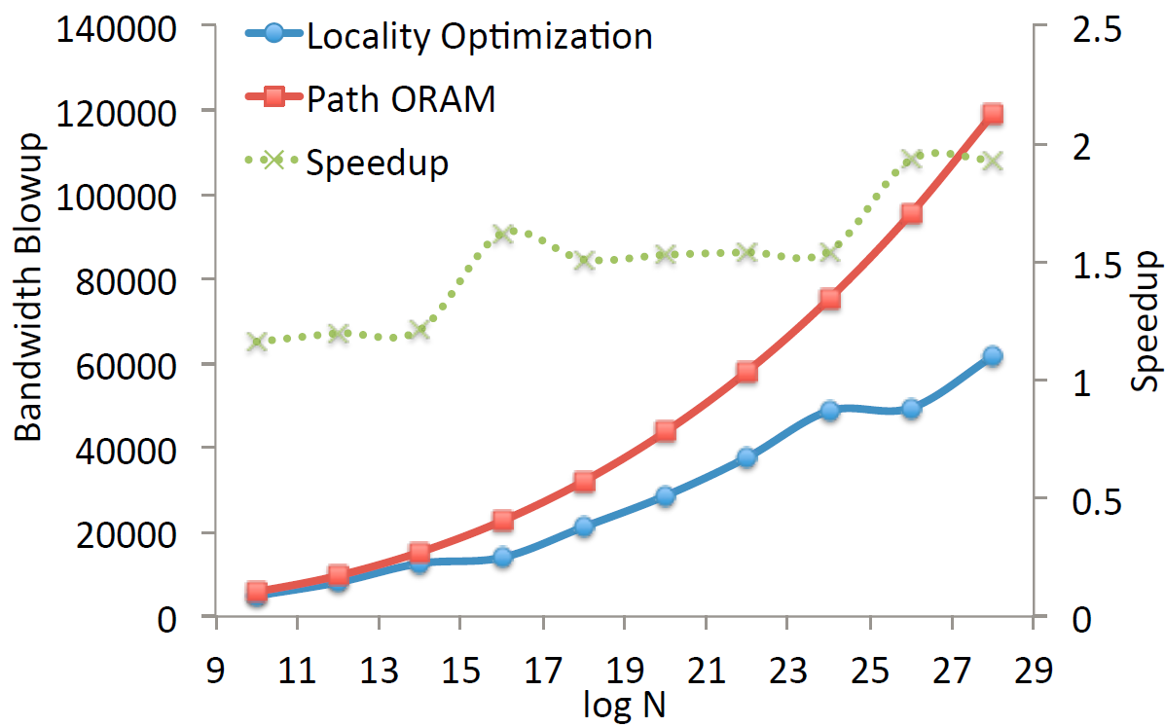
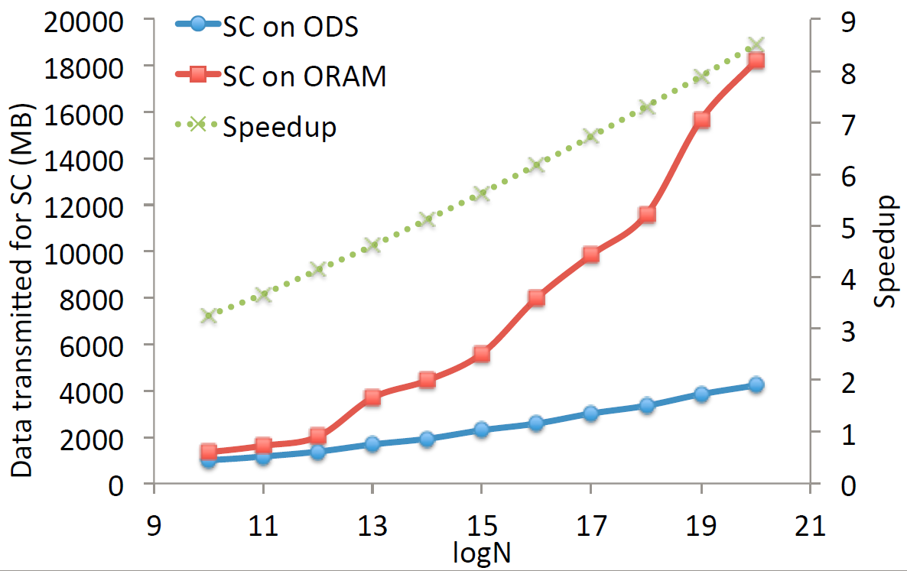
Speedup: 1000x for N=2³⁰
Speedup: 10x for N=2³⁰
Data transferred for oblivious dynamic memory allocation
Encryptions for oblivious map on secure computation
Speedup: 2x for N=2³⁰
Speedup: 9x for N=2²⁰
Bandwidth blowup for random walk on a 2-dim grid
Data transmitted for oblivious map on SC

Slide 34
Conclusion
Oblivious RAMs can provably hide data access patterns but have a high bandwidth blowup
We design oblivious data structures that reduce the bandwidth blowup for limited access patterns
For bounded-degree trees, we achieve a blowup of O(log N)
For graphs with low doubling dimensions, we achieve a blowup of O(12^{d} log^{2-1/d} N)

Slide 35

Emil Stefanov (1987-2014)
http://www.rememberingemil.org

Slide 36
Stack / Queue
Open source implementation on a garbled circuit backend coming soon
Map (AVL tree)
Heap
Deque
Doubly linked list
http://www.oblivm.com/
Thank You!
kartik@cs.umd.edu

