Slide 1
Towards
Minimizing the Annotation Cost of Certified Text Classification
Mossaab Bagdouri¹ David D. Lewis²
William Webber¹ Douglas W. Oard¹
¹University of Maryland, College Park, MD, USA
²David D. Lewis consulting, Chicago, IL, USA

Slide 2
Outline
Introduction
Economical assured effectiveness
Solution framework
Baseline solutions
Conclusion

Slide 3


Goal:
Economical assured effectiveness
1. Build a good classifier
2. Certify that this classifier is good
3. Use nearly minimal total annotations
+
?
-
(Photo courtesy of www.stockmonkeys.com)

Slide 4
Notation
F₁
α = 0.05
_{τ}
^
F₁
Training
F₁
θ
Test
Annotations

Slide 5

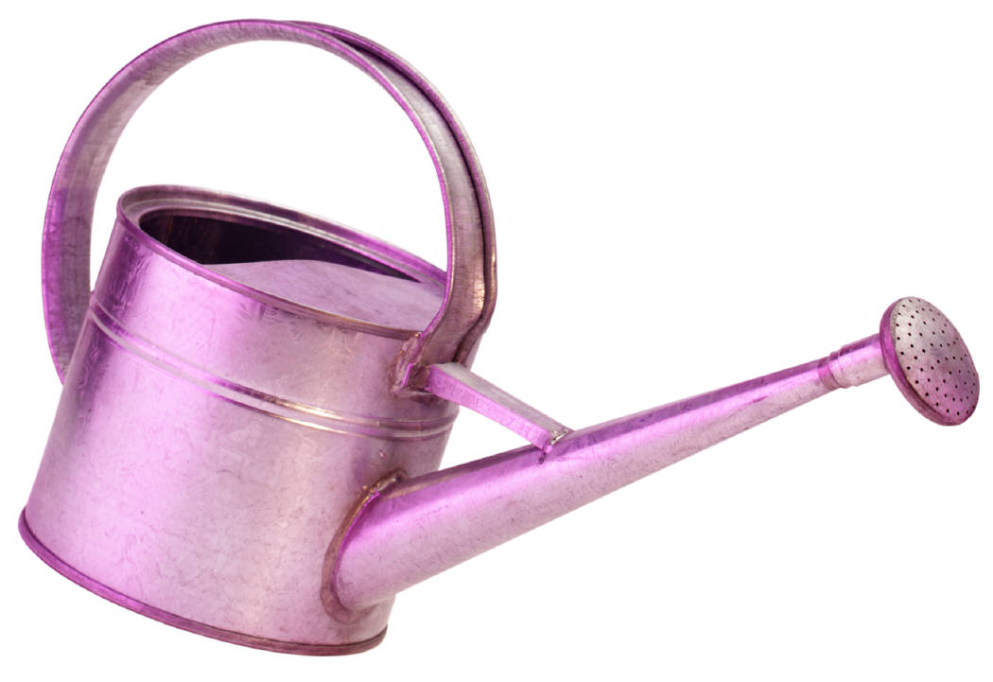
Fixed test set
Growing training set
F₁
_{τ}
^
F₁
Training
F₁
_{θ}
Test
Annotations

Slide 6
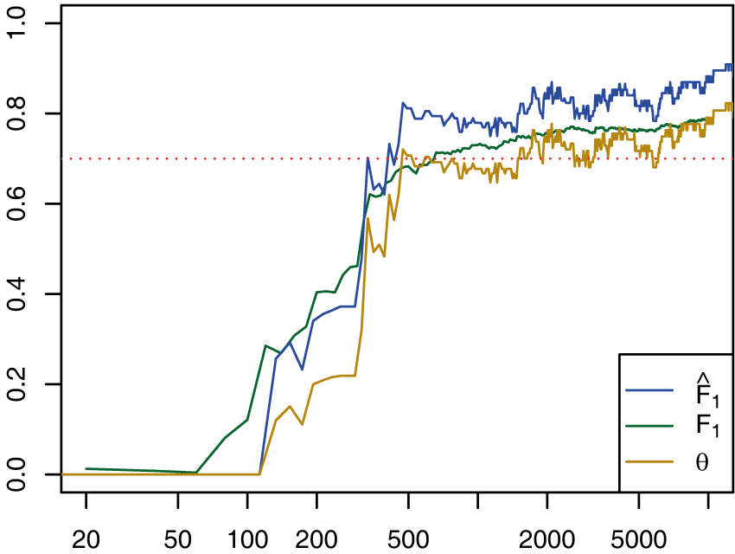
Fixed test set
Growing training set
Stop Criterion | Success
Desired | 95.00%
F₁ ≥ τ | 46.42%
θ ≥ τ | 91.87%
Collection = RCV1, Topic = M132, Freq = 3.33%
_{τ}
^
Training
Training documents
Test

Slide 7
Fixed training set
Growing test set
F₁
_{τ}
^
F₁
Test
F₁
_{θ}
Training
Annotations

Slide 8
Problem 1:
Sequential testing → bias
F₁
Stop here
Want to stop here
_{τ}
F₁
Do not stop
_{θ}
Annotations

Slide 9

Solution:
Train sequentially, Test once
F₁
Test only once
_{τ}
_{θ}
Train without testing
Test
_{θ}
Training
Training annotations

Slide 10
Problem 2:
What is the size of the Test set?
Test
Training

Slide 11
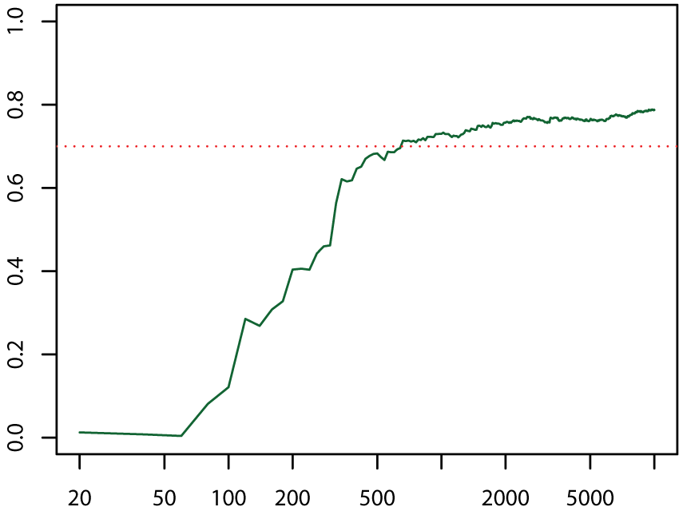
Solution:
Power analysis
Observation 1 from power analysis:
  True effectiveness greatly exceeds the target → Small test set needed
Observation 2 from the shape of learning curves:
  New training examples provide less of an increase in effectiveness
β = 0.07
Power = 1 - β
_{τ}
F₁
Training documents

Slide 12
Designing annotation minimization policies
+∞
+∞
Test
_{τ}
Training + Test ($$$)
True F₁
Training
Training

Slide 13
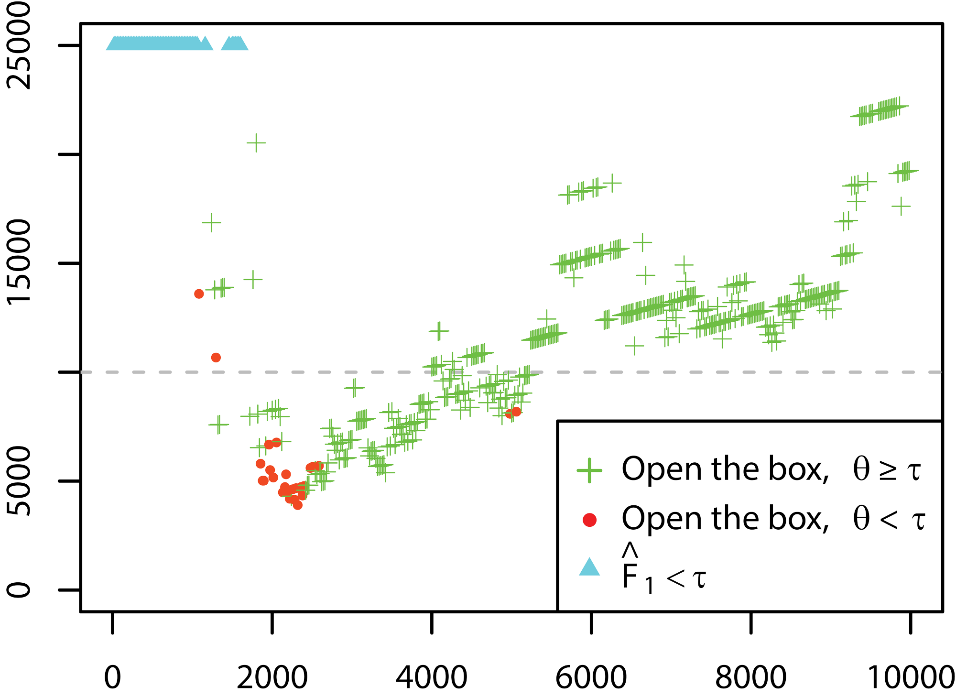
Allocation policies in practice
No closed form solution to go from an effect size on F₁ to a test set size
  → Simulation methods
True effectiveness invisible
  → Cross-validation to estimate it
No access to the entire curve
Scattered and noisy estimates
  → Need to decide online
Topic = C18, Frequency = 6.57%
Training + Test ($$$)
_{τ}
Training + Test ($$$)
True F₁
Training documents
Training

Slide 14
Estimating the true F1
(Cross-validation)
TP | FP
FN | TN
TP | FP
FN | TN
TP | FP
FN | TN
TP | FP
FN | TN
Training

Slide 15
Estimating the true F1
(Simulations)
TP∞ | FP∞
FN∞ | TN∞
Posterior distribution
TP | FP
FN | TN
Training

Slide 16
Minimizing the annotations
Infer
test set size
_{α}
_{β}
_{τ}
Measure
(F₁)
Algorithm
(SVM)
+∞
F₁
Training
Test
_{τ}
_{θ}
Training annotations

Slide 17
Experiments
Test collection: RCV1-v2
  29 topics with a prevalence ≥ 3%
  20 randomized runs per topic
Classifier: SVM^{Perf}
  Off-the-shelf classifier
  Optimizes training for F₁
Settings
  Budget: 10,000 documents
  Power 1 - β = 0.93
  Confidence level 1 – α = 0.95
  Documents added in buckets of 20

Slide 18
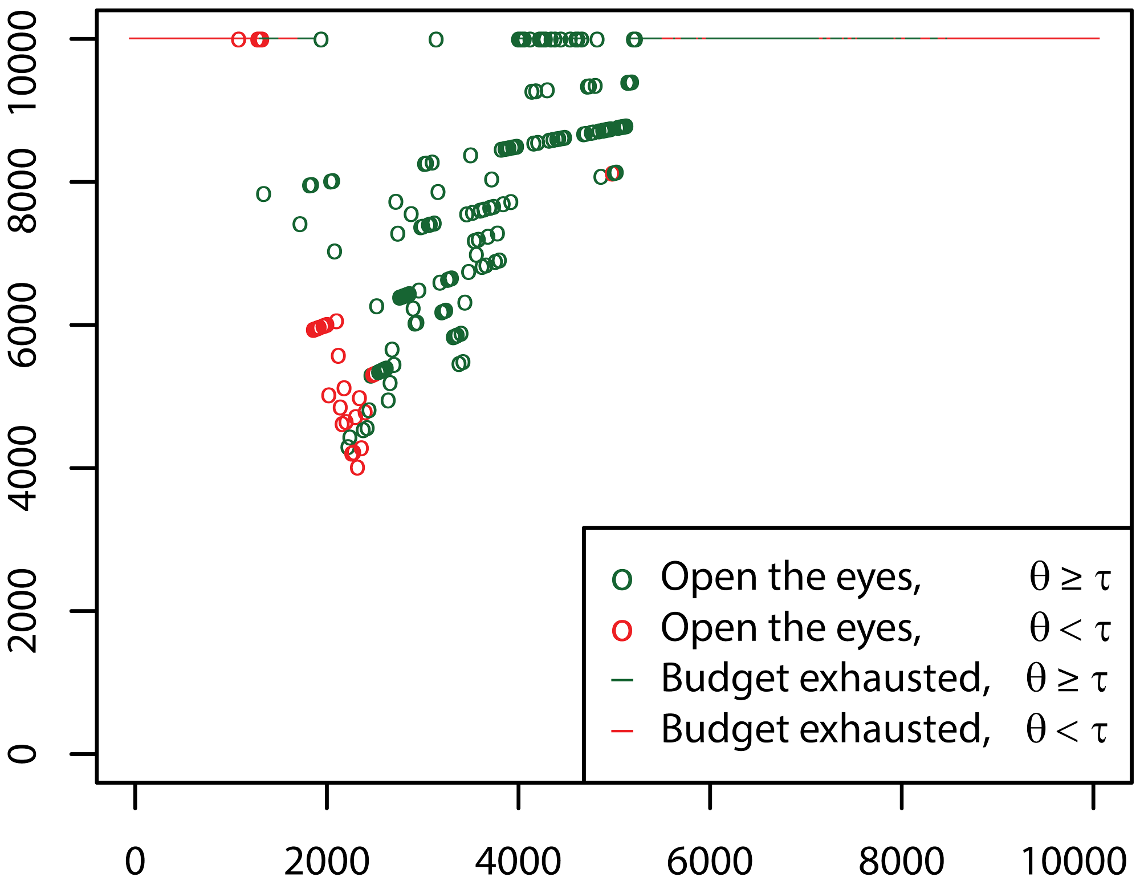
Policies
Training + Test ($$$)
Topic = C18
Frequency = 6.57%
Training documents

Slide 19
Stop as early as possible
Budget achieved in 70.52% of times
Failure rate of 20.54% > β (7%)
Sequential testing bias pushed
into process management
Topic = C18, Frequency = 6.57%
Training + Test ($$$)
Training documents

Slide 20
Oracle policies
Minimum cost policy
  Savings: 43.21% of the total annotations
  Failure rate of 27.14% > β (7%)
Minimum cost for success policy
  Savings: 38.08%
Topic = C18, Frequency = 6.57%
Training + Test ($$$)
Training documents
20

Slide 21
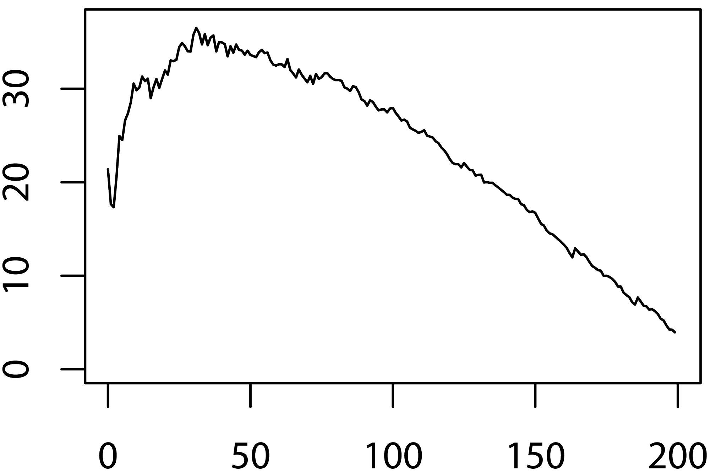
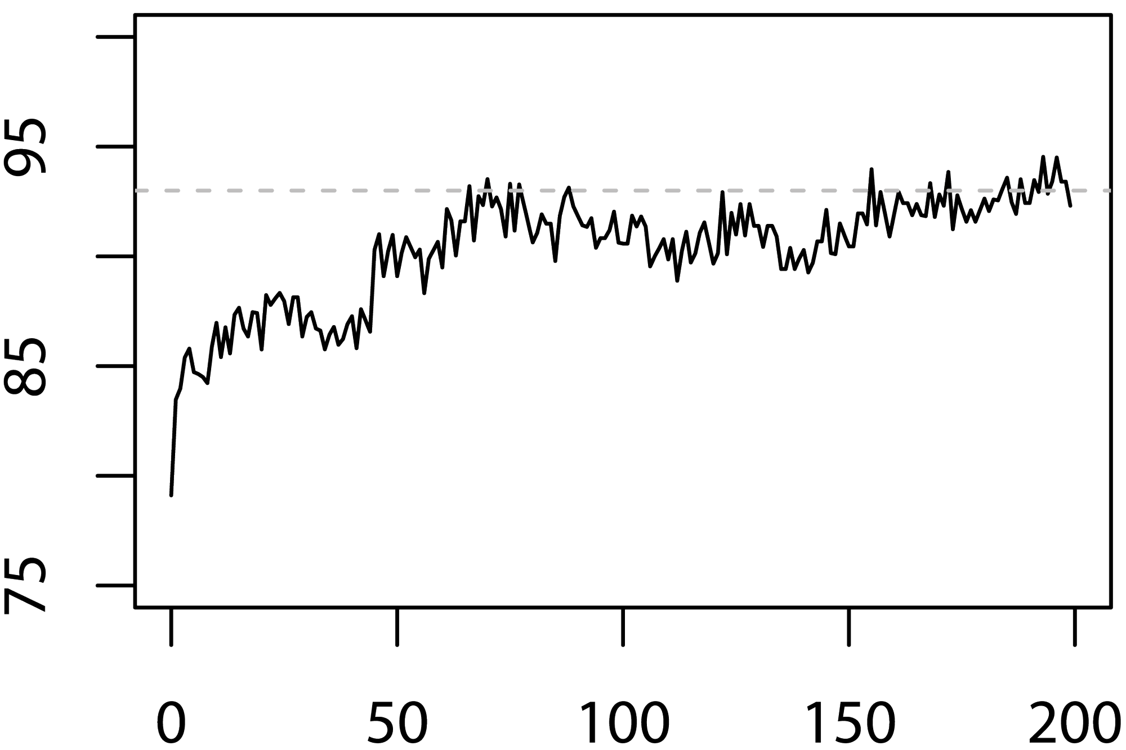
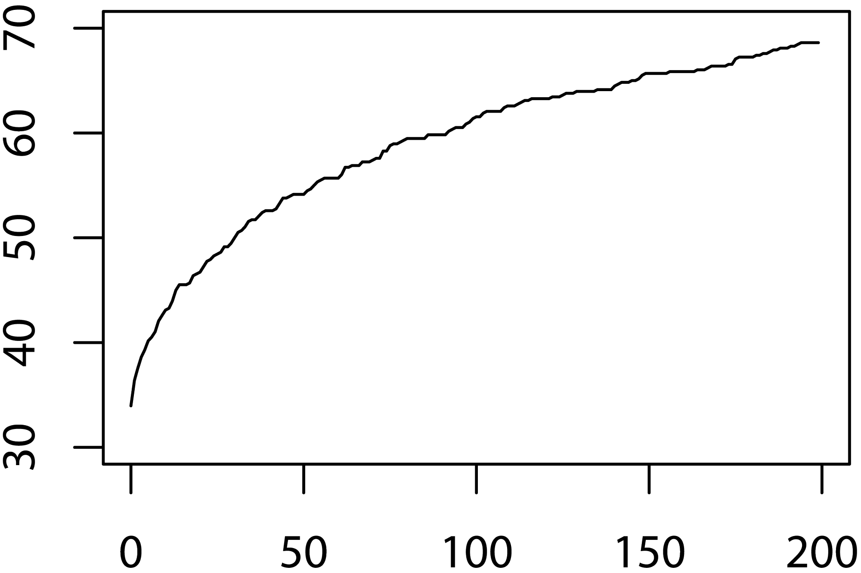
Wait-a-while policies
Savings (%)
Topic = C18, Frequency = 6.57%
w
Last chance
W=1
W=0
Success (%)
W=3
W=2
Training + Test ($$$)
Cannot open (%)
Training documents
21

Slide 22
Conclusion
Re-testing introduces statistical bias
Algorithm to indicate:
  If / when a classifier can achieve a threshold
  How many documents required to certify a trained model
Subroutine for policies minimizing the cost
Possibility to save 38% of cost

Slide 23
Towards
Minimizing the Annotation Cost of Certified Text Classification
Thank you!

