Slide 1
Journalists and Twitter
ICWSM - Wednesday, May 18, 2016 - Cologne, Germany
A Multidimensional Quantitative Description of Usage Patterns
MOSSAAB BAGDOURI
University of Maryland, College Park, USA
We conduct a large scale quantitative comparison of the usage pattern of a microblogging service by journalists, news organizations, and news consumers. Through two statistical tests of eighteen numerical features over 5,000 news producers and 1 million news consumers, we find that Arab journalists and English news organizations tend to broadcast their tweets to a large audience; that English journalists adopt a strategy of targeted and engaging communication; that journalists are more distinguishable in the Arab world than in the European English speaking countries; that print and radio journalists have a very dissimilar behavior while the television ones share some
characteristics with each of them; and that British and Irish journalists are similar to a large extent. This paper is the first to provide a multidimensional bird's-eye view on the usage pattern of journalists over Twitter.
Introduction
Twitter is becoming a primary platform for breaking news (Phuvipadawat and Murata 2010; Hu et al. 2012). This makes it useful to both the traditional news producers (i.e., journalists and news outlets) and their consumers (e.g., readers). But Twitter is also dramatically changing the traditional roles of news producers and consumers.
Funded through the ArQAT project
Journalists, for instance, interact more with the “crowds” to gather more information from ordinary people (Zak 2012), some of which have started to play the role of “citizen journalists” (Bowman and Willis 2003).
Understanding how journalists use Twitter will help us infer how their function is changing in our society. Several studies have been conducted to analyze how journalists interact with different stakeholders in the
“
”

Slide 2
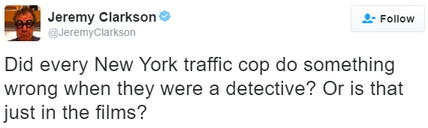
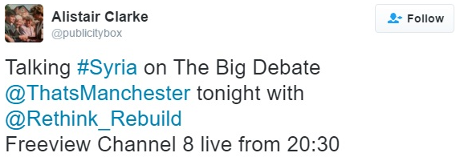
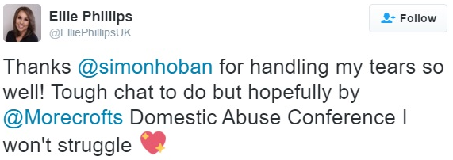
Introduction

Slide 3
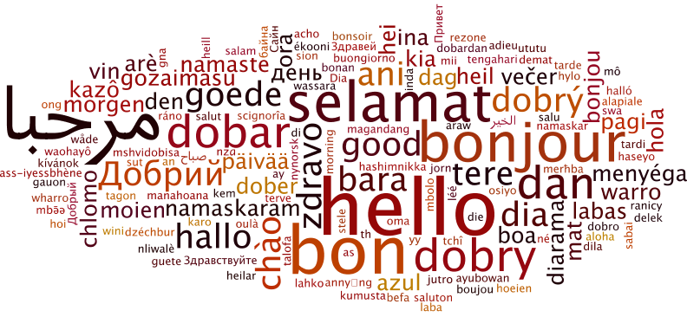
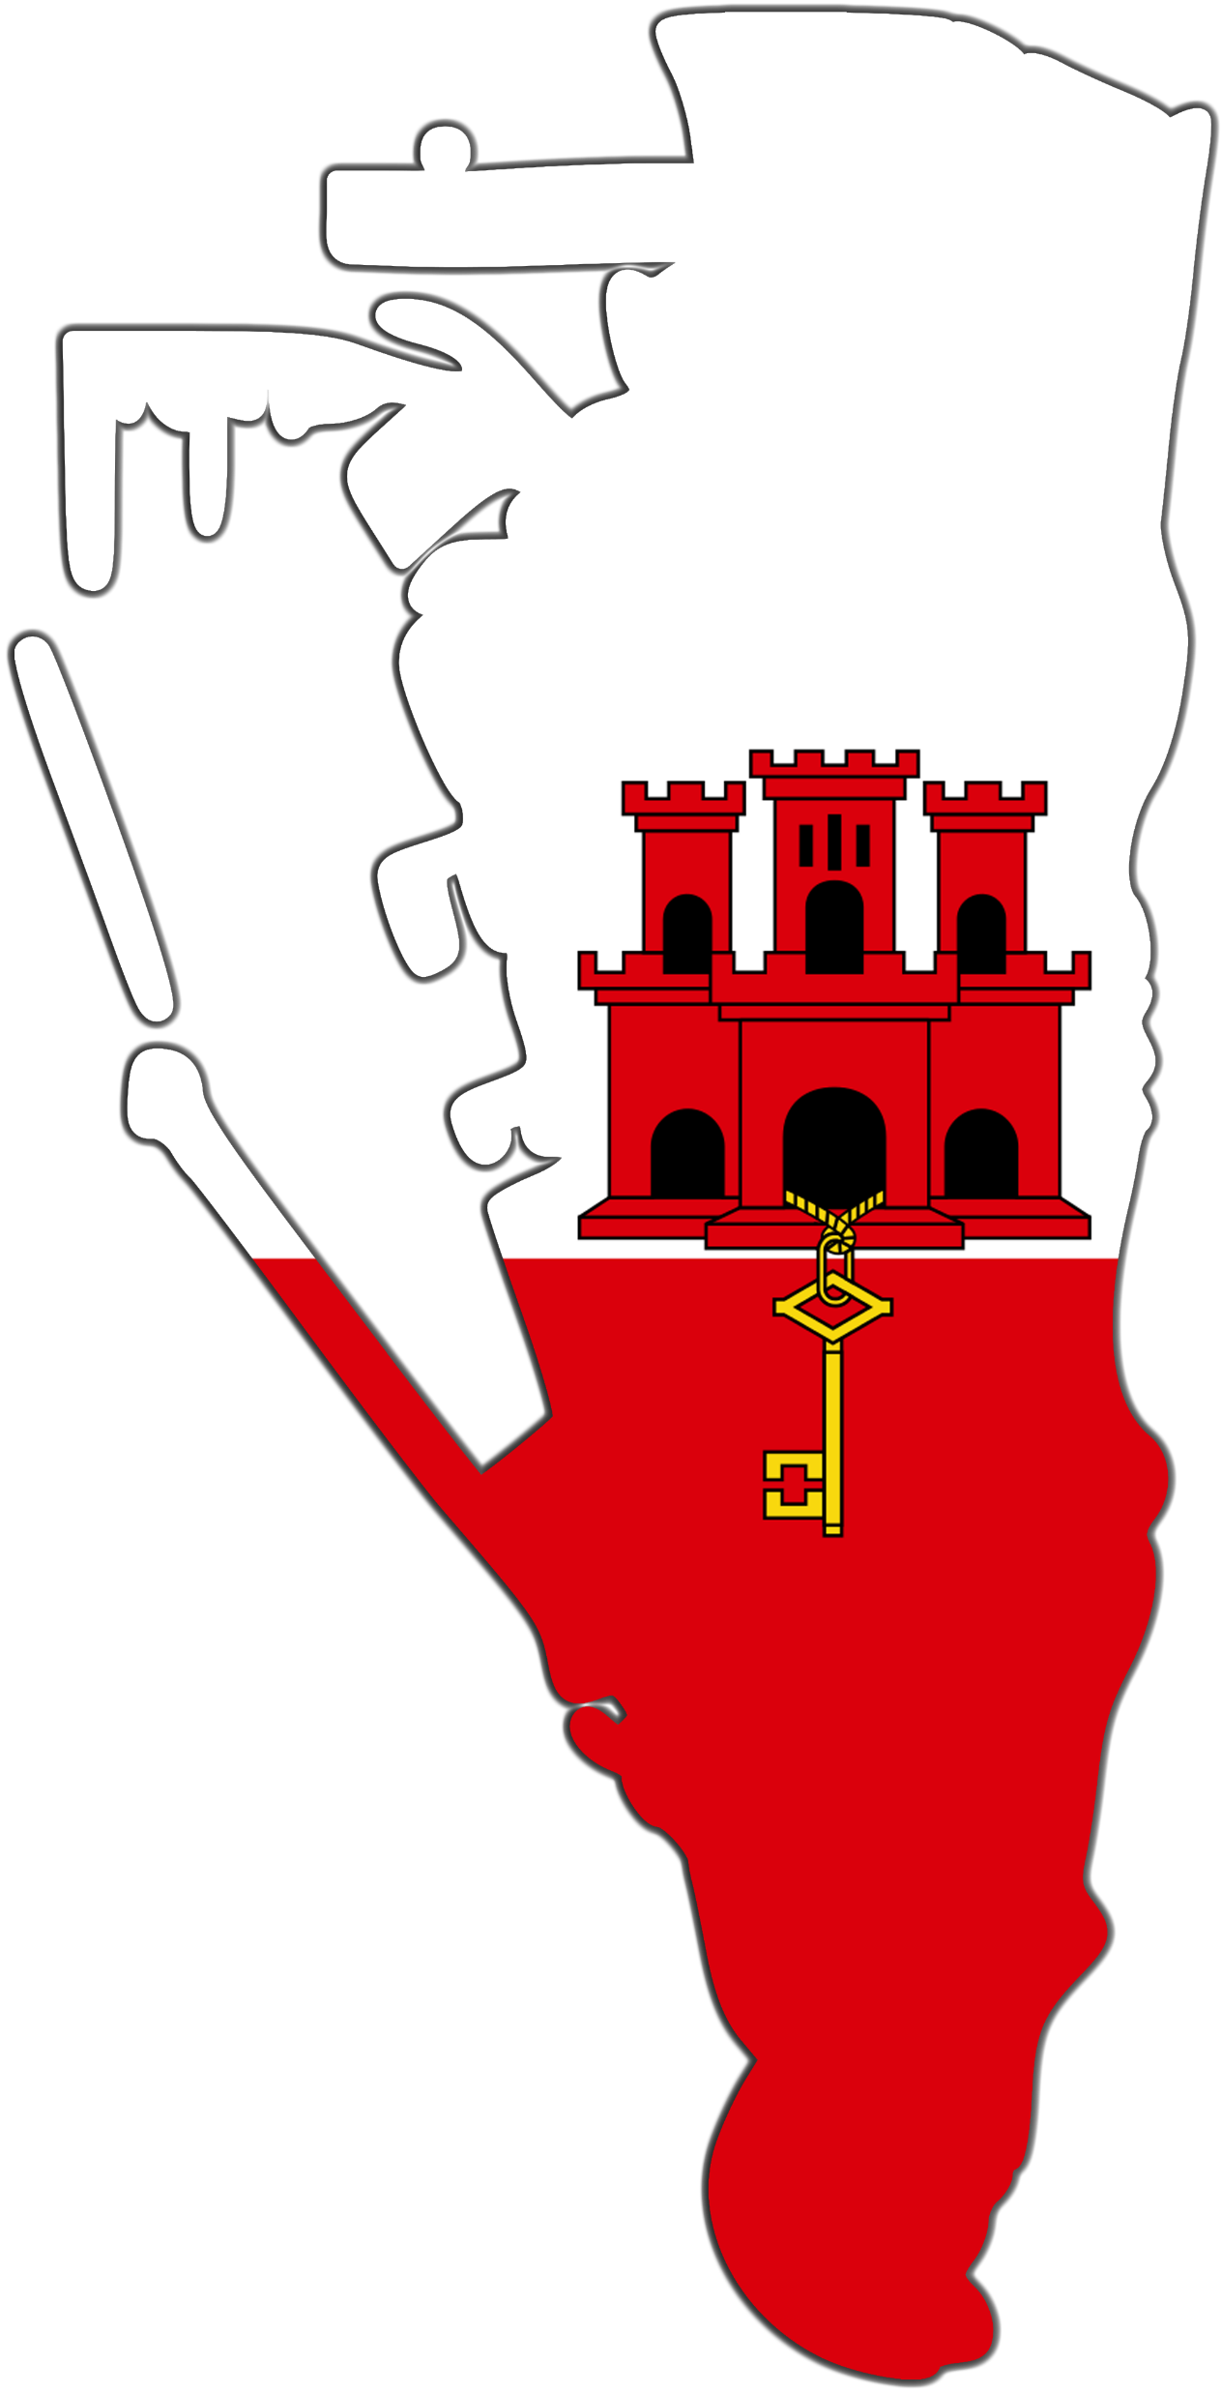
Usage Pattern?

Slide 4
Related Work
Qualitative approaches: Journalists and Social Media
Role of journalists during a natural disaster
11 interviews (Daily and Starbird, JCSCW, 2014)
Political journalists of American newspapers
11 interviews (Pamelee, JMP, 2013 )
Quantitative approaches: News and Social Media
Climate change between news outlets and Twitter
2B tweets: climate change (Olteanu et al., ICWSM’15)
Twitter user categories: journalists, organizations, ordinary
5K users, 10M tweets: (De Choudhury et al., CSCW’ 12)

Slide 5
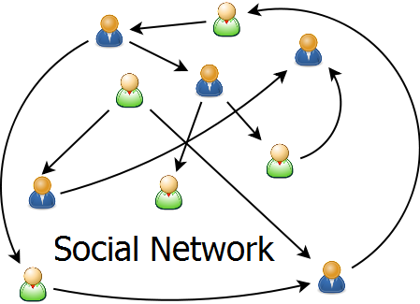
5K Producers + 1.4M “Consumers” → 2B Tweets
media.info
Bagdouri and Oard (CIKM’15)

Slide 6
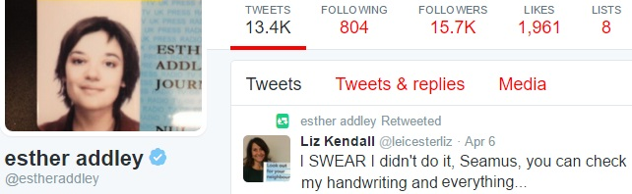
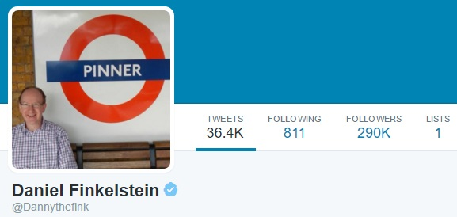
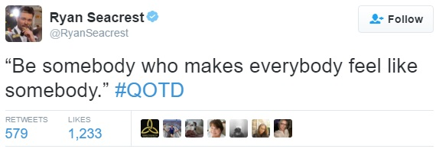
6 Aspects of 18 Features
Audience perception
Lists, Followers, % Verified Sign
Audience reaction
In-Retweets, In-Favorites
Broadcast communication
Daily Tweets, Hashtags, URLs
Targeted communication
Mentions, Replies, %Questions, %Out-Retweets, Out-favorites
Personal communication
%I (+my, mine), %We (+our, ours)
Publication medium
%Mobile, %Desktop, %App

Slide 7
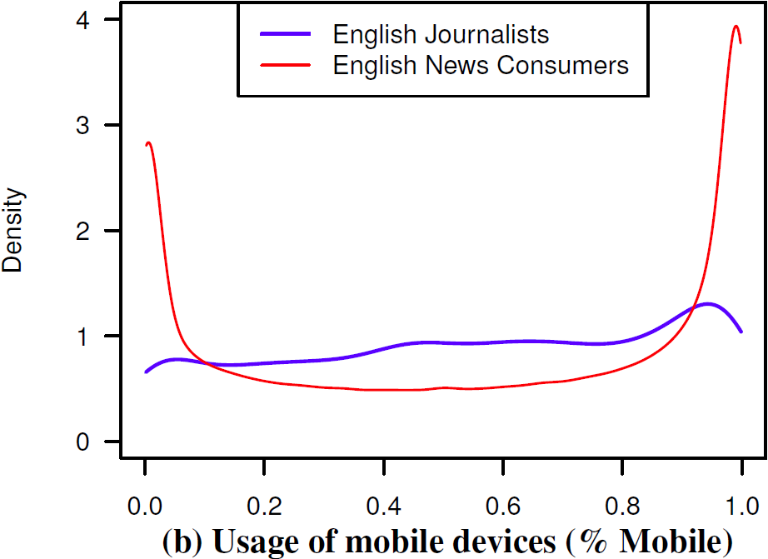
Statistical Tests
Welch’s t-test
Kolmogorov-Smirnov test

Slide 8
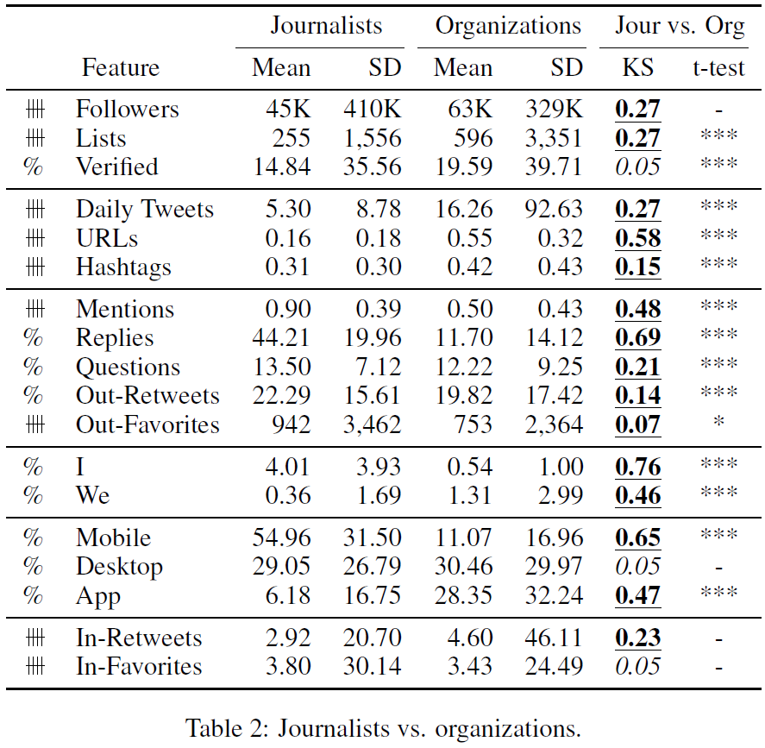
Journalists vs. Organizations
Audience perception
-
+
Broadcast communication
-
+
Journalists: targeting
Organizations: broadcasting
Targeted communication
+
-
Personal communication
+
-
Device
3rd party
Audience reaction
≈

Slide 9
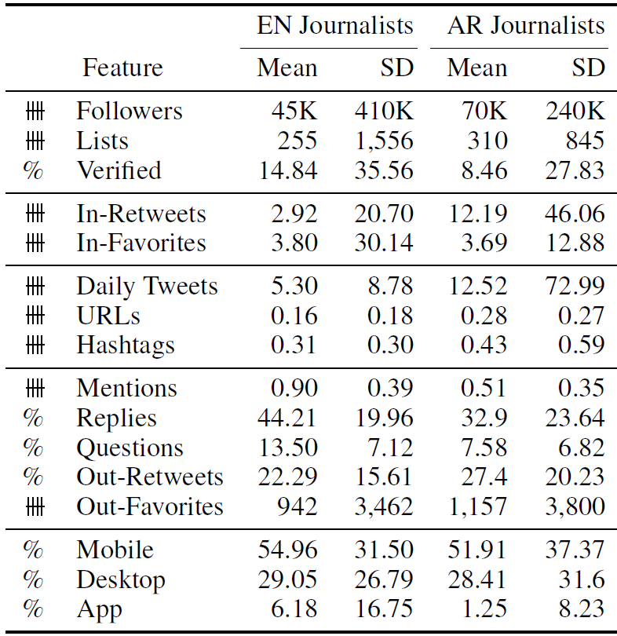
EN vs. AR Journalists
Audience perception
≈
Audience reaction
-
+
English Journalists: targeting
Arab Journalists: broadcasting
Broadcast communication
-
+
Targeted communication
+
-
Device
≈

Slide 10
Other Findings
Arab journalists
English journalists
Arab consumers
English consumers
≈

Slide 11
Journalists and Twitter
ICWSM - Wednesday, May 18, 2016 - Cologne, Germany
A Multidimensional Quantitative Description of Usage Patterns
MOSSAAB BAGDOURI
University of Maryland, College Park, USA
Douglas W. Oard
Nicholas Diakopoulos
Qatar National Research Fund
Thanks to:
Thank you!

