Slide 1



Structure Assisted Spectrum Sensing for Low-power Acoustic Event Detection
Nakul Garg, Harshvardhan Takawale, Yang Bai, Irtaza Shahid, Nirupam Roy
2nd ACM International Workshop on Intelligent Acoustic Systems and Applications 2023
Notes:
Hello everyone, my name is Nakul Garg, and today I'm excited to present our work on Structure-Assisted Low-Power Acoustic Sensing. This project is a joint effort with my colleagues Harsh, Yang, Irtaza, and our advisor Nirupam Roy.

Slide 2

Motivation
Lyra
Structural filters
Feasibility study
Future work
Conclusion
Click to play sounds
We are surrounded by plethora of acoustic information
Notes:
[Opening ambient sounds: car horn, phone ringing, birds chirping, and water running]
As you just experienced, our daily lives are filled with a myriad of sounds that often go unnoticed.

Slide 3


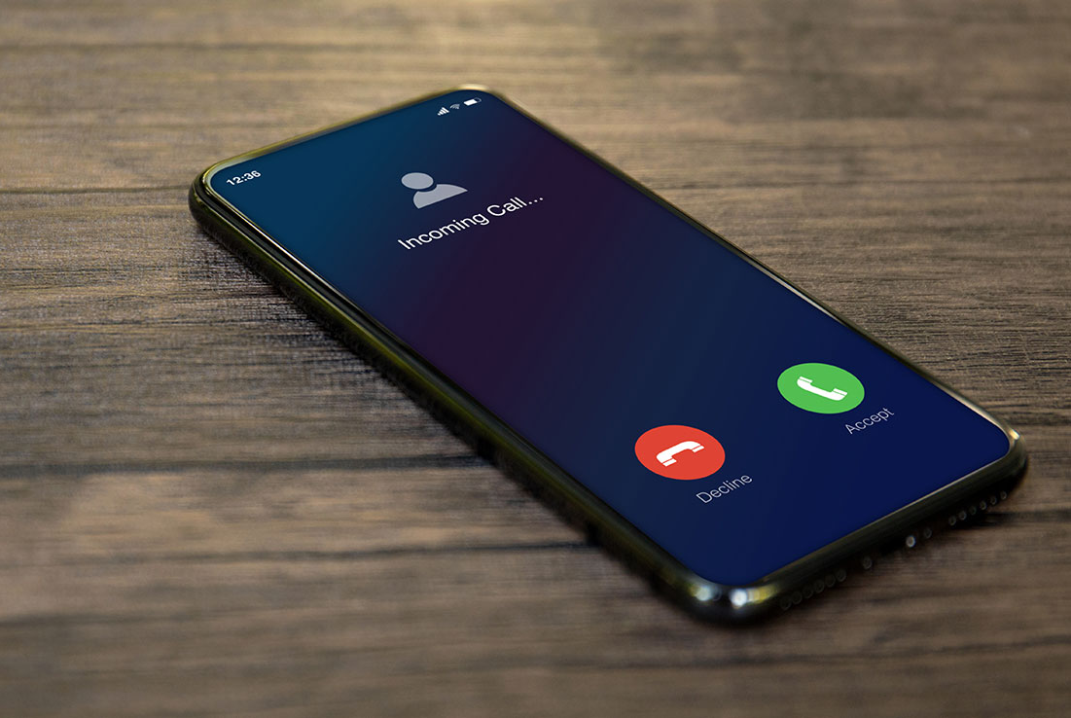


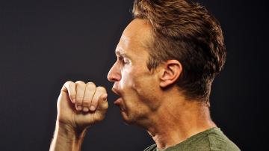
Motivation
Lyra
Structural filters
Feasibility study
Future work
Conclusion
Click to play sounds
We are surrounded by plethora of acoustic information
Notes:
Birds chirping, water running in a faucet, people walking or coughing - we are surrounded by a plethora of information that these ambient sounds have to offer. Imagine if we could tap into all this information to better understand our surroundings. The possibilities would be endless!

Slide 4
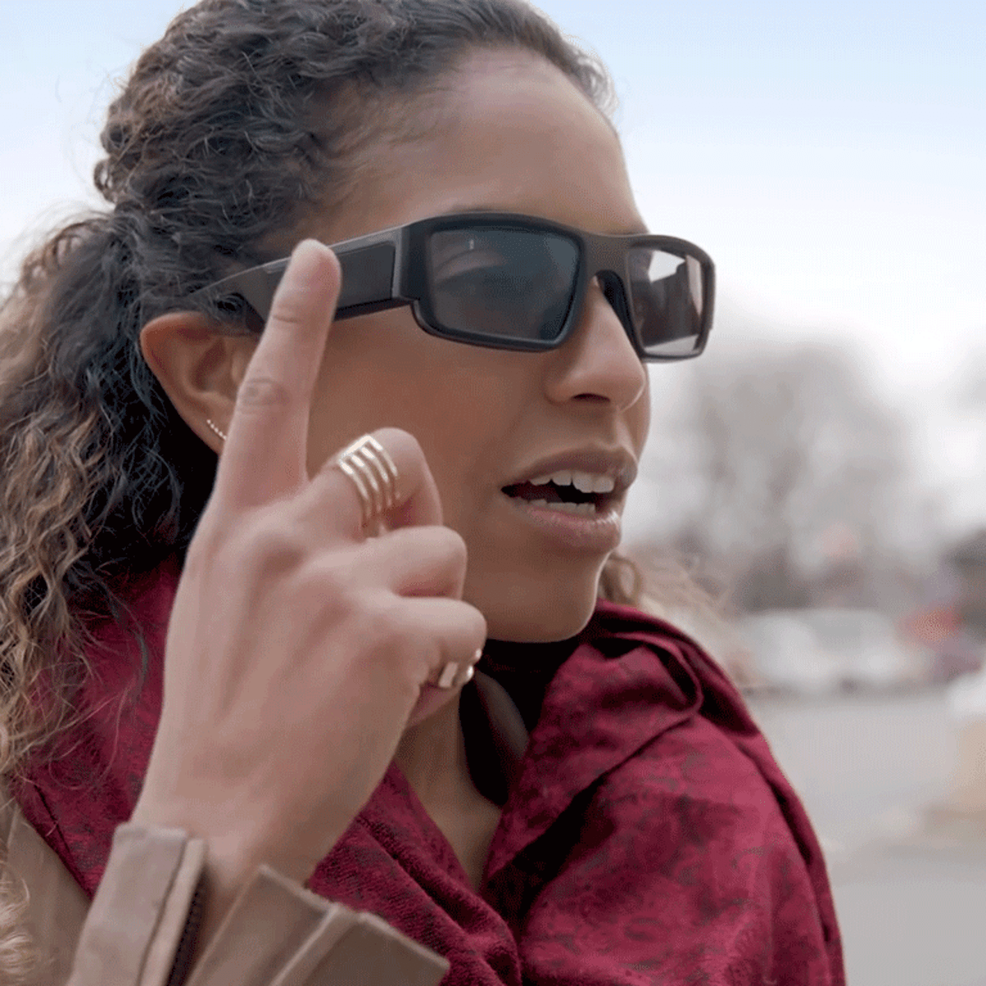
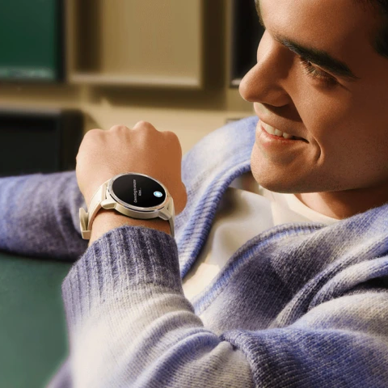
Motivation
Lyra
Structural filters
Feasibility study
Future work
Conclusion
@TheStreet
@DigitalTrends
Continuous wake word detection
Notes:
We could enable applications like
Continuous wake word detection for voice assistants that are integrated in our everyday objects

Slide 5


Motivation
Lyra
Structural filters
Feasibility study
Future work
Conclusion
@TheStreet
@DigitalTrends
Continuous wake word detection
Sensing in large areas and remote locations like farms, forests
Notes:
Or do large scale sensing in remote areas like farms and forests

Slide 6


Motivation
Lyra
Structural filters
Feasibility study
Future work
Conclusion
@TheStreet
@DigitalTrends
Continuous wake word detection
Sensing in large areas and remote locations like farms, forests
@57hours
Maintenance-free SOS system
Notes:
We could enable maintenance-free SoS sensors for emergency services during hiking and boating in limited access areas

Slide 7

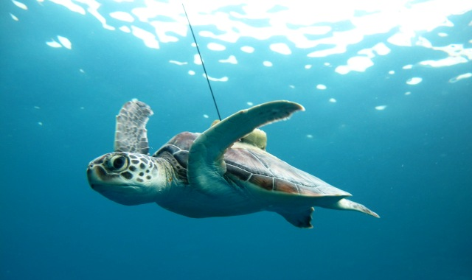
Motivation
Lyra
Structural filters
Feasibility study
Future work
Conclusion
@TheStreet
@DigitalTrends
Continuous wake word detection
Sensing in large areas and remote locations like farms, forests
@57hours
Maintenance-free SOS system
Wildlife monitoring
Notes:
We could tap into the sounds of nature both on ground and underwater to help in wildlife monitoring and preservation

Slide 8
Motivation
Lyra
Structural filters
Feasibility study
Future work
Conclusion
Existing sensors are power hungry
@TheStreet
@DigitalTrends
Continuous wake word detection
Sensing in large areas and remote locations like farms, forests
@57hours
Maintenance-free SOS system
Wildlife monitoring
Notes:
Sadly, existing sensing technology falls short for these applications. Traditional methods cannot enable these applications due to their extreme power consumption, creating a significant barrier to accessing this rich acoustic data.
To fully harness the potential of this information, we need a new approach - one that requires less power to operate and does not require maintenance after one-time deployment.

Slide 9
Motivation
Lyra
Structural filters
Feasibility study
Future work
Conclusion
Existing sensors are power hungry
@TheStreet
@DigitalTrends
Continuous wake word detection
Sensing in large areas and remote locations like farms, forests
What does it take to create
ultra-low-power acoustic sensors?
@57hours
Maintenance-free SOS system
Wildlife monitoring
Notes:
This is where our work comes into play. In this project, we ask the question, "What does it take to create ultra-low-power acoustic sensors?"
And before I answer this question let us first understand what really consumes power in an acoustic sensor?

Slide 10

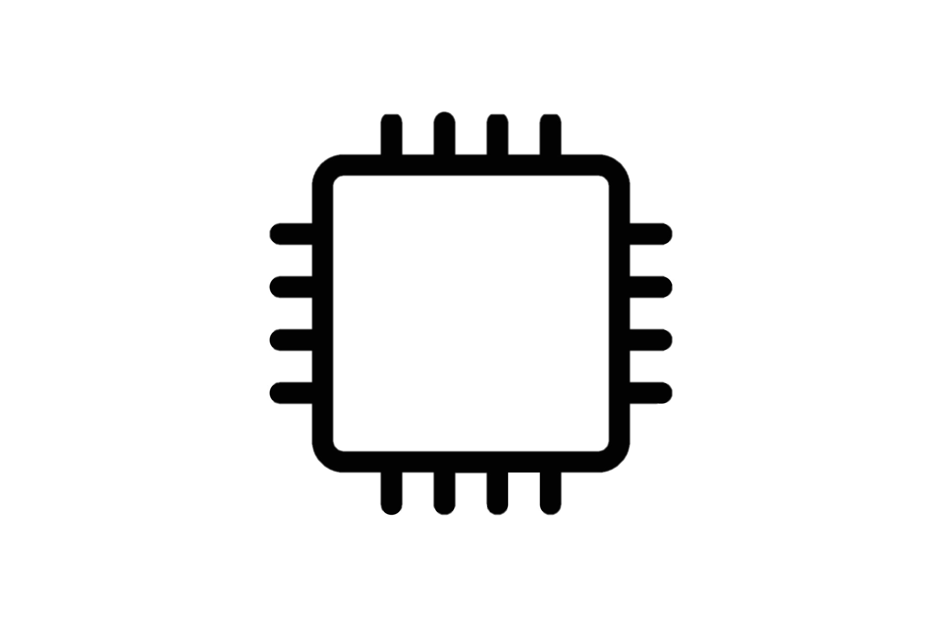

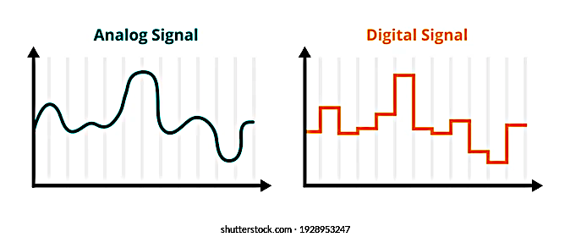
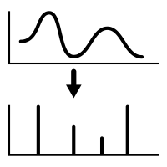
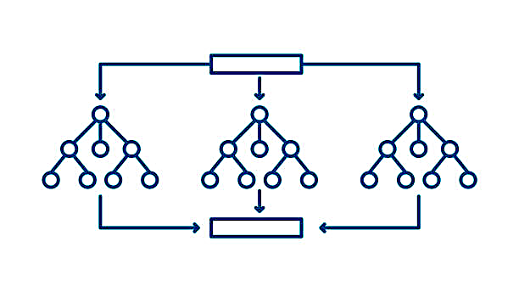
Motivation
Lyra
Structural filters
Feasibility study
Future work
Conclusion
Typical approach:
FFT
Sampling
Fast Fourier
Transform
Fourier
coefficients
Event
Microphone
ADC
Classification
Notes:
Consider the case of an acoustic event where a person utters a wake word to activate a voice assistant.
This picture shows a high-level idea of the sensing pipeline of the acoustic sensor

Slide 11
Motivation
Lyra
Structural filters
Feasibility study
Future work
Conclusion
Typical approach:
FFT
Sampling
Fast Fourier
Transform
Fourier
coefficients
Event
Microphone
ADC
Classification
Notes:
First, the sound travels as a pressure wave in air to reach the sensor

Slide 12
Motivation
Lyra
Structural filters
Feasibility study
Future work
Conclusion
Typical approach:
FFT
Sampling
Fast Fourier
Transform
Fourier
coefficients
Event
Microphone
ADC
Classification
Notes:
and then it is captured by a microphone, which converts the pressure wave into an analog electrical signal.

Slide 13
Motivation
Lyra
Structural filters
Feasibility study
Future work
Conclusion
Typical approach:
FFT
Sampling
Fast Fourier
Transform
Fourier
coefficients
Event
Microphone
ADC
Classification
Notes:
Next, this analog signal is digitized using an analog-to-digital converter, or ADC in short. This process consists of two steps: periodic sampling and quantization of the signal to a digital representation. According to the Nyquist theorem, the ADC must sample the signal at least twice the highest frequency component for successful recovery of the signal

Slide 14
Motivation
Lyra
Structural filters
Feasibility study
Future work
Conclusion
Typical approach:
FFT
Sampling
Fast Fourier
Transform
Fourier
coefficients
Event
Microphone
ADC
Classification
Notes:
Once digitized, the pipeline may employ various processing techniques depending on the application, such as analytical methods or machine learning. However, in acoustics, the Fast Fourier Transform (FFT) has become the default for spectral analysis and is widely used in most acoustic sensing and communication systems.

Slide 15
Motivation
Lyra
Structural filters
Feasibility study
Future work
Conclusion
Typical approach:
FFT
Sampling
Fast Fourier
Transform
Fourier
coefficients
Event
Microphone
ADC
Classification
Notes:
Finally, the system uses these Fourier coefficients to classify the acoustic events that were captured by the microphone.

Slide 16


Motivation
Lyra
Structural filters
Feasibility study
Future work
Conclusion
Typical approach:
hours
FFT
Sampling
Fast Fourier
Transform
Fourier
coefficients
Event
Microphone
ADC
Classification
Notes:
It turns out, in this entire pipeline ADC and FFT operations are the major culprits when it comes to power consumption. They are extremely power-hungry due to the high sampling rates and logarithmic complexities, which poses a significant challenge for low-power acoustic sensors aiming to continuously listen for acoustic cues without draining their battery life.

Slide 17
Motivation
Lyra
Structural filters
Feasibility study
Future work
Conclusion
Typical approach:
hours
FFT
Sampling
Fast Fourier
Transform
Fourier
coefficients
Event
Microphone
ADC
Classification
Can we somehow replace them?
Maybe something passive?
Notes:
In our work, we ask if we can somehow find alternatives to these power-hungry operations? Can we come up with low-power methods or even passive replacements to ADC and FFT that don't consume any energy at all.

Slide 18
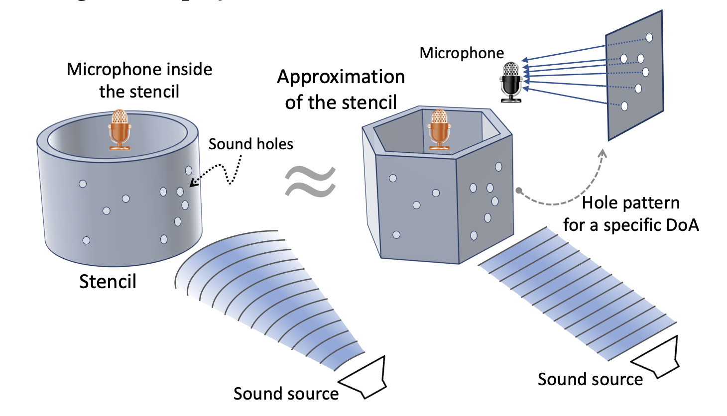
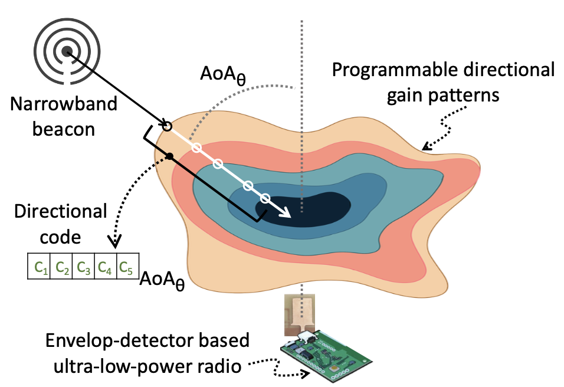
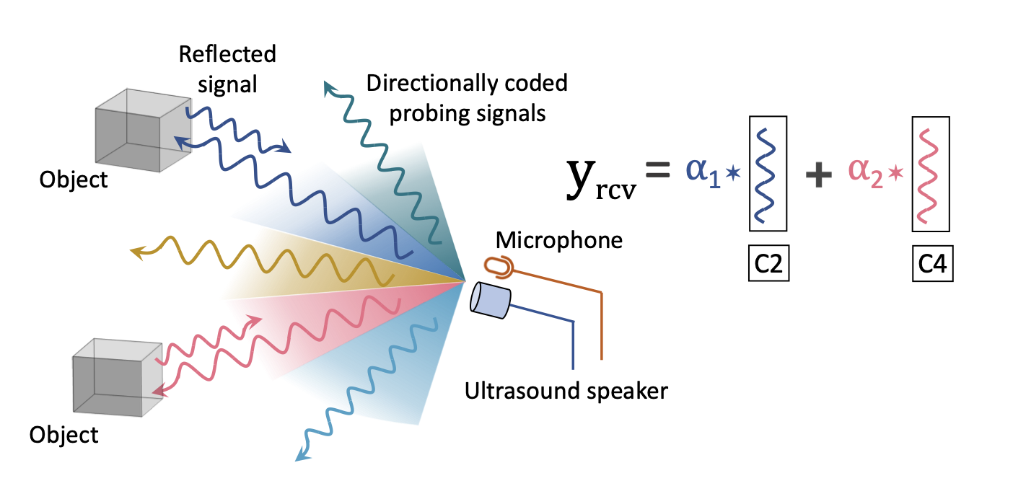
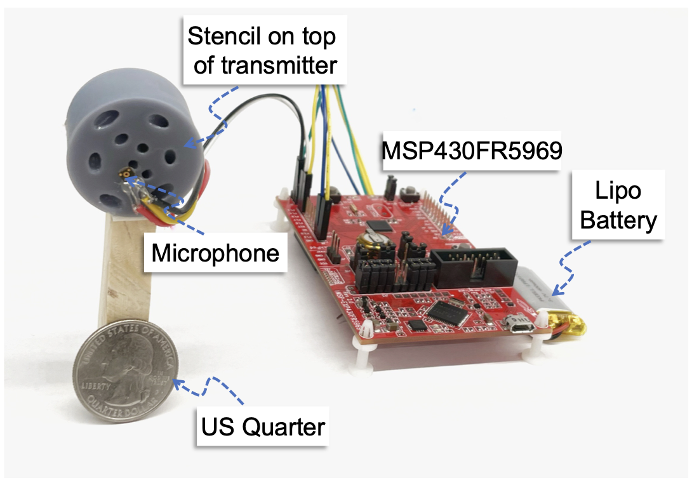
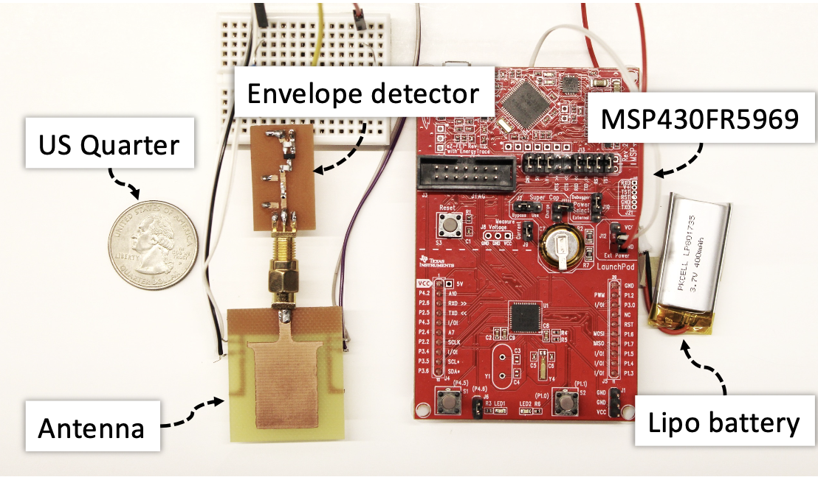
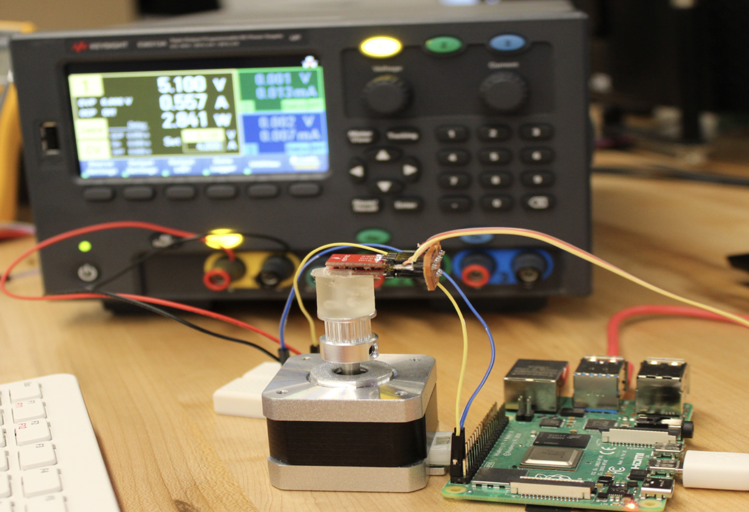
Motivation
Lyra
Structural filters
Feasibility study
Future work
Conclusion
Owlet [Mobisys’21]
Acoustic Localization
Best Demo Award
SPiDR [Mobisys’22]
Acoustic Depth Imaging
Best Paper Award
Sirius [Mobisys’23]
RF Self-Localization
(To appear)
Notes:
Actually, we have been working on low power sensing for quite some time in our lab. Our recent works presented in Mobisys 21 and 22 used passive structures to embed signatures that enables acoustic localization and imaging. With Owlet we demonstrated the potential of using 3D-printed passive structures to enable spatial awareness and direction estimation of incoming sounds without relying on an array of microphones. In SpiDR we use these structures to do depth imaging for tiny insect-scale robots and, more recently, we took these fundamental understandings to RF and made a single antenna and long-range self-localization system.
And as we were working on these topics, we stumbled upon the insight that acoustic sensors are mainly limited due to their high sampling rates and reliance on extensive FFT operations.
If we could somehow simplify their hardware front-end, we could create extremely efficient and self-sustainable sensors. And this inspired us to think about not only use 3d printed structures to embed signatures but also go even further in our pursuit of low-power sensing.

Slide 19

Motivation
Lyra
Structural filters
Feasibility study
Future work
Conclusion
Typical approach:
hours
FFT
Sampling
Fast Fourier
Transform
Fourier
coefficients
Event
Microphone
ADC
Classification
Lyra approach:
months
Event
Classification
Notes:
In our work Lyra, we are attempting to replace the power-hungry ADC and FFT operations with passive structures.

Slide 20

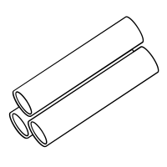

Motivation
Lyra
Structural filters
Feasibility study
Future work
Conclusion
Typical approach:
hours
FFT
Sampling
Fast Fourier
Transform
Fourier
coefficients
Event
Microphone
ADC
Classification
Lyra approach:
months
Structural filters
with microphones
Event
Classification
Notes:
These structures serve as narrowband acoustic filters that are sensitive to specific frequencies, also known as resonant frequencies.
To create a unique block that is highly sensitive to a desired set of frequencies, we arrange multiple passive structures in parallel. These structures are then incorporated with microphones that capture the resonating acoustic signal.

Slide 21
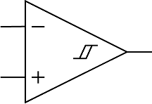
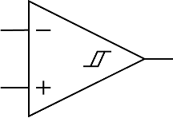
Motivation
Lyra
Structural filters
Feasibility study
Future work
Conclusion
Typical approach:
hours
FFT
Sampling
Fast Fourier
Transform
Fourier
coefficients
Event
Microphone
ADC
Classification
Lyra approach:
months
Structural filters
with microphones
Low-power
analog circuit
Event
Classification
Notes:
Instead of digitizing the captured response using ADC, we employ a series of basic energy detectors and analog comparators to determine if the energy of that is coming out of the structure is above a predefined threshold, which would indicate the presence of the resonant frequencies for that structure.

Slide 22
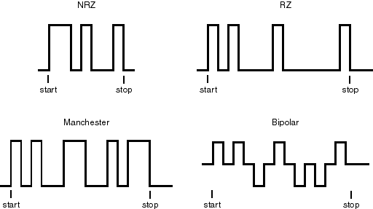
Motivation
Lyra
Structural filters
Feasibility study
Future work
Conclusion
Typical approach:
hours
FFT
Sampling
Fast Fourier
Transform
Fourier
coefficients
Event
Microphone
ADC
Classification
Lyra approach:
months
Structural filters
with microphones
Low-power
analog comparators
Frequency
detection triggers
Event
Classification
Notes:
The resulting detection outputs are a sequence of binary triggers or pulses that can be used by a classification algorithm to identify the presence of the acoustic event.
For many applications, detecting a specific pattern is more than sufficient, such as in wake word detection or activity classification.
The event pulses that we get effectively capture these patterns for such use cases.

Slide 23
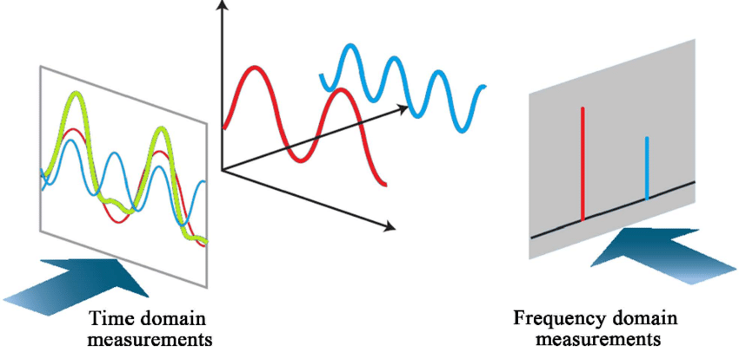
Motivation
Lyra
Structural filters
Feasibility study
Future work
Conclusion
With Lyra, we aim to detect the frequency components over time
Notes:
In summary, with Lyra, our goal is to detect frequency components over time using passive structures as replacements for ADC and FFT operations.

Slide 24
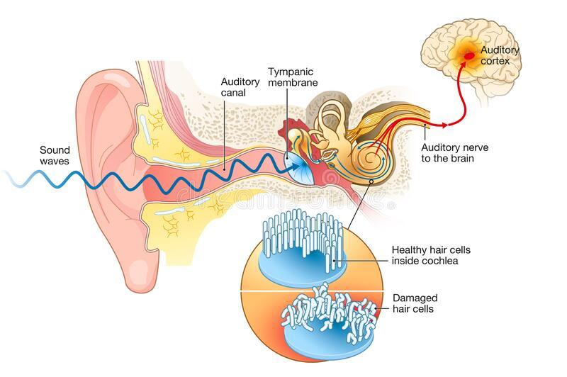
Motivation
Lyra
Structural filters
Feasibility study
Future work
Conclusion
Notes:
Let's now take a closer look at how we design our structural filters. These filters are passive devices that are designed to attenuate specific frequencies without requiring any external power. Interestingly, structure-based acoustic sensing is quite common in nature, and we can find a prime example in our own ears.

Slide 25
Motivation
Lyra
Structural filters
Feasibility study
Future work
Conclusion
Ear drum vibrates in response to sound waves
Sound enters the human ear to reach the ear drum
Notes:
When a sound wave enters our ear, it vibrates the eardrum, which is located in the inner part of our ear.

Slide 26
Motivation
Lyra
Structural filters
Feasibility study
Conclusion
Ear drum vibrates in response to sound waves
Vibrations create a standing wave in the Cochlea - a multi-resonant structure.
Sound enters the human ear to reach the ear drum
Notes:
The eardrum is connected to a long, spiral-shaped structure known as the cochlea. The cochlea is a natural structural filter that performs the most crucial part of the sensing process.

Slide 27
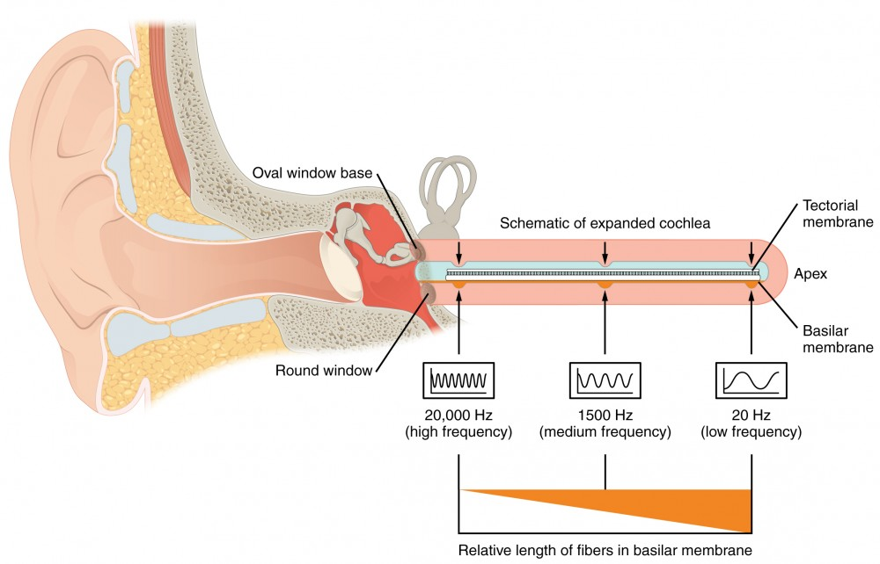
Motivation
Lyra
Structural filters
Feasibility study
Conclusion
Expand
Notes:
When the vibration travel inside the cochlea, they resonate create standing waves.

Slide 28
Motivation
Lyra
Structural filters
Feasibility study
Conclusion
Expand
Notes:
Standing wave is a result of inference of two waves traveling in opposite directions. In this case the second wave is a reflected signal from the closed end of the cochlea.
We call it standing wave because unlike traveling wave which appear to move in one direction, standing wave appear stationary and oscillate at the same point.
This standing wave creates high amplitude waves at specific regions of the cochlea.

Slide 29
Motivation
Lyra
Structural filters
Feasibility study
Conclusion
Expand
Notes:
And based on the wavelength of the acoustic wave, different regions of cochlea experience resonance.
For instance, lower frequencies resonate near the apex, while higher frequencies resonate near the base.

Slide 30
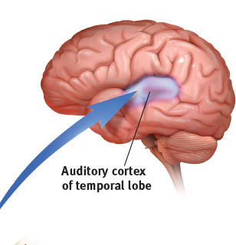
Motivation
Lyra
Structural filters
Feasibility study
Conclusion
Expand
Notes:
Finally, the hair cells present in the cochlea pick up these vibrations and send neural signals to our brain, and we can interpret the audible sound.
While replicating the cochlea may seem like a viable approach, in computing, we don't need to do that. Instead, we take the fundamental principle of standing wave resonance and create an alternative structure that enables spectral sensing. By doing so, we can develop a commercially viable solution that harnesses the power of structure-based acoustic sensing to revolutionize the way we capture and process sound.

Slide 31
Motivation
Lyra
Structural filters
Feasibility study
Conclusion
Standing wave resonance
Based on interferometry
Single-frequency detection
Parameters: Length & cross-sectional area
Notes:
Our first structure is a long tube looking like an unraveled cochlea which operates using the same standing wave principle.

Slide 32
Motivation
Lyra
Structural filters
Feasibility study
Conclusion
Standing wave resonance
Nodes
Antinodes
Based on interferometry
Single-frequency detection
Parameters: Length & cross-sectional area
Notes:
Depending on the length of the tube, only specific frequencies create a standing wave in the structure resulting in zero amplitude maximum amplitude regions know as nodes and antinodes respectively.

Slide 33
Motivation
Lyra
Structural filters
Feasibility study
Conclusion
Standing wave resonance
Helmholtz resonance
Nodes
Antinodes
Based on interferometry
Single-frequency detection
Parameters: Length & cross-sectional area
Based on mass-spring model
Multi-frequency detection
Parameters: Volume, length & cross-sectional area
Notes:
Second structure is a Helmholtz resonator which is based on a mass spring model of air oscillations. We use this structure to detect multiple frequencies at the same time.

Slide 34
Motivation
Lyra
Structural filters
Feasibility study
Conclusion
Standing wave resonance
Helmholtz resonance
Nodes
Neck
Volume of
cavity
Antinodes
Based on interferometry
Single-frequency detection
Parameters: Length & cross-sectional area
Based on mass-spring model
Multi-frequency detection
Parameters: Volume, length & cross-sectional area
Notes:
And its resonant frequency can be tuned by changing the length of the neck or the volume of the cavity.
You might have experienced this effect when blowing air on top of a bottle.

Slide 35
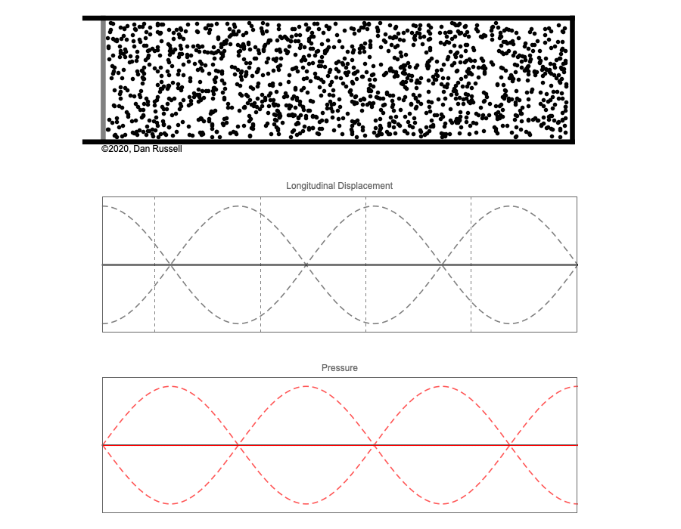

Motivation
Lyra
Structural filters
Feasibility study
Conclusion
Standing wave in the tube
Binary
output
Air particles in the tube
Node
Node
Antinode
Antinode
Pressure signal
Envelope detector
Comparator
Logic gates
Notes:
To use this structure as sensor, we place two microphones which are located at the node and antinode positions
Click
As some of you might have guessed, the frequency response for the two mics have a high amplitude and low amplitdue peak representing node and antinode.
Click
Explain the logic

Slide 36
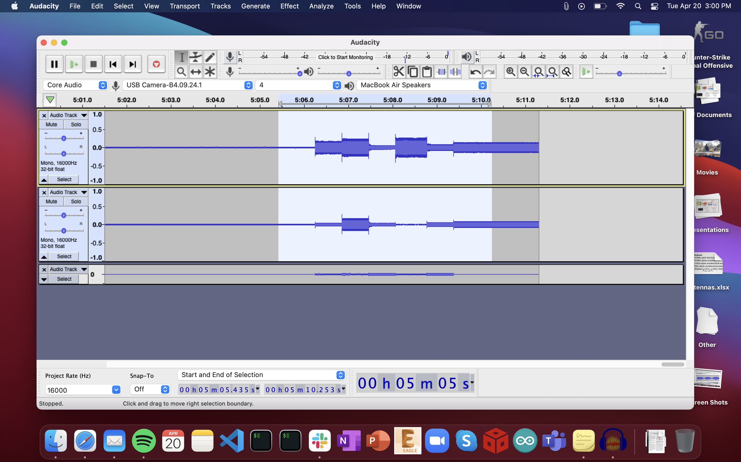
Motivation
Lyra
Structural filters
Feasibility study
Conclusion
Standing wave in the tube
Real world experiment
Node
Air particles in the tube
Node
Node
Antinode
Antinode
Antinode
Pressure signal
200Hz
1200Hz
2200Hz
3200Hz
4200Hz
5200Hz
6200Hz
Resonant
frequency

Slide 37
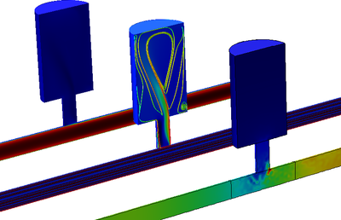
Motivation
Lyra
Structural filters
Feasibility study
Conclusion
Filter 1
Filter 2
Filter 3
Comsol simulation

Slide 38
Motivation
Lyra
Structural filters
Feasibility study
Conclusion
Filter 1
Filter 2
Filter 3
Transmitted
signal
Filter 1
Comsol simulation
Filter 2
Filter 3

Slide 39
Motivation
Lyra
Structural filters
Feasibility study
Conclusion
Lyra approach:
months
Structural filters
with microphones
Low-power
analog comparators
Frequency
detection triggers
Event
Classification
Notes:
As I reach the conclusion of the talk, I will leave you to think about the possibilities of using structures for low-power acoustic sensing. We've only just scratched the surface, and there's so much more to explore!
We all are working tirelessly, to further develop this technology and today we just shared our early insights with you. Of course, there are still challenges and flaws that needs to be addressed, but the purpose of this presentation is to leverage the platform that IASA has created for us to come together and share innovative ideas.

Slide 40

Structure Assisted Spectrum Sensing for Low-power Acoustic Event Detection
Nakul Garg, Harshvardhan Takawale, Yang Bai, Irtaza Shahid, Nirupam Roy
Visit our website for more details
http://icosmos.cs.umd.edu
Notes:
That's all I have for today. Thank you so much for your attention, and I look forward to your questions.

