Slide 1


Sirius: A Self-Localization System for Resource-Constrained IoT Sensors
Nakul Garg
Nirupam Roy
Notes:
Good afternoon, everyone! Thank you for joining me today. I am Nakul Garg from the University of Maryland College Park, and I am excited to share with you our work on self-localization for resource-constrained IoT sensors, which is a joint effort with my advisor, Prof. Nirupam Roy.

Slide 2





Internet of Low-power Things
Precision Farming
Wildlife monitoring
Climate sensing
Notes:
I do not need to over emphasis the fact that low-power IoT has opened up a world of possibilities, enabling applications such as Precision Farming and Wildlife Monitoring, and allowing us to gather invaluable data.
(Add detail – tiny sensors sensing temp without maintenance, rural area or deep forests where its hard to people to reach)

Slide 3
Internet of Low-power Things
Precision Farming
Wildlife monitoring
Climate sensing
30 Billion IoT devices by 2030
Notes:
And now not only in research topic today, it has become a huge commercial success as well. You can see that more than 30 billion IoT devices which is more than 9 times the population on earth.

Slide 4
Internet of Low-power Things
Precision Farming
Wildlife monitoring
Climate sensing
30 Billion IoT devices by 2030
Localization is important for Geo-tagging data and tracking IoT nodes
Notes:
As we know that three main focus areas in this emerging field:
Communication
Localization
On device perception
And Localization here plays an important role because it gives us important contextual information about the data.

Slide 5
Internet of Low-power Things
Precision Farming
Wildlife monitoring
Climate sensing
30 Billion IoT devices by 2030
Self-localization is necessary for scalability.
Localization is important for Geo-tagging data and tracking IoT nodes
Notes:
To truly scale a system to a large number of sensors, we require self-localization capabilities. This is like every sensor being able to figure out its own location without any help from communication or computation from external infrastructure. GPS is a great example of this.
So, my today’s talk is all about enabling self-localization on widespread resource constrained environment.

Slide 6
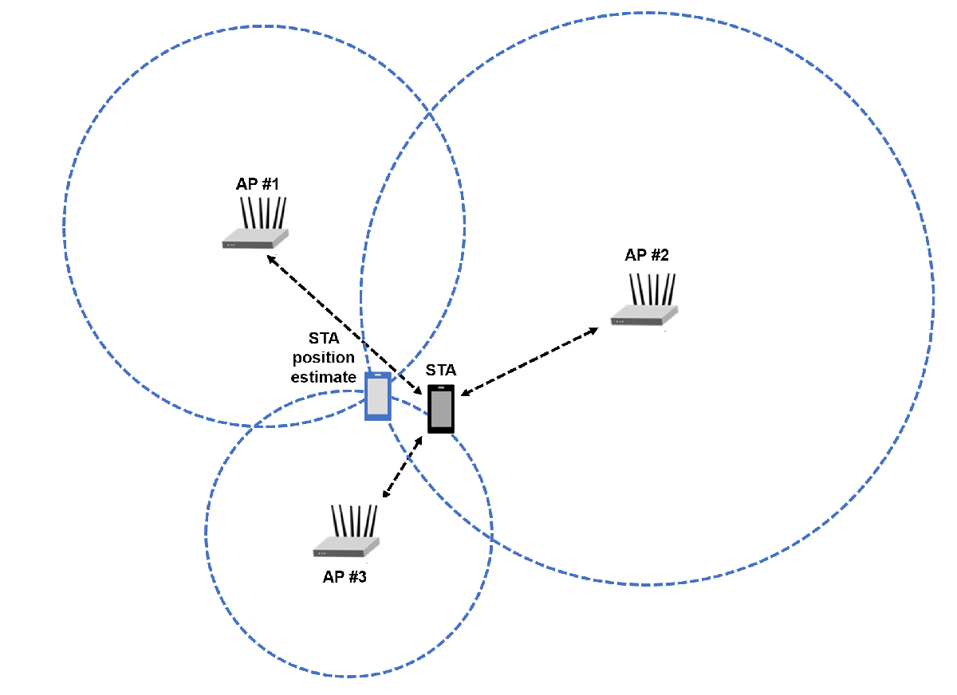
Self-Localization
Ranging based
Notes:
Existing self-localization systems can be broadly classified into two types of techniques. The first type is ranging-based systems that leverage the time of flight and propagation of wireless signals to estimate the distance from anchor points.

Slide 7

Self-Localization
AP
AP
θ'
θ
Ranging based
Angle based
Notes:
The second type of systems focuses on estimating the angle of arrival of wireless signals and utilizes triangulation techniques to determine the location. These approaches have shown promise, but they also pose significant challenges.

Slide 8
Self-Localization
AP
AP
θ'
θ
Ranging based
Angle based
Power hungry
Requires time synchronization
Large size arrays
Sophisticated
Anchors
Notes:
These techniques demand high power consumption, time synchronization, large physical sizes, and sophisticated anchor nodes.

Slide 9
Self-Localization
AP
AP
Low-power Self-localization is an open problem
θ'
θ
Ranging based
Angle based
Power hungry
Requires time synchronization
Large size arrays
Sophisticated
Anchors
Notes:
Satisfying all these factors in a single system is challenging and that’s why self-localization is still a very active field of research.

Slide 10
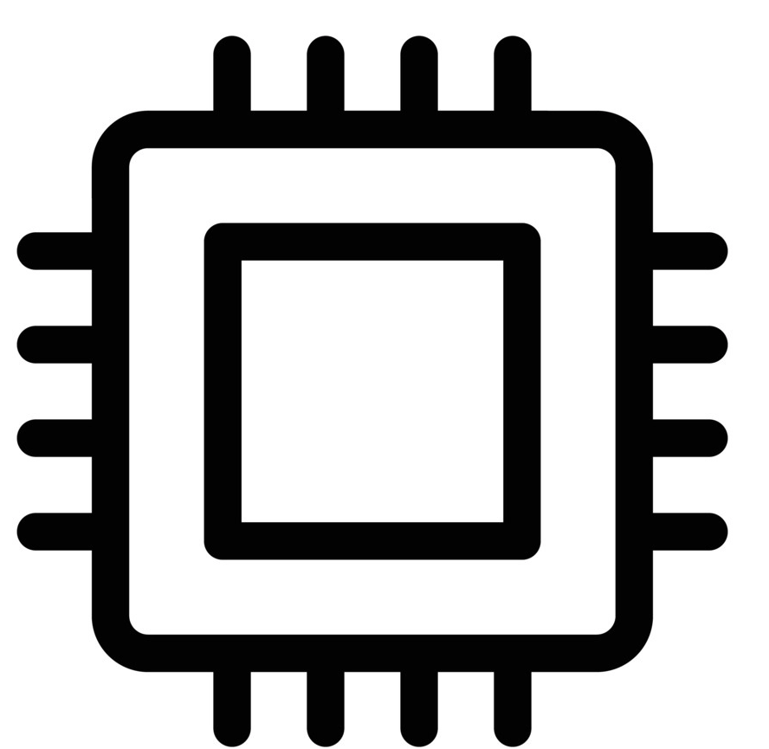
Traditional approach
ɸ
I
Q
Notes:
Let's quickly discuss the breakdown of array-based techniques used to estimate the Angle of Arrival (AoA) of an incoming RF signal.

Slide 11
Traditional approach
ɸ
I
Q
Large array of antennas for spatial sampling
Notes:
AoA estimation fundamentally requires antenna arrays for spatial sampling. They require large number of antennas placed half wavelength apart to capture the phase difference of the RF signal.

Slide 12
Traditional approach
ɸ
I
Q
Large array of antennas for spatial sampling
Power hungry ADC, oscillators, IQ-demodulation
Notes:
This approach requires power-hungry analog-to-digital converters, oscillators and complex hardware circuits for downconversion of the received signal.

Slide 13
Traditional approach
ɸ
I
Q
Large array of antennas for spatial sampling
Power hungry ADC, oscillators, IQ-demodulation
Signal processing
(FFT, Music)
Notes:
And finally, they use signal processing algorithms to estimate the angle of arrival which contributes to the overall energy of the system.
Unfortunately, these requirements of an antenna array pose significant challenges in terms of power consumption and complexity.

Slide 14
Traditional approach
Can we use a single antenna to perform AoA estimation?
ɸ
I
Q
Large array of antennas for spatial sampling
Power hungry ADC, oscillators, IQ-demodulation
Signal processing
(FFT, Music)
Notes:
We raise a question, can we extract the AoA using only one antenna and without using power-hungry front-end hardware?

Slide 15
Vision
Relax strict hardware requirements for sensing on resource constrained devices.
Leverage the capabilities of advanced machine intelligence to bridge the limitations of unsophisticated hardware.
Notes:
And I would like to take a moment and tell you that this work is one of the step towards our bigger vision of reducing hardware complexity for edge device sensing.
We're moving away from hardware-dependent approaches to machine intelligence-based approaches. It's all about making hardware sub-optimal and dealing with its shortcomings in software using the advancements is AI.

Slide 16
Vision
[1] Owlet: Enabling Spatial Information in Ubiquitous Acoustic Devices
Core Idea: Low-power Acoustic AoA Estimation
MobiSys 2021 Best Demo
[2] SPiDR: Ultra-low-power Acoustic Spatial Sensing for Micro-robot Navigation
Core Idea: Low-power Acoustic Depth Imaging
MobiSys 2022 Best Paper
[3] Sirius: A Self-Localization System for Resource-Constrained IoT Sensors
Core Idea: Low-power RF AoA Estimation
MobiSys 2023
Notes:
In the past, I and our group have applied these principles across various modalities such as acoustics to develop low-power localization and depth imaging, specifically for resource-constrained devices.
And this paper is another work in this line, where we're applying the same principles in the RF domain to make a self-localization system.

Slide 17
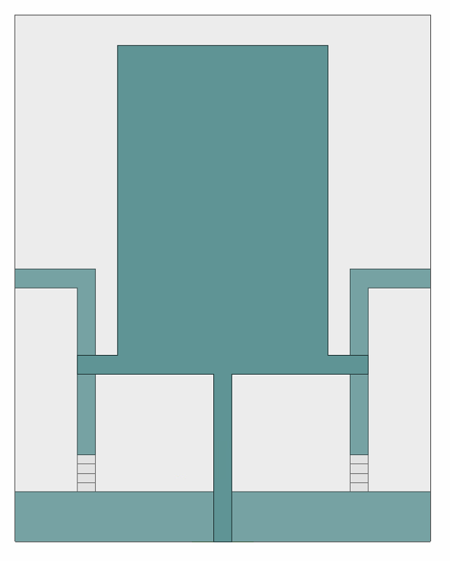
Ultra-low-power gain pattern switching
Notes:
So coming back to the question. Can we use a single antenna to perform AoA estimation. Let's see how we achieve it.
Antenna is nothing but a piece of metal that is capturing the radio frequency signals. And interestingly the shape of the antenna impacts the gain of the antenna. Typically, off-the-shelf antennas have fixed gain patterns.
We thought on what happens if we can change the shape of this gain pattern over time. Then one signal coming from one side vs other signal coming from other side can be distinguished by looking at the amplitude of the received signal.
BTW, changing the gain pattern in time is difficult. One possibility is to mechanically change the gain pattern by having a directional antenna on top of a motor. But mechanically changing the shape of the antenna is not a clever idea because we are striving for a few milliwatts of power budget.

Slide 18
Ultra-low-power gain pattern switching
PIN Diode
Switches
OFF
OFF
Notes:
Then we realized that if we can add switches that connect and disconnect the part of antennas then we can change the shape of the antenna.

Slide 19
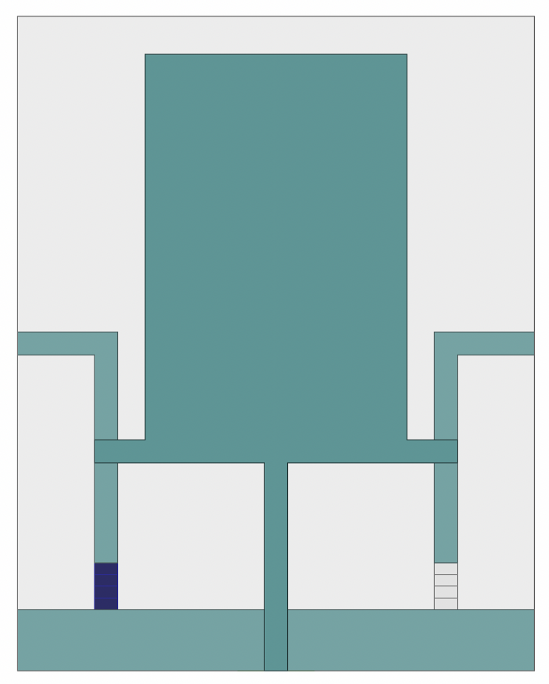
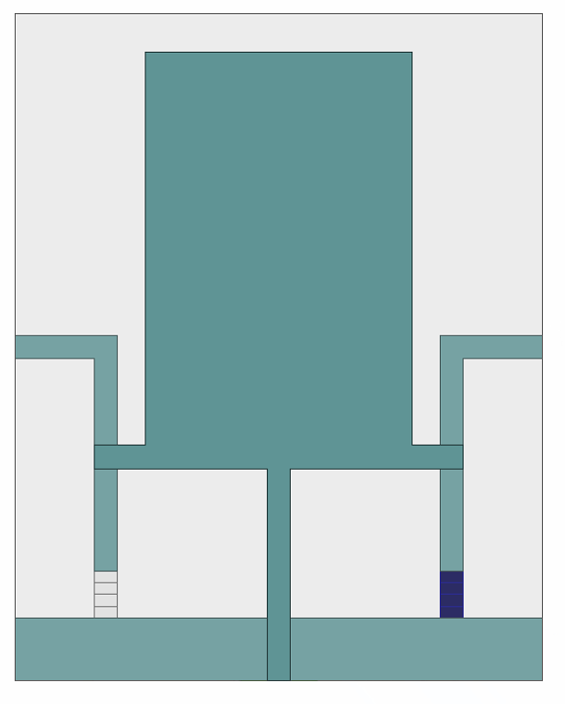
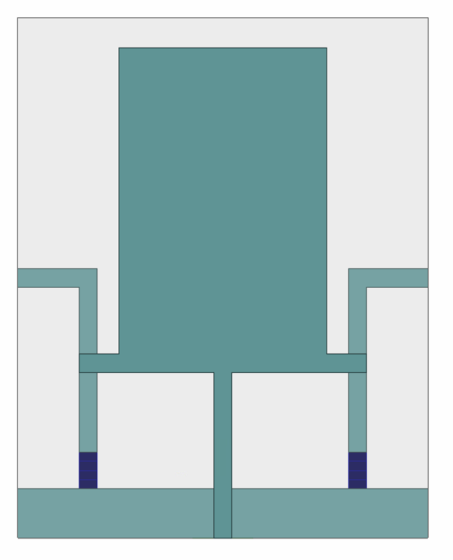
Ultra-low-power gain pattern switching
PIN Diode
Switches
OFF
OFF
ON
OFF
OFF
ON
ON
ON
Notes:
As if the total area and shape of the metal is changing which means we have a control or we have a knob which we can programmatically change the gain pattern of the antenna.

Slide 20
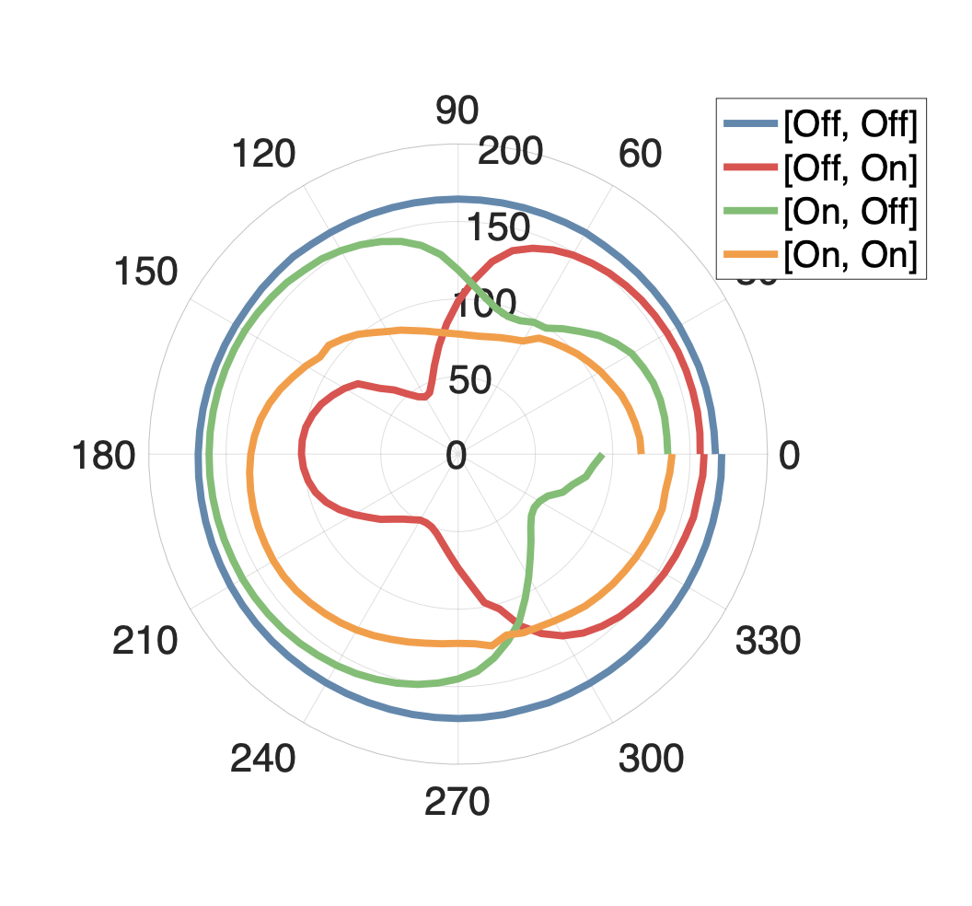
Ultra-low-power gain pattern switching
PIN Diode
Switches
OFF
OFF
ON
OFF
OFF
ON
ON
ON
Initial feasibility results
Notes:
Here we see that using just two switches, we can produce 4 unique gain patterns. This is one of our first set of results where we collect the signal coming from all directions while switching the gain pattern.

Slide 21
Diversity in gain patterns
Auto correlation matrix for increasing number of gain patterns (N)
Notes:
To check the diversity of the gain patterns, let me show you the auto-correlation matrix for varying numbers of switches.

Slide 22
Diversity in gain patterns
Least diverse
Most diverse
Auto correlation matrix for increasing number of gain patterns (N)
Notes:
Here, we see that as the number of unique patterns increases, the matrix becomes more diagonal, showcasing the diversity of the codes and the effectiveness of each code for AoA estimation.

Slide 23
Our approach: Sirius
ɸ
I
Q
Large array of antennas for spatial sampling
Power hungry ADC, oscillators, IQ-demodulation
Signal processing
(FFT, Music)
Notes:
To put it together, let's see how our system works..

Slide 24
Our approach: Sirius
ɸ
I
Q
Single antenna
Power hungry ADC, oscillators, IQ-demodulation
Signal processing
(FFT, Music)
Notes:
We first replace the large antenna array with just a single reconfigurable antenna.

Slide 25
Our approach: Sirius
ɸ
G
Passive envelope
detector
Single antenna
Signal processing
(FFT, Music)
Notes:
Now we don’t need phase at this point, so we can get rid of the complex hardware and use a passive envelope detector instead.
Infact lots of new communication systems also use this envelope detector to do high speed communication. We leverage that fact so that our new low power localization system can be applicable to these newly emerging comm system that are being invented.

Slide 26
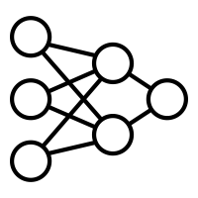
Our approach: Sirius
ɸ
G
Passive envelope
detector
Small AI model
Single antenna
Notes:
and finally, we use an efficient and small AI model to estimate the angle of arrival.

Slide 27
Our approach: Sirius
Incoming
signal
ɸ
G
Passive envelope
detector
Small AI model
Single antenna
Notes:
The core idea behind Sirius is what we call "directional code embedding”.

Slide 28
Our approach: Sirius
Incoming
signal
ɸ
G
Passive envelope
detector
Small AI model
Single antenna
Notes:
By fast switching of antenna's gain pattern, we add an angle dependent signature to the incoming signal.

Slide 29
Our approach: Sirius
Incoming
signal
ɸ
G
Passive envelope
detector
Small AI model
Single antenna
Notes:
The envelope detector extracts the energy of these fluctuations, giving the unique signature corresponding to the angle of arrival.

Slide 30
Our approach: Sirius
Incoming
signal
Directional code
embedding
ɸ
G
Passive envelope
detector
Small AI model
Single antenna
Notes:
We call this approach as “directional code embedding”. To understand this concept, let’s take a close look on how it works.

Slide 31
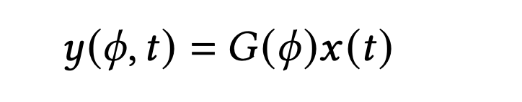
Directional Code Embedding
Incoming
signal
ɸ
G
Notes:
Consider a signal, denoted as x(t), arriving at the antenna.

Slide 32
Directional Code Embedding
Incoming
signal
ɸ
G
Gain of antenna
Notes:
The gain value, G(phi), is the gain of the antenna at this angle.

Slide 33
Directional Code Embedding
Incoming
signal
ɸ
Received signal
G
Gain of antenna
Notes:
We can write the received signal, y(phi, t), as the product of G(phi) and x(t).

Slide 34
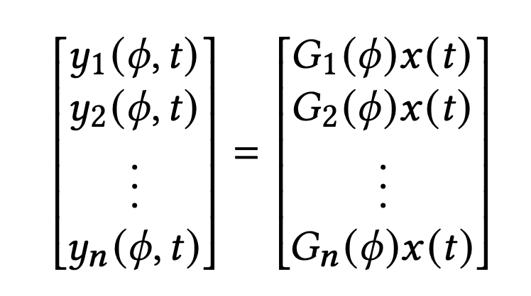
Directional Code Embedding
Incoming
signal
ɸ
Received signal
G
Gain of antenna
Notes:
By collecting the same signal with multiple gain values, we obtain a vector [y1, y2, ...] and so on, representing the varying gain values. However, this vector alone cannot serve as the code since it depends on the incoming signal's strength.

Slide 35
Directional Code Embedding
Incoming
signal
ɸ
Received signal
G
Gain of antenna
Normalize with
first gain value
Notes:
To create a direction-specific signature, independent of the incoming signal, we normalize the vector with its first element.

Slide 36
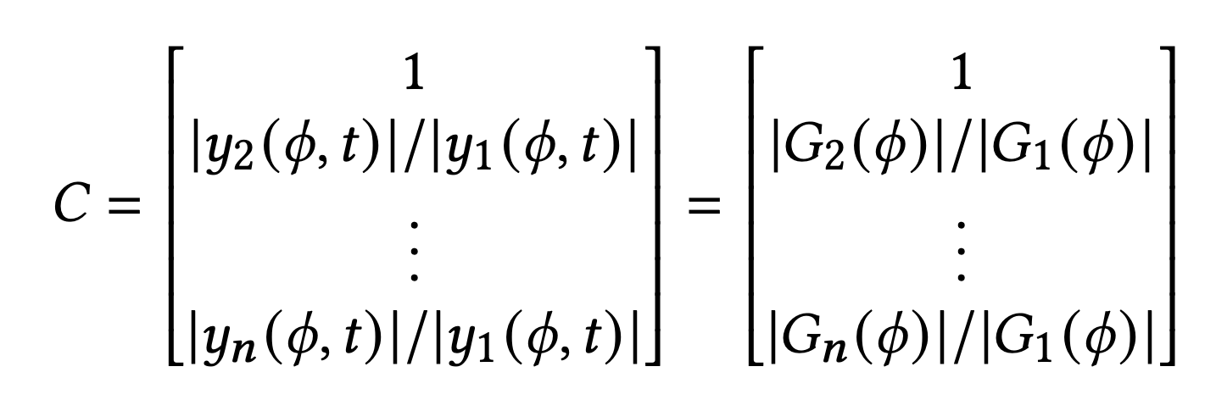
Directional Code Embedding
Incoming
signal
ɸ
Received signal
G
Gain of antenna
Normalize with
first gain value
Notes:
This new code, now normalized and direction-specific, becomes the feature that we use for angle estimation. A model can now be trained to learn the mapping between these codes to the corresponding angles, and later use it to estimate the angles in real time.

Slide 37
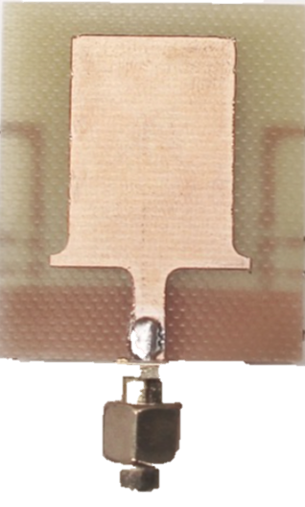
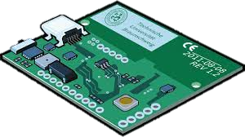




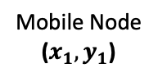
Application: Low-power Localization
Anchor Beacon
($X_{1},Y_{1}$)
$${AoA= θ}_{1}$$
$${AoA= θ}_{2}$$
Anchor Beacon
($X_{2},Y_{2}$)
Mobile Node
($x_{1},y_{1}$)
Y
X
Notes:
Now that we have angle of arrival, we can use two anchor points as transmitters, calculate the angle of arrival with both the anchors and use triangulation to get the location.
One problem that we face with anchors is the synchronization between them. When we move towards low power it makes more sense where the beacons are plug and play and we do not need any additional communication between the beacons.
In my next part of talk, I will quickly show how we can leverage Sirius and find location using unsynchronized beacons.

Slide 38
Application: Low-power Localization
Anchor Beacon
($X_{1},Y_{1}$)
$${AoA= θ}_{1}$$
How can we differentiate signals from asynchronous beacons?
$${AoA= θ}_{2}$$
Anchor Beacon
($X_{2},Y_{2}$)
Mobile Node
($x_{1},y_{1}$)
Y
X
Notes:
Due to the utilization of an envelope detector, we lose access to the demodulated data, making it challenging to differentiate between the beacons. One potential solution is to employ preambles and time division multiplexing of the channel, transmitting one beacon at a time. However, this approach would require strong time synchronization between the beacons, leading to increased costs and power consumption. Our objective, though, is to utilize unsophisticated beacons for long-term, maintenance-free deployment at scale. Another crucial factor to consider is that the envelope detector solely provides the envelope of the signal, resulting in the loss of high-frequency information details.

Slide 39
Application: Low-power Localization
Anchor Beacon
($X_{1},Y_{1}$)
$${AoA= θ}_{1}$$
How can we differentiate signals from asynchronous beacons?
$${AoA= θ}_{2}$$
Anchor Beacon
($X_{2},Y_{2}$)
Mobile Node
($x_{1},y_{1}$)
Y
X
Unequal duty cycles
Notes:
To address this challenge, we have developed a novel physical layer algorithm that leverages unequal duty-cycled beacons and exploits the non-linear properties of the envelope detector to identify the beacons. Next, I will walk through the workings of this beacon identification algorithm.

Slide 40
Beacon Identification Algorithm
Case 1
Case 2
Only Beacon 1
Is transmitting
Only Beacon 2
Is transmitting
Both beacons
are transmitting
time
time
Notes:
Imagine a time domain representation of two beacons constantly transmitting signals with distinct duty cycles.

Slide 41
Beacon Identification Algorithm
Case 1
Case 2
Only Beacon 1
Is transmitting
Only Beacon 2
Is transmitting
Both beacons
are transmitting
time
time
Notes:
Our key observation is that if the duty cycles of the two beacons differ from each other, then regardless of their time offsets, there will be a repeating time window in the received signal where only one beacon is transmitting at a time.

Slide 42
Beacon Identification Algorithm
Case 1
Case 2
Only Beacon 1
Is transmitting
Only Beacon 2
Is transmitting
Both beacons
are transmitting
collision
collision
collision
collision
collision
collision
time
time
collision window = Beacon1’s time period
collision window < Beacon1’s time period
Notes:
To identify the beacons, we take help of the collision time windows. We can classify collisions into two broad cases. In Case 1, the length of the collision is equal to the time period of the first beacon. In Case 2, the collision length is smaller than the time window of the first beacon.
Our algorithm's first objective is to locate the collision window and, based on the time window of collision, classify the type of case.

Slide 43
Beacon Identification Algorithm
Case 1
Case 2
Only Beacon 1
Is transmitting
Only Beacon 2
Is transmitting
Both beacons
are transmitting
collision
collision
collision
collision
collision
collision
beacon 2
beacon 2
beacon 2
beacon 2
beacon 2
beacon 2
time
time
collision window = Beacon1’s time period
collision window < Beacon1’s time period
Notes:
Once we have determined the case of collision, assigning the beacons becomes straightforward. In Case 2, we simply designate the exterior neighbors of the collision windows as Beacon 1 and the interior neighbors as Beacon 2, or vice versa.

Slide 44
Beacon Identification Algorithm
How do we detect collision windows?
Case 1
Case 2
Only Beacon 1
Is transmitting
Only Beacon 2
Is transmitting
Both beacons
are transmitting
collision
collision
collision
collision
collision
collision
beacon 2
beacon 2
beacon 2
beacon 2
beacon 2
beacon 2
time
time
collision window = Beacon1’s time period
collision window < Beacon1’s time period
Notes:
You may be wondering, how do we detect collisions at the first place?

Slide 45
Beacon Identification Algorithm
How do we detect collision windows?
Case 1
Case 2
Only Beacon 1
Is transmitting
Only Beacon 2
Is transmitting
Using just amplitude envelope?
Both beacons
are transmitting
collision
collision
collision
collision
collision
collision
beacon 2
beacon 2
beacon 2
beacon 2
beacon 2
beacon 2
time
time
collision window = Beacon1’s time period
collision window < Beacon1’s time period
Notes:
And how can achieve it using only the amplitude information from the envelope?

Slide 46

Collision detection: Non-linearity
Envelope detector
Envelope detector consists of a non-linear rectifier circuit which results in a beat frequency.
Notes:
Well, we leverage the non-linear properties of the envelope detector itself. The envelope detector actually consists of a non-linear circuit that results in the creation of a beat frequency whenever two different frequencies are present in the received signal.

Slide 47
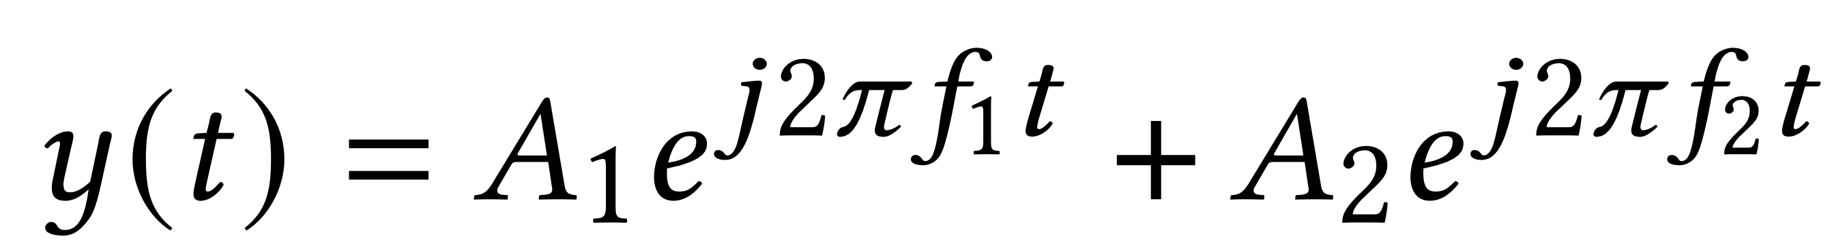
Collision detection: Non-linearity
Input1 = f₁
Input2 = f₂
Envelope detector
Notes:
If we transmit a single tone of frequency f1 from Beacon 1 and a slightly different frequency f2 from Beacon 2, the superimposed waves take the form as shown here.

Slide 48
Collision detection: Non-linearity
Input1 = f₁
Input2 = f₂
Envelope detector
Constructive
Interference
Destructive
Interference
Notes:
Notice that this includes areas of constructive and destructive interference.

Slide 49
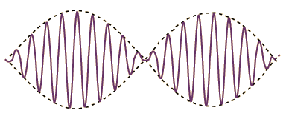
Collision detection: Non-linearity
Input1 = f₁
Input2 = f₂
Output = |f₁ - f₂|
Envelope detector
Envelope
Constructive
Interference
Destructive
Interference
Notes:
When this superimposed signal passes through the envelope detector's modulation operation, a third term of f2 - f1 emerges in the signal's envelope.

Slide 50
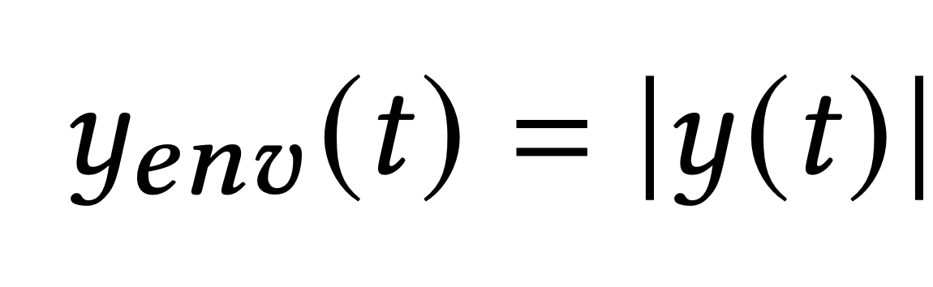
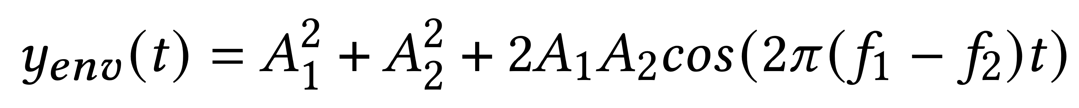
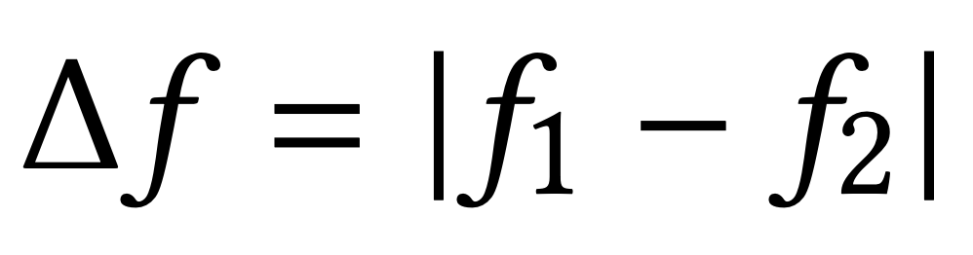
Collision detection: Non-linearity
Input1 = f₁
Input2 = f₂
Output = |f₁ - f₂|
Envelope detector
Envelope
Constructive
Interference
Destructive
Interference
Notes:
This is known as the beat frequency. This beat frequency only arises when both frequencies are simultaneously present, signifying a collision of the two beacons.

Slide 51
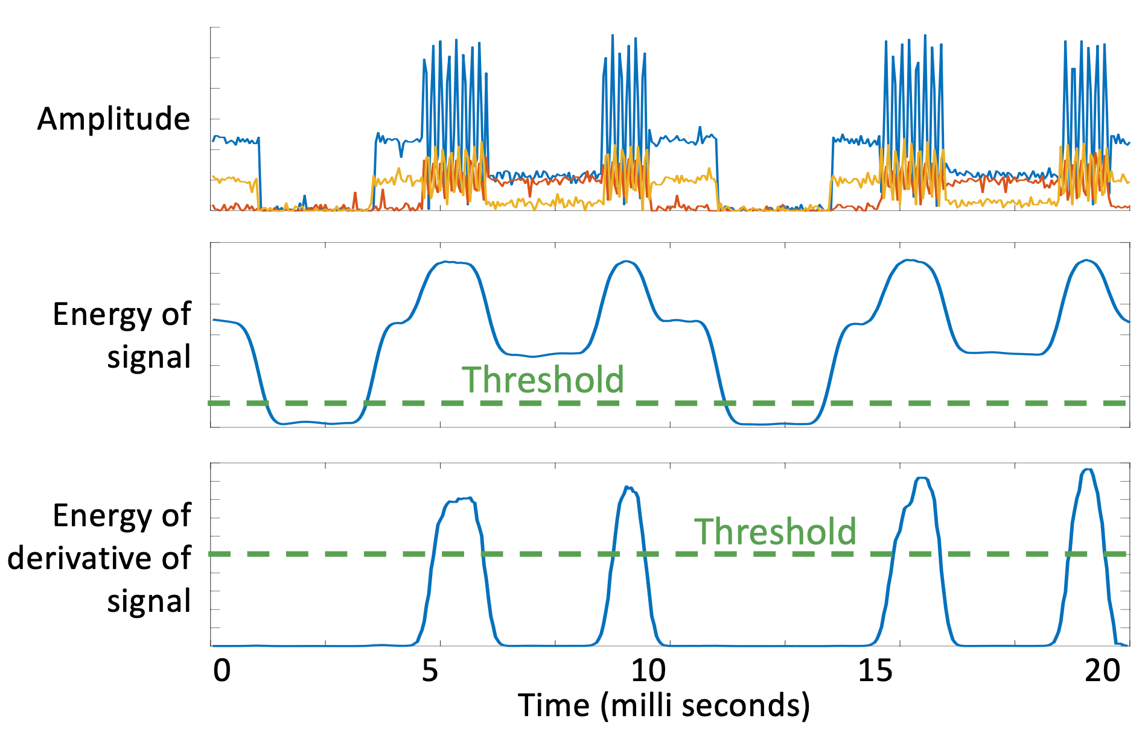
Collision detection: Non-linearity
Notes:
We utilize a simple threshold-based mechanism to identify if the resulting envelope of the received signal contains a beat frequency. This is achieved by computing the first derivative of the signal and calculating the root mean square (rms) energy.
In summary, this approach allows us to identify collision windows and label the non-collision windows with their respective beacons. By leveraging the non-linear properties of the envelope detector, we overcome the challenges posed by its use in the AoA estimation process without requiring to demodulate the signal.

Slide 52
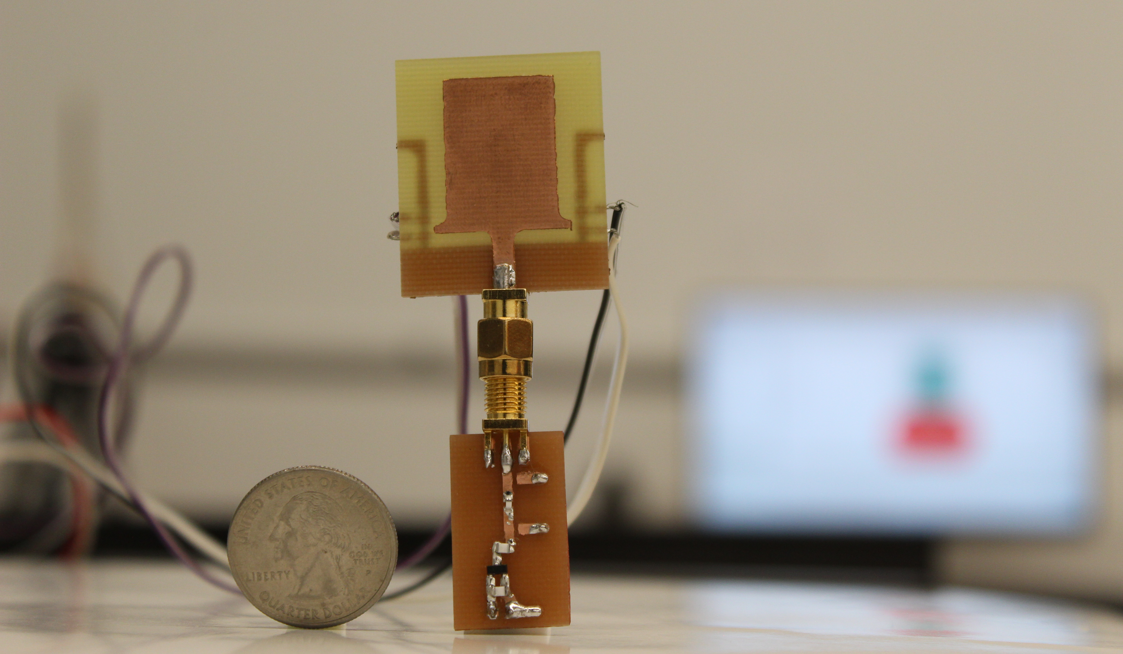
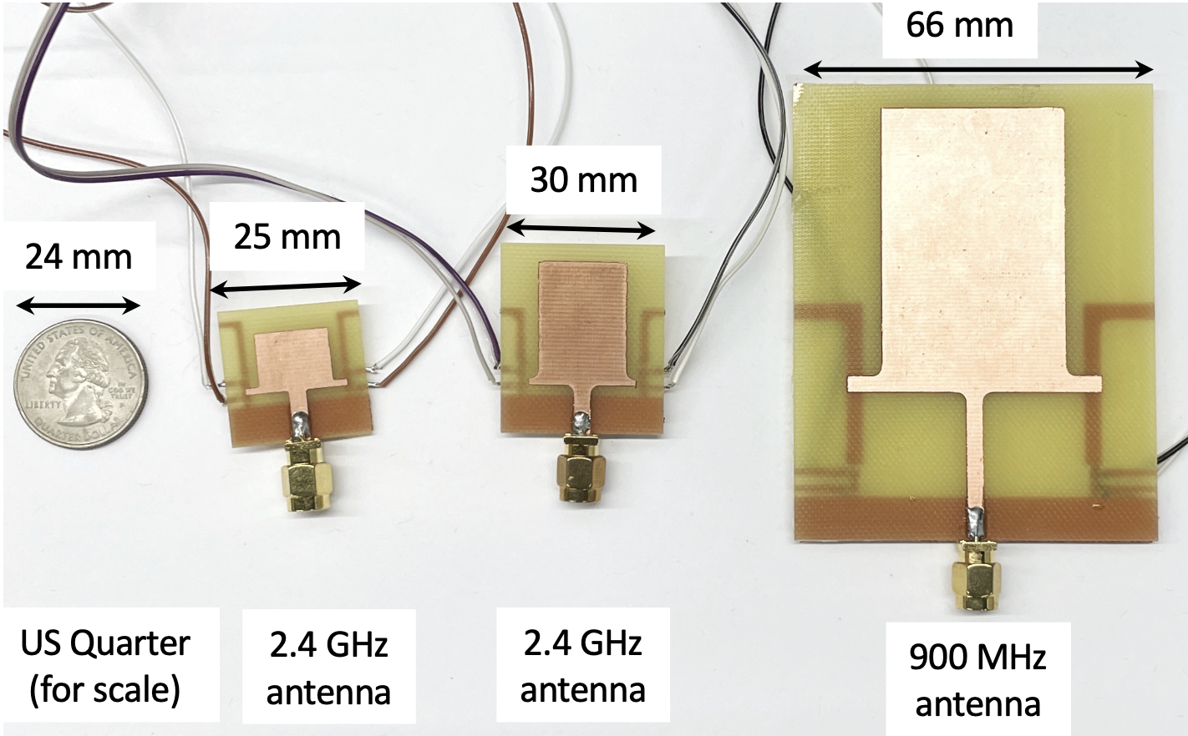
Evaluation
Notes:
We conducted a comprehensive evaluation using our in-house fabricated antenna. We designed this antenna for different ISM bands and evaluated the system's performance under different environmental conditions.

Slide 53
Evaluation
Notes:
One of the key measures is the accuracy of AoA estimation.

Slide 54
Evaluation
Median AoA error < 7 degree
Notes:
Here, we show an AoA median error of 7 degrees, comparable to state of the art antenna array-based methods, all while using a single miniaturized antenna.

Slide 55
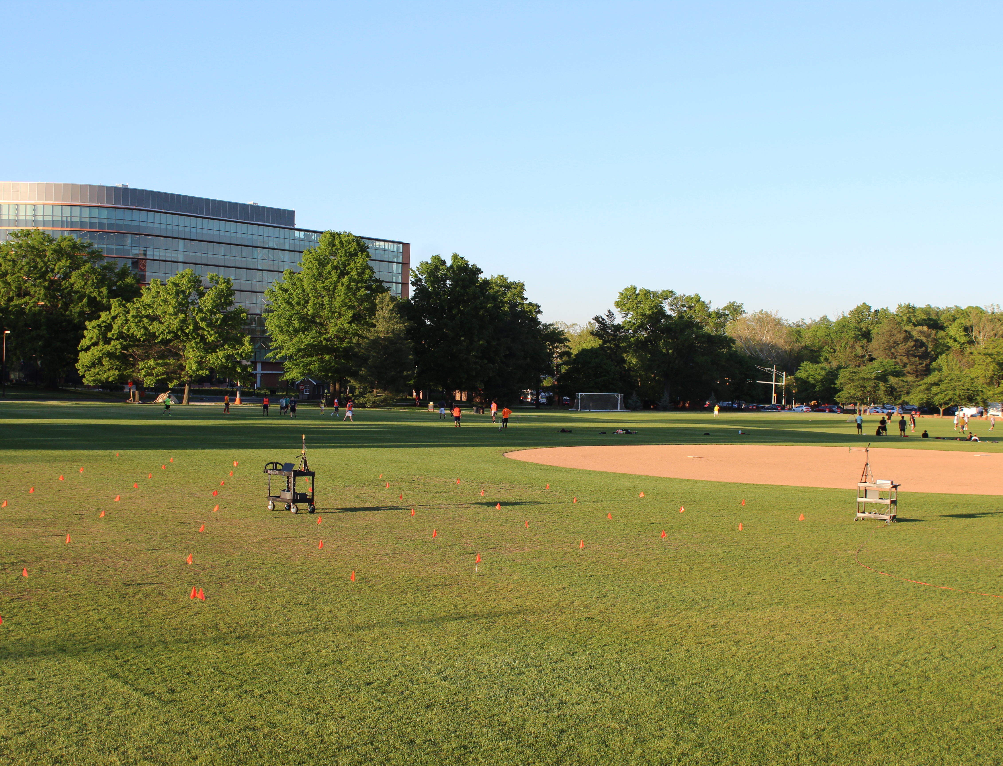
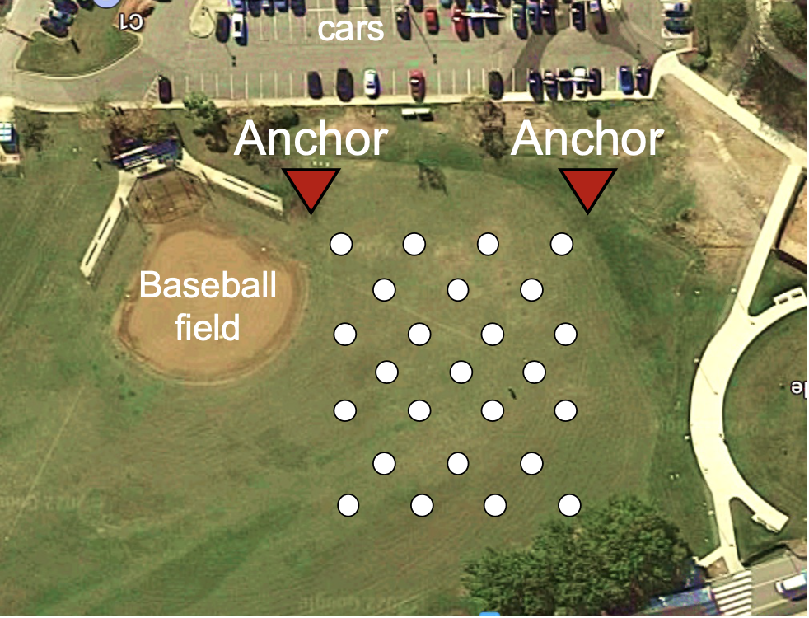
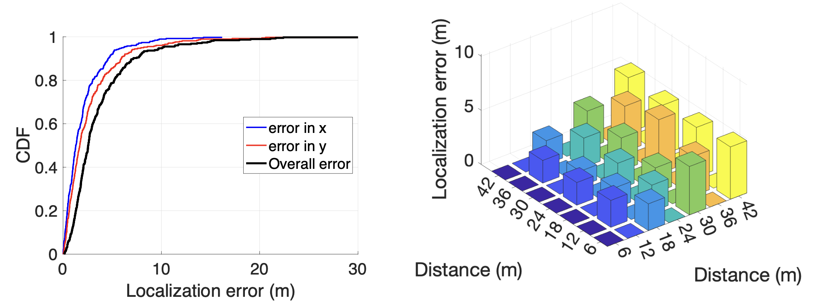
Evaluation
Notes:
To showcase the ability of Sirius in real-world scenarios. We evaluated the system in a large-scale outdoor field, which included our university baseball field.

Slide 56
Evaluation
Median Localization error < 2.5 meters (Similar to GPS)
1D error < 1.3meters
Notes:
We achieved a median localization error of 2.5 meters in 2D and 1.3 meters in 1D, allowing us to accurately localize any node in both dimensions.

Slide 57
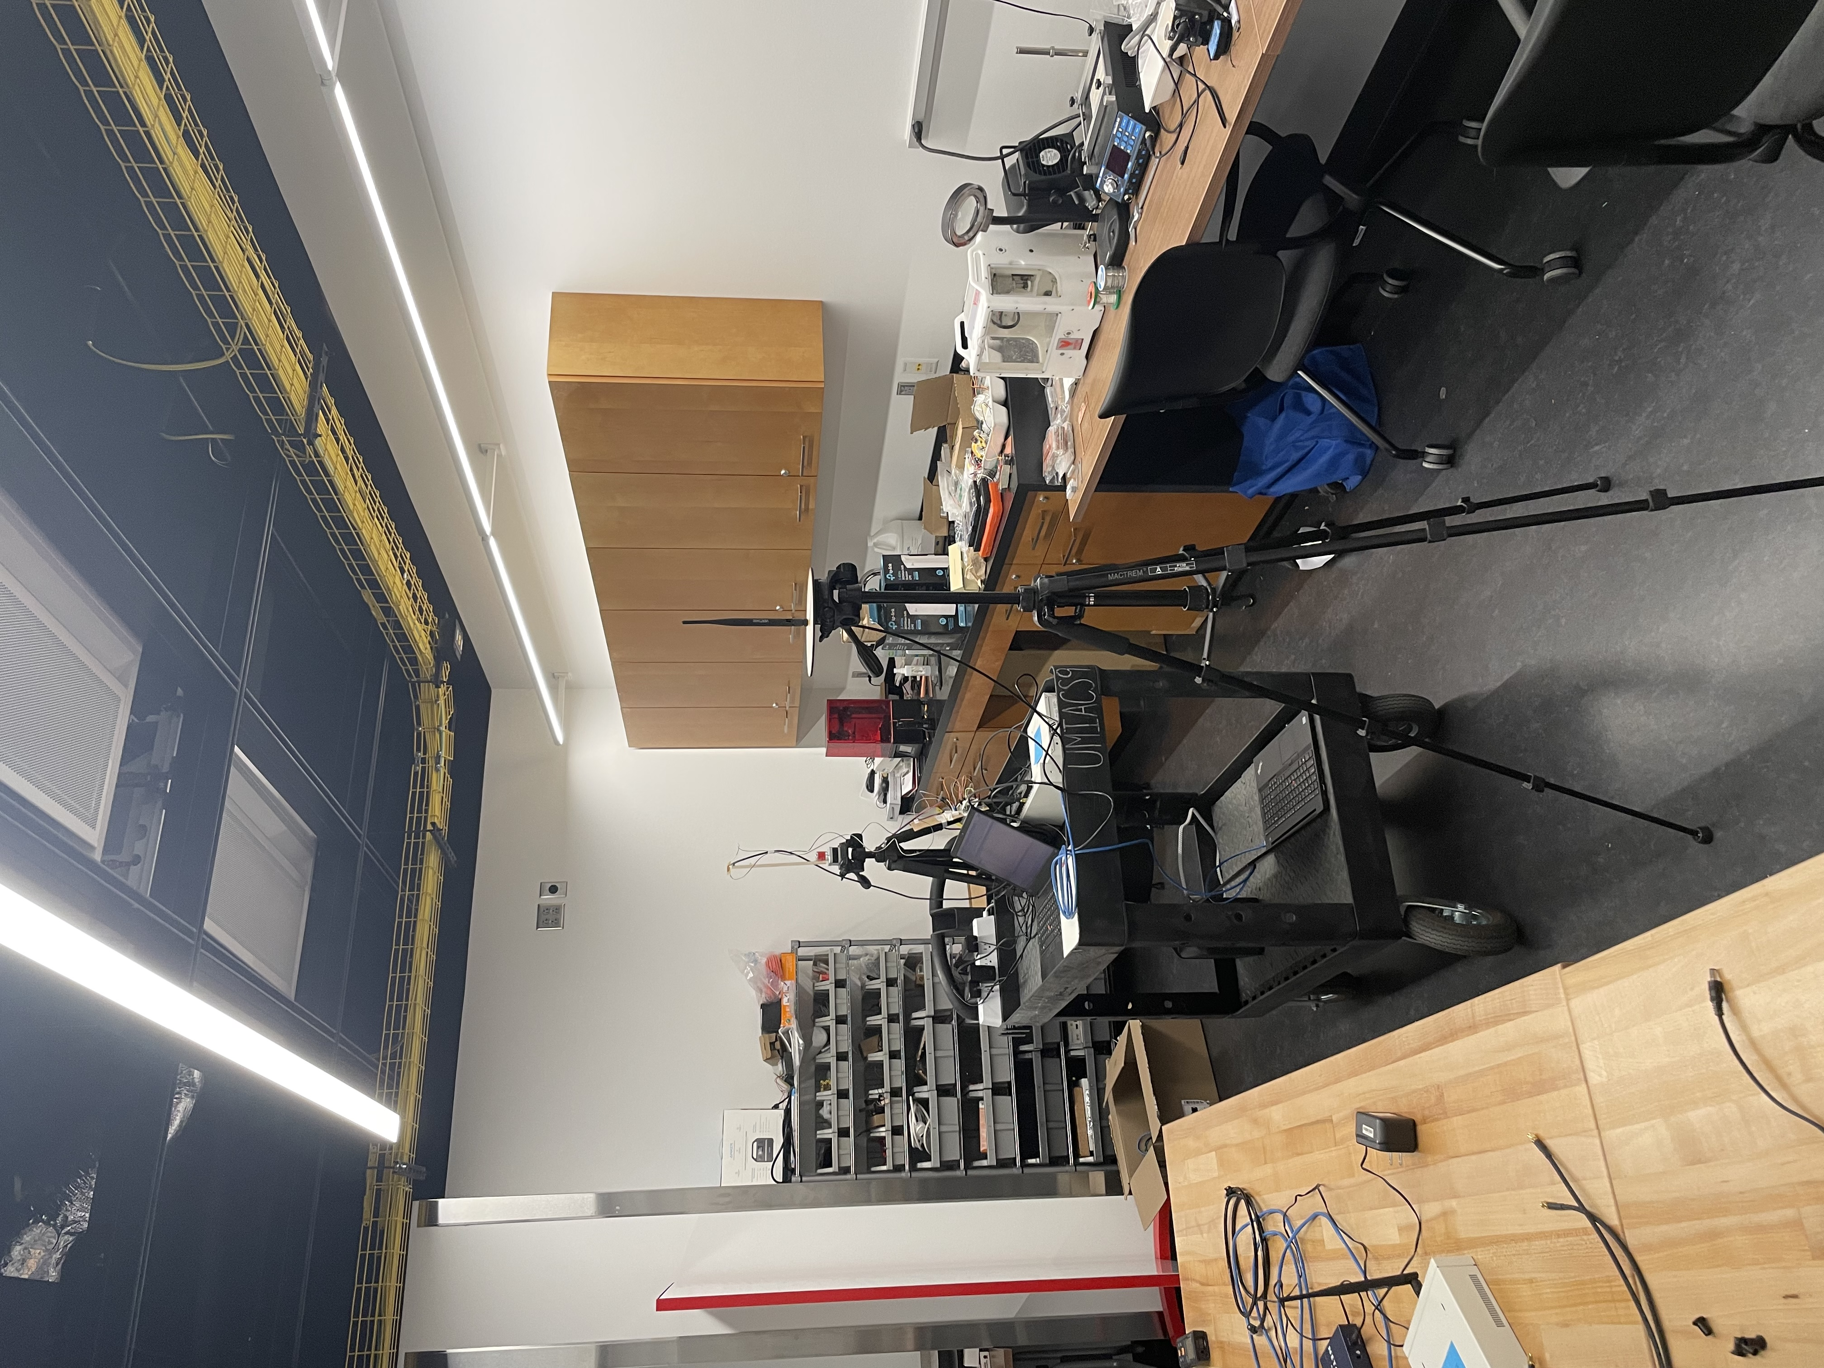
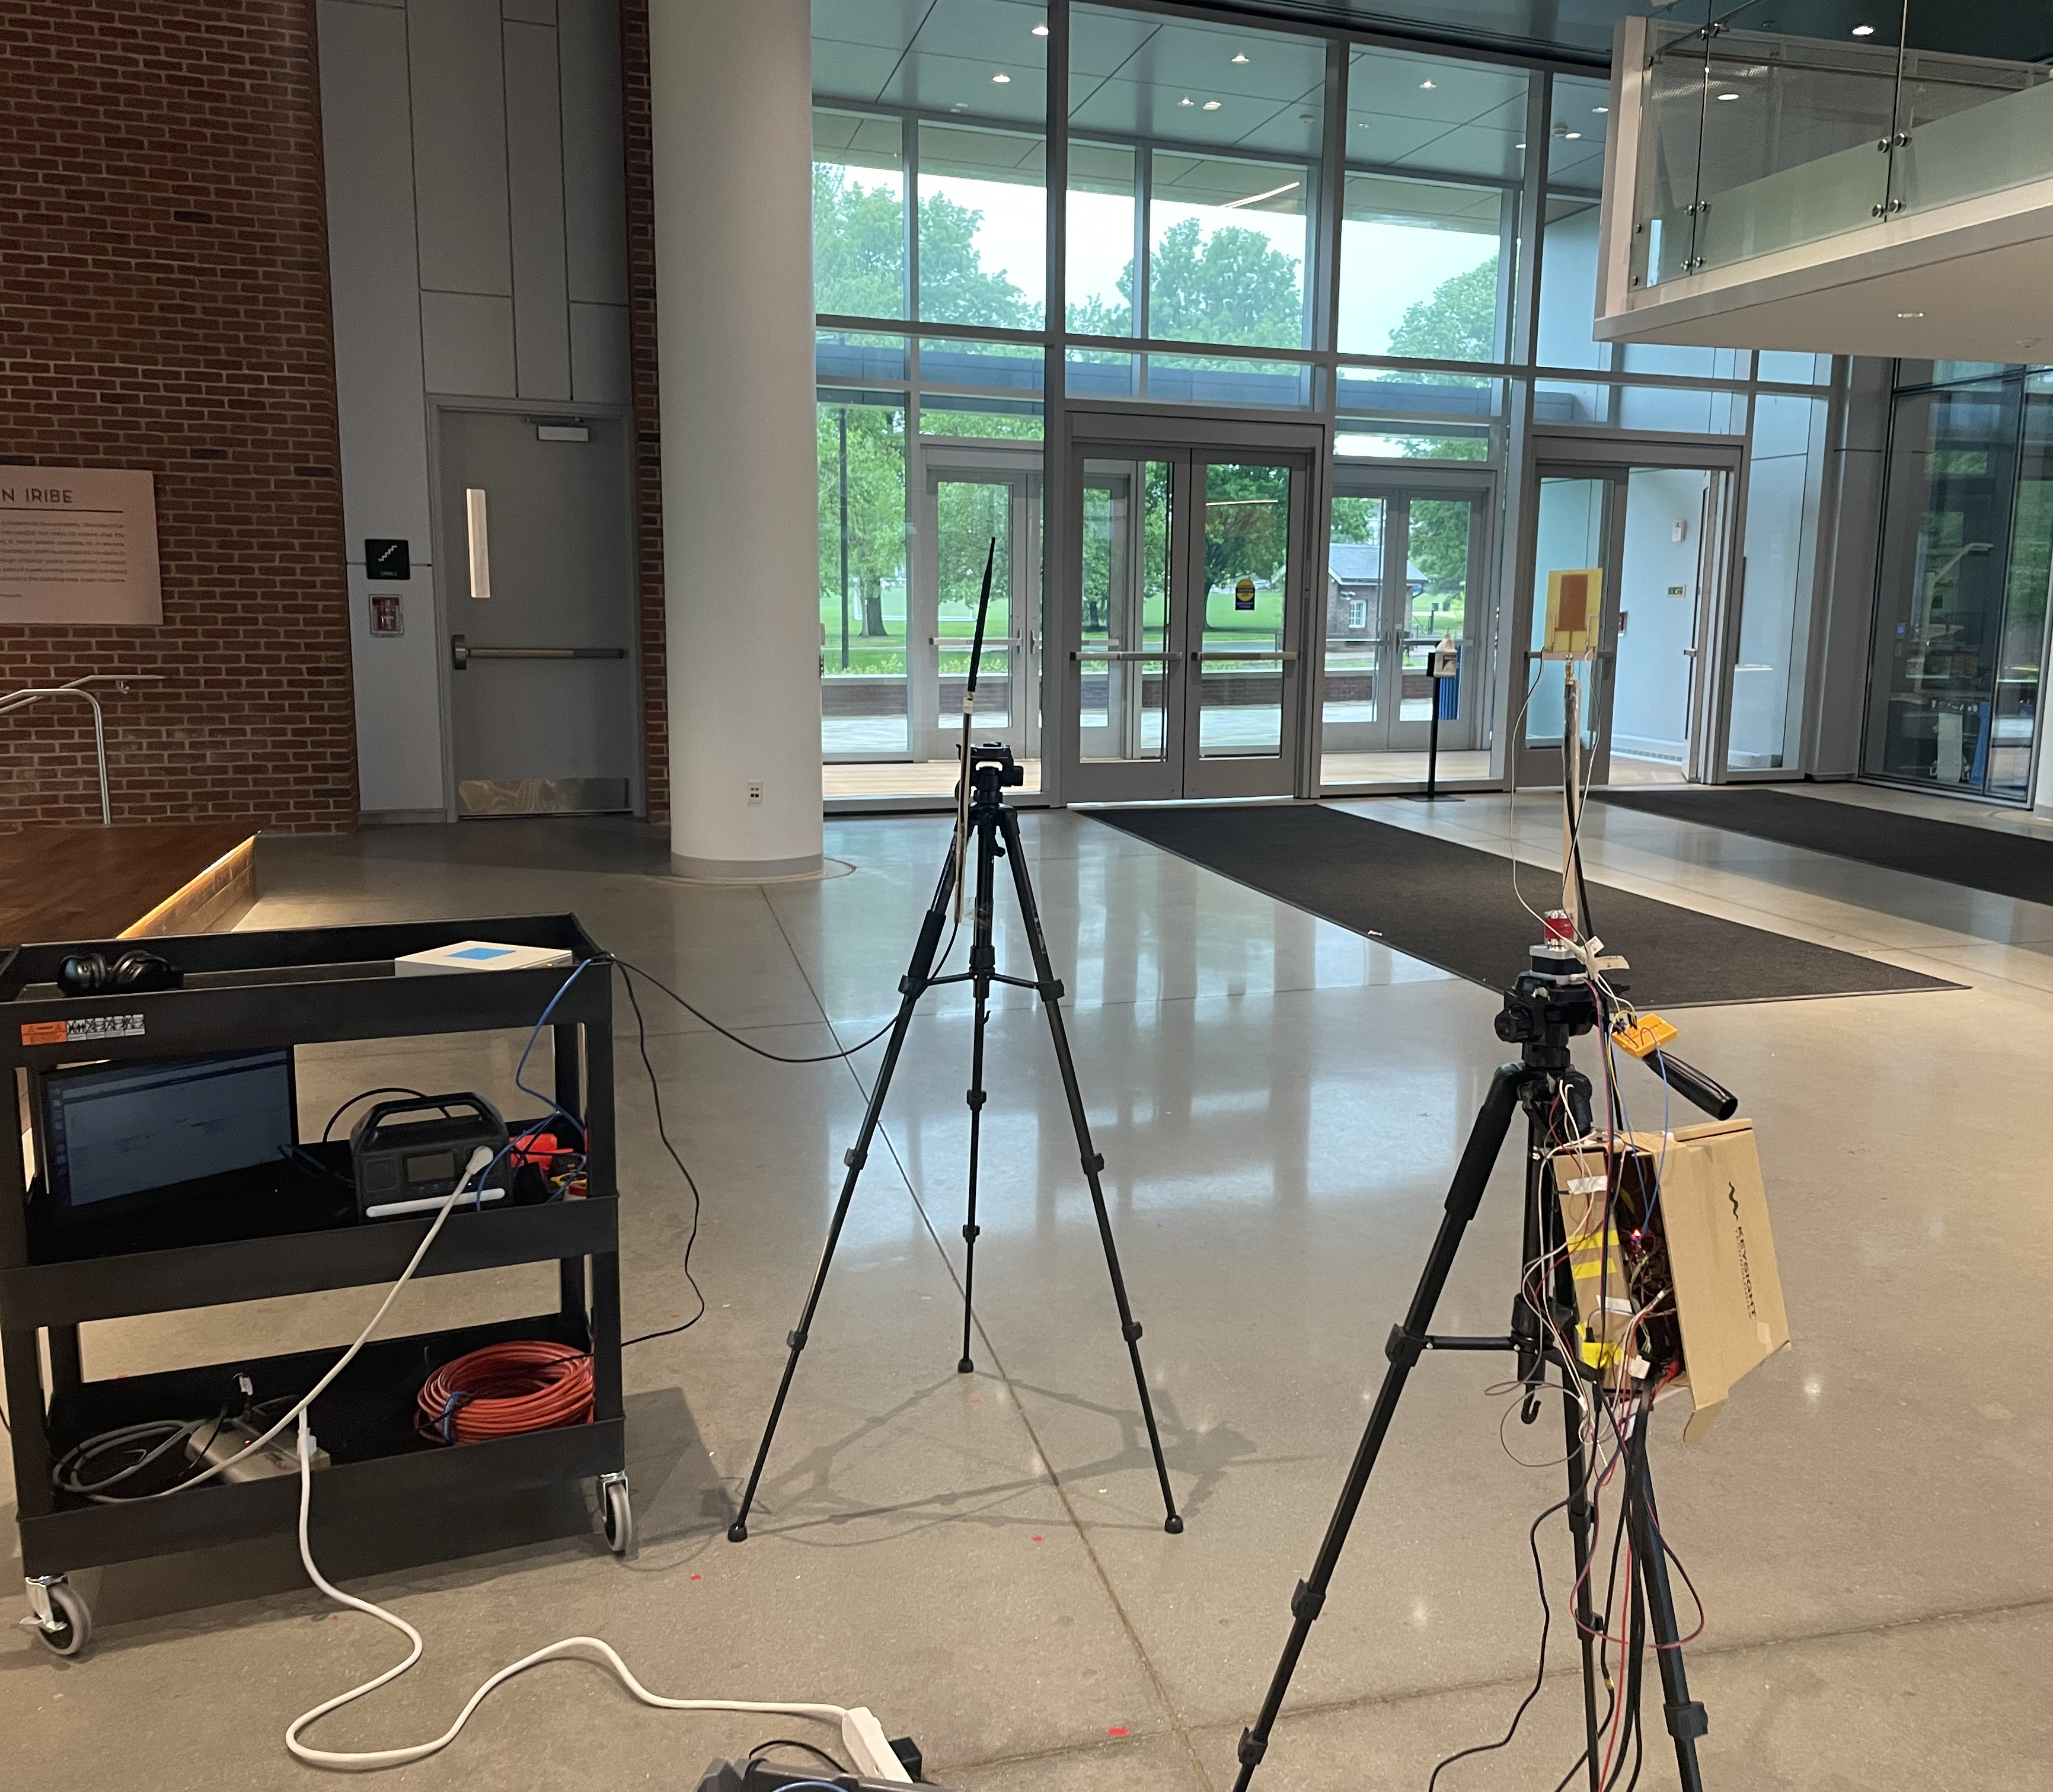
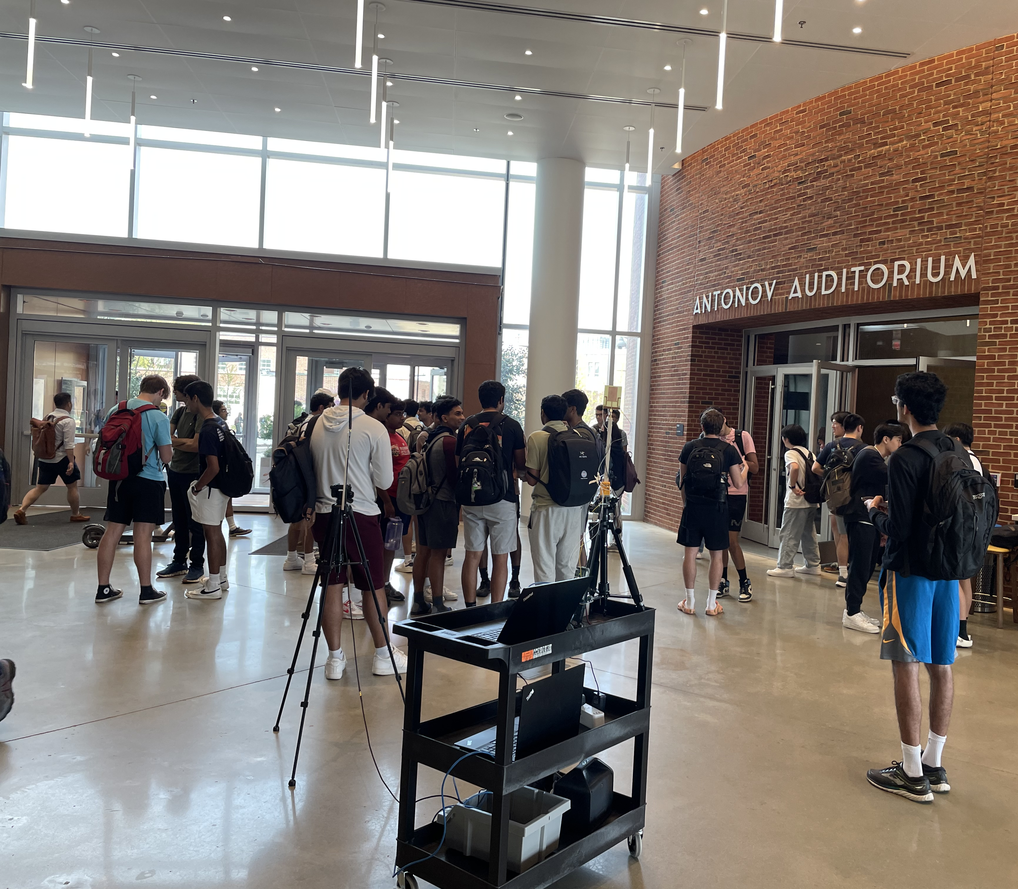
Evaluation
Notes:
We also evaluated the performance of Sirius in varying levels of multipath density.

Slide 58
Evaluation
Notes:
In most practical situations, we observed that Sirius can estimate the AoA within 10 degrees. This demonstrates the robustness of our system in various environmetns and its ability to provide reliable localization.

Slide 59
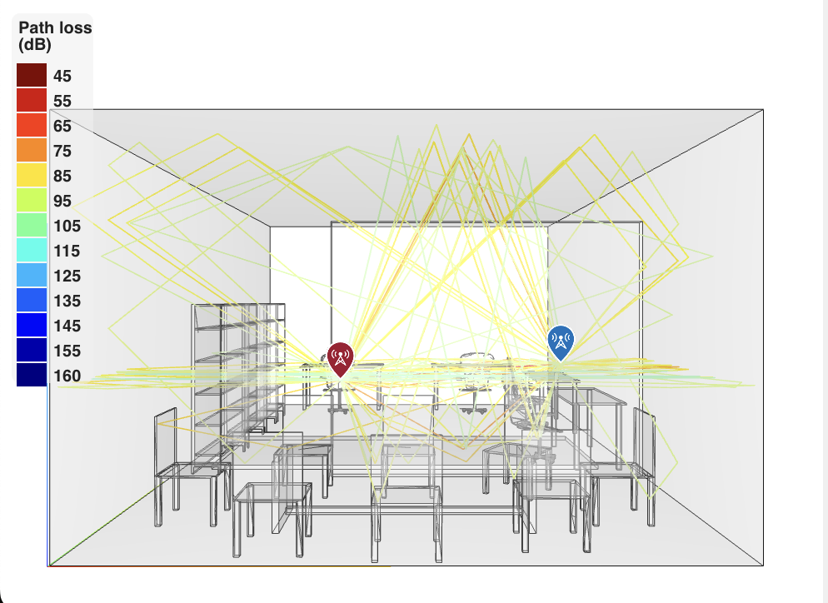
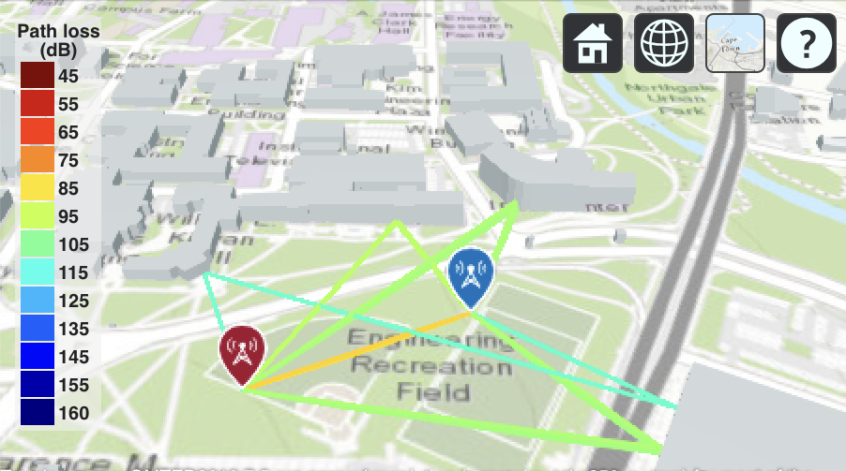
Evaluation
Notes:
To further assess the capabilities of Sirius, we conducted a simulation study that examined varying levels of LOS and NLOS cases. Our findings show that as long as there is more than 80% of the energy in the LOS path, Sirius can estimate the AoA accurately. This highlights the system's resilience in the presence of obstacles and varying propagation conditions.

Slide 60
Evaluation
+
+
=
Direct path
Reflection 1
Reflection 2
Received signal
Notes:
To further assess the capabilities of Sirius, we conducted a simulation study that examined varying levels of LOS and NLOS cases. Our findings show that as long as there is more than 80% of the energy in the LOS path, Sirius can estimate the AoA accurately. This highlights the system's resilience in the presence of obstacles and varying propagation conditions.

Slide 61
Evaluation
Notes:
To further assess the capabilities of Sirius, we conducted a simulation study that examined varying levels of LOS and NLOS cases. Our findings show that as long as there is more than 80% of the energy in the LOS path, Sirius can estimate the AoA accurately. This highlights the system's resilience in the presence of obstacles and varying propagation conditions.

Slide 62
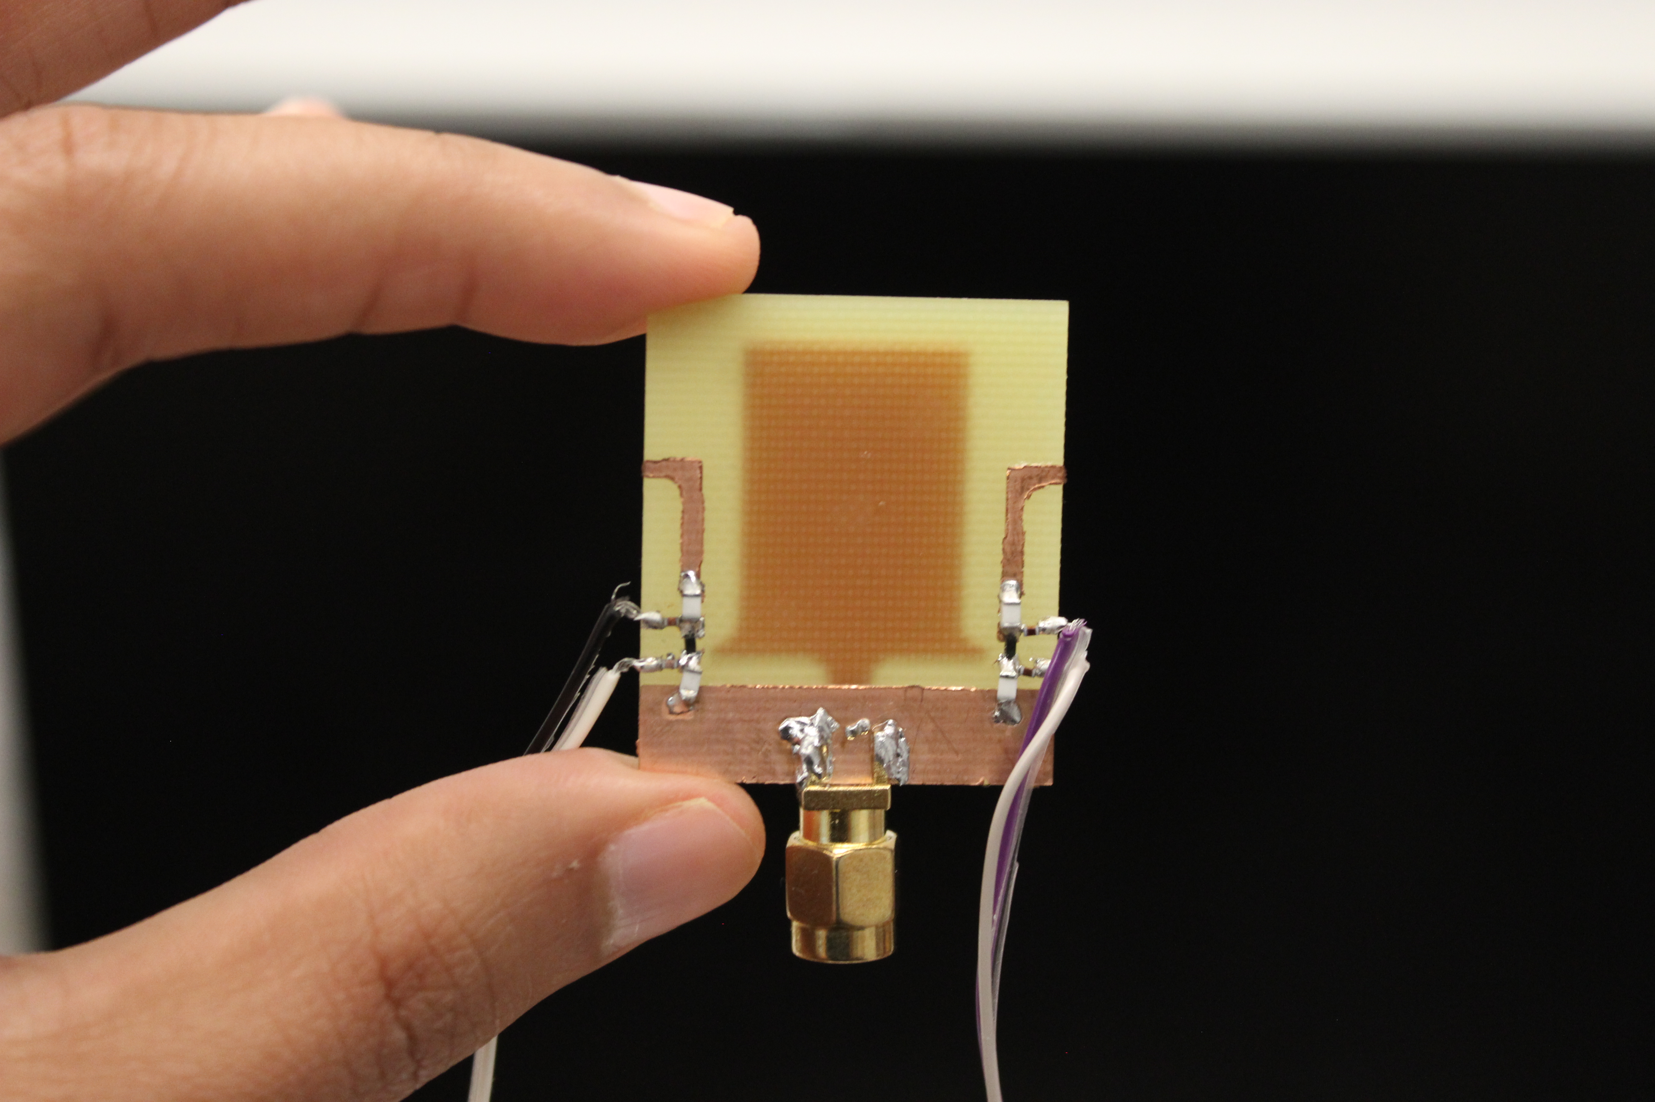

Sirius
Nakul Garg
nakul22@umd.edu
http://icosmos.cs.umd.edu
Notes:
To summarize, Sirius is a low-power self-localization system that uses a single antenna and directional code embedding to estimate the angle of arrival of a wireless signal. To learn more about Sirius and its implementation, please refer to our paper and explore our open-source artifacts. Thank you so much for listening in.

Slide 63
Evaluation
Closely placed metal surfaces create a strong multipath signal.
Notes:
We also evaluated the performance of Sirius with various types of materials as reflectors. Most common materials found in infrastructure, such as wood, brick, and glass, demonstrated excellent performance. However, we noticed a significant interference caused by metal reflectors, as they reflected the majority of the energy. This insight helps us understand the system's behavior and optimize its performance in different environments.

