Slide 1
ThermWare: Towards Side-Channel Defense
for Tiny IoT Devices
Nakul Garg, Irtaza Shahid, Erin Avllazagaj, Jennie Hill, Jun Han† , Nirupam Roy
Yonsei University†, University of Maryland College Park
Notes:
Hi everyone. my name is Nakul Garg, today I am going to present our work on side-channel defense for iot devices.
This is a joint work with Irtaza, Erin, Jennie, Prof. Jun Han and my advisor Nirupam Roy.

Slide 2
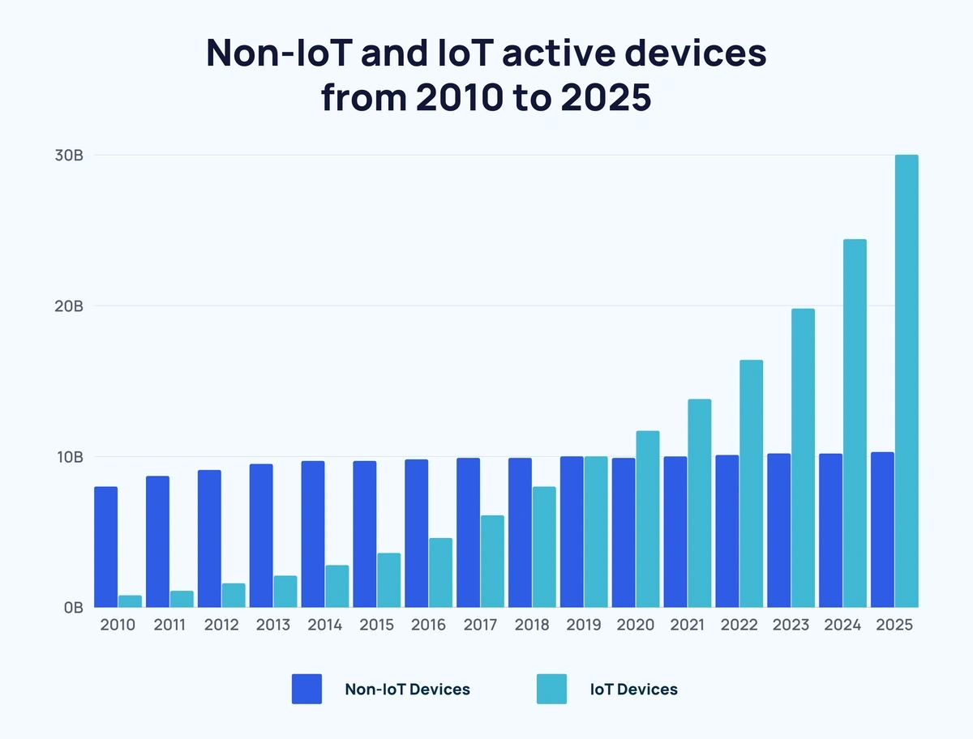
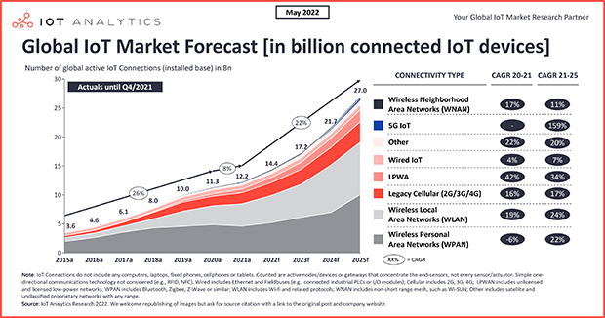
Trends in IoT
20 Billion IoT devices
Notes:
As we all know, the world is becoming more connected than ever before, and IoT devices are leading the charge.
There are currently more than 20 billion active IoT devices, and this number is rapidly increasing. Today almost everything comes with an IoT device embeded inside.

Slide 3
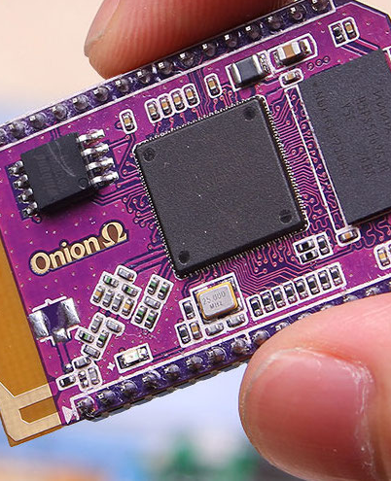
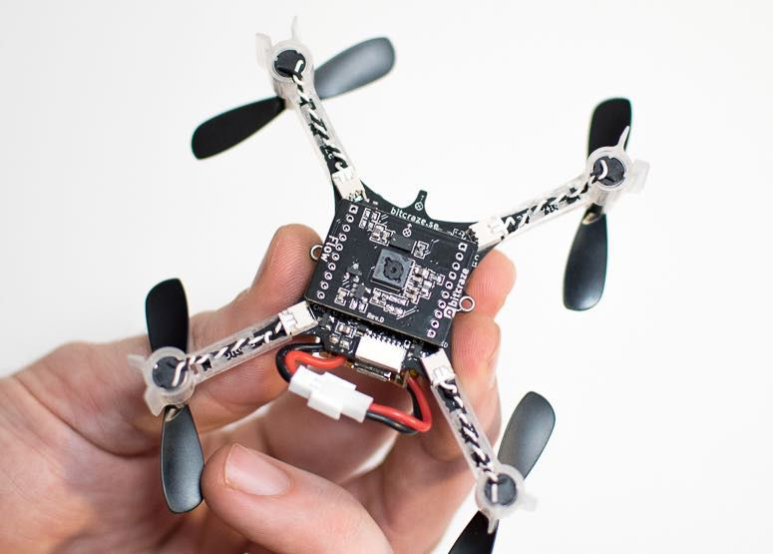
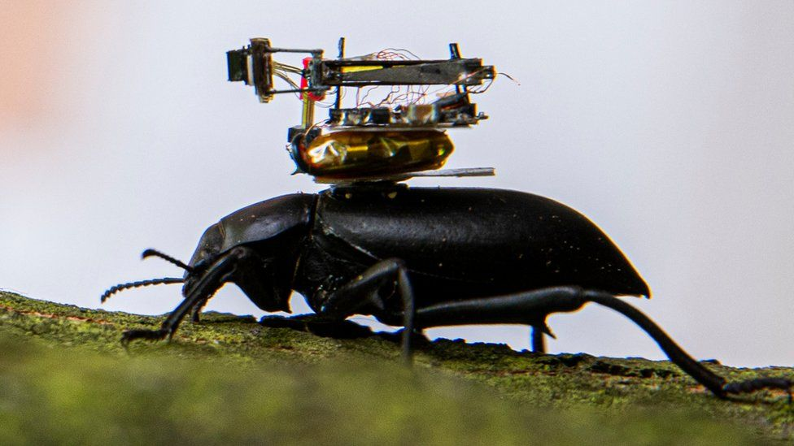
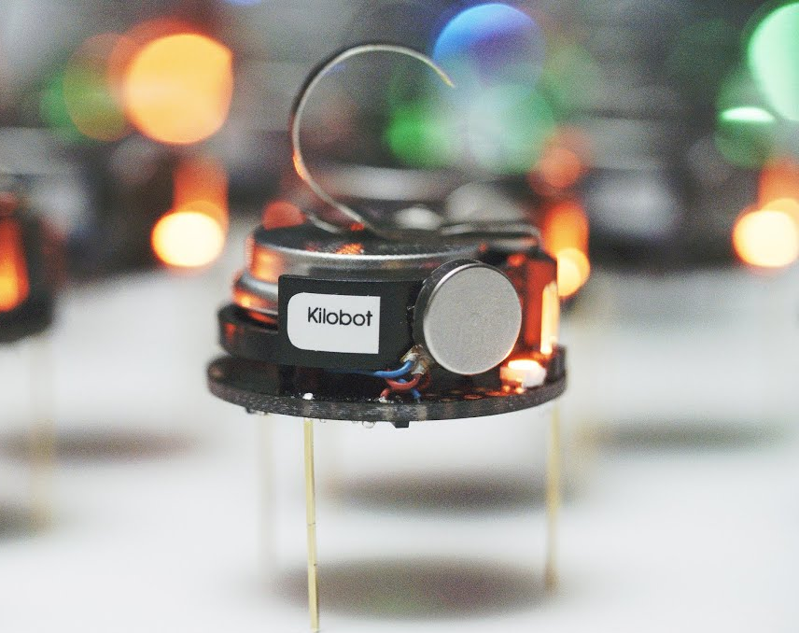
Trends in IoT
20 Billion IoT devices
Devices are getting compact
Notes:
And one clear trend is the miniaturization of these systems – things are becoming compact, complex and more application specific.

Slide 4
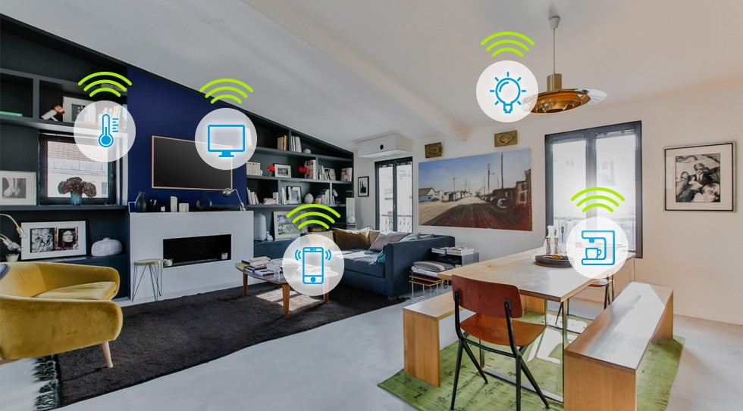
IoT at Risk
Notes:
However, one problem with miniaturization is that it comes with new vulnerabilities to security and privacy attacks.
And now, as devices get access to our private data and private spaces, it makes them a big threat.
We are at a point, when we shouldn’t be surprised if an IoT device which we use on a daily basis at our homes is used to spy on us.

Slide 5
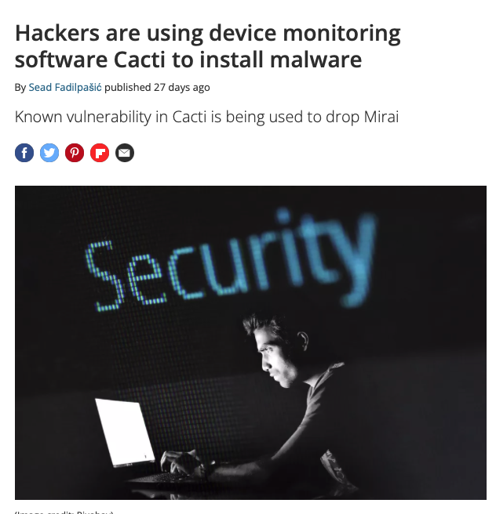
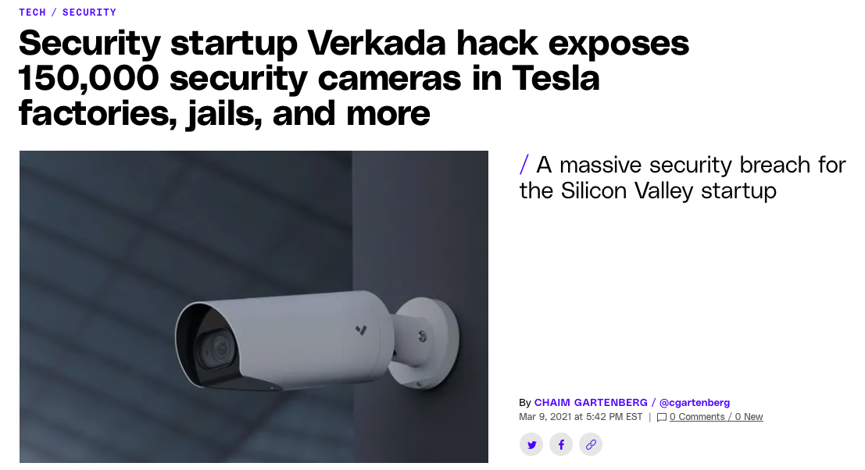
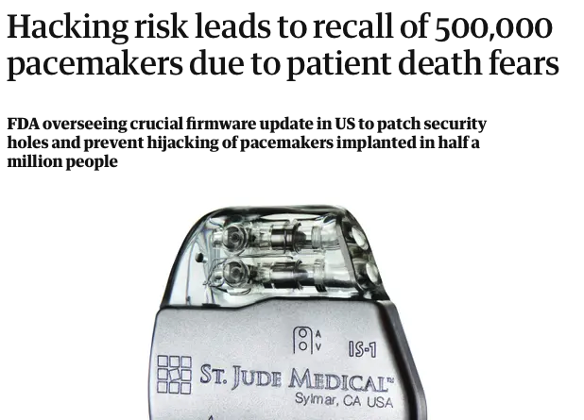
IoT at Risk
Notes:
There have already been several incidents of significant security attacks on regular IoT devices.
For instance, spying on public cameras, attacking healthcare devices, and hacking ubiquitous smart speakers with always-on microphones that listen to our conversations.
It’s just a matter of time, that we will see new kind of attacks which will be specifically launched for Tiny IoT devices.

Slide 6
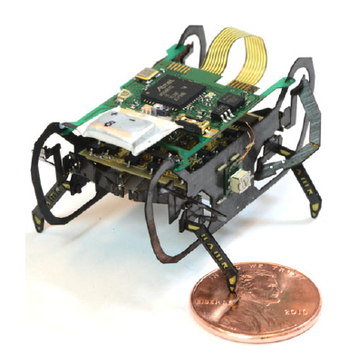
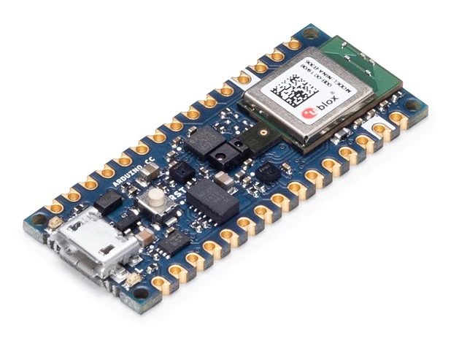
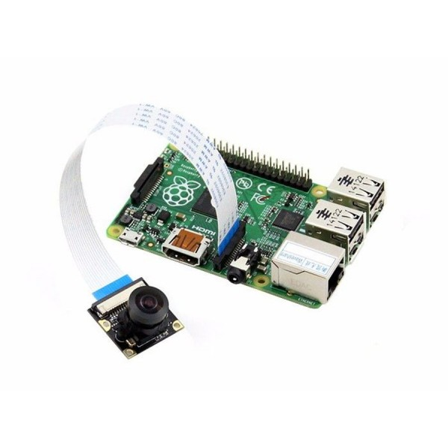
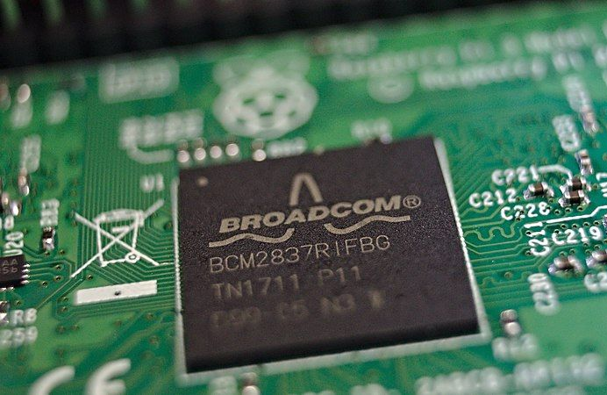
Traditional defense techniques fail
Resource-constraint systems
Insect scale robots
Arduino Nano Tiny ML
SOC on Raspberry Pi
Raspberry Pi camera
Notes:
While security has always been an interesting research area, we've never faced this kind of challenge before. These tiny IoT devices lack the resources required to run even the most basic defense softwares.
And even though we've made great strides in general security, doing it in small size is a niche problem. These tiny devices are posing a new sort of challenge to us that makes 30 years of research in security fall short while defending them.

Slide 7
Traditional defense techniques fail
Resource-constraint systems
No debugging ports
Insect scale robots
Arduino Nano Tiny ML
SOC on Raspberry Pi
Raspberry Pi camera
Notes:
The reason these embedded devices are so vulnerable is that they are resource-constrained systems with limited space and debugging ports.

Slide 8
Traditional defense techniques fail
Resource-constraint systems
No debugging ports
Insect scale robots
Arduino Nano Tiny ML
Limited compute
SOC on Raspberry Pi
Raspberry Pi camera
Notes:
Additionally, they do not have enough compute and memory for a generic OS.

Slide 9
Traditional defense techniques fail
Resource-constraint systems
No debugging ports
Insect scale robots
Arduino Nano Tiny ML
Limited compute
Specific architecture
SOC on Raspberry Pi
Raspberry Pi camera
Notes:
And they often have application-specific architectures which makes it extremely hard to implement security measures on them.

Slide 10
Side-channel Attack Defense
Notes:
Our solution is made on something unintuitive.
You have probably heard of side channel attacks. We are building a side channel defense.

Slide 11
Side-channel Attack Defense
Acoustic
Power consumption
Clock skew
Electromagnetic (EM) leaks
Notes:
Side-channel exploit the extra information generated by a system's implementation, such as the sound produced by the system or power consumption traces, to get unauthorized information of the device.
But what if we could use these side channels for defense purposes?

Slide 12
ThermWare: Thermal Side-channel Defense
Thermal image sequence
Notes:
In this work, we're taking advantage of these side channels to develop a new approach to security.
We are introducing a defense system that leverages thermal signatures to detect malware on resource-constrained IoT devices.
The thermal side-channel allows us to non-invasively monitor and analyze an embedded system, providing us with insights into any anomalous operation that may be running.

Slide 13
All operations leave a thermal signature
High level language
Assembly level
int spy_alexa()
{
record_audio()
speech_to_text()
upload_to_server()
}
PROC
LOOP: ADD R1, R2
ADD R1, R3
.
.
.
MUL R5, #2
RET
CMP AX, 97
Notes:
Any code written in a high-level language is converted into a set off assemble level instructions. These are simple instruction like read and write into registers and add and subtract operations.

Slide 14
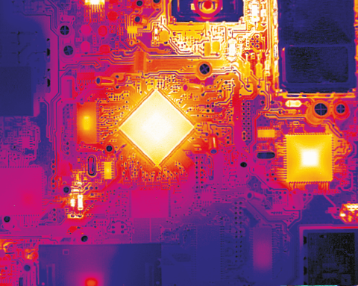
All operations leave a thermal signature
High level language
Assembly level
int spy_alexa()
{
record_audio()
speech_to_text()
upload_to_server()
}
PROC
LOOP: ADD R1, R2
ADD R1, R3
.
.
.
MUL R5, #2
RET
CMP AX, 97
Notes:
This code is then loaded onto the hardware and executed.
When these instructions are executed on the hardware, the various transistors and resistors inside the chip switch on and off.

Slide 15
All operations leave a thermal signature
ADC
Wi-Fi, BLE
High level language
Assembly level
int spy_alexa()
{
record_audio()
speech_to_text()
upload_to_server()
}
PROC
LOOP: ADD R1, R2
ADD R1, R3
.
.
.
MUL R5, #2
RET
CMP AX, 97
Memory
LAN
Processor
Notes:
This switching generates heat, which is directly correlated to the amount of activity happening at various modules inside the chip.
Therefore, if we can successfully detect this heat, it can be a side channel to identify the ongoing operations.
Our hotmobile paper, is our first successful attempt to show that such thermal signatures can be a side-channel to detect malware in embedded systems.

Slide 16
ThermWare: Thermal Side-channel Defense
Notes:
Here is an overview of Thermware. We first use a thermal camera to capture a sequence of images and then extract features from these images.
Then we use these spatio-temporal identify micro-operations running on the device and finally we train a machine learning model to identify if there is a malware running on the device.

Slide 17
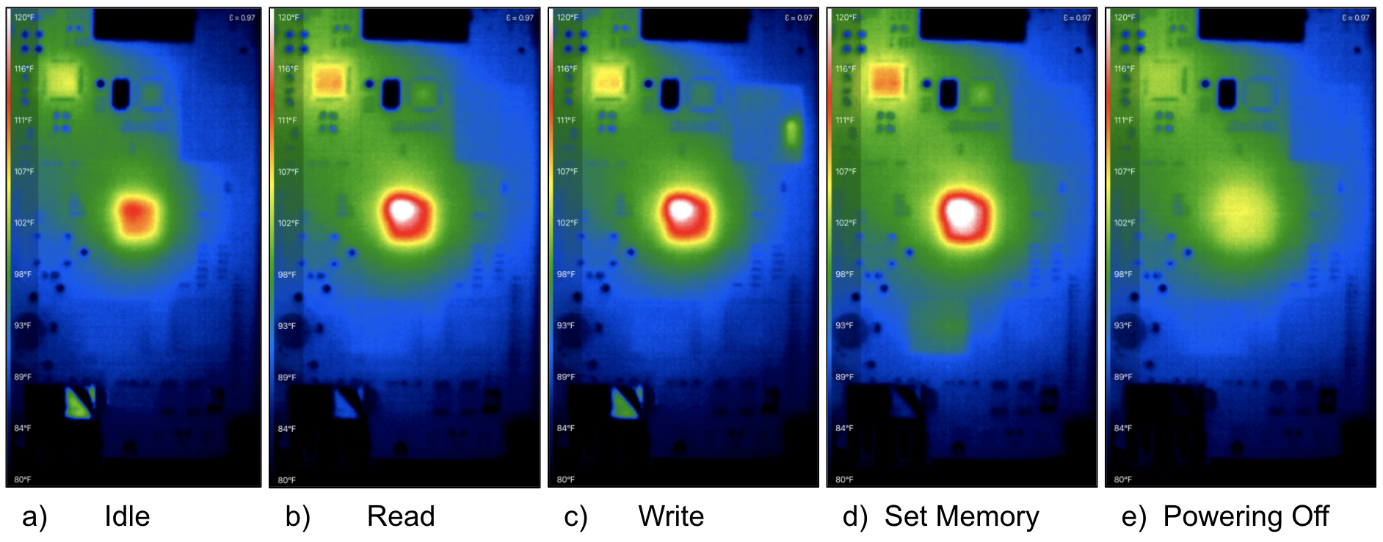
Spatio-temporal thermal monitoring can reveal underlying operations
Power management
Embedded Multimedia Card (EMMC storage)
Time
Microprocessor
Notes:
Here is a feasibility experiment that we did using a off the shelf camera and a development board.
The board is a beagle bone black and here we have highlighted the Power Management IC, the Embedded Multimedia Card and the microprocessor in the center.
On the right we see that as we excecute different file read and write operations, the corresponding parts emit heat.

Slide 18
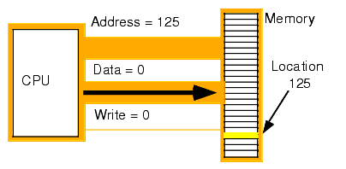
Detecting micro-operations [file writing]
Research Question 1:
Can we detect micro-operations like file writing from heat signatures?
Image processing-based detection
Learning-based detection
Research Question 2:
Can we identify if detected micro-operations are due to a malware?
Isolation Forests
Local Outlier Factors
Notes:
In this work we ask two research questions. First. Can we detect micro-operations which are the fundamental blocks of any embedded system? We have picked file writing. And we build a image processing based technique and a learning based technique.
The second question that we ask is, Can we look at a series of micro operations and classify if this is normal behaviour or a malware is present. For this we use two of the most popular approaches for malware detection which are Isolation Forests and Local Outlier Factors.

Slide 19
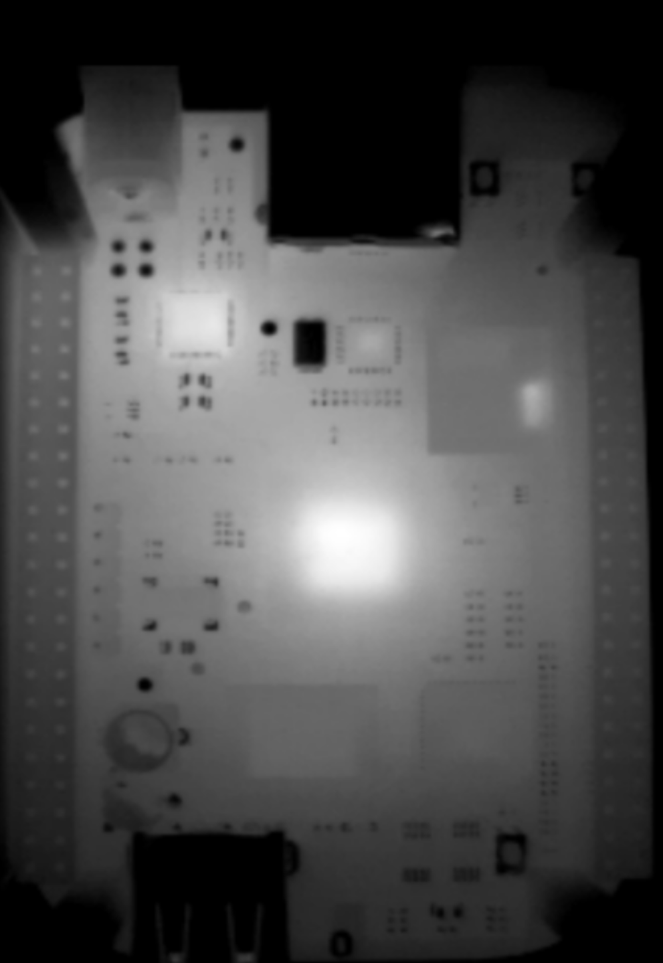
RQ1: Image processing-based detection
Captured frame from thermal camera
Notes:
In the Image processing method we take a thermal video of the device and extract features frame by frame.
Here we have taken the mean intensity of the pixels as our feature. On the write we see that it already shows a trend which correlates with the ground truth file write operation.
We remove the jitter noise by appling a low pass filter and takeing the first derivative of the signal.
By taking a threshold, we can classify if the operation is a file write or not.

Slide 20
RQ1: Image processing-based detection
eMMC
Captured frame from thermal camera
Notes:
In the Image processing method we take a thermal video of the device and extract features frame by frame.
Here we have taken the mean intensity of the pixels as our feature. On the write we see that it already shows a trend which correlates with the ground truth file write operation.
We remove the jitter noise by appling a low pass filter and takeing the first derivative of the signal.
By taking a threshold, we can classify if the operation is a file write or not.

Slide 21
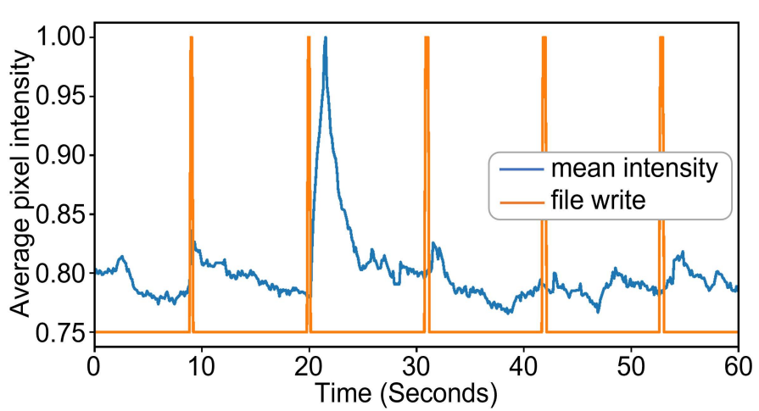
RQ1: Image processing-based detection
Feature extraction
eMMC
Captured frame from thermal camera
Notes:
In the Image processing method we take a thermal video of the device and extract features frame by frame.
Here we have taken the mean intensity of the pixels as our feature. On the write we see that it already shows a trend which correlates with the ground truth file write operation.
We remove the jitter noise by appling a low pass filter and takeing the first derivative of the signal.
By taking a threshold, we can classify if the operation is a file write or not.

Slide 22
RQ1: Image processing-based detection
File write
Feature extraction
eMMC
Captured frame from thermal camera
Notes:
In the Image processing method we take a thermal video of the device and extract features frame by frame.
Here we have taken the mean intensity of the pixels as our feature. On the write we see that it already shows a trend which correlates with the ground truth file write operation.
We remove the jitter noise by appling a low pass filter and takeing the first derivative of the signal.
By taking a threshold, we can classify if the operation is a file write or not.

Slide 23
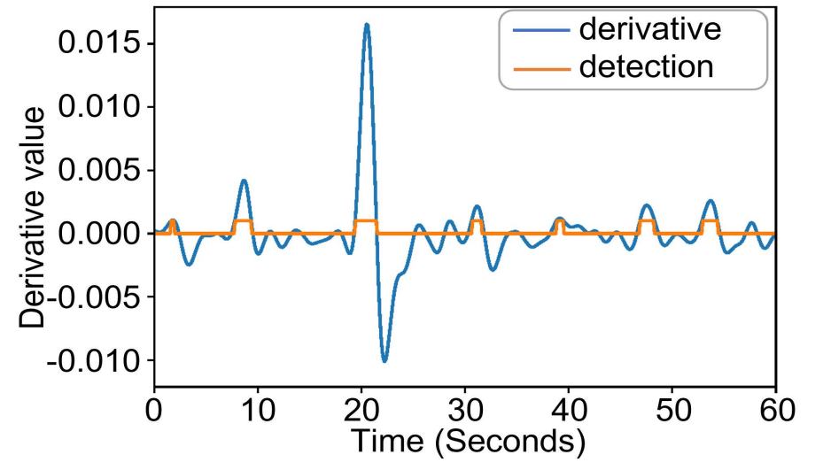
RQ1: Image processing-based detection
File write
Feature extraction
eMMC
Captured frame from thermal camera
Filtering and
smoothing
Notes:
In the Image processing method we take a thermal video of the device and extract features frame by frame.
Here we have taken the mean intensity of the pixels as our feature. On the write we see that it already shows a trend which correlates with the ground truth file write operation.
We remove the jitter noise by appling a low pass filter and takeing the first derivative of the signal.
By taking a threshold, we can classify if the operation is a file write or not.

Slide 24
RQ1: Image processing-based detection
File write
Feature extraction
eMMC
Captured frame from thermal camera
Filtering and
smoothing
File-write detected!
Thresholding
Notes:
In the Image processing method we take a thermal video of the device and extract features frame by frame.
Here we have taken the mean intensity of the pixels as our feature. On the write we see that it already shows a trend which correlates with the ground truth file write operation.
We remove the jitter noise by appling a low pass filter and takeing the first derivative of the signal.
By taking a threshold, we can classify if the operation is a file write or not.

Slide 25
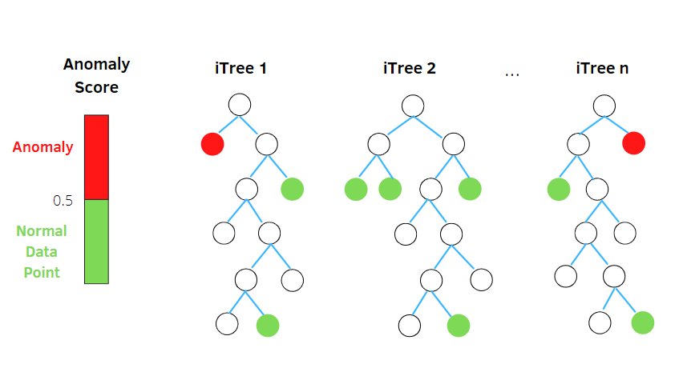
RQ2: Learning-based detection
Approaches:
Isolation Forests
Local Outlier Factors
✭ Smaller size
Notes:
We found that top 3000 pixels gave us the best representation of the region of interest.

Slide 26
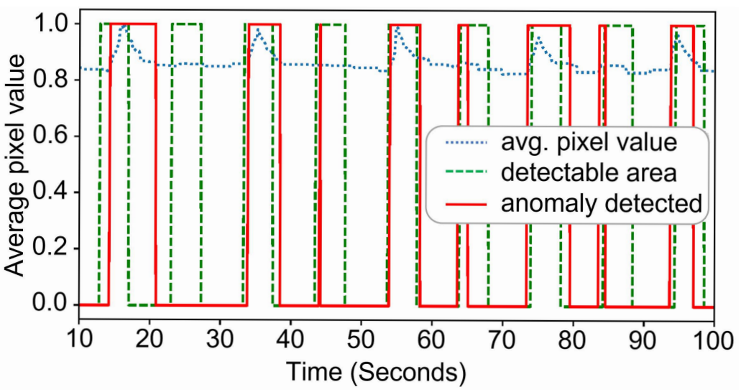
RQ2: Learning-based detection
Approaches:
Isolation Forests
Local Outlier Factors
✭ Smaller size
Feature extraction:
Step 1: Calculate min-max variability of each pixel.
Step 2: Slice top 3000 pixels for training.
Classification:
Step 3: Train IF model with 50 trees to detect anomaly.
Step 4: Run inference at 2 second sliding windows
Notes:
We found that top 3000 pixels gave us the best representation of the region of interest.

Slide 27
RQ2: Learning-based detection
Approaches:
Isolation Forests
Local Outlier Factors
✭ Smaller size
Feature extraction:
Step 1: Calculate min-max variability of each pixel.
Step 2: Slice top 3000 pixels for training.
Classification:
Step 3: Train IF model with 50 trees to detect anomaly.
Step 4: Run inference at 2 second sliding windows
Detected 8/9 anomalous file write operations
Notes:
We found that top 3000 pixels gave us the best representation of the region of interest.

Slide 28
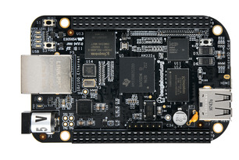
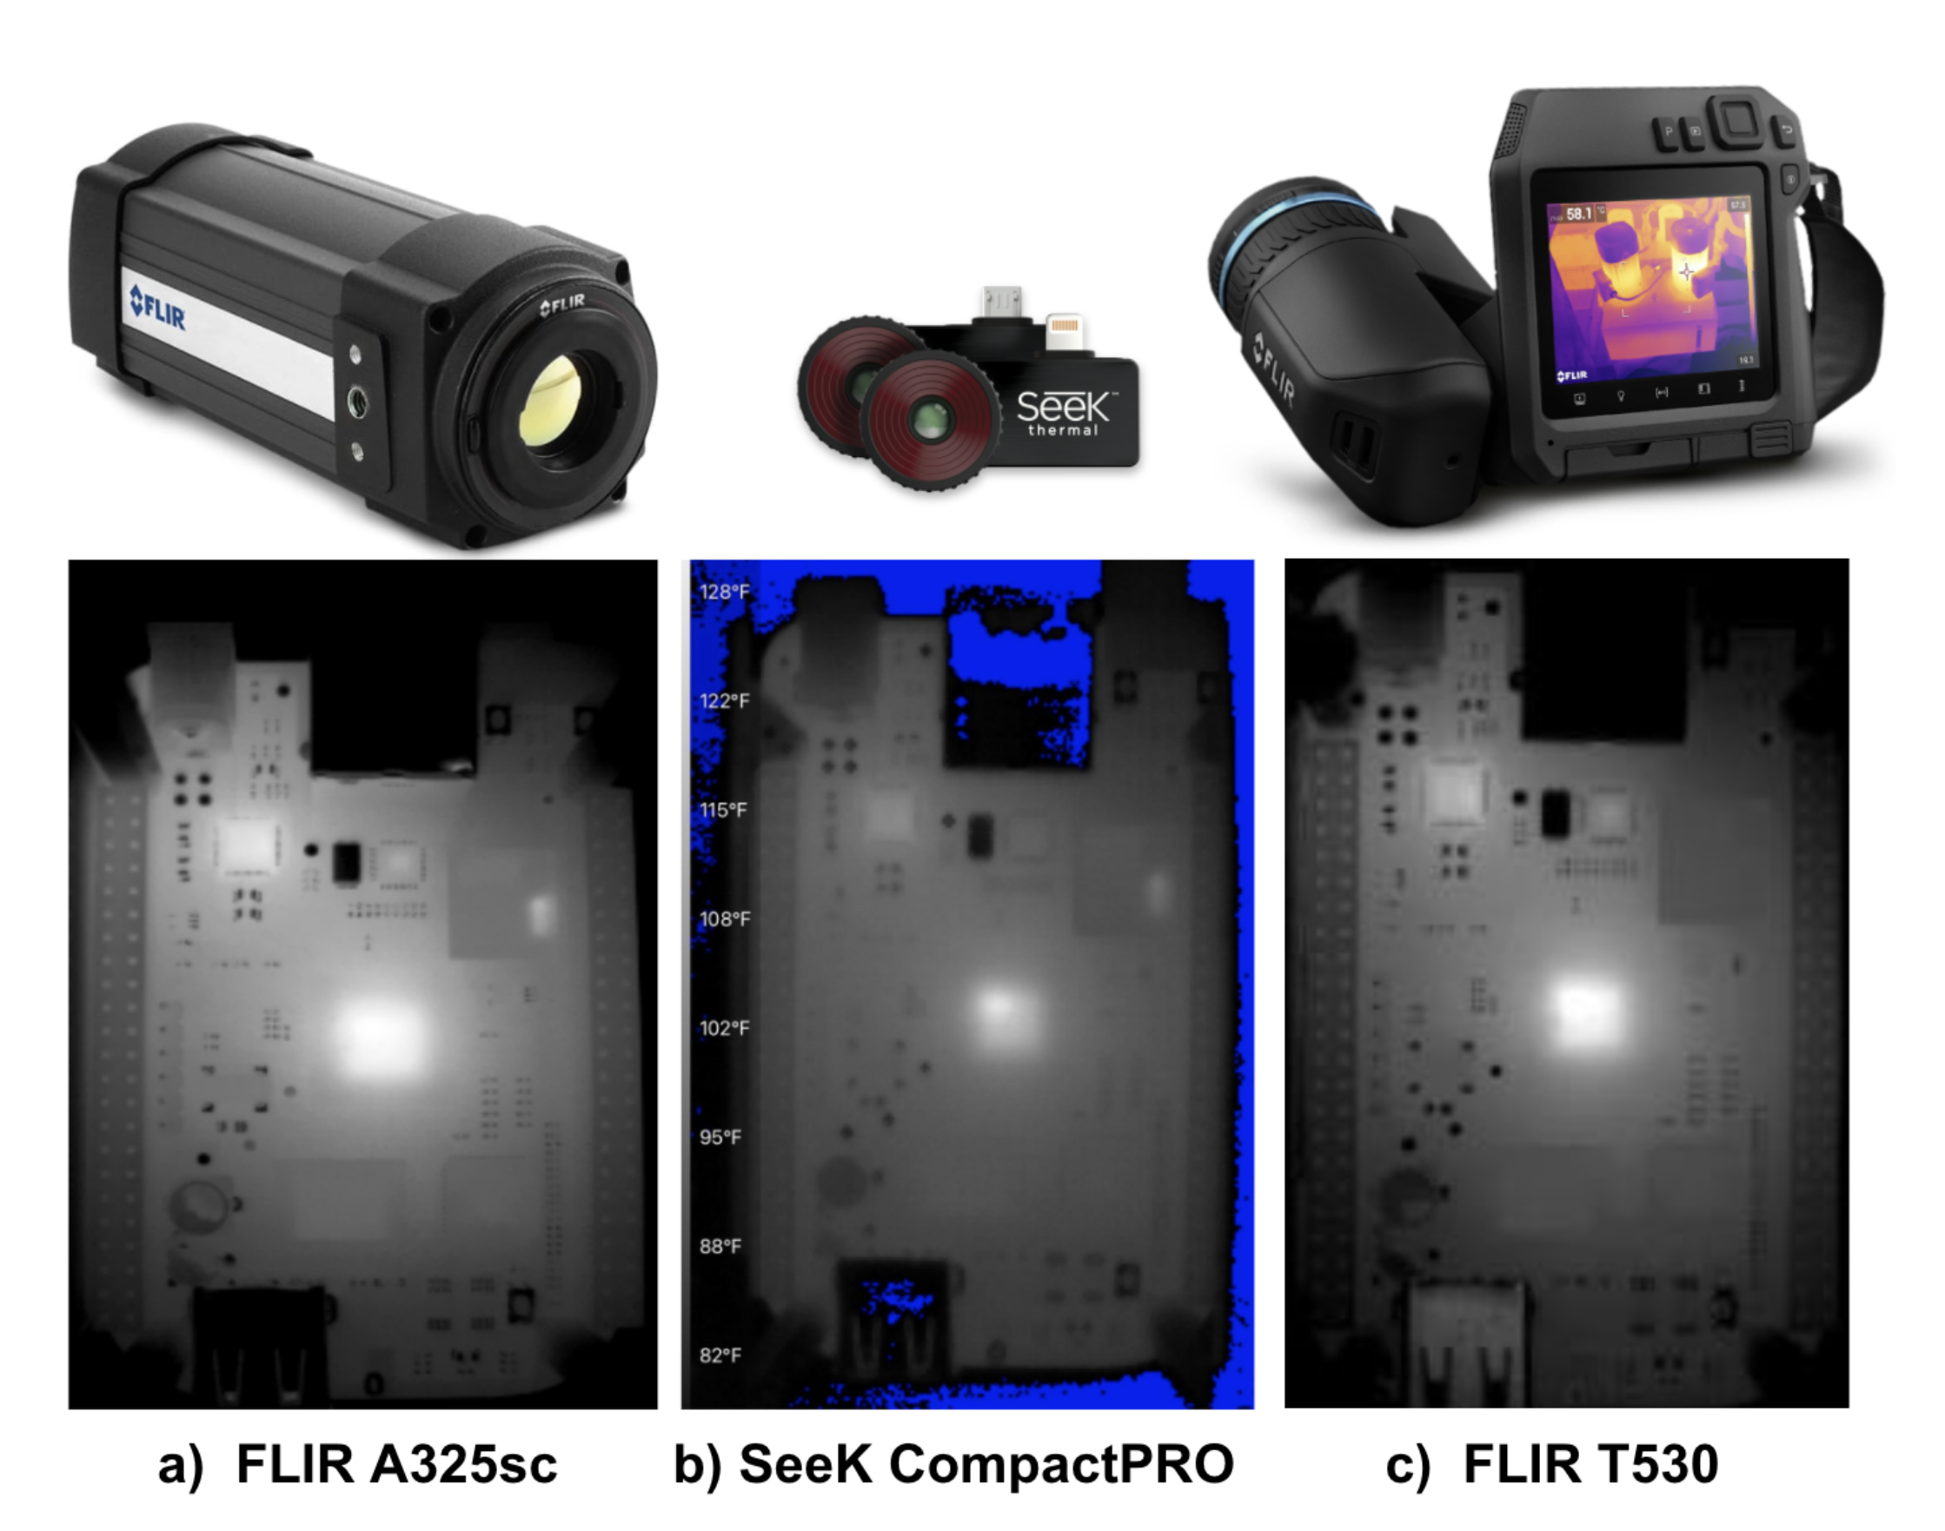
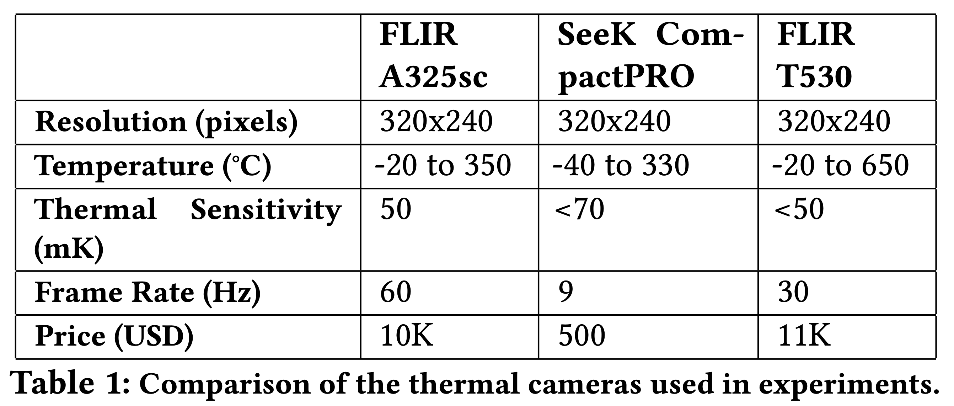
Evaluation Setup & Attack Scenarios
Single-Board Computer: BeagleBone Black
4GB 8-bit embedded Multi-Media Card (eMMC), Sitara AM3358 ARM processor, 512 MB DDR3 RAM, Ubuntu 18.04
Thermal cameras:

Slide 29
Evaluation Setup & Attack Scenarios
IoT Applications:
Temperature and air quality sensors:
Operations: Read random value -> Log in a file -> Send to server
States: Idle, Logging
Voice Assistant:
Operations: Record audio -> speech-to-text -> api call -> text-to-speech -> file write
States: Idle, Getting voice commands, Playing music
Malware: (runs in parallel to above applications)
Ransmoware SYN-flood routine from Lightaidra
Cryptomining program
Network scanning from PNScan
Telnet brute force from Mirai

Slide 30
Evaluation
Performance: File Write Detection
We perform file writes for sizes from 25KB - 1000KB
Larger file sizes (>300KB) are easier to detect

Slide 31
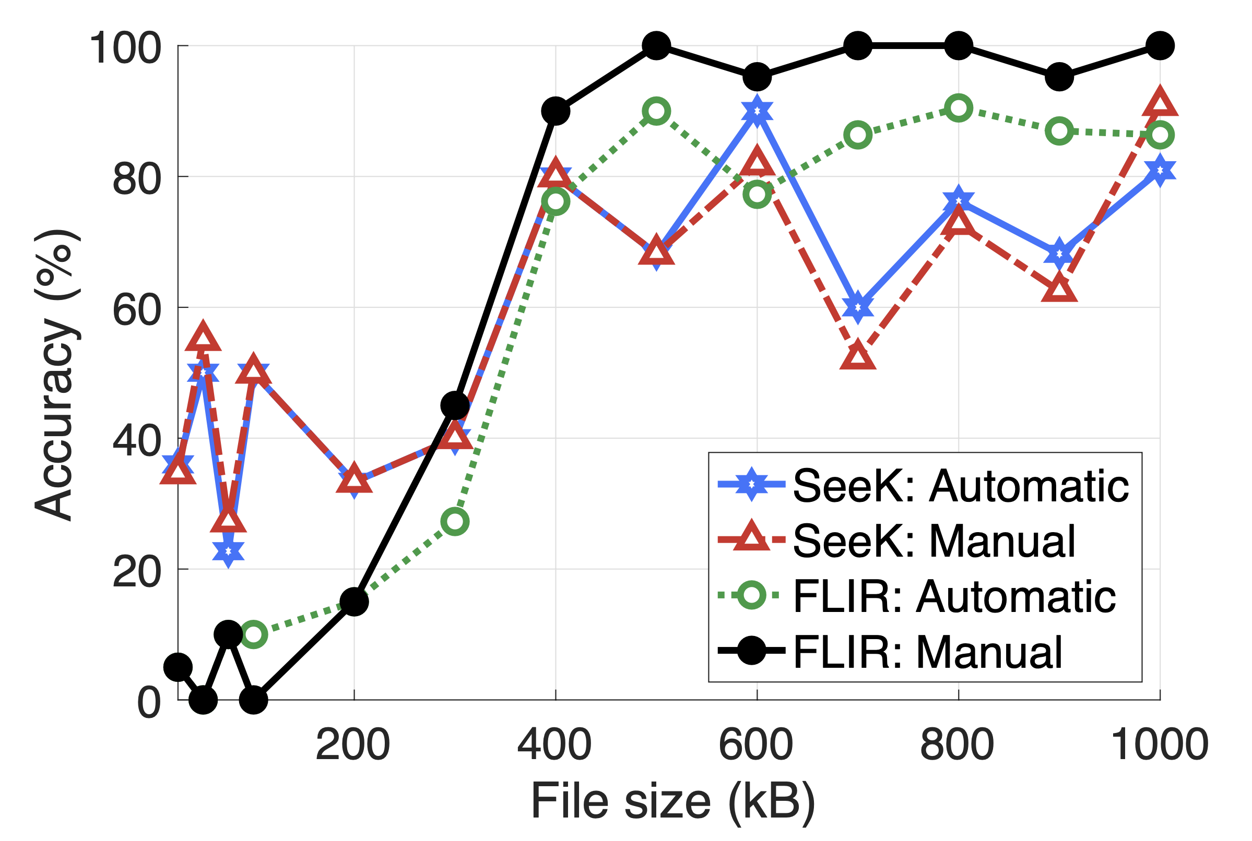
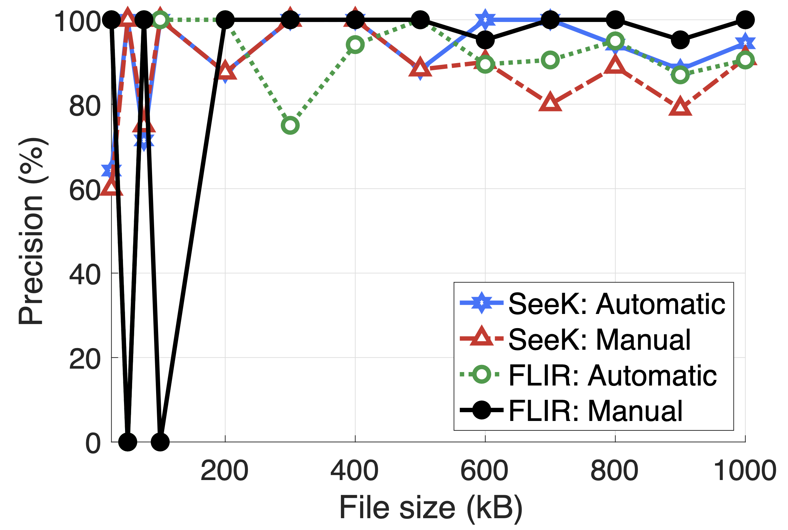
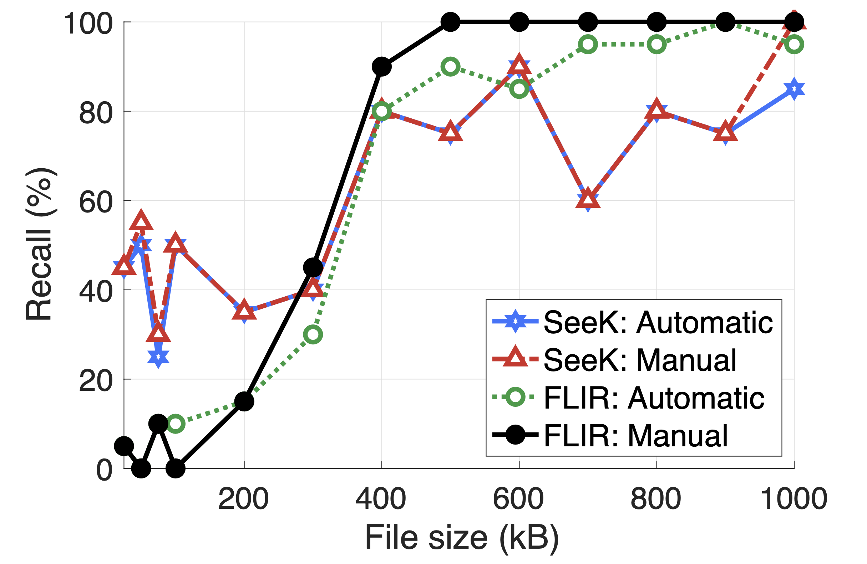
Evaluation
Performance: File Write Detection
We perform file writes for sizes from 25KB - 1000KB
Larger file sizes (>300KB) are easier to detect
Accuracy
Precision
Recall

Slide 32
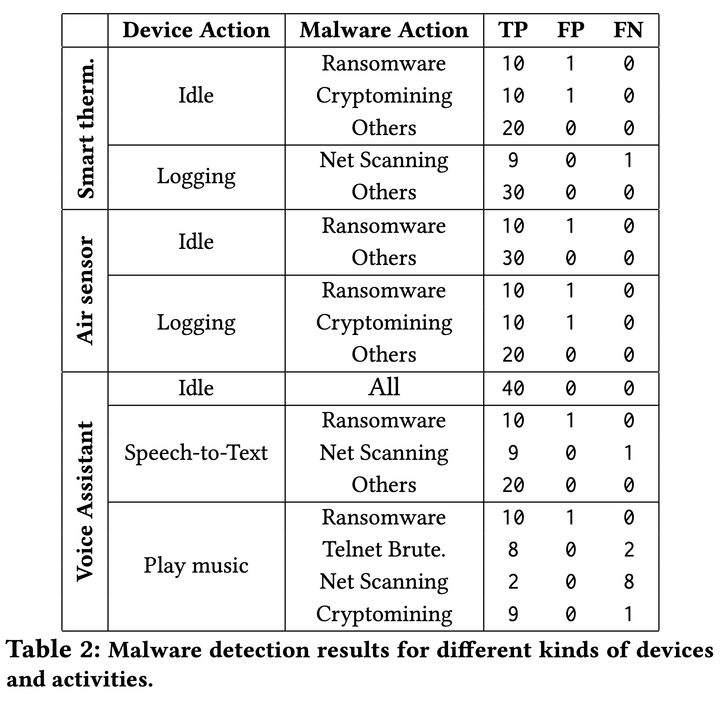
Evaluation
Performance: Malware Detection
Successful detection -> Alert raised within 1 minute of malware execution.
We run each of the malware routines on 3 applications and 4 malware actions.
Notes:
A detection is considered successful if the anomaly detector raises an alert within 1 minute of when the malware execution takes place.
False positive is counted when an alert is raised during a time window where there is no malware running and a false negative is considered when no alert is raised during malware execution.
We run each of the malware routines 10 times

Slide 33
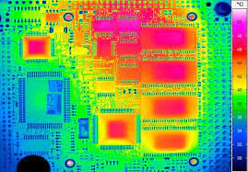
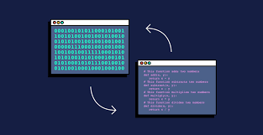
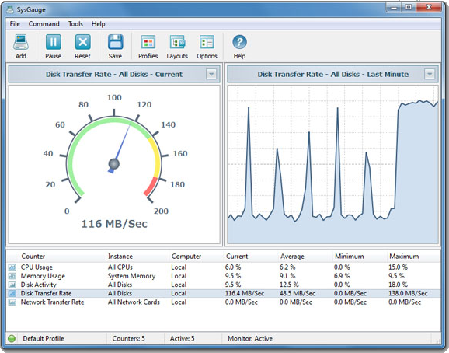
Applications beyond security
Reverse engineering operations
Performance optimization and debugging
Notes:
I’ll stop here and leave you with a. message and thermal side channels are useful I n ..
We are excited about…

Slide 34
ThermWare: Towards Side-Channel Defense
for Tiny IoT Devices
Thank you
Notes:
That’s all I have for today. Thank you very much.

Slide 36
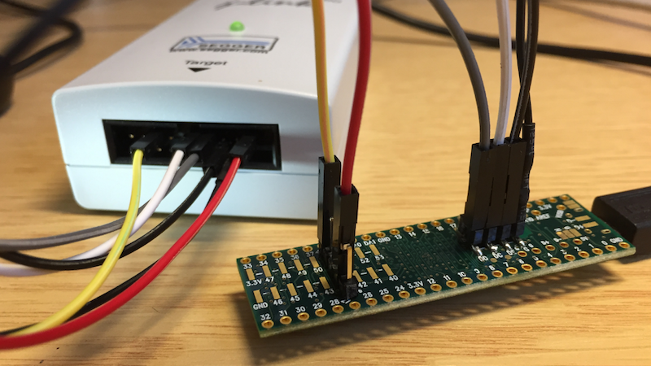
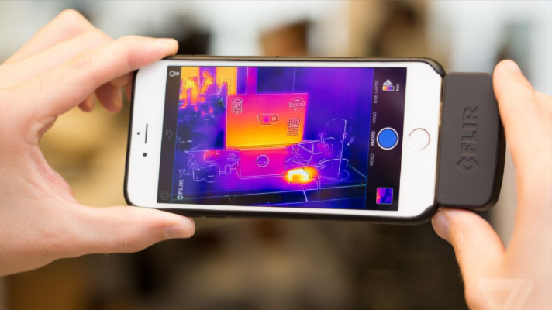
ThermWare: Thermal Side-channel Defense
Thermal image sequence
Wired
Side-channel
Notes:
In this work, we're taking advantage of these side channels to develop a new approach to security.
We are introducing a defense system that leverages thermal signatures to detect malware on resource-constrained IoT devices.
The thermal side-channel allows us to non-invasively monitor and analyze an embedded system, providing us with insights into any anomalous operation that may be running.

