Slide 1
Chapter 1 Introduction
Dana S. Nau
University of Maryland

Slide 2
Motivation
Actor: agent that performs actions
Deliberation functions
Planning
What actions to perform
Acting
How to perform them

Slide 3
Planning
Relies on prediction + search
Uses descriptive models of the actions
Predict what the actions will do
Don’t tell how to do them
Search over predicted states and possible organizations of feasible actions
Different types of actions ⇒
Different predictive models
Different planning problems and techniques
Motion and manipulation planning
Perception planning
Navigation planning
Communication planning
Task planning
a
s′ = γ(s,a)
s
• • •
Most AI planning

Slide 4
Acting
Traditional “AI planning” view:
Carrying out an action is just execution
Can ignore how it’s done
Sometimes that’s OK
If the environment has been engineered to make actions predictable
Example on next slide
Usually acting is more complicated
Example later

Slide 5
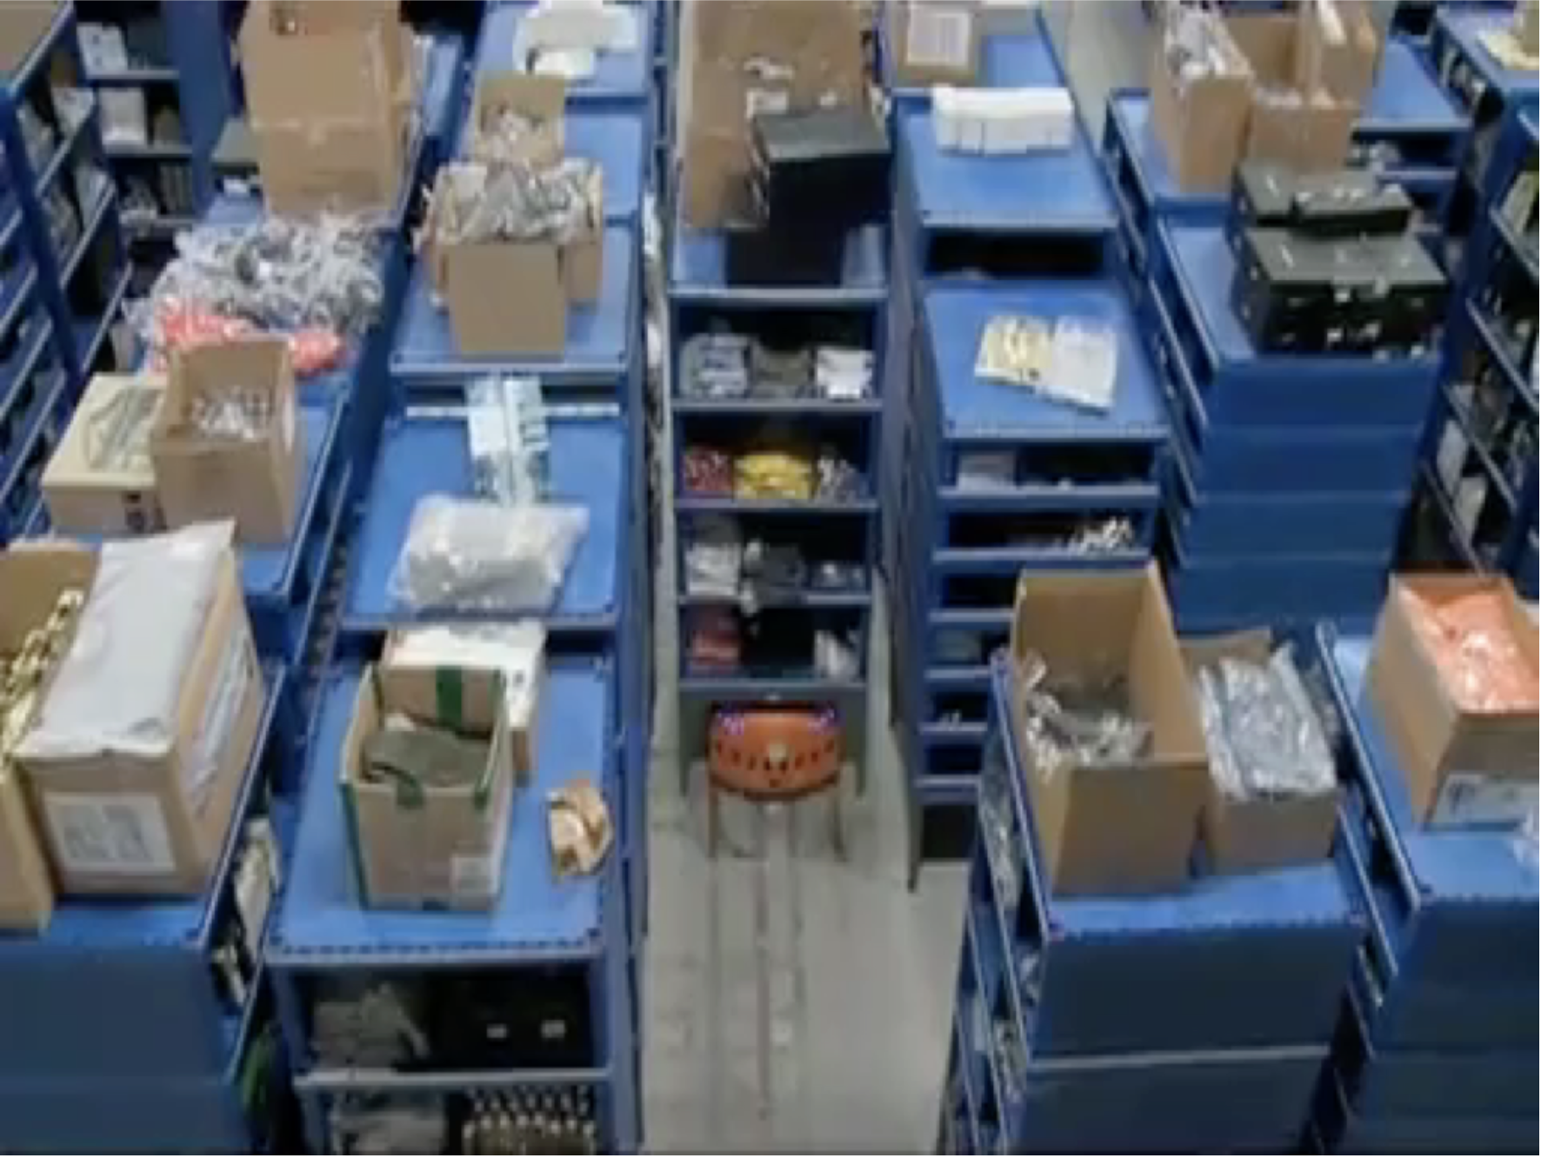
Acting as Execution
Video: https://www.cs.umd.edu/~nau/apa/kiva.mp4
Notes:
Warehouse distribution center. Automated platforms to bring cabinets to people preparing orders.
Platforms follow a precise network of guides painted on the floor. Don’t need to deliberate about how to act; environment engineered to cover all cases they’ll need to cope with.

Slide 6
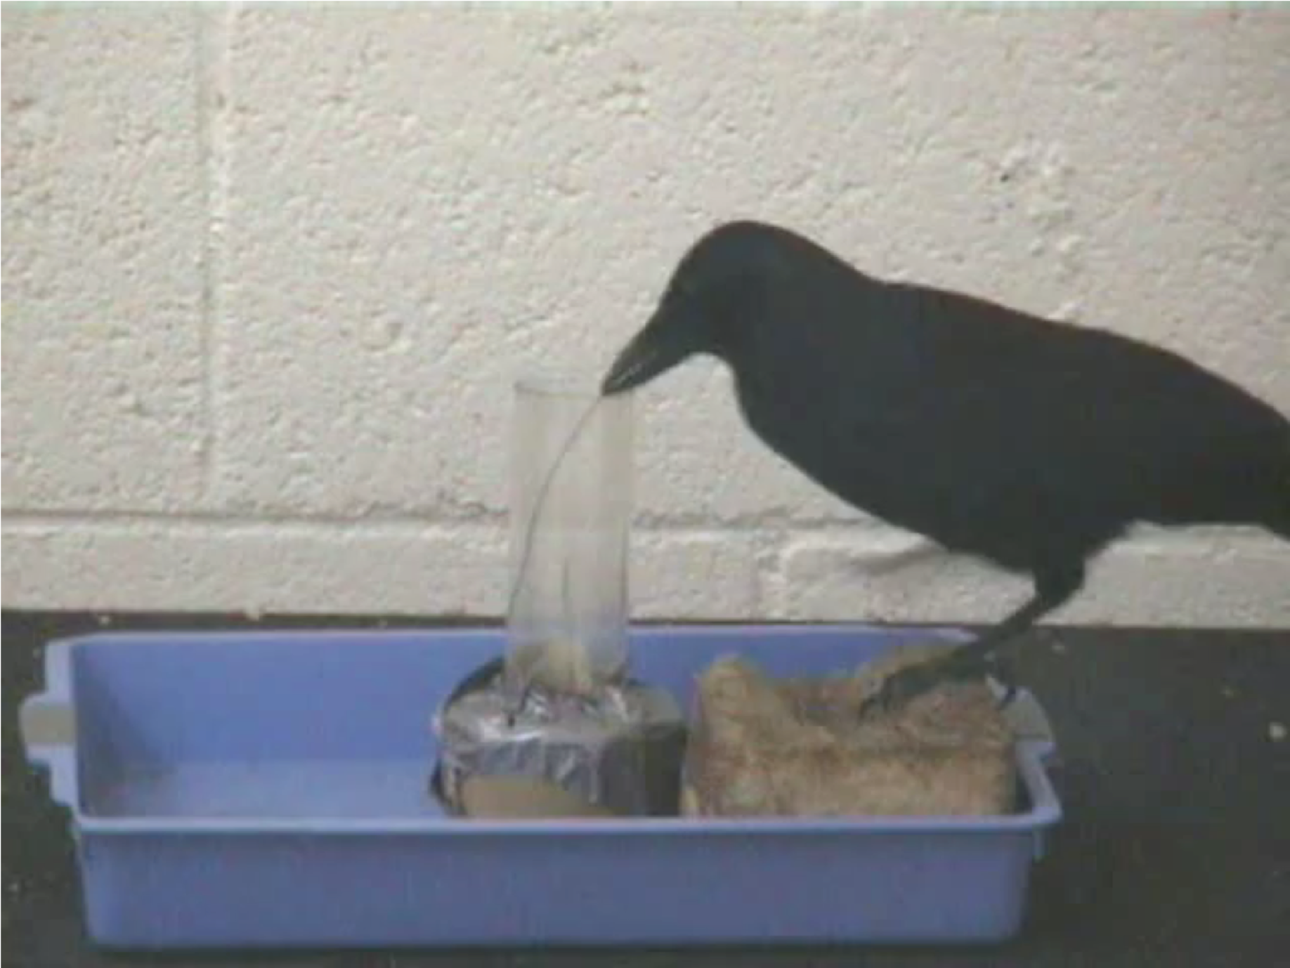
Deliberative Acting
Video: https://www.cs.umd.edu/~nau/apa/crow.mov
Notes:
New Caledonian crow trying to use a piece of wire to get food that’s out of reach, figures out it won’t work
Figures out how to brace the wire to bend it into a hook, uses the hook to get the food

Slide 7
Deliberative Acting
Actor is in a dynamic unpredictable environment
Adapt actions to current context
React to events
Relies on
Operational models telling how to perform the actions
Observations of current state

Slide 8
Planning and Acting
Multiple levels of abstraction
Actors are organized into physical subsystems
Deliberation reflects this
Heterogeneous reasoning
Different techniques
at different levels
different subsystems at same level
Continual online planning
Can’t plan everything in advance
Plans are abstract and partial until more detail is needed

Slide 9
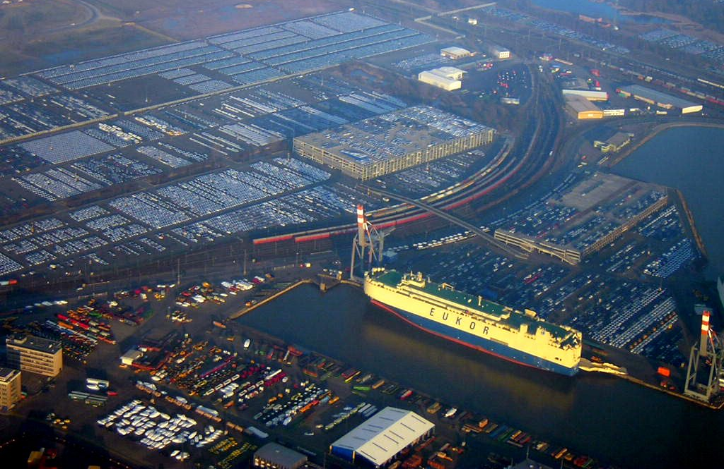
Bremen Harbor
Notes:
One of the most important European ports for transporting cars. ≈ 400,000 m², > 120,000 storage places, ≈ dozen technical treatment stations. Each year, about 6 Million cars, 18 different brands.

Slide 10
Example: Harbor Management
Planning
Acting
Importing/exporting cars
Based on Bremen Harbor
Multiple levels of abstraction
Reflect physical organization of harbor
Continual online planning
Top level can be planned offline
The rest is online, based on current conditions
Heterogeneous reasoning
Different components work in different ways
Online synthesis of automata to control their interactions

Slide 11
Example: Service Robot
Planning
Acting
Multiple levels of abstraction
Higher levels: more planning
Lower levels: more acting
Continual online planning
What room is o7 in?
What route?
What kind of door?
Close enough to door handle?
Heterogeneous reasoning
planning abstract tasks
path planning
reactive (e.g., open door)

Slide 12
Outline of Book
1: Introduction (this lecture)
2: Deterministic models
Conventional (classical) AI planning
Integrating it with acting
3: Refinement methods
Acting and planning by refining abstract activities into less-abstract activities
4: Temporal models
Reasoning about time constraints
5: Nondeterministic models
Actions with multiple possible outcomes
6: Probabilistic models
Multiple possible outcomes, with probabilities
7: Other:
perceiving, monitoring, goal reasoning, learning, hybrid models, ontologies

Slide 13
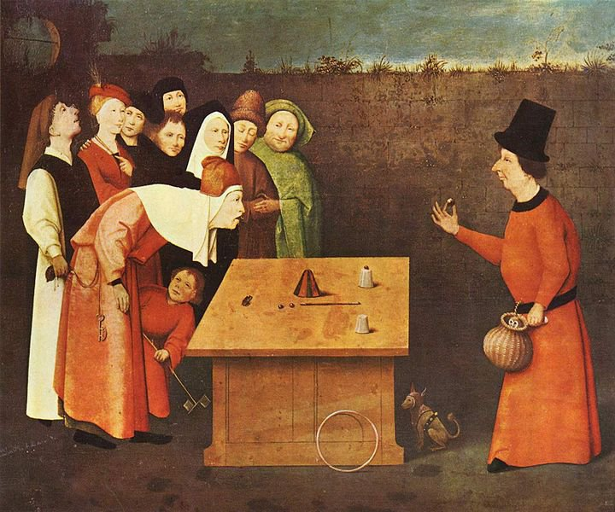
Any questions?
Cover image: The Conjuror. Hieronymus Bosch (c.1450–1516)

