Slide 1
Chapter 2
Deliberation with Deterministic Models
2.4: Backward Search
2.5: Plan-Space Search
Dana S. Nau
University of Maryland

Slide 2
Outline
Chapter 2, part a (chap2a.pdf):
  2.1 State-variable representation
  –– Comparison with PDDL
  2.2 Forward state-space search
  2.6 Incorporating planning into an actor
–––––––––––––––––––––––––––––––––––––––––––––––––
Chapter 2, part b (chap2b.pdf):
  2.3 Heuristic functions
  2.7.7 HTN planning
–––––––––––––––––––––––––––––––––––––––––––––––––
Chapter 2, part c (chap2c.pdf):
  2.4 Backward search
  2.5 Plan-space search
–––––––––––––––––––––––––––––––––––––––––––––––––
Additional slides:
  2.7.8 LTL_planning.pdf
Next ⟶

Slide 3
2.4 Backward Search
Forward search: forward from initial state
  In state s, choose applicable action a
  Compute state transition s′ = γ(s,a)
Backward search: backward from the goal
  For goal g, choose relevant action a
    A possible “last action” before the goal
    Sometimes this has a lower branching factor
Compute inverse state transition g′ = γ ^{–1}(g,a)
  g′ = properties a state s′ should satisfy in order for γ(s′,a) to satisfy g
Equivalently, if S_{g} = {all states that satisfy g} then
  S_{g′} = {all states s such that γ(s,a) ∈ S_{g}}
d3
r1
c1
c2
c3
c4
c5
d1
d2
s₀ = {loc(c1)=d1, loc(c2)=d1, …}
g = {loc(r1)=d3}
r1
d3
  Forward: 7 applicable actions
    five load actions, two move actions
  Backward: g = {loc(r1)=d3}
    two relevant actions:
    move(r1,d1,d3), move(r1,d2,d3)

Slide 4
Relevance
d3
Idea: when can a be useful as the last action of a plan to achieve g?
  a makes at least one atom in g true that wasn’t true already
  a doesn’t make any part of g false
a is relevant for g = {x₁=c₁, x₂=c₂, …, x_{k}=c_{k}} if
  at least one atom in g is also in eff(a)
    e.g., if eff(a) contains x₁ ← c₁
  eff(a) doesn’t make any atom in g false
    e.g., eff(a) must not contain x₂ ← c₂′ (where c₂′ ≠ c₂)
  whenever pre(a) requires an atom of g to be false,
    eff(a) makes the atom true
    e.g., if pre(a) contains x₃ = c₃′ (where c₃′ ≠ c₃),
      then eff(a) must contain x₃ ← c₃
r1
r2
c1
c2
c3
d1
d2
s = {loc(c1)=d1, loc(c2)=d1, loc(c3)=d1,
loc(r1)=d2, cargo(r1)=nil,
loc(r2)=d2, cargo(r2)=nil}
load(r,c,l)
pre: cargo(r)=nil, loc(r)=l, loc(c)=l
eff: cargo(r) ← c, loc(c) ← r
r1
c1
d3
g = {cargo(r1)=c1, loc(r1)=d3}

Slide 5
Relevance
move(r,l,m)
pre: loc(r)=l, adjacent(l,m)
eff: loc(r) ← m
load(r,c,l)
pre: cargo(r)=nil, loc(r)=l, loc(c)=l
eff: cargo(r) ← c, loc(c) ← r
put(r,l,c)
pre: loc(r)=l, loc(c)=r
eff: cargo(r) ← nil, loc(c) ← l
Range(r) = Robots = {r1,r2}
Range(l) = Range(m) = Locs = {d1,d2,d3}
Range(c) = Containers = {c1,c2,c3}
d3
r1
r2
c1
c2
c3
d1
d2
s = {loc(c1)=d1, loc(c2)=d1, loc(c3)=d1,
loc(r1)=d2, cargo(r1)=nil,
loc(r2)=d2, cargo(r2)=nil}
adjacent = {(d1,d2), (d1,d3), (d2,d1), (d2,d3), (d3,d1), (d3,d2)}
r1
c1
Poll: for each action below, is it relevant for g?
load(r1,c1,d1) load(r1,c1,d2) put(r2,c1,d3)
move(r1,d1,d3) move(r1,d3,d1) move(r1,d2,d3)
d3
g = {cargo(r1)=c1, loc(r1)=d3}

Slide 6
Inverse State Transitions
move(r,l,m)
pre: loc(r)=l, adjacent(l,m)
eff: loc(r) ← m
load(r,c,l)
pre: cargo(r)=nil, loc(r)=l, loc(c)=l
eff: cargo(r) ← c, loc(c) ← r
put(r,l,c)
pre: loc(r)=l, loc(c)=r
eff: cargo(r) ← nil, loc(c) ← l
Range(r) = Robots
Range(l) = Range(m) = Locs
Range(c) = Containers
If a is relevant for g, then γ⁻¹(g,a) = pre(a) ∪ (g – eff(a))
If a isn’t relevant for g, then γ^{–1}(g,a) is undefined
Example:
  g = {loc(c1)=r1}
  What is γ ^{–1}(g, load(r1,c1,d3))?
  What is γ ^{–1}(g, load(r2,c1,d1))?
d3
r1
r2
c1
c2
c3
d1
d2

Slide 7
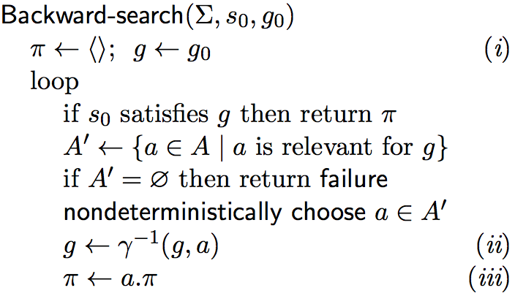
Backward Search
Cycle checking:
After line (i), put Visited ← {g₀}
After line (iii), put this:
    if g ∈ Visited then
      return failure
    Visited ← Visited ∪ {g}
  or this:
    if ∃g′ ∈ Visited s.t. g ⇒ g′ then
    return failure
    Visited ← Visited ∪ {g}
With cycle checking, sound and complete
  If (Σ, s₀, g₀) is solvable, then at least one execution trace will find a solution
(i)
(ii)
(iii)
g₁
a₁
g₄
a₄
s₀
g₂
g
a₂
g₅
a₅
a₃
g₃

Slide 8
Branching Factor
Motivation for Backward-search was to reduce the branching factor
  As written, doesn’t accomplish that
Solve this by lifting:
  When possible, leave
  variables uninstantiated
  Most implementations of
  Backward-search do this
d7
d5
d6
d4
d3
move(r1,d1,d3)
r1
move(r1,d2,d3)
d1
d2
move(r1,d4,d3)
γ⁻¹
g = {loc(r1)=d3}
. . .
γ⁻¹
move(r1,y,d3)
g = {loc(r1)=d3}
move(r1,d7,d3)

Slide 9
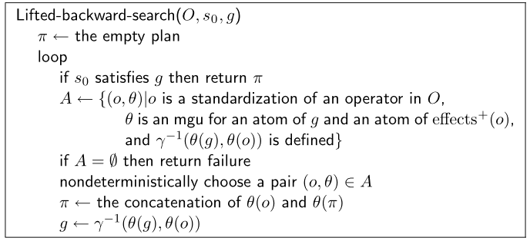
Lifted Backward Search
Like Backward-search but much smaller branching factor
Must keep track of what values were
substituted for which parameters
  I won’t discuss the details
  PSP (later) does something similar
A ,
For classical planning, this can be simplified
action template in A ,

Slide 10
Summary
2.4 Backward State-Space Search
  Relevance, γ⁻¹
  Backward search, cycle checking
  Lifted backward search (briefly)

Slide 11
Outline
Chapter 2, part a (chap2a.pdf):
  2.1 State-variable representation
  –– Comparison with PDDL
  2.2 Forward state-space search
  2.6 Incorporating planning into an actor
–––––––––––––––––––––––––––––––––––––––––––––––––
Chapter 2, part b (chap2b.pdf):
  2.3 Heuristic functions
  2.7.7 HTN planning
–––––––––––––––––––––––––––––––––––––––––––––––––
Chapter 2, part c (chap2c.pdf):
  2.4 Backward search
  2.5 Plan-space search
–––––––––––––––––––––––––––––––––––––––––––––––––
Additional slides:
  2.7.8 LTL_planning.pdf
Next ⟶

Slide 12
2.5 Plan-Space Search
Formulate planning as a constraint satisfaction problem
  Use constraint-satisfaction techniques to get solutions that are more flexible than ordinary plans
    E.g., plans in which the actions are partially ordered
    Postpone ordering decisions until the plan is being executed
      the actor may have a better idea about which ordering is best
First step toward temporal planning (Chapter 4)
Basic idea:
  Backward search from the goal
  Each node of the search space is a partial plan that contains flaws
    Remove the flaws by making refinements
  If successful, we’ll get a partially ordered solution

Slide 13
Definitions
move(r, d, d′)
pre: loc(r) = d, occupied(d′) = nil
eff: loc(r) ← d′, occupied(d′) ← r, occupied(d) ← nil
  Range(r) = Robots
  Range(d) = Range(d′) = Docks
Partially ordered plan
  partially ordered set of nodes
  each node contains an action
Partially ordered solution for a planning problem P
  partially ordered plan π such that every total ordering of π is a solution for P
s₀:
d3
r1
r2
d1
d2
Poll. Let P be the planning problem at right, and π be the partially ordered plan below. Is π a partially ordered solution for P?
d4
a₁:
a₃:
precedence
constraints:
a₁ ≺ a₃, a₁ ≺ a₄,
a₂ ≺ a₃, a₂ ≺ a₄
move(r1,d1,d3)
move(r1,d3,d2)
g:
a₂:
a₄:
r2
r1
d1
d2
move(r2,d2,d4)
move(r2,d4,d1)

Slide 14
Definitions
move(r, d, d′)
pre: loc(r) = d, occupied(d′) = nil
eff: loc(r) ← d′, occupied(d′) ← r, occupied(d) ← nil
  Range(r) = Robots
  Range(d) = Range(d′) = Docks
Partial plan
  partially ordered set of nodes that
  contain partially instantiated actions
  inequality constraints, e.g. z ≠ x or w ≠ p1
  causal links (dashed arcs)
    constraint: action a must be the action that establishes action b’s precondition p
s₀:
d3
r1
r2
d1
d2
d4
loc(r1)=x
. . .
← preconditions
move(r1, d1, x)
move(r1, x, d2)
effects →
loc(r1)=x
…
g:
r2
r1
d1
d2

Slide 15
Flaws: 1. Open Goals
move(r, d, d′)
pre: loc(r) = d, occupied(d′) = nil
eff: loc(r) ← d′, occupied(d′) ← r, occupied(d) ← nil
  Range(r) = Robots
  Range(d) = Range(d′) = Docks
Action b, precondition p
  p is an open goal if there is no causal link for p
Resolve the flaw by creating a causal link
  Find an action a (either already in π, or add it to π) that can establish p
    can precede b
    can have p as an effect
  Do substitutions on variables to make a assert p
  Add an ordering constraint a ≺ b
  Create a causal link from a to p
d3
r1
r2
d1
d2
substitute
r ← r1
loc(r1)=x
. . .
move(r1, d1, x)
loc(r1)=x
. . .
← preconditions
move(r1, d1, x)
move(r1, x, d2)
effects →
loc(r1)=x
…
move(r1, x, d2)
loc(r1)=x
…

Slide 16
Flaws: 2. Threats
A:
c: move(r, d2, y)
loc(r1)=x
Let l be a causal link from an effect of action a
to a precondition p of action b
Action c threatens l if c may come between a and b
and c may affect p
  “c may come between a and b” means the plan’s current ordering constraints don’t prevent it
    plan doesn’t already have c ≺ a or b ≺ c
  “c may affect p” means
    can substitute values for variables such that c’s effects either make p true or make p false
  Poll. In each of the cases at right, does action c threaten the causal link?
a: move(r1, d1, x)
b: move(r1, x, d2)
loc(r1)=x
B:
c: move(r, d2, y)
loc(r1)=x
a: move(r1, d1, x)
b: move(r1, x, d2)
loc(r1)=x
C:
c: move(r, d2, y)
loc(r1)=x
a: move(r1, d1, x)
b: move(r1, x, d2)
loc(r1)=x
D:
c: move(r2, d2, y)
loc(r1)=x
a: move(r1, d1, x)
b: move(r1, x, d2)
loc(r1)=x

Slide 17
Resolving Threats
c: move(r, d2, y)
loc(r)=y
threat
loc(r1)=x
Suppose action c threatens a causal link l
from an effect of action a
to a precondition p of action b
Three possible resolvers:
    1. Add a precedence constraint c ≺ a
    2. Add a precedence constraint b ≺ c
    3. Add inequality constraints that prevent c
    from affecting p
Each of these is applicable iff it doesn’t make the plan inconsistent
  e.g., 2 isn’t applicable if the plan already has c ≺ b
a: move(r1, d1, x)
b: move(r1, x, d2)
loc(r1)=x
c: move(r, d2, y)
resolver: c ≺ a
loc(r)=y
loc(r1)=x
a: move(r1, d1, x)
b: move(r1, x, d2)
loc(r1)=x
c: move(r, d2, y)
resolver: r ≠ r1
loc(r)=y
loc(r1)=x
a: move(r1, d1, x)
b: move(r1, x, d2)
loc(r1)=x

Slide 18
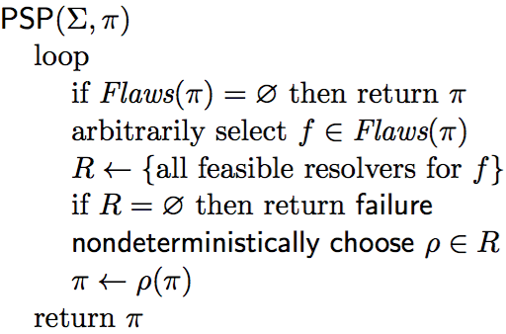
PSP Algorithm
d3
r1
r2
d1
d2
select →
2 open goals
no threats
move(r, d, d′)
pre: loc(r) = d, occupied(d′) = nil
eff: loc(r) ← d′, occupied(d′) = r, occupied(d) = nil

Slide 19
PSP Algorithm
d3
r1
r2
d1
d2
only resolver: causal link from a new action
3 open goals
no threats
↑
select
for every action a,
a₀ ≺ a ≺ a_{g}
move(r, d, d′)
pre: loc(r) = d, occupied(d′) = nil
eff: loc(r) ← d′, occupied(d′) = r, occupied(d) = nil
  Poll. Above, I said “only resolver”. Is that correct?

Slide 20
PSP Algorithm
d3
r1
r2
d1
d2
select →
only resolver: causal link from a new action
4 open goals
no threats
move(r, d, d′)
pre: loc(r) = d, occupied(d′) = nil
eff: loc(r) ← d′, occupied(d′) = r, occupied(d) = nil

Slide 21
PSP Algorithm
d3
only resolver: causal link from a new action
r1
r2
select
↓
d1
d2
5 open goals
1 threat
threat
move(r, d, d′)
pre: loc(r) = d, occupied(d′) = nil
eff: loc(r) ← d′, occupied(d′) = r, occupied(d) = nil
Poll: does a₃ threaten a₁’s precondition loc(r1)=d?

Slide 22
PSP Algorithm
d3
causal link from a₀ , with substitution d←d1
r1
r2
d1
d2
select
↓
threat
4 open goals
2 threats
threat
move(r, d, d′)
pre: loc(r) = d, occupied(d′) = nil
eff: loc(r) ← d′, occupied(d′) = r, occupied(d) = nil
Poll: does a₃ threaten the causal link for a_{g}’s precondition loc(r1)=d2?

Slide 23
PSP Algorithm
d3
r1
r2
d1
d2
threat
4 open goals
1 threat
  Constraint: r ≠ r1
select
↓
threat
move(r, d, d′)
pre: loc(r) = d, occupied(d′) = nil
eff: loc(r) ← d′, occupied(d′) = r, occupied(d) = nil

Slide 24
PSP Algorithm
d3
r1
r2
d1
d2
3 open goals
1 threat
  Constraint: r ≠ r1
select →
threat
move(r, d, d′)
pre: loc(r) = d, occupied(d′) = nil
eff: loc(r) ← d′, occupied(d′) = r, occupied(d) = nil
causal link from a₀ with substitution r←r2

Slide 25
PSP Algorithm
d3
r1
r2
d1
d2
3 open goals
no threats
threat
← select
move(r, d, d′)
pre: loc(r) = d, occupied(d′) = nil
eff: loc(r) ← d′, occupied(d′) = r, occupied(d) = nil
ordering constraint a₃ ≺ a₂

Slide 26
PSP Algorithm
d3
r1
r2
d1
d2
2 open goals
no threats
select
↓
move(r, d, d′)
pre: loc(r) = d, occupied(d′) = nil
eff: loc(r) ← d′, occupied(d′) = r, occupied(d) = nil
causal link from a₃
with substitution d′′← d′

Slide 27
PSP Algorithm
d3
r1
r2
d1
d2
causal link from a₁
1 open goal
no threats
select
↓
move(r, d, d′)
pre: loc(r) = d, occupied(d′) = nil
eff: loc(r) ← d′, occupied(d′) = r, occupied(d) = nil

Slide 28
PSP Algorithm
d3
r1
r2
d1
d2
no open goals
no threats
we’re done
move(r, d, d′)
pre: loc(r) = d, occupied(d′) = nil
eff: loc(r) ← d′, occupied(d′) = r, occupied(d) = nil
causal link from a₀
with substitution d′←d3

Slide 29
PSP Algorithm
d3
r1
r2
d1
d2
The solution we found:
Another:
Infinitely many others
move(r, d, d′)
pre: loc(r) = d, occupied(d′) = nil
eff: loc(r) ← d′, occupied(d′) = r, occupied(d) = nil

Slide 30
PSP Algorithm
d3
r1
r2
d1
d2
d4
Add another location to the initial state
Still have all of the solutions on the previous page
This time, PSP also can return partially-ordered solutions
move(r1,d1,d3)
move(r1,d3,d2)
a₀
a_{g}
move(r2,d2,d4)
move(r2,d4,d1)
move(r, d, d′)
pre: loc(r) = d, occupied(d′) = nil
eff: loc(r) ← d′, occupied(d′) = r, occupied(d) = nil

Slide 31
Selecting a Flaw
Selecting a flaw to resolve in PSP ≈
selecting a variable to instantiate in a CSP
  AND-branch in both cases
Fewest Alternatives First (FAF):
  select flaw with fewest resolvers
    ≈ Minimum Remaining Values
    (MRV) heuristic for CSPs
Poll: which flaw would FAF select first?
  A. loc(r1)=d
  B. occupied(d2) = nil
  C. occupied(d2) = nil
  D. loc(r2)=d′
  E. no preference
move(r, d, d′)
pre: loc(r) = d, occupied(d′) = nil
eff: loc(r) ← d′, occupied(d′) = r, occupied(d) = nil

Slide 32
Choosing a Resolver
Choosing a resolver for a flaw ≈ assigning a value to a variable in a CSP
  In both cases, an OR-branch
Least Constraining Resolver (LCR):
  prefer resolver that rules out the
  fewest resolvers for the other flaws
    ≈ Least Constraining Value (LCV)
    heuristic for CSPs
Poll: for loc(r1)=d in a₁ , which resolver would LCR choose first?
  causal link from a new action
  causal link from a₀ , with substitution d←d1
  causal link from a₃ , with substitutions r←r1, d′′←d
  no preference
move(r, d, d′)
pre: loc(r) = d, occupied(d′) = nil
eff: loc(r) ← d′, occupied(d′) = r, occupied(d) = nil

Slide 33
Choosing a Resolver
Least Constraining Resolver (LCR):
  prefer resolver that rules out the
  fewest resolvers for the other flaws
    ≈ Least Constraining Value (LCV)
    heuristic for CSPs
Problem (in PSP but not in CSPs):
  LCR can keep adding new actions forever
Perhaps this might work:
Avoid New Actions (ANA) heuristic:
  prefer resolvers that don’t add new actions
  use LCR as tie-breaker

Slide 34
Choosing a Resolver
Least Constraining Resolver (LCR):
  prefer resolver that rules out the
  fewest resolvers for the other flaws
    ≈ Least Constraining Value (LCV)
    heuristic for CSPs
Problem (in PSP but not in CSPs):
  LCR can keep adding new actions forever
Perhaps this might work:
Avoid New Actions (ANA) heuristic:
  prefer resolvers that don’t add new actions
  use LCR as tie-breaker
Problem: ANA will prefer these two choices:
  For loc(r1)=d in a₁, use action a₀ with substitution d←d1
  For loc(r2)=d′ in a₂, use action a₀ with substitution d′←d2
  a₁ = move(r1,d1,d2); a₂ = move(r2,d2,d1)
    Makes the problem unsolvable ⇒ need to backtrack
Perhaps use ANA anyway?

Slide 35
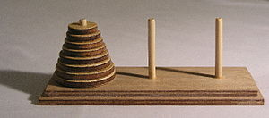
Discussion
Problem: how to prune infinitely long paths in the search space?
  Loop detection is based on recognizing states
  or goals we’ve seen before
  Partially ordered plan: don’t know the states
Prune if π contains the same action more than once?
      ⟨a1, a2, …, a1, …⟩
  No. Sometimes need the same action again in another state
    e.g., Towers of Hanoi: move disk1 from peg1 to peg2
Weak pruning technique
  Prune all partial plans that contain more than |S| actions
  Not very helpful
I don’t know whether there’s a better pruning technique
…
s
s'
s

Slide 36
Summary
2.5 Plan-Space Search
  Definitions
    Partially ordered plans and solutions
    partial plans
    causal links
  flaws:
    open goals
    threats
  resolvers
  PSP algorithm
    long example
    brief discussion of node-selection heuristics, pruning techniques

